Slide 1
20 Years of HSI-RFQ-Operation / Recent RFQ-Electrode Exchange Program
H. Vormann, GSI Darmstadt
„High Intensity RFQ meets Reality“
-Workshop Heidelberg April 2019

Slide 2
Outline
Introduction:
RFQ basic design parameters
Design history
Third revision planned for 2019
Upgrade for FAIR
Problems encountered in 2018
Short term counter measures
Outlook

Slide 3
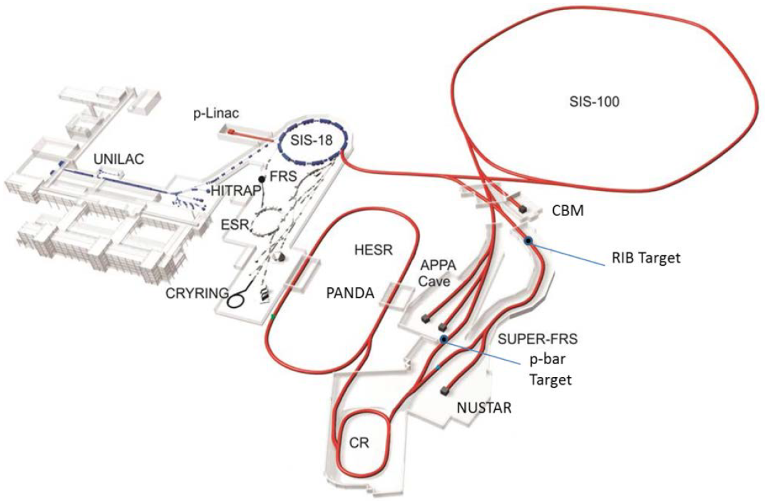
UNIversal Linear Accelerator UNILAC
 | HSI RFQ | UNILAC
ion A/q | ≤ 59.5 (i.e. ²³⁸U⁴⁺) | ≤ 8.5 (i.e. ²³⁸U²⁸⁺)
beam current (pulse) *A/q | nom. 0.25 (0.5% d.c.) | 1.76 (0.5% d.c.) | emA
input beam energy | 2.2 | (2.2 / 120IH / 1400Alv) | keV/u
output beam energy | 0.120 | 3.0 - 11.4 | MeV/u
normalized total output emittance | 0.4 | 0.8 hor. / 2.5 ver. | mm mrad
beam pulse duration | ≤ 5 | ≤ 5 | ms
beam repetition rate | ≤ 50 | ≤ 50 | Hz
operating frequency | 36.136 | 36.136 / 108.408 | MHz
length | 9.25 | ≈ 115 | m
≈ 115 m

Slide 4
20 Years....
1996 – 1999 design, fabrication (INITIAL DESIGN)
1999 commissioning
2004 RFQ IRM re-design (1st RE-DESIGN)
2008/2009 RFQ complete part. dyn. re-design (for larger acceptance) (2nd RE-DESIGN)
... 2012... performance loss
2015 August 5th: sudden performance improvement...
2015 November RF expert investigations (plungers 20...24% best)
2016 October: RF expert tests, best performance ever!
2017/2018 re-commissioning reveals performance loss
2018 Planning RFQ part.-dyn. re-design (for smaller emittance) (3rd RE-DESIGN)
2019 User beam time with reduced performance

Slide 5
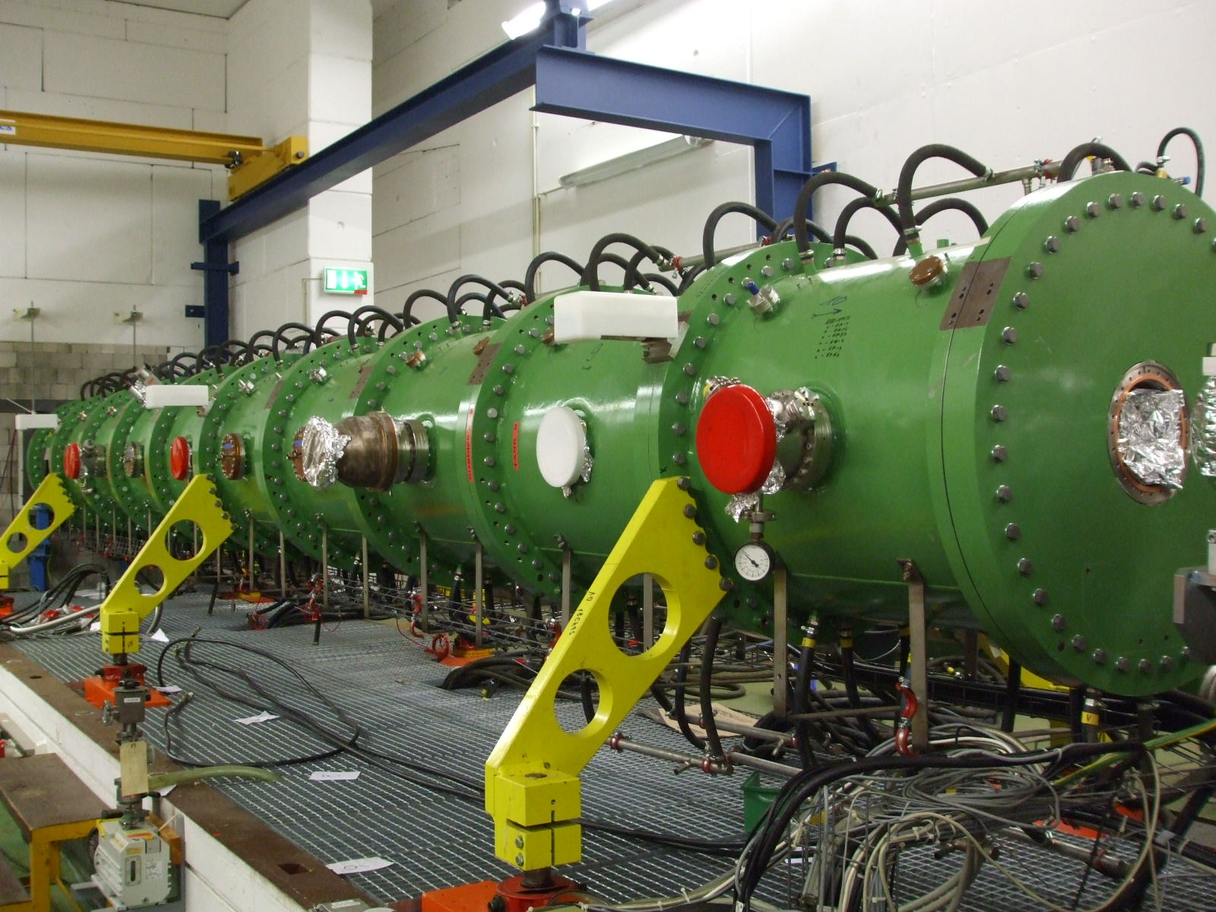
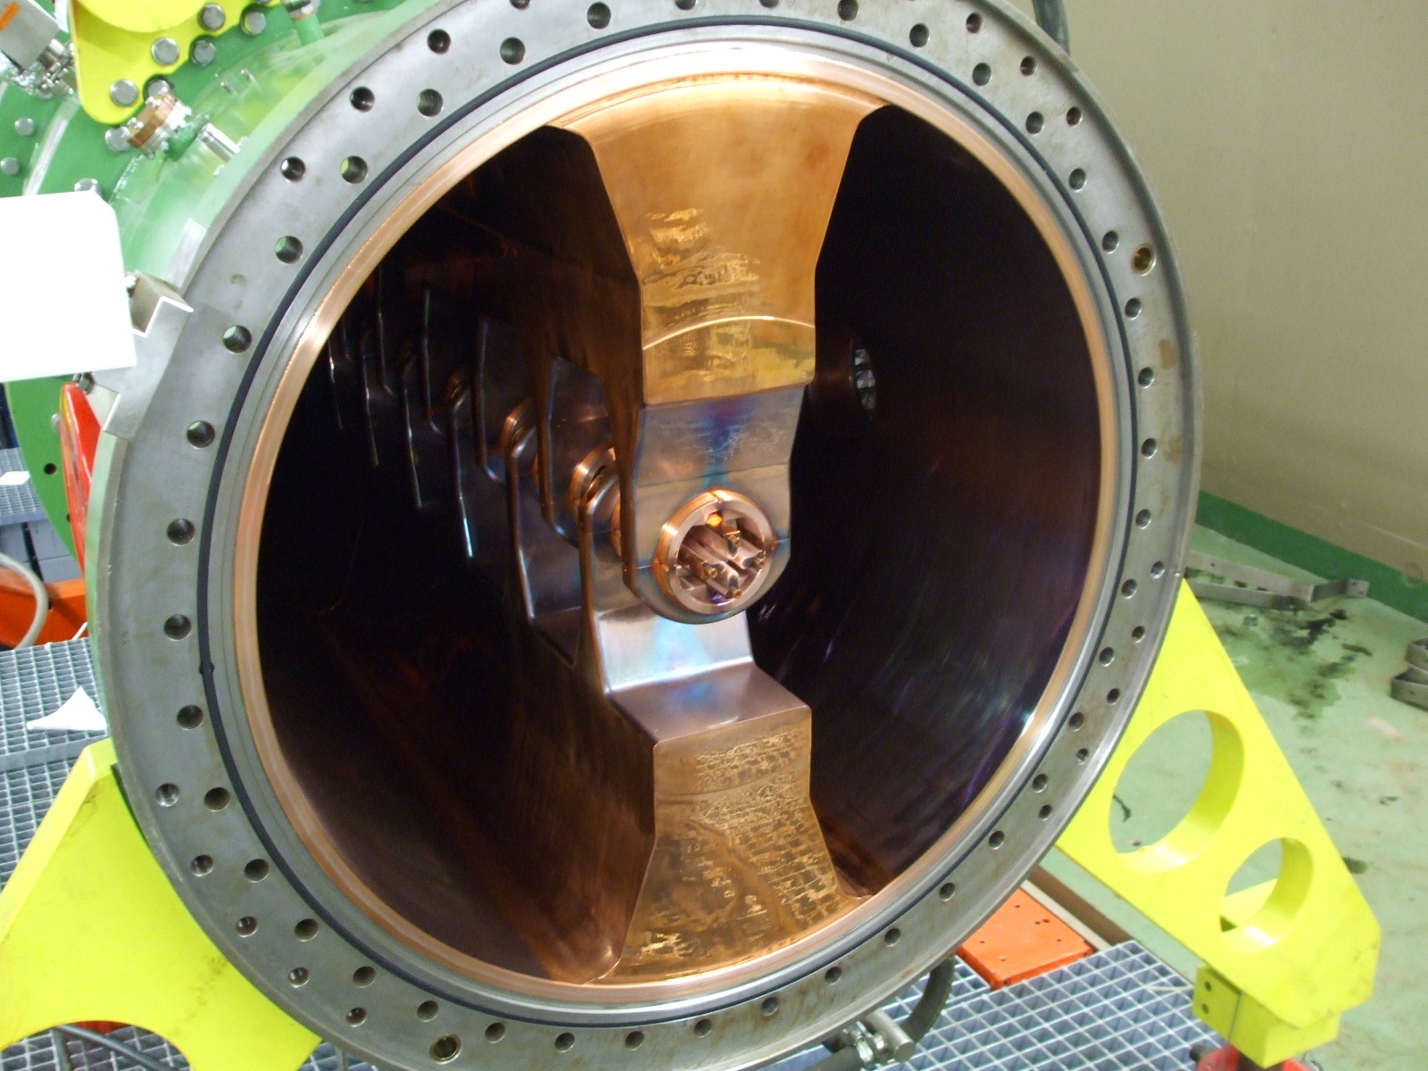
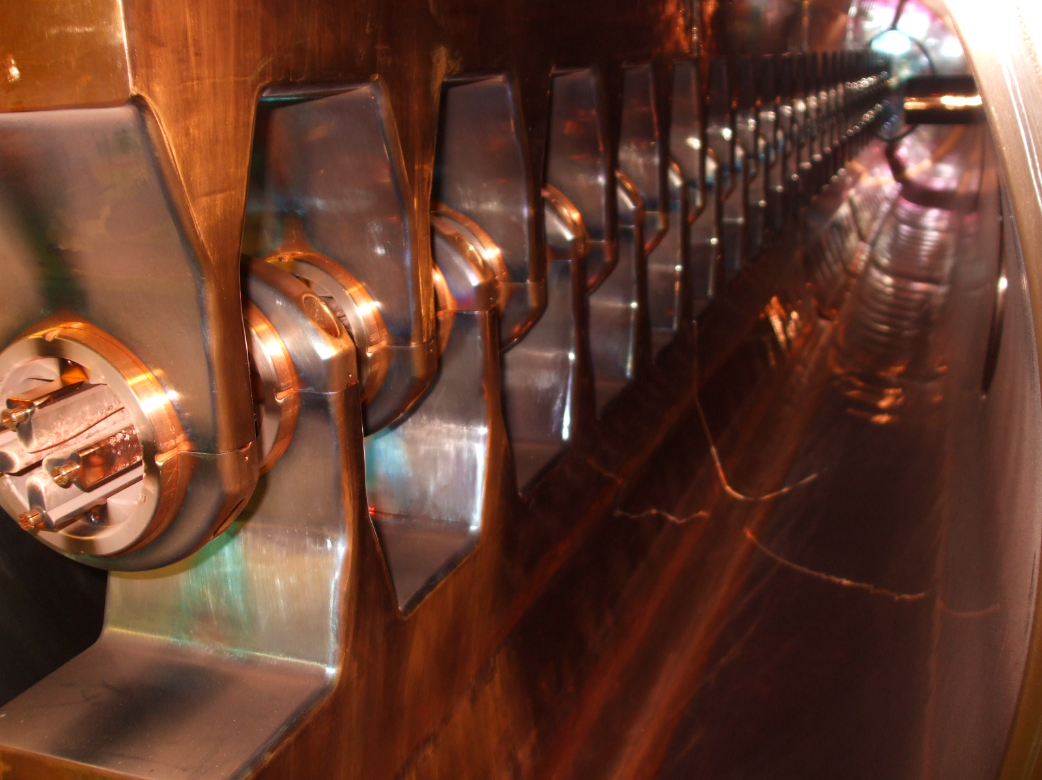
Design History – Initial Design from 1999
initial design from 1999 :
15 emA U⁴⁺ RFQ output beam current
input emittance 138 mm mrad assumed (0.3 norm.)
output emittance ≈ 19 mm mrad (0.3 norm.)
max. surface field strength 32 MV/m (=320 kV/cm)
acceptance ≈ 250 mm mrad
HSI-RFQ, during assembly work 2009 (DSCF3014,3088,3110)

Slide 6
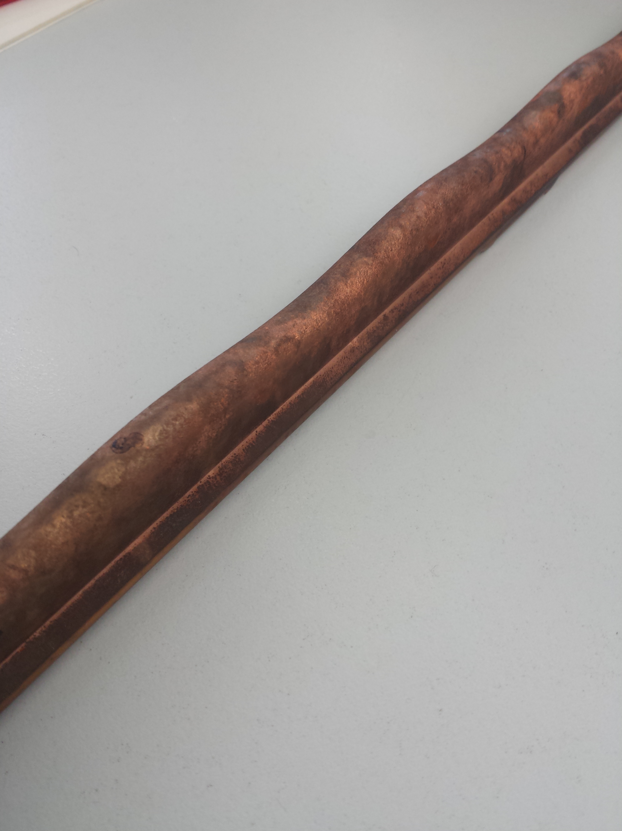
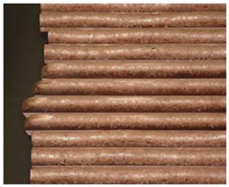
Design History – Initial Design from 1999
in operation from May 1999 to May 2004
achieved performance: 8.3 emA U⁴⁺ @RFQ output
(design 15 emA), Ar output emittance 20/22 mm mrad
re-designed because of low transmission and sparking problems at high rf-levels
Photograph: W. Barth et al, proc. EPAC2006

Slide 7
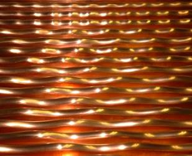
Design History – First Revision in 2004 Input Radial Matcher
Changes w.r.t. previous design:
input radial matcher: new geometry (slightly (larger apertures, smoother matching to the RFQ, smaller beam angles)
rods (massive copper) additionally galvanic copper plated
Photograph: W. Barth et al, proc. EPAC2006

Slide 8
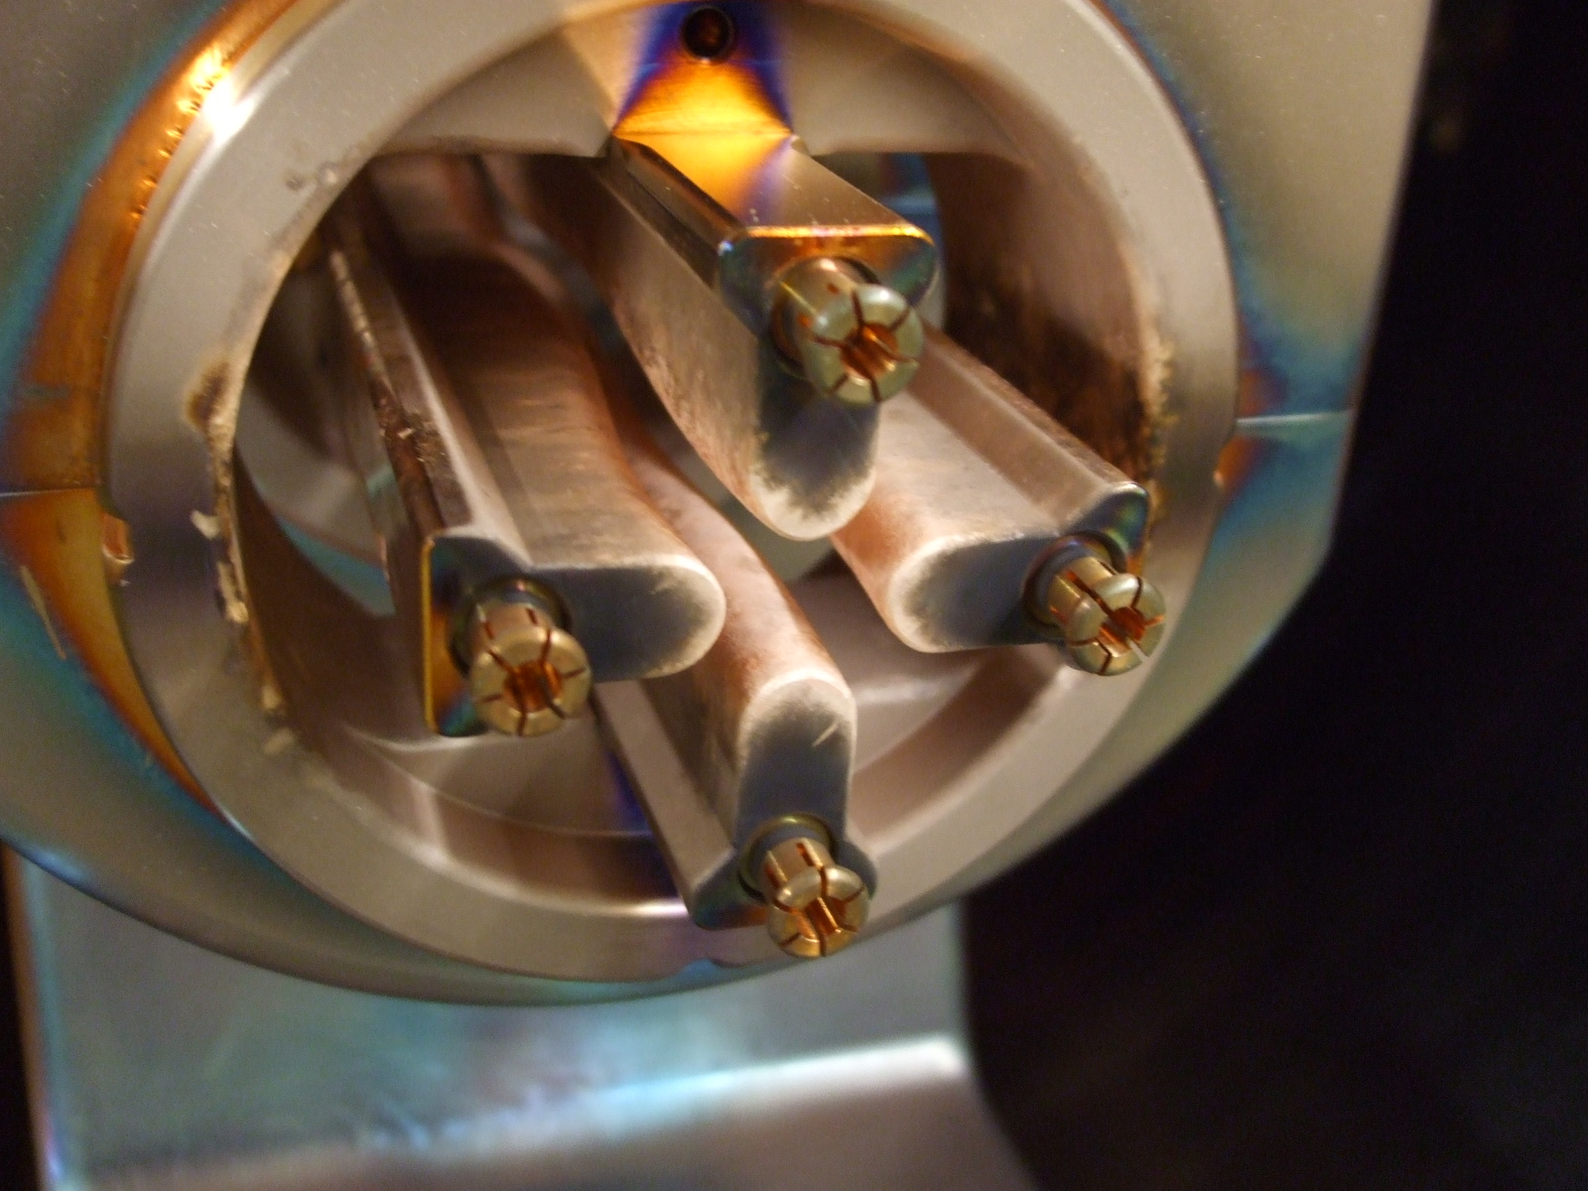
Design History – First Revision in 2004 Operational Experiences
in operation from July 2004 to April 2009
transmission increased by 15% (9.5 emA @ exit) (in good agreement with simulations)
transmission still not sufficient for FAIR: → second re-design
rods after beam operation 2004-2009

Slide 9
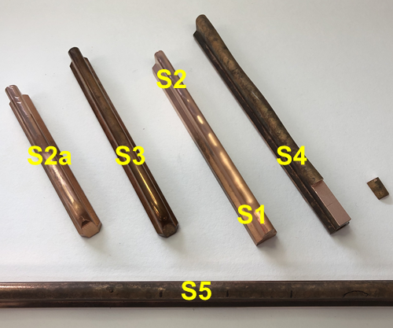
Microscopy of RFQ electrode surfaces
2019, polished, not used,
2004/2009?,
Cu-plated,
not used
1999, not used
2004, Cu-plated, used
1999, used
See talk P. Gerhard,
Tuesday Morning

Slide 10
Design History – Second Revision 2009 New Beam Dynamics Design
changes w.r.t. previous design:
complete particle dynamics re-design with larger acceptance – large aperture, higher voltages, higher rf-input power (surface fields not increased)
correction of output energy
A. Kolomiets et al, proc. LINAC2008
 | design 1999 | design 2009
voltage, kV | 125 | 155
max. field, kV/cm | 318 | 312
norm. transv. accep., mm mrad | 0.73 | 0.86
max. modul., min. aperture/mm | m ≤ 2.09 ; ap ≥ 4.02 | m ≤ 1.93; ap ≥ 4.09
transv. acceptance, mm mrad | ≈ 330 to 46 (input to output) | ≈ 390 to 54 (input to output)

Slide 11
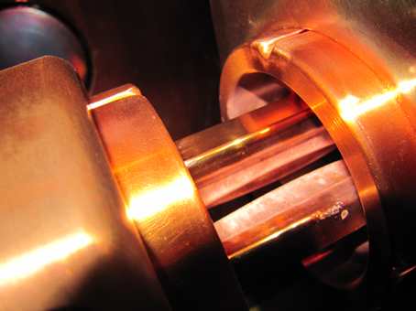
Design History – Second Revision 2009 Operational Experience
in operation since July 2009 (except shutdowns in 2013 and 2017)
achieved performance: up to 8 emA U⁴⁺, corrected output energy
higher voltage & power made rf-conditioning harder
2014: just 93% of design voltage reached
transmission still not sufficient for FAIR, subsequent IH-DTL suffers from large RFQ output emittance → third re-design
HSI beam envelopes R. Tiede / IAP 05/2008
rods after 3 years of operation (in 2012)

Slide 12
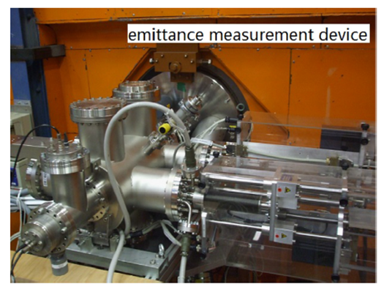
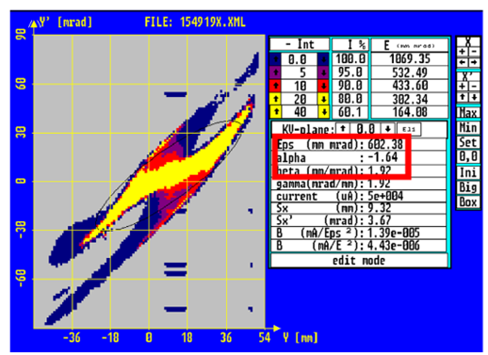
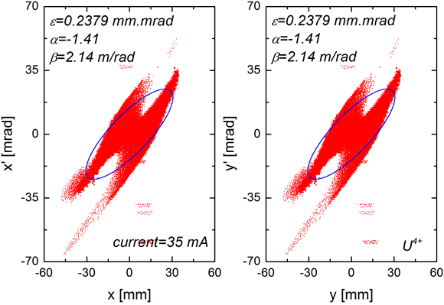
Third Revision Planned for FAIR
Strategy: moderate acceptance and voltage, match to new MEBT and IH-DTL
Planned design change:
reduce design voltage
observed in 2014: just 93% of design voltage achieved
voltage reduction solved SARAF RFQ problems!
new beam dynamics design:
use realistic input emittance (Uranium beam measurements at North Terminal 2013)
include new quadrupole-quartet for matching to RFQ
optimize output matching to new MEBT and IH-DTL

Slide 13
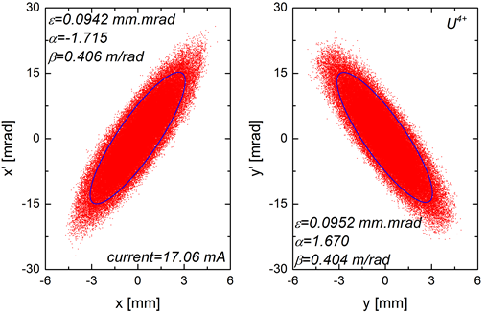
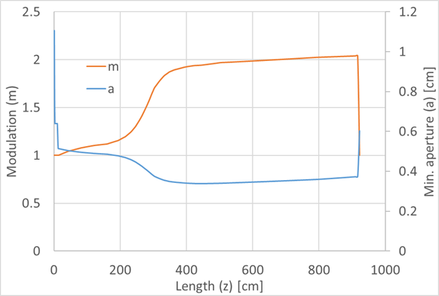
Third Revision Planned for 2019
re-design provided by A. Lombardi et al. (CERN)
TDR approved May 2018
presented to MAC 19 (June 2018)
 | Design 2009 | CERN Design for FAIR
Strategy | Increased acceptance | Moderate acceptance and voltage, match to new MEBT and IH-DTL
design ion | 238 U⁴⁺ | 238 U⁴⁺
design voltage | 155 kV | 123 kV
maximum surface field strength | 31.2 MV/m | 32 MV/m
average aperture r0 in a cell | 6.0 mm | 5.1 to 6.0 mm (excl. IRM) (average all cells: 5.32 mm)
minimum aperture in a cell | 4.1 mm (excl. IRM) | 5.1 to 3.4 mm (excl. IRM)
maximum modulation | 1.93 | 2.00
number of cells | 394 | 372
input transv. emittance (20 mA) | 200 mm mrad, 50 mm mrad rms (0.11 mm mrad, rms norm.) | 200 mm mrad, 50 mm mrad rms (0.11 mm mrad, rms norm.)
output transv. emittance (20 mA) | 31.7/29.9 mm mrad (95%, hor./vert.) | 31.2 mm mrad (95%), (0.5 mm mrad 95% norm.)
transmission (accelerated) | ≈ 80% | 78% (TOUTATIS)
transv. output distrib., C. Xiao

Slide 14
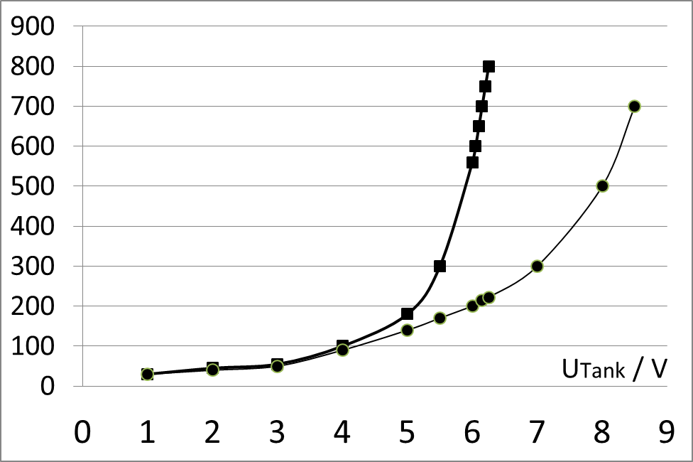
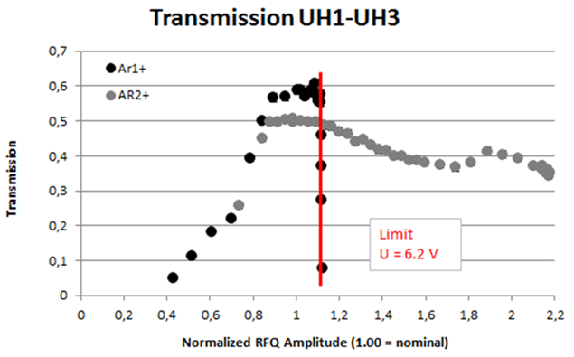
Problems encountered in June 2018
June 2018 after 1.5 years of shutdown, test run: just 73% of design voltage reached
P / kW
2018
2016

Slide 15
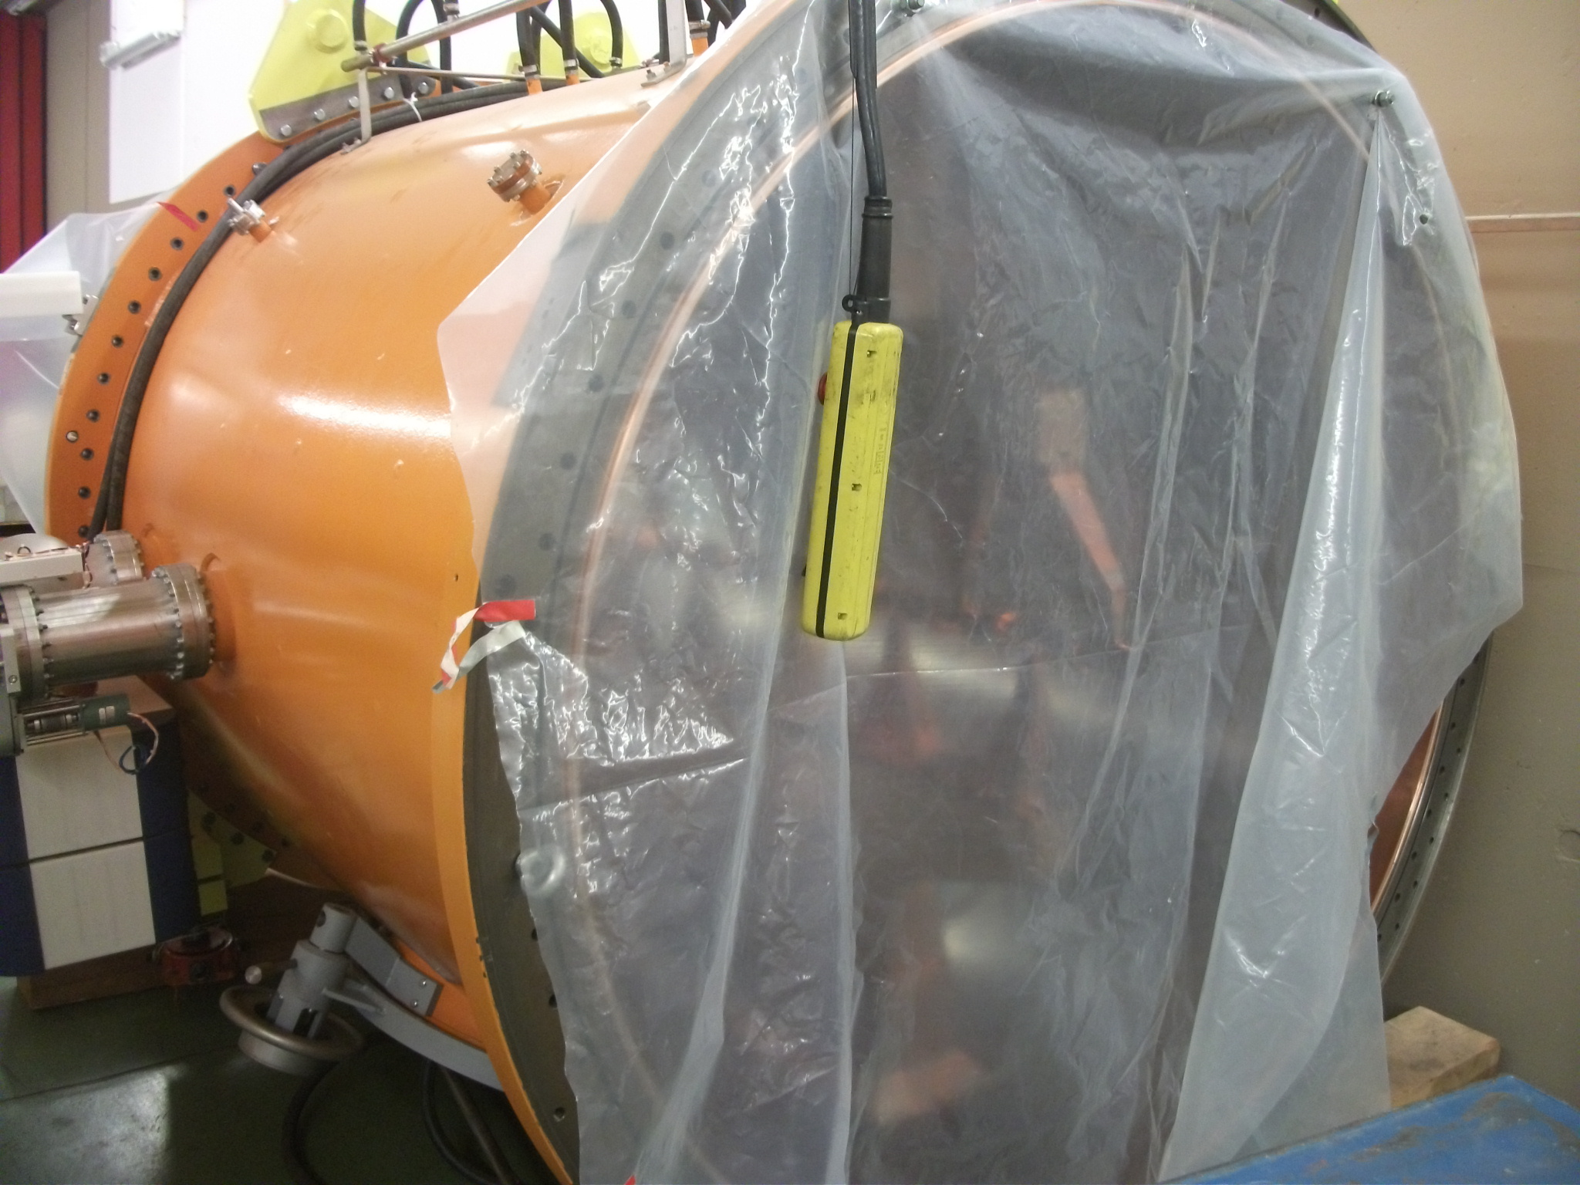
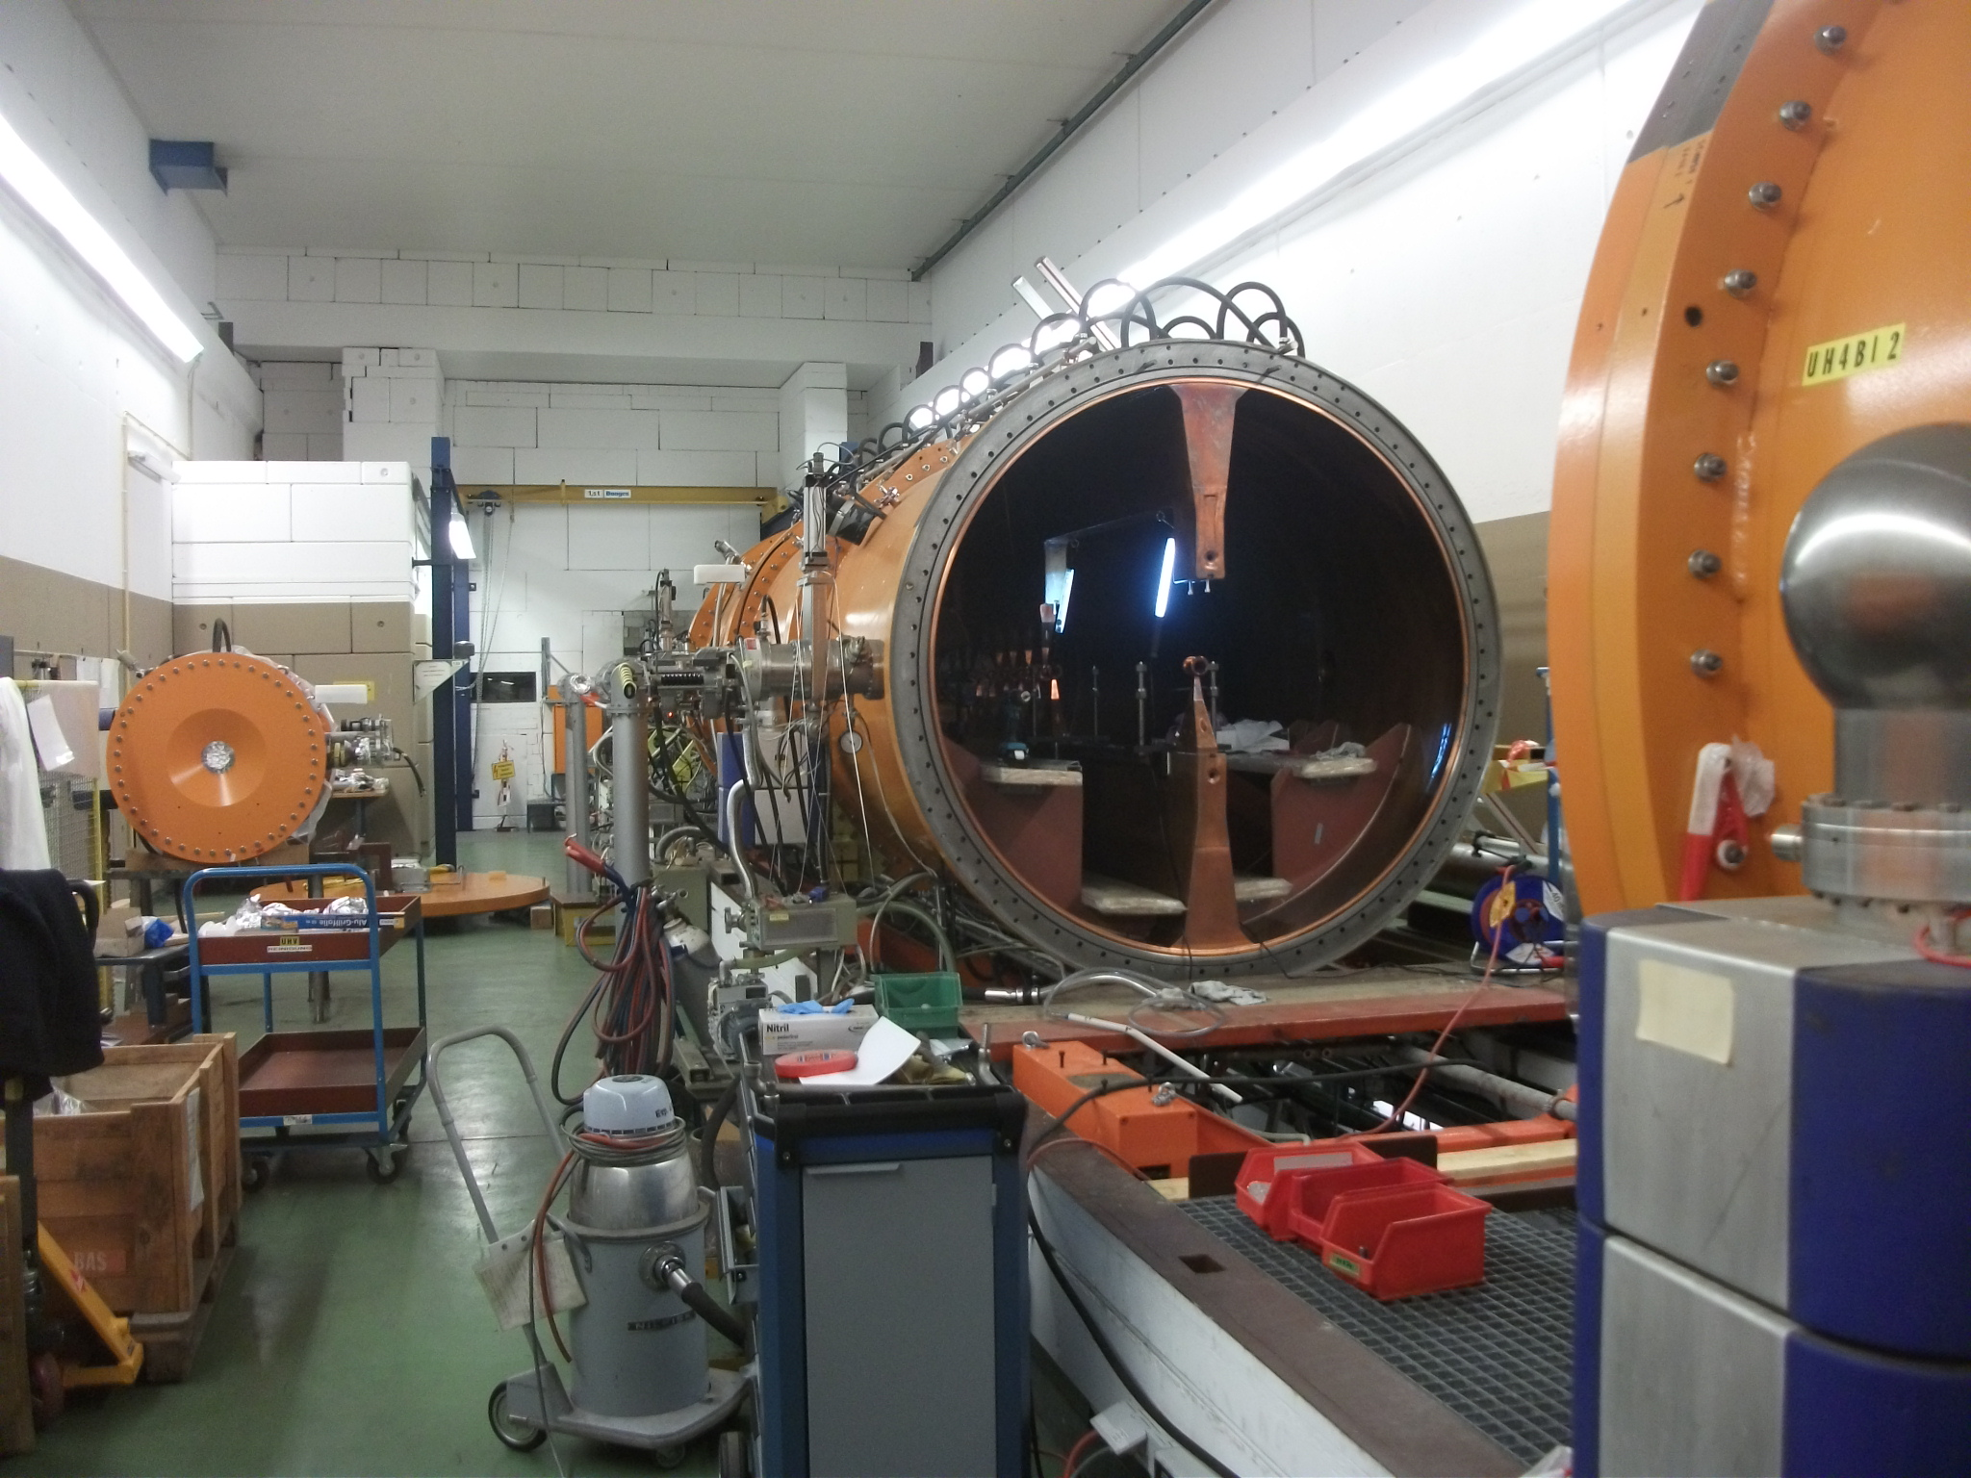
Conditions before Re-Commissioning Impact on HSI Cavities
Shutdown 2017 conditions:
RFQ, super lens, and IH-1 were vented with nitrogen
RFQ was kept under atmospheric pressure for 11 months
SL and IH-1 were disassembled for 15 months
DSCF8602
DSCF8502
IH-1/ section 4 SL IH-1/ section 1-3
Impact on HSI Cavities:
super lens (being a short version of the RFQ) and IH-1 show no issues
RFQ behaves normal up to about 45% of design voltage (Q and R_{s} as usual)
RFQ beyond 45%: exponential growth of required input power and of reflected power

Slide 16
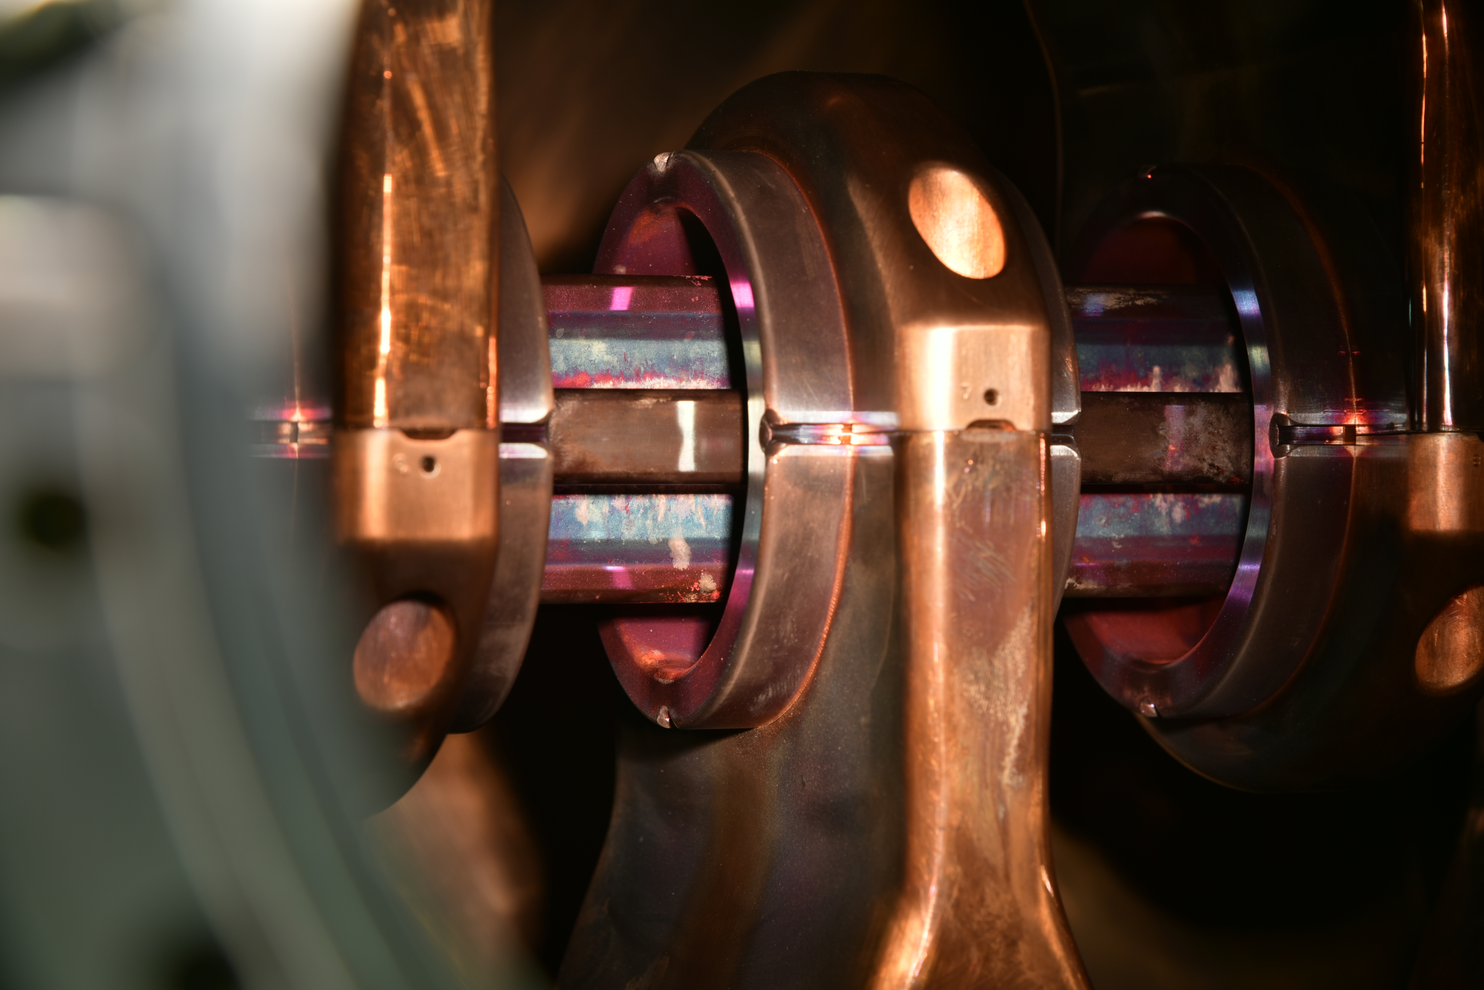
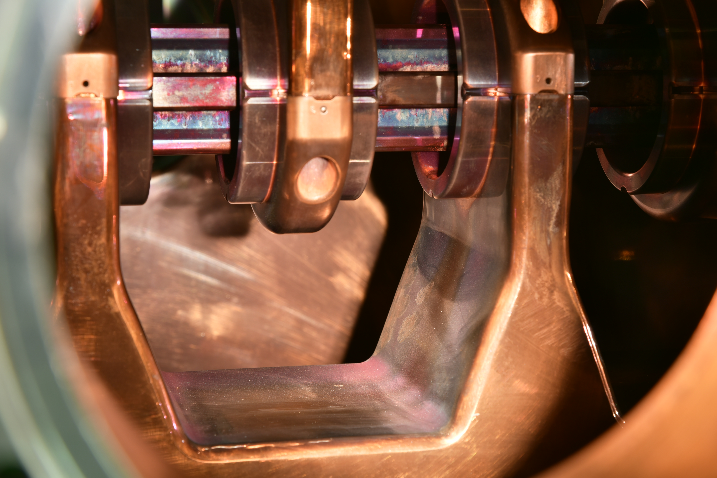
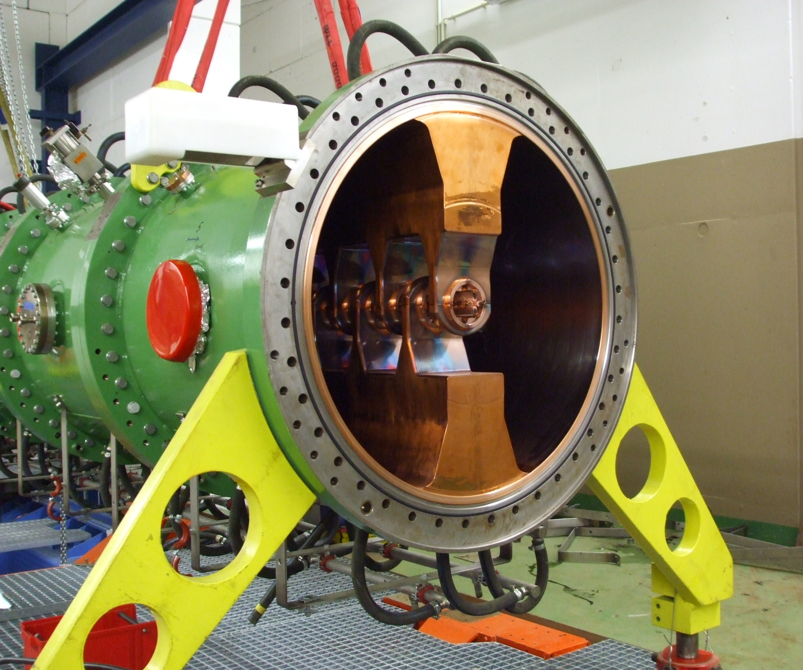
Investigations
... shutdown 2017
voltage limit imposed by reflected power, not by sparking or vacuum
classical “conditioning behavior” not observed; situation did not change for two weeks
several tank temperatures and tuner positions tested
residual gas spectrum does not reveal masses > 44, i.e., no hydro-carbonites
independent dust probe indicates no oil
visual inspection w/o special findings
photograph P. Gerhard, (August 2018)
photograph P. Gerhard, (August 2018)
RFQ-Upgrade (2009)

Slide 17
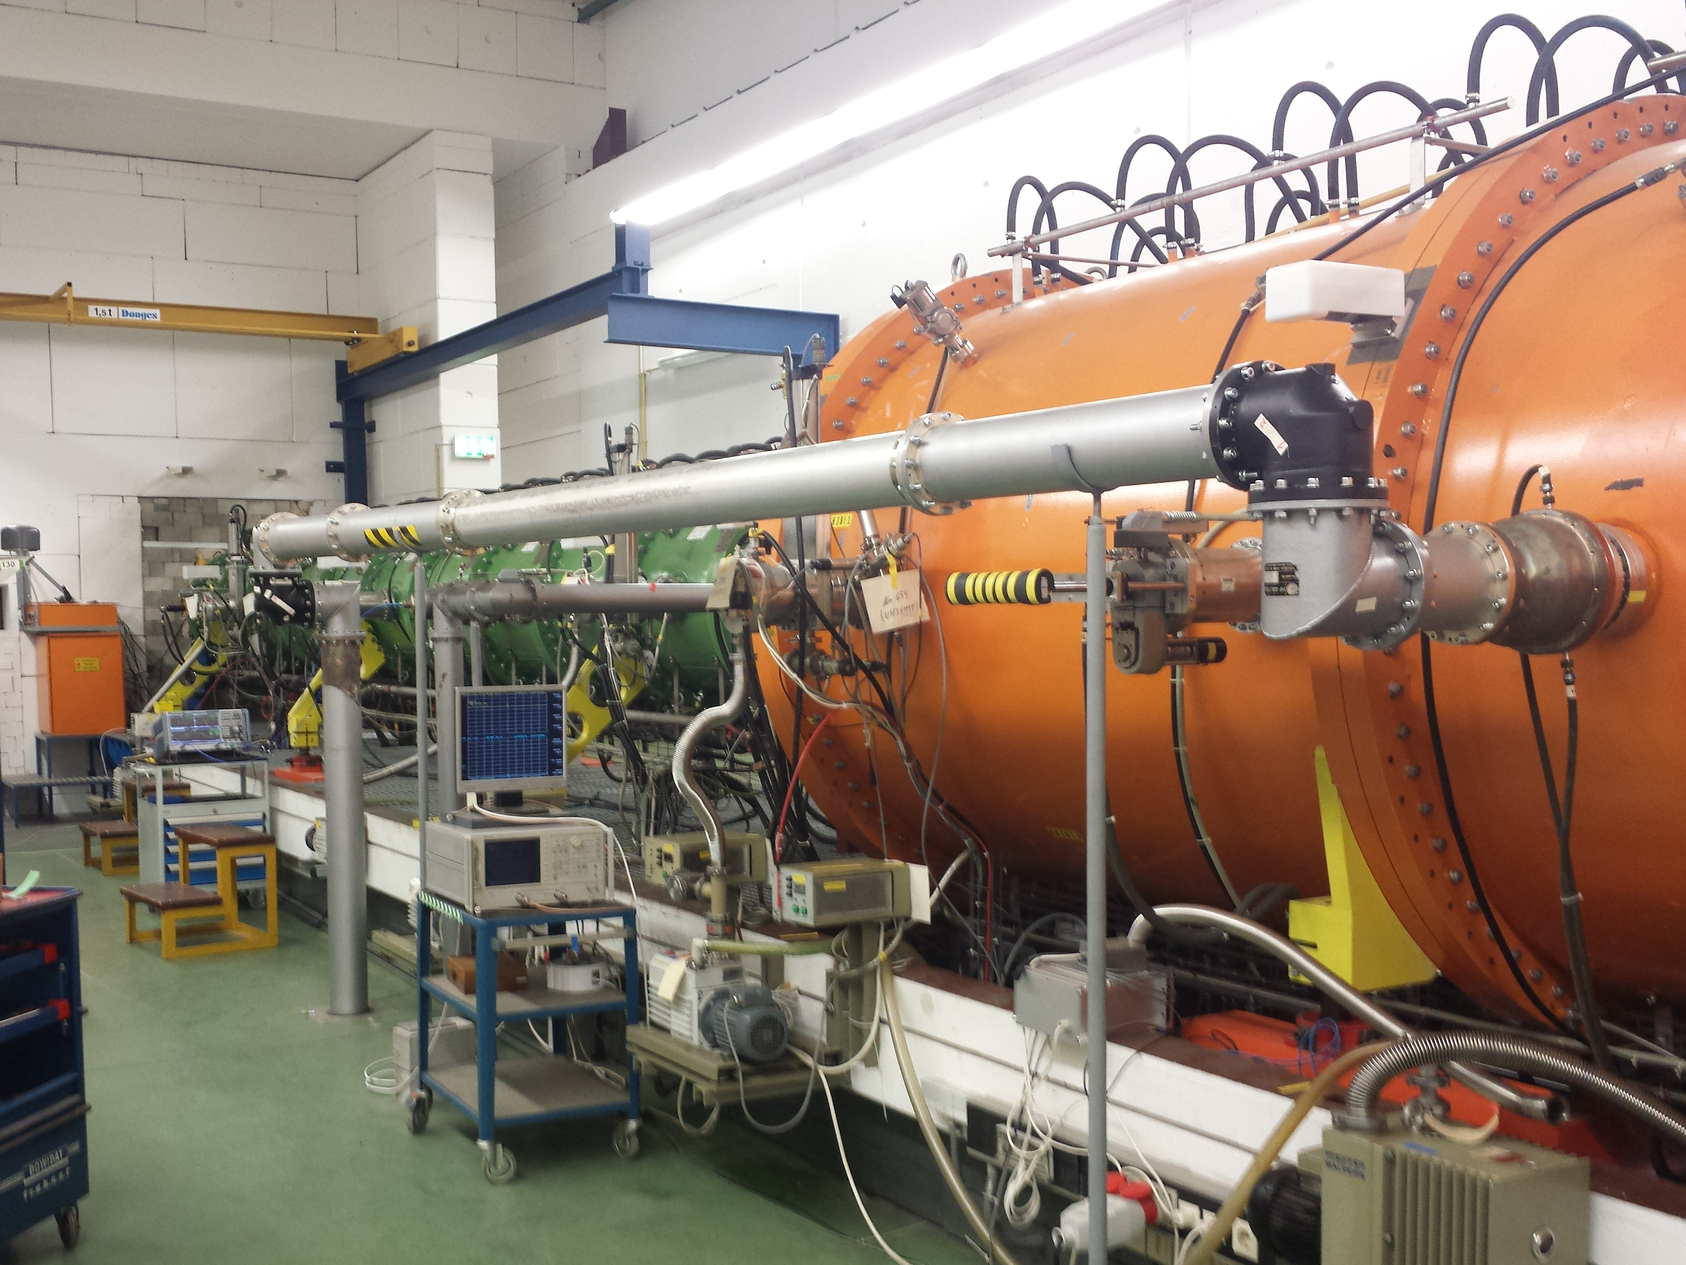
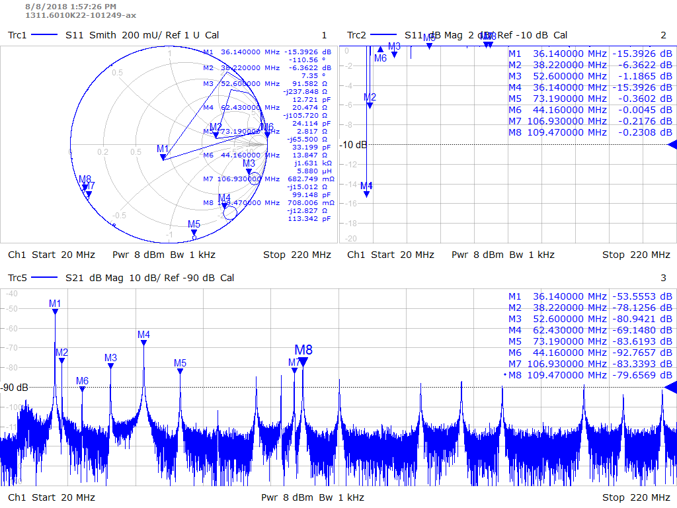
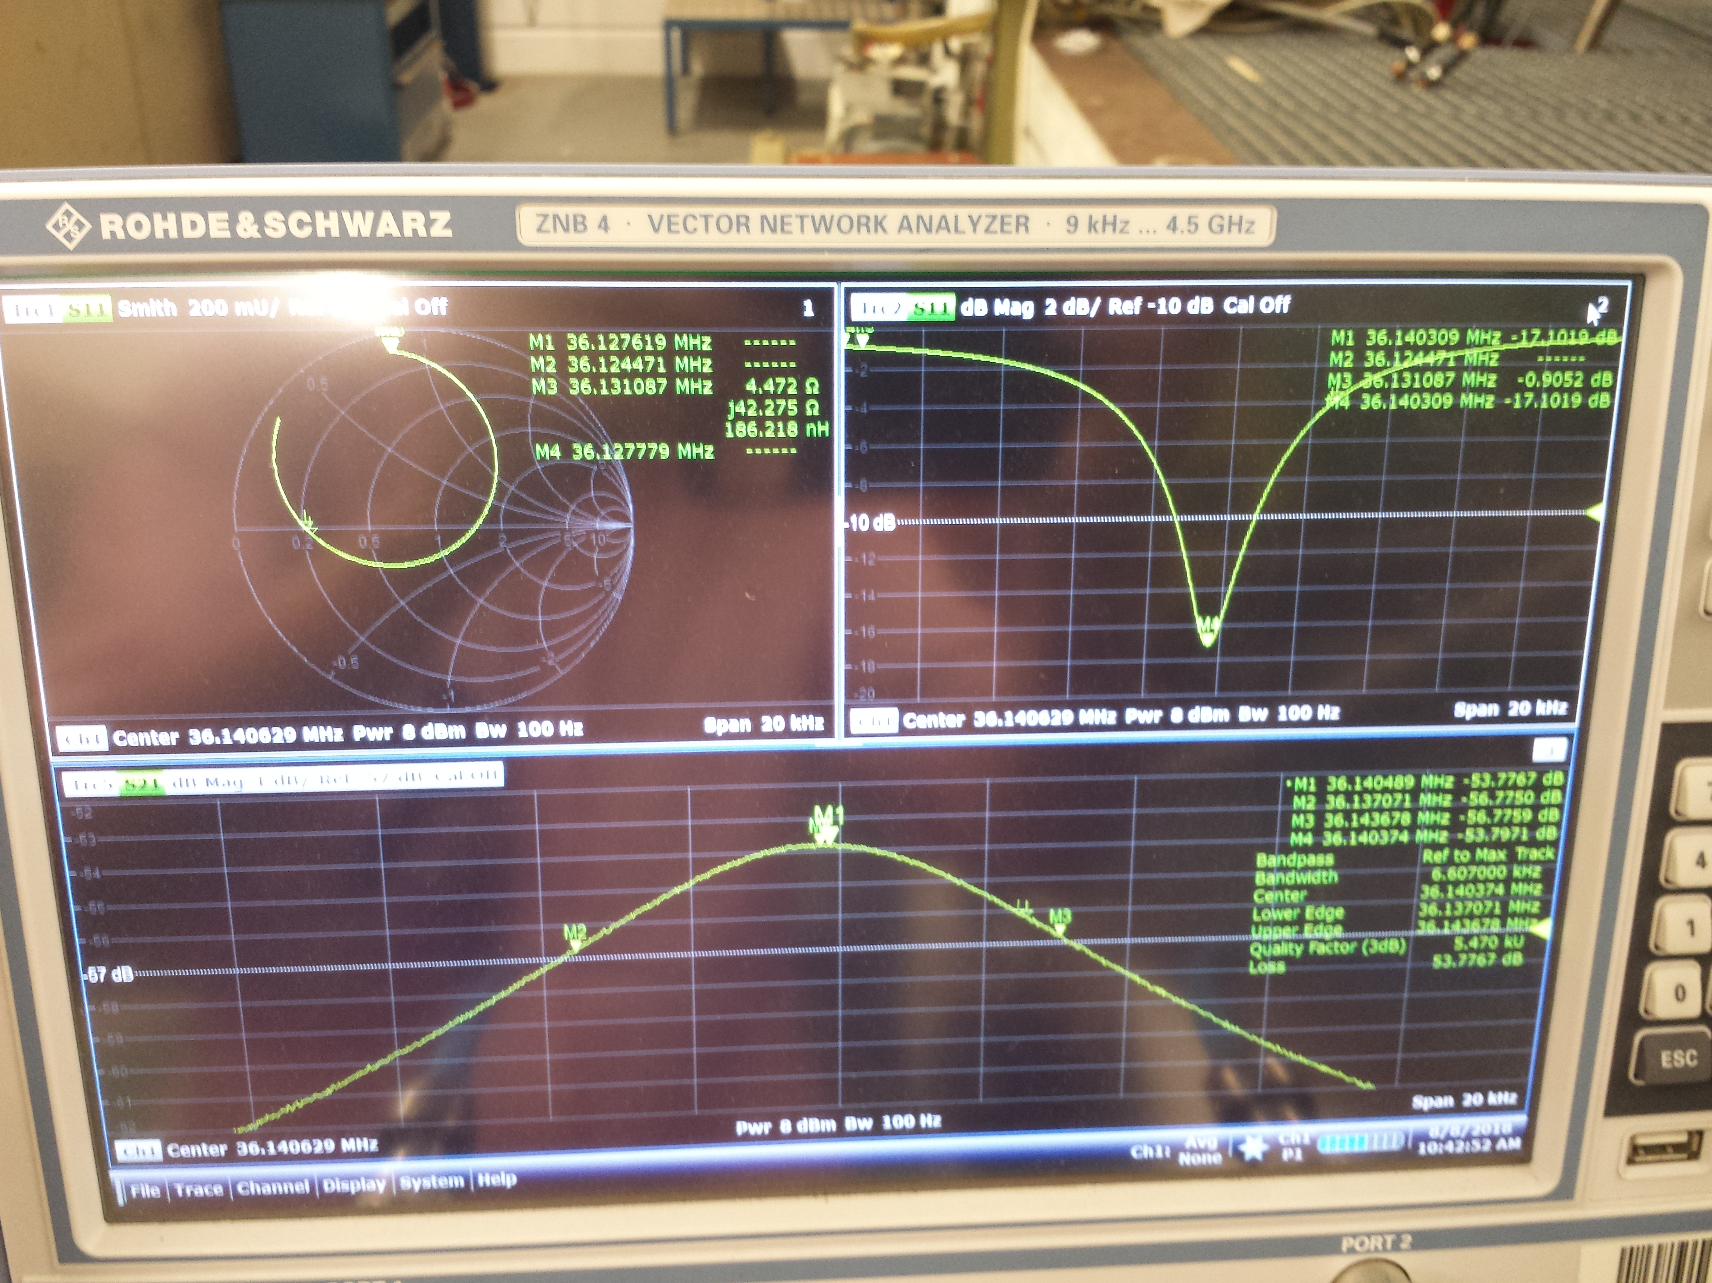
Investigations
... shutdown 2017
rf-power amplifier, power lines, rf-coupler ok
position sensitive X-ray measurements: foreseen for 17th April 2019
NWA-measurements of higher modes
several external experts consulted: S. Ramberger, P. Chiggiato, S. Calatroni, W. Vinzenz, U. Ratzinger, M. Vretenar, ...
rf power line from RFQ transmitter to IH-1 cavity
NWA measurements of higher modes

Slide 18
2012...

Slide 19
Third revision planned for FAIR suspended due to 2018 Problems
Most likely cause: after 9 years, rods exceeded lifetime
Short term solution, for beamtime 2020: re-production of rods with existing design (2009)
decision to just re-produce rods (2009 design) instead of improved but not tested new design (CERN)
→ installation of new design suspended to minimize risks for operation in 2019/20
fabrication of 2009 design rods finished in February 2019
completion of electrode „baskets“ (with carrierr rings) finished 9th April 2019
Mid term: preparation to implement CERN design (FAIR)

Slide 20
Outlook Mid Term Solution: FAIR Performance Gain
follow up the original strategy (CERN design)
postponed to 2020
material for rods and carrier rings ordered

Slide 21
Summary
after two revisions the HSI RFQ has still not reached the required beam current performance --- a third revision is planned to meet FAIR
although design is completed, this third revision has been suspended due to latest cavity voltage performance losses
cause for performance loss is still not understood; most likely lifetime of rods is exceeded
user beam time Q1/2019 with limited amplitudes successsful
to cure the cavity performance loss, new electrodes are produced, applying the 2009 design
they will be mounted immediately after the beam time (ending 2019-04-16, 06:00 h)
additionally, new rods will be produced applying the CERN design for FAIR

Slide 23
Conditioning 2009 - 2015
Notes from 2015...
5.8.15:
sxxx und vxxx in kantine: HSI-RFQ jetzt 7.9 V bei 450kW/20kWrück, faktor 2 besser als die beste kurve, Vacc14 mit 2.5Hz, während Au8+ mit 3.4V bei 50Hz und 3.2ms.
10.8.15:
HSI RFQ 8.0 V 500 kW 20 kW
12.8.15:
HSI-RFQ: Wenn der Warmhalter mit 6.42 Volt und 50 Hz mitläuft (ca. 1 ms HF), dann wirds dem tank wärmer, TK20%, und er braucht für die hohen vacc14 (8 V) mehr leistung (>500kW). Hxxx macht noch bis freitag tests, anweisung in mittagssitzung geschrieben.
7.10.15:
hsi rfq 7,60 V 600 kW 17Uhr
13.10.15:
HSI-RFQ 8,22 V bei 700 kW Vorlauf.
14.10.15:
HSI RFQ den U06er von 7.5V 2.5Hz auf 3.0 V 48 Hz 3ms Strahl (knapp 4 ms HF) geändert, so fällt der U15er (4.0 V) raus , Pxxx ändert frequenzregelung TK, schließlich TKs bei 15%, vorher bei 5%. U14 nun bei 8.21V 2 Hz nun 730 kW und 19 kW Rück.

Slide 24
2010...

Slide 25
Impact on Beamtime 2018/2019
limits deliverable A/q to 43.7;
for intense uranium A/q = 59.5 is needed
imposes considerable intensity limitations to all heavy ions
ion | mass | q_min | q_best | I_SIS18(q_best) [eµA] | I(q_min) / I(q_best) | I_SIS18(q_min) [eµA] | q(SIS18)
Pb | 208 | 5 | 4 | 411 | 0,01 | 4,11 | 65
Au | 197 | 5 | 4 | 262 | 1,00 | 262 | 25
Ag | 107 | 3 | 2 | 440 | 0,50 | 220 | 43
U | 238 | 6 | 4 | 2000 | 0,00 | 0 | 0
Fe | 56 | 2 | 1 | 44,7 | 1,00 | 44,7 | 25

Slide 26
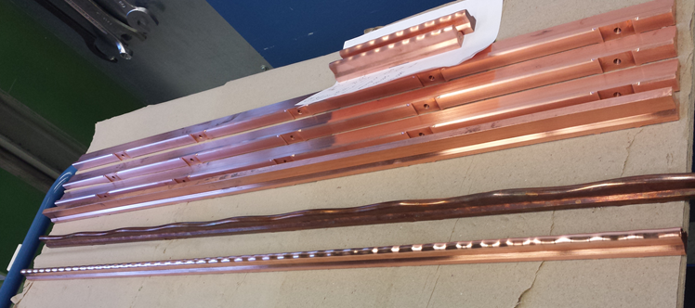
Outlook Mid Term Solution: FAIR Performance Gain
follow up the original strategy (CERN design)
postponed to 2020
material for rods and carrier rings ordered
test piece,
pre-milled pieces,
older example,
new milled rod.

Slide 27
Work Package Description High Current RFQ / UNILAC
Scope
Design, production, installation, and commissioning of the re-designed RFQ rods to meet FAIR requirements
System function
First accelerating section of the heavy ion injector linac for FAIR
System requirements
Ion energy 2.2 keV/u
Maximum design current 0.34 mA* A/q (20 emA U⁴⁺)

