Slide 1
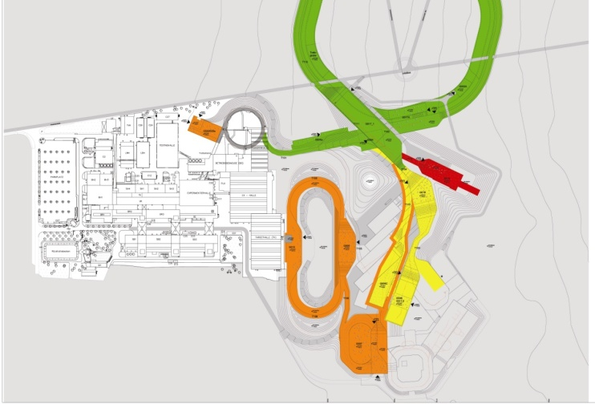
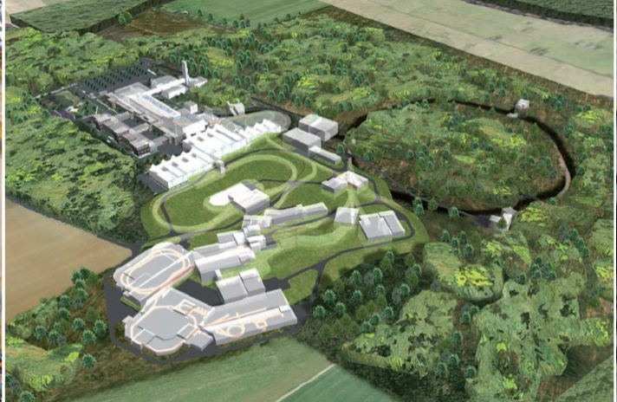
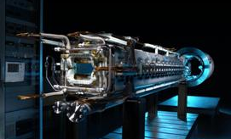
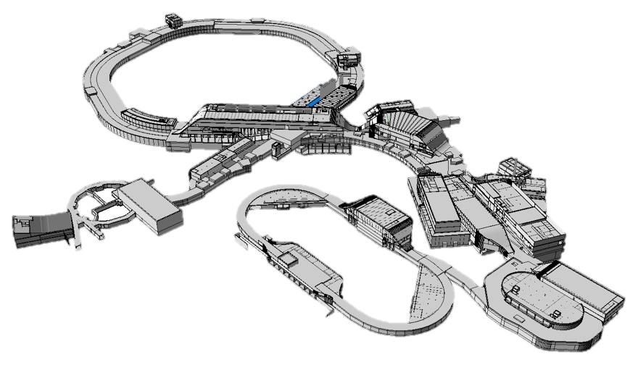

BINP Workshop
Status of SFRS
H. Simon/M. Winkler
May 20th-24th, 2019

Slide 2
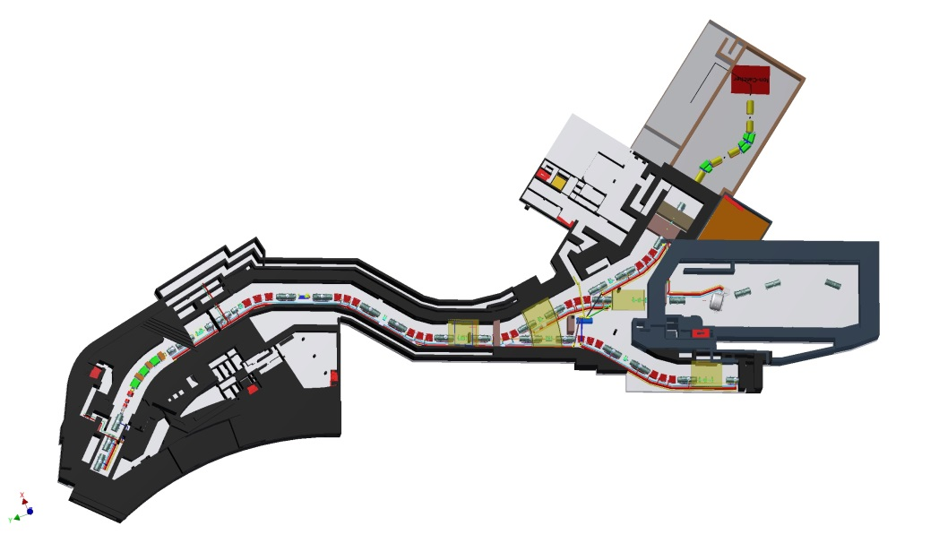
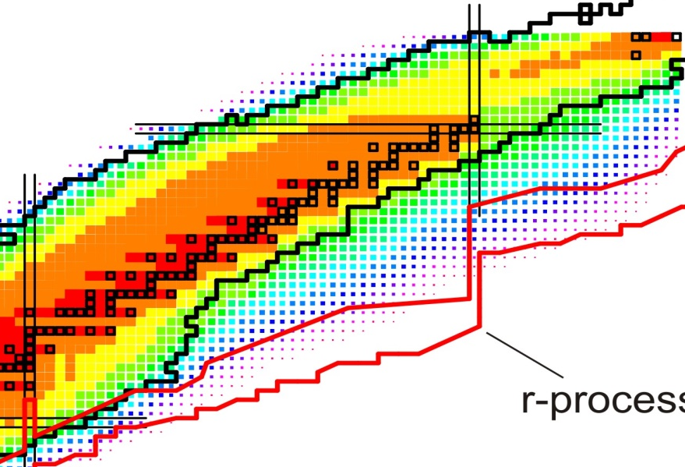
Super-FRS & NUSTAR experiments
MATS /
LaSpec
Cryogenic
stopping
cell
r-process path
3rd waiting point
HISPEC/
DESPEC
R³B
Super-FRS collab.
parts from HISPEC / R³B
to storage rings
ILIMA, EXL,...

Slide 3
General Project Schedule
➔ Super-FRS readiness required in 2025
General Component status and
associated (schedule) risks
options in case of their occurrence.

Slide 4
Actual installation plan
HEBT
Cryogenic plant
Control System
Iron shielding
Local Cryogenics
G018
Local Cryogenics
Machine installation and SAT
T103
Legal approval
HBO
M11 Super-FRS ready for beam
11/07/2024
Commissioning
Installation windows
Installation scheduling
first experiment
M12 Super-FRS ready for operation
23/10/2025
M11 Super-FRS ready for beam 11/07/2024

Slide 5
Actual installation plan (criticality)
Iron blocks
Iron shielding
Installation windows
Installation scheduling
Local Cryogenics
Components ready for installation
G018
Local Cryogenics
Local Cryogenics
Machine installation and SAT
T103
HBO
Legal approval
Target chamber
NC multipoles
M11 Super-FRS ready for beam
11/07/2024
Commissioning
Beam Instrumentation (SEM, GEM)
first experiment
M12 Super-FRS ready for operations
23/10/2025
SC dipoles
SC multiplets
multiplets ring branch
Local cryogenics installed in parallel to MEP installation
Depicted components are on track but with no or minimal float

Slide 6
Actual installation plan (possible delays)
Iron blocks
Tender or IK assignment
Risk
25% - 50%
50% - 75%
more than 75%
Iron shielding
Local Cryogenics
G018
Local Cryogenics
Production timeline
T103
HBO
Local Cryogenics
Machine installation and SAT
NC multipoles
Production timeline
Legal approval
Target chamber
KVI-CART to be closed → new provider
M11 Super-FRS ready for beam
11/07/2024
Commissioning
Beam Instrumentation (SEM, GEM)
contracts’ closure
first experiment
M12 Super-FRS ready for operations
23/10/2025
SC dipoles
SC multiplets
multiplets ring branch
Local cryogenics is the most critical component

Slide 7
Commissioning
Basic tests are performed during installation and SATBa
Cooling for the whole facility takes 1-2 months
A commissioning period of 4 month is foreseen after the beam becomes available
Pilot beam will be used to check the basic functionality of the separator
In conjunction with ramping up the performance first physics experiments can be envisaged
Based on BigRIPS startup experience

Slide 8
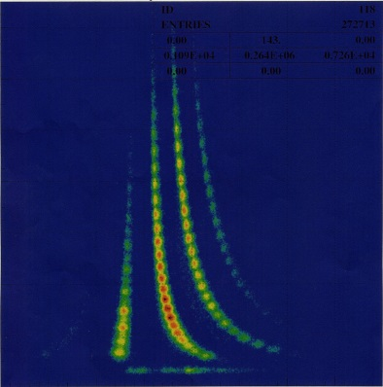
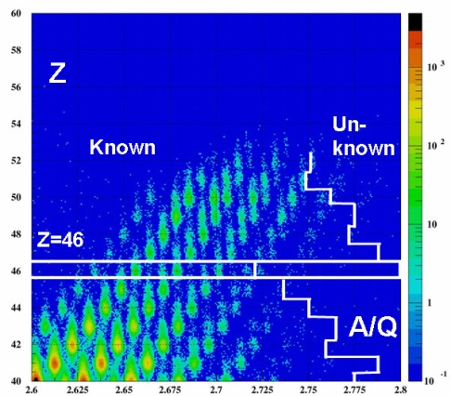
History of RIBF commissioning
Dec. 28th , 2006
First Beam ²⁷Al¹⁰⁺ 345 MeV/u at RIBF-SRC
March, 2007
12th ⁸⁶Kr³¹⁺ beam at 345 MeV/u several pnA.
13th First production of RI beams with ⁸⁶Kr beam
23rd First successful acceleration of ²³⁸U⁸⁶⁺
beam at 345 MeV/u and 0.002 pnA
27th First production of RI beams with ²³⁸U beam
May-June, 2007 (without ZDS)
with ²³⁸U beam at 345 MeV/u and 0.02 pnA max
May 16th-23th BigRIPS commissioning experiment
May 24th – June 3rd Search for new isotopes
End of June(a few days) detector testing
Nov. 2007 acceleration test with ⁸⁶Kr beams, 30 pnA
TOF
Winter break at the facility !
ΔE
ΔE
(~1x10⁸ pps)
Few months from
pilot beams to first experiments
T. Kubo RIKEN / Separator Expert Meeting

Slide 9
Procurement List (most critical items)
Target Chamber: KVI-CART will not be available to take over the production.
Local Cryogenics: Criticality depends on contract negotiation, design and manufacturing capacities.
SC Multiplets: Float is uncertain, depends on the result of the test of first-of-series.
NC Multipoles: Delay in M3. Criticality depends on contract negotiation.
SEM, GEM: IK Finland; Long production series; Support from GSI Detlab needed.
Iron Shielding: decision to be taken either for an IK partner or to start a FAIR tender.

Slide 10
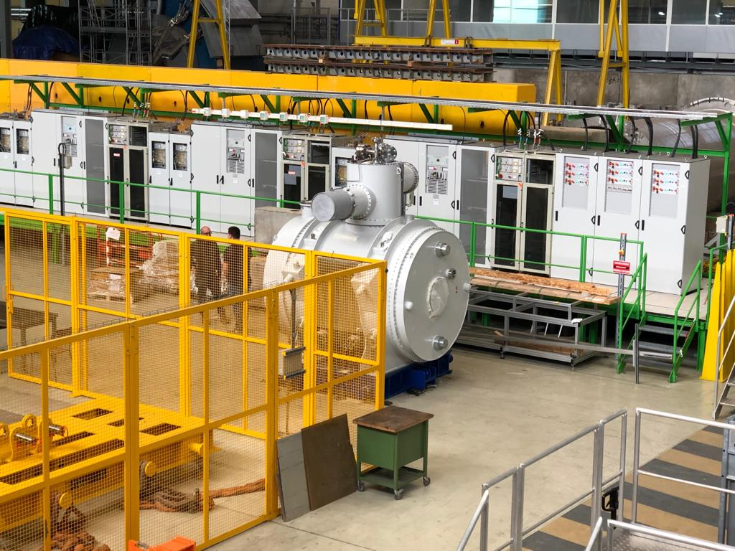
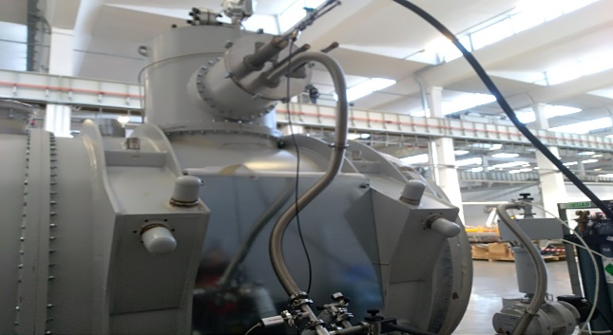
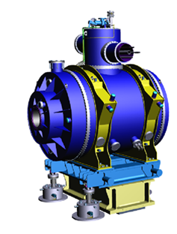
Sc Multiplets
Scope:
8 short multiplets
  QS configuration
25 long multiplets
  Quadrupol triplet
Schedule FoS SC multiplets
Contract closed 07/2015 (ASG, Genova)
Design phase for SM and LM done
  FDR 12/16
  PRR SM 07/17
  PRR LM 12/17
Construction phase for FoS running
  FAT FoS SM 01/19
  shipment to CERN
  Installation @ CERN almost final
  SAT FoS SM 11/19
≈25 ton
2.5 m
7 m
≈60 ton
Most time critical package on track

Slide 11
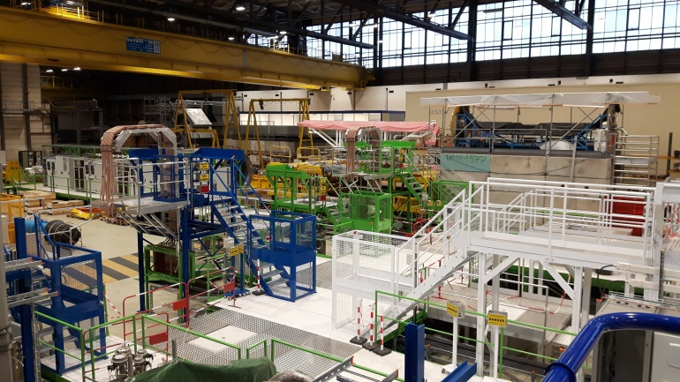
Sc Magnet testing @ CERN
Test facility at CERN for sc-
magnets with three test benches
is ready for operation.
Kick off 02/2019 (& cont. 07/2019)
Test bench 2
Test bench 1
Test bench 3

Slide 12
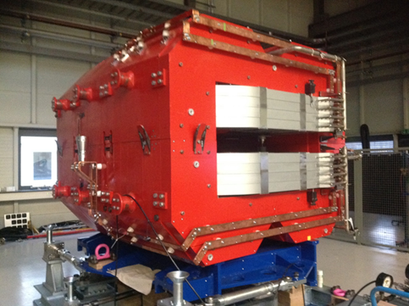
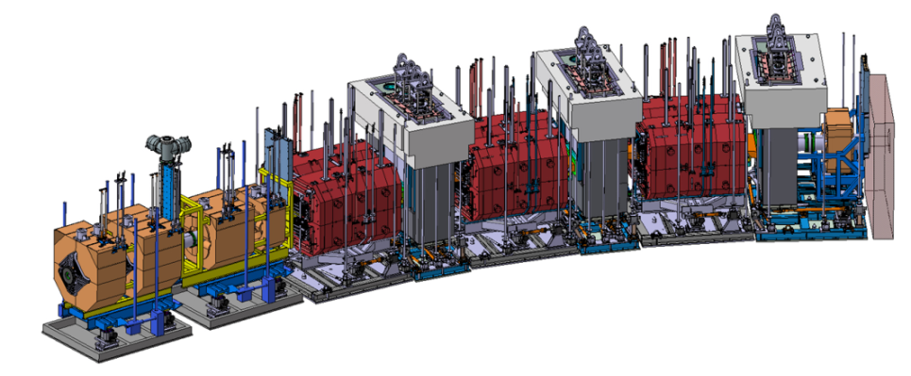
Magnets
(Radiation Resistant)
H. Leibrock,
T. Blatz et al.
interfaces: sextupole, beam catcher, pillow seal, support structure
≈95 ton
Scope:
NC magnets using MIC cable
WP1: 3 dipole magnets
(one prototype dipole built and tested)
WP2: 3 quadrupoles & 2 sextupoles
Dedicated support structure
Remote connectors and alignment
  Status / Schedule
DS for individual magnets released
CC BINP for WP1 circulating
MIC received by FAIR
Vacuum chambers for sc and nc dipoles
Focal plane chambers
Tricky vacuum chamber nc Dipole ➔ R&D
WP2: quadrupoles
Target Area

Slide 13
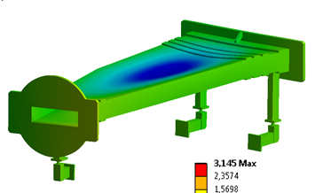
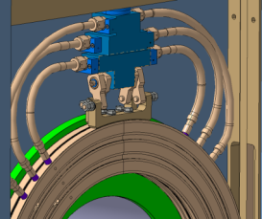
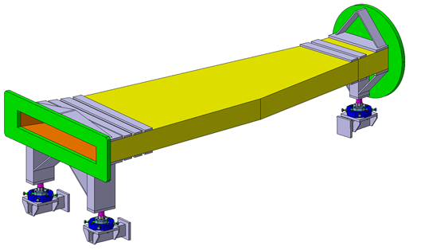

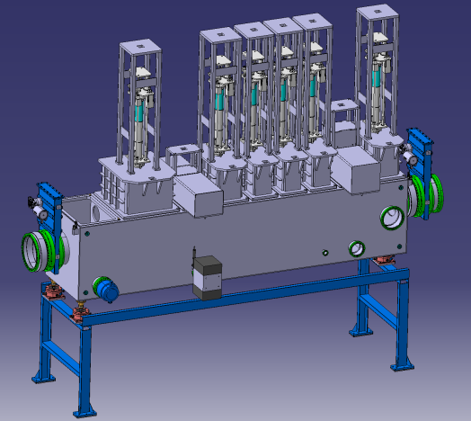
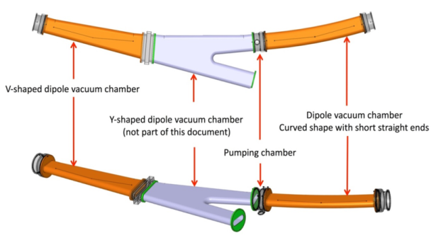
Vacuum System
S. Purushotaman,
I. Mukha,
J. Kurdal et al.
pillow seals
Vacuum system subject of CBWG 2018
  ATB optimized → cost saving
FAIR wide procurement of standard components
  1st BINP workshop (11/2018)
  21 focal plane chambers including support frames
  CC BINP, FoS chamber Q2/2020
24 vacuum chambers for sc dipoles
  21 for standard dipoles including pumping ports
  CC BINP
  3 for branching dipoles, part of dipole procurement
Vacuum chambers for target area magnets
  R&D contract for dipole chambers
  Beam pipes for NC quadrupoles/sextupoles
  shall be included in CC for multipole procurement
Ø 400 mm
rectangular: 1.200 x 200 mm
pumping ports
FLF2
standard dipole stage
branching dipole stage

Slide 14

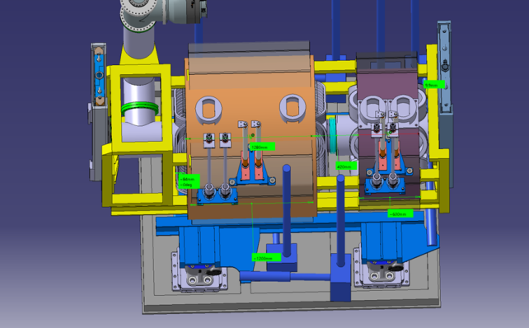
NC Multipole Magnets
Scope:
3 quadrupoles, and 2 sextupoles
NC magnets using MIC cable
Dedicated support structure
Remote connectors and alignment
Target area magnets
  Status / Schedule
DS for individual magnets just released
CC negotiations with BINP ongoing
R&D on quadrupole manufacturing.
Contract to be placed after FAIR
council assignment in 07/2019;
- production schedule ?
tender required in case negotiations fail
(→ delivery 03/2023, two months float left)
≈40 ton
≈40 ton

Slide 15
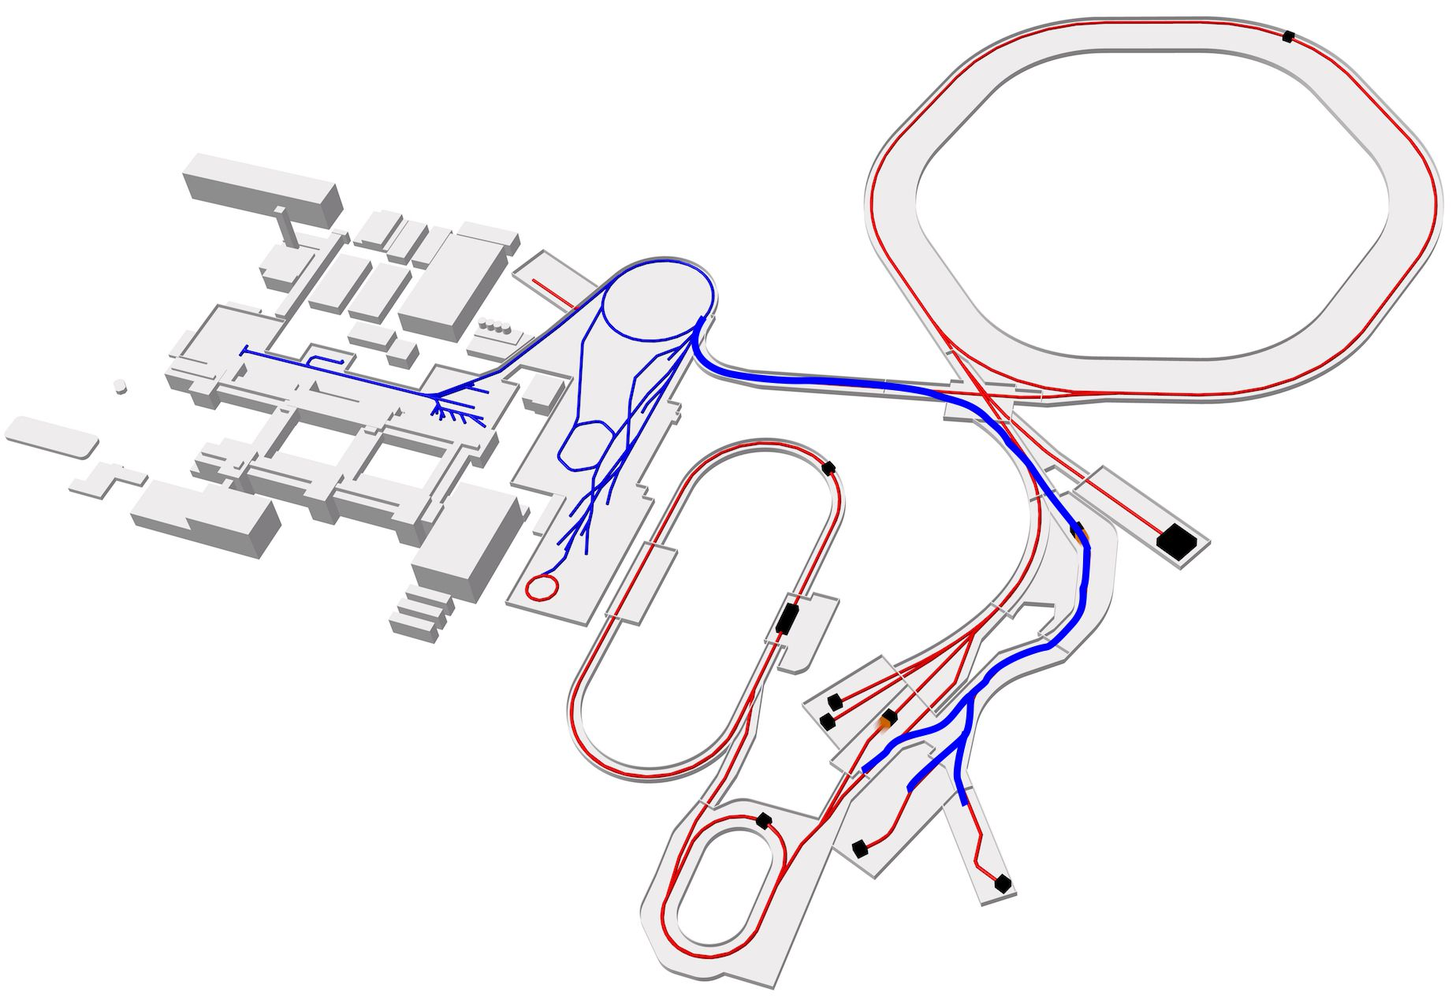
Alternative Scenario
SIS100
Super-FRS
Ring
branch
Low-energy
branch
High-energy
branch

Slide 16
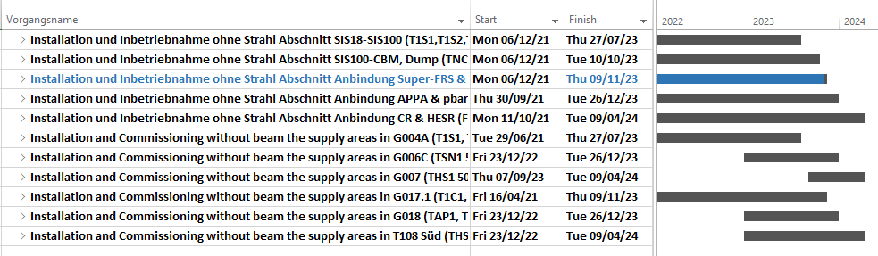
HEBT Installation
HEBT will install several beam-line segments simultaneously
The limiting factor is the access from buildings G004A and G050
Building ready for installation on Nov-2021 (G050) and Dec-2021 (G004A)

Slide 17
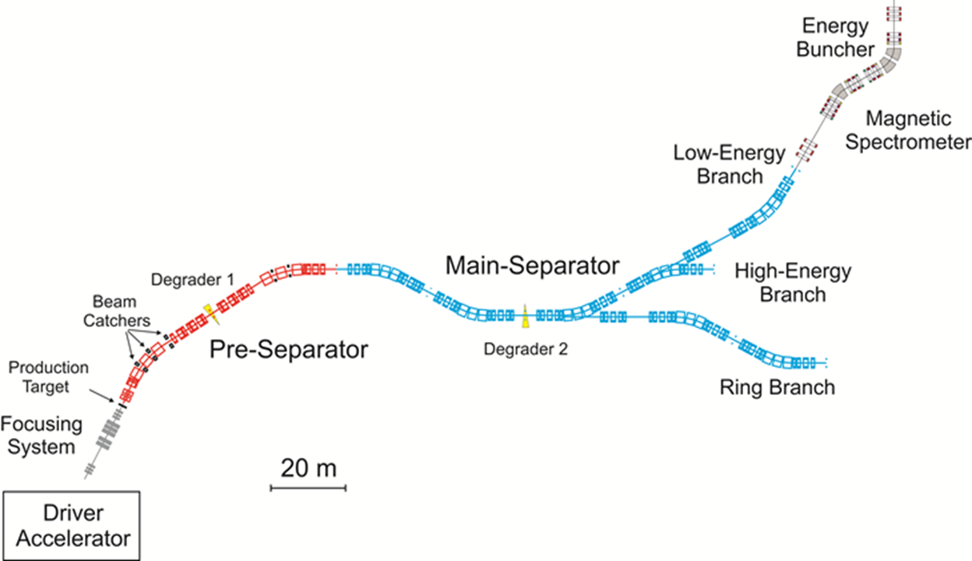
Installation Scenarios
May-24
Apr-24
Jul-2024
Staged realisation of branches in case of late deliveries
Notes:
In-Flight → energies as high as 1500 MeV/u

Slide 18
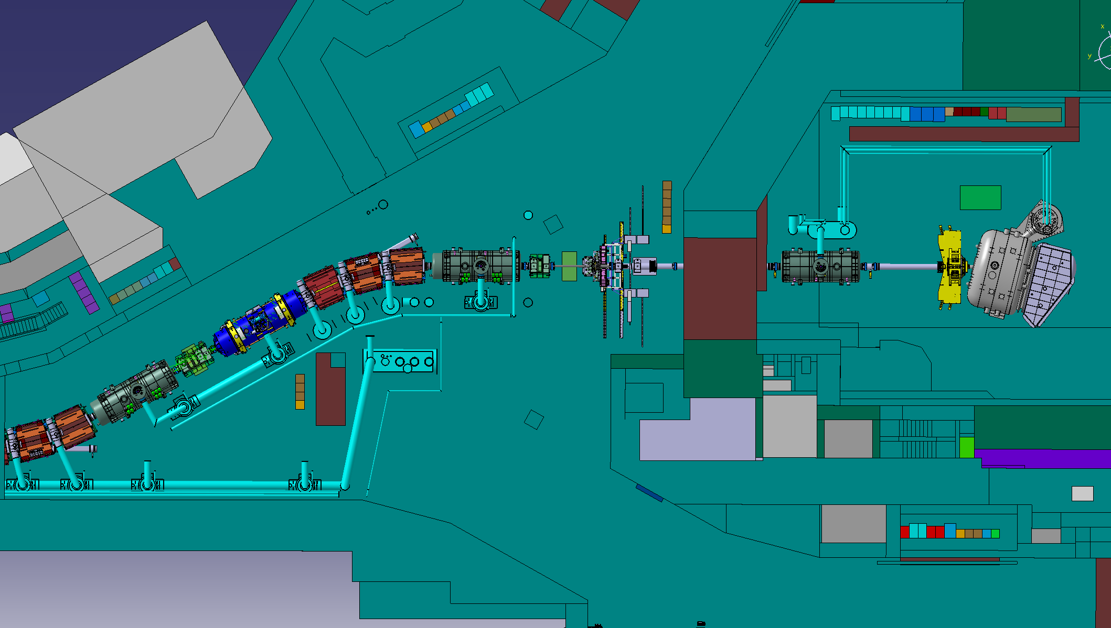
First stage:
-High energy branch (γ-setup @ FHF1) + R3B/GLAD
HISPEC
DESPEC
Super-FRS Exp.
R³B
No ring experiments
Most Experiments possible at least in start versions

Slide 19
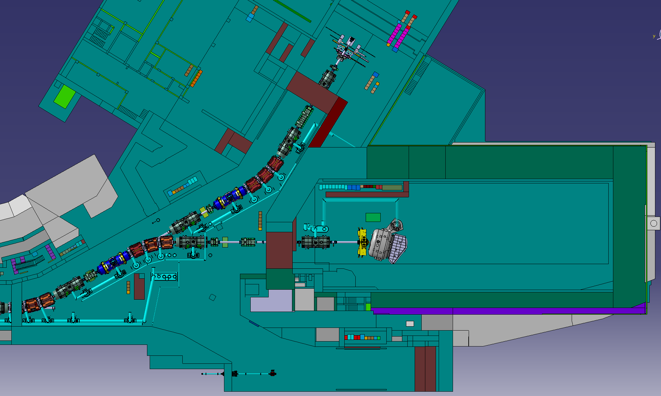
Second stage:
-(HEB (R3B/GLAD) + γ-setup @ FRF3
HISPEC
DESPEC
Super-FRS Exp.
R³B
No ring experiments
Improved performance for HISPEC/DESPEC experiment

Slide 20
Summary
- Super-FRS can be ready for operation in 2025
- Time schedule: ambitious but realistic
Allows for early experiments in Q4/2024-Q1/2025
- Risk profile in regards to machine considered as manageable
as long as contracts can be closed as per schedule and
in-kind partner comply with schedule needs
Staged installation of Super-FRS allowing for early experiments
in case time schedule risks materialize (branches not pre-sep.)
Schedule driven by manufacturing and delivery of components
BINP is one of the key partners!
Looking foward for a fruitful workshop

Slide 22
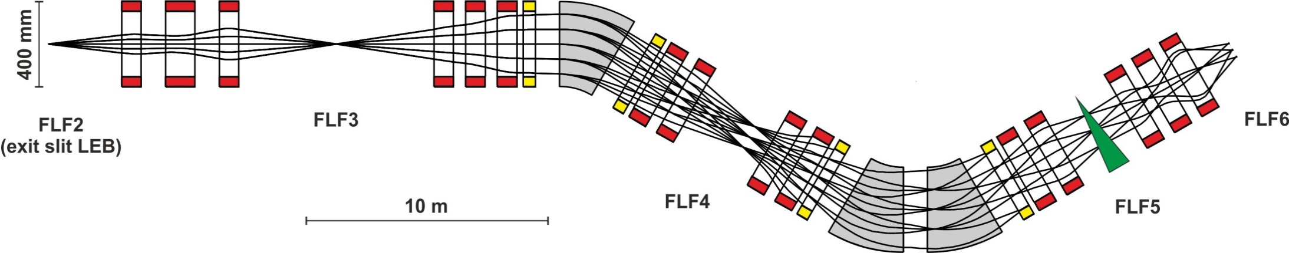
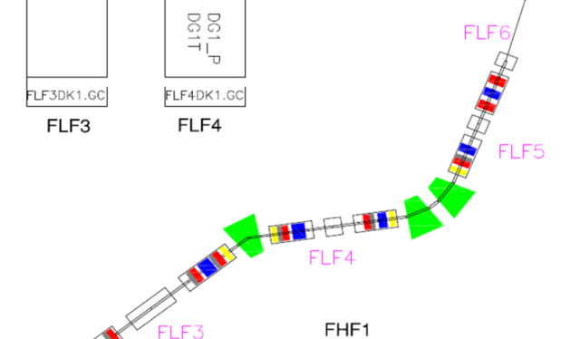
Energy buncher - long version of the LEB - in new S-shape layout (using standard multiplet magnets)
The energy buncher at the low energy branch allows to fill the cryogenic
stopping cell serving the low energy experiments MATS and LASPEC
Indian in-kind about to be returned, potential interest of France on dipoles,
multiplets should be procured within existing contract with ASG.
Endorsed by CBWG.
Design for dipoles still to be done
magnets are last in testing sequence
➔ Installation of the long version of
the LEB starts in 2025.

Slide 23

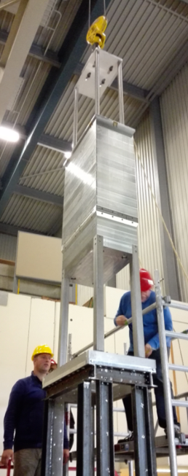
Target Chamber
Target plug
(1:1 mock-up)
Scope:
Target chamber
various plug inserts (for high-power
target and diagnostic elements)
Target chamber
≈10 ton
  Status / Schedule
  Contract with KVI-CART on design
CDR in preparation (Q1/2019)
FDR (09/2020, within contract)
Follow-up contract on manufacturing
was planned to be done with KVI
(→ M10 08/2022, no float )
KVI-CART future unclear (Info 01/2019),
official statement not released yet.
Risk analysis ongoing.
≈20 ton

Slide 24
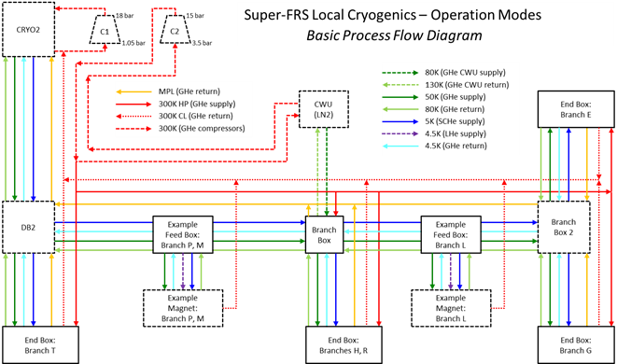
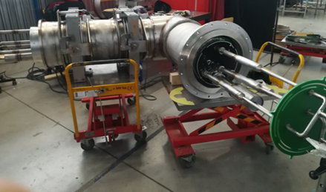

Local Cryogenics
Super-FRS Cryogenics PFD, Common Spec
Scope:
Complete Local Cryogenic System including
Feedboxes (≈60)
Cryo-Jumper (≈250 m)
Transferlines (≈300 m)
Branch Box
  Status / Schedule
  DMU concept ready
  Common specs released (= scope definition)
IKC with Poland in preparation,
M4 planned 06/2019
Measure: careful contract negotiations required, in particular concerning the design phase and the availability of parallel production lines to guarantee M10
Cryo-Jumper as developed for CERN Testing Facility

Slide 25
Procurement Status (most critical items)
Component name | Actual ongoing work | Finish date (M10) | Float [mon] | Status | Funding Status
Iron Radiation Lateral Shielding | finalising specification | 25/11/2021 | 1 | Decision to be taken either for an IK partner or to start a FAIR tender in July 2019. | FAIR, not assigned
Local Cryogenics | preparing contract | 21/12/2022 | -4.5 | Careful contract negotiations, in particular concerning the design phase and the availability of parallel production lines. | Assigned to Poland, WUST (Council decision)
SC multiplets | FoS site acceptance test | 27/07/2023 | 0 | Float is uncertain: it depends on the result of the test of first-of-series, which determines the speed of the testing process. | German In-Kind (GSI). Production by ASG, Italy
NC Multipoles | finalising specifications preparing contract | 20/03/2023 | 2 | Contract by BINP foreseen in July 2019. Contract negotiations: BINP should prioritise production | Potential EoI Russia, BINP
Target chamber | finalising design | 25/07/2022 | 9 | KVI-CART will potentially not take over the production. FDR should be completed in order to efficiently tender the manufacturing. | Assigned to Germany (GSI). Subcontractor KVI-CART, Netherlands
Tracking (GEM TPCs) Beam Profile (SEM Grids) | preparing contract | 05/09/2023 | 0 | Long production series (32+32 pieces). | Assigned to Finland, University Jyväskylä (Council decision)

Slide 26
Schedule of BigRIPS/ZeroDegree construction
Fiscal year (Apr. to Mar.) 2002 2003 2004 2005 2006 2007
BigRIPS magnets
Cryogenic plant of STQ1-5
BigRIPS focal-plane devices & vacuum sys.
High-power target & beam dump
Field-map measurement & optics calculation
BigRIPS radiation shielding
ZeroDegree magnets
ZeroDegree focal-plane devices & vacuum system
Beam-line detectors, electronics, DAQ system
Control system
BigRIPS radiation-safety stuff
Continuous operation of cryocoolers (STQ6-23)
Continuous operation of cryogenic plant (STQ-15)
SRC-BigRIPS beam line
Infrastructure
(Installation)
First RI beams
RI-beam experiment
(BigRIPS & ZD)
(ZD)
(BigRIPS & ZD)
(ZD)
(ZD)

Slide 27
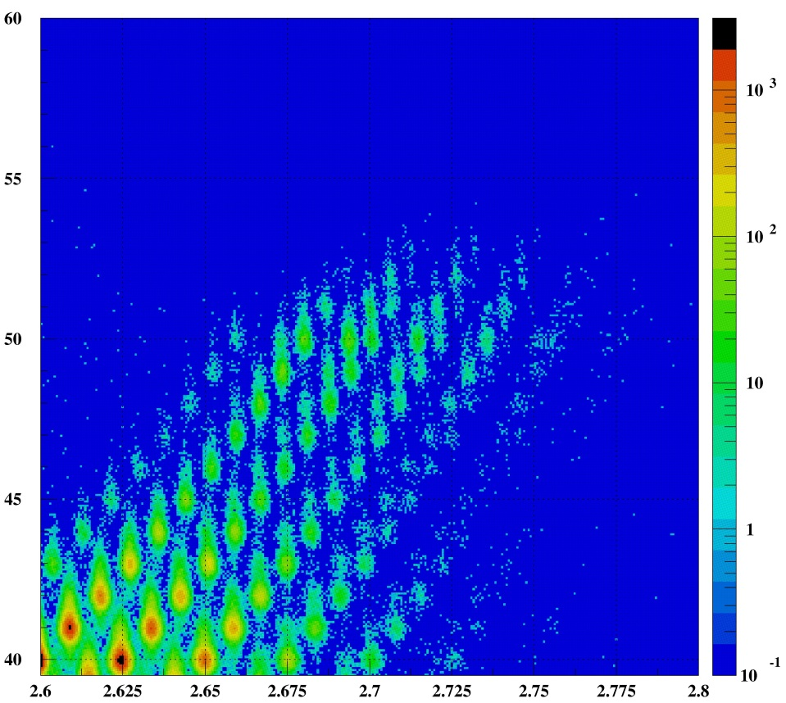
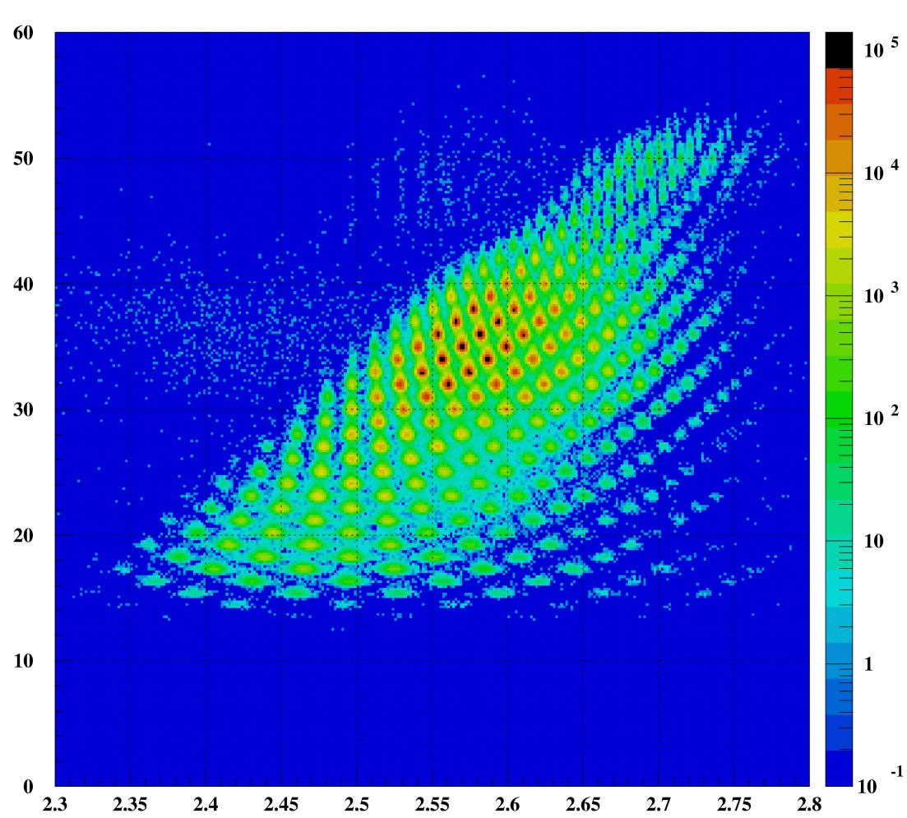
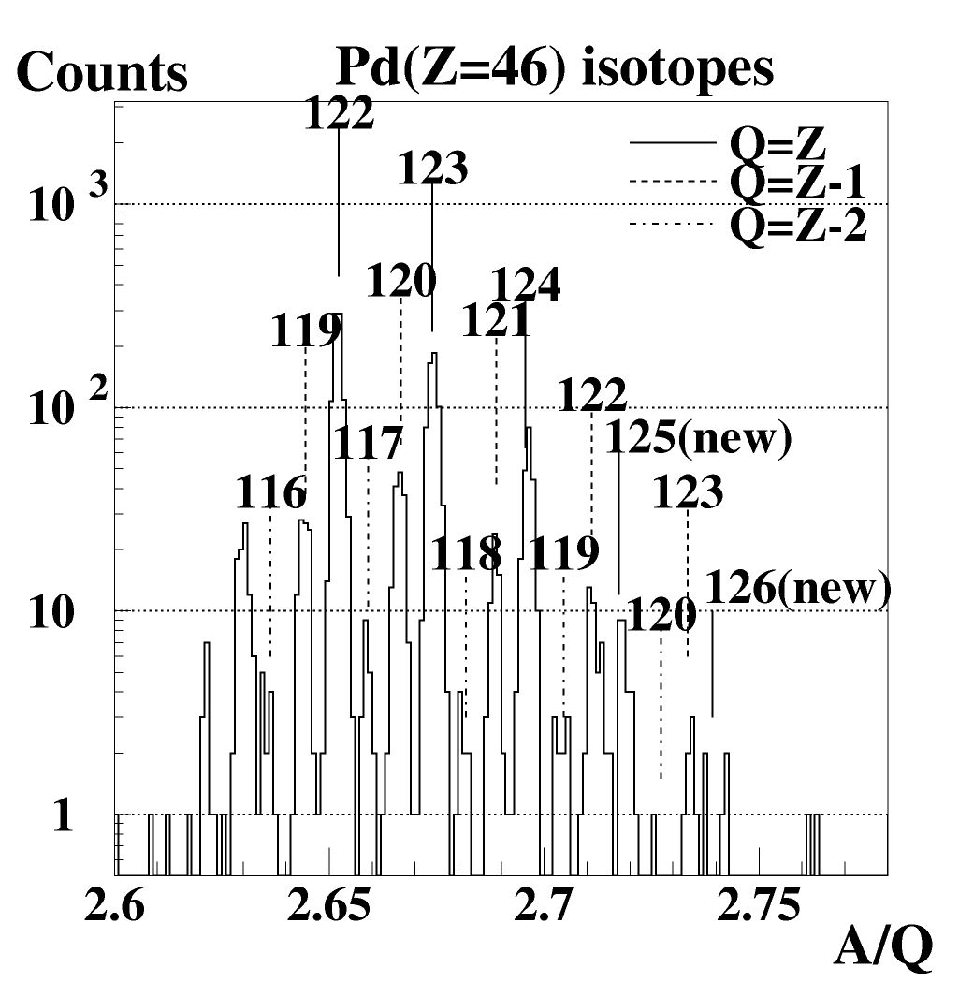
Searching for new isotopes
Z
May 2007
Bρ: 7.438 Tm
Total dose: 3.6×10¹²
Total time: 25.4 hour
Z=46
¹²⁵Pd
A/Q
Z
A/Q

Slide 28
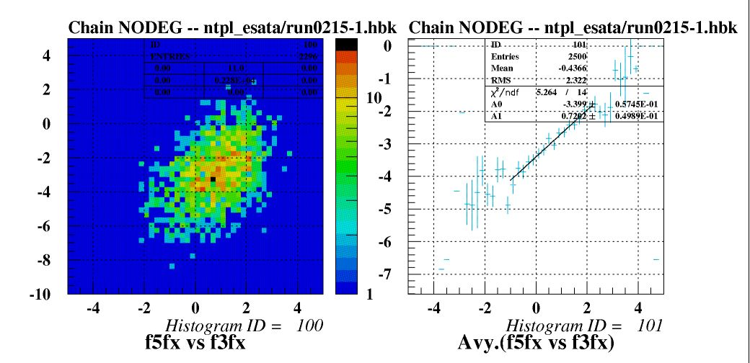
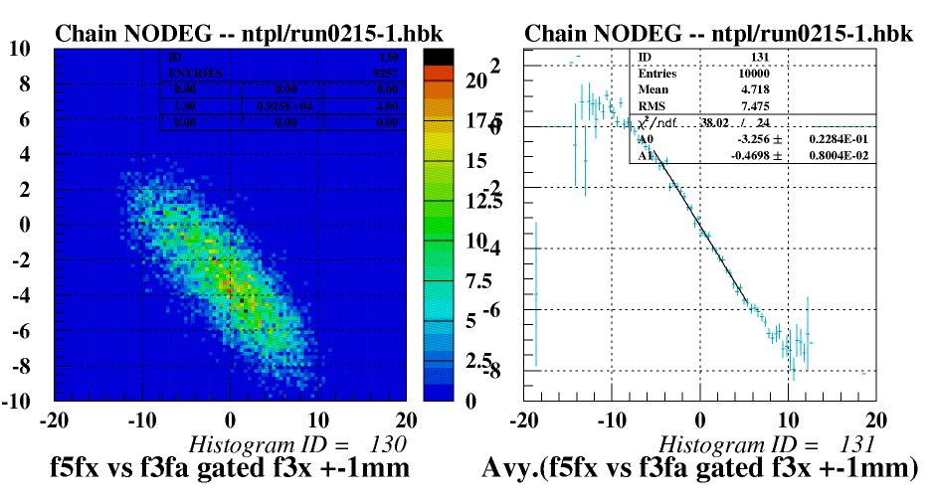
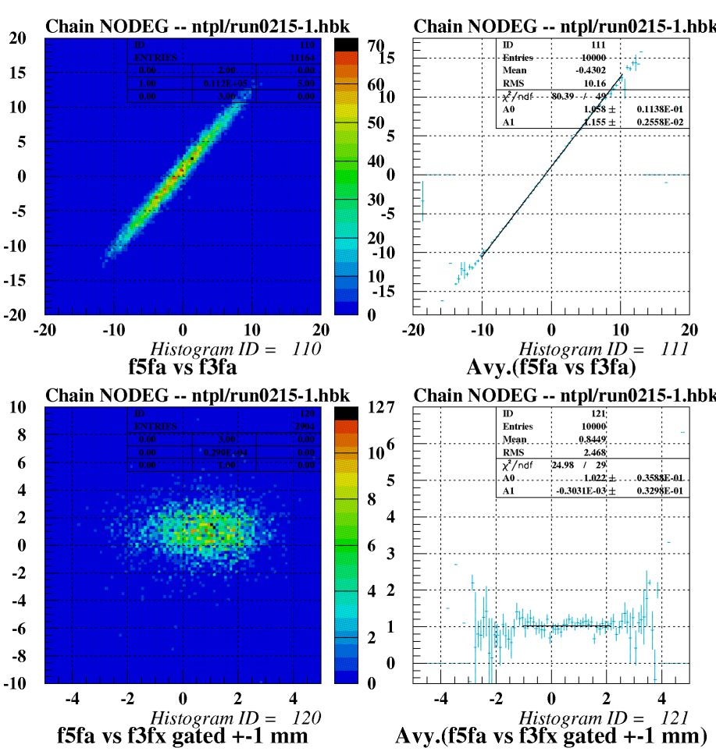
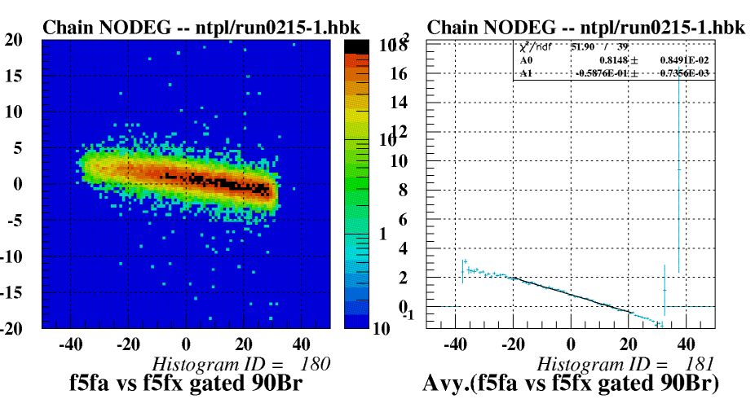
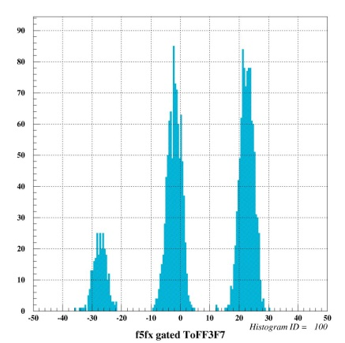
Position and angle correlation between F3 and F5 measured with RI beams
F5X
(x|x)
(x|a)
F3a
(a|a)
(a|δ)
(a|x)
(x|δ)
F3x gate: ±1 mm, F3a gate: ±1 mrad
(x|d) gate: ±1 nsec in TOF(F3-F7)

Slide 29
Super-FRS and experiments @ FAIR
NUSTAR DAQ TDR accepted 2018 by ECE
https://edms.cern.ch/document/2024803/1
Experiment Areas („Caves“)
separated by several 100m.
Experiments on large scale
Couple local DAQ systems to one system
Run common dead time and time stamped systems together
Avoid specific (signal) cabling inbetween caves
➔Collector Ring

Slide 30
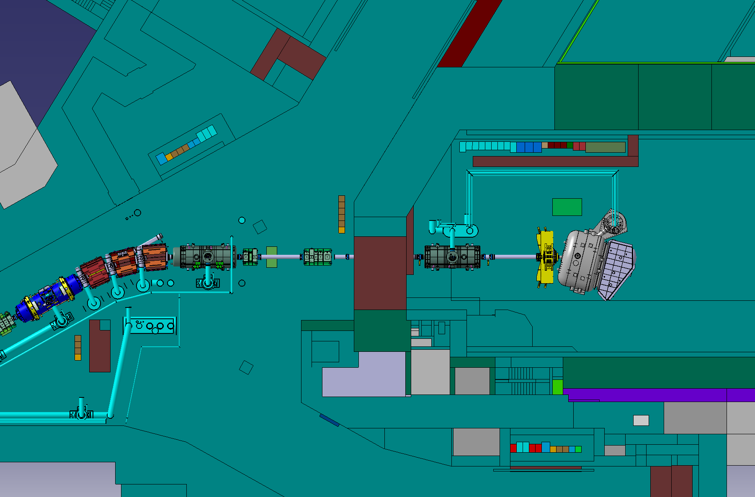
Alternative Scenario 1
HEB (PID setup @ FHF1) + R3B/GLAD

