Slide 1
FAIR Project Planning and Progress
Natalya Winters, Head of PMO Planning
BINP-FAIR collaboration coordination meeting
20-05-2019

Slide 2
Re-baseline 2019
January 2019: Level 1 Team during final Re-baselining Workshop
New FAIR Project schedule baseline frozen on the 12.02.2019

Slide 3
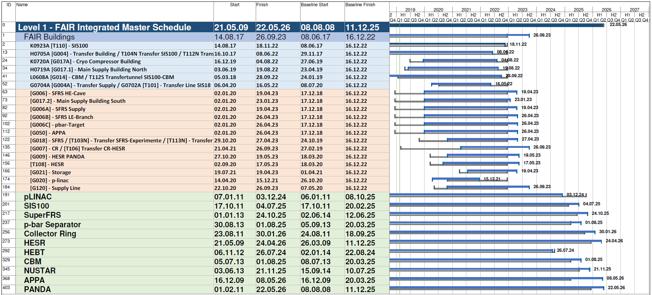
Baseline 2019
Baseline Dates 2016
New Baseline Dates
Early Science in the second half of 2025
Completion of the full FAIR MSV expected until mid of 2026

Slide 4
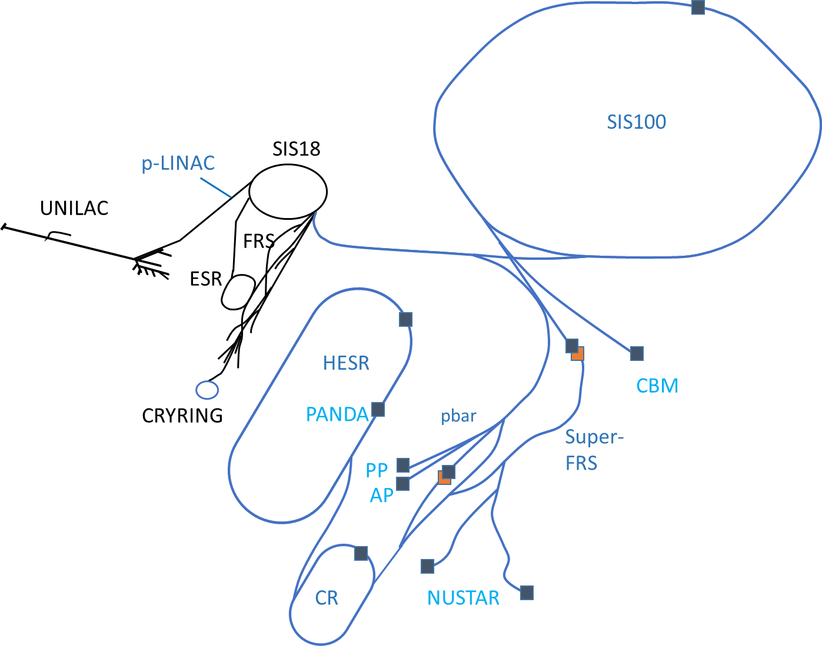
FAIR MSV Completion Dates
Baseline 2019: Sequential realization along the beam driven by SIS100
p-LINAC Q4 2024
SIS100
Q3 2025
M11: Q2 2025
pbar
Q3 2025
HESR
Q2 2026
S-FRS Q4 2025
beam from SIS100
M11: Q4 2023
M11: Q3 2024
CR
Q1 2026
M11: Machine ready for beam – Installation and cold commissioning completed
M11: Q2 2024
indicates start of pilot beam operation e. g. Q3 2025

Slide 5
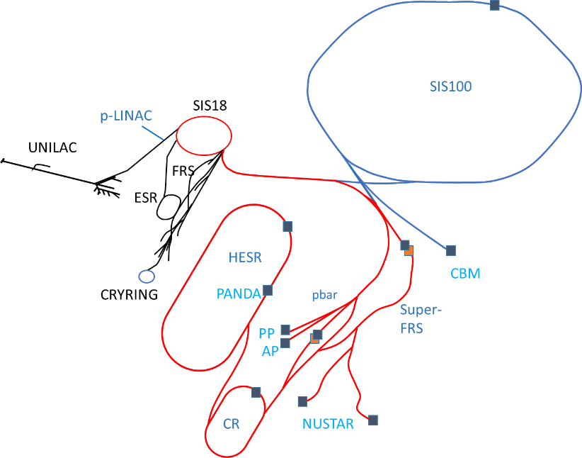
actual scenario
Project Review recommendation
Prioritization of S-FRS commissioning with SIS18 beam
p-LINAC Q4 2024
SIS100
Q3 2025
M11: Q2 2025
pbar
Q2 2024
HESR
Q3 2025
S-FRS Q4 2024
beam from SIS18
M11: Q4 2023
M11: Q3 2024
CR
Q2 2025
M11: Machine ready for beam – Installation and cold commissioning completed
M11: Q2 2024
indicates start of pilot beam operation e. g. Q3 2025

Slide 6
FAIR Critical Path
Sequential realization
delivery & installation of local cryogenics, quadrupole units and commissioning of SIS100
and the subsequent machines in the south area
Prioritization of S-FRS commissioning with SIS18 beam
construction of south area buildings
delivery & installation of Super-FRS multiplets and local cryogenics
installation CR
commissioning works of all machines

Slide 7
Overview Level 2 Plan CR
The manufacturing / procurement plans of all CR components have been
discussed and agreed during FAIR-BINP workshop in November 2018
(in Novosibirsk). Time schedules have been implemented in the MS Project Plans.

Slide 8
CR - Critical Path
Procurement Plans
PSP-number | Component name | Actual Milestone working on | Finish date M10 actual (baseline)
2.5.2.1 | Dipole magnet | M8 (FoS manufacturing) | 17.08.2023
2.5.10 | Stochastic Cooling | M4, M5, M6, M7, M8, M9 | 01.01.2023
Installation and Commissioning without Beam
Plan | Start date | Finish date
Installation plan | 16.08.22 | 11.09.23
Commissioning without Beam | 1.10.23 | 10.05.24

Slide 9
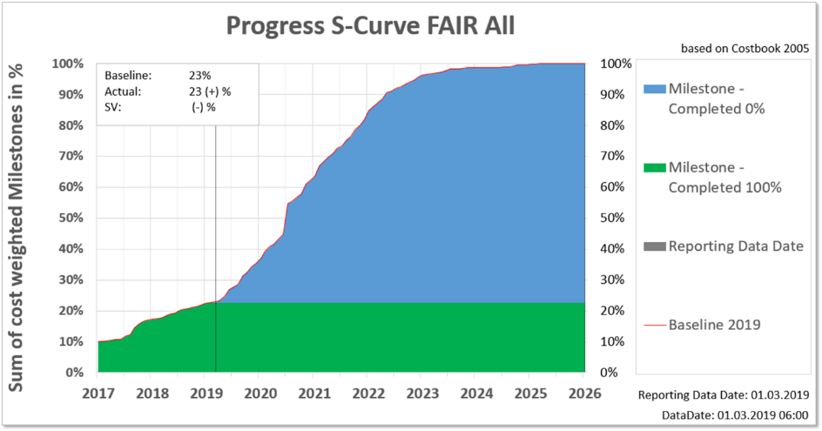
Earned Value Management
project progress monitoring
Schedule variance analysis is used at
every project level to monitor progress

Slide 10
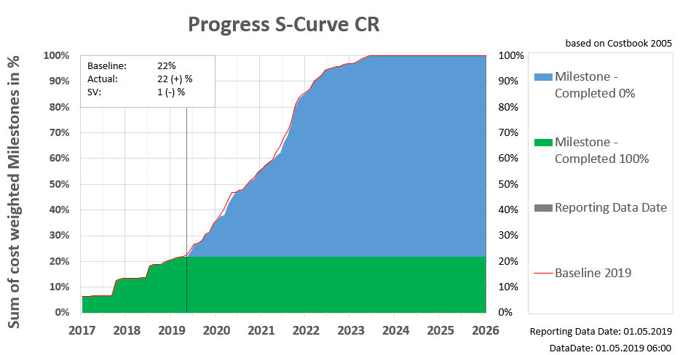
CR S-Curve
 | Work Package | additional Progress for 2019 all Milestones | Comments
 |  | 13,7%
2.5.2 | Magnets | 5,8% | CDR, FDR of major magnet components will be done in 2019.
2.5.10 | Stochastic Cooling | 3,6% | Stochastic Cooling – depends on GSI campus improvements.
2.5.7 | Vacuum | 1,3% | Vacuum chambers prototypes planned to be produced and assembled with sc mw tubes.
2.5.3 | Power Converters | 1,2% | PC CDRs should be passed. Prototyping of subsystems.
2.5.5 | Injection/Extraction | 0,9% | HV cables problem: almost solved…
2.5.6.10 | Beam Instrumentation BINP | 0,7%
2.5.6.20 | Beam Instrumentation GSI | 0,3%
The planned milestones at BINP were corrected after contract signing in the middle of 2018. Major milestones are realistic for 2019 and other years.

Slide 11
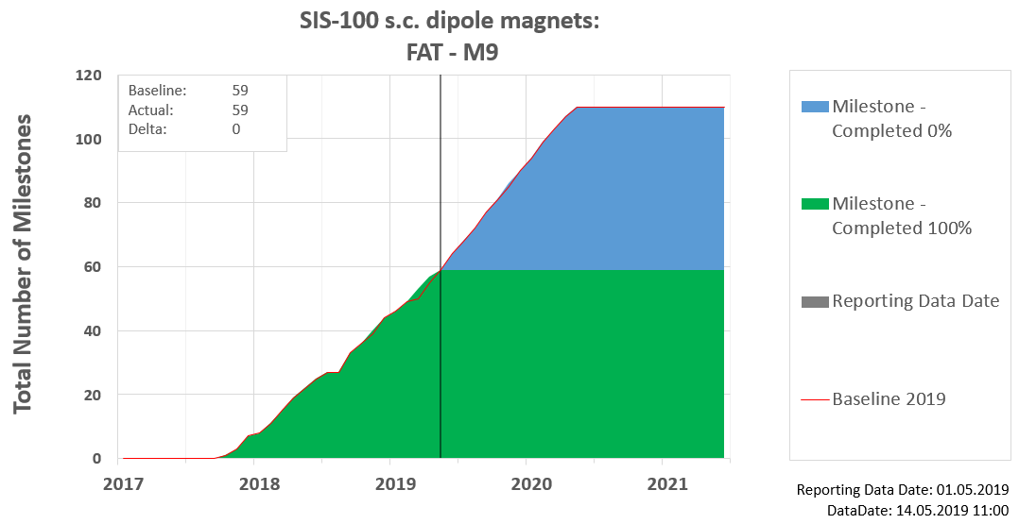
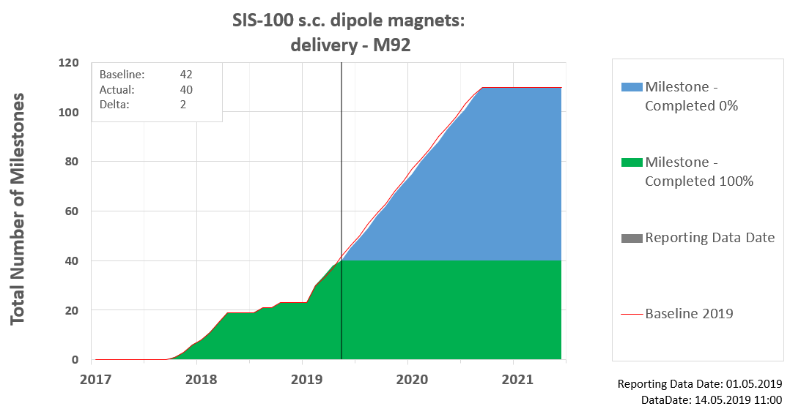
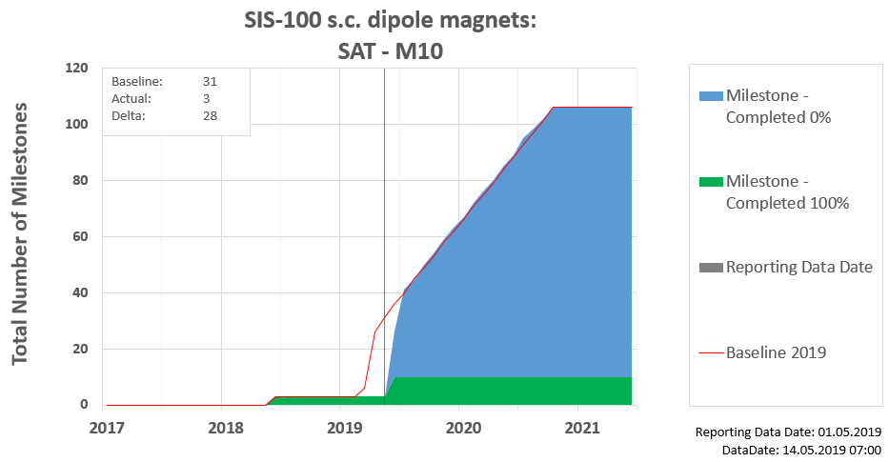
Progress Status:
Series Components Dashboard
Example from SIS-100
SIS -100 s.c. dipole magnets
SPI 100%
SPI 95 %
SPI 30 %
60 s.c. dipole modules producted, 40 s.c. dipole modules delivered,
36 successfully tested, but documentation approvement is ongoing
SPI= Schedule Performance Index
Similar S-Curve dashboard will be used for all subprojects @ series components to show progress during production, delivery @ SAT

Slide 12
FAIR counts on you!
Stable schedule & monthly status report from BINP to FAIR to update MS Project Plan are high required – O. Gorda contact person for BINP by FAIR.
You input will be used for:
present overall current project status to all committee (Council, MAC, AFC …) → stable & trustful relationship between all FAIR partners
to organize logistics and warehouse of CR series components
analyze and manage critical path of CR - particularly CR installation
plan cash outflow reliable → punctual payment of bills by FAIR
…

Slide 13
Thank you for your attention!
FAIR counts on you!

