Slide 1
3D MODELING OF THE DECAPOLE CORRECTORS
Kseniia Riabchenko
Budker Institute of Nuclear Physics Siberian Branch of Russian Academy of Science
2019

Slide 2
OUTLINE
Main tasks of the study;
Main settings;
Gradient and integral estimate;
Current estimate;
Pole geometry;
3D model of iron decapole:
dimensions
field quality
integral
gradient
harmonics;
3D model of iron free decapole:
dimensions
field quality
integral
gradient
harmonics;
Conclusion;
Thanks.

Slide 3
Main tasks of the study
The task was set: to design a full scale prototype of the two types of decapole correctors: with and without iron and the main tasks of the study include:
Creating 3D models of two types of correctors
3D simulation of the field
Determine whether to make a corrector with the presented parameters

Slide 4
Main settings of the decapoles
Iron decapole:
Hyperbola radius, mm | 232
Coil / pole length, mm | 390
Integral, T/m^3 | 180 ÷ 200
Free iron decapole:
Coils length, mm | 900
Integral, T/m^3 | 180 ÷ 200

Slide 5
Gradient and integral estimate
$$B=kr^{4}$$
$$B= \frac{G_{5}}{24}r^{4}$$
$$G_{5}= \frac{∂^{4}B}{∂B^{4}}$$
$$G_{5}=\frac{200}{L}$$
$$B^{′′′′}L=200\frac{T}{m^{3}}$$
$$G_{5}=200\frac{T}{m^{4}}$$
$$L=1 m$$
$$G_{5}=512,8\frac{T}{m^{4}}$$
$$L=0,39 m$$

Slide 6
Current estimate
$$\oint{Hdl=I}$$
$$I= \frac{G_{5}}{480π}r^{5}{10}^{7}$$
$$B= \frac{G_{5}}{24}r^{4}$$
$$r=0,23 m$$
$$I=2,2 kA$$

Slide 7
Pole geometry
As an example, the equations describing the poles of a:
Quadrupole
Sextupole
$$R^{2}=2xy$$
$$R^{3}=3x^{2}y−y^{3}$$
And what about the decapole? A formula describing the hyperbolic geometry of the poles of the corrector was obtained:
After that, the equation on x, which is necessary for working in the Opera program, was derived:
$$R^{5}=5x^{4}y−{10x^{2}y}^{3}+y^{5}$$
$$x^{2}=y^{2}+\sqrt{\frac{4y^{4}}{5}+\frac{R^{5}}{5y}}$$

Slide 8
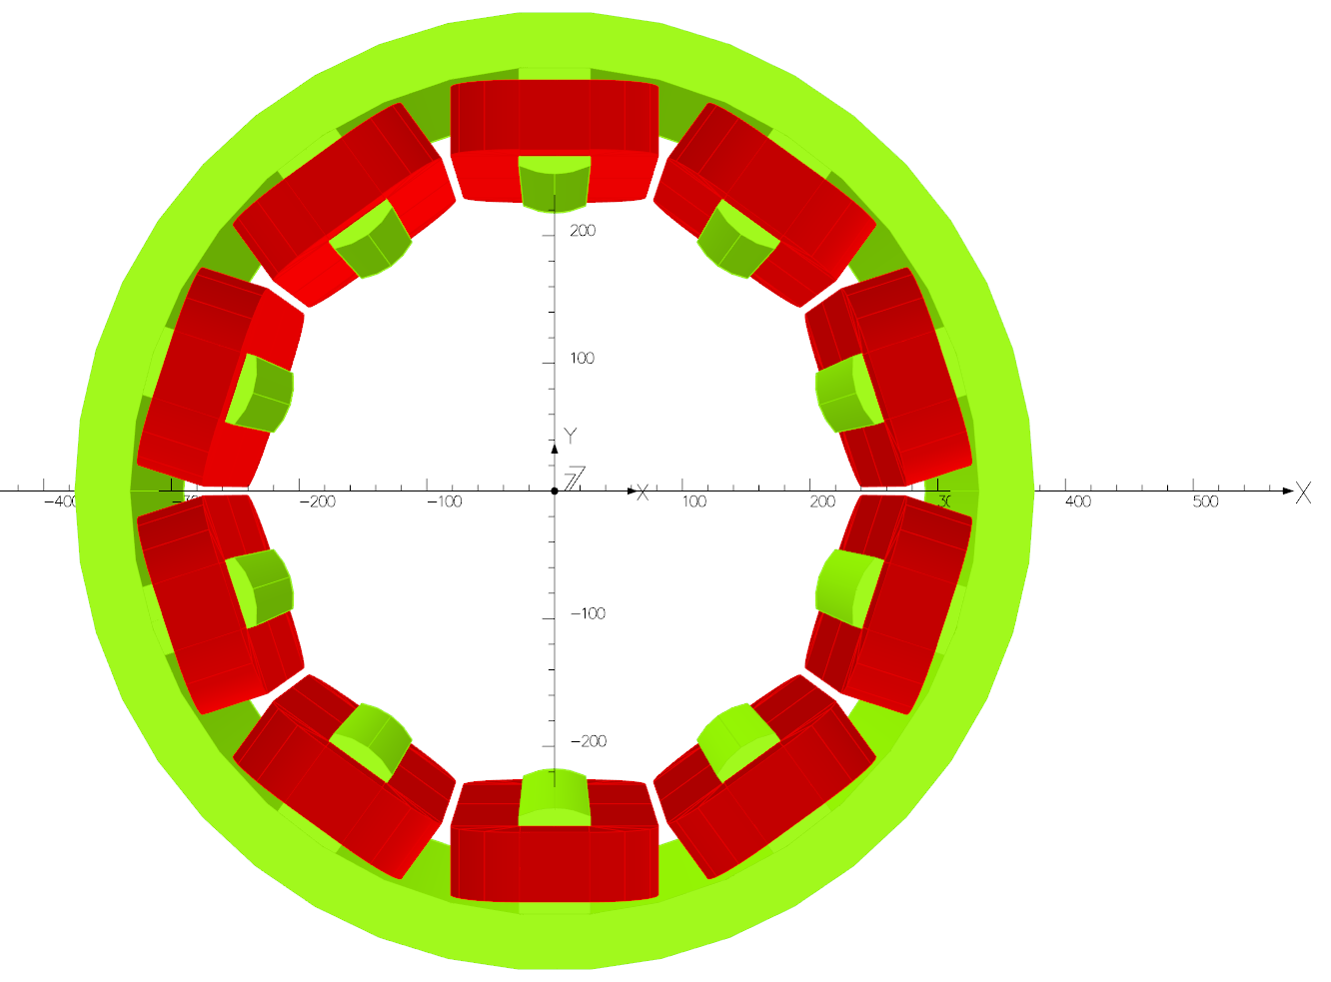
3D model of iron decapole I
R = 230 mm
L = 390 mm
h = 40 mm
b = 70,97 mm
a = 52,06 mm
3D model of the pole

Slide 9
3D model of iron decapole II
Main parameters of the coils
Width, mm | 50
Thickness, mm | 50
Length, mm | 390
Current, A*turnes | 2000
Current density, A/mm^2 | 0,8
Gradient integral: 187,997 $\frac{A}{m^{2}}$
Integral harmonics:
$$B_{15}=\frac{b_{15}}{b_{5}}=\frac{−173.97}{152367.04}=−1,1×{10}^{−3}$$

Slide 10
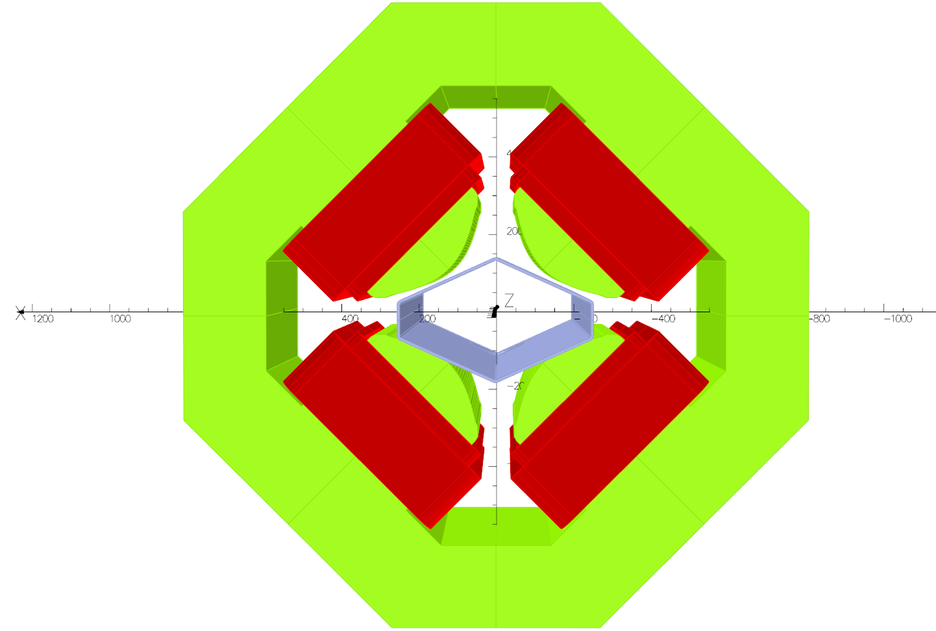
3D model of iron free decapole I
Yoke
Vacuum chamber
Coils
Hyperbolic pole
3D model of a quadrupole lens with a vacuum chamber
Decapole iron-free corrector should be placed between the poles of the lens and the outer walls of the vacuum chamber

Slide 11
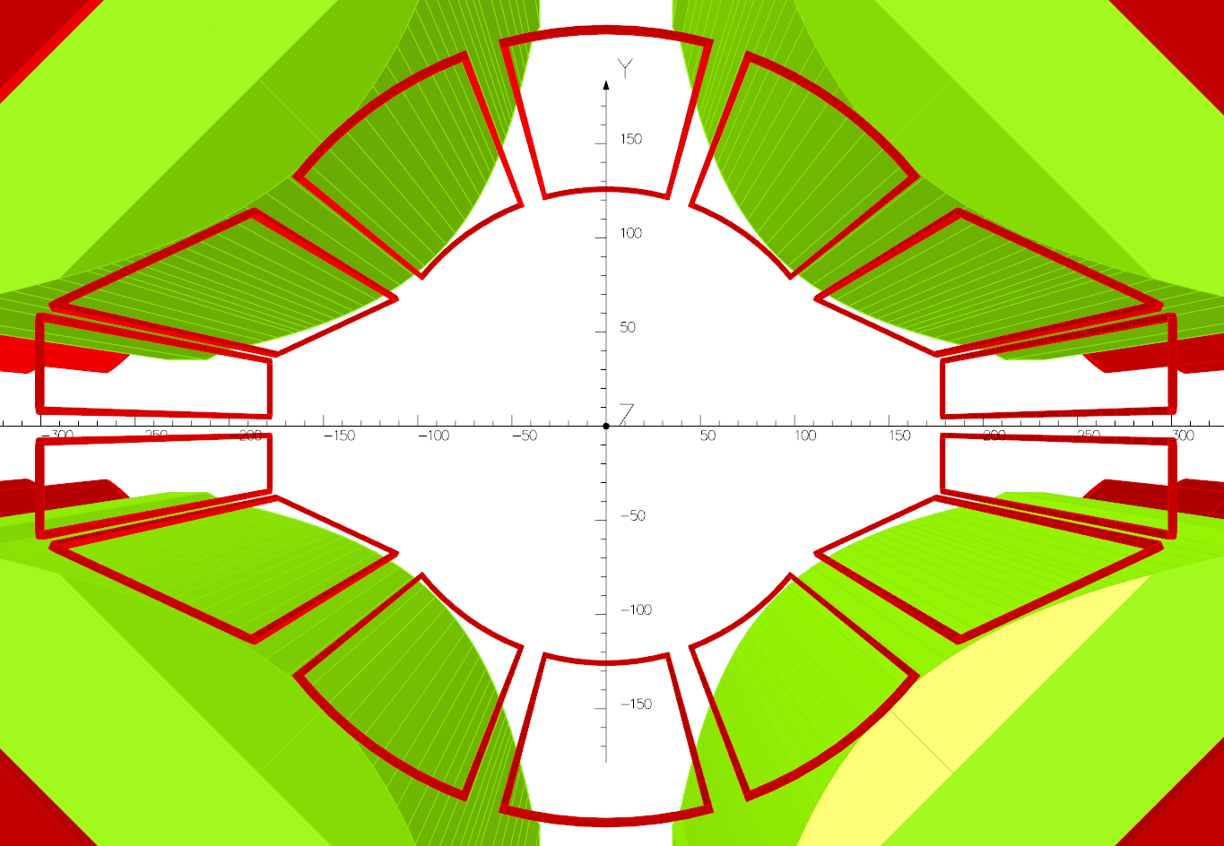
3D model of iron free decapole II
Width, mm | 3
Thickness, mm | 3
Length, mm | 900
$$I_{1}$$
$$I_{2}$$
$$I_{2}$$
$$I_{3}$$
$$I_{3}$$
I1, A*turnes | -710
I2, A*turnes | 320
I3, A*turnes | -390
j1, A/mm^2 | -78,89
j2, A/mm^2 | 35,56
j3, A/mm^2 | -43,33
$$I_{3}$$
$$I_{3}$$
$$I_{2}$$
$$I_{2}$$
$$I_{1}$$

Slide 12
3D model of iron free decapole III
The current in the main quadrupole coils is I = 0 A
80 mm
Gradient integral: 173,67$\frac{A}{m^{2}}$
85 mm
Integral harmonics:
35 mm
$$B_{15}=\frac{b_{15}}{b_{5}}=\frac{0,11}{−462,32}=−2,41×{10}^{−4}$$
10 mm
$$B_{1}=0,53$$
15 mm
$$B_{3}=−3,88$$

Slide 13
3D model of iron free decapole IV
The current density in the main quadrupole coils is j = 4,54 $\frac{A}{{mm}^{2}}$
80 mm
Integral harmonics:
85 mm
35 mm
$$B_{15}=\frac{b_{15}}{b_{5}}=\frac{−1,81×{10}^{−8}}{−1,71×{10}^{−4}}=1,06×{10}^{−4}$$
10 mm
$B_{1}=−$7,14
15 mm
$B_{3}=−$4,17

Slide 14
Conclusion
In the course of the work:
the necessary numerical estimates were made
three-dimensional models of two types of decapole correctors are obtained
their optimal parameters are determined
and the ways of further improvement are found

Slide 15
Thanks for your attention!!!
For any questions please contact us by mails:
kseny121195@mail.ru
tanij-r@mail.ru
astar_qqq@yahoo.com

Slide 16
3D MODELING OF THE DECAPOLE CORRECTOR
Kseniia Riabchenko
Budker Institute of Nuclear Physics Siberian Branch of Russian Academy of Science
2019

Slide 17
3D model of iron free decapole with vacuum chamber

