Slide 1
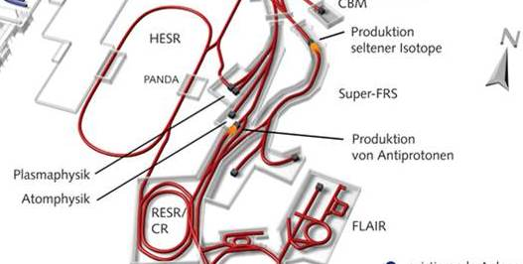
Matching CR - HESR
May 24, 2019 I Dieter Prasuhn

Slide 2
Outline
Parameters of the CR extracted anti-proton beam
Acceptance of HESR
Origin of the mismatch discussion
Solutions

Slide 3
Parameters of the CR beam at extraction
Table copied from: Christina Dimopolou, 6th BINP-FAIR-GSI Workshop, December 2014

Slide 4
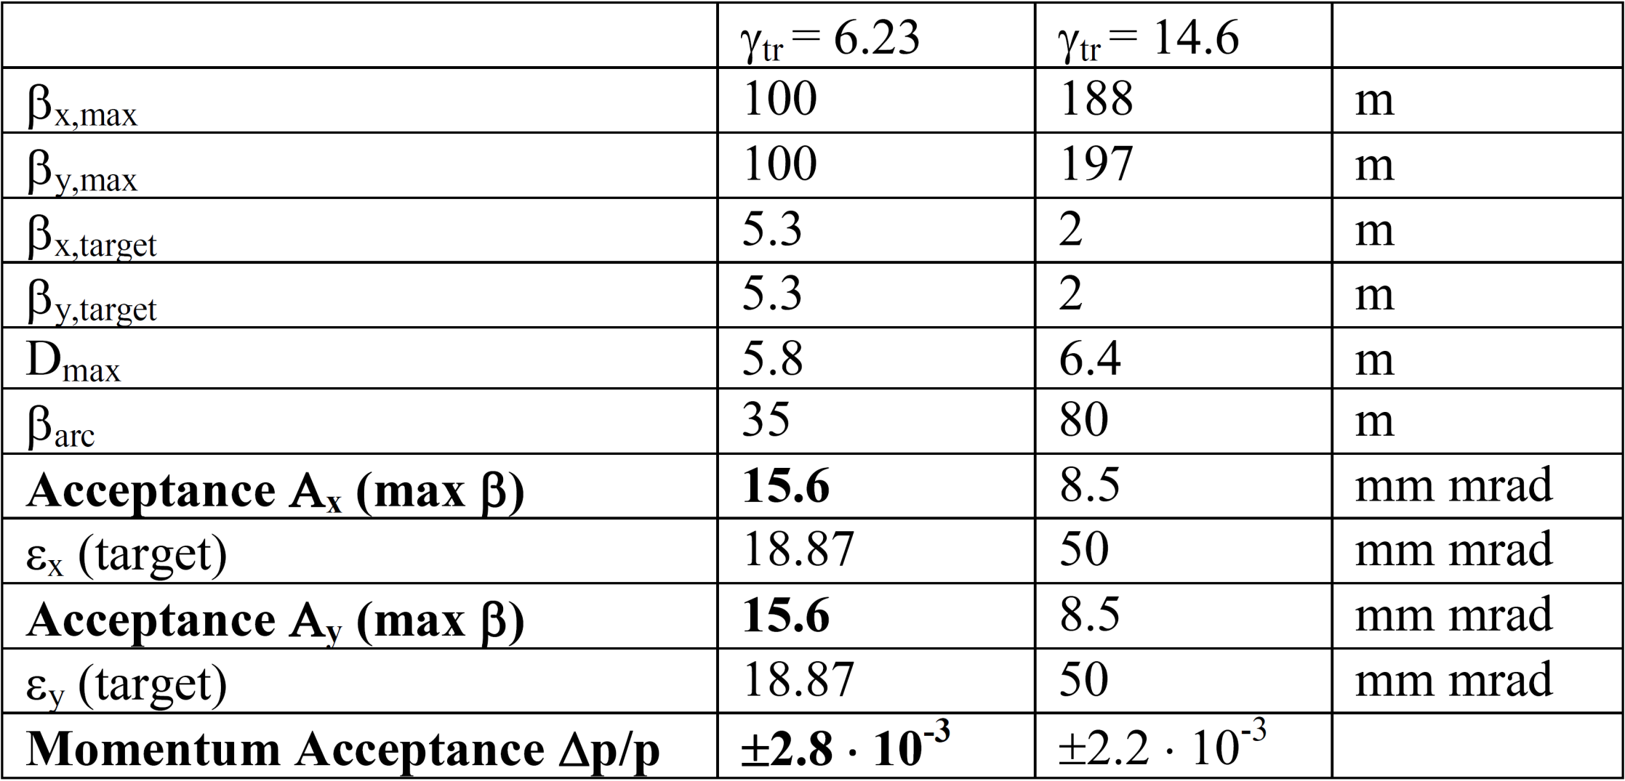
Acceptance of HESR
Defined by the maximum lattice functions and the aperture of the vacuum chambers:

Slide 5
Comparison of Data
 | CR rms values | 99% particle content |  | HESR acceptance (100%)
Horizontal | 1.25 mm mrad | 6*rms value | 7.5 mm mrad | 15.6 mm mrad
Vertical | 1.25 mm mrad | 6*rms value | 7.5 mm mrad | 15.6 mm mrad
Δp/p | 5*10⁻⁴ | 3*rms value | 1.5*10⁻³ | 2.8*10⁻³
In Principle everybody is happy
BUT:

Slide 6
The limit in HESR acceptance
The anti-proton beam has to be accumulated before acceleration
Stochastic cooling in all planes is needed at injection
For momentum cooling 2 methods are available:
 | Advantage | Disadvantage
Filter cooling | Fast cooling time Small equilibrium Δp/p | Limitted momentum acceptance (1*10⁻³)
TOF cooling | Large momentum acceptance | Long cooling time Large equilibrium Δp/p

Slide 7
Comparison of Data
 | CR rms values | 99% particle content |  | HESR acceptance (100%)
Horizontal | 1.25 mm mrad | 6*rms value | 7.5 mm mrad | 15.6 mm mrad
Vertical | 1.25 mm mrad | 6*rms value | 7.5 mm mrad | 15.6 mm mrad
Δp/p | 5*10⁻⁴ | 3*rms value | 1.5*10⁻³ | 2.8*10⁻³
Momentum acceptance of FILTER cooling: 1*10⁻³

Slide 8
two ways out:
CR:
Adjust mixing to reduce the cooled Δp/p in CR
Was discussed by Oleksii Gorda, 6th BINP-FAIR-GSI workshop, December 2014
HESR:
After injection start with TOF cooling
When Filter cooling acceptance is reached switch to Filter cooling
Fast switching between TOF and Filter cooling has been tested at COSY
Filter cooling and TOF cooling is foreseen for the HESR
So, this solution is realistic to accept 100% anti-protons from CR in HESR

