Slide 1
Site Management
Lean Construction Workshop
Harald Hagelskamp, Hartmut Reich-Sprenger
2nd BINP/FAIR CR Workshop Meeting,
20.-24. May 2019

Slide 2
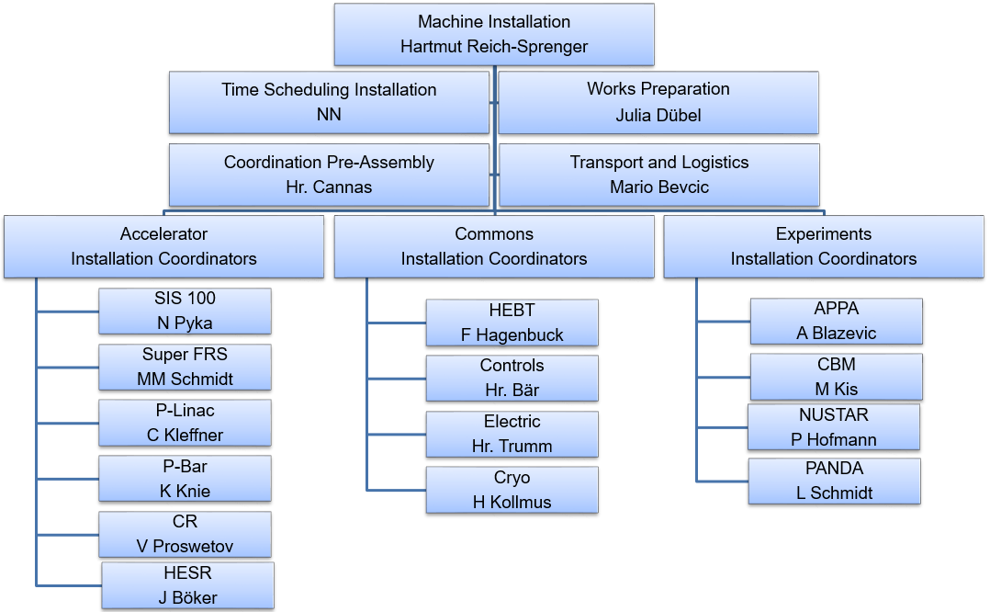
Installation Team
An integrated approach to Machine Installation.

Slide 3
Installation – Strategy and Team
  Roles and Reponsibilities of the Installation Team:
  All installation activities for all Subprojects are centrally coordinated by the Installation Team.
  The responsibility for the coordination and timing lies with the Installation Team.
  The responsibility for the technical correctness and quality of the installation lies with the Subproject (WPL/SPL).
  Resources will be employed interchangeably between Subprojects, where specialist expertise allows.
  Pre-defined work packages will be executed by external resources, however, guided and coordinated by the FAIR Installation Team.
Clear Role Definition & Sharing of Work Load.

Slide 4
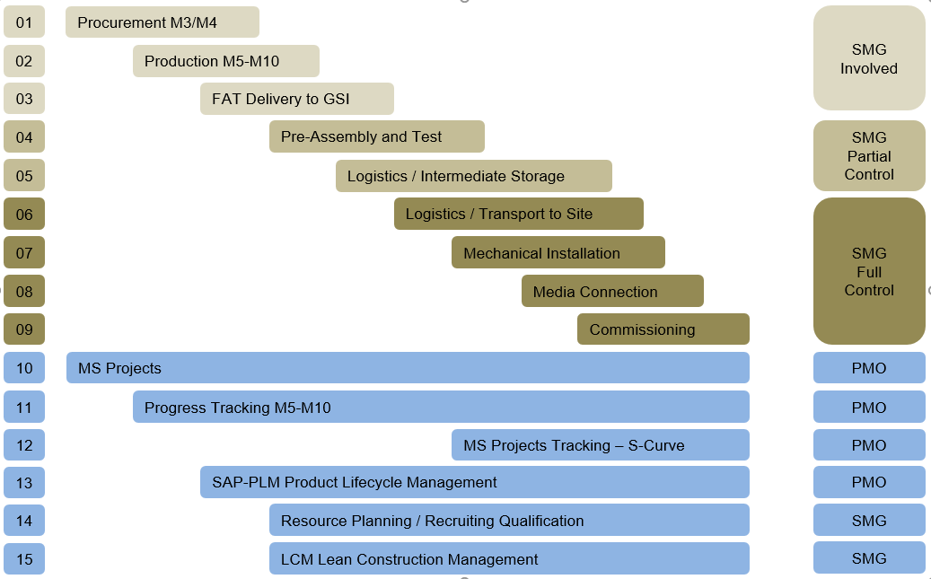
Machine Installation Processes
Well defined and controlled Processes are the key to success.

Slide 5
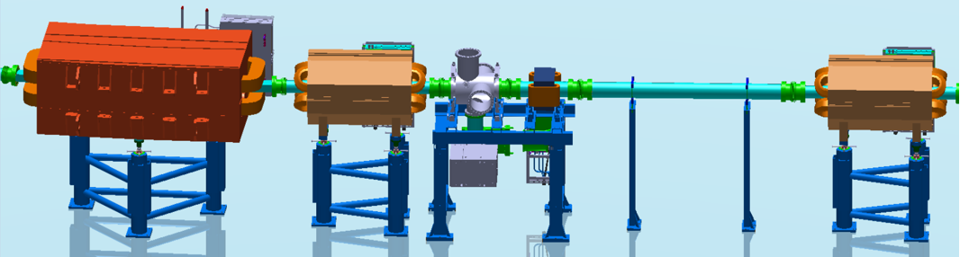
Pre-Assembly and Testing
nc dipole unit
nc 4-pole unit
BI&nc steerer
straight vacuum
nc 4-pole
  Definition of Pre-Assembly:
  The Pre-Assembly Process is understood (defined) to include all activities required to complete an assembly group ready for installation in the FAIR Buildings.
    Planning and coordination of workshop capacity.
    Planning and coordination of tools and lifting devices.
    Planning and coordination of assembly resources.
Assembly Groups – Transport Units minimize work scope in the tunnel

Slide 6
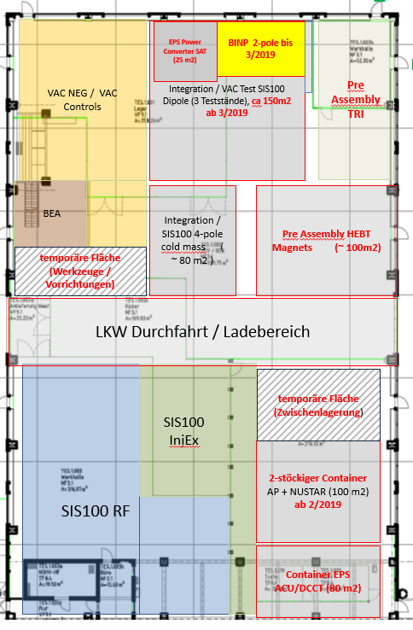
Pre-Assembly and Testing
  The Tasks of the Pre-Assembly Team are to coordinate and logistically plan all pre-assembly activities.
      The responsibility for the coordination and timing lies with the Installation Team.
      The responsibility for the technical correctness and quality of the installation remains with the Subproject.
Workshop Lay-out
Limited Workshop Capacity requires central Coordination

Slide 7
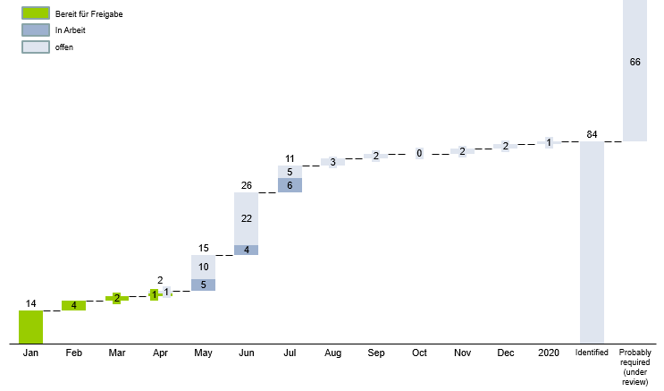
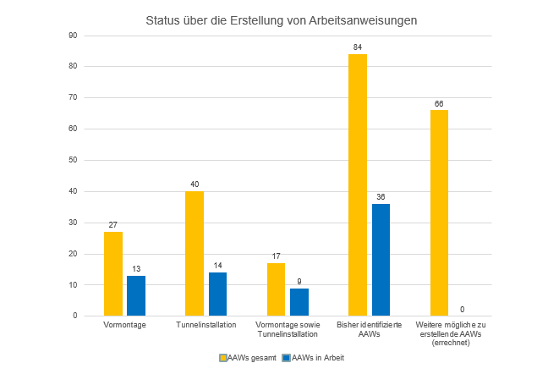
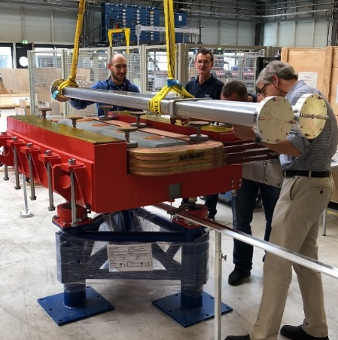
Pre-Assembly and Testing –
Preparation of Work Instructions
      repeatability of work steps.
      improved Quality Preformance.
      easier training of less experienced personnel or external resources.
      personnel can be deployed interchangeably.
      approx. 140 Instruction cover 80-90% of Components and Assemblies.
      21 are completed – 85 by Dec. 2019
Harmonized Work Instructions enable Standard Processes

Slide 8
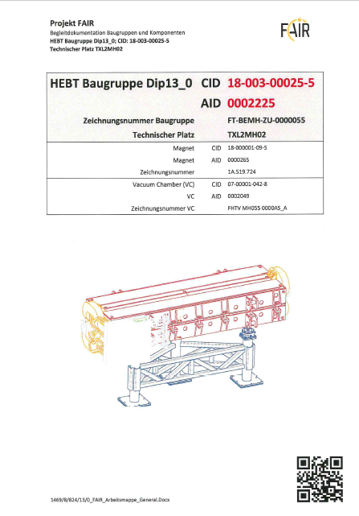
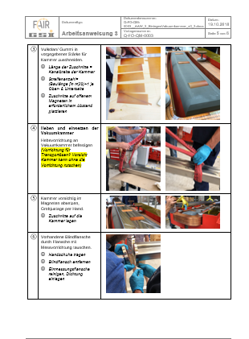
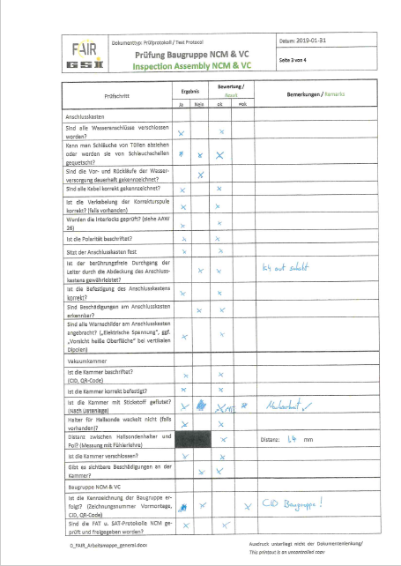
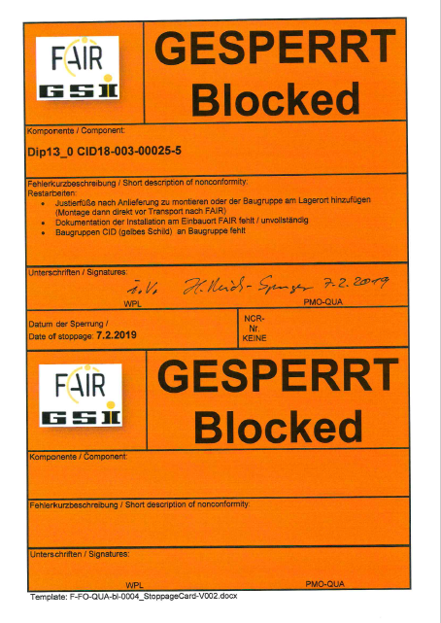
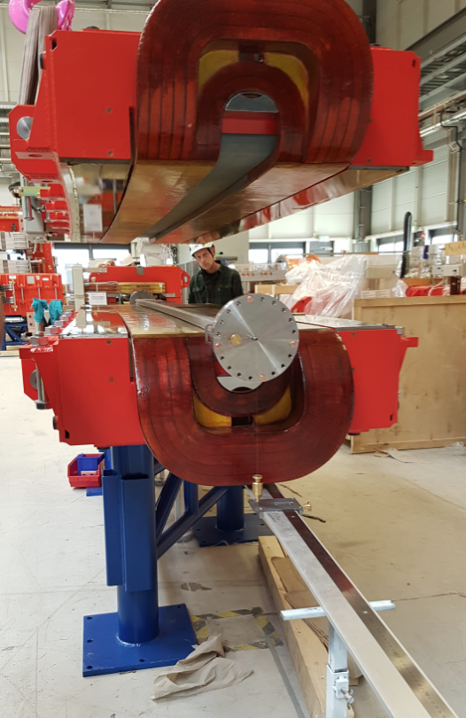
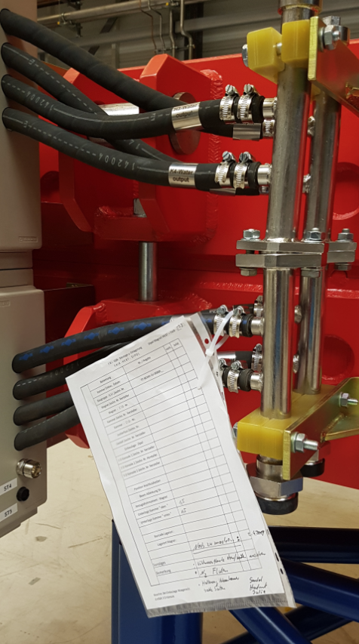
Pre-Assembly and Testing –
Preparation of Work Instructions
Read
Build
Check
LoP - Store
Well defined Processes are the basis for a good Plan and Control

Slide 9
Machine Installation Processes
Well defined and controlled Processes are the key to success.

Slide 10
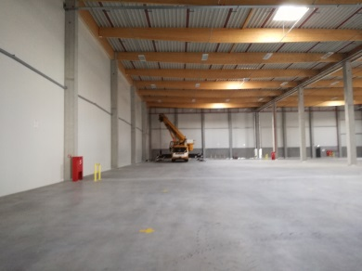
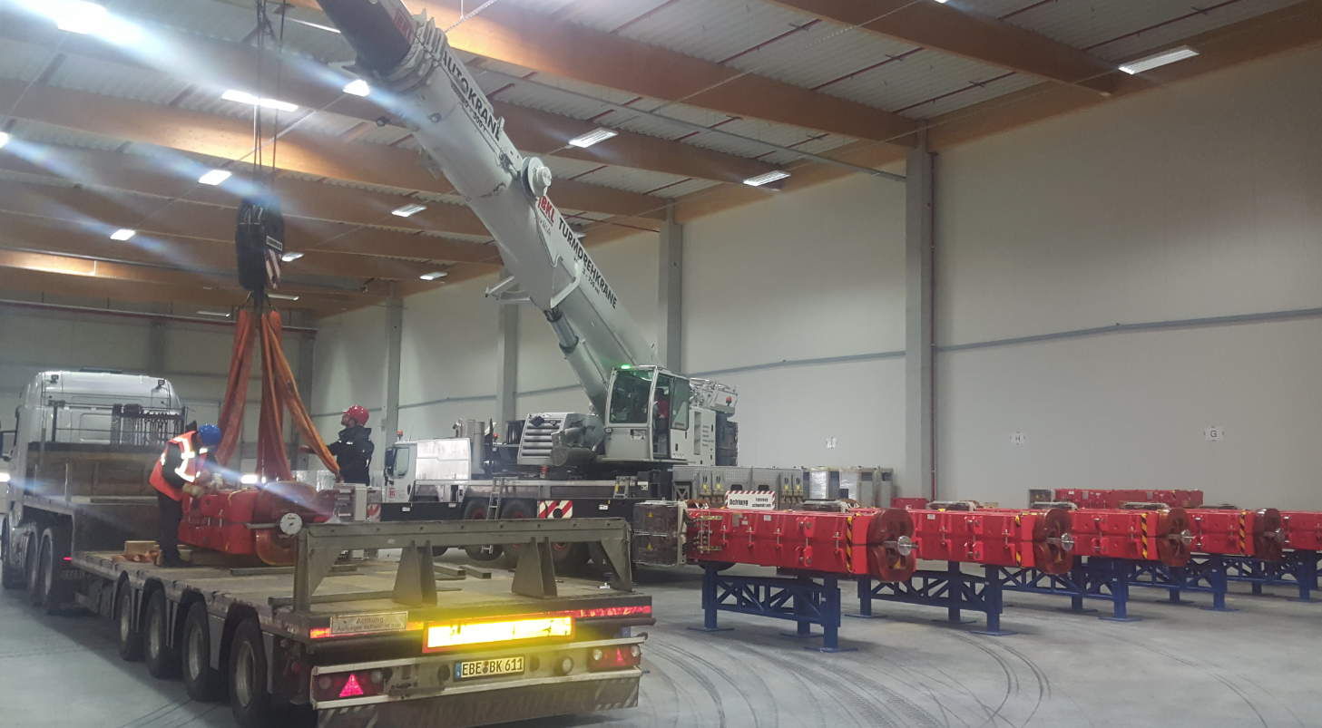
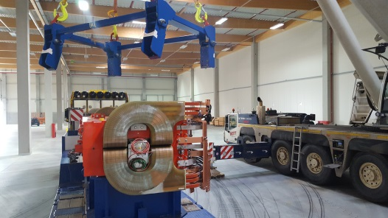
Logistics - Intermediate Storage
  FAIR is renting 9000m² of storage area approx. 10km from FAIR site for the next four years.
  DB Schenker is contracted as Logistic Services Provider to manage all loading and storage activities and to perform all transports to Fair site and to GSI.
  All Components (Assembly Groups) will be taken into storage after completion of Pre-Assembly and after successful completion of all relevant functional tests.
  All Assembly Groups (Transport Units) will be packed and loaded for transport to site according to installation sequence and requirements, to allow testing and preservation of completed beam line sections.
  Status of all Components (delivery, storage, necessary rest work) are recorded and tracked in SAP PLM (Product Lifecycle Management).
Central Logistic Control to ensure steady flow of components to FAIR Site.

Slide 11
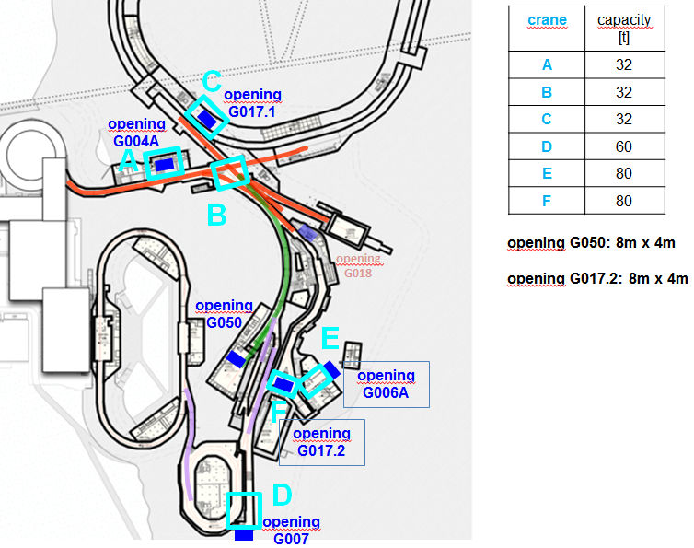
Logistics – Transport to FAIR Site
  Contractor Tasks
  Daily transport of Material and Equipment.
  Daily cleaning and refuse removal.
  Participation in daily and weekly LCM Steering meetings.
  Daily request for usage of Cranes and Lifts.
  FAIR Site Team Tasks
  Coordination of LCM Steering meetings
  Supervision of logistical activities of Contractor.
  Supervision of adherence to EHS and Fire Prevention Requirements.
  Operation of Cranes and Lifts.
The Guideline Document „Internal Logistics“ becomes an integral part of the Contracts

Slide 12
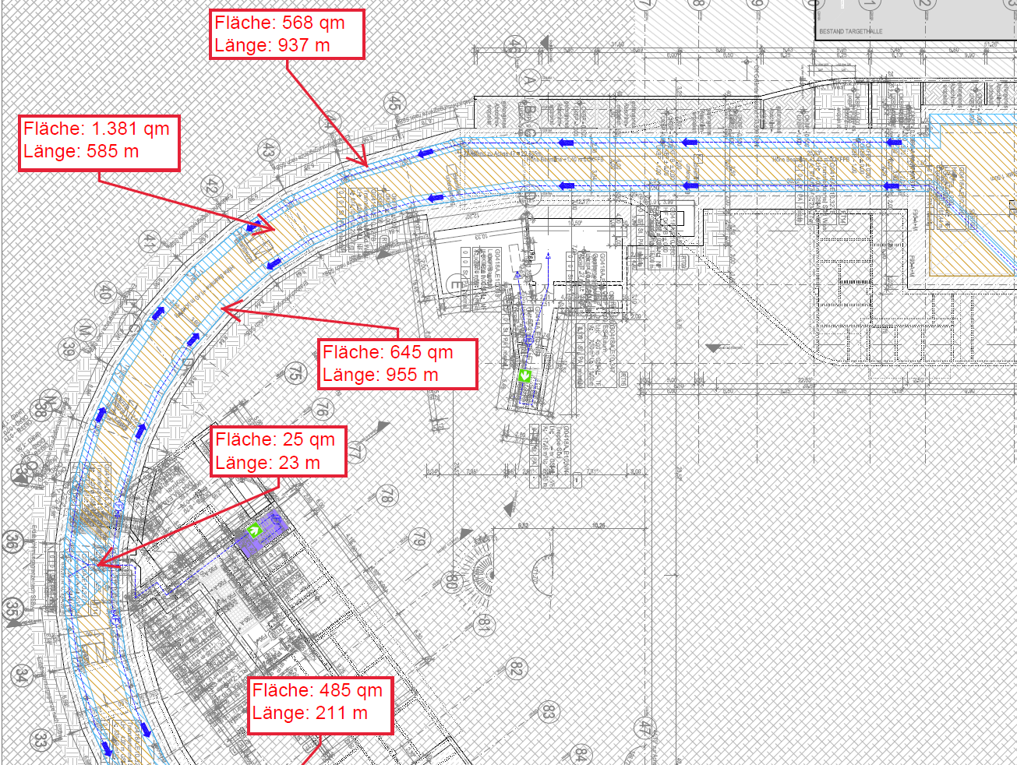
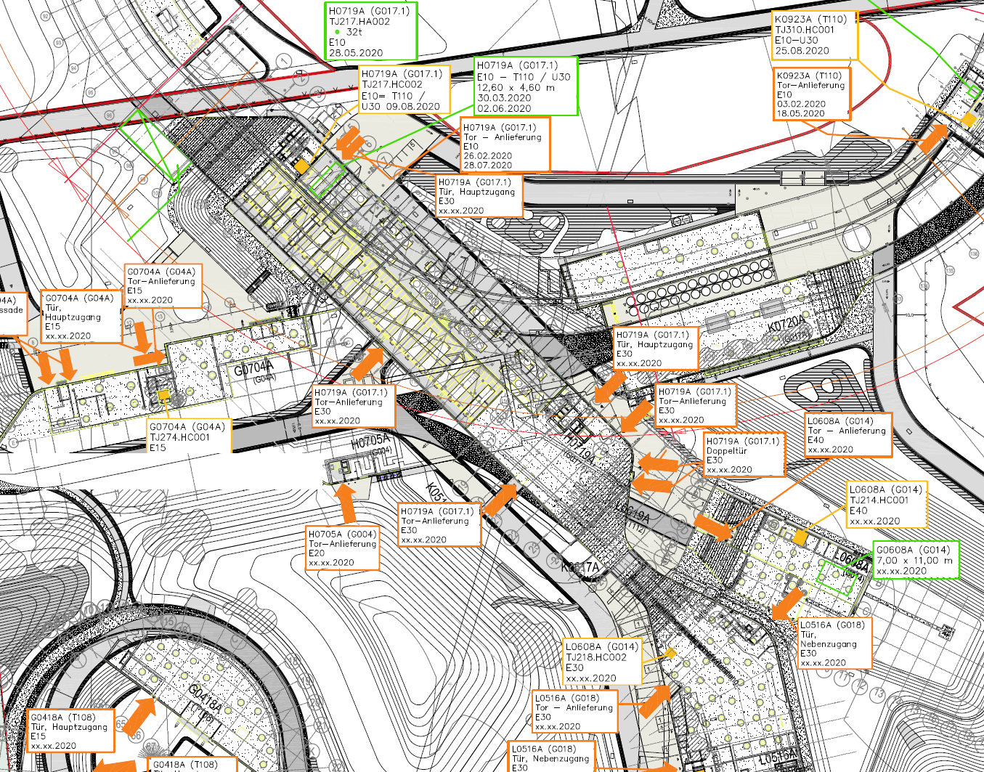
Logistics – Transport to FAIR Site
Site Internal Logistics – started in 2018
  to develop concepts for organizing the logistics processes inside the buildings.
  to manage the interfaces between Machine Installation Team and Contractors for Technical Services Equipment.
  Planning of transportation and escape routes.
  Planning and estimate of temporary storage areas.
  Control of bottlenecks, ie. access capacities of cranes and lifts.
  Estimation of material quantities and dimensions/weights.
The coordination of the Internal Site Logistics will be managed
in the LCM Tool by Site Management and the Machine Installation Team.

Slide 13
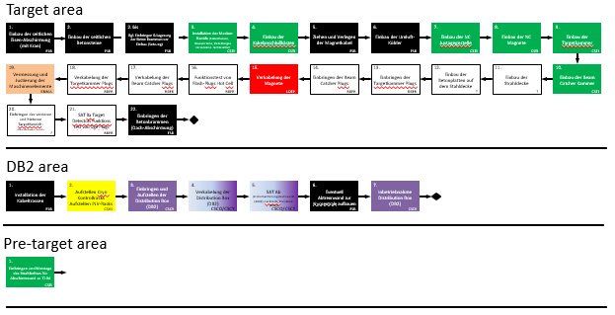
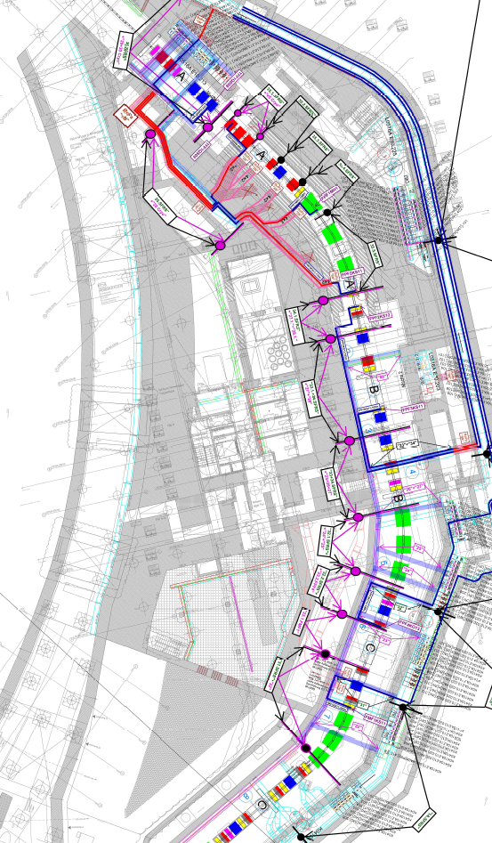
Machine Installation - Mechanical
2016: First Machine Installation Concepts were developed for each Accelerator System and Experiment Group.
Flow Charts
MS Projects Schedules
2019: Review of first Concepts by the Machine Installation Team to define detailed Installation Sequences by Assembly Group.
to ensure that beam line sections are completed, leak tested and preserved for later commissioning.
to start tracking the delivery and pre-assembly status of each Assembly Group to ensure continuous installation along the beam line.
Detailed Installation Sequence defines delivery priorities.

Slide 14
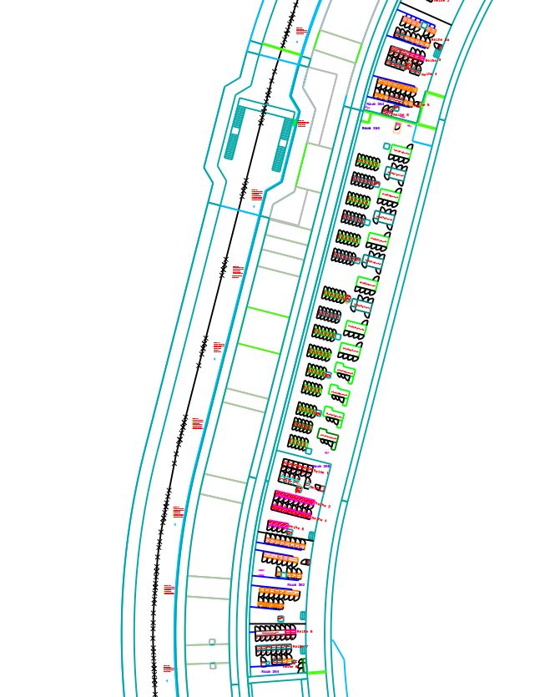
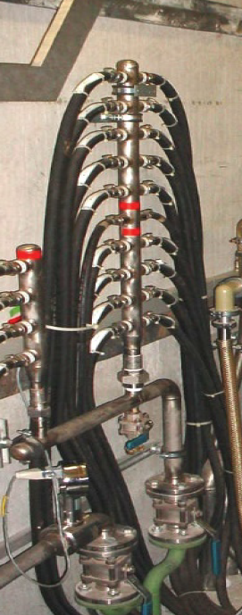
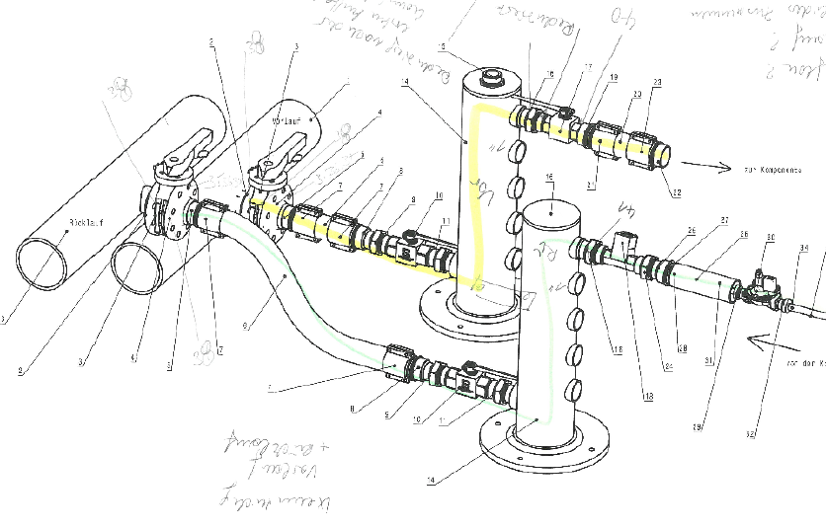
Machine Installation – Media Connection
Electrical:
Machine Power Racks will be installed before and during cable installation by Electrical Contractors.
guided by User Cable Data Base
to facilitate efficient placing and connections of cables to connecting points.
Cooling Water:
Defined interface between Installation of Cool Water Distribution and Connection to Machine Components.
standard distribution headers are agreed and will be supplied by Contractor.
Establish a dedicated team for the installation of cooling water systems.
Dedicated installation teams for media connections

Slide 15
Machine Commissioning
Commissioning Concepts Technical Service Equipment
Commissioning Concepts Machine
Obtain Operating Permits!
Integrated Commissioning Concepts
for Technical Service Equipment and Machine Systems

Slide 16
Machine Installation Processes
Well defined and controlled Processes are the key to success.

Slide 17
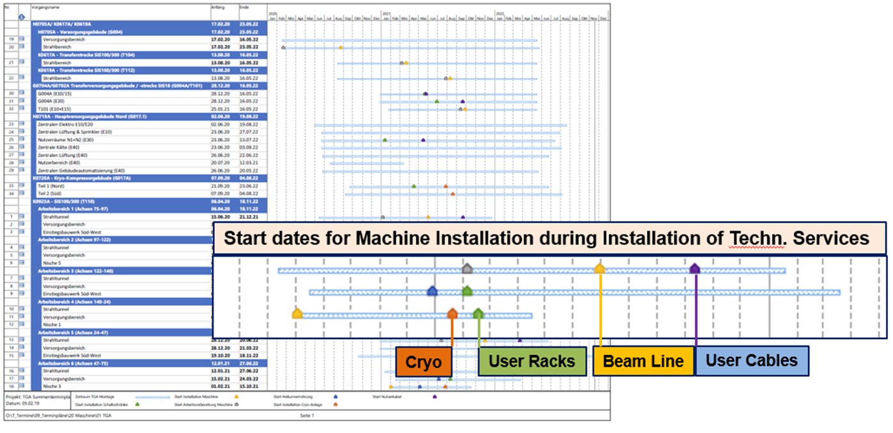
Site Management Tools
MS Projects
Integrated LCM Results and MS Projects Plans
Technical Services and Machine Installation

Slide 18
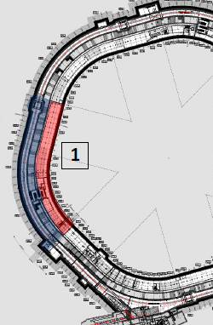
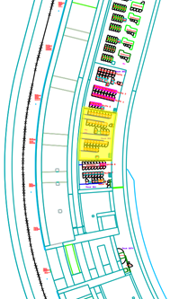
Site Management Tools
Progress Tracking Installation
Define Installation Sequence
Progress tracking by “PULL” System.
Expedite deliveries according to installation sequence.
prepare and perform Pre-Assembly according to inst. sequence.
Prepare work instructions and other documentation according to installation needs.
50 Components in Beam Line.
7 Components installation ready.
104 Racks in Service tunnel.
0 racks installation ready.
Detailed Expediting to ensure on-time completion

Slide 19
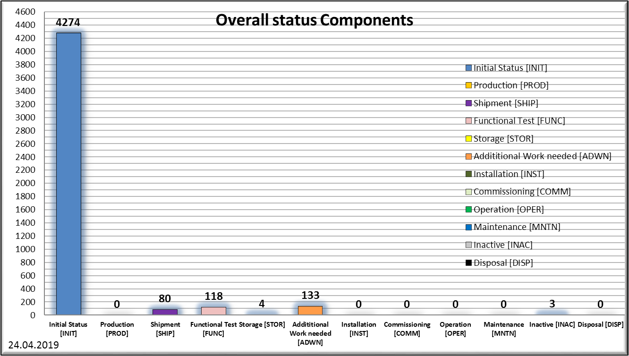
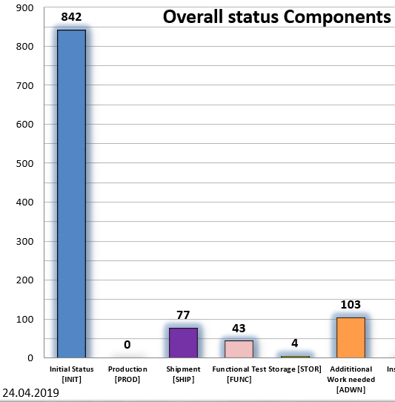
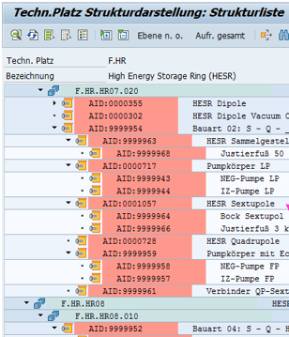
Site Management Tools
SAP-PLM Product Lifecycle Management
The Objective:
To implement PLM as the lead tool to control
all logistical movements of components after FAT Milestone at supplier.
status of readiness for installation of all component assemblies.
to enable just-in-time delivery to final installation location.
The Status:
more than 4000 components (CID) registered in PLM (25.000).
only 800 CID with logistic status data.
only 120 CID with status of readiness for installation..
The Plan:
to complete the PLM data base with CID for all component assemblies with sub-assembly structure
To implement a process for regular updates of the PLM databank with logistics data, ie. delivery dates, storage location, remaining work status.
SAP-PLM to steer logistics and assembly status.

Slide 20
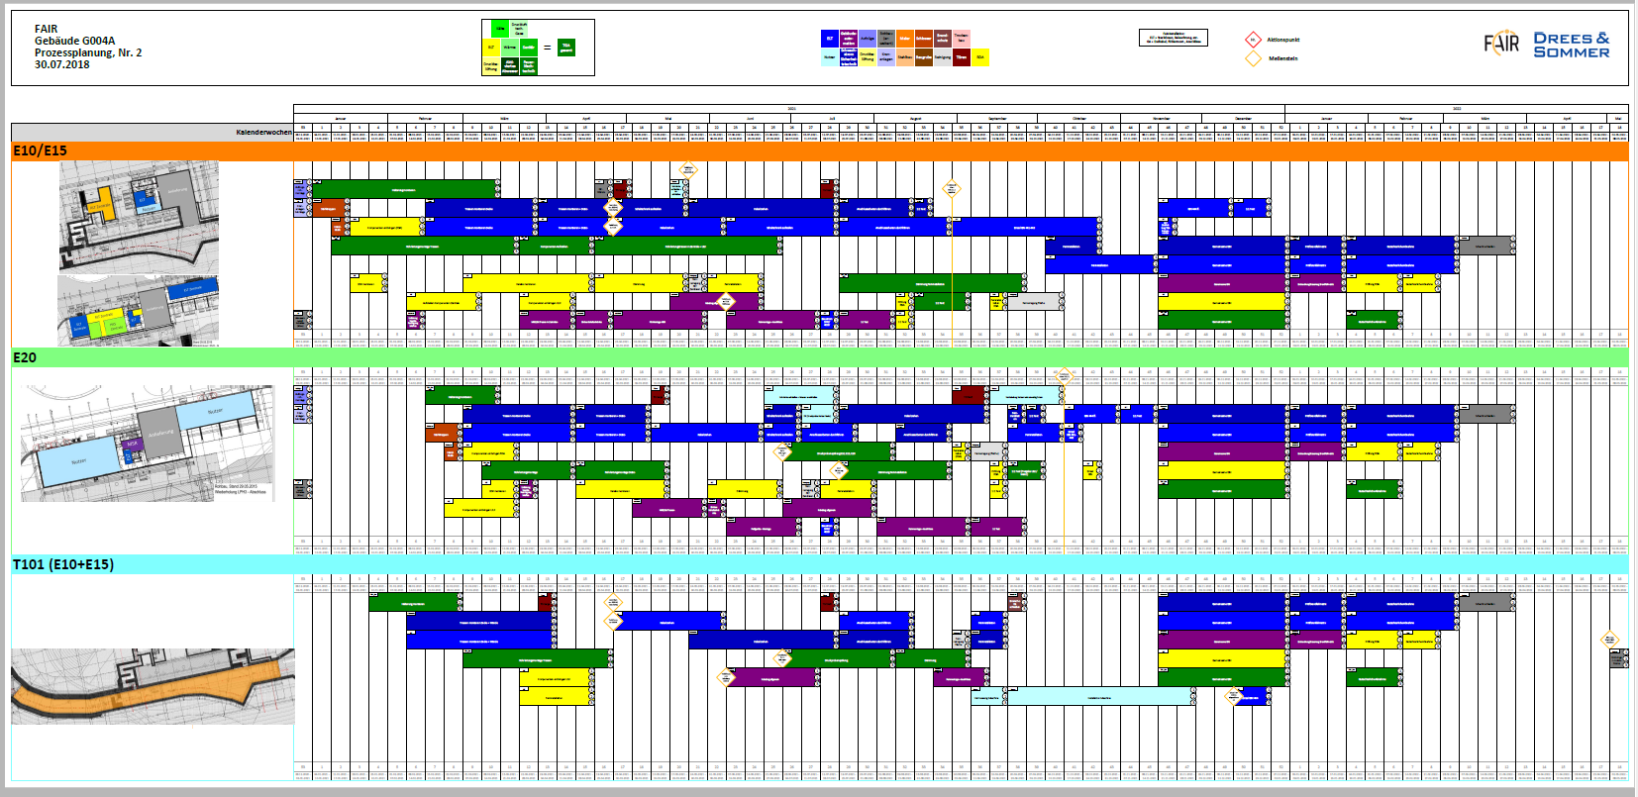
Site Management Tools
LCM – Lean Construction Management
Implemented in 2017
to ensure an integrated approach to process planning between machine and technical services.
to secure and steer an optimized and continuous installation process.
to identify and eliminate impediments and obstructions early and effectively.
to implement a PULL-SYSTEM.
Integrated Process Planning and Control

Slide 21
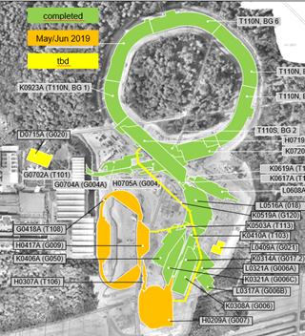
Site Management Tools
LCM – Lean Construction Management
  Allmost all Buildings are completed.
    HESR (T108) in May/June 2019
    APPA (G050) in May 2019
    CR (G007) in May/June 2019
  Workshop Results are integrated into the MS Projects Plans of FSB.
  LCM wordkshops will continue with Contractors in 2020.
Parallel Installation of the Machine Components and of Technical Services Equipment.
Early start for installation of user supply units (racks, power converter,….).

Slide 22
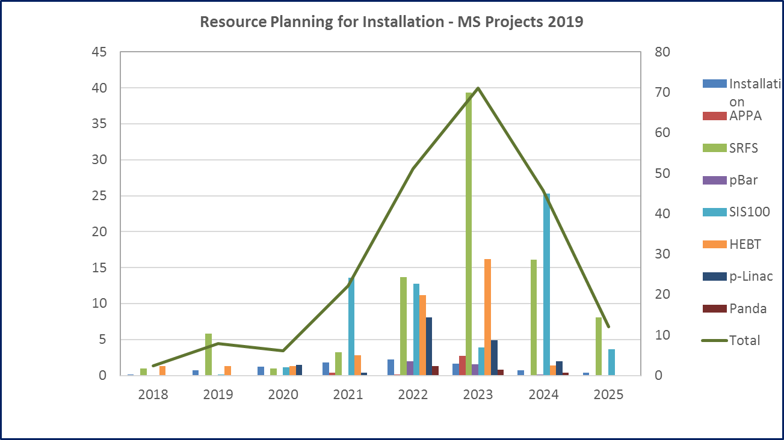
Site Management Tools
Resource Planning
Total required resource capacity 372 FTE
Resources required for storage and logistics 31 FTE
Resources for Work Preparation & Instructions 35 FTE
Resources for Installation 306 FTE
Total in MS Projects 218 FTE
Resources are defined with generic qualifications
Personnell from GSI, In-Kind Partners and external contrctors.
Recruiting, Training, Qualification for Pre-Assembly and Installation.
Installation Resource Plan will be reviewed by Dec. 2019

Slide 23
Summary
The Installation Strategy is implemented and detailed installation concepts and sequences are in preparation.
The Installation Phase is defined and detailed to be Processes-driven and to follow a PULL-Principle.
Processes planning and control takes an integrated approach to include
  supply, delivery and pre-assembly phases of the components
  and to include the interfaces and installation activities for the Technical Services Equipment.

Slide 24
Next steps for CR Installation:
  LCM Process Planning and integration into MS Projects Plans.
  Detailed Plan of Installation Sequence along the Beam Line and in Supply Areas, as well as connections to electrical and cooling water supply.
  Plan the logistical requirements inside the buildings.
  Detailed Delivery Plan to match the Installation Sequence.
  Plan the logistical requirements for delivery, pre-assembly and storage.
  Plan the required resources.

Slide 25
Thank You
Let’s move CR

