Slide 1
CR BINP-Workshop 21.05.2019 Overall process analysis machine installation CR
J. Dübel-Müller
21.05.2019

Slide 2
CR | Einbringen der Maschine - Machine Installation
Aktionsliste – List of actions
ID |  | Aktion erforderlich - Action required |  | Wer? Who? |  | Bis wann? Until?
1. |  | Versorgungsbereich: Zeitpunkt der Einbringung der stochastischen Kühlleitungen zu klären (1,25m Höhe). Supply area: Clarify when the stochastic cooling lines should be installed (1.25m high).
2. |  | Strahlbereich: Durch wen wird der Kabelanschluss der Netzgeräte und Low Level Racks ausgeführt? Beam area: Who is responsible for the cable connection of the power supplies and low level racks?
3. |  | Nachfolgend ist nur RRF dargestellt. Erstrebenswert wäre eine ähnliche Detailschärfe für alle Bereiche. Only RRF is shown in the following. A similar sharpness of detail would be desirable for all areas.
4.
6.
7.
8.
9.

Slide 3
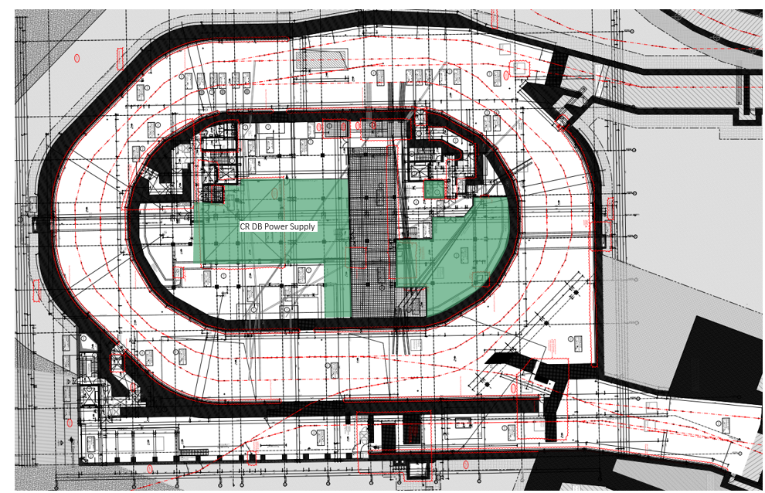
CR | Machine Installation
Overall process analysis G007/ E10 – Supply Area RRF CR Debuncher
Rough timeframe
Nov./ Dec. 2022 and
Feb./ Mar. 2023
Stochastic cooling line
See point 1 List of actions

Slide 4
CR | Machine Installation
Overall process analysis G007/ E10 – Supply Area RRF CR Debuncher
external
execution
external execution
TGA comple-ted
Transport of power supply units
(CR BB)
Position of the power supplies.
Before tunnel installa-tion
Transport equipment+power supply equipment
Electrical connection power supply unit 400V Netz
Systemintegration (RRF)
Air supply (external)
Assemblies are positioned and integrated
Overall integration(RRF)
Protection of power supply units
(CR BB)
Transport Low Level Racks
(CR BB)
Systemintegration Low Level (RRF)
No pre-assembly possible.
Duration approx. 4 weeks.
With electric forklift.
Positioning together with user desired.
No pre-assembly possible.
Duration approx. 4 weeks.
Dust-free environment or safe protection against dust.
- Cable pull completed
- Electricity available
Cooling air available
- Cable trays laid and cable trays above the low level racks (length compensation)
Ring HF (RRF)

Slide 5
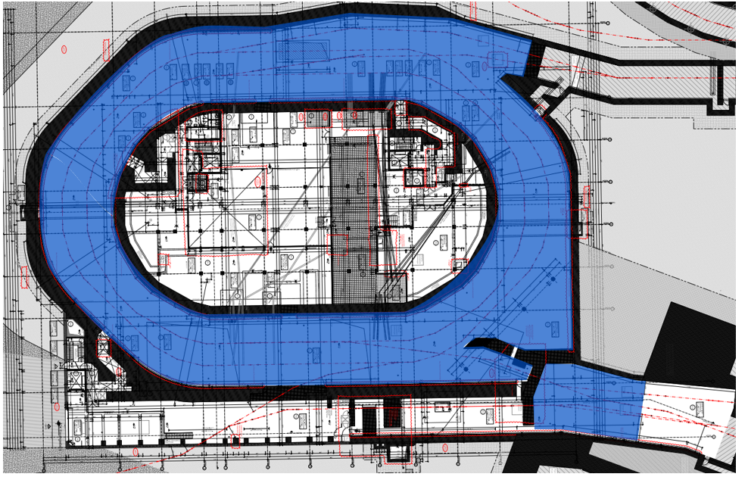
CR | Machine Installation
Overall process analysis G007/ E10 – Beam Area RRF CR
Rough timeframe
Sep. 2022 - Jun. 2023

Slide 6
CR | Machine Installation
Overall process analysis G007/ E10 – Beam Area RRF CR
external
execution
Placing 5 cavities
Alignment of 5 cavities on Blue-/ Beamline
Connec-tion of cavities to VAC (CF flange)
Connection of cables to cavities
Placing 5 power amplifier
Cable connection to power amplifiers
Placing 5 x 2 Tetrodes
Cable connection to Low Level Racks
Installation of tetrodes in power amplifier
total integra-tion
Placing 3 Interface- racks (wall)
Cable connection to Inter-faceracks
By whom? (see action list ID 2)
Durch wen?
- Lifting device required
- special care, tetrodes are very sensitive, therefore installation shortly before total/ final integration
Placing water distributors
Connec-ting water distributor.(to system)
Cable connection to power supply units
To central water system/ to components (lay hoses)
Connec-ting water distributor.(to compo-nents)
Ring HF (RRF)

