Slide 1
Radiation resistant Super-FRS quadrupoles and sextupoles
May 23rd, 2019

Slide 2
Heavily shielded target area
The positions of radiation resistant quadrupoles FPF1QT11 (Quadrupole 1a), FPF1QT12 (Quadrupole 1b), FPF1QT13 (Quadrupole 2), the two sextupoles FPF1KS11, FPF2KS11 and the three dipoles FPFMH1, FPFMH12 and FPFMH13 are indicated.

Slide 3
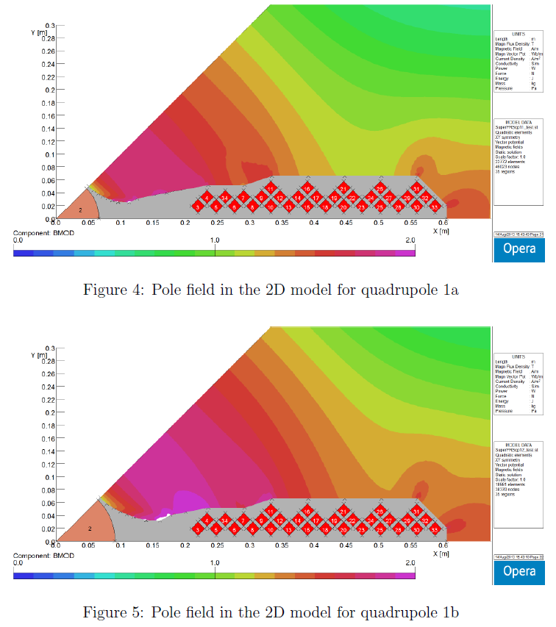
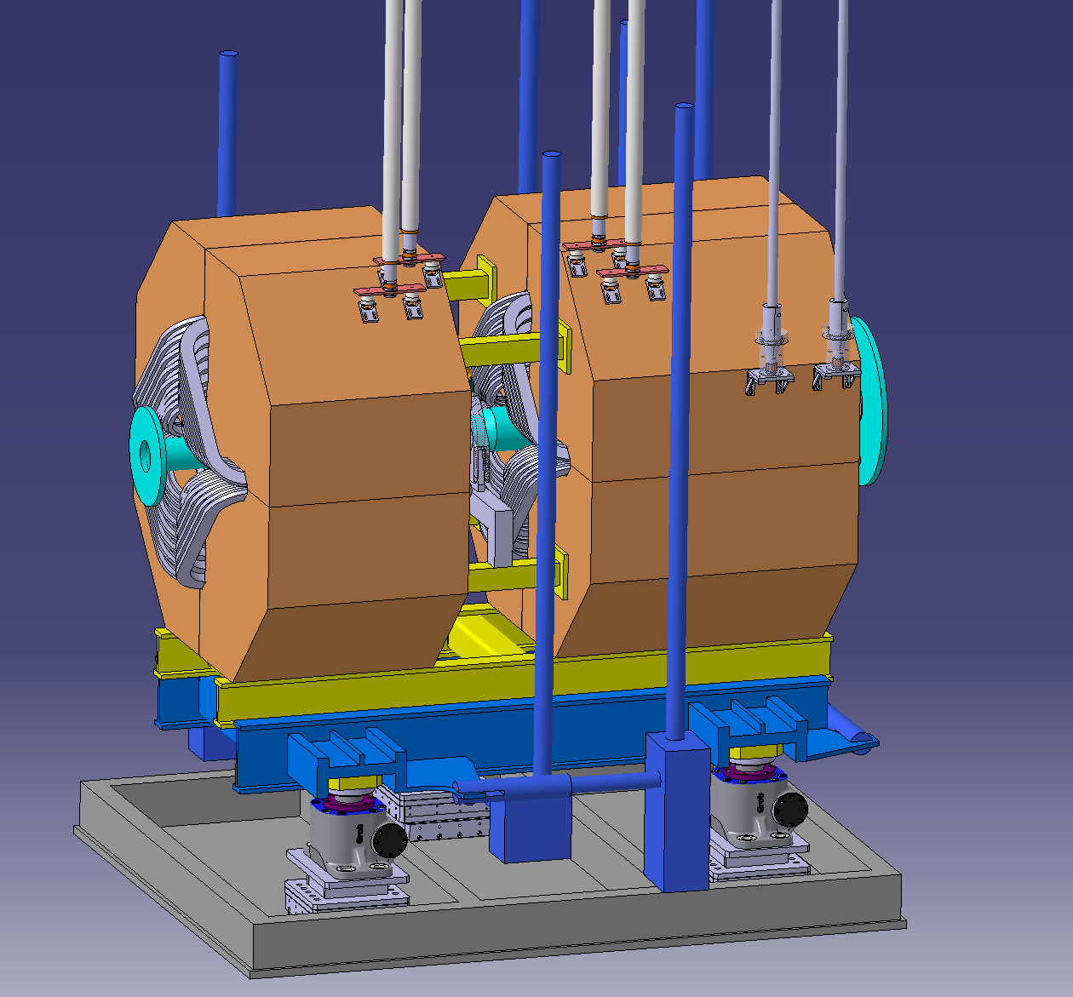
First two radiation resistant quadrupoles
Opera 2d models
quadrupole 1a
quadrupole 1b

Slide 4
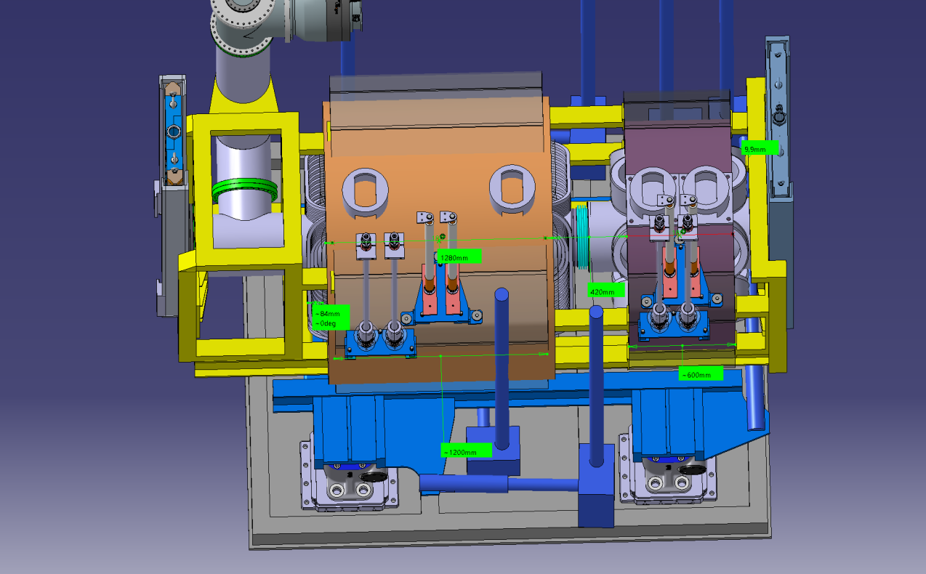
Quadrupole 2 – Sextupole combination

Slide 5
Second Sextupole
The second radiation resistant sextupole must be mounted on an adjustment device into a framework. This sextupole framework must combine the pillow seal and the magnet with the beam catcher BC3 to a stiff structure.

Slide 6
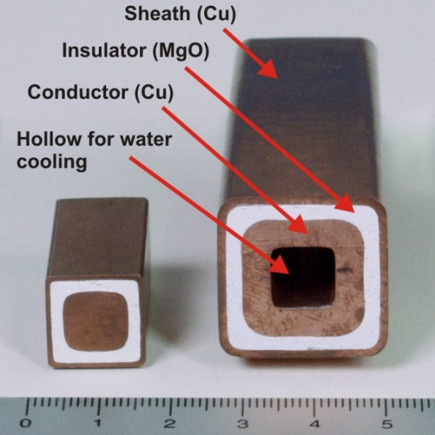
Main requirements of the 8 radiation resistant magnets
PSP code | Magnet | Number of magnets | Min. field strength | Max. field strength | Effective length (m) | Useable aperture (mm) | Field Quality
2.4.2.1.1 | Dipole 1 | 3 | 0.15 T | 1.6 T | 2.400 | 1200 × 140 | ±3∙10⁻⁴
2.4.2.2.1 | Quadrupole 1a | 1 | 1.6 T/m | 15.4 T/m | 0.933 | Ø 130 | ±1∙10⁻³
2.4.2.2.1 | Quadrupole 1b | 1 | 1.2 T/m | 11.8 T/m | 1.244 | Ø 180 | ±1∙10⁻³
2.4.2.2.2 | Quadrupole 2 | 1 | 0.6 T/m | 6.1 T/m | 1.200 | 380 × 240 | ±1∙10⁻³
2.4.2.3.1 | Sextupole 1 | 2 | 3.5 T/m² | 34 T/m² | 0.600 | Ø 380 | ±5∙10⁻³
All magnets must be equipped with radiation resistant cables
The dipoles are indirect cooled (left),
all other magnet are direct cooled (right)

Slide 7

radiation resistant Hitachi cables
All quadrupoles and both sextupoles designed with the parameters of the hollow 2000A-H cables.
Minimum winding radius ca. 5.5×diameter = 110 mm.

Slide 8
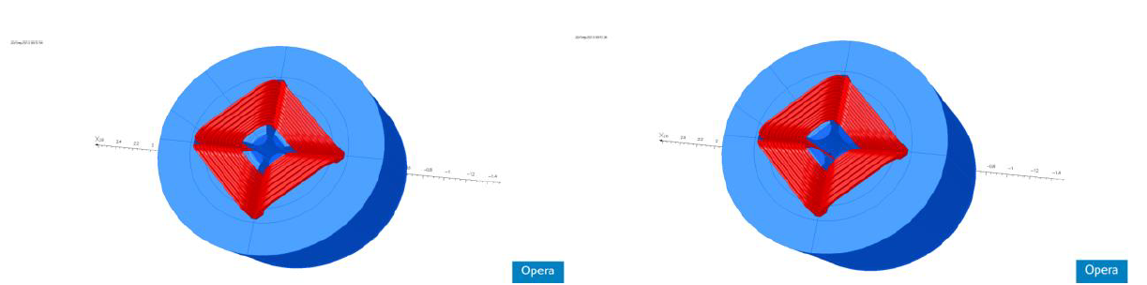
First two radiation resistant quadrupoles
quadrupole 1a
quadrupole 1b
PSP code | Magnet | gap (mm) | Dimension (m) (x,y,z) | Max. current | inductance (mH) | Resistance (mOhm) | Power (kw) | H2O (l/min)
2.4.2.2.1 | Quadrupole 1a | 70 | 1.19 / 1.8 / 1.8 | 981 | 72 | 49 | 47 | 27
2.4.2.2.1 | Quadrupole 1b | 95 | 1.15 / 1.8 / 1.8 | 1408 | 80 | 59 | 116 | 67
Magnetical design made by Peter Rottländer (GSI)

Slide 9
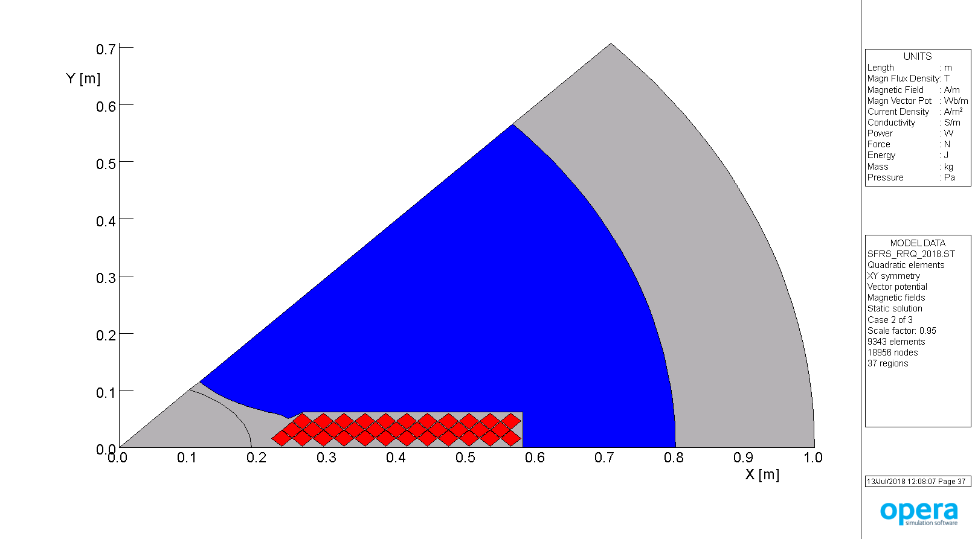
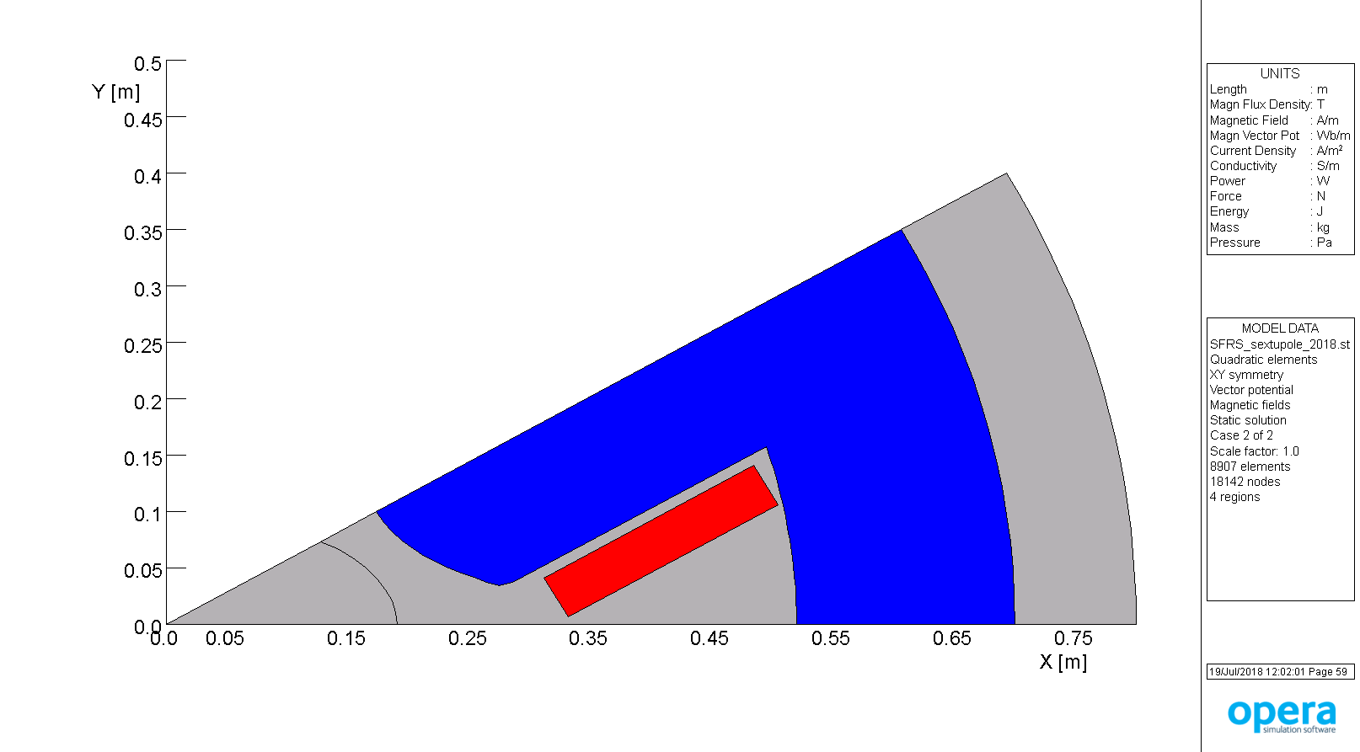
Third radiation resistant quadrupole and radiation resistant sextupole
quadrupole 2
sextupole 1
PSP code | Magnet | gap (mm) | Dimension (m) (x,y,z) | Max. current | inductance (mH) | Resistance (mOhm) | Power (kw) | H2O (l/min)
2.4.2.2.2 | Quadrupole 2 | 163 | 1.5 / 1.6 / 1.6 | 1800 | 61 | 64 | 205 | 115
2.4.2.3.1 | Sextupole 1 | 195 | 0.75 / 1.3 / 1.3 | 1800 | 18.3 | 28 | 90 | 52
Magnetical design made by Alexander Kalimov

Slide 10
Coil cross section quadrupole 1a/1b
Opera 2d models

Slide 11
Coil cross section quadrupole 2
Opera 2d models

Slide 12
Twist lock system
Twist lock system at J-PARC for automated lifting of radiation resistant magnets

Slide 13
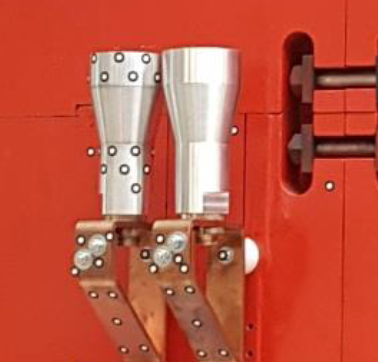
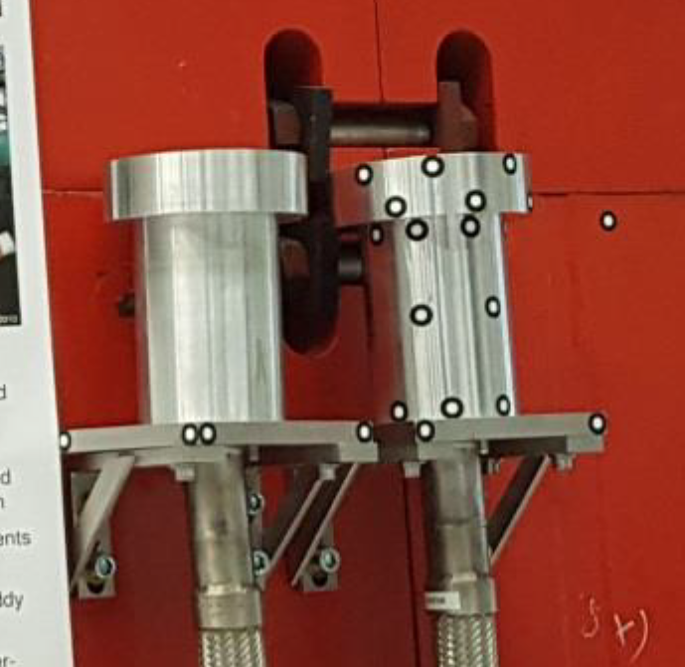
Current and water connections
The connections of current.
The connections of water.

Slide 14
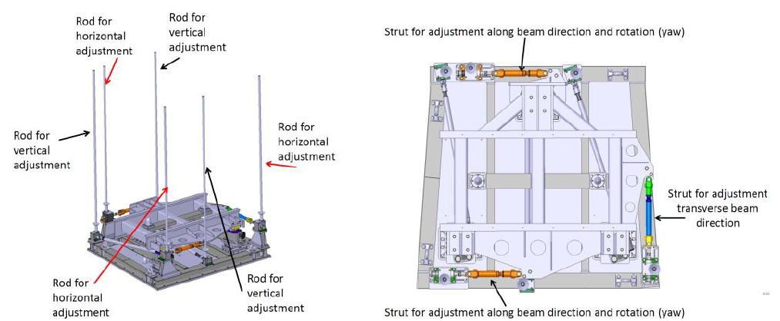
Alignment system of a dipole.
Left: overview with the six adjustment rods, right: top view on the support frame.
A 3-strut system is used for horizontal adjustments.
The same principle will be used for the quadrupol 1a/1b, quadrupol 2/sextupole and sextupole/beamcatcher .

Slide 15
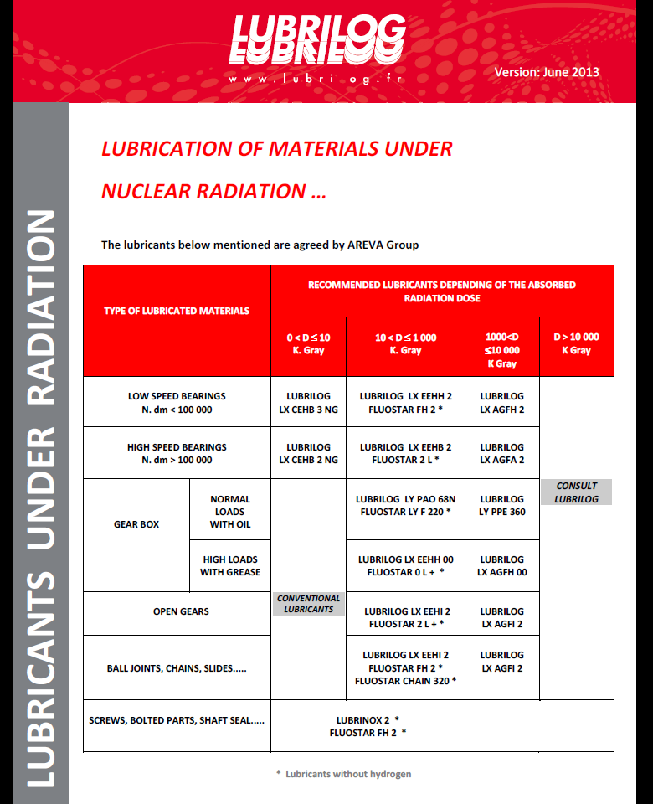


radiation resistant lubricant
All gears and bearings must be lubrified with the lubricant FLUOSTAR FH 2 of the company LUBRILOG (France). This lubricant is radiation resistant up to 1.0 MGy.

Slide 16
Rods for horizontal adjustment
Rods for vertical adjustment
Lances for current
Rod for horizontal adjustment
Lances for current
Rod for vertical adjustment

Slide 17
plane surfaces
bayonet socket
plane surfaces
bayonet socket

Slide 18
Status of specifications of radiation resistant Super-FRS multipole magnets
Quadrupole 1a/1b: specification is approved
Quadrupole 2 and sextupoles: specification is approved
Drawing of adjustable support frames of quadrupoles and the first sextupoles in almost finished. Waiting for the last test of the lifting gears of the support frame of the dipole prototype.

Slide 19
Suggested next step
R&D-Contract with BINP
  Magnetostatic 3D modeling
  Creation of 3D CAD models of multipole magnets
  Development of technology for the production of magnets
    The process of manufacturing of radiation-resistant coils.
    Iron yoke production
    Development of the procedure for assembling and connecting magnets
  Magnetostatic 3D modeling of 3D CAD models
  CDR after 11 months?

Slide 20
