Slide 1
Radiation resistant SFRS multipoles.
D. Gurov, A.Utkin for CR team
BINP, Novosibirsk
May 23, 2019
2nd FAIR-BINP Workshop, Darmstadt, Germany

Slide 2
Contents
Parameters of multipoles
Wire for coils
Construction of Quadrupole2
Field in yoke
Yoke saturation and longitudinal field distribution
Field quality
Construction of sextupole
Field in yoke
Yoke saturation and longitudinal field distribution
Field quality

Slide 3
Parameters of multipoles
2.4.2.2.1 | Quadrupole 1a | 1 | 1.6 T/m | 15.4 T/m | 0.933 | Ø 130 | ±1∙10⁻³
2.4.2.2.1 | Quadrupole 1b | 1 | 1.2 T/m | 11.8 T/m | 1.244 | Ø 180 | ±1∙10⁻³
2.4.2.2.2 | Quadrupole 2 | 1 | 0.6 T/m | 6.1 T/m | 1.200 | 380 × 240 | ±1∙10⁻³
2.4.2.3.1 | Sextupole 1 | 2 | 3.5 T/m² | 34 T/m² | 0.600 | Ø 380 | ±5∙10⁻³

Slide 4
Wire for coils
Wire 2000A-H
Minimal bending radius 120-130 mm.
Maximal length of wire – 60 m.
Maximal current 2000 Amper.

Slide 5
Construction of Quadrupole2
Coil contain 4 separate segments 11 turns each (length of wire in segments varies from 42 to 50 meters)
Maximal current – 76 kA ( 1730 A per turn)
Quarter of yoke with coils (dimensions are in cm)

Slide 6
Construction of Quadrupole2 coil
Longitudinal dimensions of all segments of coil are equal on area 96 mm.
The ends of wire in segments are directed upwards (along the neck of the yoke)
We propose to make not a monolithic, but a composite coil and place the segments in the frame and rigidly fix them in places of their equal longitudinal size

Slide 7
3D magnetic calculations for quadrupole2
Calculations was made at “Mermaid” software for magneto-static calculatins
Calculated 1/8 of quadrupole magnet
Steel type, used in calculations – Armco
Calculations was made for total currents 10, 20, 40, 60, 75.4 kA
Yoke length 1060 mm.
Inscribed radius 163 mm.

Slide 8
Field in yoke
Field in yoke (kGs) at maximal gradient value
Permeability in yoke at maximal gradient value

Slide 9
Yoke saturation and longitudinal field distribution

Slide 10
Field quality
Field quality at 140 mm radius

Slide 11
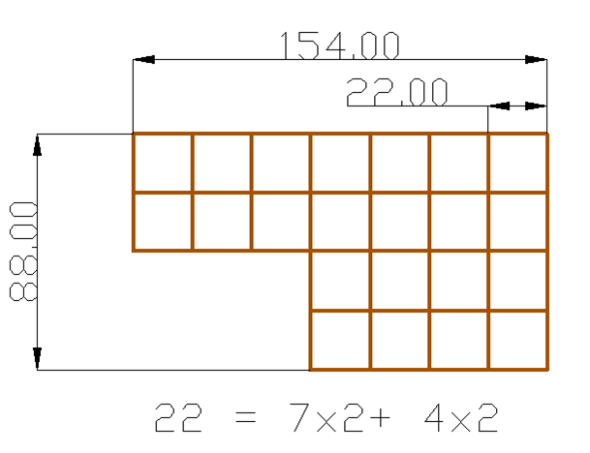
Construction of sextupole
Calculations was made at “Mermaid” software for magneto-static calculatins
Calculated 1/8 of sextupole magnet
Steel type, used in calculations – Armco
Calculations was made for total currents 3.6, 18, 27, 36 kA
Yoke length 600 mm, inscribed radius 200 mm.
Length of wire, required for coil is about 55 meters.
Imax= 1720A

Slide 12
3D magnetic calculations for sextupole

Slide 13
Field in yoke
Field in yoke (kGs) at maximal gradient value
Permeability in yoke at maximal gradient value

Slide 14
Yoke saturation and longitudinal field distribution

Slide 15
Field quality
Field quality at 190 mm radius

