Slide 1
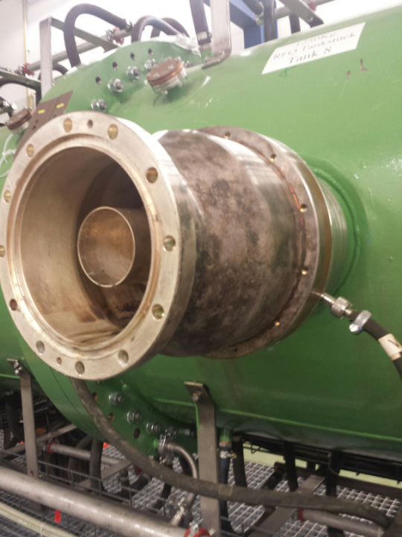
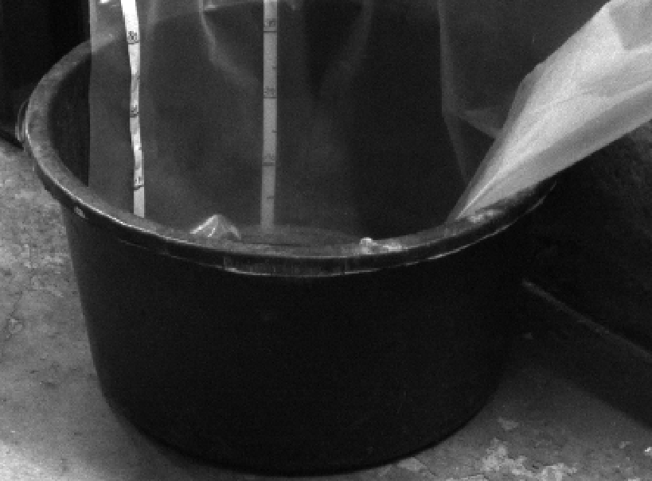
Machine meeting 12.02.19 - UNILAC
UNILAC:
RF conditioning ongoing in parallel to beamtime
Coupling loop HSI-RFQ had water leak to rf line; had to be exchanged
Maximum HSI RFQ voltage right now 5.8V
All other cavities are fine and prepared as well
Rain water leak seems to be fixed, as last weekend during the first stronger rain since the roof repair, no water has entered into the tunnel!
Commissioning of the HSI with Ar and Sn beam has been successful and right now the operator training is on schedule according to the beam setup plan. HLI will start on Thursday with C.

Slide 2
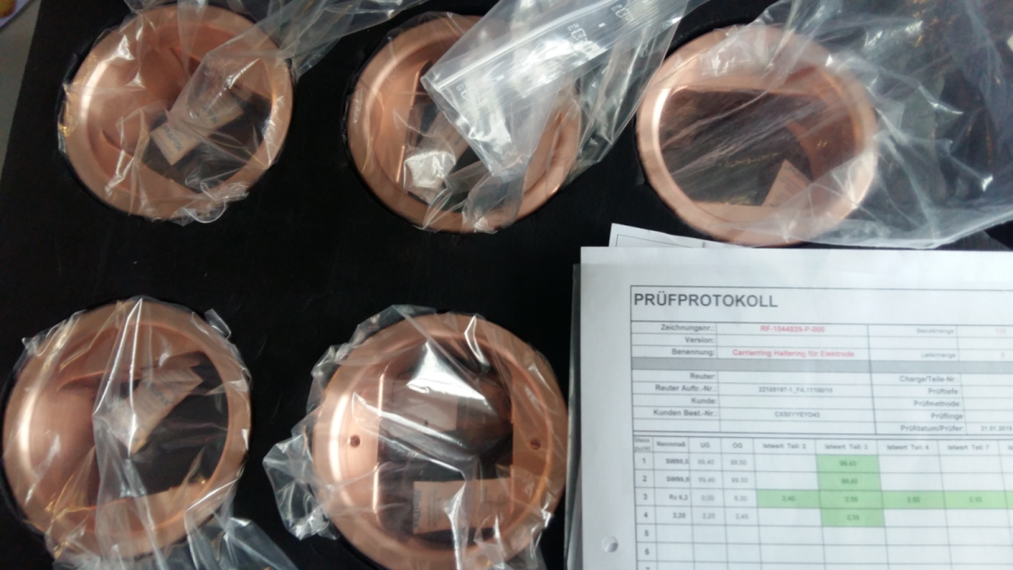
Machine meeting 12.02.19 - UNILAC
HSI RFQ:
electrode milling is ongoing but no new finished parts
carrier ring series production released
RF: after successful SAT test, the new plunger drives await final okay by quality assurance (Sturm) and will then be stored until their use!

Slide 3
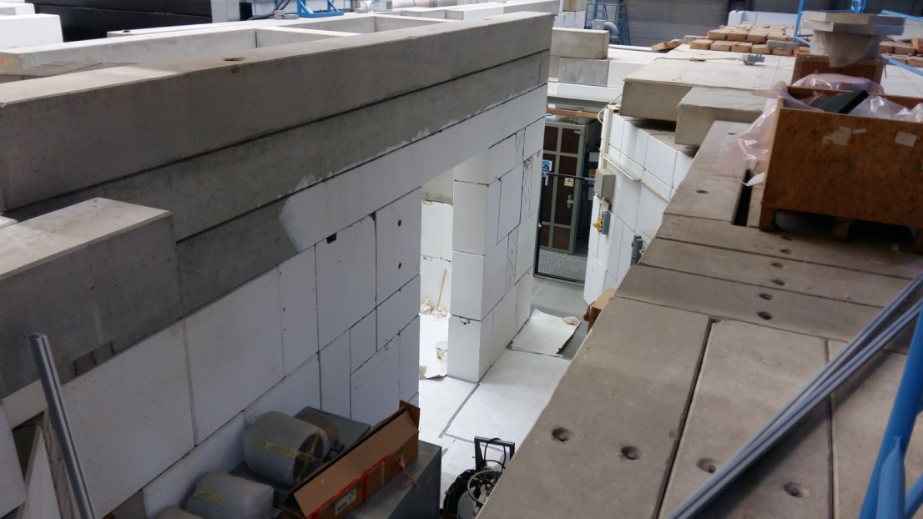
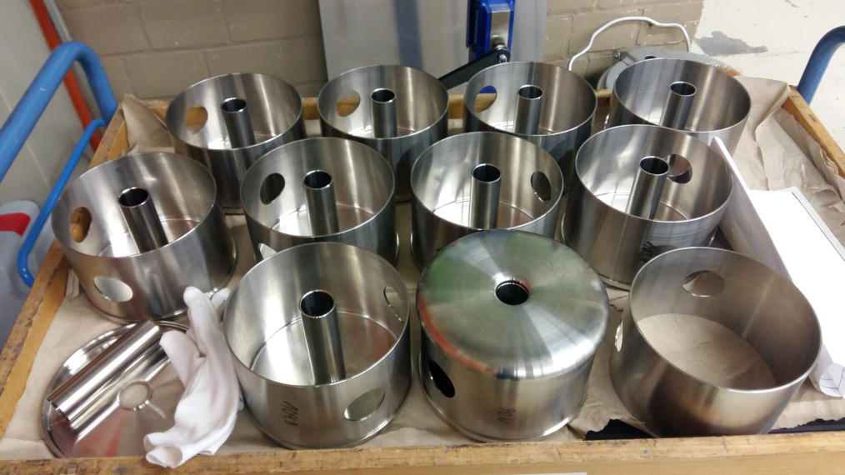
Machine meeting 12.02.19 - UNILAC
FOS:
Preparation of Z7 is ongoing
The 2nd prototype drift tube has been copper plated and the result was as expected. No compromises can be afforded w.r.t. surface preparation
UHV controls upgrade:
Project on track

Slide 4
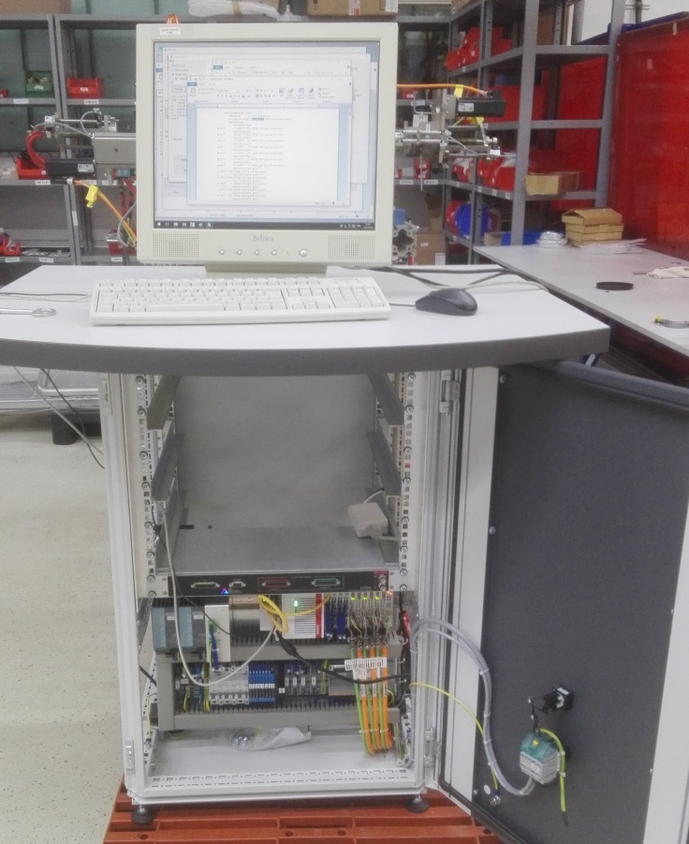
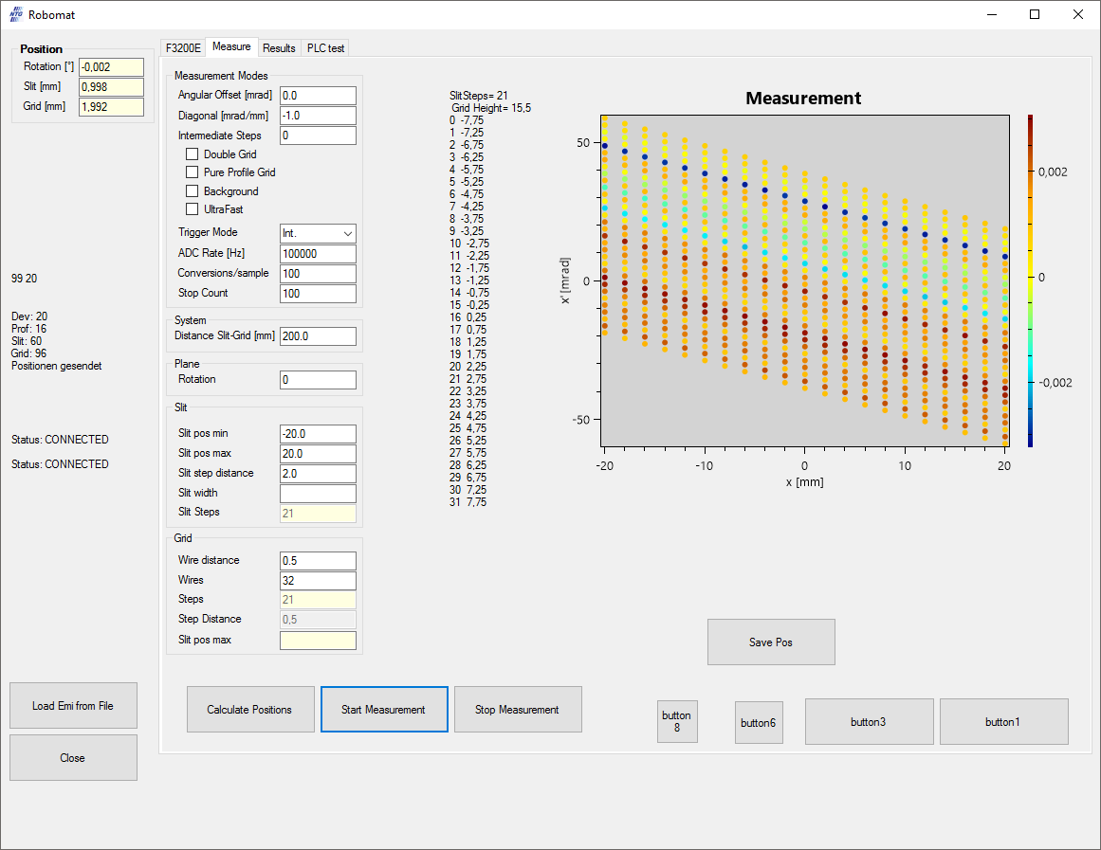
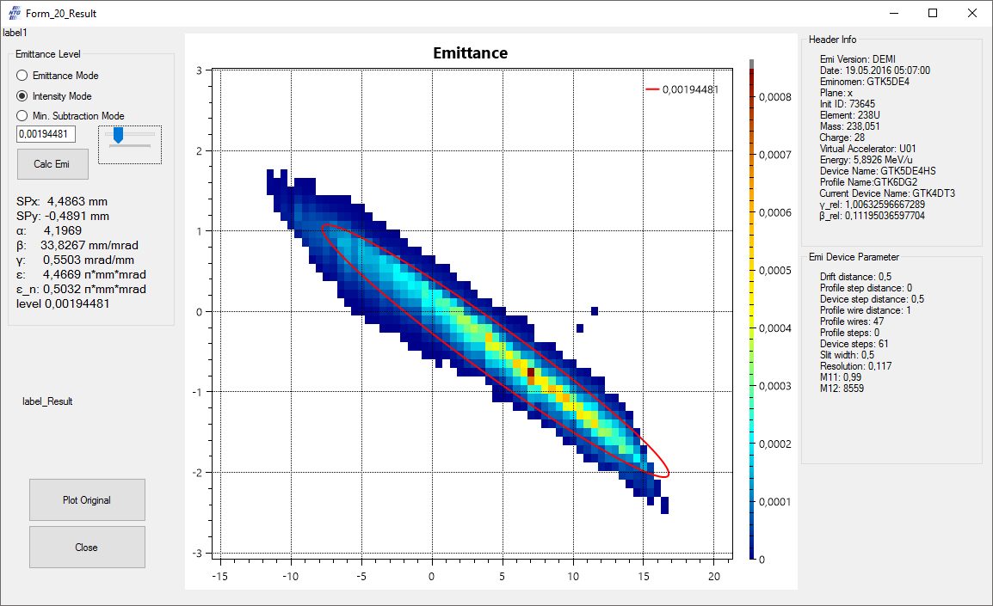
Machine meeting 12.02.19 - UNILAC
ROBOMAT
The production of the standalone electronics for our mobile 4d emittance scanner ROSE is well on its way. The basic functionality has been proven and all major hardware changes are done. The FAT is currently scheduled for the second half of April 2019 directly followed by a SAT, which for beam availability reasons is currently planed at the HIT facility.

