Slide 1


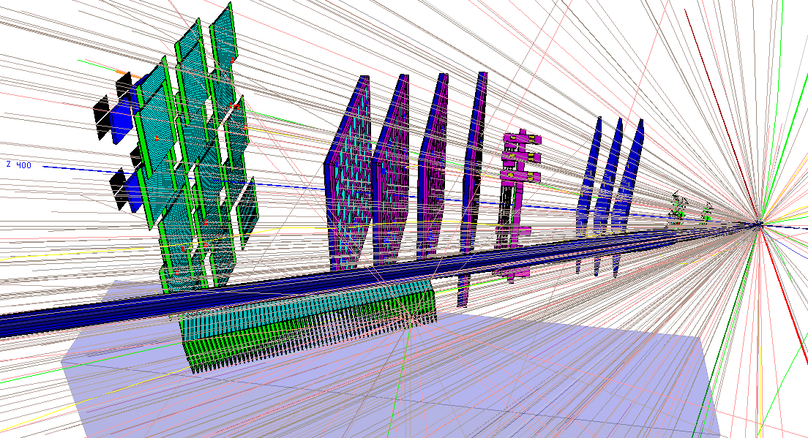

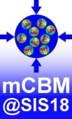
UrQMD
Au+Au 1.24 AGeV collision
Status of mCBM@SIS18
Christian Sturm
for the CBM Collaboration

Slide 2
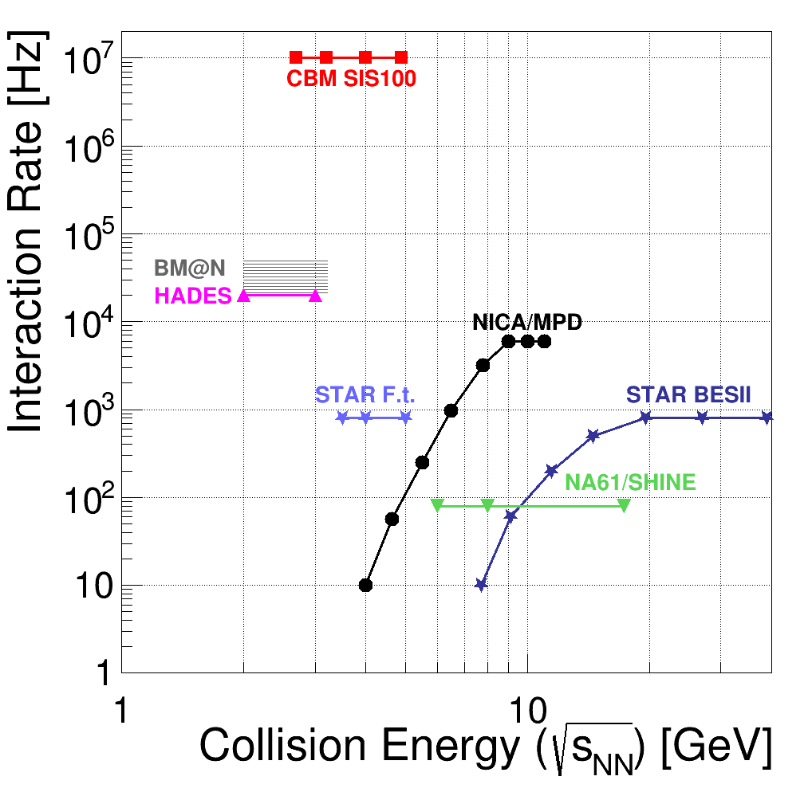
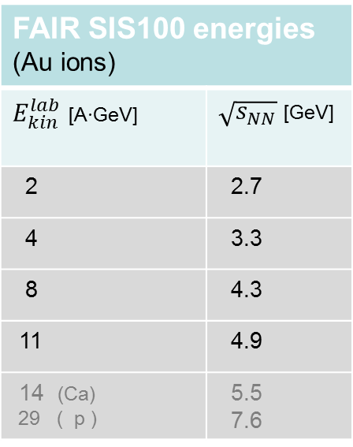
Experiments exploring dense QCD matter:
Rate capabilities
FAIR SIS100 energies (Au ions)
$E_{kin}^{lab}$ [A∙GeV] | $\sqrt{s_{NN}}$[GeV]
2 | 2.7
4 | 3.3
8 | 4.3
11 | 4.9
14 (Ca) 29 ( p ) | 5.5 7.6
CBM‘s unique feature:
ultimate rate capability for
high statistics measurement
of rare probes

Slide 3
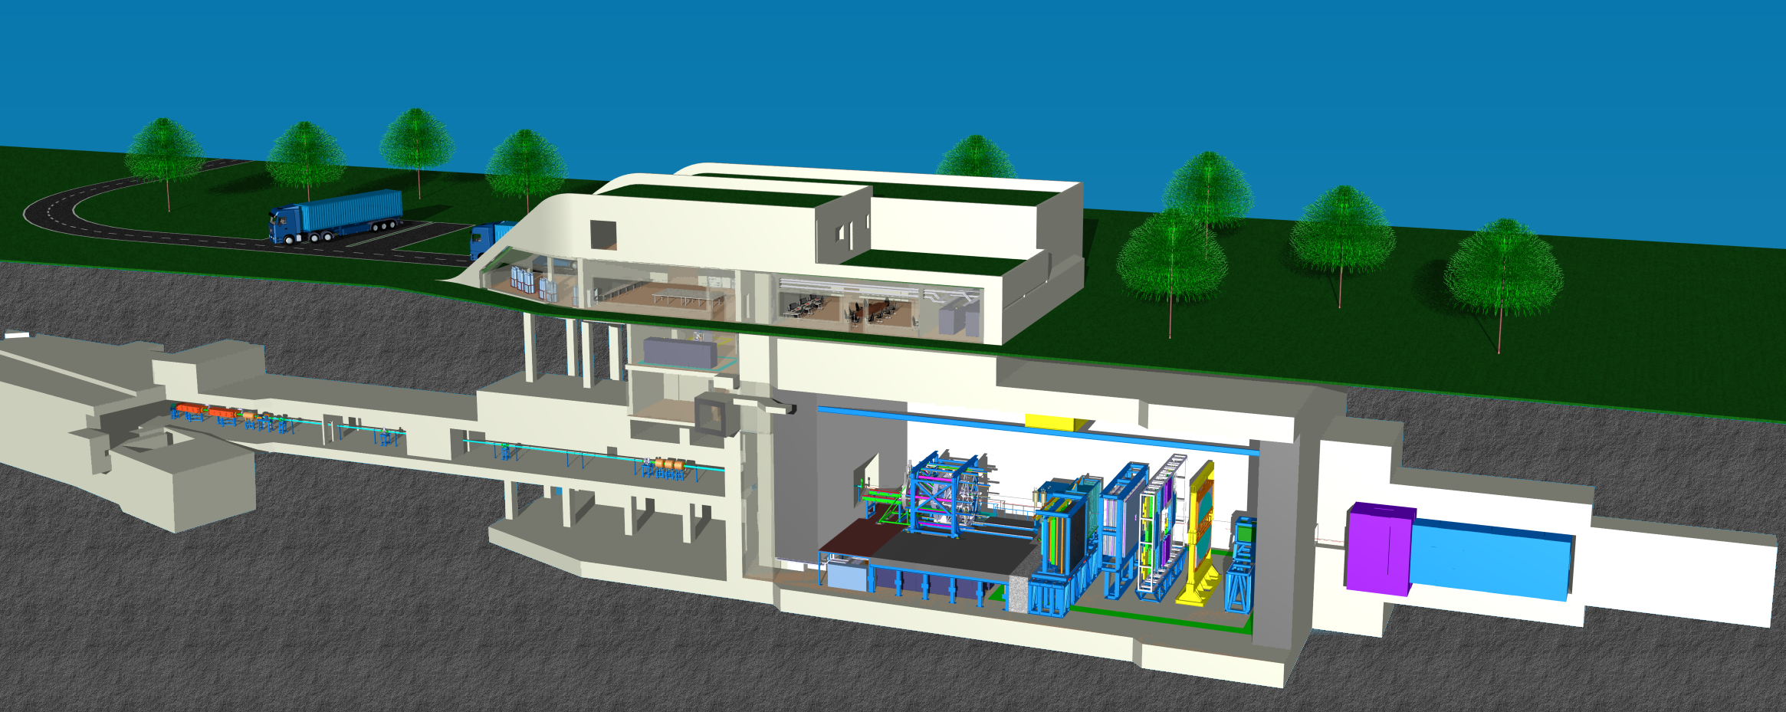
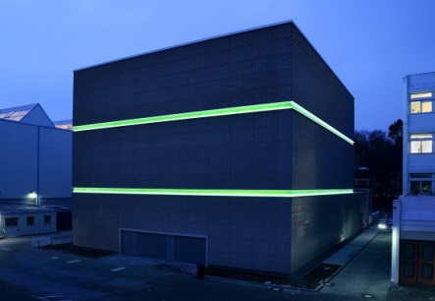
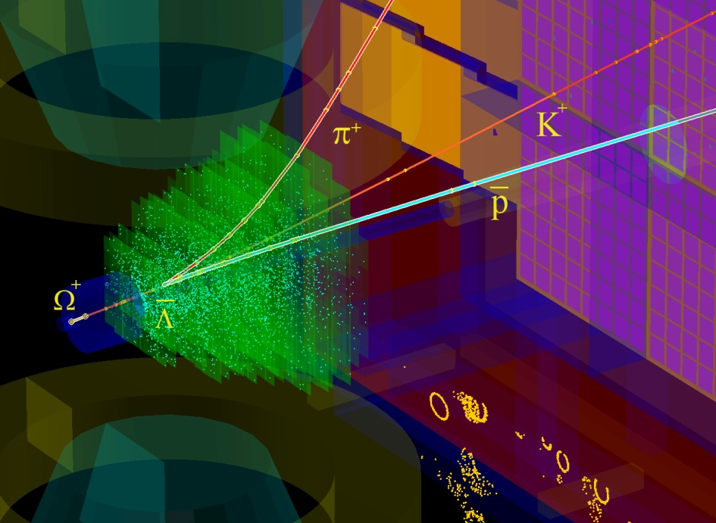
The high-performance free-streaming DAQ system of CBM
DAQ room:
data pre-processing
on FLES input cluster
Green IT Cube:
online
time slice building and event selection
data transport
μ-slices
data
tree
flow
1 TB/s
Green IT Cube
data
~ 800m
~80m
raw
Main features:
radiation tolerant detectors and front-end electronics
free-streaming DAQ system
  all detector hits with time stamps,
  software based event selection

Slide 4
CBM data transport and processing
FLES
Timeslice Building
Free-streaming FEE
assigning
time stamps
to hits
FPGA: DPB, µslice building,
FLES interface
Event Reconstruction
1-100cm
Copper
GBTx
100 m
Optical
800 m
Optical
Event Selection
TFC
Archiving
GBTx : CERN rad.-hard interface ASIC
DPB : Data Processing Board
TFC : Timing and Fast Control Syst.
FLES : First Level Event Selector
µslice (µS) : self contained data block for a subset of the experiment, minimal size depends on degree of data time sorting
Timeslice : collection of µS, self contained data block for the full experiment and a given time interval, includes overlap to avoid edge losses

Slide 5
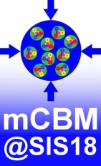
A CBM full-system test-setup at GSI/FAIR: mCBM@SIS18
concept:
detector prototypes at θ_{lab} ≈ 25°
no B-field → straight tracks
high resolution TOF (T₀ – TOF stop wall)
CBM collision rates
Test beam at SPS
Nov./Dec. 2016
mPSD
target
beam
25°
mMVD, mSTS, mMUCH, mTRD, mTOF, mRICH, mECAL
T₀ diamond
Topics to be addressed
free streaming read-out and data transport to the mFLES
online reconstruction
offline data analysis
controls
detector tests of final detector prototypes

Slide 6
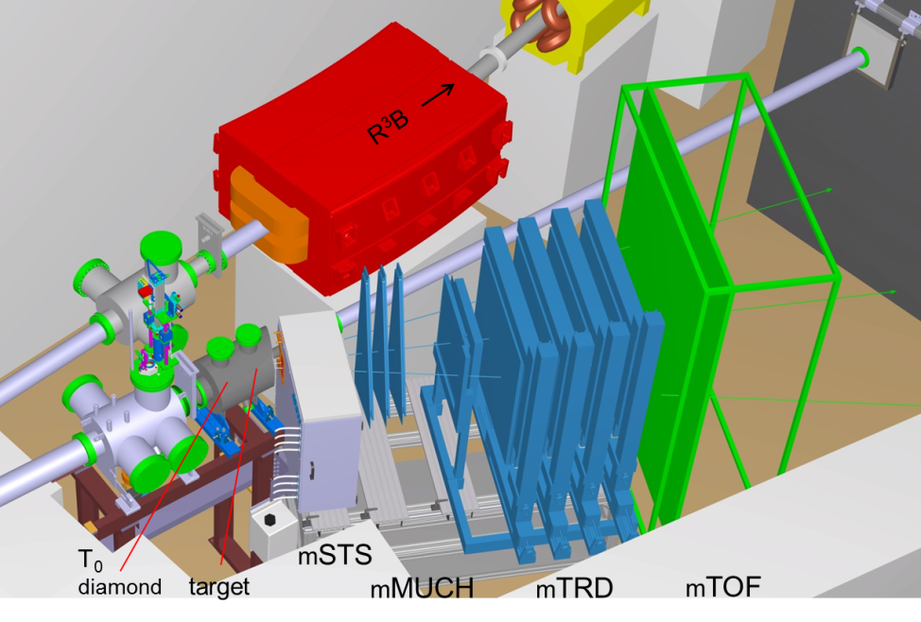
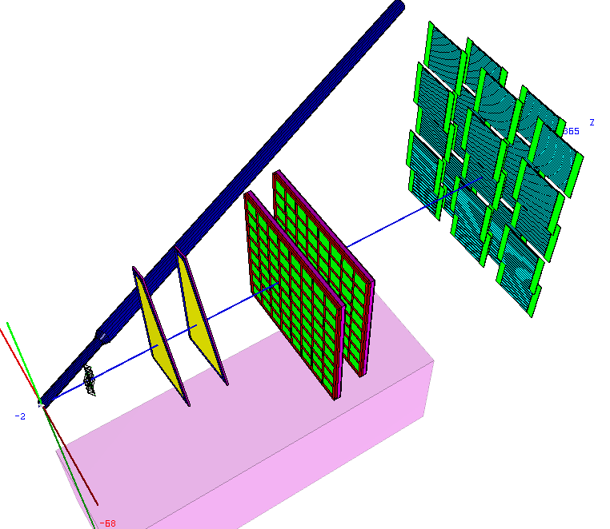
Engineering design
Setup for 2018
(ROOT geom.)

Slide 7
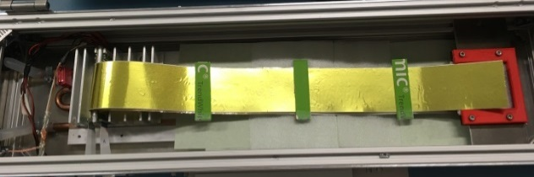
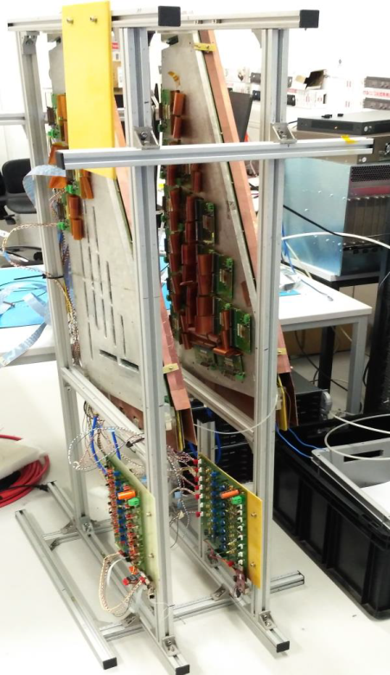
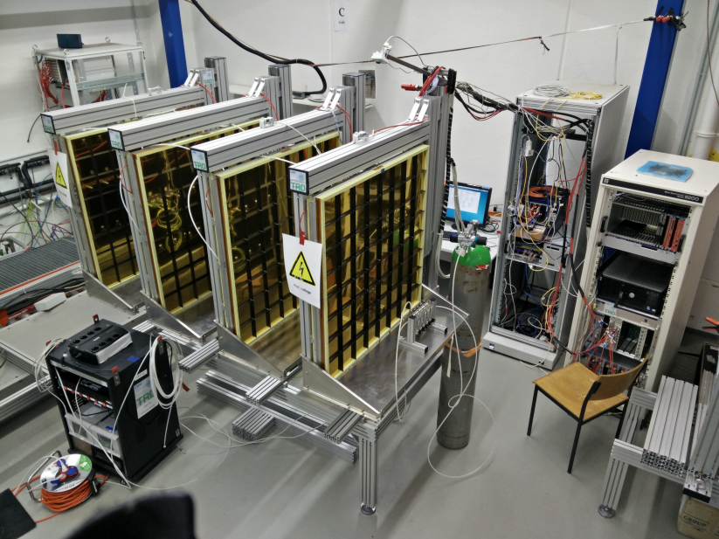
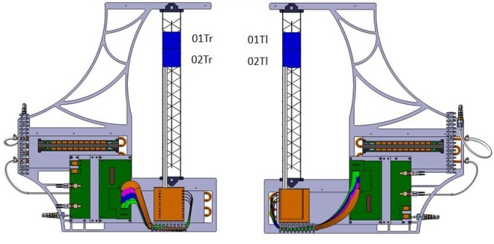
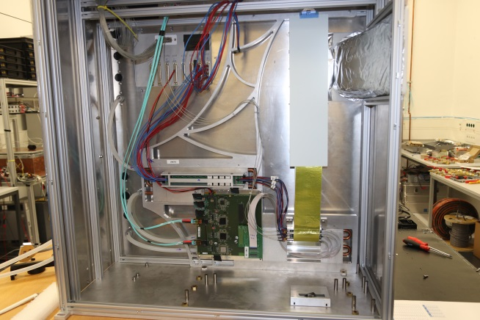
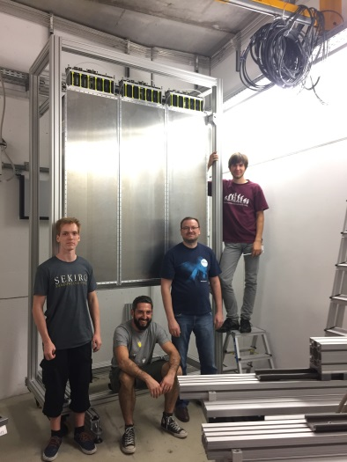
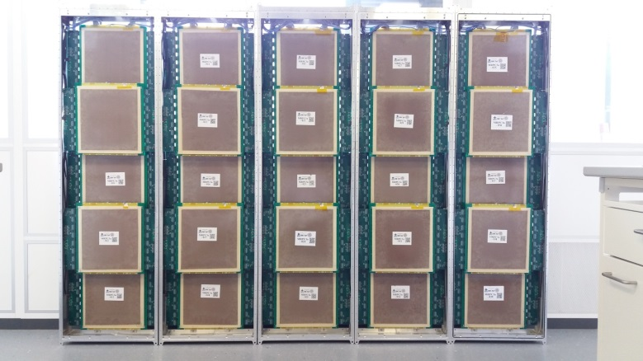
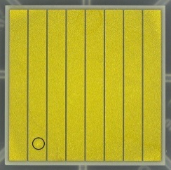
mCBM subsystems in 2018 / Q1 2019
mSTS @ GSI
mMUCH @ VECC
mTRD @ Münster & Frankfurt
mTOF modules @ HD
T0 @ GSI

Slide 8
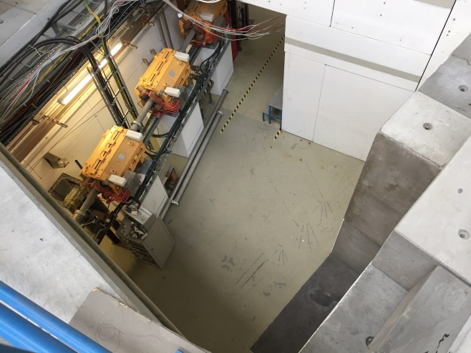
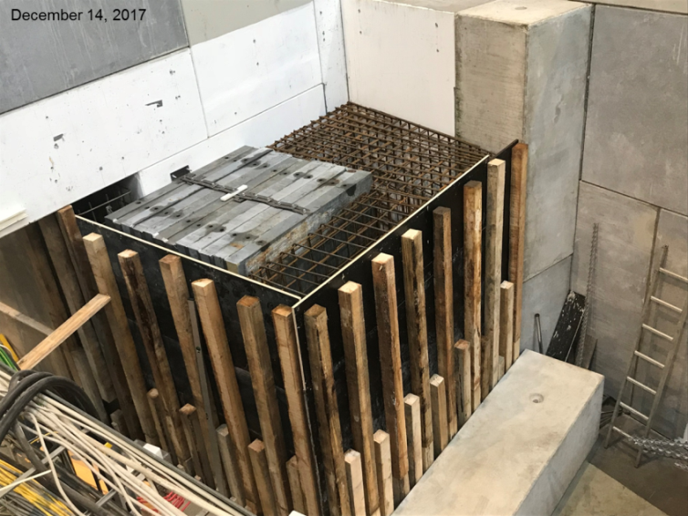
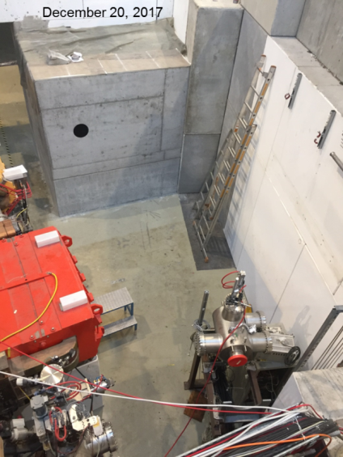
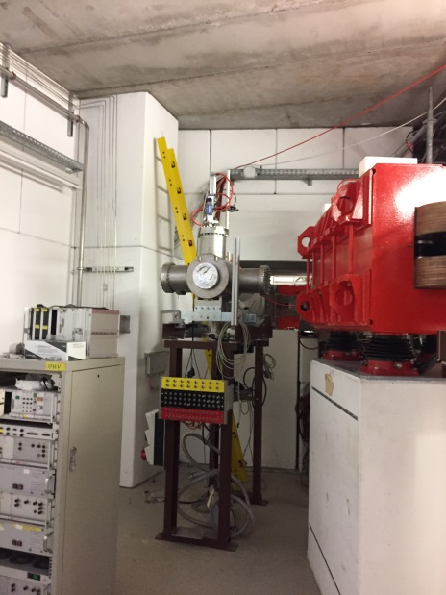
Construction of mCBM
Nov. 2, 2017
Feb. 8, 2018

Slide 9
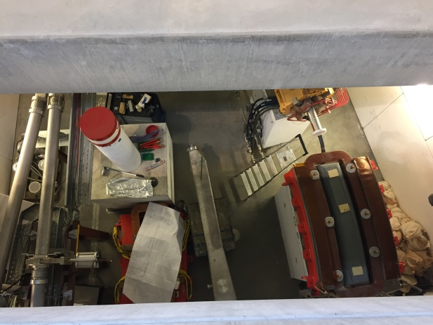
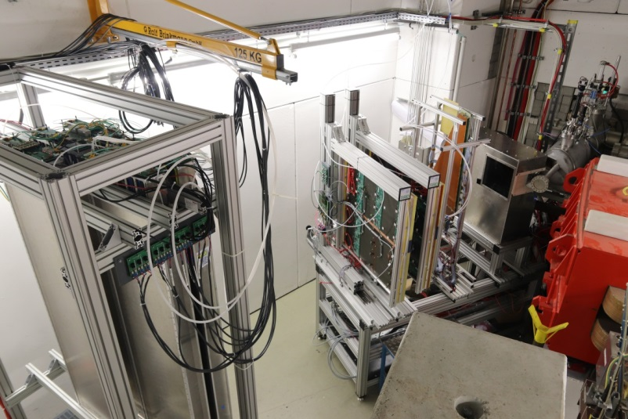
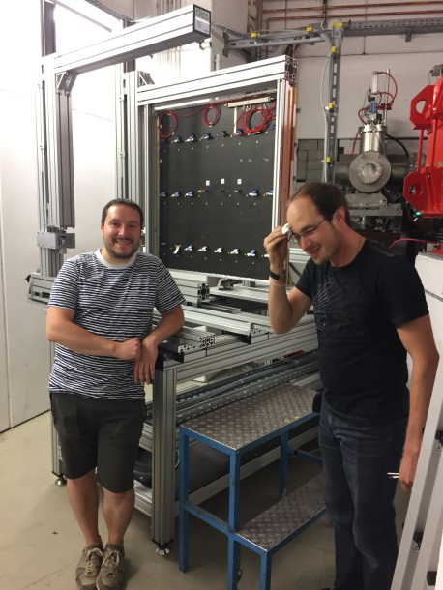

Construction of mCBM
March 21, 2018
Sept. 20, 2018
Nov. 29, 2018
Sept. 9, 2018

Slide 10
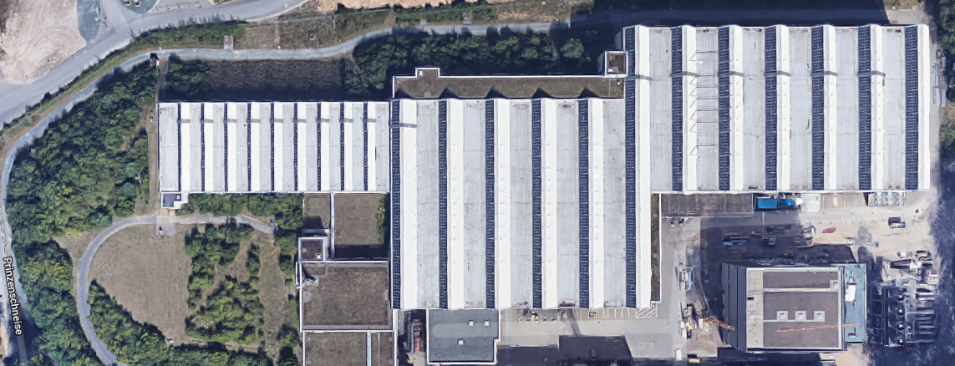
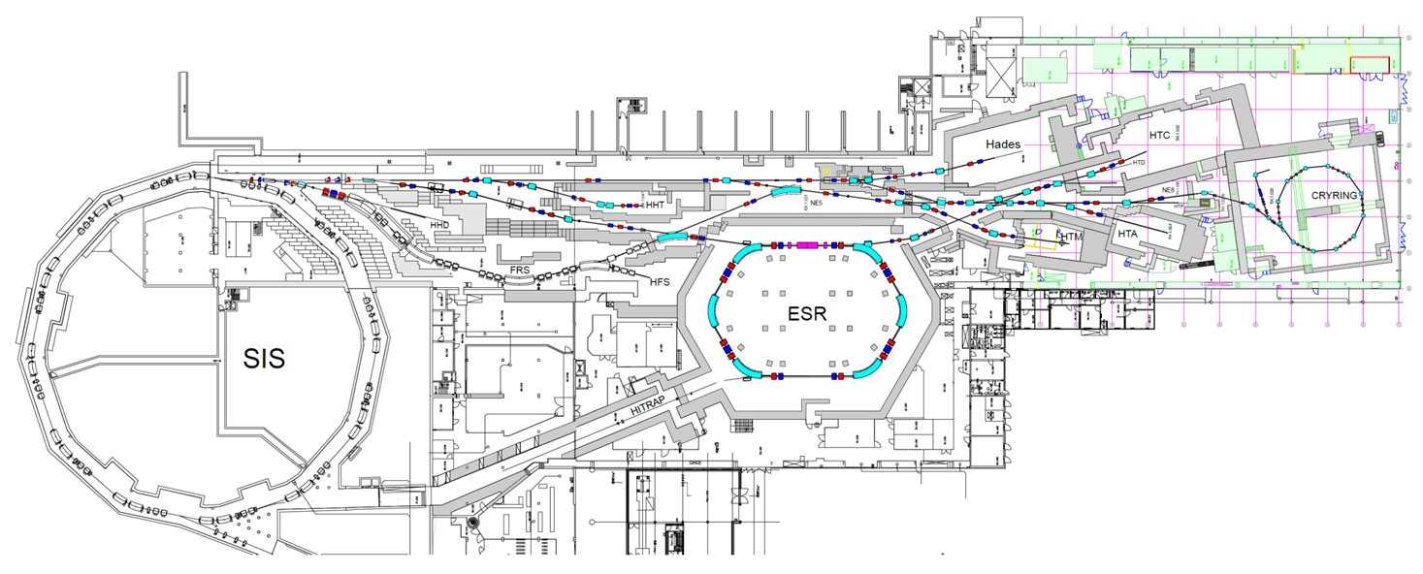
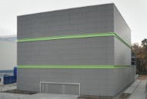
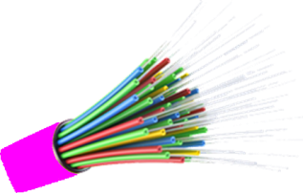
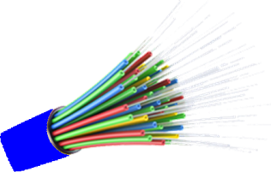
mCBM data path into the Green IT Cube
Green
Cube
288x multi-mode OM4 fibers, 50 m long:
mCBM cave – DAQ container
144x each
144x single-mode OS2 fibers, 300 m long:
DAQ container – Green Cube

Slide 11
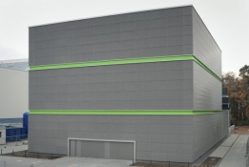
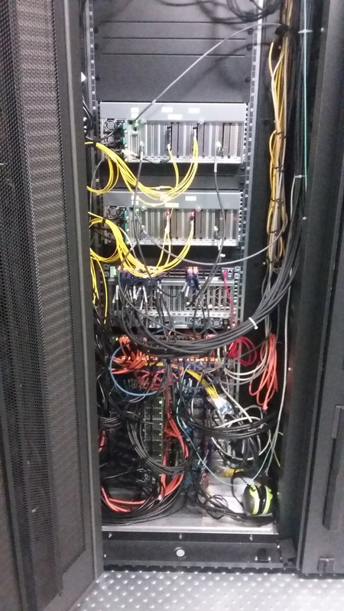
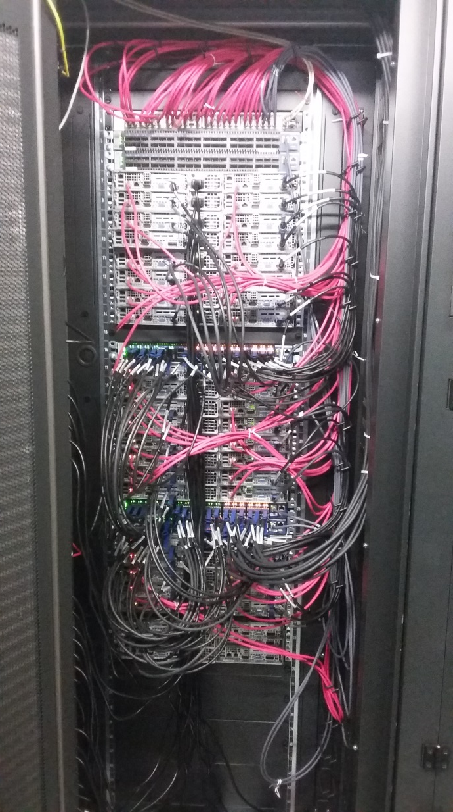
mFLES racks @ Green IT
Rack GC-5A60
Rack GC-5A61
entry stage
processing stage
Infiniband
switches
are
cabled with nodes
144x OS2 fibers
end here
2x mFLES
input nodes
38x mFLES
processing nodes
are online,
80 TB hard drives
mFLES
login node
optical links to Green IT Cube commissioned and tested
mFLES software ready for basic operation, full flesnet chain installed and tested

Slide 12
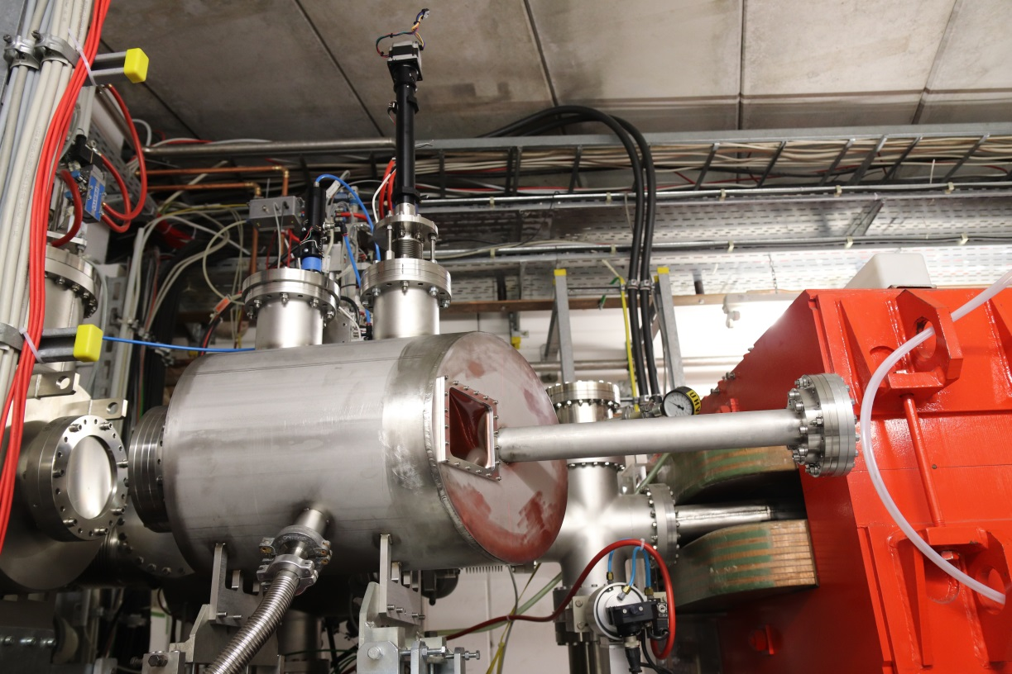
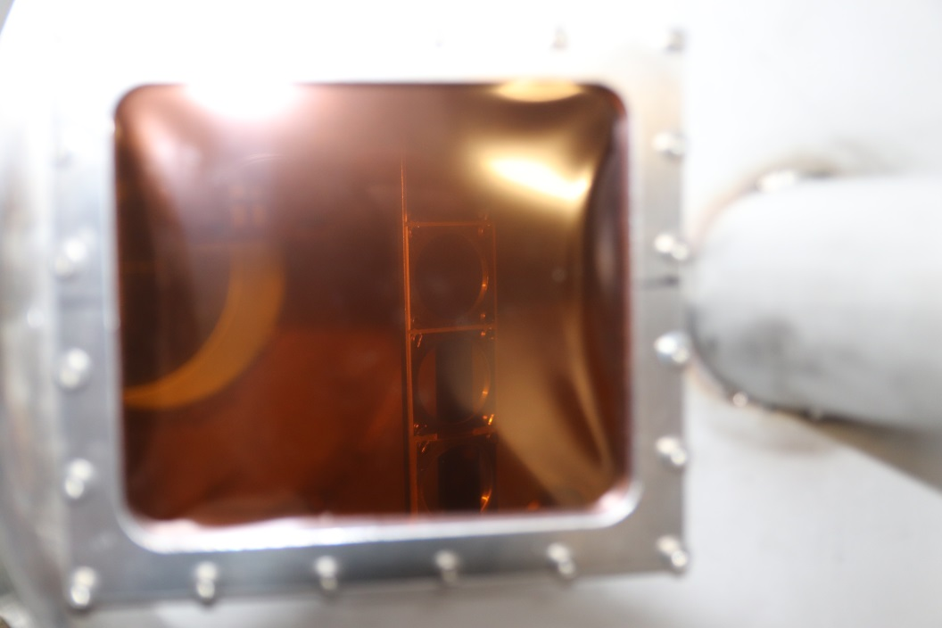
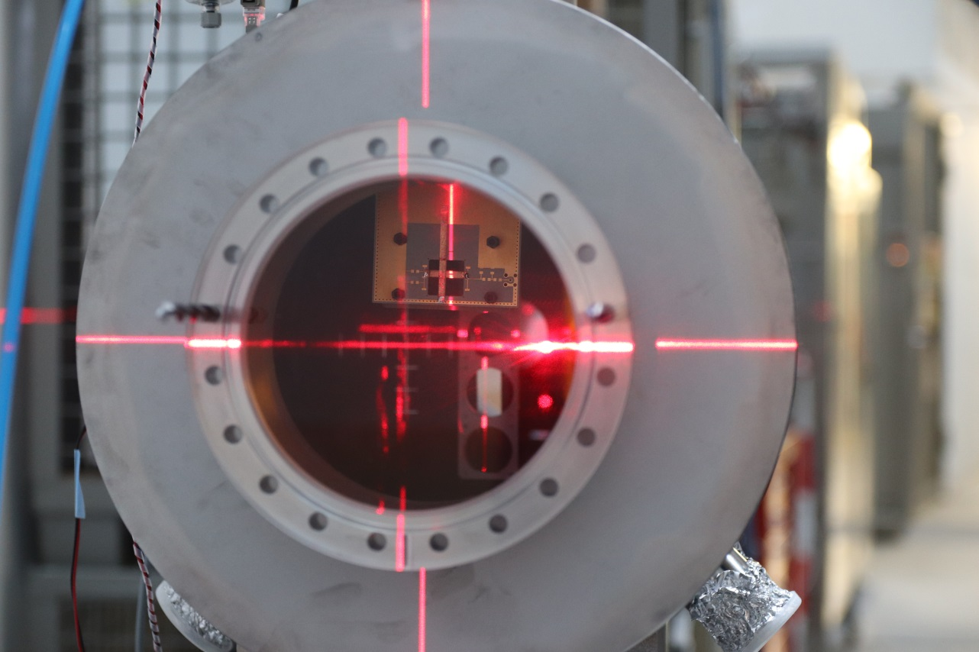
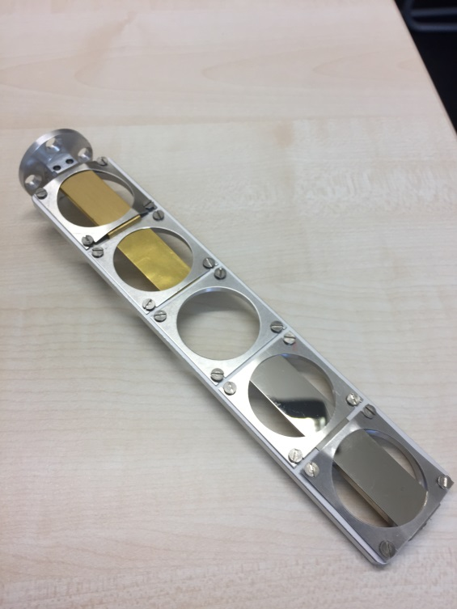
The new mCBM target chamber

Slide 13
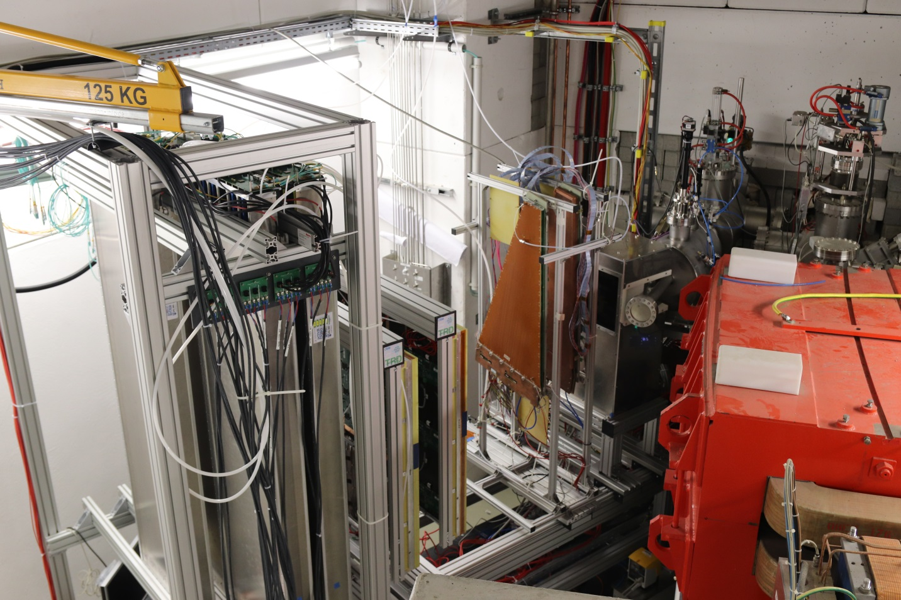
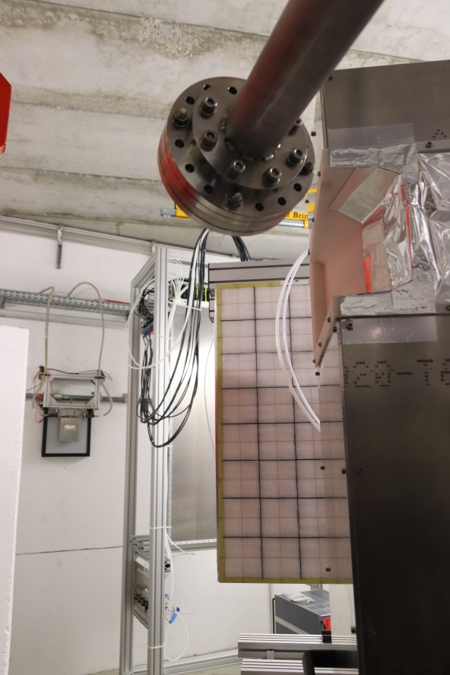
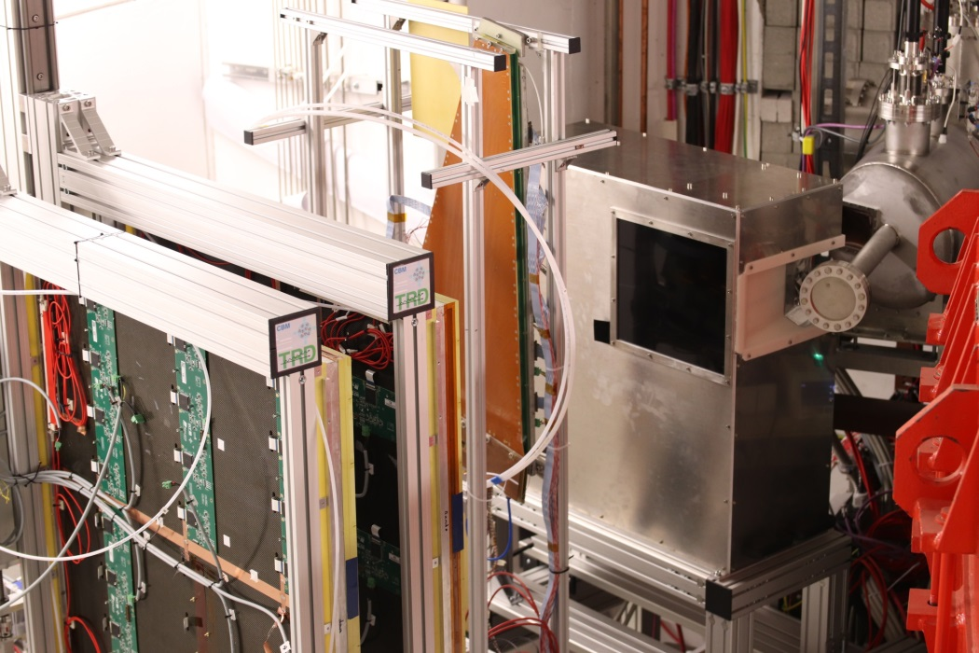
mCBM ready for commissioning (Nov. 2018)

Slide 14
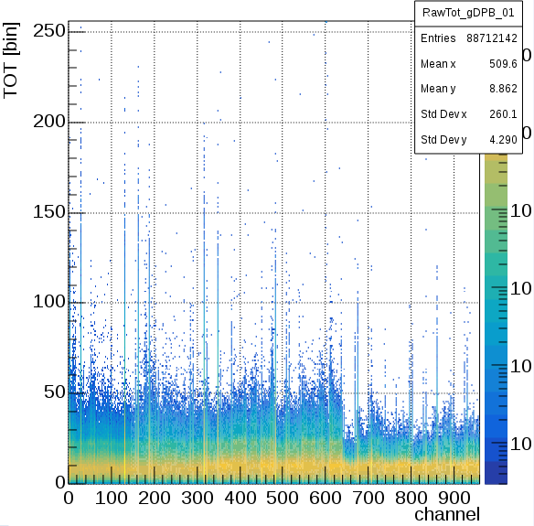
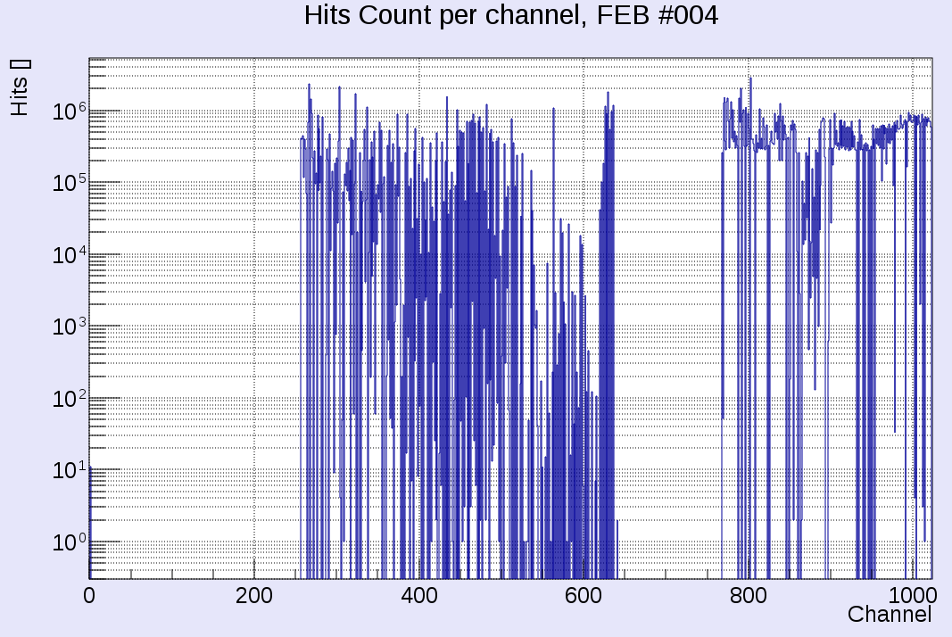
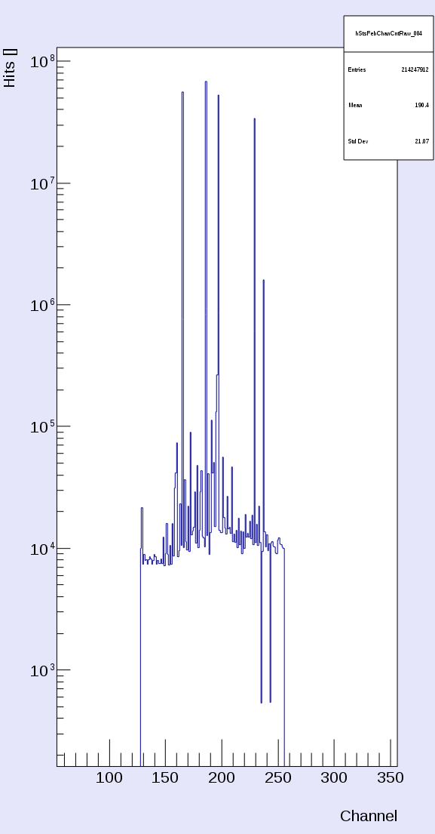
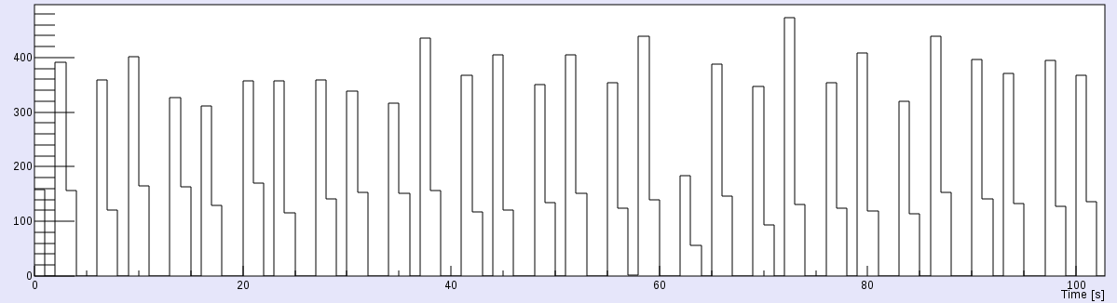
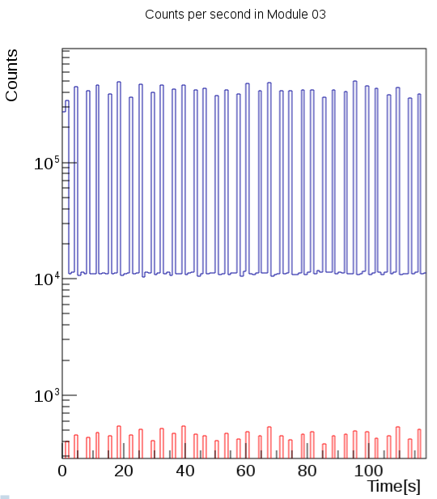
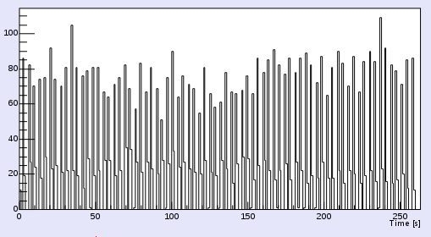
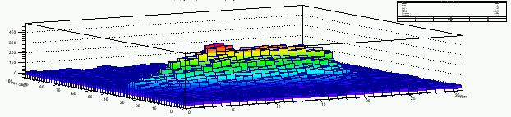
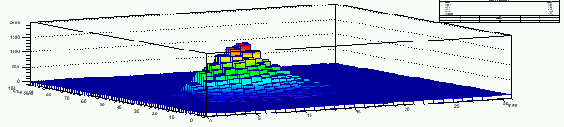
First preliminary results
Dec. 5th, 2018, Ag (42+) 0.95AGeV
individual data streams from:
mMUCH
mTOF
mSTS
beam profile
5m downstream
in front of the beam dump

Slide 15
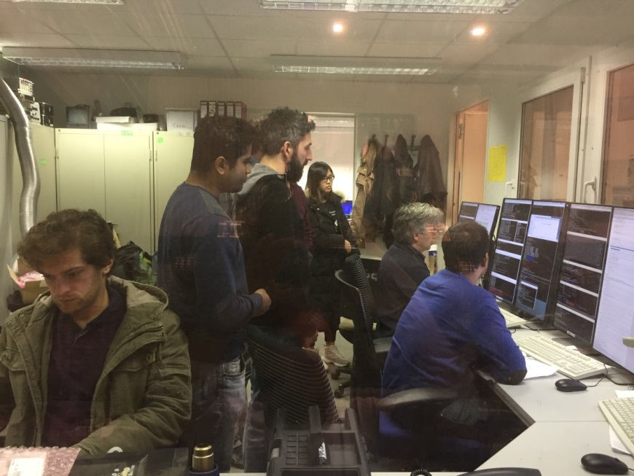
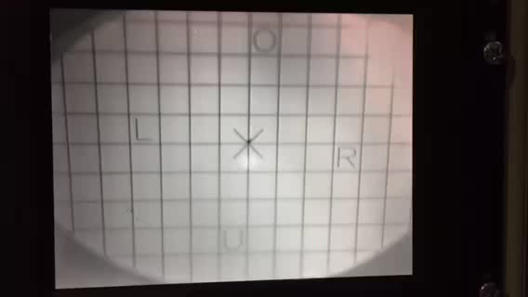

First preliminary results
Dec. 14, 2018, 01:12
beam:
Ag (45+), 1.2 AGeV,
1.4 s spill
2x spills
mSTS
mMUCH
mTOF A
mTOF B
1st combined,
synchronized
data transport
of all mounted
subsystems !

Slide 16

To Do for 1st mCBM commissioning beam time, March 2019
hit rates
not fully understood,
T0 saturation ?
furthermore:
reconstruction of events, 4D data analysis
complete mSTS detector station-0, exchange mMUCH electronics parts
commissioning of new mCBM control room
prepare installation of mRICH and mPSD modules

Slide 17

mCBM data taking 2019 & 2020
2018→ 2019 | development & commissioning data transport, data analysis, detector tests
2019→ 2020 | approaching full performance subsystems completed, high-rate data transport / processing → online reconstruction
requested beamtime
was fully granted
by GSI/FAIR G-PAC
new mCBM
control room
2018 – Q1 2019:
1st tests during engineering runs Nov./Dec. 2018
4x weeks mCBM (parasitc) beam: March 4 – March 31, 2019
beam: ¹⁰⁷Ag, 1.65 AGeV (top SIS18)
by G-PAC granted beam time for 2018 (→ 2019):
51 parasitic shifts → 41h / 28d ≈ 1 - 2h / d
fixed slots per day (i.e. 12:00 – 13:00 & 18:00 – 19:00)

Slide 18

CBM Collaboration: 55 institutions, 470 members
China:
CCNU Wuhan
Tsinghua Univ.
USTC Hefei
CTGU Yichang
Chongqing Univ.
Czech Republic:
CAS, Rez
Techn. Univ. Prague
France:
IPHC Strasbourg
Germany:
Darmstadt TU
FAIR
Frankfurt Univ. IKF
Frankfurt Univ. FIAS Frankfurt Univ. ICS
GSI Darmstadt
Giessen Univ.
Heidelberg Univ. P.I.
Heidelberg Univ. ZITI
HZ Dresden-Rossendorf
KIT Karlsruhe
Münster Univ.
Tübingen Univ.
Wuppertal Univ.
ZIB Berlin
Russia:
IHEP Protvino
INR Troitzk
ITEP Moscow
Kurchatov Inst., Moscow
VBLHEP, JINR Dubna
LIT, JINR Dubna
MEPHI Moscow
PNPI Gatchina
SINP MSU, Moscow
Ukraine:
T. Shevchenko Univ. Kiev
Kiev Inst. Nucl. Research
India:
Aligarh Muslim Univ.
Bose Inst. Kolkata
Panjab Univ.
Univ. of Jammu
Univ. of Kashmir
Univ. of Calcutta
B.H. Univ. Varanasi
VECC Kolkata
IOP Bhubaneswar
IIT Kharagpur
IIT Indore
Gauhati Univ.
Korea:
Pusan Nat. Univ.
Poland:
AGH Krakow
Jag. Univ. Krakow
Warsaw Univ.
Warsaw TU
Romania:
NIPNE Bucharest
Univ. Bucharest
Hungary:
KFKI Budapest
Eötvös Univ.
30th CBM Collaboration meeting in Wuhan
24-28 September 2017
CBM Scientists

Slide 19
Backup
mCBM

Slide 20



From 1st Beam Time retreat (Feb. 2018): mCBM major goals for 2018
start version for 2018
mTOF
mTRD
mSTS
target
beam
Start the CBM full system test:
operate mTRD, mTOF (+ T₀ counter) and mSTS (1x station)
data transport to mFLES @ Green IT Cube incl. event building
parasitic beam: ions, T_{lab}> 1 AGeV & slow extraction (10s), 10⁵ - 10⁶ s⁻¹
(→ ¹⁰⁷Ag/¹⁰⁹Ag 1.65AGeV is fine !)
basic data analysis → correlated hits between detector stations
Support by beam diagnostics team required.
No show-stopper visible.
ü
ü
ü
ü
ü

Slide 21

mCBM data taking 2021 & 2022
2020 → 2021 | 1st benchmark run Λ reconstruction production runs benchmark coll. systems: Ni+Ni 1.93AGeV & Au+Au 1.24AGeV
2021 → 2022 | 2nd benchmark run Λ reconstruction in Ni+Ni and Au+Au collisions at various projectile energies → Λ production excitation function
proposal to be submitted in 2019/20
Λ - slope parameter:
smaller than proton
not explained by transport models
reason unclear:
  rescattering cross section ?
  repulsive potential ?

Slide 22



mCBM@SIS18
A CBM full system test-setup
for high-rate nucleus-nucleus collisions at GSI/FAIR
CBM prototype detector systems
free streaming read-out and data transport to the mFLES
up to 10 MHz collision rate
first commissioning beam in December 2018
green IT cube

Slide 23


2018 - 2022
mCBM@SIS18
full system test-setup for high-rate A+A collisions
to test prototype detectors
to test front-end electronics (FEE)
to develop & test the data transport to DPB & FLIB (1st and 2nd FPGA)
to develop & test the data transport to FLES
to develop & test μ-slice + time-slice building
to test & develop data transport using a CRI
to develop & test a general timing + fast control system (TFC)
to develop & test the detector + experiment control system (DCS & ECS)
to develop & test the online reconstruction + selection
to develop & test the software online framework
to develop & test the data analysis
2018 –
Q2 2019
Q2 2019
+
CBM @SIS100
2025 -
Christian Sturm, GSI

Slide 24

Design of the mCBM test-setup
top view
side view
mRICH
mTOF
mTRD
mPSD
mMUCH
support table
(with rail system)
support table
(with rail system)
mSTS
target
beam

Slide 25
mCBM read-out and data transport
Start version

Slide 26




Present read-out chain of mSTS
STS modules
8 STS-XYTER v2.0 on FEB-8
Common
GBTx
Readout Board
μTCA crate
with AFCK
boards
FLES input node
with FLIB
boards
copper link
optical link
optical link
HTD cave, on detector
DAQ container
Green Cube

Slide 27
mDAQ and mFLES 2018 (start version)
present design
1
6
2
3
4
5
 |  | Device | Function | Location
1 | 70x | GBTx | data concentrator | Cave, on detector
2 | 12x | AFCK | 1st layer FPGA board | DAQ container
3 | 96x | Optical fibers | Data transport | DAQ → Green IT Cube
4 | 4x | FLIB | 2nd layer FPGA board | Green IT Cube
5 | 2x | mFLES input node | Input stage | Green IT Cube
6 | 42x | mFLES compute nodes | Processing stage | Green IT Cube

Slide 28

mCBM read-out, data transport and processing
Final version

Slide 29
mDAQ and mFLES 2019 (SIS100 version)
present design
1
2
3
4
5
 |  | Device | Function | Location
1 | 70x | GBTx | data concentrator | Cave, on detector
2 | 6x | CRI | FPGA board (1x layer only) | DAQ container
3 | 2x | mFLES input node | Input stage | DAQ container
4 | 96x | Optical fibers | Data transport | DAQ → Green IT Cube
5 | 42x | mFLES compute nodes | Processing stage | Green IT Cube

Slide 30





mCBM Cave (HTD @ SIS18 facility)
HTD MU1
dose rate
additional shielding
modified switching magnet (HTD MU1)
new beam dump
additional shielding
    FLUKA calculations (right fig.):
    10⁸ Au ions s⁻¹, 1.24 AGeV,
    2.5 mm Au target (P_{int} = 10%)
    vertical section: beam level
requirement: $\dot{D}≤ 0.5 μ$Sv/h

Slide 31

Design of the mCBM Cave - HTD
additional shielding

Slide 32


Monte Carlo shielding calculations (FLUKA)
10⁸ Au ions s⁻¹, 1.24 AGeV, on 2.5 mm Au target (P_{int} = 10%)
vertical section: beam level
dose rate
requirement: $\dot{D}≤ 0.5 μ$Sv/h

Slide 33


mCBM beam line
Present concept:
beam diagnostic chamber
scintillation screen
vacuum: accelerator
beam pipe
carbon, d=100mm
vacuum: experiment
target chamber
T₀ diamond counter
target ladder
small permanent magnet (?)
(to bend-out low-E δe)
vacuum: experiment
scintillation screen
in front of the beam dump
atmospheric pressure

Slide 34




Example: mSTS integration
4 C-frames (“Units”)
holding the ladders with modules
holding the read-out and powering electronics
(FEB, C-ROB, POB) on cooling plates
beam pipe

Slide 35



mRICH
Aerogel radiator (few cm thick)
New proposal by the RICH group:
Aerogel proximity focusing RICH
to be installed for phase II / 2019,
≈ 0.5m² acceptance,
need 50 – 70 cm space behind mTOF
open issues:
read-out
DiRICH & TRBnet to be included
into the mCBM DAQ
→ synergy with mPSD
detector integration
integration into mCBM
d
3x2 MAPMT
module(s)

Slide 36

mCBM – support infrastructure
gas area
counting house
DAQ container
mCBM
cave
Green Cube

Slide 37



Hit rates at mCBM (simulation)
mSTS, 1st station
max. (design) rate: 1.5 MHz/cm²
mTOF
max. (design) rate: 20 kHz/cm²
Input:
UrQMD, Au+Au 1.24 AGeV, mbias,
incl. δ-electrons

Slide 38




mCBM benchmark observable: Λ reconstruction
Λ→pπ⁻
Feasibility study using mSTS & mTOF (3x stations):
straight track candidates mTOF → mSTS (hit station-0, hit station-1) assuming primary vertex on (0,0,0)
proton and pion candidate by selection on transverse distance to primary vertex
momenta from time-of-flight assuming proton and pion mass → p, M_{inv}
$$π^{−}$$
$$p$$
$$Λ→p+ π^{−}$$

Slide 39








mCBM benchmark observable: Λ reconstruction
Simulation input: 10⁸ UrQMD events, min. bias
Acceptance
Efficiency
Ni+Ni 1.93AGeV
Au+Au 1.24AGeV
S/B = 8.4
S/B = 0.24
$$π^{−}$$
$$p$$
$$Λ→p+ π^{−}$$

Slide 40




Λ production at SIS18 energies – mCBM reference data
Ni + Ni 1.93 AGeV
Au + Au 1.23 AGeV
M. Merschmeyer et al. (FOPI), PRC 76, 024906 (2007)
H. Schuldes et al. (HADES)
EPJ Web of Conferences 171, 01001 (2018), SQM2017
midrapidity

Slide 41

Physics of the benchmark observable
Data:
HADES : Eur. Phys. J. A (2011) 47
FOPI : PRC 76, 024906 (2007)
IQMD transport calculation:
C.Hartnack et al., PR 510 (2012)
Λ - slope parameter:
smaller than proton
not explained by transport models
reason unclear:
  rescattering cross section ?
  repulsive potential ?

Slide 42

Granted mCBM beam time 2018 - 2019
“For this task, we apply (1) for 30 shifts of parasitic beam time, distributed over
four development weeks. At the end of that year’s block of SIS18 beam
we apply (2) for 21 shifts (one full week) of parasitic beam time to perform
high-rate detector tests.” mCBM@SIS18 proposal, submitted on June 19, 2017

Slide 43

Announcement for beam time request 2020 - 2021

Slide 44


mCBM @ SIS18 facility

Slide 45
Backup
CBM intro

Slide 46

Experimental challenges
Perform measurements at unprecedented reaction rates
10⁵ - 10⁷ Au+Au reactions/sec
→ fast and radiation tolerant detectors
→ free-streaming read-out electronics
→ high speed data acquisition and
high performance computer farm for online event selection
Identification
of leptons and hadrons
Determination of
(displaced) vertices (σ ≈ 50 μm)
momentum resolution
$$δp /p≅1\%$$
Central Au+Au at 25 A GeV / UrQMD+GEANT4
160 p, 450 π⁺ + π⁻, 44 K⁺, 13 K⁻

Slide 47


CBM
hadrons
HADES
p+p, p+A
A+A (low mult.)
large acceptance
low material budget
Time of Flight
Silicon
Tracking
System
s.c. Dipol
Magnet
data transport to a
DAQ/FLES HPC cluster
Projectile
Spectator
Detector
C.Sturm, GSI
46

Slide 48
CBM
dileptons
Ring
Imaging
Cherenkov
Time of Flight
Silicon
Tracking
System
Transition
Radiation
Detector
(4/10)
s.c. Dipol
Magnet
Micro
Vertex
Detector
Muon
Detector
(SIS100 version)
Projectile
Spectator
Detector
data transport to
DAQ/FLES HPC cluster
C.Sturm, GSI
47

