Slide 1

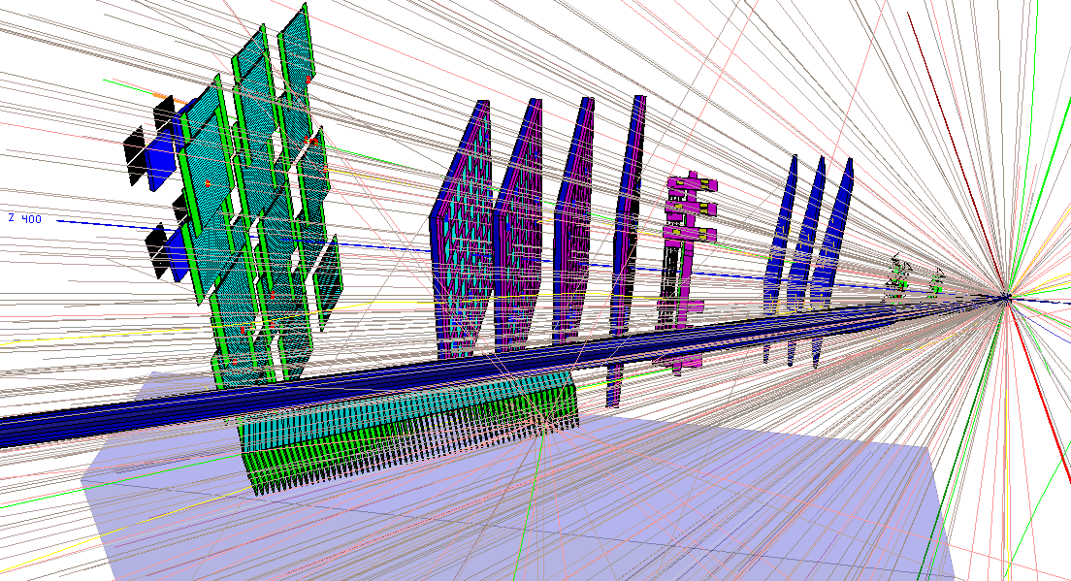
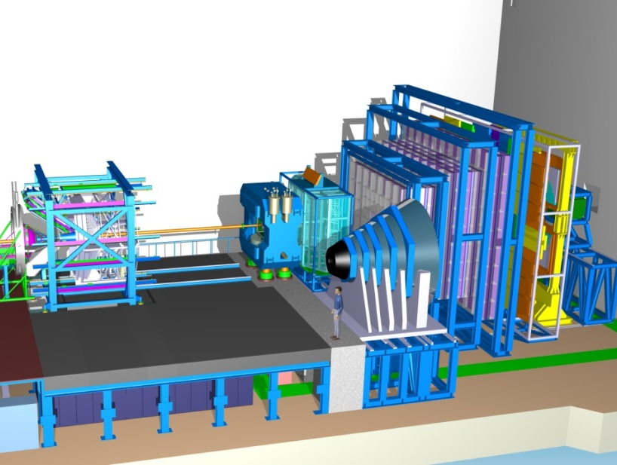
2018 - 2022
mCBM@SIS18
full system test-setup for high-rate A+A collisions
to test prototype detectors
to test front-end electronics (FEE)
to develop & test the data transport to DPB & FLIB (1st and 2nd FPGA)
to develop & test the data transport to FLES
to develop & test μ-slice + time-slice building
to test & develop data transport using a CRI
to develop & test a general timing + fast control system (TFC)
to develop & test the detector + experiment control system
to develop & test the online reconstruction + selection
to develop & test the software online framework
to develop & test the data analysis
2019
2020
+
CBM @SIS100
2024 -
Christian Sturm, GSI

Slide 2
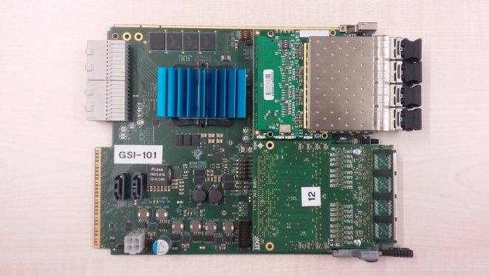
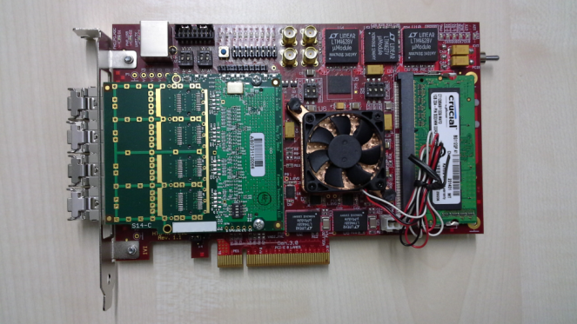
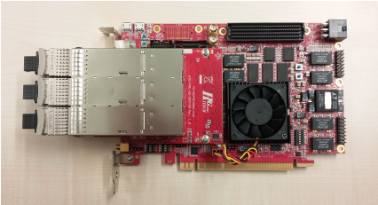
CBM DAQ upgrade (2019)
Pre-Processing
µS Tx
10 Gb Optical link
µS Rx
FLES PCI-E interface
DPB
FLIB
CRI-12
CRI = Common Readout Interface
Pre-Processing
FLES PCI-E interface
2 KINTEX-7 FPGA boards replaced by a ZYNQ Ultrascale+ FPGA board
Firmware functionality stays the same

Slide 3
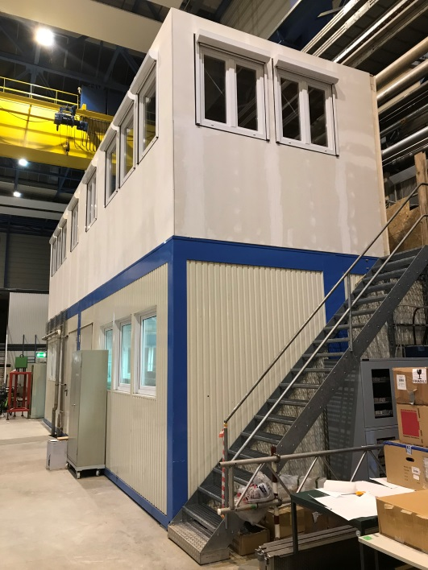
mCBM data taking 2019 & 2020
2018→ 2019 | development & commissioning data transport, data analysis, detector tests
2019→ 2020 | approaching full performance subsystems completed, high-rate data transport / processing → online reconstruction
requested beamtime
was fully granted
by GSI/FAIR G-PAC
new mCBM
control room
2018 – Q1 2019:
1st tests during engineering runs Nov./Dec. 2018
4x weeks mCBM (parasitc) beam: March 4 – March 31, 2019
beam: ¹⁰⁷Ag, 1.65 AGeV (top SIS18)
by G-PAC granted beam time for 2018 (→ 2019):
51 parasitic shifts → 41h / 28d ≈ 1 - 2h / d
fixed slots per day (i.e. 12:00 – 13:00 & 18:00 – 19:00)

Slide 4
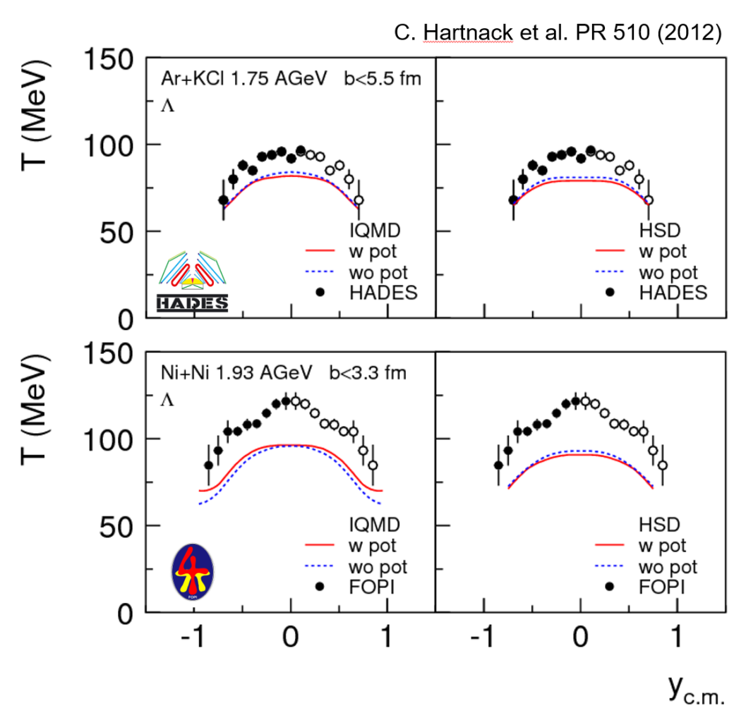
mCBM data taking 2021 & 2022
2020 → 2021 | 1st benchmark run Λ reconstruction production runs benchmark coll. systems: Ni+Ni 1.93AGeV & Au+Au 1.24AGeV
2021 → 2022 | 2nd benchmark run Λ reconstruction in Ni+Ni and Au+Au collisions at various projectile energies → Λ production excitation function
proposal to be submitted in 2019/20
Λ - slope parameter:
smaller than proton
not explained by transport models
reason unclear:
  rescattering cross section ?
  repulsive potential ?

Slide 5
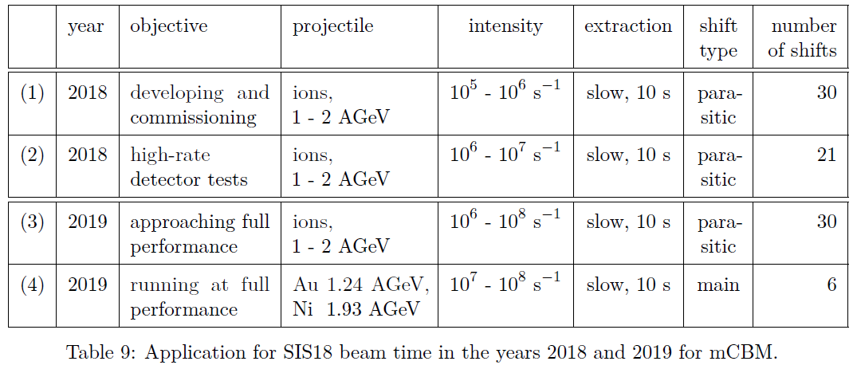
Granted mCBM beam time 2019 - 2020
“For this task, we apply (1) for 30 shifts of parasitic beam time, distributed over
four development weeks. At the end of that year’s block of SIS18 beam
we apply (2) for 21 shifts (one full week) of parasitic beam time to perform
high-rate detector tests.” mCBM@SIS18 proposal, submitted on June 19, 2017

Slide 6
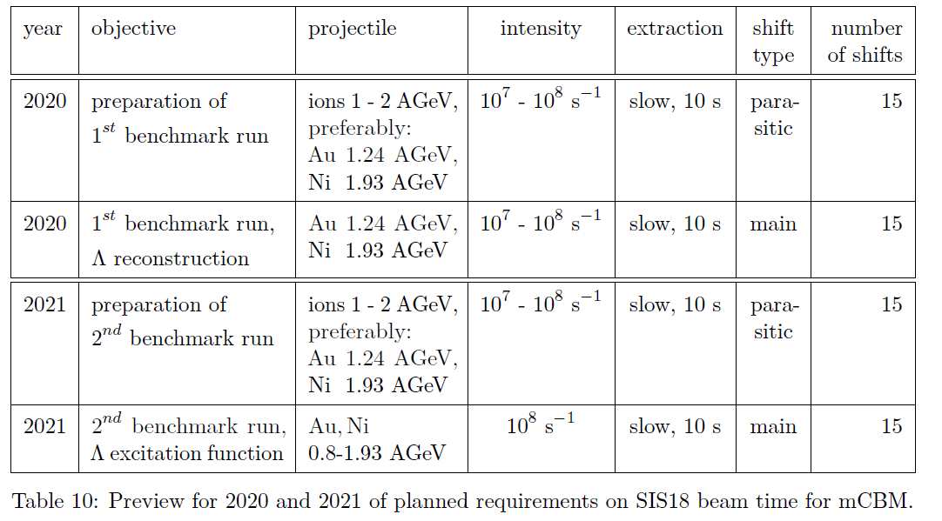
Announcement for beam time request 2020 - 2021

Slide 7
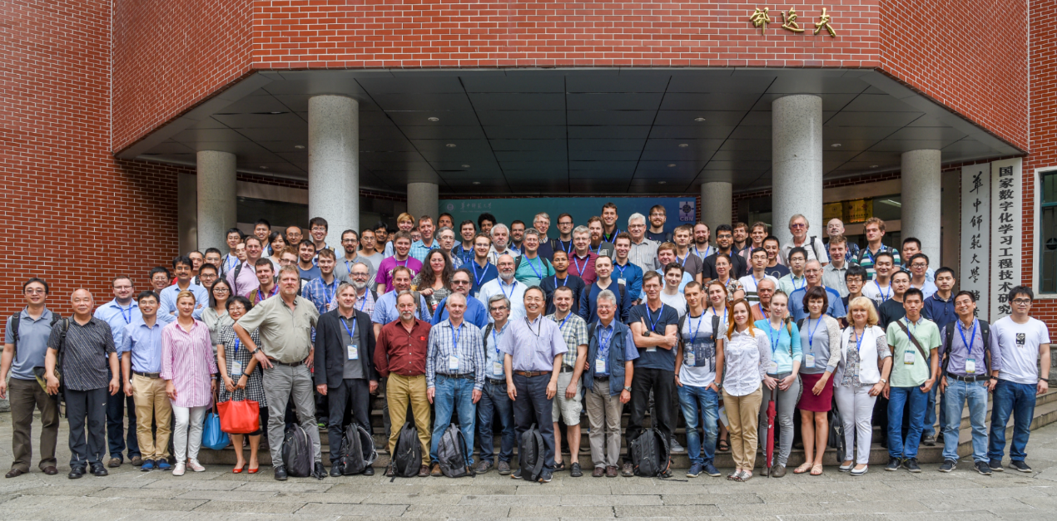
CBM Collaboration: 55 institutions, 470 members
China:
CCNU Wuhan
Tsinghua Univ.
USTC Hefei
CTGU Yichang
Chongqing Univ.
Czech Republic:
CAS, Rez
Techn. Univ. Prague
France:
IPHC Strasbourg
Germany:
Darmstadt TU
FAIR
Frankfurt Univ. IKF
Frankfurt Univ. FIAS Frankfurt Univ. ICS
GSI Darmstadt
Giessen Univ.
Heidelberg Univ. P.I.
Heidelberg Univ. ZITI
HZ Dresden-Rossendorf
KIT Karlsruhe
Münster Univ.
Tübingen Univ.
Wuppertal Univ.
ZIB Berlin
Russia:
IHEP Protvino
INR Troitzk
ITEP Moscow
Kurchatov Inst., Moscow
VBLHEP, JINR Dubna
LIT, JINR Dubna
MEPHI Moscow
PNPI Gatchina
SINP MSU, Moscow
Ukraine:
T. Shevchenko Univ. Kiev
Kiev Inst. Nucl. Research
India:
Aligarh Muslim Univ.
Bose Inst. Kolkata
Panjab Univ.
Univ. of Jammu
Univ. of Kashmir
Univ. of Calcutta
B.H. Univ. Varanasi
VECC Kolkata
IOP Bhubaneswar
IIT Kharagpur
IIT Indore
Gauhati Univ.
Korea:
Pusan Nat. Univ.
Poland:
AGH Krakow
Jag. Univ. Krakow
Warsaw Univ.
Warsaw TU
Romania:
NIPNE Bucharest
Univ. Bucharest
Hungary:
KFKI Budapest
Eötvös Univ.
30th CBM Collaboration meeting in Wuhan
24-28 September 2017
CBM Scientists

Slide 8
Backup
mCBM

Slide 9
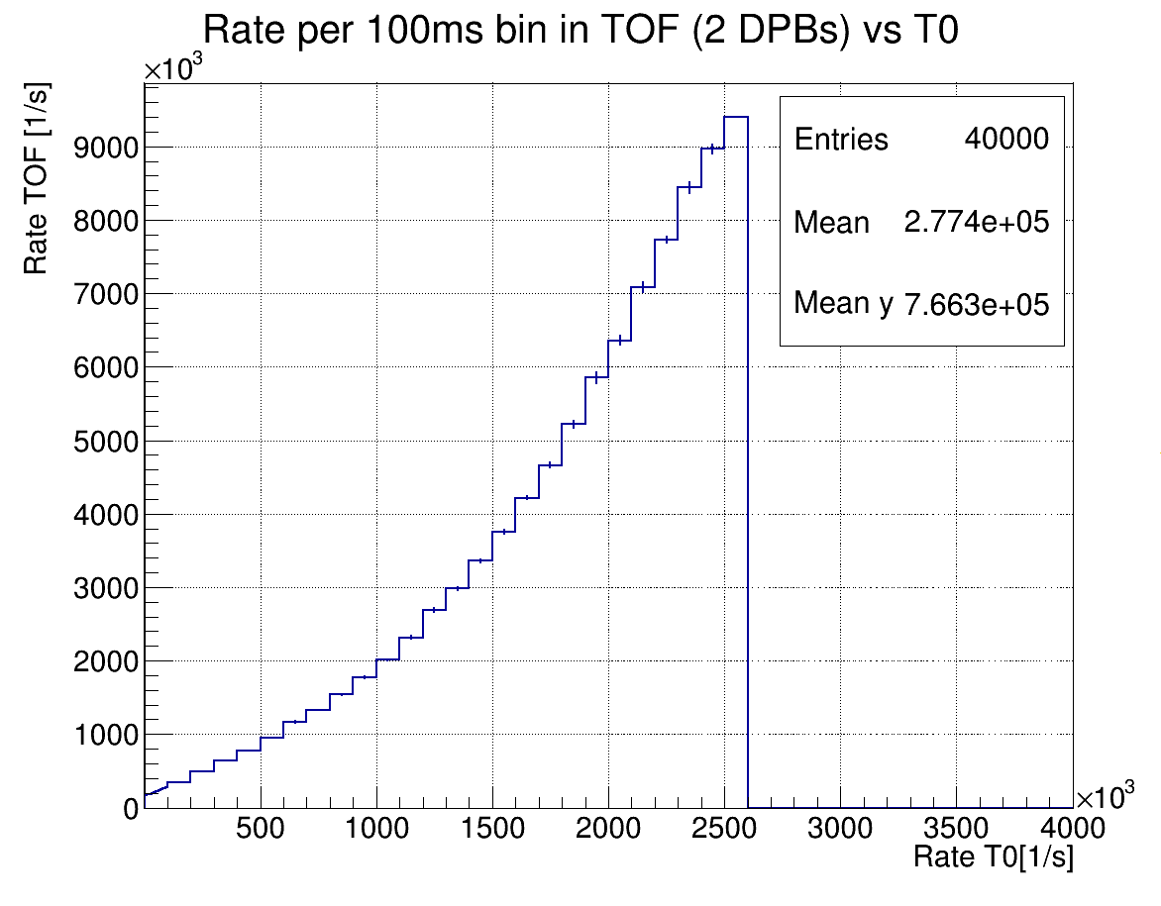
To Do for 1st mCBM commissioning beam time, March 2019
hit rates
not fully understood,
T0 saturation ?
furthermore:
reconstruction of events, 4D data analysis
complete mSTS detector station-0, exchange mMUCH electronics parts
commissioning of new mCBM control room
prepare installation of mRICH and mPSD modules

Slide 10
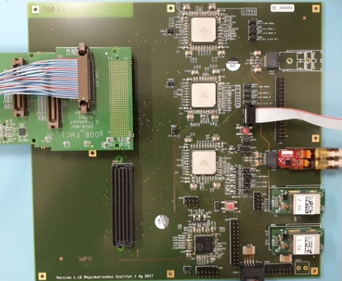
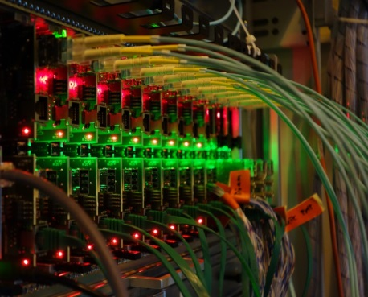
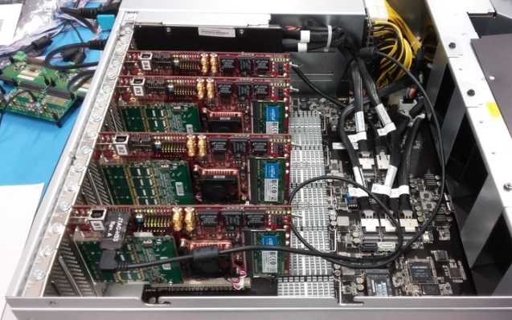
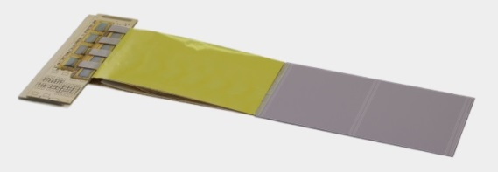
Present read-out chain of mSTS
STS modules
8 STS-XYTER v2.0 on FEB-8
Common
GBTx
Readout Board
μTCA crate
with AFCK
boards
FLES input node
with FLIB
boards
copper link
optical link
optical link
HTD cave, on detector
DAQ container
Green Cube

Slide 11
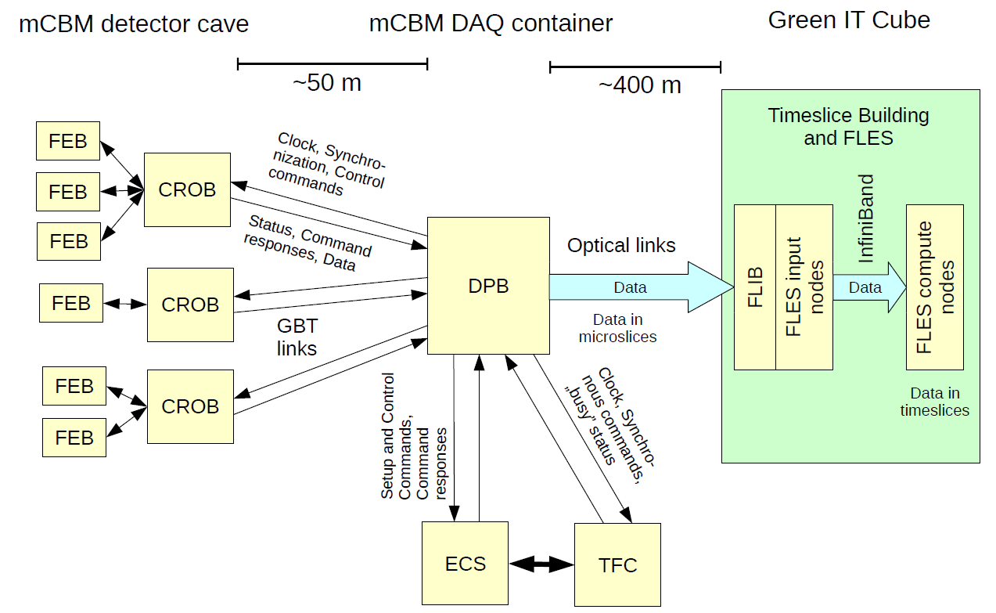
mCBM read-out and data transport
Start version

Slide 12
mDAQ and mFLES 2018 (start version)
present design
1
6
2
3
4
5
 |  | Device | Function | Location
1 | 70x | GBTx | data concentrator | Cave, on detector
2 | 12x | AFCK | 1st layer FPGA board | DAQ container
3 | 96x | Optical fibers | Data transport | DAQ → Green IT Cube
4 | 4x | FLIB | 2nd layer FPGA board | Green IT Cube
5 | 2x | mFLES input node | Input stage | Green IT Cube
6 | 42x | mFLES compute nodes | Processing stage | Green IT Cube

Slide 13
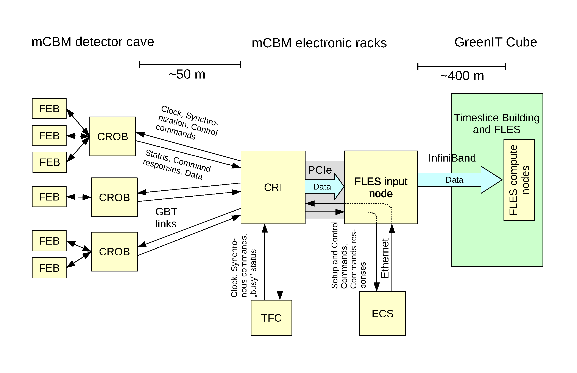
mCBM read-out, data transport and processing
Final version

Slide 14
mDAQ and mFLES 2019 (SIS100 version)
present design
1
2
3
4
5
 |  | Device | Function | Location
1 | 70x | GBTx | data concentrator | Cave, on detector
2 | 6x | CRI | FPGA board (1x layer only) | DAQ container
3 | 2x | mFLES input node | Input stage | DAQ container
4 | 96x | Optical fibers | Data transport | DAQ → Green IT Cube
5 | 42x | mFLES compute nodes | Processing stage | Green IT Cube

Slide 15
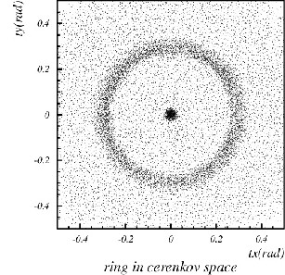
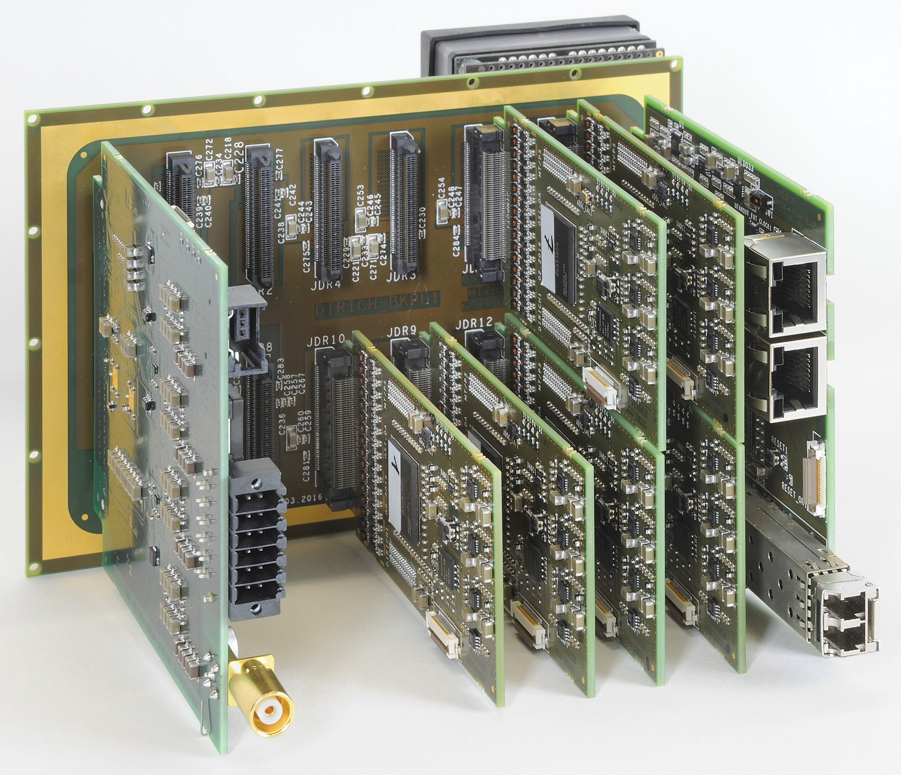
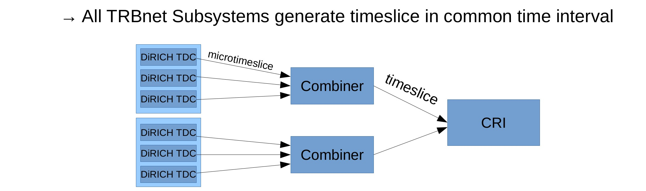
mRICH
Aerogel radiator (few cm thick)
New proposal by the RICH group:
Aerogel proximity focusing RICH
to be installed for phase II / 2019,
≈ 0.5m² acceptance,
need 50 – 70 cm space behind mTOF
open issues:
read-out
DiRICH & TRBnet to be included
into the mCBM DAQ
→ synergy with mPSD
detector integration
integration into mCBM
d
3x2 MAPMT
module(s)

Slide 16
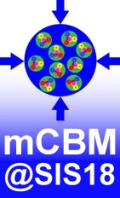
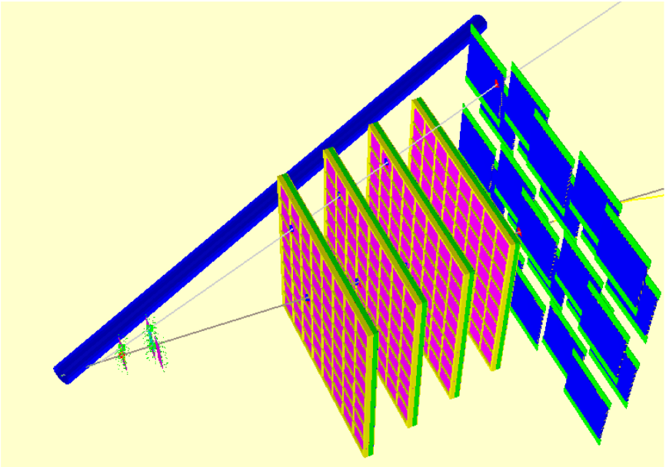



mCBM benchmark observable: Λ reconstruction
Λ→pπ⁻
Feasibility study using mSTS & mTOF (3x stations):
straight track candidates mTOF → mSTS (hit station-0, hit station-1) assuming primary vertex on (0,0,0)
proton and pion candidate by selection on transverse distance to primary vertex
momenta from time-of-flight assuming proton and pion mass → p, M_{inv}
$$π^{−}$$
$$p$$
$$Λ→p+ π^{−}$$

Slide 17
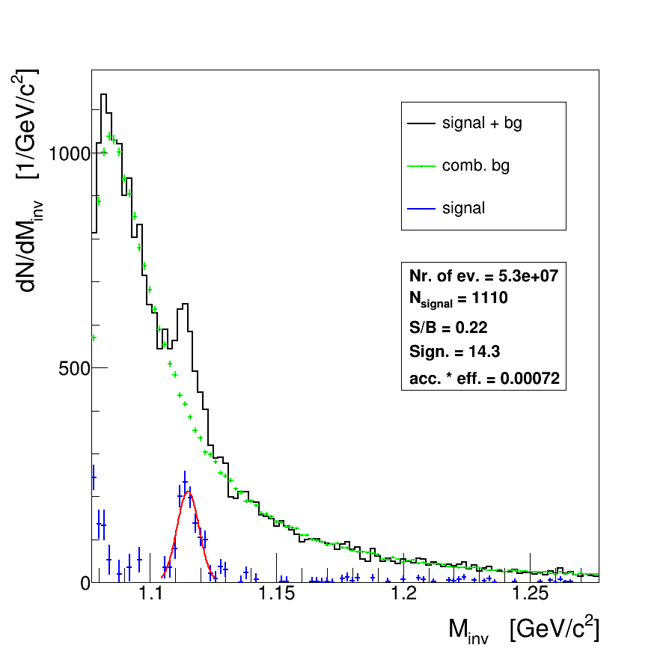
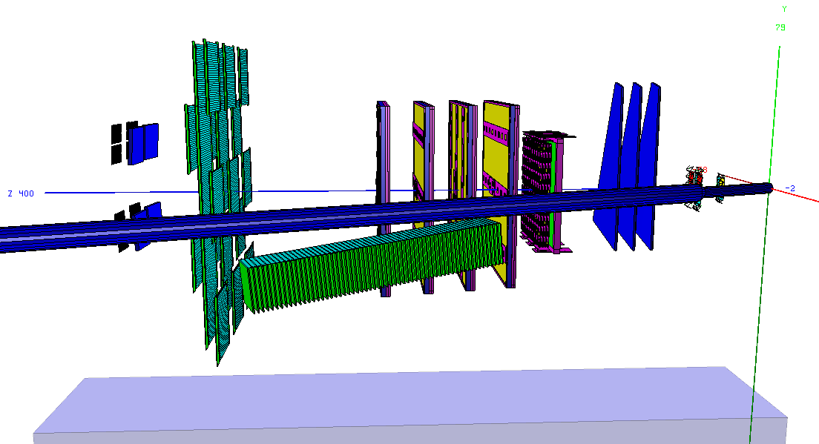

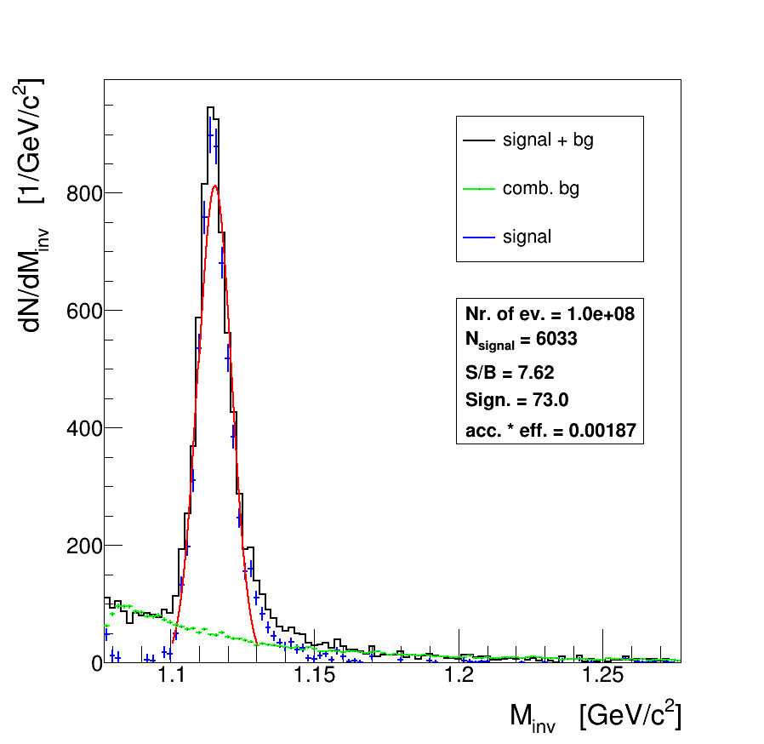
Next steps - simulations
Au+Au 1.24 AGeV
ROOT geometry:
sis18_mcbm_20deg_long
go back to 25° ?
→ sis18_mcbm_25deg_long
re-run Au+Au & Ni+Ni simulations
reproduce results of the feasibility study
for Λ reconstruction (proposal) with
“standard” CBM tools
Ni+Ni
1.93 AGeV

Slide 18
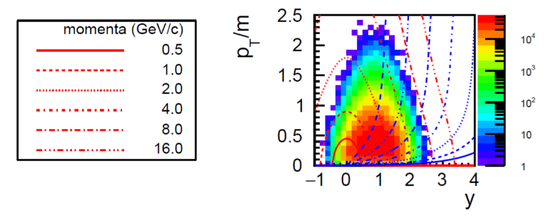
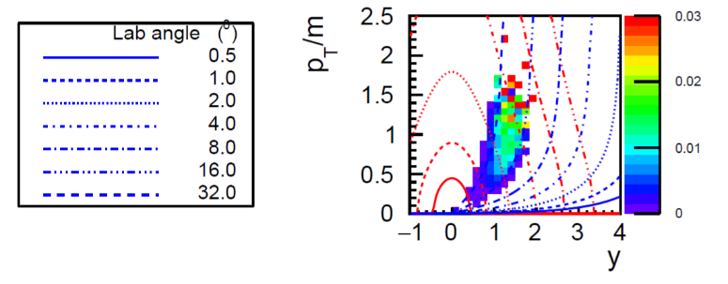
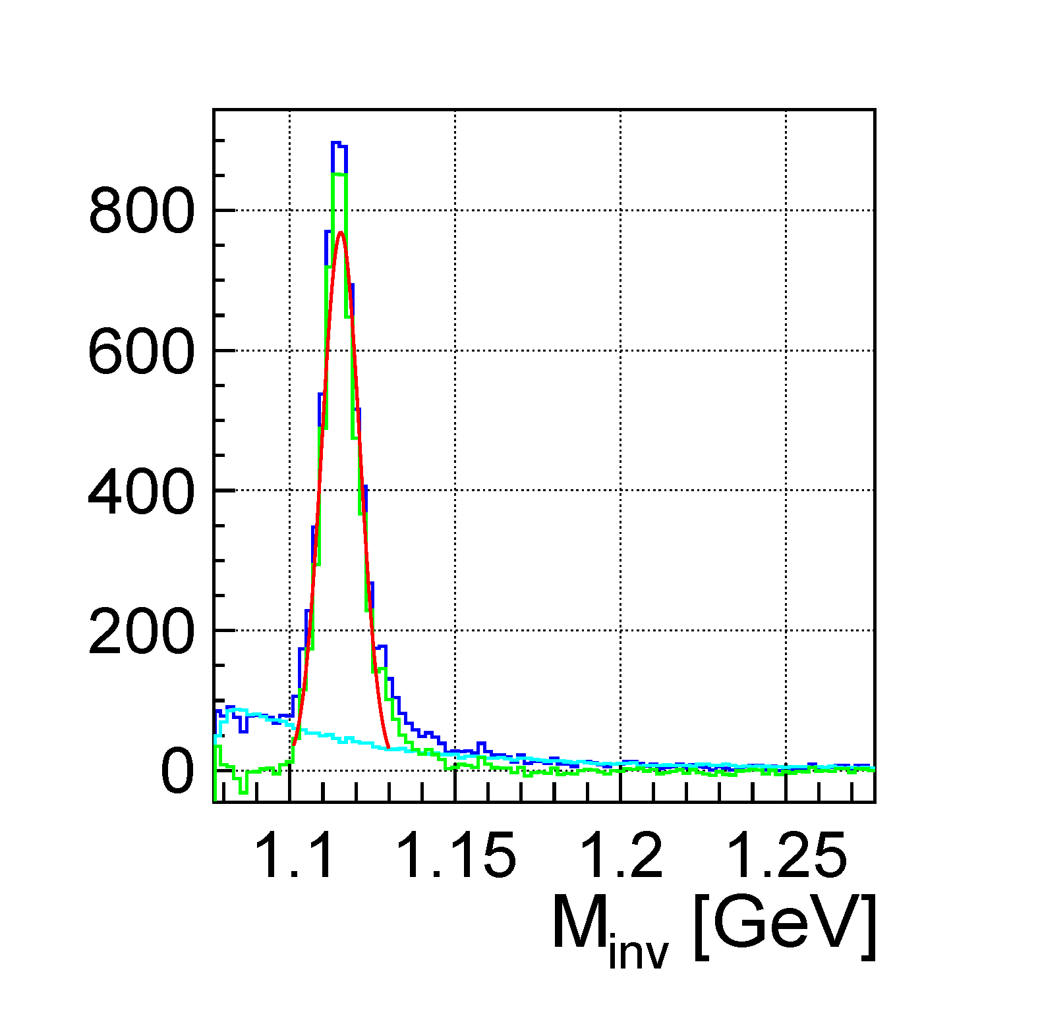
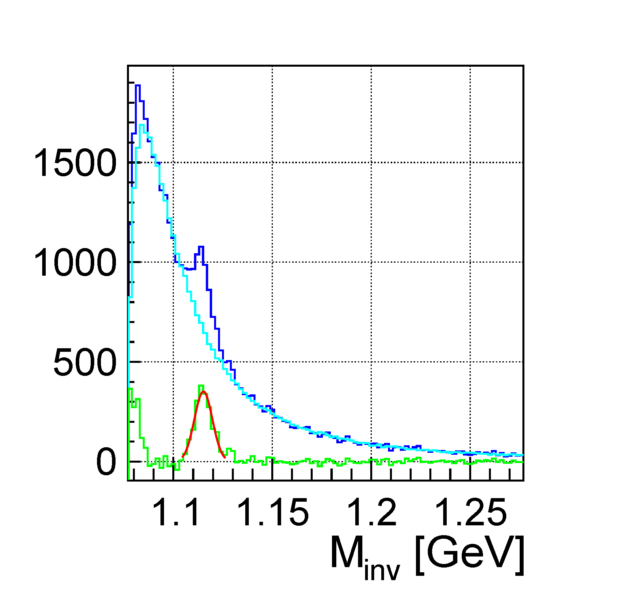




mCBM benchmark observable: Λ reconstruction
Simulation input: 10⁸ UrQMD events, min. bias
Acceptance
Efficiency
Ni+Ni 1.93AGeV
Au+Au 1.24AGeV
S/B = 8.4
S/B = 0.24
$$π^{−}$$
$$p$$
$$Λ→p+ π^{−}$$

Slide 19


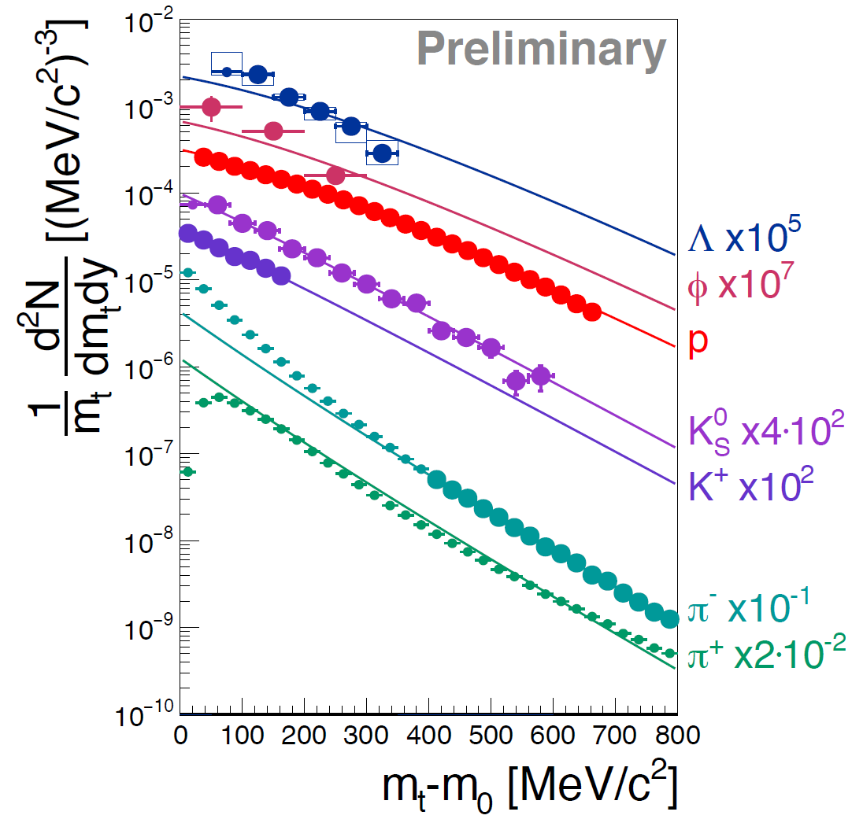
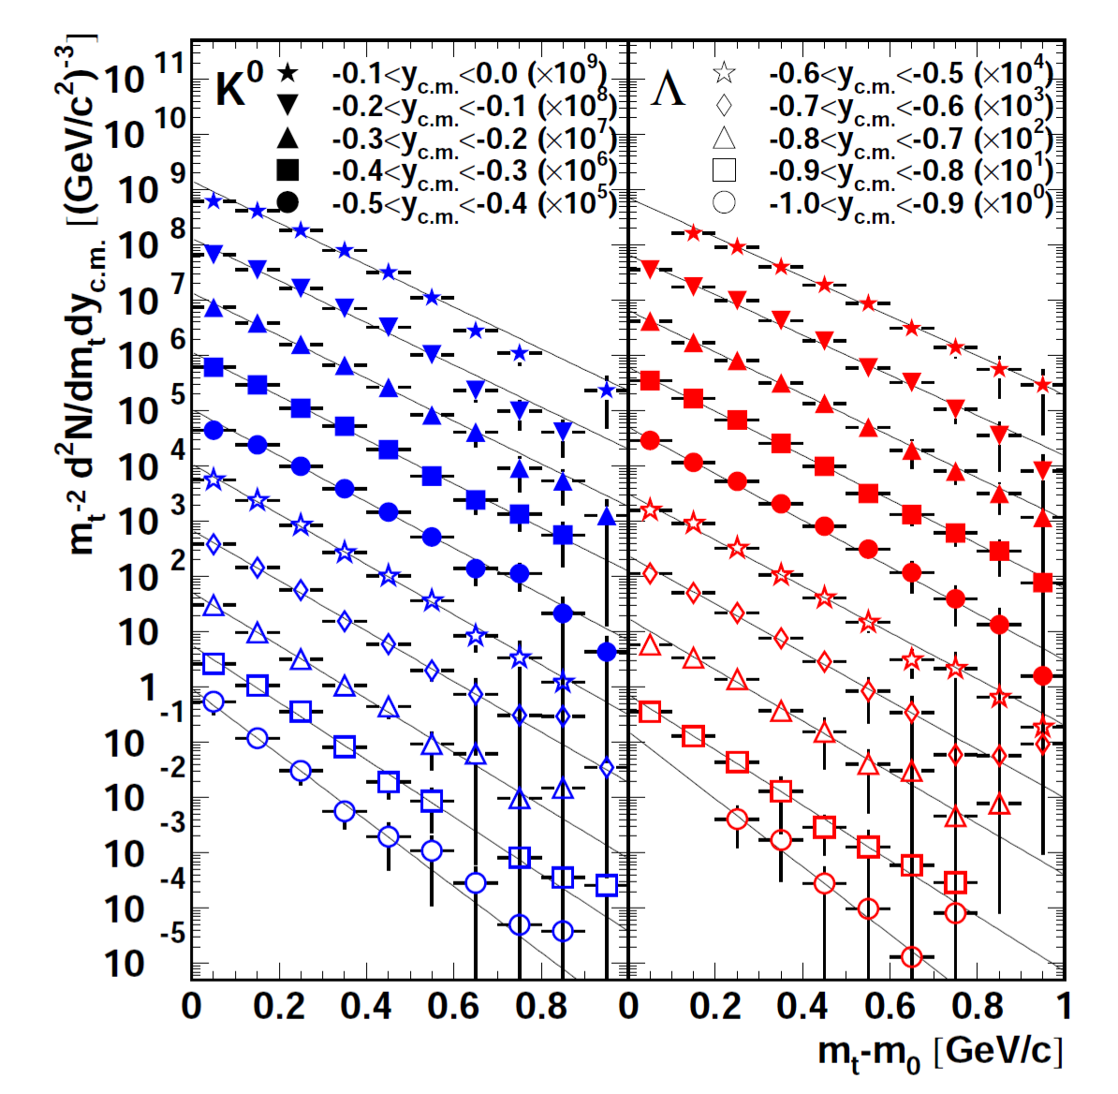
Λ production at SIS18 energies – mCBM reference data
Ni + Ni 1.93 AGeV
Au + Au 1.23 AGeV
M. Merschmeyer et al. (FOPI), PRC 76, 024906 (2007)
H. Schuldes et al. (HADES)
EPJ Web of Conferences 171, 01001 (2018), SQM2017
midrapidity

Slide 20

Physics of the benchmark observable
Data:
HADES : Eur. Phys. J. A (2011) 47
FOPI : PRC 76, 024906 (2007)
IQMD transport calculation:
C.Hartnack et al., PR 510 (2012)
Λ - slope parameter:
smaller than proton
not explained by transport models
reason unclear:
  rescattering cross section ?
  repulsive potential ?

Slide 21
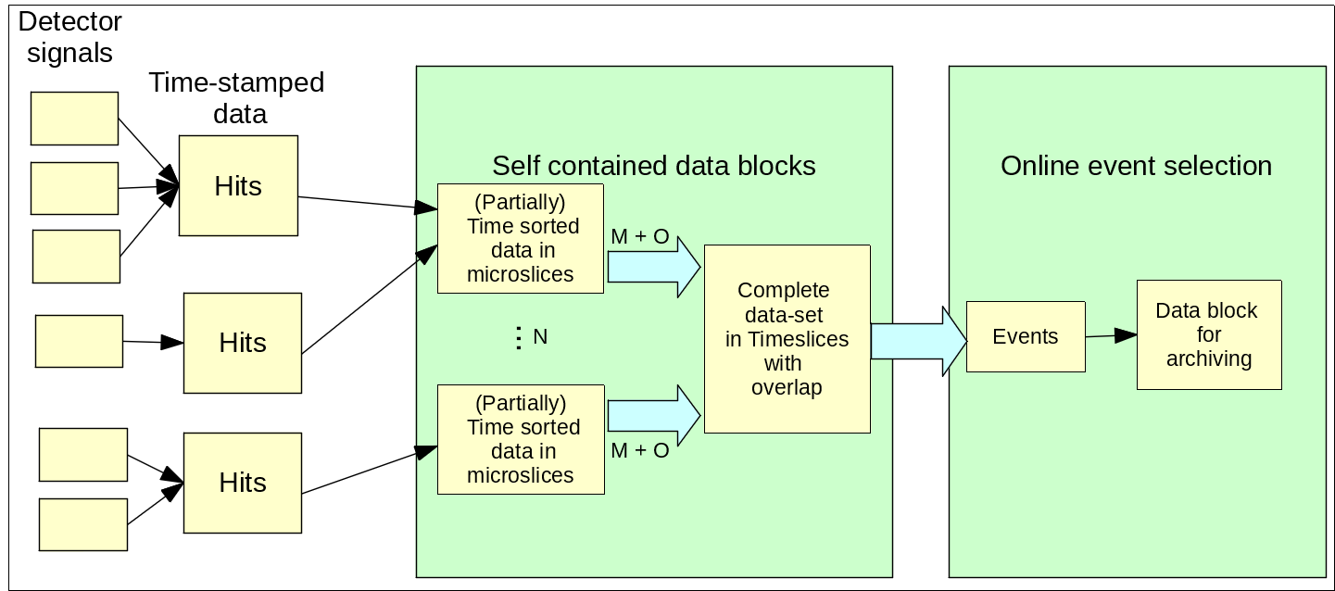
CBM data types - up to event selection
Computing farm
FLES Input
DPB
FEE
N = Detector systems & “sectors” within
M = Number of microslices per timeslice
O = Number of overlap microslices needed to avoid edge losses in reconstruction
Typical size: microslices ~ 10-1000 µs, timeslices ~ 0.1-10 ms

