Slide 1
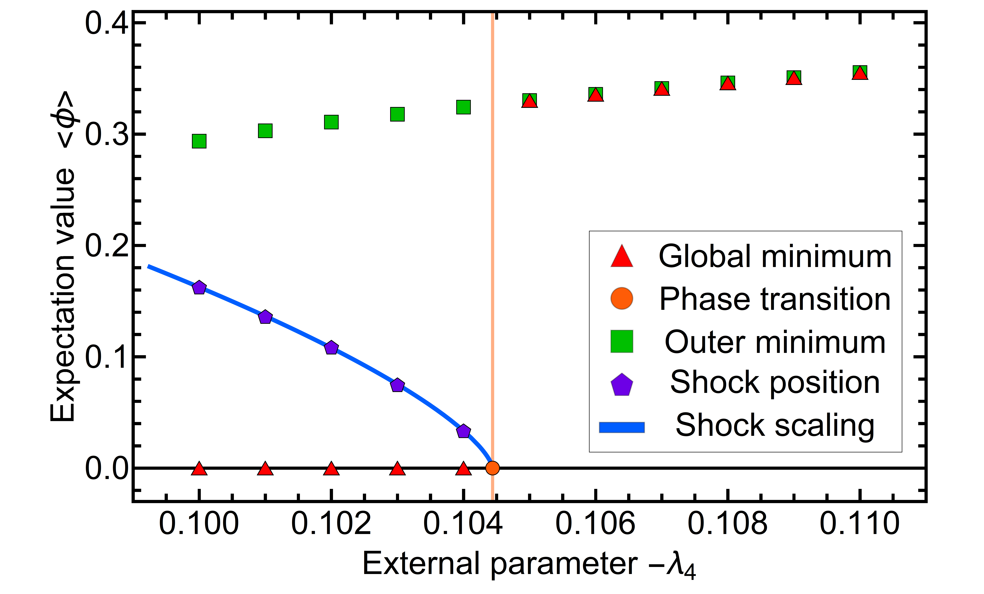
Resolving phase transitions with Discontinuous Galerkin methods
Functional Methods in Strongly Correlated Systems
Nicolas Wink
Work in collaboration with:
Eduardo Grossi
Jan M. Pawlowski
Grossi, NW, arxiv:1903.09503
Grossi, Pawlowski NW, in prep.

Slide 2
PDEs
Partial differential equations
For simplicity:
scalar with one spatial dimension
Partial differential equations of interest:
Conservation term (Goldstone modes)
Diffusion term (Radial mode)
Source term (Fermions)
A lot of physical systems are described (partially) by this class of equations:
Maxwell equations
General relativity + Magneto Hydro
Navier–Stokes equations
Functional renormalization Group equations
Discontinuous Galerkin methods are designed precisely designed for this set of equations

Slide 3
PDEs
Conservation laws
Consider only the scalar conservation law
Given numerical approximations
and
Several options how the residual should vanish
On each node of the mesh:
Residual orthogonal to all test functions in some space:
Finite difference methods
Finite volume methods
….
Finite element methods
Spectral methods
…

Slide 4
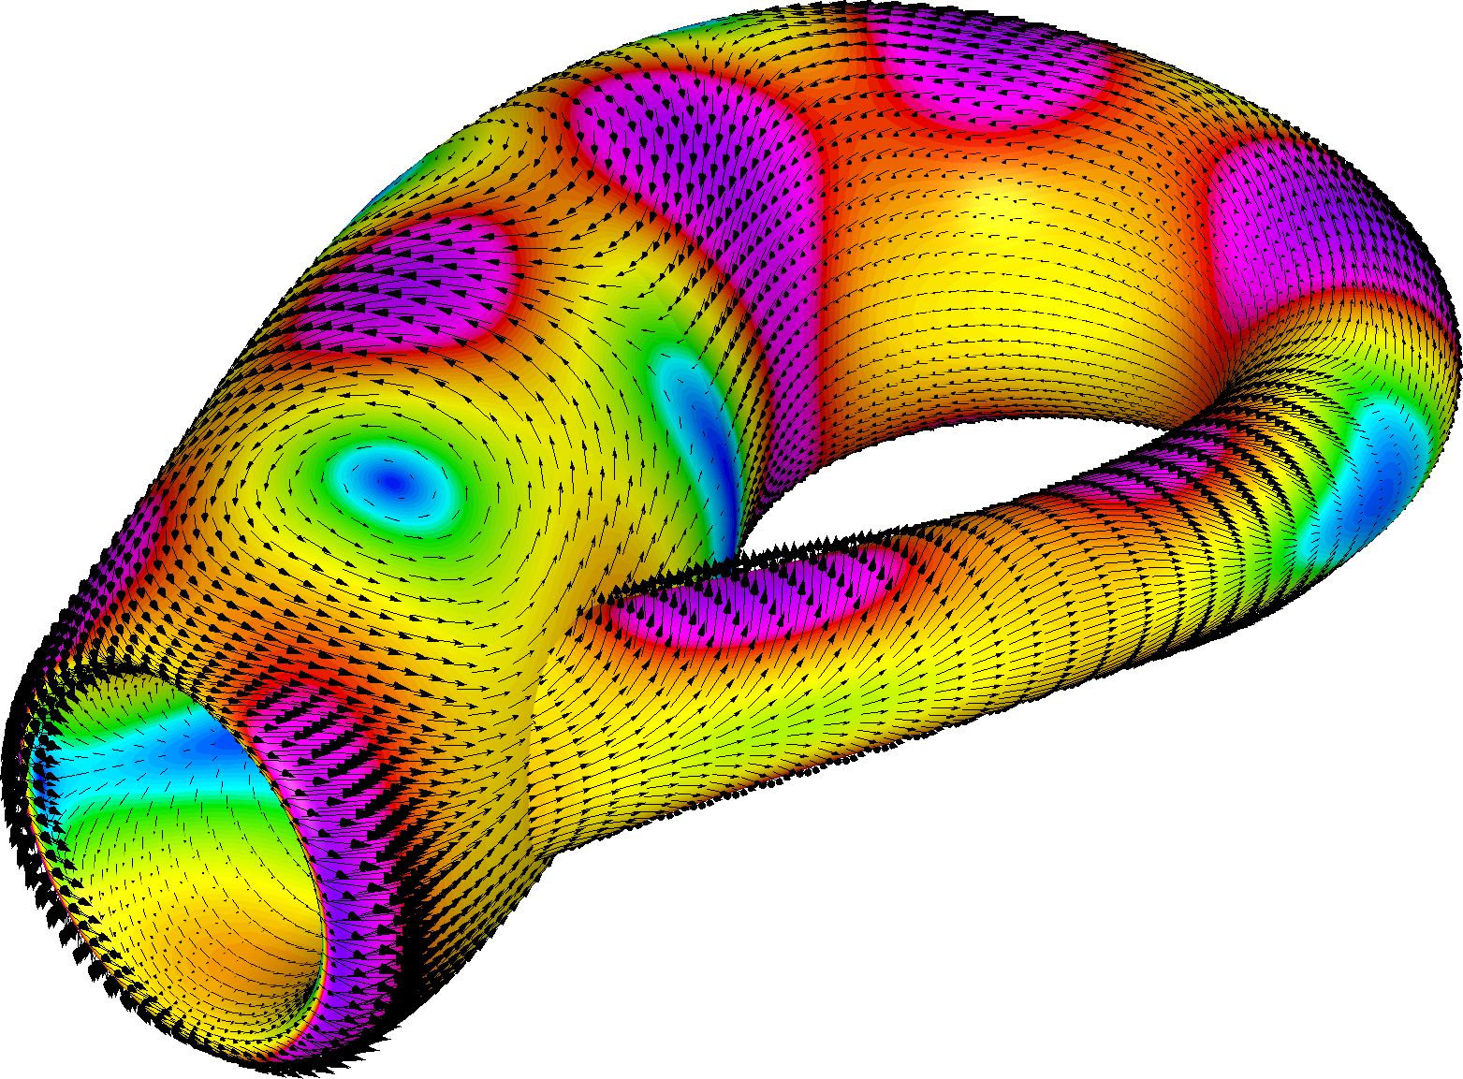
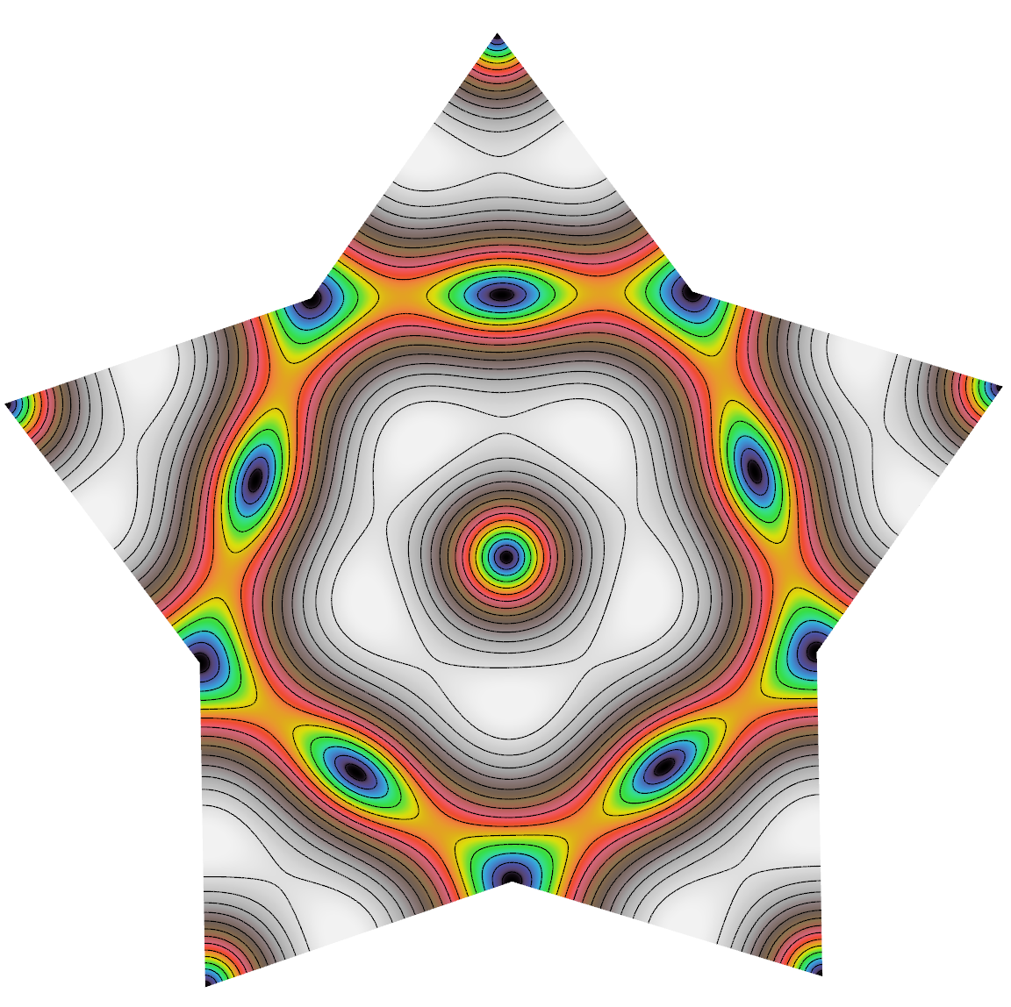
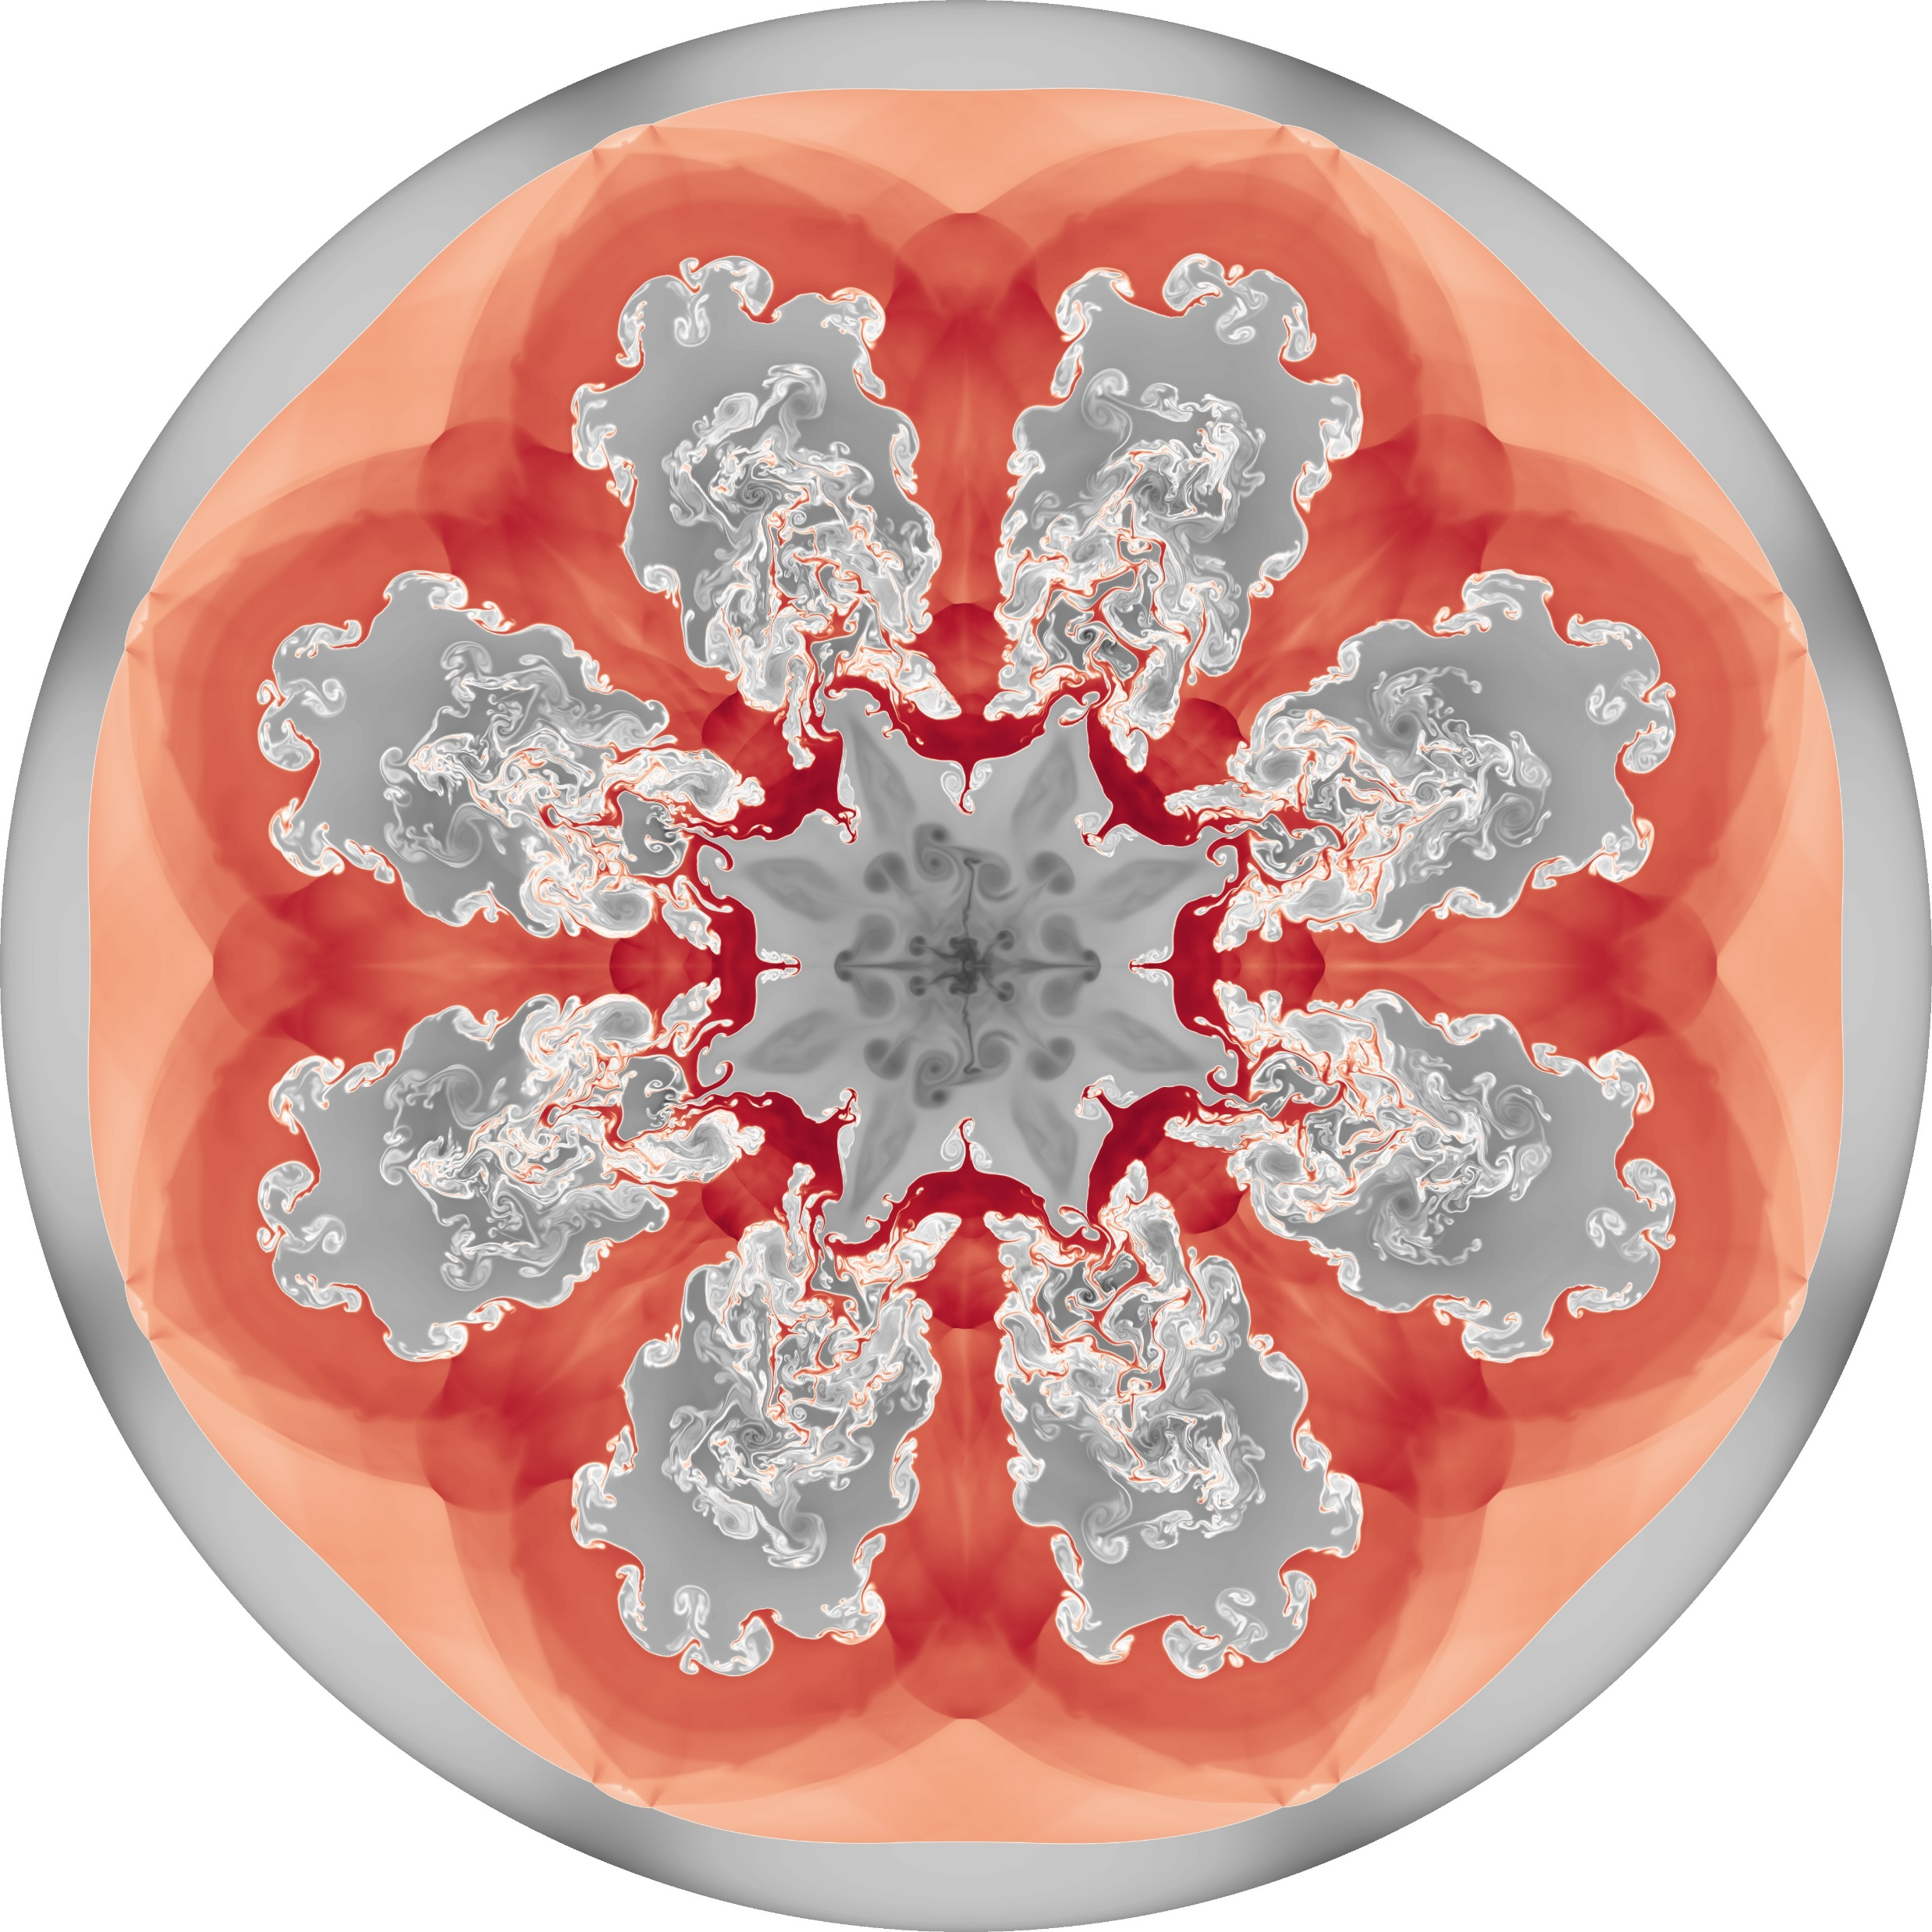
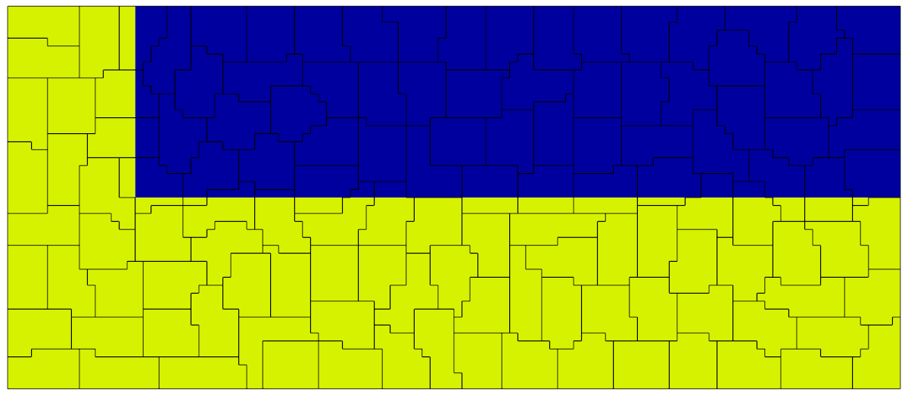
Copyright: https://mfem.org/img/gallery/ex3-klein-1-full.png
Copyright: https://mfem.org/img/gallery/maxwell-snowflake-full.png
Discontinuous Galerkin methods
Copyright: https://mfem.org/img/gallery/hres_icfcyl_4096_5-full.jpg
Copyright: https://glvis.org/img/gallery/triple-pt-np128.gif

Slide 5
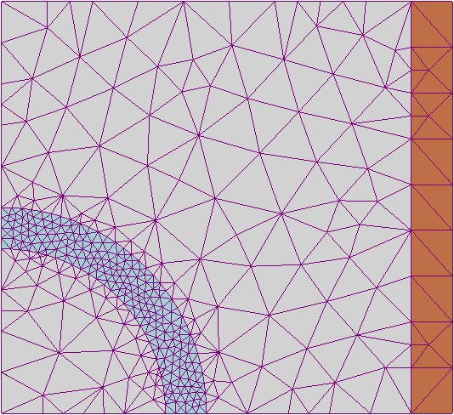
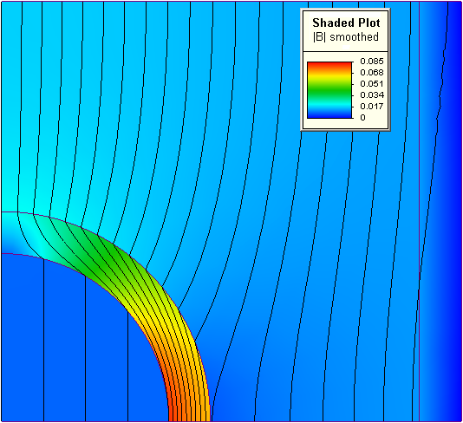
DG
The basic idea
The method combines two basic ideas:
Finite volume methods
Finite element methods
Residue vanishes for cell averages
Local & geometric flexible
Inherently discontinuous
Higher order accuracy problematic
Residue vanishes in a weak sense
High order accuracy & geometric flexible
Usually continuous
Method is “global” (one giant matrix)
Take the best from both
Discontinuous Galerkin methods
Slightly more technical: An extension of finite element methods that reduces to finite volume schemes at lowest order
Copyright: https://en.wikipedia.org/wiki/Finite_element_method
Copyright: https://en.wikipedia.org/wiki/Finite_element_method

Slide 6
DG
Local approximation
Approximate solution over computational domain
Copyright: https://en.wikipedia.org/wiki/Finite_element_method
Expand the solution in each element in a local polynomial basis of degree N
Good choice (obviously) important
Legendre polynomials
Spectral convergence
Gauss-Lobatto points
Ensures well conditioning while switching between bases
Modal expansion
Nodal expansion
Modes
Nodes
(Orthogonal) polynomial basis
Associated Lagrange polynomial
Hesthaven, Warburton, Nodal Discontinuous Galerkin Methods (2008)

Slide 7
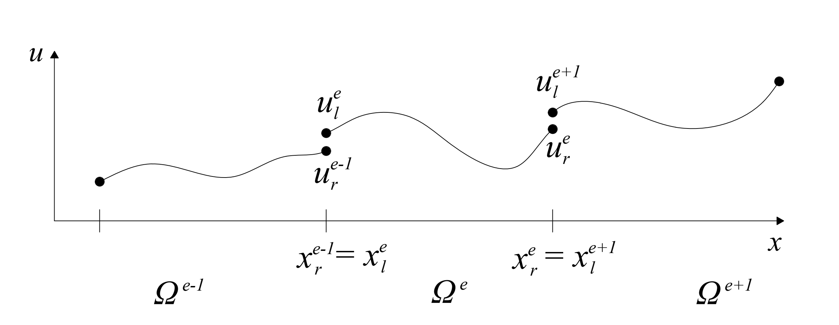
DG
Weak formulation
Discontinuous elements: More degrees of freedom than equations!
Partial integration
Weak form
Copyright: https://en.wikipedia.org/wiki/Finite_element_method
Numerical flux
Connects elements (closes set of equations)
Paredes, PhD thesis (2016)
Hesthaven, Warburton, Nodal Discontinuous Galerkin Methods (2008)

Slide 8
DG
Numerical flux
Numerical flux
Strong form
Restricted by rather general conditions (consistency, …)
Defines how to treat a jump discontinuity between elements
Acts physically like a tiny dissipation
A variety of choices available
Copyright: https://en.wikipedia.org/wiki/Finite_element_method
Constant related to the propagation speed of information
Lax-Friedrichs flux
Usually an efficient, accurate and robust choice
Average
Difference
Hesthaven, Warburton, Nodal Discontinuous Galerkin Methods (2008)

Slide 9
Functional Renormalization Group

Slide 10
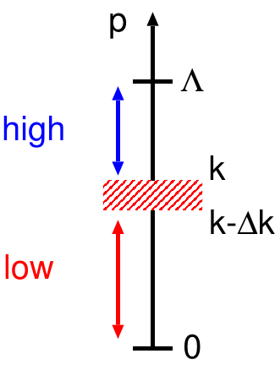
FRG
Functional Renormalization Group
Non-perturbative first principle method
Systematically integrate out momentum shells
Access to physical mechanisms
No sign problem
Chemical potential
Real time
Wetterich equation:
RG-time:
Momentum scale
Integrating theory from to includes all quantum effects
Reference scale (set to 1 here)

Slide 11
O(N) - Model

Slide 12
O(N)
Relevant in many physical settings:
(Pseudo)-scalar sector in QCD
Higgs potential
Condensed matter
…
O(N) - Model
N-component scalar theory with classical action:
Invariant:
Finite field expectation value signals spontaneously broken symmetry
Lowest order approximation in a derivative expansion, LPA:
Flow equation
Rescale with (N-1)

Slide 13
O(N)
Connecting to DG
Flow equation for the effective potential:
Introduce new variable for the derivative:
Not ideally suited for numerical applications
RHS now defines a flux:
Standard conservative form
Initial & Boundary conditions:
We require a solution on
Boundary conditions required for inflow boundary conditions
Allows for access to first & second order phase transitions
Boundary condition at large field values required, but naturally suppressed for physical potentials
Together with
and
Grossi, NW, arxiv:1903.09503

Slide 14
Second order phase transition

Slide 15
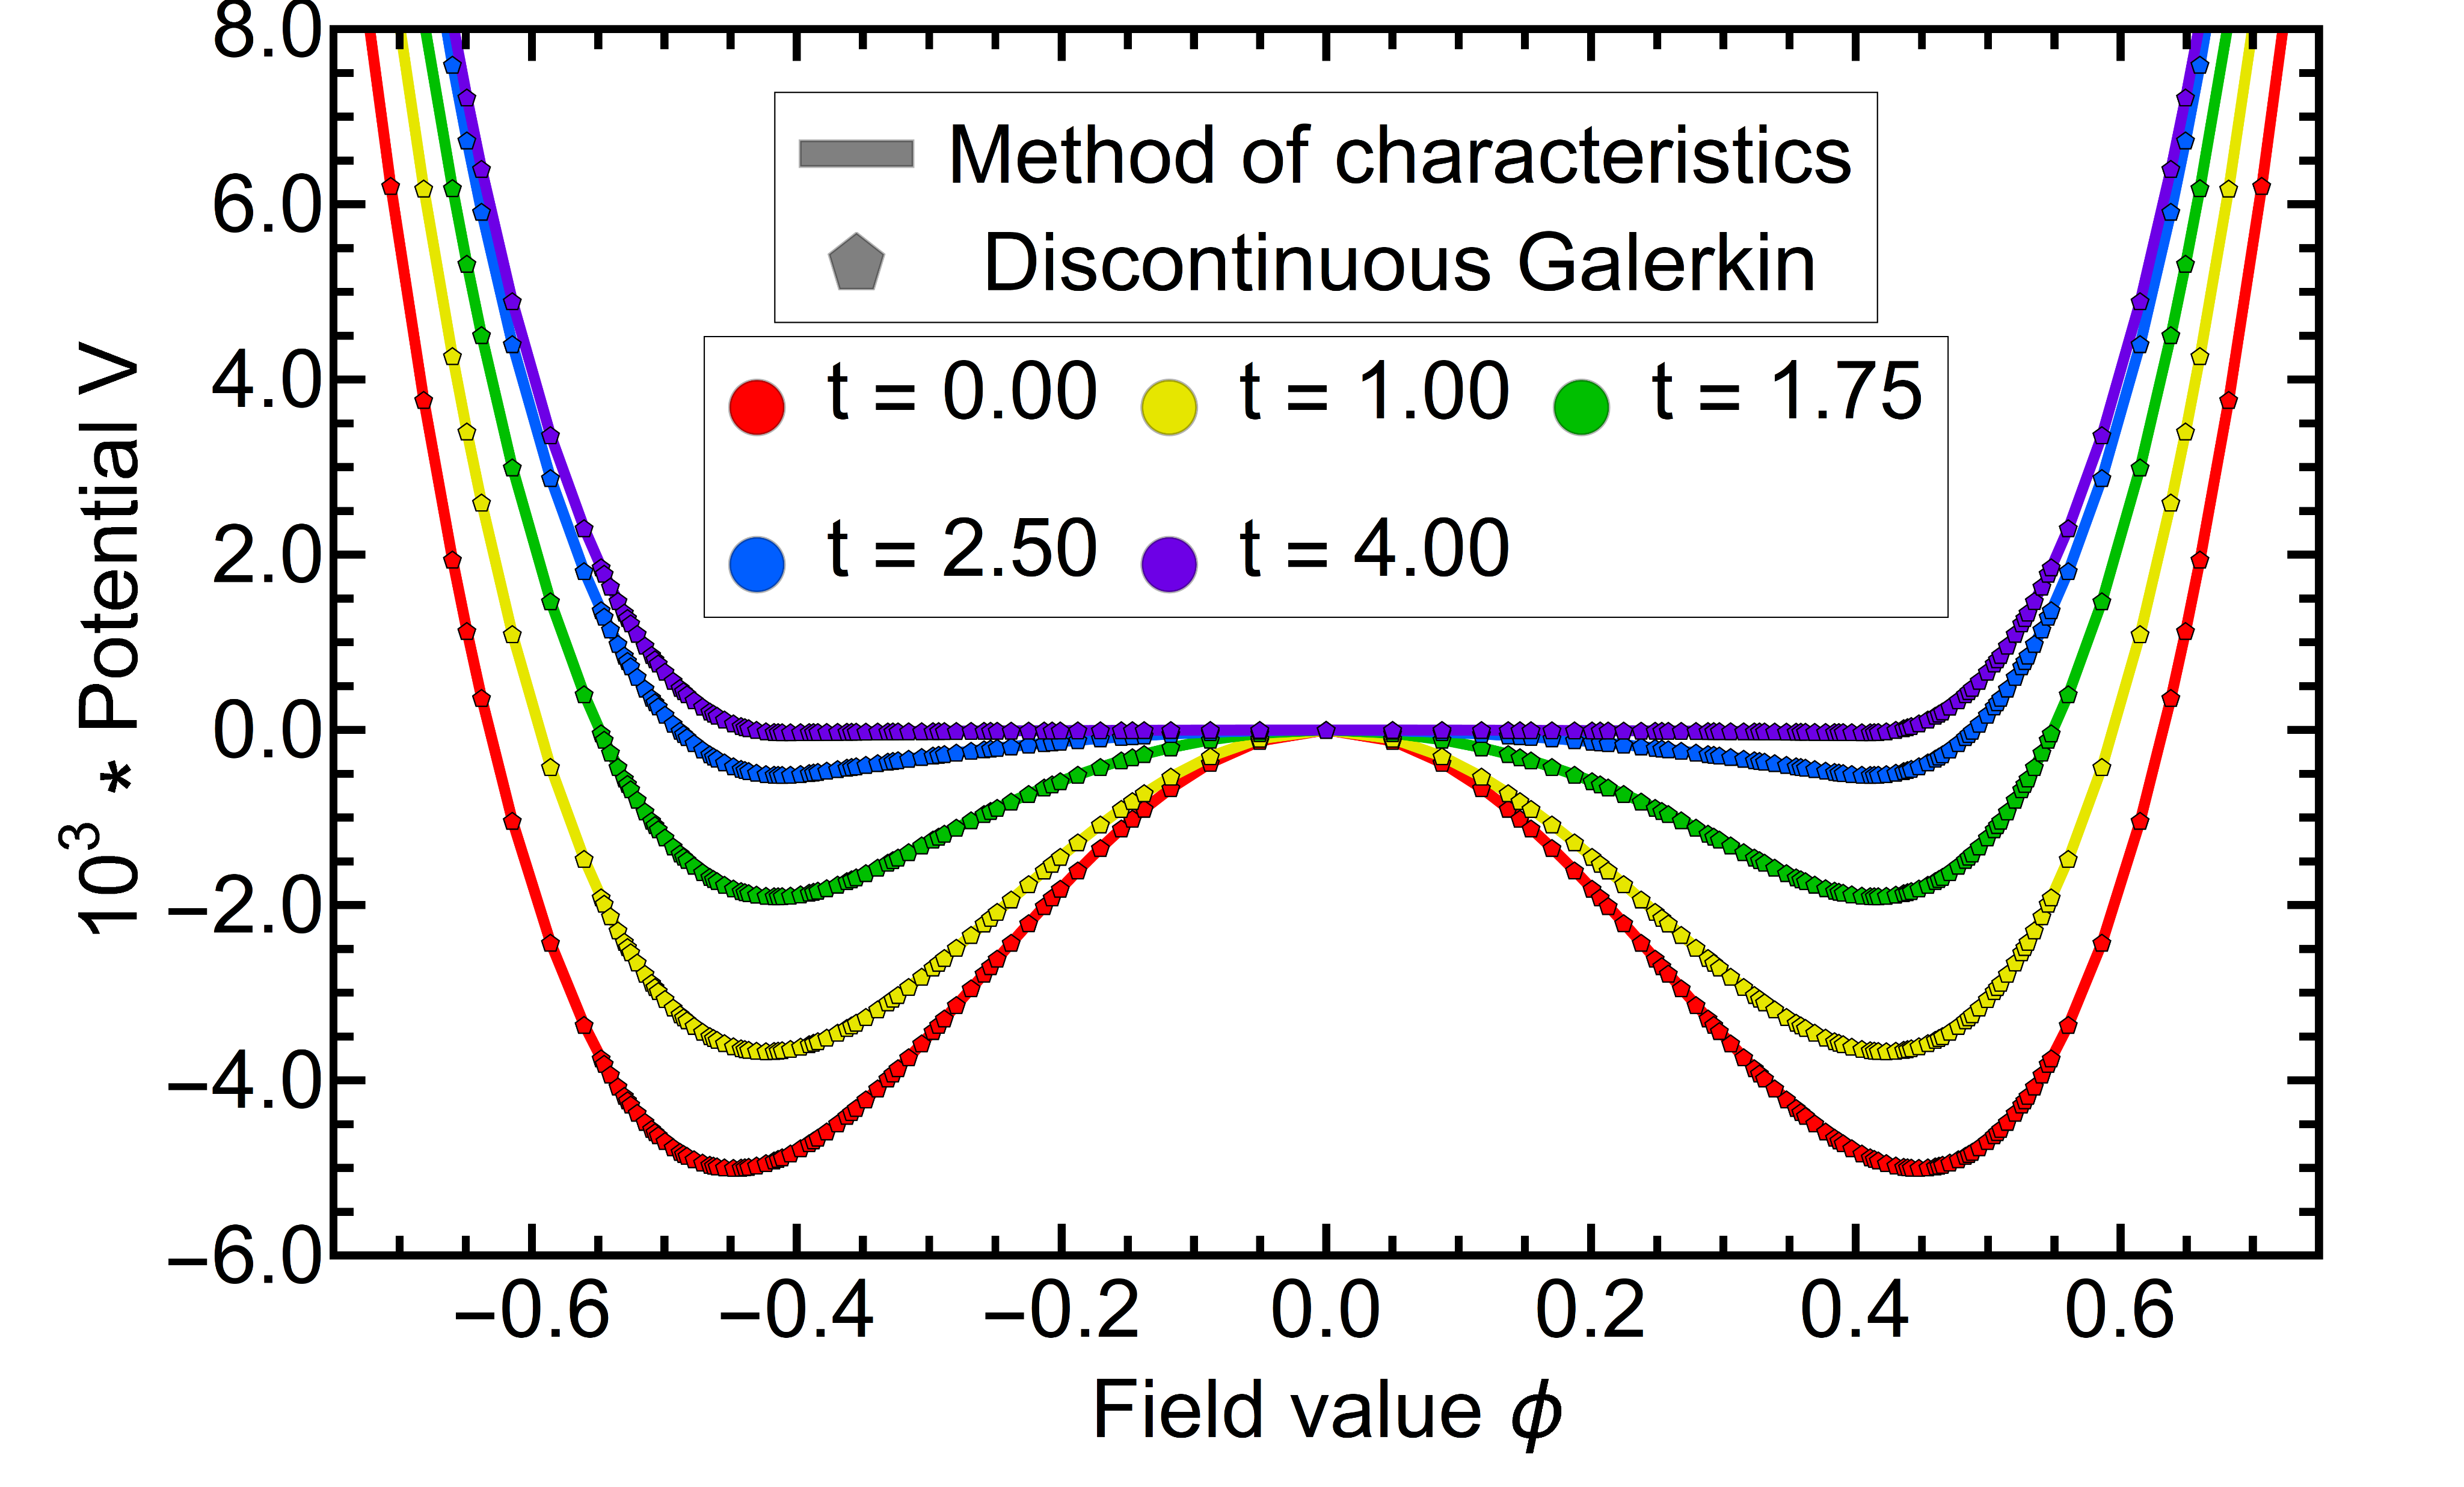
2nd-order
Potential
Initial condition:
Calculated with N=5, K=30
Grossi, NW, arxiv:1903.09503

Slide 16
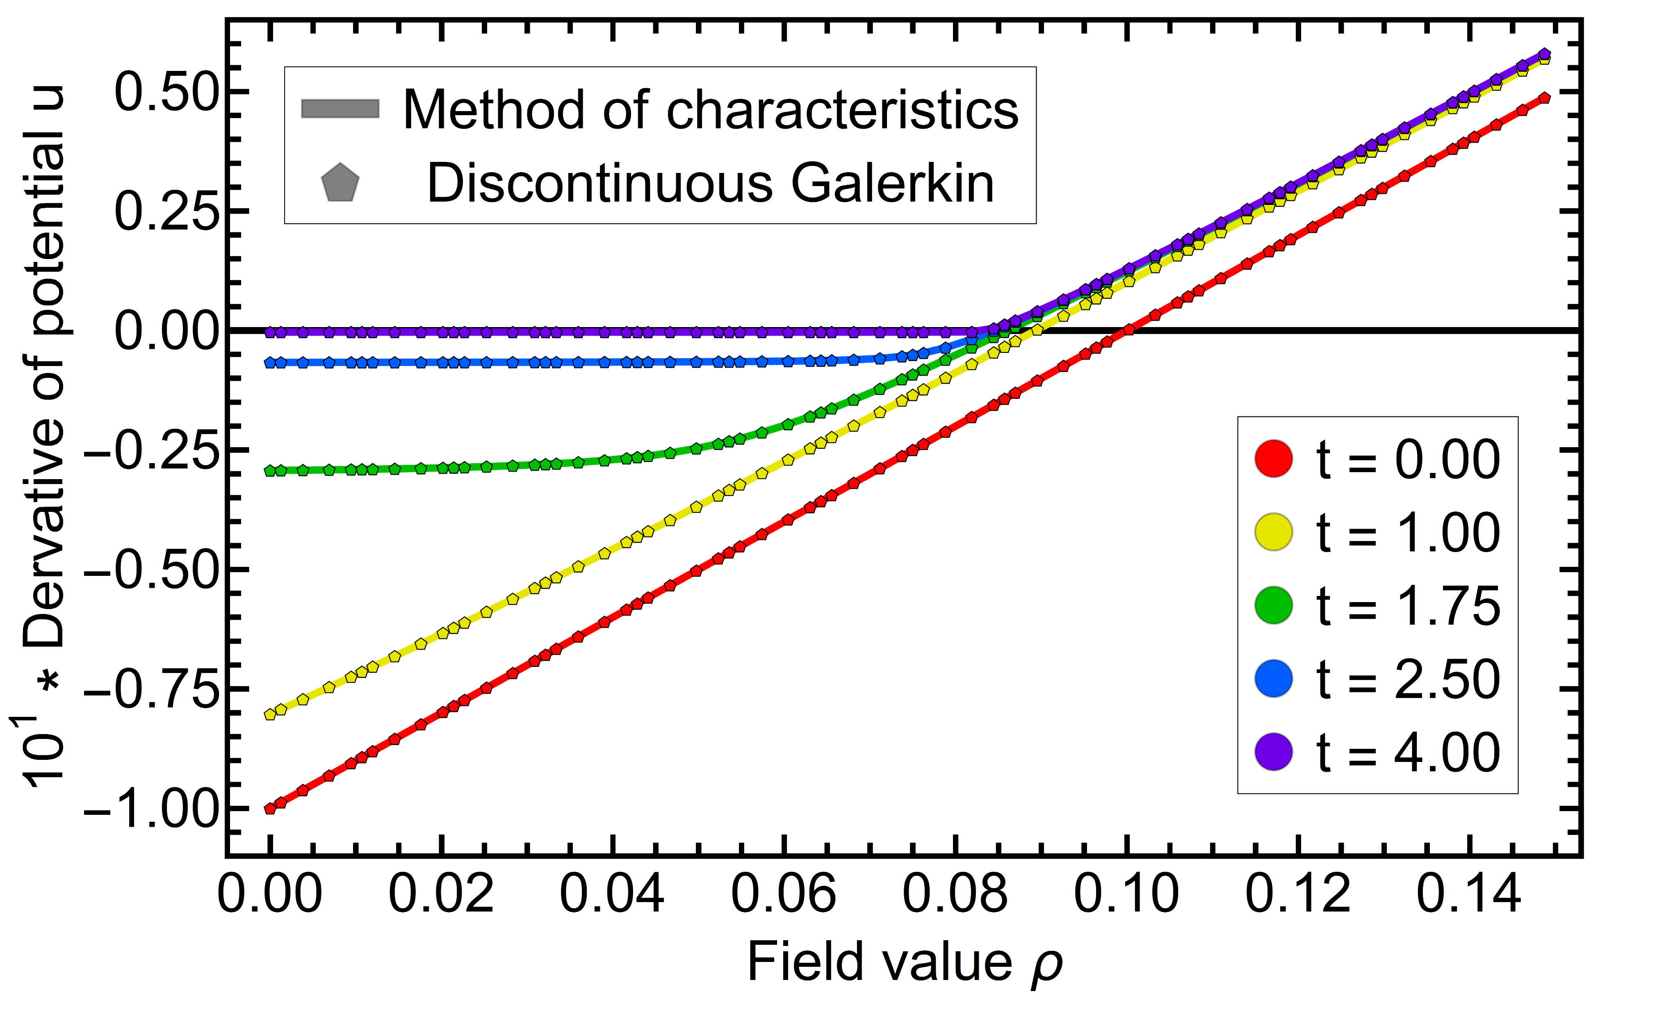
2nd-order
Derivative
Initial condition:
Zero crossing signals position of minimum
Example of symmetry broken phase
Convexity restoration nicely visible
Calculated with N=5, K=30
Grossi, NW, arxiv:1903.09503

Slide 17
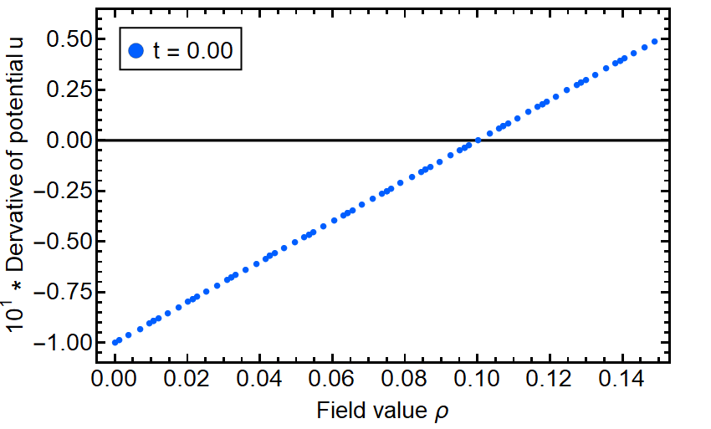
2nd-order
Derivative
Initial condition:
Zero crossing signals position of minimum
Example of symmetry broken phase
Convexity restoration nicely visible
Calculated with N=5, K=30
Grossi, NW, arxiv:1903.09503

Slide 18
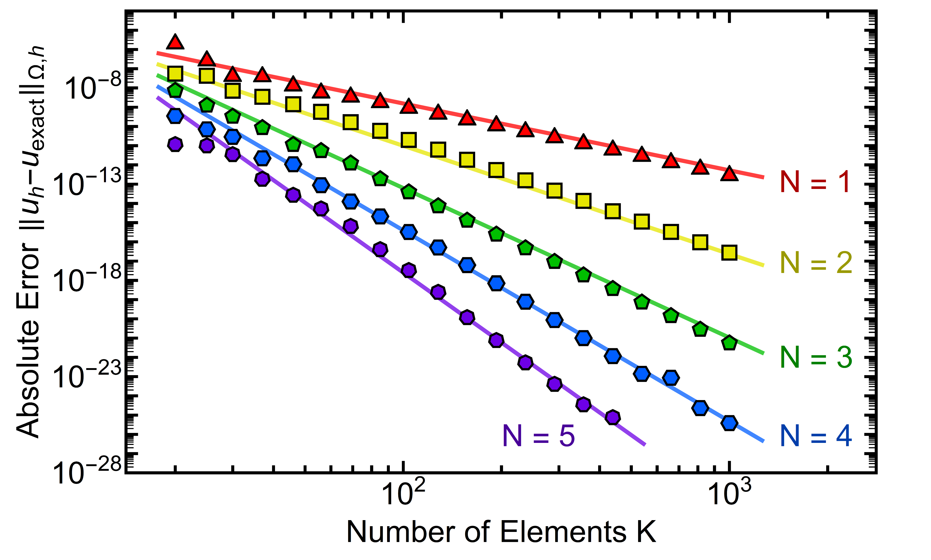
2nd-order
Convergence
Initial condition:
t=1.75 (already kink like)
Power law in number of elements
Spectral convergence in local approximation order
Lines from a single fit
25 order of magnitude!
Grossi, NW, arxiv:1903.09503

Slide 19
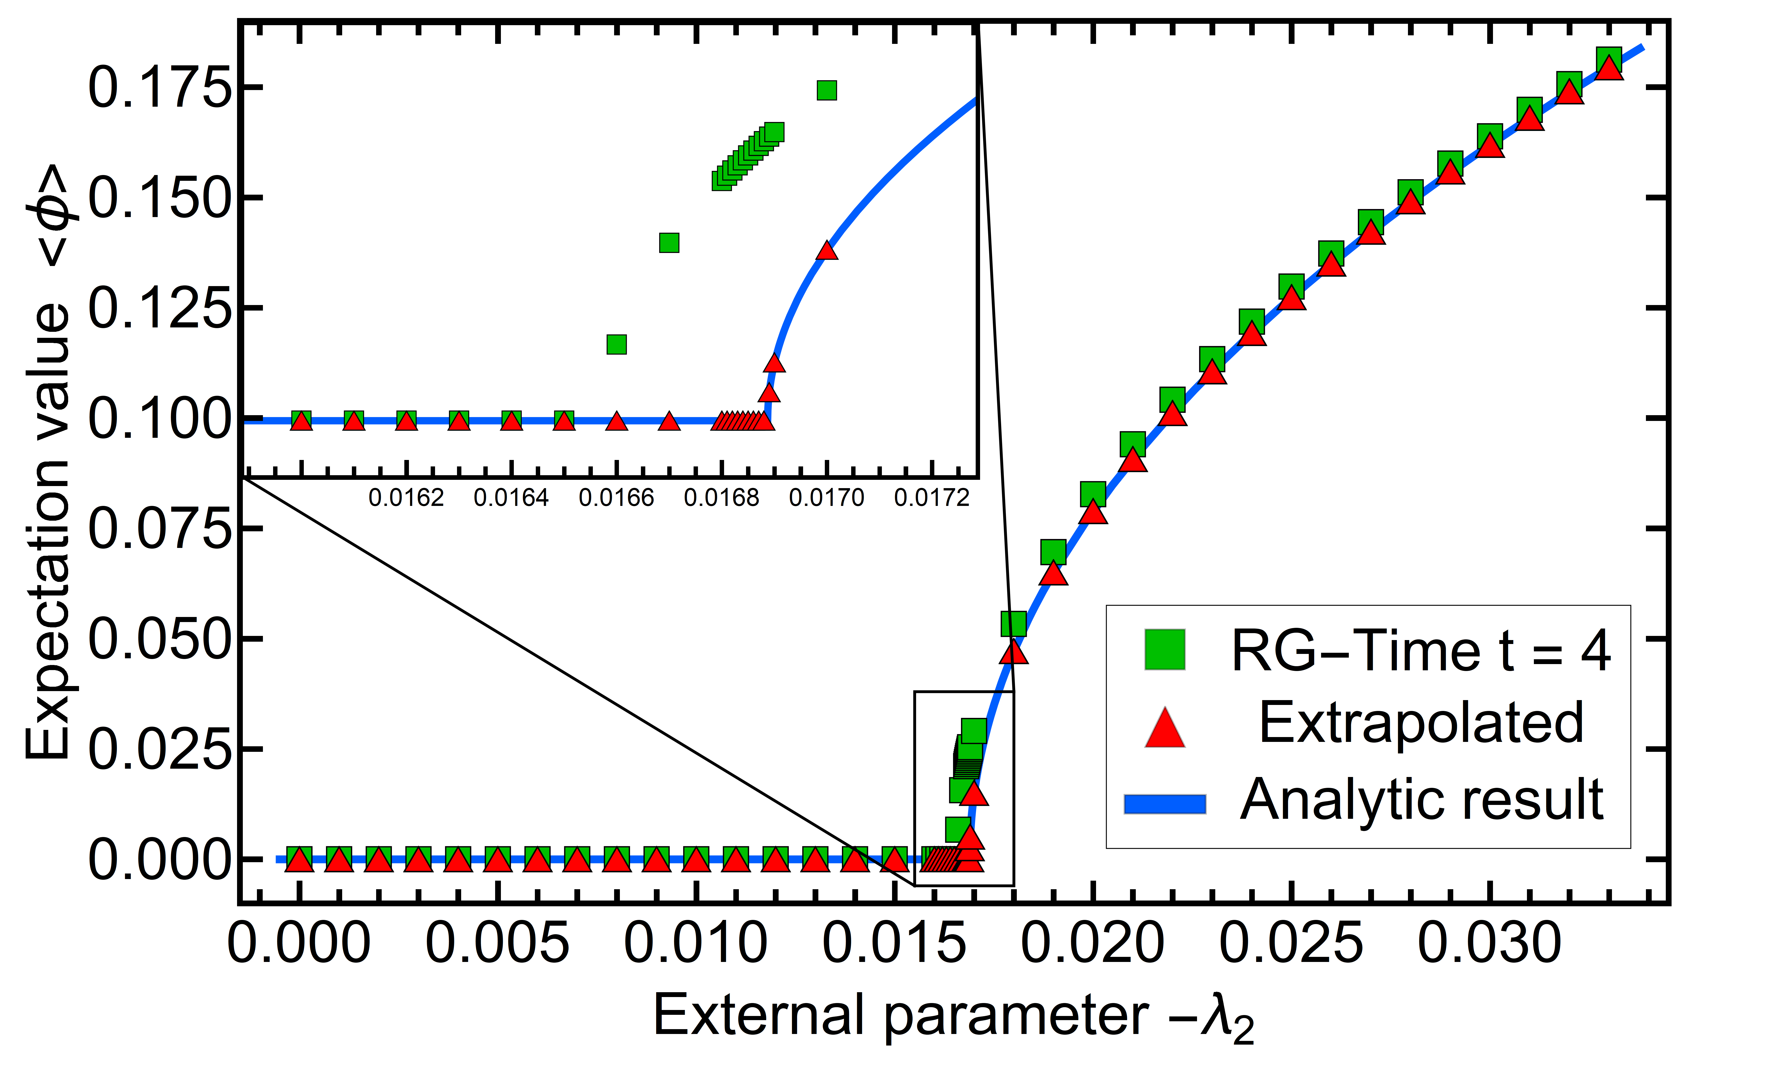
2nd-order
Phase transition
Initial conditions:
Second order phase
Critical exponent agrees with mean field (within error)
Extrapolation to infinite time easily possible
Calculated with N=5, K=120
Grossi, NW, arxiv:1903.09503

Slide 20
First order phase transition

Slide 21
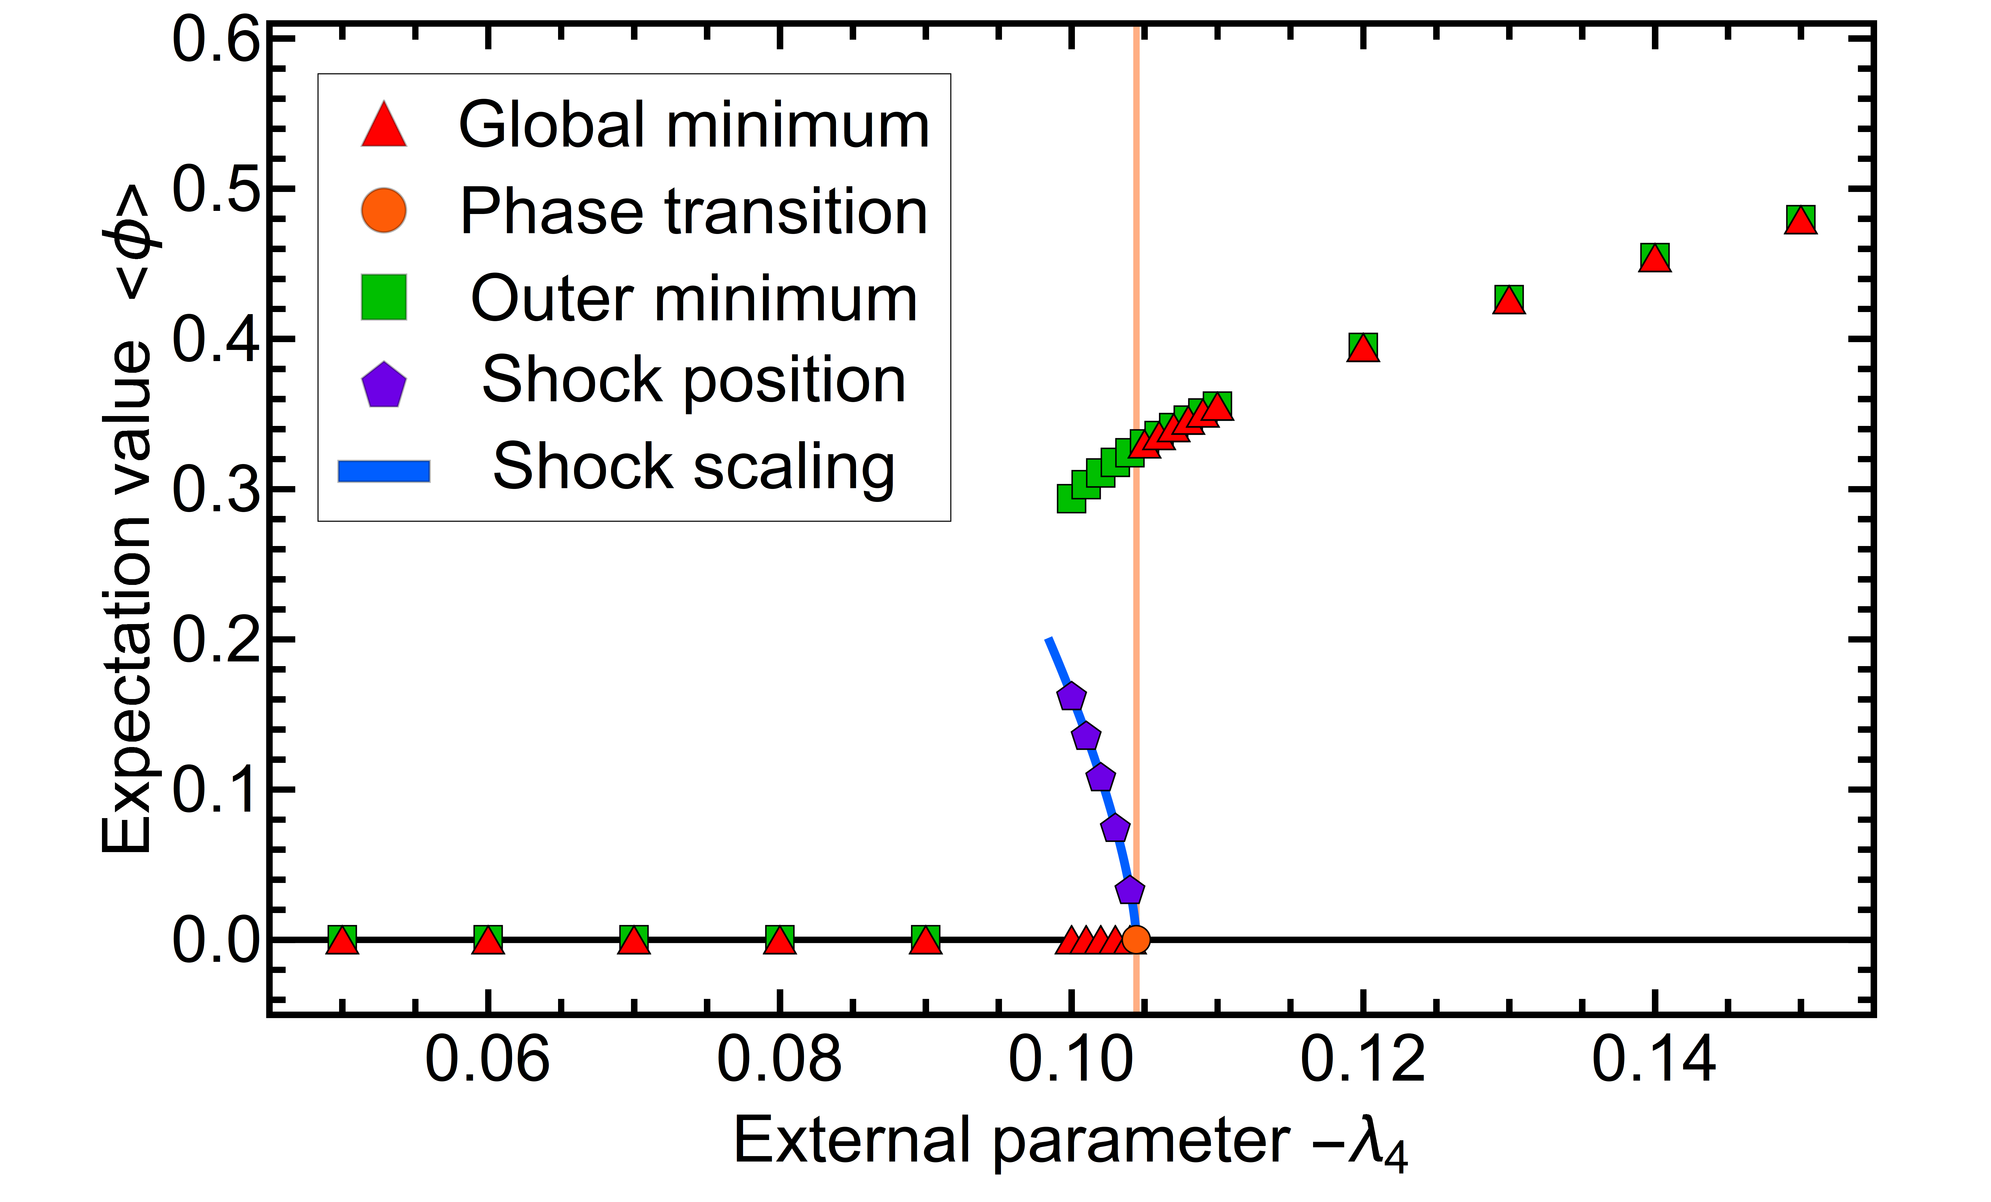
1st-order
Initial condition:
1st-order phase transition
with
Calculated with N=5, K=200
Grossi, NW, arxiv:1903.09503

Slide 22
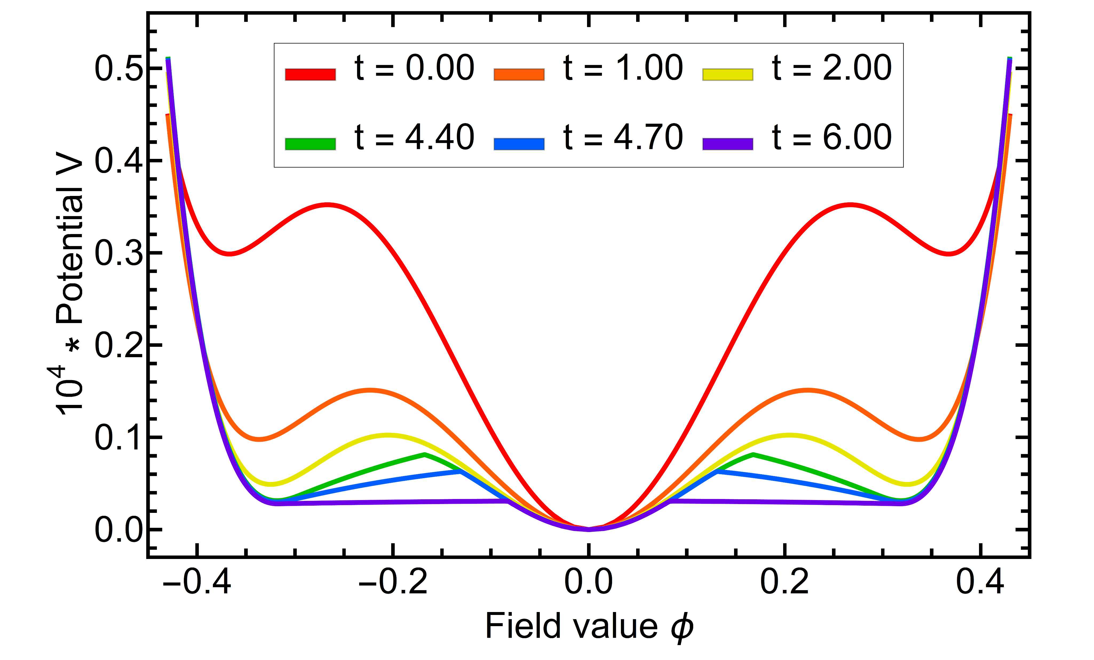
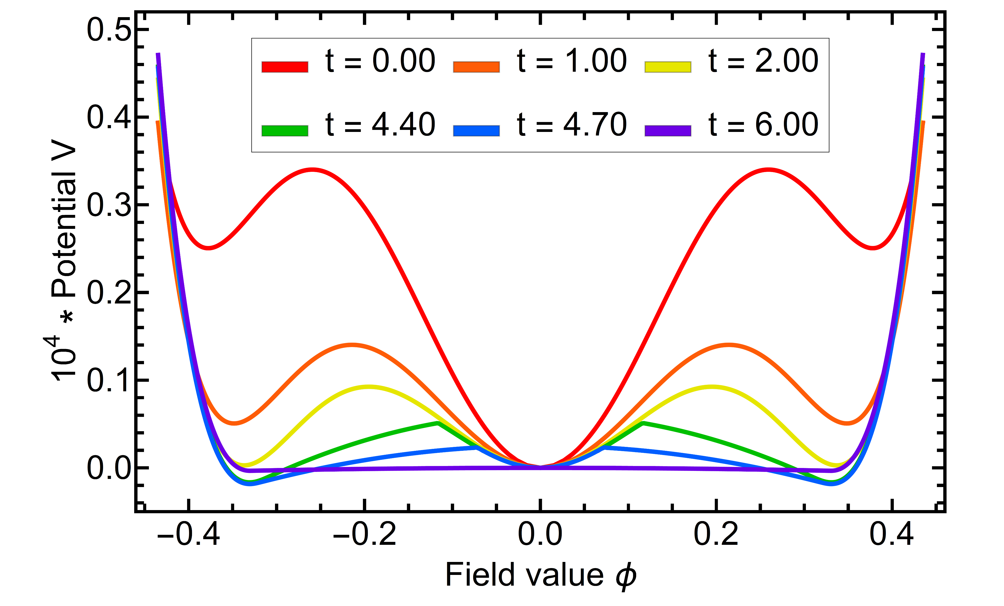
1st-order
Initial condition:
Potential
with
Symmetric phase
Broken phase
Calculated with N=5, K=200
Grossi, NW, arxiv:1903.09503

Slide 23
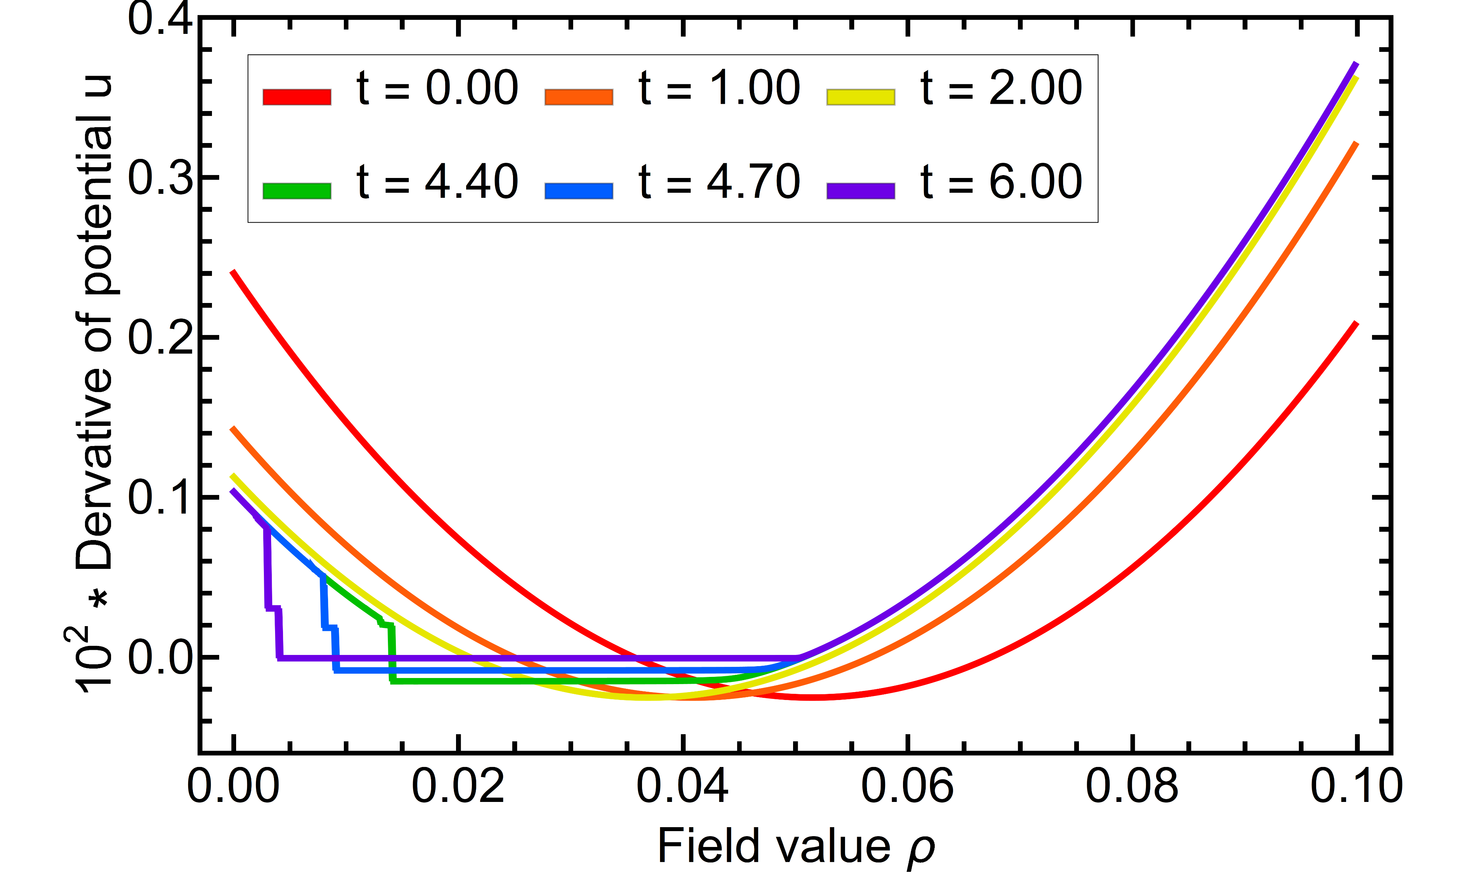
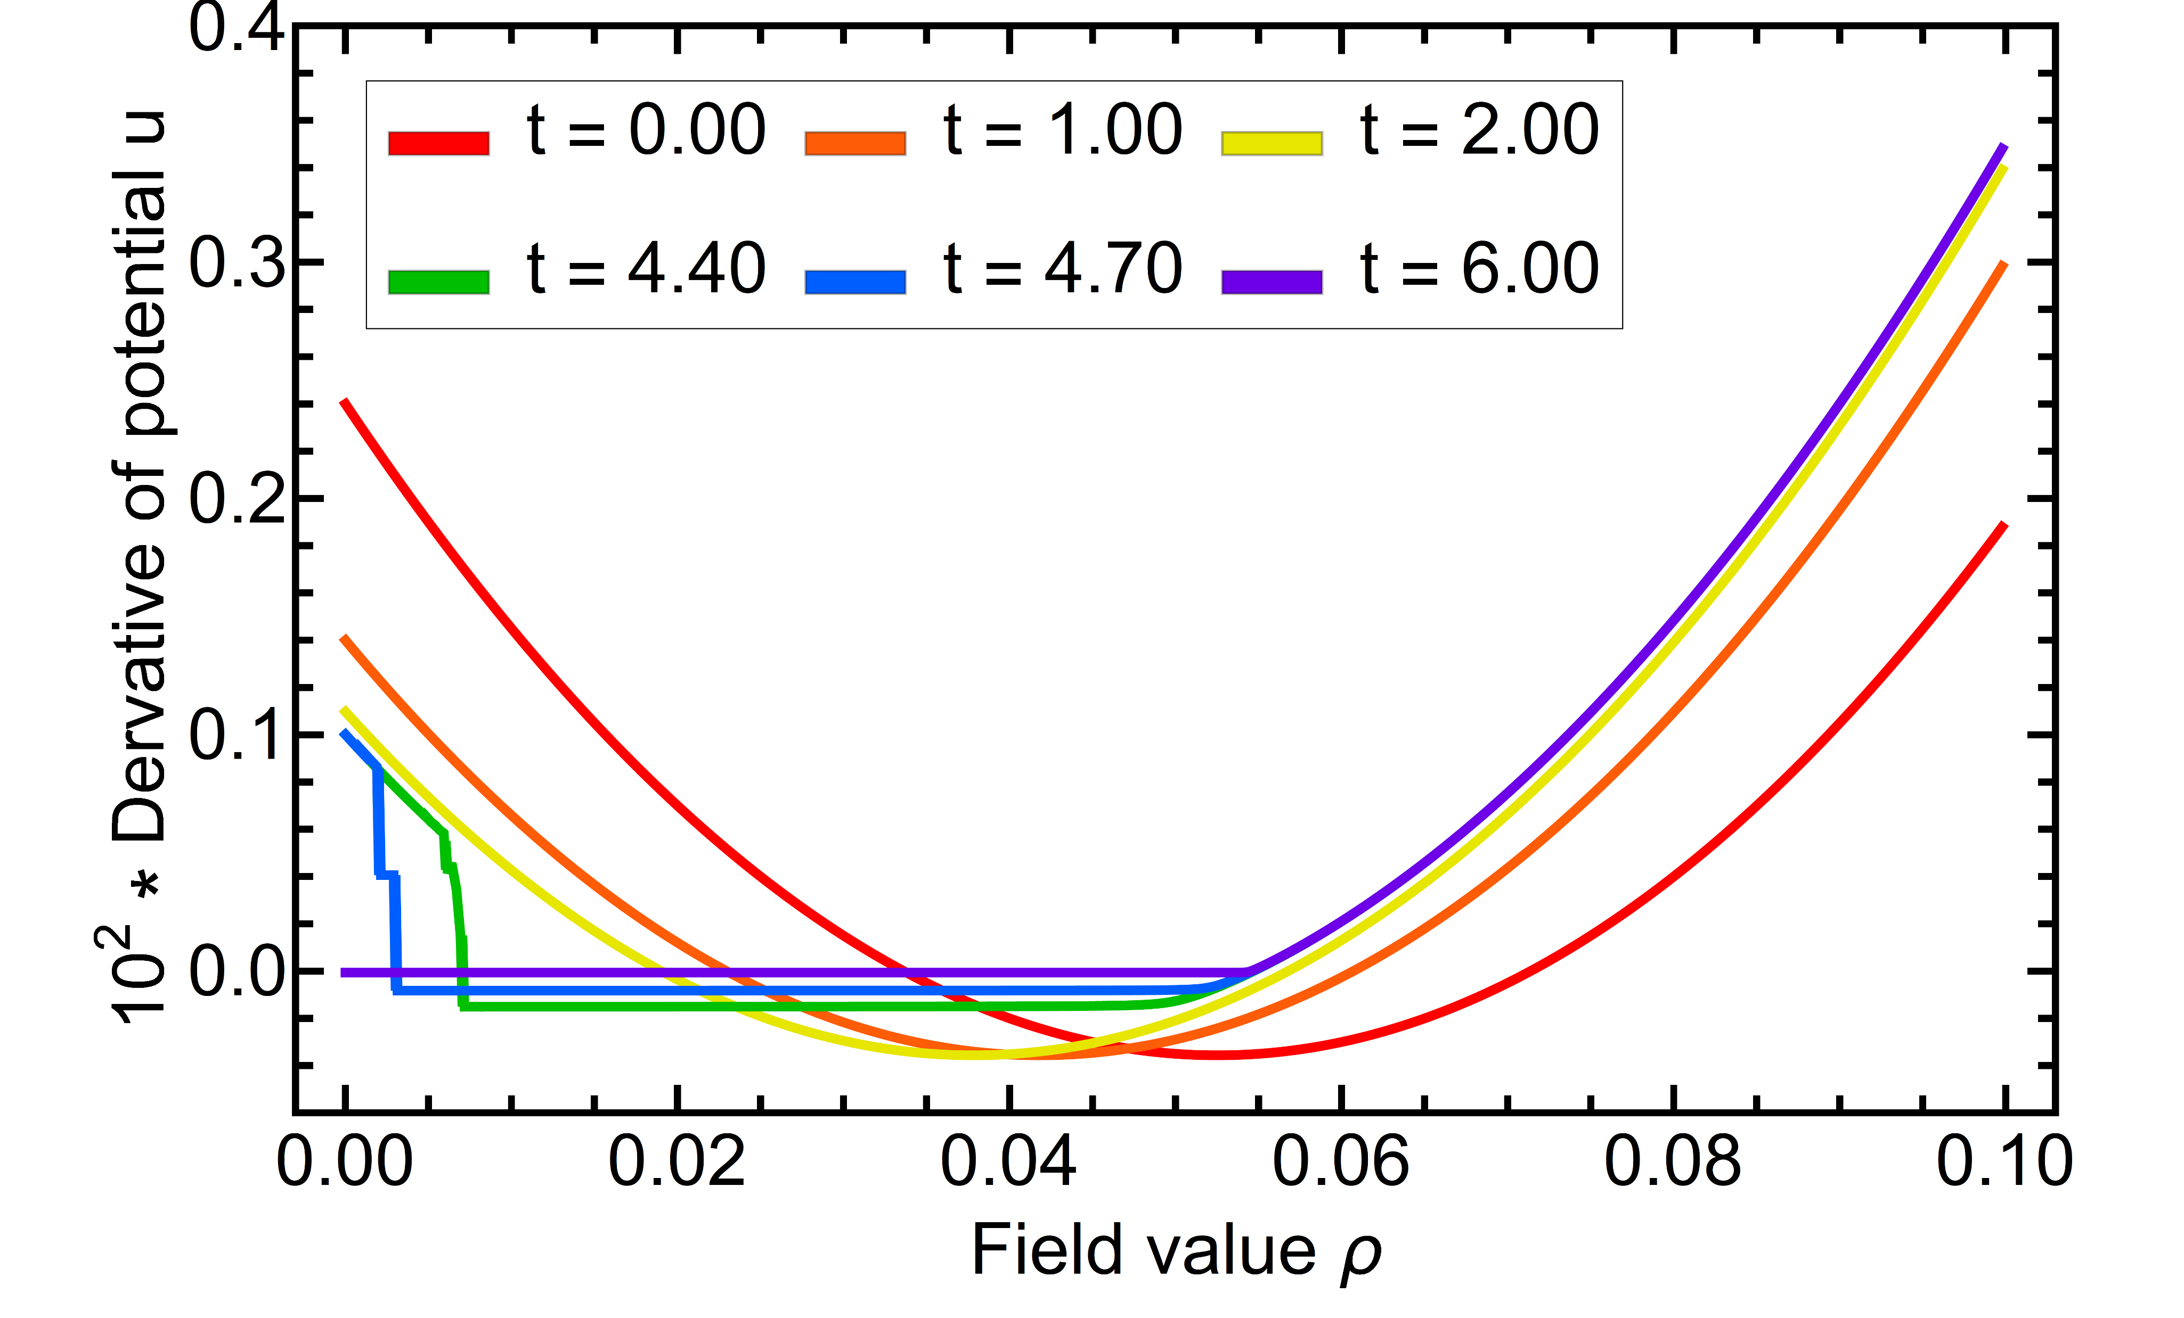
1st-order
Initial condition:
Derivative
with
Symmetric phase
Broken phase
For other values of the coupling the shock doesn’t freeze for positive values of the field
Mechanism for first order phase transition in terms of shocks
Calculated with N=5, K=200

Slide 24
1st-order
Initial condition:
Derivative
with
Symmetric phase
Jump discontinuity forms and freezes in!
Non-trivial second minimum present
First order phase transition during the flow
Calculated with N=5, K=200
Grossi, NW, arxiv:1903.09503

Slide 25
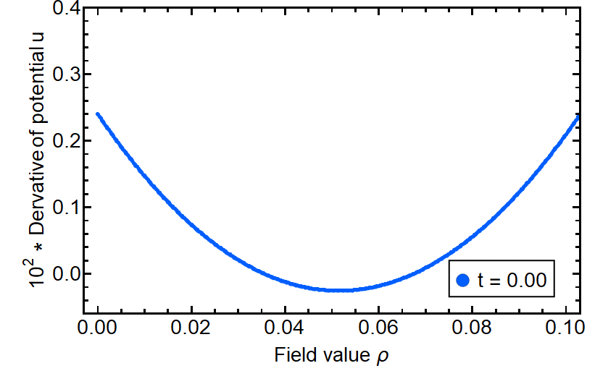
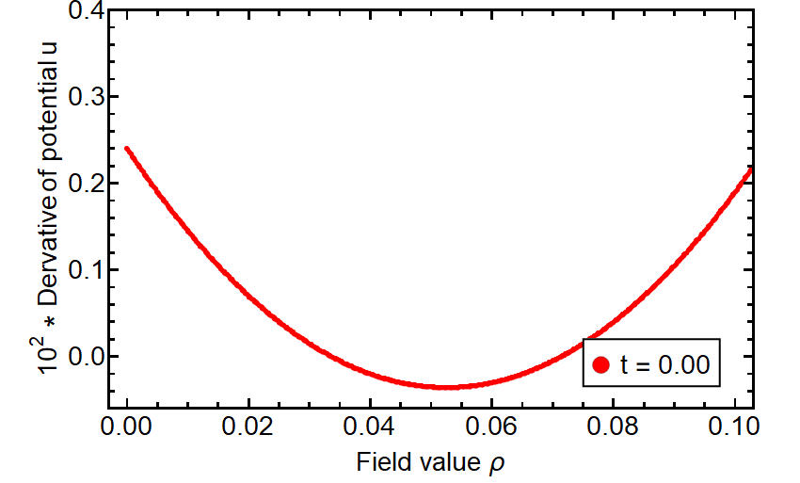
1st-order
Initial condition:
Derivative
with
Symmetric phase
Broken phase
For other values of the coupling the shock doesn’t freeze for positive values of the field
Mechanism for first order phase transition in terms of shocks
Calculated with N=5, K=200
Grossi, NW, arxiv:1903.09503

Slide 26
1st-order
Initial condition:
1st-order phase transition
with
First order phase transition
Position of the phase transition determined by “second order transition” of the position of the shock
Shock agrees with power law (exponent: 0.68±0.01)
Universal properties?
Calculated with N=5, K=200
Grossi, NW, arxiv:1903.09503

Slide 27
Beyond Large N

Slide 28
PDEs
Including Diffusion
Reformulate as first order system
Diffusion term almost everywhere convection dominated
Consider Finite Difference for now (We also did DG methods)
Convection dominated Upwind scheme
Grossi, Pawlowski, NW, in prep.

Slide 29
Quark Meson model

Slide 30
Quark-Meson
Chiral phase diagram
Quark-Meson model topic in several talks
d=4 & N=4
c.f. Talks by Carl Zelle, Fabian Rennecke, Martin Steil, ....
Resulting phase structure well known
Braun, Pawlowski, Rennecke, Schaefer, Wambach, and many more ….
Conservation term (Pions)
Diffusion term (Sigma meson)
Source term (Quarks)
Grossi, Pawlowski, NW, in prep.

Slide 31
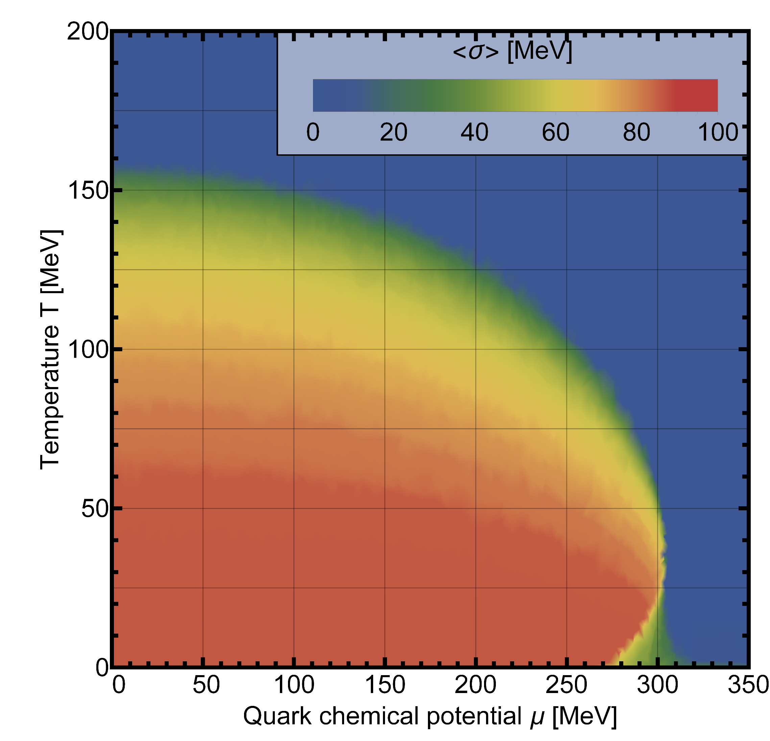
QM
Chiral phase diagram
Stable scheme
No adjustment of grid points, final RG-time ....
Pick once and enjoy the result
Grossi, Pawlowski, NW, in prep.

Slide 32
PDEs
DG vs FDM
Pro & Cons of Finite Difference Methods:
Stable
Intuitive
Extremely fast/easy to implement and use
First order accurate (Godunov's theorem)
Generalisation to higher dimensions induces headaches
Efficient use of implicit methods becomes complicated
Geometric flexibilty (use RG properties)
Finite accurarcy quickly problematic (double precision)
Grossi, Pawlowski, NW, in prep.

Slide 33
Summary & Outlook
Analogy between hydro and flow equations
Applying Discontinuous Galerkin methods to the FRG
Mechanism for first order phase transitions
Robust numerical treatment in the vicinity of phase transitions
Thank you for your attention!

Slide 34
Discontinuous Galerkin methods

Slide 35
DG
Different formulations
Modal expansion
Nodal expansion
Discontinuous elements: More degrees of freedom than equations!
Copyright: https://en.wikipedia.org/wiki/Finite_element_method
Partial integration
Weak form
Partial integration
Outward pointing normal vector
Numerical flux
Connects elements (closes set of equations)
Partial integration
Strong form
Mathematically equivalent, but not numerically!
Hesthaven, Warburton, Nodal Discontinuous Galerkin Methods (2008)

Slide 36
DG
Implementation
Modal expansion
Nodal expansion
Local approx
Strong form
Copyright: https://en.wikipedia.org/wiki/Finite_element_method
Introduce matrices:
Mass matrix
Stiffness matrix
Only requires local inversion of the mass matrix
Introducing a reference element everything is rescaled to a matrix product (N x N)*(N x K)
Discretized equation
Hesthaven, Warburton, Nodal Discontinuous Galerkin Methods (2008)

Slide 37
Burgers equation

Slide 38
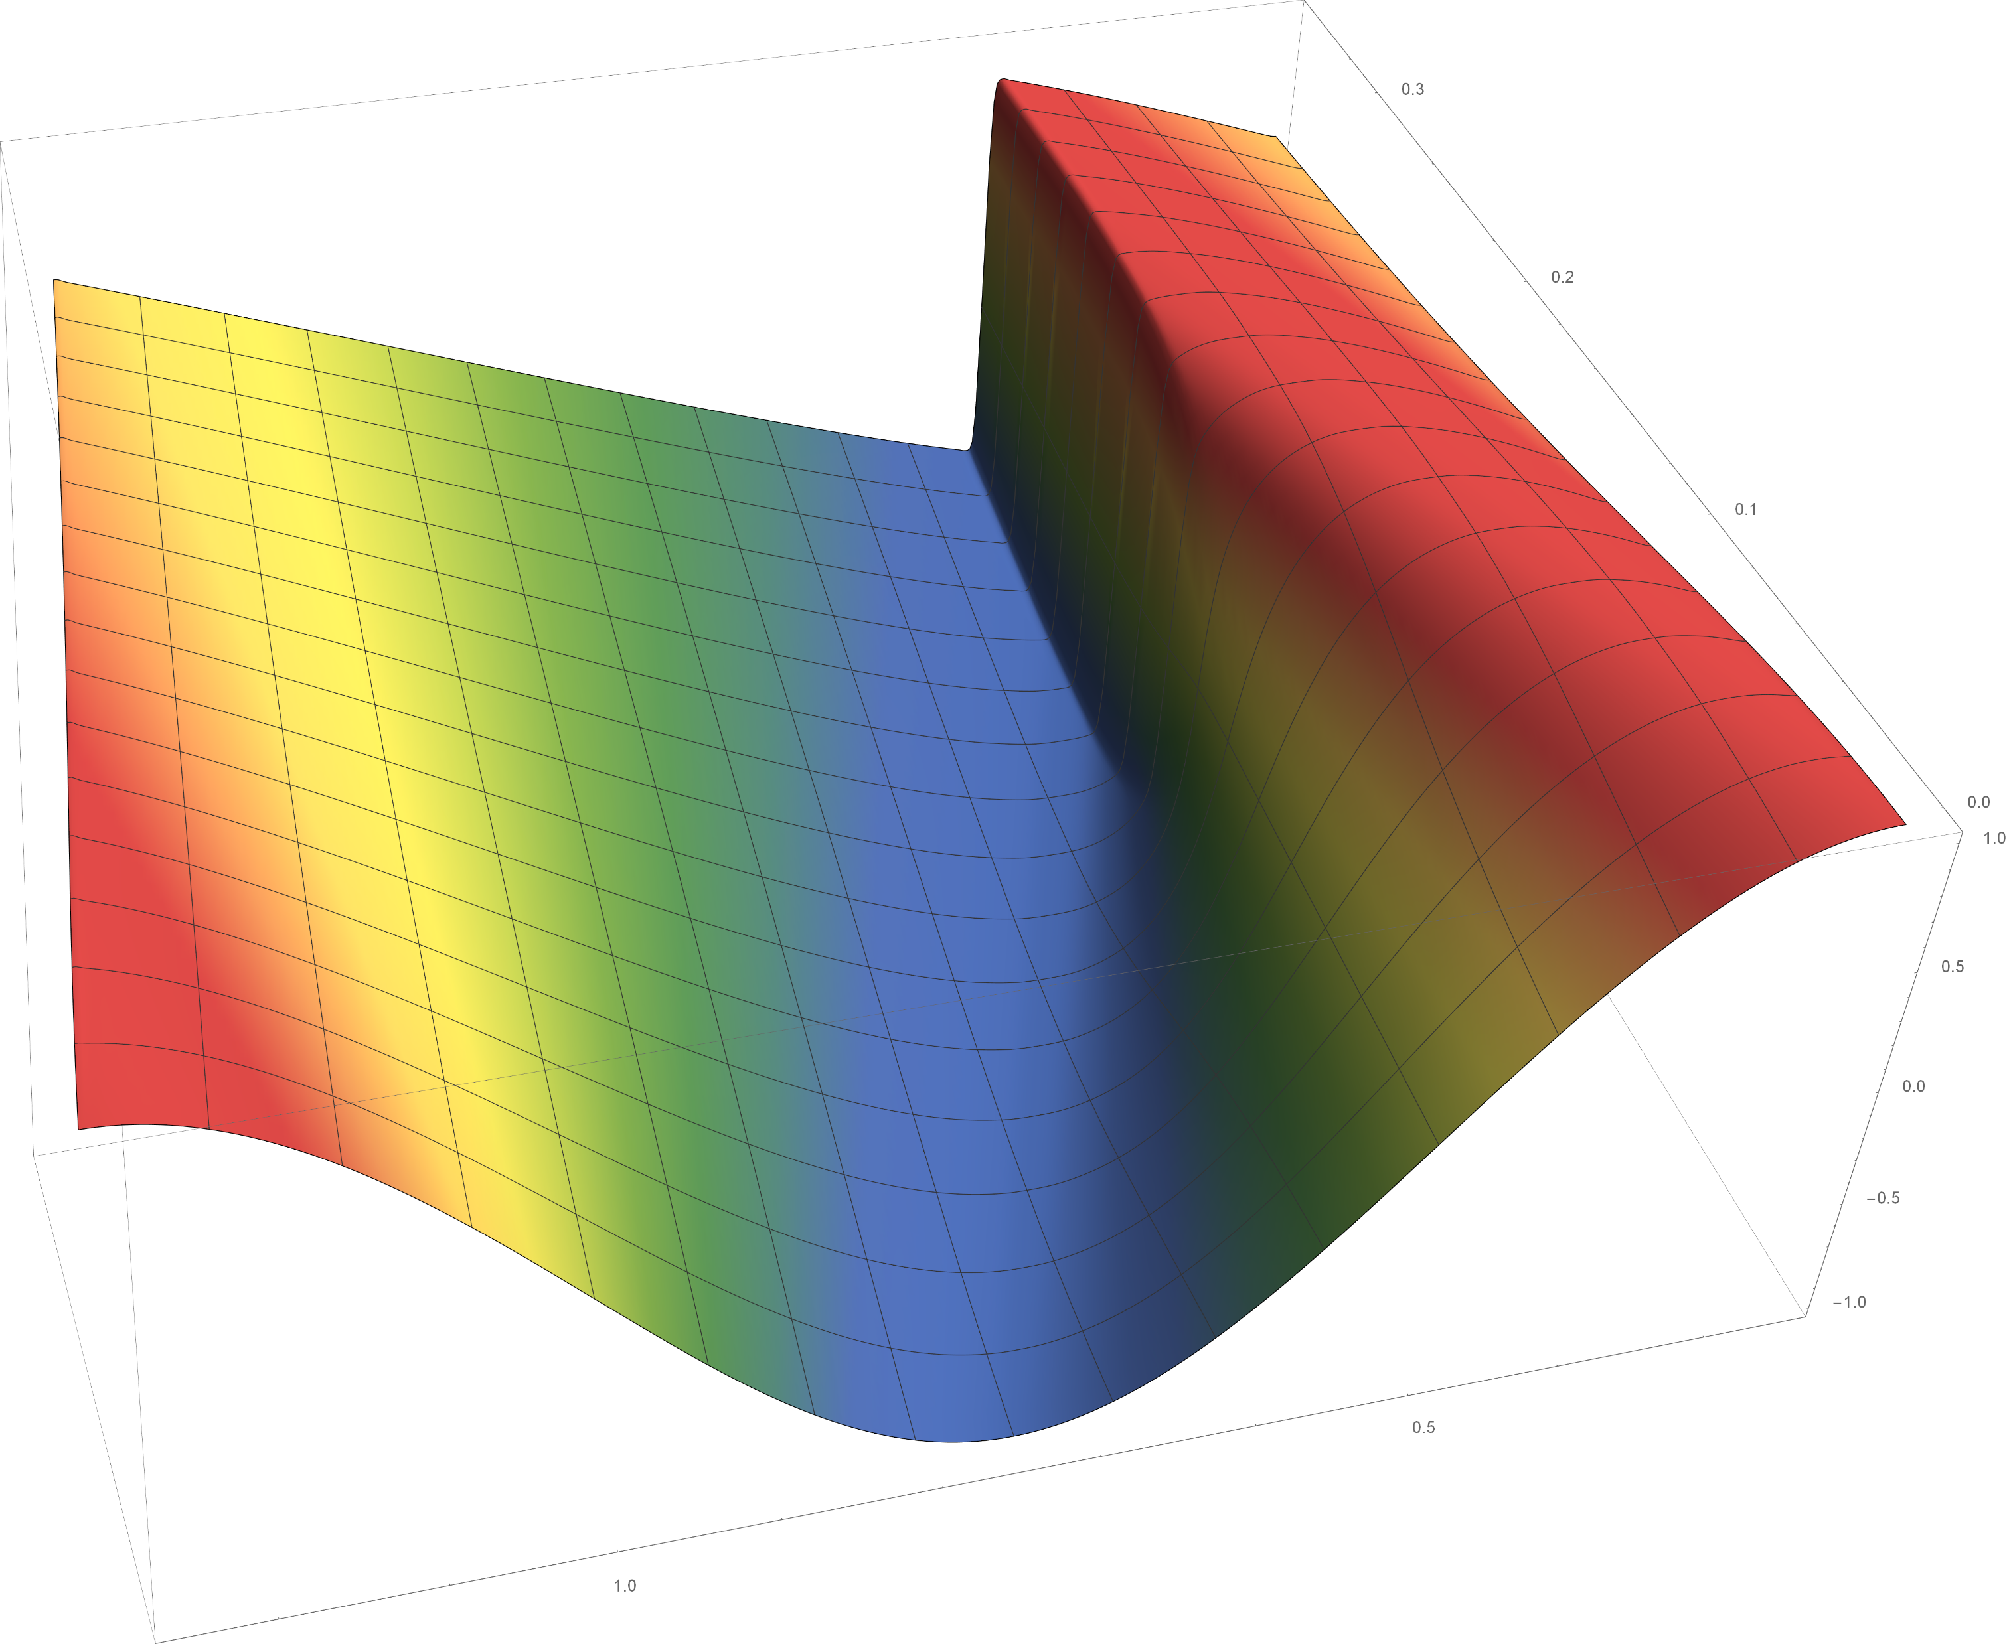
Burgers
Burgers equation
Appears in many areas of applied mathematics:
Fluid mechanics
Nonlinear acoustics
Gas dynamics
Traffic flow
….
with
Prototype for conservation law that can develop shock waves
Time t
Simple wave as initial condition
Wave breaks when characteristics meet
Discontinuous regime well understood due to analytic solution of the viscous Burgers equation
Wave breaks & shock wave forms
Space x

Slide 39
Second order phase transition

Slide 40
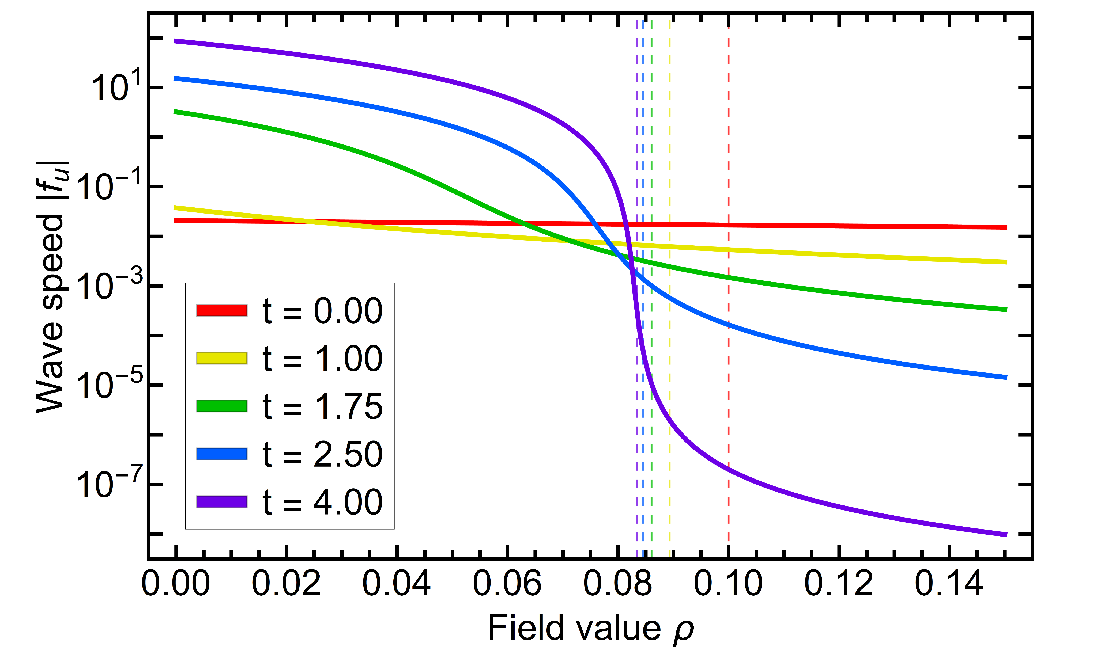
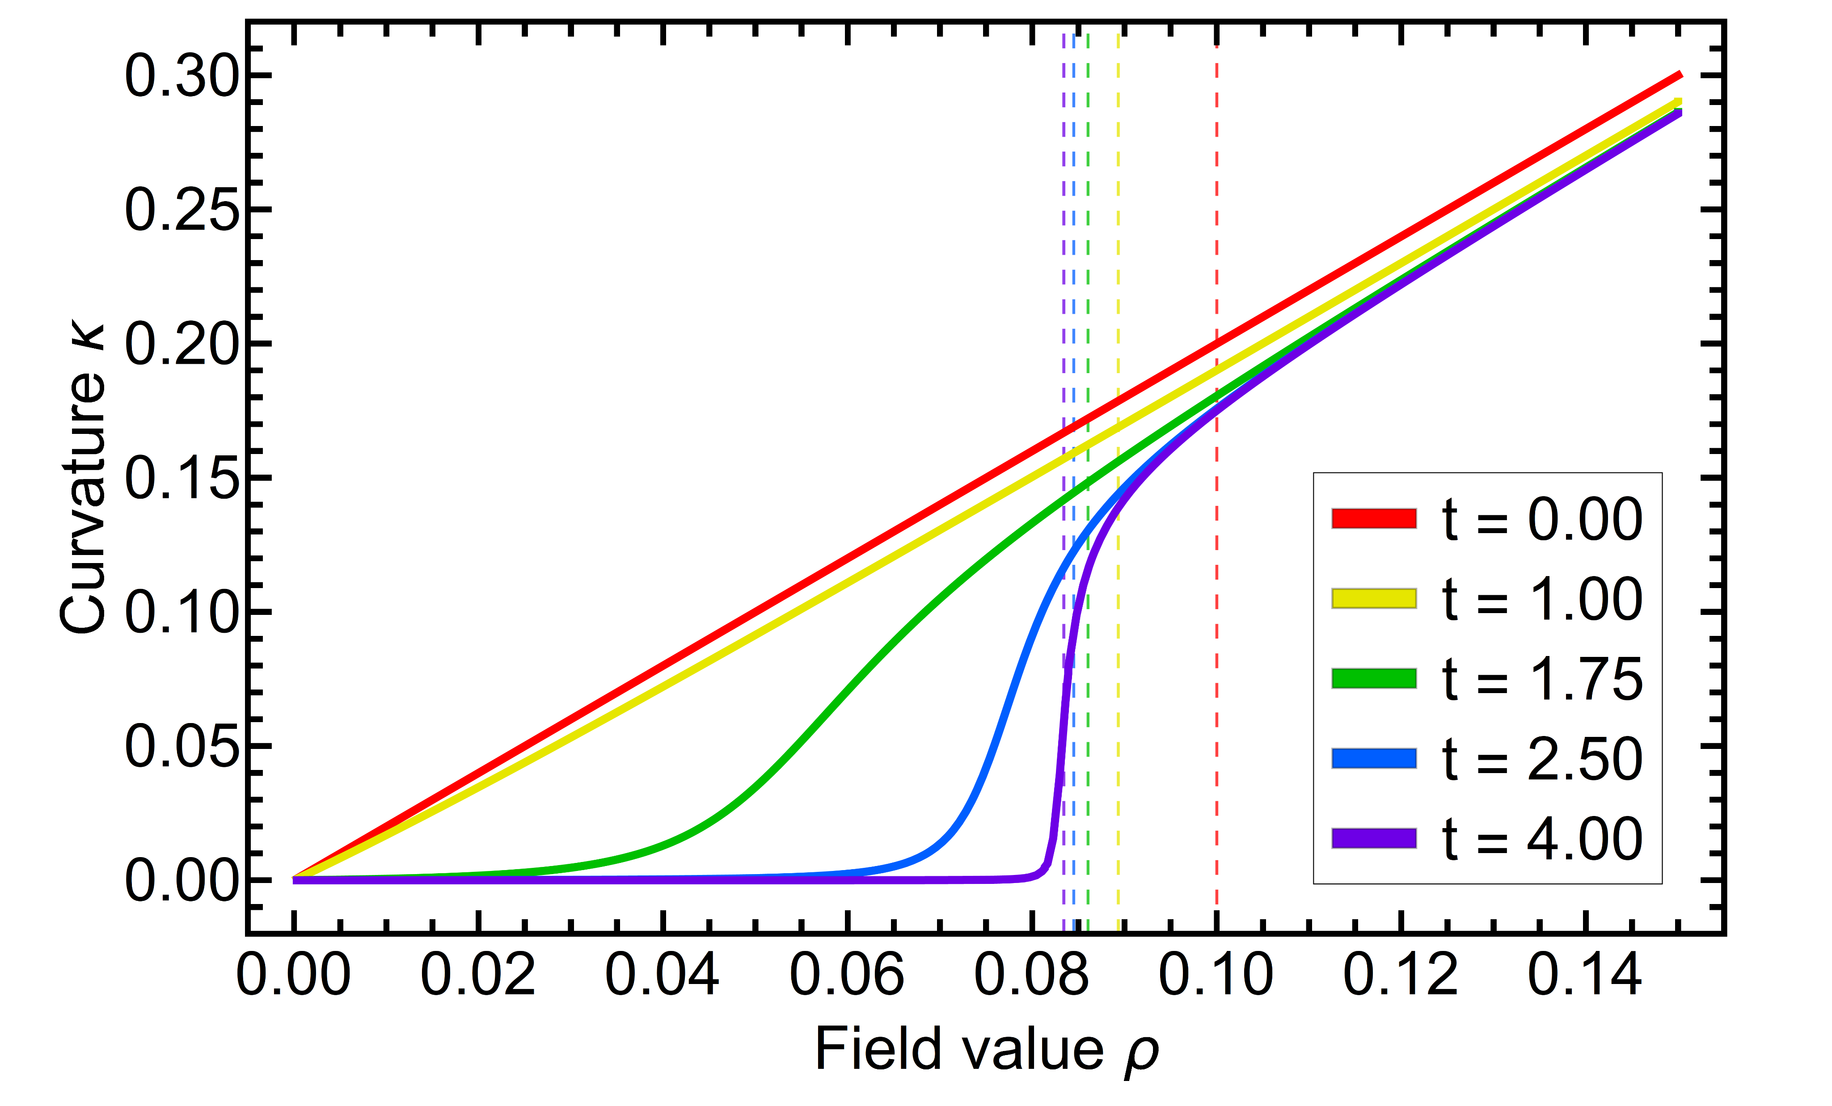
2nd-order
Other properties
Initial condition:
Wave speed
Curvature
Wave speed strongly suppressed at large field values
Derivatives are easily available
Justifies Taylor methods in that regime (only local structure relevant)

Slide 41
Riemann problem

Slide 42
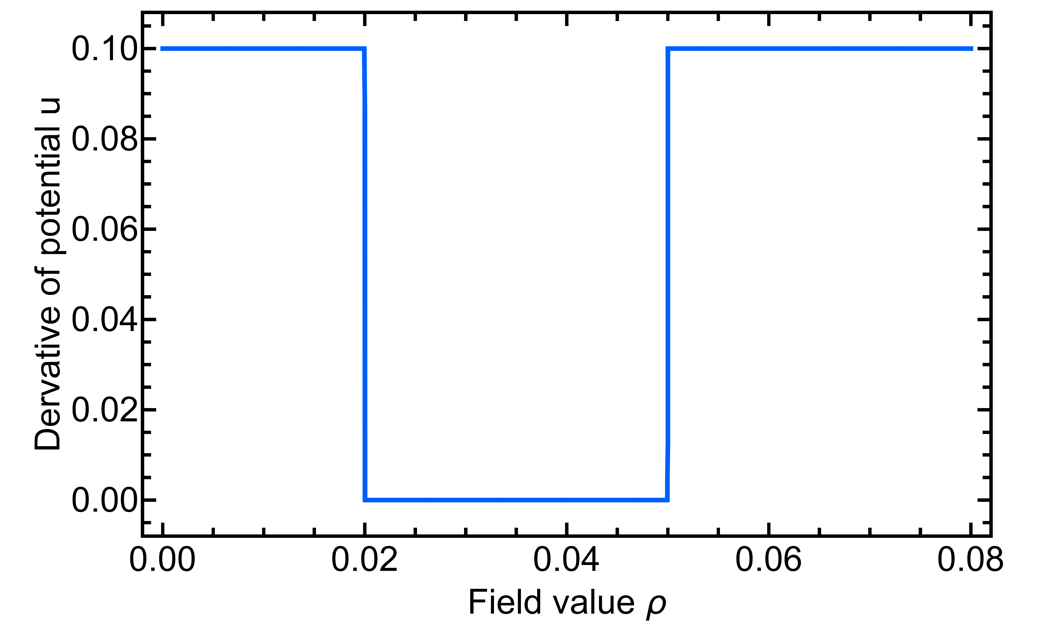
Riemann
Riemann problem
Information flows from large to small field values and is faster for smaller values of the derivative!
What does this imply for discontinuities?
Jump discontinuities can form if the derivative of the initial potential has a minimum
Relevant in physical cases
Consider the initial conditions:
Solving for piecewise constant initial conditions known as Riemann problem
Left jump will lead to shock wave (Speed given by Rankine-Hugoniot condition)
Right jump will lead to rarefaction wave
Unique solution defined via entropy condition

Slide 43
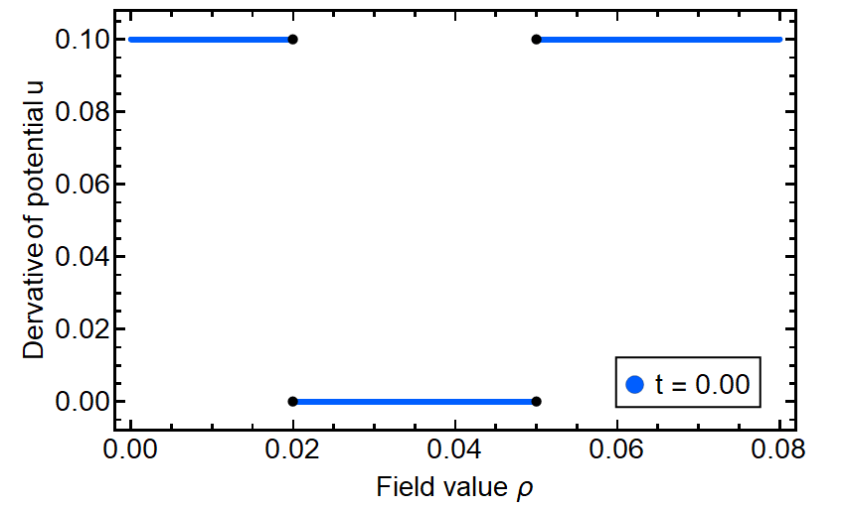
Riemann
Derivative
Calculated with N=3, K=1500

Slide 44
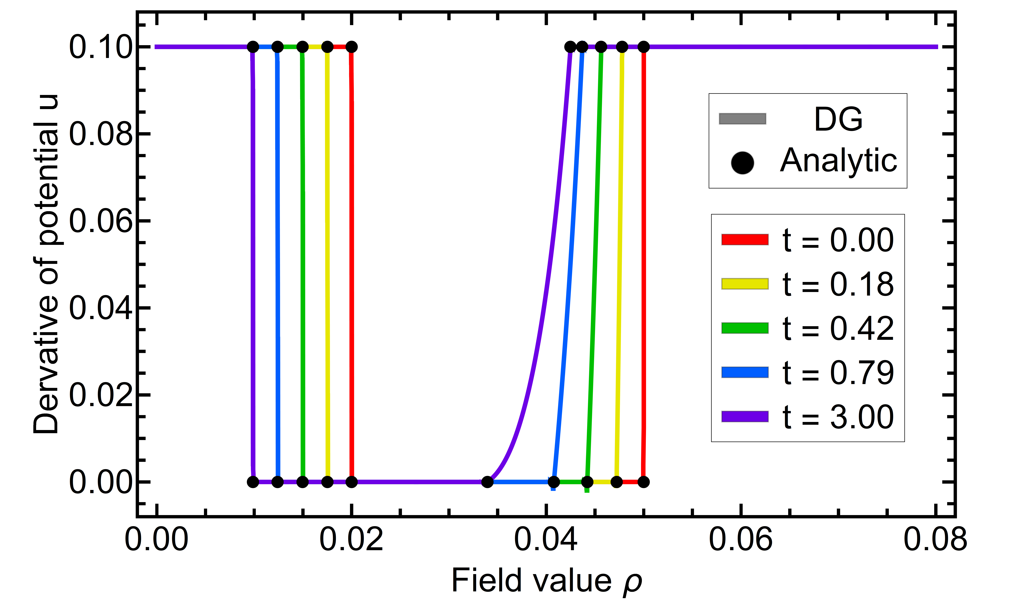
Position of jump discontinuity:
Riemann
Derivative
Points of non-analyticities easily obtained analytically
Change suppressed exponentially for large times
Change additionally suppressed for larger jumps
Oscillations removed in post-processing (formal accuracy can be kept!)
Calculated with N=3, K=1500

Slide 45
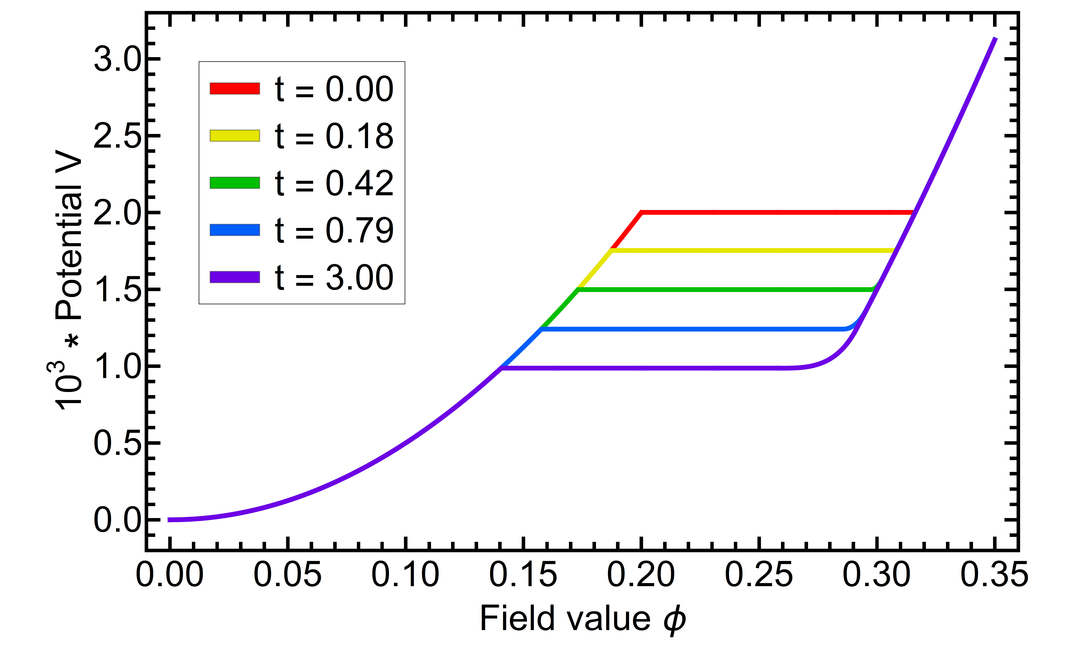
Results
Riemann problem
Integration
Calculated with N=3, K=1500

Slide 46
Riemann
Potential
Calculated with N=3, K=1500

Slide 47
First order phase transition

Slide 48
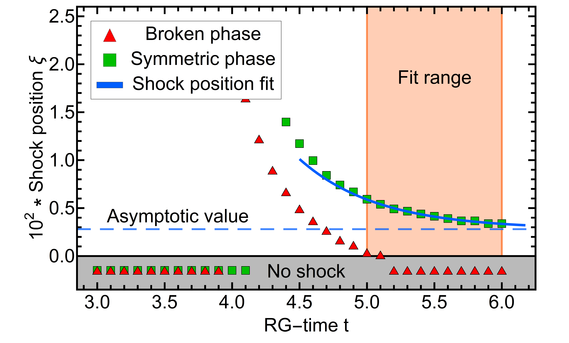
1st-order
Initial condition:
Shock position
with
Position extracted via concentration kernel
Asymptotic behavior determined by Riemann problem
Confirmed by numerical simulation
Extrapolation to asymptotic limit easily possible
Exponential decay
Calculated with N=5, K=200

