Slide 1
Transverse Dynamics in Rings
G. Franchetti, GSI
14/1/2019

Slide 2
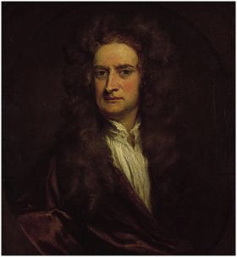
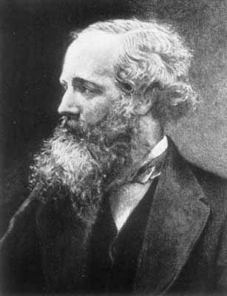


Motion of particles
I. Newton
J.C. Maxwell

Slide 3
The Lorentz force
Electric field
Magnetic field
B
[Tesla]
E
[N/q]
F
[N]
v
[m/s]
F
[N]
Magnetic field does not
make work

Slide 4
The Lorentz force
B
B-field
v
F
V
F

Slide 5
The Lorentz force
At t = ∆t
At t = 0
B-field
V
V
F
F

Slide 6
V
V
V
F
V
F
V
F
B-field
F
V
F
V
F
V
V
V
F
F
F
F

Slide 7
B-field
V

Slide 8
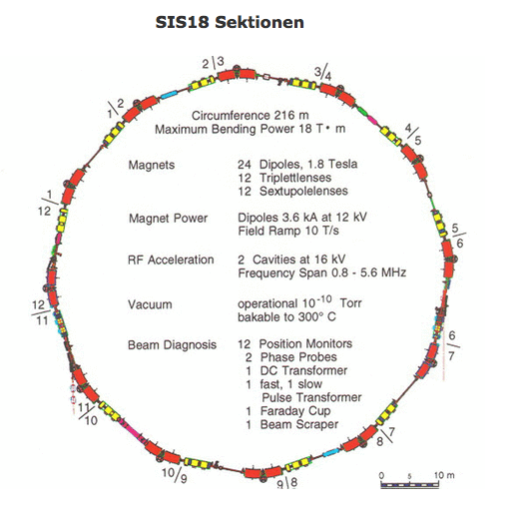
Example: SIS18
maximum
B = 1.8 Tesla
Bending radius = 10 m
But this for the correct
particle energy !

Slide 9
Energy ←→ Momentum
Kinetic energy
of the ion
energy
momentum

Slide 10
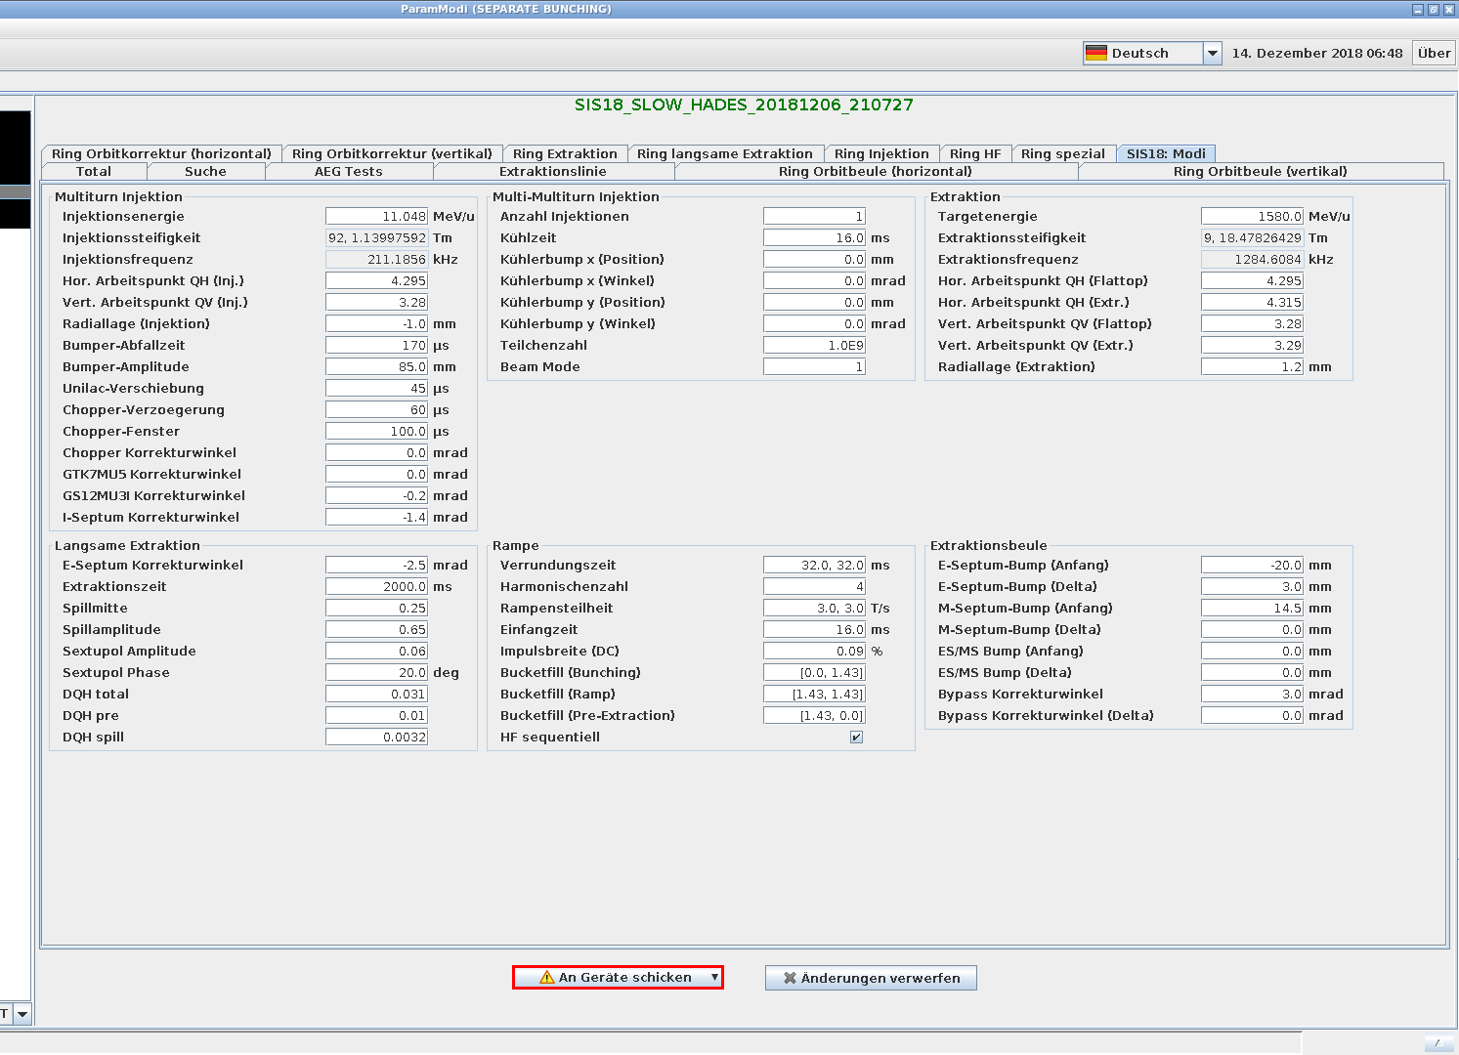
Injection energy
E_{k} = 11.048 MeV/u
Rigidity
B𝞺 = 1.13997592 Tm

Slide 11
Notation
Energy is per nucleon
1 Nucleon
11.048 MeV/u
Silver
Energy → 11.048 x 107 MeV
107 nucleons

Slide 12
Ion property
Energy
per nucleon
Ion
momentum
Ion
velocity

Slide 13
Argon: Silver 107, Charge +45
Injection energy
E_{k} = 11.048 MeV/u
= 11.048 x 10⁶ e/u
= 1.77008 x 10⁻¹² J/u
m_{u} = 1.66056 x 10⁻²⁷ Kg
E = 107 m_{u} c² + E_{k} 107
= 1.59688 x 10⁻⁸ + 1.89399 x 10⁻¹⁰ J
= 1.61582 x 10⁻⁸ J
Ion momentum
p = 8.22818 x 10⁻¹⁸ Kg m / s
Ion velocity
v = 45766823.10 m/s

Slide 14
Accelerator settings
Ion momentum
Ion charge
q
Accelerator radius

Slide 15
Argon: Silver 107, Charge +45
Ion momentum
p = 8.22818 x 10⁻¹⁸ Kg m / s
Ion charge
Tm
Q = 45 e
Accelerator radius
Tesla
m

Slide 16
Energy matching
v₀
Uniform B-field

Slide 17
Revolution time
v₀
Uniform B-field

Slide 18
Silver: Mass 107, Charge +45
At injection energy
Circumference = 216.72 m
Ion velocity
microseconds
v = 45766823.10 m/s
Revolution frequency →
211179.87
Hz

Slide 19
Frequency
f = 211185.6 Hz
Revolution frequency
211179.87
Hz

Slide 20
Radial displacement → -1 mm

Slide 21
L₀ = 216.72 m
Change in circumference
DL = – 2 𝞹 10⁻³ m
f = f₀ (1 + DL/L₀)
Orbit with radial shift
f = 211185.99 Hz
Orbit

Slide 22
Energy mismatch / Momentum mismatch
Momentum →p₀
Matched
particle
Energy → E₀
Velocity → v₀
Momentum →
Mis-matched
particle
Energy →
Velocity →
Only one “variation” is necessary → the other two automatically follow
We take → 𝞭p “off-momentum”

Slide 23
Energy mismatch: simple example
V
Uniform B-field
Transverse displacement

Slide 24
Simple estimate
For SIS18 type of machine
Mismatch
(big!)

Slide 25
What if B is wrong?
For SIS18 type of machine
“wrong” B
(big!)
dB/B have to be very small → smaller than 10⁻⁴

Slide 26
Revolution time ?
V
Particle goes faster
Uniform B-field
Circumference is
Larger !

Slide 27
Revolution time ?
Particle goes faster
V
Uniform B-field
Smaller ?
Larger ?
Circumference is
Larger !

Slide 28
At energy E₀ change particle momentum → 𝛿p/p₀
Always grow
Change of revolution
time
E₀
C = circumference
Always decrease
E₀

Slide 29
Transition energy
Change of 𝛅p/p₀ →
Change of revolution time
Below
transition
Above
transition
E₀
Transition
energy

Slide 30
Problem: a particle not in the correct position
v₀
v₀
New
Particle orbit
Uniform B-field
Ideal orbit:
Reference orbit

Slide 31
Problem: a particle not in the correct position
New
Particle orbit
Uniform B-field
Ideal orbit:
Reference orbit

Slide 32
From the reference orbit
s
New
Particle orbit
Ideal orbit:
Reference orbit

Slide 33
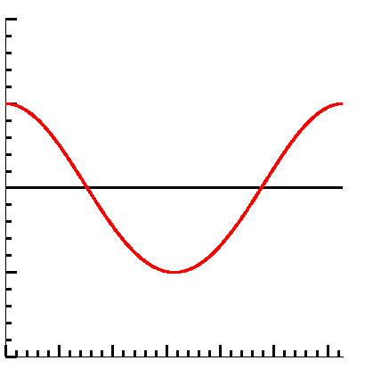
From the reference orbit
x
1 oscillation
in one turn
Particle injected with
Wrong position
Reference orbit
s

Slide 34
A Ring with drifts
Dipole
Vacuum pipe
Dipole
Ideal reference orbit
𝜌₀
Dipole
Dipole

Slide 35
Problems: particle in wrong position
Dipole
Vacuum pipe
Dipole
Ideal reference orbit
𝜌₀
Dipole
Dipole

Slide 36
Problems: particle with wrong energy
Dipole
Vacuum pipe
Dipole
Ideal reference orbit
𝜌₀
Dipole
Dipole

Slide 37
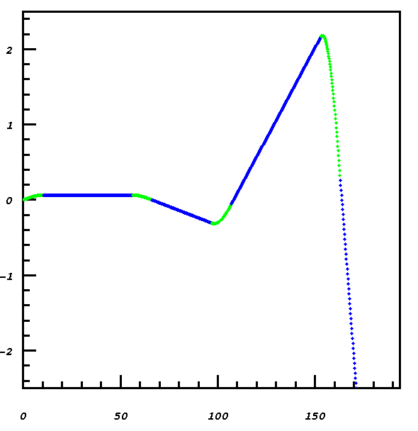
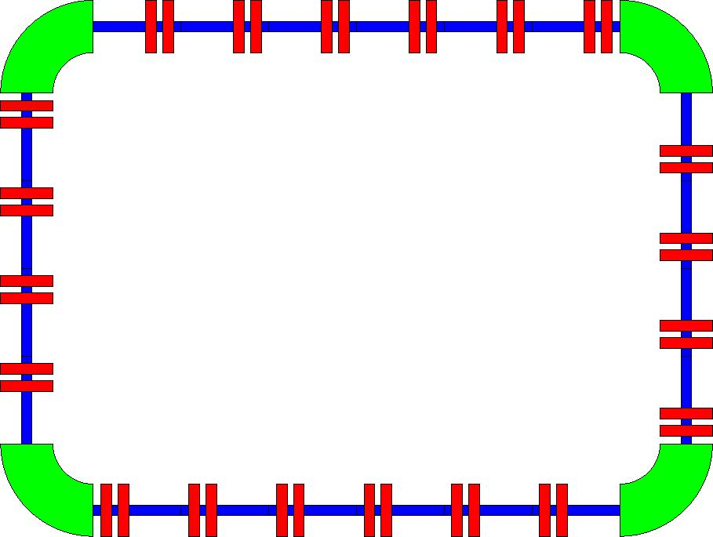
From the reference frame of the reference orbit
x
Drift
Bend
s
Motion unstable !!

Slide 38
Observation
x
Drift
Bend
There is an
“over-focusing”
Therefore transverse
motion is unstable
only the design particle
is ”accepted”
Bend is focusing !
s

Slide 39
Focusing element
𝛼’ >0
𝛼 >0
X > 0
s

Slide 40
Defocusing element
𝛼 >0
𝛼 >0
X > 0
s

Slide 41
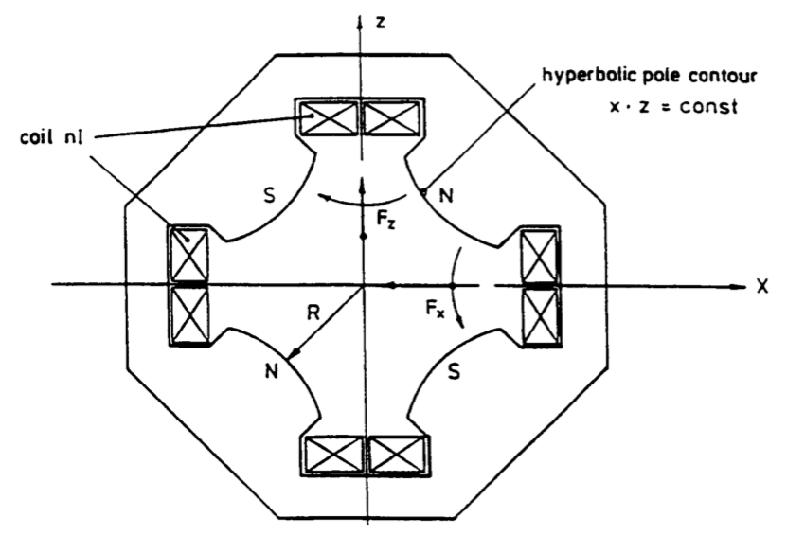
Quadrupoles
It is set by the
Current on the coils

Slide 42
Dynamics
x
L
Uniform B-field
x
s

Slide 43
Dynamics
x
L
s

Slide 44
Quadrupoles
The bending angle
depends on the quantity
If “k” is constant →
particles are focused
In the same way

Slide 45
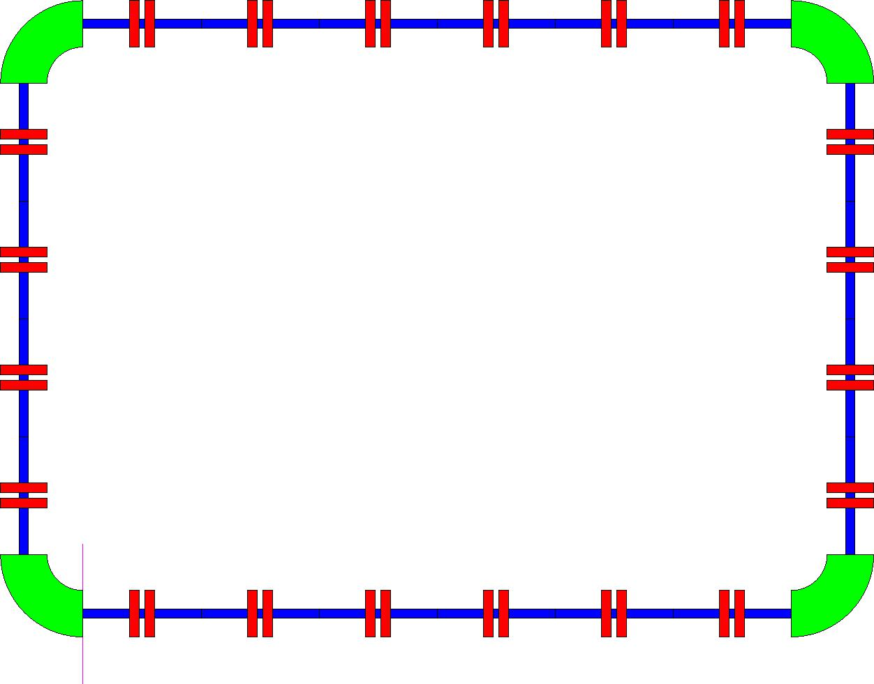
FODO structure
F
O
D

Slide 46
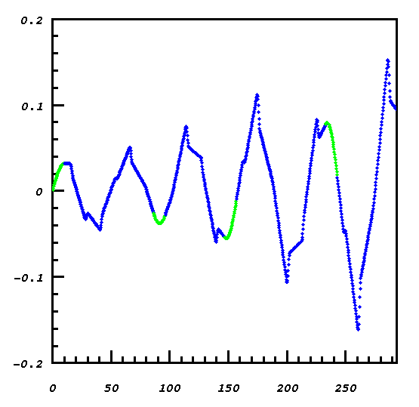
Stable dynamics
5
3
4
2
1
5 oscillations +
something
TUNE= number of
oscillations
Q_{x} = 5.15

Slide 47
4.295 oscillations
3.28 oscillations

Slide 48
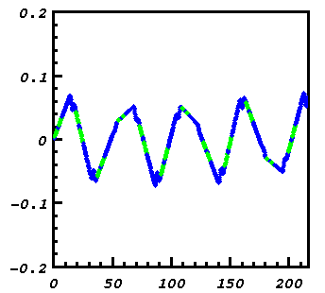
Qx = 4.34
1
2
3
4

Slide 49
Envelope
One particle
With a certain
Transverse energy
E

Slide 50
Envelope
2 particles
With a certain
Transverse energy
E

Slide 51
Envelope
10 particles
With a certain
Transverse energy
E

Slide 52
Envelope
200 particles
With a certain
Transverse energy
E

Slide 53
Transverse particle energy ?
Look at
trajectories
turn after turn
At length
30 meters

Slide 54
Particle trace first turn

Slide 55
Particle trace second turn

Slide 56
Particle trace 50 turns
It is the same
particle !
The energy is
The same

Slide 57
Plot x and x’
X’
This is the
Same particle
Turn after turn
The ellipse
means that the
energy is
preserved
x

Slide 58
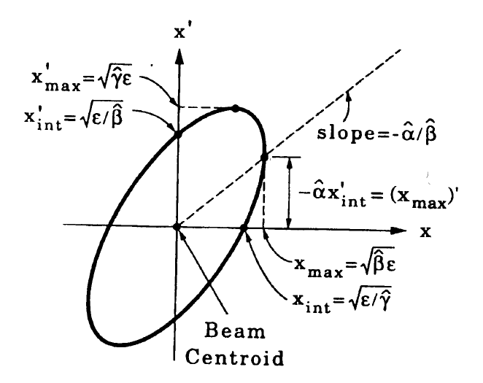
Feature of the ellipse
The orientation of the ellipse
Depends on the parameters
Area of the ellipse
=
𝜋

Slide 59
The ellipse rotate and stretch
x’
Lab
frame
x
x’
x
s

Slide 60
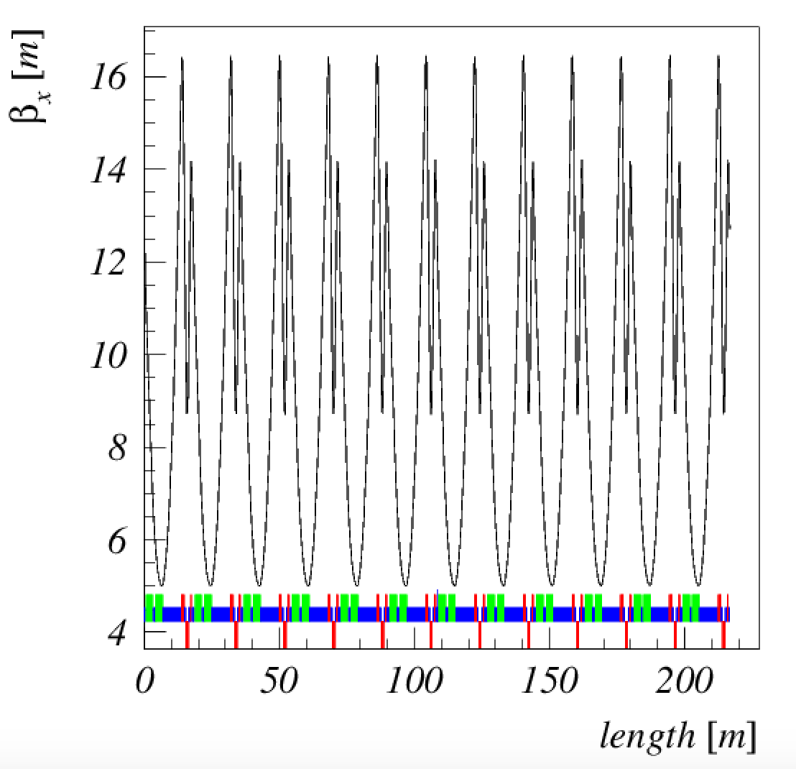
Optical functions

Slide 61
Injection of a beam: matched
X’
Fill with particles
Envelope
x

Slide 62
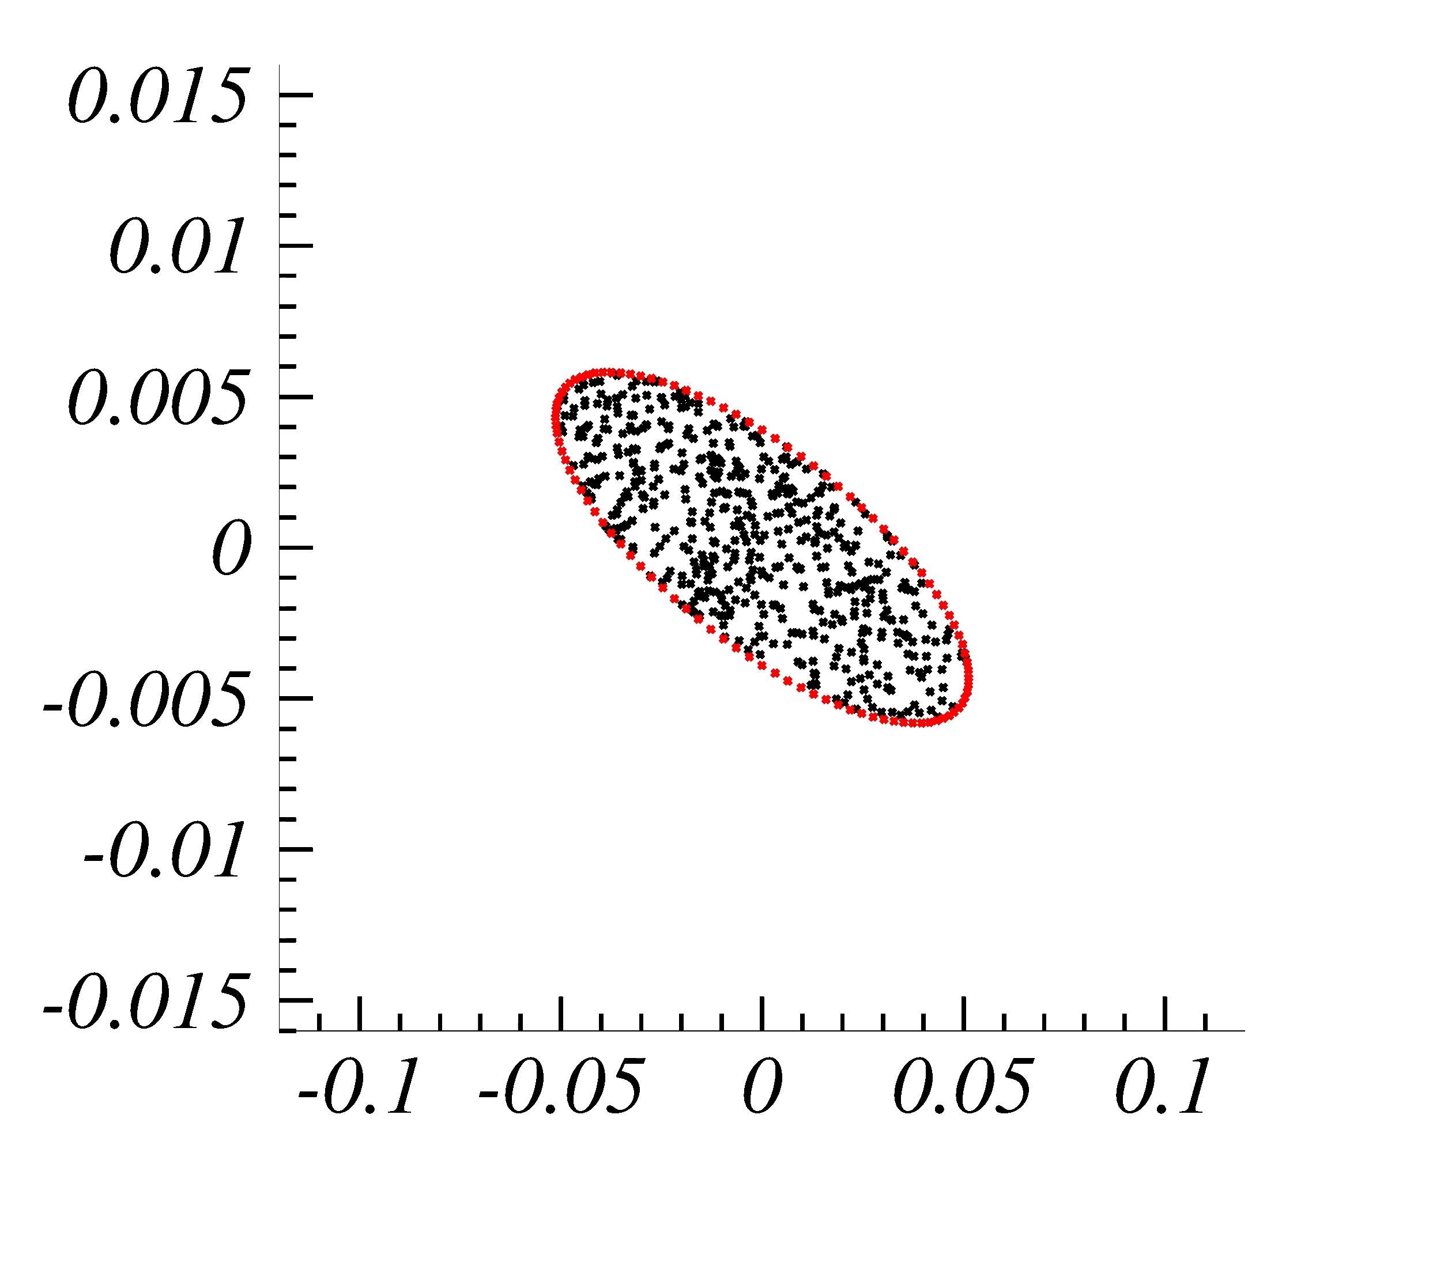
Injection of a beam: matched

Slide 63
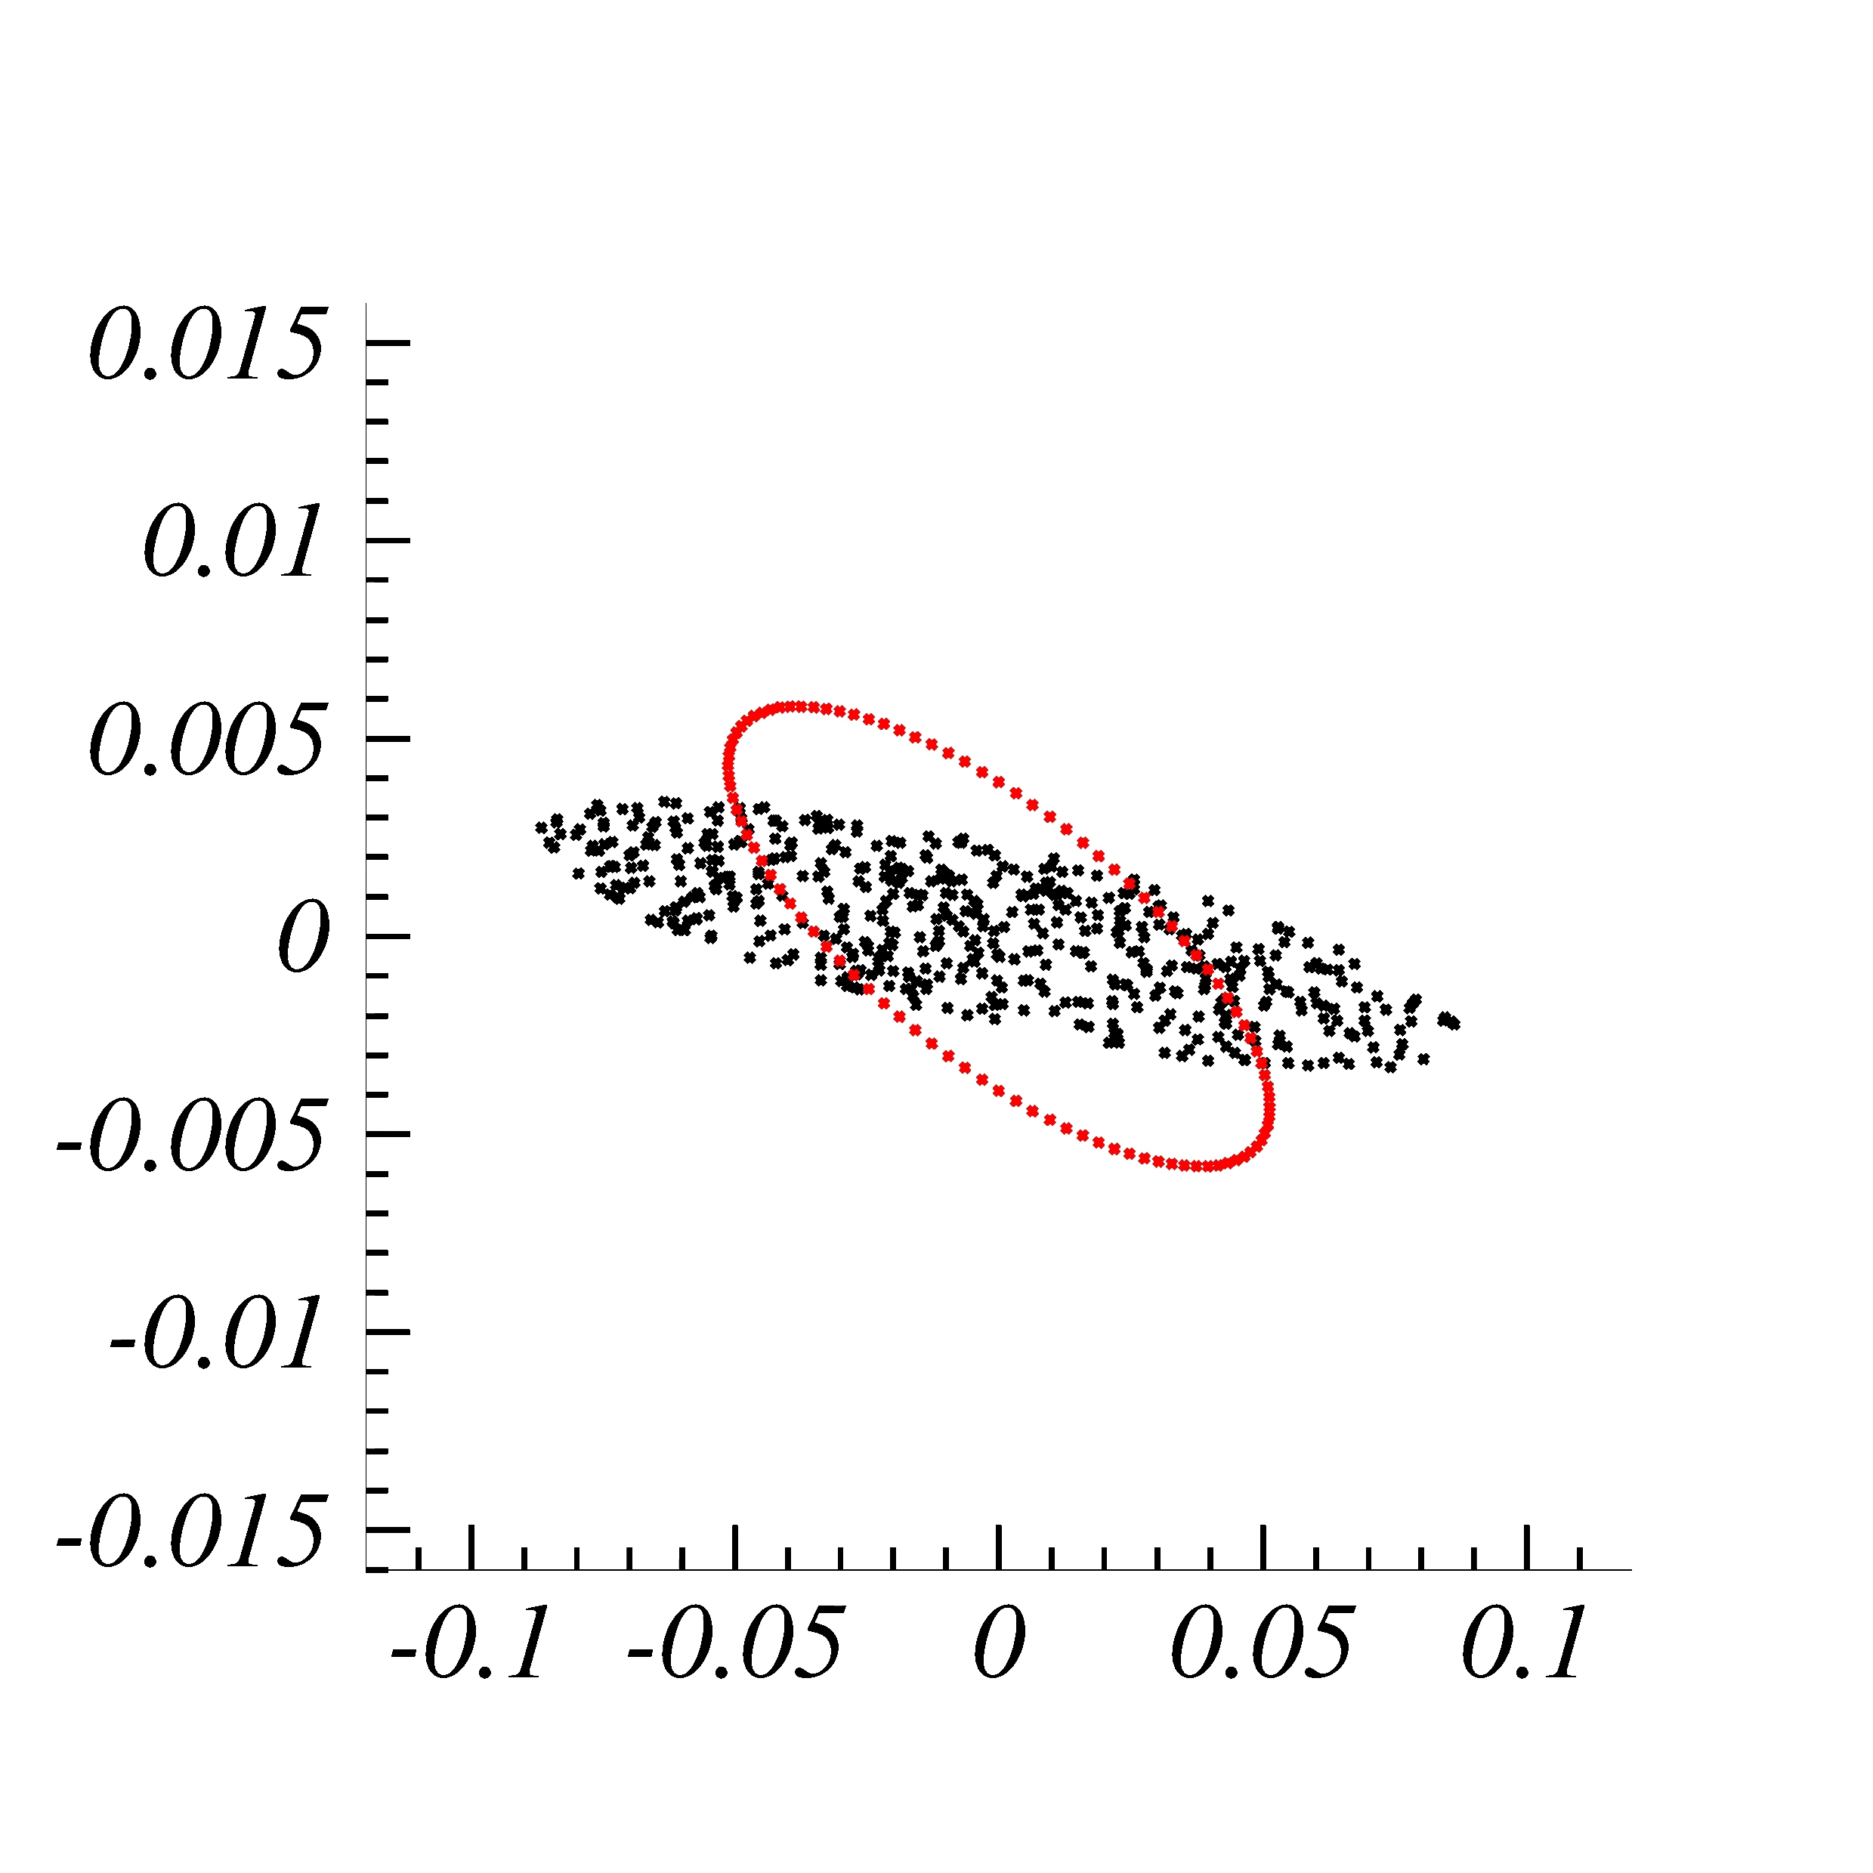
Mismatched beam: consequences

Slide 64
Second order effects
The tune is
Changed !!

Slide 65
Second order effects
Chromaticity
Tune is dependent on the off-momentum: each particle have a slightly different tune

Slide 66
High order effects: dp/p = 10⁻³
Emittance
Increase !!

Slide 67
Energy mismatch: new closed orbit
V
Uniform B-field
New closed
orbit
Transverse displacement

Slide 68
Dispersion
X’
X’f
(D_{x}, D’_{x} ) dp/p
xf
Position of
The new closed orbit
x

Slide 69
Dispersion changes along the ring
Dispersion in one period is SIS18

Slide 70
Dispersion Matching
X’
x

Slide 71
Dispersion mis-Matching
X’
(D_{x}, D’_{x} ) dp/p
x

Slide 72
Dispersion mis-Matching
X’
(D_{x}, D’_{x} ) dp/p
(D_{x}, D’_{x} ) dp/p
x

Slide 73
Driven systems → Resonances

Slide 74
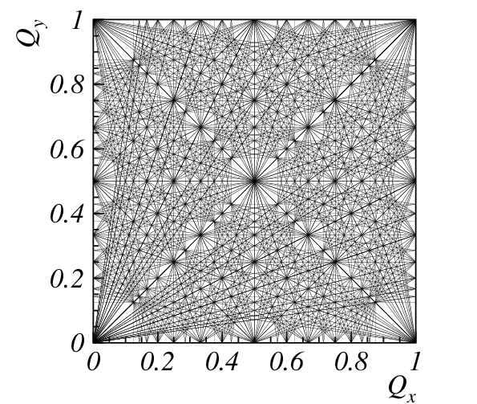
Resonances on working diagram
order

Slide 75
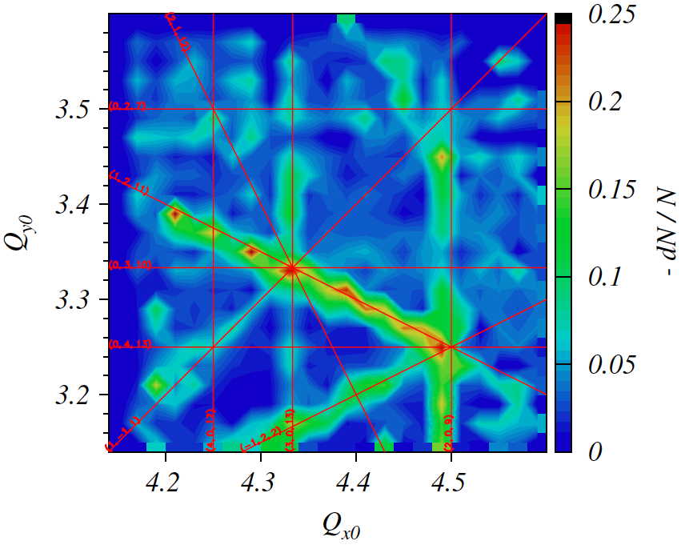
Resonances → SIS18

Slide 76
Resonances → SIS18
3 Qx = 13

Slide 77
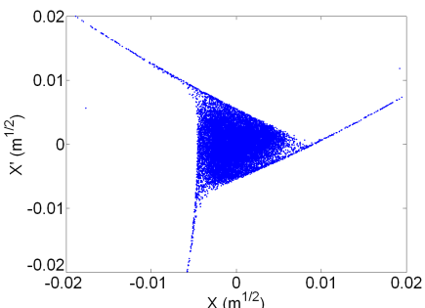
Effect of third order resonance
Away from any resonance
Near the 3rd order resonance
Phase space orbits are ellipses
Phase space orbits are deformed in triangles

Slide 78
More topics…
Courant-Snyder theory, optics
Closed orbit distortions, beta beats
Theory of resonances
High intensity, coupling with resonances
Ripples and emittance growth
Longitudinal dynamics, buckets and acceleration
For questions or discussion:
Giuliano Franchetti tel. 1535, g.franchetti@gsi.de

