Slide 1
HESR general overview and lattice
January 21, 2019 I Dieter Prasuhn

Slide 2
Outline
Experiments in HESR
Requirements for the system design
Lattice properties of HESR
Outlook

Slide 3
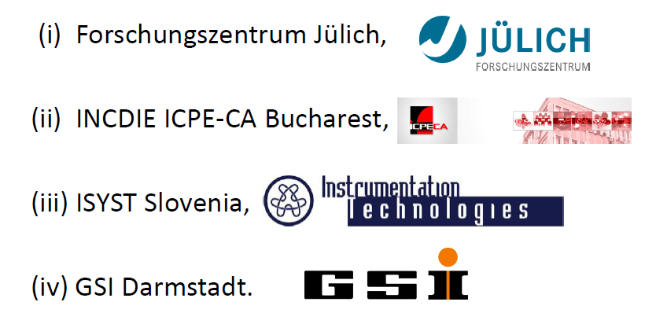
HESR consortium members

Slide 4
In-Kind contributions to HESR
Forschungszentrum: Leading Lab of the Consortium
System design, technical supervision
Delivery of all technical components except:
FAIR: Main dipol and quadrupol magnets
Romania: Sextupole and corrector magnets and
corresponding power converters
Slovenia: DAQ for beam diagnostics
Vacuum slow control
GSI: ACU and DCCT for PoCo, Controls

Slide 5
User collaborations interested in HESR
PANDA: Antiproton-proton interaction
APPA: Stored Particles Atomic Physics Research Collaboration
NUSTAR: Isomeric Beams, Lifetimes and Masses
Exotic nuclei studied in light ion induced reactions

Slide 6
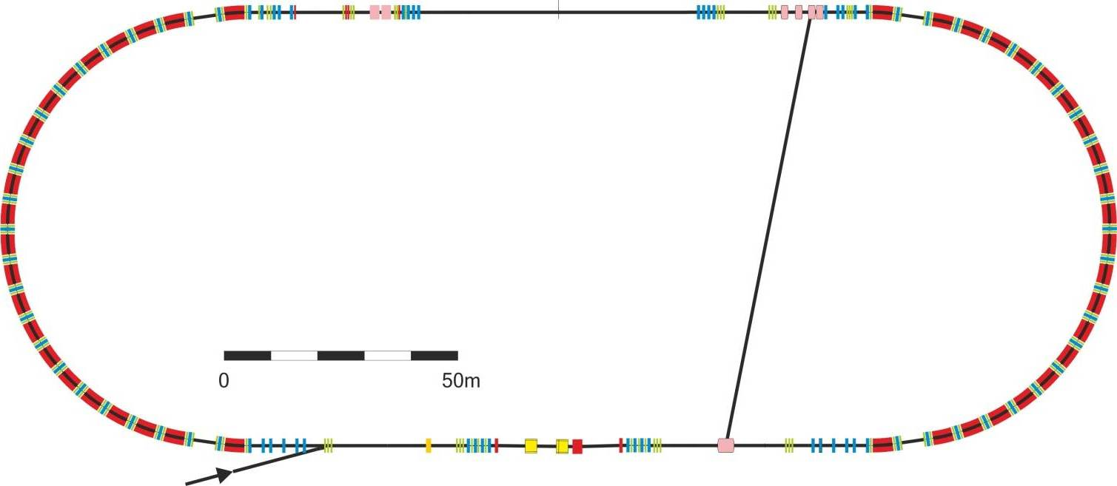
Locations for Experiment Collaborations
Proposed space for KOALA,
possibly also for ILIMA and EXL,
Locations for SPARC
Injection from CR
PANDA

Slide 7
Design criteria for the HESR
The HESR was originally designed as a synchrotron and storage ring for anti-proton physics with one internal user:
PANDA
So, PANDA defined the basic design criteria:
Momentum Range: 1.5 GeV/c 15 GeV/c
Strong cooling in the presence of a thick internal target

Slide 8
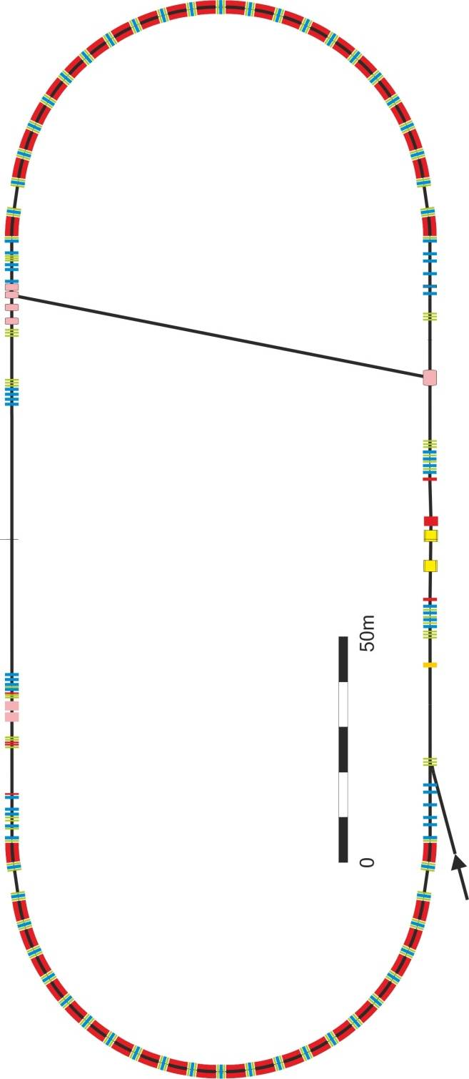
Basic Data of HESR
Circumference 574 m
2 arcs of 155 m
2 straight sections of 132 m
Magnetic rigidity: 5 – 50 Tm
Injection from CR at 13 Tm
Maximum dipole field: 1.7 T
Dipole field at injection: 0.4 T
Dipole field ramp: 0.025 T/s
Kicker
Stochastic cooling
PU
Electron cooler
PANDA
Injection from CR

Slide 9
Cooling in HESR
Electron cooling:
8 MeV electron cooler
Stochastic cooling:
for β>0.84
Frequency band 2-4 GHz

Slide 10
Modes of Operation with PANDA
Experiment Mode | High Resolution Mode | High Luminosity Mode
Target | Hydrogen Cluster / Pellet target with 4*10¹⁵ cm⁻²
rms-emittance | 1 mm mrad
Momentum range | 1.5 – 8.9 GeV/c | 1.5 – 15.0 GeV/c
Intensity | 1*10¹⁰ | 1*10¹¹
Luminosity | 2*10³¹ cm⁻² s⁻¹ | 2*10³² cm⁻² s⁻¹
rms-momentum resolution | 5*10⁻⁵ | 1*10⁻⁴
1.5 – 15 GeV/c

Slide 11
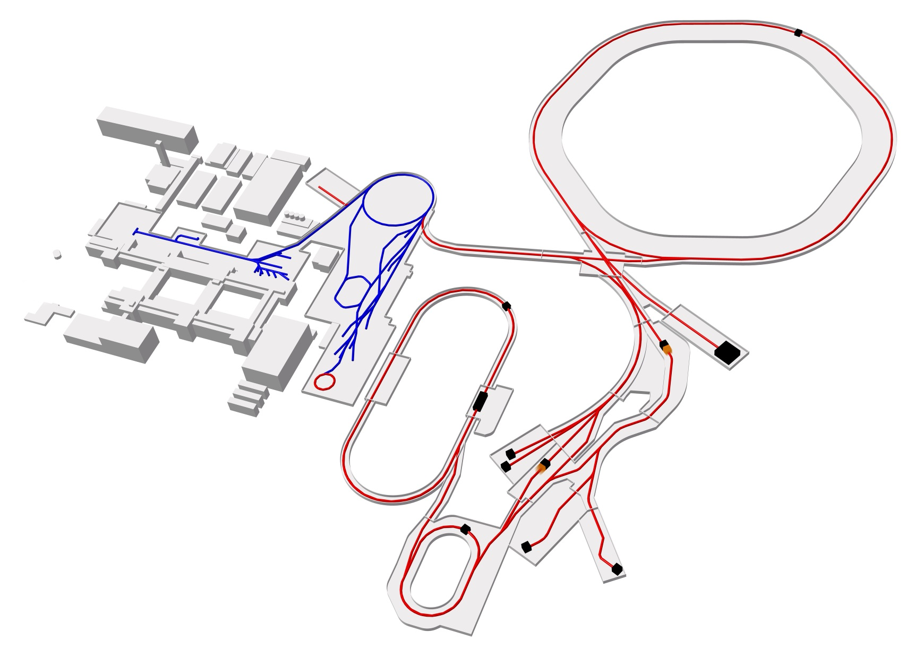
Antiproton Chain for the MSV
acceleration in p-linac to 70 MeV
multiturn injection into SIS18, acceleration to 4 GeV
transfer of 4 SIS pulses to SIS100
acceleration to 29 GeV and extraction of single bunch
antiproton target and separator for 3 GeV antiprotons
collection and 10 s pre-cooling of 10⁸ p-bars in the Collector Ring CR
Every 10 s transfer of 10⁸ p-bars at 3 GeV to HESR
accumulation and storage of antiprotons in the HESR

Slide 12
The accumulation process in HESR

Slide 13
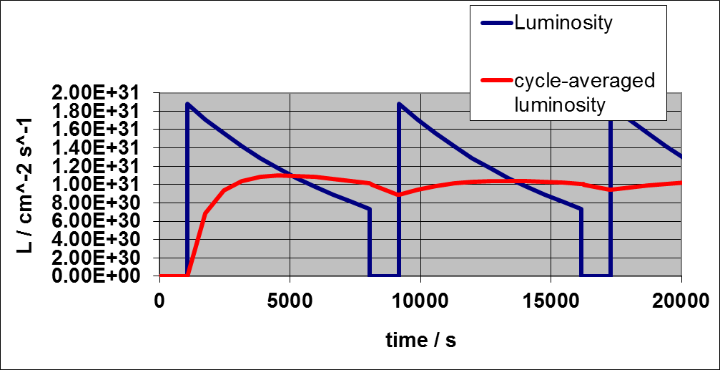

Slide 14
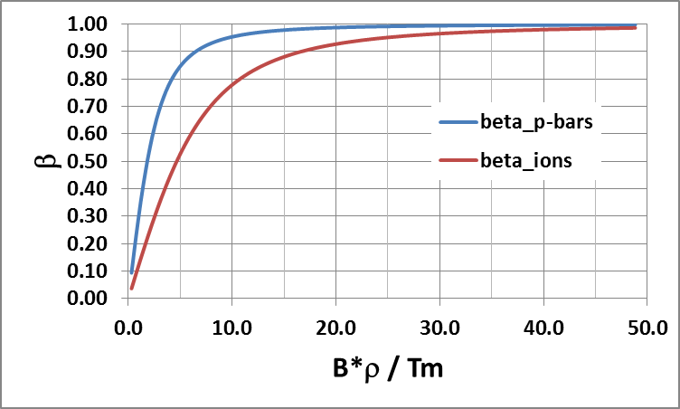
Velocities of ions as function of Bρ
Momentum range of HESR
Original stoch. cooling system
Injection momentum

Slide 15
Lattice Requirements
Flexibel ion optics:
Optimum optics for injection and accumulation
Acceleration without γ_{tr} crossing
Propper phase advance for stochastic cooling
Adjustable γ_{tr} for optimal mixing at different energies
Low β-values at interaction point of PANDA

Slide 16
The lattice
Lattice is mirror symmetrical about both central axes
Bending sections with missing dipole sections for D=D‘=0 in the straight sections
Straight sections quasi telescopic
Tunes and γ_{tr} are defined by the setting of quadrupoles in the arcs
γ_{tr} can be varied at constant tunes
Tunes are optimized for the required phase advance between StoCo Pickup and Kicker
Sextupoles in the arcs are used to optimize chromaticity
Sextupoles in the straights optimize the dynamic aperture

Slide 17
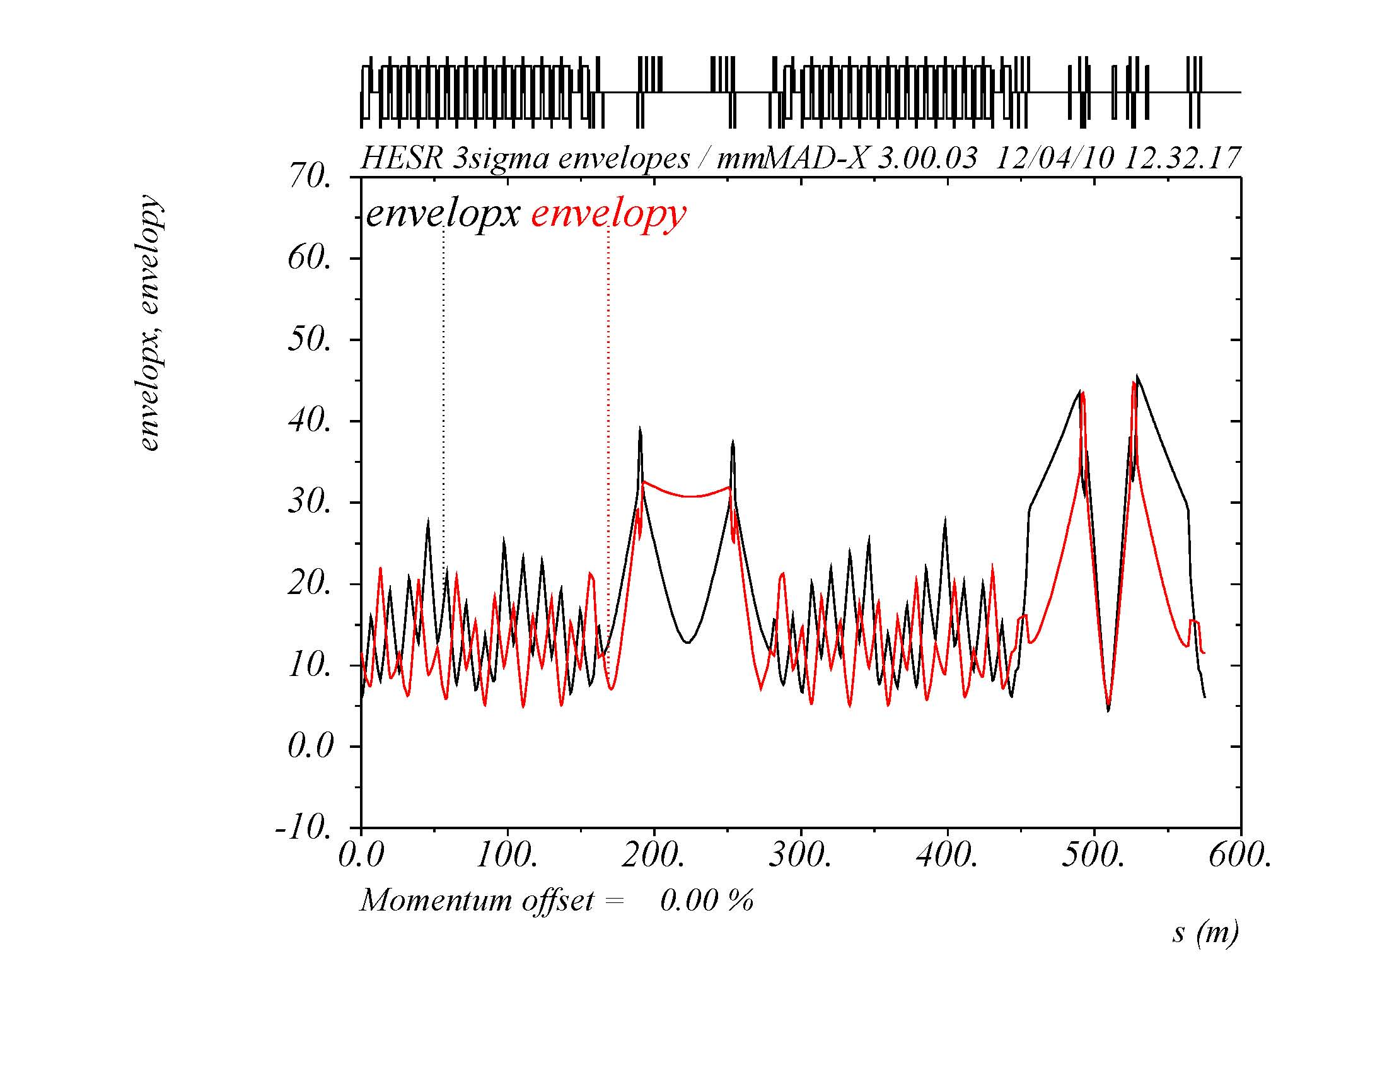
3.8 GeV/c
Qx=7.611
Qy=7.613
γtr=6.2
Injection and
Accumulation

Slide 18
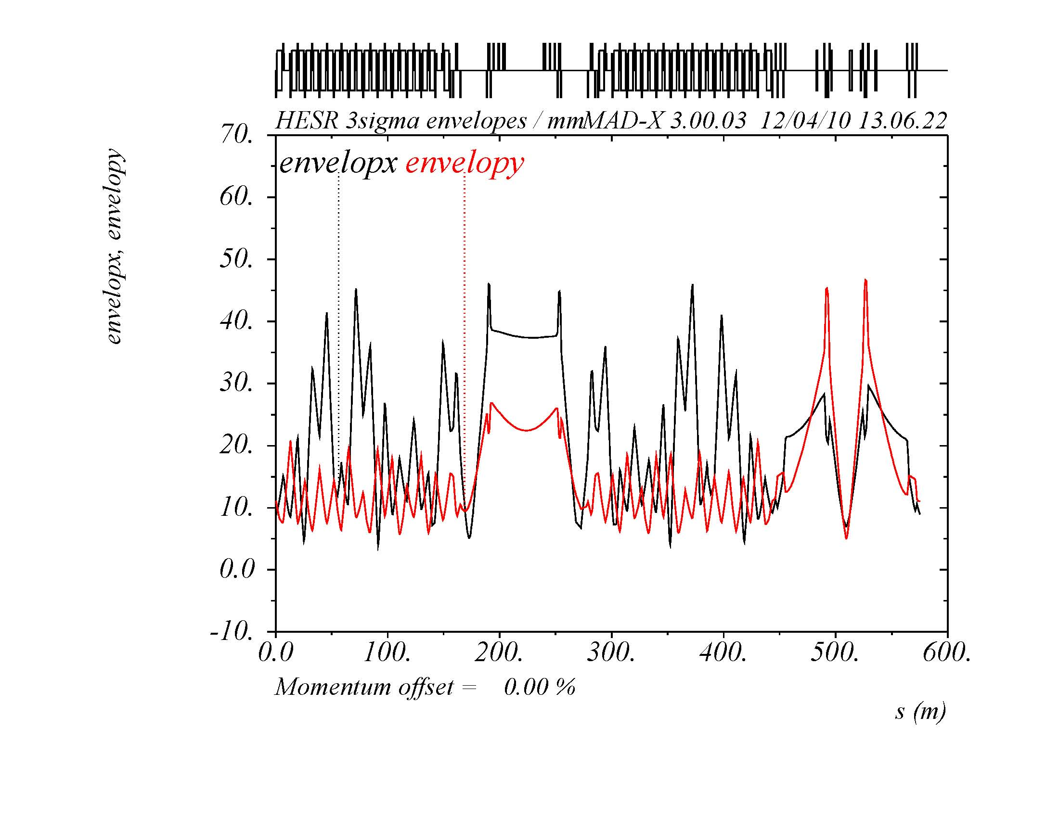
3.8 GeV/c
Qx=7.614
Qy=7.613
γtr=18.72
acceleration

Slide 19
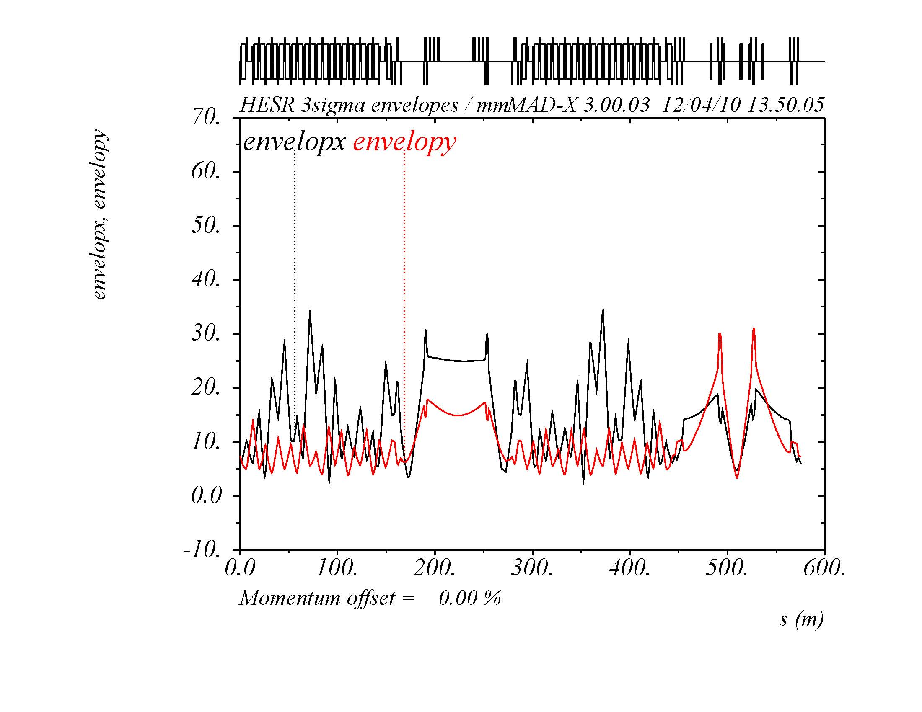
8.0 GeV/c
Qx=7.614
Qy=7.613
γtr=18.72
debunching

Slide 20
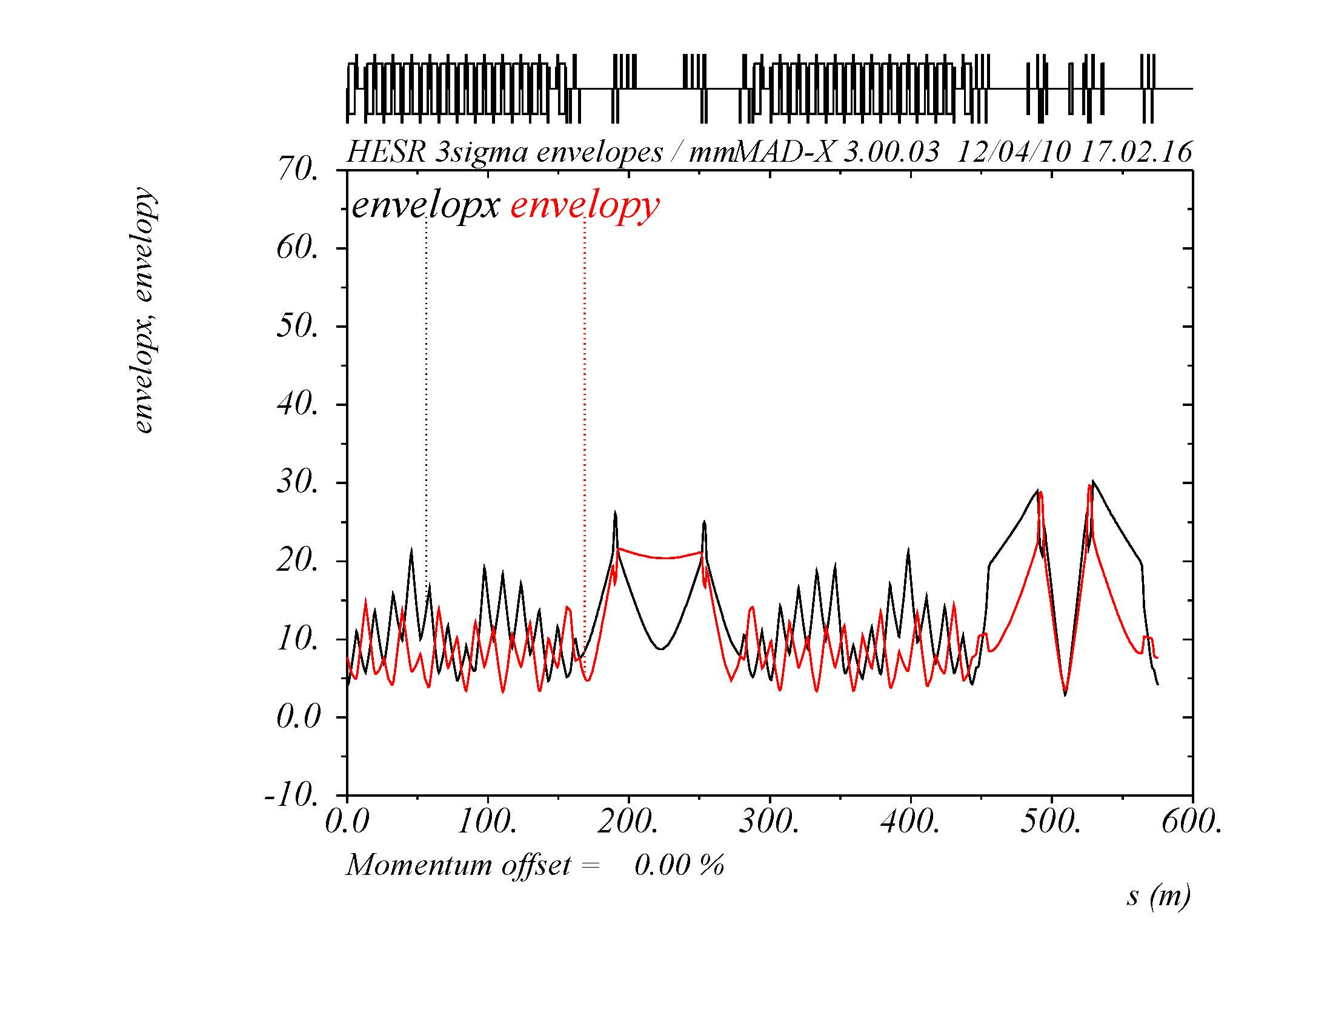
8.0 GeV/c
Qx=7.611
Qy=7.613
γtr=6.2
rebunching

Slide 21
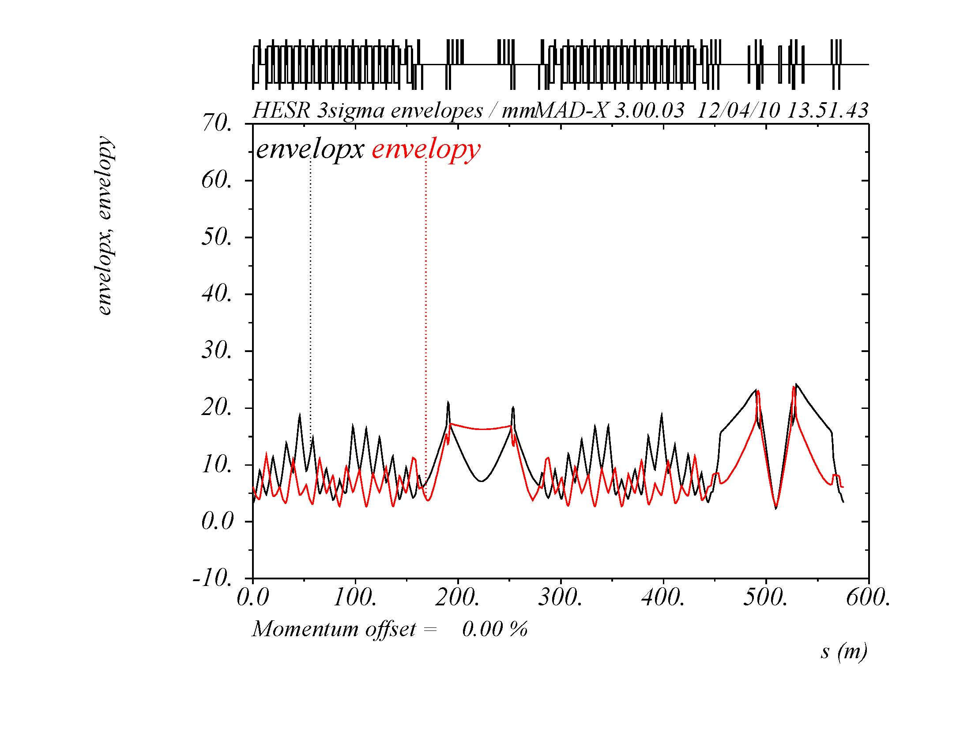
15.0 GeV/c
Qx=7.611
Qy=7.613
γtr=6.2
change to
experiment
optics

Slide 22
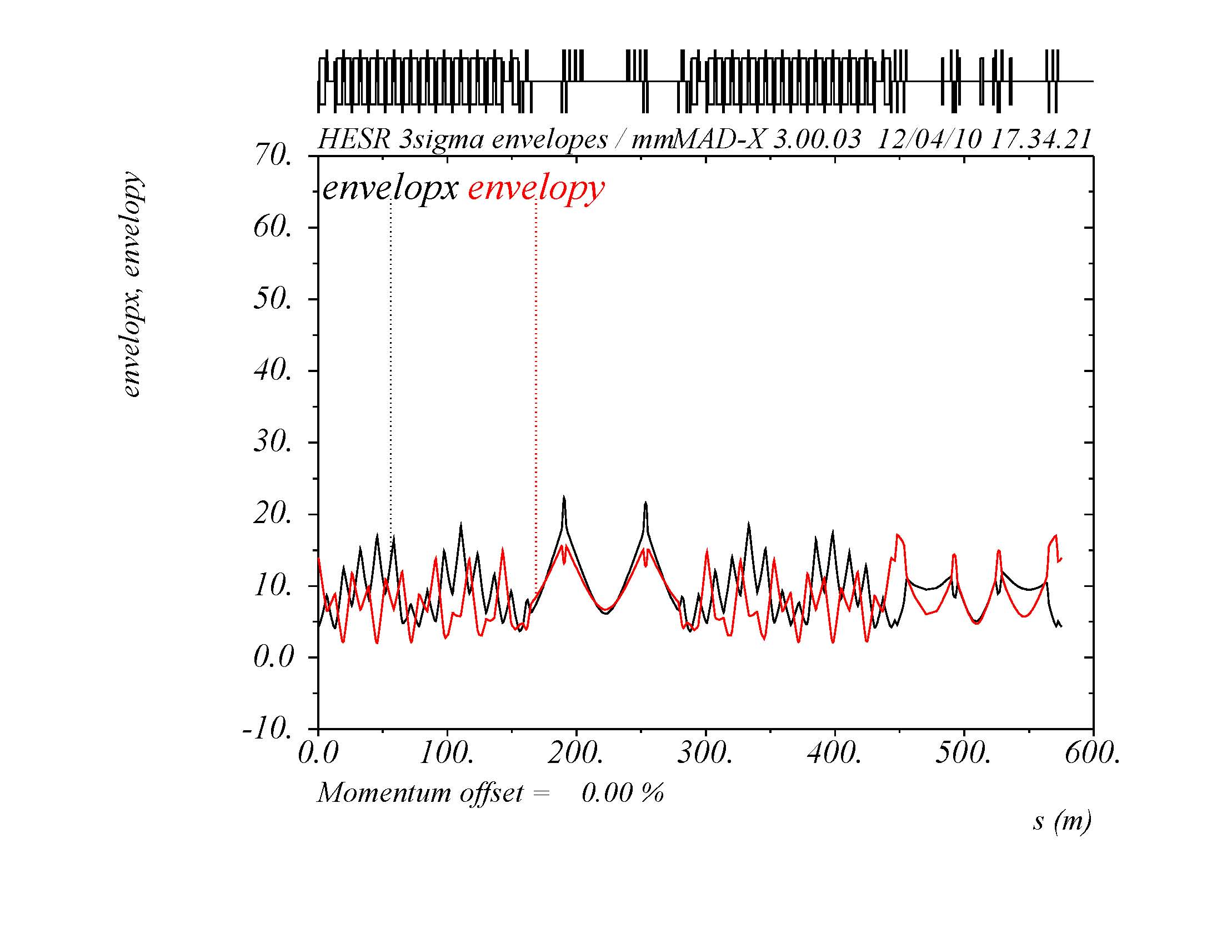
15.0 GeV/c
Qx=7.608
Qy=7.608
γtr=6.2

Slide 23
Outlook
The HESR lattice design
fullfills the requirements for internal target experiments
optimizes conditions for stochastic cooling
fullfills also requirements for electron cooling (in a later stage)
We expect that
all components for the HESR are delivered end of 2020
can be installed as soon as the building is ready (2023)
and then commissioned
with beam after CR commissioning
or earlier with a separate injection line from SIS18/ESR

Slide 24
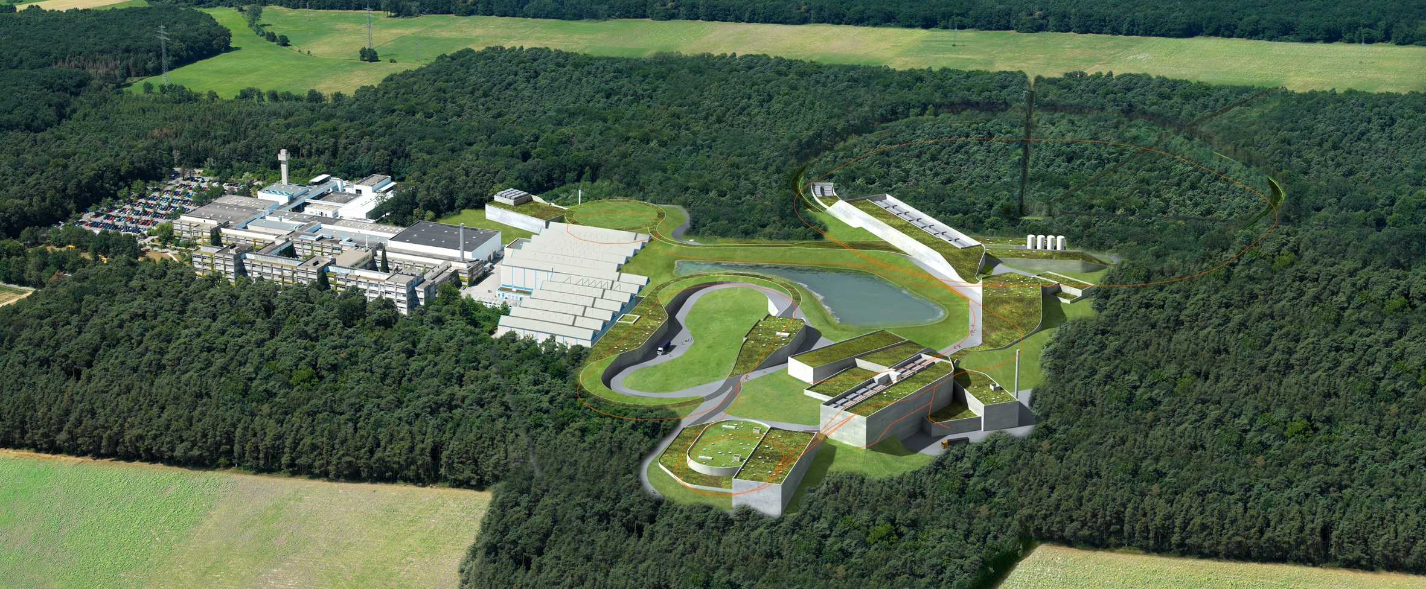
Thank you for your attention
Thank you for your attention

