Slide 1

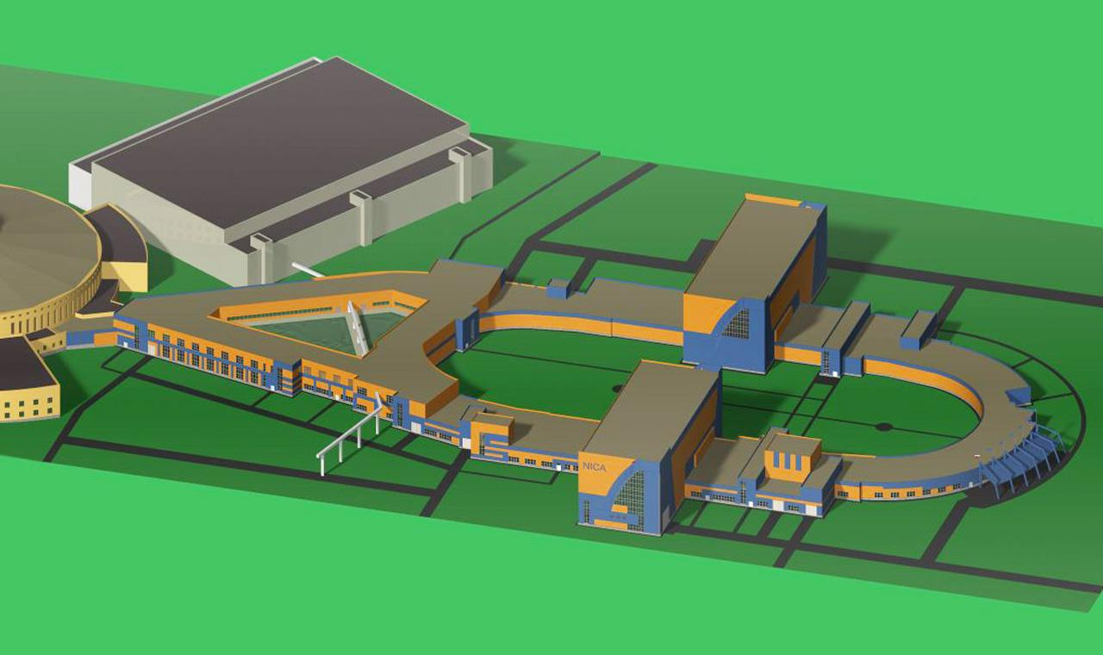

NICA in heavy ion mode – status and plans

Slide 2
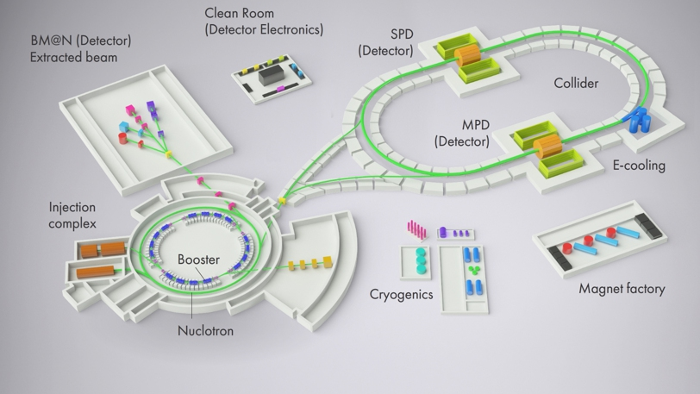
Heavy ion colliding beams up to ¹⁹⁷Au⁷⁹⁺ + ¹⁹⁷Au⁷⁹⁺
at √s_{NN} = 4 ÷ 11 GeV , L_{average}= 1x10²⁷ cm⁻²⋅s⁻¹
Light-Heavy ion colliding beams of the same energy range and L
Polarized beams of protons and deuterons in collider mode:
p↑p↑ √s_{pp} = 12 ÷ 26 GeV L_{max} ≈ 1x10³² cm⁻²⋅s⁻¹
d↑d↑ √s_{NN} = 4 ÷ 13.8 GeV
NICA beams
Extracted beams of light ions and polarized p and d for fixed target experiments:
Li ÷ Au = 1 ÷ 4.5 GeV /u ion kinetic energy
p, p↑ = 5 ÷ 12.6 GeV kinetic energy
d, d↑ = 2 ÷ 5.9 GeV/u ion kinetic energy

Slide 3

Stages of the experimental program realization
Stage I
Fixed target experiment with heavy ions
Stage II
Basic configuration of the collider and detector
Full configuration, heavy ion collisions
Collisions of heavy ions with light ions (protons)
Stage III
Spin physics program

Slide 4
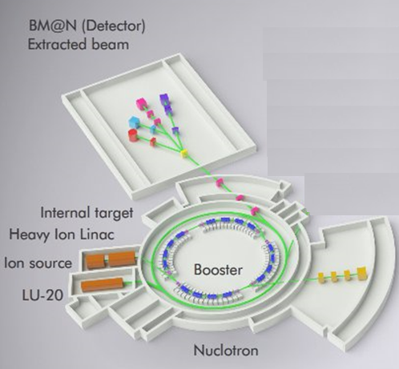
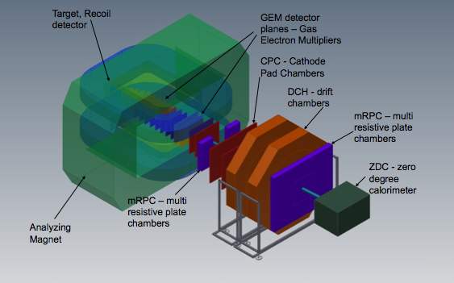
Experiment
“The Baryonic Matter at Nuclotron”
- fixed target experiment at the Nuclotron extracted beams
which main goals are investigations of strange / multi-strange hyperons, hypernuclei production and short range correlations
NICA Stage I:
Injection complex: KRION, HILAc, LU20
Synchrotron Booster
BT Line Booster – Nuclotron
Nuclotron upgraded
BM@N Detector setup
Parameters:
E_{beam} = 1-6 GeV/u; beams: from p to Au; Intensity~10⁷ s⁻¹ (Au)

Slide 5
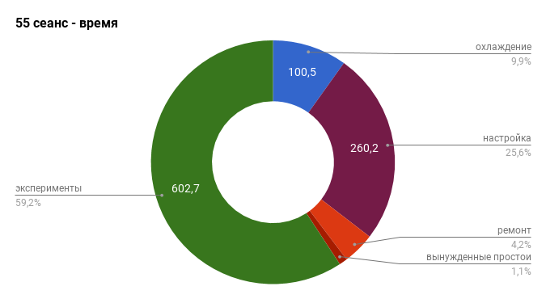
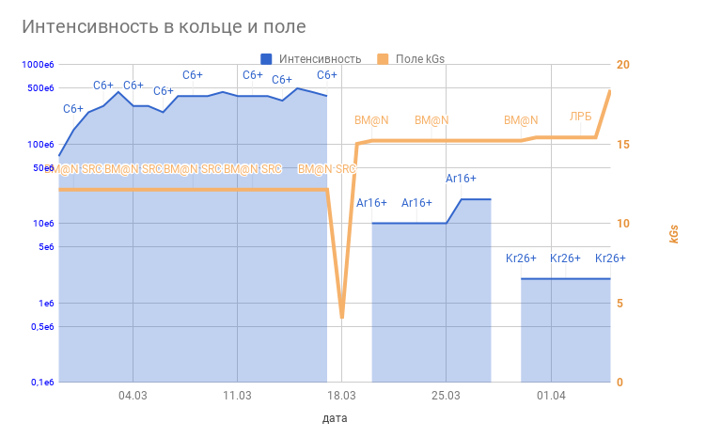
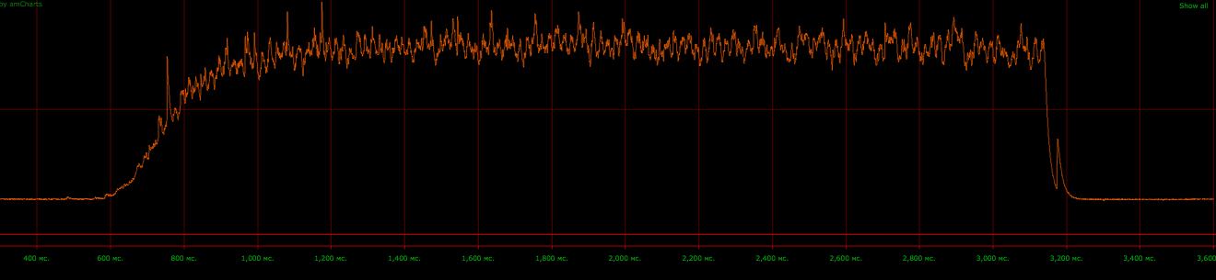
Run 55: February – April 2018
Two tech runs @ 2016-2017
the first run with startup configuration of BM@N
experiment BM@N SRC
30/03/2018
Kr²⁶⁺
0,5
1,0
1,5
2,0
2,5
3,0
s
¹²C BM@N SRC
⁴⁰Ar ⁸⁴Kr BM@N
03.04

Slide 6
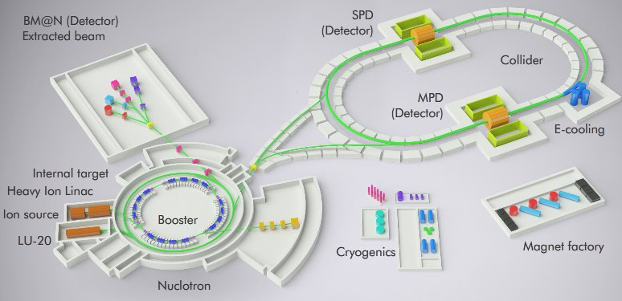
NICA-MPD heavy-ion program
NICA Stage II:
The stage II is split in two phases:
Stage II-a: The basic configuration of the NICA complex
Stage II-b: The project (full) configuration of the NICA complex

Slide 7
Facility components – status
2015-2018
KRION
Linac HILAc
KRION
Linac HILac
Ion sources
Booster (25 Tm)
1(2-3) single-turn injection,
storage of (2 ÷ 4)×10⁹ ions,
acceleration up to 100 MeV/u,
electron cooling, acceleration
up to 600 MeV/u
Ion sources
Booster (25 Tm)
1(2-3) single-turn injection,
storage of (2 ÷ 4)×10⁹ ions,
acceleration up to 100 MeV/u,
electron cooling, acceleration
up to 600 MeV/u
Linac LU-20
Linac LU-20
Fixed Target Area
Fixed Target Area
Slow resonance extraction
Stripping (80%) ¹⁹⁷Au³¹⁺ => ¹⁹⁷Au⁷⁹⁺
IP-2
Nuclotron (45 Tm)
injection of one bunch
of ≤ 2×10⁹ ions,
acceleration up to
1 - 4.5 GeV/u max.
Nuclotron (45 Tm)
injection of one bunch
of ≤ 2×10⁹ ions,
acceleration up to
1 - 4.5 GeV/u max.
Collider
L ≥ 10²⁷ см⁻²с⁻¹
IP-1
work in progress
assembly
commissioned / existing

Slide 8
Facility components – status
2019
KRION
Linac HILac
KRION
Linac HILac
Ion sources
Booster (25 Tm)
1(2-3) single-turn injection,
storage of (2 ÷ 4)×10⁹ ions,
acceleration up to 100 MeV/u,
electron cooling, acceleration
up to 600 MeV/u
Ion sources
Booster (25 Tm)
1(2-3) single-turn injection,
storage of (2 ÷ 4)×10⁹ ions,
acceleration up to 100 MeV/u,
electron cooling, acceleration
up to 578 MeV/u
Linac LU-20
Linac LU-20
Fixed Target Area
Fixed Target Area
Slow resonance extraction
Stripping (80%) ¹⁹⁷Au³¹⁺ => ¹⁹⁷Au⁷⁹⁺
IP-2
Nuclotron (45 Tm)
injection of one bunch
of ≤ 2×10⁹ ions,
acceleration up to
1 - 4.5 GeV/u max.
Nuclotron (45 Tm)
injection of one bunch
of ≤ 2×10⁹ ions,
acceleration up to
1 - 4.5 GeV/u max.
Collider
L ≥ 10²⁷ см⁻²с⁻¹
IP-1
work in progress
assembly
commissioned / existing

Slide 9
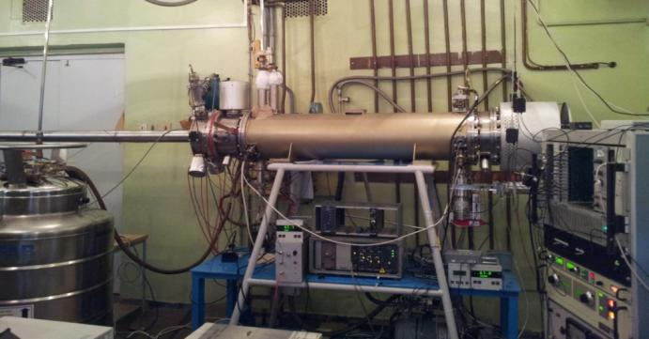
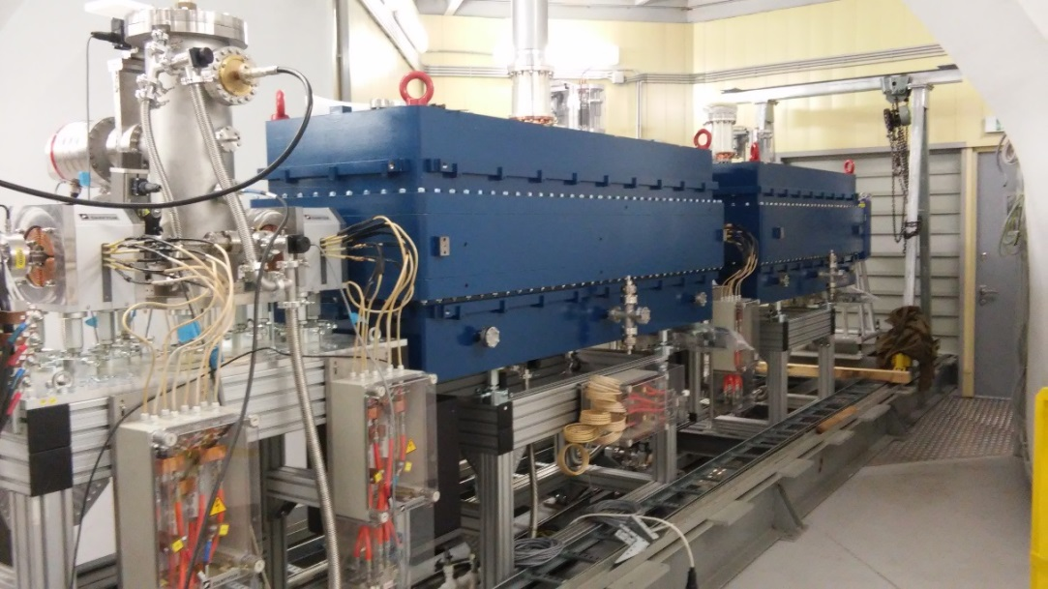
Injection - chain
for heavy ions
KRION
Linac HILAc
KRION
Linac HILac
Heavy ion source KRION ESIS type project up to 1.5·10⁹ Au³¹⁺ particles per cycle (achived 5·10⁸ Au³¹⁺ )
at repetition frequency up to 10 Hz
Booster (25 Tm)
up to 578 MeV/u
Overall commissioning
3.2 MeV/u, Au³¹⁺, 10.2016
Nuclotron (45 Tm)
up to 4.5 GeV/u

Slide 10
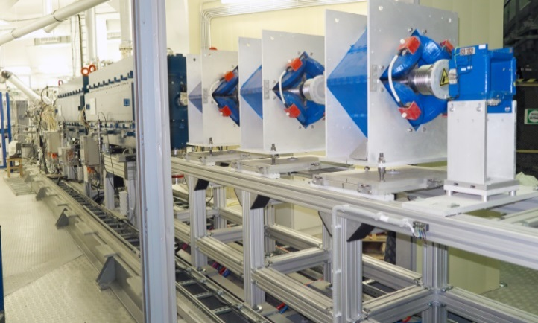
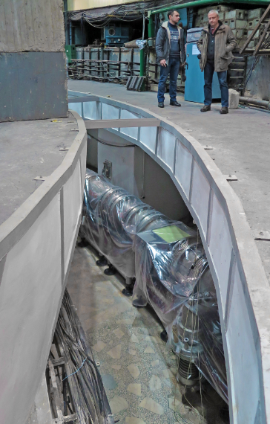
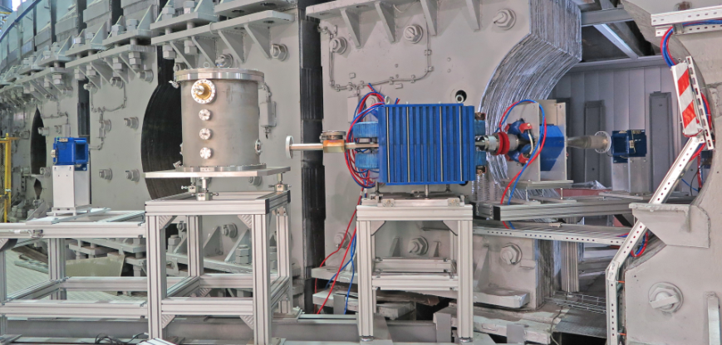
Injection - chain
for heavy ions
KRION
Linac HILAc
KRION
Linac HILac
HiLac – Booster
channel
mounting started
Booster (25 Tm)
up to 578 MeV/u
Nuclotron (45 Tm)
up to 4.5 GeV/u
17.01.19
Booster - Nuclotron
channel contracted to BINP
commissioning at end of 2019

Slide 11
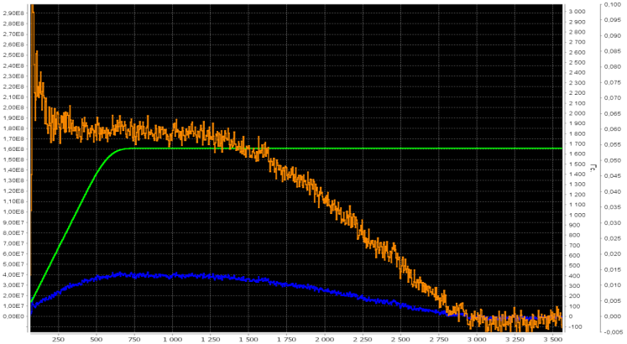
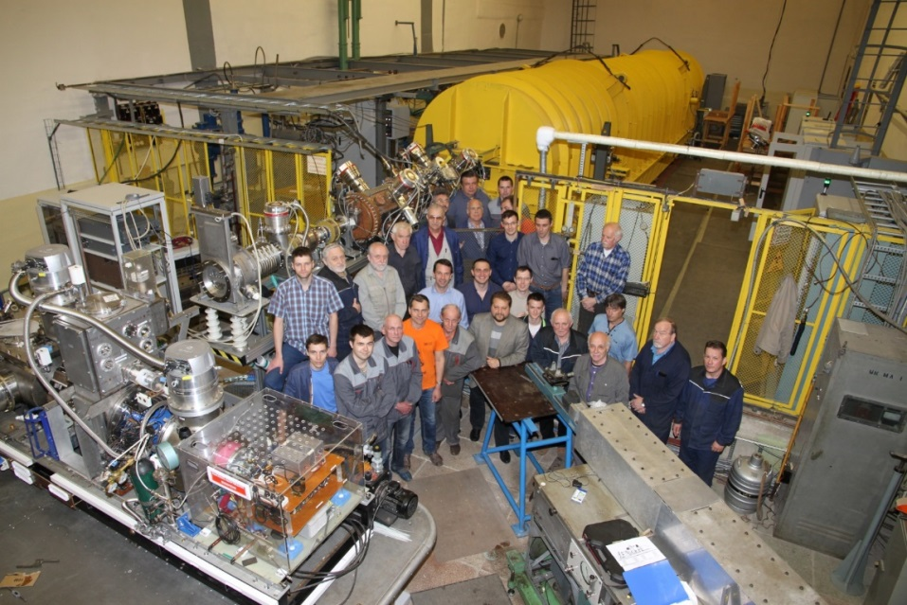
Injection - chain
for light ions
New fore-injector for LU-20 with buncher + Source of Polarized Ions
1.8 E8
Ion sources
Ion sources
Linac LU-20
Linac LU-20
Polarized protons
JINR, INR, ITEP, MEPHI,
Resonator is fabricated in Sneshinsk
Nuclotron (45 Tm)
up to 4.5 GeV/u
3 runs in 2016-2017 (#52-54) with d↑, 1 run (#54) with stable p↑ beam
 | Polarized deutrons | Polarized protons
Obtained beam current in 2017 (source) | 2 mA | 0.4 mA
Project beam current (source) | 5-6 mA | 5-6 mA
Obtained beam intensity in 2017 (Nuclotron) | 2.2x10⁹ ppc | 1.8x10⁸ ppc
Project beam intensity (Nuclotron) | 1-2x10¹⁰ ppc | 1-2x10¹⁰ ppc

Slide 12
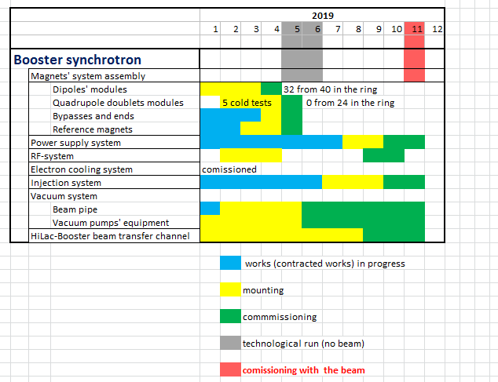
Time-schedule
Booster
Booster (25 Tm)
up to 578 MeV/u
Apr-May 2019 –
technological run
Oct-Nov 2019
- commissioning with the beam

Slide 13
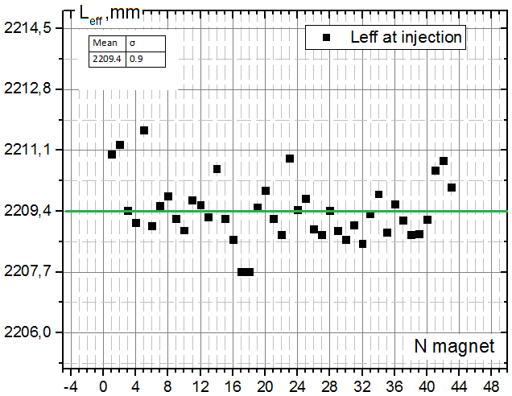
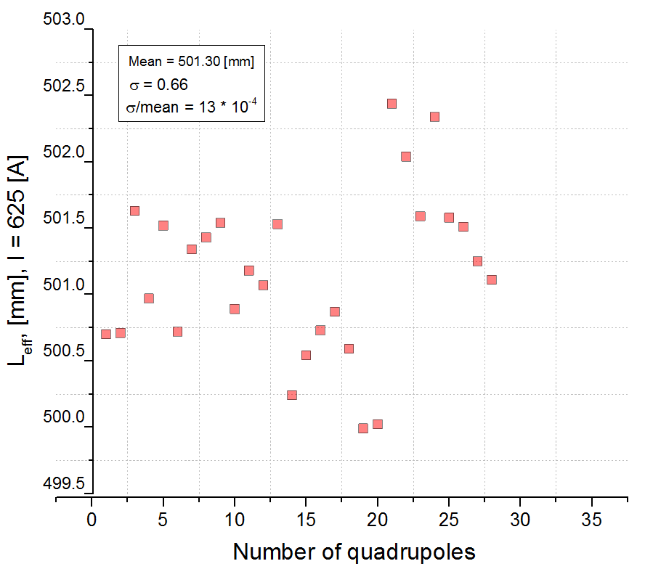
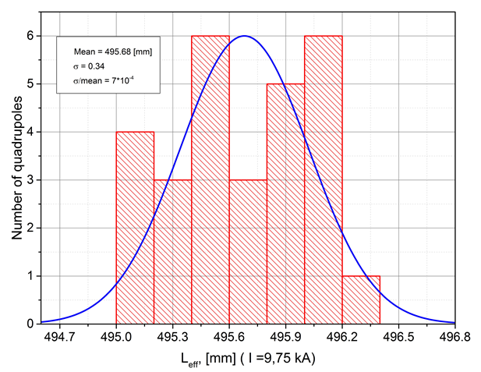
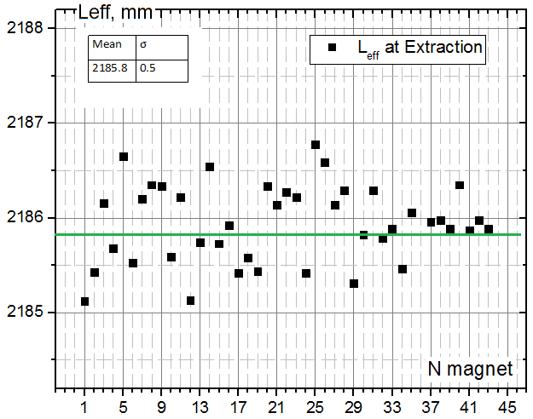
Booster dipoles
Testing results
Booster quadrupoles
Leff. @ 625 A
σrms = 4*10^(-4)
Leff. @ 9745 A
σrms = 2.3*10^(-4)

Slide 14
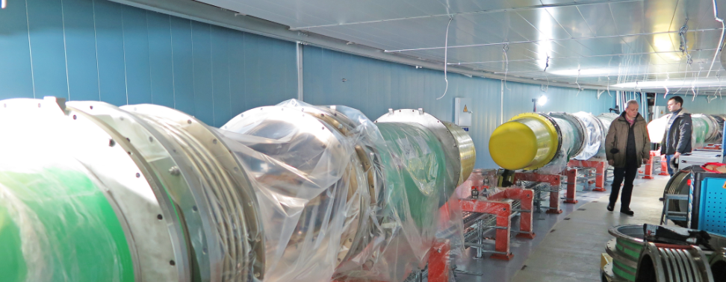
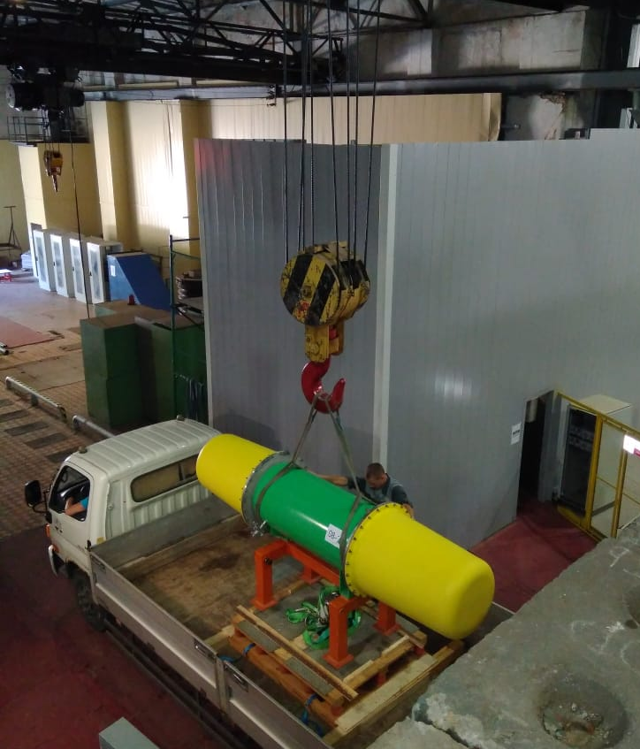
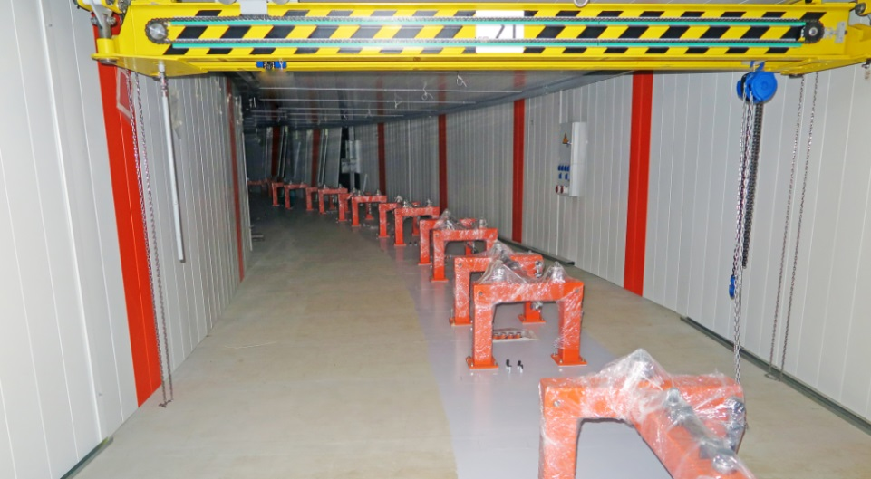
Booster
20 dipoles’ units delivered to the tunnel
Booster (25 Tm)
up to 578 MeV/u
17.01.19

Slide 15
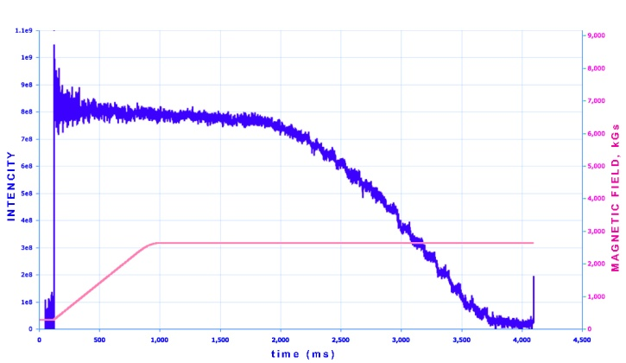
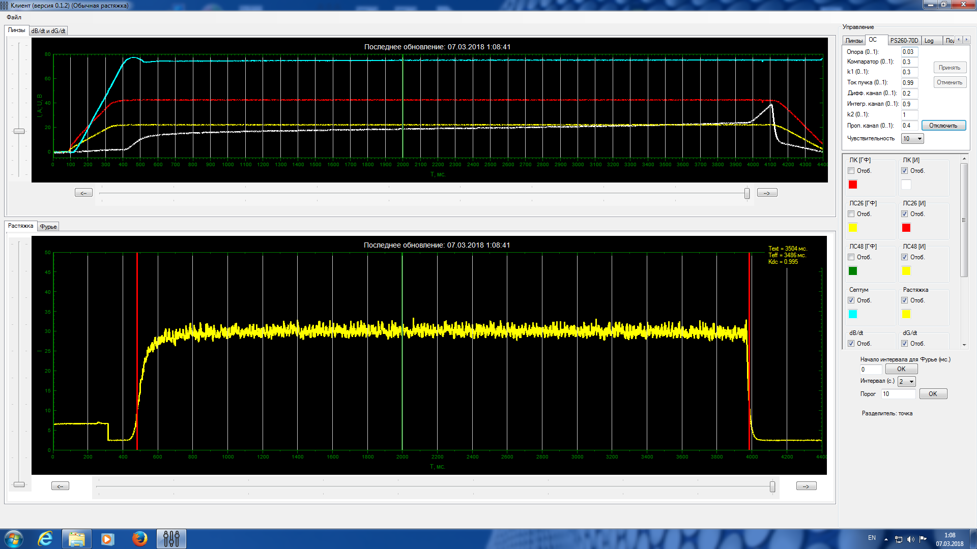
Nuclotron: polarized deuterons and protons
8E8
Routine operation of SPI and new fore-injector
Polarized deuterons acceleration: Intensity up to 2*10⁹ per cycle
Nuclotron: slow extraction
¹²C⁺⁶ beam extraction (3,5 Gev/u) RUN #55 (05.02.18-05.04.18)
¹²C⁺⁶ 5*10⁸ T_{spill} = 4s, k_{dc}= 99,5%
Nuclotron: tasks
for 2020
Acceleration of ¹⁹⁷Au⁷⁹⁺ up to 4.5 GeV/u
Injection system for ¹⁹⁷Au⁷⁹⁺ from Booster at 578 MeV/u
Slow extraction system for ¹⁹⁷Au⁷⁹⁺ at 1 ÷ 4.5 GeV/u

Slide 16
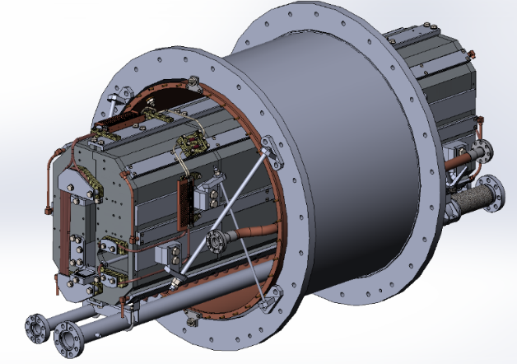
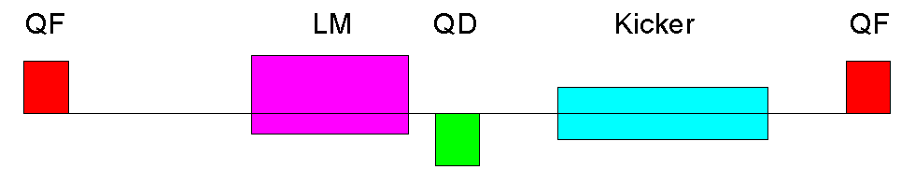
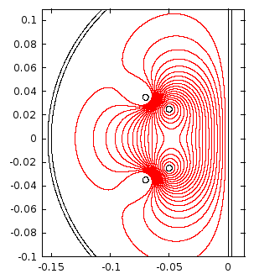
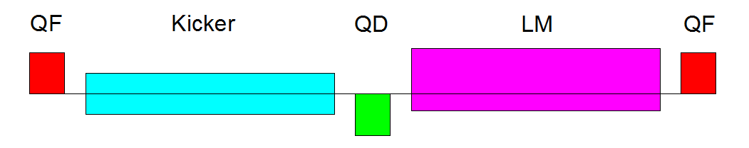
Nuclotron high energy beam injection system
Lambertson magnets are based on existing spare yokes for slow extraction system of Nuclotron
Concept has been developed
Nuclotron fast extraction system
Design of a cold kickers is in progress
Warm prototype for mechanical tests has been manufactured
Nuclotron (45 Tm)
up to
4.5 GeV/u max.
16

Slide 17
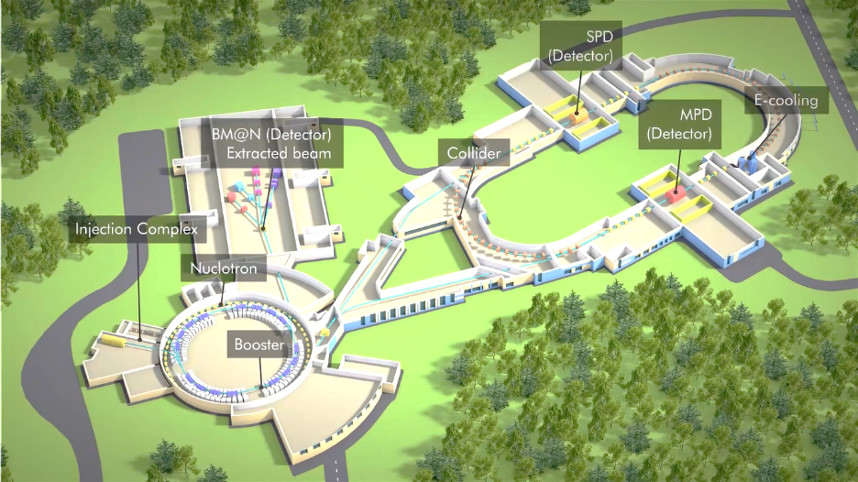

Nuclotron-Collider beam transport channel
Magnetic element | Number | Effective length, m | Max. magnetic field (gradient), T (T/m)
Long dipole | 21 | 2 | 1.5
Short dipole | 6 | 1.2 | 1.5
Quadrupole Q10 | 22 | 0.353 | 31
Quadrupole Q15 | 6 | 0.519 | 31
Steerer | 33 | 0.466 | 0.114
Magnets of the Nuclotron-Collider channel are in development by SigmaPhi.

Slide 18
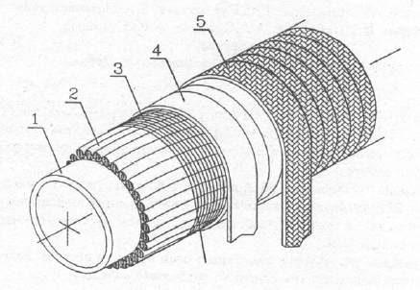
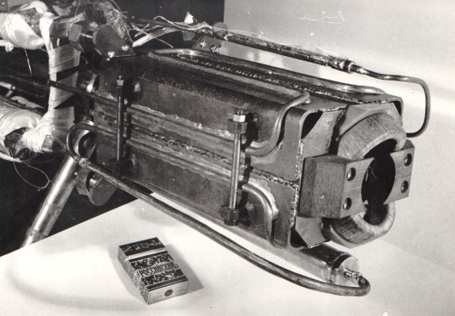
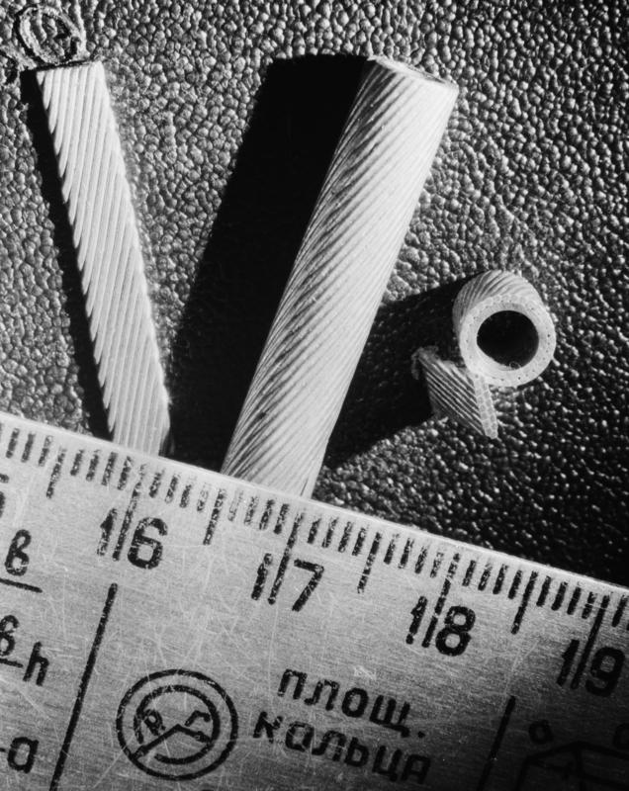
NICA Collider
Nuclotron magnets’ technology
SC-cable
Developed at 1980-th…
“Nuclotron”-cable
SC-magnets for synchrotrons
“Nuclotron”- magnets

Slide 19
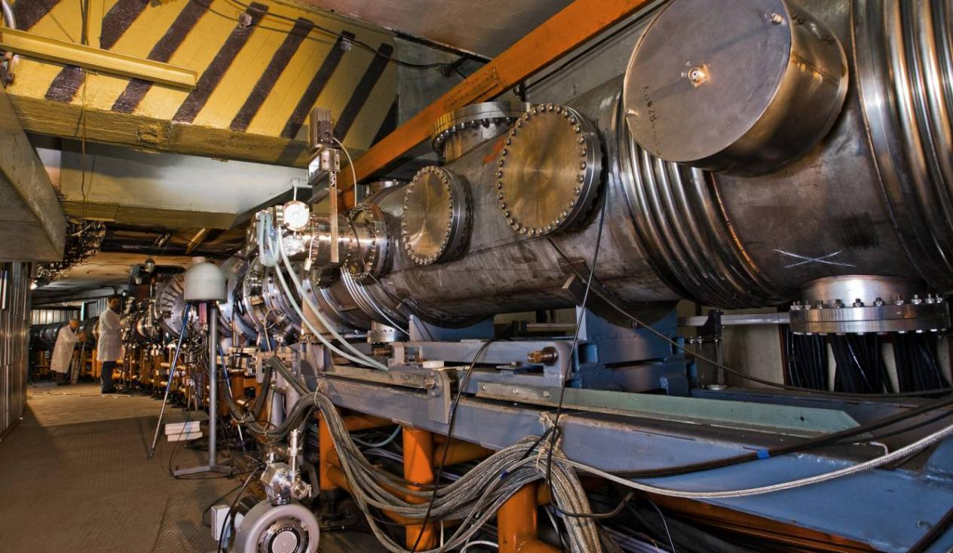
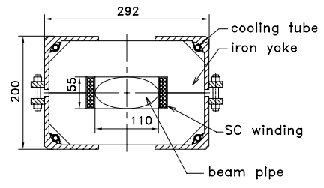
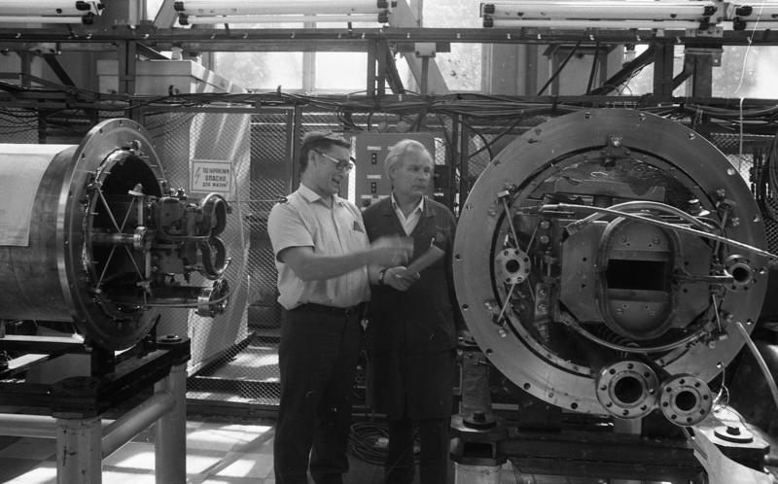
First Superconducting heavy ion accelerator
Nuclotron – Superconducting Synchrotron
operation since 1993

Slide 20
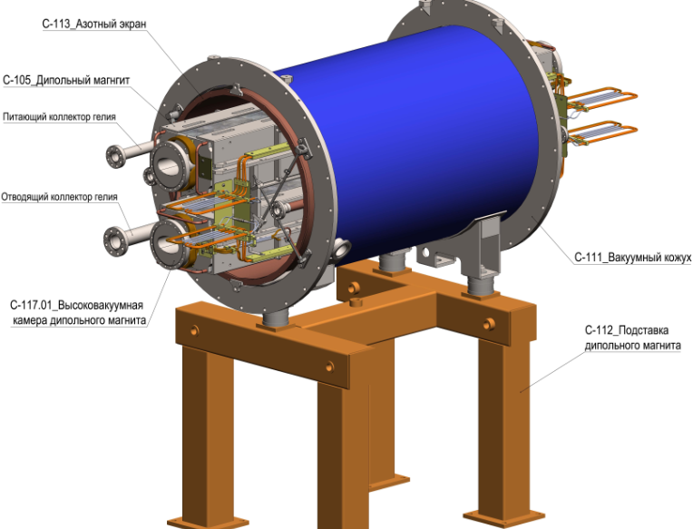
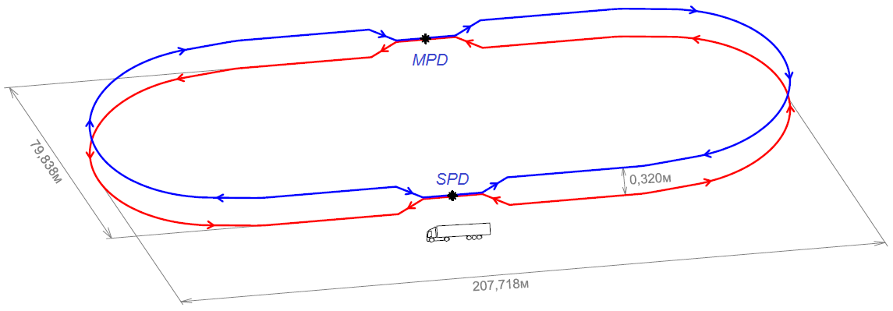
NICA Collider
Nuclotron magnets’ technology
Racetrack of 503.04 m circumference
2 Interaction points
0.32 m vertical beam separation
double-aperture sc-magnets with 1.8 T max field
45 T·m magnetic rigidity
ion kinetic energy range from 1 GeV/u to 4.5 GeV/u for Au⁷⁹⁺
vacuum: 10⁻⁹ Pa;
Average luminosity 10²⁷ cm⁻²·s⁻¹ for gold ion collisions at √s_{NN} = 9 GeV.

Slide 21
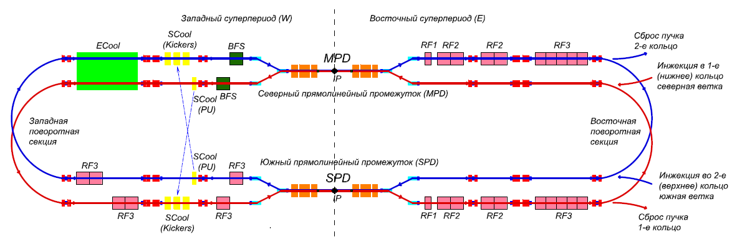
NICA Stage II-a (basic configuration):
1. Injector chain: KRION => Booster => BTL BN => Nuclotron
2. BTL Nuclotron => Collider
3. Collider equipped with
RF-1 (barrier voltage system) for ion storage
RF-2 in a reduced version: 2 cavities per ring instead 4 (50 kV RF amplitude instead 100 kV)
1 channel of S-cooling per ring (cooling of longitudinal deg. of freedom)
Result: 22 bunches of the length σ ∼ 2 m per collider ring that = 5e25 cm⁻²⋅s⁻¹.
NICA Stage II-b (full configuration):
Collider
+ RF-2 systems in the project version
+ RF-3 systems in the project version
+ S-cooling (transverse)
+ E-cooling
Result: 22 bunches of the length σ = β-star = 0.6 m per collider ring that = 1e27 cm⁻²⋅s⁻¹.

Slide 22
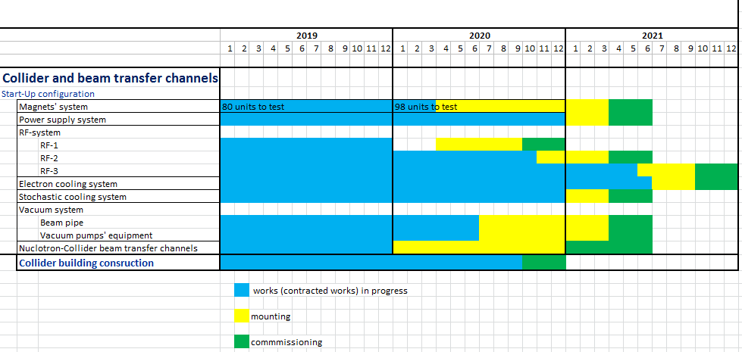
Time-schedule
Collider
IP-2
Collider
L ≥ 10²⁷ см⁻²с⁻¹
IP-1

Slide 23
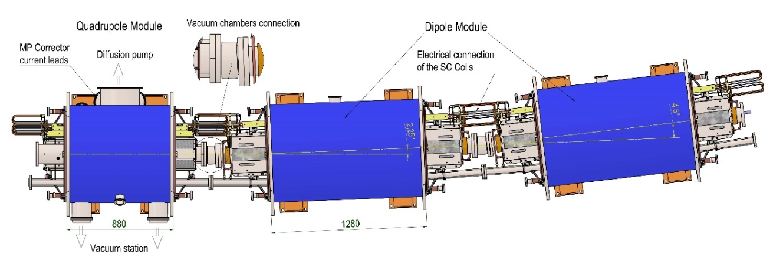
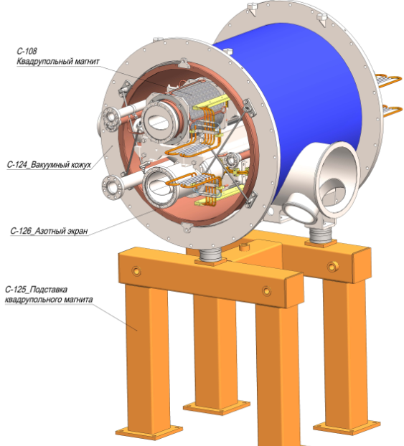
Collider magnets’ system
Assembly and testing
Parameter | Dipole | Lens
Number of magnets | 80+8* | 78+12**
Max. magnetic field (gradient) | 1.8 T | 23.1 T/m
Effective magnetic length | 1.94 m | 0.47 m
Beam pipe aperture (h/v) | 120 mm / 70 mm
Distance between beams | 320 mm
Overall weight | 1670 kg | 240 kg
*- beams vertical elevation dipoles
**- final focus quadrupoles
178 structural sc-magnets to assemble and test

Slide 24
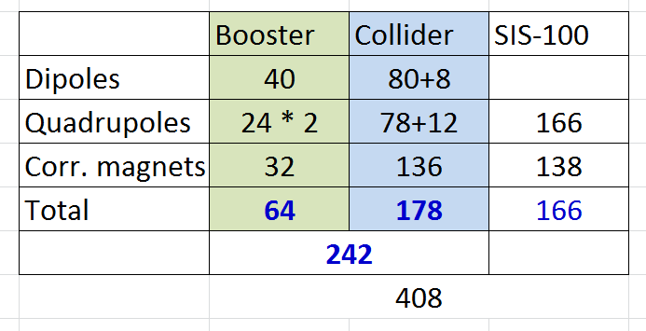
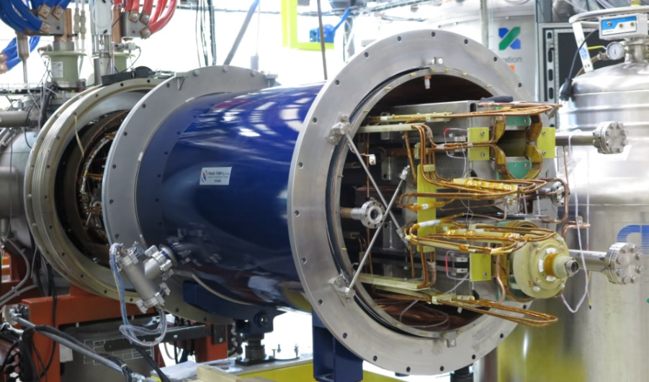
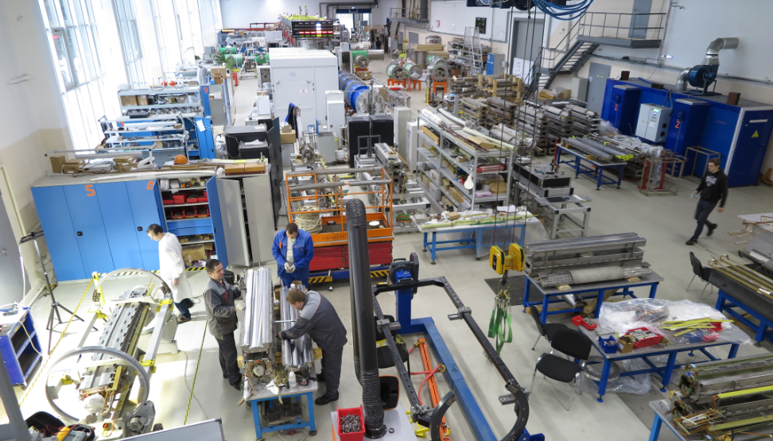
SC-magnets to assembly and testing

Slide 25
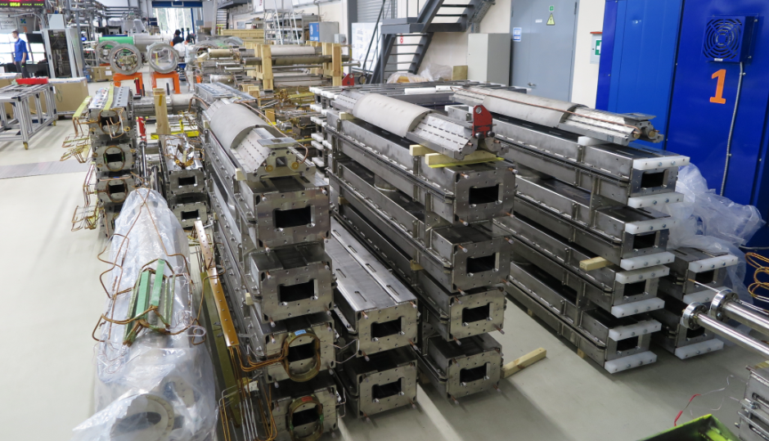
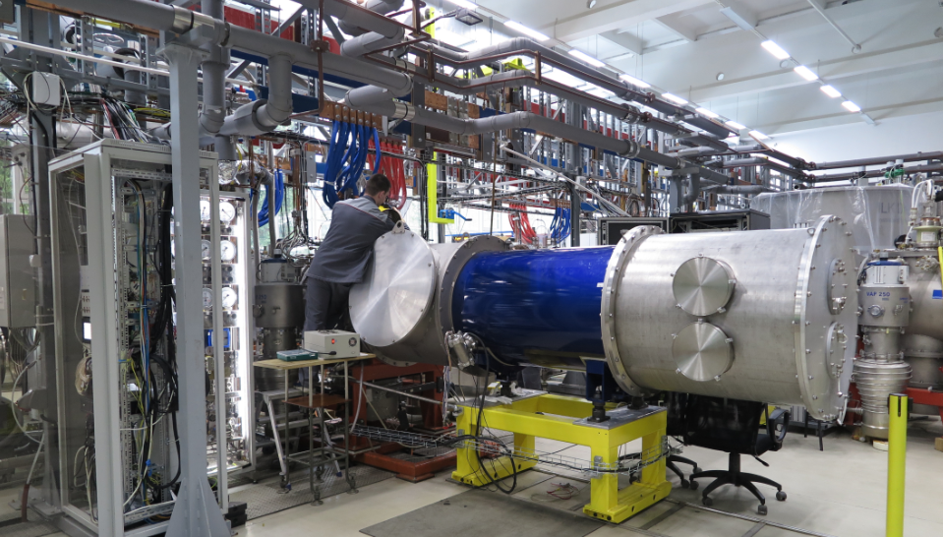
NICA Collider magnets testing
26 dipoles’ yokes delivered to JINR
5 dipoles’ successfully passed cryogenic tests
testing results

Slide 26
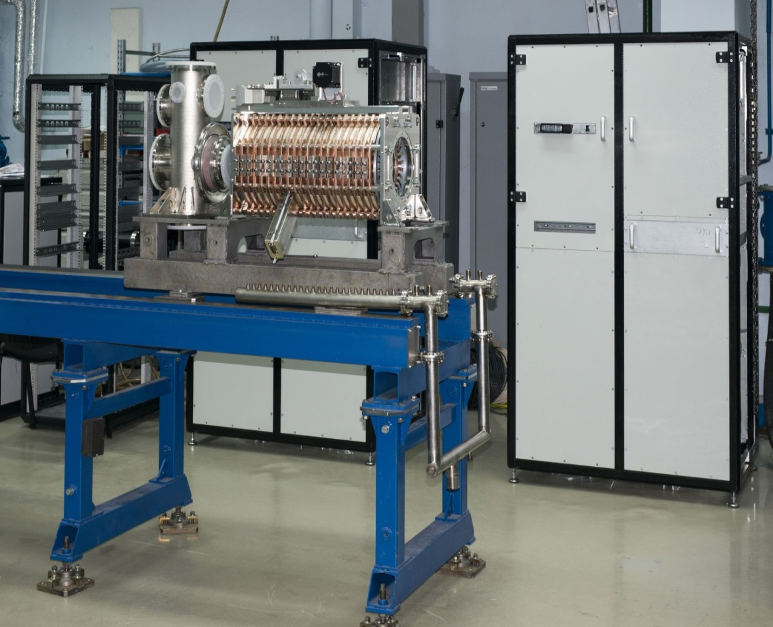
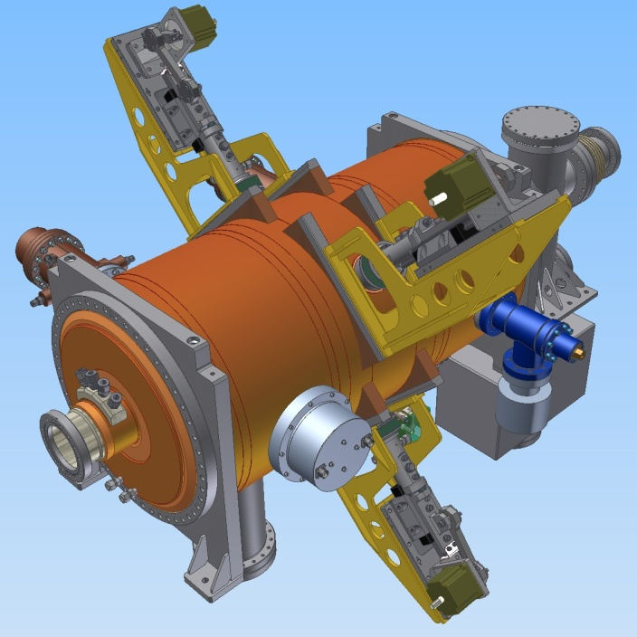
RF-system
RF system for basic configuration is under construction at BINP – 2020
RF system for project configuration is under development at BINP – 2021
RF1 station: preparation for the tests
3D model of RF3 station

Slide 27
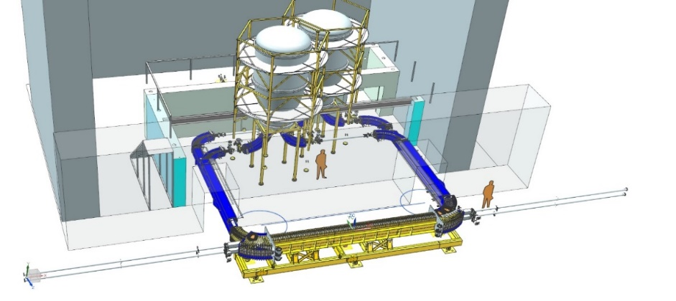
Electron Cooling System of NICA Collider, Ions ¹⁹⁷ Au⁷⁹⁺
HV Electron Cooler for NICA Collider
Design and construction at BINP
Installation at NICA in 2021
together with 4 RF2 and 16 RF3 stations
Parameter | Value
Electron energy, MeV Energy instability, ΔE/E | 0.2 – 2.5 ≤ 1⋅10⁻⁴
Electron beam current, A | 0.1 – 1.0
Cooling section length, m | 6.0
Solenoid magnetic field, T Field inhomogeneity, ΔB/B | 0.05 – 0.2 ≤ 1⋅10⁻⁵

Slide 28



Injection-system
Length, m | 2.5
Max magnetic field, T | 1
Aperture, mm×mm | 45×45
Septum thickness, mm | 3
Pulse shape | semisinusoidal
Pulse duration, μs | ~ 10
Septum
Technical design development is in progress.
Concept of power supply has been developed.

Slide 29





Beam-dump system
Beam dump system – under designing
Kickers
Lambertson magnet
Septa

Slide 30



How does NICA collider look like?
LHC
…like others
RHIC
NICA

Slide 31



Luminosity
Collider
For round beams and head-on collisions
Number of bunches n_{b} has to be as large as possible
but the inter-bunch distance is to be large enough
to avoid parasitic collisions inside detector
Train of bunches is prepared by injection chain
the bunch intensity N_{b} has to be maximal
the emittance ε growth has to be minimized in all elements of injection chain
beta function in collision point β* has to be as small as possible
but comparable with bunch length σ_{s}
to avoid luminosity reduction due to “hour-glass” factor
Detector

Slide 32


Synchrotrons
tune diagram
  Major effects limiting the luminosity
  Space charge
  Luminosity lifetime
  IBS
  Instabilities
ideal if = const for all particles in the beam, but
self space charge effect
beam-beam effect
tunes vs dp/p:

Slide 33



  Space charge
The bunch brightness N_{b}/ε is limited by two main space charge effects:
incoherent shift of the betatron tune (Laslett tune shift)
- bunching factor
beam-beam parameter (linear part of the tune shift due to fields of opposite bunch)
For NICA collider parameters

Slide 34

The beam space charge creates the major luminosity limitation
Large luminosity requires
  Small circumference, C
  Short separation length, C/n_{b}
  value of σ_{s}/β* in 1-2
  Large emittance => large acceptance

Slide 35

Beam Maintenance in Collider Rings with Cooling Technique
Beam Maintenance in Collider Rings with Cooling Technique
10000
1000
100
10
1
Two modes of the collider operation
E-Cooling
Stochastic cooling
Time, s
τ_{IBS} (3D equilibrium)
τ_{stoch} (D.Möhl)
τ⊥ e-cooling
τ|| e-cooling
IBS dominated regime: Stochastic cooling is used to suppress beam
IBS influence.
Space charge dominated regime: Electron cooling is used to maintain
bunch 3D emittance.
1 1.5 2 2.5 3 3.5 4 4.5 5
E, GeV/u
Space charge dominated mode (ΔQ ≤0.05) | IBS dominated mode
ε and dp/p are optimized independently. The bunch relaxation? is suppressed by cooling. Luminosity is limited by space charge effects | ε and dp/p are “equi-partitioned”, either fast bunch relaxation. Luminosity can be obtained at small ΔQ<0.05
I.Meshkov Three stages of the NICA project COOL’2015 18 September 2015

Slide 36

Ring + vertical beam separation
Rings structure
Ring symmetry =2
Two Beams ⬄ symmetric optics

Slide 37


Lattice
Two Beams ⬄ symmetric optics
Ring + vertical beam separation

Slide 38


Ring + vertical beam separation
Lattice
Ring symmetry =2
Beta-IP = 0.6m
Beta-max=145m
Two Beams ⬄ symmetric optics

Slide 39

Collider scheme plan view

Slide 40

Collider electrical power supply scheme
for 1 ring (2nd-blue-upper)
Main power supplies
Additional power supplies
Индекс | Max Ток, А
2-PS-1 | 10500
2-PS-2 | 1000
2-PS-3 | 600
Индекс | Max Ток, А
2-APS-1… 2-APS-60 | 300

Slide 41

Structural quads’ feed currents

Slide 42



Collider quads spec.

Slide 43

Ring-10 –
quads lengths adjusted to power all magnets in series
Beta-functions
Linear optics
Beam Vertical separation magnets
MPD+ECool solenoids
RF-system
Corrector magnets:
Closed Orbit
Chromaticity
X-Y-coupling
Edge fields
Qx,y = 9.44
β* = 0.6m

Slide 44





Chromaticity correction
sF1=43 T/m^2
sD1=173 T/m^2
sF2=43 T/m^2
sD2=173 T/m^2

Slide 45






Quadrupoles’ fringe field effect

Slide 46




FF-quads fringe fields shrink DA
Beta_IP=0.35 m
S.A. Glukhov, E.B. Levichev,
RuPAC-2016

Slide 47







FF-quads fringe fields shrink DA
Ring dynamic aperture
Beta_IP=0.35 m
Beta_IP=0.50 m
Beta_IP=0.60 m
25 % luminosity decrease
Beta_IP=0.35 m
Beta_IP=0.60 m
use octupoles to “correct” fringe field effect

Slide 48




Correction magnets setup
Chromaticity correction
X-Y coupling correction
Fringe fields correction
sF1=43 T/m^2
sD1=173 T/m^2
sF2=43 T/m^2
sD2=173 T/m^2
oF1=150 T/m^3
oF2=60 T/m^2
oF1=150 T/m^3
oF2=60 T/m^2
[T/m]: -2.48
0.18
0.57
0.64
9.44
9.44
sF1=48 T/m^2
sD1=185 T/m^2
sF2=48 T/m^2
sD2=185 T/m^2
[T/m]: -2.51
0.26
0.59
0.61
oF1=150 T/m^3
oF2=60 T/m^2
oF1=150 T/m^3
oF2=60 T/m^2
Orbit correction
9.10
9.10
+
Bx=0.15 T
By=0.15 T

Slide 49

Ring tune
9.10 9.44
3 % of focusing strength

Slide 50


9.10 9.44
Ring tune

Slide 51

Thank you

Slide 52

Main properties, EOS
- particle yields & spectra, ratios, femtoscopy, flow
In-Medium modification of hadron properties
- onset of low-mass dilepton enhancement
Deconfinement (chiral) phase transition at high ρ_{B}
- enhanced strangeness production
QCD Critical Point
- event-by-event fluctuations & correlations
Y-N (hyperon-Nucleon) interactions in dense nuclear matter - hypernuclei
NICA-MPD heavy-ion program

Slide 53



Spin Physics Detector (SPD)
Physics tasks
Nucleon spin structure studies
Drell-Yan pairs Direct photons J/ψ production
spin-dependent effects in elastic pp, pd and dd scattering;
spin effects in exclusive hadron production;
spin effects in production of hadrons with high p_{T}
Timeline
open a project for the SPD design: Jan. 2019
preparation of CDR: 2019
preparation of TDR (+ prototyping); stage I: 2020 – 2022
stage II: 2023
construction of the detector: 2022 – 2025
first measurements: 2025
Polarized beams
p↑p↑ at √s_{pp} = 12 - 27 GeV, L_{av} ≈ 10³² cm⁻²s⁻¹
d↑d↑ at √s_{NN} = 4 - 13 GeV
longitudinal and transverse polarization in SPD and MPD
SPD/NICA will provide a unique opportunity not available at other facilities
to study all the eight nucleon PDF in one experiment
and obtain comprehensive information on the nucleon spin structure
at high statistical level and with minimal systematic uncertainties.
Notes:
Study of nucleon spin structure must prove the sum rule and to solve a puzzle of “spin deficit”. NICA collider will provide collisions of protons and deuterons with all combinations of polarization – transversal and longitudinal. It will allow to measure all 8 intrinsic-transverse-momentum PDFs at leading twists in one experiment. MMTDY mechanism and SIDIS processes are good tools for these measurements.

Slide 54

Nuclotron: polarized deuterons and protons
8E8
Routine operation of SPI and new fore-injector
Polarized deuteron acceleration: Intensity up to 2*10⁹ per cycle
Polarized protons
Deuteron Spin Structure experiment, internal target
1.8 E8

Slide 55

Nuclotron: slow extraction
¹²C⁺⁶ beam extraction (3,5 Gev/u) RUN #55
¹²C⁺⁶ 5*10⁸ T_{spill} = 4s, k_{dc}= 99,5%
⁷⁸Kr⁺²⁶ beam extraction (2,8 Gev/u) RUN #55
⁷⁸Kr 2*10⁵ T_{spill} = 10s, k_{dc}= 99,3%
55

Slide 56
Nuclotron: status for 2018
Parameter | Project | Status (June 2018)
Max. magn. field, T | 2 | 2 (1.7 T routine)
B-field ramp, T/s | 1 | 0.8 (0.7 routine)
Accelerated particles | p–U, d↑ | p↑, d↑, p – Xe
Max. energy, GeV/u | 12 (p), 5.8 (d) 4.5( ¹⁹⁷Au⁷⁹⁺) | 5.6 (d, ¹²C), 3.6 (⁴⁰Ar¹⁶⁺)
Intensity, ions/cycle | 1E11(p,d), 2E9 (A > 100) | d 4*10¹⁰ (2*10¹⁰ routine), ⁷Li³⁺ 3*10⁹ ¹²C⁶⁺ 2*10⁹ ⁴⁰Ar¹⁶⁺ 1*10⁶ ⁷⁸Kr²⁶⁺ 2*10⁵ ¹²⁴Xe⁴²⁺ 1*10⁴
• Acceleration of ¹⁹⁷Au⁷⁹⁺ up to 4.5 GeV/u
• Injection system for ¹⁹⁷Au⁷⁹⁺ from Booster at 578 MeV/u
• Slow extraction system for ¹⁹⁷Au⁷⁹⁺ at 1 ÷ 4.5 GeV/u
• Upgrade of control system (synchronization)
Nuclotron: tasks

Slide 57




Dy –correction
- skipped

Slide 58




X-Y Coupling suppression
4 skew quads /
half ring [T/m]:
-2.48
0.18
0.57
0.64

Slide 59


9.44 9.10
Ring tune
-300 А – to all quads (except FF) +0 А to D-quads in arcs

Slide 60
9.10 9.44
Ring tune

