Slide 1
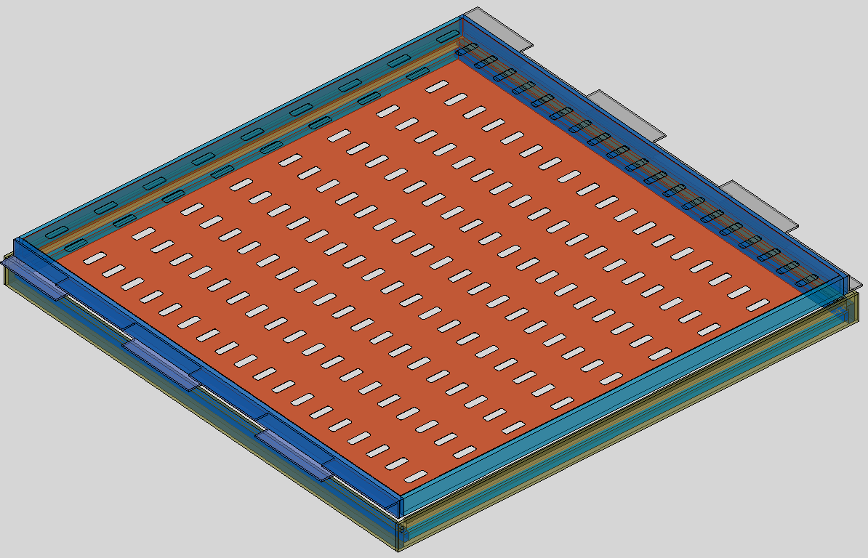




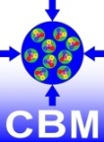
Inner zone of the TRD wall
Construction details for
Bucharest TRD Module Type 1 (Buch-TRD)
Laura Radulescu for CBM-TRD Bucharest team
CBM-TRD Retreat, 27-29 March, 2019

Slide 2
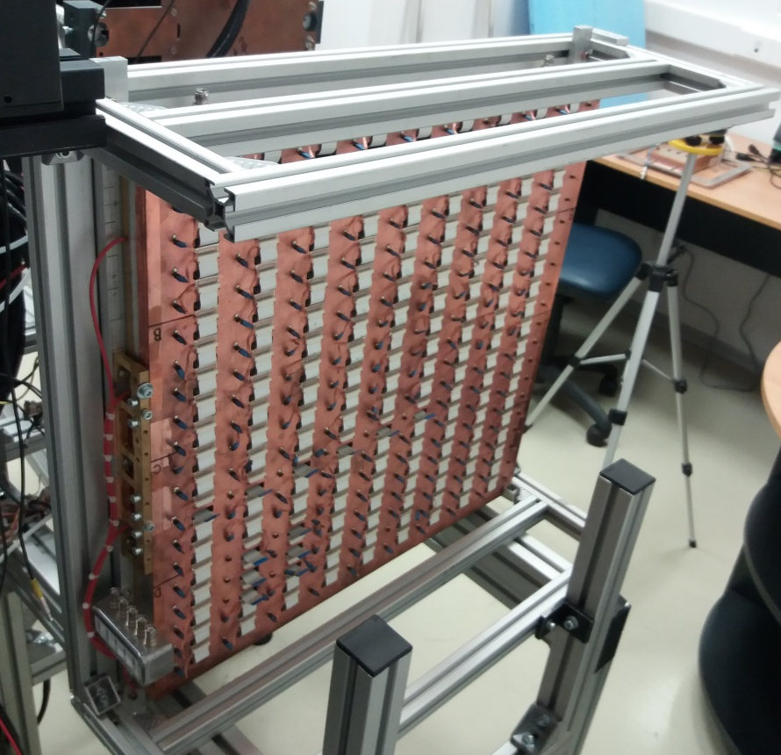
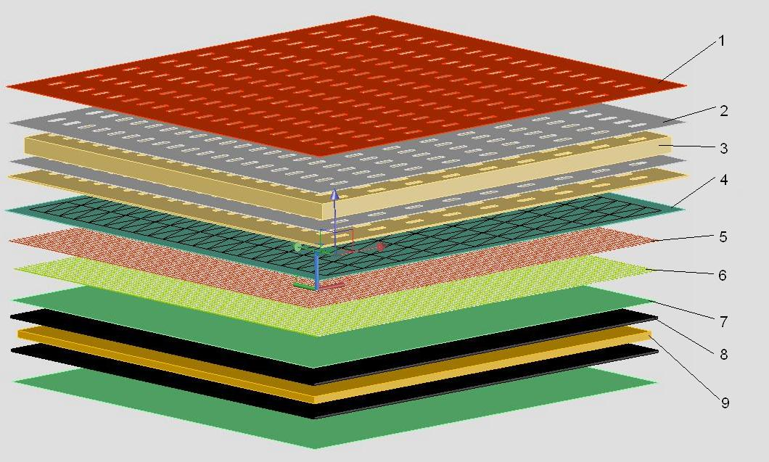
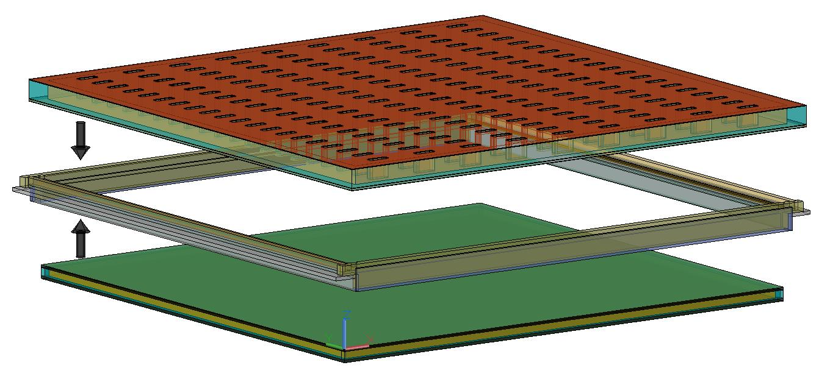
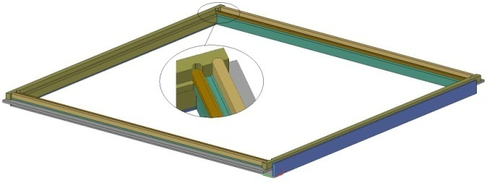
The TRD 2012 prototype
The TRD 2012 structure
1 - Cu tape, 2 - C Fibber, 3 – Honeycomb, 4 – Pad plane, 5 – Anod wires, 6 – Cathod wires, 7 – Kapton with Al, 8 – Rohacell, 9 – Honeycomb
600 mm
600 mm

Slide 3
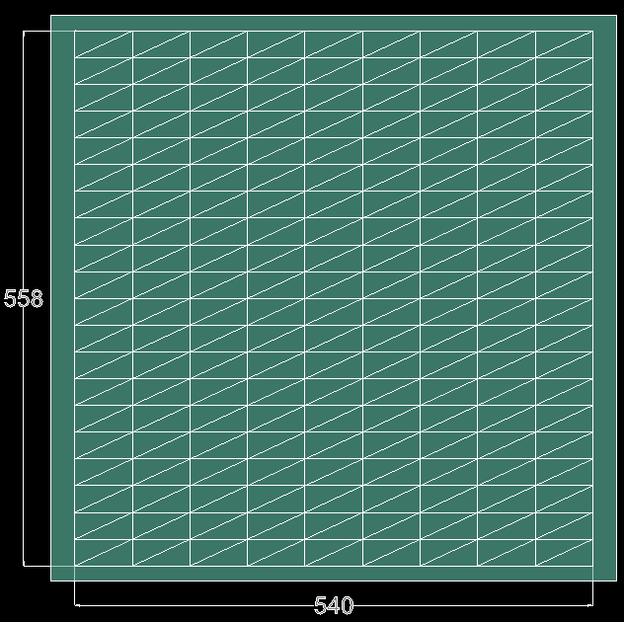
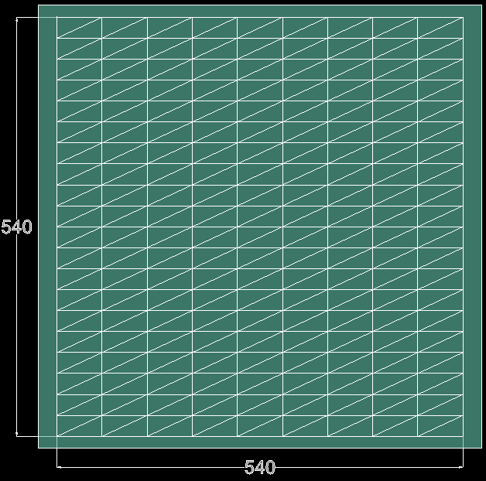
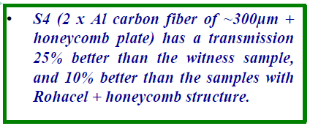
From 2012 Prototype to Buch - TRD
2012 Prototype pad plane
The Buch - TRD pad plane
From TDR:
General dimensions are:
570mm x 570mm
The CBM-TRD 2012 Prototype absorption tests have shown:
M. Petris, Alternative Chamber design
CBM TRD TDR, 14-15 March 2017, GSI Darmstadt
http://indico.gsi.de/conferenceDisplay.py?confId=5654

Slide 4
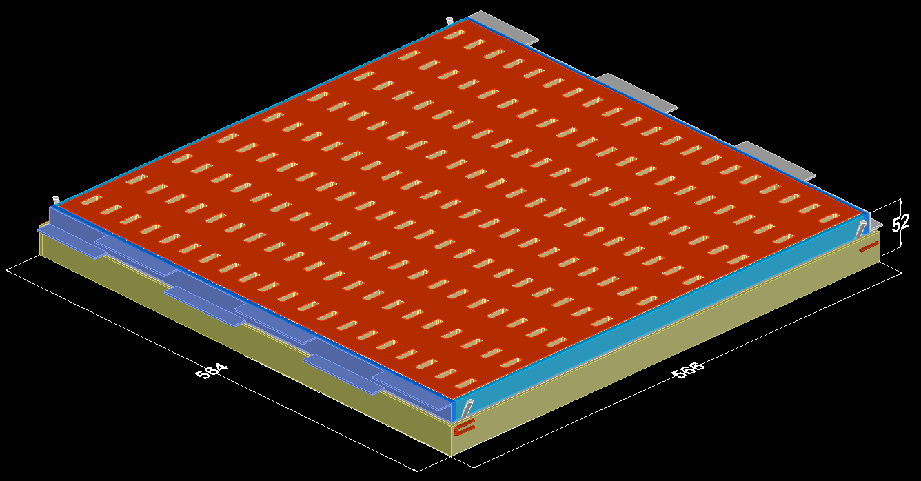
Buch - TRD - compact version

Slide 5
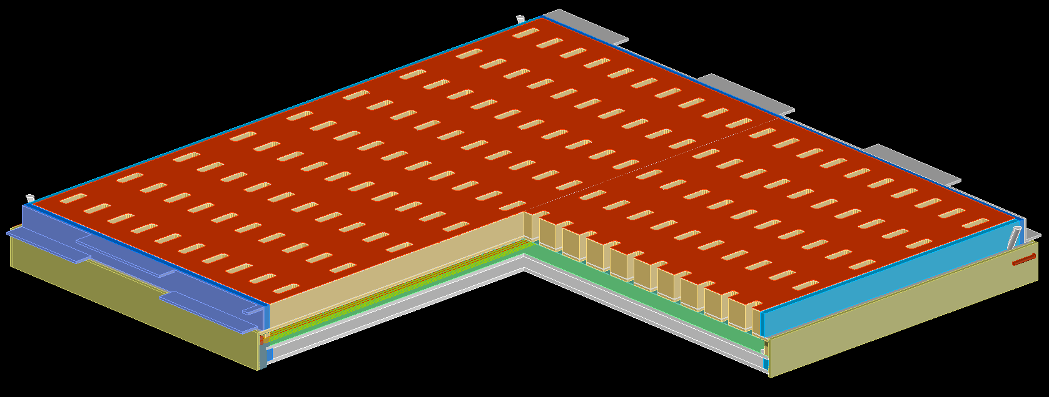
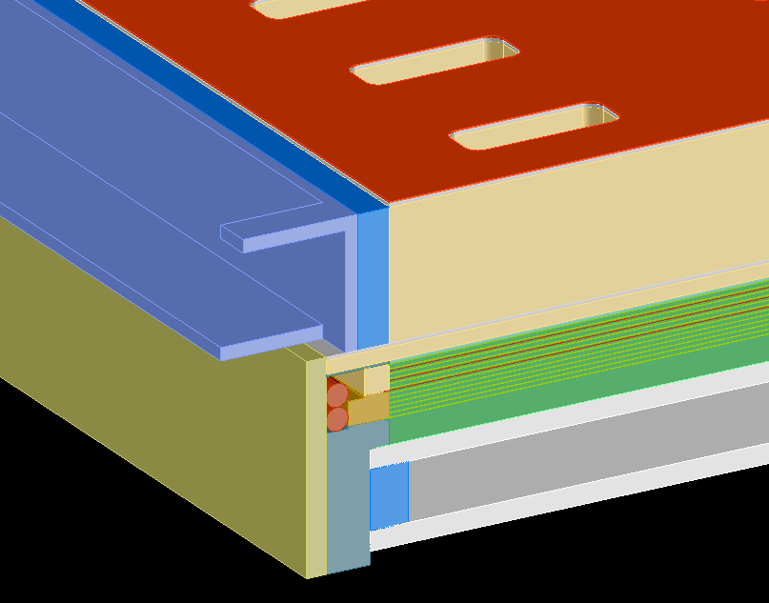
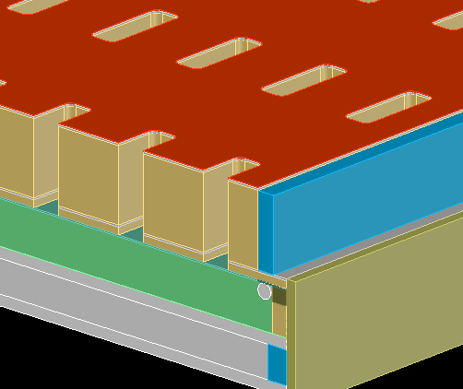
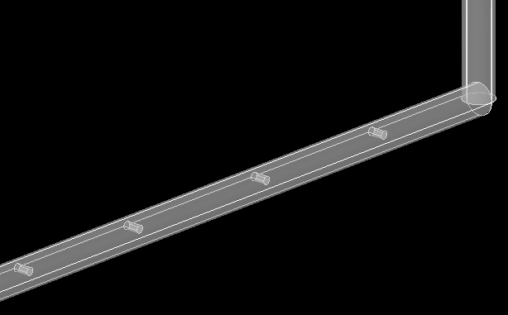
Buch - TRD - sections

Slide 6
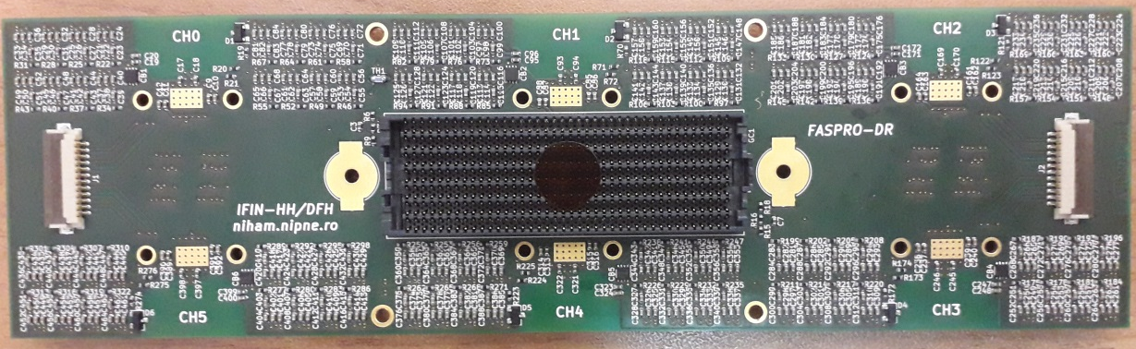
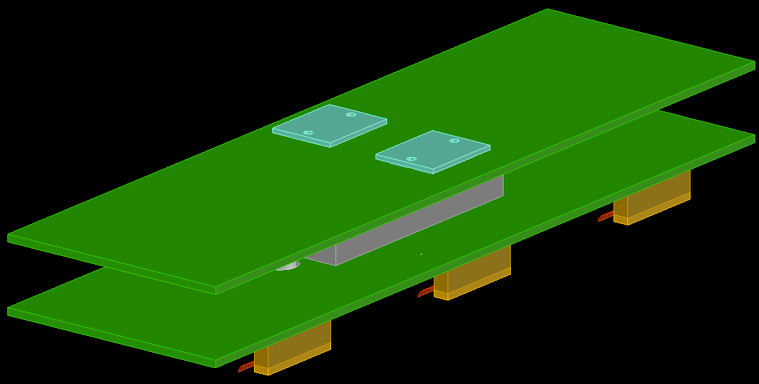
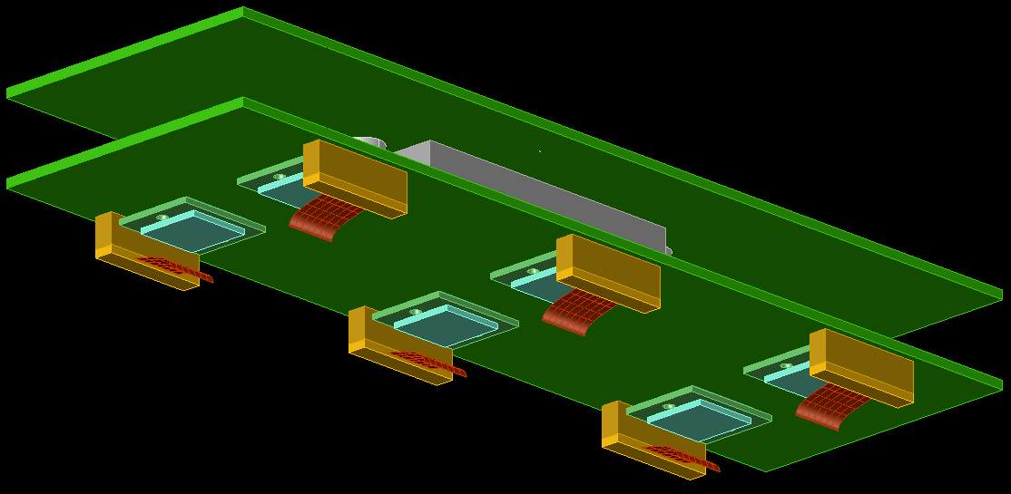
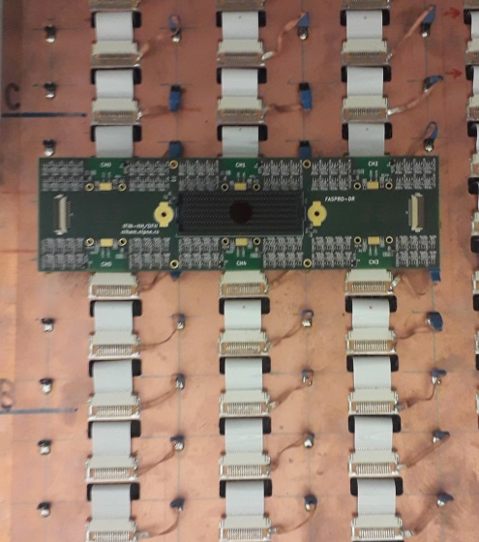
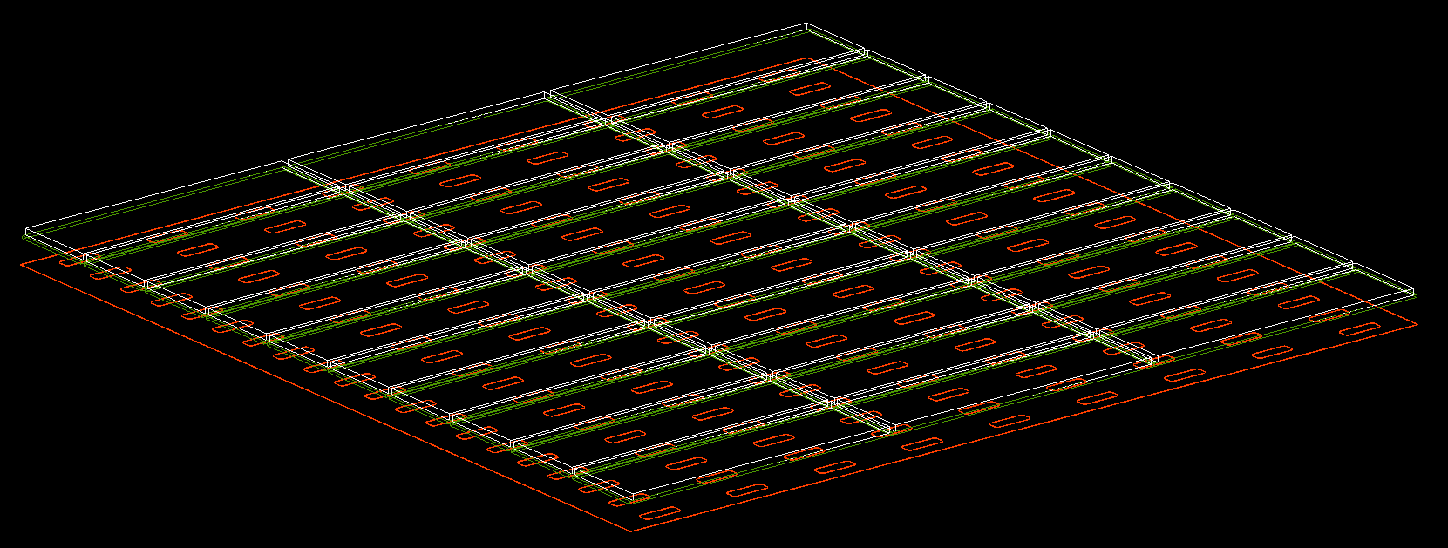
FEE – FASP and GETS
GETS
FASPRO
FASP

Slide 7
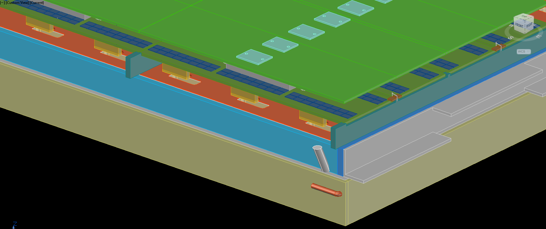
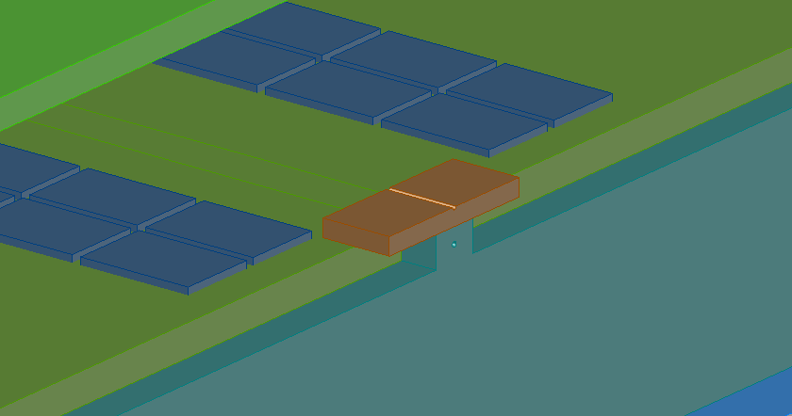
FEE connection to the detector frame

Slide 8
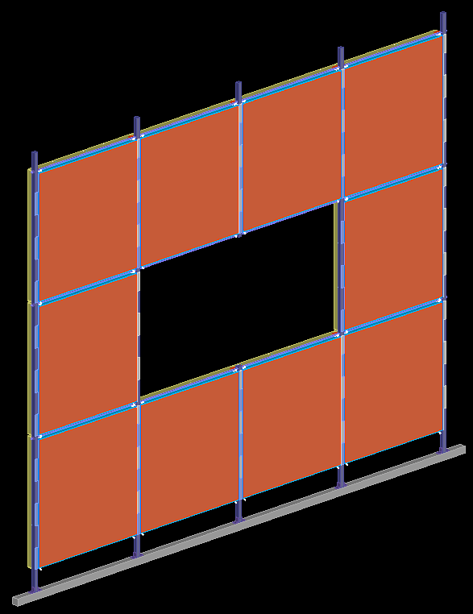
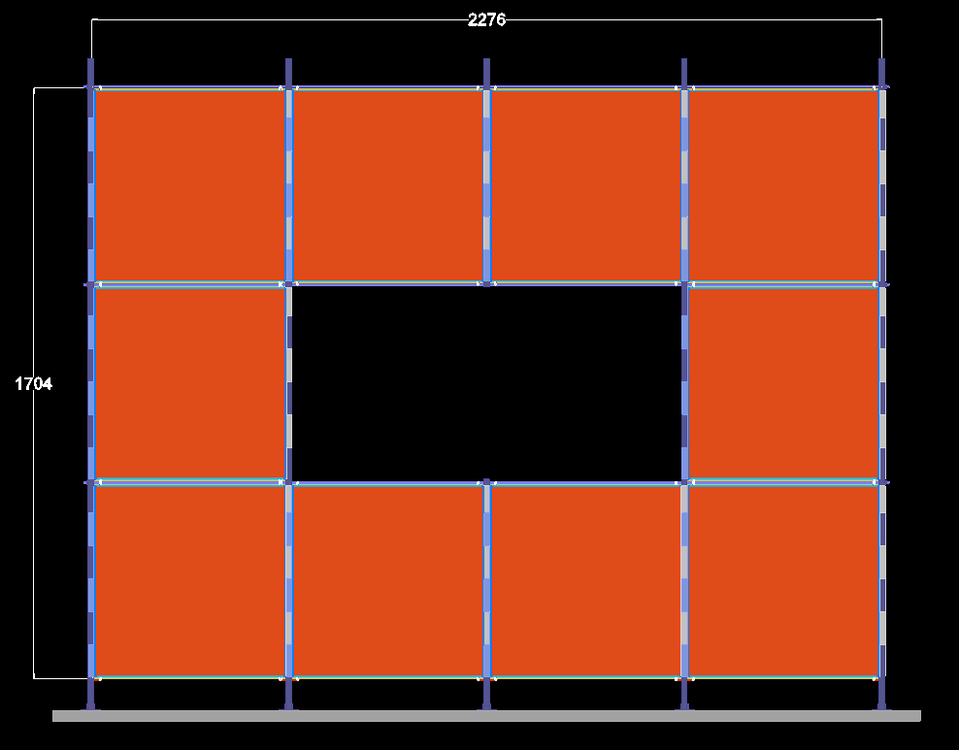
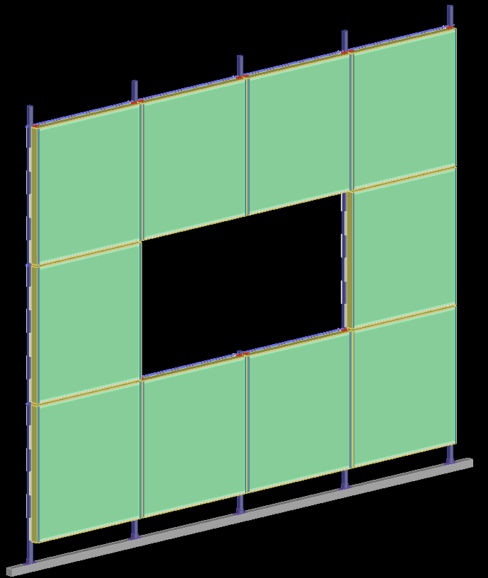
The TRD inner wall structure based on Buch - TRD

Slide 9
CBM-TRD HPD Bucharest team
Alexandru Bercuci, Valerica Aprodu, Daniel Bartos, Gheorghe Caragheorgheopol,
Vasile Catanescu, Viorel Duta, Mariana Petris, Mihai Petrovici, Lucia Prodan,
Andrei Radu, Claudiu Schiaua, Victor Simion

Slide 10
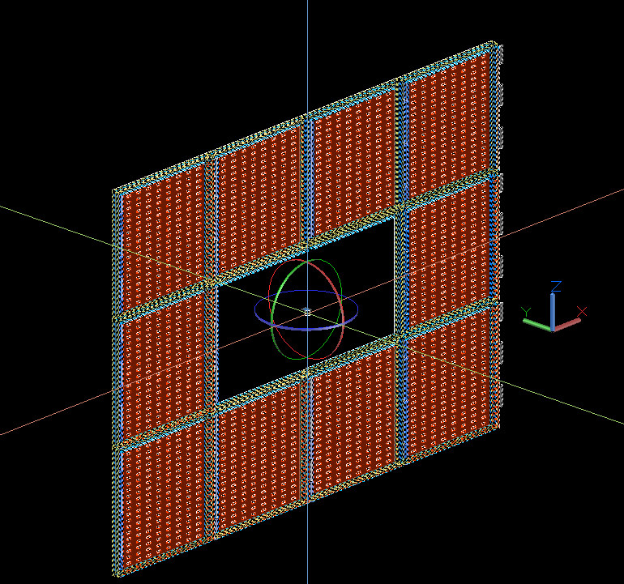
Thank you!

