Slide 1
Status Funding
CBM and HADES experiment
8th CBM Resource Review Board meeting
26th November 2018
Report
CBM and HADES Resource Coordinator
Jürgen Eschke

Slide 2
Overview
Reminder status funding of CBM at 7th RRB meeting
Status funding of the CBM day 1 setup
and of the CBM start version (Phase 1 setup / MSV)
Status Contracts for FAIR shareholder contributions
Status Funding of HADES@SIS18 (FAIR Phase 0)
and of HADES@SIS100 (FAIR Phase 1)
Next steps

Slide 3
Country funding (in 2017 prices [M€]) CBM day 1 setup 7th RRB 28.11.2017
and CBM phase 1 setup (CBM start version)

Slide 4
Experiment funding CBM day 1 setup 8th RRB 26.11.2018 (in 2005 and 2018 prices [M€])
and CBM phase 1 setup (CBM start version@SIS100)

Slide 5
Country funding (in 2018 prices [M€]) CBM day 1 setup 8th RRB 26.11.2018
and CBM phase 1 setup (CBM start version)

Slide 6
Country funding (in 2005 prices [M€]) CBM day 1 setup 8th RRB 26.11.2018
and CBM phase 1 setup (CBM start version)

Slide 7
Funding CBM day-1 setup (RRB8, 26 Nov. 2018)
87% secured funding
2018 prices
k€

Slide 8
Country funding (in 2018 prices [M€]) CBM day 1 setup 8th RRB 26.11.2018
and CBM phase 1 setup (CBM start version)

Slide 9
Country funding CBM day 1 setup 7th and 8th RRB
percentage secured funding
country | secured funding | secured funding + EoI
Germany | 29,9% | 34,4%
Russia | 26,8% | 28,7%
India | 10,1% | 10,1%
Poland | 5,3% | 5,3%
Romania | 5,2% | 5,2%
China | 7,5% | 7,5%
Czech Republic | 0,4% | 0,4%
Hungary | 0,1% | 0,5%
France | 0,8% | 0,8%
Korea | 0,0% | 0,2%
Ukraine | 0,0% | 0,2%
common fund | 0,0% | 6,0%
 | 86,1% | 99,5%

Slide 10
CBM Cost Matrix and HADES Cost Matrix
please consult distributed
cost matrix for all details!

Slide 11
Status CBM collaboration contracts (Russia)
Project | Partner in Russia | Task | Costs (€ 2005 ) | Council Decision | Status contract
SC dipole magnet | BINP Novosibirsk | Design and Construction | 3.758 Mio | 9.07.2014 | signed
STS | JINR Dubna | Construction of detector ladders for first 4 stations | 2.115 Mio | 10.12.2013 | signed
PSD | INR Troitzk | Design and Construction | 0.778 Mio | 30.06.2015 | signed
RICH | PNPI Gatchina | Construction of mechanical structures, gas system | 1.2 Mio | 9.11.2016 | signed
MUCH | PNPI Gatchina | Construction of absorbers, mechanical structures, gas system | 1.822 Mio | 9.11.2016 | signed
TOF | ITEP | Inner zone | 0.468 Mio | 9.11.2016 | In preparation (draft agreed)
11

Slide 12
Status CBM in-kind contracts (other shareholders)
Project | Partner Institution | Task | Costs k€ 2005 | Council decision | Status In-Kind contract
STS | AGH, Crakow, Poland | Design and Construction of STS-XYTER chip | 572 | 30.06.2015 | Signing in process
STS STS STS | JU, Crakow AGH, Crakow GSI, Germany | Sensors and assembly Front End Boards, test procedures for STS-XYTER chip and FEE STS system | 707 261 4630 | 28.06.2016 28.06.2016 28.06.2016 | In preparation Signing in process Signed
HADES | JU, Crakow, Poland | HADES ECAL Mechanical frame | 200 | 30.06.2015 | Signed (frame delivered and installed in HADES cave)
STS | WUT, Warsaw, Poland | Development of DAQ Data Processing Boards (DPBs) | 260 | 30.06.2015 | In preparation
TOF | IFIN-HH, Bukarest, Romania | RPC chambers | 748 | 30.06.2015 28.06.2016 | In preparation (draft )
TOF | GSI, Germany | FEE | 740 | 28.06.2016 | In preparation
MUCH | VECC, Kolkata +12 Indian Institutes | GEM chambers and FEE | 3790 | 10.12.2015 | In preparation (draft )
12

Slide 13
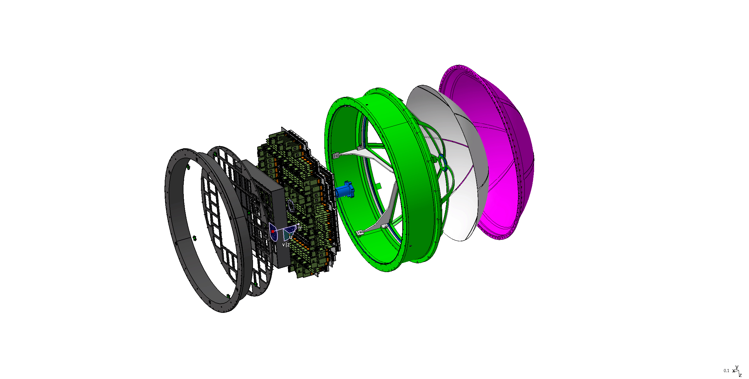
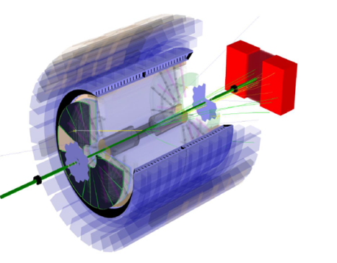
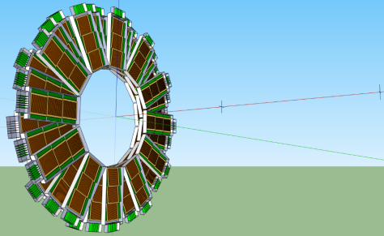
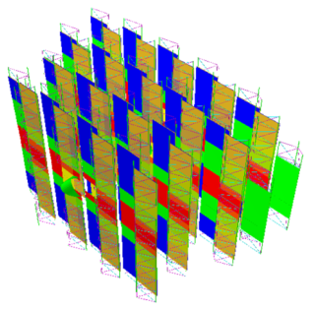
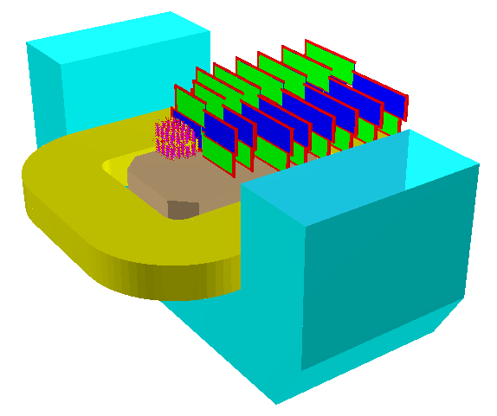
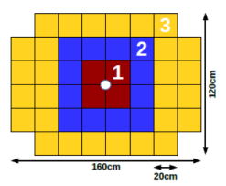
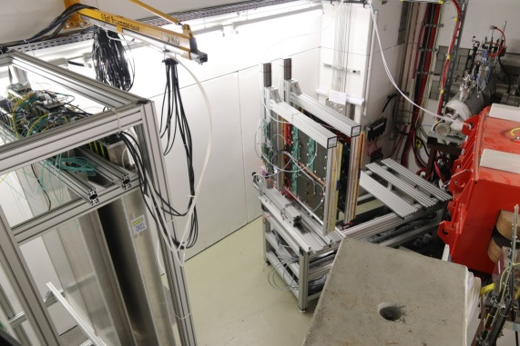
CBM – FAIR Phase 0 projects (2018 – 2024)
1. Install, commission and use 430 out of 1100
CBM RICH multi-anode photo-multipliers (MAPMT)
including FEE in HADES RICH photon detector
2. Install, commission and use
10% of the CBM TOF modules
including read-out chain
at STAR/RHIC (BES II 2019/2020)
3. Upgrade BM@N experiment
with 4 Silicon stations of CBM/STS design in the
BM@N experiment at the Nuclotron JINR/Dubna
(Au-beams in late 2020)
no additional core invest needed !
4. Install, commission and use the Project
Spectator Detector at the BM@N experiment
5. mini CBM (mCBM@SIS18) demonstrator for
full CBM data taking and analysis chain
26.11.2018
8th CBM RRB Jürgen Eschke, CBM RC
13

Slide 14
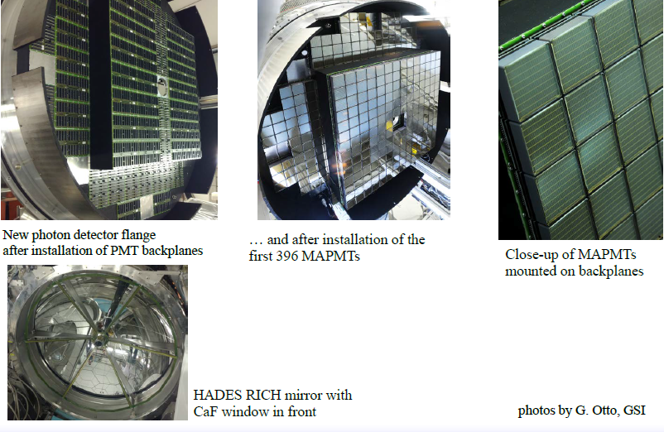
A success story: Usage of CBM funded detectors beforehand in HADES
Win-win situation – efficient use of funding
Sharing of MAPMTs after 2025 between CBM and HADES posible (plug in – plug out)

Slide 15
Summary CBM Costs and Funding
The CBM collaboration has defined the “day 1“ setup, which will be operational, when the SIS100 beam will be switched on in 2025 (present planning), and which is funded to about 90% at present.
The total cost of the CBM day 1 version (37,53 M€ in 2005 prices) is reduced by 0,36 M€ (2005 prices) compared to the RRB7 estimate (37,89 M€ in 2005 prices), because the costs for operating the DAQ/FLES online system at full bandwidth (10 MHz event rate) is shifted to the phase 1 setup of the CBM experiment.
Conclusion:
The CBM day 1 setup has 87% secured funding (93% with Common Fund)
The CBM start version (including ECAL and the full bandwidth of the DAQ/FLES) has 80,2% secured funding (85,8% with Common Fund)

Slide 16

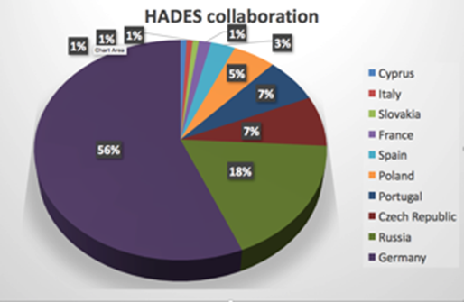
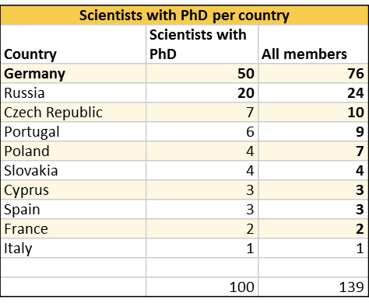
HADES Timeline
Upgrade phase, preparation for SIS18 (FAIR phase 0))
  Until 2018: Installation of CBM/HADES photo-detector for RICH, ECAL detector
  2019: Installation Forward detector
  2020: Installation MDC readout upgrade
2019-2024 (experiment campaign at SIS18 - FAIR phase 0)
  we plan three long runs, e.g.:
    𝜋+(CH₂)_{n}/LH₂: baryon em transition form factors,
    baryonic resonances with strangeness
    p+A/p+p: strangeness/vector mesons in medium
    A+A: medium system at maximal energy
2025 on (HADES at SIS100)
  Transfer spectrometer to new experimental hall
  Cold matter physics (p+A)
  Exclusive measurements (p+p)
  A+A collisions
Notes:
XB

Slide 17
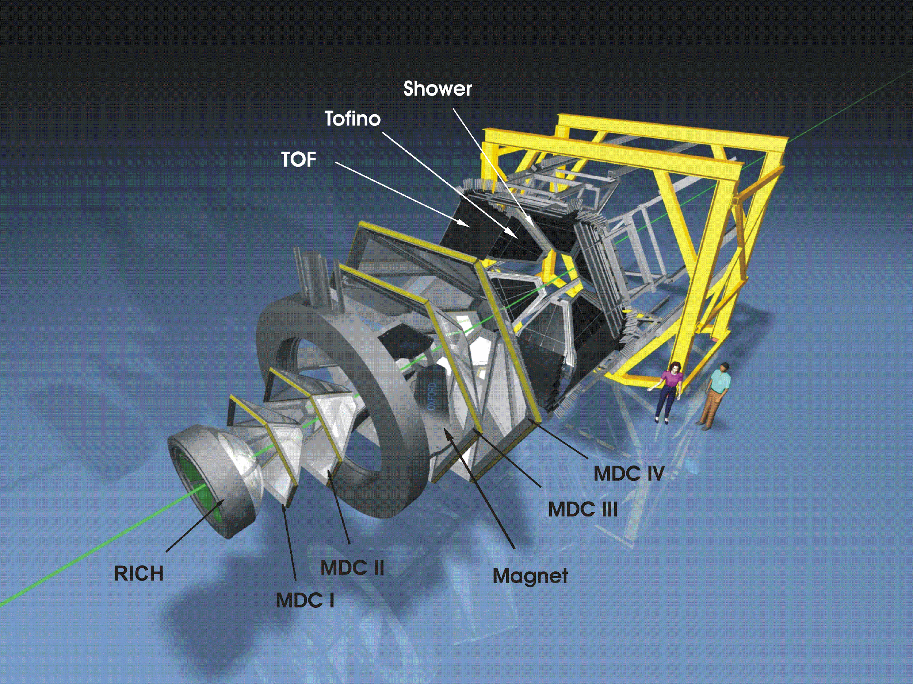
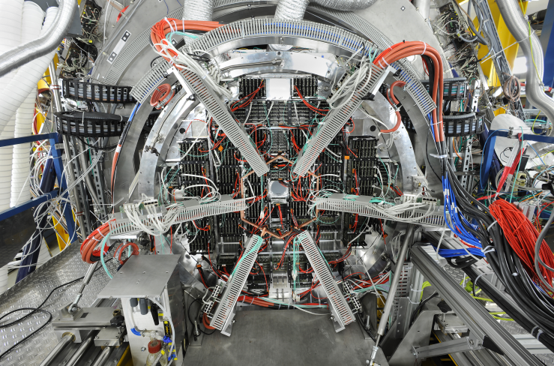
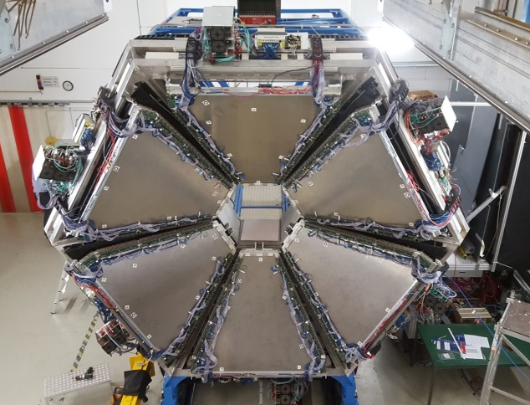
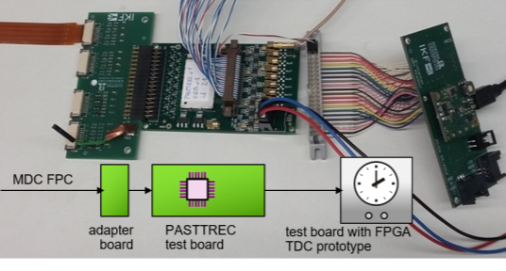
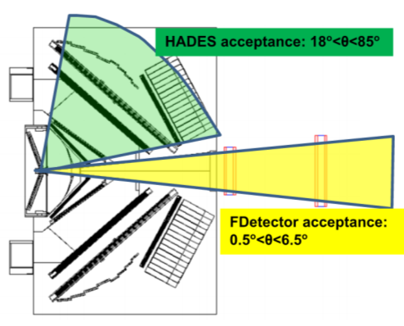
HADES upgrades
HADES Spectrometer
RICH Upgrade
HADES Calorimeter
Finished, Ready for Beam
4 Sectors Ready for Beam
RICH (HADES/CBM phase 0 project) – finished, ready for beam
  Gain in lepton pair detection efficiency (x 3)
  Improved background/noise rejection:
    Better conversion pair rejection
    Precise time information (down to 300ps precision)
  Joint (CBM/PANDA/HADES) development of read-out system based on TRB3 platform.
Electromagnetic Calorimeter – 4 sectors ready for beam in 2019
  π0 and η decays into γγ channel
  Electromagnetic decays of baryonic resonances
  Improved e/π separation: important for di-electron spectroscopy
  Proven technology: lead glass modules read out with Hamamatsu PMTs
MDC readout upgrade – Installation in 2020
  Multi-hit TDC (TRB based) – essential for high rate experiments
  Read-out trigger rate increase from 50 kHz to 200 kHz
Forward Detector (HADES/PANDA phase 0 project) – installation in 2019
  Enhance HADES capabilities for exclusive channels – forward region
  Hyperon production and EM decays
  PID via TOF, dE/dx(straw tube) – no magnetic field
MDC readout upgrade
Installation in 2020
Forward Detector –
Installation in 2019
Notes:
HADES upgrade projects, summary page.
RICH upgrade finished, ready for production beam in Feb. 2019
HADES ECal: 4 sectors out of 6 ready to collect data, Feb. 2019
Forward Detector: extends the acceptance for angles < 6 degrees, will be installed in 2019
MDC readout upgrade: scheduled for 2020

Slide 18
HADES upgrade costs
Costs of HADES RICH upgrade of ~1311 k€ as FAIR-Phase-0 activity @SIS18 included in CBM RICH project
(additional funding CBM Wuppertal, Giessen and CBM GSI (40% (plus spares) of CBM MAPMTs
2. Additional funding from PANDA FZJ for the Forward Detector

Slide 19
HADES upgrade for
FAIR Phase 0 (SIS18) & FAIR Phase 1 (SIS100)
%
Secured Czech Contribution to HADES increased by 117k€ (2005 prices) and by 402k€ (2005 prices) for EoI since the 7th RRB.
Notes:
one can edit/change the numbers is table
numbers seems to be OK.

Slide 20
Sumary HADES Costs and Funding
The total cost of the HADES upgrade (FAIR phase 0 (SIS18) and FAIR phase 1 (SIS100)) of 2,453 M€ (2005 prices) is almost unchanged.
The HADES upgrade for SIS18 (total costs in 2005 prices is 1,118 M€) has 94,4% secured funding.
The full HADES upgrade costs including the moving to the CBM cave at SIS100 has 53,8% secured funding at present, mainly because the ECAL instrumentation with new 3’’ Photomultiplier is not fully funded yet.

Slide 21
Next steps
HADES: Take data at SIS18
CBM:
finalize and sign missing collaboration and in-kind contracts
efforts to fully secure the funding for CBM day-1 setup
CBM construction MoU (next talk) → start signing process soon

Slide 22
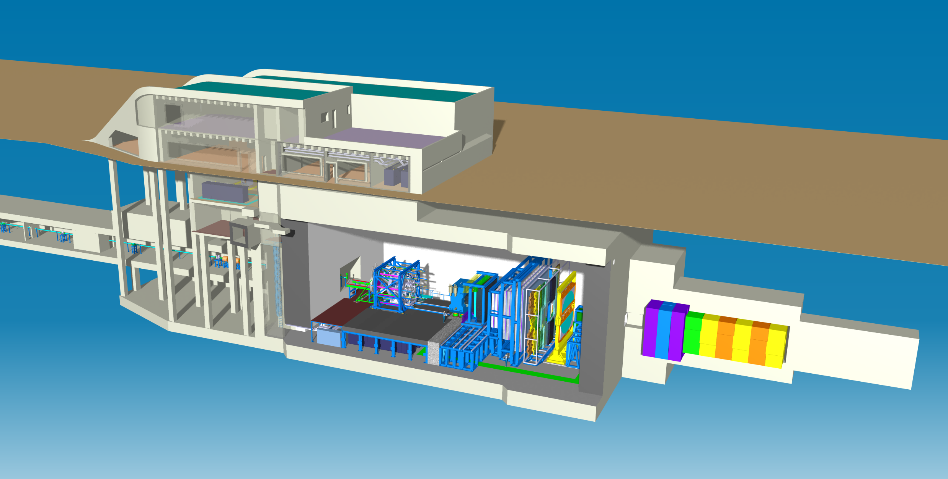
Thank you for your attention!

Slide 23
Backup slides

Slide 24
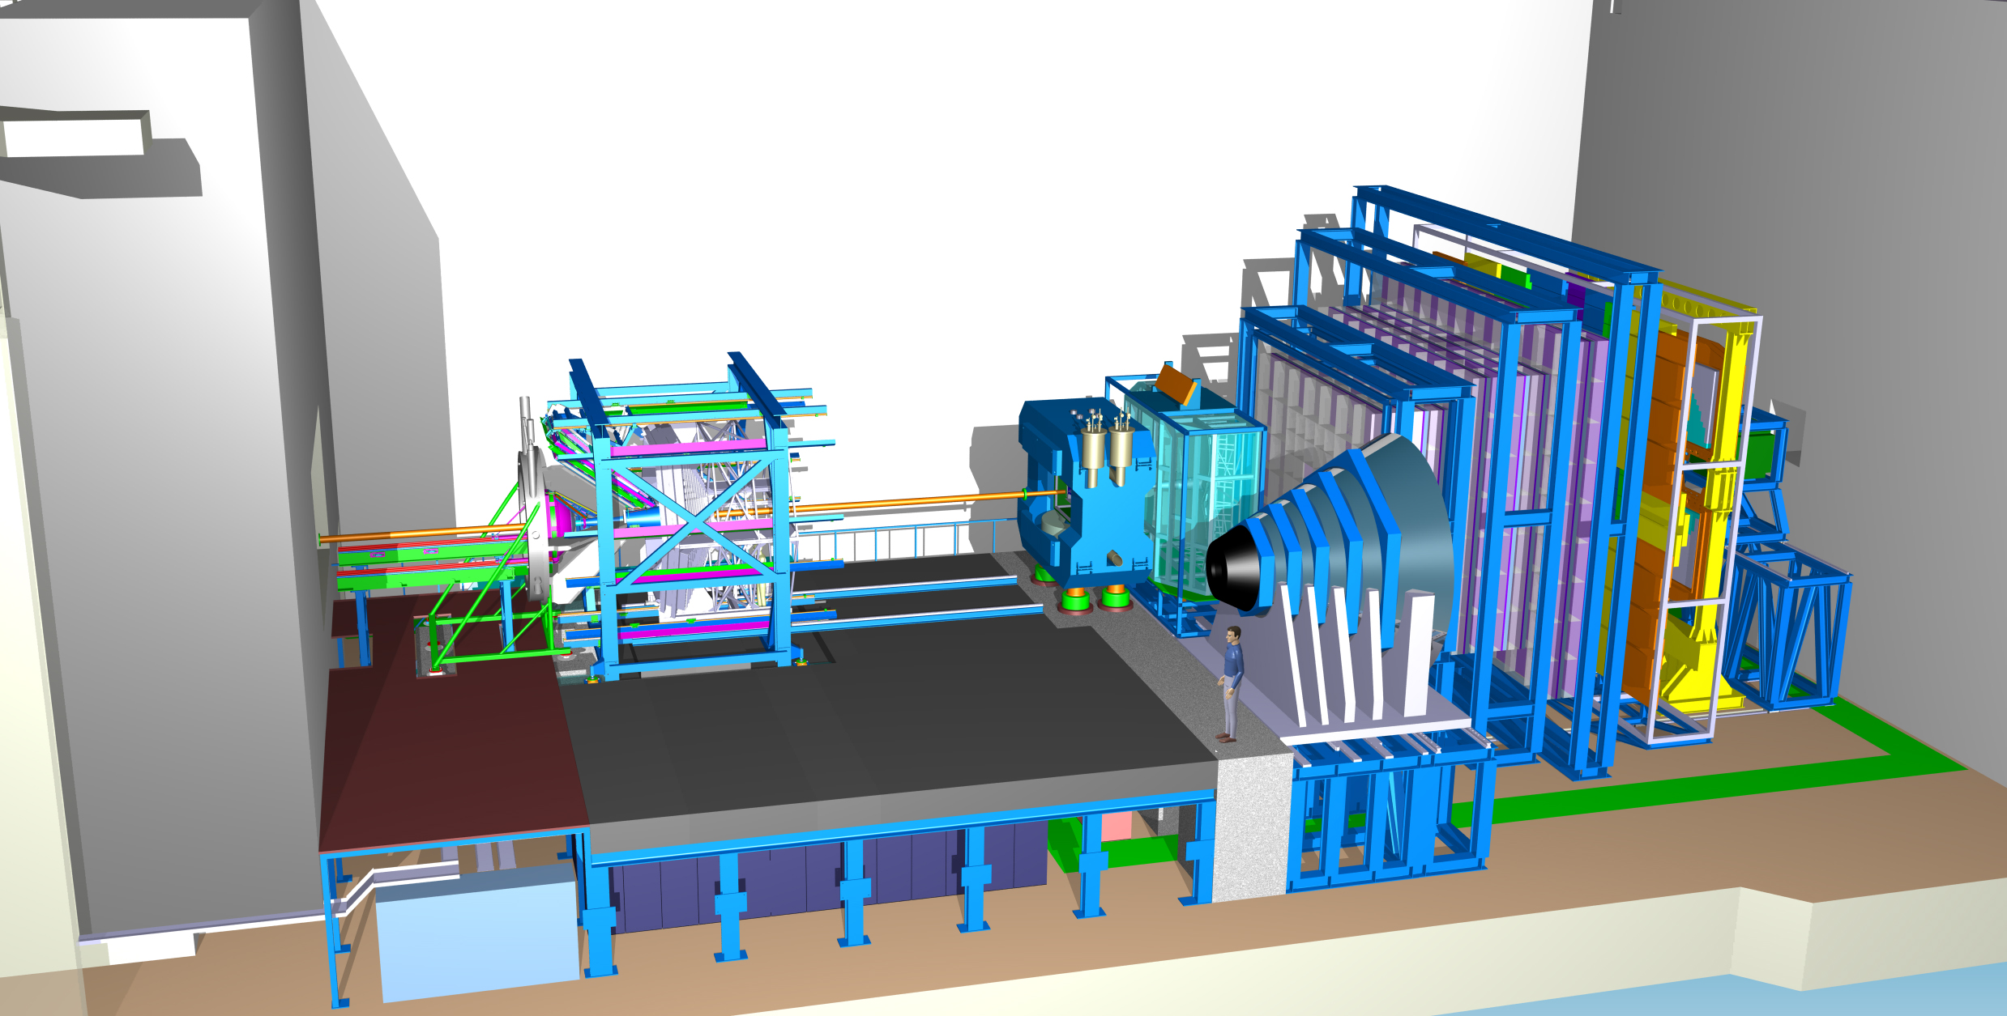
TRD
Time of Flight
Dipol
Magnet
Silicon
Tracking
System
RICH
MUCH
DAQ/FLES HPC cluster
Projectile
Spectator
Detector

Slide 25
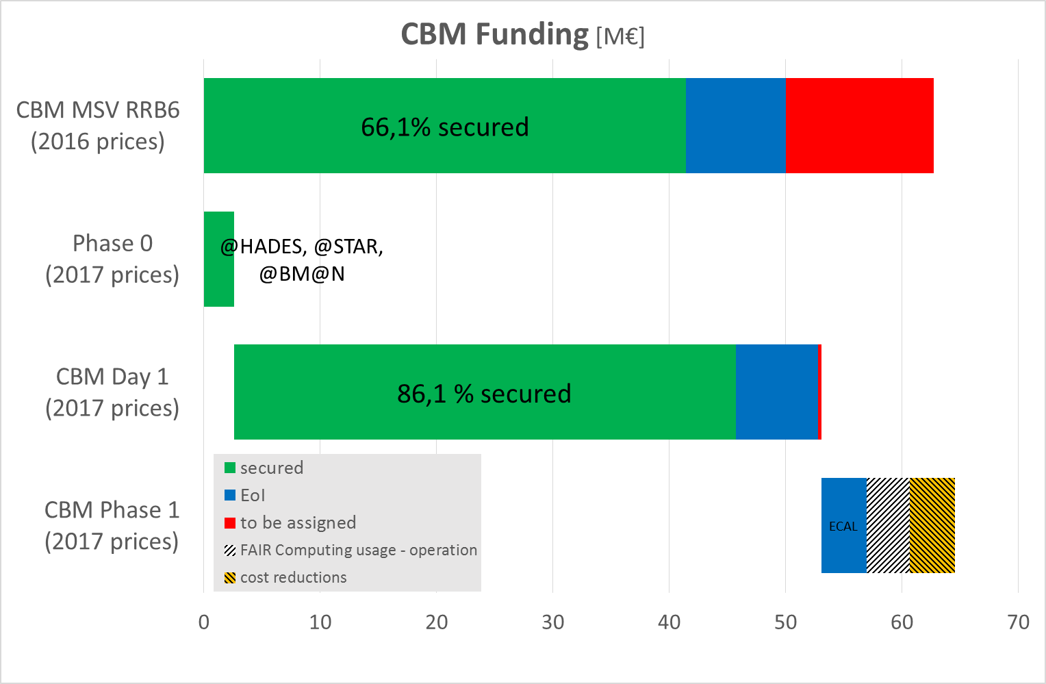
Phases CBM Funding 28.11.2017

Slide 26
Costs and funding of CBM phase 0 activities
Phase 0 Activity | Hardware k€
HADES RICH | 1311 ¹)
STAR TOF | 467 ¹)
STAR FLES | ---
Upgrade BM@N experiment with 4 Silicon stations of CBM/STS design | 3250 ²)
PSD at BM@N | 800 ¹)
mCBM@SIS18 CBM full system test setup | 389 ³)
no additional core invest needed !
¹) Funding secured by CBM funds ²) Funding provided by JINR Dubna ³) preparation cave, platforms and DAQ – funding secured

Slide 27
New escalation factor – decision of the FAIR council summer 2017
Year | new Inflation Factor
2005 | 1,000
2008 | 1,164
2009 | 1,104
2010a | 1,138
2010b | 1,138
2011 | 1,204
2012 | 1,220
2013 | 1,227
2014 | 1,224
2015 | 1,211
2016 | 1,364
2017 | 1,400
2018 | 1,436
2019 | 1,474
2020 | 1,513
2021 | 1,552
2022 | 1,593
2023 | 1,635
2024 | 1,677
2025 | 1,721

Slide 28
HADES construction Costs (completion in year 2000)
HADES system | total cost [in 1998 Euros, (DM/2)] | GSI | Collaboration Members | Other
RPC | 1100 | - | 1100 (EU) | -
Magnet | 2150 | 2150 | - | -
Forward Wall | 400 | 50 | 150 | 200
MDC | 2300 | 140 | 2160
RICH | 1500 | - | 1500 | -
TOF | 1050 | - | 1050 | -
Shower | 390 | - | 390 | -
Infrastructure costs not included
 | 8890 | 2340 | 6350 | 200
Taking into account
the total construction
costs of HADES,
the level of funding rises to:
HADES (Phase 0): 98,6%
HADES (Phase 1): 89,5 %
All numbers in kEUR (DM/2), based on 1998 DM prices

Slide 29
Status CBM/HADES Technical Design Reports November 2018
Nr. | CBM subsystem | Status
1 | Superconducting dipole magnet | approved
2 | Silicon Tracking System (STS) | approved
3 | Ring Imaging Cherenkov Detector (RICH) | approved
4 | Projectile Spectator Detector (PSD) | approved
5 | Muon Chamber System (MUCH) | approved
6 | Time of Flight (TOF) system | approved
7 | Transition Radiation Detector (TRD) | approved
8 | Micro-Vertex Detector (MVD) | submission 2019
9a | Online Systems: Data Acquisition (DAQ) | submission 2019
9b | Online Systems: First Level Event Selection (FLES) | submission 2020
10 | Electromagnetic Calorimeter (ECAL) | submission t.b.d.
11 | HADES Electromagnetic Calorimeter | approved

Slide 30
CBM status: score card
26.11.2018
8th CBM RRB Jürgen Eschke, CBM RC

