Slide 1
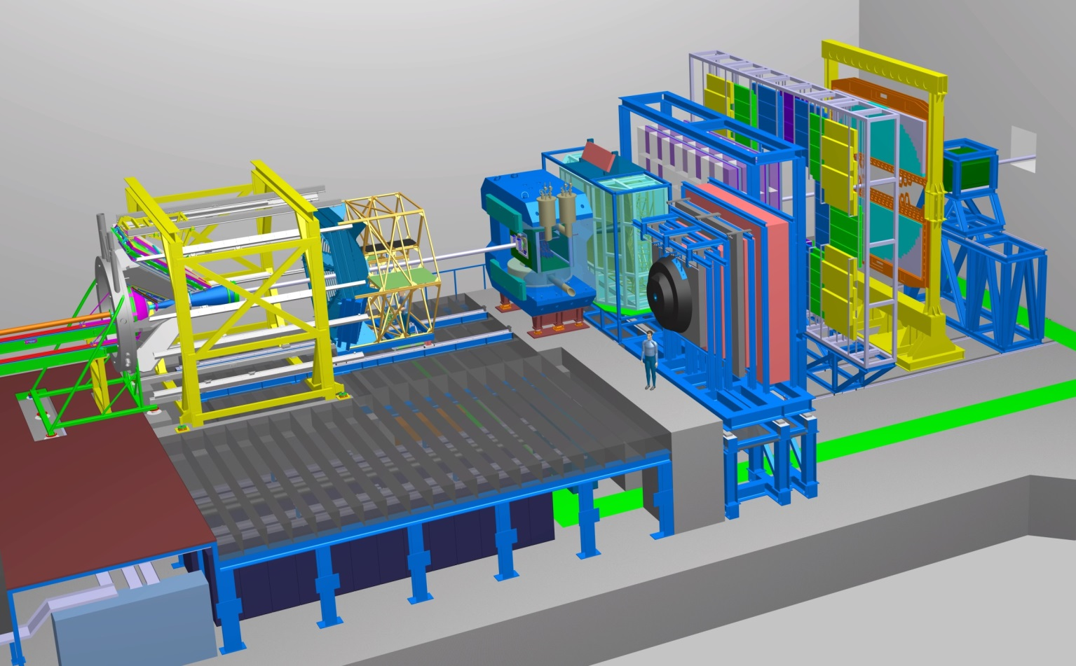
The Compressed Baryonic Matter Experiments
CBM
HADES
Outline: Reminder: Physics case
Status of experiments (HADES & CBM)
Day-1 Setup ( > 2024)
FAIR Phase 0 program (2018 – 2024)

Slide 2
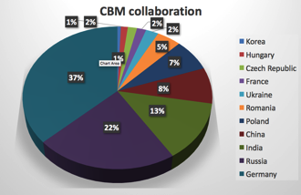
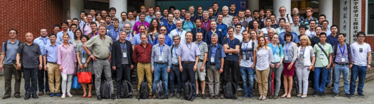
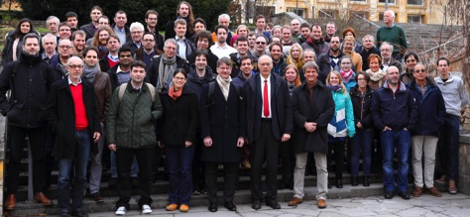
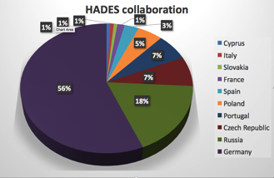
C.B.M. – Collaborations
CBM Collaboration: 436 members, 11 countries
HADES Collaboration: 139 members, 9 countries

Slide 3
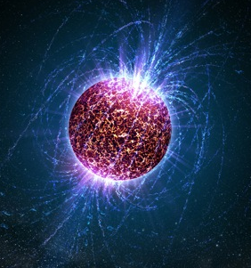
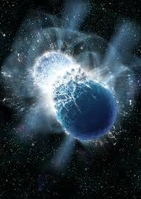
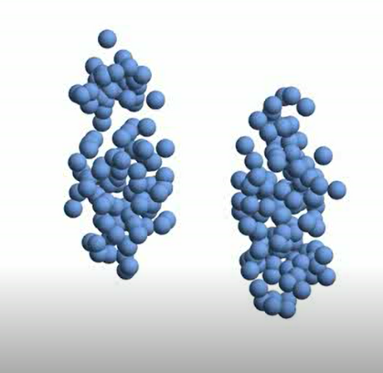
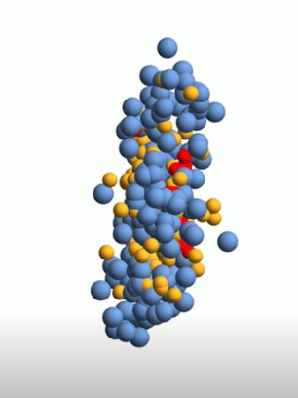
Dense Baryonic Matter
Neutron stars
Temperature
T < 10 MeV
Density
ρ < 10 ρ₀
Lifetime
T ~ infinity
Neutron star merger
Temperature
T < 50 MeV
Density
ρ < 2 – 6 ρ₀
Reaction time
(GW170817)
T ~ 10 ms
Heavy ion collisions at SIS100
Temperature
T < 120 MeV
Density
ρ < 8ρ₀
Reaction time
t ~ 10⁻²³ s
Isospin symmetric matter
Compressed Baryonic Matter
Notes:
http://www.sciencemag.org/news/2017/10/merging-neutron-stars-generate-gravitational-waves-and-celestial-light-show

Slide 4
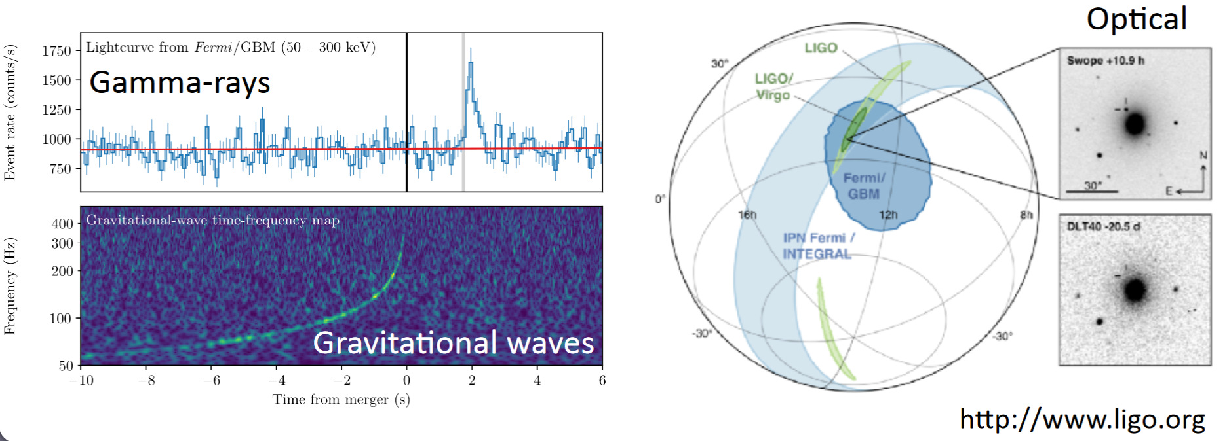
Neutron star merger
GW170817
M. Hanauske et al.,
J. Phys.: Conf. Ser.
878 012031

Slide 5
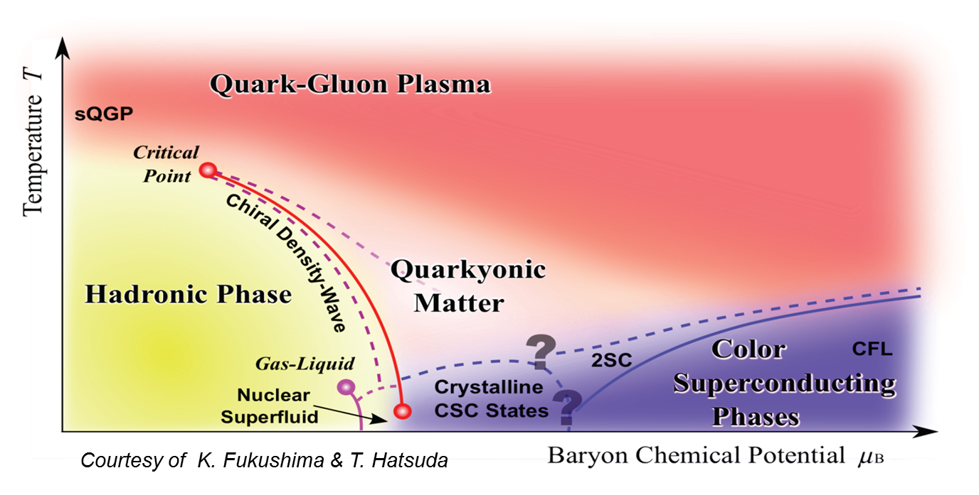
CBM – Goals
Mission:
    Systematically explore QCD matter at large baryon densities with
high accuracy and rare probes.
Fundamental questions:
Equation of State of QCD matter at neutron star densities
Phase structure of QCD matter
Chiral symmetry restoration at large densities
Bound states with strangeness
Charm in dense baryonic matter

Slide 6


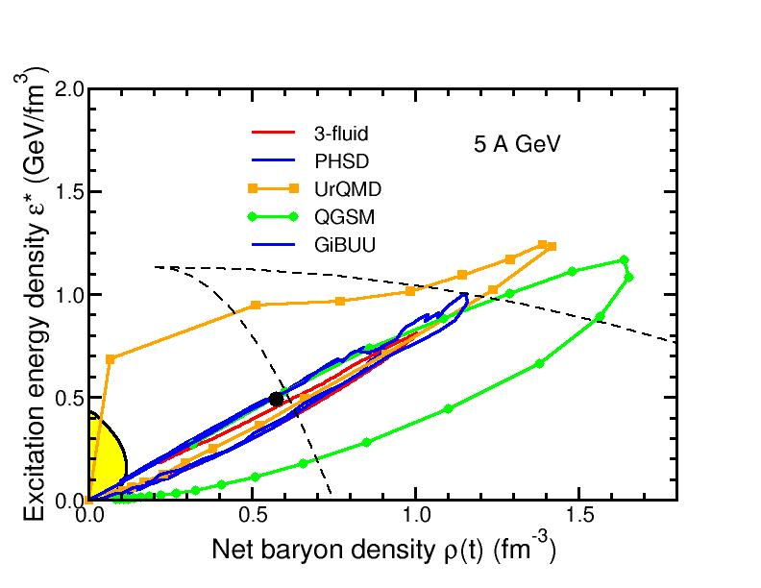
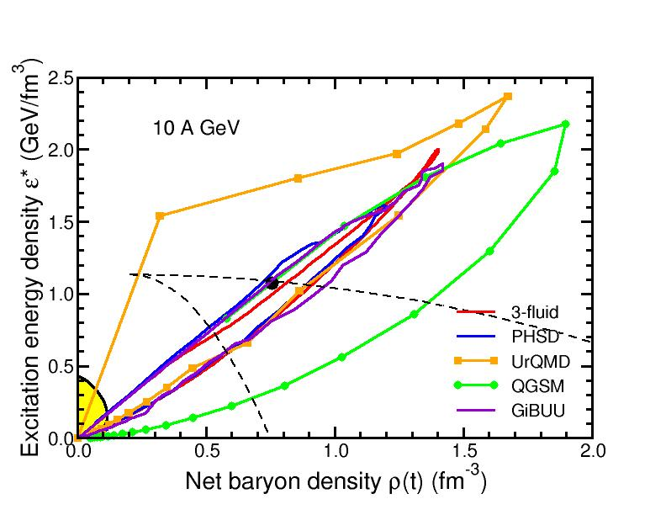
Baryon densities in central Au+Au collisions
5 A GeV
10 A GeV
8 ρ₀
5 ρ₀
I.C. Arsene et al., Phys. Rev. C 75, 24902 (2007)
phase
coexistence
phase
coexistence

Slide 7
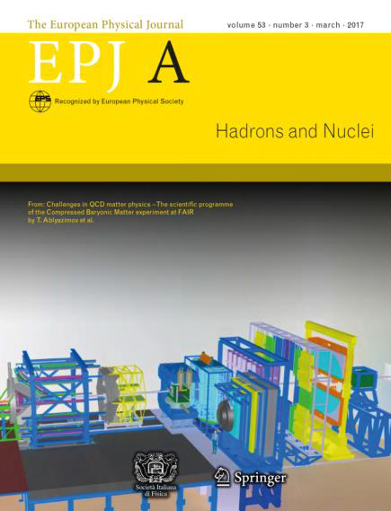
CBM physics and observables
QCD equation-of-state
collective flow of identified particles
particle production at threshold energies
Eur.Phys.J. A53 (2017) 60
Phase transition
excitation function of hyperons
excitation function of LM lepton pairs
Critical point
event-by-event fluctuations of conserved quantities
Chiral symmetry restoration at large ρ_{B}
in-medium modifications of hadrons
dileptons at intermediate invariant masses
Strange matter
(double-) lambda hypernuclei
Search for meta-stable objects (e.g. strange dibaryons)
Heavy flavour in cold and dense matter
excitation function of charm production

Slide 8
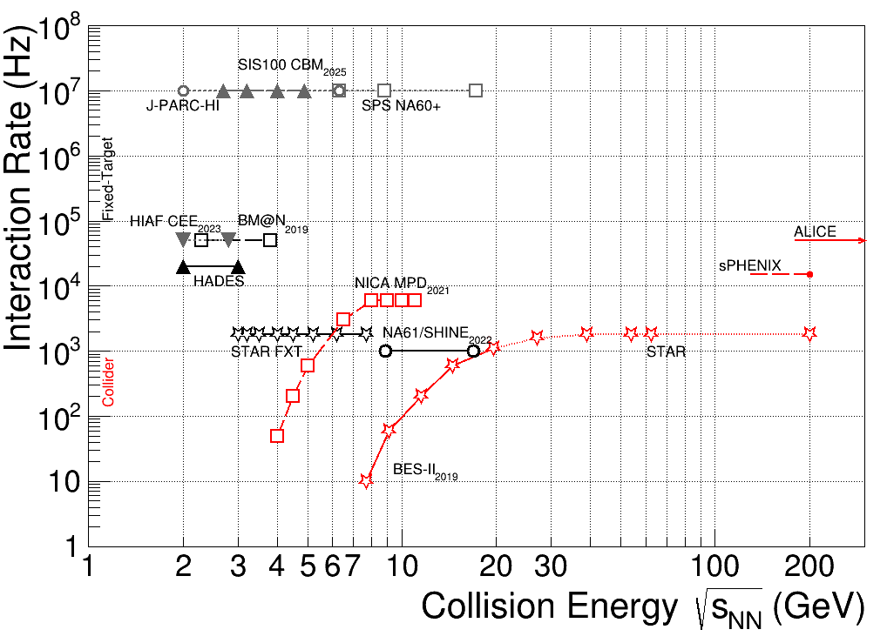
CBM – experimental efforts
Exploration of QCD phase diagram
as international effort:
NA61 @ SPS / CERN
BM@N @ Nuclotron/JINR
STAR (FXT) @ RHIC/BNL
MPD @ NICA / JINR
CEE @ HIAF
? @ J-PARC
Running
Approved
Conceptual design
CBM‘s unique feature:
Comprehensive high statistics measurement of rare probes

Slide 9
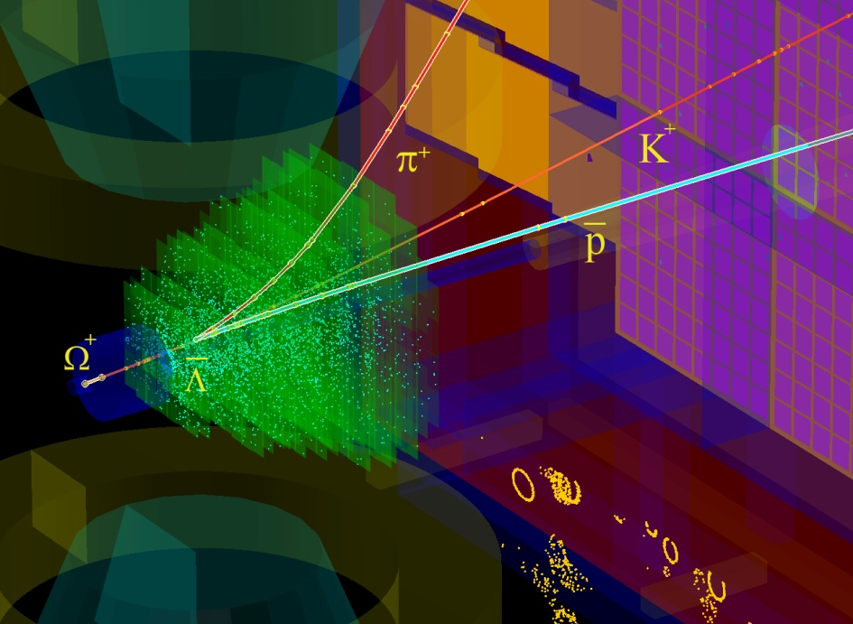
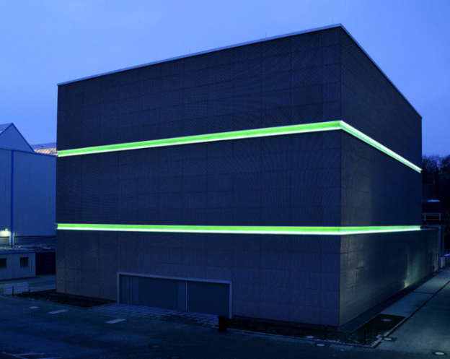
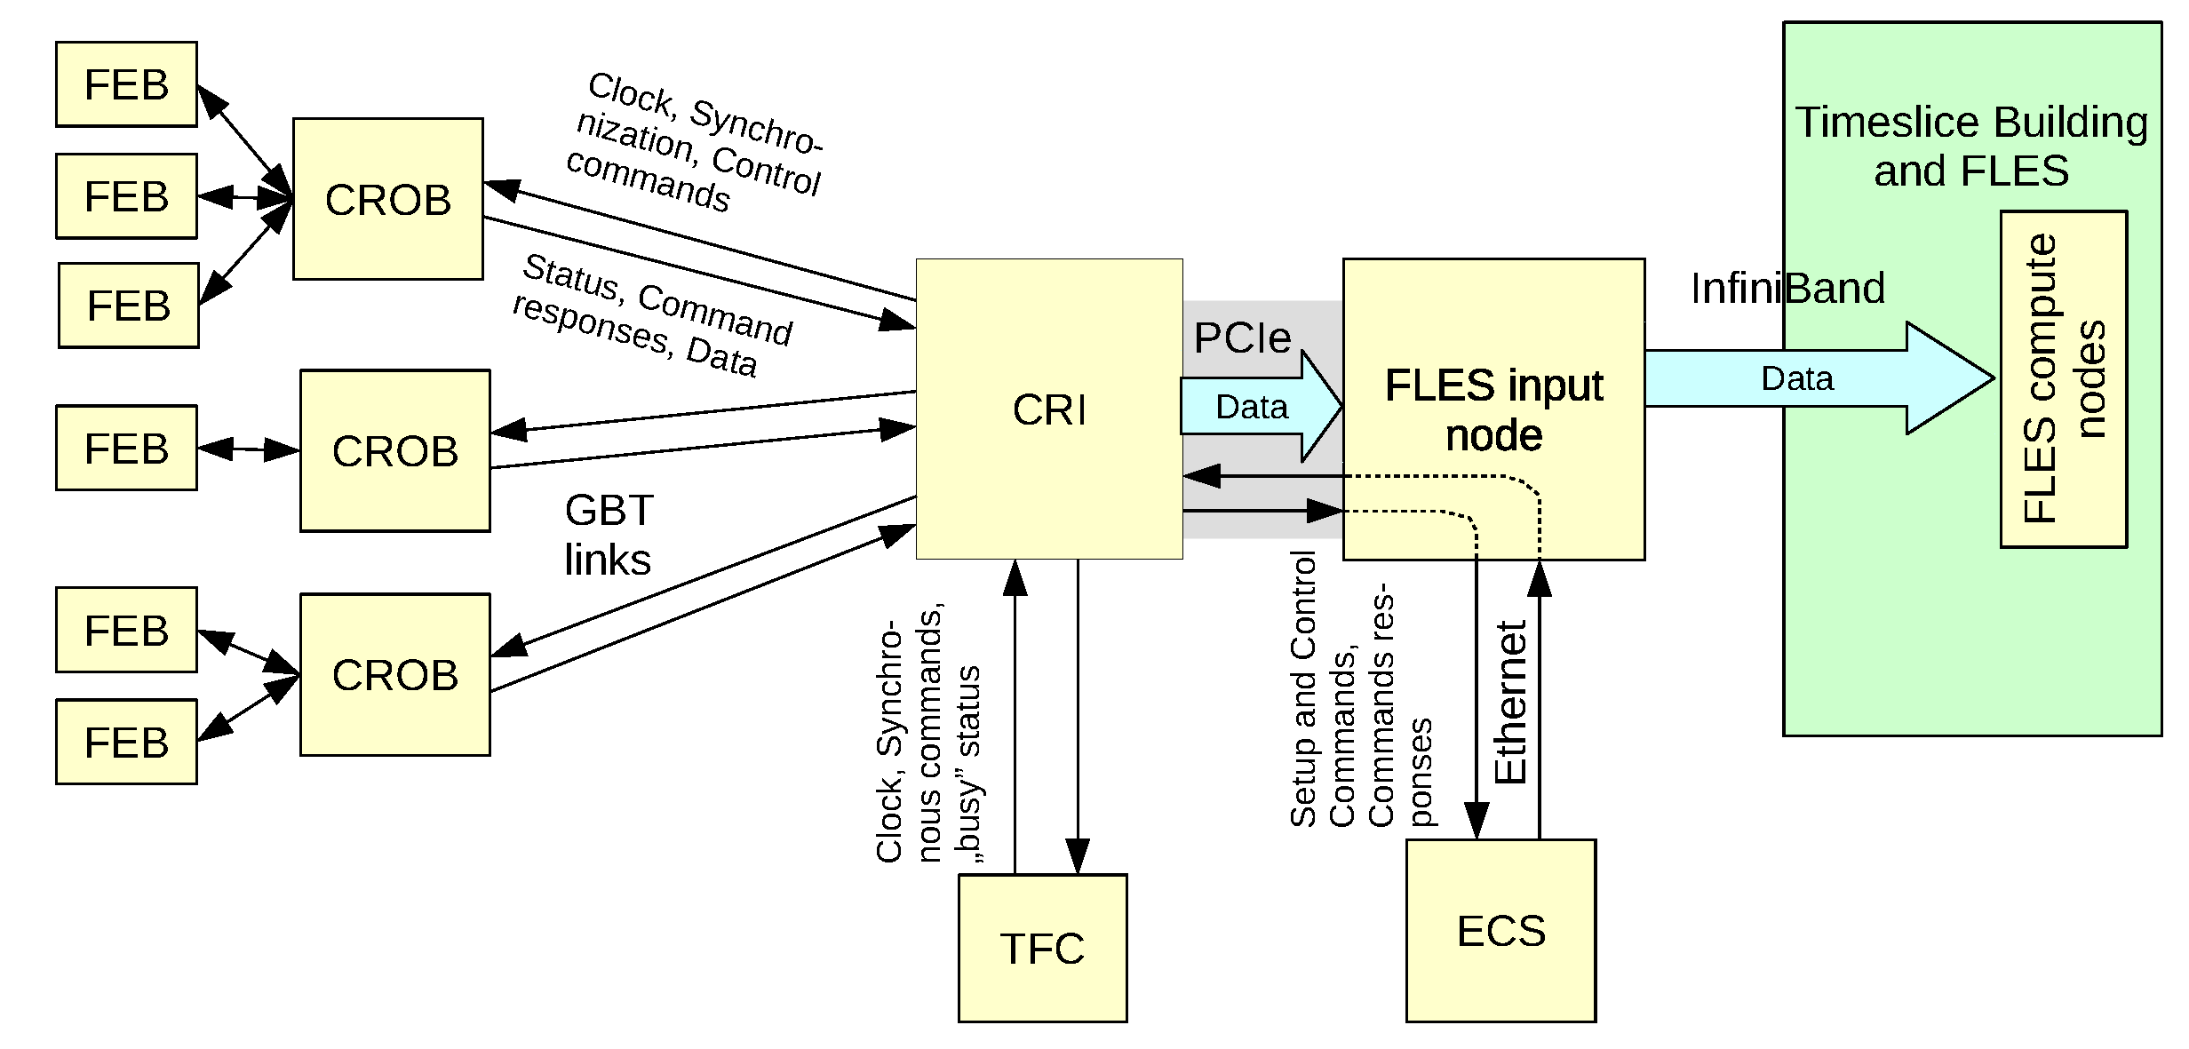
CBM data processing system
Au + Au, 10A GeV
Reaction rate Au + Au:
10⁷ collisions per second
Data rate: ~ 1 TB/s
green IT cube
Main features:
radiation tolerant detectors and front-end electronics
free streaming (triggerless) data with time stamps,
software based event selection

Slide 10
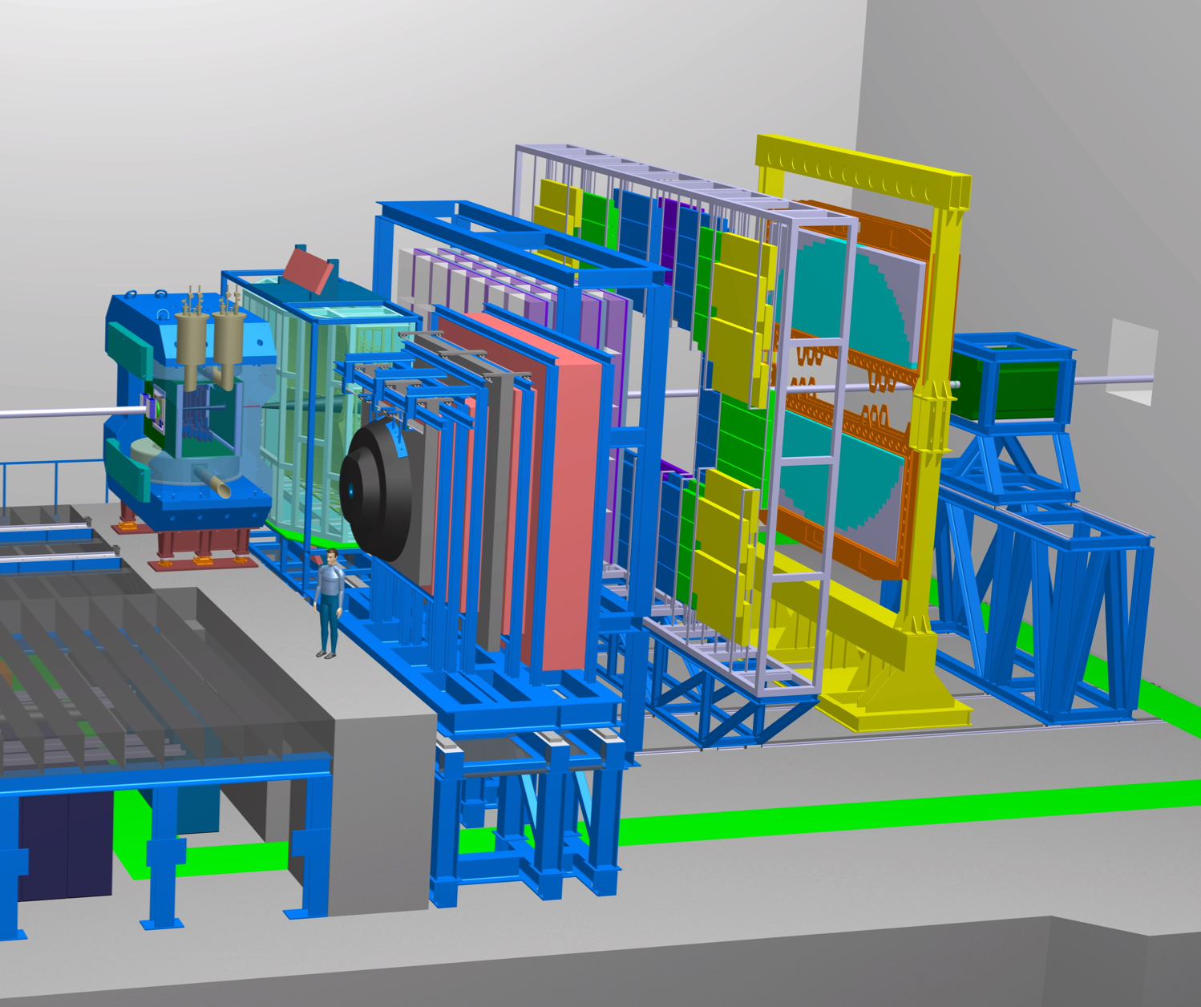
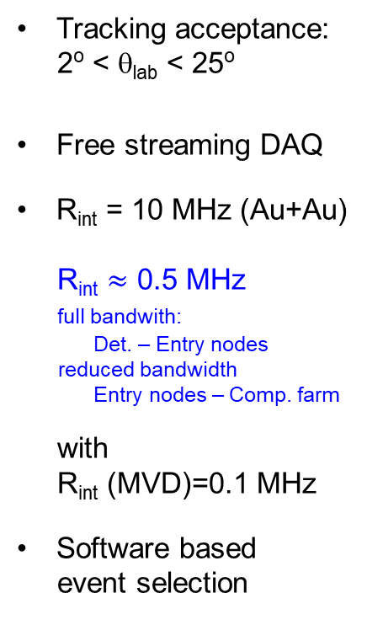
CBM experimental setup (day-1)
Tracking acceptance:
2º < θ_{lab} < 25º
Free streaming DAQ
R_{int} = 10 MHz (Au+Au)
R_{int} $≈$ 0.5 MHz
full bandwith:
Det. – Entry nodes
reduced bandwidth
Entry nodes – Comp. farm
with
R_{int} (MVD)=0.1 MHz
Software based
event selection
Dipole
Magnet
RICH
Ring
Imaging
Cherenkov
TRD
Transition
Radiation
Detector
TOF
Resistive
Plate
Chambers
MVD
Micro
Vertex
Detector
STS
Silicon
Tracking
System
MUCH
Muon
Detection
System
(parking pos.)
ECAL
Electro-
Magnetic
Calorimeter
PSD
Projectile
Spectator
Detector
Day-1 setup
funding: ~ 90% secured
Day-1 setup = MSV (Phase-1) setup – Compute Performance - ECAL

Slide 11
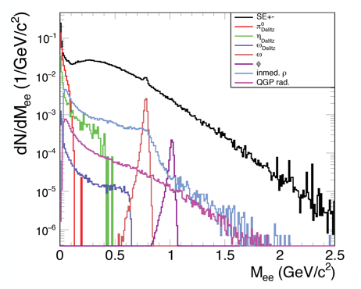
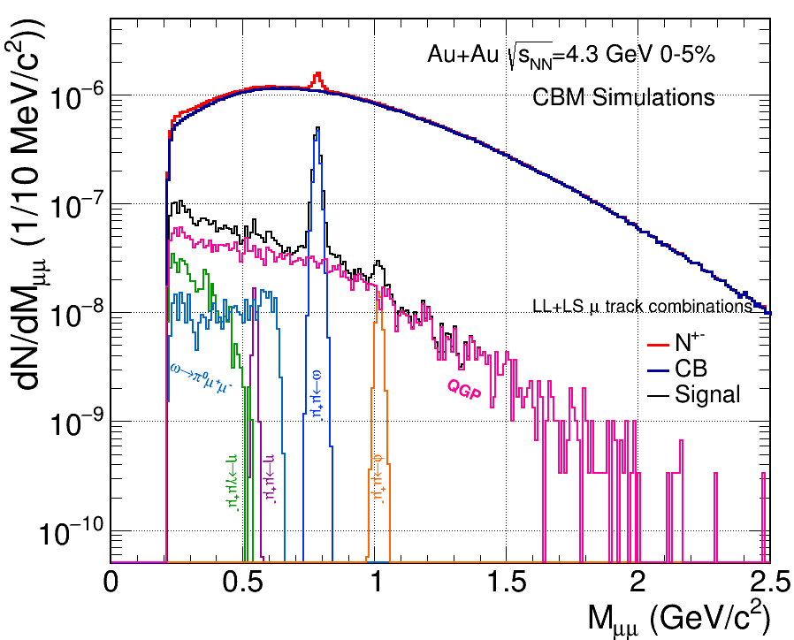

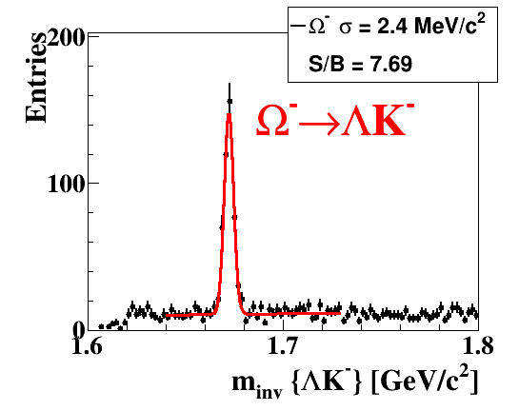
Physics potential of Day-1 configuration
Unique, unprecedented measurements in SIS100 energy range
excitation function of dilepton yields (e⁺e⁻, μ⁺μ⁻)
excitation function of multi strange hyperon production
LMR
e⁺e⁻
IMR
CBM & HADES physics programs are endorsed by JSC.

Slide 12
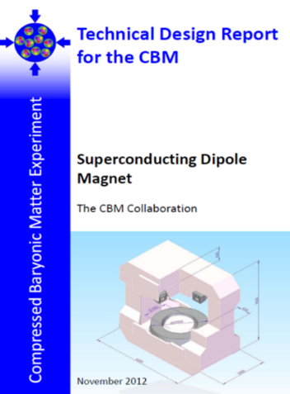
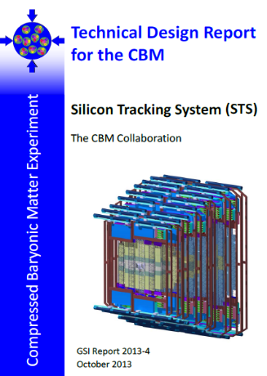
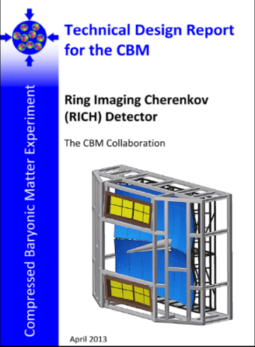
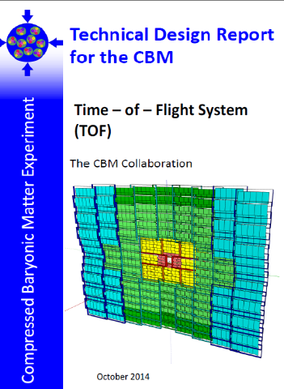
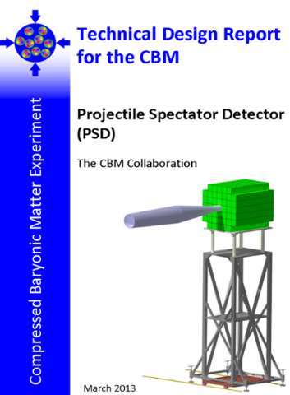
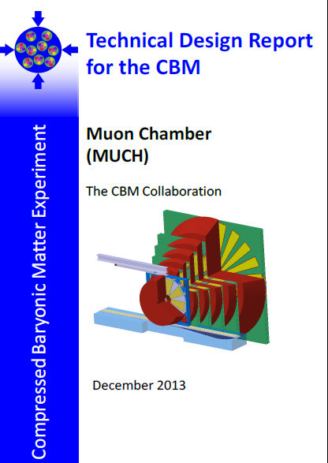
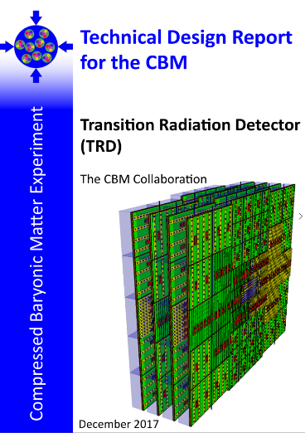
CBM Technical Design Reports
# | Project | TDR Status
1 | Magnet | approved 2013
2 | STS | approved 2013
3 | RICH | approved 2014
4 | TOF | approved 2015
5 | MuCh | approved 2015
6 | PSD | approved 2015
7 | TRD | approved 2018
8 | MVD | submission 2019
9a | Online Systems: DAQ | submission 2019
9b | Online Systems: FLES | submission 2020
10 | ECAL | submission t.b.d.

Slide 13
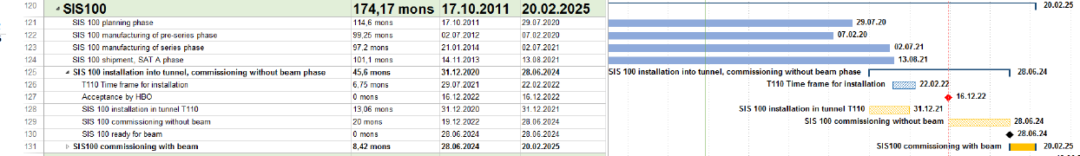
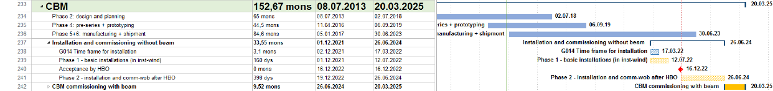
FAIR / CBM schedule
as presented in ECE 26.7.2017
  Dec ‘21 to Jul ‘22 1st installation window
  Dec ‘22 Building acceptance
  Dec ‘22 to Jun ‘24 Installation & commissioning w/o beam
  Mar ’23 Cryo: DB2 cold; cool down CBM Magnet
  Jun ‘24 to Mar ‘25 Commissioning beam from SIS100
*Rebaselining of project planned for end 2018 !

Slide 14
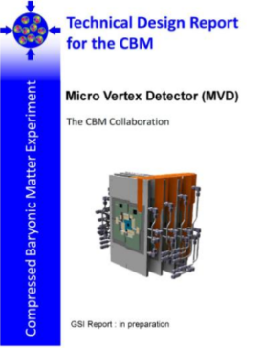
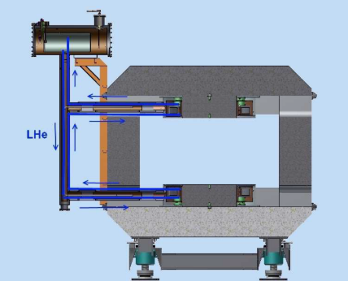
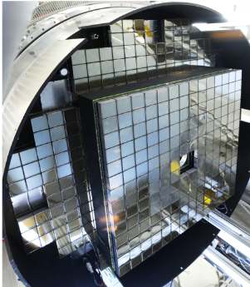
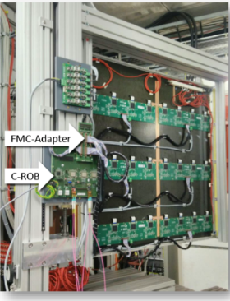
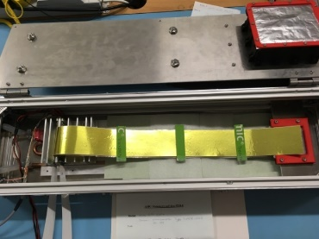
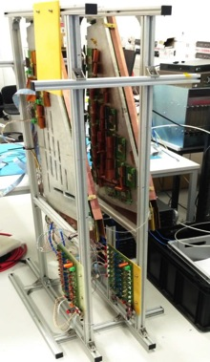
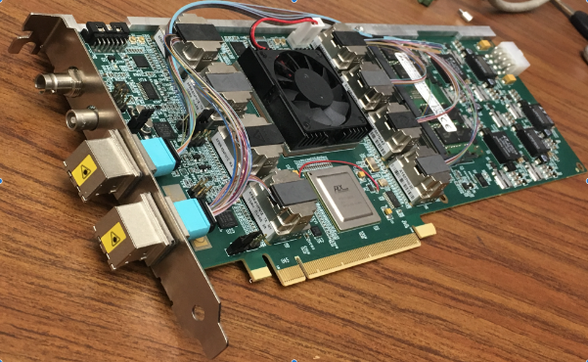
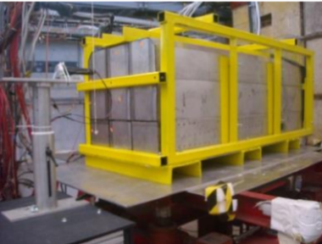
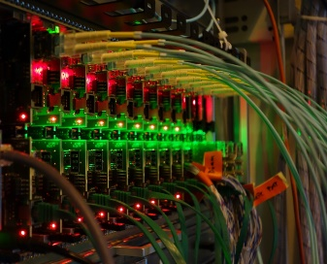
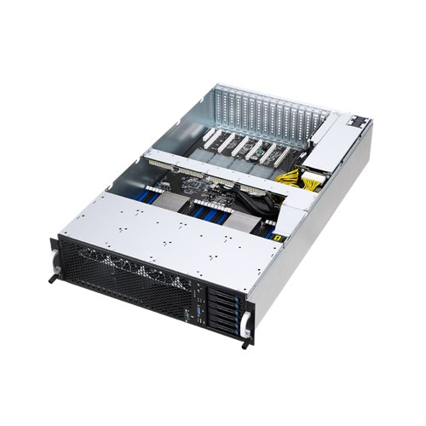
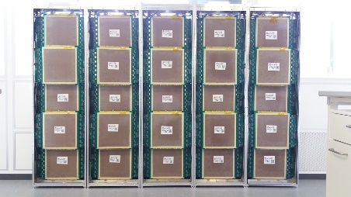
Progress in developments
Magnet
GSI Darmstadt,
BINP Novosibirsk,
JINR Dubna
MVD
IKF Frankfurt,
IPHC Strasbourg,
Pusan Nat‘l Univ.
STS
GSI Darmstadt,
JINR Dubna,
KIT Karlsruhe,
JU Crakow,
AGH Crakov,
KINR Kiev,
Univ. Tübingen,
Warsaw UT
RICH
Univ. Giessen,
Univ. Wuppertal,
PNPI Gatchina,
GSI Darmstadt
TRD
NIPNE Bucharest,
Univ. Frankfurt,
Univ. Heidelberg,
Univ. Münster
PDR in Apr. 19
TDR in 2019
MUCH
Aligarh Muslim Univ.,
Bose Inst. Kolkata,
Panjab Univ.,
Univ. of Jammu.
Univ. of Kashmir,
Univ. of Calcutta,
B.H. Univ. Varanasi,
VECC Kolkata,
IOP Bhubaneswar,
NISER Bhubaneswar,
IIT Kharagpur,
IIT Indore,
Gauhati Univ.,
PNPI Gatchina
TOF
THU Beijing,
NIPNE Bucharest,
GSI Darmstadt,
TU Darmstadt,
USTC Hefei,
Univ. Heidelberg,
ITEP Moscow,
HZDR Rossendorf,
CCNU Wuhan
Full 2sided ro demostrated,
sensor contracting started
MAPMT ready for
HADES beam.
2 chambers operational
for mCBM beam.
PSD
INR Moscow,
TU Darmstadt,
CTU Prague,
NPI Rez
DAQ
GSI Darmstadt
KIT Karlsruhe
Warsaw UT
IRI Frankfurt
FLES
FIAS Frankfurt
Univ. Frankfurt
Preproduction and tests
done for mCBM & eTOF
Response studies at CERN
confirmed TDR performance
Data sync. within
subsys. demonstrated
Concept. Design done,
prototype FLESnet
running
2 modules ready for mCBM

Slide 15
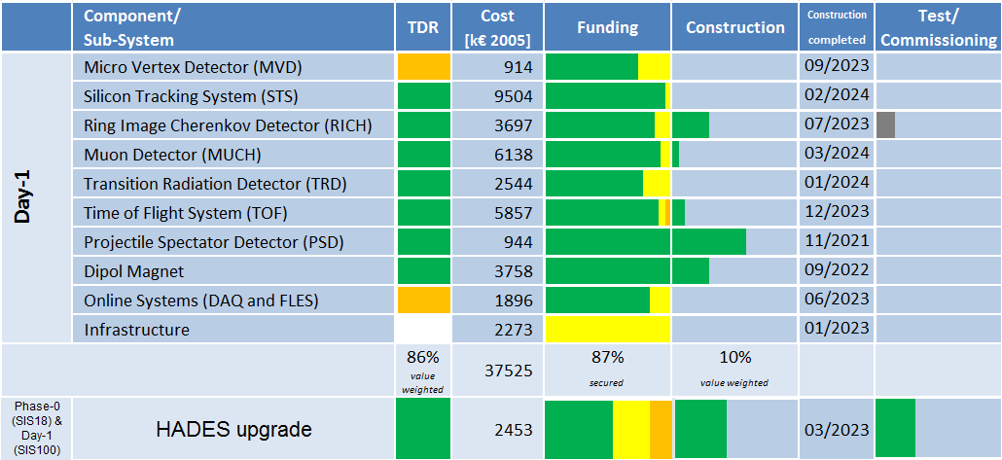
CBM status: score card

Slide 16
CBM organisation
Collaboration Board
Chair N. Xu (CCNU), Dep. A. Kugler (NPI-CAS)
Spokesperson
N. Herrmann (UHD), Dep. S. Chattopadhyay (VECC) , V. Ladygin (JINR)
Management Board
Resource
Board
J. Eschke (FAIR)
Technical
Board
W.F.J. Müller (FAIR)
Computing
Board
V. Friese (GSI)
Physics
Board
I. Selyuzhenkov (GSI)
Conference &
Editorial Board
H.R. Schmidt (UTÜB, GSI)
China
N. Xu (CCNU)
Cave M. Kis (GSI)
SIM V. Friese (GSI)
Hadron I. Vassiliev (GSI)
Czech Rep.
A. Kugler (NPI-CAS)
Magnet P. Senger (GSI)
EDC P.A. Loizeau (GSI)
Dilepton T. Galatyuk (TUD)
Germany
K.Kampert (UWU)
MVD J. Stroth (UFRA, GSI)
ODM J. DeCuveland (FIAS)
C2F I. Selyuzhenkov (GSI)
Hungary
G. Wolf (WRCP)
STS H.R. Schmidt (UTÜB, GSI)
DPF F. Uhlig (GSI)
Charm (M. Deveaux (UFRA))
MUCH S. Chattopadhyay (VECC)
ALG M. Zyzak (GSI)
India
S. Chattopaghay (VECC)
I
RICH C. Höhne (UGI),
K. Kampert (UWU)
OAE NN
Korea
I.-K.Yoo (PNU
INF NN
TRD C. Blume (UFRA)
Poland
P.Staszel (UJAG)
TOF I. Deppner (UHD)
Acronyms
MVD – Micro Vertex Detector SIM - SIMulation
STS – Silicon Tracking System EDC – Experiment & Detector Control
MUCH – MUon Chambers ODM – Online Data Management
RICH – Ring Imaging Cherenkov detector DPF – Data Processing Framework
TRD – Transition Radiation Detector ALG – ALGorithms
TOF – Tim Of Flight detector OAE – Offline Analysis Environment
ECAL – Electromagnetic CALorimeter INF – software INFrastructure
DAQ – Data AcQuisition system
FLES- IN – First Level Selector – Input Nodes C2F – Correlation, Flow, Fluctuations
Romania
M. Petrovici (IFIN-HH)
ECAL I. Korolko (ITEP)
Russia
Y. Zaitsev (ITEP)
PSD F. Guber (INR)
Ukraine
V. Putgatch (KINR)
DAQ D. Emschermann (GSI)
FLES-IN J. DeCuveland (FIAS)

Slide 17
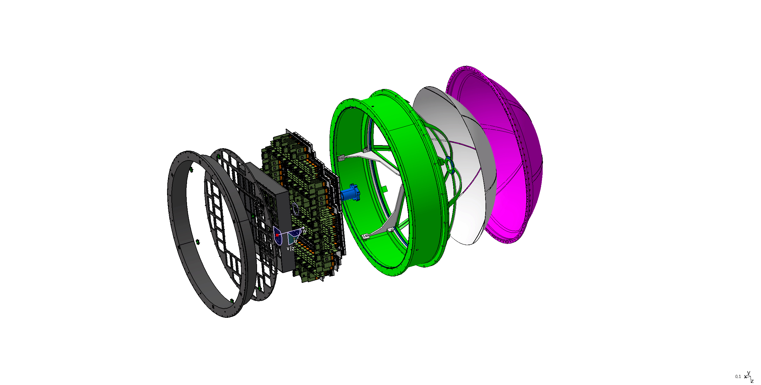
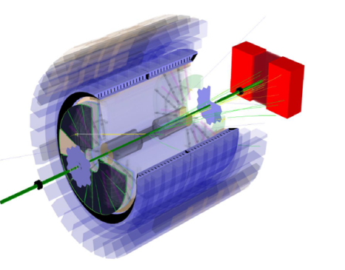
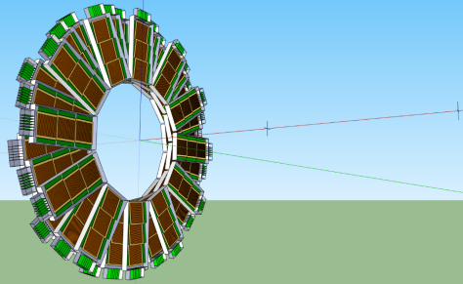
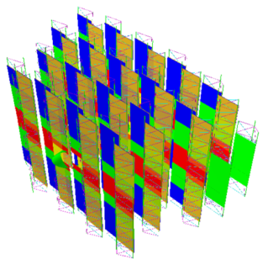
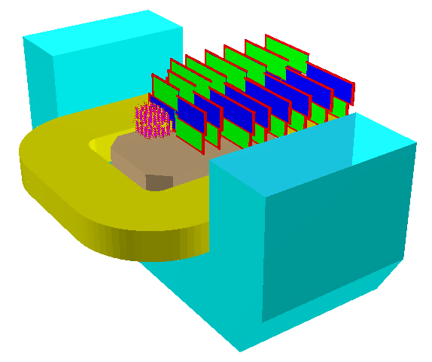
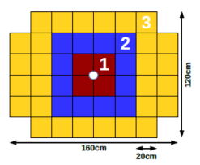
CBM – FAIR Phase 0 projects (2018 – 2024)
1. Install, commission and use 430 out of 1100
CBM RICH multi-anode photo-multipliers (MAPMT)
including FEE in HADES RICH photon detector
2. Install, commission and use
10% of the CBM TOF modules
including read-out chain
at STAR/RHIC (BES II 2019/2020)
3. Upgrade BM@N experiment
with 4 Silicon stations of CBM/STS design in the
BM@N experiment at the Nuclotron JINR/Dubna
(Au-beams in late 2020)
4. Install, commission and use the Project
Spectator Detector at the BM@N experiment
5. mini CBM (mCBM@SIS18) demonstrator for
full CBM data taking and analysis chain
17

Slide 18






Phase-0: Ag+Ag, 1.65A GeV @ SIS18
Expected dielectron invariant mass spectrum
4.5×10⁹ events
10 kHz trigger rate
4 wks beam on target
Physics run scheduled for Feb/Mar 2019
(Multi)-Strangeness in Ag+Ag.
Understanding of the Ξ⁻ excess.
Access for the first time at this collision energies intermediate mass range
Participating CBM groups:
Univ. Wuppertal
Univ. Giessen
GSI Darmstadt
Univ. Frankfurt
TU Darmstadt

Slide 19





HADES upgrades
HADES Spectrometer
RICH Upgrade
HADES Calorimeter
Finished, Ready for Beam
4 Sectors Ready for Beam
RICH (HADES/CBM phase 0 project) – finished, ready for beam
  Gain in lepton pair detection efficiency (x 3)
  Improved background/noise rejection:
    Better conversion pair rejection
    Precise time information (down to 300ps precision)
  Joint (CBM/PANDA/HADES) development of read-out system based on TRB3 platform.
Electromagnetic Calorimeter – 4 sectors ready for beam in 2019
  π0 and η decays into γγ channel
  Electromagnetic decays of baryonic resonances
  Improved e/π separation: important for di-electron spectroscopy
  Proven technology: lead glass modules read out with Hamamatsu PMTs
MDC readout upgrade – Installation in 2020
  Multi-hit TDC (TRB based) – essential for high rate experiments
  Read-out trigger rate increase from 50 kHz to 200 kHz
Forward Detector (HADES/PANDA phase 0 project) – installation in 2019
  Enhance HADES capabilities for exclusive channels – forward region
  Hyperon production and EM decays
  PID via TOF, dE/dx(straw tube) – no magnetic field
MDC readout upgrade
Installation in 2020
Forward Detector –
Installation in 2019
Notes:
HADES upgrade projects, summary page.
RICH upgrade finished, ready for production beam in Feb. 2019
HADES ECal: 4 sectors out of 6 ready to collect data, Feb. 2019
Forward Detector: extends the acceptance for angles < 6 degrees, will be installed in 2019
MDC readout upgrade: scheduled for 2020

Slide 20






π Beam experiments with HADES at GSI
HADES
π⁻p→X
Ideal tool (and unique in world) for baryon resonance studies
→ invaluable source of information on QCD
η
ω
Successful pioneering experiment in 2014
in the N(1520) region
π⁻p:
Hadronic channels: ππN (ρn), ηn, ωn, ΛK
Partial Wave Analysis for baryon spectroscopy
(together with γ beam data)
e⁺e⁻ : time-like baryon transitions
(cf electron scattering)
π⁻A:
cold matter studies, collective ρ-induced
baryon-hole excitations
π⁻p→ne⁺e⁻
Off-shell ρ
preliminary
Point-like baryons
Beam request for investigation of the N(1720) region

Slide 21




eTOF & HPC software in STAR at RHIC (BNL)
CBM eTOF sector
(Jan. 2018)
Correlation:
CBM-eTOF
with STAR TPC
from Run18
CBM groups:
Tsinghua Univ. Beijing
GSI Darmstadt
TU Darmstadt
Univ. Frankfurt
Univ. Heidelberg
USTC Hefei
CCNU Wuhan
Test module operational (Oct. 2016)
STAR DAQ interface (Jan. 2017)
Full sector test (Spring 2018)
Wheel installation (Fall 2018)
BES II data taking (2019/2021)
Transfer of modules to FAIR (2022/23)

Slide 22





CBM-STAR eTOF: module production & test in HD
Nov.6, 2018
36 modules
108 MRPCs
72 GBTX PCBs
216 GET4 PCBs
216 PADI PCBs
6912 channels
DAQ/FLES HW/SW

Slide 23





CBM-STAR eTOF: status
Nov.6, 2018
Nov. 23, 2018:
all eTOF modules installed
and functional,
SW integration ongoing.

Slide 24



Phase-0: STS & PSD in BM@N (JINR)
Silicon Tracking Stations
dipole magnet
GEM tracker
PSD calorimeter
(synergies with usage
in NA61/shine)
Au beams up to 4.5 GeV/u
BM@N timeline: NICA white paper
(Eur. Phys. J. A (2016) 213
2018 Installation of PSD detector (MoU signed)
2020 Au beams from Nuclotron
Installation of 4 Si Tracking Stations (MoU signed)
Improvement in efficiency
& signal / backrgound
Participating CBM groups:
GSI Darmstadt,
Univ. Tübingen,
JINR Dubna,
INR Moscow

Slide 25










CBM Phase-0: mCBM
Demonstrator for full CBM data taking and analysis chain
under full load (Au-Au, 10⁷ interactions/s)
mFLES racks @ Green IT Cube
mPSD
mTOF
mCBM will focus on:
Free streaming data transport to a computer farm
Online reconstruction and event selection
Offline data analysis
Requested beam time was fully granted by G-PAC
mTRD
mMVD
mSTS
mMUCH
mRICH
Common effort of all CBM groups!

Slide 26








mCBM (Nov. 2018)
mCBM program:
Q1 2019 detector & daq commisioning
Q1 2020 high rate demonstrator
Q1 2021 physics benchmark (Λ – prod)
Q1 2022 physics: Λ – excitation function

Slide 27
Summary / Conclusion
CBM scientific program at SIS100 is unique
explore QCD matter at neutron star core densities
employ high statistics capibility
to achieve high-precision of multi-differential observables
to enable rare processes as sensitive probes
CBM day-1 setup allows start of program with significant discovery potential
excitation function of hyperons production
excitation function of di-lepton production
study of light hypernuclei
CBM Phase 0 activities targeted towards usage and understanding
of major components & production of physics results with CBM devices
CBM – RICH sensors & readout in HADES at SIS18
CBM – TOF and HPC software in STAR at RHIC/BNL
CBM – PSD and CBM - STS in BM@N at Nuclotron/JINR
Integration of all subsystems & FLES in mCBM at SIS18
CBM collaboration is open for contributions from additional groups.
CBM needs the sustained support of all funding agencies for HW and SW projects.

