Slide 1
Construction MoU of CBM Collaboration
8th CBM Resource Review Board meeting
26th November 2018
Report
CBM Resource Coordinator
Jürgen Eschke

Slide 2
Overview
Purpose of Construction MoU (CMoU)
CERN model
Content CMoU
Common Fund
Next steps

Slide 3
Construction MoU of CBM Collaboration
Purpose of Construction MoU (for construction phase):
inside the collaboration
Collaboration agrees on responsibility for construction work packages
CMoU defines:
In-Kind contributions of member institutions (hardware),
but also substantial manpower contributions of member institutions
→ only these CBM member institutions are eligible to sign CMoU
(others downgraded to associated members)
Organizational, managerial and financial rules of collaboration

Slide 4
Construction MoU of CBM Collaboration
Purpose of Construction MoU (for construction phase):
to the outside
FAIR GmbH as Host Laboratory
FAIR needs to be confident about:
  solidity of collaboration's construction plans and capacity
  funding of experiment construction
Relation: Host Lab ←→ Collaboration (rights and duties)
Funding Agencies
Funding Agencies need to be confident about:
  solidity of collaboration's construction plans and capacity
  financial contributions of other funding agencies
Operation phase will be regulated by an additional document (Addendum to MoU)

Slide 5
CERN model
(we do not reinvent the wheel)
CERN has implemented the
RRB process for the LHC experiments
LHC collaborations have concluded
MoUs for construction and operation phase
Most of funding agencies participate at the CERN RRBs since many years and have signed MoUs for the LHC experiments
→ we profit from this successful model

Slide 6
CBM organisation
Collaboration Board
Chair N. Xu (CCNU), Dep. A. Kugler (NPI-CAS)
Spokesperson
N. Herrmann (UHD), Dep. S. Chattopadhyay (VECC) . V. Ladygin (JINR)
Management Board
Resource
Board
J. Eschke (FAIR)
Technical
Board
W.F.J. Müller (FAIR)
Computing
Board
V. Friese (GSI)
Physics
Board
I. Selyuzhenkov (GSI)
Conference &
Editorial Board
H.R. Schmidt (UTÜB, GSI)
China
N. Xu (CCNU)
Cave M. Kis (GSI)
SIM V. Friese (GSI)
Hadron I. Vassiliev (GSI)
Czech Rep.
A. Kugler (NPI-CAS)
Magnet P. Senger (GSI)
EDC P.A. Loizeau (GSI)
Dilepton T. Galatyuk (TUD)
Germany
K.Kampert (UWU)
MVD J. Stroth (UFRA, GSI)
ODM J. DeCuveland (FIAS)
C2F I. Selyuzhenkov (GSI)
Hungary
G. Wolf (WRCP)
STS H.R. Schmidt (UTÜB, GSI)
DPF F. Uhlig (GSI)
Charm (M. Deveaux (UFRA))
MUCH S. Chattopadhyay (VECC)
ALG M. Zyzak (GSI)
India
S. Chattopaghay (VECC)
I
RICH C. Höhne (UGI),
K. Kampert (UWU)
OAE NN
Korea
I.-K.Yoo (PNU
INF NN
TRD C. Blume (UFRA)
Poland
P.Staszel (UJAG)
TOF I. Deppner (UHD)
Acronyms
MVD – Micro Vertex Detector SIM - SIMulation
STS – Silicon Tracking System EDC – Experiment & Detector Control
MUCH – MUon Chambers ODM – Online Data Management
RICH – Ring Imaging Cherenkov detector DPF – Data Processing Framework
TRD – Transition Radiation Detector ALG – ALGorithms
TOF – Tim Of Flight detector OAE – Offline Analysis Environment
ECAL – Electromagnetic CALorimeter INF – software INFrastructure
DAQ – Data AcQuisition system
FLES- IN – First Level Selector – Input Nodes C2F – Correlation, Flow, Fluctuations
Romania
M. Petrovici (IFIN-HH)
ECAL I. Korolko (ITEP)
Russia
A. Akidinov (ITEP)
PSD F. Guber (INR)
Ukraine
V. Putgatch (KINR)
DAQ D. Emschermann (GSI)
FLES-IN J. DeCuveland (FIAS)

Slide 7
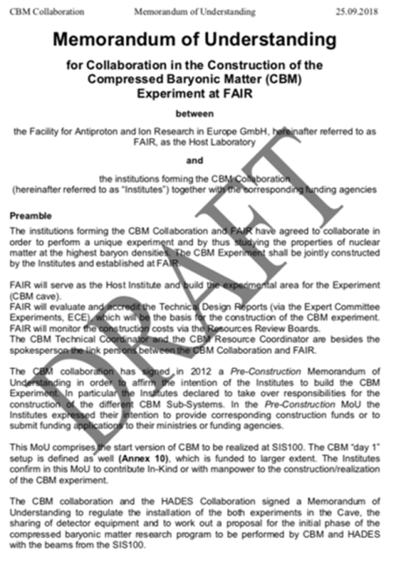
Memorandum of Understanding
for Collaboration in the Construction of the
Compressed Baryonic Matter (CBM) Experiment at FAIR
between
the Facility for Antiproton and Ion Research in Europe GmbH, as the Host Laboratory
and
the institutions forming the CBM Collaboration together with the corresponding funding agencies
Article 1 Parties to this MoU
Article 2 Purpose of this MoU
Article 3 Duration of this MoU and its Extension
Article 4 The CBM Experiment and Collaboration
Article 5 Program of Work for the Construction Phase of the CBM Experiment
and Sharing of responsibilities for its Execution
Article 6 Common Projects and Common Fund
Article 7 Obligations of FAIR as Host Laboratory, and of the Institutes
Article 8 Relationship CBM Collaboration – FAIR
Article 9 Rights and Benefits of the Institutes
Article 10 Administrative and Financial Provisions
Article 11 Amendments
Article 12 Disputes
Article 13 Effective date
Article 14 Annexes
Article 15 Final Provisions

Slide 8
ANNEXES (CBM Construction MoU)
Annex 1: List of Institutions (and names of the Collaboration Board members) forming the CBM Collaboration
Annex 2; List of Funding Agencies and their Representatives
Annex 3a: List of the members of the CBM Collaboration given by Country and by Institute
Annex 3b: Organisation rules of the CBM Collaboration, Management structure of the CBM Collaboration, Management Board members and of persons holding management positions in the CBM Collaboration
Annex 4a: Detailed compilation of the Construction Cost and Funding of the Detector/Subsystems, and of Responsibilities for the Construction Workpackages by the Institutes.
Annex 4b: Summary Tables on Construction Cost and Funding with the Values of Commitments by Funding Agency to the CBM Detectors/Subsystems.
Annex 5: Status of Technical Design Reports
Annex 6: List of substantial manpower contributions of Institutes to Subsystem Construction, to Computing Subprojects, to the Physics Working Groups and to Preparation and Coordination tasks
Annex 7: Construction Schedule
Annex 8: Procedures for the Common Construction Fund for the Cave Infrastructure
Annex 9: General conditions applicable to experiments at FAIR
Annex 10: The CBM Day 1 experimental setup

Slide 9
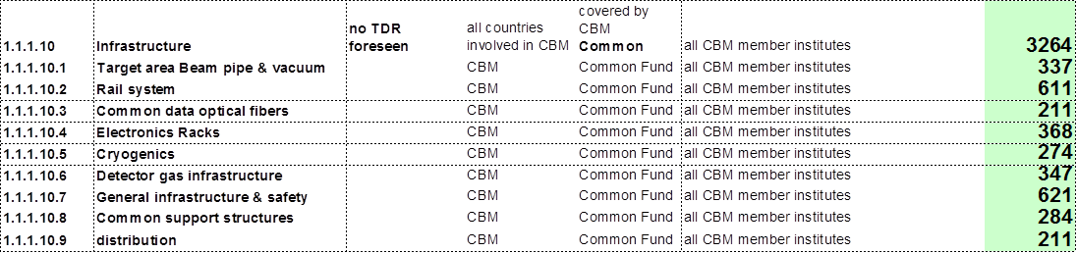
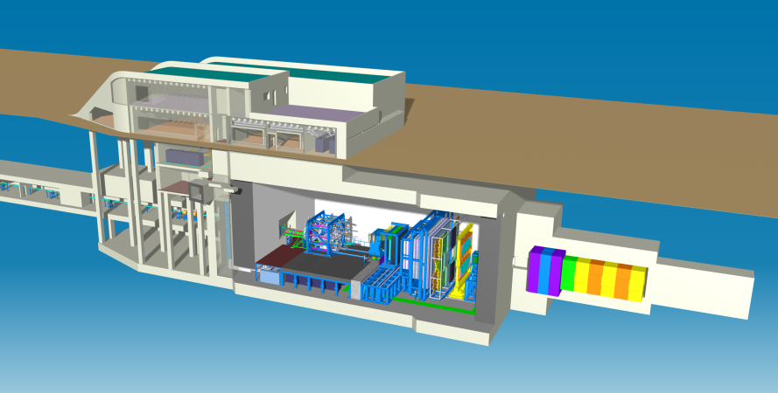
CBM Common Fund
The cave infrastructure items are of common interest of all participating institutes in the CBM collaboration. They need to be purchased and installed in the CBM cave in order to provide a proper technical environment in the CBM cave for the mounting of all detector systems (in-kind contributions of the CBM member institutes).
Cost estimate and expenditures [in k€ and 2018 prices] for the CBM cave infrastructure:
Year | Expenditures [k€]
2017 | 30
2018 | 130
2019 | 450
2020 | 890
2021 | 1515
2022 | 249
Total [k€] | 3264

Slide 10
CBM Common Fund
CBM collaboration decided to implement a Common Fund for covering the investment costs of the CBM cave infrastructure (PSP code 1.1.1.10) of about 3,3 M€ (2018 prices).
Decision of the CBM Collaboration Board (Sept. 2017):
„The CB sees the urgent need to collect the following amounts per member institute per PhD holder in the following years for covering the investment costs of the cave infrastructure:
2018 – 500 Euro
2019 – 2000 Euro
2020 – 3500 Euro
2021 – 4500 Euro
2022 – 500 Euro
The capability of the CBM member institutes to contribute with these annual payments depends on the support of the corresponding national funding agencies.
The CBM CB therefore urges the FAIR management to ask the funding agencies at the next RRB meeting to implement common funds for the FAIR experiments.”

Slide 11
CBM Common Fund
Procedure for Common Fund
It is planned to cover the investment costs of the CBM cave infrastructure (PSP code 1.1.1.10) of about 3,3 M€ (2018 prices) by the Common Fund.
The CBM collaboration has decided to implement a Common Fund. Each full member institute shall contribute according to the number of PhD holders working for CBM. The annual due amounts per institute have been defined such that the required expenditures for the cave infrastructure are covered.
The implementation of the CBM Common Fund depends on the support of the national funding agencies from the corresponding country.

Slide 12
CBM Common Fund
Breakdown of the suggested annual contributions to the CBM Common Fund for the
member institutes of the CBM collaboration (CBM data base 25th September 2018):

Slide 13
CBM Common Fund
Breakdown of the suggested annual contributions to the CBM Common Fund for the
member institutes of the CBM collaboration (CBM data base 25th September 2018):
amount [k€] | country
243,2 | China
64,0 | Czech Republic
76,8 | France
1100,8 | Germany
38,4 | Hungary
473,6 | India
12,8 | Korea
320,0 | Poland
153,6 | Romania
691,2 | Russia
89,6 | Ukraine
3264

Slide 14
Next Steps
Collaboration will start to collect money for Common Fund asap
Finalization of draft of CBM construction MoU
Start of signing of CMoU intended for end 2019

Slide 15
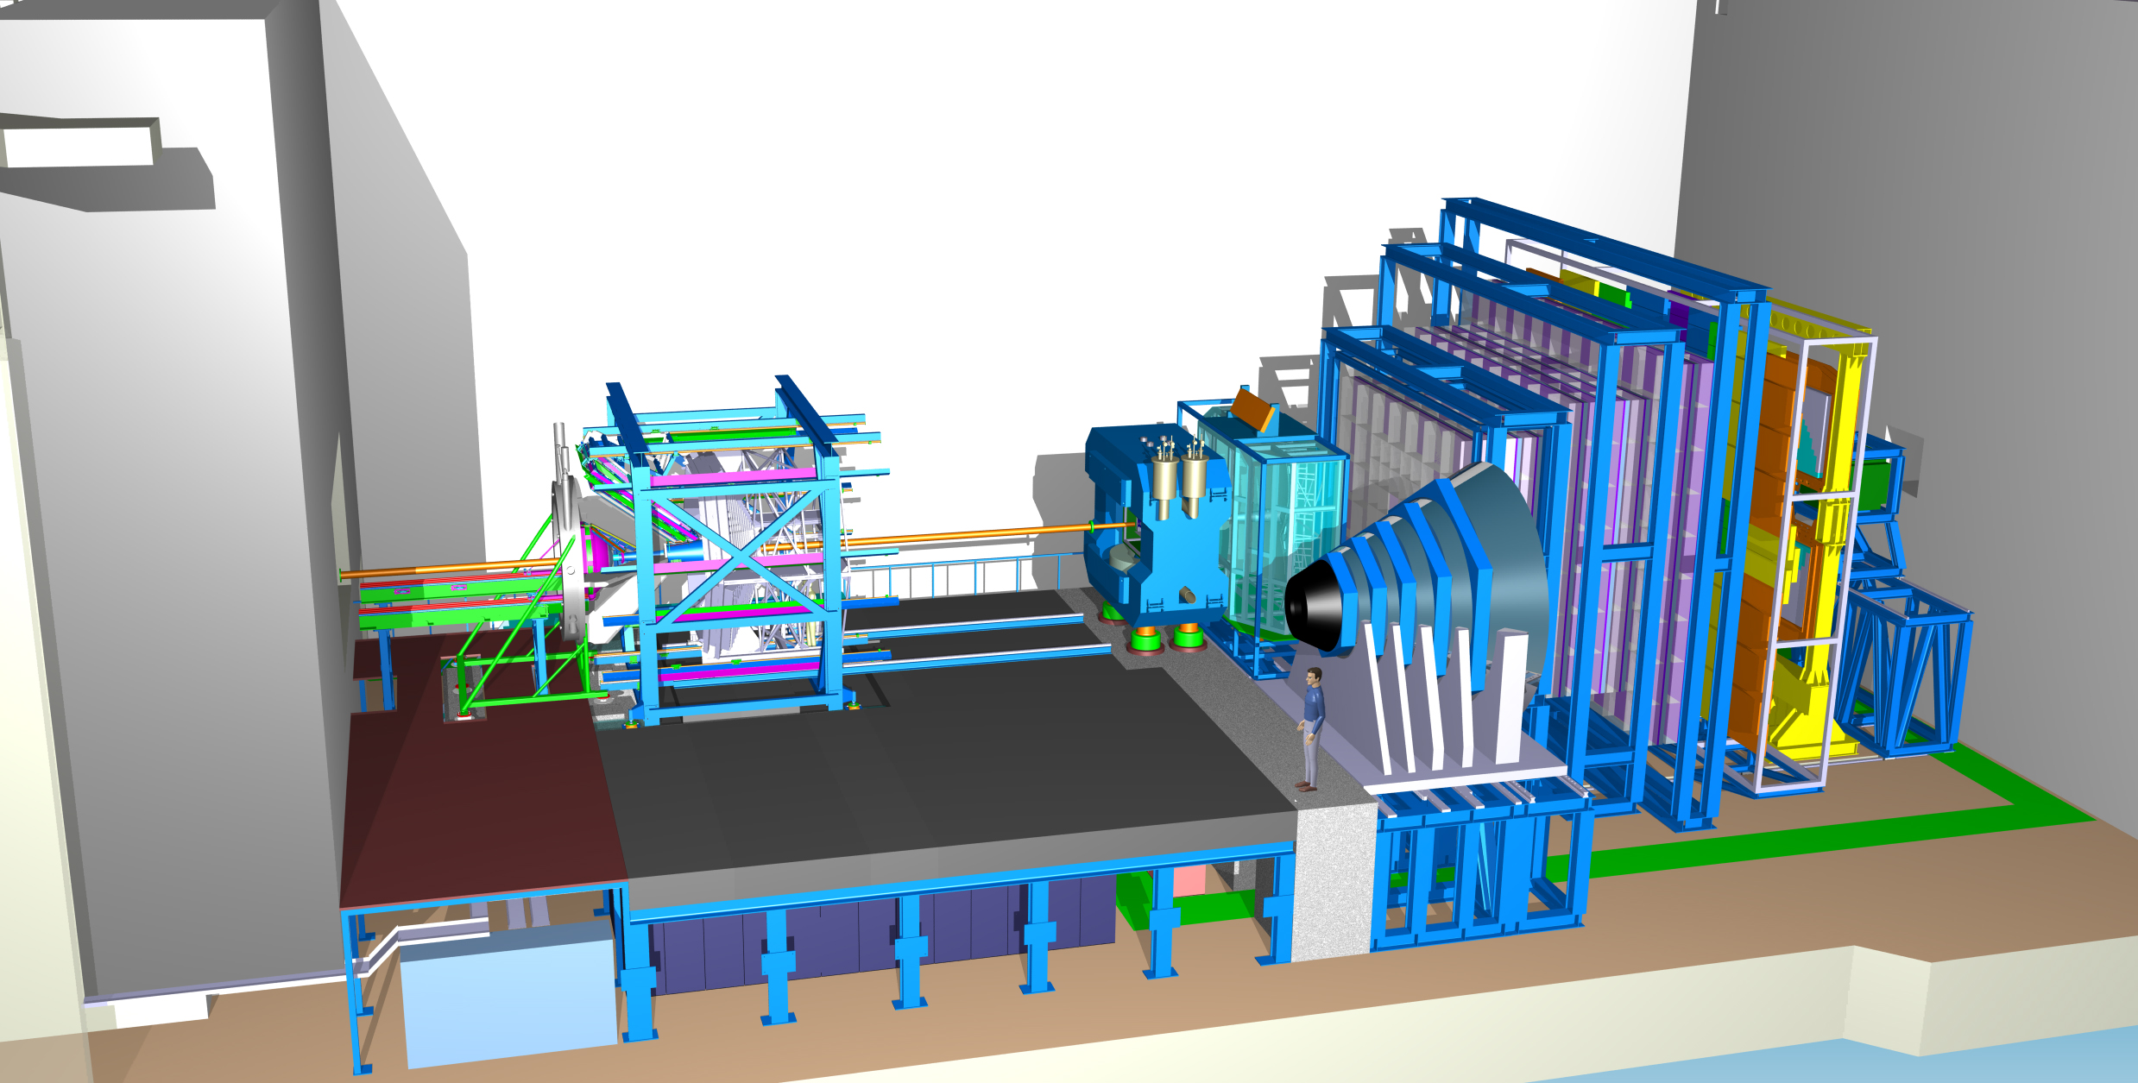
Thank you for your attention!
TRD
Time of Flight
Dipol
Magnet
Silicon
Tracking
System
RICH
MUCH
DAQ/FLES HPC cluster
Projectile
Spectator
Detector

Slide 16
Backup Slides
(slides from Paolos RRB talk)

Slide 17
Common Infrastructure Items proposed by the Collaborations for Common Fund for construction
Host lab vs experiment responsibility
  All infrastructures, which are experiment specific, i.e. would not or be different if a different experiment would enter the cave, are to be borne by the experimental collaboration,
  The non-experiment-specific infrastructures are provided by the host lab.
Definition of Common Infrastructure Items decided by the individual collaboration
  Items being in the experiment’s responsibility
  Indispensable for Day-1 operation of the experiment
  Representing a common infrastructure for the experiment
  Cannot be taken over by an individual institution.
Eligible items may be proposed by Collaboration after internal agreement
Established procedure in HEP experiments around the world

Slide 18
Collaboration’s Proposals
 | PSP | Name | ECB value [2005 k€]
CBM | 1.1.1.10.1 | Target area Beam pipe & vacuum | 235
 | 1.1.1.10.2 | Rail system | 425
 | 1.1.1.10.3 | Common data optical fibers | 147
 | 1.1.1.10.4 | Electronics Racks | 257
 | 1.1.1.10.5 | Cryogenics | 191
 | 1.1.1.10.6 | Detector gas infrastructure | 242
 | 1.1.1.10.7 | General infrastructure & safety | 433
 | 1.1.1.10.8 | Common support structures | 198
 | 1.1.1.10.9 | Power & standard media distribution | 147
 | CBM Subtotal |  | 2,273
NUSTAR | 1.2.1.2.4 | LEB Detectors and slit system for FLF6 for MATS/LaSpec | 135.7
 | 1.2.1.2.5 | LEB Beam line to MATS-LaSpec hall for MATS/LaSpec | 154.0
 | 1.2.1.7 | LEB Beam line to MATS RFQ for MATS/LaSpec | 200.0
 | 1.2.2.2.1 | HISPEC/DESPEC Beamline (1st share) | 127.1
 | 1.2.2.5.1 | HISPEC/DESPEC Safety (1st share) | 132.1
 | 1.2.5.1.1.3.3 | R3B Valve box GLAD | 128.1
 | 1.2.5.1.1.3.4 | R3B Infrastructure magnets (3rd sh.) | 200.0
 | NUSTAR Subtotal |  | 1,077.0
PANDA | 1.4.1.18.1 | Supports | 2,400
 | 1.4.1.18.2 | Supplies | 760
 | 1.4.1.18.3 | Controls | 400
 | 1.4.1.19.4 | DAQ | 980
 | PANDA Subtotal |  | 4,540
Total |  |  | 7,890
Table shows current proposals by respective collaborations
Common Funds to be shared according to model suited best for each community
  CBM, PANDA and NUSTAR: equal share among all members of the respective collaboration with PhD degree eligible to appear on the authors’ list
  In case of NUSTAR sharing in sub-collaborations will be considered
  APPA: still under discussion, very different and heterogeneous community, potential amounts very small

Slide 19
Collaboration’s Proposals
 | PSP | Name | ECB value [2005 k€]
CBM | 1.1.1.10.1 | Target area Beam pipe & vacuum | 235
 | 1.1.1.10.2 | Rail system | 425
 | 1.1.1.10.3 | Common data optical fibers | 147
 | 1.1.1.10.4 | Electronics Racks | 257
 | 1.1.1.10.5 | Cryogenics | 191
 | 1.1.1.10.6 | Detector gas infrastructure | 242
 | 1.1.1.10.7 | General infrastructure & safety | 433
 | 1.1.1.10.8 | Common support structures | 198
 | 1.1.1.10.9 | Power & standard media distribution | 147
 | CBM Subtotal |  | 2,273
NUSTAR | 1.2.1.2.4 | LEB Detectors and slit system for FLF6 for MATS/LaSpec | 135.7
 | 1.2.1.2.5 | LEB Beam line to MATS-LaSpec hall for MATS/LaSpec | 154.0
 | 1.2.1.7 | LEB Beam line to MATS RFQ for MATS/LaSpec | 200.0
 | 1.2.2.2.1 | HISPEC/DESPEC Beamline (1st share) | 127.1
 | 1.2.2.5.1 | HISPEC/DESPEC Safety (1st share) | 132.1
 | 1.2.5.1.1.3.3 | R3B Valve box GLAD | 128.1
 | 1.2.5.1.1.3.4 | R3B Infrastructure magnets (3rd sh.) | 200.0
 | NUSTAR Subtotal |  | 1,077.0
PANDA | 1.4.1.18.1 | Supports | 2,400
 | 1.4.1.18.2 | Supplies | 760
 | 1.4.1.18.3 | Controls | 400
 | 1.4.1.19.4 | DAQ | 980
 | PANDA Subtotal |  | 4,540
Total |  |  | 7,890
Table shows current proposals by respective collaborations
Common Funds to be shared according to model suited best for each community
  CBM, PANDA and NUSTAR: equal share among all members of the respective collaboration with PhD degree eligible to appear on the authors’ list
  In case of NUSTAR sharing in sub-collaborations may be considered
  APPA: still under discussion, very different and heterogeneous community, potential amounts very small
We’d like to ask the RRBs to recognise that
CBM, NUSTAR and PANDA propose to finance some infrastructure components in the experiments’ responsibility via Common Funds

Slide 20

Draft Construction MoU for CBM
The CBM collaboration agreed on a draft Construction MoU
  Distributed with the documents for the RRBs
Open for discussion and feedback from the funding agencies
To serve as a model for other FAIR collaborations

Slide 21
Structure of draft MoU for CBM
Main body text of MoU
Annexes:
List of Institutions (and names of the Collaboration Board members) forming the CBM Collaboration
List of Funding Agencies and their Representatives
List of the members of the CBM Collaboration given by Country and by Institute
Organisation rules of the CBM Collaboration, Management structure of the CBM Collaboration, Management Board members and of persons holding management positions in the CBM Collaboration
Detailed compilation of the Construction Cost and Funding of the Detector/Subsystems, and of Responsibilities for the Construction Workpackages by the Institutes.
Summary Tables on Construction Cost and Funding with the Values of Commitments by Funding Agency to the CBM Detectors/Subsystems.
Status of Technical Design Reports
List of substantial manpower contributions of Institutes to Subsystem Construction, to Computing Subprojects, to the Physics Working Groups and to Preparation and Coordination tasks
Construction Schedule
Procedures for the Common Construction Fund for the Cave Infrastructure
General conditions applicable to experiments at FAIR
The CBM Day 1 experimental setup

Slide 22
Structure of draft MoU for CBM
Main body text of MoU
Annexes:
List of Institutions (and names of the Collaboration Board members) forming the CBM Collaboration
List of Funding Agencies and their Representatives
List of the members of the CBM Collaboration given by Country and by Institute
Organisation rules of the CBM Collaboration, Management structure of the CBM Collaboration, Management Board members and of persons holding management positions in the CBM Collaboration
Detailed compilation of the Construction Cost and Funding of the Detector/Subsystems, and of Responsibilities for the Construction Workpackages by the Institutes.
Summary Tables on Construction Cost and Funding with the Values of Commitments by Funding Agency to the CBM Detectors/Subsystems.
Status of Technical Design Reports
List of substantial manpower contributions of Institutes to Subsystem Construction, to Computing Subprojects, to the Physics Working Groups and to Preparation and Coordination tasks
Construction Schedule
Procedures for the Common Construction Fund for the Cave Infrastructure
General conditions applicable to experiments at FAIR
The CBM Day 1 experimental setup
We’d like to ask the RRBs to
consider the CBM draft MoU as model for other collaborations

