Slide 1
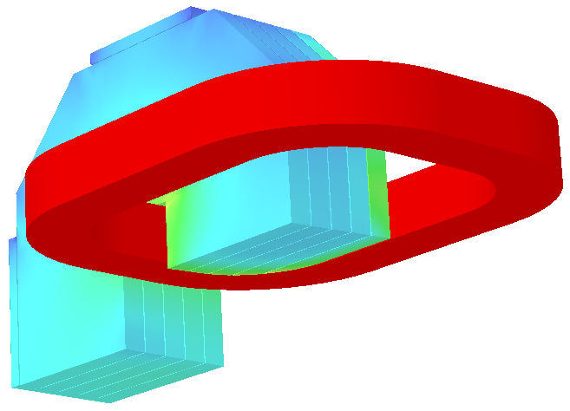
Eddy Currents in a PANDA-type Dipole J. Lühning, GSI
3D model of a dipole magnet similar to PANDA (for simplicity only one octant is considered / 3-fold symmetry)
Yoke consists of 16cm thick plates, insulation between plates, only on outer perimeter the plates are connected by big plates without insulation
In transient calculation (with OPERA’s ELEKTRA) the current is ramped from 25% to 100% in 60 seconds
Resistivity of steel 100nΩ·m

Slide 2
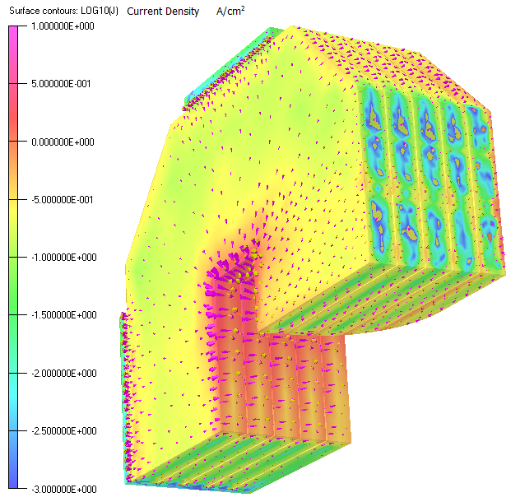
Eddy current density [A/cm²] (logarithmic) after 1 second (T=1s). Arrows indicate eddy current direction

Slide 3
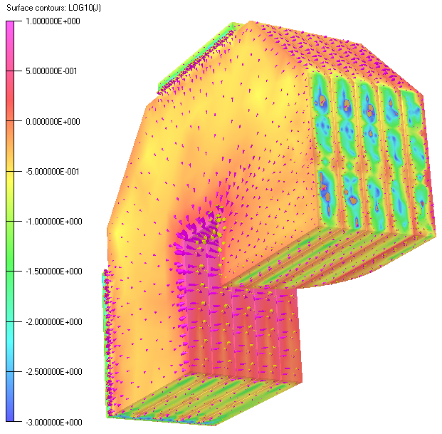
T=2s

Slide 4
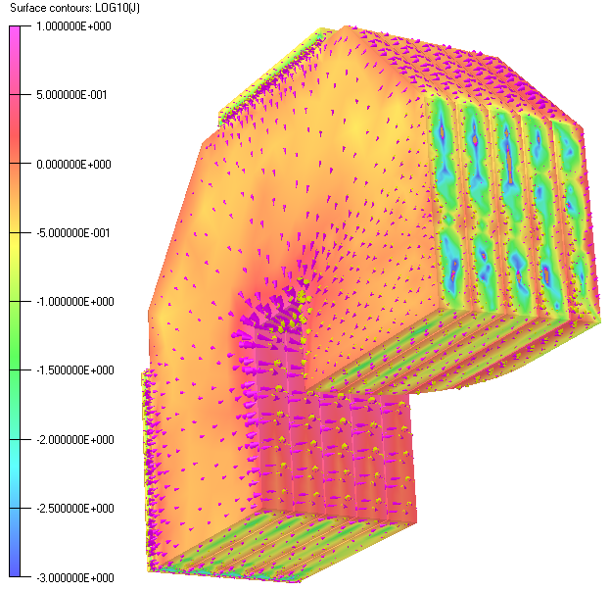
T=4s

Slide 5
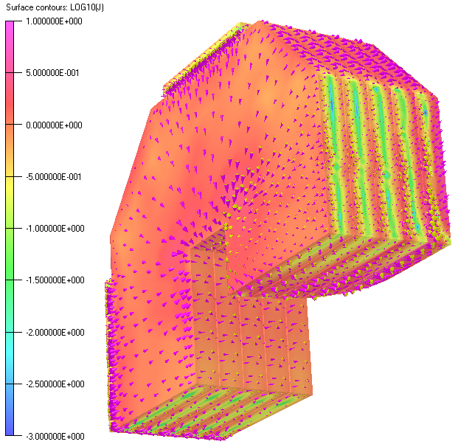
T=20s

Slide 6
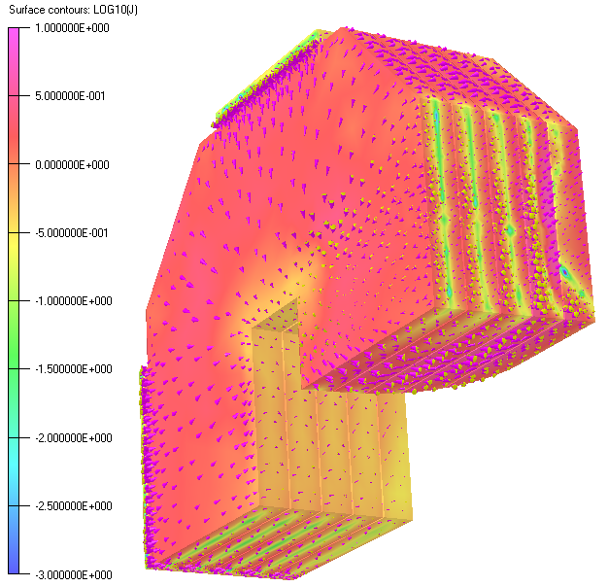
T=40s

Slide 7
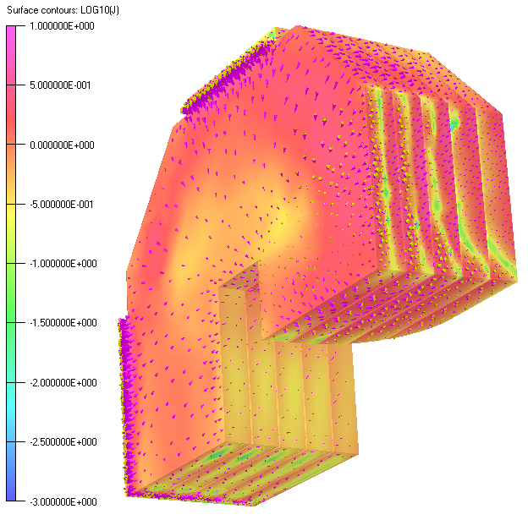
T=58s

Slide 8
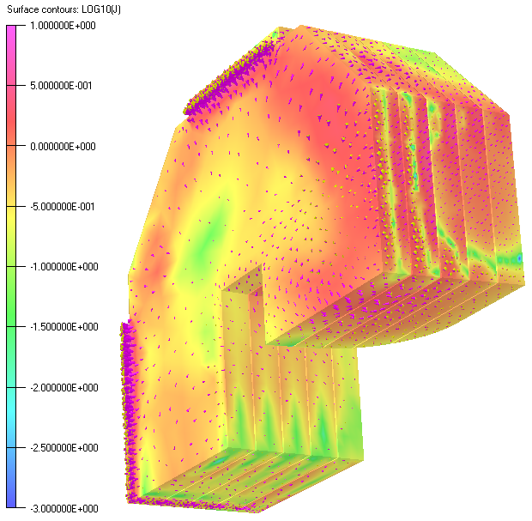
T=60s

Slide 9
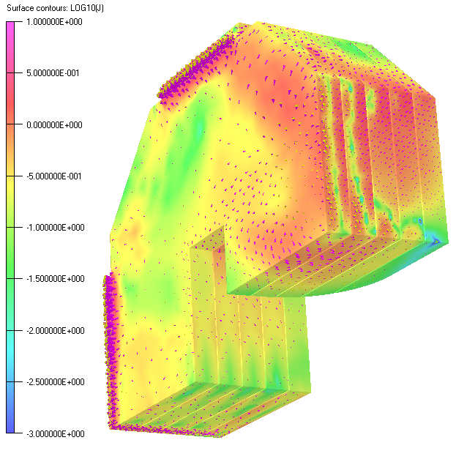
T=62s

Slide 10
When the dipole current is raised then eddy currents in the yoke plates delay the rise of the dipole field.
In first order, the delay seems to be about proportional to the thickness of the yoke plates. For plates of 10cm thickness the calculated delay is about 1 second.
Non-insulated connection plates on the outer perimeter of the yoke plates seem to have no big influence on the field delay. Near to the coils, however, non-insulated plates connecting the yoke plates would give rise to very high eddy currents.

