Slide 1
PANDA-Meeting Autumn 2018
Magnetic field measurement of Microchannel-Plate-Photomultipliers
Photonis XP85112-Q-HA (SN 9002108)
and Hamamatsu R13266-07-M64M (SN YH0250)
M. Németh-Csóka, M. Böhm, A. Lehmann, D. Miehling, M. Pfaffinger, S. Stelter
06.11.2018

Slide 2
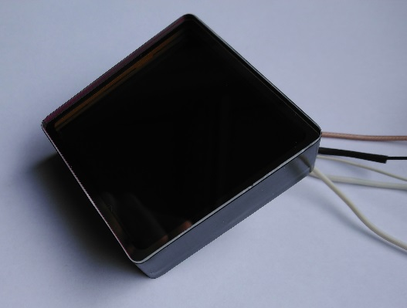
Introduction of sensors
2x2 inch² sensors with 8x8 pixels each:
Photonis XP85112-Q-HA (SN 9002108)
Hamamatsu R13266-07-M64M (SN YH0250)
Picture of a Photonis-sensor
Requirements for usage of MCP-PMTs in the Barrel-DIRC

Slide 3
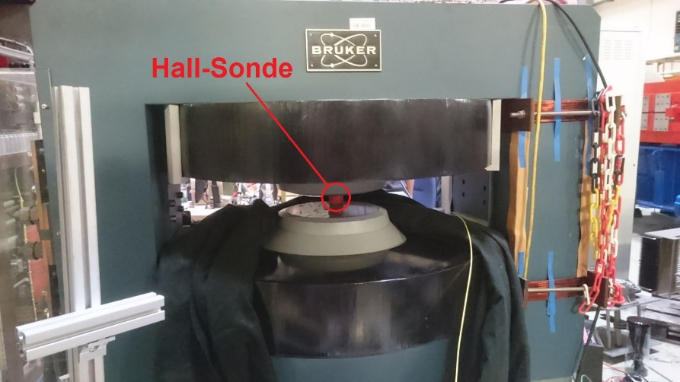
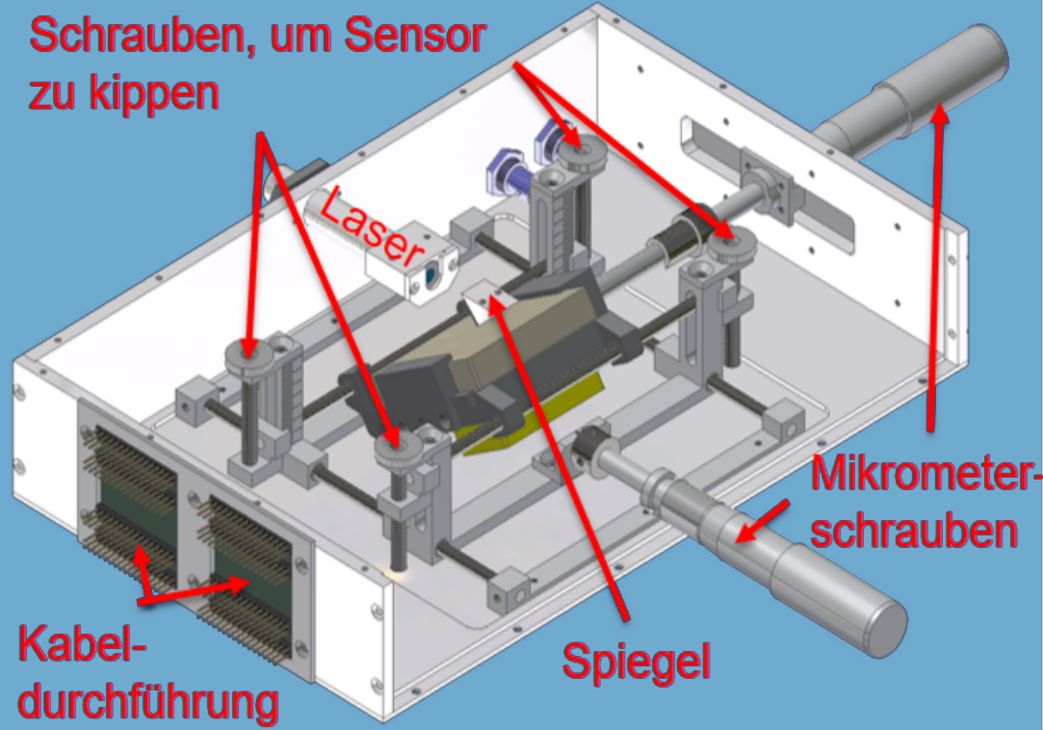
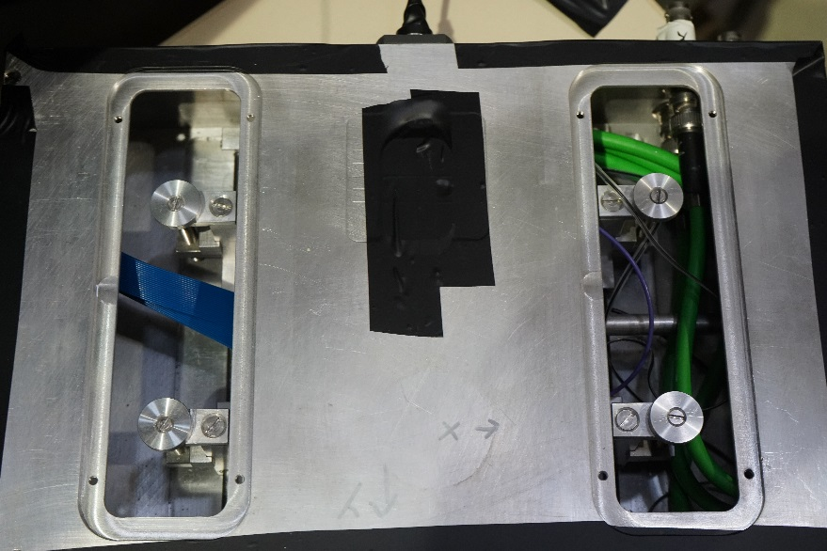
Measurement setup
Dipole magnet
Measurement box for scanning across sensors

Slide 4
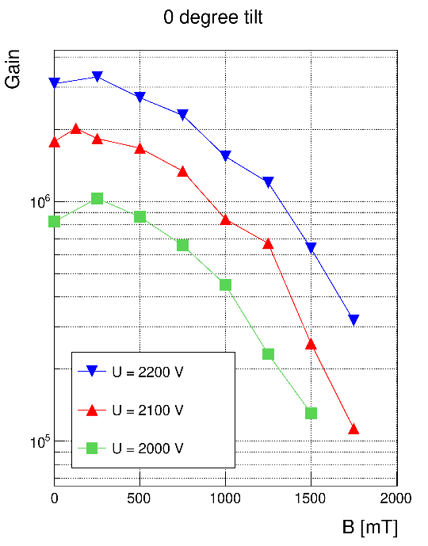
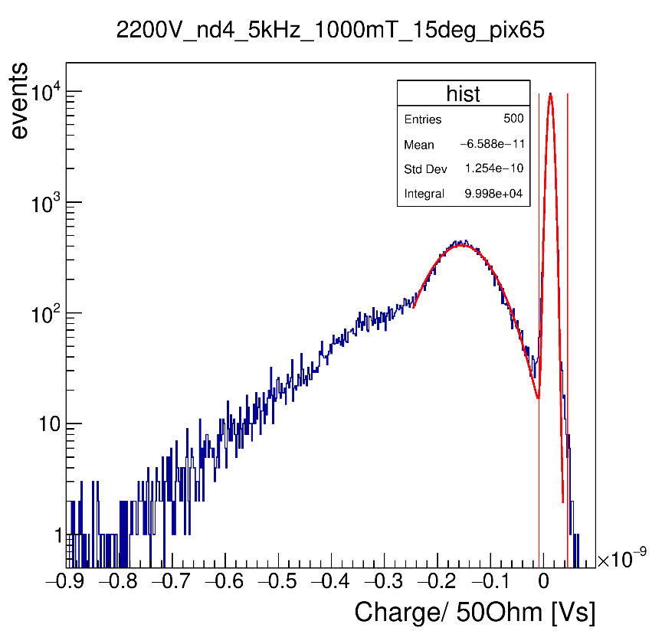
Oscilloscope measurements
Photonis
Determining gain of one pixel at different tilt angles and voltages
Example for oscilloscope measurement

Slide 5
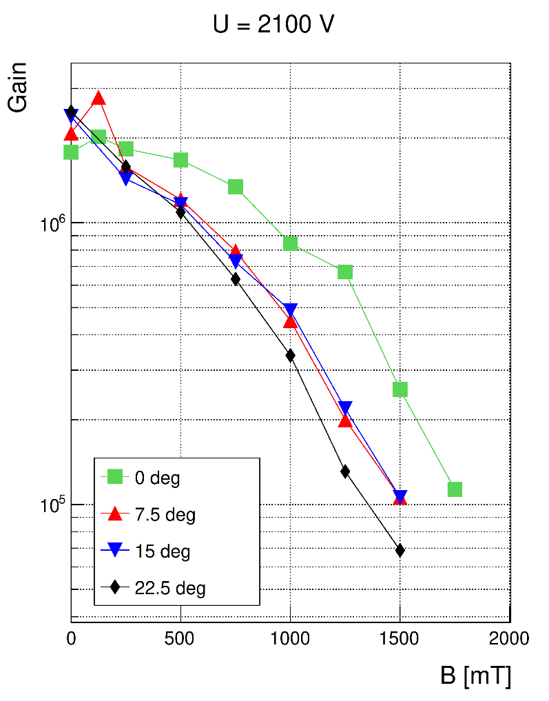
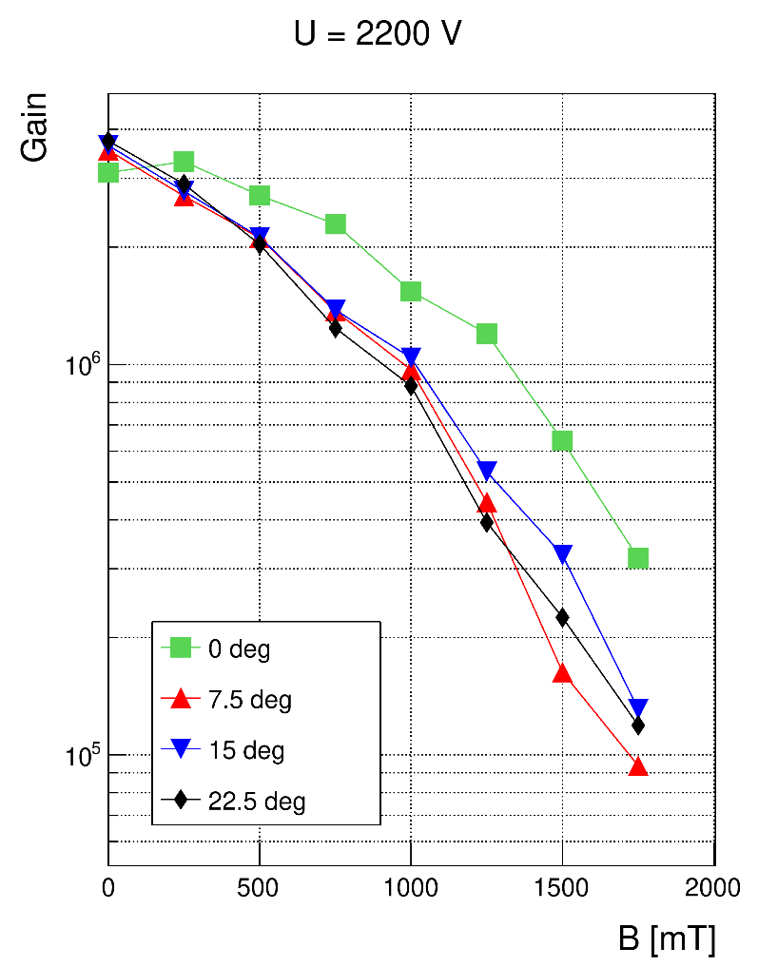
Oscilloscope measurements
Photonis
Comparision of different tilt angles at a certain voltage

Slide 6
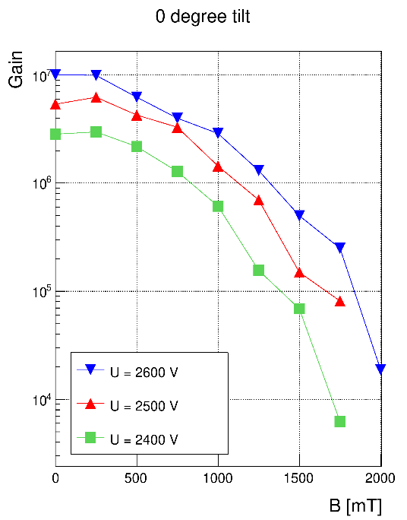
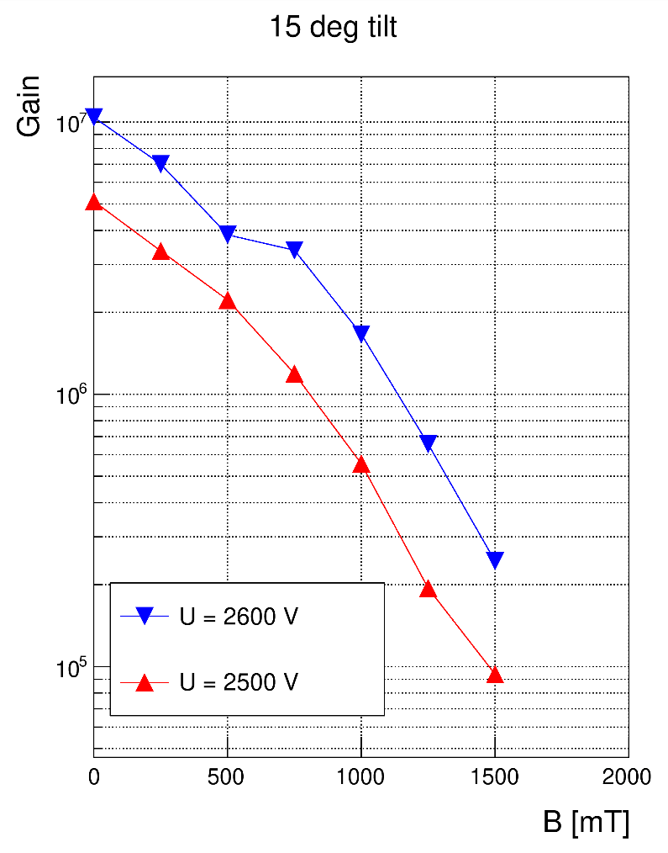
Oscilloscope measurements
Hamamatsu

Slide 7
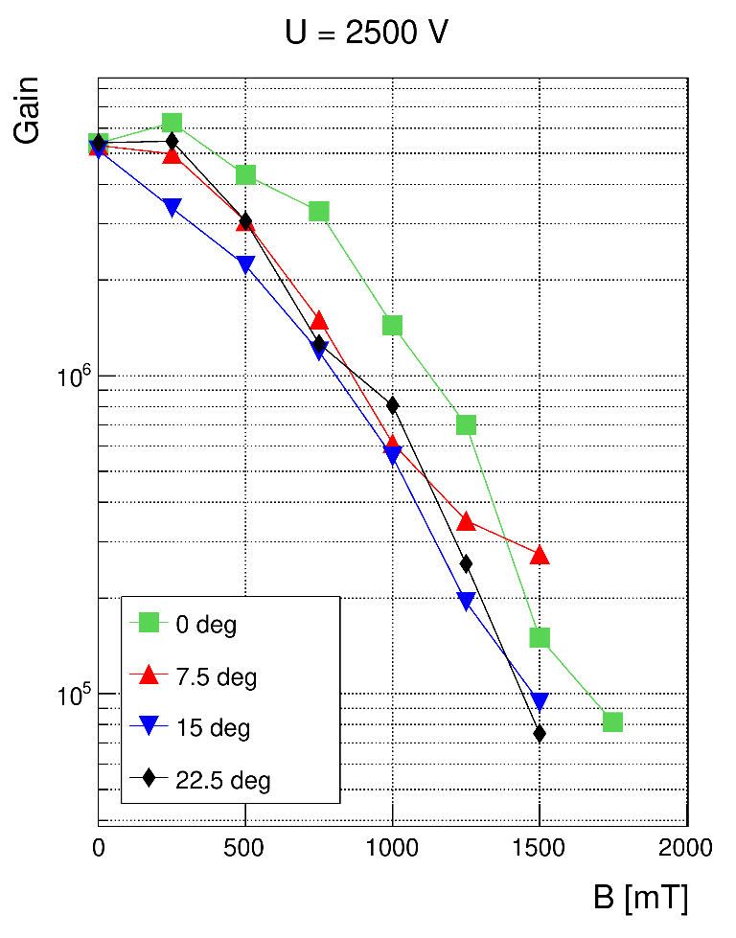
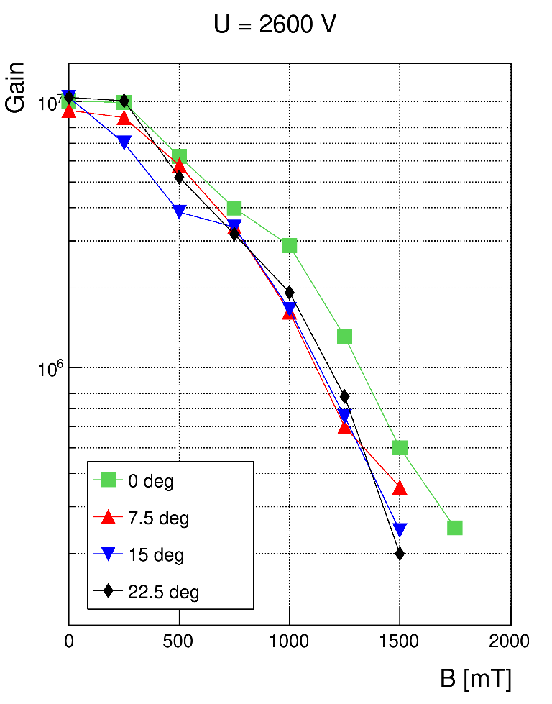
Oscilloscope measurements
Hamamatsu
Comparision of different tilt angles at a certain voltage

Slide 8
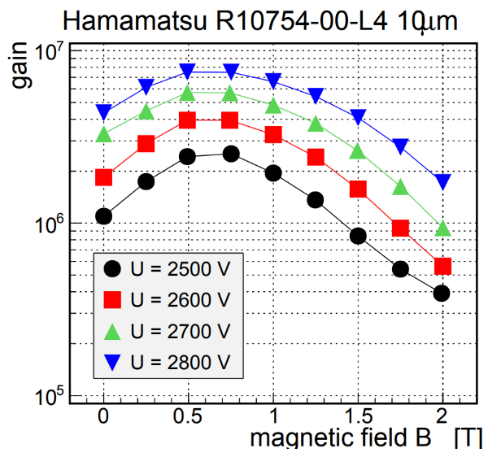
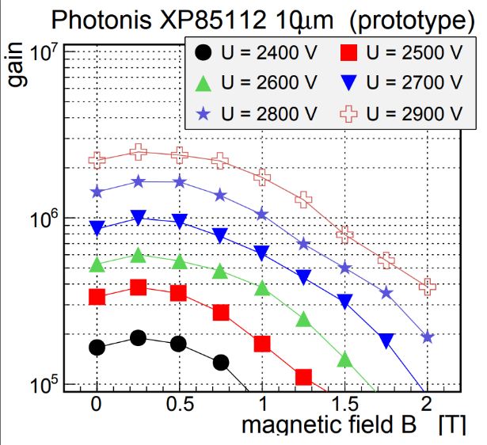
Oscilloscope measurements
Comparison with previous sensor types
No ALD-protection-layer and no film
Photonis
Hamamatsu

Slide 9
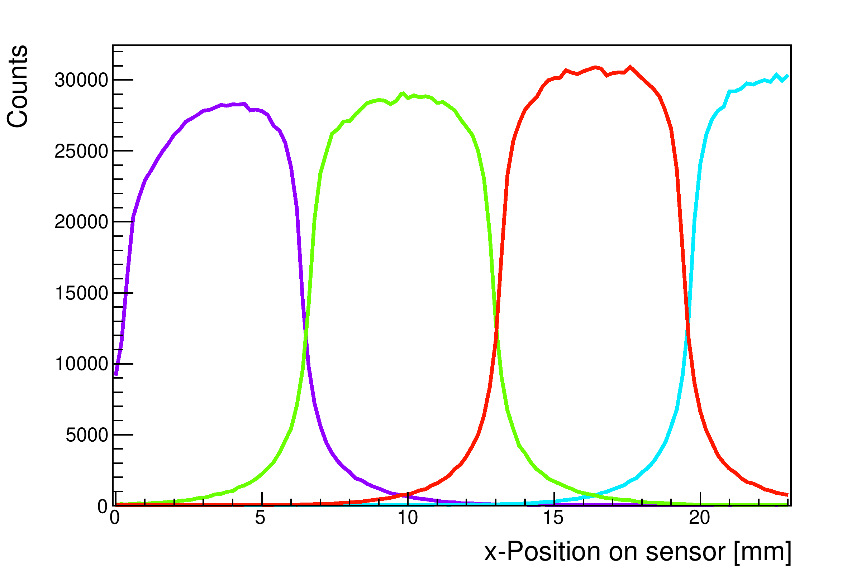
TDC-Readout-Board (TRB) - measurements
Crosstalk
Hamamatsu:
U = 2600 V
Photonis:
U = 2200 V
Example for a crosstalk-measurement with scanning in x-direction in 0,2mm steps

Slide 10
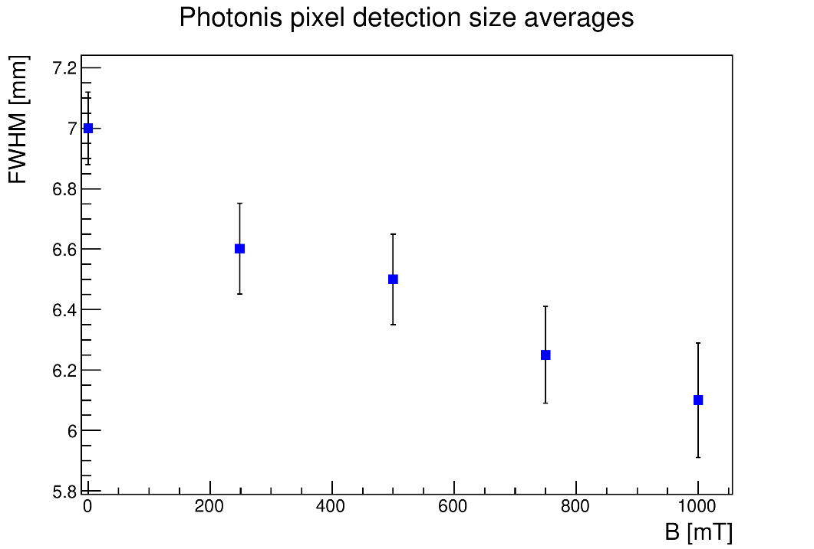
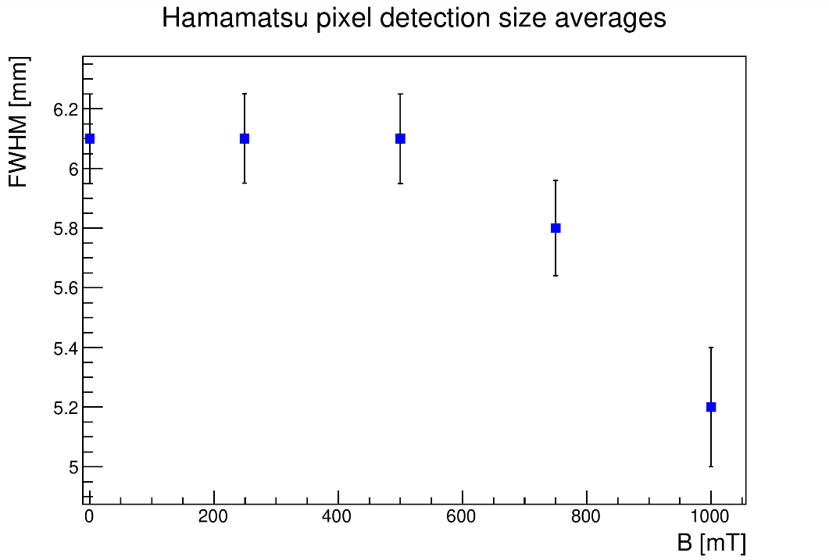
TRB-measurements
Crosstalk in magnetic field
Photonis
Hamamatsu
→ Crosstalk decreases slightly

Slide 11
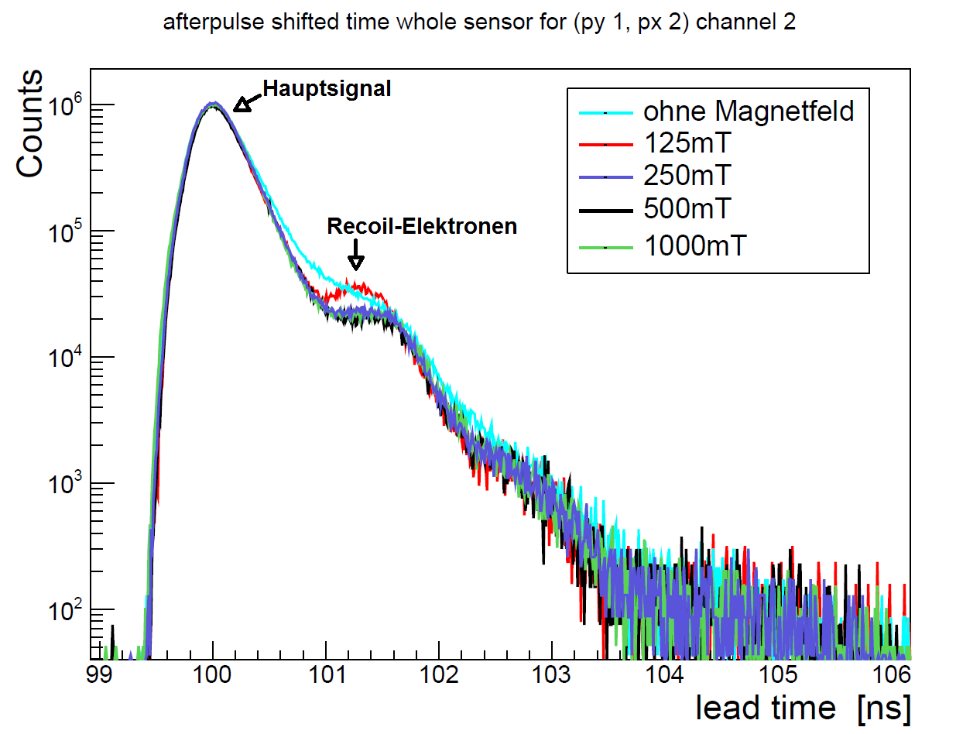
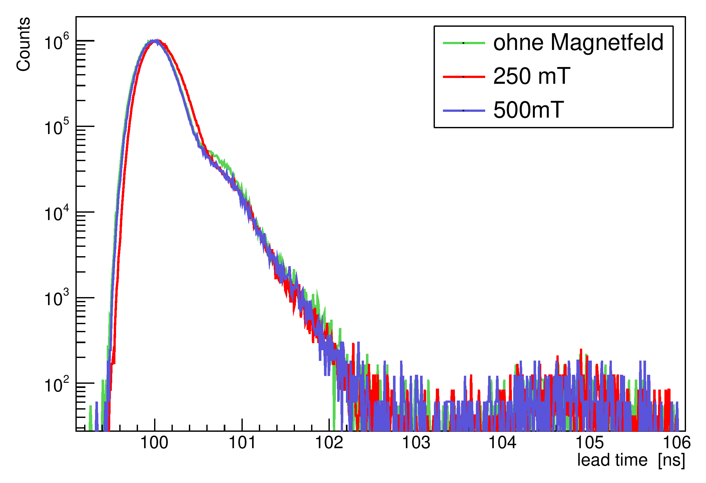
TRB-measurements
Time resolution changes
Photonis
Hamamatsu
Recoil-electron-peak „fuses“ with main peak
This effect remains static at higher magnetic field strenghts
Graphic: detected signal as a function of time

Slide 12
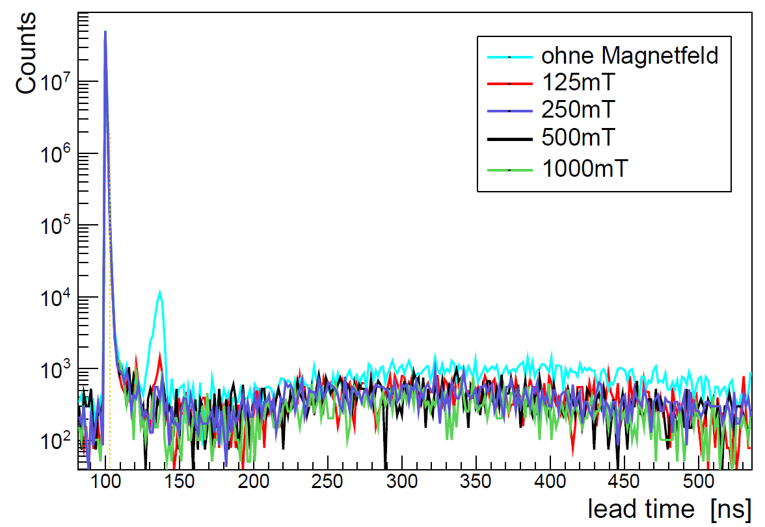
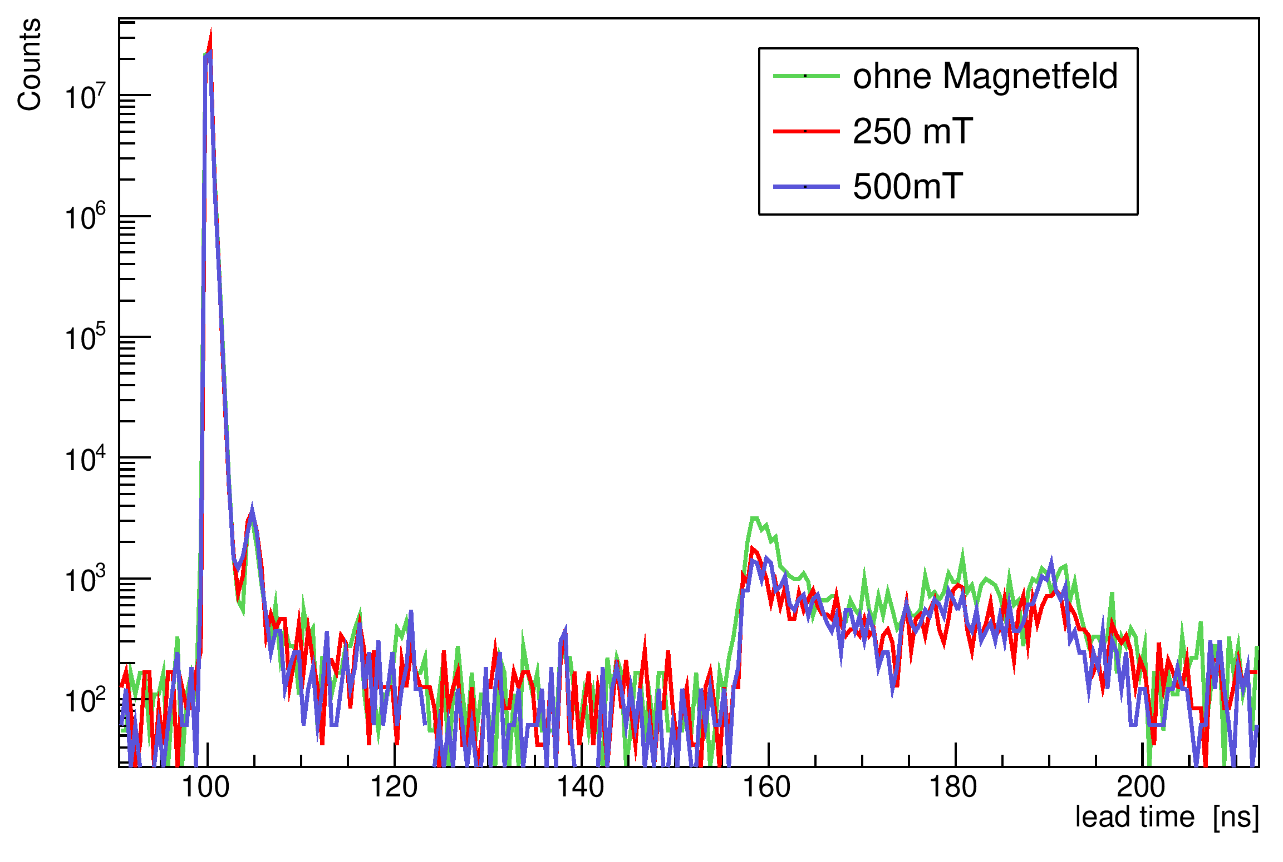
TRB-measurements
Afterpulsing
Photonis
Hamamatsu
Ionised particles produce a time-delayed signal
→ afterpulse-signals tend to decrease at higher magnetic field
Graphic: detected signal as a function of time

Slide 13
Conclusion
Impact of magnetic field:
Crosstalk → small decrease for both sensors
Time resolution → Photonis-sensor
Afterpulsing → tendency to decrease
Quelle: https://www.researchgate.net/figure/A-photomultiplier-the-first-detector-able-to-sense-a-single-optical-photon-is-shown_fig2_51537407
Quelle: https://www.gsi.de/work/forschung/experimentelektronik/digitalelektronik/digitalelektronik/module/trigger_synchronisation/trb.htm

