Slide 1
Update on MCP-PMT oszillations and first try of CE measurement
D. Miehling, M. Böhm, A. Lehmann,
M. Németh-Csóka, M. Pfaffinger, S. Stelter
PANDA-Meeting 18/3, November 6, 2018

Slide 2
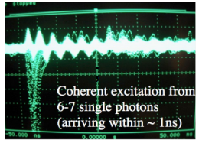
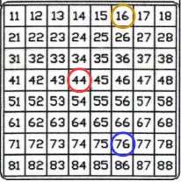
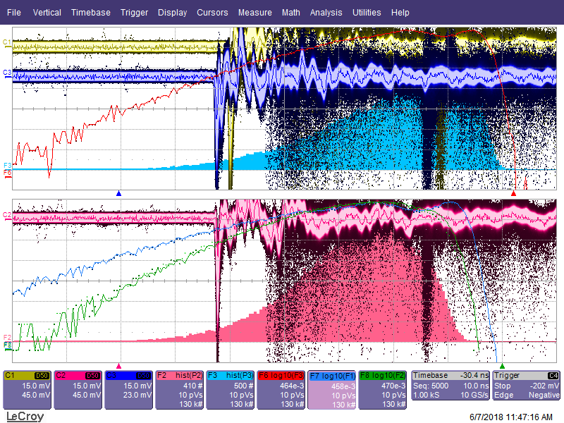
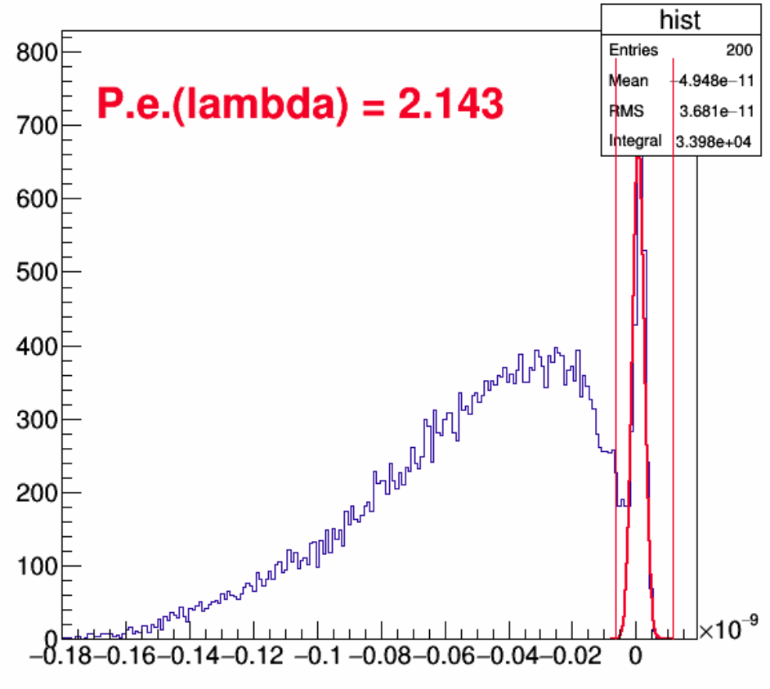
Reminder: Oscillations in MCPs at higher intensities
Oscillations in Pixels at a few
photoelectrons per pixel
upper right corner: Jerry Vav‘ra with
old (2005) Photonis tube
lower right: Hamamatsu JS0022
illumination of complete sensor (about 1,3 pe/pixel,
80 pe/sensor)
x: 10 ns/div, y: 15 mV/div
trigger: laser
number of photo electrons:
pe $=−\ln{(I_{Pedestal}/I_{all})}$
NIM A876 (2017) 141-144

Slide 3
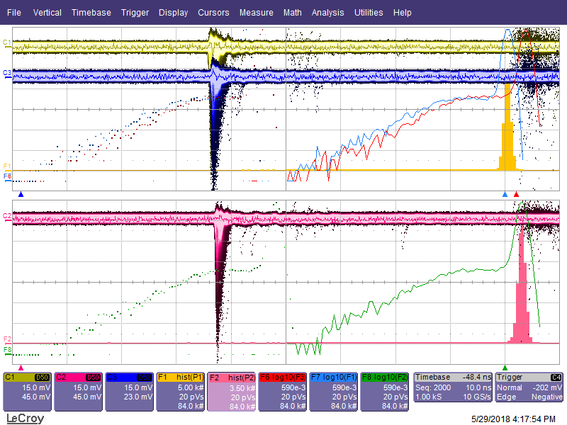
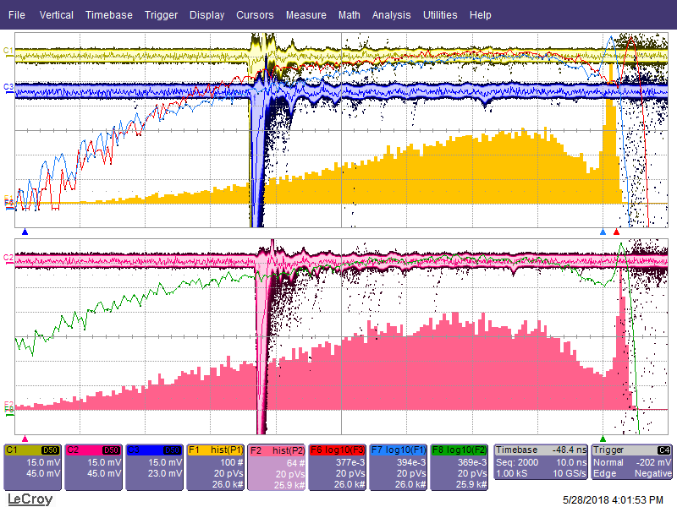
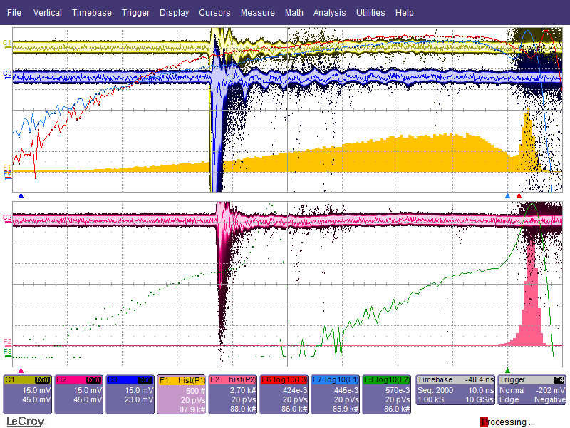
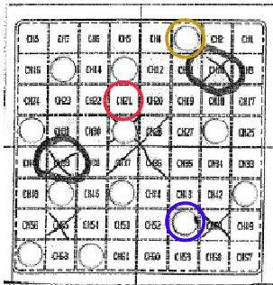
Reminder: Oscillations in MCPs at higher intensities
Hamamatsu YH0250, ALD-coated, 10 µm pores, ${10}^{6}$ gain,
x: 10 ns/div, y: 15 mV/div, Trigger: Laser
nd2,6, without aperture,
0,08 pe/pixel,
5 pe/sensor
nd1,3, aperture with 3 holes,
2 pe/pixel,
6 pe/sensor
nd1,3, aperture with 12 holes,
2 pe/pixel,
24 pe/sensor

Slide 4
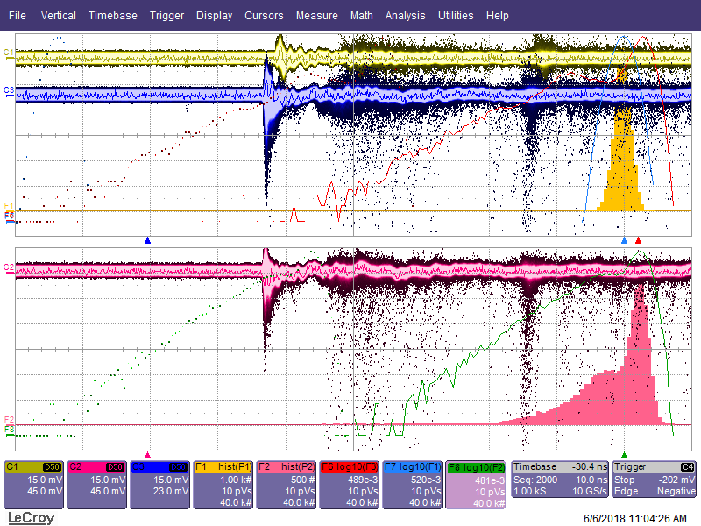
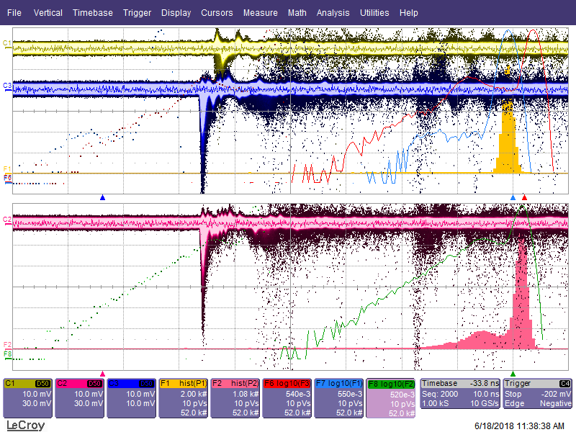
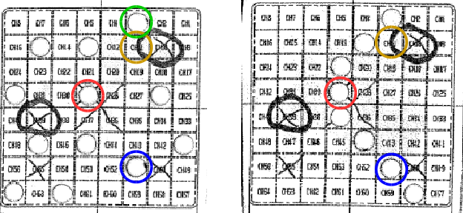
Oscillations in MCPs at higher intensities
Hamamatsu JS0022, ALD-coated + film, 10 µm pores, ${10}^{6}$ gain, x: 10 ns/div, trigger: laser
different configurations with the other pixels show no difference (open, wired together, …)
→ seems to be effect in MCP
nd1,3, 12 hole aperture,
0,3 pe/p, 3,5 pe/s, y: 15mV/div with BP, other pixels grounded via 50 Ω
nd1,3, 8 hole aperture,
0,3 pe/p, 2,4 pe/s, y: 10 mV/div
w/o BP, other pixels are open

Slide 5
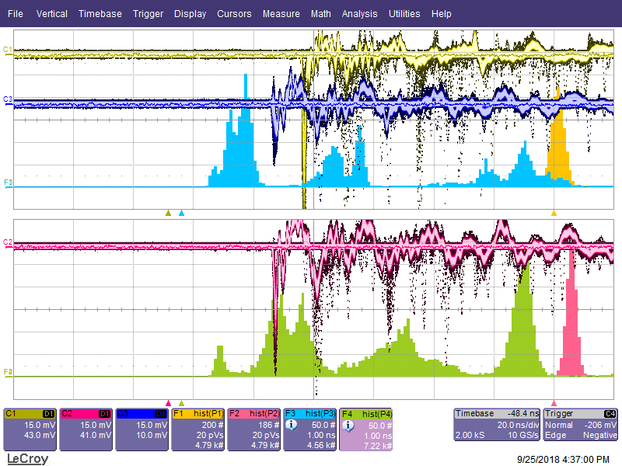
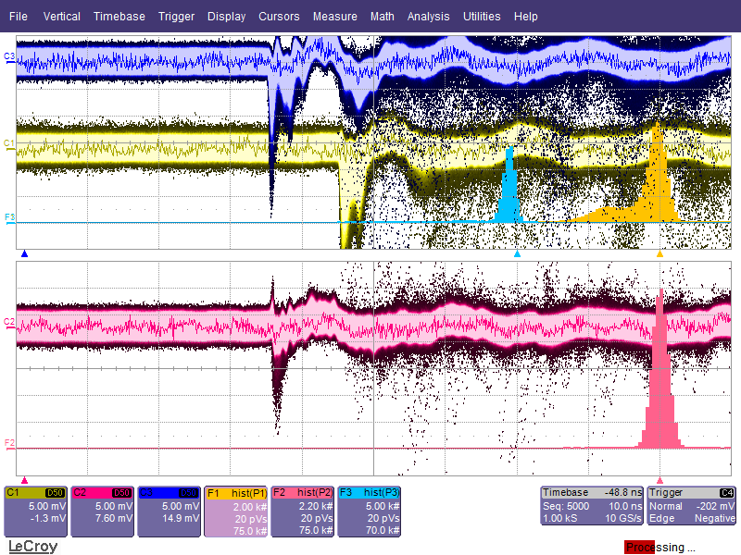
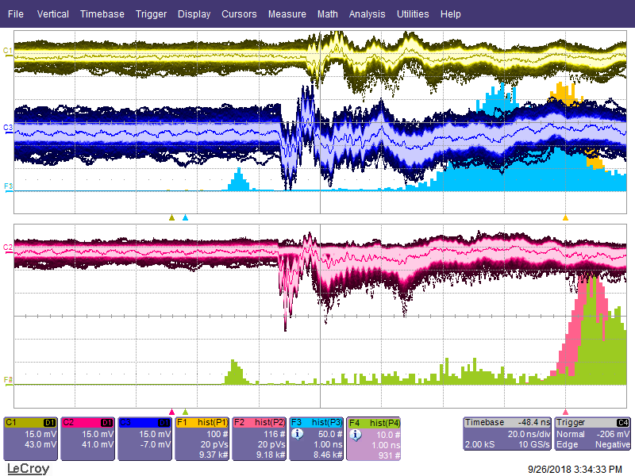
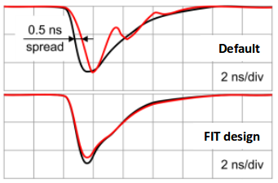
Oscillations in MCPs at higher intensities
Idea (from ALICE collaboration, Performance of Planacon MCP-PMT photosensors under extreme working conditions, DIRC talk 2018 from Yu.A. Melikyan) : in-line resistors to damp down the oscillations
yellow: no resistor,
red: 50 Ω,
blue: 75 Ω,
other pixels wired together to ground
up: every pixel with 56 Ω
Problem at ALICE (left) comes from blockwise readout (up,
red: 16 pixel with 50 Ω, yellow: 16 pixel with 75 Ω, blue: 32 pixel with no resistor

Slide 6
Oscillations in MCPs at higher intensities
simple in-line resistor will not help most likely
maybe simulation with LTSpice? experts?
Photonis is aware of this problem and tries to fix it

Slide 7
First try of collection efficiency (CE) measurement
collection efficiency is the probability that a photoelectron creates a signal (losses due to missing the MCP pore / absorption, …)
Photonis can measure it, so we want to try it, too
idea: $CE=N_{pe@anode@15kHz} / N_{pe@PC/MCP@15kHz}$
first one is simple: Poisson distribution with charge spectrum (with a PiLas at 15 kHz and a nd-Filter for example)
for the second one we need a little detour

Slide 8
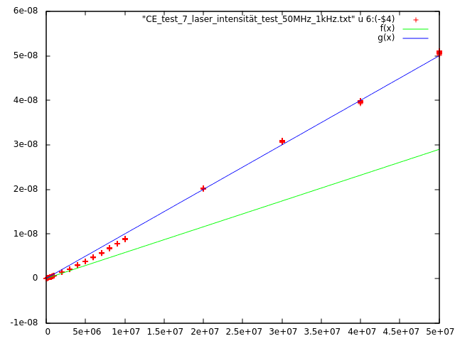
First try of collection efficiency (CE) measurement
use of QE-Setup (200V between PC and MCP and current measurement), with a beam splitter
one beam goes to a photodiode to measure the intensity of the PiLas
the other one goes through the nd-Filter to the sensor ( 1-2 photoelectrons per pulse) → extreme low current at the MCP → increase PiLas frequency to 10-50 MHz → increases current to 10pA level
known problem: PiLas intensity is not linear
$N_{pe@PC/MCP@15kHz}=\frac{1}{50MHz} \frac{I_{MCP@50MHz}}{e} / F$
F corrects the non-linearity with the data from the photodiode
$F=\frac{I_{Diode@50MHz}}{I_{Diode}@15kHz}\frac{15kHz}{50MHz}$
$CE=\frac{N_{pe@anode@15kHz} ∗e ∗15kHz}{I_{MCP@50MHz}}\frac{I_{Diode@50MHz}}{I_{Diode@15kHz}}$
laser intensitiy with linear fit for high and low frequencies

Slide 9
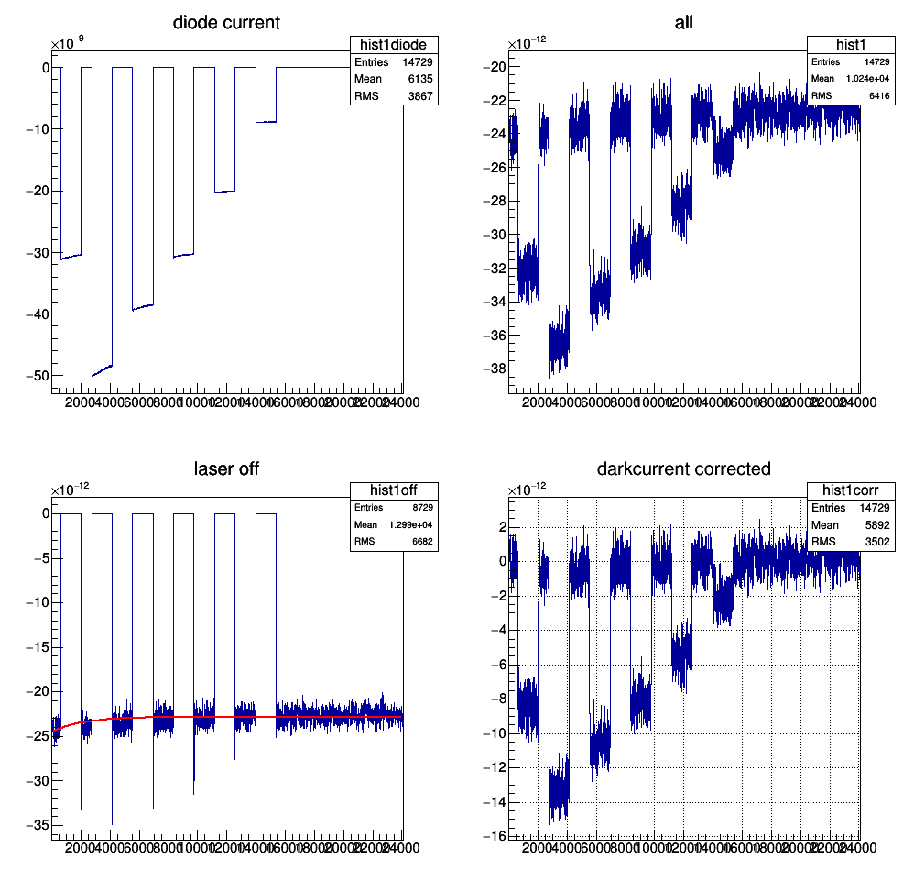
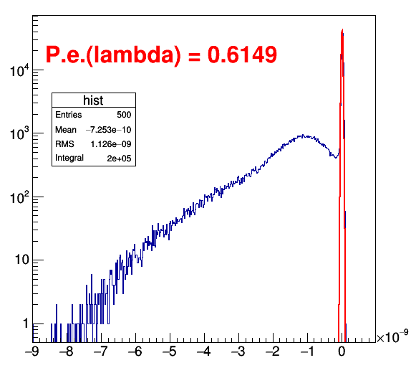
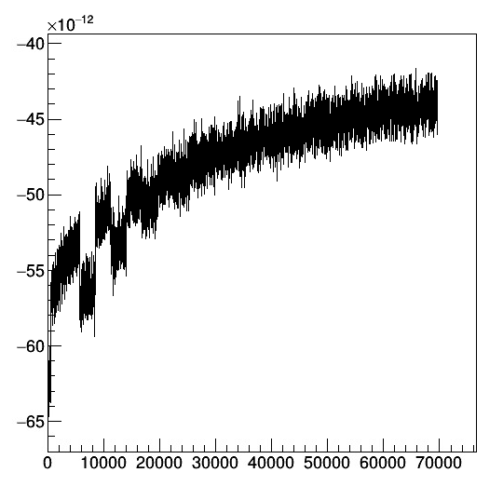
First try of collection efficiency (CE) measurement
Photonis 9001394 (BSRD) , 10 µm pores
long cooldown (hours to days) required and/or fit

Slide 10
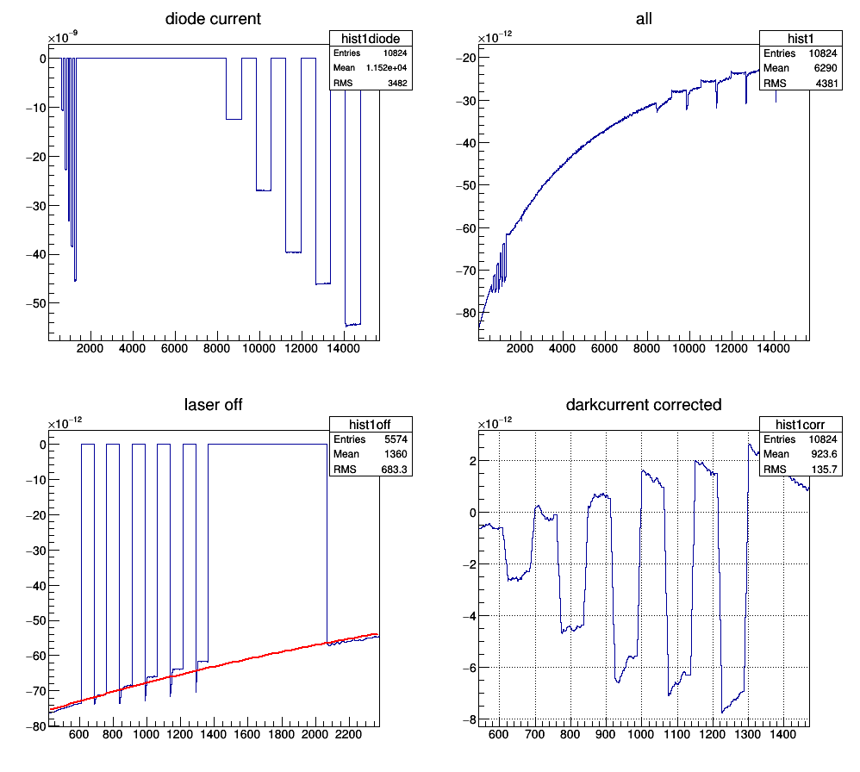
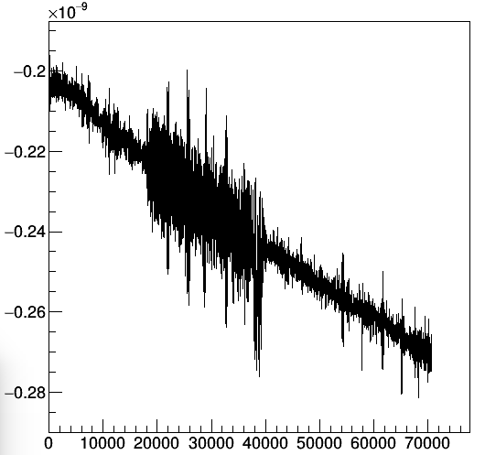
First try of collection efficiency (CE) measurement
Photonis 9002108 (Hi-CE) , 10 µm pores
noise and laser problems → high errors on CE

Slide 11
First try of collection efficiency (CE) measurement
results:
~60% for 9001394 seems reasonable
9002108 seems to be higher (70-130%), but final measurement is to be done
 | 50 MHz | 40 MHz | 30 MHz | 20 MHz | 10MHz
9001394 (try 1) | 65% | 62% | 64% | 63% | 60%
9001394 (try 2) | 63% | 62% | 63% | 61% | 70%

Slide 12
Summary
oscillations and how to get rid of them need to be investigated further (Carstens talk?)
waiting for Photonis‘ idea
CE measurement seems to work in principle → next sensors will be Hamamatsu tubes to investigate the effect of the film on the CE
remeasurement of Photonis Hi-CE tube

Slide 13
Thank you for your attention!

Slide 14
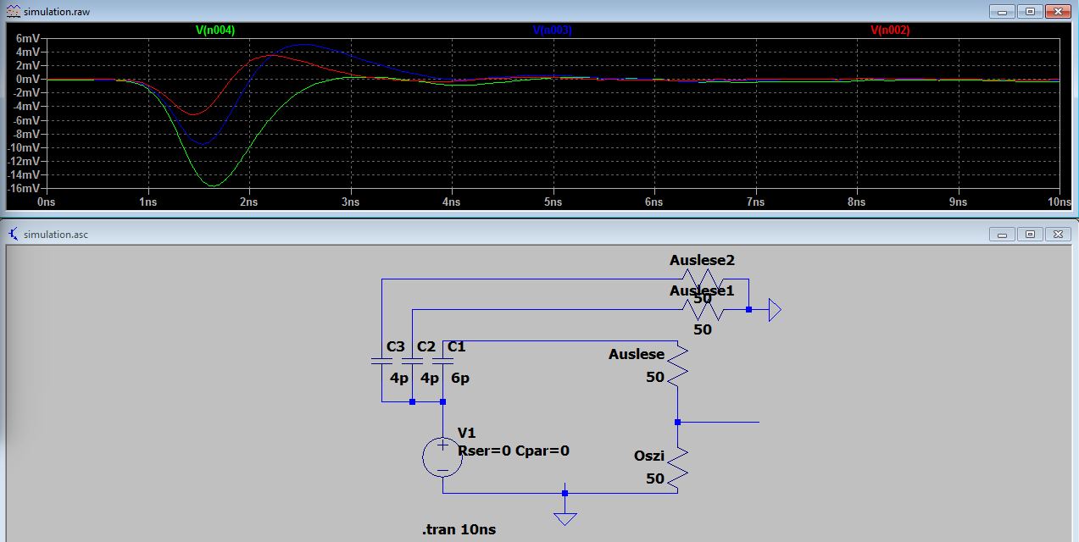
Backup: Oscillations in MCPs at higher intensities
simple try in LTSpice

