Slide 1
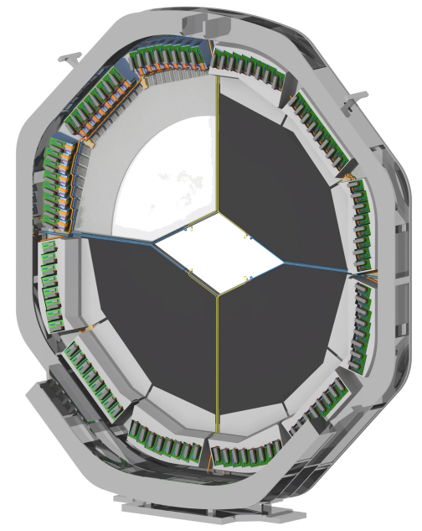
Preliminary Results of CERN Testbeam 2018 for Endcap DISC DIRC Prototype
Simon Bodenschatz, Lisa Brück, Michael Düren, Erik Etzelmüller, Klaus Föhl, Avetik Hayrapetyan, Jan Hofmann, Sophie Kegel, İlknur Köseoğlu, Jhonatan Pereira de Lira, Mustafa Schmidt, Marc Strickert
PANDA CM 18/3 – PID-Cherenkov - 2018/11/06

Slide 2
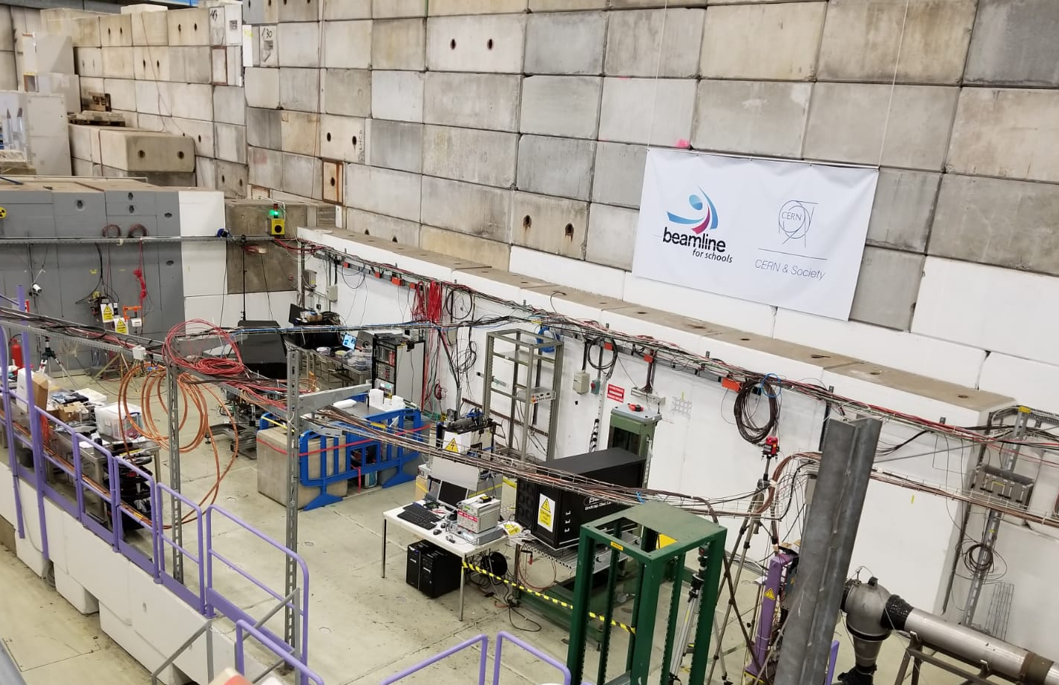
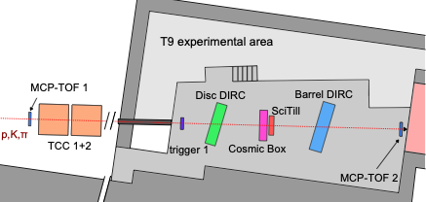
Testbeam 2018
TOF2
SiPM Boxes
Move in Y Direction
Barrel DIRC
Angle scan
TOF1

Slide 3
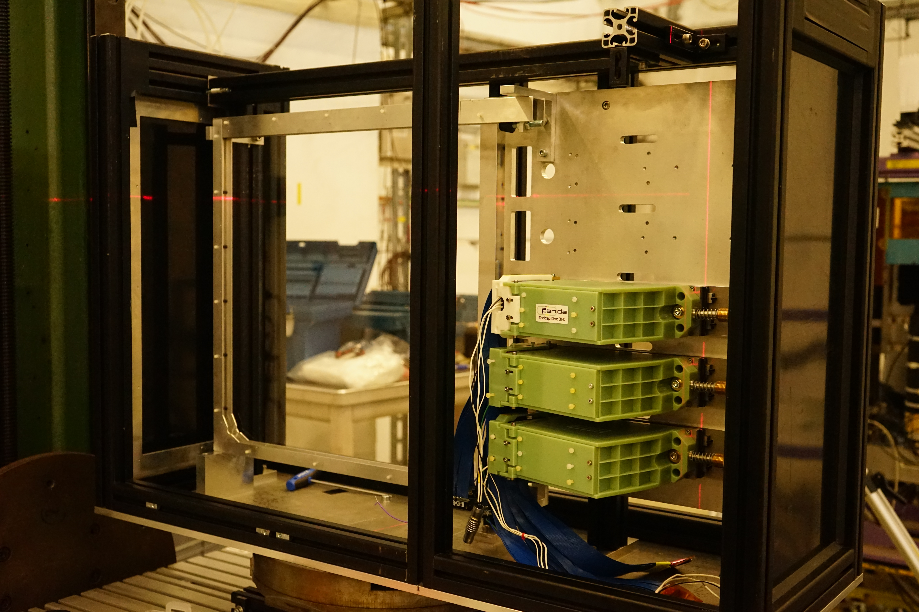
EDD Prototype

Slide 4
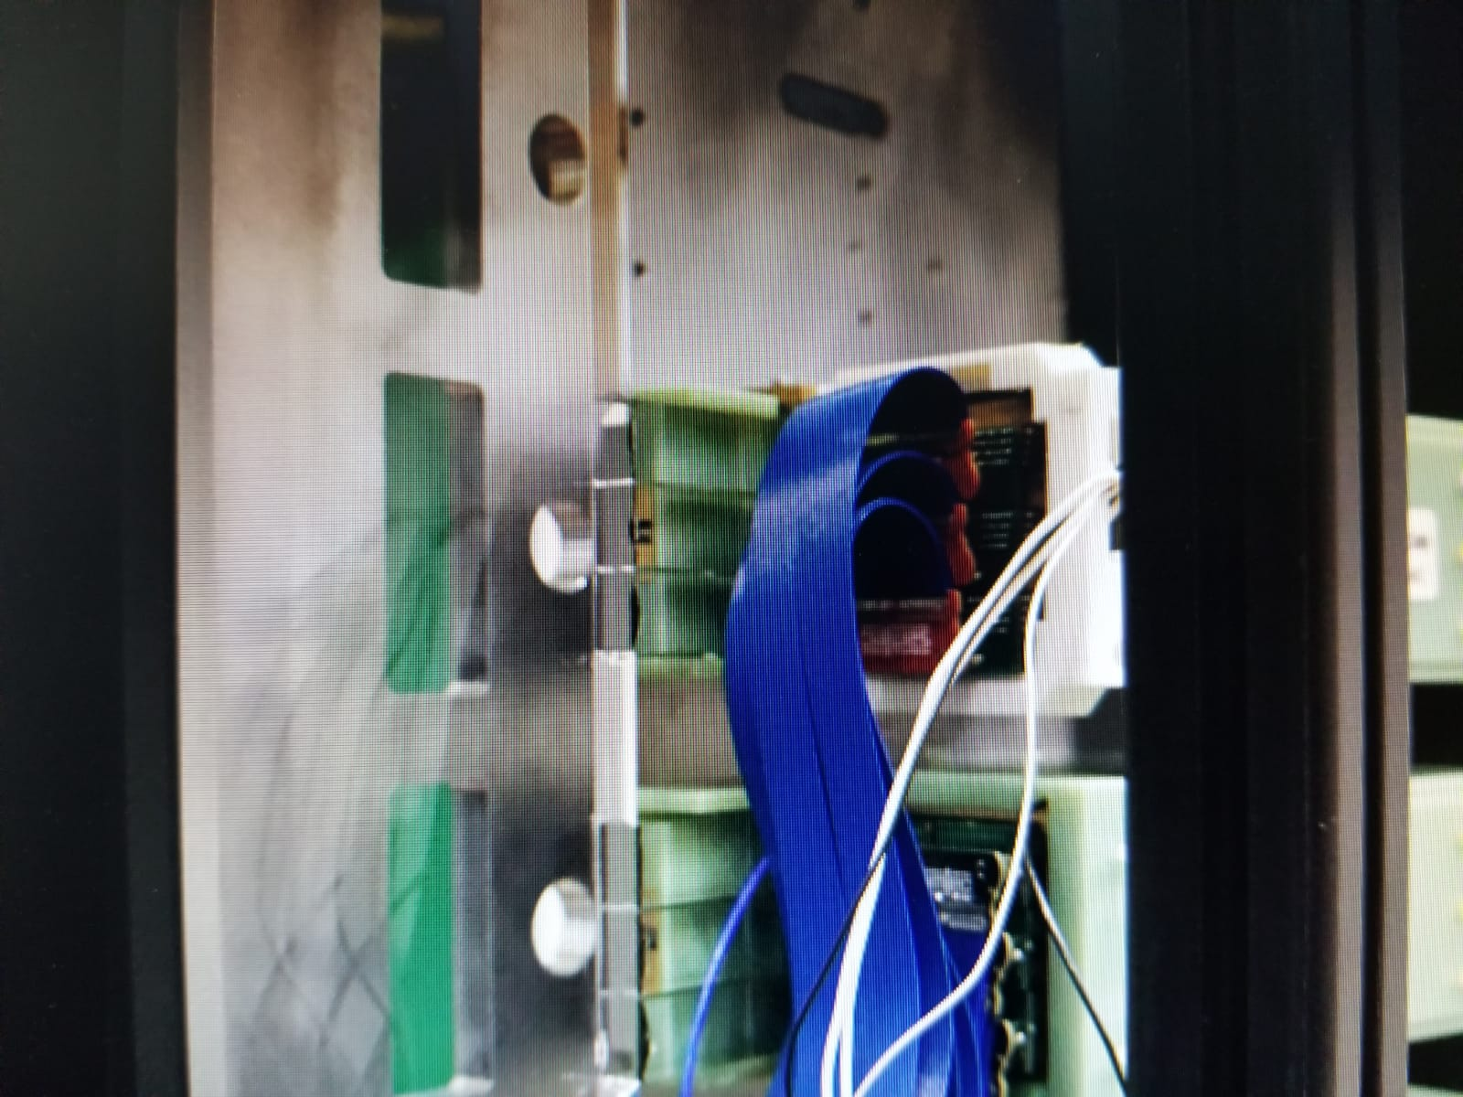
EDD Prototype-FEE connection from inside of the black box
EDD-Prototype
9 Focusing Elements (FEL)
3 Read-out Modules (ROM)
3 Photosensors (MCP-PMTs)
Photonis Aqua
3 Rows, 288 pixels
Hamamatsu
6 Rows, 384 pixels
Photonis 2mm
3 Rows, 288 pixels
In total 960 connected channels
Focusing Elements
Photonis Aqua
Prototype

Slide 5
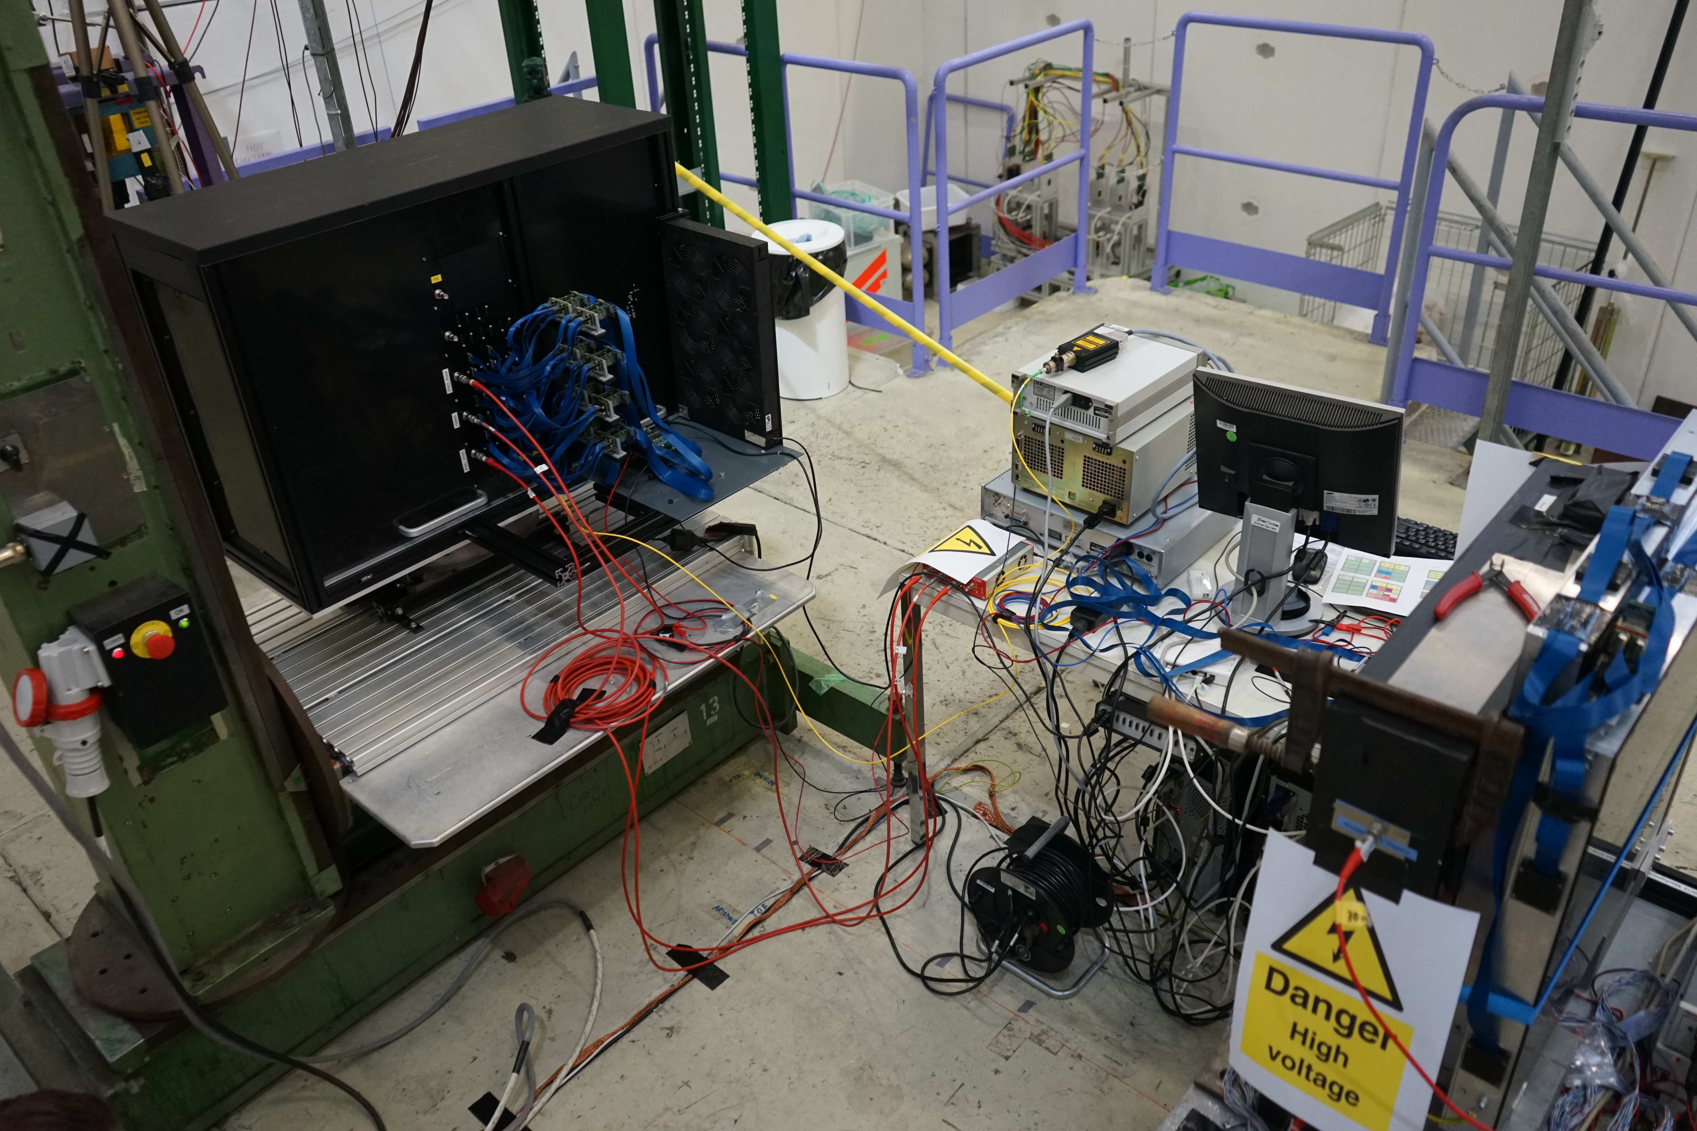
EDD Prototype

Slide 6
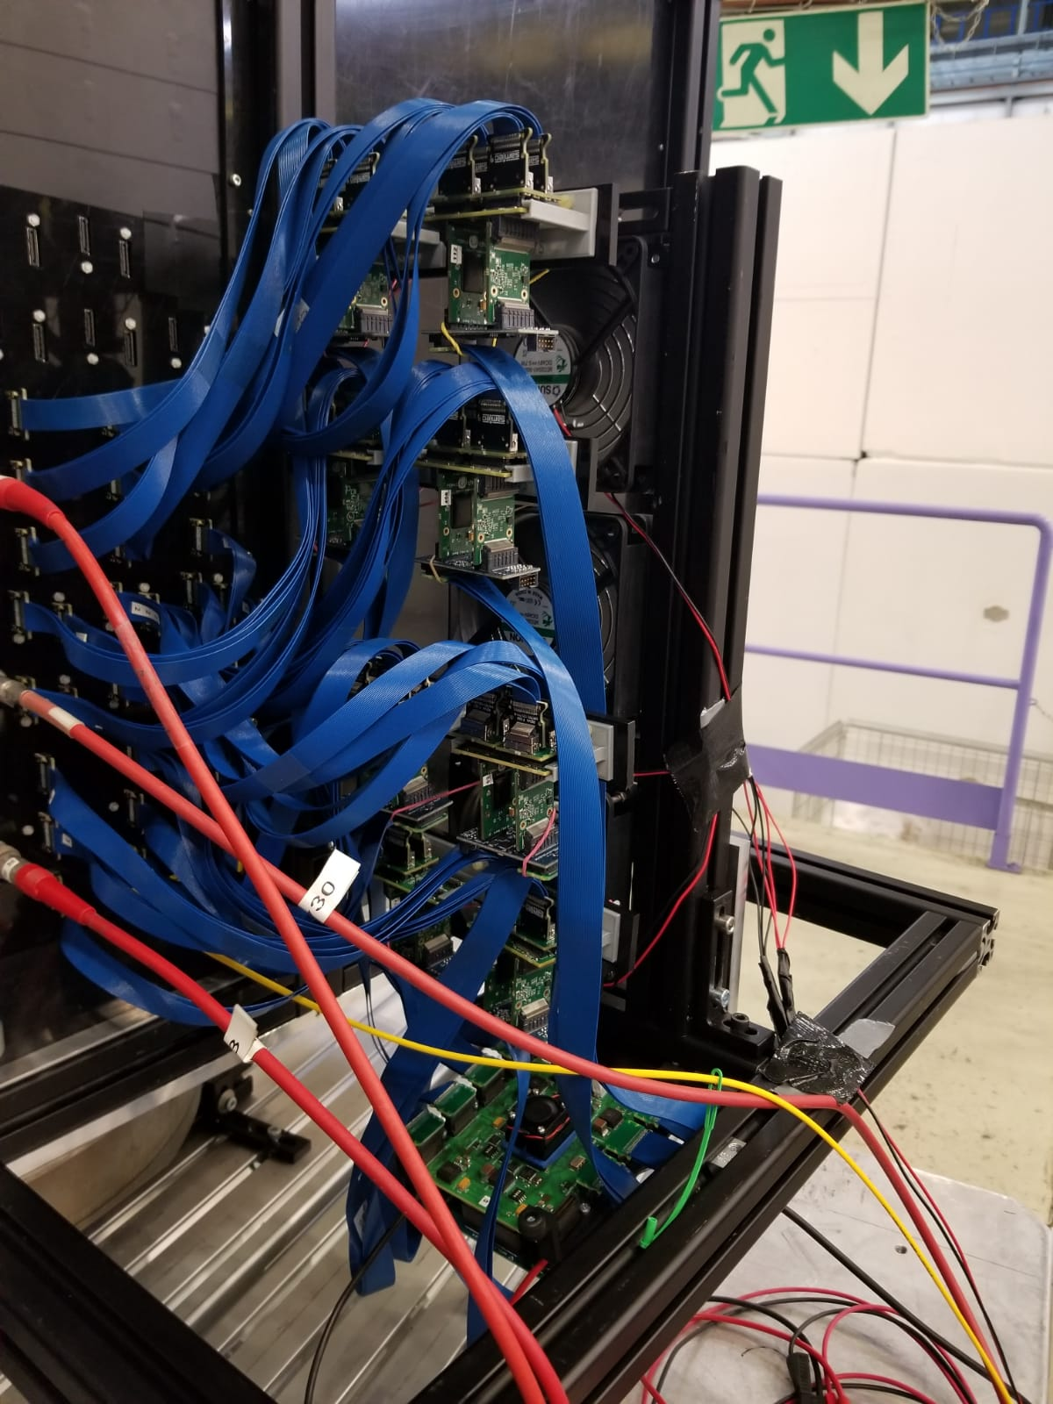
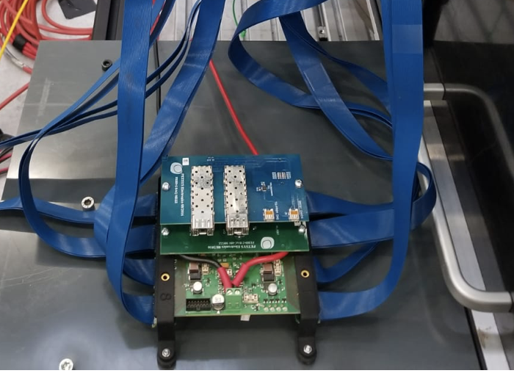
Prototype-FEE connection from outside of the black box
Front-end Electronics
18 ASICs
15 ASICs are connected to one D-Board (EDD Prototype)
3 ASICs are connected to second D-Board (SiPMs, MCP-TOFs, Laser)
First results are obtained from Photonis Aqua.
4 and half ASICs, (288 Channels) are connected to Photonis Aqua.

Slide 7
Offline analysis
Mapping between pixels of photonis aqua and ASIC channels
Time difference between laser and pixels of photonis aqua
Time Difference between ASICs
All MCP-PMTs are connected to ASICs with identical cables
Equalization of data
Y Scan, between 5mm to 379mm, step size 17mm
p = 10 GeV/c
Angle Scan, 3º -18º with step size 1º
p = 4 GeV/c
Current analysis only includes if events are between TOF1 & TOF2 time interval

Slide 8
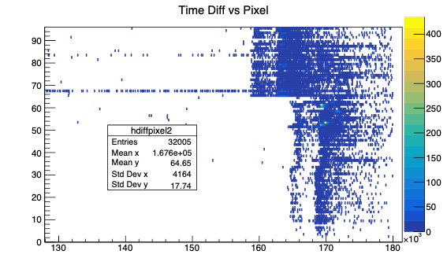
Laser trigger & photonis aqua for 3 FELs
Each focusing element (FEL) is connected to two different ASICs
Pixel
FEL 2
ASIC 16
ASIC 1
Time_FEL2-Time_Laser [ps]

Slide 9
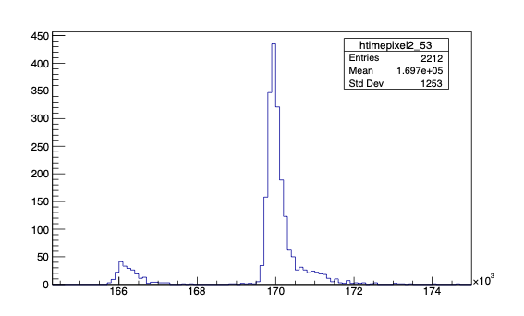
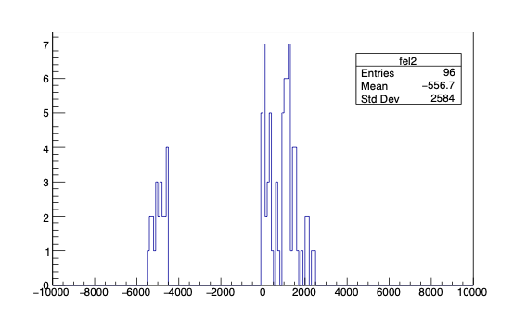
Equalization of data
Pixel 53 has the largest amount of events
xpeak is the reference time
#Entries
Time difference between all pixels and xpeak for FEL2
#Entries
xpeak
Time_Pixel53-Time_Laser [ps]
Time_pixel-xpeak [ps]

Slide 10
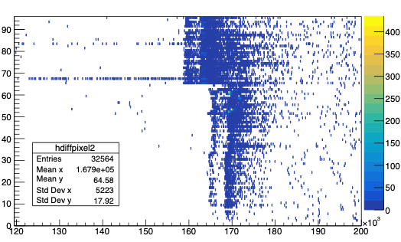
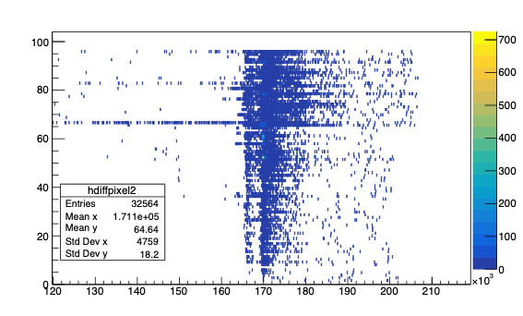
Equalization of FEL2 data
Before equalization
After equalization
FEL2
FEL2
Pixel
Pixel
Time_FEL2-Time_Laser [ps]
Time_FEL2-Time_Laser [ps]

Slide 11
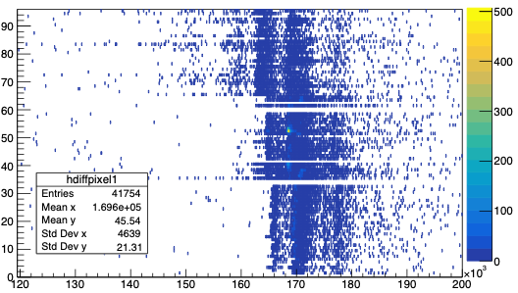
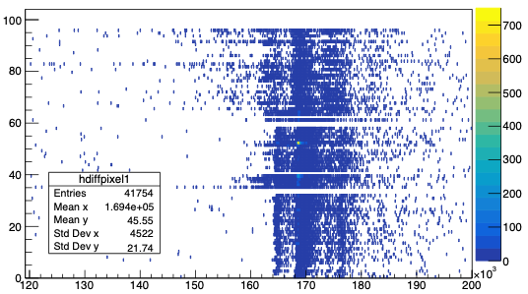
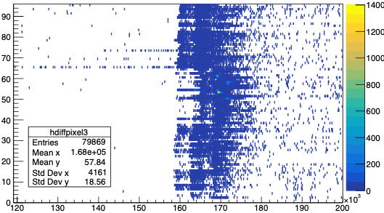
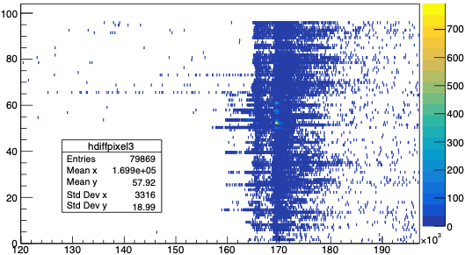
Equalization for FEL1 & FEL3 data
Before equalization
After equalization
Pixel
FEL1
Pixel
FEL1
Time_FEL1-Time_LASER [ps]
Time_FEL1-Time_LASER [ps]
Pixel
FEL3
Pixel
FEL3
Time_FEL3-Time_LASER [ps]
Time_FEL3-Time_LASER [ps]

Slide 12
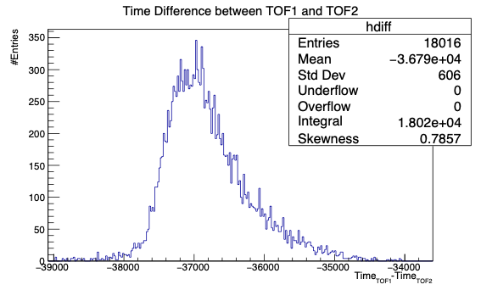
Trigger selection
EDD
CBX
CBY
TOF1
TOF2
SiPM
[ps]
Time Interval for Triggers is between -34ns to -39ns was selected
p = 10GeV/c

Slide 13
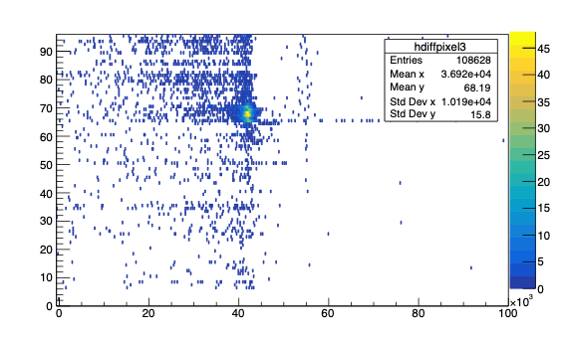
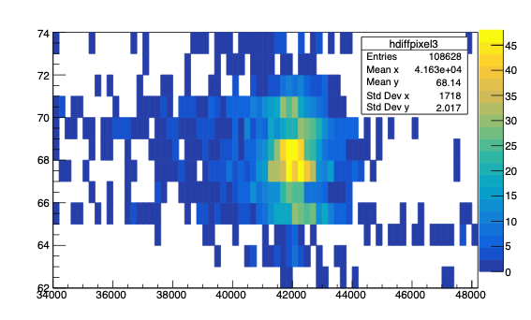
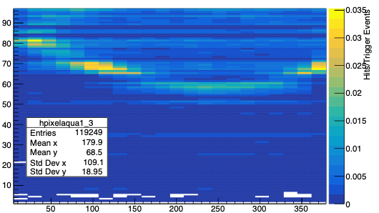
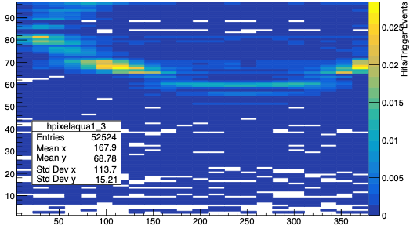
Equalized data for FEL3
-39ns < Time_TOF1-Time_TOF2 < -34ns
Time Cut: 40ns < Time_TOF1-Time_FEL2 < 44ns
y=141mm
Pixel
Pixel
Time_TOF1-Time_FEL3 [ps]
Time_TOF1-Time_FEL3 [ps]
Pixel
Pixel
Y Position [mm]
Y Position [mm]

Slide 14
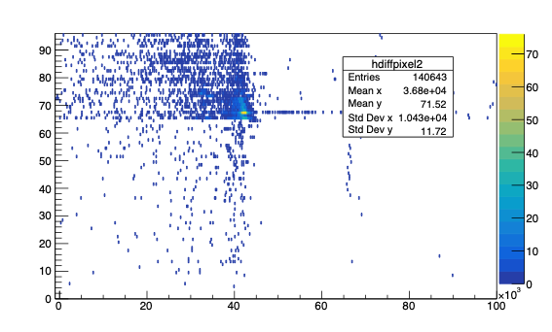
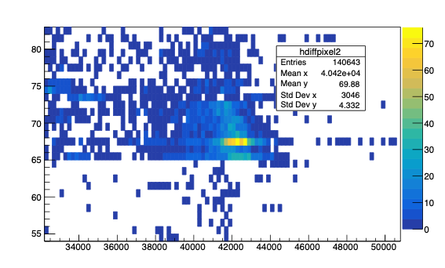
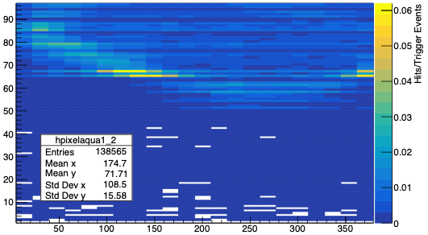
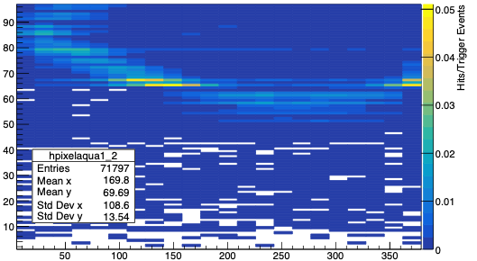
Equalized data for FEL2
-39ns < Time_TOF1-Time_TOF2 < -34ns
y=141mm
Time Cut: 38ns < Time_TOF1-Time_FEL2 < 45ns
Pixel
Pixel
Time_TOF1-Time_FEL2 [ps]
Time_TOF1-Time_FEL2 [ps]
Pixel
Pixel
Y Position [mm]
Y Position [mm]

Slide 15
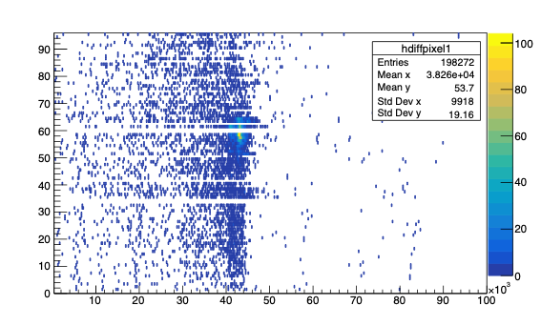
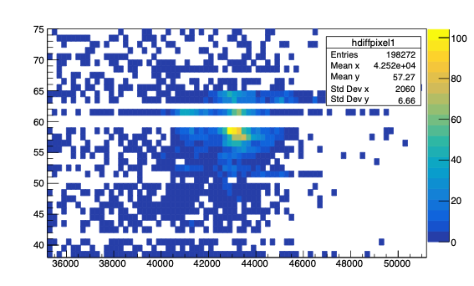
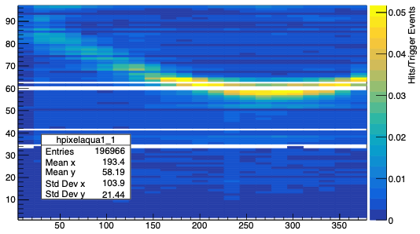
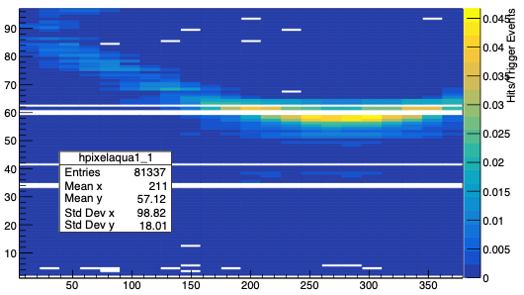
Equalized data for FEL1
-39ns < Time_TOF1-Time_TOF2 < -34ns
Time Cut: 41ns < Time_TOF1-Time_FEL1 < 45ns
y=226mm
Pixel
Pixel
Time_TOF1-Time_FEL1 [ps]
Time_TOF1-Time_FEL1 [ps]
Pixel
Pixel
Y Position [mm]
Y Position [mm]

Slide 16
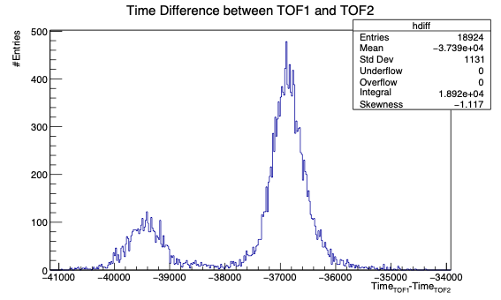
Trigger selection
EDD
CBX
CBY
TOF1
TOF2
SiPM
pion
proton
pion: -38ns < Time_TOF1 - Time_TOF2 < -34ns
proton: -41ns < Time_TOF1 - Time_TOF2 < -38ns
p = 4GeV/c

Slide 17
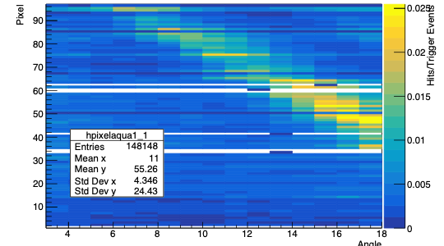
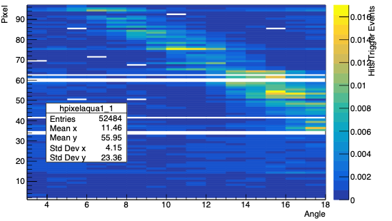
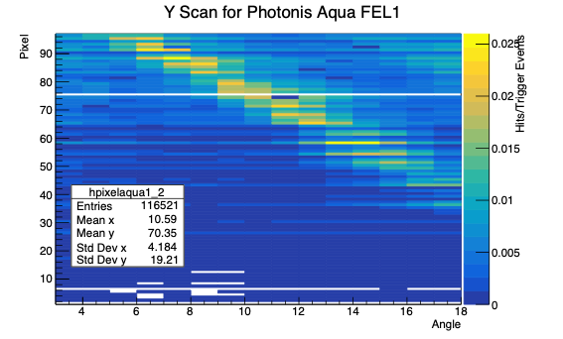
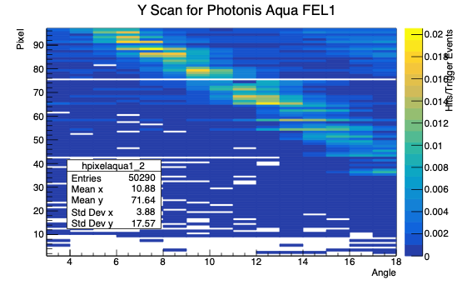
Preliminary results of angle scan for pion
-38ns < Time_TOF1-Time_TOF2 < -34ns
FEL1
Time Cut: 41ns < Time_TOF1-Time_FEL1 < 45ns
FEL1
FEL 2
FEL 2
Time Cut: 41ns < Time_TOF1-Time_FEL2 < 45ns

Slide 18
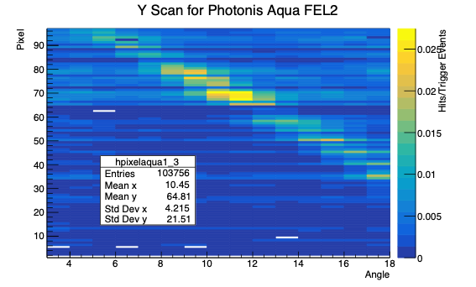
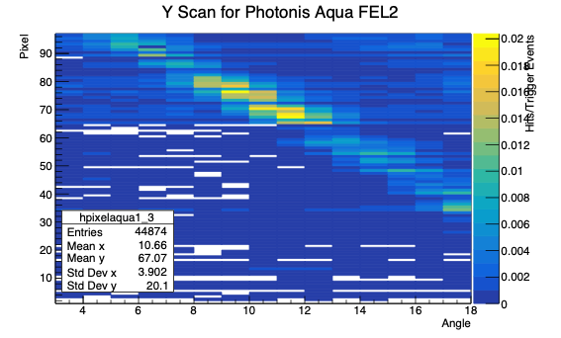
Preliminary results of angle scan for pion
-38ns < Time_TOF1-Time_TOF2 < -34ns
Time Cut: 41ns < Time_TOF1-Time_FEL3 < 45ns
FEL 3
FEL 3

Slide 19
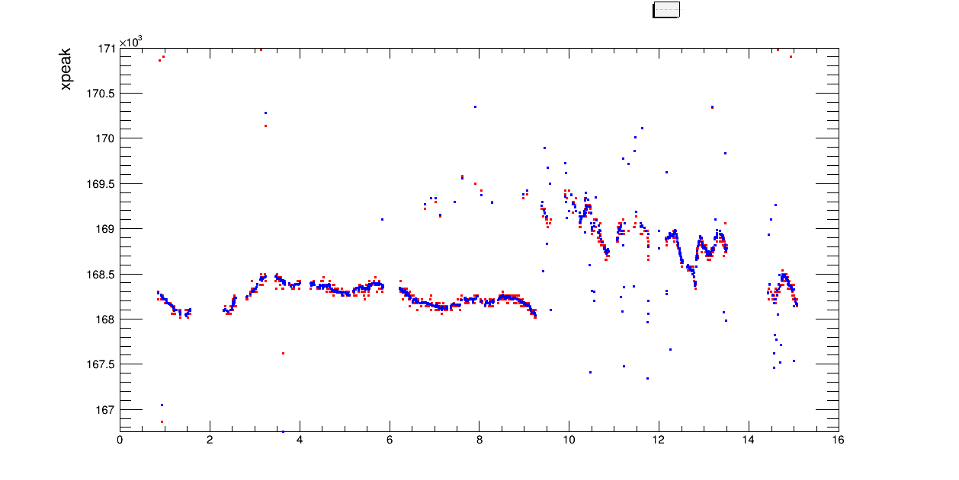
Channel 53 peak behavior during the days
Y Scan
[ps]
Blue dots: Gaus Fit
Red dots: Data
Angle Scan
Days in August

Slide 20
Preliminary analysis
Equalization is done
Missing Channels are identified.
MCP-TOFs are used as triggers for
p = 10 GeV/c -39ns < TOF1 - TOF2 < -34ns
p = 4 GeV/c -38ns < TOF1 - TOF2 < -34ns for pion
-41ns < TOF1 - TOF2 < -38ns for proton
Proper time cuts to reduce the background

Slide 21
Future plans about analysis
MCP-TOF1 and SiPM boxes will be used as triggers
Reconstruct Cherenkov angle
SiPM boxes will be used to
Eliminate background with spatial cut
Improve Cherenkov angle resolution
All steps will be repeated for also Hamamatsu & Photonis 2mm
Time walk correction

Slide 22
Thank you.

Slide 23
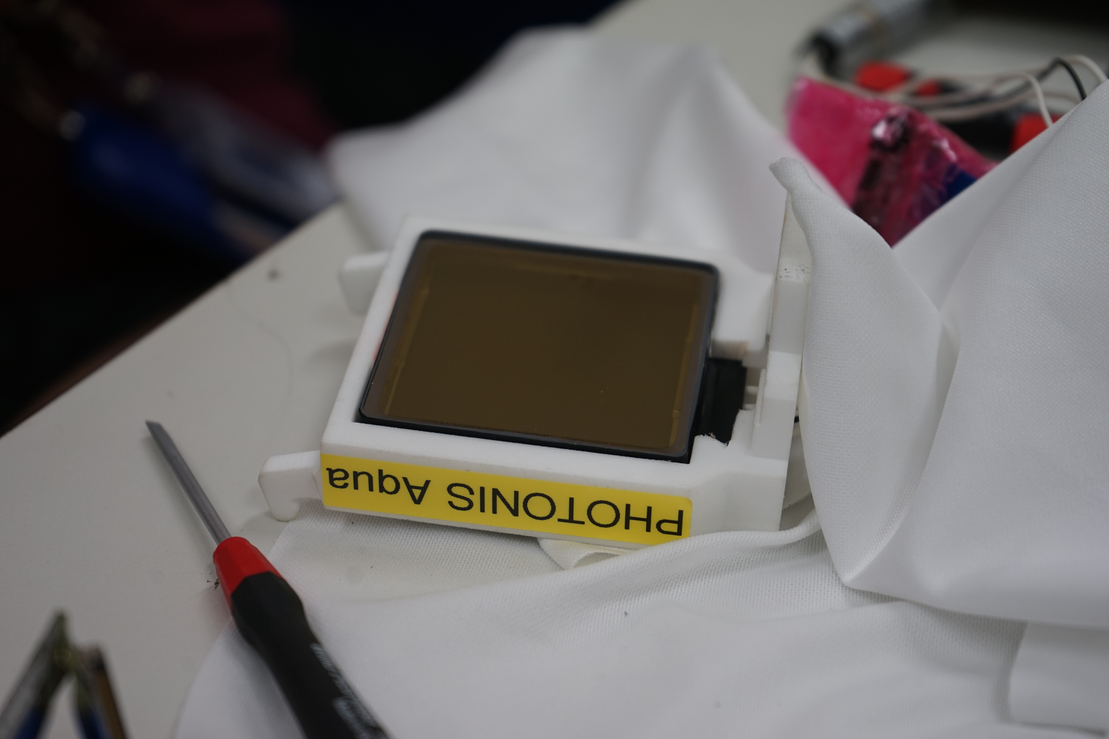
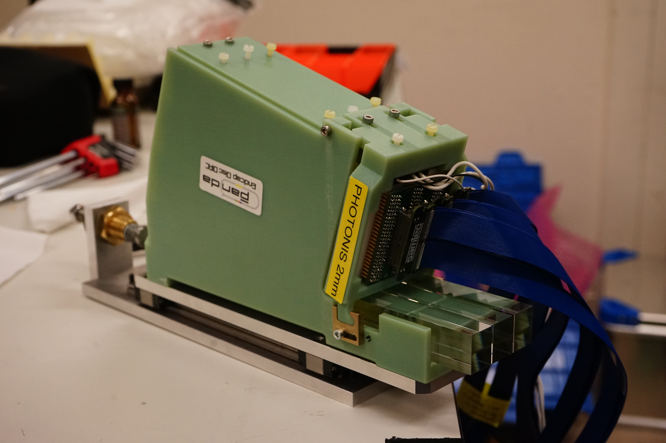
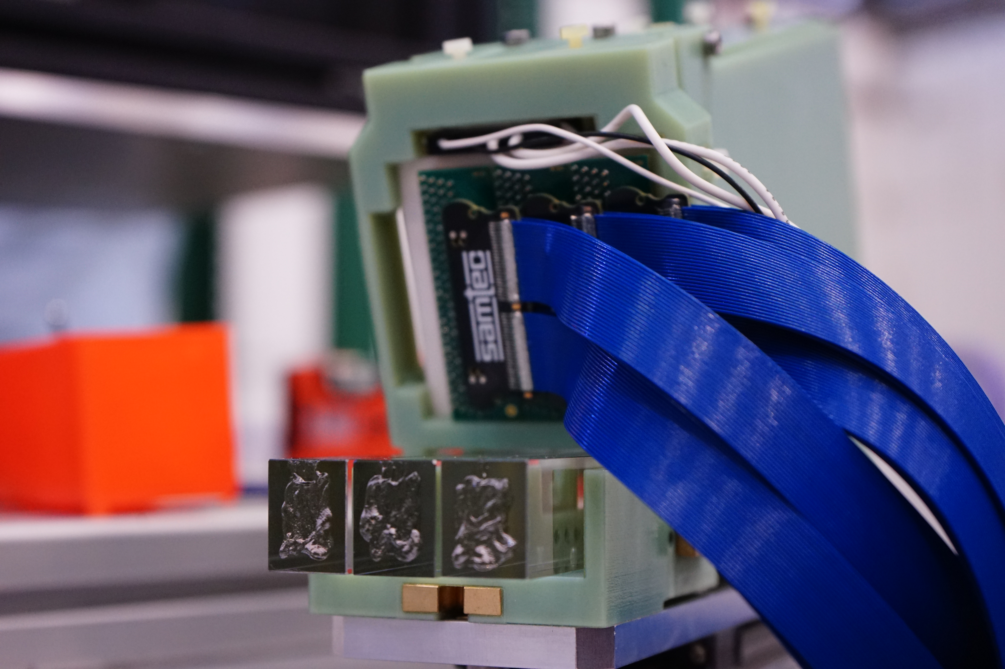
Backup
SiPM bars
Photonis Aqua
Photonis 2mm
Photonis 2mm

