Slide 1
Some results from the FRICH prototype test beam at BINP
Sergey Kononov^{ab} on behalf of the PANDA Forward RICH group
ª Budker Institute of Nuclear Physics, Novosibirsk, Russia
^{b} Novosibirsk State University, Novosibirsk, Russia

Slide 2
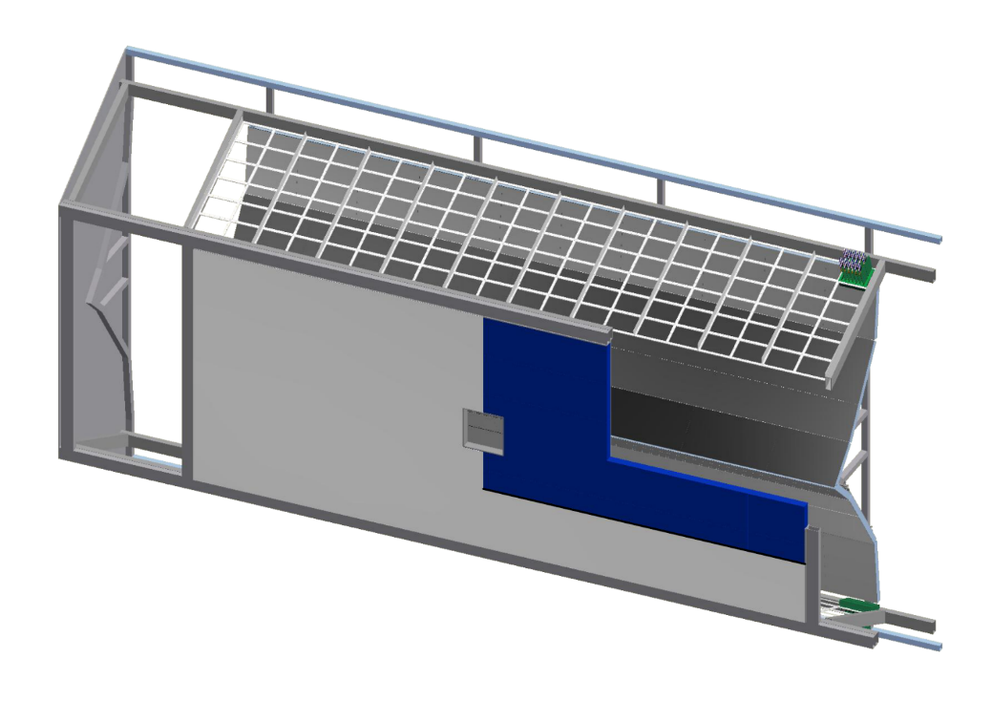
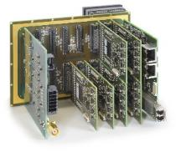
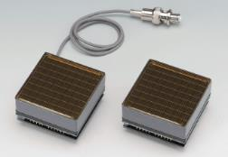
PANDA FRICH baseline design
DiRICH FEE (GSI)
Designed for H12700 readout
12x32ch preamp+disc+TDC
2 Gbps output link
Mirrors
2 mm float glass
Al+SiO₂ coating
Aerogel radiator
Focusing 2- or 3-layer aerogel
n≈1.05
Total thickness – 40 mm
Photon Detector
H12700 MaPMTs (Hamamatsu)
flat panel
8x8 anode pixels of 6mm size

Slide 3
Test beam of F(A)RICH prototype at BINP VEPP-4 (2018)
Electron beam parameters in 2018
Energy range | 3 GeV
Averaged intensity | up to 100 e⁻ / s
Energy spread | 2.6%
Purpose of the tests beam:
Test H12700 MaPMTs and PADIWA&TRB3 readout
Obtain single photon resolution for several aerogel configurations and compare with expected ones

Slide 5
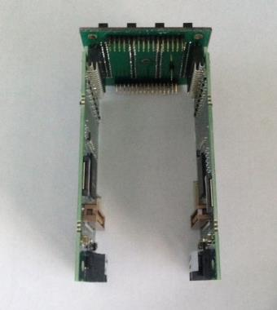
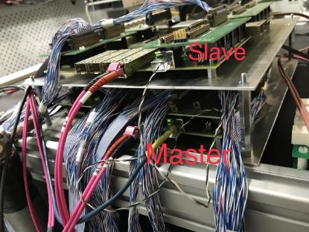
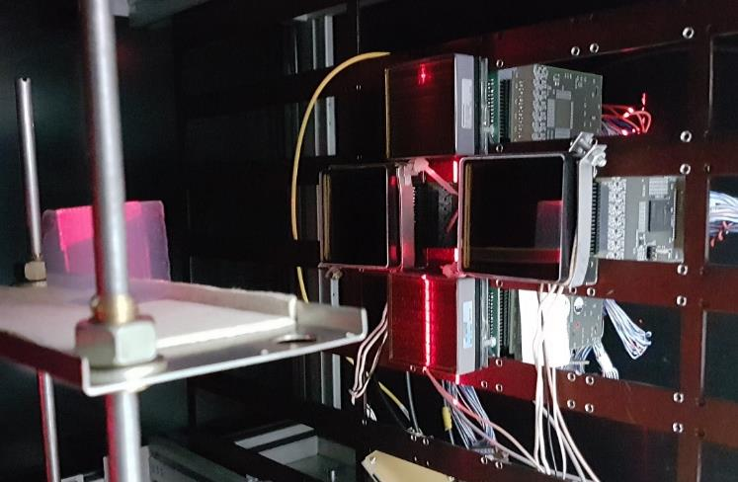
F(A)RICH prototype readout
Custom adapter
Custom adapter board to couple 4 PADIWAs to a H12700 MaPMT (PADIWA couple with Planacon MCP PMT without adapter)
2 TRB3 boards and 14 PADIWA3 boards – 224 channels (cover 3.5 64-anode PMTs)
Each TRB board transmits data via Gbit-ethernet switch to a PC
GSI DABC software used for DAQ from TRB
Triggered by coincidence of signals from the sc. counter before F(A)RICH and the NaI calorimeter
Trigger signal is blocked by PC for readout period. Sync between subsystems is assured by the same event number observed
TRB3 boards
PADIWA
Planacon MCP PMT
H12700

Slide 6
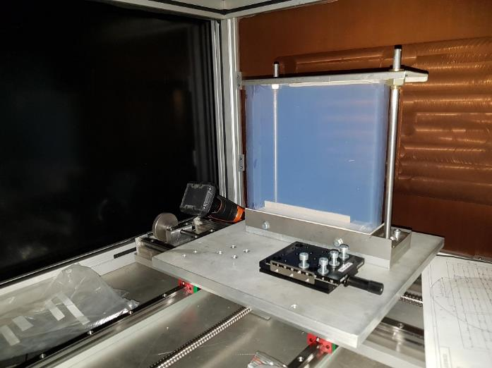
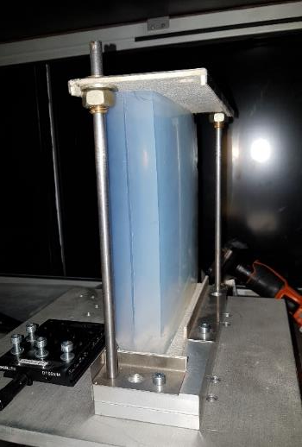
Tested aerogel radiator samples (test beam run on 3-4 June 2018)
1
e⁻
2
Configuration 1 n₁ = 1.0514, t₁ = 2 cm
n₂ = 1.0503, t₂ = 2 cm
Configuration 2 n₁ = 1.0514, t₁ = 2 cm
n₂ = 1.0514, t₂ = 2 cm
Monolithic aerogels: 3 three-layer samples of 30-40 mm thickness
About 300k event per setup configuration were collected

Slide 7
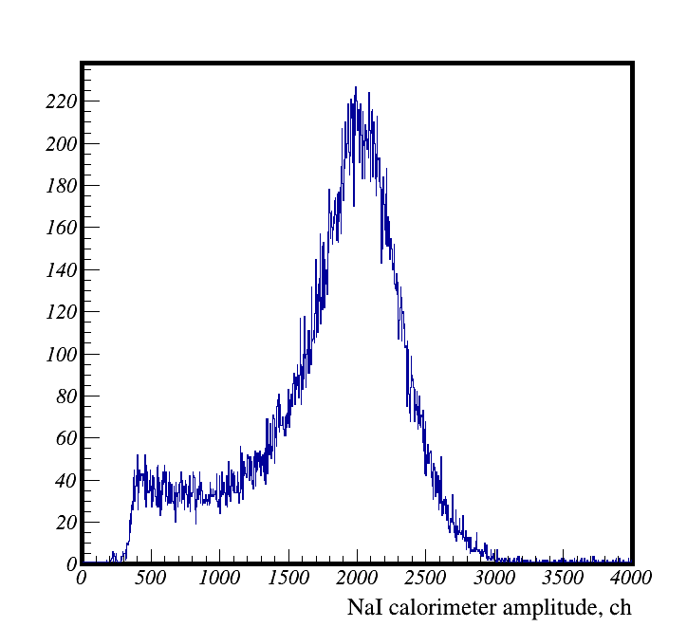
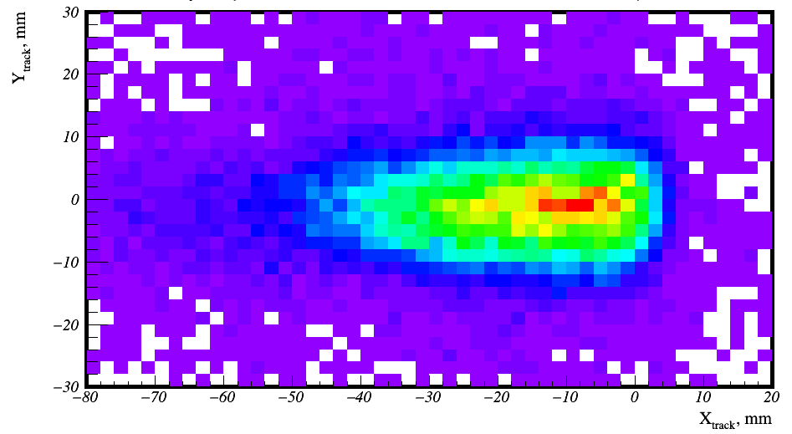
Event selection
NaI calorimeter amplitude distribution
and cut interval
Reconstructed track position XY-map at PMT
and cut region

Slide 8
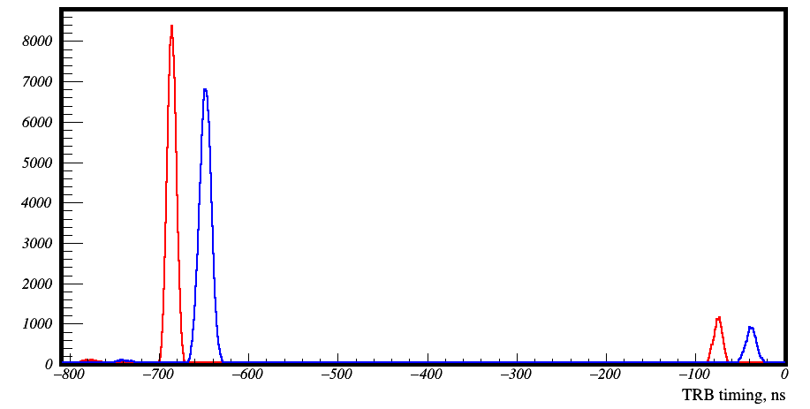
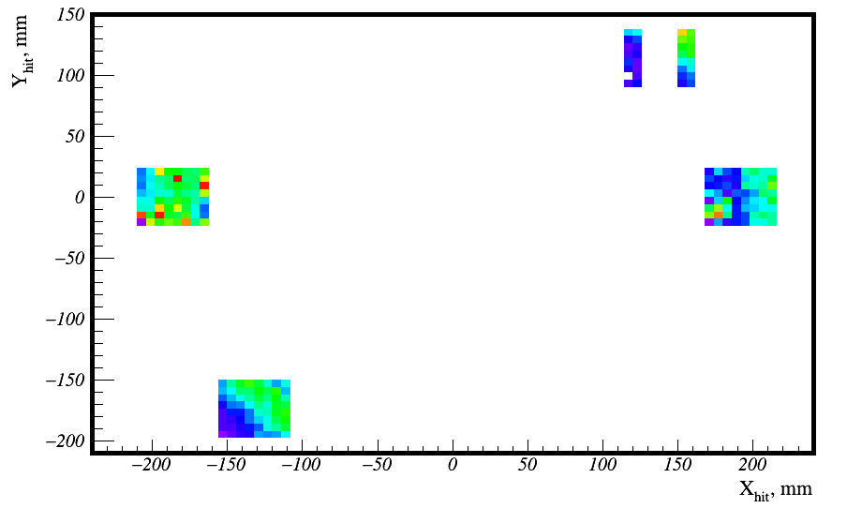
Hit plots
Leading edge
Hit timing distribution
VEPP-4M bunch structure can be seen with 600 ns separation.
Timing resolution here is determined by the rough measurement of reference timing in TRB3
Hits are selected by leading edge timing in 30ns interval
Trailing edge
Coincident bunch
Next bunch
Hit XY map
The ring is not seen here because the e⁻ beam is too wide

Slide 9
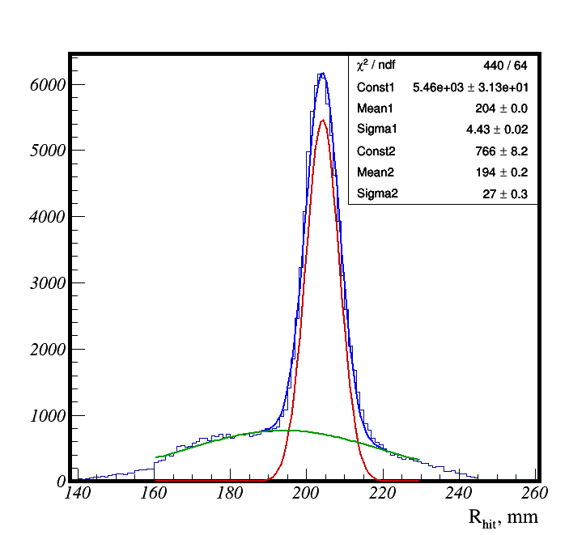
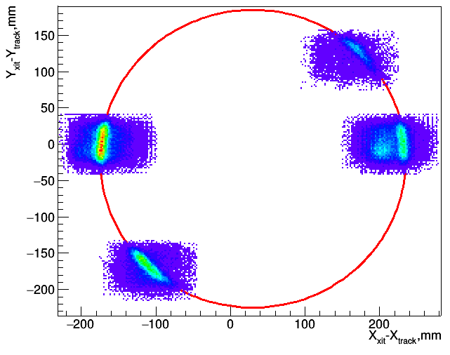
Cherenkov rings
Run: 03 June 2018
PD: 4 MaPMTs
Aerogel: Configuration 1
Aerogel-PMT distance: 600 mm
Aerogel
PMTs
Background time-correlated hits
Preliminary results:
R = 204 mm
σ_{R1} = 4.4 mm (6.6 mrad)

Slide 10
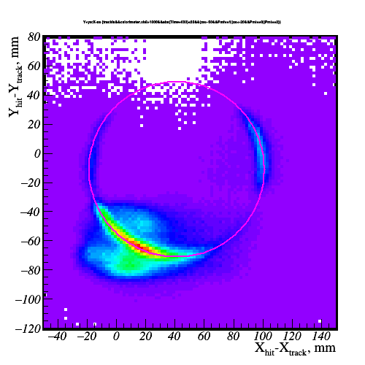
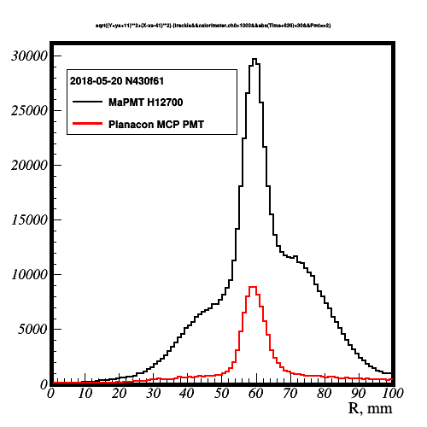
Cherenkov rings with Planacon MCP PMTs short focusing distance of FARICH for SCTF
Run: 20 May 2018
PD: 2 Planacons, 1 MaPMT
4-layer aerogel
Aerogel-PMT distance: 200 mm
—Planacon MCP PMT
—H12700 MaPMT
NB: Low background & lower PDE with Planacons

Slide 11
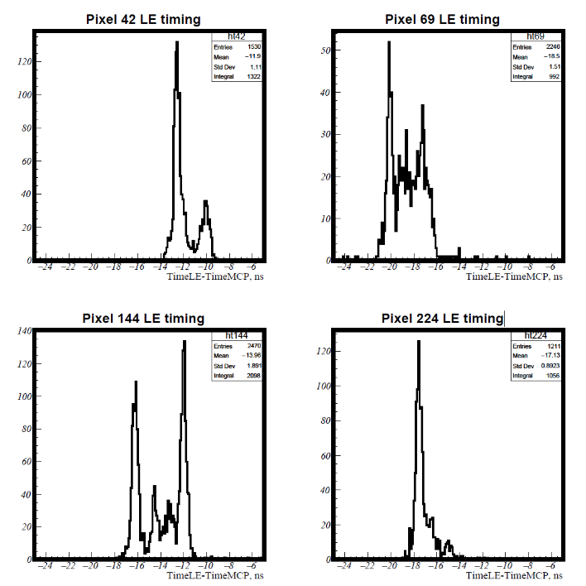
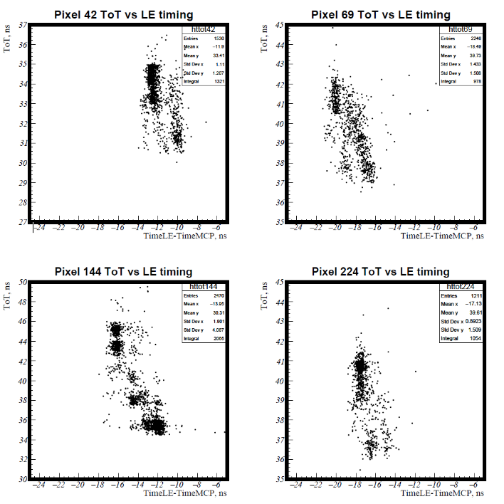
Time + ToT plots for MaPMTs 3 June 2018
Leading edge timing distributions for 4 random anodes of different MaPMTs
Corresponding timing vs ToT scatter plots
“signal”
“crosstalk:”
NB: 2-4 ns separation between peaks. Earlier one has largest ToT (amplitude). Looks like crosstalks between anodes or common crosstalk.

Slide 12
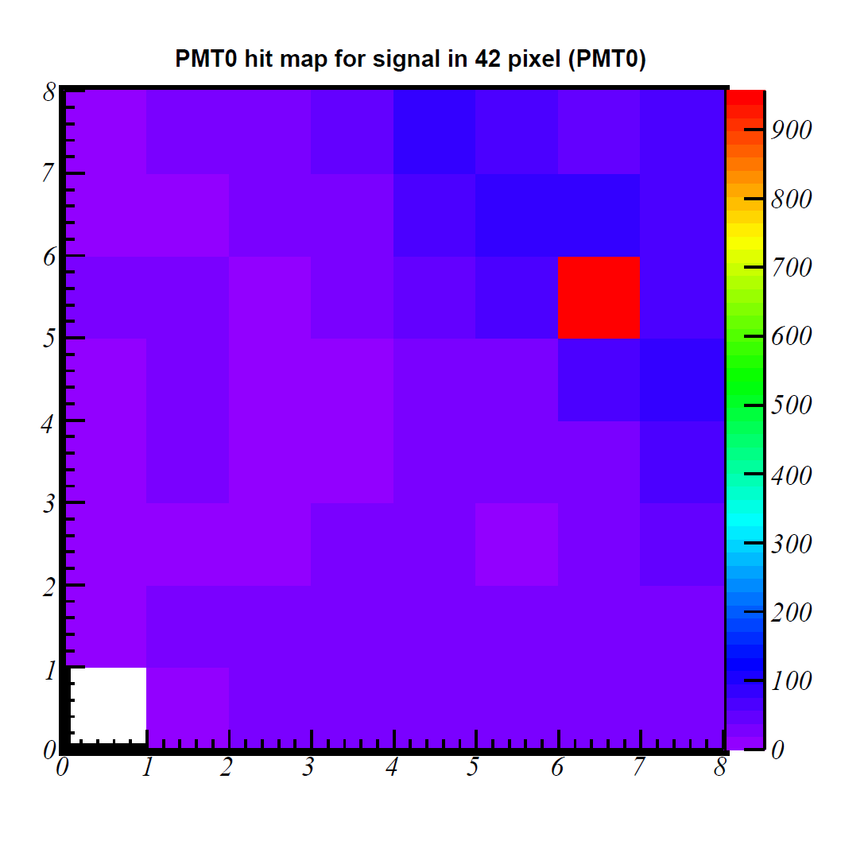
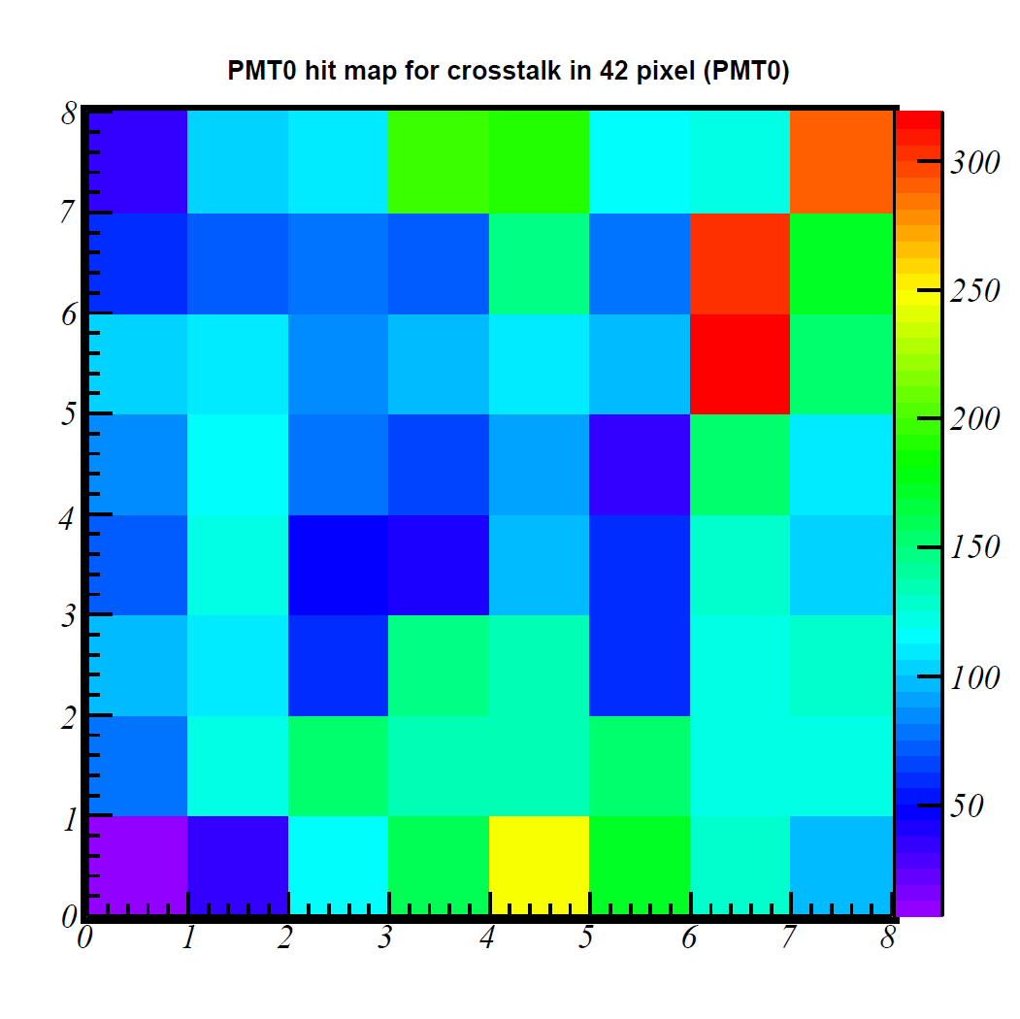
Signal and crosstalks hit patterns
Events with signal hits in anode 42
Events with crosstalk hits in anode 42
NB: No typical pattern of neighboring anodes

Slide 13
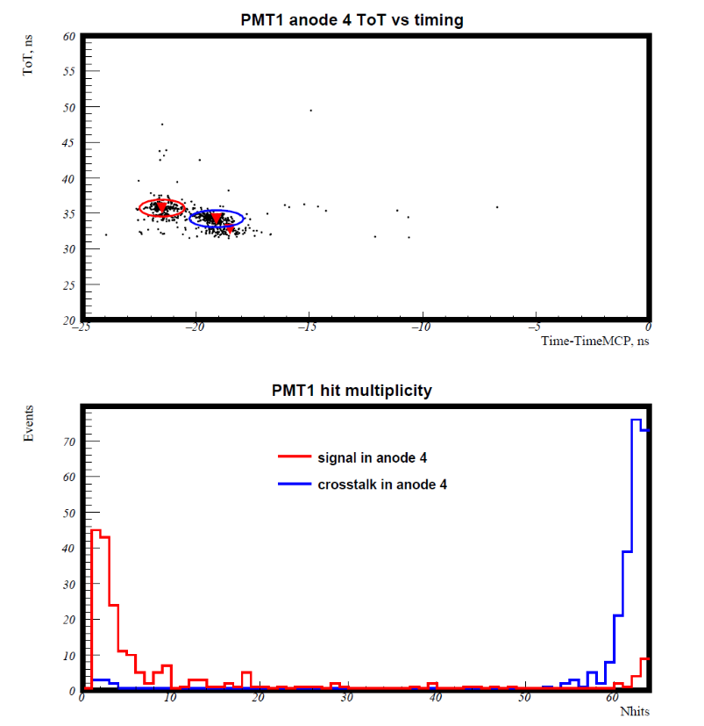
Hit multiplicity for signal and CT
Signal and CT hits are determined by ROOT::TSpectrum2 class.
Cut regions – ellipses.
NB: Almost all nodes of the MaPMT fire when we observe crosstalk in one anode.

Slide 14
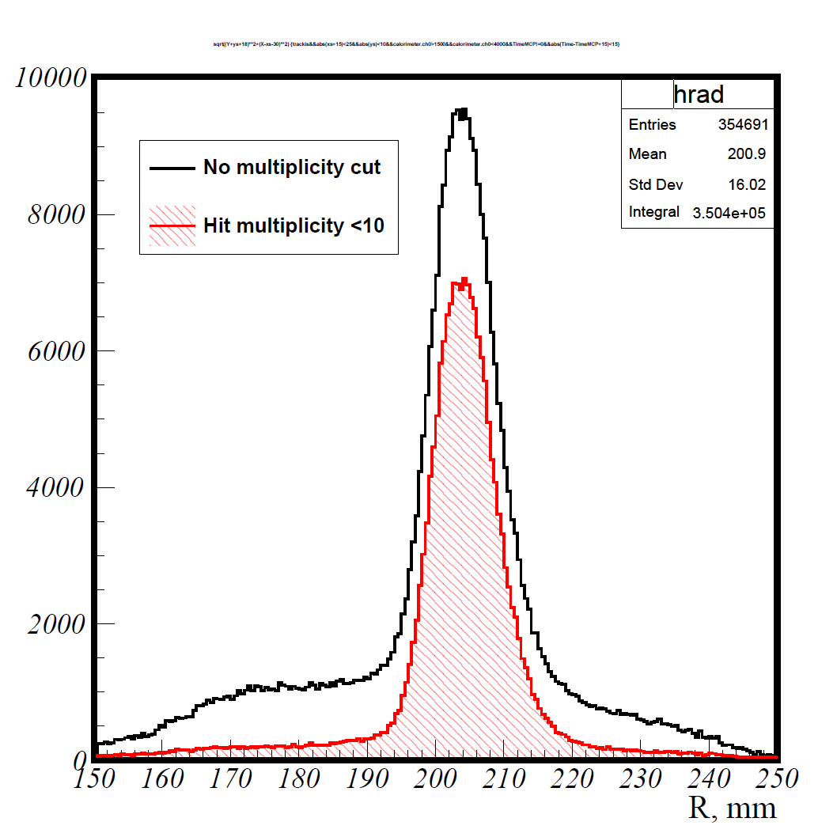
Hit radius distribution with multiplicity cut
Apply per-event cut for number hits in 30-ns window
5x S/B increase
NB: still non-negligible background remains

Slide 15
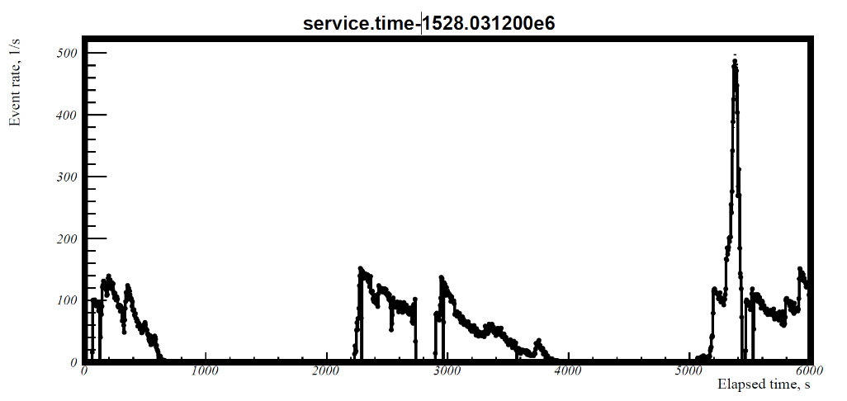
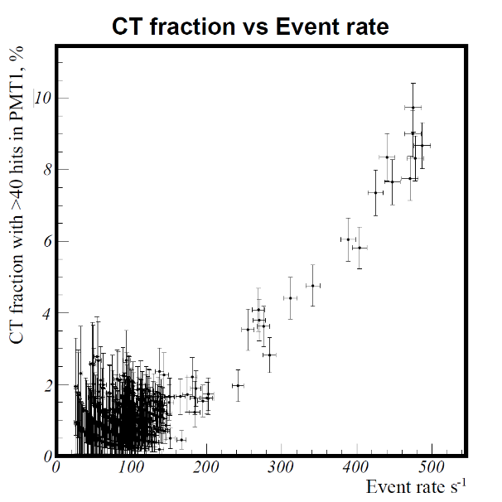
Run 3 June 2018.
Event rate during 2 hours
measured in 4 sec intervals
Fraction of events with CT in PMT1 as function of event rate
NB: For 20-cm ring radius setups we should avoid event rates higher than 200 s⁻¹.

Slide 16
Speculations on the nature of crosstalk
Studies with pulsed laser illumination show that single photon signals can not cause CT to exceed standard calibrated PADIWA thresholds. It should be many photon signals.
A relativistic particle produces about 20 Cherenkov photoelectrons in 1.5 mm window of MaPMT.
BINP electron test beam is not essentially collimated and originates from 5-cm bunches in the VEPP-4M accelarator.
Electrons and positrons scattered far from the beam may be a cause of the large signals in MaPMT and CT on all anodes.
Probably origin: parasitic capacitive coupling between the last dynode and anodes.
This effect should be event rate dependent for bunched beam.
More studies with laser illumination and particle sources with aim to suppress the crosstalk w.r.t. signal. Options: RF-filters, HV divider redesign, even another PMT.
May be an issue in PANDA. Study of effect with MC is needed.

Slide 17
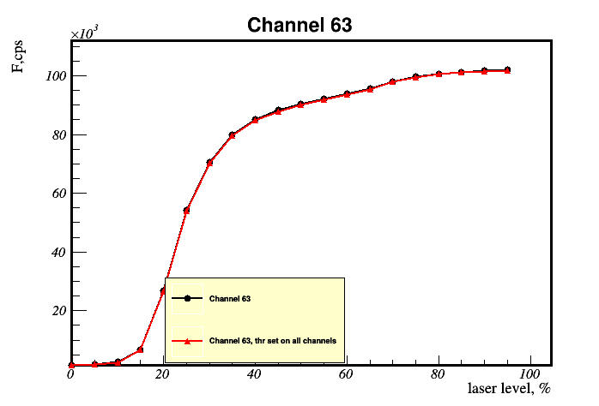
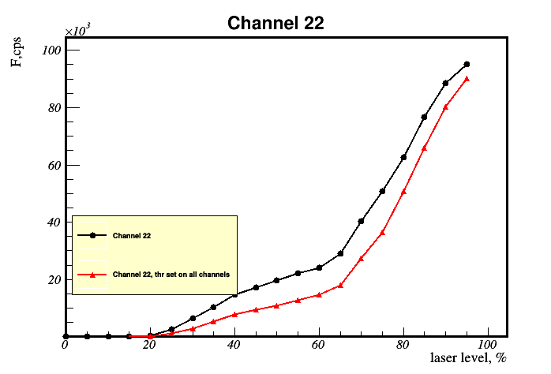
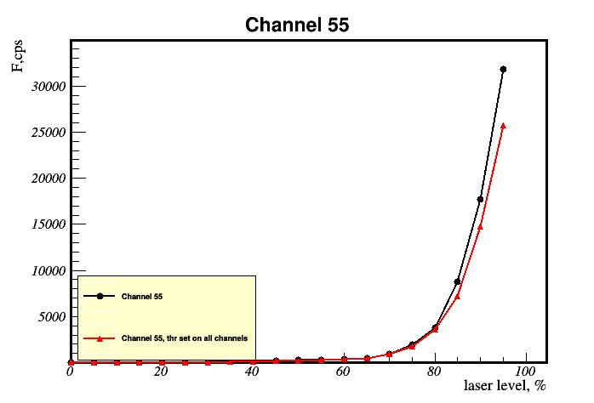
Pulsed laser illumination: intensity scan
Illuminated anode
During illumination intensity scans there were problems with HV power source interference and external light leaks.

Slide 18
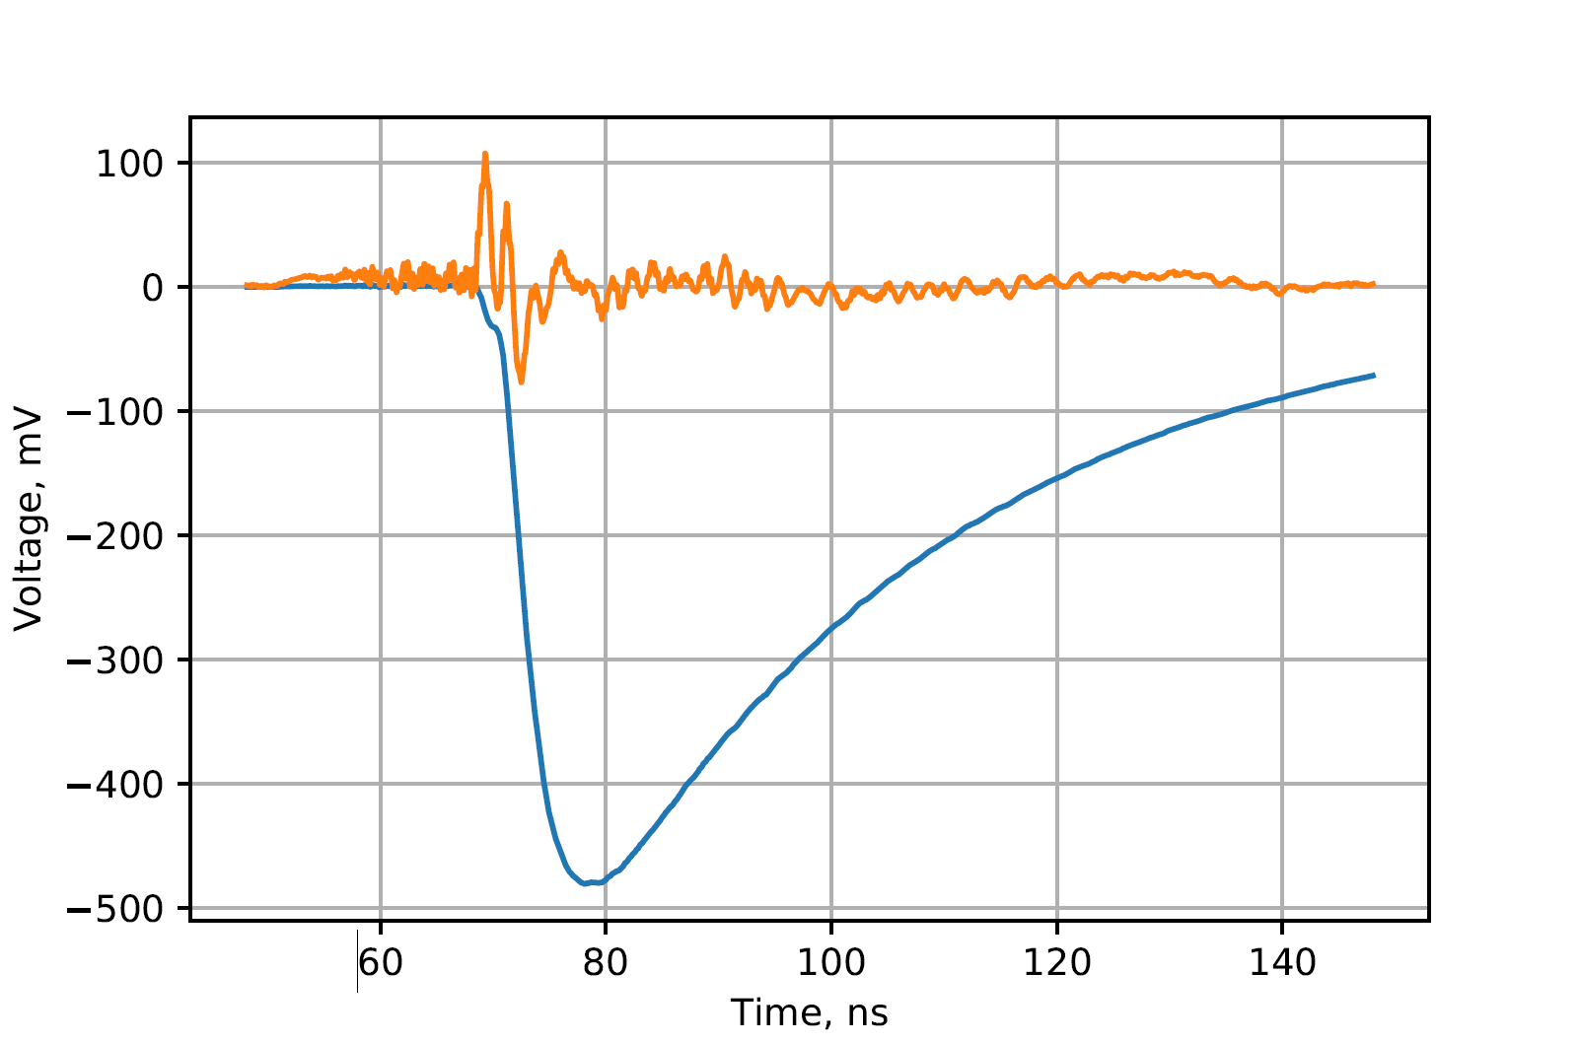
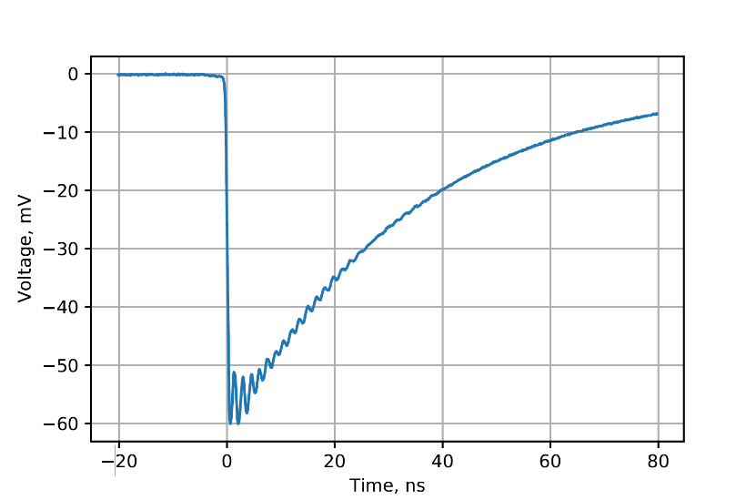
Signal and crosstalk averaged waveforms
Pulsed illumination from a laser
Light source: PiLas PiL051x, 510nm, Δt<140 ps
Oscilloscope: Keysight MSOX6004A, 6 GHz BW with differential active probe N2752A, 6 GHz BW
Signal viewed directly on illuminated anode, CT viewed on a distant anode
All anodes connected to PADIWA
CTx10
Signal
Single photon pulse
(very sharp rise time)
Signal amplitude is ~9 p.e.
CT amplitude is about 2% of signal
CT negative swing is delayed by a few ns w.r.t. signal at the same voltage level.

Slide 19
Bandwidth filtering by oscilloscope
Signal
Crosstalk
Filtering helps to suppress CT but at the cost of increasing signal rise time and worse timing resolution (not measured but should be at worst proportional to rise time).
Still viable option to explore in case of a high intensity particle background in PANDA (should be simulated).

Slide 20
Conclusion and outlook
First test beam with a dedicated FRICH prototype was carried out on 3-4 June 2018. 5 different aerogel radiators are tested. Analysis is in progress.
Gained experience with TRB3 & PADIWA electronics but more to learn with DiRICH FEE.
High hit multiplicity events were observed that clutter the ring pattern. Origin is believed to be coincidences with beam particles hitting MaPMT directly. May be a problem for high intensity mode in the real experiment. Should be studied with MC.
DiRICH is expected to be delivered in a week or so. Original plans were to buy it in May but better than nothing.

