Slide 1
Barrel DIRC Installation
Andreas Gerhardt
PANDA Collaboration Meeting 18/3
Darmstadt, 2018/11/06

Slide 2
Outline
Barrel DIRC Main Components
Installation Procedure Radiator Barrel
Installation Procedure Readout Unit
Intervention Procedures
Summary & Outlook
Andreas Gerhardt – PANDA CM 18/3

Slide 3
Barrel DIRC Main Components
Readout Unit
Internal radius 448mm
External radius 1080mm
Total weight ≈ 500kg
Radiator Barrel (SciTil Support)
Internal radius 448mm
External radius 538mm
Total weight ≈ 400kg
Andreas Gerhardt – PANDA CM 18/3

Slide 4
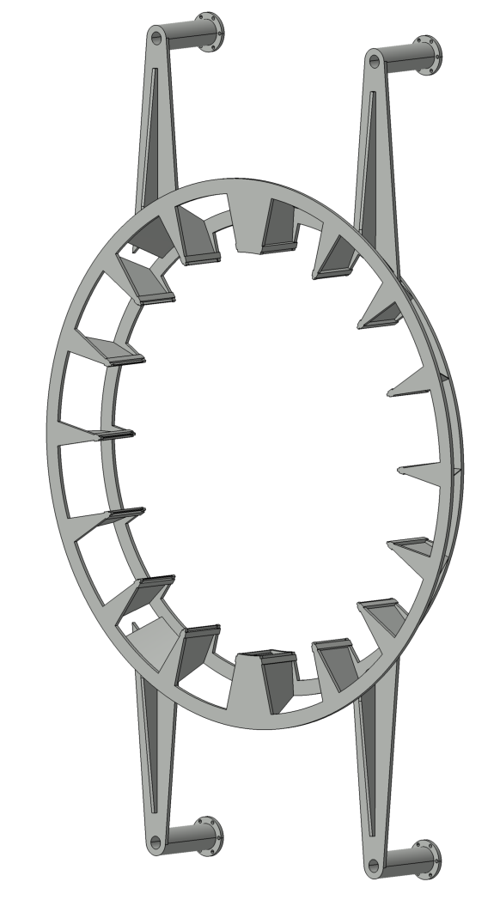
Barrel DIRC Main Components – Readout Unit
1X Readout Unit Support Ring
Aluminum alloy
Total weight ≈ 20-25kg
Andreas Gerhardt – PANDA CM 18/3

Slide 5
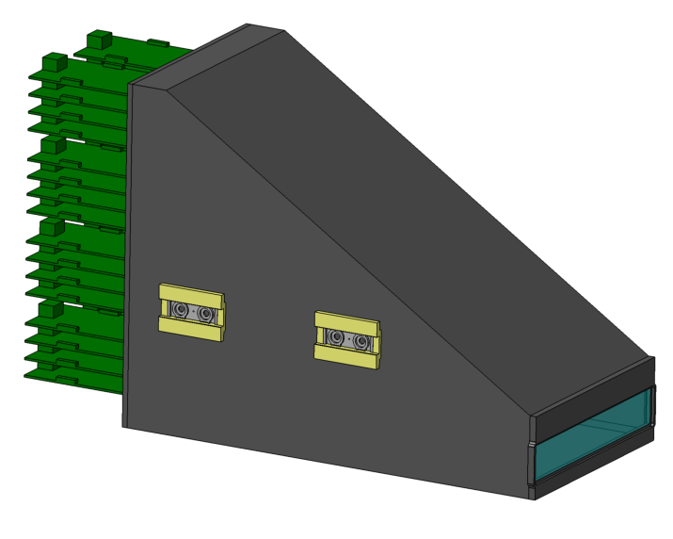
Barrel DIRC Main Components – Readout Unit
16X Prism Box including
FEE
MCP-PMTs
Synthetic fused silica prism
Coupling flange
Linear unit
Total weight of one box ≈ 18-20kg
Andreas Gerhardt – PANDA CM 18/3

Slide 6
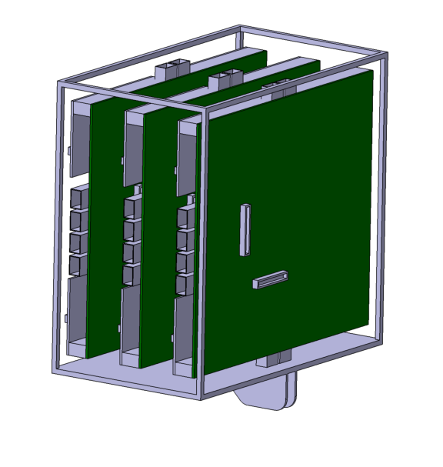
Barrel DIRC Main Components – Readout Unit
Sub-Racks including
TRBs
CTS
Network switches
etc.
Andreas Gerhardt – PANDA CM 18/3

Slide 7
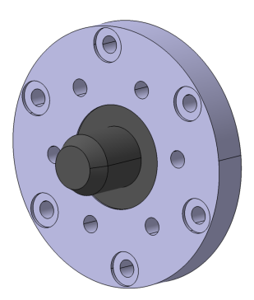
Barrel DIRC Main Components – Readout Unit
4X Centering Flange
Each centering flange is attached to the cryostat upsteam flange to allow easy installation and enable alignment of the support ring.
Andreas Gerhardt – PANDA CM 18/3

Slide 8
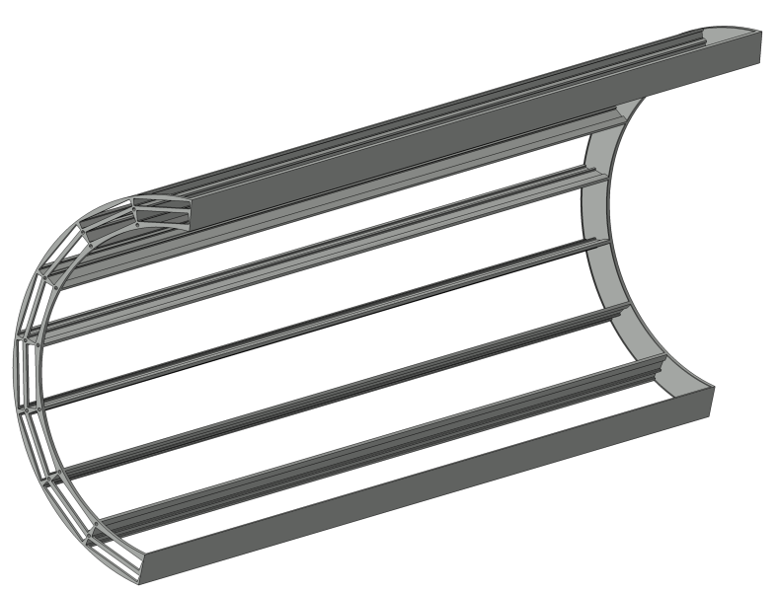
Barrel DIRC Main Components – Radiator Barrel
2X Radiator Barrel Support Frame
Extruded aluminum profiles and half rings
Andreas Gerhardt – PANDA CM 18/3

Slide 9
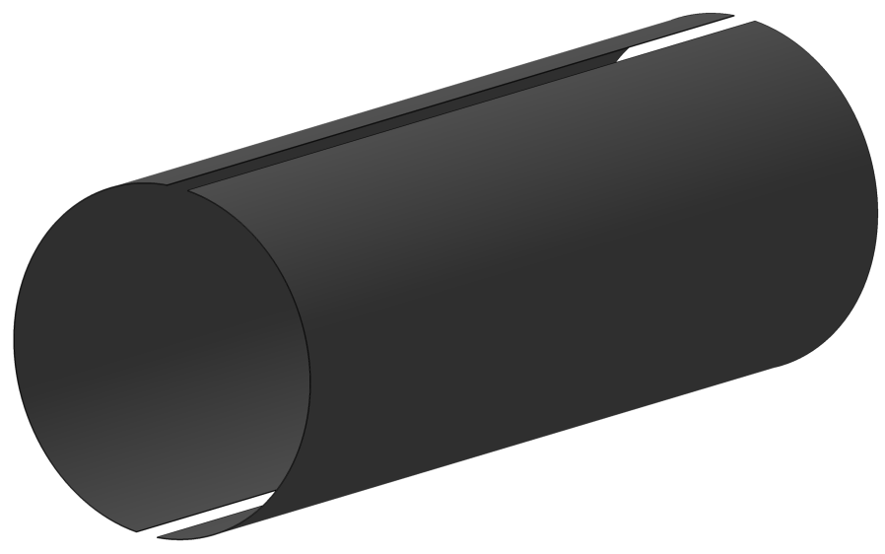
Barrel DIRC Main Components – Radiator Barrel
2X Inner Sheets
To reach a high stiffness of the frame
Thickness 1-2 mm
Andreas Gerhardt – PANDA CM 18/3

Slide 10
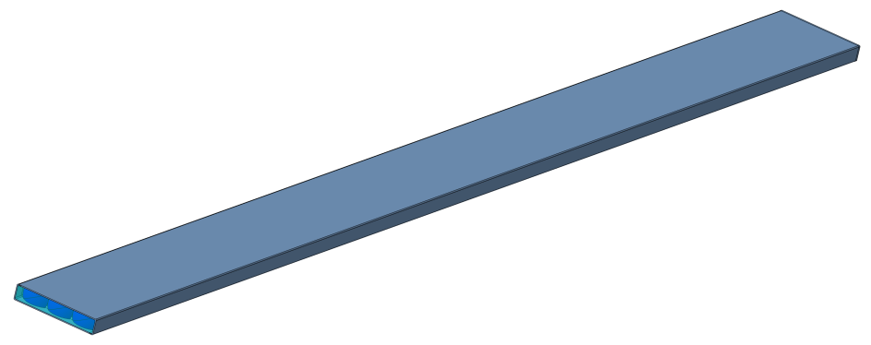
Barrel DIRC Main Components – Radiator Barrel
16X Bar Box including
Radiator bars
Spring-loaded mirrors
Block of spherical lenses
Total weight of one box ≈ 20kg
Andreas Gerhardt – PANDA CM 18/3

Slide 11
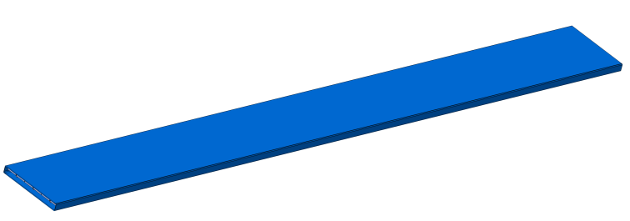
Barrel DIRC Main Components – Radiator Barrel
16X SciTil Box including
SciTil super module
Andreas Gerhardt – PANDA CM 18/3

Slide 12
Barrel DIRC Main Components – Radiator Barrel
2X Outer Sheets
To reach a high stiffness of the frame
Thickness 1-2 mm
Andreas Gerhardt – PANDA CM 18/3

Slide 13
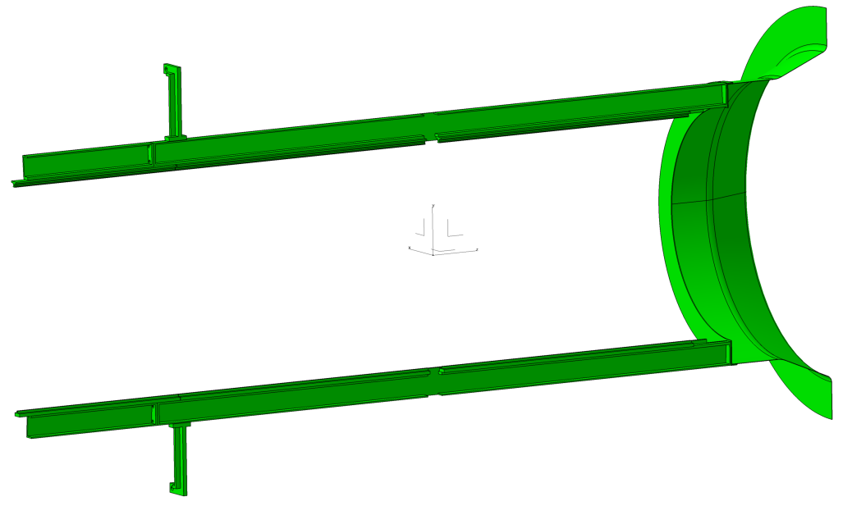
Installation Procedure Radiator Barrel
Radiator barrel attachment structure
downstream cone
central tracker beams
Andreas Gerhardt – PANDA CM 18/3

Slide 14
Installation Procedure Radiator Barrel
Option A – Installation of the two half-cylindrical frames:
half frame with inner and outer sheet
Andreas Gerhardt – PANDA CM 18/3

Slide 15
Installation Procedure Radiator Barrel
Option A – Installation of the two half-cylindrical frames:
half frame with inner and outer sheet
Andreas Gerhardt – PANDA CM 18/3

Slide 16
Installation Procedure Radiator Barrel
Option A – Installation of the two half-cylindrical frames:
half frame with inner and outer sheet
Andreas Gerhardt – PANDA CM 18/3

Slide 17
Installation Procedure Radiator Barrel
Option A – Installation of the two half-cylindrical frames:
Access to the central tracker beams and the upstream cone is needed to mount the frames.
half frame with inner and outer sheet
Andreas Gerhardt – PANDA CM 18/3

Slide 18
Installation Procedure Radiator Barrel
Option B – Installation of the whole barrel frame:
whole barrel support frame preassembled on central tracker beams
Andreas Gerhardt – PANDA CM 18/3

Slide 19
Installation Procedure Radiator Barrel
Option B – Installation of the whole barrel frame:
whole barrel support frame preassembled on central tracker beams
Andreas Gerhardt – PANDA CM 18/3

Slide 20
Installation Procedure Radiator Barrel
Option B – Installation of the whole barrel frame:
whole barrel support frame preassembled on central tracker beams
Andreas Gerhardt – PANDA CM 18/3

Slide 21
Installation Procedure Radiator Barrel
Option B – Installation of the whole barrel frame:
No access inside the barrel needed to mount the frames. Central tracker beams can be integrated in the radiator barrel.
whole barrel support frame preassembled on central tracker beams
Andreas Gerhardt – PANDA CM 18/3

Slide 22
Installation Procedure Radiator Barrel
SciTil installation:
Installation of 16 boxes one by one.
SciTil box
Andreas Gerhardt – PANDA CM 18/3

Slide 23
Installation Procedure Radiator Barrel
SciTil installation:
Installation of 16 boxes one by one.
SciTil box
Andreas Gerhardt – PANDA CM 18/3

Slide 24
Installation Procedure Radiator Barrel
SciTil installation:
Installation of 16 boxes one by one.
SciTil box
Andreas Gerhardt – PANDA CM 18/3

Slide 25
Installation Procedure Radiator Barrel
SciTil installation:
Installation of 16 boxes one by one.
SciTil box
Andreas Gerhardt – PANDA CM 18/3

Slide 26
Installation Procedure Radiator Barrel
SciTil installation:
Installation of 16 boxes one by one.
Andreas Gerhardt – PANDA CM 18/3

Slide 27
Installation Procedure Radiator Barrel
Bar box installation:
Installation of 16 boxes one by one.
bar box
Andreas Gerhardt – PANDA CM 18/3

Slide 28
Installation Procedure Radiator Barrel
Bar box installation:
Installation of 16 boxes one by one.
bar box
Andreas Gerhardt – PANDA CM 18/3

Slide 29
Installation Procedure Radiator Barrel
Bar box installation:
Installation of 16 boxes one by one.
bar box
Andreas Gerhardt – PANDA CM 18/3

Slide 30
Installation Procedure Radiator Barrel
Bar box installation:
Installation of 16 boxes one by one.
bar box
Andreas Gerhardt – PANDA CM 18/3

Slide 31
Installation Procedure Radiator Barrel
Bar box installation:
Installation of 16 boxes one by one.
Andreas Gerhardt – PANDA CM 18/3

Slide 32
Installation Procedure Readout Unit
centering flange
readout frame
cryostat upstream flange
centering flange
Andreas Gerhardt – PANDA CM 18/3

Slide 33
Installation Procedure Readout Unit
centering flange
readout frame
cryostat upstream flange
centering flange
Andreas Gerhardt – PANDA CM 18/3

Slide 34
Installation Procedure Readout Unit
centering flange
readout frame
Readout frame is attached and aligned before entering the prism boxes.
cryostat upstream flange
centering flange
Andreas Gerhardt – PANDA CM 18/3

Slide 35
Installation Procedure Readout Unit
linear unit
prism box
Installation of 16 prism boxes one by one.
Andreas Gerhardt – PANDA CM 18/3

Slide 36
Installation Procedure Readout Unit
linear unit
prism box
Installation of 16 prism boxes one by one.
Andreas Gerhardt – PANDA CM 18/3

Slide 37
Installation Procedure Readout Unit
linear unit
prism box
Installation of 16 prism boxes one by one.
Andreas Gerhardt – PANDA CM 18/3

Slide 38
Installation Procedure Readout Unit
Installation of 16 prism boxes one by one.
Andreas Gerhardt – PANDA CM 18/3

Slide 39
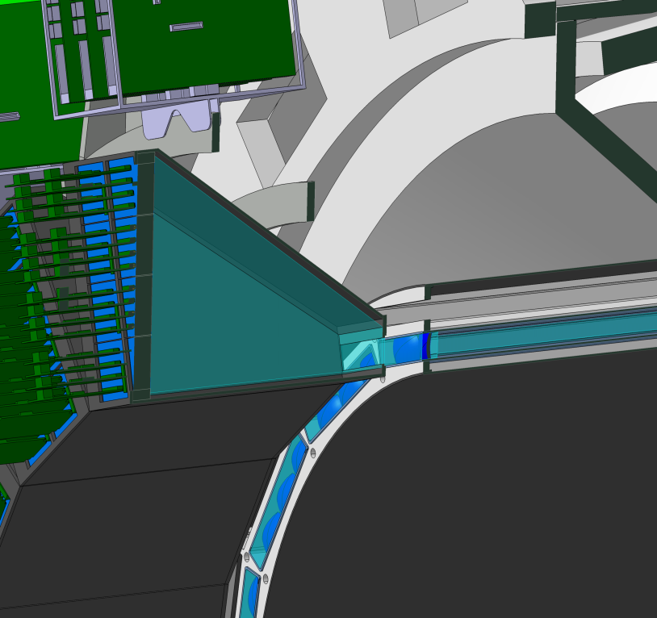
Installation Procedure Readout Unit
prism box
bar box
Gap of 3-4 cm to allow a step by step coupling process of each prism box and bar box.
Andreas Gerhardt – PANDA CM 18/3

Slide 40
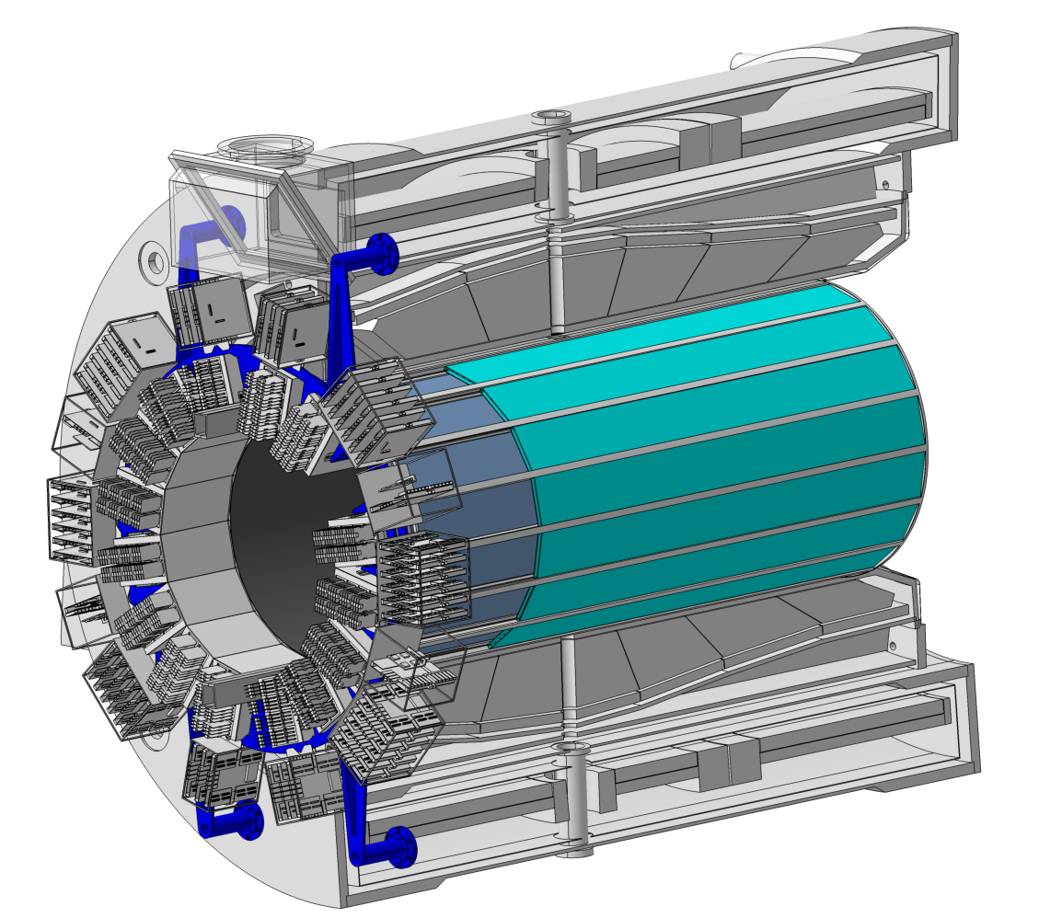
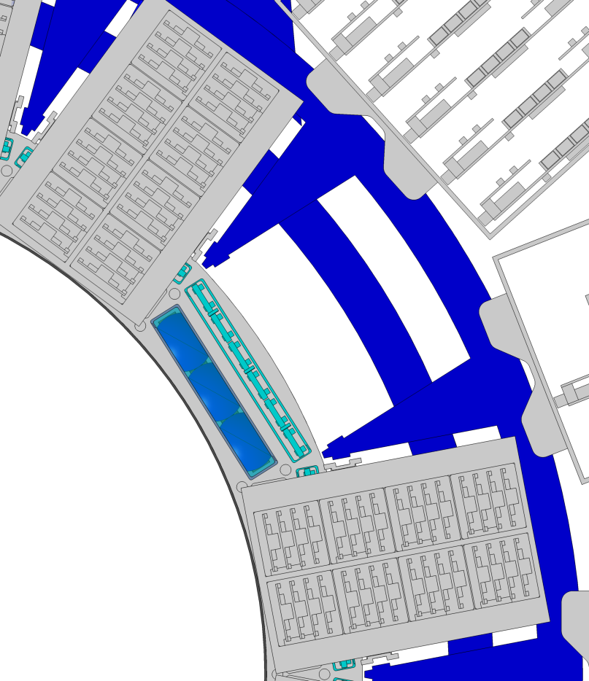
Intervention Procedures
Intervention procedure to exchange single components, electronics, etc. ...
SciTil box
readout frame
barrel frame
bar box
Andreas Gerhardt – PANDA CM 18/3

Slide 41
Intervention Procedures
An exchange of one single bar box or SciTil box is possible without removing the whole readout unit.
prism box
SciTil box
bar box
Andreas Gerhardt – PANDA CM 18/3

Slide 42
Intervention Procedures
An exchange of one single bar box or SciTil box is possible without removing the whole readout unit.
prism box
SciTil box
bar box
Andreas Gerhardt – PANDA CM 18/3

Slide 43
Intervention Procedures
An exchange of one single bar box or SciTil box is possible without removing the whole readout unit.
prism box
SciTil box
bar box
Andreas Gerhardt – PANDA CM 18/3

Slide 44
Intervention Procedures
An exchange of one single bar box or SciTil box is possible without removing the whole readout unit.
prism box
SciTil box
bar box
Andreas Gerhardt – PANDA CM 18/3

Slide 45
Intervention Procedures
An exchange of one single bar box or SciTil box is possible without removing the whole readout unit.
prism box
SciTil box
bar box
Andreas Gerhardt – PANDA CM 18/3

Slide 46
Intervention Procedures
An exchange of one single bar box or SciTil box is possible without removing the whole readout unit.
prism box
SciTil box
bar box
Andreas Gerhardt – PANDA CM 18/3

Slide 47
Intervention Procedures
An exchange of one single bar box or SciTil box is possible without removing the whole readout unit.
prism box
SciTil box
bar box
Andreas Gerhardt – PANDA CM 18/3

Slide 48
Intervention Procedures
An exchange of one single bar box or SciTil box is possible without removing the whole readout unit.
prism box
SciTil box
bar box
Andreas Gerhardt – PANDA CM 18/3

Slide 49
Intervention Procedures
An exchange of one single bar box or SciTil box is possible without removing the whole readout unit.
prism box
SciTil box
bar box
Andreas Gerhardt – PANDA CM 18/3

Slide 50
Intervention Procedures
An exchange of one single bar box or SciTil box is possible without removing the whole readout unit.
prism box
SciTil box
bar box
Andreas Gerhardt – PANDA CM 18/3

Slide 51
Summary & Outlook
Many things are in progress at the moment (DIRICH backplane ordered, coupling tests in progress, outgassing tests for screening materials start soon).
We need to define and confirm an installation procedure to start with the production design.
Andreas Gerhardt – PANDA CM 18/3

