Slide 1

Prospects
for the study of baryon-rich matter
at new facilities
Volker Friese
Helmholtzzentrum für Schwerionenforschung
Darmstadt, Germany
CPOD 2018
Corfu, 27 September 2018

Slide 2
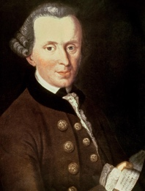

Metaphysics
NUSTAR
CBM
PANDA
I. What can we know?
Atomic Physics
Biophysics
Plasma Physics
Material research

Slide 3

Current research centres in high-density heavy-ion physics
NUSTAR
CBM
PANDA
GSI: HADES
Atomic Physics
CERN: NA61
BNL: STAR
Biophysics
Plasma Physics
Material research

Slide 4
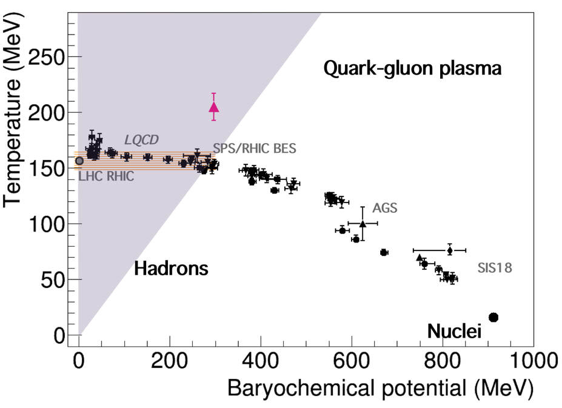
Current research centres in high-density heavy-ion physics
Compilation by T. Galatyuk, QM 2018
NUSTAR
CBM
Atomic Physics
We try to probe QCD matter with heavy-ion collisions.
The main control parameter is the collision energy.
Systematic investigations (“scans”): NA49 (1999-2002), STAR (2010-today), NA61
An impressive plenitude of data was obtained, but basic questions remain to be solved:
  Is there a critical point?
  Is there a chiral / deconfinement phase transition?
  What is the nuclear equation of state?
Biophysics
Plasma Physics
Material research

Slide 5
Current research centres in high-density heavy-ion physics
Compilation by T. Galatyuk, QM 2018
NUSTAR
CBM
Atomic Physics
These questions will be addressed by running experiments - but also by new, dedicated facilities and experiments.
Punch line is, coverage of the entire energy range - and statistics:
  precision measurements;
  systematic measurements;
  extending the menu of currently addressable observables.
Biophysics
Plasma Physics
Material research

Slide 6
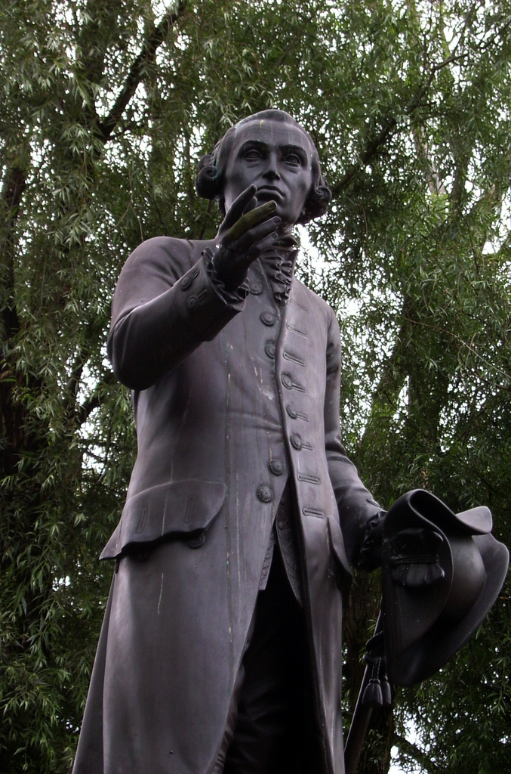
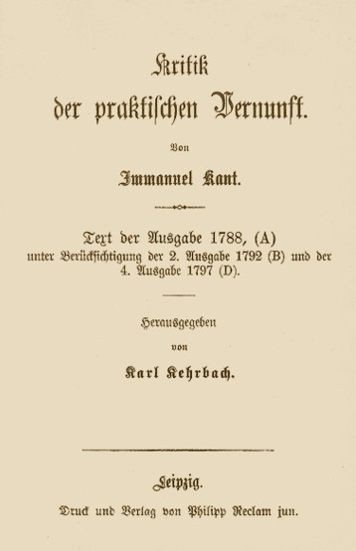
Ethics
NUSTAR
CBM
PANDA
II. What shall we do?
Atomic Physics
Biophysics
Plasma Physics
Material research

Slide 7
Future research centres in high-density heavy-ion physics
NUSTAR
CBM
PANDA
NICA
FAIR
Atomic Physics
J-PARC-HI
HIAF
Biophysics
Plasma Physics
Material research

Slide 8
NICA
NUSTAR
CBM
PANDA
Nuclotron-based Ion Collider Facility, Dubna, Russia
Atomic Physics
Biophysics
Plasma Physics
Material research

Slide 9
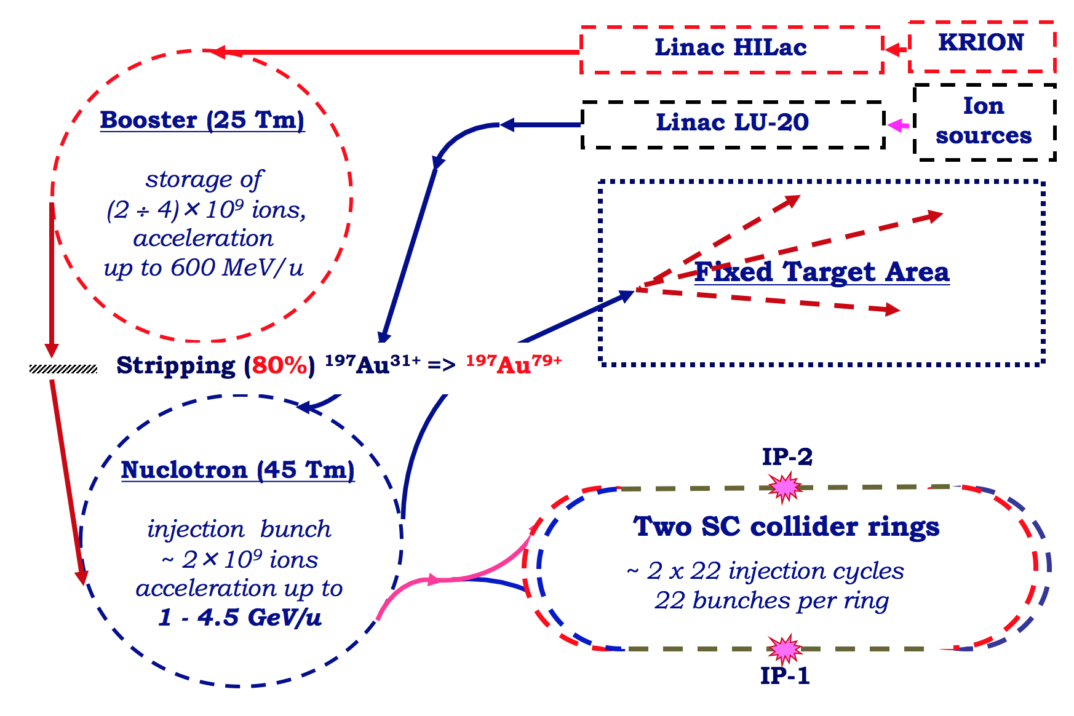
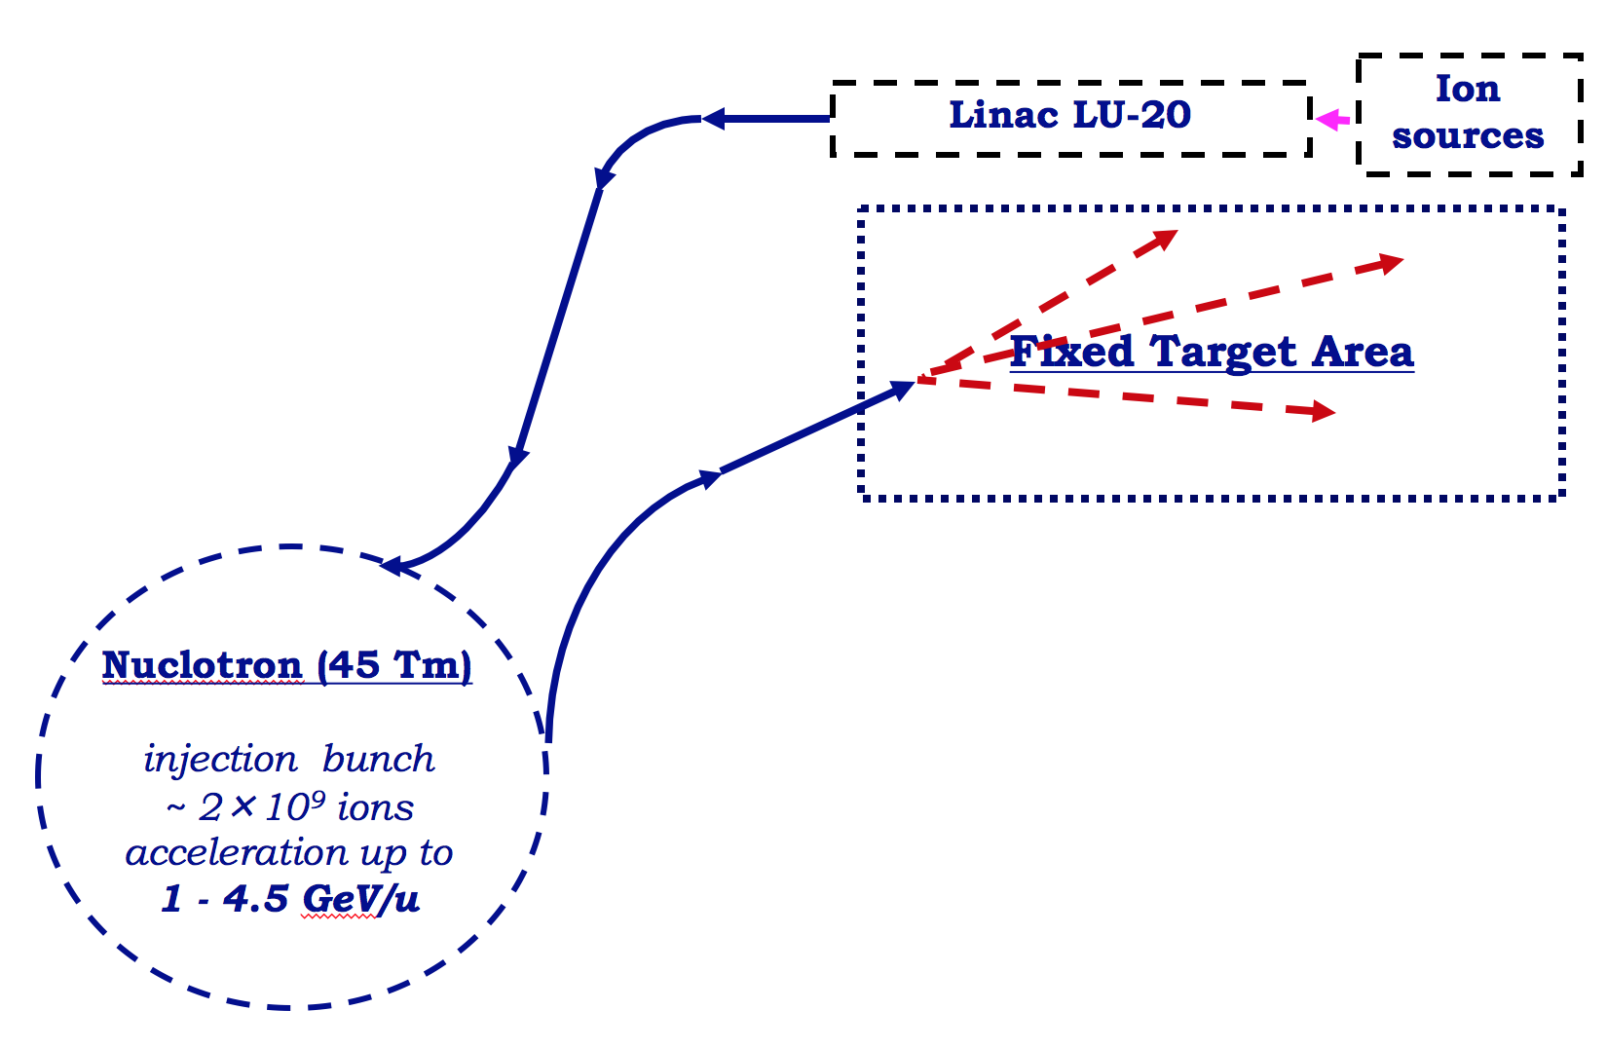
NICA - acceleration scheme
New: LINAC, booster, collider (U = 500 m)
Slow extraction to fixed-target:
E_{beam, kin} = 1 - 4.5 GeV/u
(Au)
Intensity 10⁹ ions/spill
Collider:
  up to 5.5 + 5.5 GeV
  (Au + Au)
  luminosity 10²⁷ cm⁻² s⁻¹
  at top energy
V. Kekelidze, QM 2018

Slide 10

NICA
V. Kekelidze, QM 2018

Slide 11
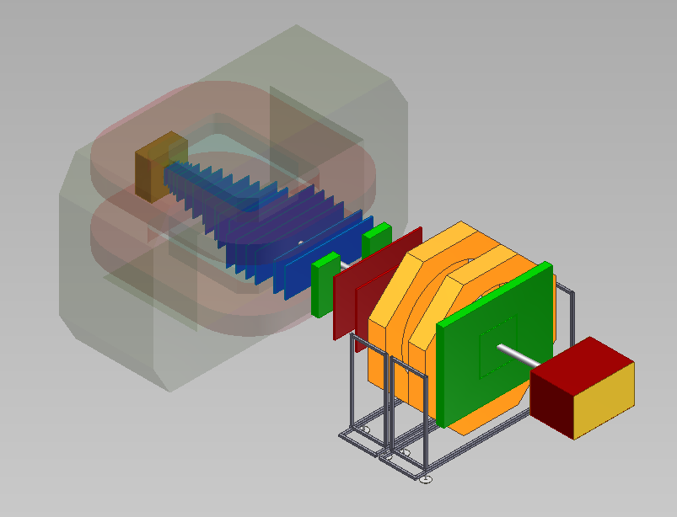
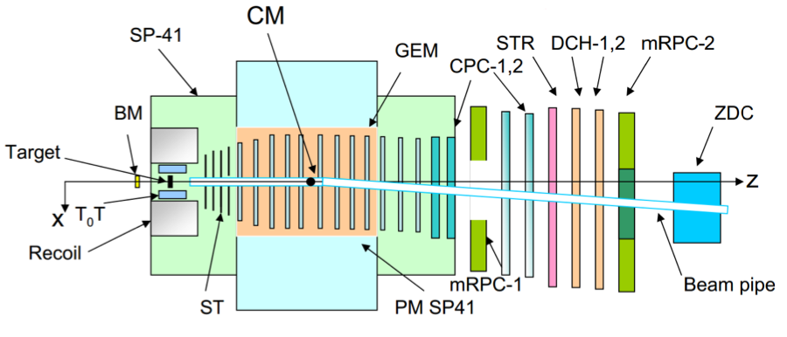
BM@N
Baryonic Matter @ Nuclotron
courtesy M. Kapishin
Fixed-target, forward hadron spectrometer
Large-aperture magnet filled with radiation-hard tracking devices (GEM / Si)
Hadron ID by time-of-flight (RPC)
Forward calorimeter
Already in operation with light beams (up to Kr²⁶⁺)
Au + Au in 2020 with 10 kHz interaction rate
2021: upgrade with Si trackers (CBM); increase interaction rate to 50 kHz

Slide 12

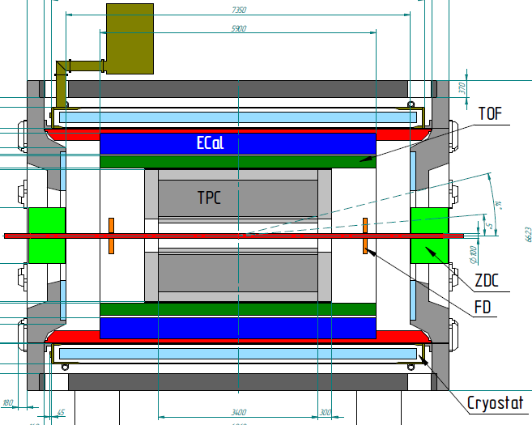
The MPD experiment
Multi Purpose Detector
V. Kekelidze, QM 2018
Stage 1 (2020):
  barrel-type collider experiment ( |η| < 1.2 for TPC+TOF )
  hadron + electron identification, calorimetry
  forward calorimeter for centrality and event plane
Stage 2 (2023):
  endcap (increase acceptance)
  Inner tracking system (charm)

Slide 13
NICA: status
courtesy M. Kapishin
Civil construction well progressed and in schedule
MPD hall ready for installation in 2019
MPD detectors in production
Start of data taking 2021

Slide 14
NICA
NUSTAR
CBM
PANDA
Atomic Physics
For more details, see talk by M. Kapishin, today, 11:00
Biophysics
Plasma Physics
Material research

Slide 15
FAIR
NUSTAR
CBM
PANDA
Facility for Anti-Proton and Ion Research, Darmstadt, Germany
Atomic Physics
Biophysics
Plasma Physics
Material research

Slide 16
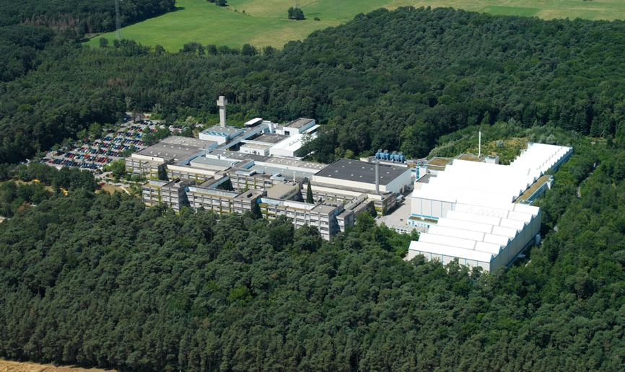
GSI
Main Facilities:
Linear Accelerator
Heavy-Ion Synchrotron
Fragment Separator
Experimental Storage Ring
UNILAC
SIS-18
FRS
ESR
GSI Helmholtzzentrum für Schwerionenforschung mbH
Founded 1969
About 1,400 employees (750 scientific staff)
About 1,200 external scientists
Heavy-ion Physics
Super-heavy elements
Particle cancer therapy

Slide 17
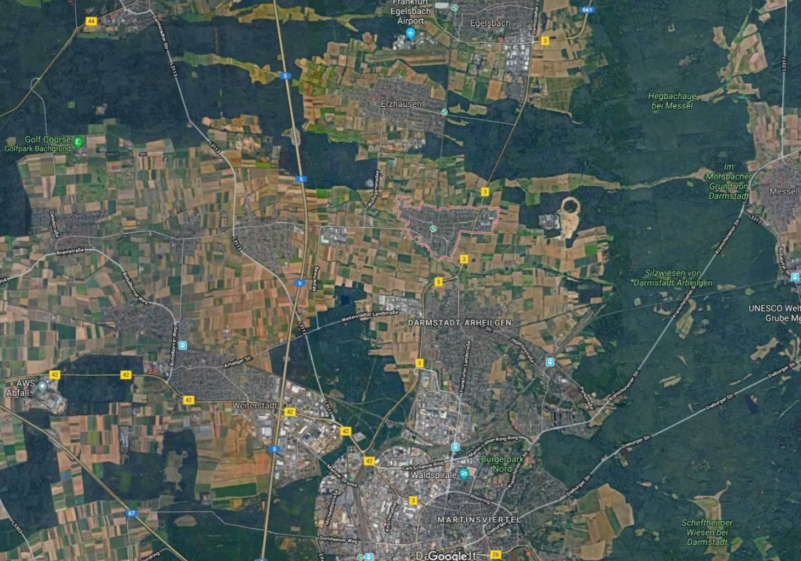
Location

Slide 18

FAIR schematically
p-Linac
SIS18
SIS100/300
S-FRS
HESR
Fully stripped heavy ions up to 11 / 35 GeV/u with 10¹⁰/s
U²⁸⁺ 1.5 GeV/u with 10¹²/s
Protons up to 30 / 90 GeV with 3x10¹³/s
Anti-protons: 1.5 - 11 GeV, 10¹¹/s
Radioactive ion beams up to 2 GeV/u
CR
FAIR phase 1
FAIR phase 2

Slide 19
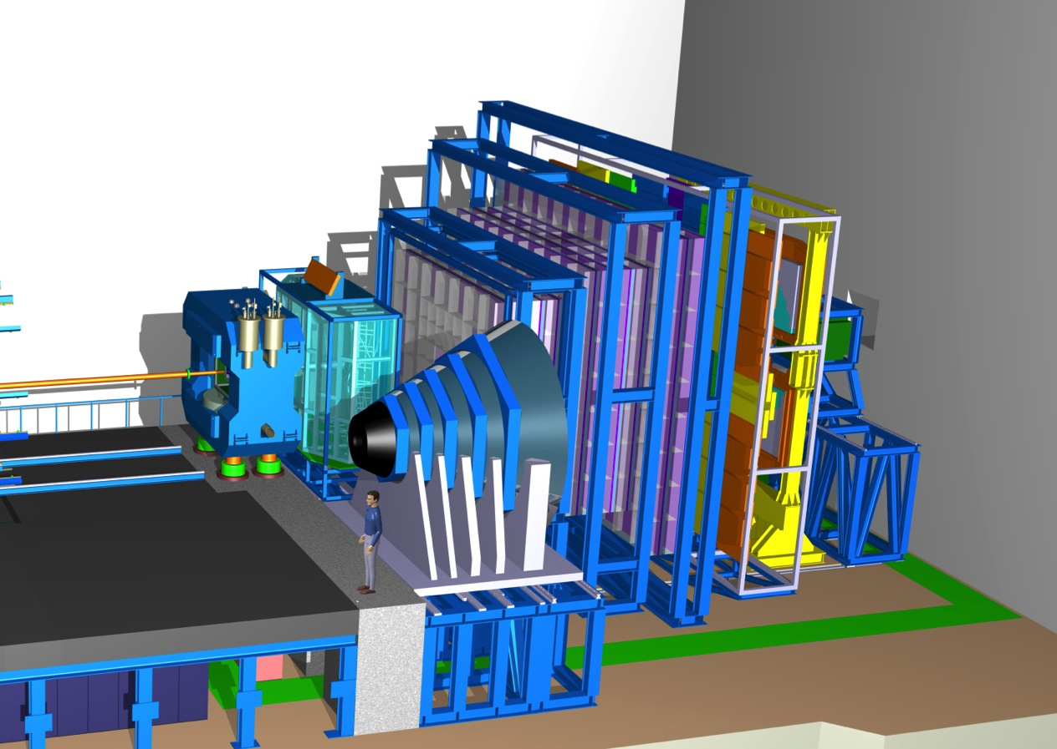
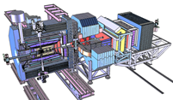
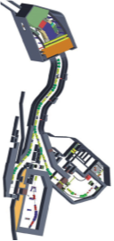
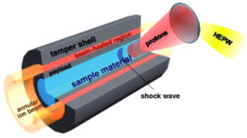
FAIR: Research Programmes
CBM: Nuclear Matter and the QCD-Phase Diagram
(nuclear collisions)
PANDA: Hadron Structure
(p - pbar collisions)
NUSTAR: Nuclear Structure
(rare-isotope beams)
APPA: Atomic and Plasma Physics
(ion and anti-proton beams,
highly bunched beams)

Slide 20
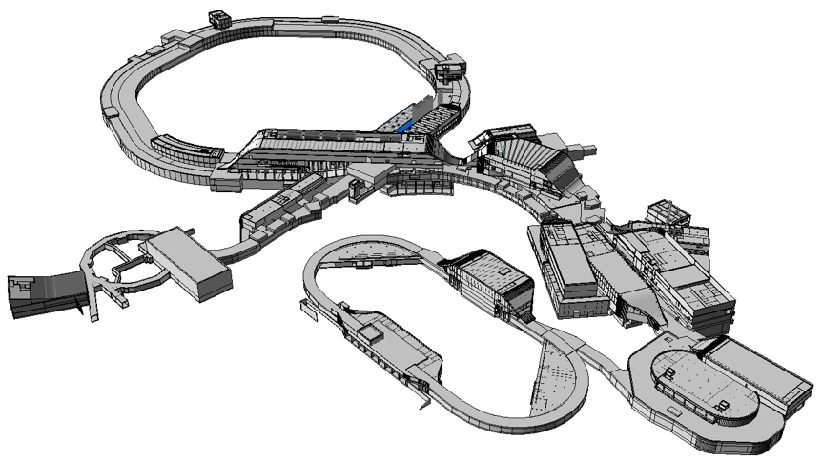
FAIR: Civil Construction
3.2 km beam lines (1.1 km SIS-100)
Total area: 200,000 m²
Area of buildings: 98,000 m²
Volume of buildings: 1,05 Mio. m³
Sub-structure:
1,350 concrete pillars, 60 m deep

Slide 21

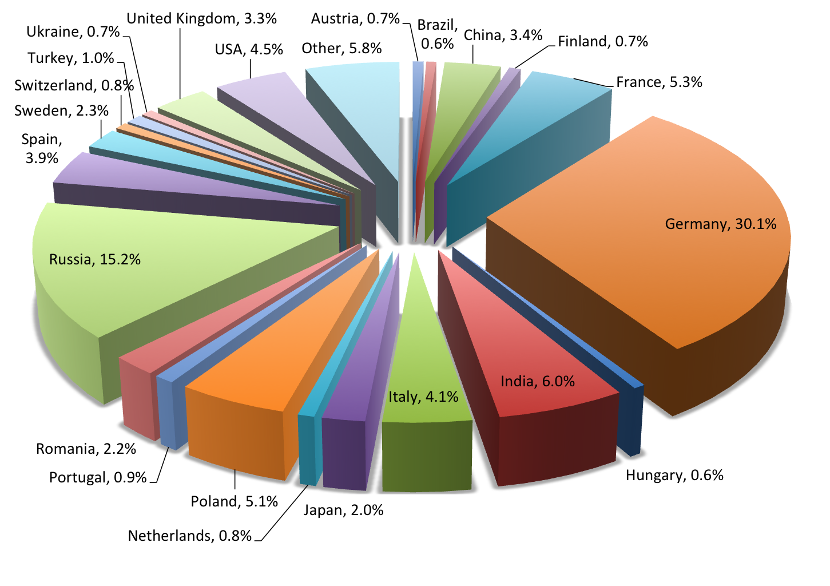
FAIR: some facts
largest current project in fundamental science in Germany
forefront research in nuclear, hadron, atomic, anti-matter, plasma and applied physics.
about 2,500 users
full completion by 2025
total costs: 1.7 Mrd. €
financing:
  FR Germany 60%
  State of Hessen 10%
  International Partners 30%

Slide 22
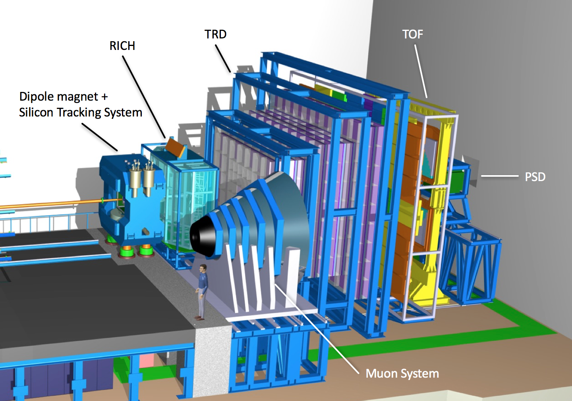
The CBM experiment at FAIR
Fixed-target spectrometer
Hadron, electron and muon ID
Large (central to forward) acceptance
Tracking in dipole field
Electron ID after tracking
Extreme rate capability: up to 10⁷ / s
Trigger-less readout
Event building and selection on CPU in real-time
Now under construction;
Full-system test (mCBM) February 2019
2024 commissioning with SIS-100 beam

Slide 23
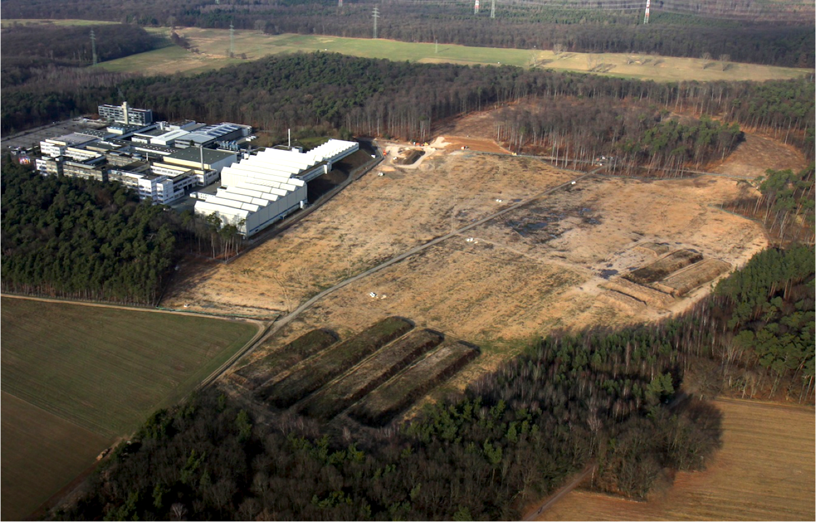
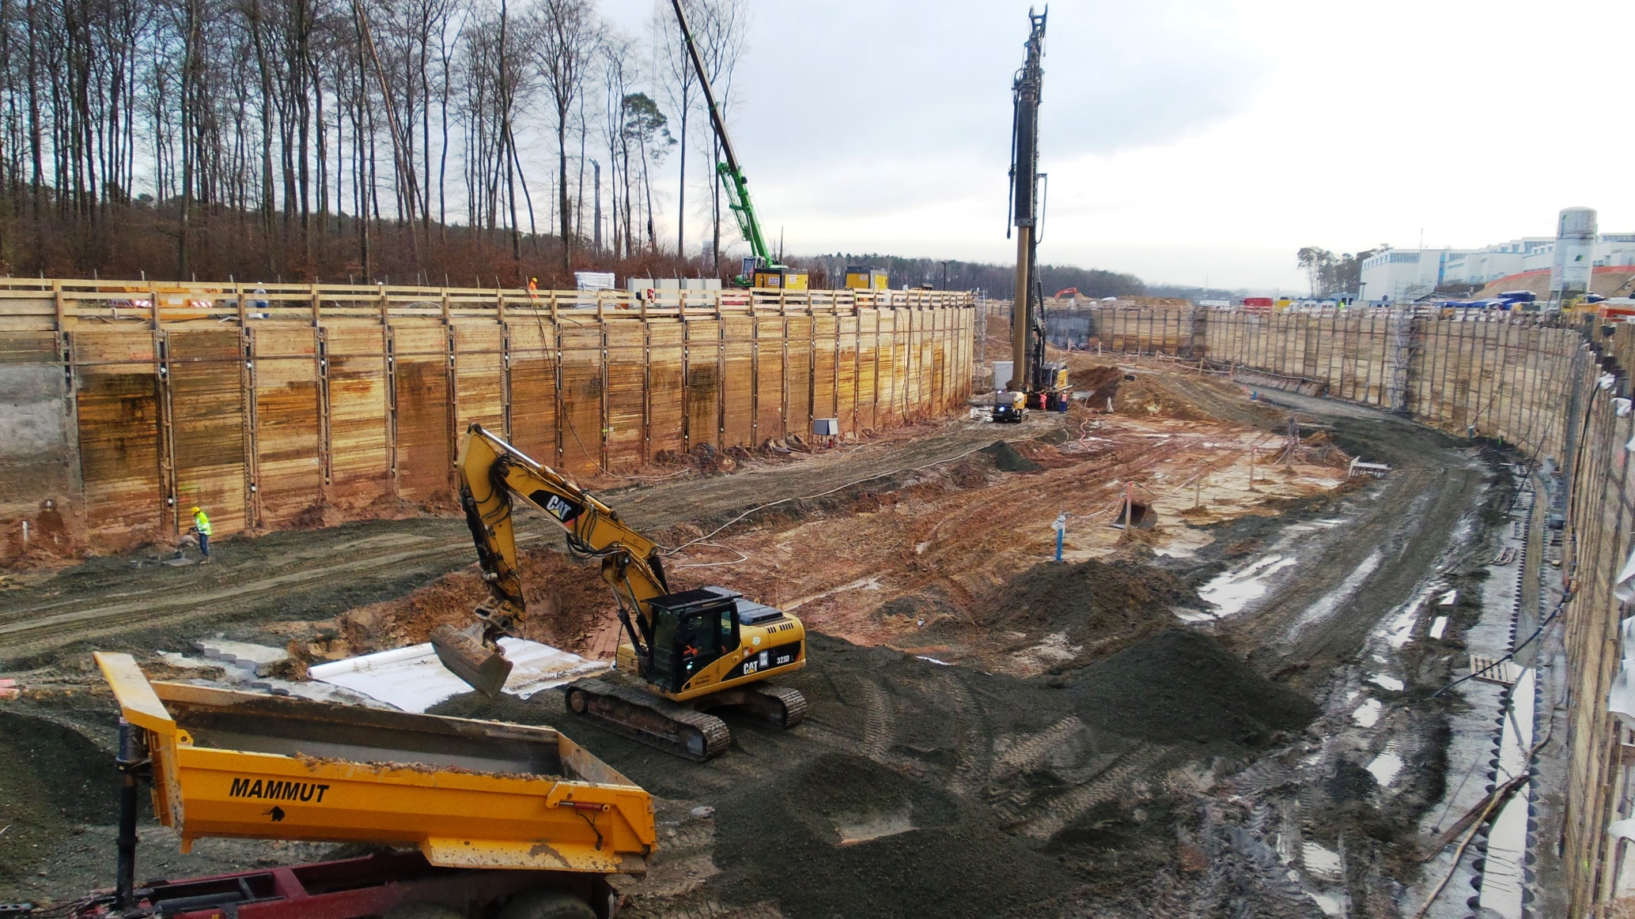
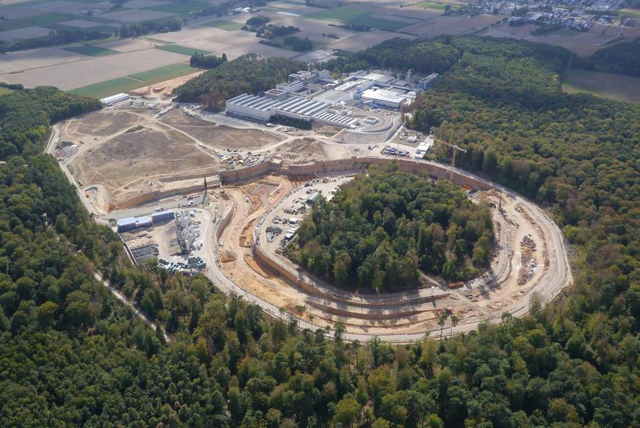
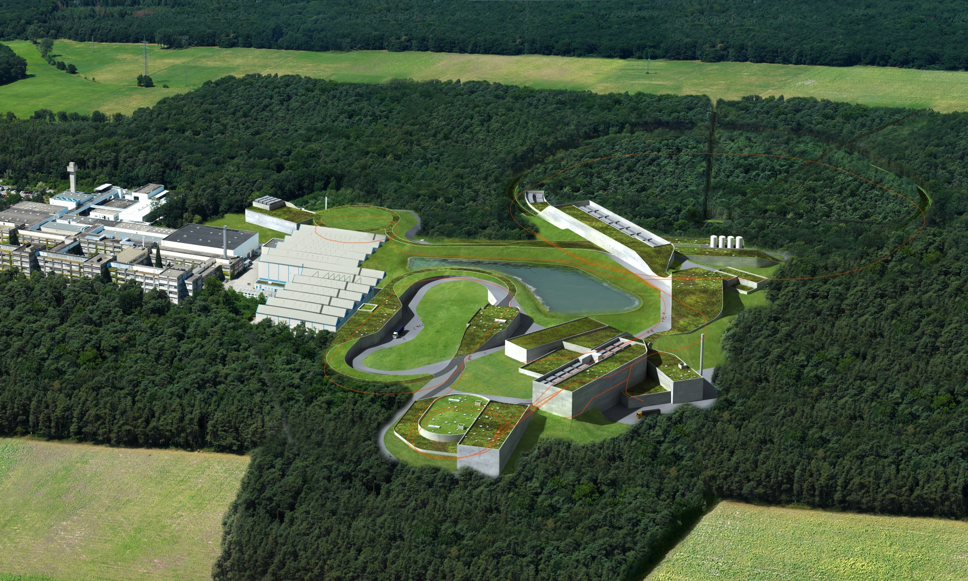
FAIR Timeline
July 2017: Start of excavation and trench sheeting
January 2018: Civil construction north area awarded (SIS tunnel, CBM building)
July 2018: Start of shell construction
2022: Buildings completed
2025: Completion of full facility and start of operations

Slide 24

Work in Progress

Slide 25
HIAF
NUSTAR
CBM
PANDA
Heavy-Ion Accelerator Facility, Huizhou, China
Atomic Physics
Biophysics
Plasma Physics
Material research

Slide 26
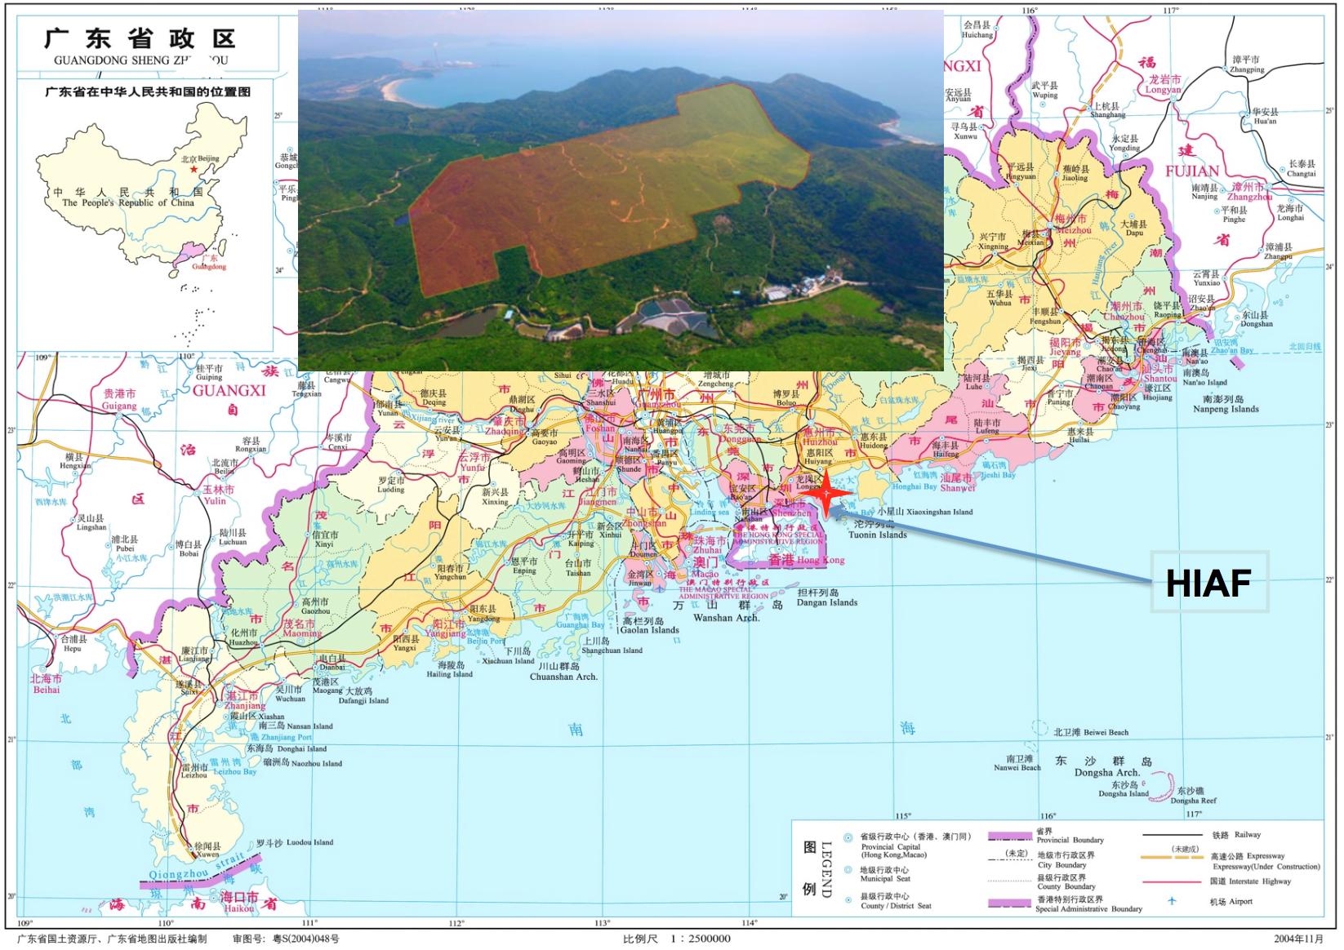
HIAF
Heavy-Ion Accelerator Facility, Huizhou, China
One of the large-scale research facilities in China to boost basic science in the 12th 5-years-plan
(2011-2015)
Approved 2015
Budget: 2.6 B CNY (320 M €)
Start of construction 2018
Start of operation 2024
NUSTAR
CBM
PANDA
Atomic Physics
Biophysics
courtesy N. Xu
Plasma Physics
Material research

Slide 27
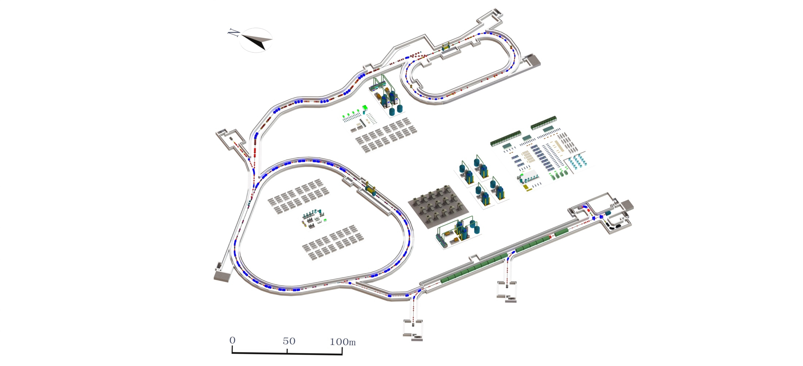
HIAF
SRing
U = 273m; 13 - 15 Tm
High-intensity
extracted beams
(10¹¹ ppp)
NUSTAR
CBM
PANDA
SECR
Atomic Physics
iLinac (SC)
100 m; 22 MeV/u U³⁵⁺
BRing
U = 600m; 34 Tm
0.2 - 0.8 GeV/u
Biophysics
Plasma Physics
Material research
Imp.cas.cn

Slide 28
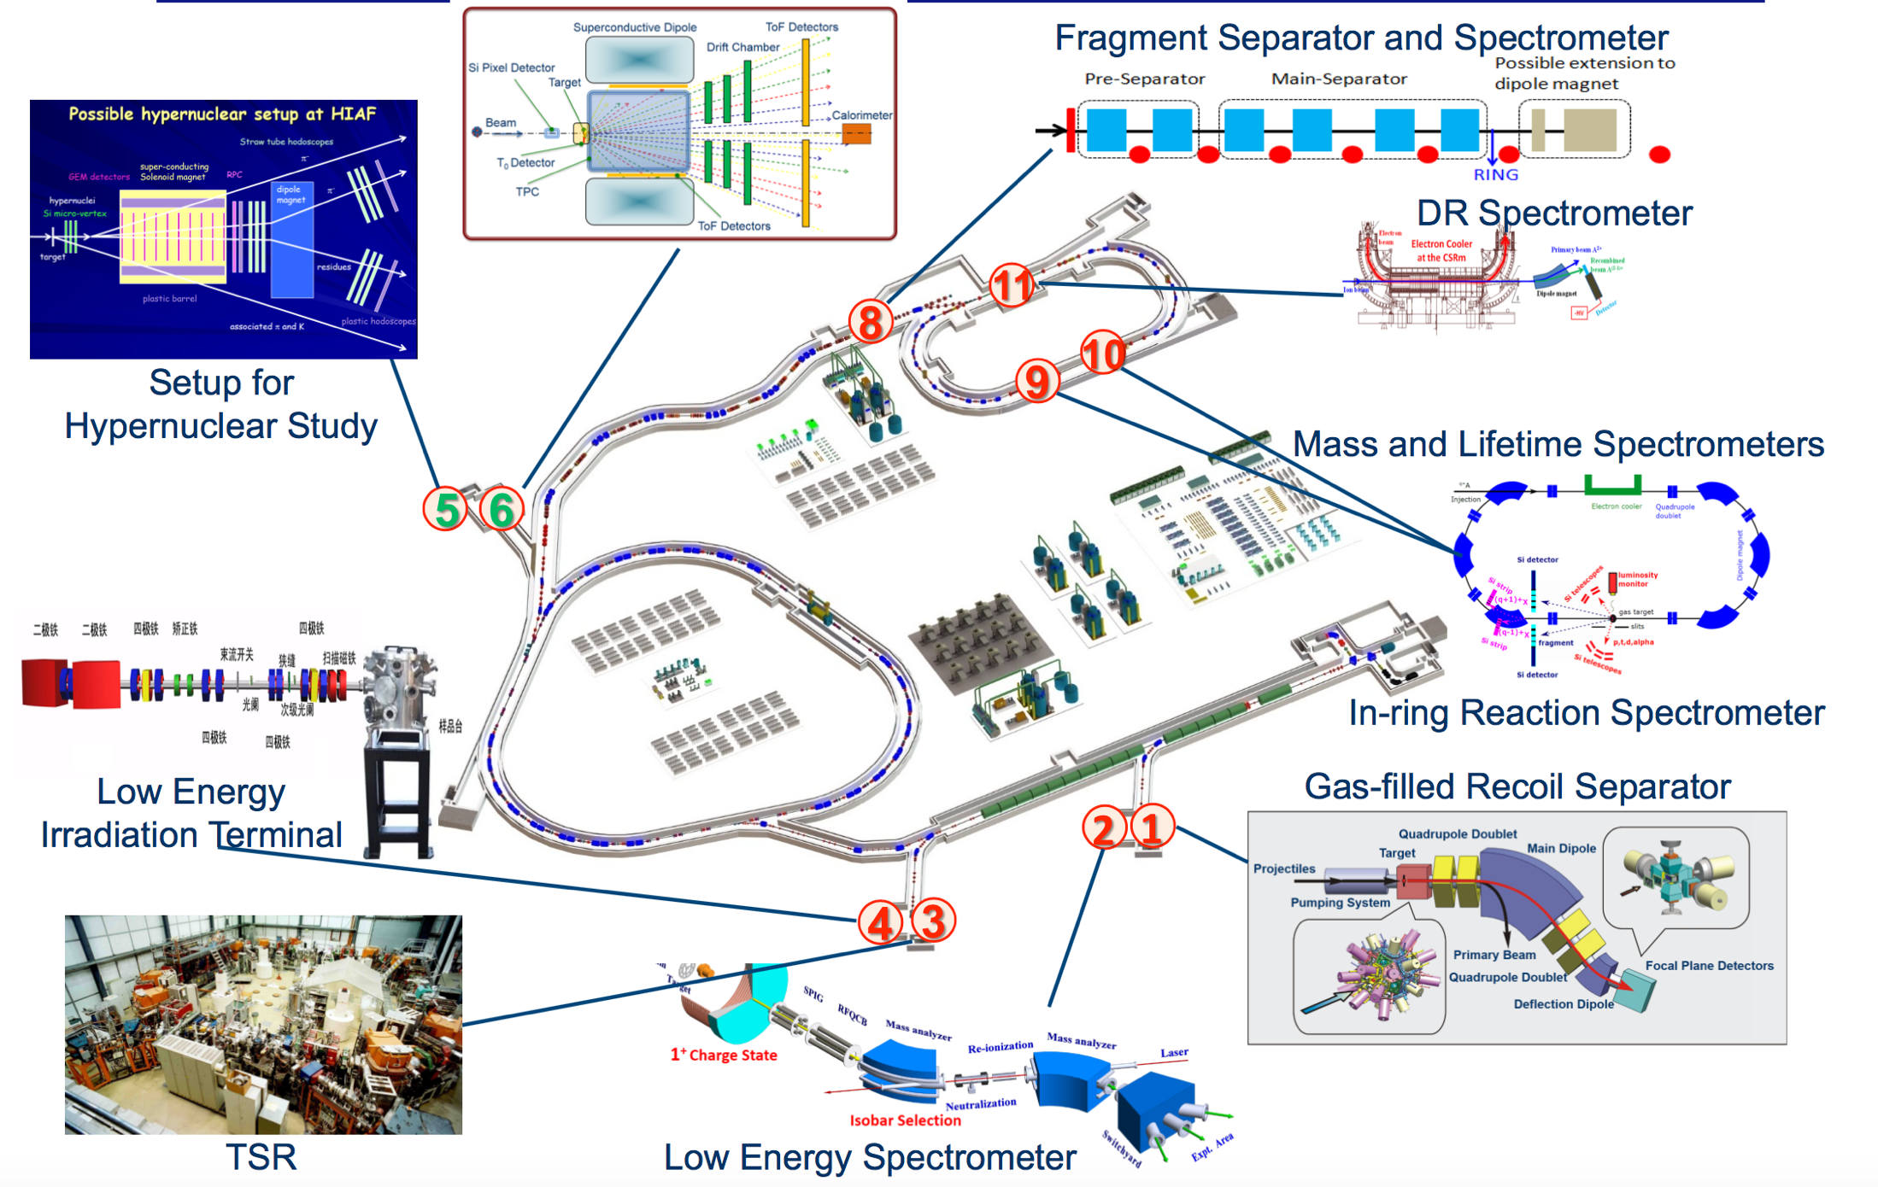
HIAF
CBM
Research topics:
Nuclear structure and reaction dynamics
QCD phase structure at high baryon densities
QCD and nucleon structure
Applied physics
Atomic Physics
Biophysics
courtesy N. Xu
Plasma Physics
Material research

Slide 29
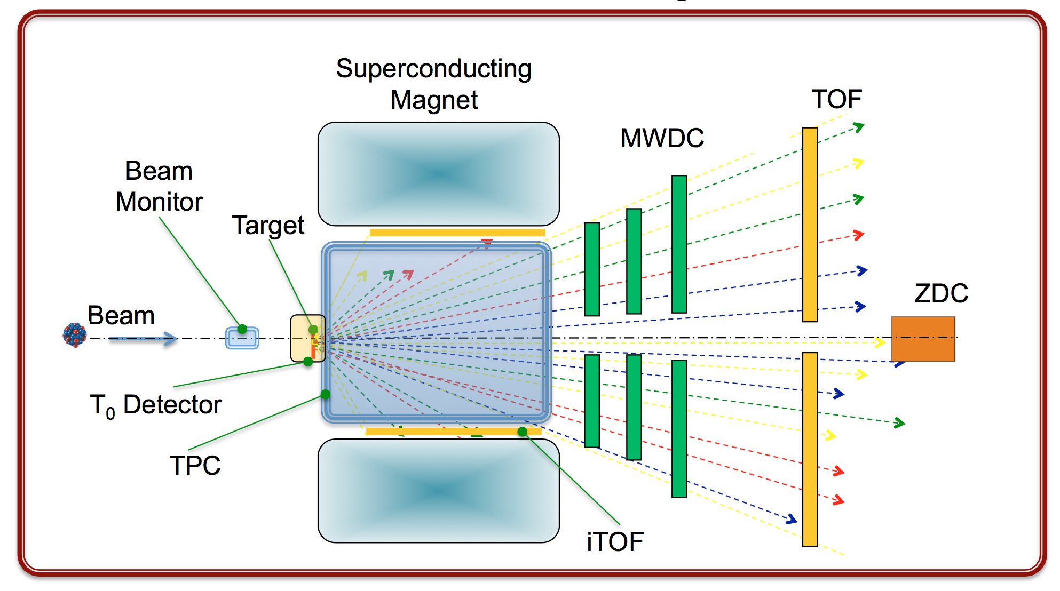
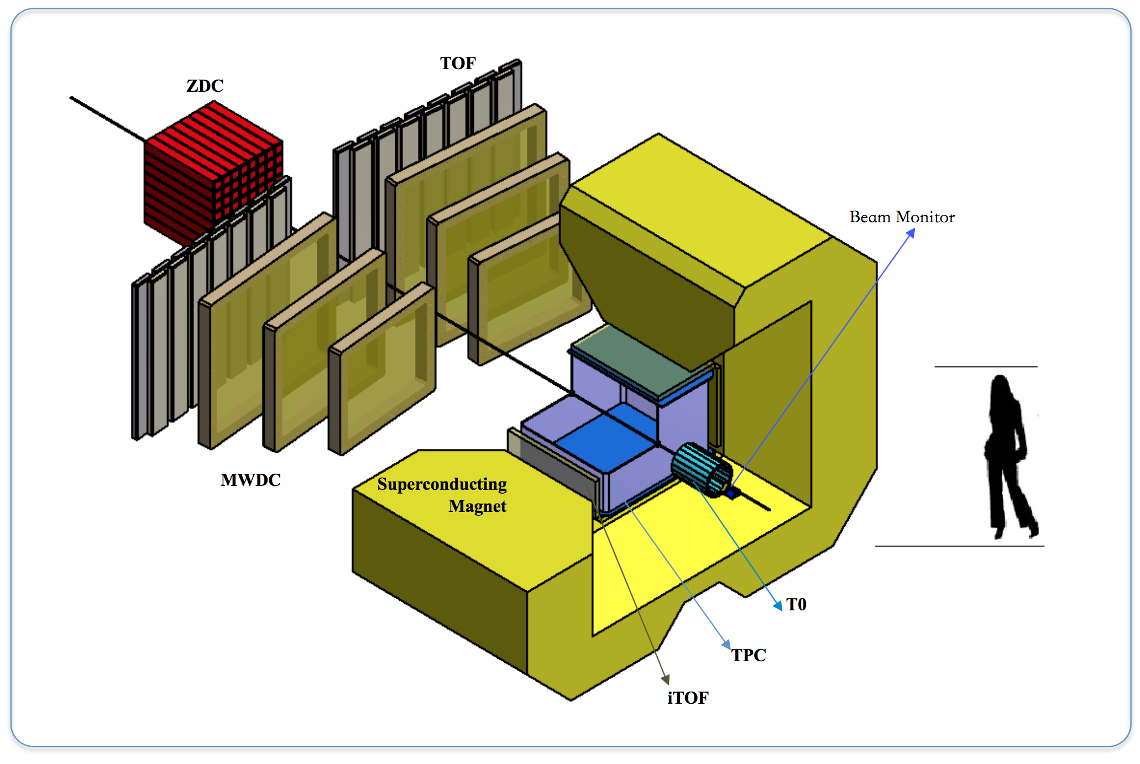
The CEE experiment at HIAF
CSR External-Target Experiment
NUSTAR
CBM
PANDA
Atomic Physics
courtesy N. Xu
Hadron spectrometer (proton and pion ID)
QCD critical point (proton fluctuations)
Directed flow
Symmetry energy (proton flow, π⁻/π⁺
Interaction rates: > 100 kHz
Large acceptance
Triggerless DAQ
Biophysics
Plasma Physics
Material research

Slide 30
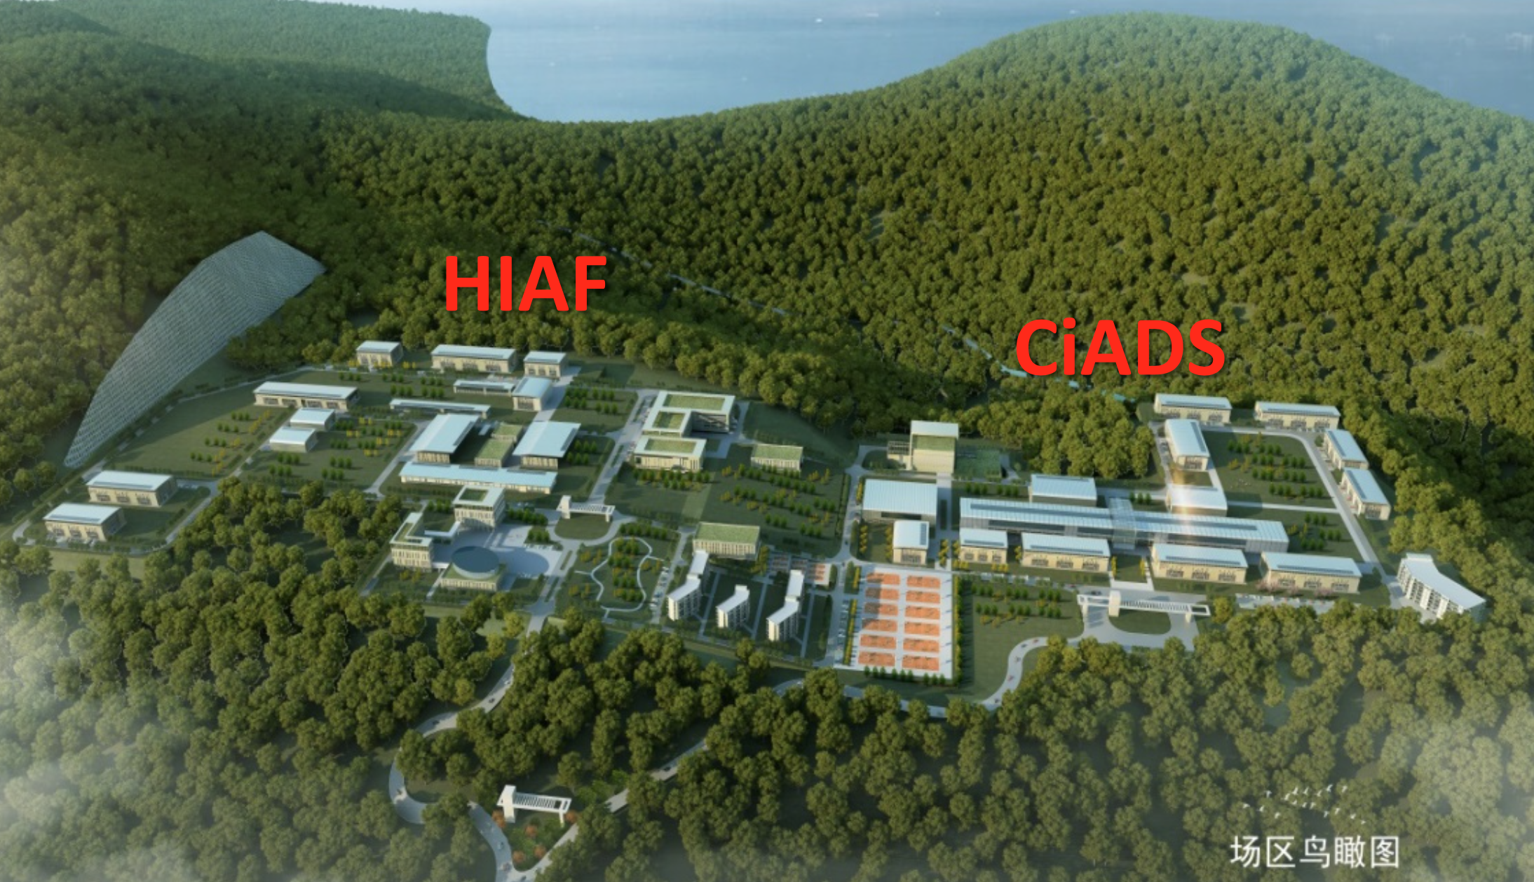
HIAF in 2024
CBM
courtesy N. Xu
Plasma Physics
Material research

Slide 31
J-PARC-HI
NUSTAR
CBM
PANDA
J-PARC Heavy-Ion Program, Tokai, Japan
(Proposed)
Atomic Physics
Biophysics
Plasma Physics
Material research

Slide 32
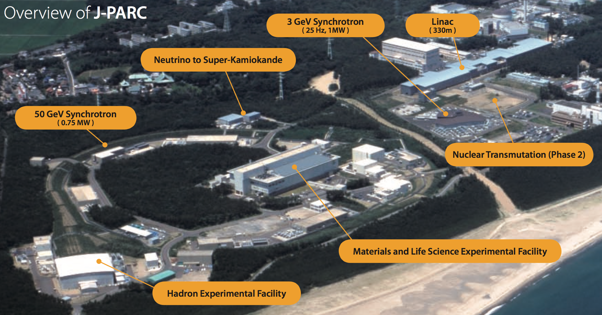
J-PARC today
CBM
j-parc.jp
Proton acceleration facility for very intense proton beams (50 GeV)
Research with secondary beams (π, K, anti-p)
Plasma Physics
Material research

Slide 33
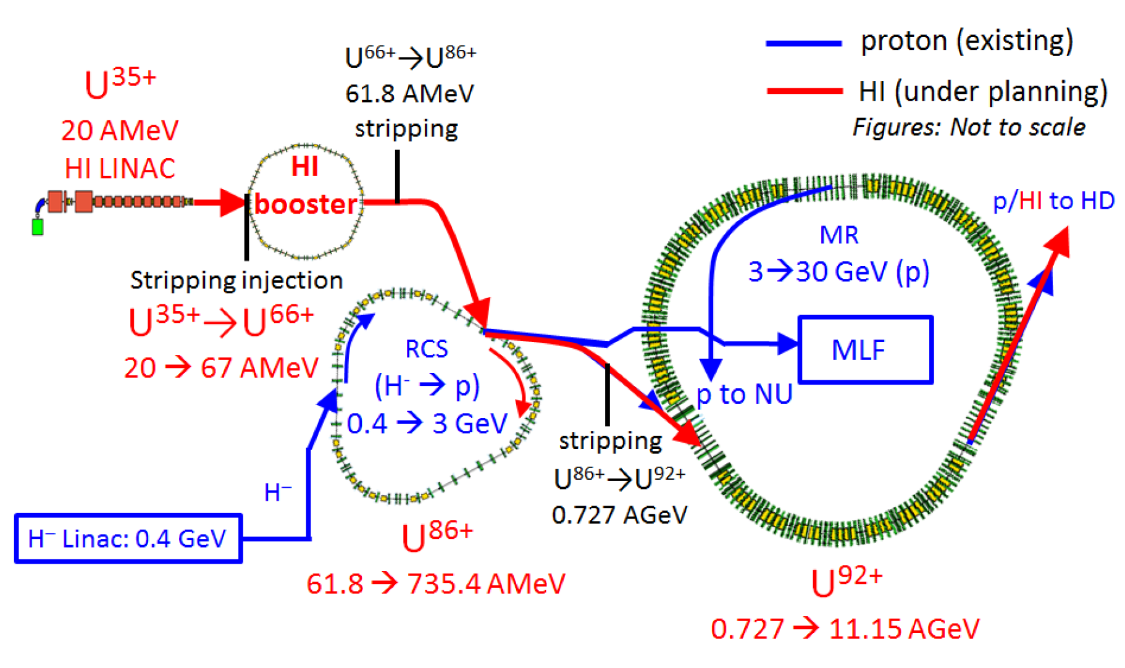
J-PARC-HI
CBM
H. Sako, QM 2018
Proposal: Add a heavy-ion injection branch (LINAC, booster) to the existing proton accelerator complex
Slow extraction of extremely intense beams (10¹¹ / s)
Beam energy range: 1 - 19 GeV/u
Plasma Physics
Material research

Slide 34
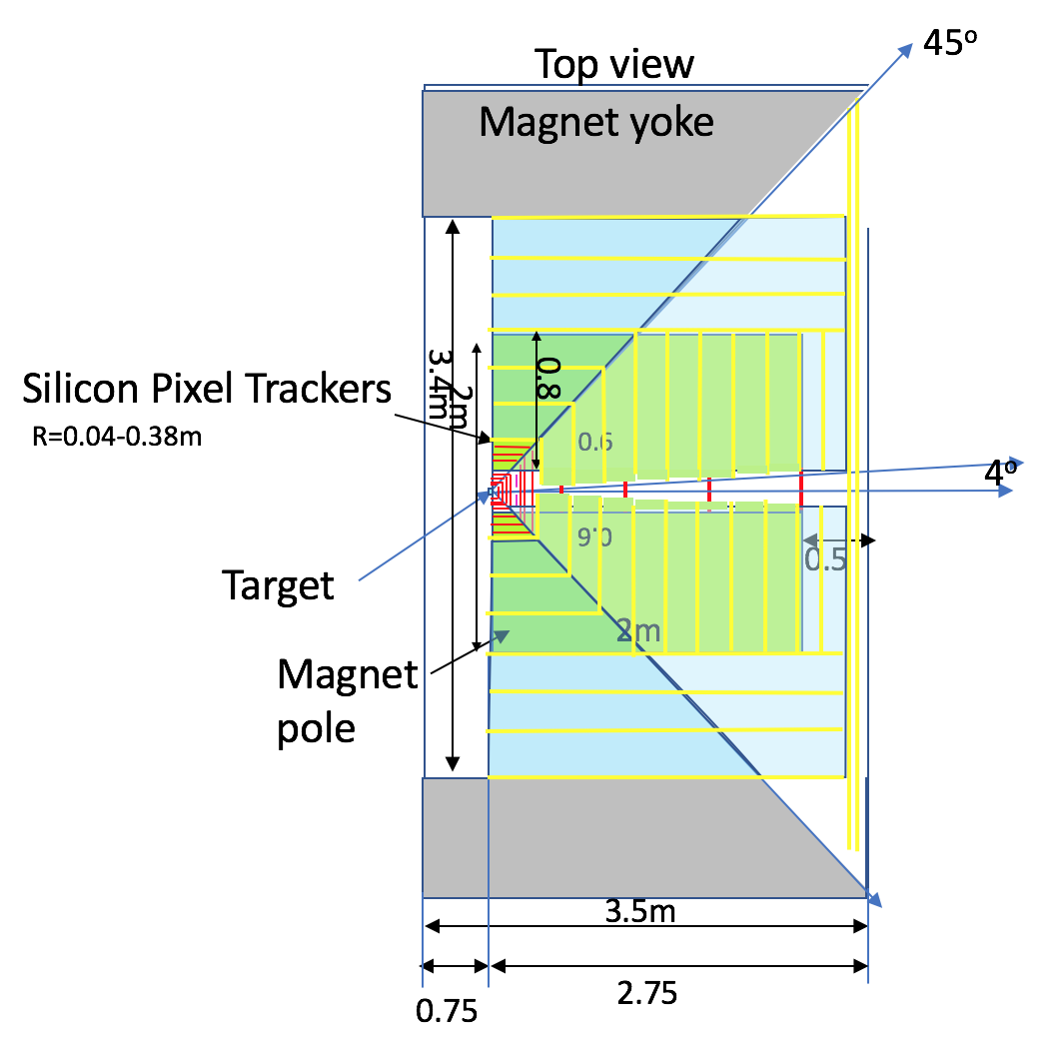
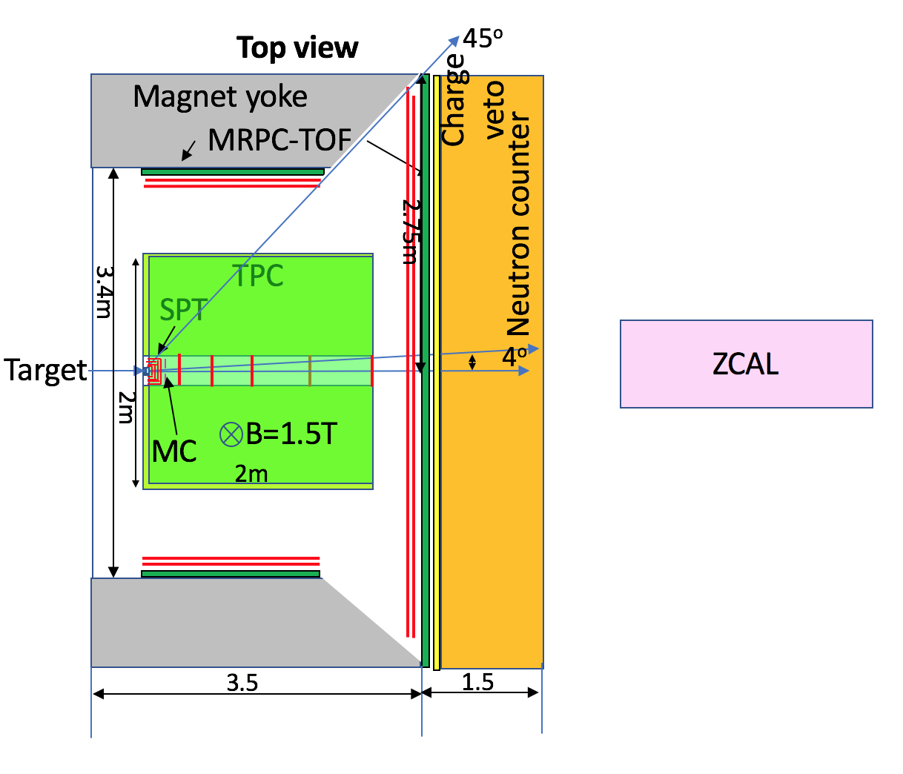
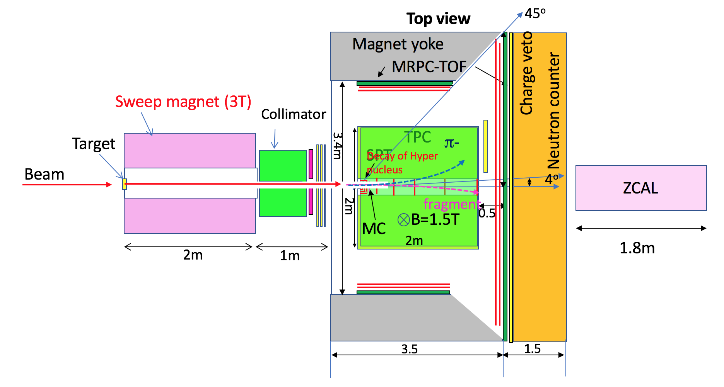
Proposed experiments at J-PARC-HI
Muon spectrometer (SPT, absorbers + GEM trackers)
4π acceptance
interaction rate 10⁷ / s
CBM
Hypernuclei spectrometer
(second magnet)
Forward rapidity
interaction rate 10⁸ / s
Hadron spectrometer
(SPT, TPC + TOF)
4π acceptance
interaction rate < 10⁶ / s
neutron counter
Plasma Physics
Material research
H. Sako, QM 2018

Slide 35
J-PARC-HI
NUSTAR
CBM
PANDA
Atomic Physics
For more details, see talk by T. Sakaguchi, today, 11:45
Biophysics
Plasma Physics
Material research

Slide 36
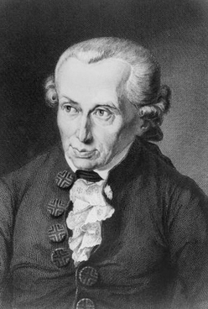
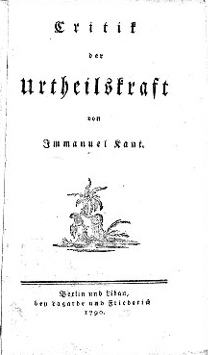
Theology
NUSTAR
CBM
PANDA
III. What may we hope?
Atomic Physics
Biophysics
Plasma Physics
Material research

Slide 37
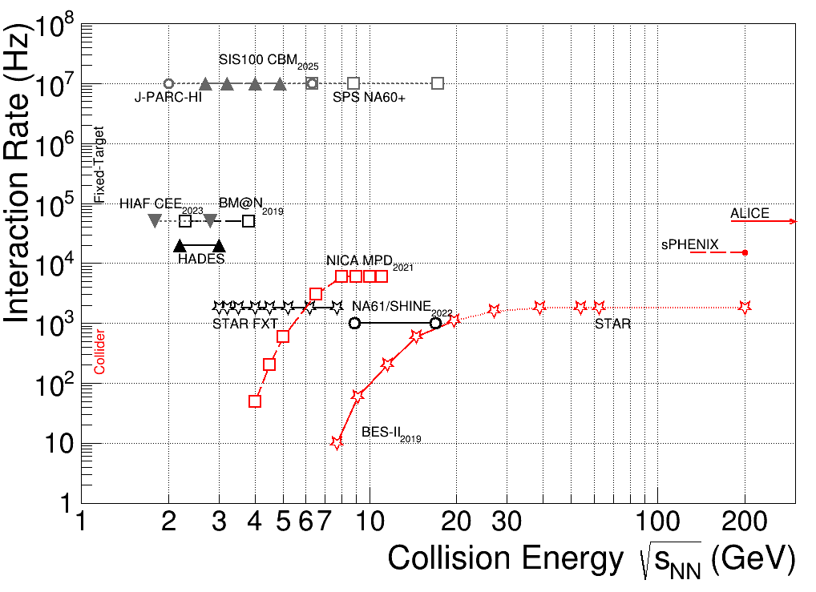
Collision energy
J-PARC-HI
2.0 - 6.2
STAR
3.0 - 200
NA61
4.9 - 17.3
HADES
2.4 - 2.6
MPD
2.7 - 11.0
CBM
2.7 - 5.0 (8.5)
BM@N
2.0 - 3.5
Biophysics
CEE
1.8 - 2.7
Plasma Physics

Slide 38
Interaction rates
CBM collab., EPJA 53 (2018) 60; update by T. Galatyuk
running
approved / under constr.
proposed

Slide 39
Availability
CBM @ FAIR: many research programmes; competition for beam
  however: parallel operation to storage-ring experiments, e.g. PANDA
  machine operation 9 months/year; estimated 3 months/year for CBM
MPD @ NICA: sole user of collider ring (later shared only with SPD)
CEE @ HIAF: competition with other research programmes (similar to CBM)
BM@N @ NICA: at the moment only user of extracted beams

Slide 40
Mode: fixed-target vs. collider
Fixed-target experiments:
  Lower energy, potentially higher interaction rate (limit not by accelerator but by detector capacity)
  Easier coverage of forward rapidity region
  Acceptance changes with energy (can be partially compensated by magnetic field)
  Projectile spectators are hard to measure
Collider experiments:
  Larger energy range
  Interaction rate usually limited by the accelerators; beam quality deteriorates when running below maximum energy
  Harder to measure spectators (beam hole), but possible on both sides
  Acceptance stays approximately constant with energy.
Pros and cons: good to have both even at the same energy!

Slide 41
Coverage
 | CEE | BM@N | CBM | MPD | HADES | NA61 | STAR | J-PARC
hadrons
fluctuations
electrons
muons
charm

Slide 42
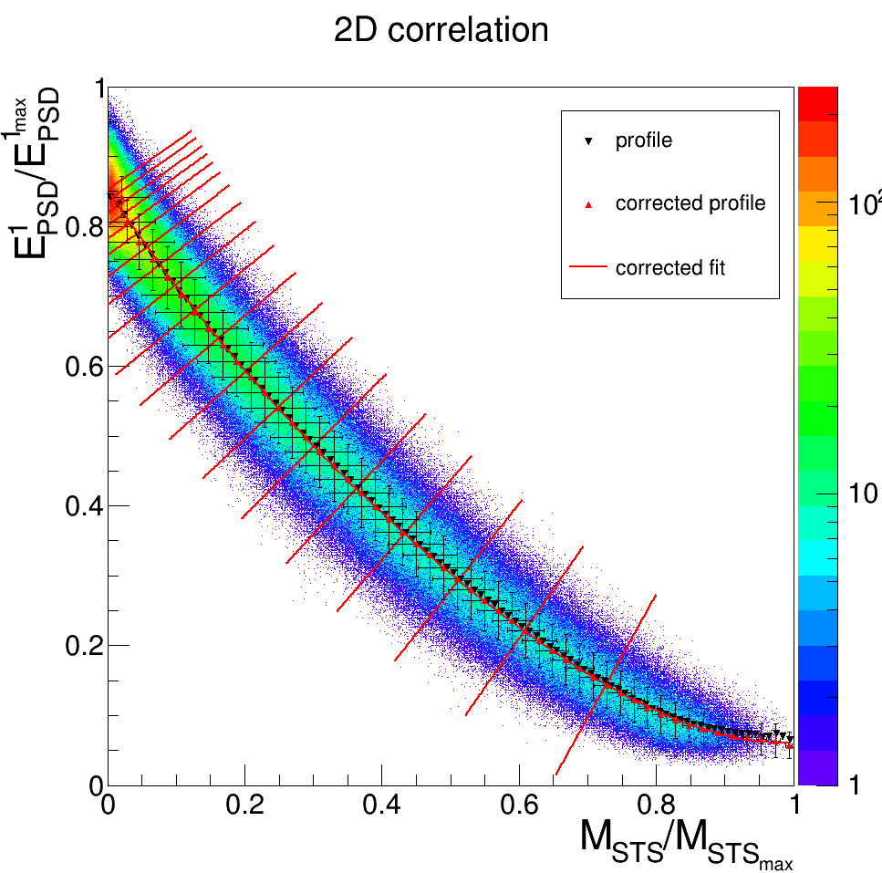
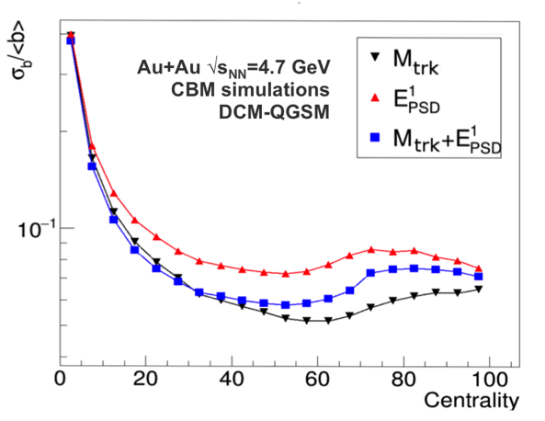
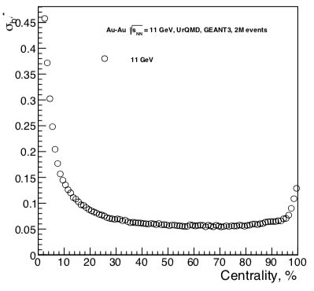
Performance: event centrality
CBM
Energy in forward calorimeter
Charged-track multiplicity in main tracker
MPD
Energy in 2 forward calorimeters

Slide 43
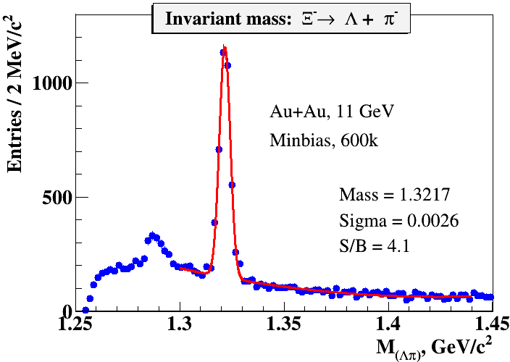
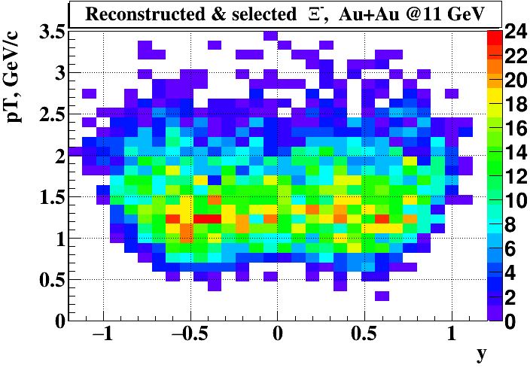
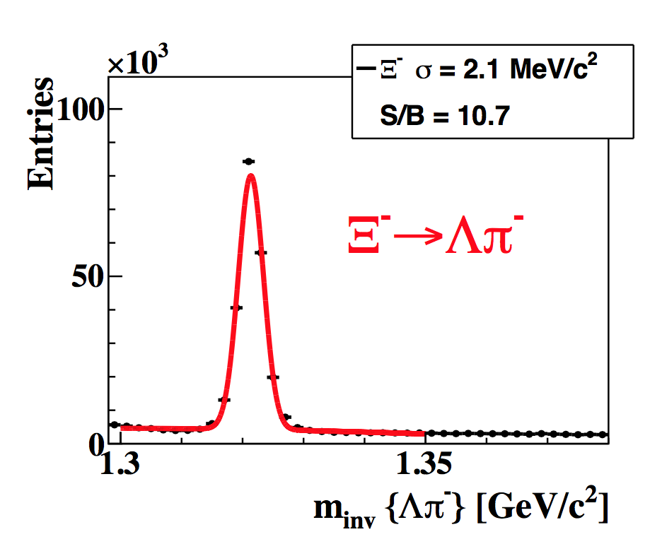
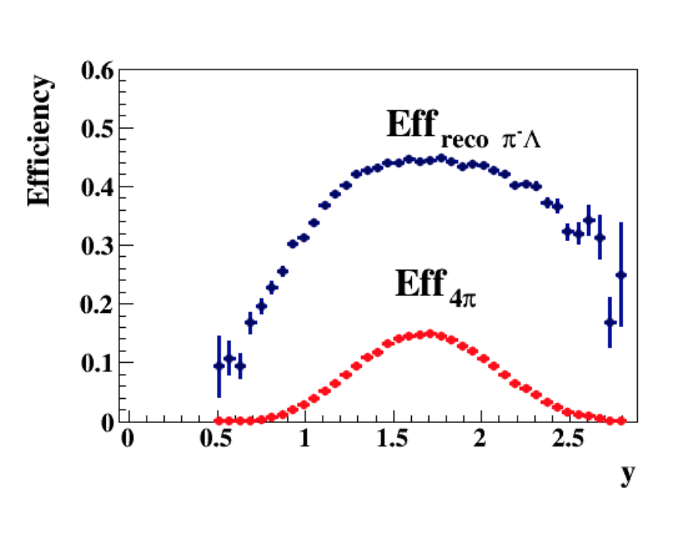
Performance: (anti-) hyperons
MPD
V. Kekelidze, QM 2018
CBM
Au+Au, p_{beam} = 10A GeV
(sqrt(s_{NN}) = 4.7 GeV)
I. Vassiliev, QM 2018

Slide 44
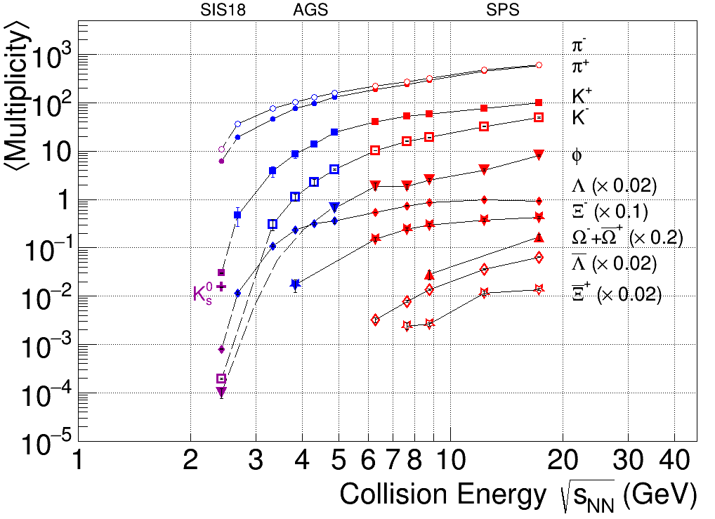
Performance: (anti-) hyperons
Both MPD and CBM will allow precision measurements for multi-strange hyperons (spectra flow).
CBM will also be able to address anti-Omega.
?
Compilation by C. Blume. C. Markert, T. Galatyuk
 | sqrt(s_{NN}) | Run time | Event rate | Ξ⁻ | Ξ⁺ | Ω⁻
HADES | 2.6 GeV | 4 w | 10 kHz | 2.5 x 10³
MPD (s1) | 11 GeV | 10 wk | 5 kHz | 1.5 x 10⁶ | 8 x 10⁴ | 1.5 x 10⁴
CBM | 3.8 GeV | 1 wk | 10 Mhz | 4 x 10⁹ | 5 x 10⁶ | 3.3 x 10⁵

Slide 45
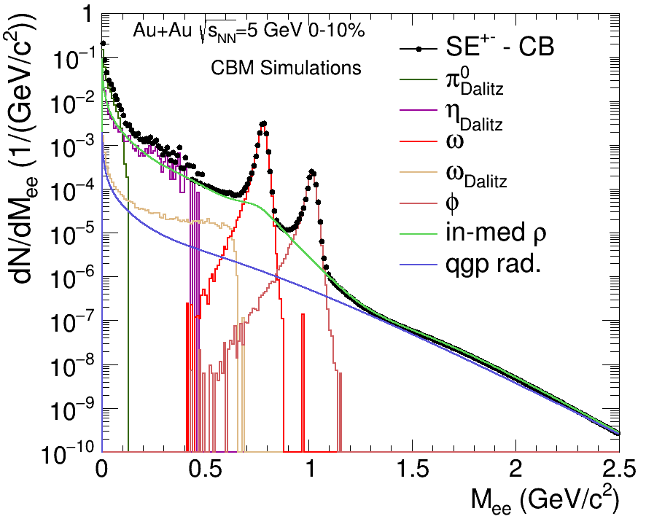
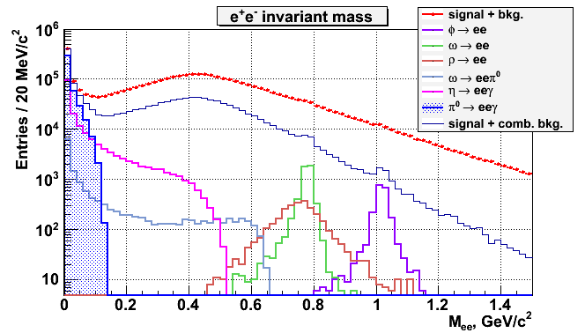
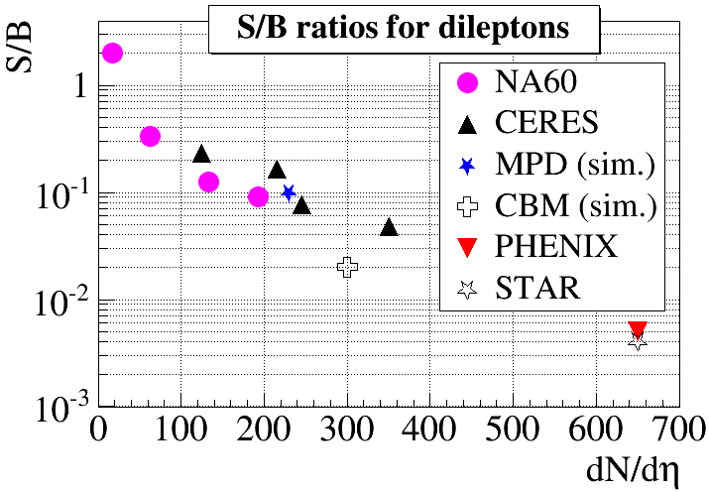
Performance: electron pairs
CBM, Au+Au, sqrt(s_{NN}) = 5 GeV
MPD, Au+Au, sqrt(s_{NN}) = 8 GeV
Performances of CBM and MPD are competitive to dedicated lepton-pair experiments.

Slide 46
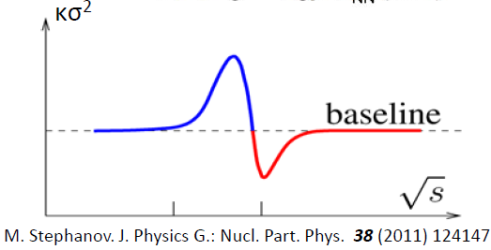
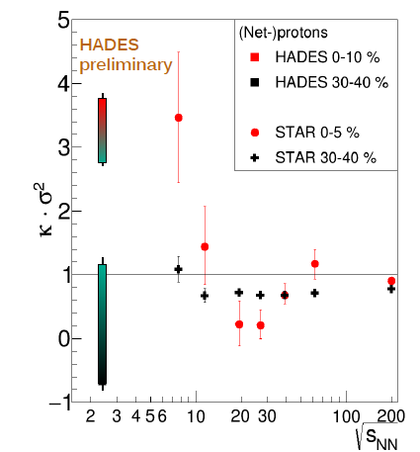
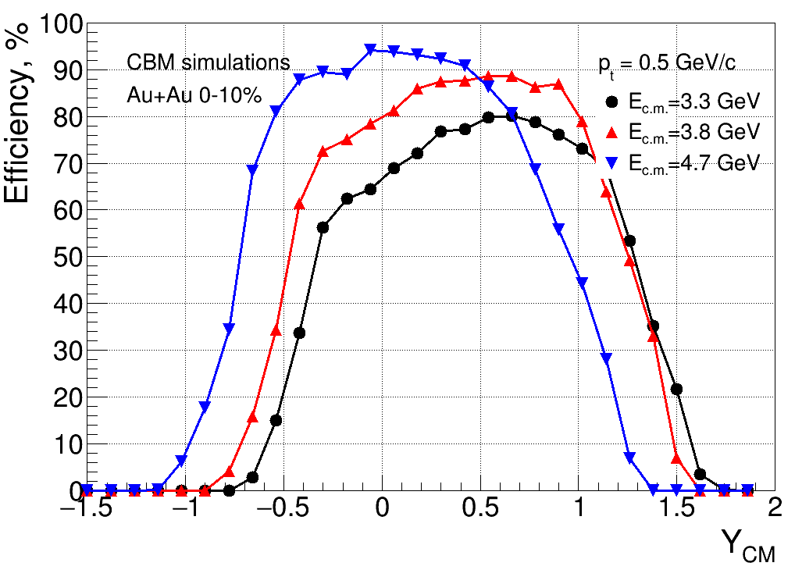
Fluctuations
M. Lorentz, QM 2017
CEE
CBM
MPD
Current and future experiments will continue the excitation function:
Critical point? Phase transition?

Slide 47

Conclusions
The next decade will bring many nightshifts, many data to digest ,and hopefully answers to the main questions of our field!
Thanks to M. Kapishin, T. Sakaguchi, N. Xu and T. Galatyuk for providing information and materials!

