Slide 1
MIMOSIS,
the CMOS Pixel Sensor for the CBM Micro-Vertex Detector
Frédéric Morel on behalf of the
mIcPHC team of IPHC and
IKF team

Slide 2
Outline
CBM
Introduction
MVD
Requirements
MIMOSIS
Global architecture
MIMOSIS0
Preliminary results
Conclusion

Slide 3
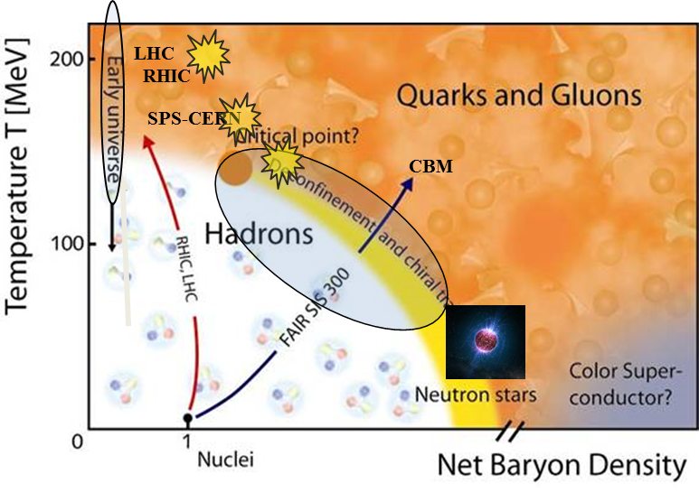
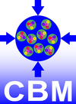
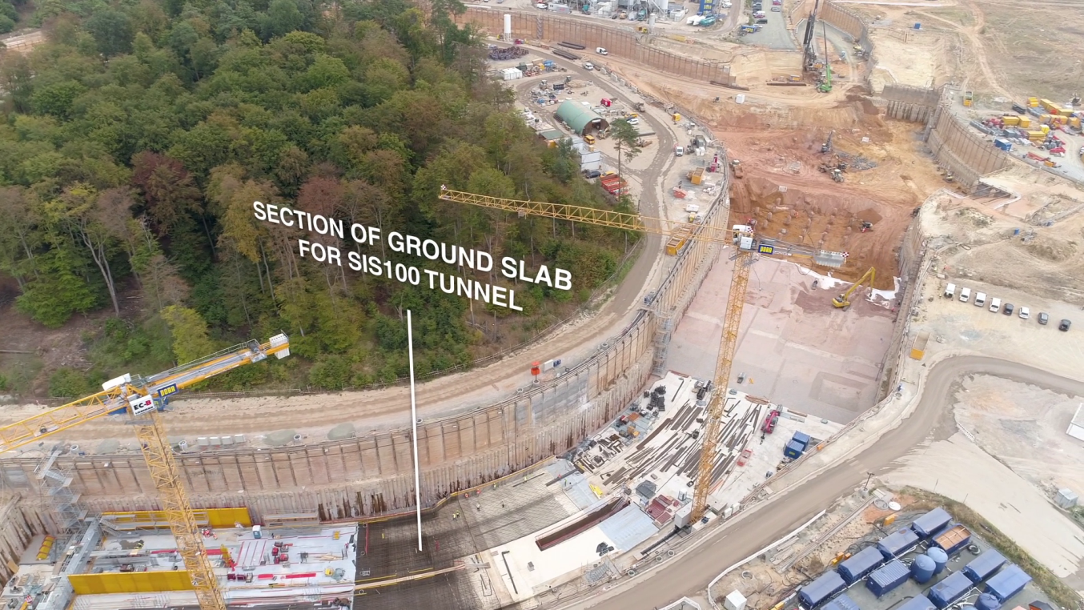
CBM: experiment
30/08/2018
Detector installation and commissioning: 2021–2024
First beam: 2025
Iouri Vassiliev | 2nd Heavy Flavor Meet| Kolkata (India)

Slide 4
CBM: detector
Fixed Target experiment
Joachim Stroth | 56th Winter Meeting on Nuclear Physics | Bormio (Italy)

Slide 5
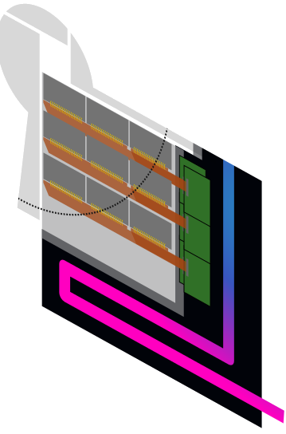
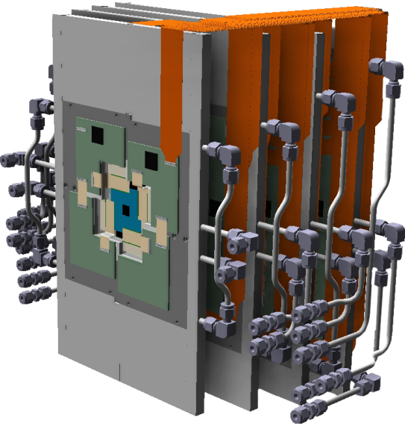
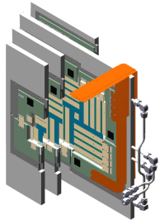
MVD: introduction
Micro Vertex Detector (MVD) for the CBM experiment at GSI/FAIR:
Secondary vertex determination (~50 µm), background rejection in di-electron spectroscopy, reconstruction of weak decays
Vacuum/magnetic field operation
4 stations
~300 CMOS sensors
Power dissipation: 150 W
Radiation tolerance: >3 10¹³n_{eq}/cm² & >3 Mrad
Quadrant (smallest functional unit):
CVD Diamond / TPG carrier for heat evacuation
CMOS pixel sensors: 50 µm thin, 150 mW/cm², ~10 µs read-out
Aluminum heat-sink (actively cooled)
Vacuum
Beam
Beam
Beam
20 cm
#2
#3
#0
#1

Slide 6
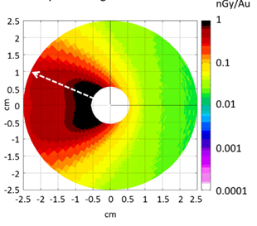
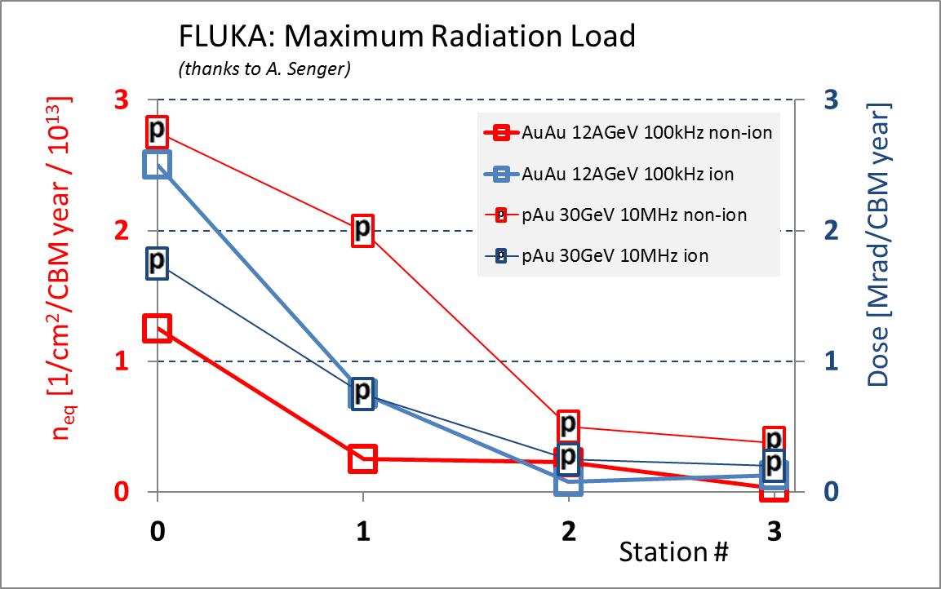
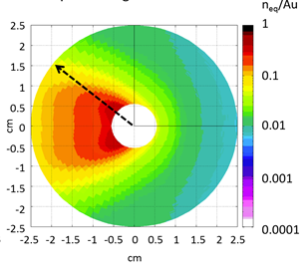
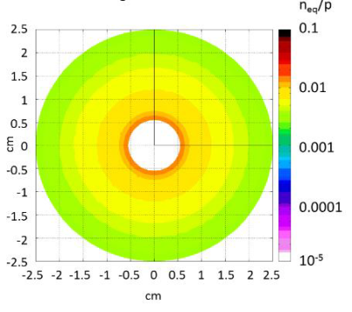
MVD: radiation
Au Au (1%) 12 AGeV
Non-ionizing
MIMOSIS benchmark
@ -20°C without safety margin
Ionizing
p Au (1%) 30 GeV
Non-ionizing
Stations at 5, 10, 15 and 20 cm
Michal Koziel| deutsche physikalische gesellschaft 2017| Münster (Germany)

Slide 7
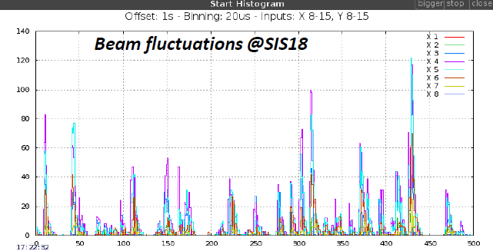
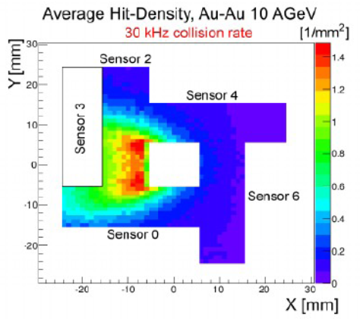
MVD: hit density
Non uniform hit density in time and space
Michal Koziel| deutsche physikalische gesellschaft 2017| Münster (Germany)

Slide 8
MVD: sensor requirement
 | ALPIDE (demonstrated) | MIMOSIS (MVD design goal) | Factor
Ion. Rad. Tolerance | 2.7 Mrad | > 3 Mrad | 1
Non. Io. Tolerance | 1.7 10¹³ neq/cm² | > 3x10¹³ neq/cm² | 2
Heavy ion tolerance | N/A | 1 kHz / cm² | --
Time resolution | 5-10 μs | 5 μs | 2
Hit rate | > 12 kHz/mm² | 700 kHz/mm² (peak) | 56
Data rate | 1 Gbps | 2.5 Gbps | 2.5
Data reduction | Trigger | Elastic buffer | --
Power consumption (depending on hit density) | 20-35 mW/cm² | 50-75 mW/cm² | 0.4
GBTx compatible | No | Yes | --
ALPIDE is not sufficient to fulfil all the requirements of the MVD
Need a new architecture based on ALPIDE
Joachim Stroth | 56th Winter Meeting on Nuclear Physics | Bormio (Italy)

Slide 9
MIMOSIS
x16
Matrix
Region 1
504 x 2 x 8 pixels
Reg. 2
Reg. 3
Reg.4
x8
Pixel
Pixel
Pixel
Priority Encoder
Pixel
Pixel
Matrix dimension: 1024 (col.) x 504 (row)
Pixel dimension: 26.88 µm (height) x 30.24 µm (width)
SEU hardened by design with TMR/Hamming (except for data)
Integration time: 5 µs
TowerJazz 180 nm
Dig
Analog FE
DACs
10 bits @ 20 MHz
Digital Periphery
x16
PE Driving and Cluster Finding
PEDCF
PEDCF
PEDCF
16 bits @ 20 MHz
Multi-Frame Pattern Emulation
Data Generation for Multi-Frame Pattern Emulation
DGMFPE
DGMFPE
DGMFPE
Pixel Config
Management
16 bits @ 20 MHz
Region Readout Unit 1
RRU 2
RRU 3
RRU 4
SRAM
128 x 16 bit x 2
32 bits @ 40 MHz
Registers
32 bits @ 40 MHz
Super Region Readout Units
SRAM
64 x 32 bit x 8
I2C
Slowcontrol
Sequencer
256 bits @ 40 MHz
Top Frame Generator
128 bits @ 80 MHz
20 MHz
40 MHz
80 MHz
Top Elastic Buffer
2048 x 128bit
CLK: 40 MHz
PLL
320 MHz
Clock gen
320 MHz
Serializer
N x 320 MHz (N = 1, 2, 4, 8)
SLVS Ref
SLVS
Pad Ring

Slide 10
MIMOSIS: Data Path
Glue Logic Block
Block with Dual Port Mem
Pix.
Region
Dual Port Memories for each block are (except elastic buffer):
filled in series with data from bin time N
emptied in parallel, the data from bin time N-1
8064 Pixels ➔ 1 Region through 2 Priority Encoder
4 Regions ➔ 1 Super Region through a common bus
16 Super Regions ➔ 1 Elastic buffer through a multiplexer
x1008
Pixel PE
x8
Pixel PE
•••
Region PE
•••
Region PE
x4
Super Region
Region U.
•••
Region U.
x16
Super Region Unit
•••
Super Region Unit
Mux
Elastic Buffer
1,2,4,8 outputs @ 320 Mbps

Slide 11
MIMOSIS: Elastic buffer
Write speed is 4 times higher than read speed
Use time structure of beam fluctuations to average data frames
The buffer can store up to 9 maximal frames
Time bin N = 5µs
Time bin N+1 = 5µs
Time bin N+2 = 5µs
Data Frame N-3
Data Frame N-2
Data Frame N-1
HEADER
IDLE
TRAILER
DATA

Slide 12
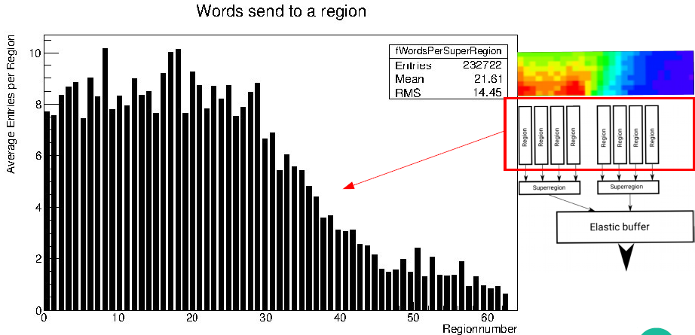
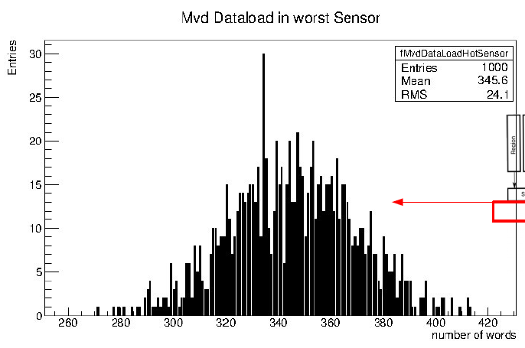
MIMOSIS: bandwidth
Component | Average | Maximum (3x average +2 sigma) | Available
Region | 10/14 | 55/70 | 100
Super region | 37/55 | 135/230 | 400
Elastic-Buffer input | 345/600 | 1120/1790 | 3200
Elastic Buffer output |  |  | 800
Au/Au 10 AGeV 100kHz
16 bits words during 5 µs
Beam fluctuations:
Field: 100%/30%
Simulation
Simulation
Philipp Sitzmann| deutsche physikalische gesellschaft 2017| Münster (Germany)

Slide 13
MIMOSIS: Pixel
Sensing part
Amplification
In-pixel Memory
AC coupling
Bias2
Shaping time few µs
Full custom digital
MV Bias1
Amp
Comp
Dual Port
2 words of 1 bit
Pixel output
Charge inj.
160 aF
DC coupling
2 versions of sensing part:
DC coupled (similar than Alpide)
AC with medium voltage bias
Small Area and Low power shaper amplifier:
Different versions (1 closed to Alpide)
In-pixel Memory:
New version with double counting removal
Bias1
Charge inj.
160 aF
Different pixel architecture tested with CE18 chips family
(see A. Dorokhov in Front End Electronics 2018)

Slide 14
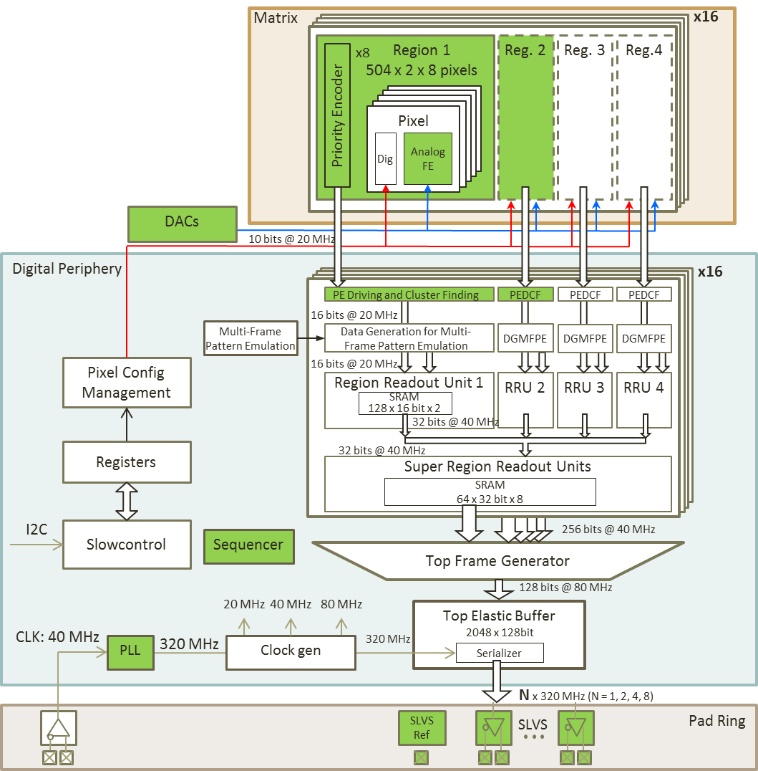
MIMOSIS: development plan
MIMOSIS0: portion of pixel array ➔ may 2017
2 regions wide prototype with AC and DC coupled pixels
MIMOSIS1: 1st full size sensor prototype ➔ Q1 2019
MIMOSIS2: 2nd full size sensor prototype ➔ End 2019
MIMOSIS3: final sensor pre-production ➔ 2020

Slide 15
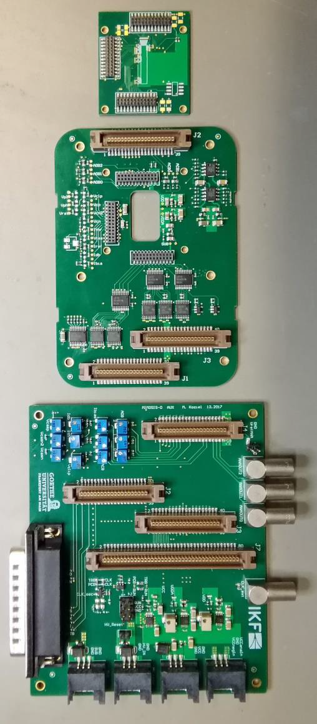
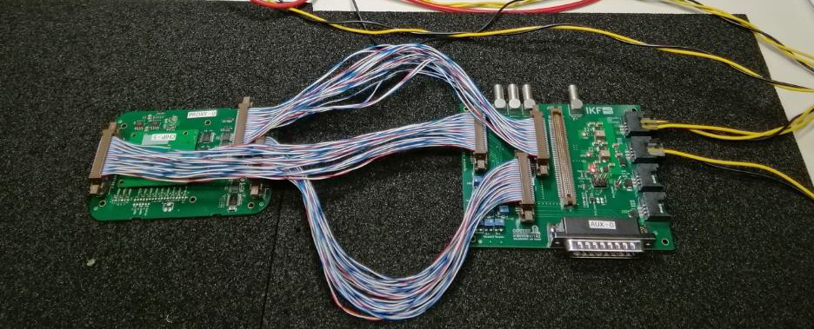
MIMOSIS0: test setup
Test setup developed by IKF with support of IPHC test team

Slide 16
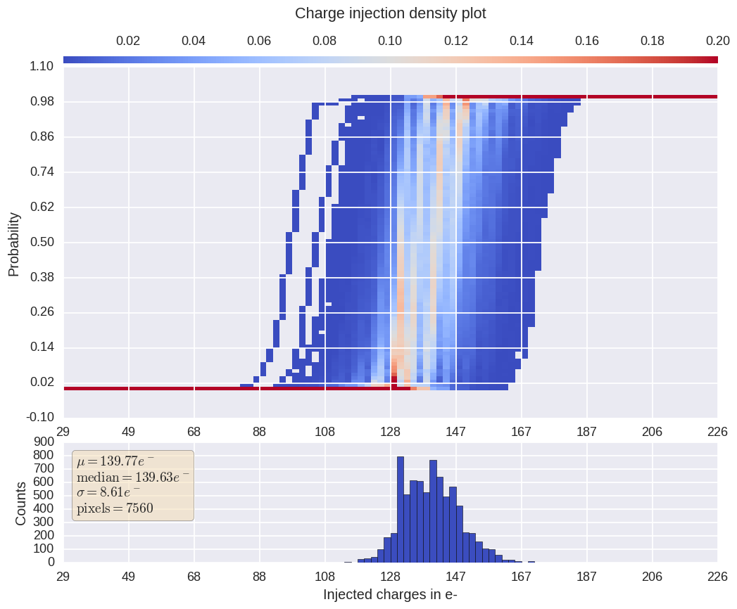
MIMOSIS0: preliminary results
S-curves density plot from all DC coupled pixels

Slide 17
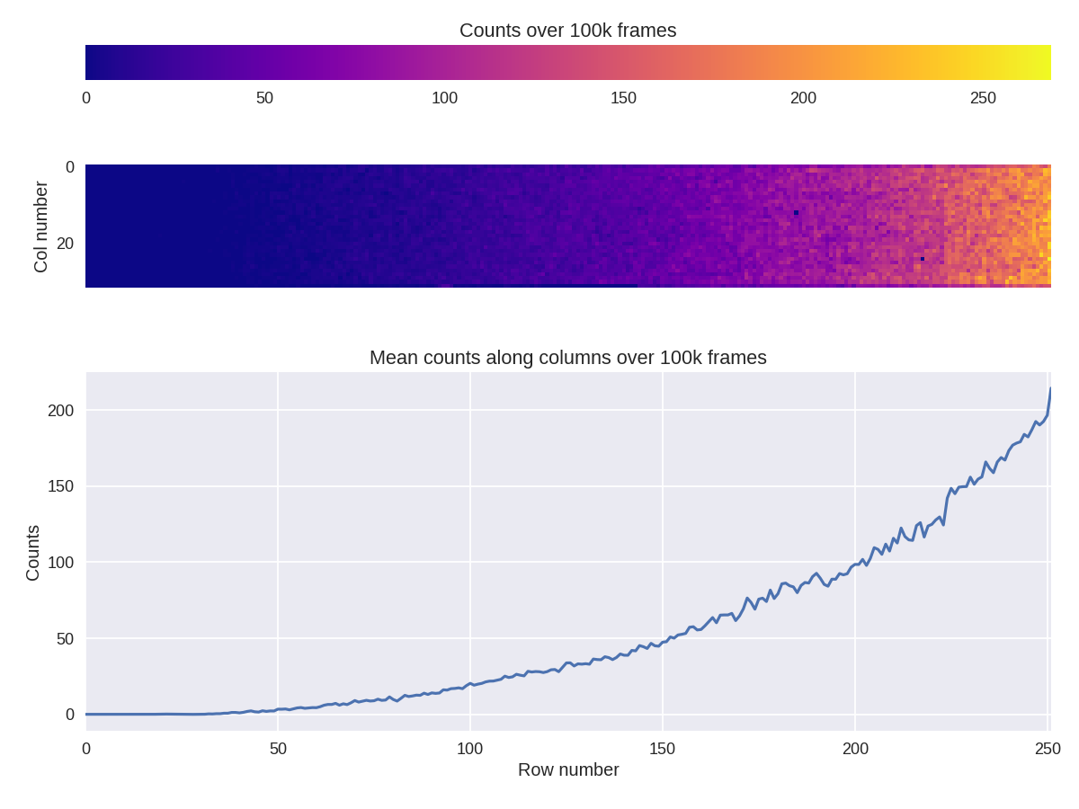
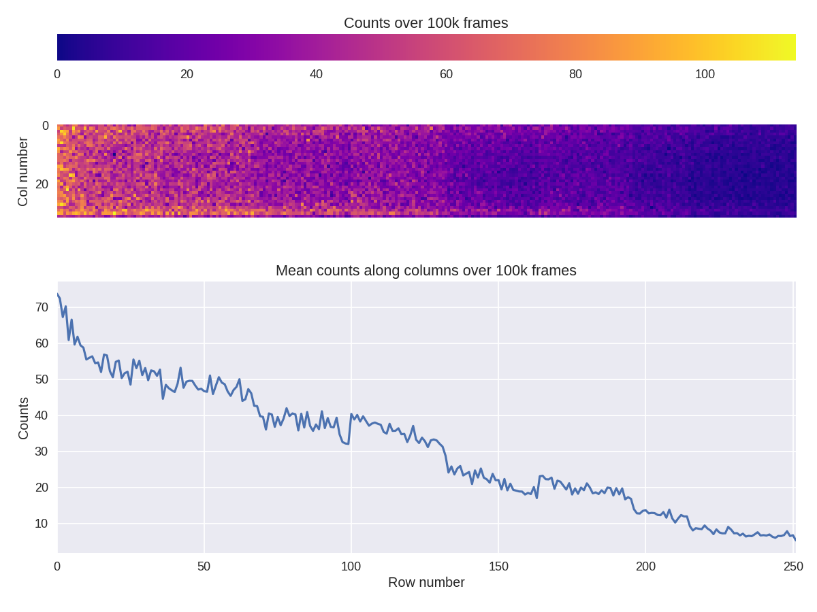
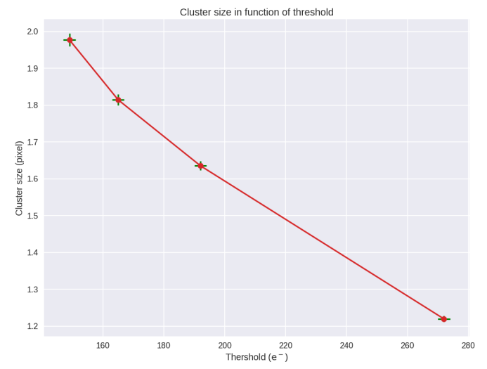
MIMOSIS0: preliminary results
Fe55 response for DC and AC coupled Pixel
Cluster size in function of threshold

Slide 18
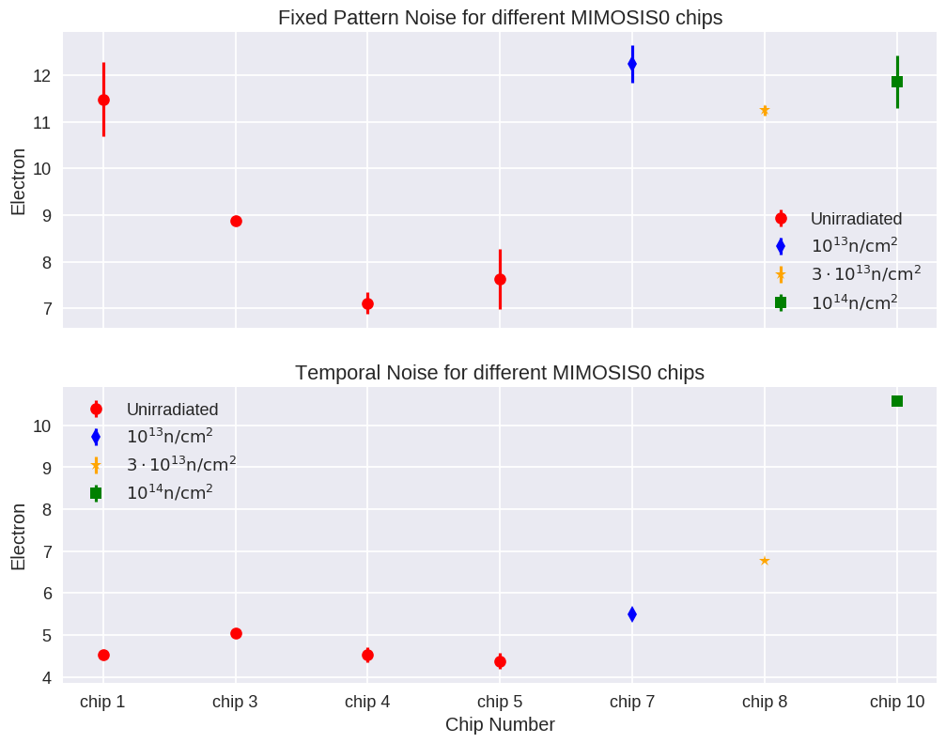
MIMOSIS0: preliminary results
Temporal Noise and Fixed Pattern Noise after Irradiation
Irradiated chips

Slide 19
Conclusion
Close collaboration between IPHC and IKF for tests and design
Tests:
Preliminary results of MIMOSIS0 are encouraging
AC coupled pixels are promising
Good accordance between tests from MIMOSIS0 and CE18 chips family
Design:
MIMOSIS0 has validated a part of digital readout of MIMOSIS1
Digital periphery is under development ➔ no showstopper seen
Next steps:
Continuing heavy testing (radiations) of MIMOSIS0 and CE18 chips family
Finalize design of MIMOSIS1 which will be very closed to the final sensors

