Slide 1
Novel production method for large double-sided microstrip detectors of the CBM STS
Patrick Pfistner, M. Caselle, T. Blank, P. v. Wintzingerode, M. Weber
for the CBM collaboration

Slide 2
Outline
Compressed Baryonic Matter (CBM) experiment @ FAIR
Silicon Tracking System (STS)
Detector module conception and its challenges
Detector module production based on TAB bonding
Novel detector module production approach based on Au stud – solder bump bonding

Slide 3
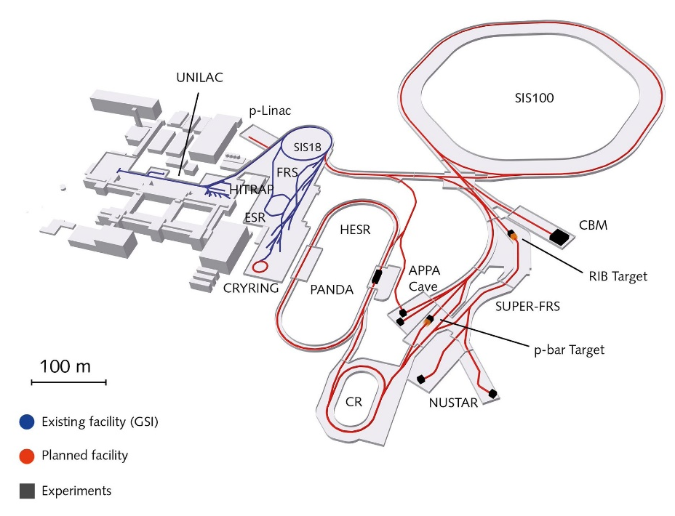
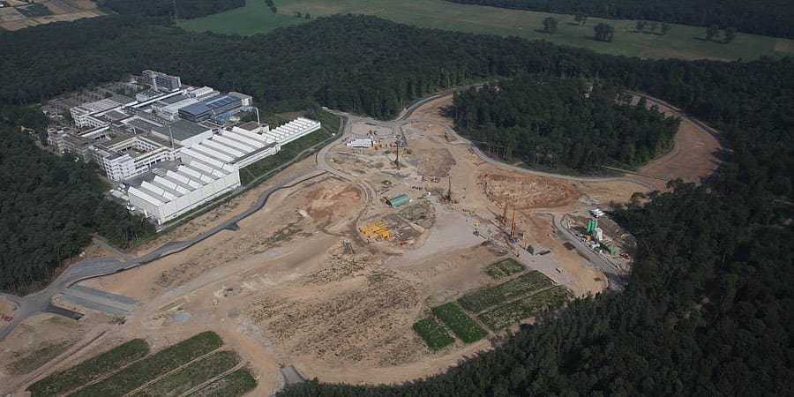
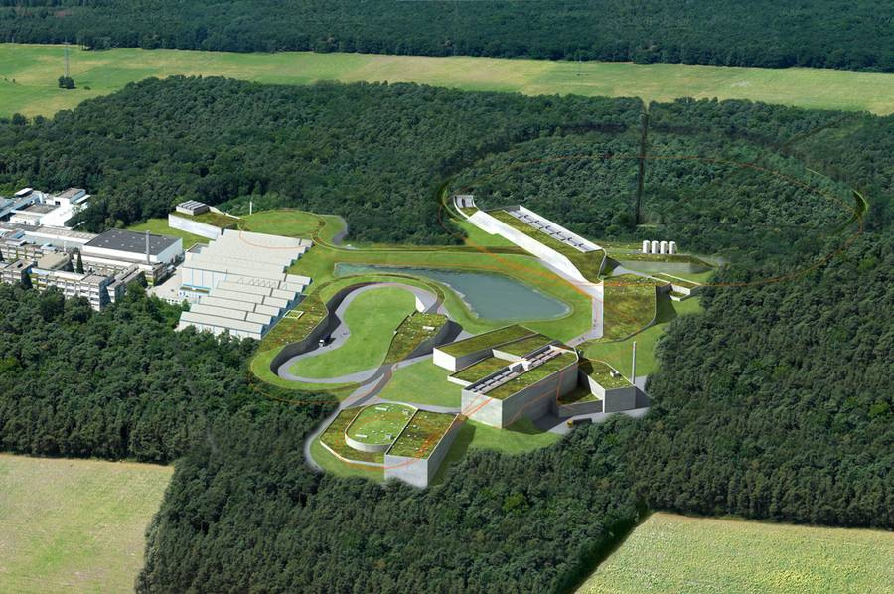

Facility for Antiproton and Ion Research (FAIR)
CBM
https://res.cloudinary.com/wired-de/iu/s--5kacTFBm--/c_fill,f_auto,h_450,q_auto:good,w_900/fair_gsi_credits_fairjan_schafer.jpg.jpg
https://www.gsi.de/fileadmin/_processed_/8/9/csm_FAIR-beschriftet_MSV_DE_Feb18_4408267c7b.gif
CBM one of the major scientific programs at FAIR
highest baryon densities at still moderate temperatures
Link to drone video of FAIR construction site
https://Drone video of FAIR construction site June 2018-
https://fair-center.de/typo3temp/pics/5510babc84.jpg
Notes:
Message: FAIR will try to answer fundamental questions about matter and the universe and the strong force. Creation of quark-gluon plasma. Explore fundamental symmetries, symmetry breaking
The international Facility for Antiproton and Ion Research (FAIR) in Darmstadt will provide unique research opportunities in the fields of nuclear, hadron, atomic and plasma physics [16].
4 main fields:
APPA: Atomic, Plasma Physics and Applications
CBM
NUSTAR Nucear Structure, Astrophysics and Reactions
PANDA: Proton – Antiproton Annihilation at Darmstadt
More than 3000 scientists
Sis18 pre-accelerator for sis100 synchrotron
Put into operation 2022, full operation 2025
In order to select events containing those rare observables, the tracks of each collision have to be reconstructed and filtered online with respect to physical signatures.
This concept represents a paradigm shift for data taking in high-energy physics experiments: CBM will run without hierarchical trigger system.
Self-triggered read-out electronics, a high-speed data processing and acquisition system, fast algorithms, and, last but not least, radiation hard detectors are indispensable pre-
requisites for a successful operation of the experiment.
The research program devoted to the exploration of compressed baryonic matter will start with primary beams from the SIS100 synchrotron (protons up to 29 GeV, Au up to 11 AGeV, nuclei
with Z/A = 0.5 up to 14 AGeV), and will be continued with beams from the SIS300 synchrotron (protons up to 90 GeV, Au up to 35 AGeV, nuclei with Z/A = 0.5 up to 45 AGeV).
Link to 2 min drone video of FAIR construction site from August 2018

Slide 4
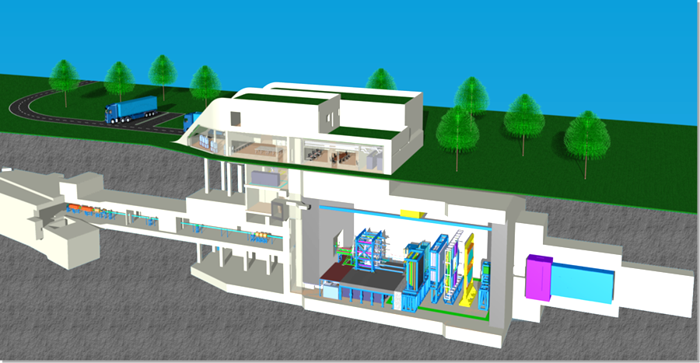
CBM experiment at FAIR
Heavy ions, especially Au
High rate, fixed target
Unprecedented precision and statistics
Exploration of new energy range
Notes:
Message: CBM is fixed target, high-rate experiment to create highest baryon densities in nucleus-nucleus collision, especially Au ions.
The CBM detector is designed to measure the collective behavior of hadrons, together with rare diagnostic probes such as multi-strange hyperons, charmed particles and vector mesons decaying into lepton pairs with unprecedented precision and statistics. Most of these particles will be studied for the first time in the FAIR energy range.
The multiplicity of charged particles is up to 700 per event within the detector accep-
tance
Center of mass energy 2-5 GeV
CERN TeV range
Pb
A=207 Z=82
Au
A=197 Z=79
Explore properties of dense matter
Search in-medium modifications of hadrons
Search for transitions from dense hadronic matter to quark-gluon matter
Search critical end-point in phase diagram of strongly interacting matter
Challenges:
Measure rare and penetrating probe
The CBM detector is designed to measure the collective behavior of hadrons, together with rare diagnostic probes such as multi-strange hyperons, charmed particles and vector mesons decaying into lepton pairs with unprecedented precision and statistics. Most of these particles will be studied for the first time in the FAIR energy range. In order to achieve the required precision, the measurements will be performed at reaction rates up to 10 MHz. This requires very fast and radiation hard detectors, a novel data read-out and analysis concept including free streaming front-end electronics, and a high performance computing cluster for online event selection.
HADES:
The main experimental goal is to investigate properties of dense nuclear matter created in the course of heavy ion collisions and ultimately learn about in-medium hadron properties (like masses, decay widths). The matter created in such collisions differs from the one studied at SPS, RHIC or LHC because it consists mainly of baryons (nucleons and its excited states- baryon resonances) and little mesons and can be compressed up to 3 times nuclear matter density for about 10-12 fm/c.
The research program devoted to the exploration of compressed baryonic matter will start with primary beams from the SIS100 synchrotron (protons up to 29 GeV, Au up to 11 AGeV, nuclei
with Z/A = 0.5 up to 14 AGeV), and will be continued with beams from the SIS300 synchrotron (protons up to 90 GeV, Au up to 35 AGeV, nuclei with Z/A = 0.5 up to 45 AGeV).

Slide 5
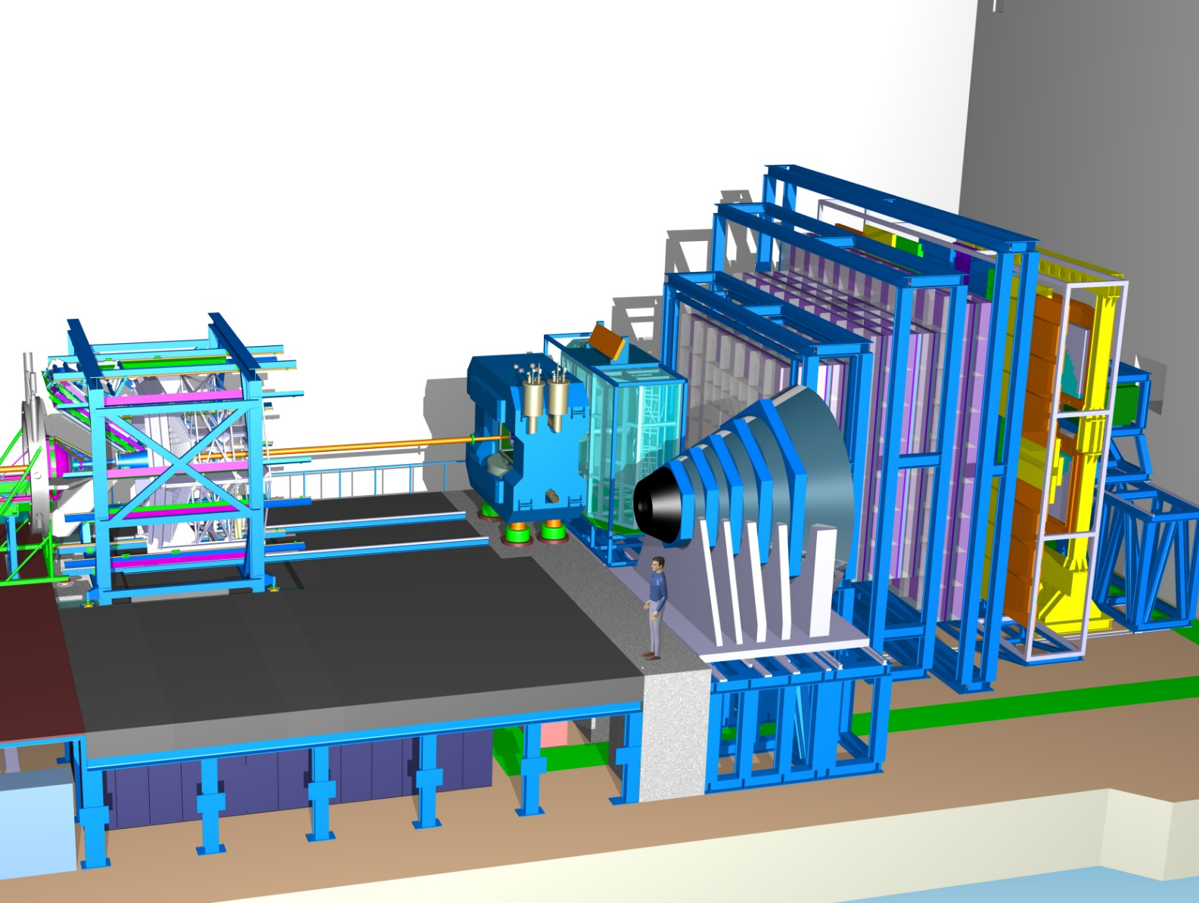
CBM detectors
TRD
TOF
RICH
STS
Muon
Detector
Notes:
Message: big detector system with similar components to other detectors @CERN e.g.
How do we actually measure rare observables?
Technique to measure rare observables:
Tracking and vertex reconstruction in STS (pixel + strip) in high magnetic field (1T dipole magnet)
Electron identification in RICH and TRD, or, alternatively muon identification in muon detector
TOF measurements with diamond strip and Resistive Plate chamber arrays
Shashlik type ECAL as in LHCb, HERA-B, PHENIX to measure direct photons and neutral mesons decaying into photons
MVD: The MVD consists of 3 Monolithic Active Pixel Sensors (MAPS) layers located at 5, 10, and 15 cm downstream of the target in the vacuum.
The pixel size will be between 18×18 μm2 and 20×40 μm2. A position resolution of σ = 3.5 – 6 μm can be achieved depending on the pixel size.
RICH: The RICH detector is designed to provide identification of electrons and suppression of pions in the momentum range below 10 GeV/c.
CO2 with a pion threshold for Cherenkov radiation of 4.65 GeV/c will be used as radiator gas.
TRD: 3 TRD stations each consisting of 3 detector layers for particle tracking and for the identification of electrons and positrons with p>1.5 GeV/c (γ≥1000).
MUCH: The experimental challenge for muon measurements in heavy-ion collisions at FAIR energies is to identify low-momentum muons in an environment of high particle densities.
The CBM concept is to track the particles through a hadron absorber system, and to perform a momentum-dependent muon identification. This concept is realized by segmenting the hadron absorber in
several layers, and placing triplets of tracking detector planes in the gaps between the absorber layers.
6 hadron absorber layers (iron plates of 3×20 cm, 30 cm, 35 cm and 100 cm thickness) and 18 gaseous tracking chambers located in triplets behind each iron slab.
The identification of a muon depends on its momentum which varies with the mass of the vector mesons and with beam energy.
Timing Multi-gap Resistive Plate Chambers (MRPC)
An array of Resistive Plate Chambers will be used for hadron identification via TOF measurements. The TOF wall covers an active area of about 120 m2 and is located about 6 m downstream of the target for measurements at SIS100, and at 10 m at SIS300.
The required time resolution is on the order of 80 ps. For 10 MHz minimum bias Au+Au collisions the innermost part of the detector has to work at rates up to 20 kHz/cm2.
Electromagnetic Calorimeter (ECAL)
A “shashlik” type calorimeter as installed in the HERA-B, PHENIX and LHCb experiments will be used to measure direct photons and neutral mesons (π0 ,η) decaying into photons.
The ECAL will be composed of modules which consist of 140 layers of 1 mm lead and 1 mm scintillator, with cell sizes of 3×3 cm2, 6×6 cm2, and 12×12 cm2. The shashlik modules can be arranged
either as a wall or in a tower geometry with variable distance from the target.

Slide 6
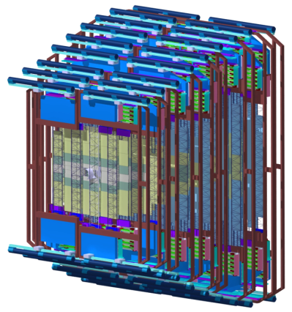
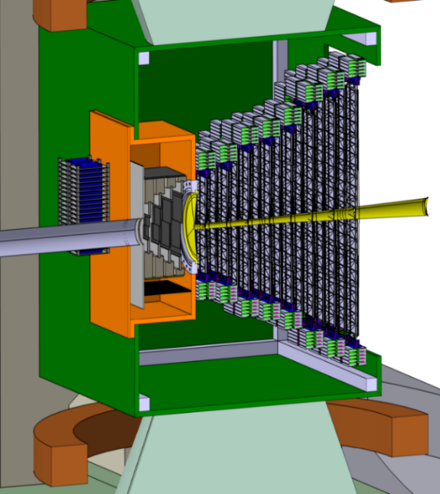
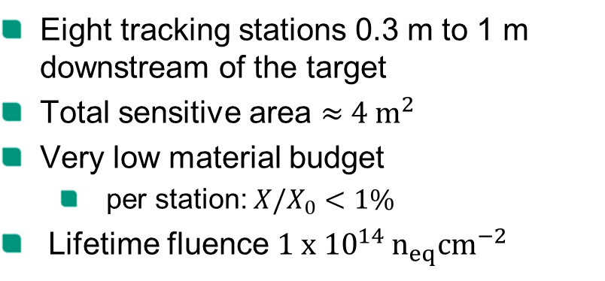
STS system view
STS
STS
target
1 m
beam
Eight tracking stations 0.3 m to 1 m downstream of the target
Total sensitive area $≈{ 4 m}^{2}$
Very low material budget
  per station: ${X/X}_{0}<1\%$
Lifetime fluence ${1 x 10}^{14 }n_{eq}{cm}^{−2}$
MVD
Notes:
Message: big detector, low material budget requirements. High hit rates, lifetime fluence, radiation hardness
LHC TT tracker is very similar to STS due to ist forward spectrometer geometry

Slide 7

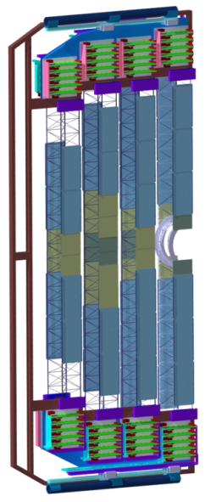
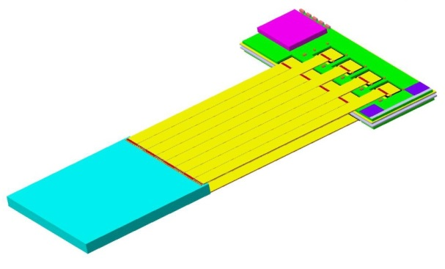
STS structure
Half-station
Ladder
17 ladder variations
Detector module
Double-sided microstrip sensor
  Pitch: 58µm
  2 x 1024 channels
2 x 8/16 low mass microcables
2 x 8 STS-XYTER ASICs
2 FEB-8
Front-end board (FEB)
Microcables
Sensor
2 x 8 ASICs
Notes:
Message: complex module conception with lots of individual parts due to physical requirements of the experiment, especially momentum resolution, i.e. low material budget

Slide 8
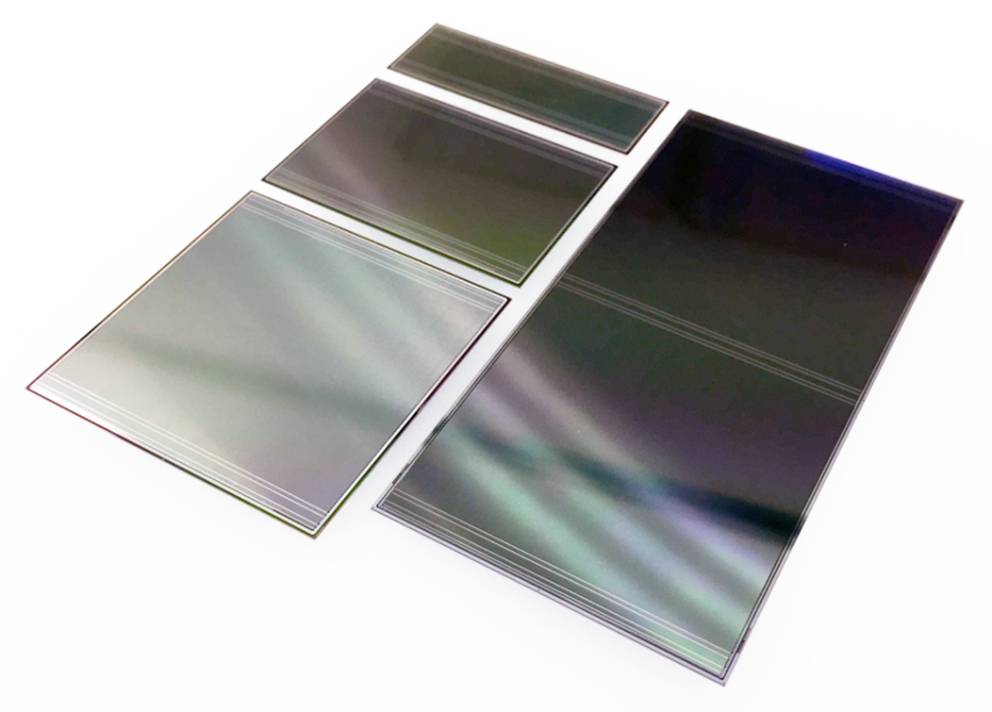
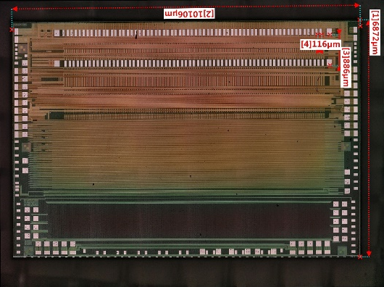
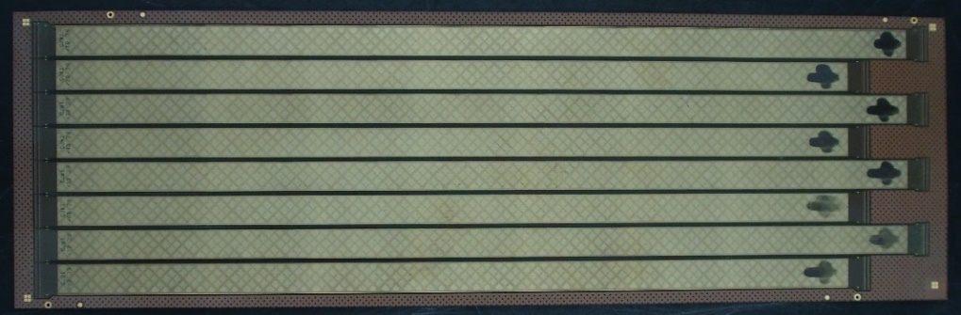
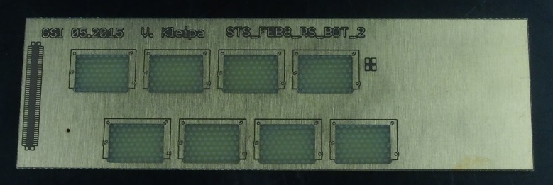
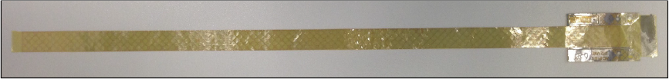
Module components
STS-XYTER readout ASIC with 128 channels. Size: 7 mm x 10 mm
Double-sided silicon microstrip sensors. Thickness: 300 µm. Sizes: 62 mm x 22, 42, 62, 124 mm
FEB-8 readout board dummy
Low mass microcables with varying length. Top: single cable. Bottom: sheet of 8 cables. Pitch:116 µm
Notes:
Message: High complexity due to multitude of components !
More than 20 module types! (22)
Lots of different cables (bias, not biased, lengths…) : lot of care necessary during assembly to not mix things up
Focus on cable and module variation
Small sensors for high granularity close to the beam, bigger sensors for the outer regions.

Slide 9
STS numbers
Part | Quantity
Stations | 8
Ladders | 106
Modules | 896
Frontend boards (FEB) | 1792
STS XYTER ASICs | 14 336
Microcables | 14 336 or 28 672
Channels | 1.8 million
Three module production centers
  JINR (50 of 120 %), stations 1 - 4
  KIT (40 of 120%), stations 5 - 8
  GSI (30 of 120 %), stations 5 - 8
Module production schedule: Sep. 2019 – June 2021
Detector finished beginning of 2024
Notes:
Why two numbers for cables? Will be clear in a few minutes.

Slide 10
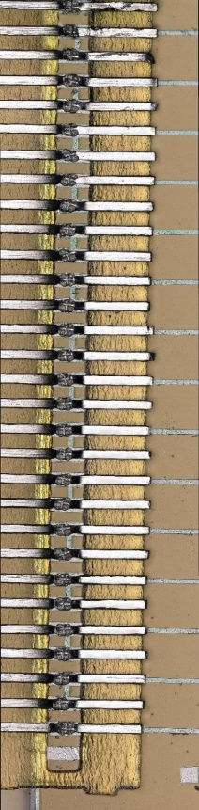
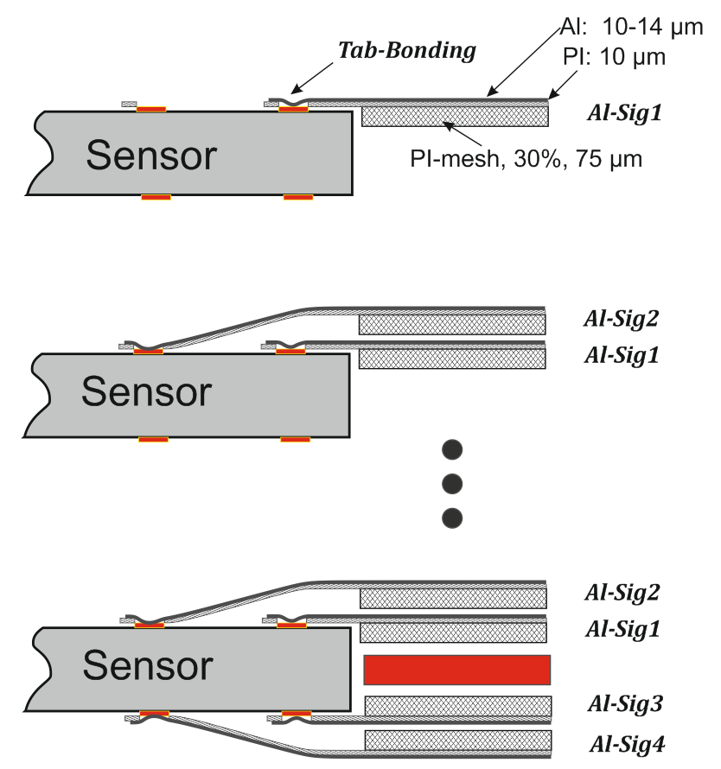
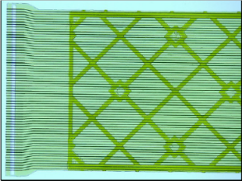

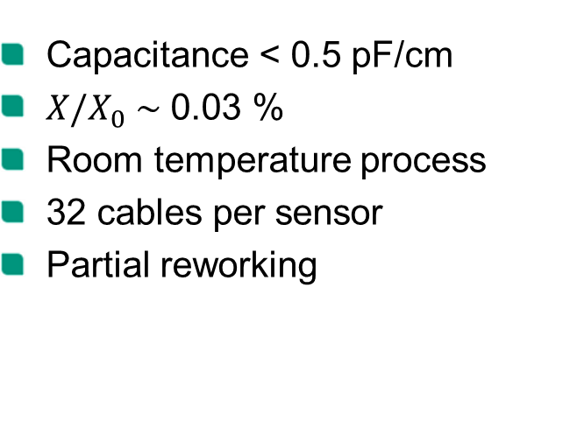
Module assembly: Al – Al TAB bonding
64 channels with 116 µm pitch
15 µm Al on 10 µm PI
Al-Al TAB bonding
Assembly workflow
Capacitance < 0.5 pF/cm
${X/X}_{0} \sim$ 0.03 %
Room temperature process
32 cables per sensor
Partial reworking
Notes:
Al trace-Breite? 30 µm auf Kabel 112 µm Pitch, 45 µm vorne bei 116 µm Pitch
Dicke 15µm
Measured with LCR meter. Put shielding and all lines to GND. Measured one line with respect to GND.
X0= 2*15 µm Alu * ¼ Füllfaktor + 2*10 µm PI + 2*75 µm Pi meshed (30%)

Slide 11
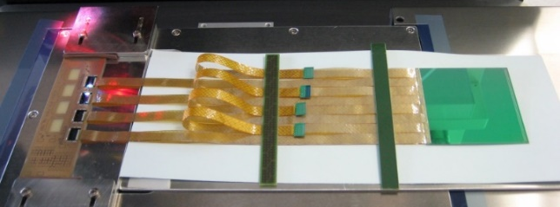
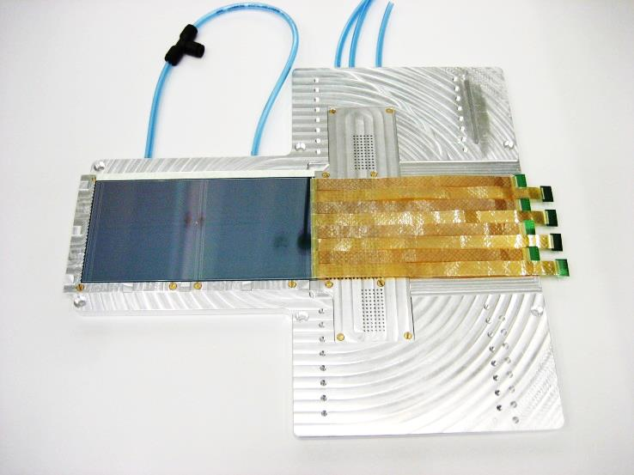
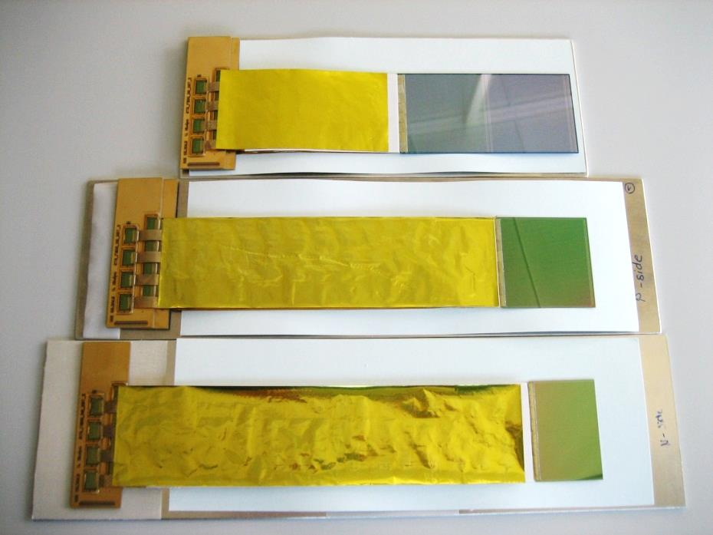
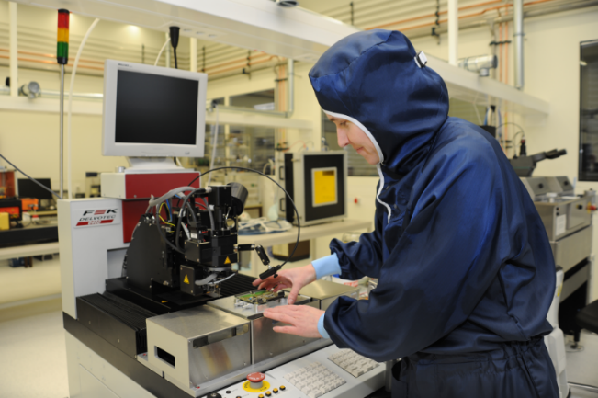
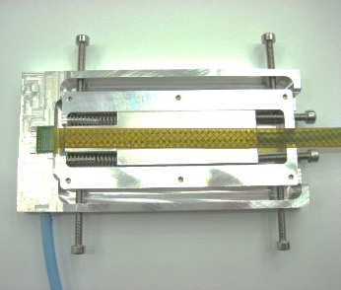
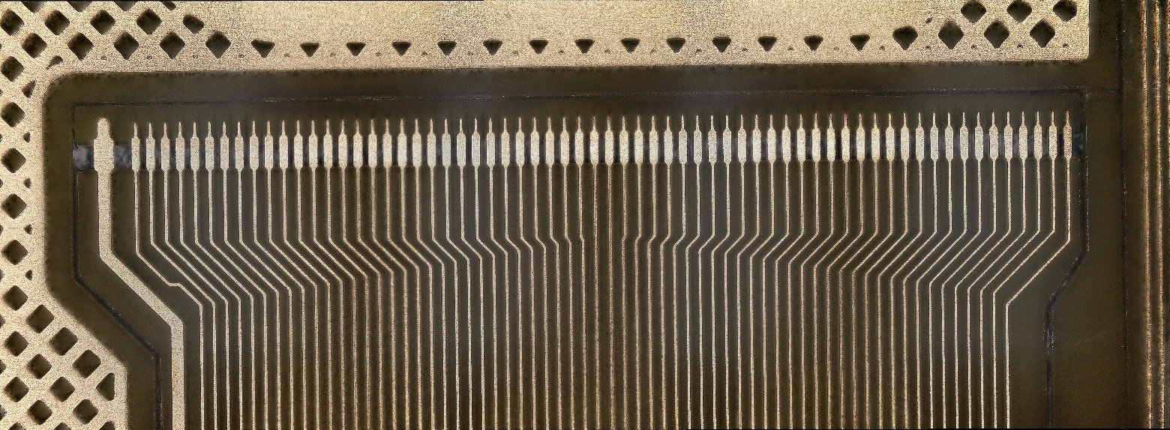
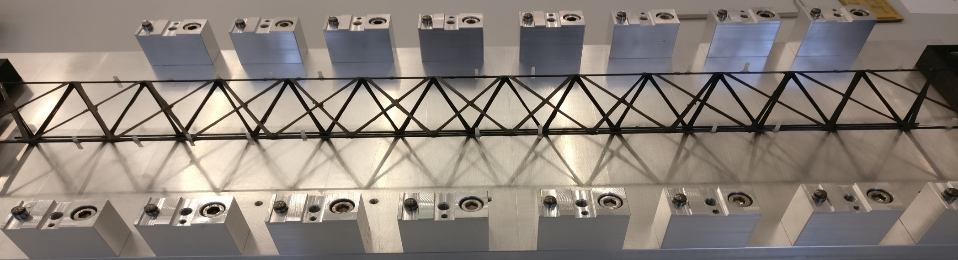
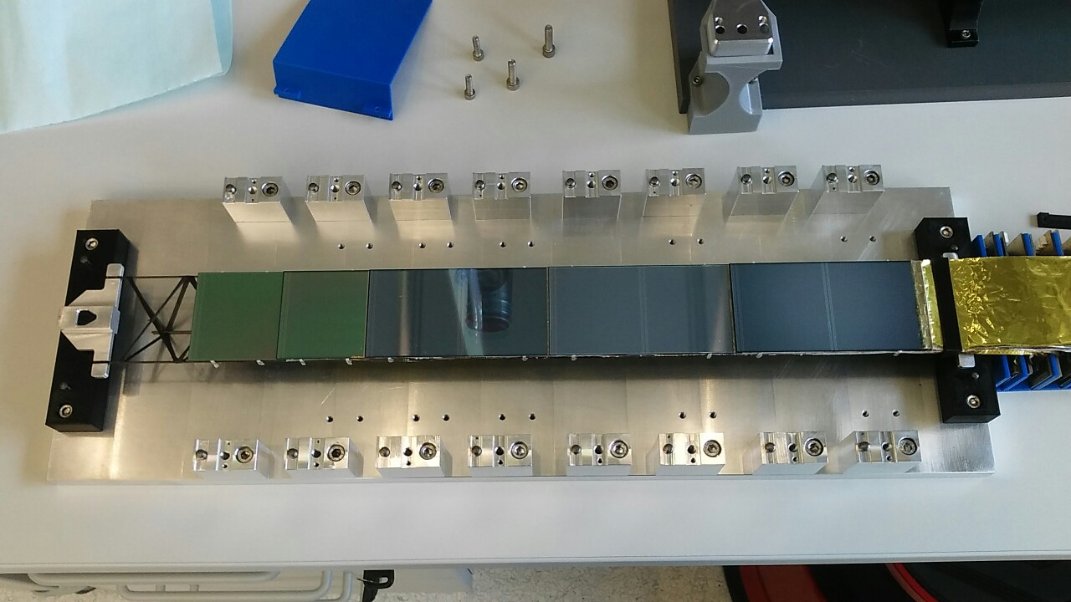
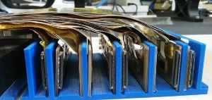
Module assembly: TAB bonding @ GSI
Several complete dummy modules built
Modules with real sensor and one STSXYTER ASIC tested in beam time at COSY Feb. 2018
Glueing ROCs on FEB-8
Sensor-side bonding
Dummy modules with shielding
ROC-side bonding
Well-established, several full modules with different cable lengths and sensor sizes built and integrated into light-weight carbon ladder frame
Manual procedure
Single supplier in Kharkov, Ukraine
Carbon ladders before (top) and after (bottom) module mounting
FEB-8 boards
Copper microcable designed for TAB bonding.
Notes:
JINR: Dubna nahe Moskau, Russland. Größte Forschungszentrum für Kern- und Teilchenphysik in Russland

Slide 12
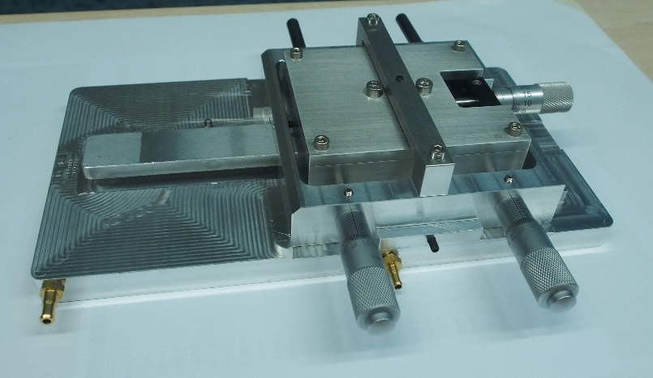
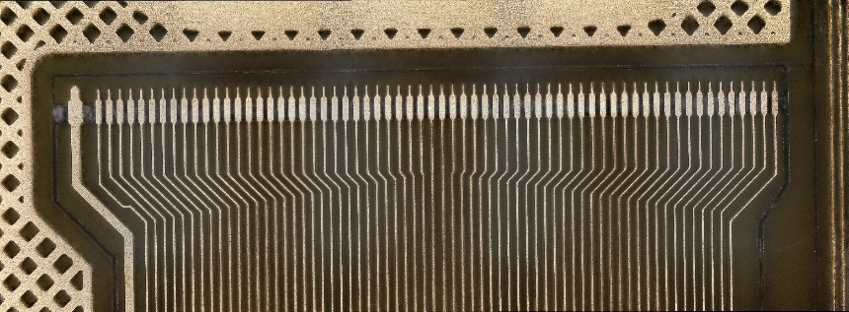
Module assembly: Cu - Al TAB bonding
More industry experience with Cu
Combining several cables possible due to higher yield
  Less complex assembly
Cu is hard, can destroy bond pad
Cu - Al TAB bonding requires temperature, which leads to increased oxidation
  Idea: TAB bond on Au bumps
TAB bonding jig
ROC
Au bumps
Window lasered in PI
Schematic top view of TAB bonding on Au bumps
µcable
Copper microcable designed for TAB bonding
Cu signal lines

Slide 13
Novel approach: Gold stud – solder process

Slide 14
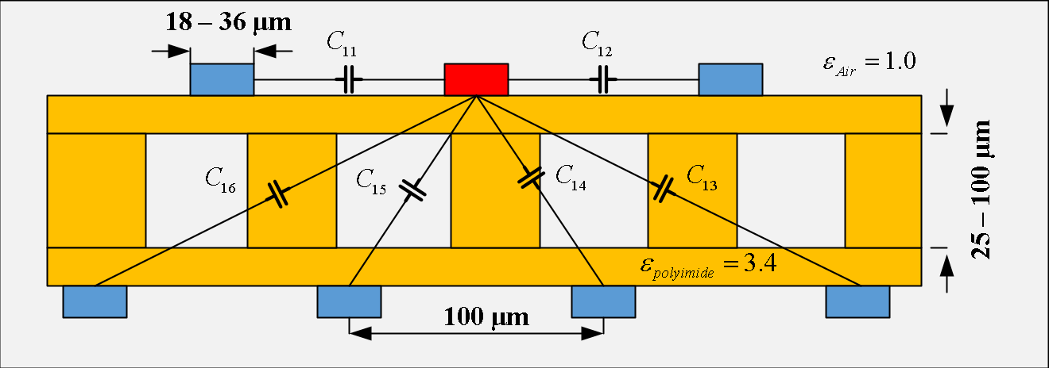
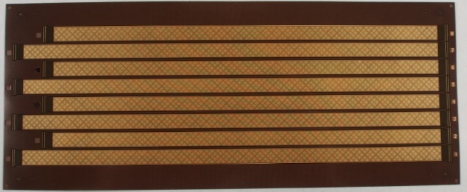
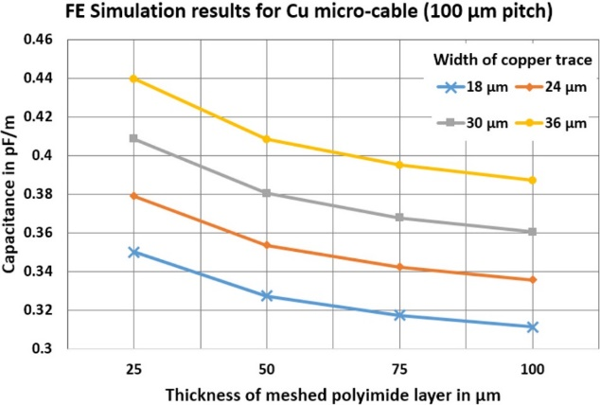
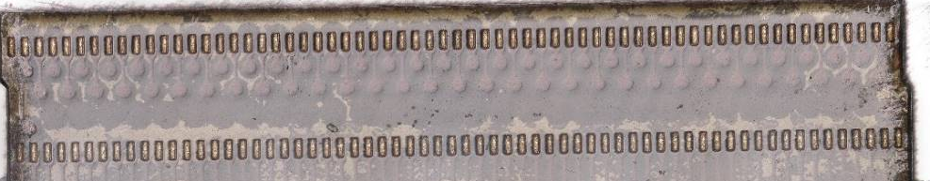
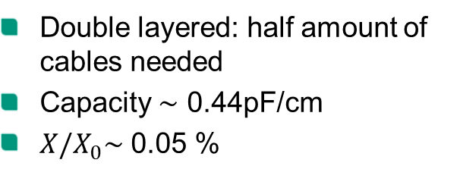
Copper microcables for Au-solder process
FEM simulation (COMSOL)
Alternative assembly solution
Higher degree of automization
Reworking of full cable
Double layered: half amount of cables needed
Capacity $\sim$ 0.44pF/cm
${X/X}_{0}\sim$ 0.05 %
Notes:
Wie Kapazität gemessen?
X0 = 2*8µm Cu * ¼ Füllfaktor + 25 µm glue + 25 µm PI + 75 µm PI meshed (30%)

Slide 15
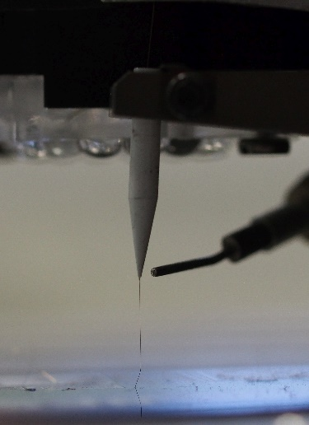
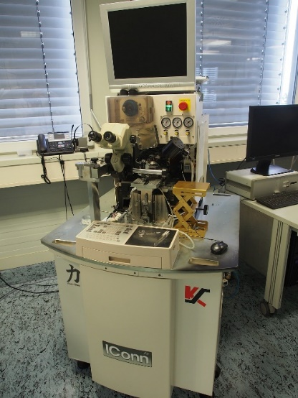
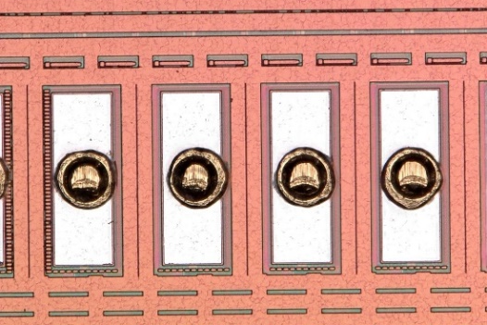
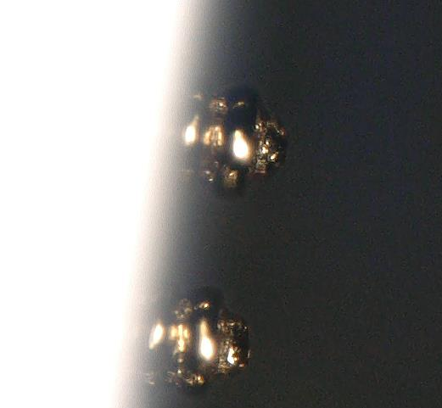
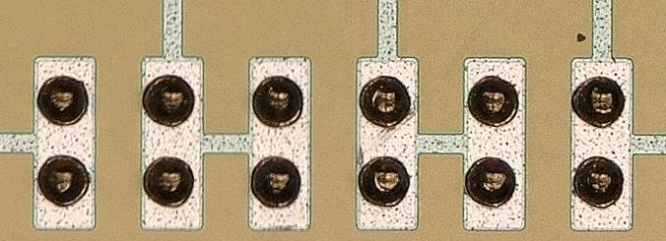
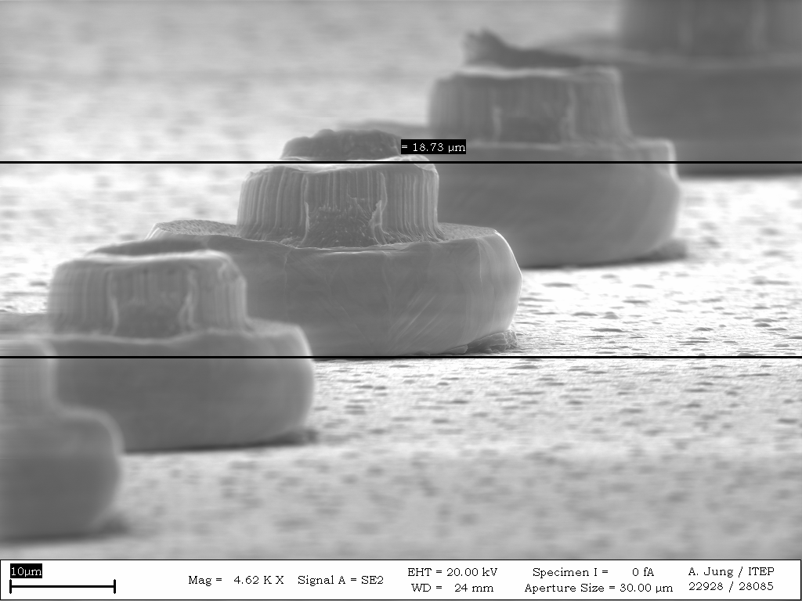
ROC and sensor side: Gold stud bumping
Iconn ball wire bonder
  20 bumps/s
STS parameters
  25 µm Au wire
  Bump diameter 60 µm
  Bump height: 30 µm
Capillary with Au wire
Gold bumps (diameter 60 µm) on STSXYTER
Double balls to improve mechanical strength
Au bump on top of another Au bump
Fast, flexible, reliable
18.09.2018
Patrick Pfistner – Novel production method for large double-sided microstrip detectors of the CBM Silicon Tracking System at FAIR

Slide 16
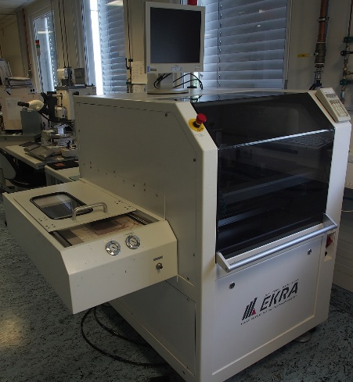
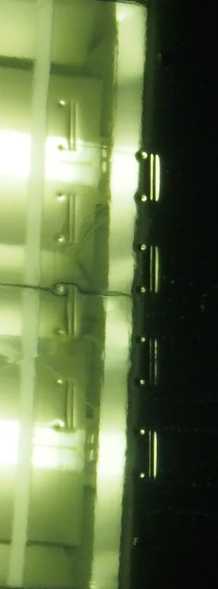

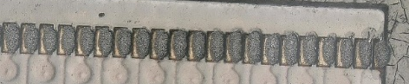
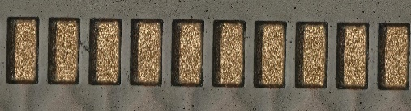
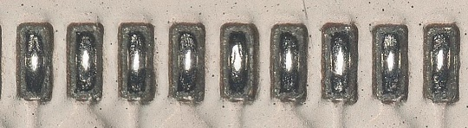
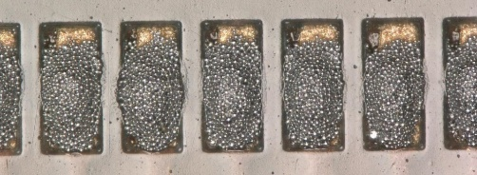
Cable side: Solder printing and reflow
Lasered openings
RoC side
Sensor side
Solder printing machine
40 µm stainless steel stencil to print 8 cables simultaneously
1. Bond pads with Au surface finish
2. After printing type 7 solder paste
3. After reflow of the solder paste

Slide 17
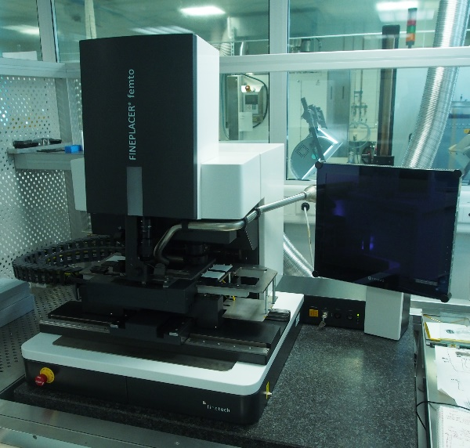
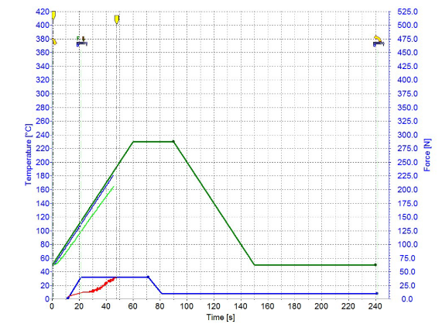
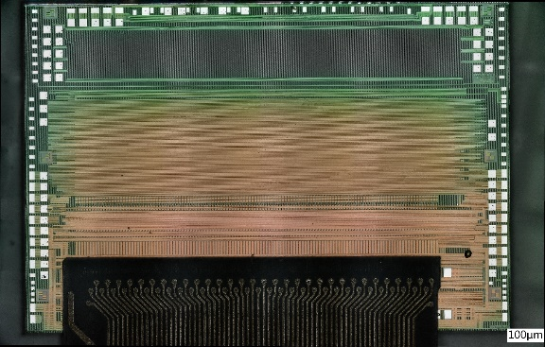


1st interconnection: ROCs on µcables
Femto fineplacer flip chip machine (0.5 µm accuracy)
ROC bonded onto µcable
Thermocompression bonding process
  F = 40 N
  T = 230 °C
ROC-µcable bonding profile
Cu µcable bonded on dummy ROC
Microcable bonded on STSXYTER
Bonding process
18.09.2018
Patrick Pfistner – Novel production method for large double-sided microstrip detectors of the CBM Silicon Tracking System at FAIR
Notes:
Example bonding profile: T=140 °C; F=20 N; t=45 s
Reflow: two plateaus T=170°C und T=250 °C jeweils mit HCOOH

Slide 18




Underfill for spark protection and improved mechanical strength
Underfill
ROC
Cable
Underfill
Underfill application
Cu cable on STSXYTER protected by underfill
ROC and cable after disconnection
LV cable has to be protected from HV on sensor edge
Small gap ~ 20 µm, additional obstructions by gold bumps
First tests with Polytec EP601-LV (Viscosity: 240 mPas) are encouraging
Optimized cable layout for underfill application foreseen
Sensor
Application windows for underfill
Improved cable design

Slide 19



High mechanical robustness
Shear test: quantitative measurement of mechanical strength
2-3 kg shear strength without underfill
  Ball lift-off gold bump connection is the weak link, not Au-solder
Optimization of bumping parameters should increase mechanical strength further
Cable torn apart outside the connection area after application of underfill
ROC
Shear direction
Au bumps
Cable
Shear test setup. Cable is clamped down firmly while the shear tool shears the RoC
Shear test reveals that all Au bumps are lifted off the ROC

Slide 20





2nd interconnection: in-house bonding machine for sensor side
Camera 1
µCables
Sensor
Camera 2
In-house bonding machine currently under construction
    Fixed, heatable bond head
    Screw-on vacuum plates for cable fixation
    Heatable table moving in x,y,z and phi with submicron precision
    Bond force up to 100 N
    Two-camera system for alignment of cable and sensor
    Built-in syringe for automated underfill application
    N2 reflow process possible
Four stepper motors (x,y,z,$φ$) with sub-micron resolution
  Bond force up to 100 N, force controlled by force sensor
Temperature regulated heatable bond head and sensor plate
Top and bottom camera
Automated vacuum control
Syringe for underfill application
Top camera
Bondhead
µCables
Sensor
Sensor too big to be handled by machines
    Sensor on table, cable picked up by machine
Very challenging!
Bottom camera
Image of sensor dummy bond pads (left) and cable bond pads (right) taken by implemented cameras
Notes:
Mikroschrittauflösung :39 nm
Lenses Lensation TCST-40-40C
-working distance 40 mm
-Resolution: 4.8 µm
Depth of Field: 143 µm
Cameras;
Basler acA2440-75uc and Basler acA1300-200um
Sensor size: ½ “, 11 mm
Pixel size:

Slide 21
Summary
Very low material budget requirements for the STS force the readout electronics outside the beam aperture which leads to a complex detector module conception
Detector module production is divided internationally between three institutes
Al – Al TAB bonding as primary interconnection technology
A novel high-density interconnection method for large double-sided microstrip sensors has been developed
Au stud – solder process enables a new bonding technology of ASIC and sensor on flex microcable

Slide 22
Thank you for your attention!

Slide 23
Backup slides

Slide 24
Station sizes

Slide 25



Sensor sizes
STS 1
outer parts of large stations
standard sensors throughout the stations
strip length
fill gaps at beam hole
few sizes,
small numbers
6.2 cm × 2.2 cm
6.2 cm × 4.2 cm
6.2 cm × 6.2 cm
6.2 cm × 12.4 cm

Slide 26





30 ns rise time
self-triggering:
channels deliver stream of ADC values above threshold + timestamp
128 channels
n-XYTER chip
- from a neutron imaging project
- used for current prototyping (v1, v2.0)
NIM A 568 (2006) 301–308
170 ns rise time
128 channels
per channel:
two-stage internal trigger
adapted to high capacitive load
back-end GBT compatible
STS-XYTER chip
- dedicated development for STS, now v2.0

Slide 27
Silicon Tracking System (STS) design constraints
Coverage
  aperture 2.5° < Θ < 25°
No event pile-up
Efficient hit & track reconstruction
Minimum granularity
  largest read-out pitch compatible with the required spatial resolution
  maximum strip length compatible with hit occupancy and S/N performance
Radiation hardness
Integration, maintenance
  Confined space inside dipole magnet
  Cooling
  Extraction possibility
Momentum resolution
  Δp/p ~ 1%
  material budget per station 0.3 - ~1% X₀
Read-out electronics must be located outside the beam aperture!
Notes:
Momentum resolution requirement has strong effects on design: electronics outside aperture !!
No pile-up: interaction rates 0.1 - 10 MHz, self-triggering read-out, timestamp resolution < 5 ns, signal shaping time < 20 ns
Efficient hit & track reconstruction: close to 100% hit efficiency; > 95% track eff. for p > 1GeV/c

Slide 28


Underfill breakdown test
side view
Kapton
Underfill
8mm
Air inclusion
top view

Slide 29
Fundamental questions of QCD
What is the equation of state of QCD matter at high net-baryon densities, and what are the relevant degrees of freedom at these densities? (→ core collapse supernovae, neutron stars, early universe).
Is there a phase transition from hadronic to quark-gluon matter, or a region of phase coexistence and a critical point? Do exotic QCD phases like quarkyonic matter exist?
To what extent are the properties of hadrons modified in dense baryonic matter? Are we able to find indications of chiral symmetry restoration? (→ origin of hadron masses, i.e. of the visible universe).
How far can we extend the chart of nuclei towards the third (strange) dimension by producing single and double strange hypernuclei? Does strange matter exist in the form of heavy multi-strange objects?
Notes:
Source: Senger, slide 15
Two properties of QCD explain the basic features of the observed spectrum of hadrons - confinement and chiral symmetry breaking. Chiral symmetry breaking leads to a non-vanishing quark anti-quark condensate, qq(250 MeV)^3, in the vacuum.
Chiral symmetry of QCD broken, otherwise quarks are massless. Broken by Higgs mechanism. Massive fermions do not exhibit chiral symmetry, as the mass term in the Lagrangian, m¯𝜓ψ, breaks chiral symmetry explicitly.
In particle physics, a hyperon is any baryon containing one or more strange quarks, but no charm, bottom, or top quark.^{[citation needed]} This form of matter may exist in a stable form within the core of some neutron stars
Three quarks. Fermions, Hadrons.
Invariance under parity transformation by a Dirac fermion is called chiral symmetry. The chirality of a particle is more abstract: It is determined by whether the particle transforms in a right- or left-handed representation of the Poincaré group.^{[a]}
For massless particles – photons, gluons, and (hypothetical) gravitons – chirality is the same as helicity; a given massless particle appears to spin in the same direction along its axis of motion regardless of point of view of the observer.
For massive particles – such as electrons, quarks, and neutrinos – chirality and helicity must be distinguished.

Slide 30

QCD phase diagram at very high T
N of baryons ≈ N of antibaryons; early universe
L-QCD finds smooth crossover from hadronic matter to Quark-Gluon Plasma
ALICE, ATLAS, CMS at LHC; STAR, PHENIX at RHIC
Courtesy of K. Fukushima & T. Hatsuda
Notes:
Resembles early universe.
Wikipedia: Lattice QCD (L-QCD) is a well-established non-perturbative approach to solving the quantum chromodynamics (QCD) theory of quarks and gluons. It is a lattice gauge theory formulated on a grid or lattice of points in space and time.
When the size of the lattice is taken infinitely large and its sites infinitesimally close to each other, the continuum QCD is recovered.
Relativistic Heavy-Ion Collider(RHIC): Brookhaven, New York: first and one of only two operating heavy-ion colliders, and the only spin-polarized proton collider ever built.
In 2010, RHIC physicists published results of temperature measurements from earlier experiments which concluded that temperatures in excess of 345 MeV (4 terakelvins or 7 trillion degrees Fahrenheit)
had been achieved in gold ion collisions, and that these collision temperatures resulted in the breakdown of "normal matter" and the creation of a liquid-like quark–gluon plasma.^{[7]}
Why chemical potential and density seem interchangeable in this plots???
Essentially, chemical potential is a measure of how the energy of a system changes as you add another particle to it.
Here, it is shown that the Fermi momentum pF is dependent on density1/3. Since the Fermi energy is proportional to p2F, it is also proportional to density2/3.
The chemical potential is proportional to the Fermi energy, so it is also proportional to density2/3.
Finally, Critical Point is not really a critical point but a cross over point. This behaves as a true critical point for a phase transition if you take zero mass for quarks and zero chemical potential.

Slide 31

CBM physics cases

Slide 32


Heavy ion collisions and observables

Slide 33




Baryon densities in central Au+Au collisions
8 ρ₀
5 ρ₀
I.C. Arsene et al., Phys. Rev. C 75, 24902 (2007)
Notes:
This is illustrated in Fig. 2, where the excitation energy density in the center of the collision zone is shown as a function of the net-baryon density for central Au+Au
collisions at beam energies of 5A and 10A GeV as predicted by several transport models and a hydrodynamic calculation [15, 16]. The solid lines correspond to
the time evolution of the system; they turn in a clockwise sense, and the dots on the curves labelled UrQMD and QGSM correspond to steps of 1 fm/c in collision time.
The dashed lines enclose the expected region of phase coexistence.
According to these model calculations, the density in the center of the ﬁreball exceeds 6 times saturation density ρ0 at a beam energy of 5 AGeV, and at 10 AGeV even
a density above 8ρ0 is reached. At such densities, the nucleons are expected to fuse and form large quark bags.

Slide 34


Experimental challenges
Combination of a large-acceptance fast detector and a high-speed data read-out system with high-luminosity beams.
Rate capability is key feature to measure observables with high precision
extremely high
interaction rates
required !
e⁺e⁻
μ⁺μ⁻
Statistical model, A. Andronic, priv. com.
Notes:
10 AGeV at the Alternating Gradient Synchrotron (AGS)

Slide 35




Discovery potential
Hypernuclei yields at midrapidity for central collisions (thermal model)
CBM energy range
CBM energy range
A. Andronic et al., Phys. Lett. B697 (2011) 203
Notes:
A hypernucleus is a nucleus which contains at least one hyperon (a baryon carrying the strangeness quantum number) in addition to the normal protons and neutrons.
The presence of a critical point is expected to lead to a non-monotonic behaviour of the κσ^2observable. the volume-independent cumulant ratio κσ^2 (excess kurtosis times squared standard deviation).
These results clearly call for a high-precision measurement of higher-order ﬂuctuations at lower beam energies in order to search for the peak in κσ^2.
The Poisson expectation is denoted as dotted line at kσ^2= 1.
Maximum in hypernuclei yield is due to the superposition of two effects: the increase of light nuclei production with decreasing beam energy, and the increase of hyperon production with increasing beam energy.
Up to now only very few double-Λ hypernuclei events have been found.
Die Kurtosis gibt an, wie weit die Randbereiche einer Verteilung von der Normalverteilung abweichen. Der Kurtosis-Wert 0 gibt an, dass die Daten der Normalverteilung perfekt folgen.
Wenn ein Kurtosis-Wert wesentlich von 0 abweicht, kann dies darauf hinweisen, dass die Daten nicht normalverteilt sind.
Der Exzess gibt die Differenz der Wölbung der betrachteten Funktion zur Wölbung der Dichtefunktion einer normalverteilten Zufallsgröße an

Slide 36
Summary
model calculations predict the creation of strongly interacting QCD matter at extreme values of density, similar to neutron star core densities.
opportunity to explore the QCD phase diagram in the region of high net-baryon densities, to study the equation of state, to search for phase transitions, chiral symmetry restoration, and exotic forms of (strange) QCD matter with a dedicated experiment.
Measurement of the collective behaviour of hadrons, together with rare diagnostic probes such as multi-strange hyperons, charmed particles and vector mesons decaying into lepton pairs with unprecedented precision and statistics
Reaction rates up to 10MHz requires very fast and radiation hard detectors, a novel data read-out and analysis concept including free streaming front-end electronics.
Notes:
model calculations predict the creation of strongly interacting QCD matter at extreme values of density, similar to neutron star core densities.
opportunity to explore the QCD phase diagram in the region of high net-baryon densities, to study the equation of state, to search for phase transitions, chiral symmetry restoration, and exotic forms of (strange) QCD matter with a dedicated experiment.
Measurement of the collective behaviour of hadrons, together with rare diagnostic probes such as multi-strange hyperons, charmed particles and vector mesons decaying into lepton pairs with unprecedented precision and statistics. Most of these particles will be studied for the ﬁrst time in the FAIR energy range.
Reaction rates up to 10MHz requires very fast and radiation hard detectors, a novel data read-out and analysis concept including free streaming front-end electronics.

Slide 37

Collider vs. fixed target experiments
s_{NN} = (E₁ + E₂)² – (p₁ + p₂)²
collider:
p₁ + p₂ = 0 → √s_{NN} = E₁ + E₂
fixed target: E₂ = m, p₂ = 0
s_{NN} = (E_{kin}+ 2m)² – p₁²
s_{NN} = 2m·(E_{kin}+ 2m)
for E_{kin}>> m : √s_{NN} = 1.4·√ E_{kin}

