Slide 1
HEST status
2018.09.25
m.sapinski

Slide 2
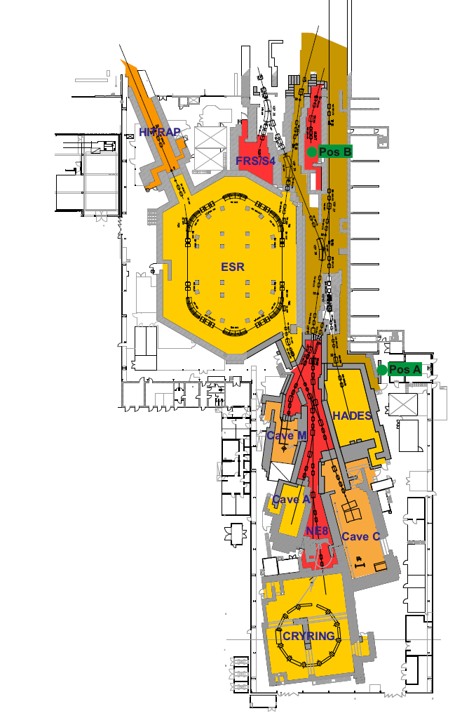
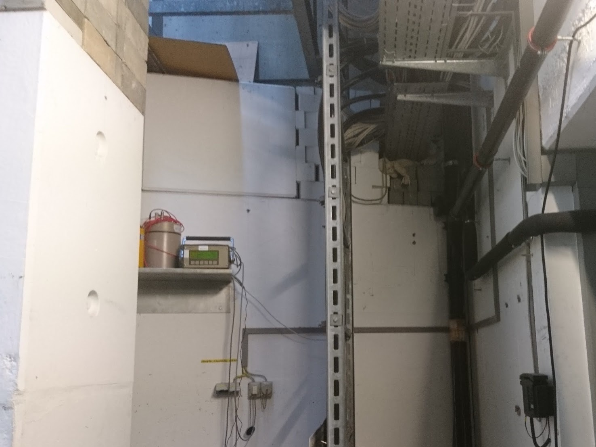
Shielding
Three openings in the concrete shielding walls closed:
cable tray
cable duct
better closing of holes in pion target bunker
hole in the wall

Slide 3
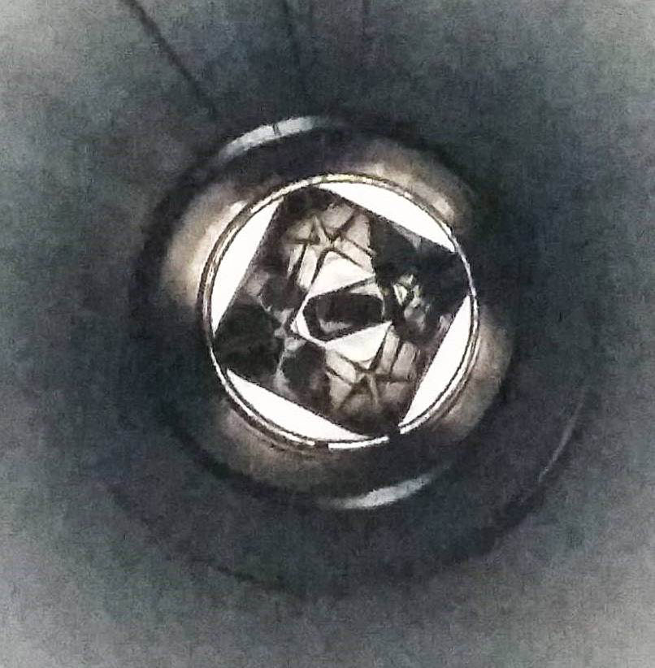
Beam pipe inspection
Three sectors vented, opened in 6 places and inspected
GTH2DK2, GTH2DKY, GTH2DKA, bellow next to GHADKY1, bellow next to GHADDK2, GHADDK3
no obstacles found
SEM of a PDC in GHADDK3 slightly bend – repaired in situ
not enought activation to pinpoint beam loss location
courtesy O. Geithner
view from GHADDK2 through pion target area

Slide 4
Preliminary ToDo list for engineering run (I)
Dry run
check all equipment line-by-line, use the sequencer where it is possible
With beam
HHD/HTP: measure extraction efficiency and fit beam optics using measurements from screen GS06DF, GTE1DK1/DF and GTH2DK4/DG (this is on HADES line)
HADES:
setup the beam to the target using low-energy beam (200 MeV/u), measure loss pattern using BLMs
setup the beam to target using high-energy beam, measure loss pattern using BLMs
check other optics (from Sebastian, Sabrina)
spill-structure investigation, extraction efficiency versus sextupole settings

Slide 5
Preliminary ToDo list for engineering run (II)
With beam (cd)
HTC/HTD: bring beam to target, give mini-CBM some time to tune the detectors
HTA/HTM: bring beam to the target, optimize beam spot
ESR: establish injection, try extraction to Cryring

