Slide 1
Exploring Electromagnetic structure of baryons and hyperons with HADES
P. Salabura
M. Smoluchowski Institute of Physcis
Jagiellonian University, Kraków
Poland
EMMI workshop GSI 2018
„

Slide 2
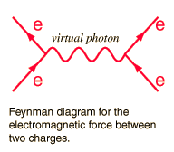
Motivation
em. probes
B
Electromagnetic probes ideal tool to study
Baryon structure at different q² scales
q²
B
G. Brown,M. Rho, W.Weise NPA(1985) 669
„two-phase” model of nucleon
ρ
coupling of ρ to pion cloud and γ to core describes chargé distribution of nucleon
Size of pion is almost entirely determined by coupling to ρ meson

Slide 3
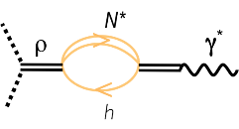
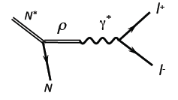
Vaccumm
Radiation from hot hot and dense baryonic medium
ρ_{medium} →e+e-
ρ →e+e-
In HADES energy regime dominated by baryons!

Slide 4

Various kinematical regimes
Figure from G. Eichmann
annihilation experiments
e- scattering experiments
N*→Ne+e-
N
e+
q² >0
N
N (N*)
, helicity
amplitudes,..
e-
N
= -q²
$$=M_{N∗}−M_{N}$$
N*
N
Transition Form Factors
HADES: Dalitz decays of Baryons
Vector Meson Dominance in play?
„QED”
Magnetic G_{M} (q² )
Electric G_{E} (q² )
Coulomb G_{C} (q² )

Slide 5
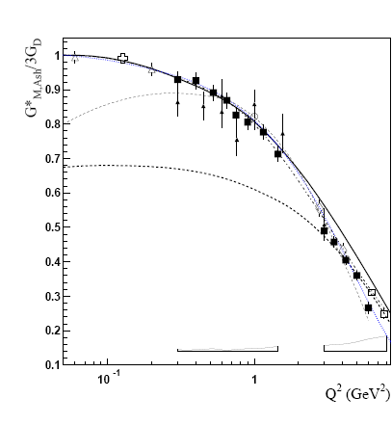
Electro-scatering experiments
Data JLAB, MAMI
γ*
„pion cloud”
I. G. Aznauryan and V. D. Burkert,
Prog. Part. Nucl. Phys. 67, 1 (2012)
„quark core”
Meson electroproduction
Δ₃₃ (1232) J^{P} =3/2 ⁺ → N J=1/2⁺ γ*
Dominant M1 (-1)^{L+1} (spin flip) transition –
G_{M} (q² ) plays dominant role
At small q² important role of pion cloud !

Slide 6
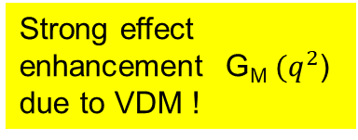


Results and predictions for D₁₃(1520)→Nγ*
Completely dominated by meson cloud and ρ (with some ω mixture)
Dielectron inv mass spectrum
Data CLAS : theory T. Pena et al. PRD93(2017)
ω
$$q^{2}$$
$$q^{2}$$
Space-like
Time - like
Strong effect enhancement G_{M} ${(q}^{2}$) due to VDM !

Slide 7
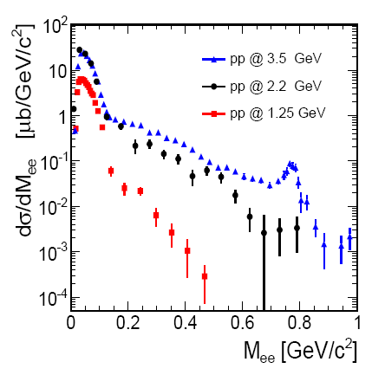
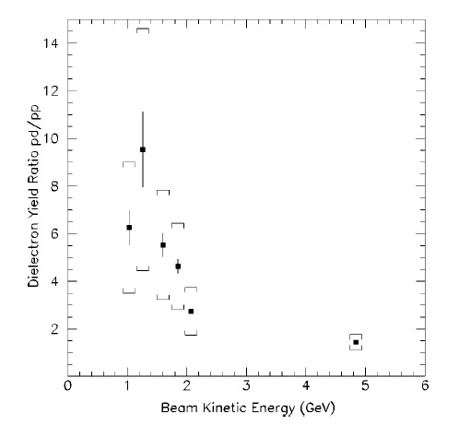
Excition function of e+e- @ SIS18
Inclusive e+e-
DLS/HADES data: strong isospin effects !
π°→γ e+e-
η→e+e- γ
η ω
M>M_{π}⁰
ω→e+e-
σ (dp)/σ(pp)
η, Δ
~2
Δ→Ne+e-
1 2 3 4 5 E_{beam} (GeV)
DLS: PRC57 (1998)1867
HADES PLB715(2012)314,arXiv:1703.08575
M_{e+e-} < 0.15 GeV/c² dominated by π⁰ Dalitz
M_{e+e-} > 0.15 GeV/c² : Resonance (Δ, N*)→Ne+e- , NN bremsstrahlung ,η →γe+e- , ω→e+e-
thresholds (GeV): E_{s} ^{η}= 1.25 , E_{s}^{ω}= 2.1
Strategy to separate baryon resonance contribution: study exclusive channels
with pionic and dielectron final states

Slide 8
Δ →Nγ* Transition

Slide 9
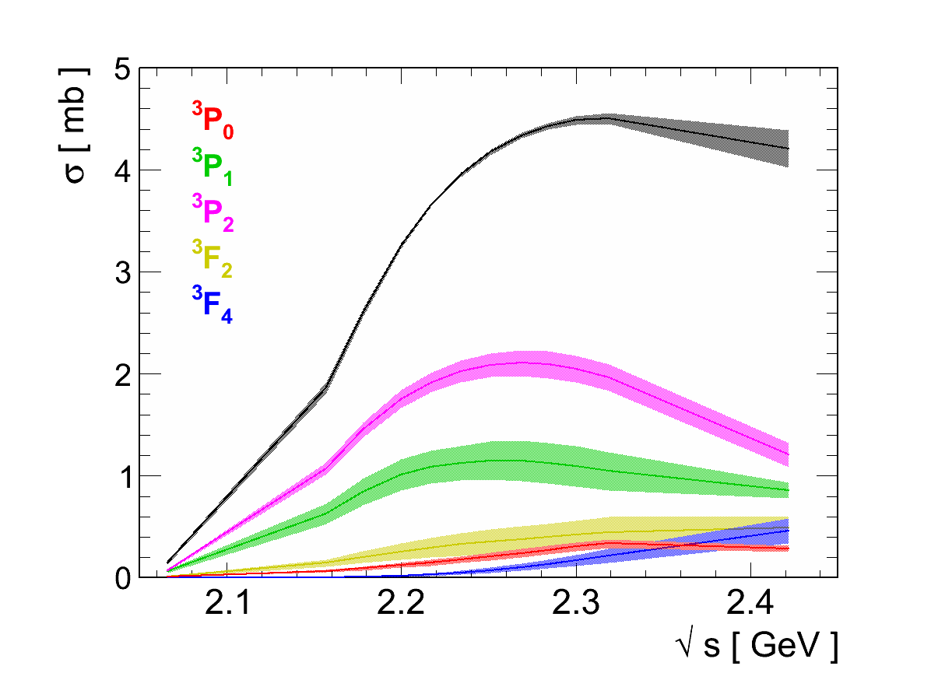
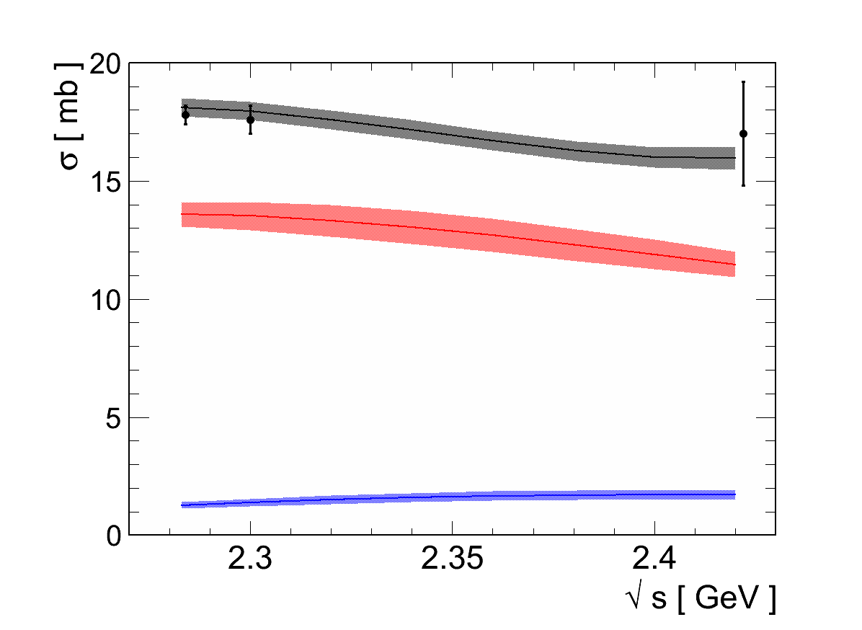
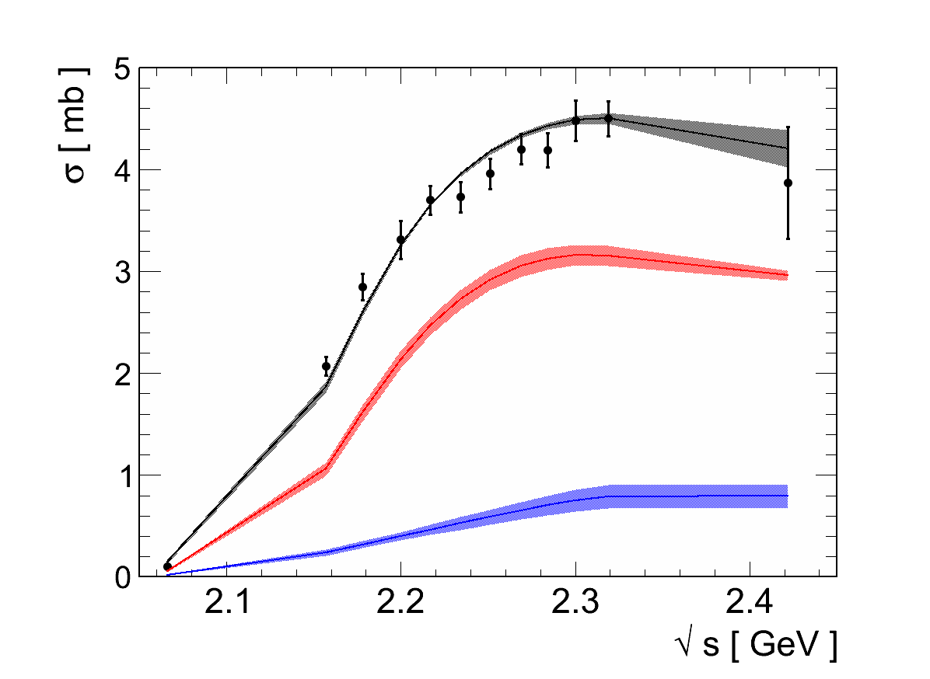


Separating Δ (pπ⁺, pπ⁰) in pp@1.25 GeV
13 PNPI + 2 HADES data sets
$$npπ^{+}$$
$$ppπ^{0}$$
Bonn-Ga PWA solutions
FINAL STATES:
P₃₃(1232) and
P₁₁(1440) in πN state
HADES :
Eur. Phys. J. A51 (2015) 137
red Δ(1232)P₃₃
blue N(1440)P₁₁

Slide 10
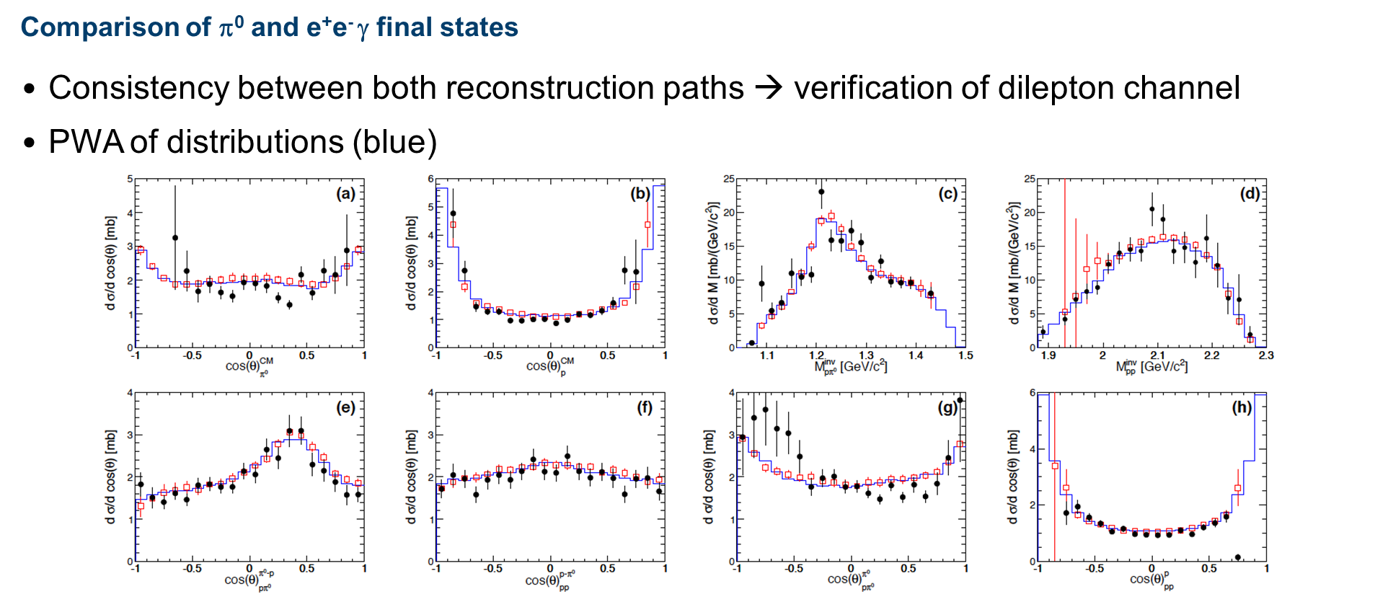
Proof of principle
Hadronic decay channel (red) fixed from one pion data and BGa PWA (blue) and compared to fitted dielectron pp→pp(π⁰ →e+e-γ) channel (black)

Slide 11
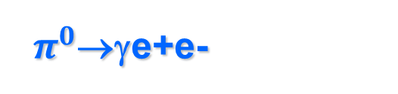
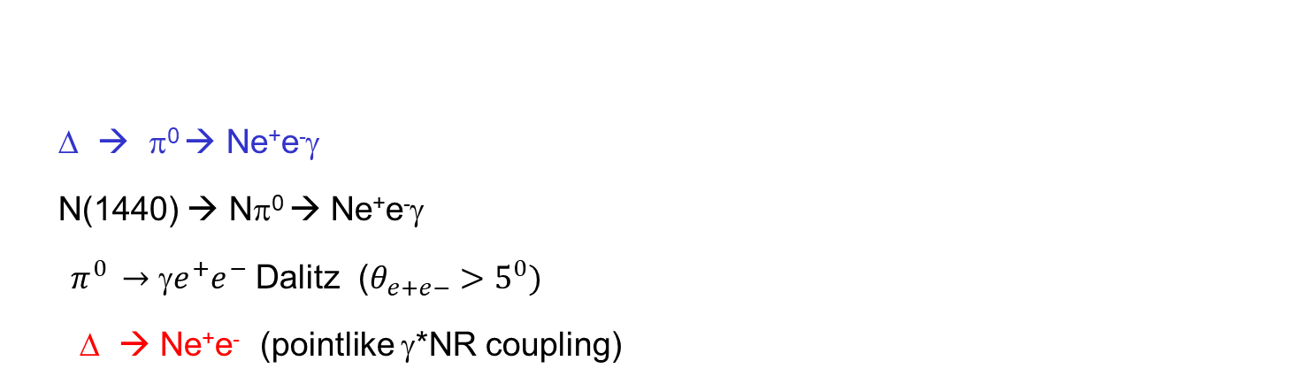
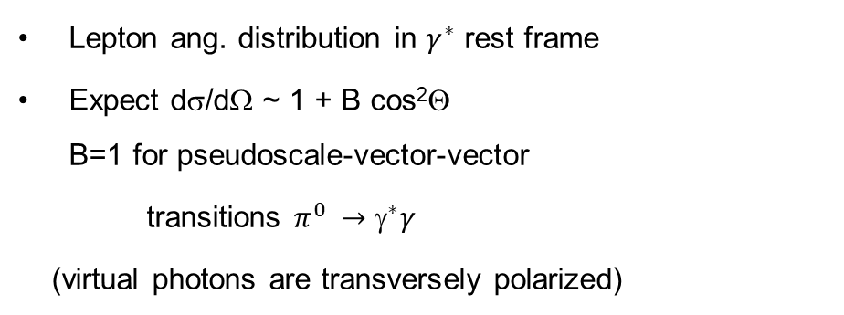
$π^{0}$→γe+e-
Δ → π⁰ → Ne⁺e⁻γ
N(1440) → Nπ⁰ → Ne⁺e⁻γ
$π^{0 }→{e}^{+}e^{−}$ Dalitz ($θ_{e+e−}>5^{0})$
Δ → Ne⁺e⁻ (pointlike γ*NR coupling)
Lepton ang. distribution in $γ^{∗}$ rest frame
Expect dσ/dΩ ~ 1 + B cos²Θ
B=1 for pseudoscale-vector-vector
transitions $π^{0 }→^{∗}γ$
(virtual photons are transversely polarized)

Slide 12
Δ⁺ { → pe⁺e– }
core
cloud
ρ
G. Ramalho, M. T. Pena, et al Phys. Rev. D 93 014003 (2017),
Δ mass
pion cloud
Quark core
HADES Phys. Rev. C95 (2017) no.6, 065205 )
Cloud , core contributes at different q² scales

Slide 13
Angular distributions for Δ→pe+e- and leptons
acceptance corrected
Δ Production in CM
e± in helicity frame
PWA solution for P₃₃ from hadronic channels
dσ/dcosθ ~ 1 + B cos²θ ; B=1.17±0.34
Δ⁺ →pe+e- : model based on PWA solution for P₃₃ and Dalitz decay (Ramahlo & Pena)
Δ⁺ →pe+e- : model assuming dominance of G_{M} ; transverse photon polarization
BR (Δ→pe+e-)=
4.19 10⁻⁵ ± 0.62 (sys) ± 0.32(stat)
Consistent description
First measurement : PDG entry

Slide 14
Virtual photons from p-n collsions
bremmstrahlung

Slide 15
pn→pnγ* →pne+e-
Many calculations (most recent only!): R. Shyam/ U. Mosel PRC 82:062201, 2010
R. Shyam , U. Mosel Phys. Rev. C 82:062201, 2010
L.P. Kaptari, B. K¨ampfer, NPA 764 (2006) 338
data: HADES PLB690 (2010)118 , EPJA 7, 149 (2017)
„quasi-elastic p-n bremsstrahlung”
difficult theoretical problem faced since 80’es
off shell nucleon em. FF (in time-like region)
nucleon-nucleon potential
Conservation of gauge invariance in calculations
Sham & Mosel’ 2010
Experimental finding : excess of p-n over p-p (p-p fixed by Δ Dalitz Decay !)
Explanation Shym&Mosel 2010 : emission from charged pion exchange line..
Simple picture: annihilation of pions from cloud in nucleon…
„pp” Δ→Ne+e-
!

Slide 16


Lepton angular distribution in γ* rest frame
$$300>M_{ee}>140$$
$$M_{ee}>300 MeV/c^{2}$$
OBE calculations
„ρ-like”
E. L. Bratkovskaya, at. al
Phys. Lett. B 348, 325 (1995).
helicity frame
„Δ”
B
Δ→pe+e- model: Dalitz decay with
dσ/dcosθ ~ 1 + cos² θ
dσ/dcosθ ~ 1 + B cos²θ ; fit B=1.52±0.58 in AGREEMENT WITH pp data
isotropic
dσ/dcosθ ~ 1 + B cos²θ ; fit with B= -0. 4 ± 0.2.
for π+π- →ρ→ e+e- expected B= -1 HINT for Vector meson contribution in „quesielastic” bremsstrahlung

Slide 17
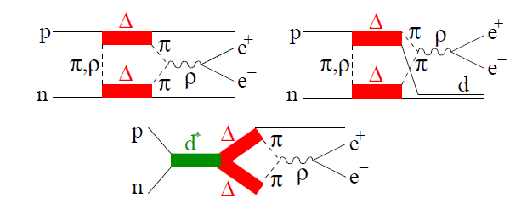
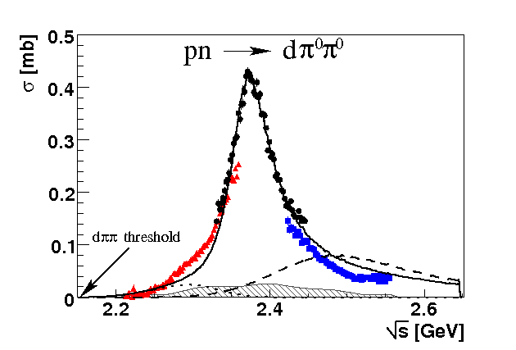
Alternative explanation: ΔΔ→pnρ fusion and FSI of dibaryon decays?
M. Bashkanov and H. Clement,
Eur. Phys. J. A 50, 107 (2014)
production by ΔΔ→ρNN
only possible for pn channel (9j coeff.)!
d* M ≈ 2380 MeV
J^{p} =3 ⁻ Γ ≈70 MeV
d* →e+e- X (direct) not included
WASA
d*
ΔΔ
HADES
17

Slide 18
Dalitz decays of Higher mass resonances

Slide 19
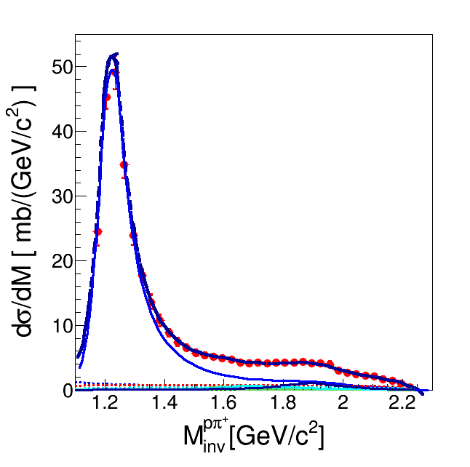
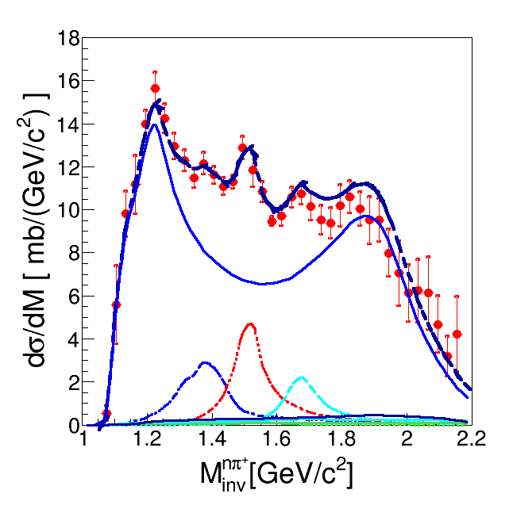
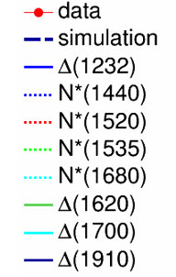
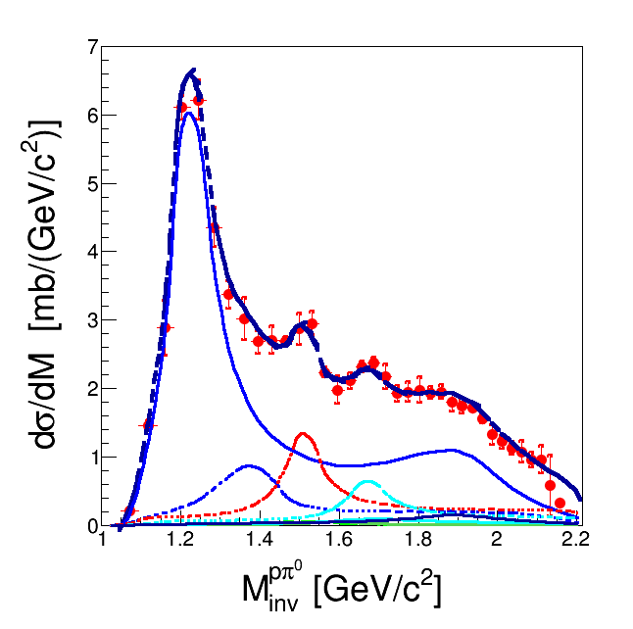
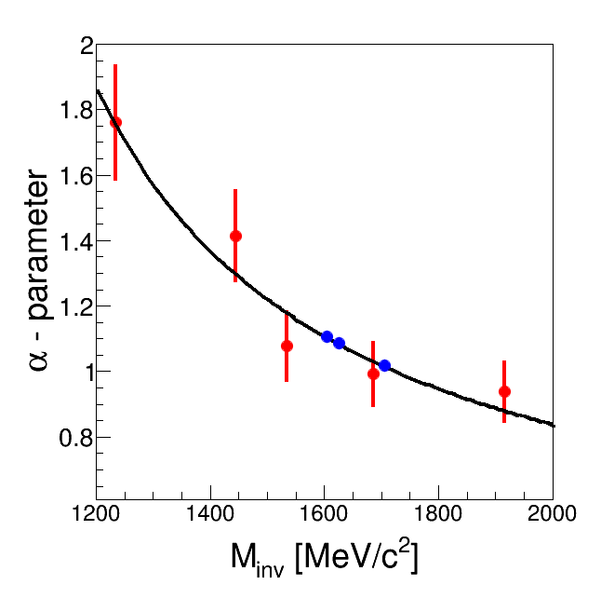
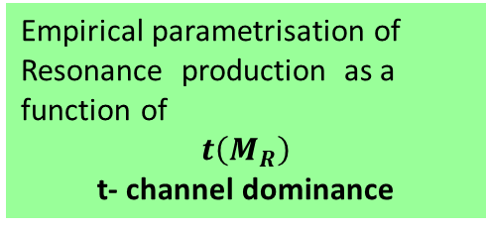


Exclusive pp→ppe+e- / pp(n)π⁰⁽⁺⁾ @ 3.5 GeV
n p π⁺
Resonance model:
Z. Teis et al., Z. Phys. A356 (1997) 421
J. Weil et al. (GiBUU) Eur. Phys. J. A48 (2012) 111
HADES : EPJA 50(2014) 42
Incoherent sum of (Δ, N*) resonances
R ( $\overline{q_{3}})$
p₁
p₂
$\overline{t}=(\overline{q_{3}}−\overline{q_{1,2}}$)
p p π⁰
Empirical parametrisation of Resonance production as a function of
$$t\left(M_{R}\right)$$
t- channel dominance
Recently confirmed also by π+π- channel

Slide 20

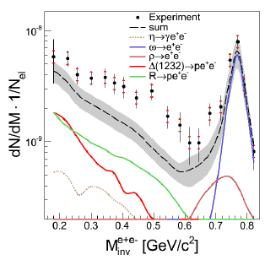
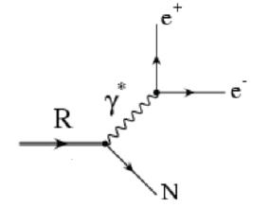
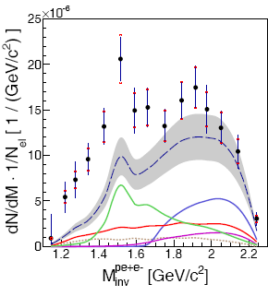
p+p→ppe⁺e⁻ @ 3.5 GeV
HADES coll. EPJA50(2014) 82
„QED” cocktail :
several contributing resonances : N*(1520), N*(1720), Δ(1620), Δ(1905),.. dΓ/dm taken from M. Zetenyi, Gy. Wolf, Heavy Ion Phys. 17, 27 (2003) (no mass dep. eTFF-”QED”)
Excess above „QED” cocktail . Seems to originate from N*(1520) region (second resonance)

Slide 21
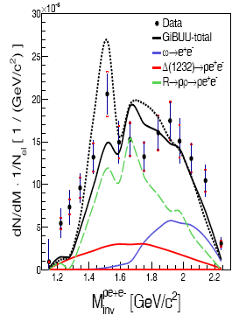
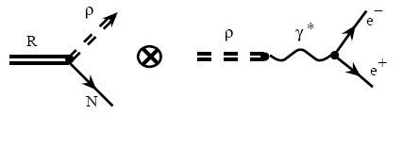
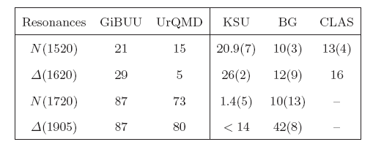
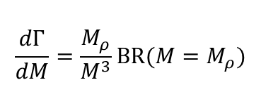
Comparison to models with strict VDM
Resonance model + strict VDM
with ρ dominance
$$\frac{dΓ}{dM}=\frac{M_{ρ}}{M^{3}}BR(M=M_{ρ})$$
Resonance -> Nρ Branching Ratios
Good description by „HADES resonance model” with lower (!) BR
R→ Nρ ,as compared to PDG, (B-Ga PWA upper limits)
Contr. to e+e-
38%
15%
22%
7%
Status 2014 !

Slide 22
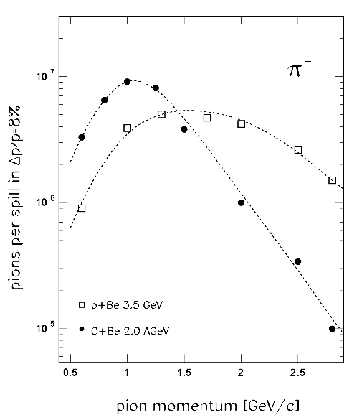
π induced reactions
GSI π⁻ momentum range 0.65-2.5 GeV/c
resonance mass can be selected by beam mom.
HADES : final states: 2πN, πN e+e- (word unique)
First measurement around √s ≅1.5 GeV second resonance
p=656, 690, 748, 800 MeV/c
Range of Beam energy Scan

Slide 23
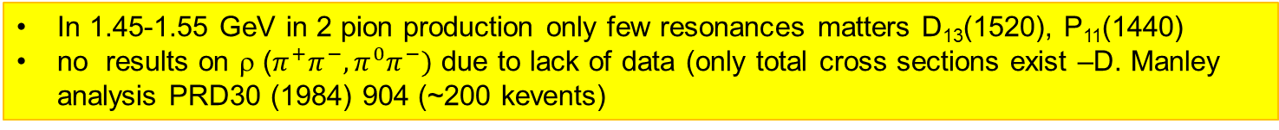
Second resonance region-BGa PWA
π⁻p→π⁰π⁰ n
γp→π⁰π⁰ p
I, J^{P}
D₁₃(1520)+..
σ [mb]
D₁₃(1520)+..
σ[μb]
P₁₁(1440)+..
P₁₁(1440)+..
F₁₅(1680)+..
Data Cristall Ball
Data Bonn
√s [GeV]
In 1.45-1.55 GeV in 2 pion production only few resonances matters D₁₃(1520), P₁₁(1440)
no results on ρ ($π^{+}π^{−}, π^{0}π^{−})$ due to lack of data (only total cross sections exist –D. Manley analysis PRD30 (1984) 904 (~200 kevents)

Slide 24
Full differential information available
Projection of Dalitz plot: decays
Production mechanism
ρ

Slide 25
Invariant masses
p=656 MeV/c
P11
D13
Decay states
Intermediate waves
Decay state

Slide 26
Projection in Helicity Frame
sensitive to ρ
sensitive to Δπ
P11
D13
Decay states
Intermediate waves
Decay state

Slide 27
Total cross sections
Preliminay
BGa PWA
π
π
Separation into final states

Slide 28
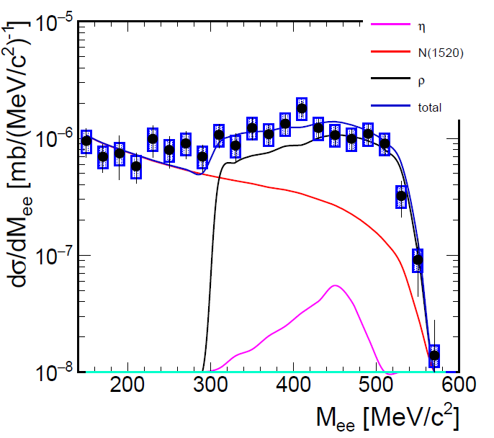
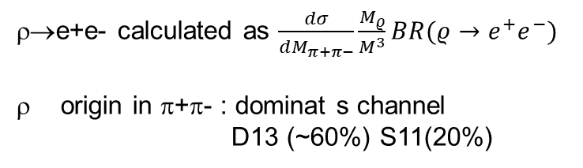
π⁻p→e+e-n @ √s=1.5 GeV
ρ from PWA
N1520→ne+e
QED
Strong rise of „VDM type”
Comparison to model with ETFF of D13 (Ramahlo/Pena) and lepton angular distributions is on-going
ρ→e+e- calculated as $\frac{dσ}{dM_{π+π−}}\frac{M_{ρ}}{M^{3}}BR(ρ→e^{+}e^{−})$
origin in π+π- : dominat s channel
D13 (~60%) S11(20%)

Slide 29
Hyperon Production and em. decays

Slide 30
Λ Production in HADES
pp @ 3.5 GeV
inklusive
PLB785 (2018) 574
Exclusive p+p→p(N*→KΛ)
EPJ. A50 (2014) 81
Λ polarization in p+Nb

Slide 31
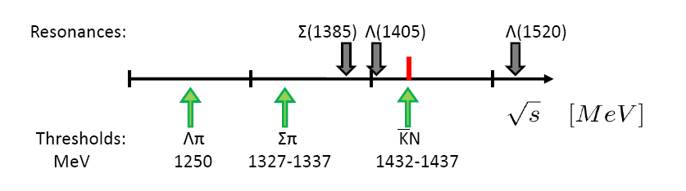
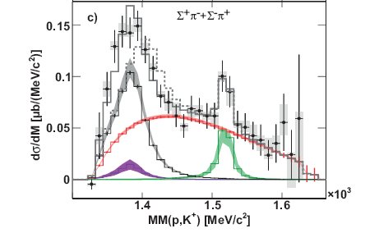

Λ(1405)
Controversial nature of Λ(1405)
Does not fit in QM state pattern
q⁴q admixture..
Molecule with two poles Σπ, K-N
K-N bound state
Λ(1405) pole
Different line shapes in K⁻ p, π⁻ p, γp reactions – dependence on reaction mechanism
-> triangle singularity in pp and π-(p)p → N*→K*(Kπ)Σ? (Bayar,..Oset) PRC97(2018)

Slide 32
Ξ⁻ (1321) production : HADES Puzzle
Strong enhacement above models Stat. hadronization, UrQMD, GiBUU
No data in NN collisions close to threshold..
Phys.Rev.Lett. 114 (2015) no.21, 212301
HADES

Slide 33
HADES upgrade: HADES/PANDA Phase0
Extend hyperon programme to radiative Y→Λγγ*( e+e- ) decays
production of double strange cascade Ξ⁻ in p+p, p+A
Proton beams with I~ 10⁸ p/s (DAQ upgrade to 200 kHz)
Maximum SIS18 Energy 4.5 GeV

Slide 34
Kaxiras, Sayuer’85:

Slide 35
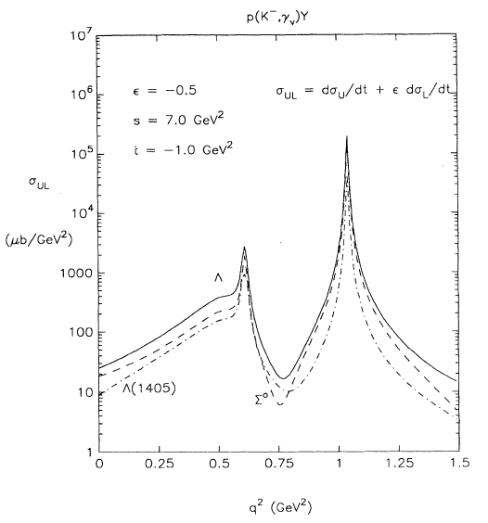
Hyperon Dalitz Decays
VMD: Huge enhancement predicted
R. Williams et. al. PRC48(1993)1381
Explore Dalitz decays of hyperons of the type Λ*/Σ*→Λγ*
(terra incognita..)
For example Σ*(1385)→Λe+e- is SU(3) analogue of Δ→Ne+e- (3/2⁺ →1/2⁺ )
(decouplet-octet transition)
Λ(1520)→Λe+e- (3/2⁻ →1/2⁺ ) excited –ground state transition
Large q² provide information about coupling to meson cloud..
K⁻p →Y γ*
(M_{e+e-}) ²

Slide 36
Upgrade in Forward direction

Slide 37
Experimental challange
production cross sections in pp~100 μb
tagging e+e- , photons by Λ ground state (displaced vertex)
Identify Λ(1520) / Σ*(1385) by narrow Λe+e- inv. mass
Extract BR and M_{ee} dependence
Inclusive σ @ E_{b} = 4.5 GeV
Λ ~350 μb
Λ(1520) ~ 130 μb ?
Exclusive Σ*⁺(1385)→σ ~20 μb @E_{b} =3.5 GeV
HADES pp@ 3.5 GeV PRC95(2017)015207

Slide 38
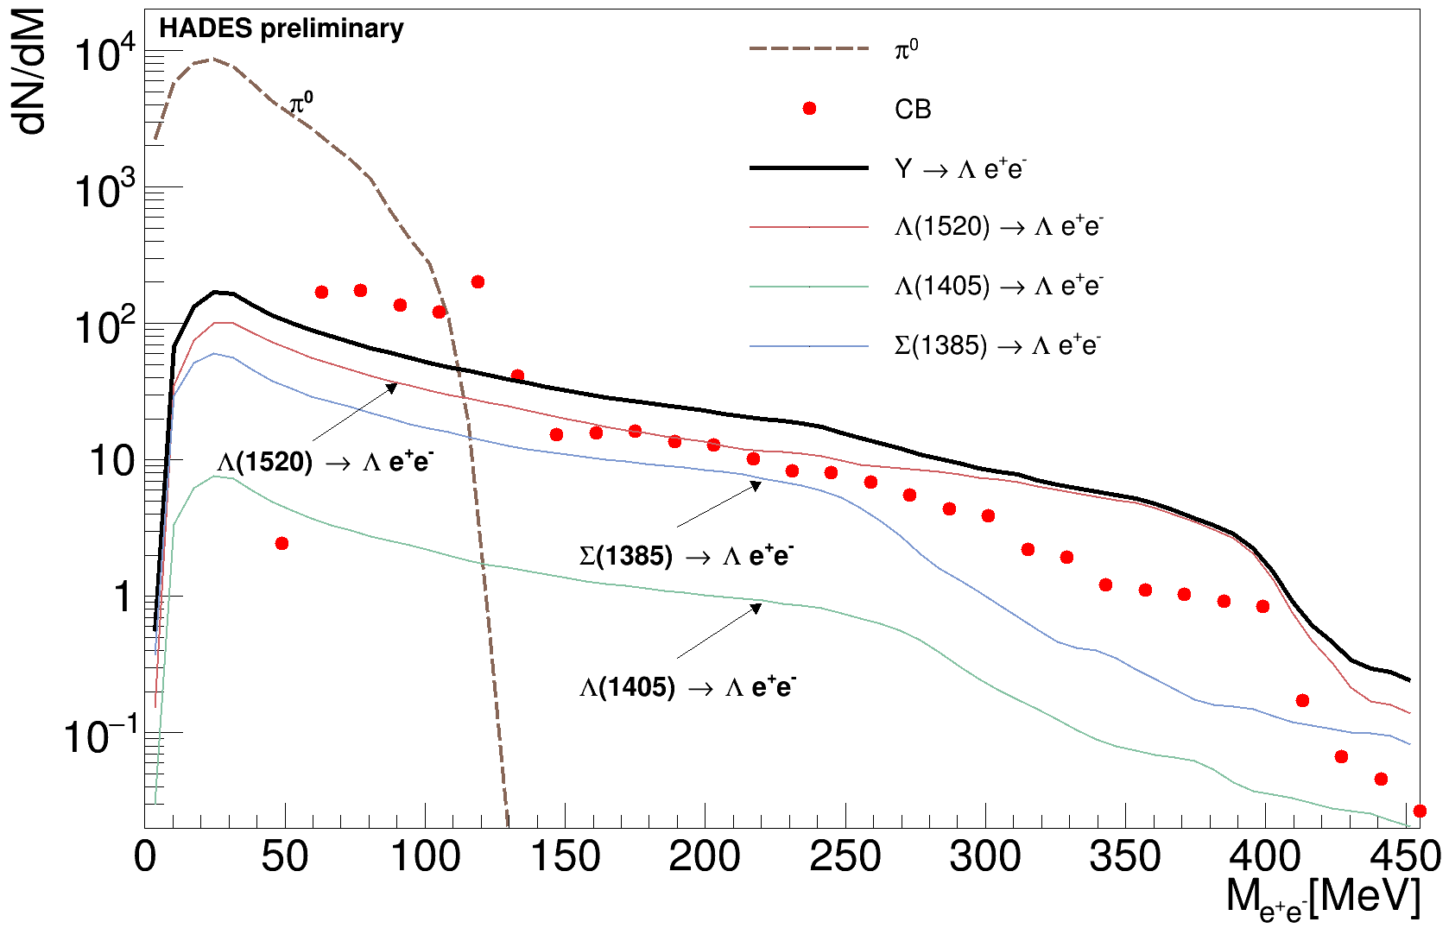
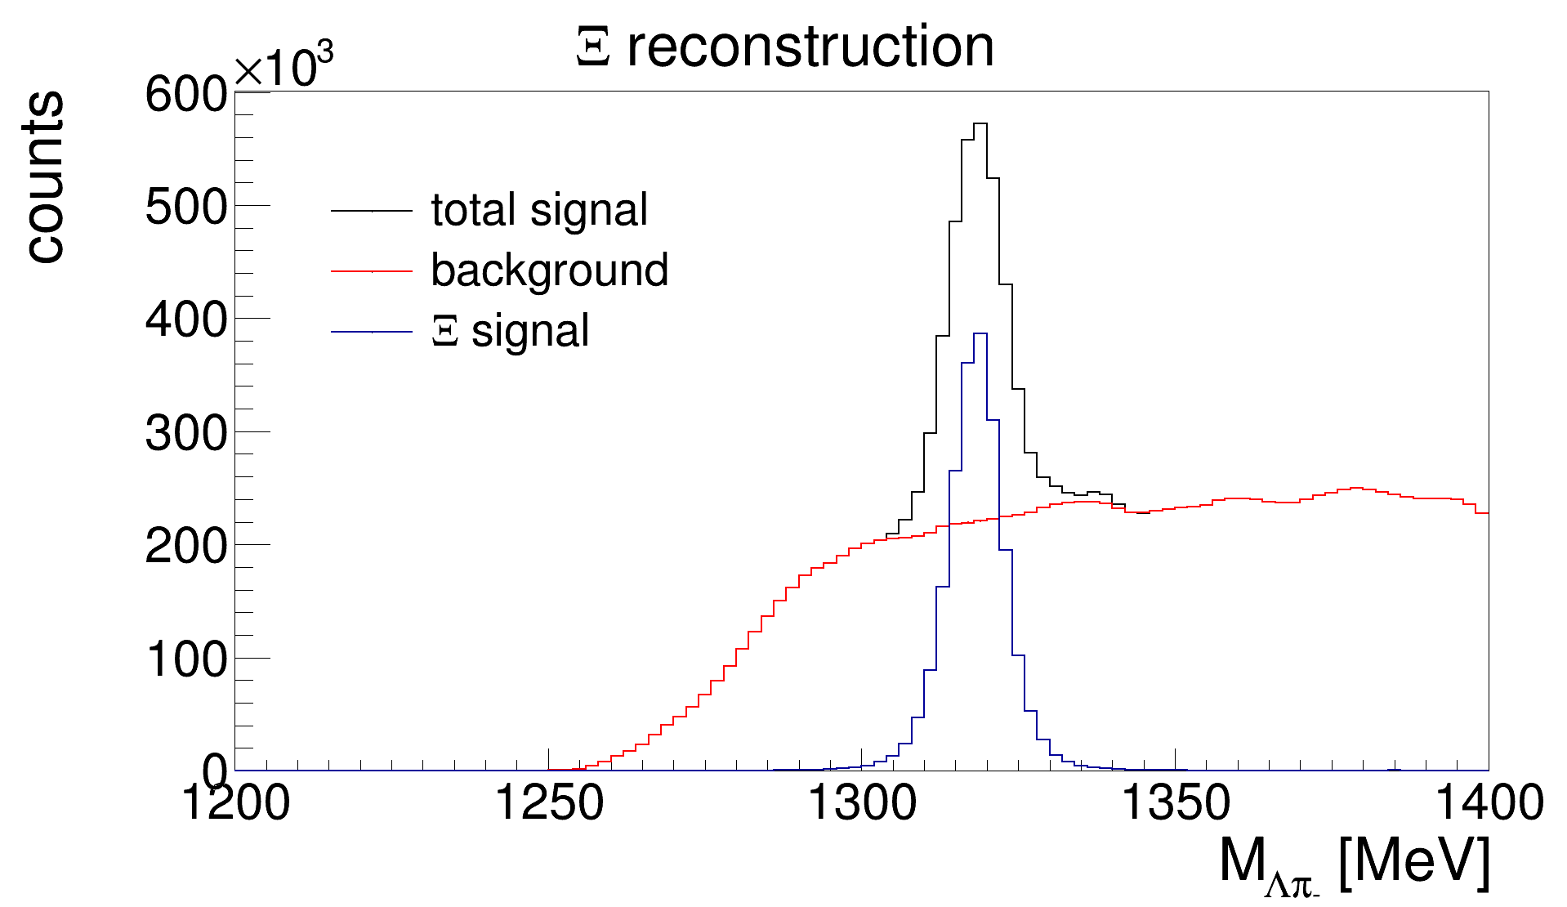
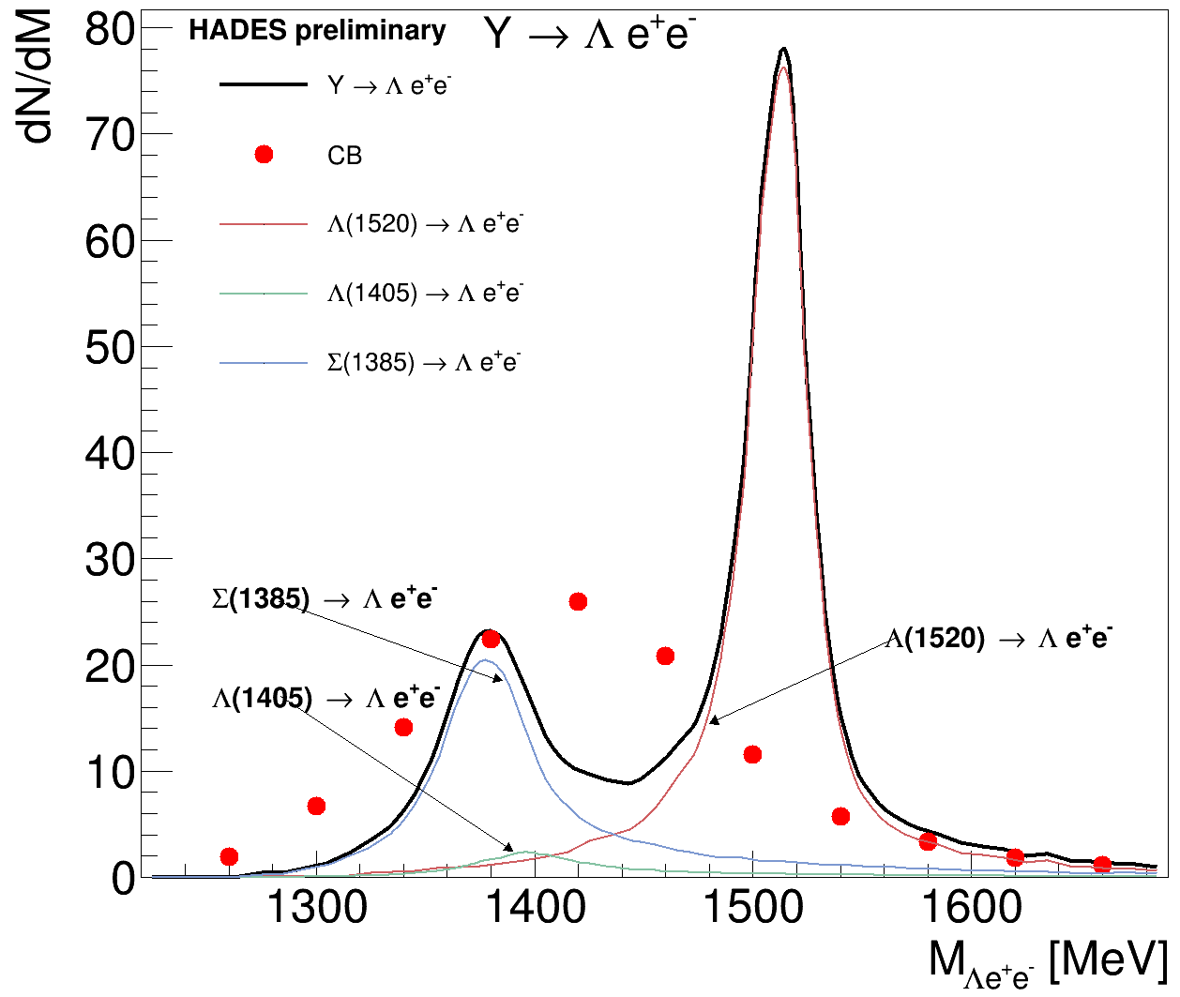
Simulation results p+p @ 4.5 GeV

Slide 39
Summary
Radiative decays of baryons studied in proton and pion induced reactions show strong effects of intermediate vector meson (ρ) states along VDM
Hints for important role of meson cloud
Continuation of pion beam programme at SIS18 in 3 and 4’th resonance region (>2019)
Extension of programme to studies of Hyperon Dalitz to study baryons with strange content

Slide 40
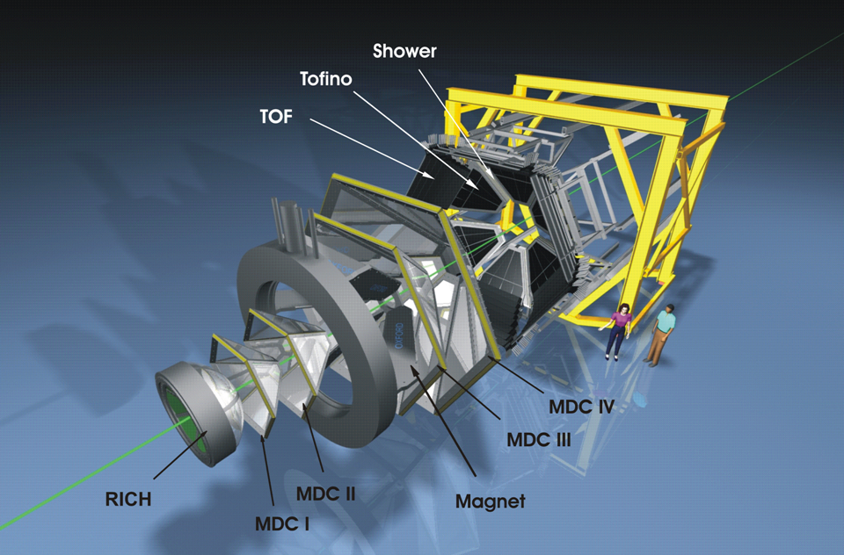
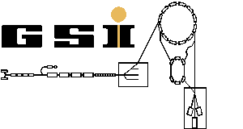
The HADES collaboration
  Cracow (Univ.), Poland
    Darmstadt (GSI), Germany
      Dresden (FZD), Germany
        Dubna (JINR), Russia
        Frankfurt (Univ.), Germany
        LIP, Portugal
        Giessen (Univ.), Germany
        München (TUM), Germany
        Moscow (ITEP,RAS), Russia
        Nicosia (Univ.), Cyprus
        Orsay (IPN), France
      Rez (CAS, NPI), Czech Rep.
    Sant. de Compostela (Univ.), Spain
SIS
GSI
and with particular thanks to A. Sarantsev
Notes:
The HADES detector is installed on the GSI facility, but HADES is a european collaboration. Actually 150 persons working in about 156institutions all over Europe. 15” tot 45”

Slide 41
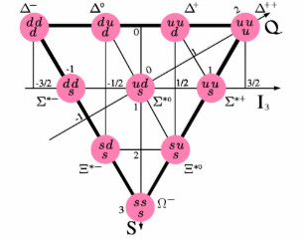
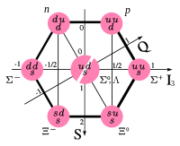
Hyperon decouplet & octet (ground states)
U=3/2
U=1
U=1/2
U=0
U=1/2
U=0;U=1
U=1/2
SU(3) flavour sym.
S=3/2 (↑↑ ↑)
Spin w.f symmetric
S=1/2 (↑↑↓,…
Spin w.f mixed-sym.
Transitions decouplet→octet with conserved „U-spin” are allowed in SU(3)
Σ*(1385)→Λγ* is anologue of Δ(1232) →Nγ* transition (measured by HADES)
role of pion cloud (vector mesons), SU(3) symmetry?

Slide 42
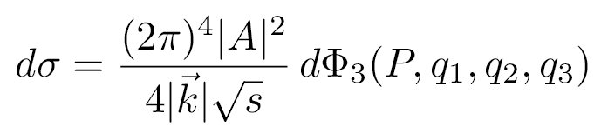
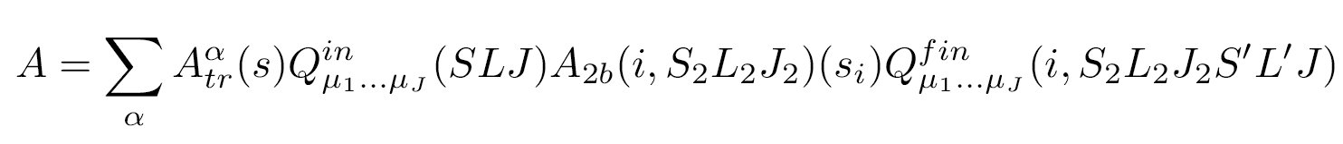
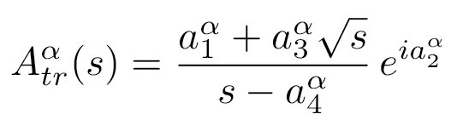
p+p @ 1.25 GeV – P₃₃ Δ(1232), P₁₁ N(1440) resonance production
below ppη production threshold
Partial Wave Analysis
Final: S₂L₂J₂
PWA applied to hadronic – NNπ channel
in collaboration with Bonn-Gatchina group
p
p
Initial : SLJ
maximum log-likelihood
event-by-event
A. V. Anisovich et al.
Eur. Phys. J. A34 (2007) 129
Final: S’L’
Coherent sum of partial waves
Energy dependent solutions: many experimental sets treated together by max. Log-likehood method event by event
Detector acceptances taken into account
initial
NN system
system of two
final particles
two-final particle
system and spectator
transition amplitude
final state amplitude
(resonant, non resonant)

Slide 43
Separation into final states: Δπ, Nσ(I=0), N*π
π-p→π⁰π⁰ n
γp→π⁰π⁰ p
Δπ
Nσ
N(1440) π
N(1520) π
Δπ
Nσ
N(1440) π
N(1520) π
σ [mb]
σ[μb]
√s [GeV]
Dominat channels in 2π⁰ are Δπ and Nσ (2π⁰ in I=0)
ρ does not contribute because it is I=1, hence does not decay to 2 π⁰

