Slide 1
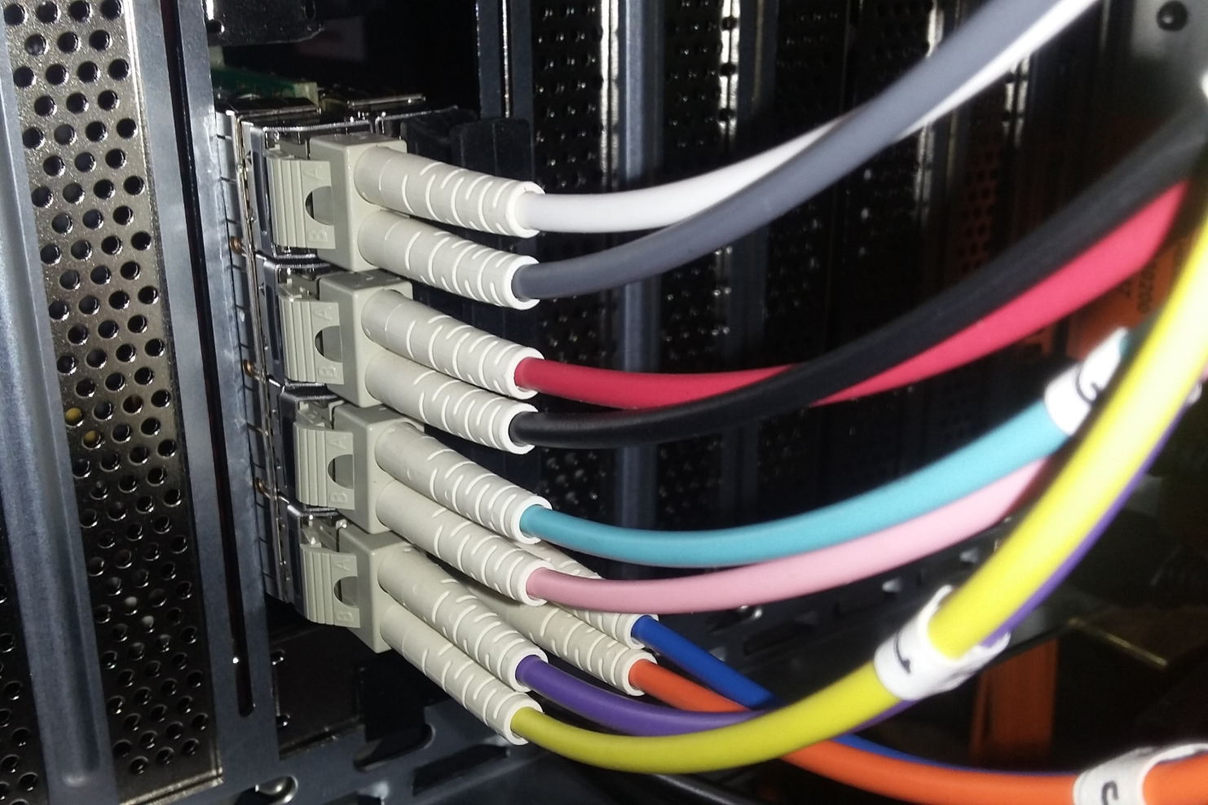
eTOF DAQ upgrade 2018
Towards completion of the eTOF wheel
David Emschermann
STAR-CBM workshop
PI Heidelberg – 29.09.2018

Slide 2
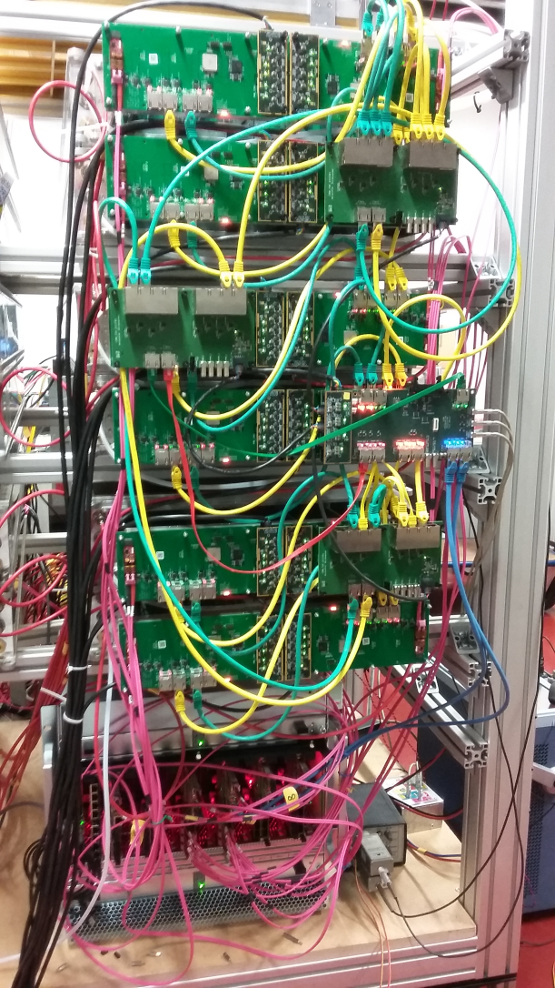
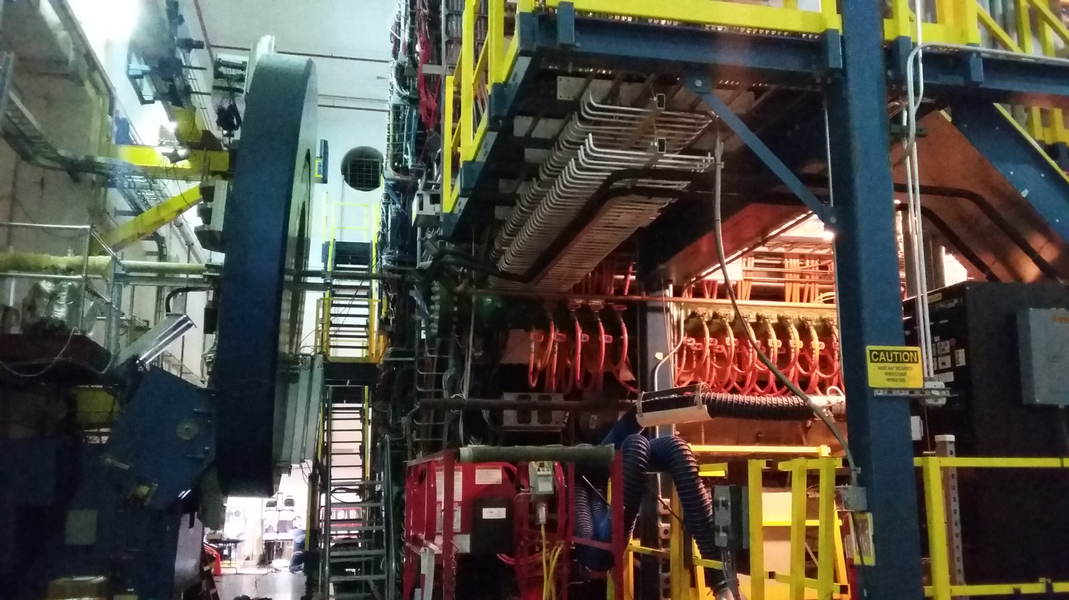
eTOF todo for end of 2018
1) install eTOF modules – here:
2) upgrade eTOF DAQ = focus of this talk

Slide 3
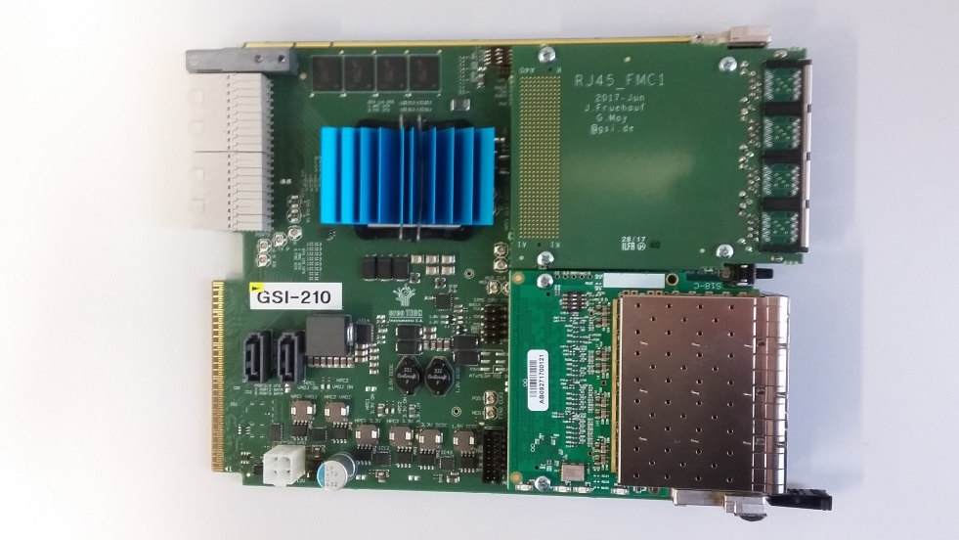
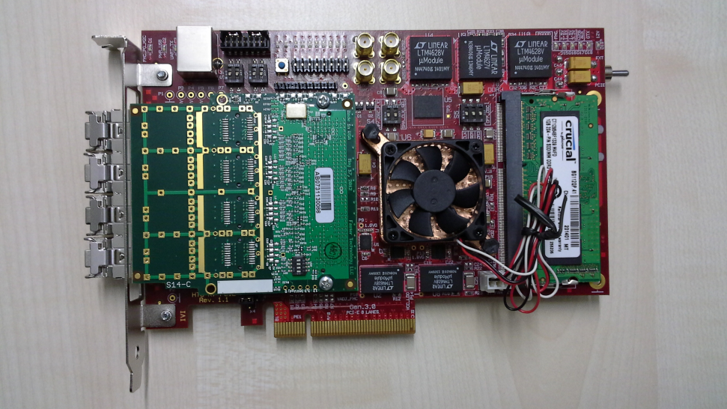
eTOF readout components: DPB, FLIB (2018)
GBTx-DPB
FLIB-8
12x, each taking 6x GBT links
2x, each taking 6x FLIM links
2 x 6 x 6 = 72 GBT links =
36 modules = 1 eTOF wheel

Slide 4
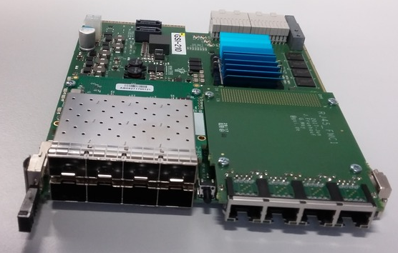
AFCK configuration for 6x eTOF-GBTx and 1x FLIM
7
6
5
4
GTX115
GTX117
FMC channel number
3
2
1
0
GBTx ROB #1 - links
FLIM – link #1
not used
AFCK boards can be power-cycled individually in the μTCA crate

Slide 5
AFCK upgrade
mount FMCs on AFCKs
need 12x RJ45 - FMCs
need 12x FM-S18 - FMCs
need screws for mounting
install 12x AFCK in μTCA crate
pack multimode SPFs
12x 7 = 84 SPF (no spares)
12x 8 = 96 (including spares)
tune the multimode FLIM connection parameters between μTCA and etofin001
remove JTAG programming PC from cave
eTOF sector – AFCK ID
13 - .203
14 - .204
15 - .205
16 - .206
17 - .207
18 - .208
19 - .209
20 - .210
21 - .211
22 - .212
23 - .213
24 - .214
eTOF
mapping

Slide 6
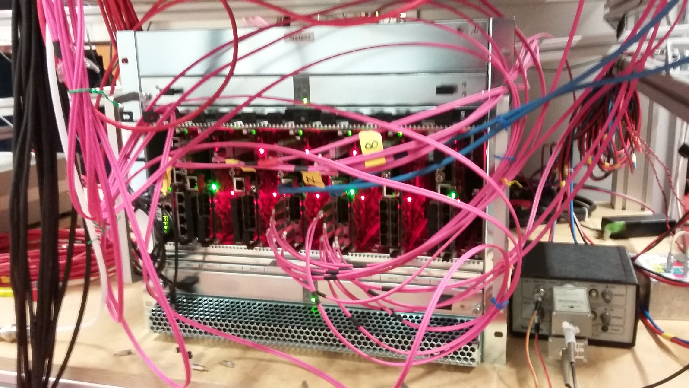
μTCA crate upgrade
move crate to SE1 (= eTOF rack)
install 12x GBT-AFCKs
install USB extender to mTCA crate and connect to etofin001
move AFCK programming scripts to etofin001

Slide 7
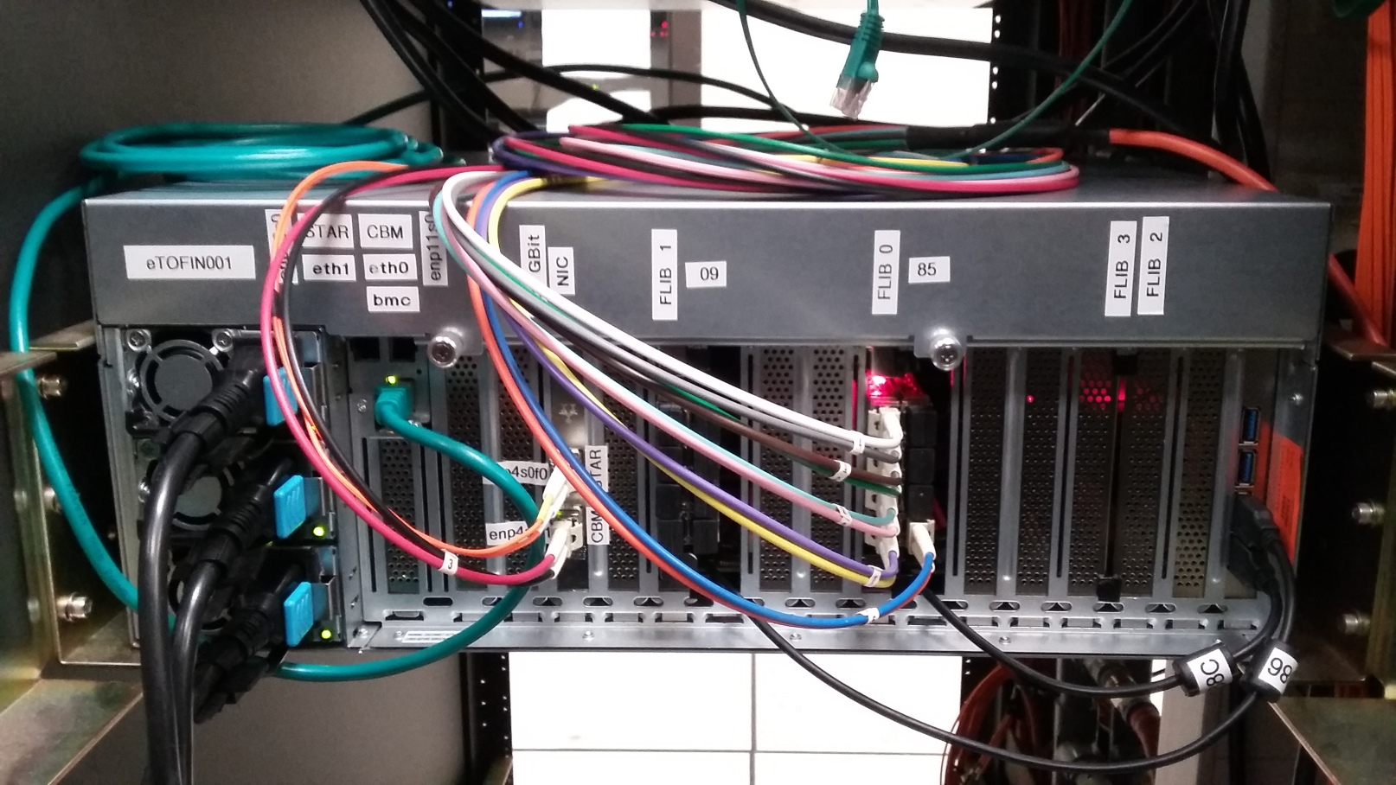
etofin001 upgrade
etofin001 is already fully populated with 2x FLIBs
modify USB JTAG connection to 2x FLIB (need extension cable)
update FLIB firmware (-> to hardware version 27)
update FLESNET software to mCBM version

Slide 8
Summary
all hardware for the eTOF DAQ upgrade hardware is available
DAQ installation exercised and commissioned at mCBM
etofin001: can we obtain direct internet access for updates ?
estimated time for eTOF DAQ upgrade 2-3 working days on site
proposal to travel to STAR on 27. October 2018, stay ~ 1 week

Slide 9
Backup
Backup

Slide 10
mCBM – taking CBM to the next level
p = ?
July
September

Slide 11
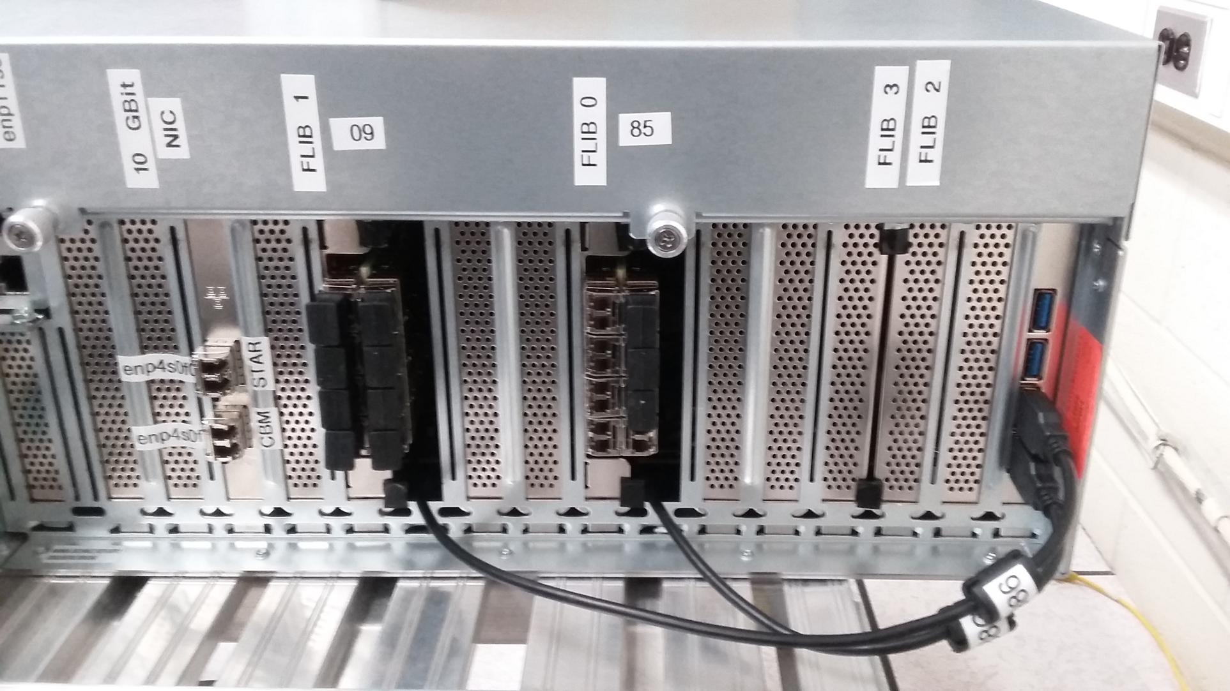
etofin001 add-ons

