Slide 1
Latest results from overlapping strip analysis in Run18
Lyu Pengfei
Department of Engineering Physics,
Tsinghua University, Beijing, China
September 29, 2018
STAR-CBM Joint Workshop

Slide 2
Outline
Background
Overlapping strip analysis with CBM-Root (done by Ingo)
Overlapping strip analysis in STAR-eTOF software framework
Summary

Slide 3
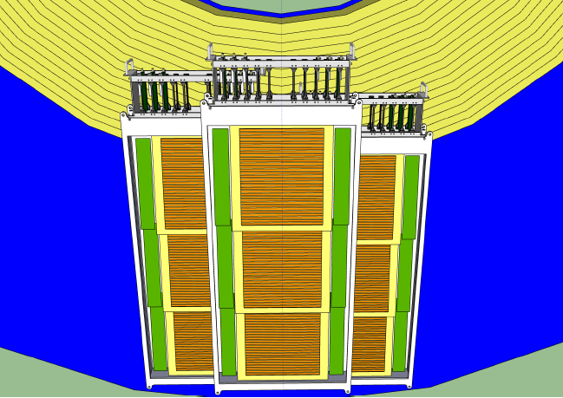
Introduction
3 modules are installed to the endcap in Run18:
Module one (middle) contains 3 MPRCs composed of float glass (USTC).
Module two and three contain 3 MPRCs composed of low-resistive glass each (THU).
Purpose of the overlapping strip analysis:
Verify the performance of these MRPC counters.
Help to confirm the software framework.
Notes:
eTOF project is part of the BESII detector upgrade at STAR

Slide 4
Overlapping strip analysis with CBM-Root
The overlapping strip analysis is carried out with the CBM-Root macros.
From Ingo’s talk on April 5
Notes:
eTOF project is part of the BESII detector upgrade at STAR

Slide 5
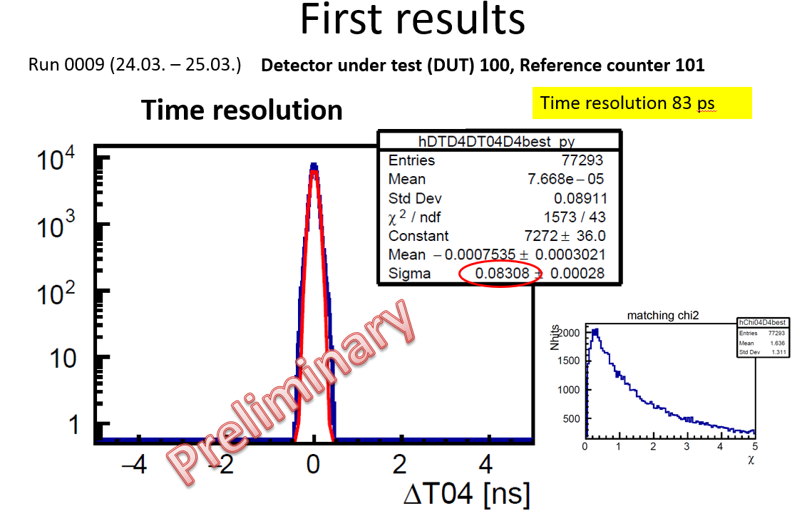
Overlapping strip analysis with CBM-Root
The overlapping strip analysis is carried out with the CBM-Root macros.
From Ingo’s talk on April 5
Notes:
eTOF project is part of the BESII detector upgrade at STAR

Slide 6
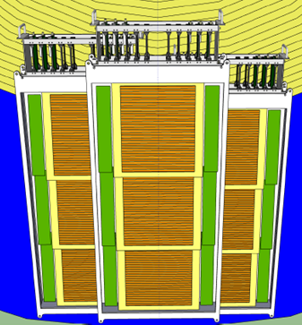
Overlapping strip analysis with STAR software
The overlapping strip analysis is repeated with the eTOF software, based on the calibration file produced by StETofDigiMaker, StETofCalibMaker and StETofHitMaker
It is done on the upper two counters in each module.
Dut: counter in the front
Ref: counter in the back
Overlapped strip: 2
Selection window on Dut: 6
Dut2
Dut1
110
100
Dut3
120
111
101
121
Analyzed file: 19156044
Events: 230k
Ref2
Ref1
Ref3
112
102
122
Notes:
eTOF project is part of the BESII detector upgrade at STAR

Slide 7
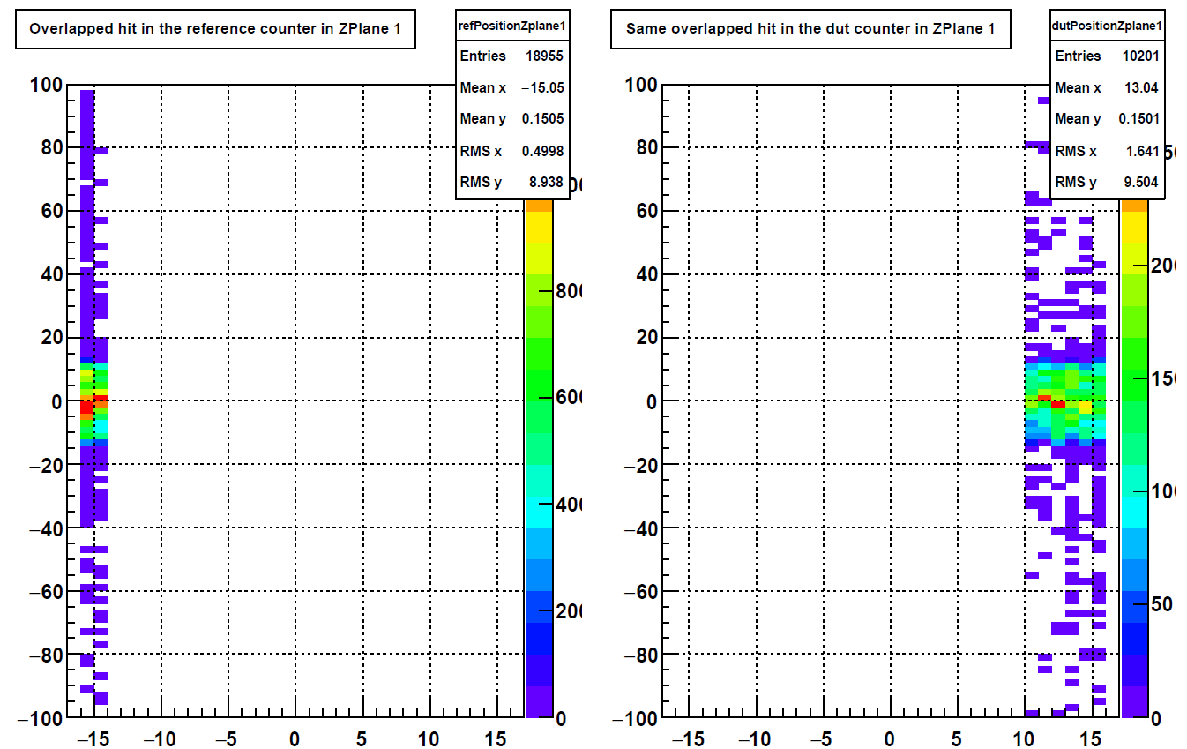
Overlapping strip analysis
Hits from last 2 strips in Ref1
Hits from last 6 strips in Dut1 while there are hits in last 2 strips in Ref1
The two entry numbers were used to estimated the efficiency, however, this is not correct since the noise cannot be eliminated.
Notes:
eTOF project is part of the BESII detector upgrade at STAR

Slide 8
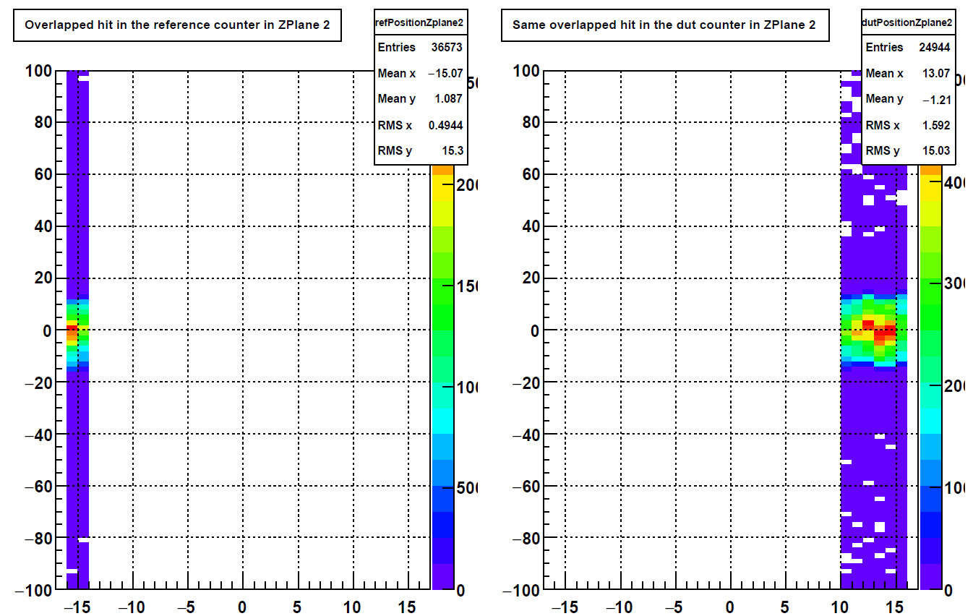
Overlapping strip analysis
Hits from last 2 strips in Ref2
Hits from last 6 strips in Dut2 while there are hits in last 2 strips in Ref2
Notes:
eTOF project is part of the BESII detector upgrade at STAR

Slide 9
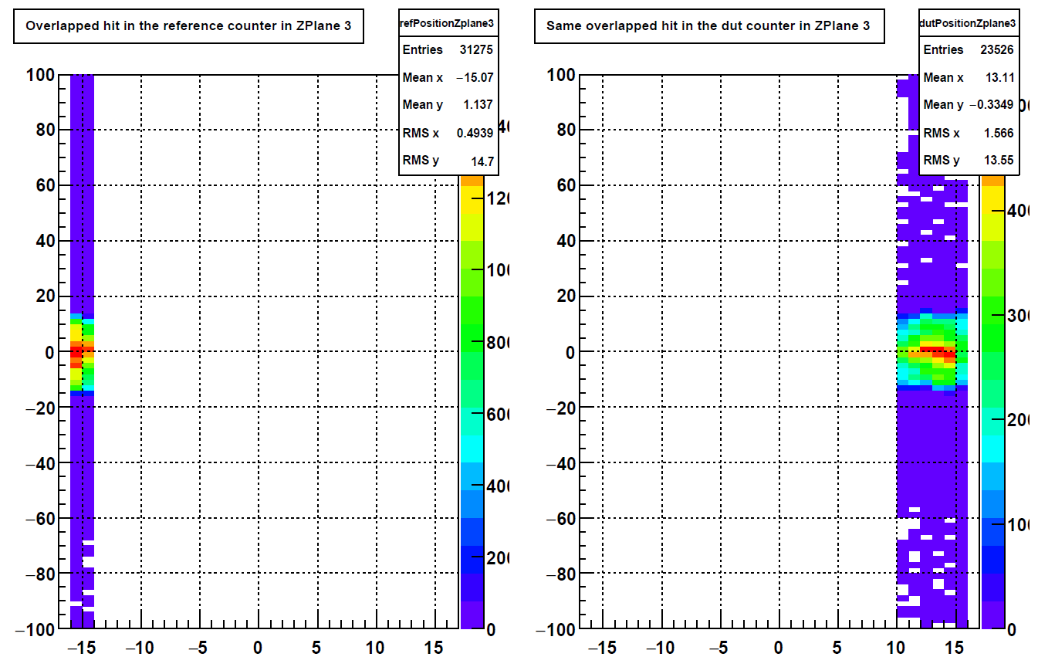
Overlapping strip analysis
Hits from last 2 strips in Ref3
Hits from last 6 strips in Dut3 while there are hits in last 2 strips in Ref3
Notes:
eTOF project is part of the BESII detector upgrade at STAR

Slide 10
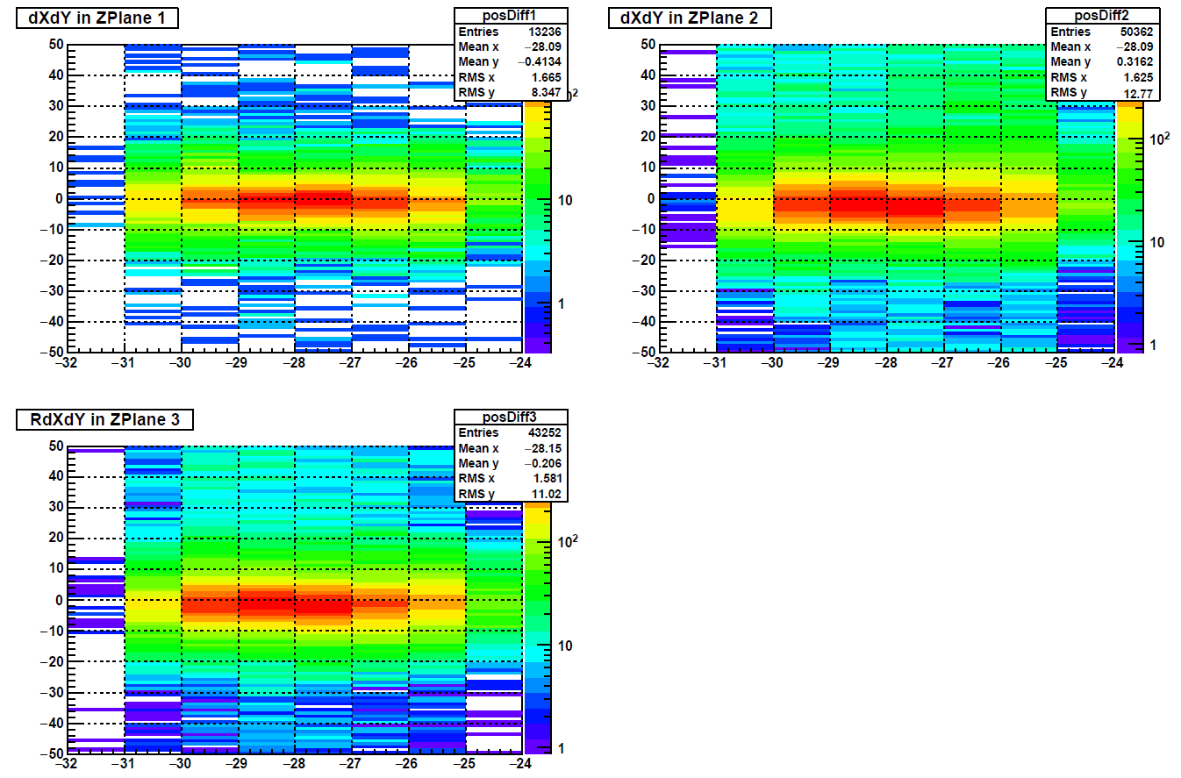
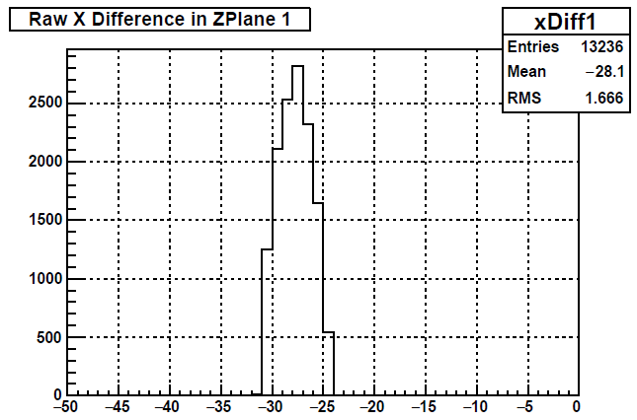
Overlapping strip analysis
Position difference between each hit pairs in Dut and Ref.
Notes:
eTOF project is part of the BESII detector upgrade at STAR

Slide 11
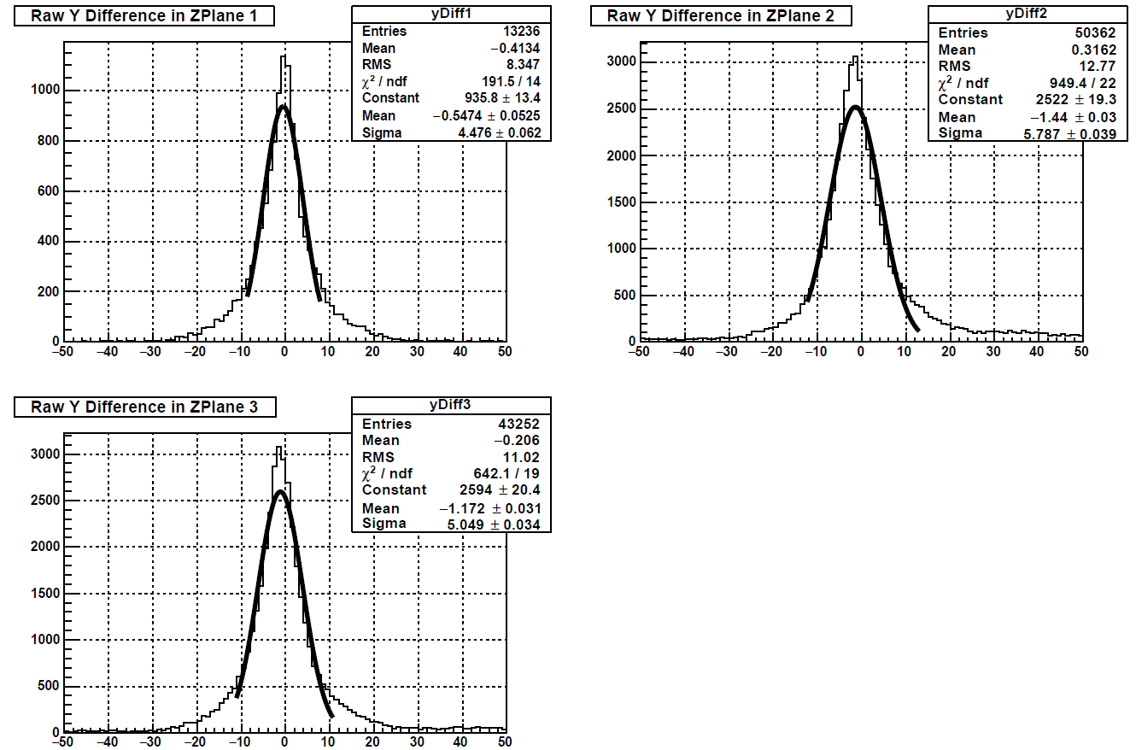
Overlapping strip analysis
dy distribution of each hit pairs between Dut and Ref.
The expected value of dy is got by one-sigma Gaussian fit.
Analyzed file: 19156044
Events: 230k
Notes:
eTOF project is part of the BESII detector upgrade at STAR

Slide 12
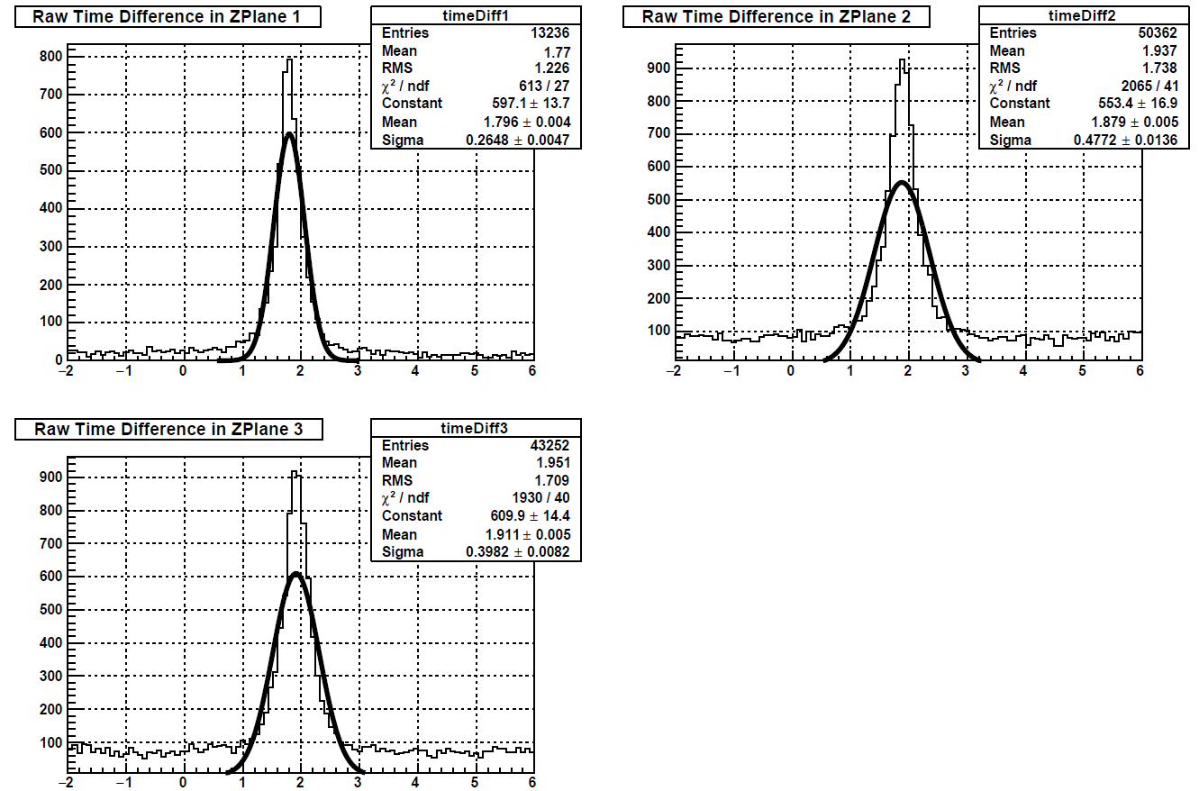
Overlapping strip analysis
Raw time diff distribution of each hit pairs between Dut and Ref.
The expected value of dt is got by one-sigma Gaussian fit.
Notes:
eTOF project is part of the BESII detector upgrade at STAR

Slide 13
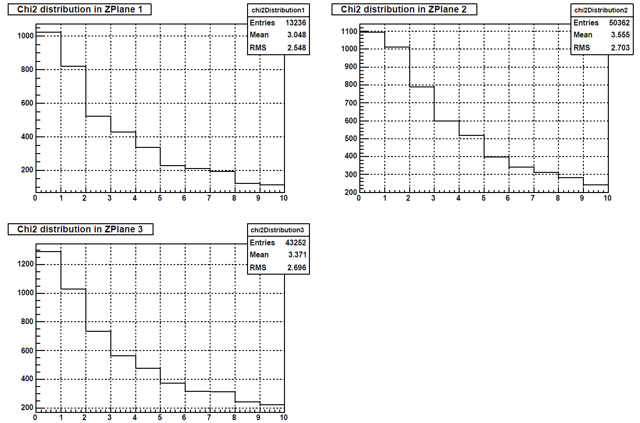
Overlapping strip analysis
Chi2 distribution of each hit pairs between Dut and Ref.
$$Chi2=\frac{1}{3}({\left(\frac{x1−x2−\overline{dx}}{σ_{x}}\right)}^{2}+{\left(\frac{y1−y2−\overline{dy}}{σ_{y}}\right)}^{2}$$
$$+{(\frac{t1−t2−\overline{dt}}{σ_{t}})}^{2})$$
$$σ_{x}=σ_{y}=1 cm$$
$$σ_{t}=0.2 ns$$
$$Requiring: Chi2<2$$
Notes:
eTOF project is part of the BESII detector upgrade at STAR

Slide 14
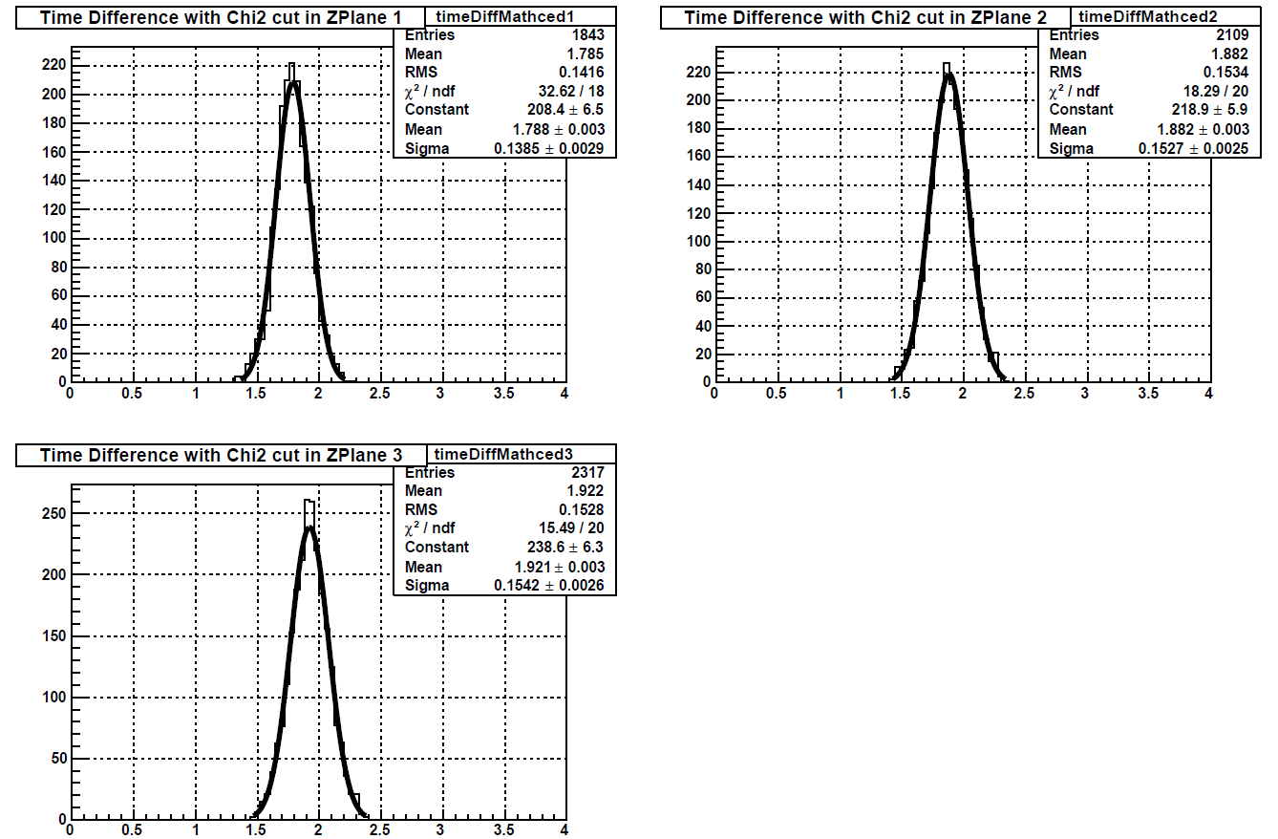
Overlapping strip analysis
Time difference (Tref - Tdut) cut on chi2.
The independent resolution of each counter is around 100 ps (after divided by $\sqrt{2}$).
Notes:
eTOF project is part of the BESII detector upgrade at STAR

Slide 15
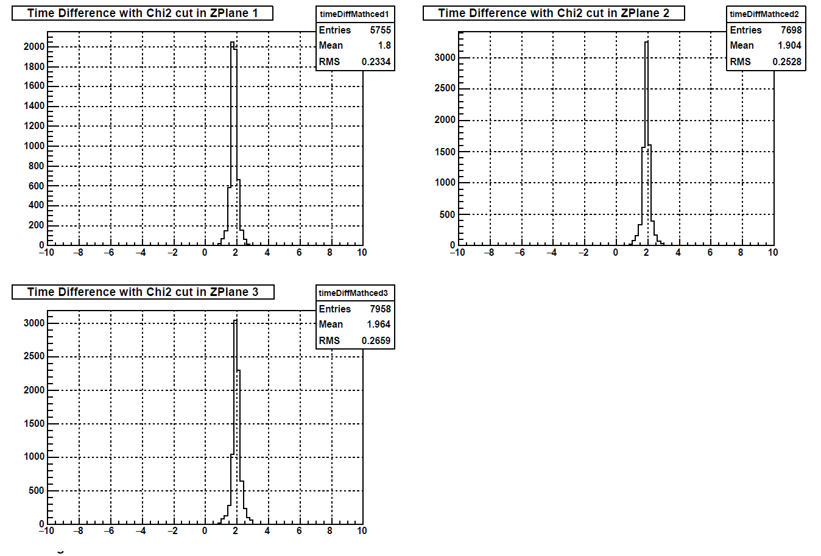
Overlapping strip analysis
The results from the same run but without walk correction.
Thanks Philipp, the walk correction works in a good way.
Notes:
eTOF project is part of the BESII detector upgrade at STAR

Slide 16
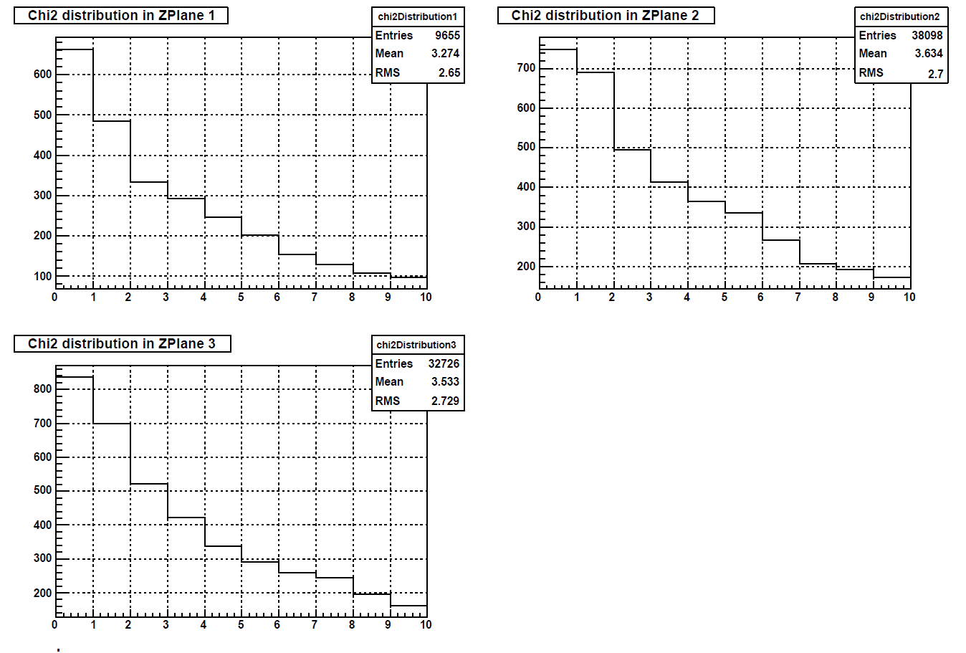
Overlapping strip analysis
Analysis on 21 MuDst files from day 160. 110k events.
Notes:
eTOF project is part of the BESII detector upgrade at STAR

Slide 17
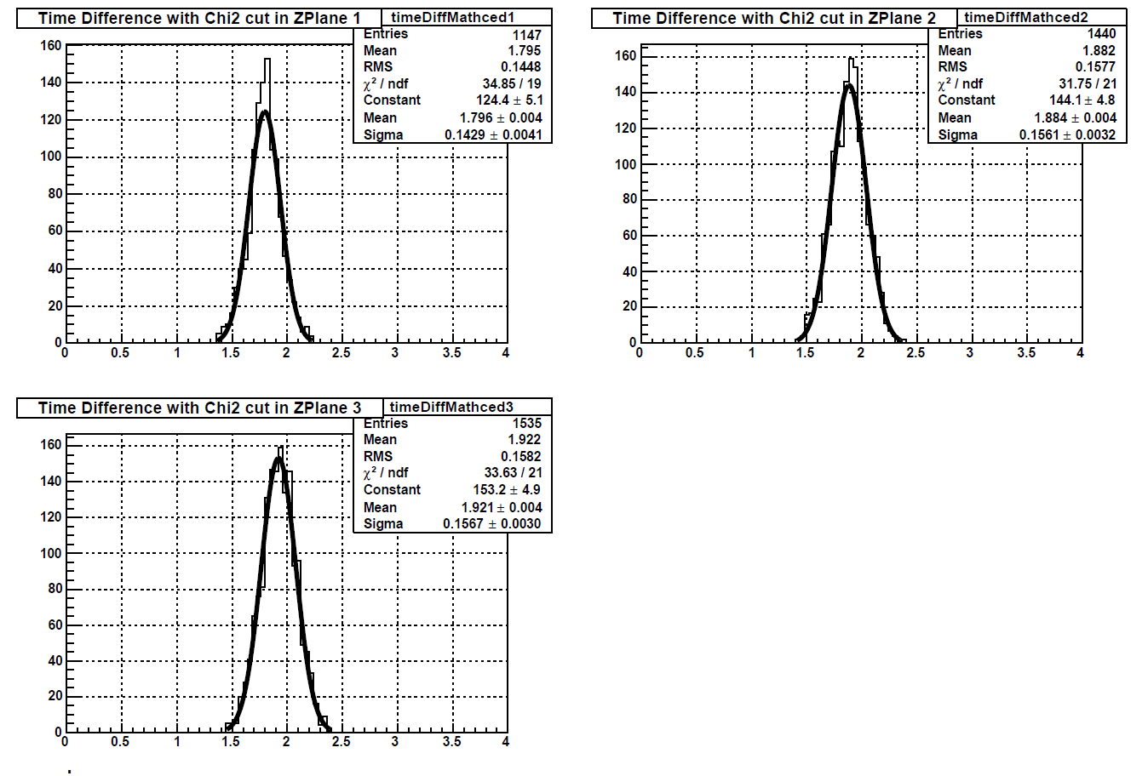
Overlapping strip analysis
Analysis on 21 MuDst files from day 160. 110k events.
The result (143 ps, 156 ps, 157 ps) is consistent with that from day 156.
Notes:
eTOF project is part of the BESII detector upgrade at STAR

Slide 18
Summary
The latest independent time resolution from the overlapping strip analysis is around 100 ps.
The results are consistent with different runs, either from daq files or event.root files.
It will get improved with further development in the calibration.
The efficiency should be obtained with help of additional detector system.
LYU PENGFEI STAR COLLABRATION MEETING, LEHIGH UNIVERSITY JUL 16-21, 2018

Slide 19
Thank You!
Lyu Pengfei
Department of Engineering Physics,
Tsinghua University, Beijing, China
Sep 29, 2018
STAR-CBM Joint Workshop

