Slide 1
Machine meeting 28.08.18 - UNILAC
RF gallery cleaning and reconstruction
HSI RFQ:
electrode reproduction:
preparation finished
spec: cleaning
carrier ring reproduction: waiting for EV / EKW
planning and preparation of exchange 2019
preparation of gas stripper tests in November
FoS:
Dummy cavity delivery in September
Professional cleaning by external company
Nitrogen line: Planning for modernization/upgrade for future use
Leak water detection in tunnel, caves, technical areas
Budget 2019

Slide 2
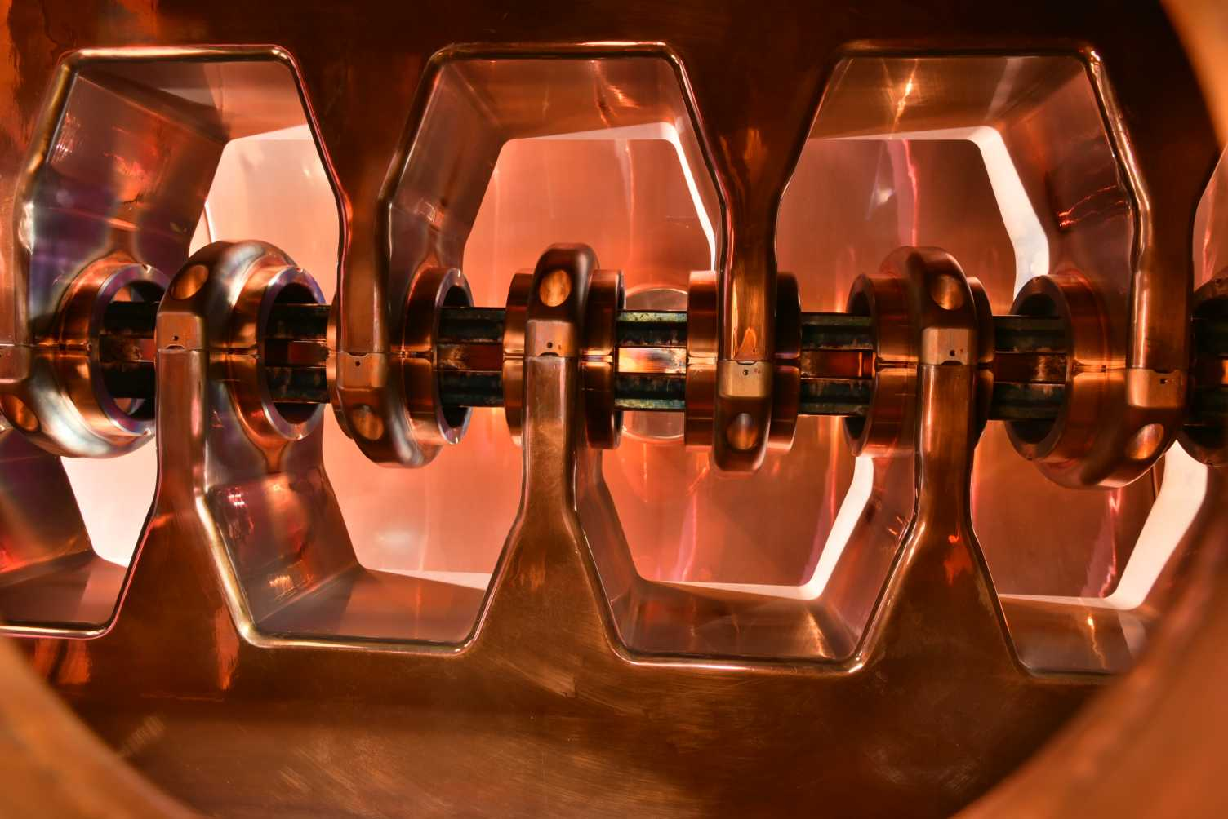
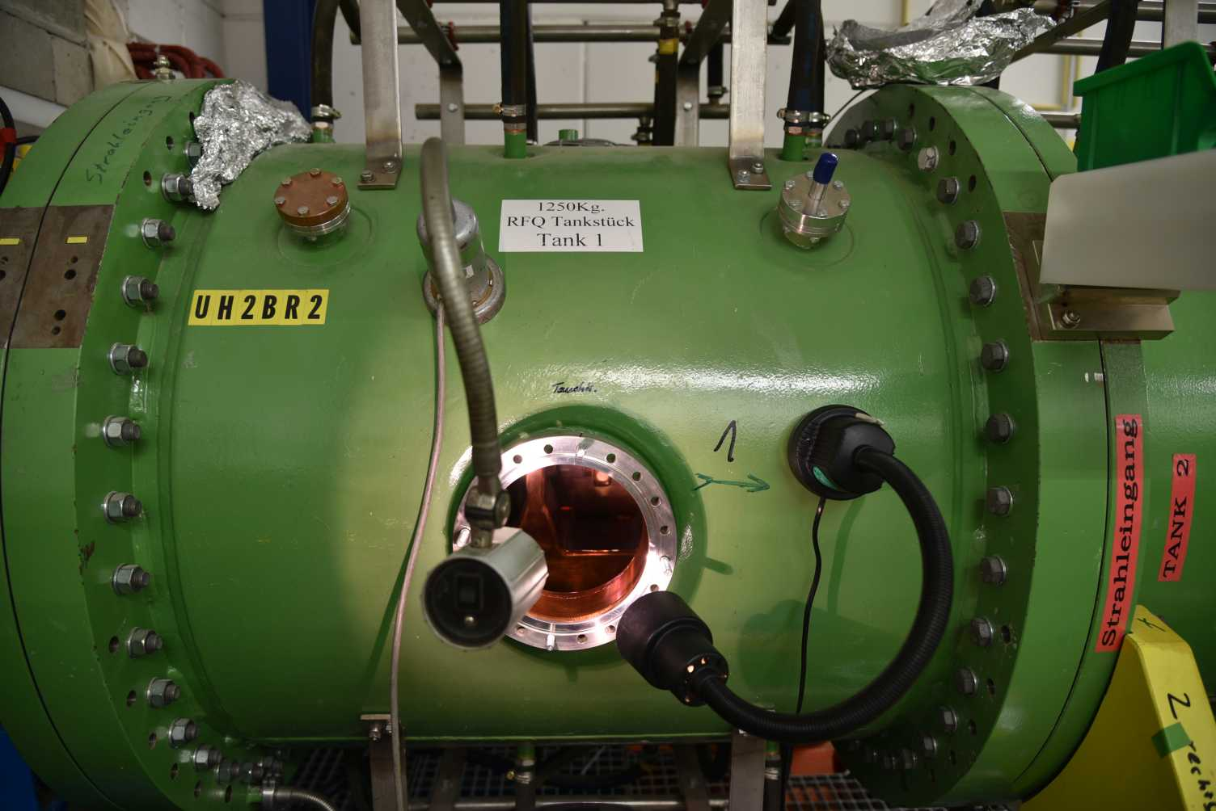
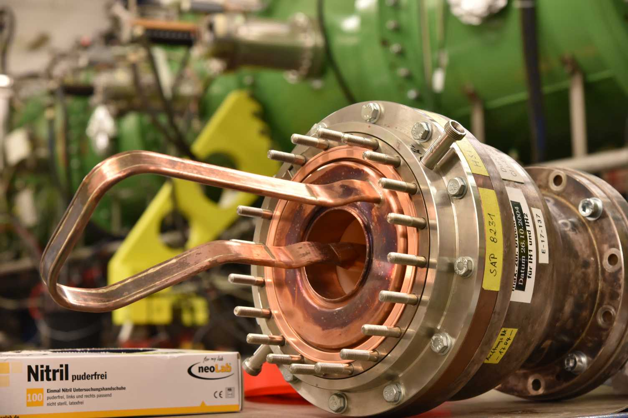
Machine meeting 28.08.18 – UNILAC
HSI-RFQ August 2018

Slide 3
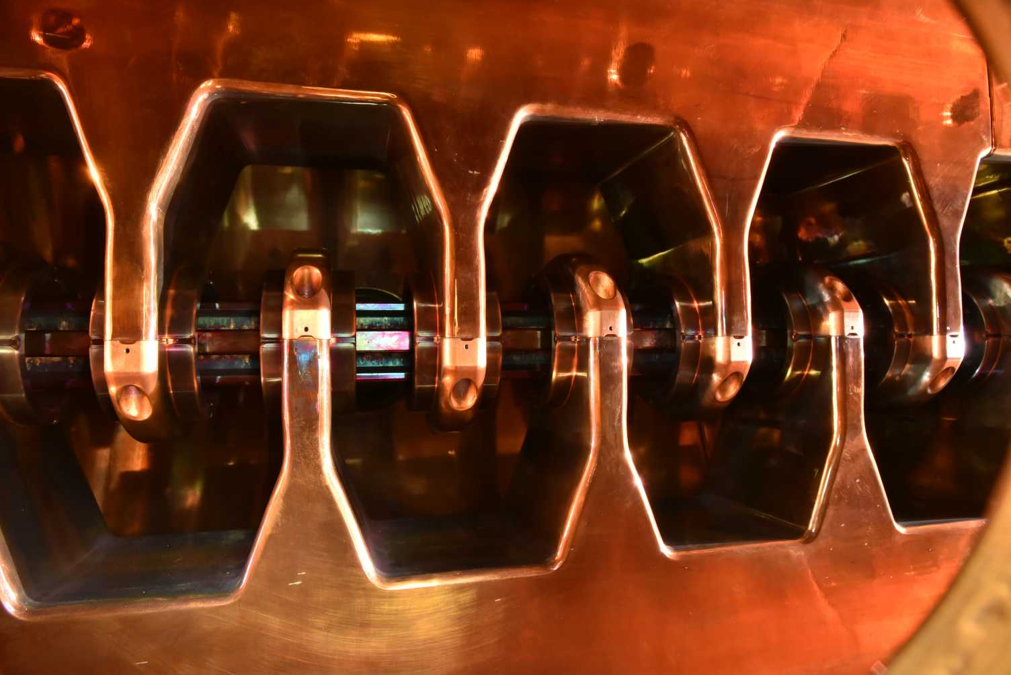
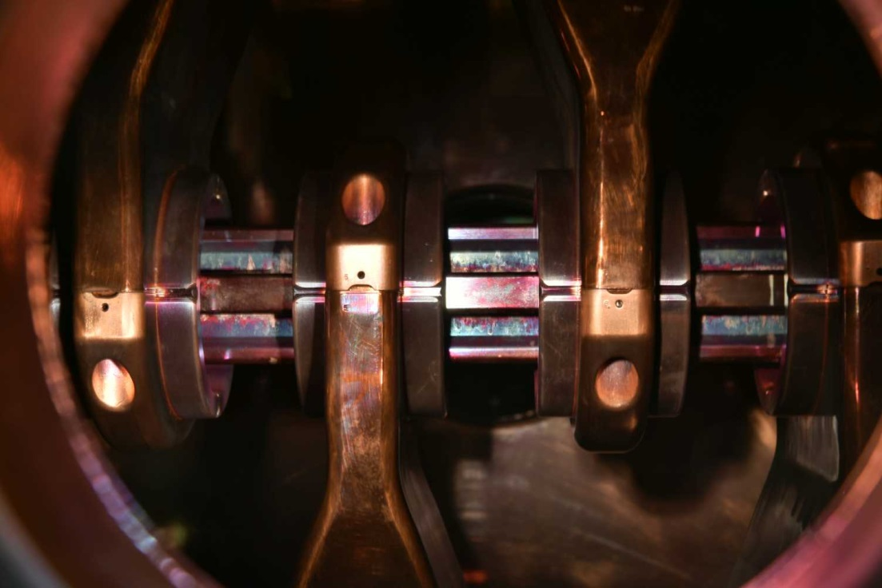
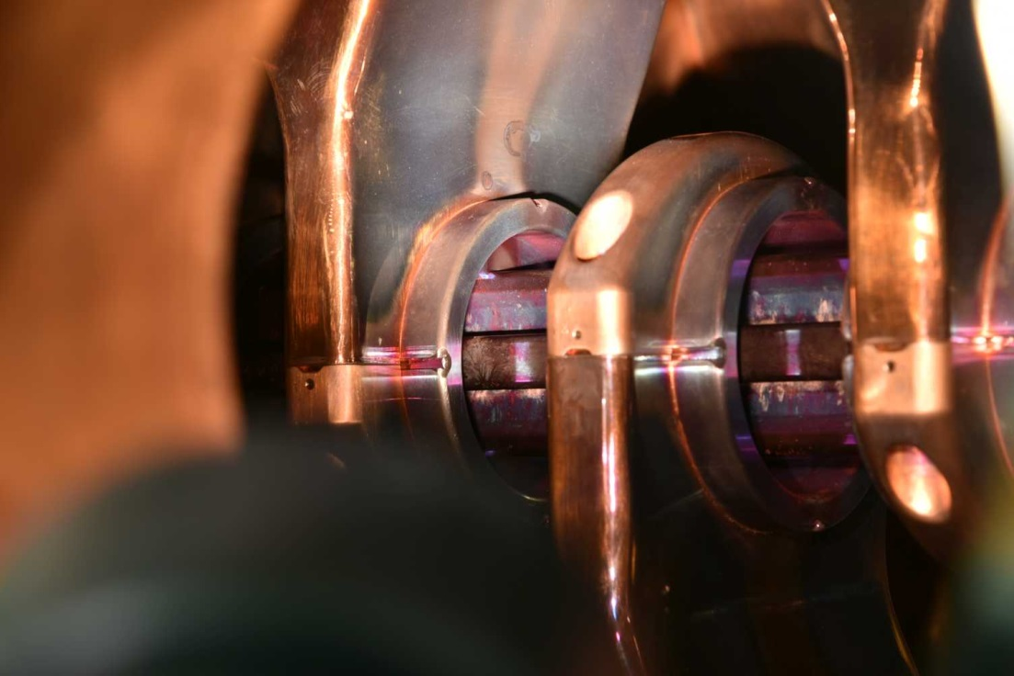
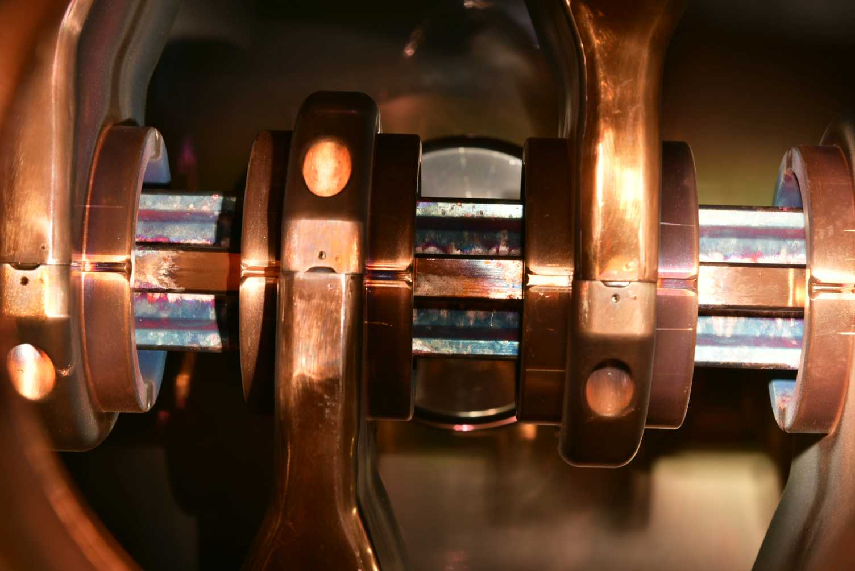
Machine meeting 28.08.18 - UNILAC

Slide 4
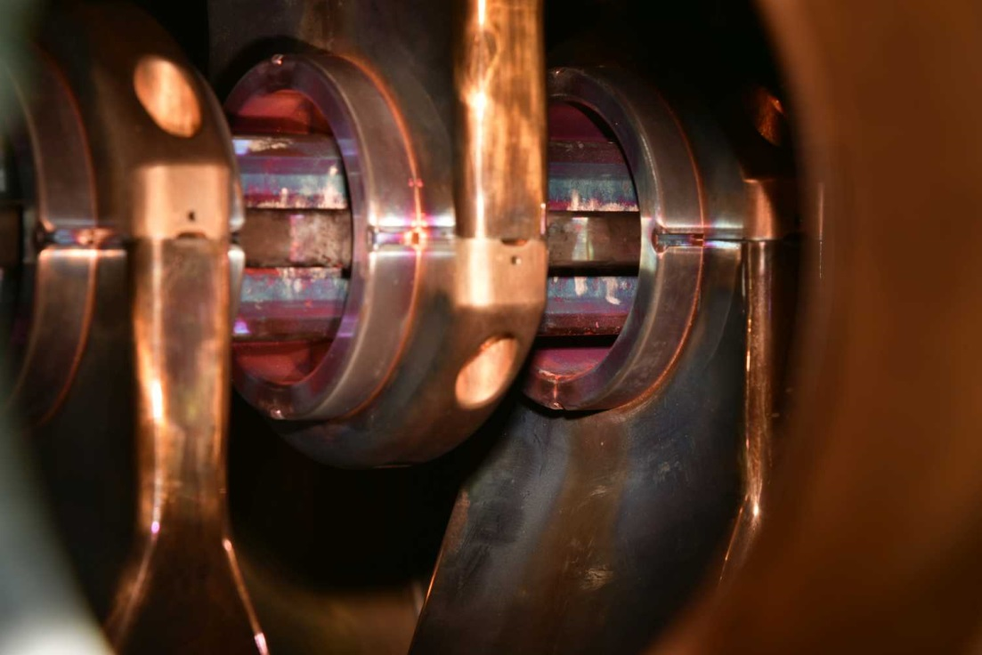
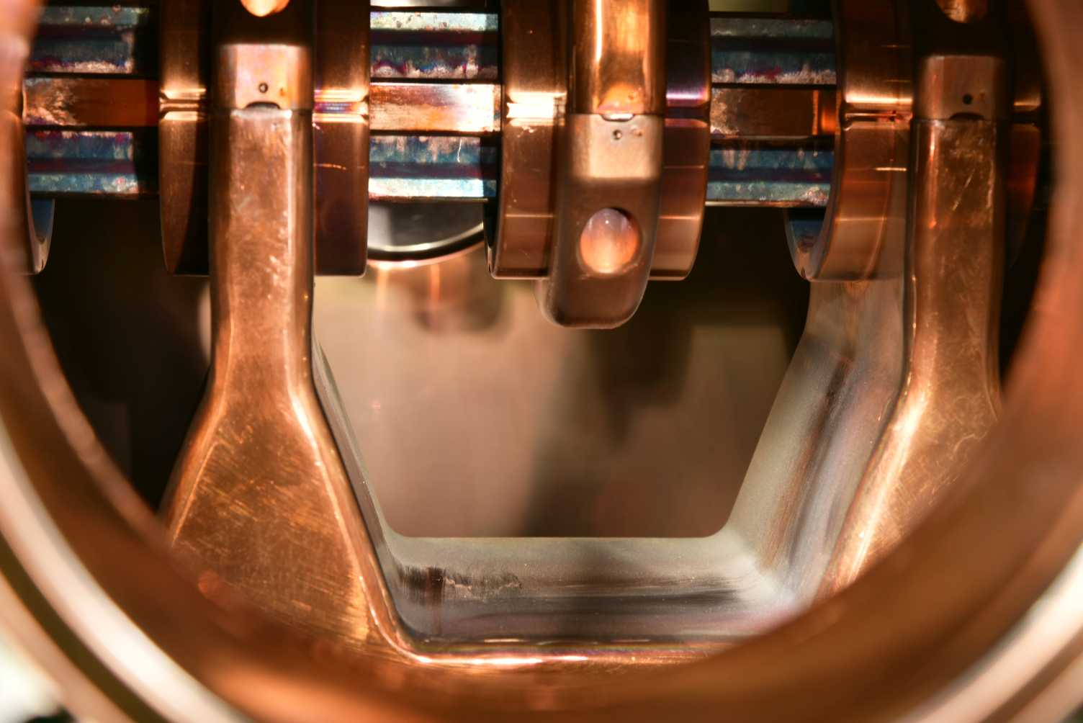
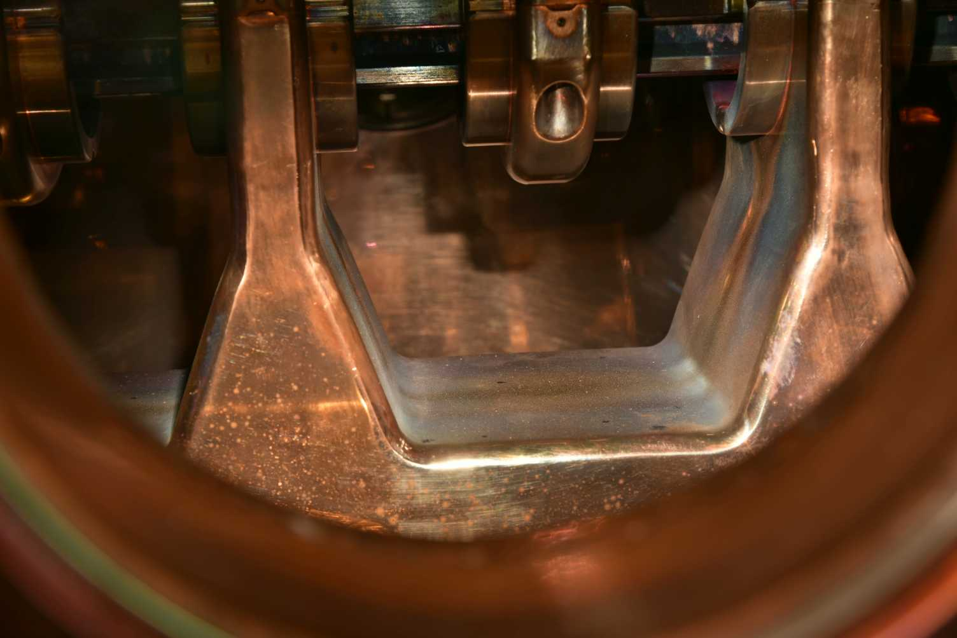
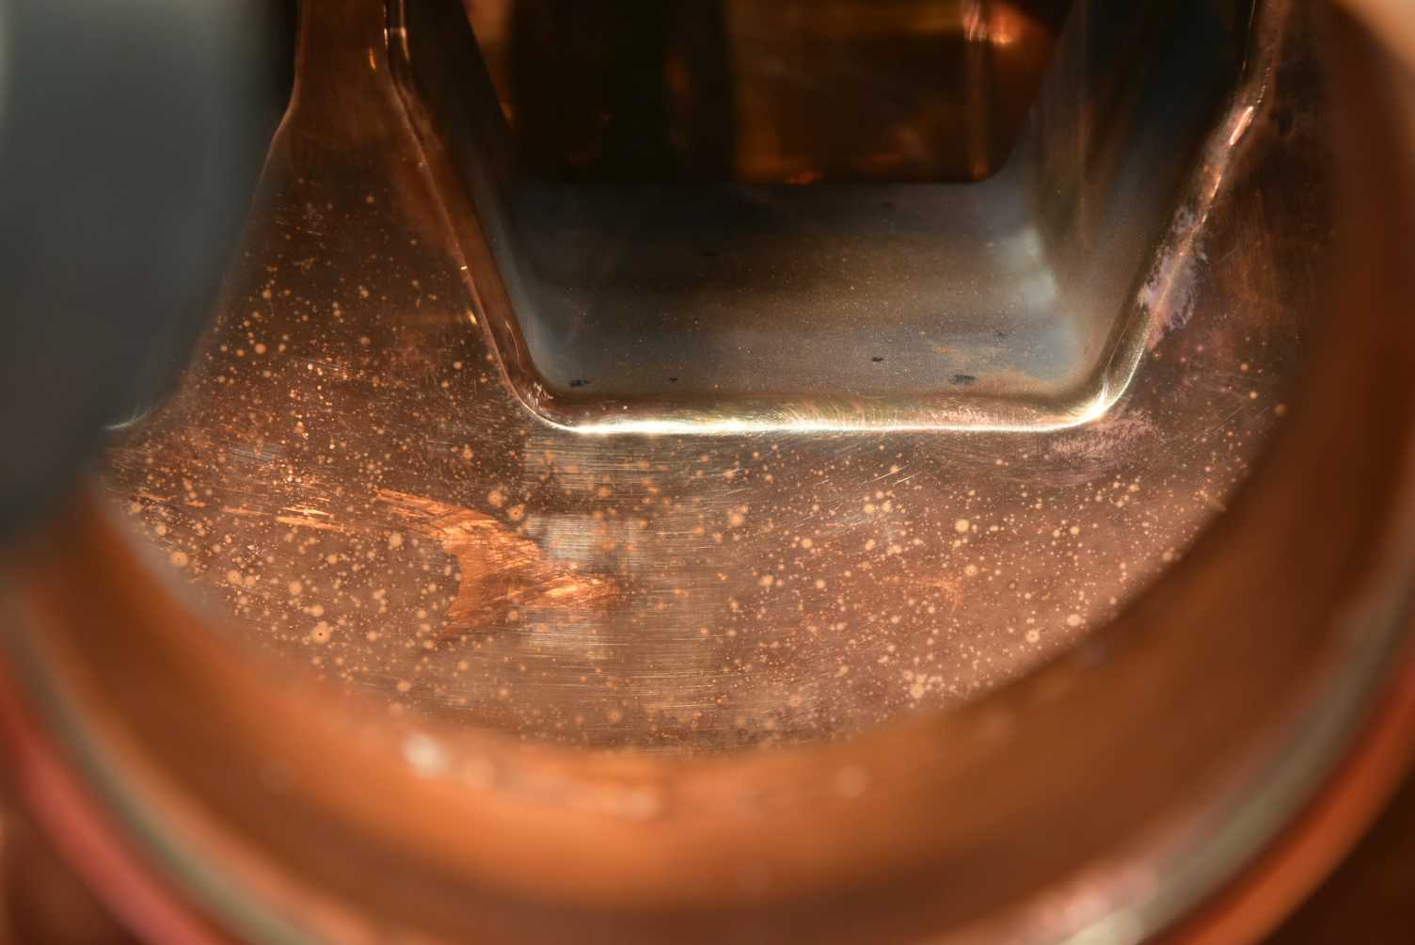
Machine meeting 28.08.18 - UNILAC

Slide 5
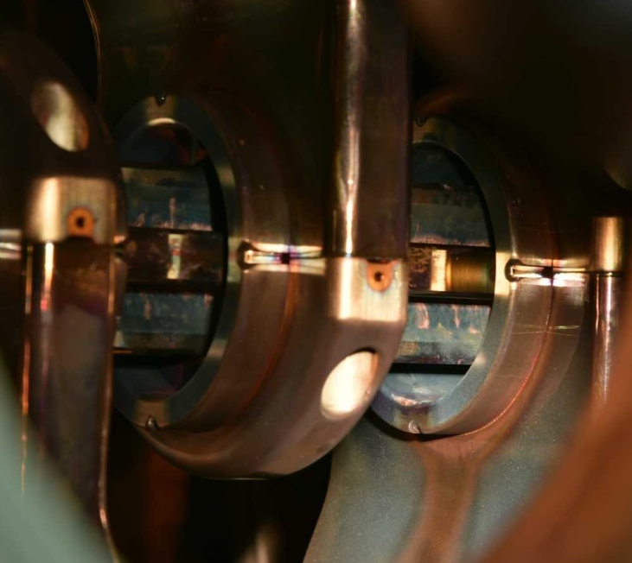
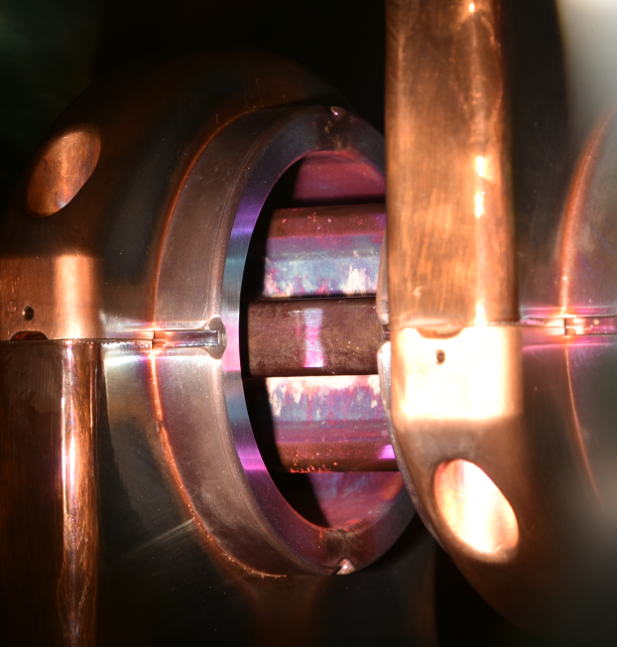
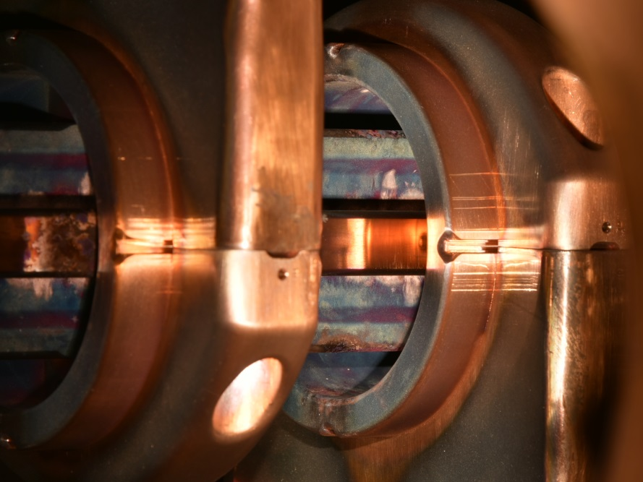
Machine meeting 28.08.18 - UNILAC

Slide 6
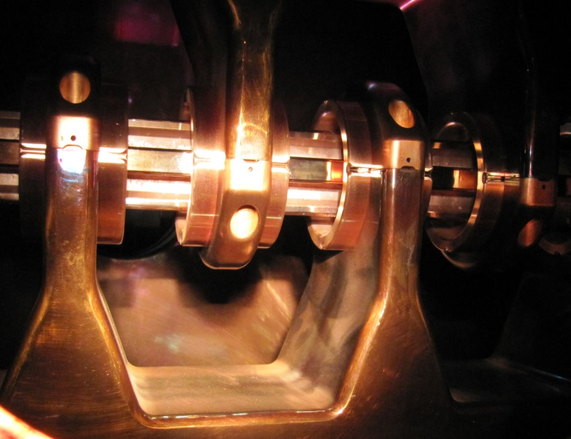
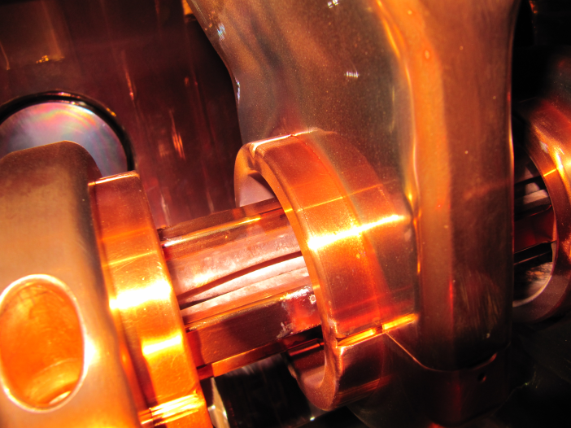
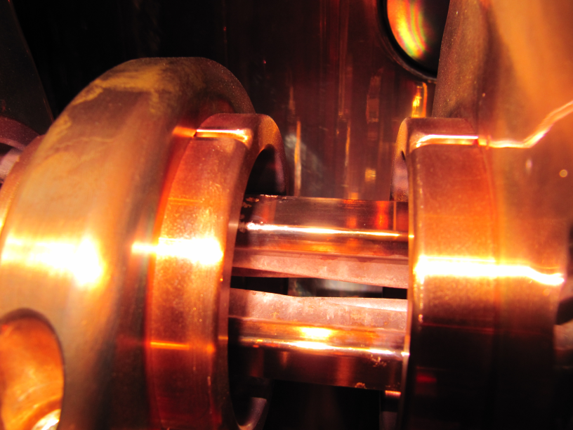
Machine meeting 28.08.18 – UNILAC
HSI-RFQ 2012

Slide 7
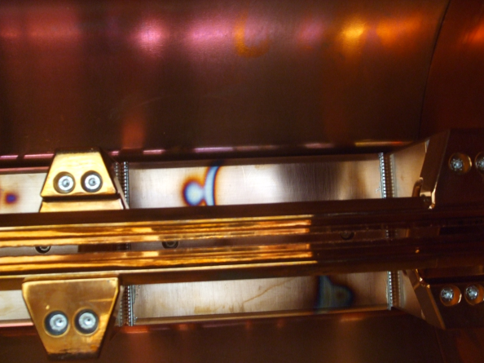
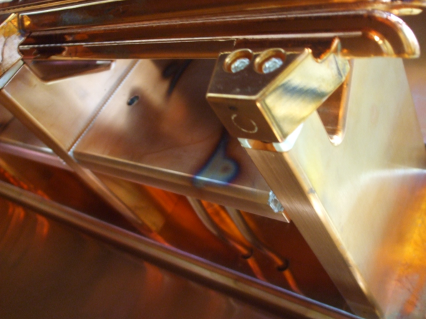
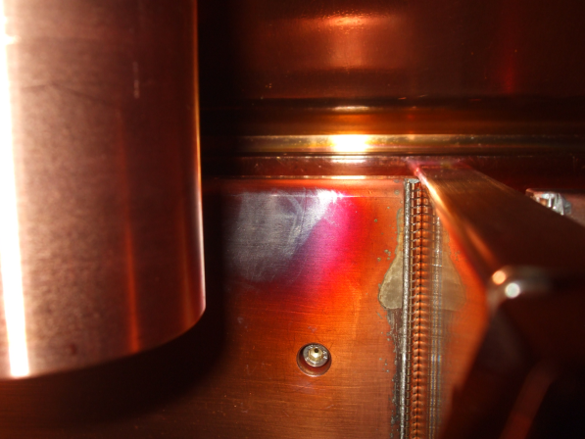
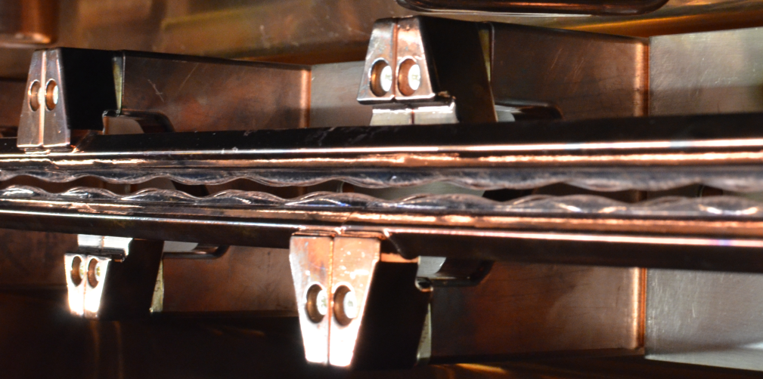
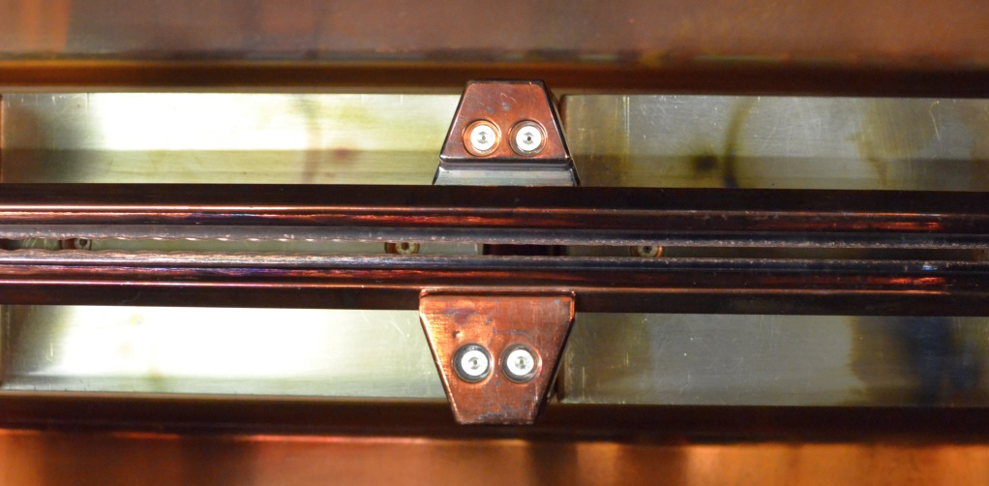
Machine meeting 28.08.18 – UNILAC
HLI-RFQ 2010-2012

