Slide 1

An Application of the AMPT Model
for SIS100 / FAIR Energies
Zi-Wei Lin
East Carolina University
32nd CBM Collaboration Meeting
01 - 05 October 2018
GSI, Darmstadt

Slide 2
Outline
A Multi-Phase Transport (AMPT) model
Incorporation of finite nuclear thickness to string melting AMPT
Analytical understanding by extending the Bjorken ε formula
to lower energies such as SIS100 / FAIR energies
Comparisons of extended Bjorken formula with AMPT results
Summary

Slide 3
A Multi-Phase Transport (AMPT) Model
AMPT aims to provide a self-contained kinetic description
of essential stages of high energy heavy ion collisions:
Event-by-event from initial condition to final observables
Can address non-equilibrium dynamics
(e.g. partial equilibration and thermalization, initial flow)
Self-consistent Chemical and kinetic freeze-out
Publicly available since 2004 and often updated:
source codes at http://myweb.ecu.edu/linz/ampt/
It is also a test-bed of different ideas & may lead to new discoveries:
  the discovery of v₃ by Alver & Roland
v₂ & v₃ may be dominated by anisotropic parton escape
  instead of hydrodynamics flow, due to low/modest opacity

Slide 4
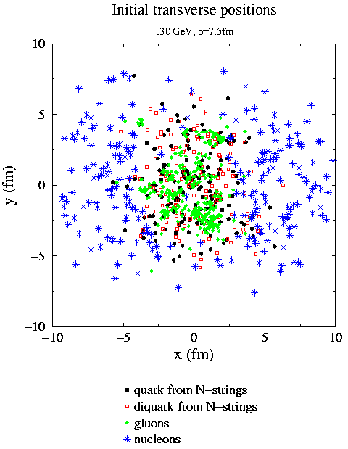
String melting version of AMPT
String Melting AMPT:
we convert strings into partonic matter;
should be more realistic at high energies;
this enabled AMPT to produced enough v2
at high energies using pQCD-like small
parton cross section.
ZWL and Ko, PRC 65 (2002)
Initial condition in default AMPT:
soft (strings) & hard (minijets)
Strings are in high density
overlap area,
but not in parton cascade.
◉
Beam axis
minijets
Notes:
For Au+Au @ 200A GeV: minijets account for ~ 1/3 total E_{T}

Slide 5
Structure of String Melting AMPT
HIJING1.0:
minijet partons, excited strings, spectator nucleons
A+B
Generate parton space-time
Strings melt to q & qbar via intermediate hadrons
ZPC (parton cascade)
Partons kinetic freezeout
Hadronization (Quark Coalescence)
Extended ART (hadron cascade)
Hadrons freeze out (at a global cut-off time);
then strong-decay most remaining resonances
Final particle spectra
ZWL et al. PRC72 (2005)

Slide 6
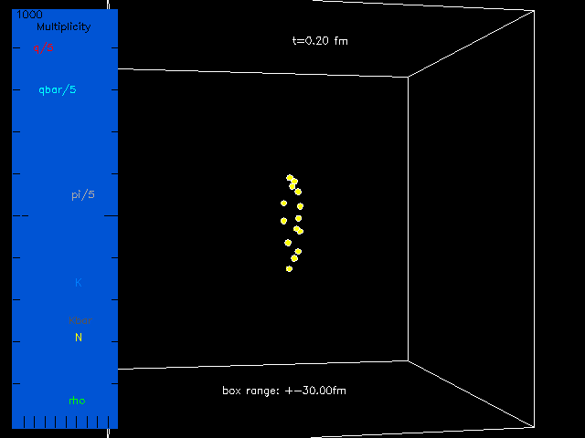
String melting AMPT : 1 central Au+Au event at 200AGeV
Side view:
Beam axes
Notes:
Color: gluon (2 red), q (2 red), qbar (5 cyan); pi (15 gray), k (11 light blue), kbar (14 dark gray), K*/K*bar (6 magenta), rho (3 deep green), omega/phi/eta/allOthers (1 white), p/n (7 yellow), pbar/nbar (12 violet), Delta/N*/Lambda/Sigma & bar (12 violet).
% Look at bottom middle: an anti-strange meson (turns out to be K*bar) is created ~3.8 fm/c, then decayed to a Kbar and a pion at ~10.6 fm/c.
You can see rho decays on middle to left, a white object decays to pions at top middle.

Slide 7
AMPT: default (Def) versus string melting (SM)
 | AMPT-Def [1] | AMPT-SM [2] | AMPT-SM in [3] | AMPT-SM in [4]
Lund string a | 2.2 | 2.2 | 0.5 | 0.55 for RHIC, 0.30 for LHC
Lund string b(GeV⁻²) | 0.5 | 0.5 | 0.9 | 0.15, also limit P(s)/P(q) ≤ 0.4
α_{s} in parton cascade | 0.47 | 0.47 | 0.33 | 0.33
Parton cross section | ~3 mb | ~ 6 mb | 1.5 mb | 3 mb
Model describes | dN/dy, p_{T} not v2 or HBT | v2 & HBT not dN/dy or p_{T} | dN/dy, v2 (LHC) not p_{T} | dN/dy, p_{T} & v2 (π,K@RHIC, LHC)
[1] ZWL et al. PRC64 (2001).
[2] ZWL and Ko, PRC 65 (2002); ZWL et al. PRC 72 (2005).
[3] Xu and Ko, PRC 83 (2011).
[4] ZWL, PRC 90 (2014): AMPT-SM can be tuned to reasonably reproduce simultaneously
dN/dy, p_{T} –spectra & v2 of low-p_{T} (<2GeV/c) π & K data
for central (0-5%) and mid-central (20-30%) 200AGeV Au+Au collisions (RHIC)
or 2.76AGeV Pb+Pb collisions (LHC).
Predictions for 5.02ATeV Pb+Pb collisions in Ma and Lin, PRC(2016)
Notes:
Also set upper limit on the strangeness quark suppression factor as 0.4.

Slide 8
String melting version of AMPT at RHIC/LHC energies
dN/dy of π & K:
ZWL, PRC 90 (2014)
v2 of π & K (mid-central collisions):
p_{T} -spectra of π & K (central collisions):

Slide 9
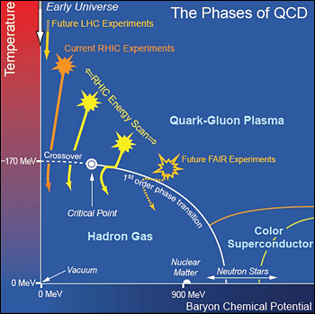
Application of string melting AMPT to lower energies
At lower energies, trajectory of nuclear collisions is important for potential effects from the QCD critical point.
Trajectory depends on the time evolution of energy density ε or T
& net-baryon density n_{B} or μ_{B}
Before studying these effects,
the model first needs to describe
the initial densities,
including the peak value
and time dependence:
ε^{max}, ε(t), …
from bnl.gov

Slide 10
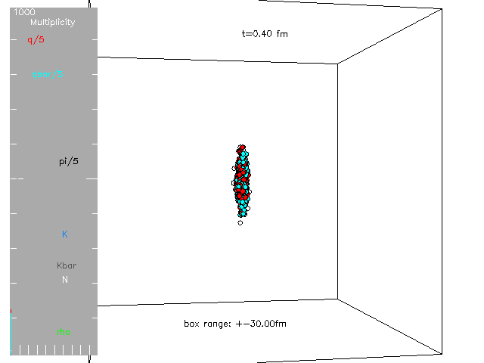
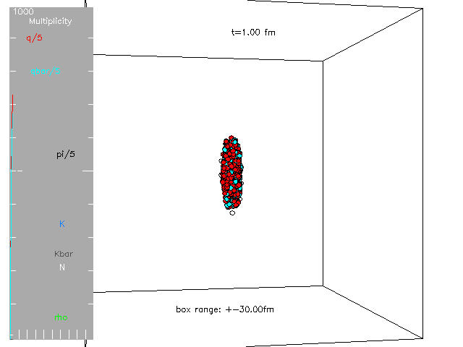
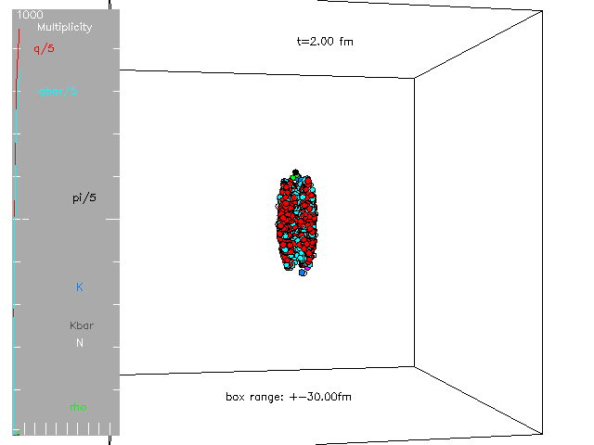
String melting AMPT
was implemented for high energies:
finite nucleus width was neglected.
At lower energies,
finite width may have important effects.
So we have recently included finite width
to string melting AMPT.
ZWL & Y. He, in progress
1 central Au+Au event
at 200AGeV

Slide 11
Incorporation of finite nuclear thickness for string melting AMPT
Effect of finite thickness
(filled circles):
is large at low energy,
gives much lower ε^{max}
and different shape
small effect at high energy
as expected
What about analytical understanding?
→ extension of the Bjorken ε formula to lower energies
ZWL, arXiv:1704.08418v2/PRC(2018)

Slide 12
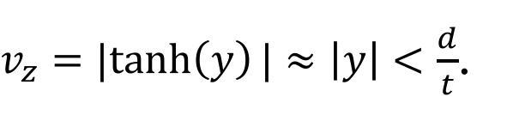
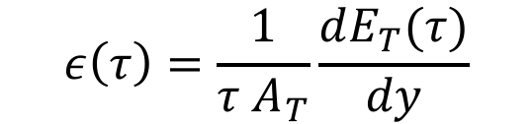
Extension of the Bjorken ε formula
A common model is
the Bjorken formula:
$$ε\left(τ\right)=\frac{1}{τ A_{T}}\frac{dE_{T}(τ)}{dy}$$
At high energies, initial particles are produced
from a pancake (at z=0) at t=0.
For partons in a thin slab of thickness -d<z<d
in central rapidity (y~0) at time t :
X
$v_{z}=|tanh\left(y\right)|≈\left|y\right|<\frac{d}{t}$.
Energy within the slab is then
X
0
z
X
Bjorken, PRD 27 (1983)
Notes:
Vz*t = ct* tanh(y) ~ ct* y < d. “A (well-known) factor of 2 error appears in the original” Bjorken paper, from PHENIX NPA757 (2005).

Slide 13
Extension of the Bjorken ε formula
Bjorken, PRD 27 (1983)
In spite of Fig.1,
the Bjorken formula neglects
finite thickness of (boosted) nuclei
→ it is only valid at high energies
where crossing time << τ_{F}
From PHENIX NPA757 (2005):

Slide 14
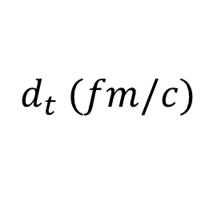

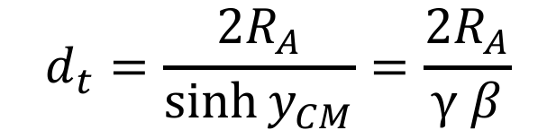
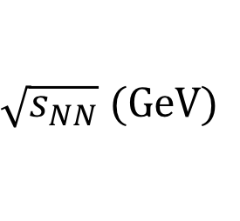
Extension of the Bjorken ε formula
Considering central A+A collisions
in the center-of-mass frame
& using the hard sphere model for nucleus:
crossing time
0
z
t = 0
$$d_{t}=\frac{2R_{A}}{\sinh{y_{CM}}}=\frac{2R_{A}}{γ β}$$
For central Au+Au collisions:
 | 3 | 5 | 11.5 | 27 | 50 | 200
 | 10.5 | 5.3 | 2.2 | 0.91 | 0.49 | 0.12
t = d_{t} /2
$$\sqrt{s_{NN}} (GeV)$$
$$d_{t} (fm/c)$$
Need crossing time << τ_{F}
→ the Bjorken formula is only valid for
for τ_{F} = 0.5 fm/c.
t = d_{t}
$$\sqrt{s_{NN}}>\sim 50 GeV$$

Slide 15
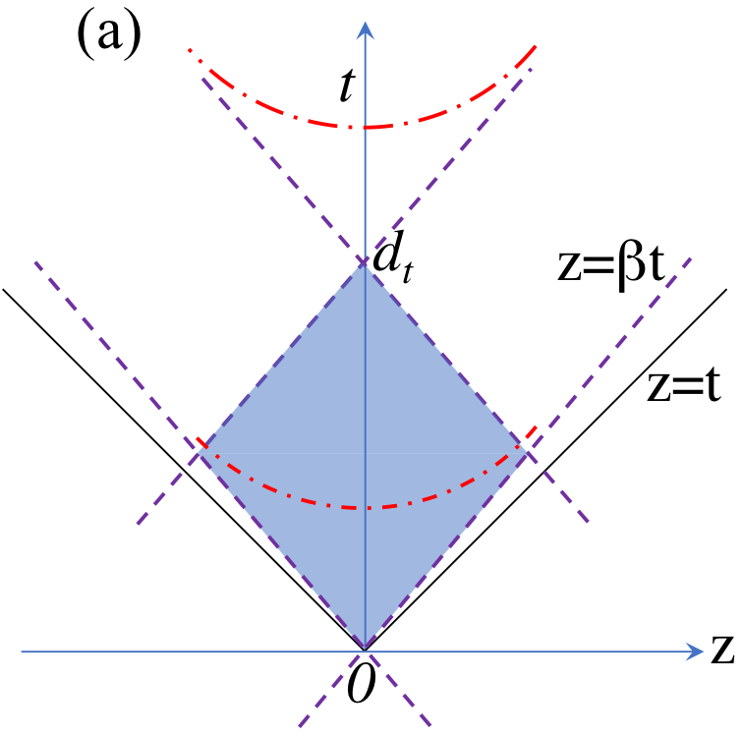
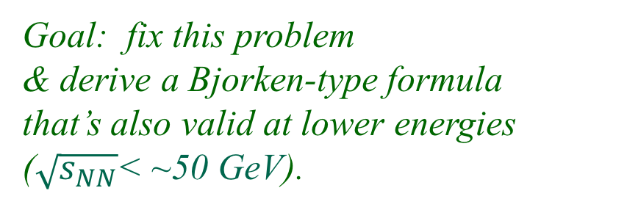
Extension of the Bjorken ε formula
Goal: fix this problem
& derive a Bjorken-type formula
that’s also valid at lower energies
($\sqrt{s_{NN}}$< ~50 GeV).
Kajantie et al.
NPB (1983)
Consider a schematic picture:
two nuclei come into contact at time 0
and pass each other at time d_{t} .
The shaded area
is the primary collision region,
so initial energy production takes place
over a finite duration of t & z.
We shall neglect secondary scatterings
& only consider the central region (η_{s} ~0)
Notes:
light-cone boundaries

Slide 16
Extension of the Bjorken ε formula
Picture for the Bjorken formula:
collision point
collision point
Notes:
light-cone boundaries

Slide 17
Extension of the Bjorken ε formula
Method:
introduce the finite time duration
in the initial energy production
(but neglect the finite z-width)
Picture with finite thickness:

Slide 18

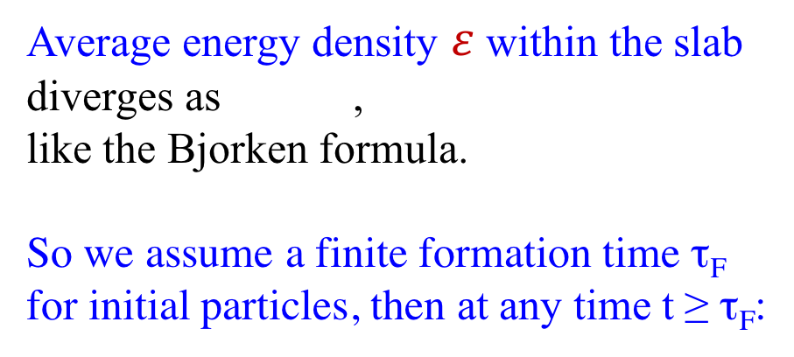
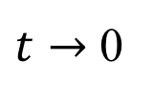
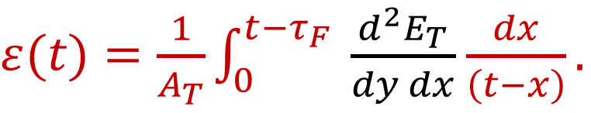
Extension of the Bjorken ε formula
Average energy density $ε$within the slab
diverges as ,
like the Bjorken formula.
So we assume a finite formation time τ_{F}
for initial particles, then at any time t ≥ τ_{F}:
$t→$ 0
$ε(t)=\frac{1}{A_{T}}\int_{0}^{{t−τ}_{F}}{ \frac{d^{2}E_{T}}{dy dx}}$ $\frac{dx}{\left(t−x\right)}.$
This applies even during the crossing time.
$$\frac{d^{2}E_{T}}{dy dx}$$
To proceed, we now take a specific form for the time profile .

Slide 19
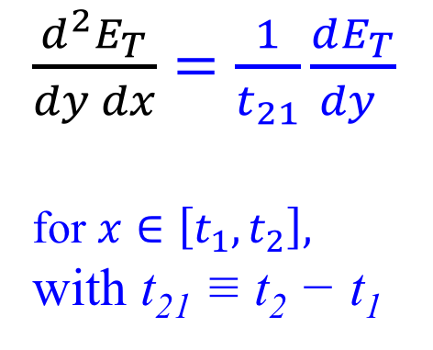

Extension of the Bjorken ε formula: the uniform profile
$ε(t)=\frac{1}{A_{T}}\int_{0}^{{t−τ}_{F}}{ \frac{d^{2}E_{T}}{dy dx}}$ $\frac{dx}{\left(t−x\right)}$
The simplest (uniform) profile:
initial energy (at y~0) is produced
uniformly from time t₁ to t₂ :
$\frac{d^{2}E_{T}}{dy dx}=\frac{1}{t_{21}}\frac{dE_{T}}{dy }$
for $x∈\left[t_{1},t_{2}\right],$
with t₂₁ ≡ t₂ − t₁
x

Slide 20
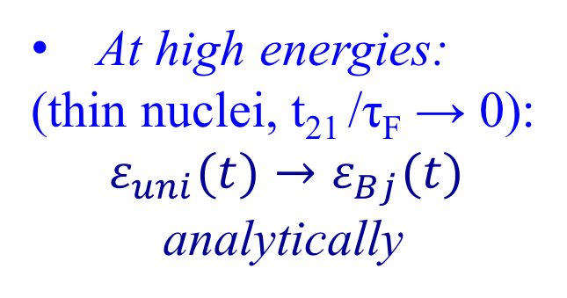

Extension of the Bjorken ε formula: the uniform profile
→ solution:
ZWL, arXiv:1704.08418v2/PRC(2018)
$$ε(t)$$
At high energies:
(thin nuclei, t₂₁ /τ_{F} → 0):
$$ε_{uni}(t)→ε_{Bj}(t)$$
analytically
Bjorken formula
Central Au+Au@11.5GeV
At lower energies:
very different
from Bjorken
Uniform formula
dE_{T}/dy parameterization
from PHENIX PRC 71 (2005)
t₁+τ_{F}
t₂+τ_{F}

Slide 21


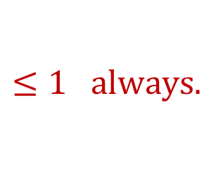

Extension of the Bjorken ε formula: the uniform profile
Peak energy density:
→ ratio over Bjorken:
$$≤1 always.$$
ZWL, arXiv:1704.08418v2/PRC(2018)
1) For t₂₁ /τ_{F} → 0 (high energy):
ratio → 1 (→ Bjorken)
$$ε(t)$$
Bjorken formula
Central Au+Au@11.5GeV
2) For t₂₁ /τ_{F} >>1 (low energy):
ratio → 0;
so the peak energy density
<< Bjorken value
much less sensitive to τ_{F}
$ε_{uni}^{max}$ $∝\ln\left(\frac{1}{τ_{F}}\right)$, not $\frac{1}{τ_{F}},$
$$ε_{uni}^{max}$$
Uniform formula
t₁+τ_{F}
t₂+τ_{F}
FWHM width in t >> Bjorken
Notes:
Let t₁ = 0 for simplicity

Slide 22
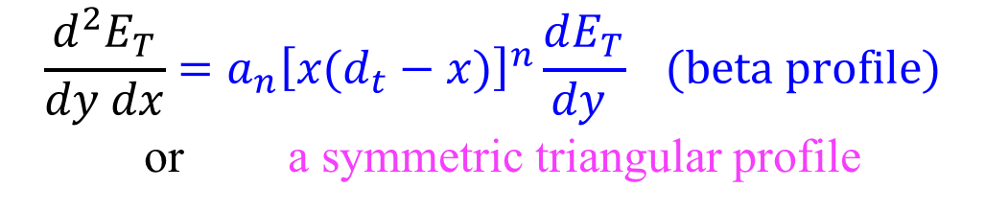
Extension of the Bjorken ε formula: beta or triangular profiles
A more realistic profile:
~0 energy is produced at x = 0 & d_{t} ,
most energy is produced around x = d_{t} /2 :
0
z
$$\frac{d^{2}E_{T}}{dy dx}=a_{n}{\left[x(d_{t}−x)\right]}^{n}\frac{dE_{T}}{dy } (beta profile)$$
or a symmetric triangular profile
x = 0
x = d_{t} /2
x
x = d_{t}
Circles: time profile of initial partons within mid-η_{s}
from string melting AMPT for central Au+Au @11.5 GeV.

Slide 23

Applying extended formula to central Au+Au collisions
We compare 1) the uniform time profile (with t₁ = 0 & t₂ = d_{t} ),
2) the beta time profile (n = 4). 3) the Bjorken formula:
At low energy:
At high energy,
solution ~ Bjorken.
$$ε^{max}$$
<< Bjorken value,
is much less sensitive to τ_{F} :
factor of 2.1 or 2.5 change (not factor of 9) when τ_{F} changes from 0.1 to 0.9 fm/c.
Notes:
Checked 200GeV: dEt/deta=0.5*(2A)*0.73*ln(srts/2.35)=639GeV, so eBj(0.3fm/c)=1.25*dEt/deta/0.3*[3.14*(1.12*197^(1/3))^2]=20. GeV/fm^3.
Uniform hs lower emax since energy is deposited over a long period of time (for the naïve choice).

Slide 24
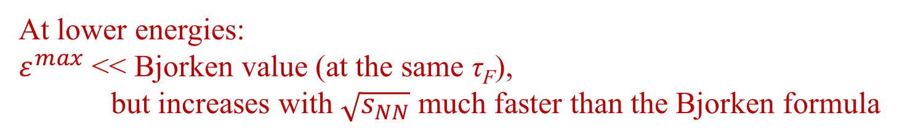
Applying extended formula to central Au+Au collisions
At lower energies:
$ε^{max}$ << Bjorken value (at the same τ_{F}),
but increases with $\sqrt{s_{NN}}$ much faster than the Bjorken formula
Peak energy density averaged
over the nucleus transverse area
ZWL, arXiv:1704.08418v2/
PRC(2018)

Slide 25
Comparison of extended Bjorken formula with AMPT results
Overall:
AMPT with F.T.
(filled circles)
~ our extension
AMPT w/o F.T.
(open circles)
~ Bjorken formula,
Small effect
of finite thickness
at 200 GeV.
F.T.=finite thickness
ε_{uni}(t) ~ ε_{beta}(t), since here we set t₁ & t₂ of the uniform profile
so that it has the same mean & standard deviation as the beta profile.

Slide 26
Comparison of extended Bjorken formula with AMPT results
Note: AMPT has
variable τ_{F} ,
Woods-Saxon,
secondary scatterings,
transverse expansion,
finite width in z.
Here we set t₁ & t₂ of
the uniform profile
and triangular profile
so that they each have the same
mean & standard deviation
as the beta profile (n=4).

Slide 27
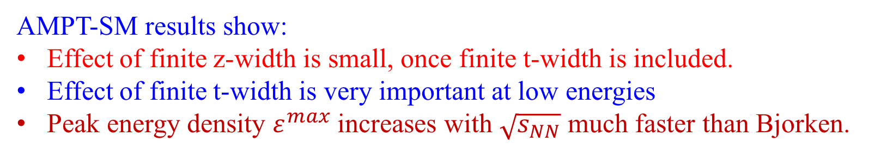
Results from string melting AMPT
Our analytical results include finite width in t but not the finite width in z.
AMPT-SM results show:
Effect of finite z-width is small, once finite t-width is included.
Effect of finite t-width is very important at low energies
Peak energy density $ε^{max}$ increases with $\sqrt{s_{NN}}$ much faster than Bjorken.

Slide 28
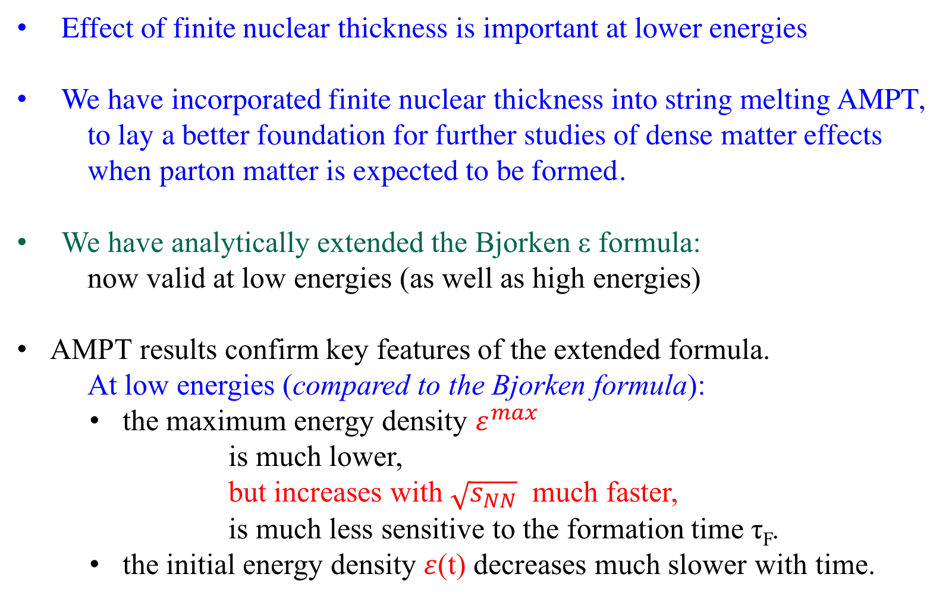
Summary
Thank you!
Effect of finite nuclear thickness is important at lower energies
We have incorporated finite nuclear thickness into string melting AMPT,
to lay a better foundation for further studies of dense matter effects
when parton matter is expected to be formed.
We have analytically extended the Bjorken ε formula:
now valid at low energies (as well as high energies)
AMPT results confirm key features of the extended formula.
At low energies (compared to the Bjorken formula):
  the maximum energy density $ε^{max}$
        is much lower,
  but increases with $\sqrt{s_{NN}}$ much faster,
  is much less sensitive to the formation time τ_{F}.
  the initial energy density $ε$(t) decreases much slower with time.

