Slide 1
FAIR Operation Modes
Dr. Sabrina Appel, Accelerator Physics Department, GSI, Darmstadt
Notes:
Optimierung der Multi-Turn-Injektion in Schwer-Ionen-Synchrotrons

Slide 2
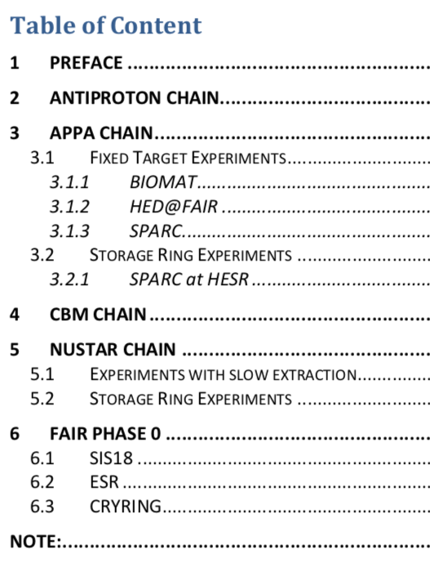
Reference beam parameters
EDMS Link:
https://edms.cern.ch/document/1606986/3
Under Approval: 12/14

Slide 3
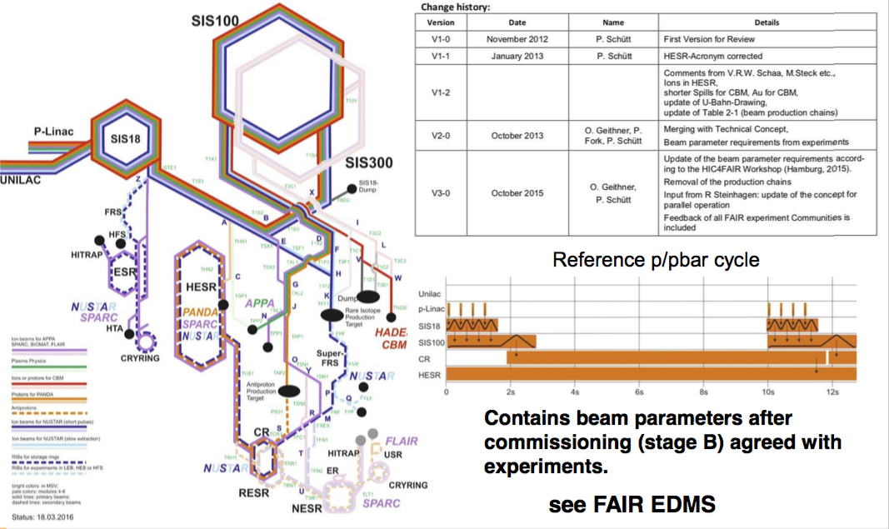
FAIR Operation Modes (April 2016)
Revision

Slide 4
Change history
Change history:
Version | Date | Name | Details
V1-0 | November 2012 | P. Schütt | First Version for Review
V1-1 | January 2013 | P. Schütt | HESR-Acronym corrected
V1-2 |  |  | Comments from V.R.W. Schaa, M.Steck etc., Ions in HESR, shorter Spills for CBM, Au for CBM, update of U-Bahn-Drawing, update of Table 2-1 (beam production chains)
V2-0 | October 2013 | O. Geithner, P. Fork, P. Schütt | Merging with Technical Concept, Beam parameter requirements from experiments
V3-0 | October 2015 | O. Geithner, P. Schütt | Update of the beam parameter requirements according to the HIC4FAIR Workshop (Hamburg, 2015). Removal of the production chains Input from R Steinhagen: update of the concept for parallel operation Feedback of all FAIR experiment Communities is included
V4-0 | 2019 | S. Appel + O. Boine-Frankenheim | Revision for EDMS relase
V3-0 can be found under https://edms.cern.ch/document/1688183/1

Slide 5
Table of Content
Introduction
Antiproton Beams
APPA
CBM/HADES
NUSTAR
Parallel Operation
Open Topics

Slide 6
Example: Antiproton Beams
Short description of experiment aim
Detailed description of beam chain
(per experiments)
Beam parameters for Commissioning + MSV
Future Options (after MSV)

Slide 7
Additional and open topics
Additional topics
Add detailed description of commissioning
Different possible commission scenarios
Proposal: Separated commission document
Open (not up-to-date) topics
Ion source status
Spill structure
APPA cave and stripper
Gamma_t-jump (Proton)
Beam line SIS18->HESR

