Slide 1
FAIR Experiments & Accelerator – 14st Dec. 2018
FAIR – Construction & Installation
Harald Hagelskamp
Site Manager

Slide 2
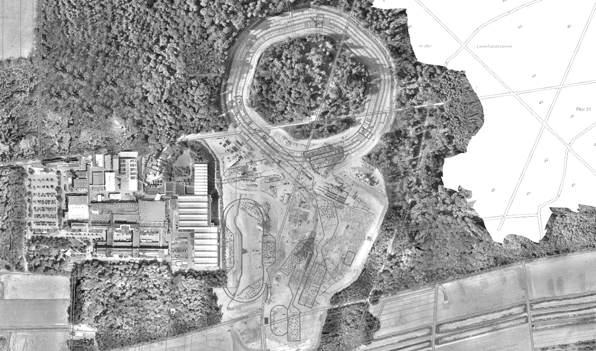
FAIR Project Progress
Contracting Strategy - Civil Construction Packages
Earth Works North; Civil Works North & South
T110N, 4. BA
T110N, 5. BA
Strategy Parameters:
Earth Works.
Civil Works Package North.
Civil Works Package South.
Defining the Contracting Packages to meet Market Capacities.
Reducing Contractor Performance Risks.
Managing Interfaces.
T110N, 3. BA
K0923A (T110N, 1. BA)
T110N, 2. BA
Area North
T110S
T110S
(G017A)
Area South
K0720A (G017A)
D0715A (G020)
(G017.1)
G0702A (T101)
K0619A (T112))
K0617A
H0705A (G004)
K0617A (T104)
G0704A (G004A)
H0705A (G004)
(G014)
L0516A (G018)
K0519A (G120)
G0418A (T108)
K0503A (T113)
H0417A (G009)
K0410A (T103)
K0406A (G050)
L0409A (G021)
K0314A (G017.2)
L0321A (G006A)
H0307A (T106)
K0321A (G006C)
L0317A (G006B)
K0308A (G006)
H0209A (G007)
Harald Hagelskamp - Fair Exp. & Acc. 14.12.2018
2

Slide 3
FAIR Project Progress
Civil Works - Procurement and Contracting Status
Pos. | Awarding Item | Company | Status | Contract Award Date
VE 300-025 | Earth Works Area „North“ | ABN consortium | awarded | 26.05.2017
VE 300-026 | Civil Works Area „North“ | PORR | awarded | 29.01.2018
VE 300-027 | Site Logistics and Temporary Services | ZÜBLIN | awarded | 19.03.2018
VE 300-028a | Indoor Elevators | TAG | awarded | 09.04.2018
VE 300-029 | Site Power Supply and Site Security | GAT | awarded | 29.01.2018
VE 300-031 | Civil Works Area „South“ | - | published on 04.09.2018
VE 300-028b | Indoor Overhead Cranes - Special | - | published on 04.09.2018
VE 300-028c | Indoor Overhead Cranes - Normal | - | published on 04.09.2018
Notes:
3

Slide 4
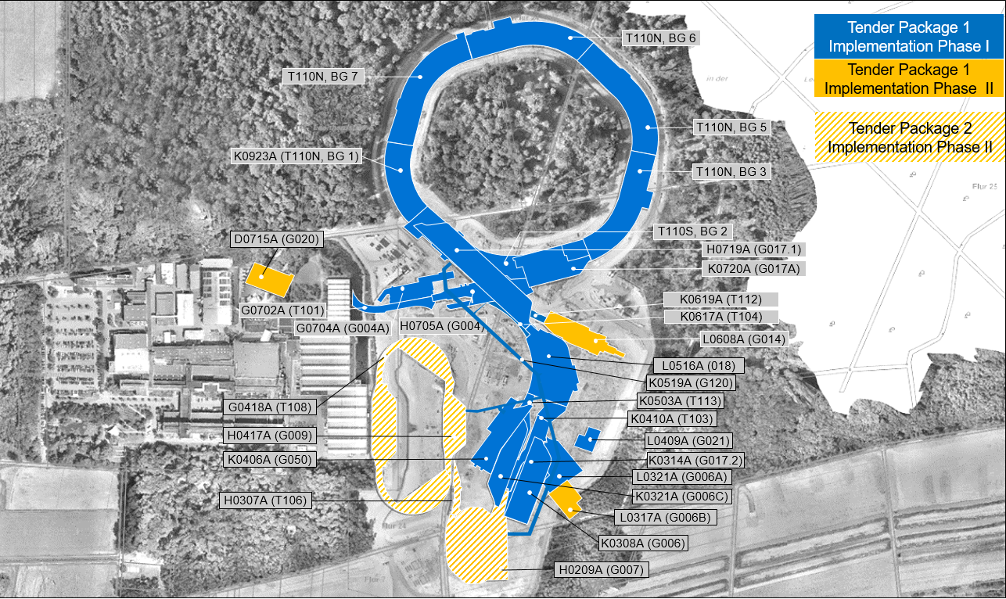
FAIR Project Progress
Contracting Strategy - Technical Building Installations Packages
Mechanical & Electrical & Process (MEP)
Strategy Parameters:
Economical viability accross all Trades.
Attract and address a suitable group of qualified Contractors.
Grouping of Trades by Functionality.
Minimise Functional Interfaces.
Reduced Execution Interfaces.
Reduced QA Mangement Effort.
Optimised Commissioning Processes.
Reduced Warranty and Risk Interfaces.

Slide 5
FAIR Project Progress
Technical Building Installations - Procurement and Contracting Status
Pos. | Awarding Item | Specifications | Status | Planned Contract award date
VE 400-001 | Ventilation Systems | Ventilation, Air Conditioning | published on 26.09.2018 | Q3 / Q4 2019
VE 400-003 | Sanitary / Technical Gases | Water and Wastewater, Compressed Air, Helium, Nitrogen | published on 25.09.2018 | Q3 / Q4 2019
VE 400-005 | Heating/ Cooling | Heating, Cooling for AC and Machine | published on 13.10.2018 | Q3 / Q4 2019
VE 400-002 | Electrical Power Facilities | High&Low Voltage, Telecommunication and IT, Data System, | published on 10.10.2018 | Q3 / Q4 2019
VE 400-007 | Safety and Security Systems | Fire Detection System, BOS- Radio, Access Control / Door Controls | published on 28.09.2018 | Q3 / Q4 2019
VE 400-004 | Firefighting Systems | Firefighting Systems, High Pressure Sprinkler Systems | published on 08.10.2018 | Q3 / Q4 2019
VE 400-006 | Building & Process Automation Systems | Automation Systems, Control panels, Operation Facilities, divers Building Automation Systems | Not yet published | Q2 / 2020

Slide 6
FAIR Project Progress
Procurement and Contracting Status and Forecast 30.10.2018
 | 2017 |  |  |  | 2018 |  |  |  | 2019
 | Q1 | Q2 | Q3 | Q4 | Q1 | Q2 | Q3 | Q4 | Q1 | Q2 | Q3 | Q4
Milestones
Pre-conditions
Construction Permits
Building Area „North“ Building Area „South“
Construction Contract: Tendering & Award Process
Excavation Area „North“ Site Logistics and Temporary Services Site Power Supply and Site Security Civil Works Area „North“ Elevators Cranes and Hoists Civil Works Area „South“ Interior Finishing Works „Package 1“ Technical Building Services „Package 1“
Construction Execution
30/10/2018
07/18
04/19
Cost Review to check cost development
supported by market data
BMBF‘s grant decision to support amendment notice
04/17
11/18
Granting construction permits by building prior to commencement of works
04/18
09/19
Granting construction permits by building prior to commencement of works
05/17
09/17
03/18
10/17
01/18
01/18
11/17
04/18
09/18
02/19
09/18
10/19
07/19
11/19
Note 1)
09/18
10/19
Note 1) Expected start of tendering process for “package 2” in Q4/2019 … Q1/2020 depending on cost review results
Start Excavation Area „South“
06/17
11/19
Start Excavation
Area „North“
03/18
Start Civil Works Area „North“
Start Civil Works Area „South“
12/19
Announcement
Contract award
Completed
Current Schedule
Status 30/10/2018

Slide 7
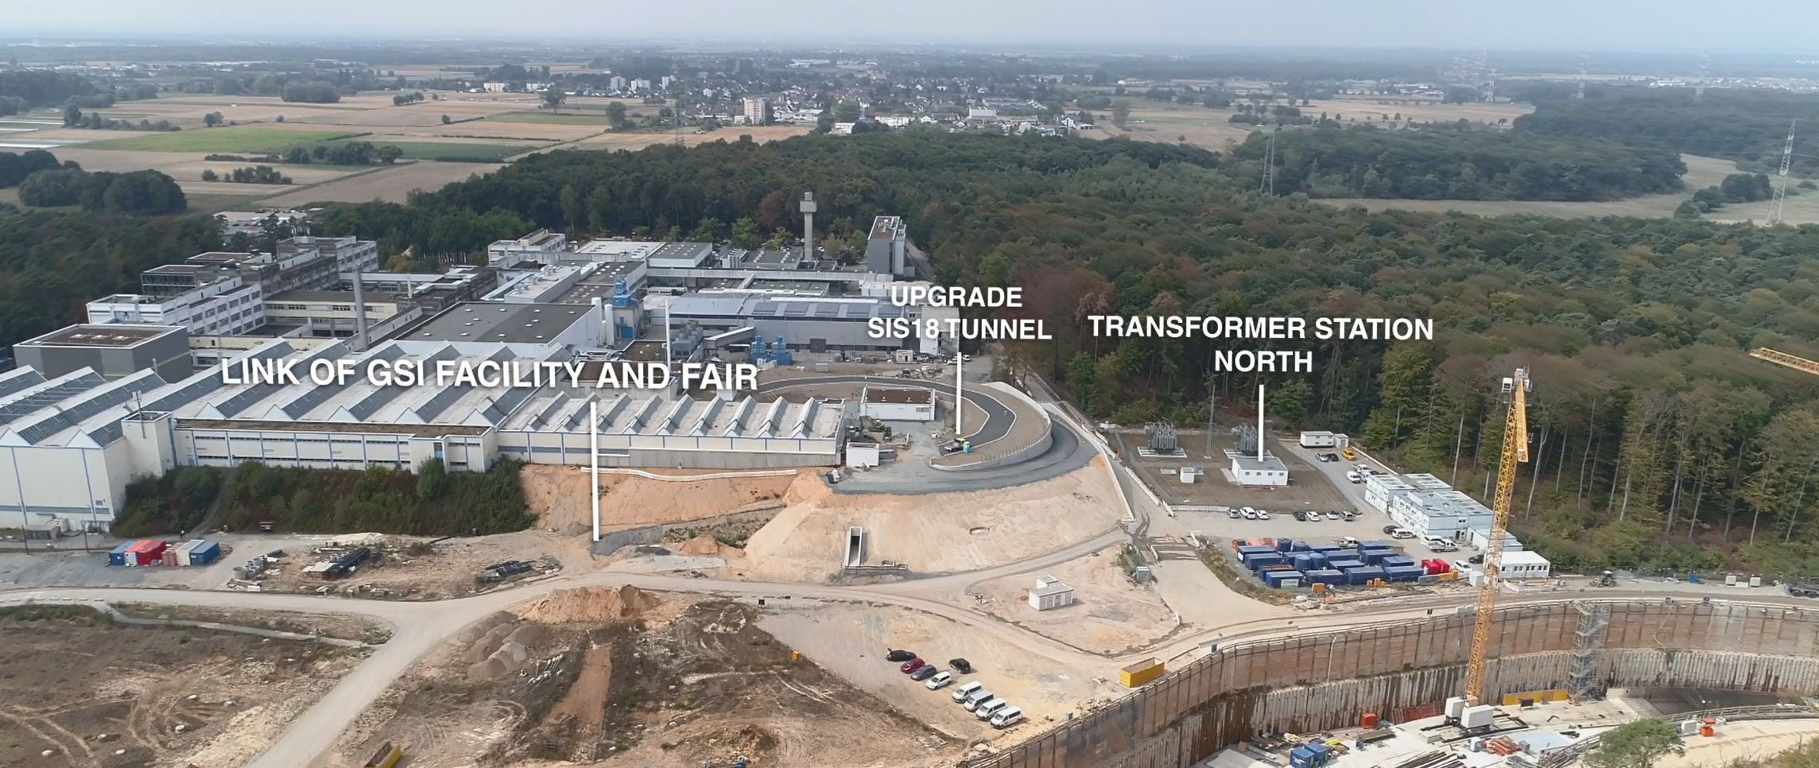
FAIR Project Progress – Civil Construction
Completion of interface works between GSI and FAIR
Harald Hagelskamp - Fair Exp. & Acc. 14.12.2018
7

Slide 8
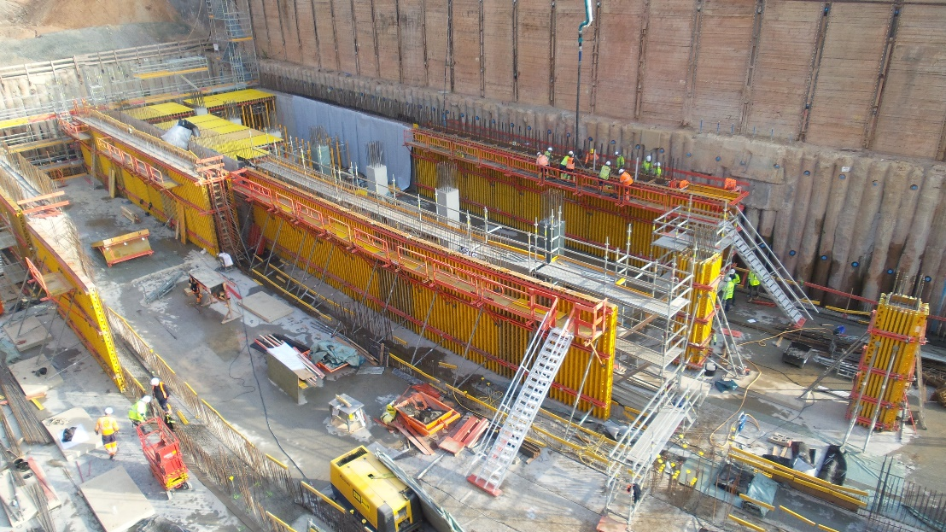
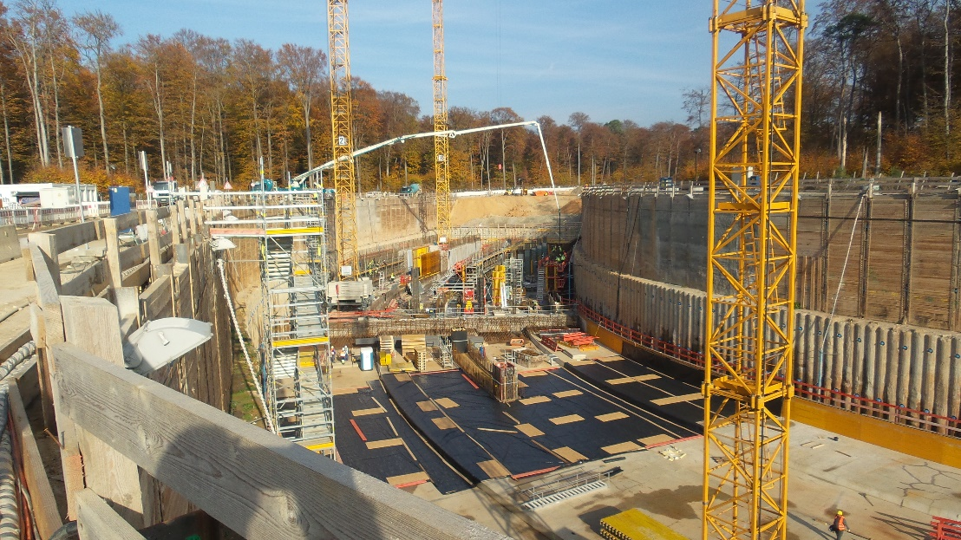
FAIR Project Progress – Civil Construction
Excavation Pit 1 Area North – SIS 100 Tunnel
Concrete works of 1st section tunnel walls – 9th November 2018
Preparation of formworks for the tunnel roof
Concrete works preparation for the next foundation slab sections
Harald Hagelskamp - Fair Exp. & Acc. 14.12.2018
8

Slide 9
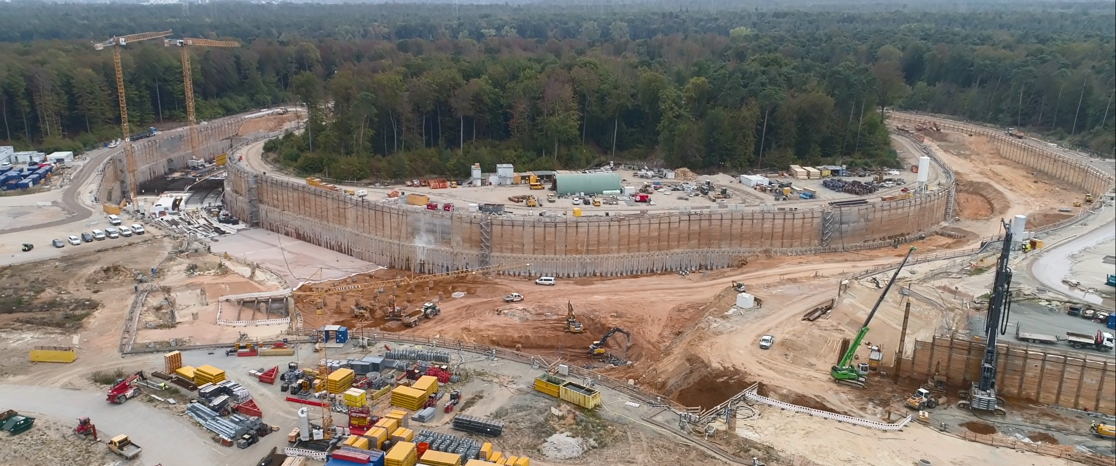
FAIR Project Progress – Civil Construction
Excavation Pit 2 and 3 Area North
Harald Hagelskamp - Fair Exp. & Acc. 14.12.2018
9

Slide 10
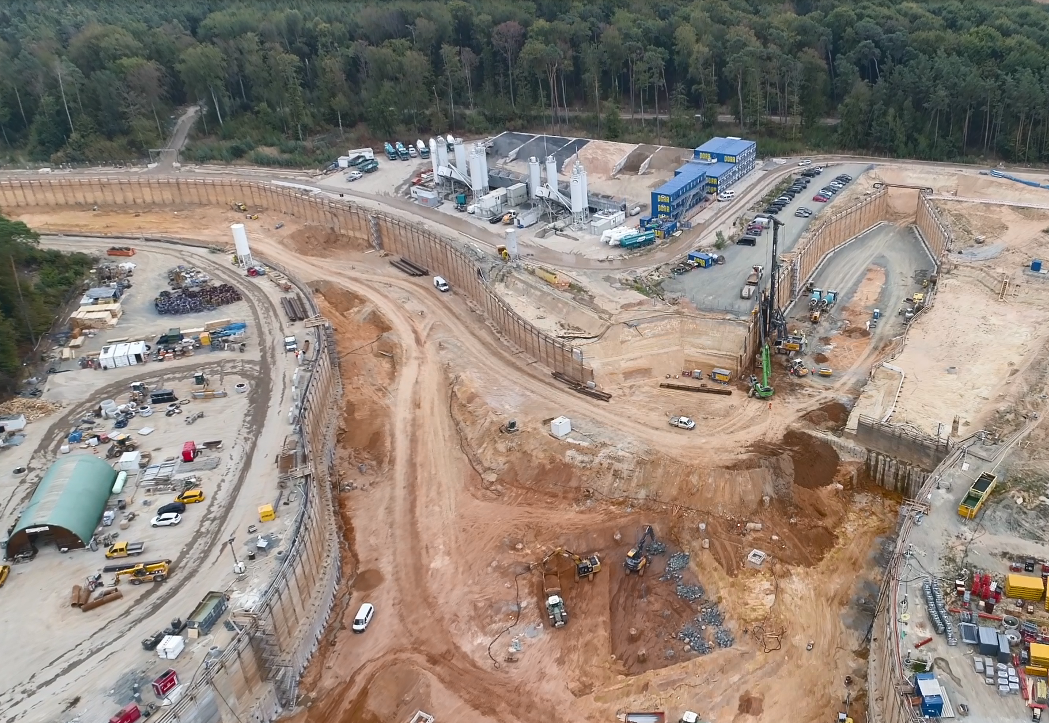
FAIR Project Progress – Civil Construction
Excavation Pit 4 Area North – CBM Experiment Building
Harald Hagelskamp - Fair Exp. & Acc. 14.12.2018
10

Slide 11
FAIR Site Management
Accelerator & Experiment Installation
Harald Hagelskamp - Fair Exp. & Acc. 14.12.2018
11

Slide 12
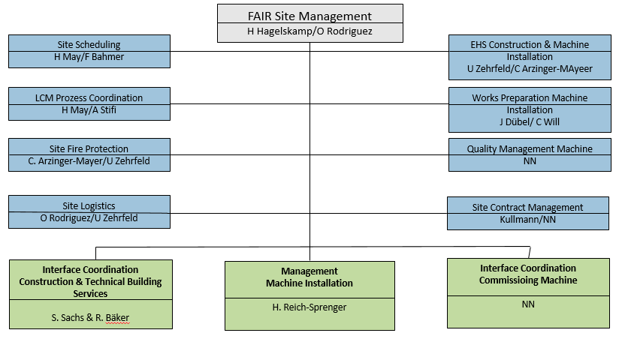
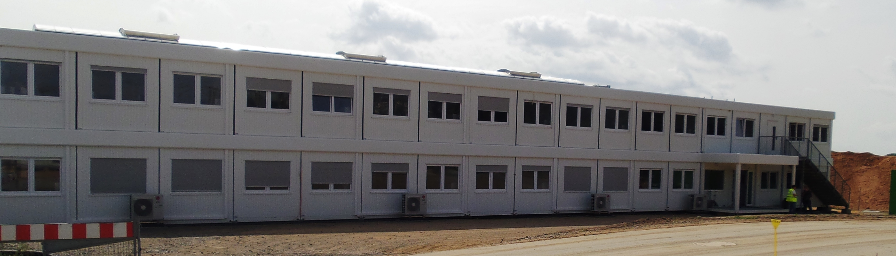
Site Management Organization

Slide 13
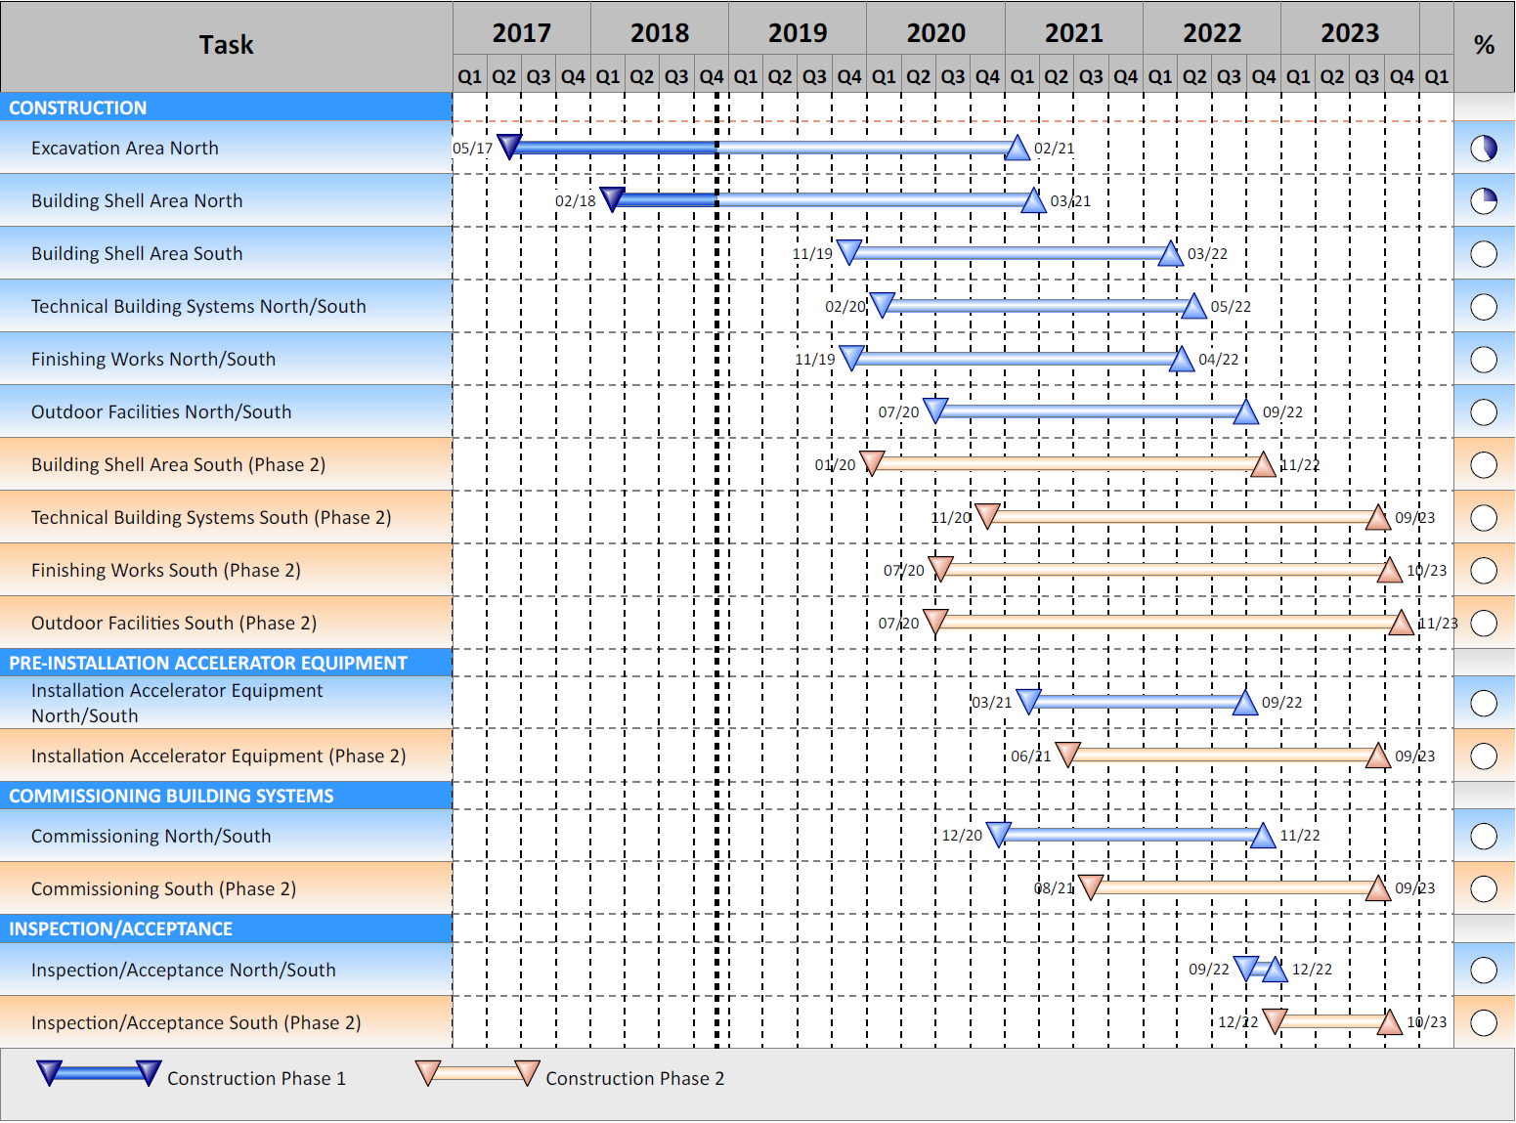
Site Management
Interface Coordination
Civil, Technical Services and Acc. & Exp.
Simultaneous Installation
2020 - 2022

Slide 14
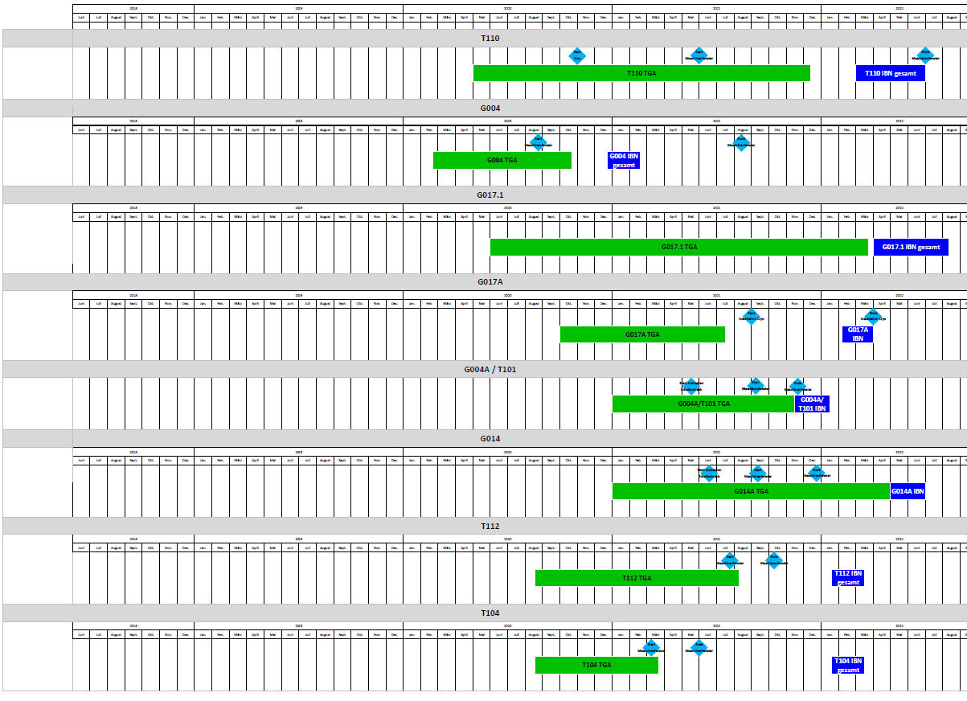
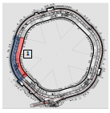
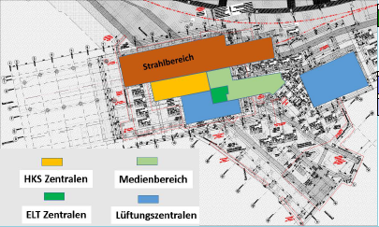
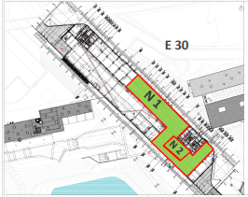
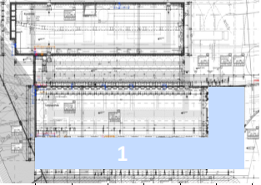
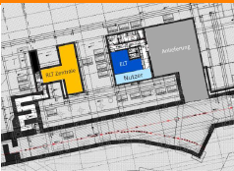
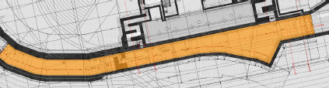


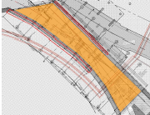
Site Management
Interface Coordination
Simultaneous Installation of Technical Services in Buildings of Area North
2020
2021

Slide 15
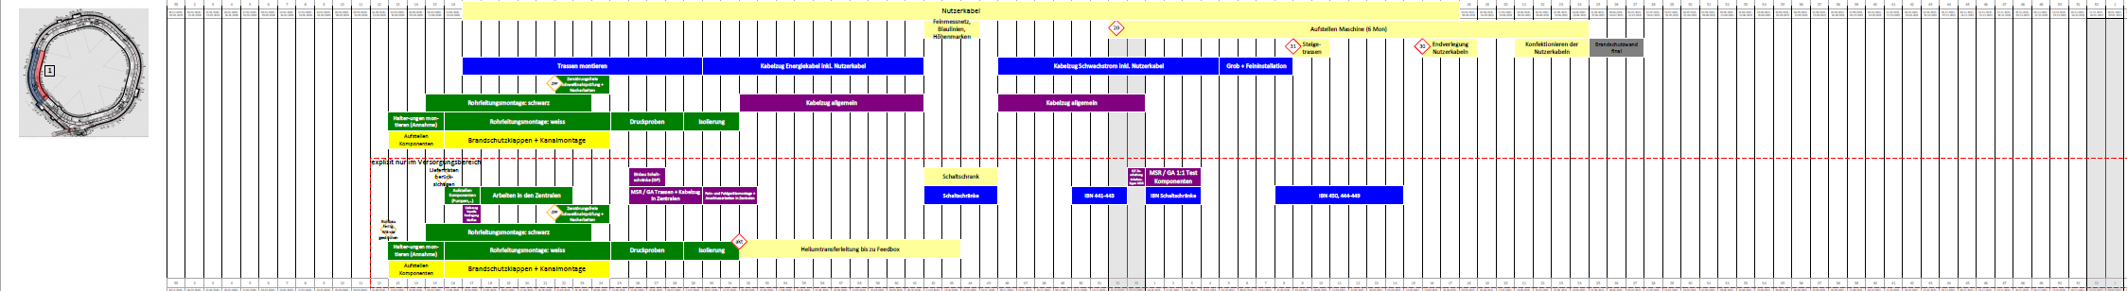
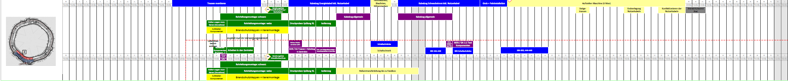
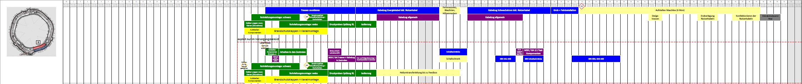
Site Management
Interface Coordination
Lean Construction Management (LCM)
2020
2021
6 months overlap
of minimum 3 sections

Slide 16
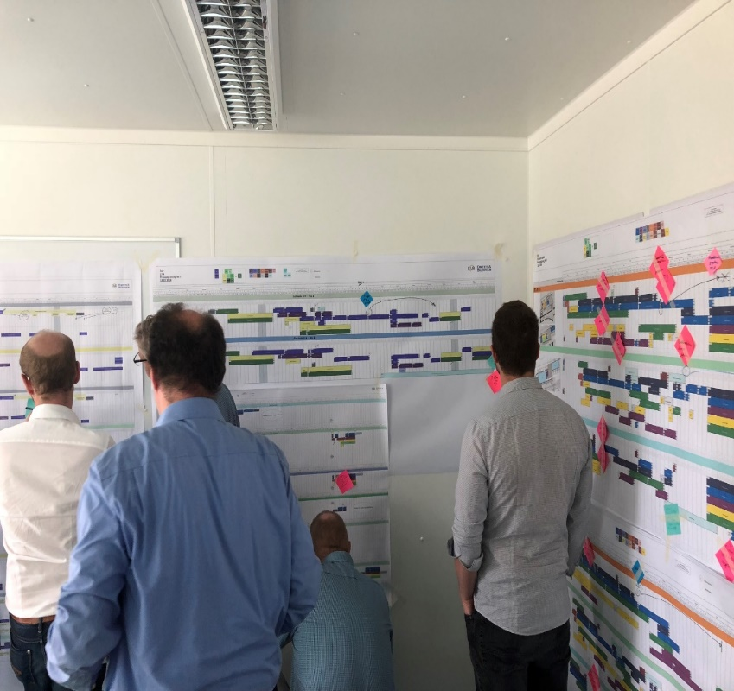
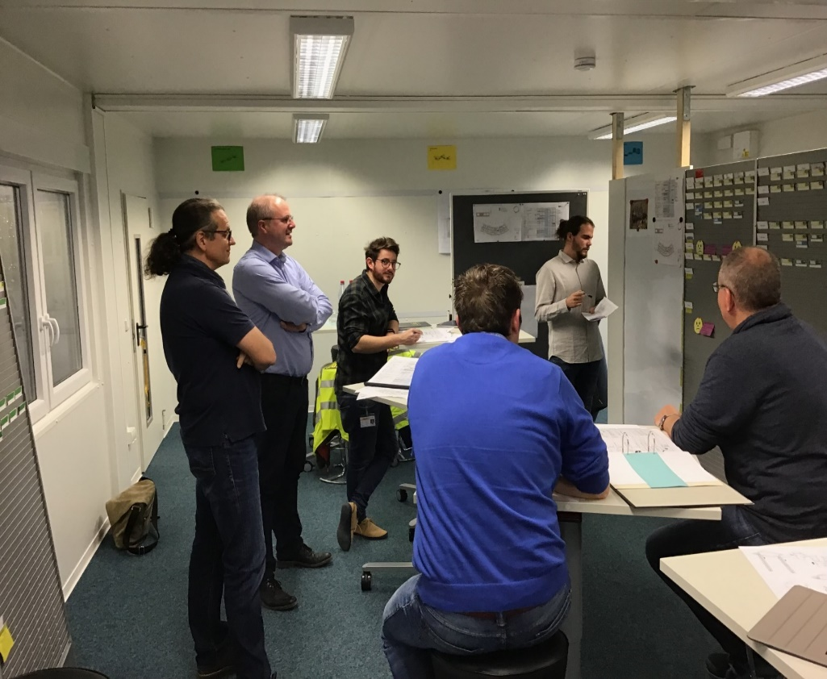
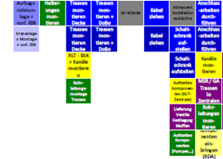
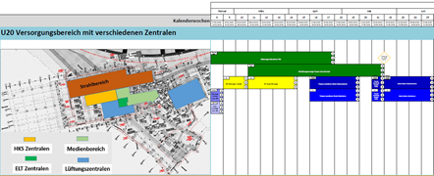
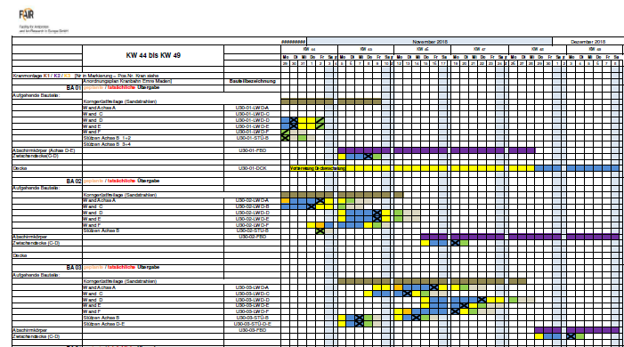
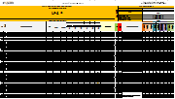
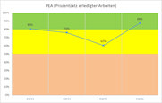
Site Management
Interface Coordination
Lean Construction Management Tool (LCM)
Team Effort
(1) Verständnis & Gesamtprozess
(2) Prozessplanung
(3) 6 Wochenvorschau
(4) Wochenplanung
(5) Kennzahlen

Slide 17
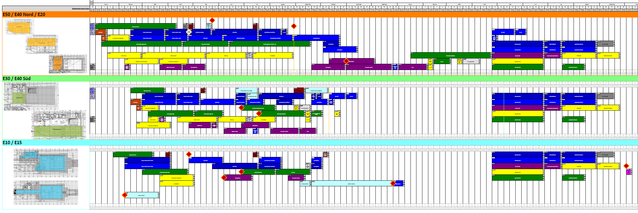
Site Management
Interface Coordination
Lean Construction Management (LCM)
The Installation of the Acclerator Components will take place simultaneously and interactively with the installation of the Building Technology Equipment.
LCM was selected as a Process Coordination Tool to manage all Interfaces during the simultaneous Installation of Building Technology Services and Accelerator and Experiment System Components.
A Strategy Plan was developed to ensure a coordinated Supply, Delivery and Installation of all Accelerator and Experiment Components.
An Installation Team was established to ensure the successful Implementation of the Strategy Plan.

Slide 18
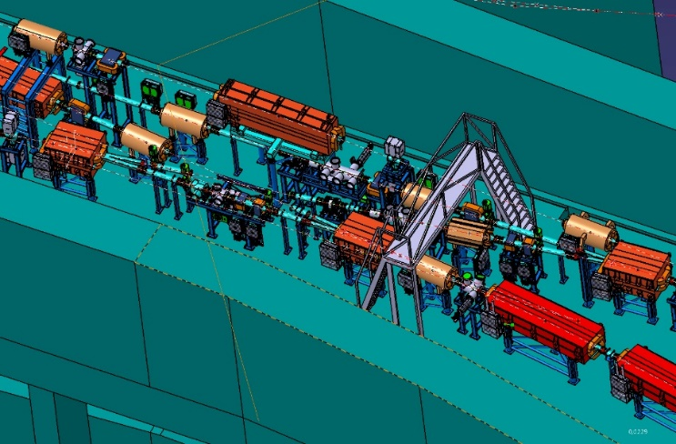
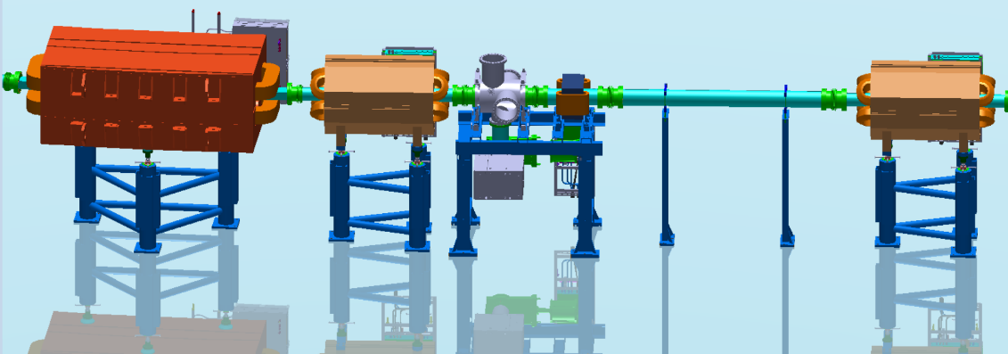
Site Management
Installation Team
  The Roles and Reponsibilities of the Installation Team
    All installation activities for all Subprojects are centrally coordinated by the Team.
      Sharing and allocation of Resources will be done interchangeably between Subprojects.
      Sharing and transfer of Lessons Learnt from between Subprojects.
      The responsibility for the coordination and timing lies with the Installation Team.
      The responsibility for the technical correctness and quality of the installation lies with the Subproject.
    Pre-defined installation packages
      The Team is preparing documented modularized Installation Work Instructions.
      Will be executed by internal and external resources.
      Always supervised and coordinated by FAIR personnel.
    Assembly Groups and Transport Modules

Slide 19
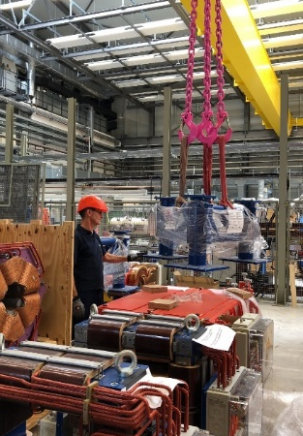
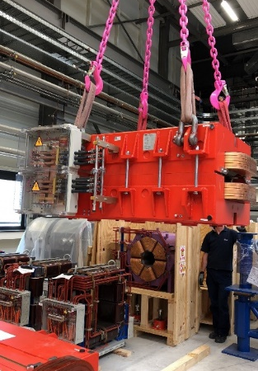
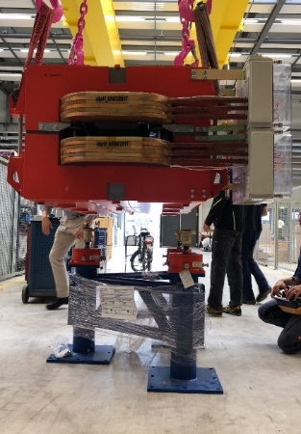
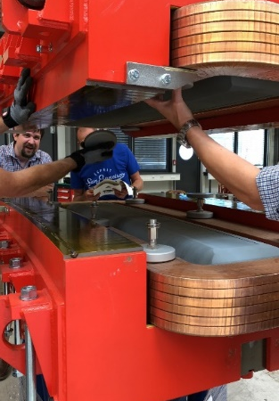
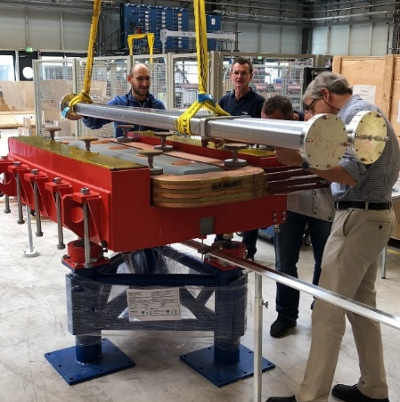
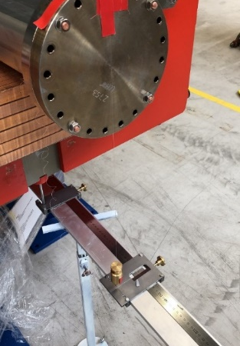
Site Management
Pre-Assembly
HEBT Mini-workshop 01.08.2018 – Trial Assembly of a Dipole
Workshop Observations
Impediments during preparation:
  No Responsible Personwas assigned.
  Assembly drawings not clear.
  Preparation delayed, i.e. cleaning of vac chamber.
  magnet alignment units not in stock
Impediments during pre-assembly:
  wrong sling gear
  missing extension for torque wrench
  suppliers accessories kit with incorrect bolts
  wrong or inefficient adjustment gear
  correct fixing accessory (rubber sheets) not in stock.g dimension,
  Workshop Conclusion
  Preassembly of all components at GSI have to be coordinated and centrally managed in order
  to optimise processes
  to make optimal use of available space, capacities and resources.
  to ensure timeous availability for installation at FAIR.
Consignment base frame
Consignment magnet
Pre-assembly magnet to frame
Opening
Integration vacuum chamber
Adjustment vacuum chamber inside magnet

Slide 20
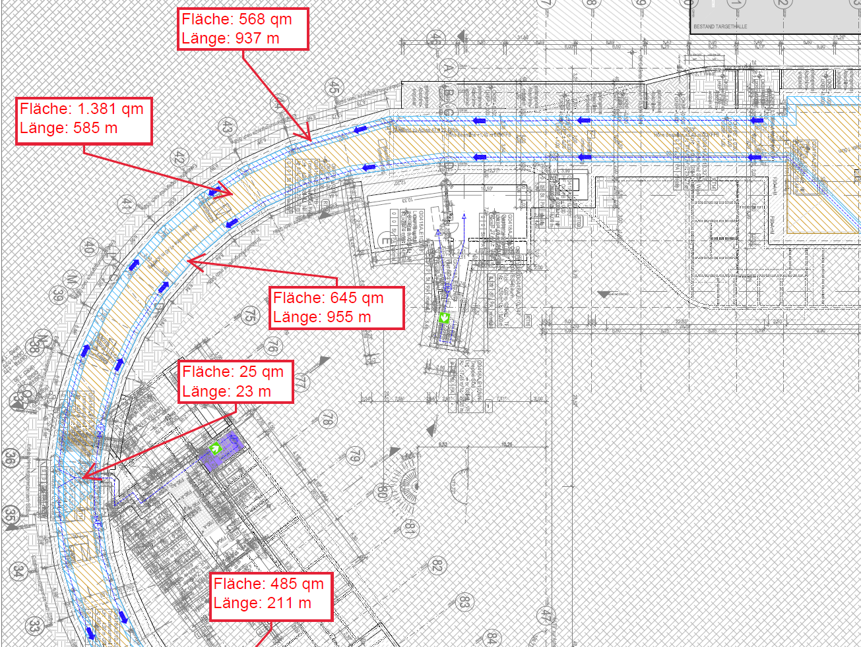
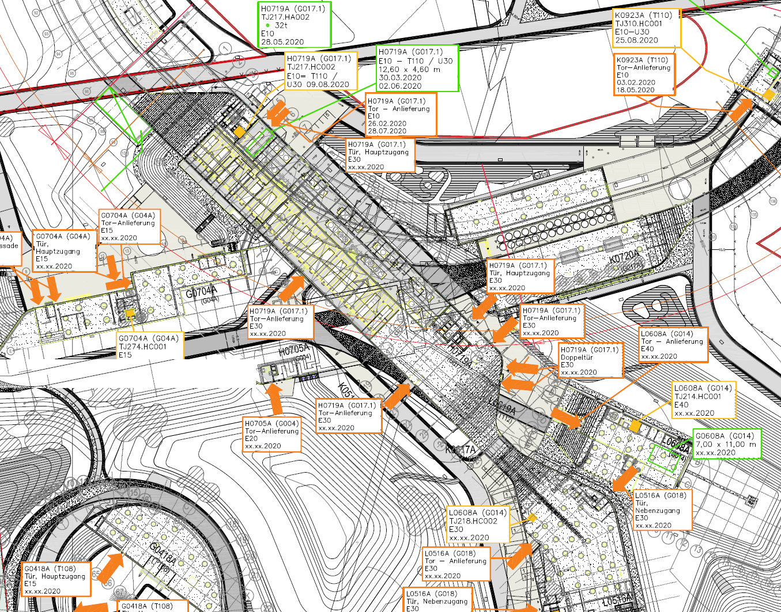
Site Management
Internal Logistics
FAIR Site Management Team manages all Internal Site Logistics
  Internal Logistics is the Coordination of all Logistical Activities of the Contractors from the Entrance into the Buildings to the final Installation Location:
  Coordinating Personnel access to the Buildings and inside the Buildings.
  Coordinating Material Flows into the Building.
  Allocation of Transportation Routes inside the Buildings.
  Allocation of Temporary Storage Areas inside the Buildings.
  Allocation the use of Cranes and Lifts inside the Buildings.

Slide 21
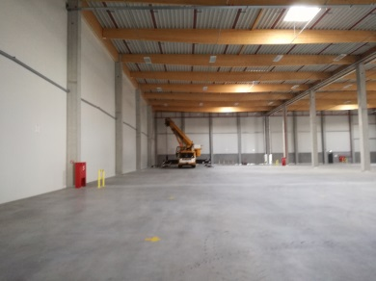
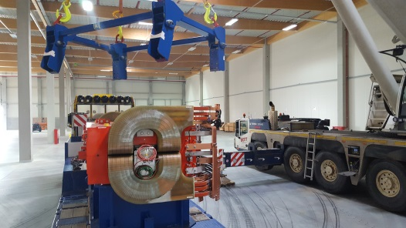
Site Management
Logistics and Warehousing of Accelerator Components
All Accelerator Components to be stored ready for Installation
  FAIR Components will be stored in a 9000m² facility starting 2018 until 2021.
  The Storage Facility will be managed by an external Service Provider.
  Stored Components will have passed SAT A Tests and will be ready for installation in the FAIR buildings.
  Components will be pre-assembled as Transportation Unit before shipping to FAIR site.
  The goal is to perform all possible assembly work before transportation to site, therby minimizing the work scope inside the buildings.
  Status of Delivery and Storage including scope of remaining works is tracked and maintained in SAP PLM (Product Lifecycle Management).

Slide 22
FAIR Project Progress
Next Steps
Complete all Contracting of Civil Works Package Area South in Q3/4 2019.
Complete all Contracting of all Technical Services Packages in Q4 2019.
Complete Implementation of all Site Logitical Management Functions.
Ensure continued implementation of Site Installation Strategy Plan.
Prepare and finalise Installation Concepts and Work Instructions for the Installation.
Ossendorf & Hagelskamp Project Review Kick-off 2018-11-21
22

Slide 23
FAIR Project Progress
Thank you for your attention !
Harald Hagelskamp - Fair Exp. & Acc. 14.12.2018
23

Slide 24
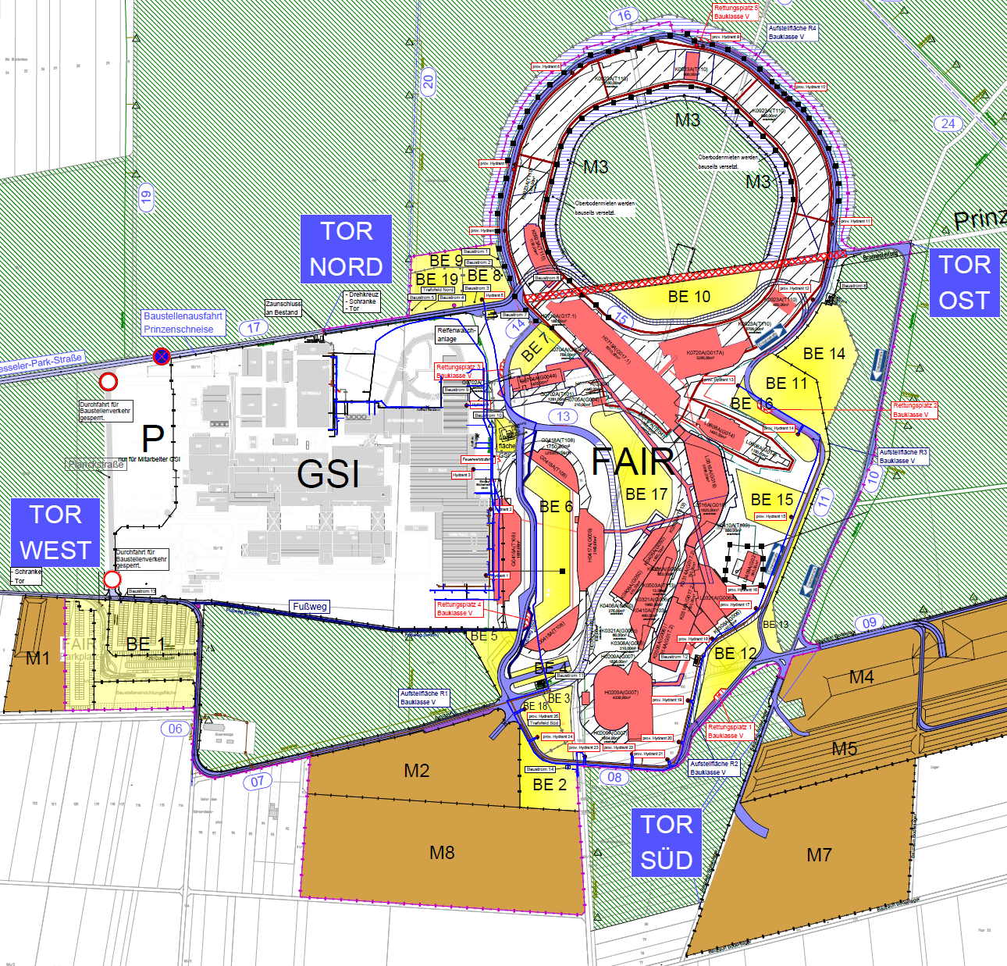
Site Management
External Logistics
Contractor Züblin provides all External Site Logistics Services
Security and Access Control
Personnel Movements – 1200 to 1500 workers daily.
Material Deliveries – 300 trucks daily.
Traffic Movements – 600 daily.
Allocation of Laydown Areas for Contractors.
Coordination of Crane Positions.
Coordination of Concrete Pump Positions.
Coordination and Supervision of Water Supply Installations.
Contractor GAT provides all Electrical Power Supplies on Site.

Slide 25
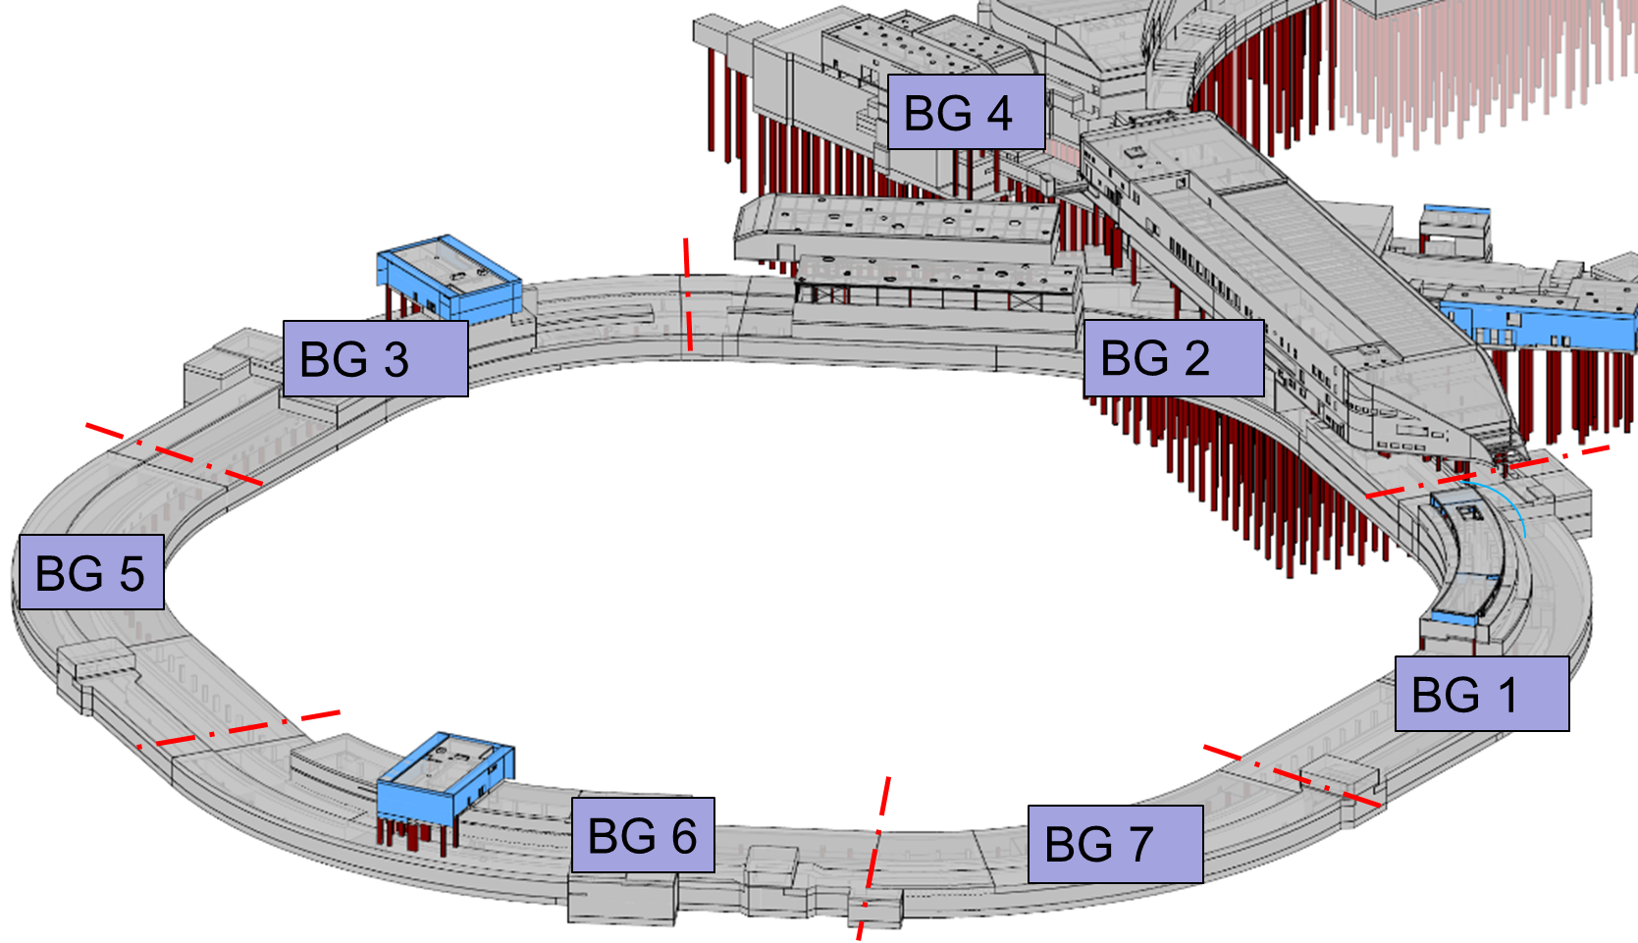
FAIR Project Progress – Civil Construction
Overview of Excavation Pits Area North
Harald Hagelskamp - Fair Exp. & Acc. 14.12.2018
7

Slide 26
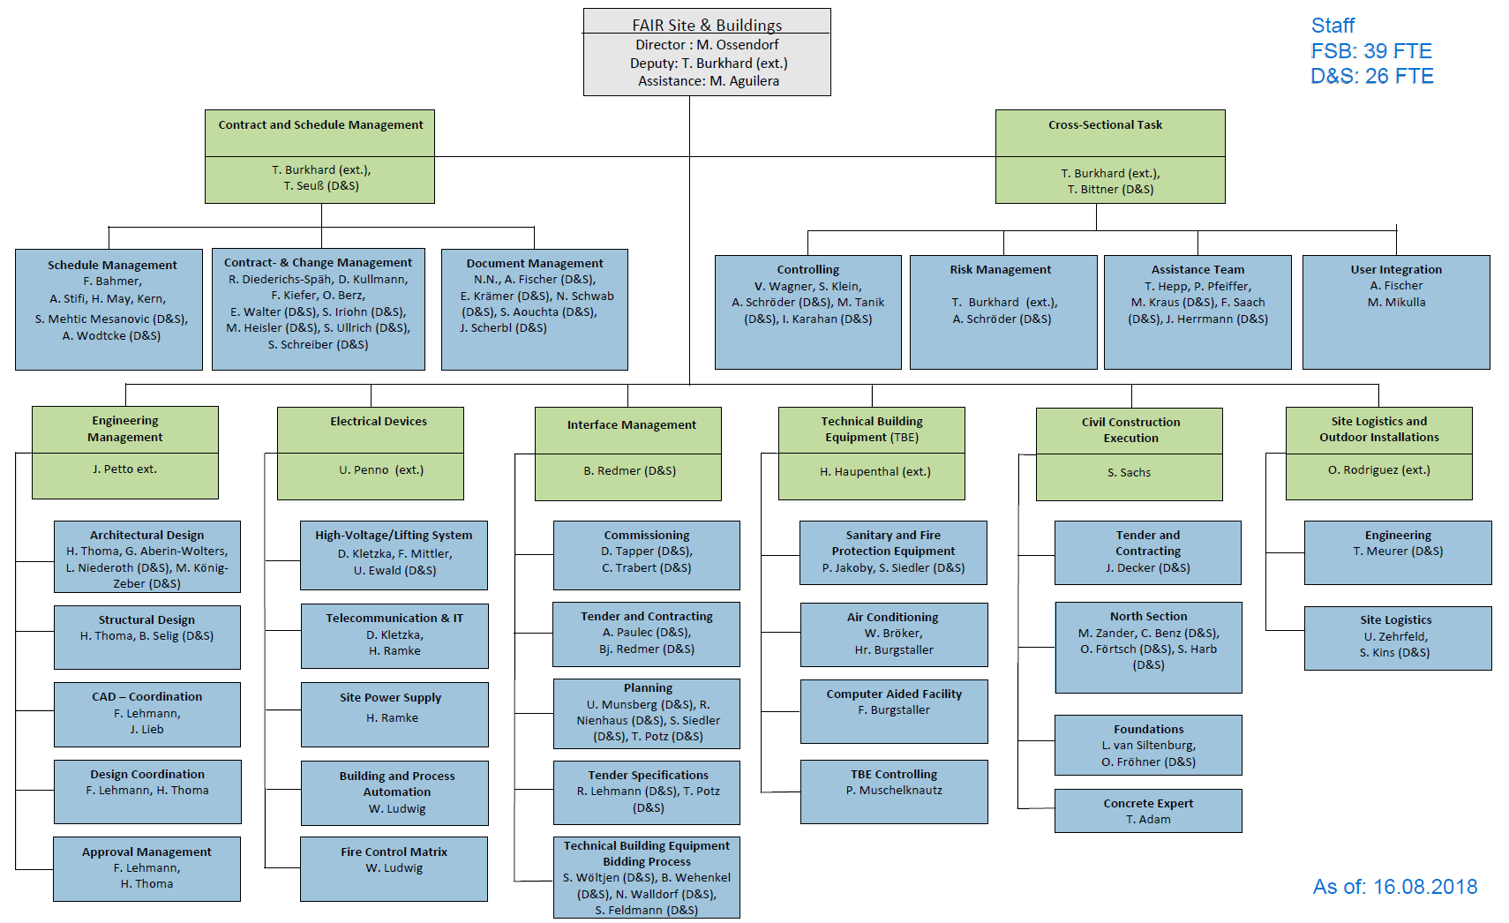
FSB Organization

