Slide 1
Beam Time Schedule
A first propose
BTS 2018v30
Daniel Severin
Beam time coordinator

Slide 2
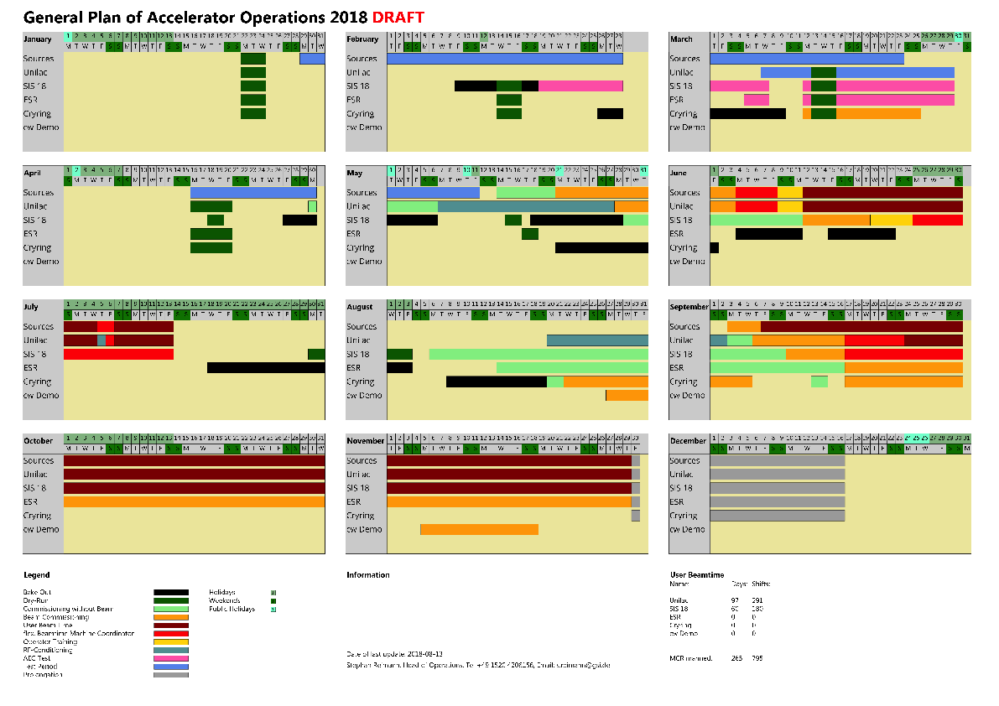
General Plan of Acceleration Operations 2018 DRAFT

Slide 3
General Plan of Acceleration Operations 2018 DRAFT

Slide 4
Beam Time Schedule 2018 Assumptions
Operation with beam starts mid of September
A3 energy
SIS18 re-commissioning
ESR commissioning
FRS commissioning
RFQ limitation max. 6V
HADES test with A4 end of Sep./beginning of Oct. is positive
Possible prolongation until 17th of Dec.
Each day of operation improves the machine status for 2019
Especially for ESR-CRYRING and FRS

Slide 5
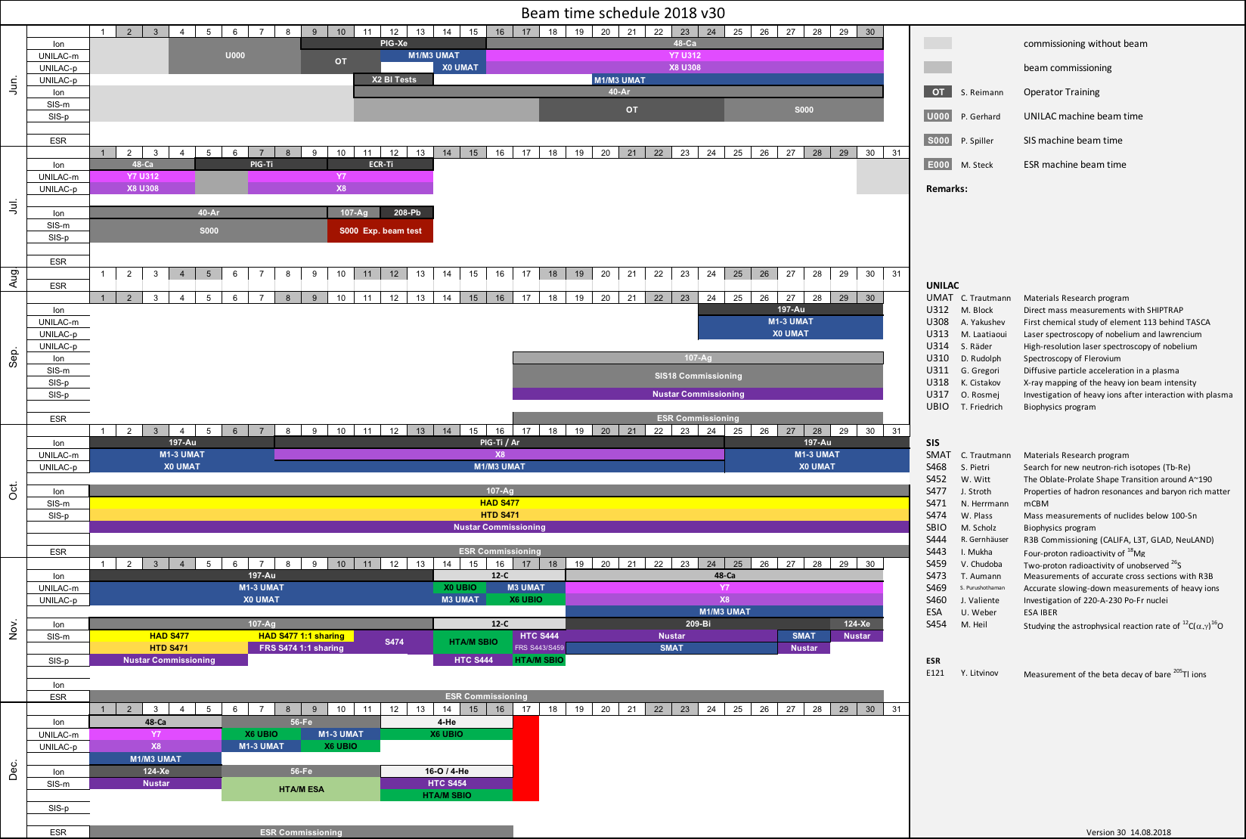
Beam Time Schedule 2018 DRAFT

Slide 6
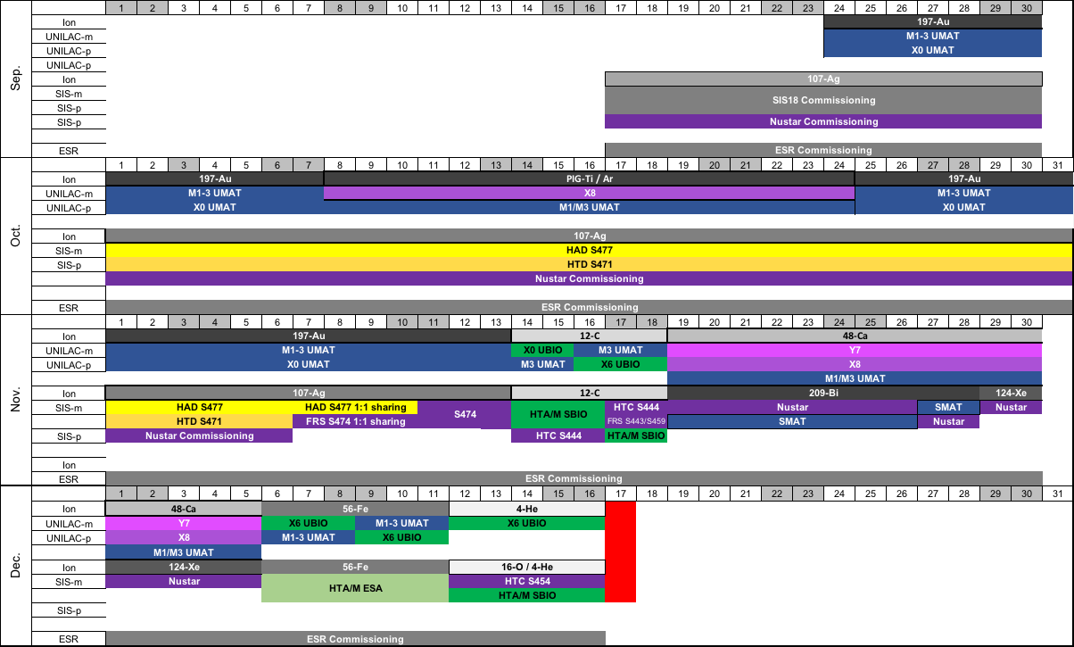
Beam Time Schedule 2018 DRAFT

Slide 7
Beam Time Schedule 2018 DRAFT
?
Fix points needed for Bio

