Slide 1
The PANDA GEM Tracker
Take R. Saito
GSI, Darmstadt, Germany
HIM, Mainz, Germany
RIKEN, Wako, Japan
On behalf of the PANDA GEM subgroup

Slide 2
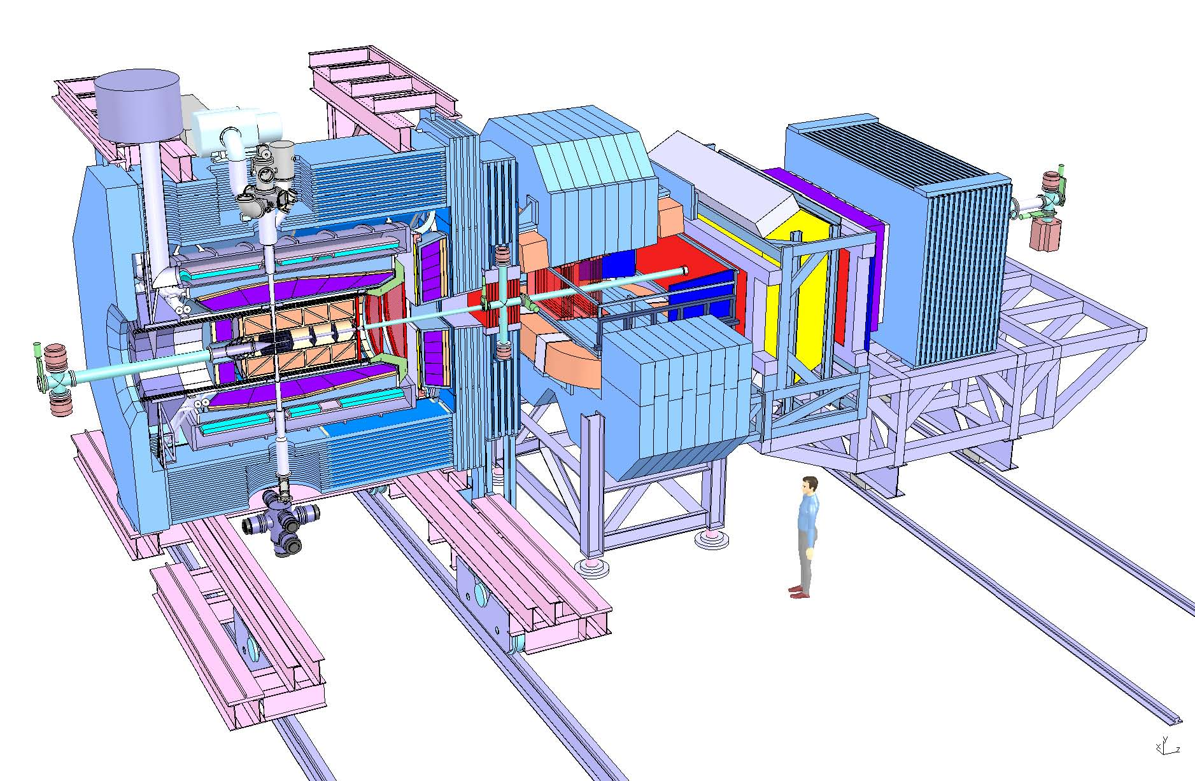
PANDA@FAIR Setup Overview
Target
Central Tracker GEM-TPC
p
Forward Tracker Planar-GEMs
Superconducting solenoid (2T)
+ iron return yoke
~12 m
Forward Spectrometer
Target Spectrometer

Slide 3
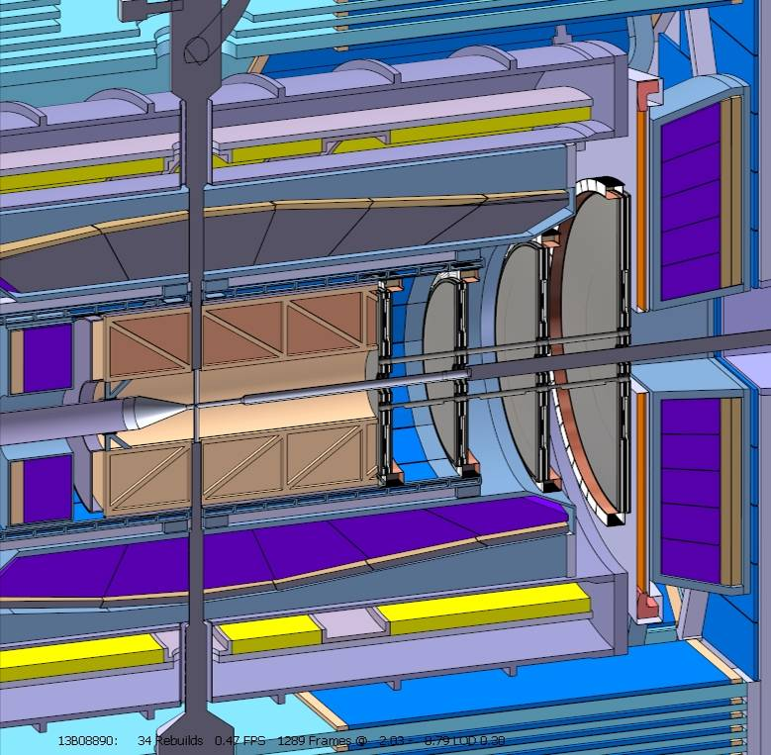
GEM-Detectors@PANDA Basic assumptions
Figures of Merit:
Particle identification
Momentum resolution δp/p (p,θ,z,r)
  particle momentum p
  scattering angle θ
  vertex coordinates z, r
Basic assumptions:
  GEM-TPC (‘short’ version: 1,5 m → 1,2 m)
  GEM-Tracker, 3..4 stations
  Maximize shape-conformity Full angular coverage (φ) not possible
  Radiation hardness 100 krad
Target spectrometer@PANDA ‘V833’

Slide 4
GEM: Gas Electron Multiplier

Slide 5
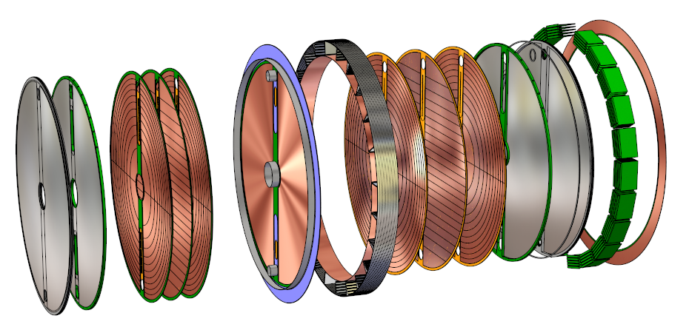
Planar GEM-Trackers Detector assembly
Possible cabling hooks: central bar & circumference
Pad Plane Support & Media-Distribution
Cooling Support & LV- Distribution
Front-End Electronic
Window
GEM stack
Drift electrode
Shielding Cover
&
Read-out Plane

Slide 6
Planar GEM-Trackers Layer stacking
active
active
10 10 2 2 2 2 2 2 10 10 mm

Slide 7
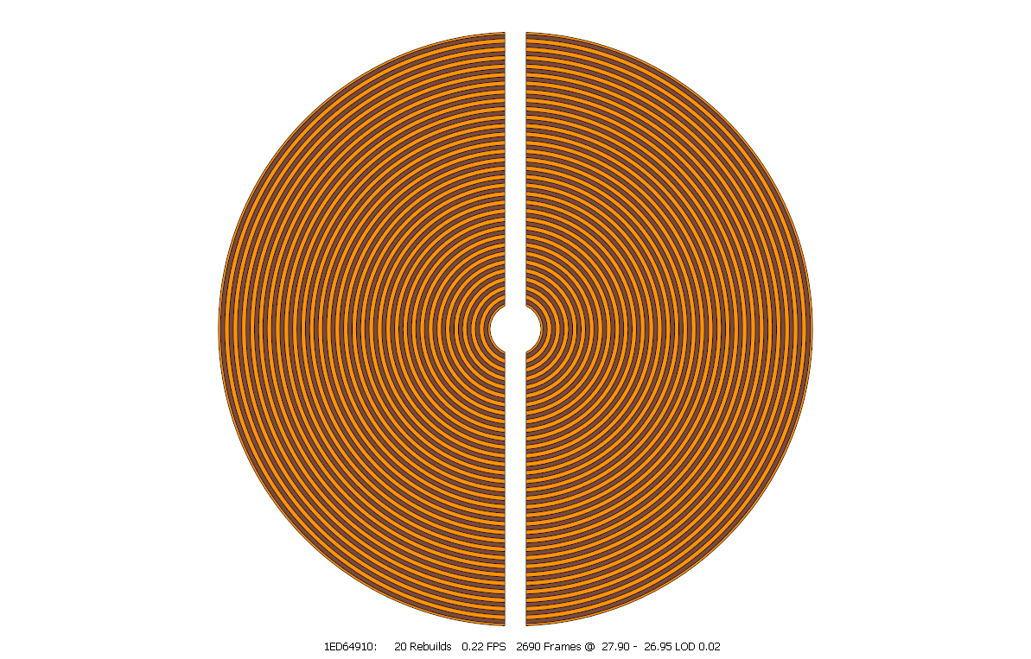
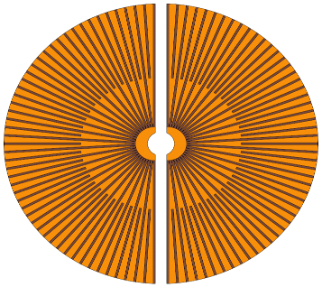
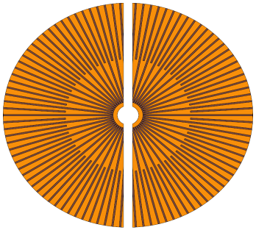
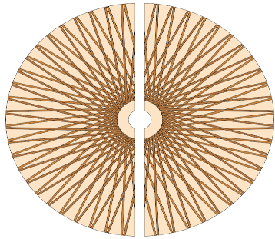
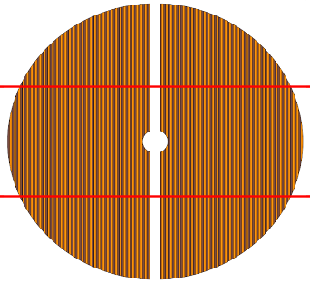
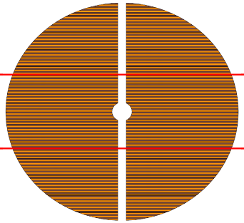
PadPlane Pattern design
 | Circular | Radial ‚acentric‘ | Radial ‚isocentric‘ | 60°Tilted | Cartesian
GEM
1/2 | 5888 (1571) |  |  | 5880 (2096)
3 | 9600 (1571) |  |  | 9600 (2096)
4 | 13440 (1571) |  |  | 13400 (2096)
Required for constant resolution, Assumed in simulations
Problems with Patching (GEM4)
  Patching process
  Signal routing
  → Dead areas & Increased material budget (Support & Additional routing layers) → Cut channels → unequal length, non-uniformity in response

Slide 8
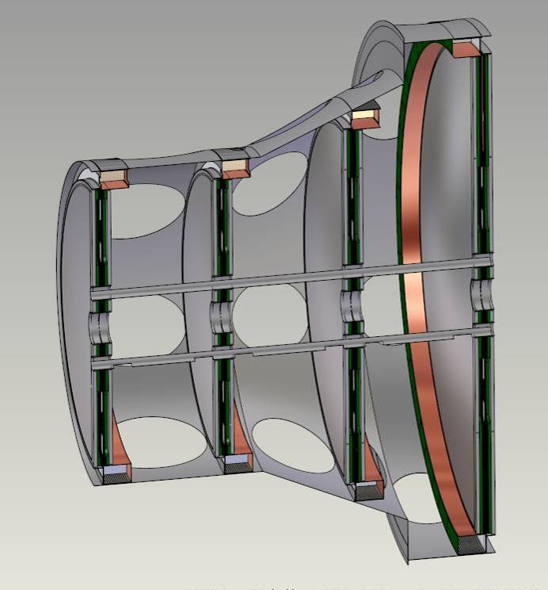
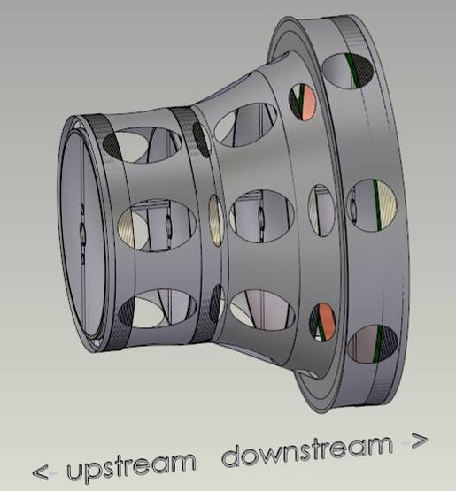
Detector-Mounting ‘Riddle’ design
Optimize position determination → Maximize inter-detector distances
Equalize weighting of information → Balance inter-detector distances
Maximize shape-conformity
Symmetrise the loads, moments and thicknesses
  Minimize mounting and adjustment efforts
  Simple & stiff support structures
  Multi-conical shape of the supports (‘Matroschka’ principle)
  Shell structure (0.5..1mm CRP)
  50µm sag

Slide 9
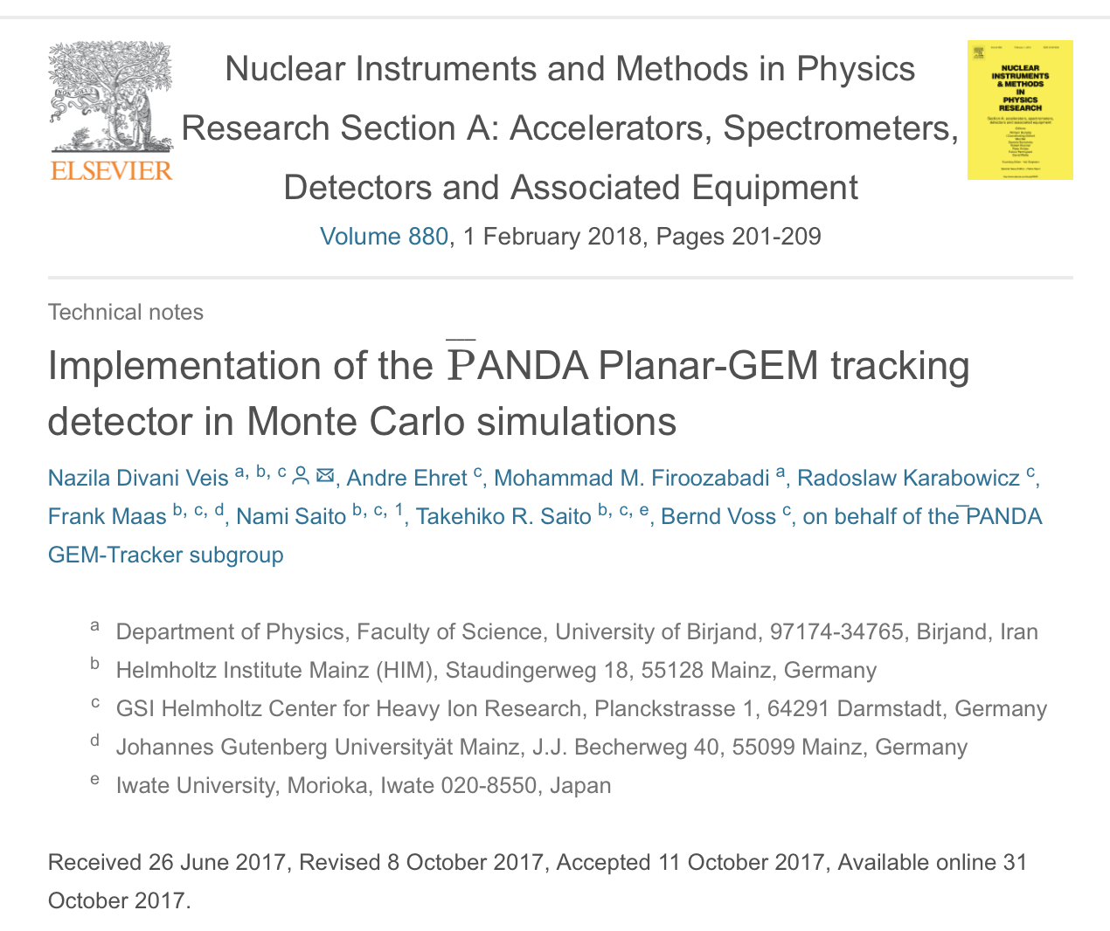

Slide 10
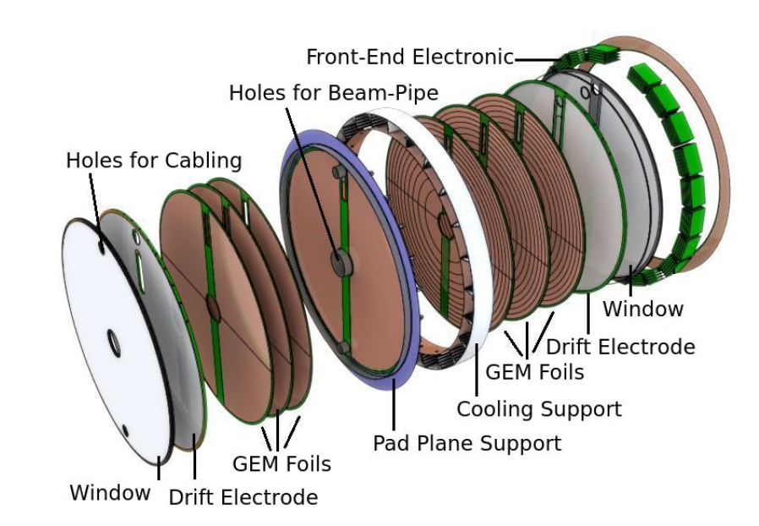
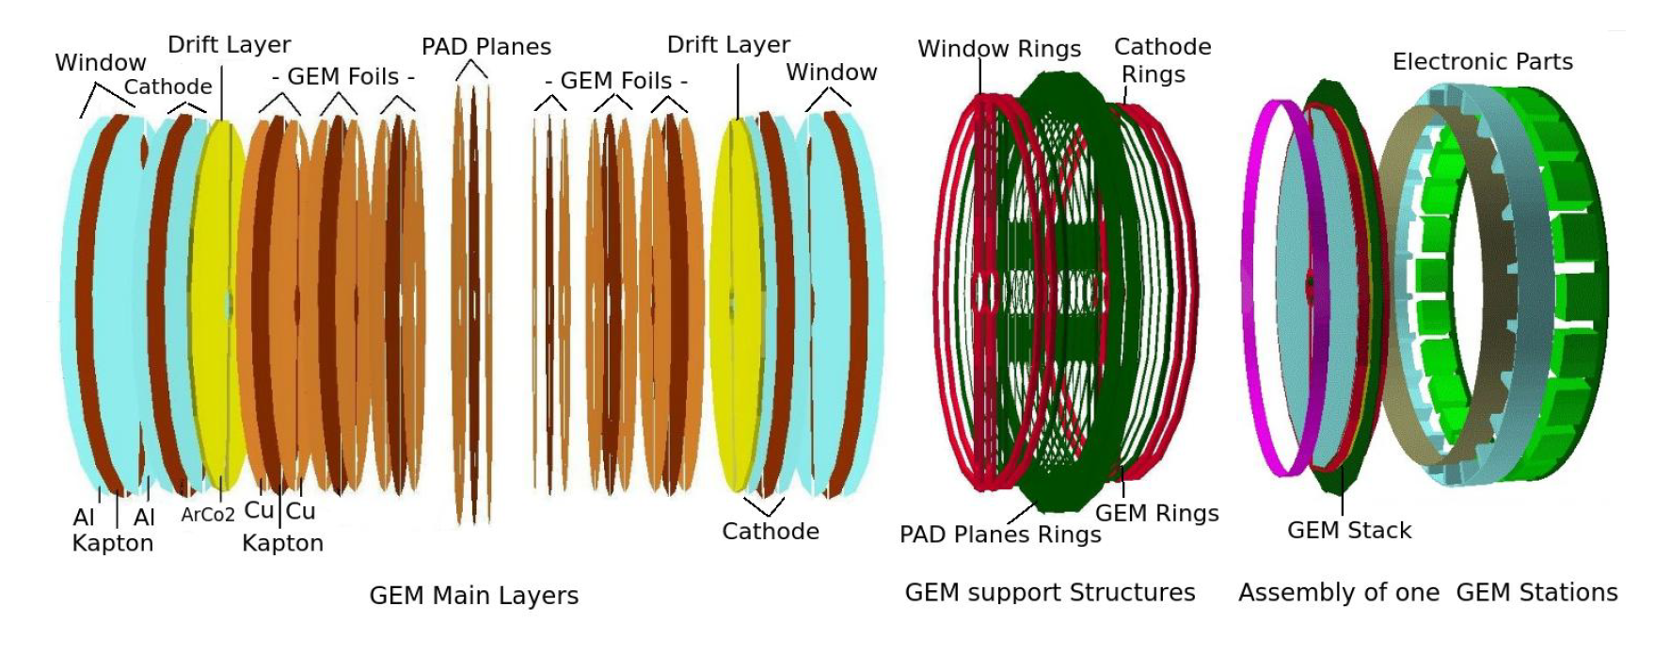
Implementation in MC

Slide 11
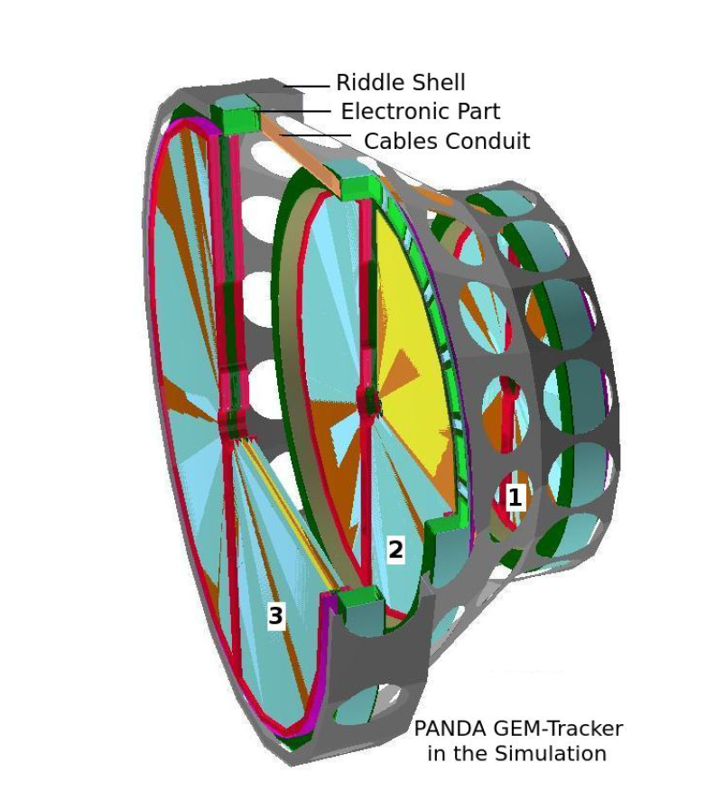
Implementation in MC

Slide 12
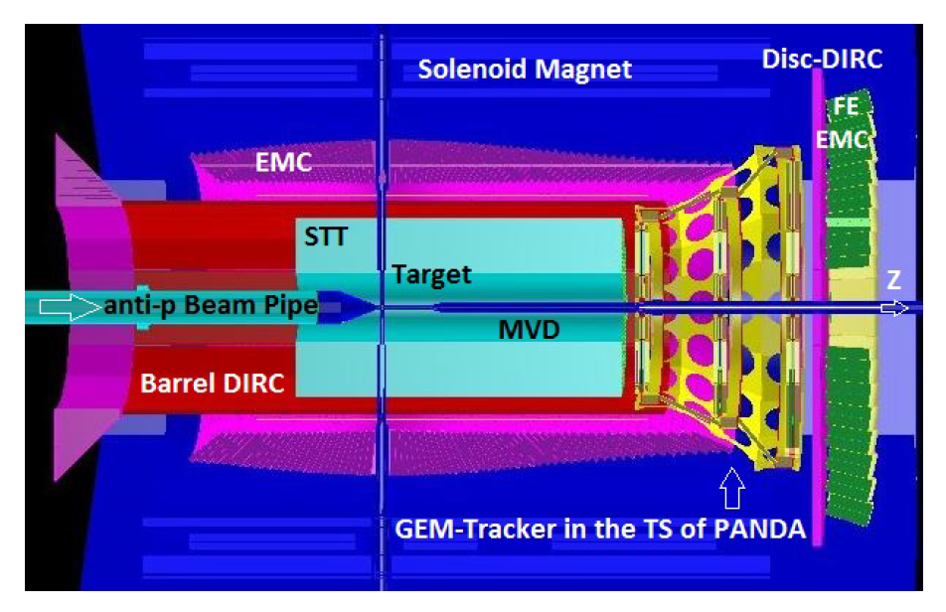
Implementation in MC

Slide 13
Tracking with PANDA GEM
Basic hit-position reconstruction algorithm
Developed by Radek Karabowicz and Nami Saito
BarrelTrackFinder
Developed by Radek Karabowicz
GEM stand alone
GEM + Other detectors

Slide 14
Implementation in MC

Slide 15
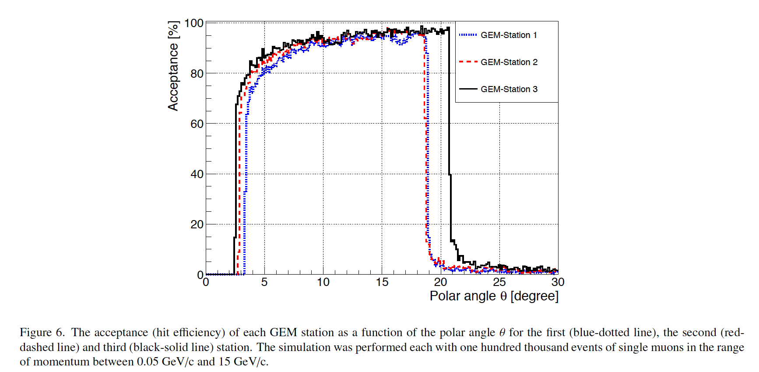

Slide 16
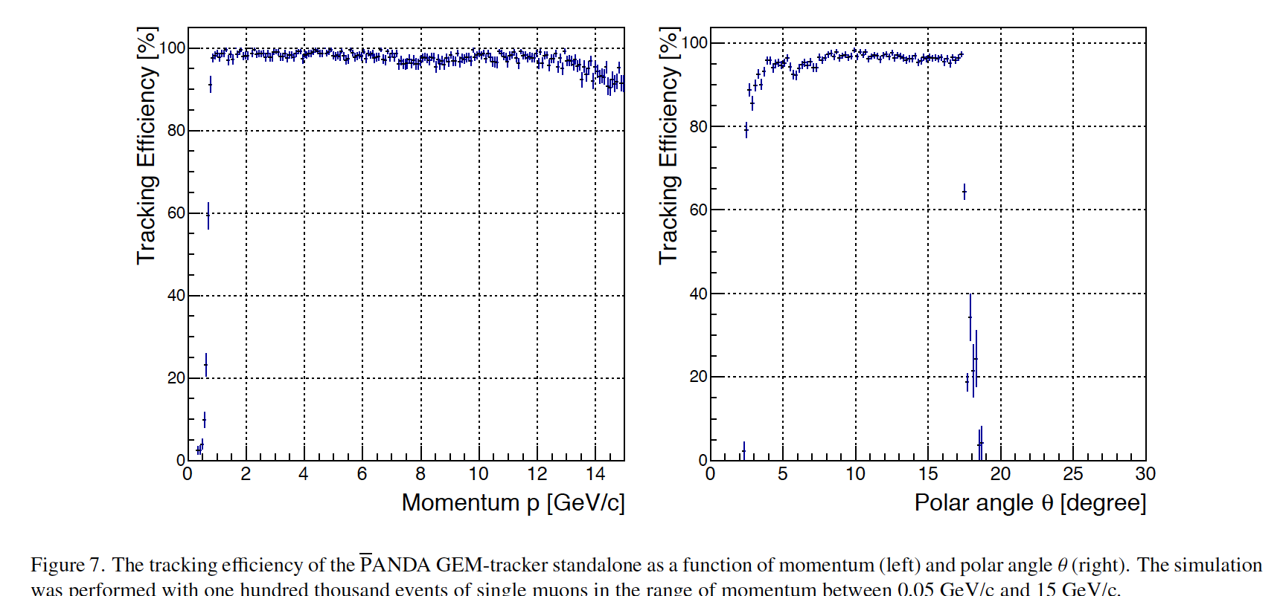

Slide 17
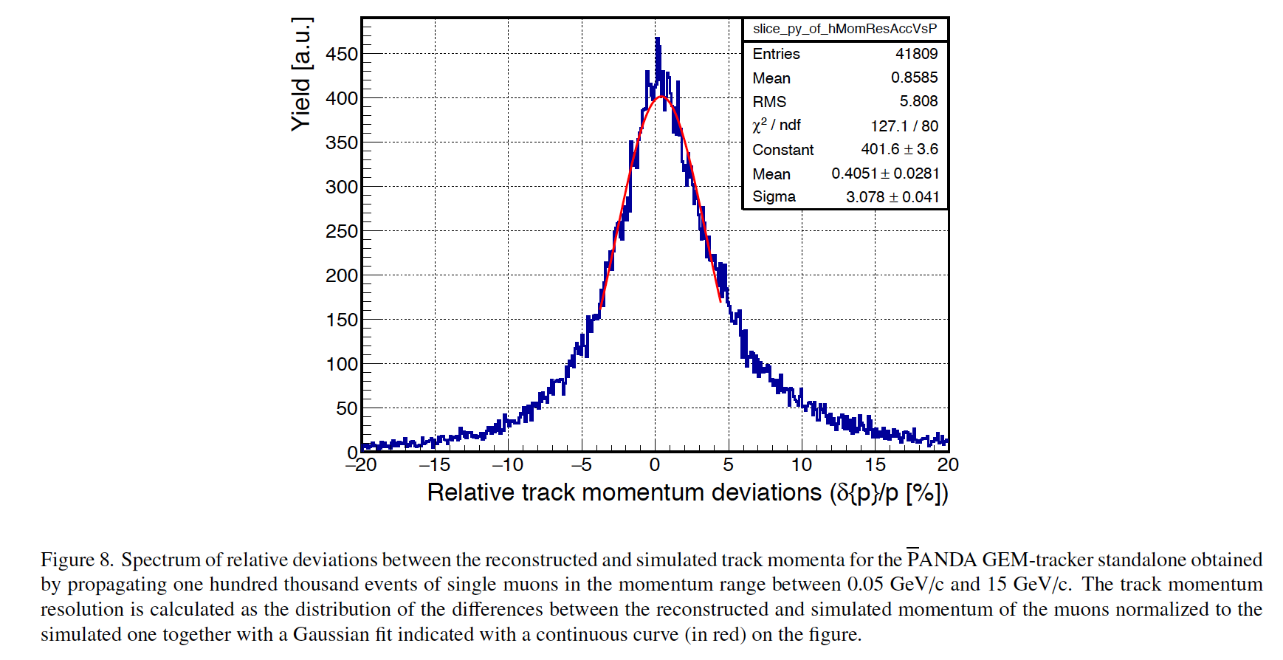

Slide 18
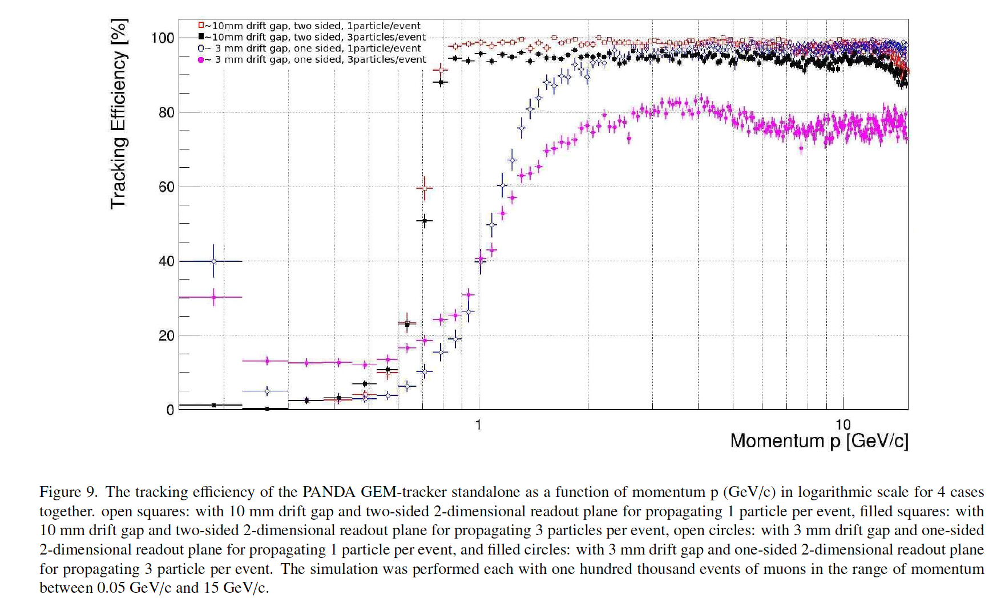

Slide 19
Summary
GEM detector: under development
MC with GEM detectors
  Basic investigation for the GEM performance was done by Radek and Nami
  Detailed volume implementation was made by Nazila Divani
  Reconstruction method was developed by Radek with BarrelTrackFinder
  Reasonable track efficiency and resolutions
However,
Detailed studies with MC are still in progress
Physics simulations must be done again

