Slide 1
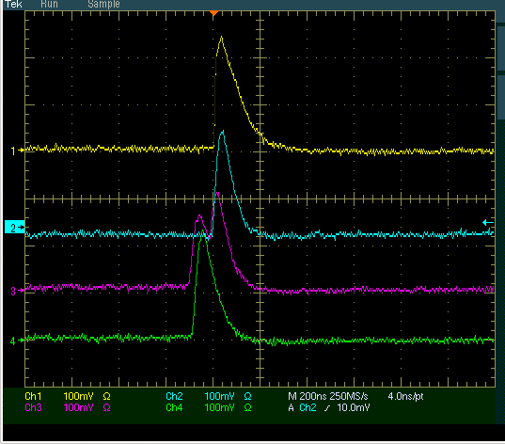
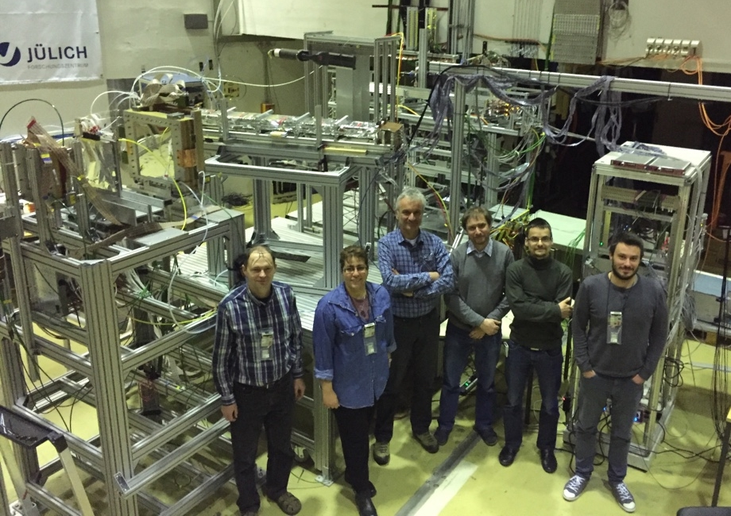
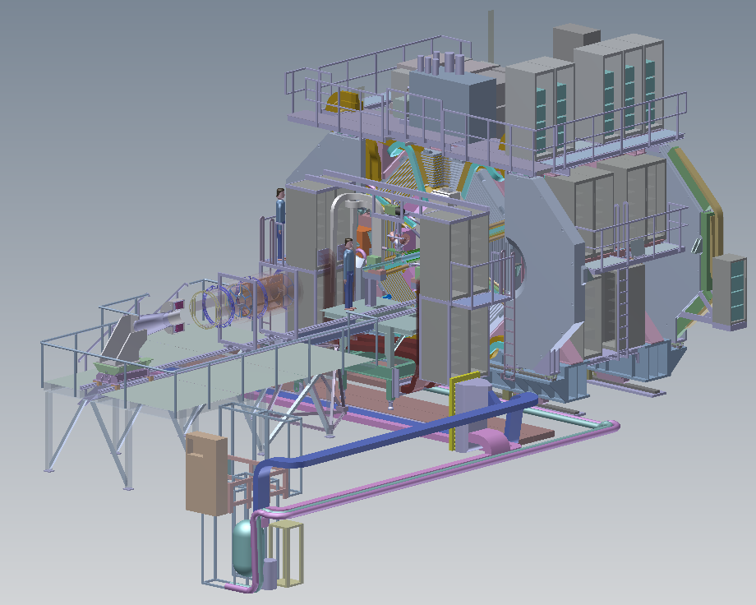
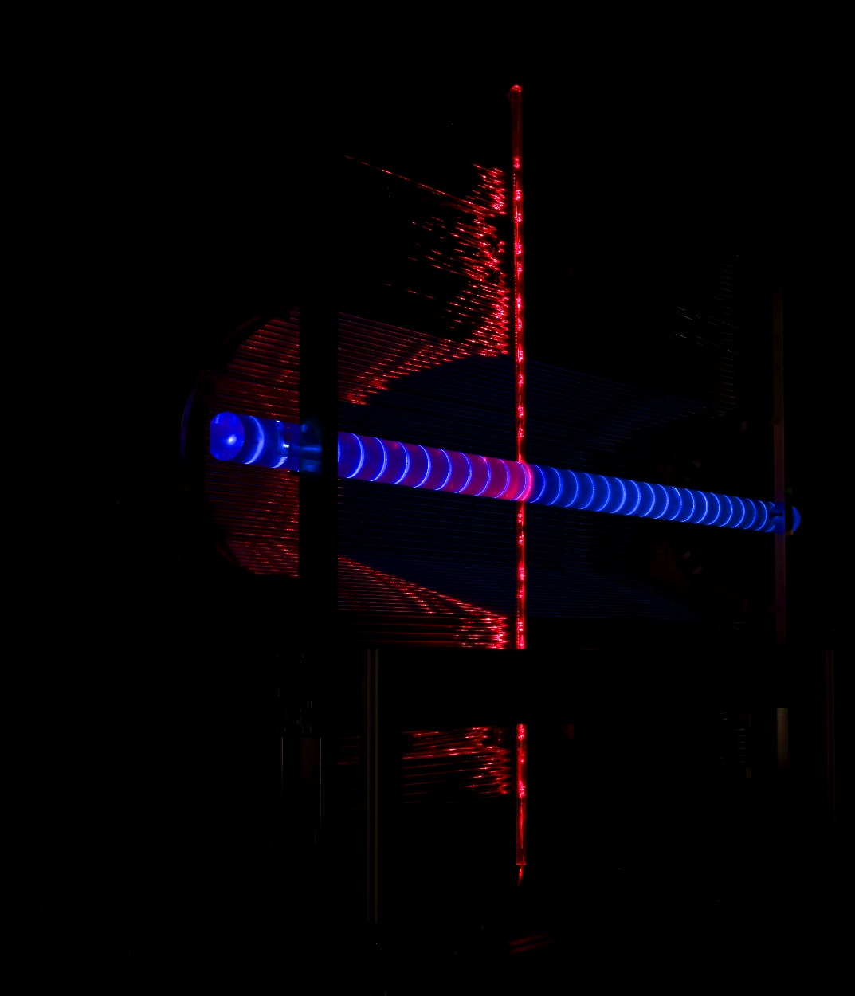
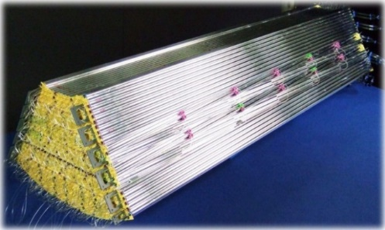
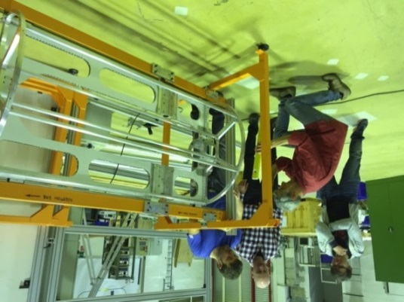
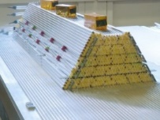
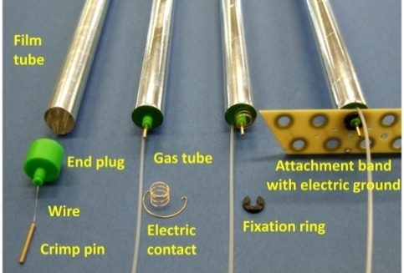
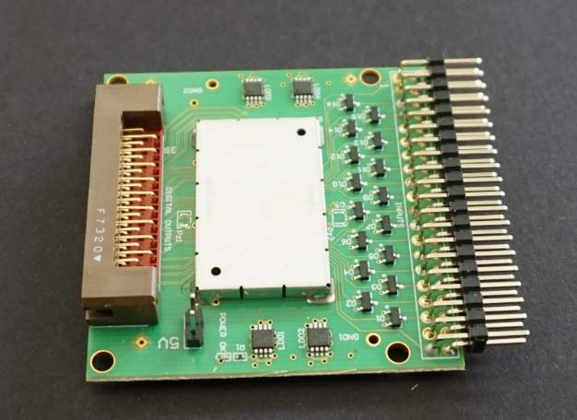
STT
Sep-18, 2018 | Peter Wintz (for the STT group)

Slide 2
Outline STT Status
System Overview
Raw Data & T0 Extraction
Calibrations & Tracking & PID
In-Beam Results (preliminary!)

Slide 3
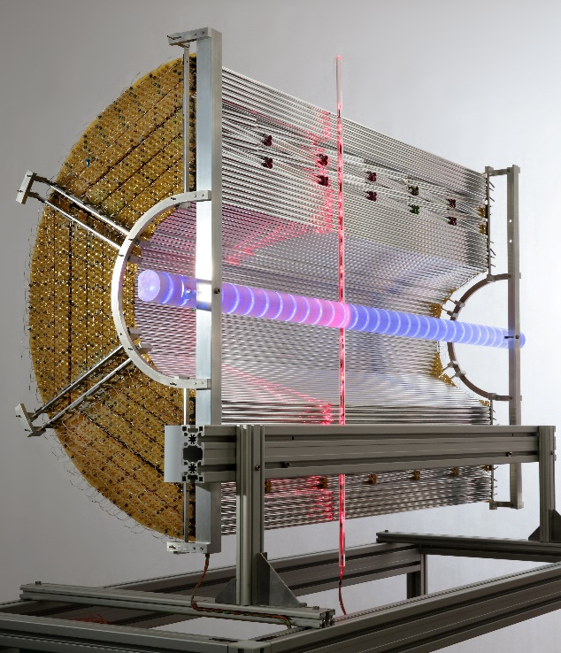
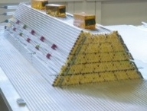
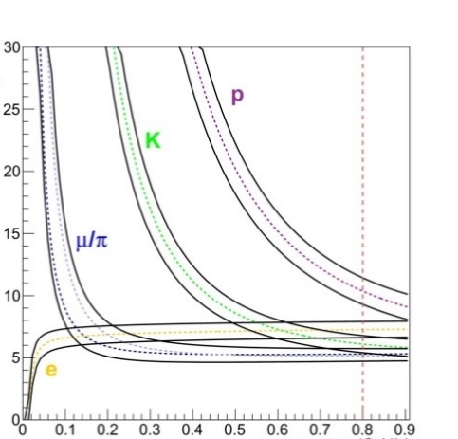
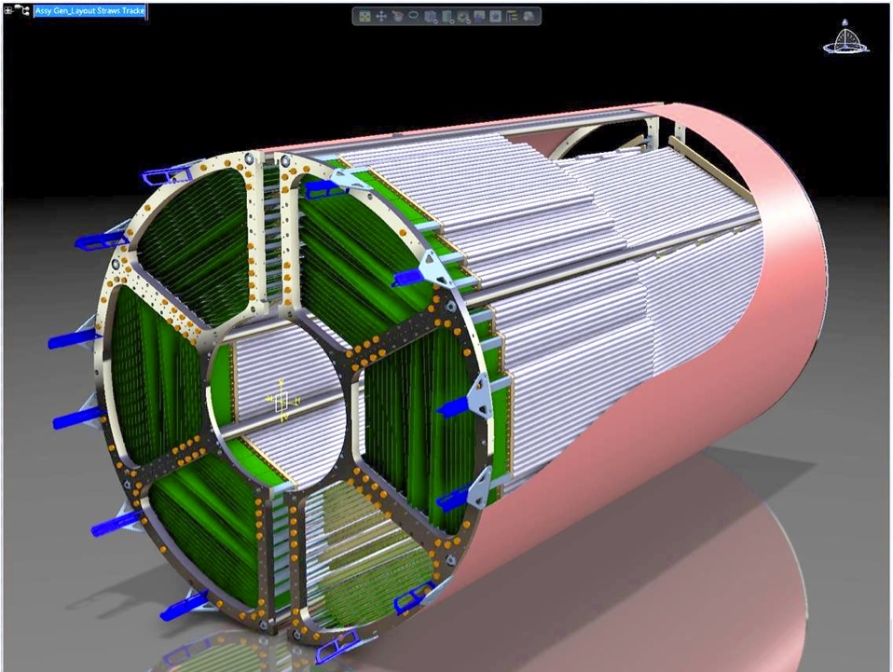
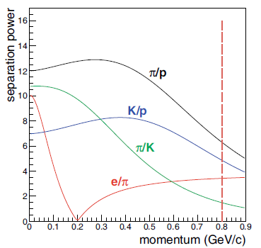
Central straw tube Tracker
4224 straws in 19 axial and 8 stereo (±3°) layers
27µm Al-Mylar, 1400 mm length, 10 mm diameter
Ar/CO₂ gas mixture at 1 bar overpressure
X/X₀ = 1.25% by self-supporting straw layers
Drift time & charge readout for PID (dE/dx)
Continuous data stream readout (~ 15GB/s)
Real-time tracking & input to SW trigger (event ID)
Straw components, self-supporting sector and STT prototype (half-barrel)
dE/dx simulation for STT (TDR, Eur.Phys.J. A49 (2013) 25)
1650 mm
$$S=\frac{\left\langle E_{1}\right\rangle −\left\langle E_{2}\right\rangle }{{(σ}_{1}+σ_{2})/2}$$
Separation power
dE/dx (arb. units)
STT
3D-view
Momentum (GeV/c)
Momentum (GeV/c)
Straw layout

Slide 4
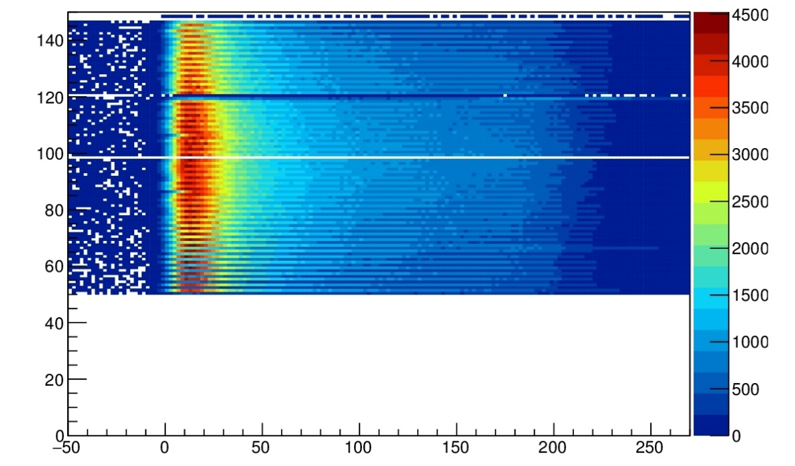
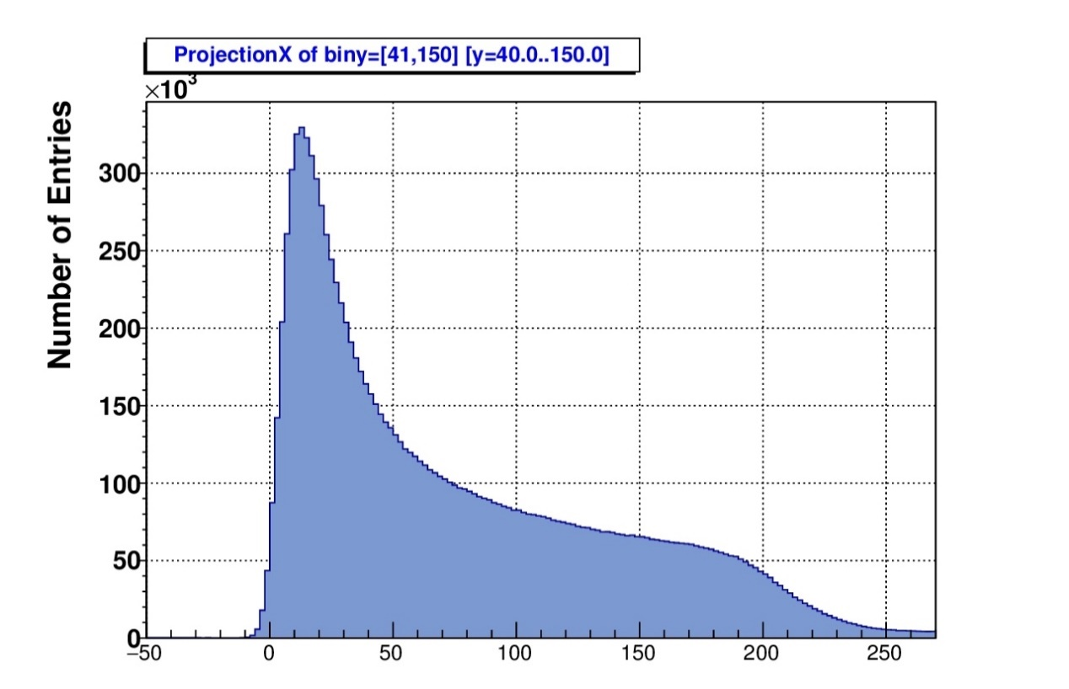
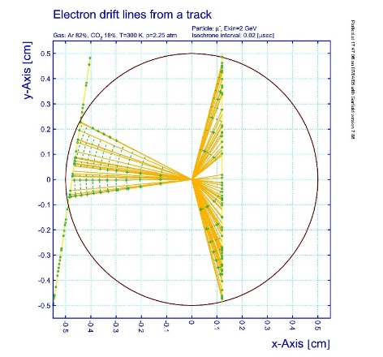
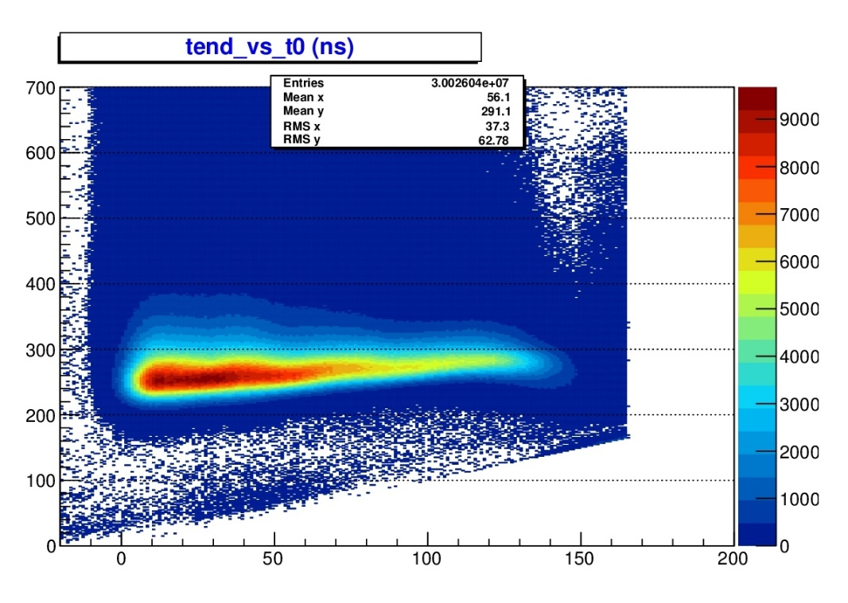
raw data & basic principles
Straw signal raw data
channel number: i_{chan} → i_{straw}, i_{layer}
signal times t_{LE}, t_{TE}
Calibrations:
wire positions i_{chan}: x,y,(z)
drift time spectrum t_{LE}: T0 determined or extracted
r(t) isochrone radius – drift time calibration
Signal pulse width ToT ( = t_{TE} - t_{LE})
which observable for PID ?
Proton beam
Straw channel no.
Switched off in Apr-18
Beam Time
Deuteron beam,
1.5 GeV/c
TDC TE-Time (ns)
TDC LE-Time (ns)
Straw signals (in-beam)
TDC LE-Time (ns)

Slide 5
Raw Hit intensities
Full luminosity
20×10⁶ events / s × 3-4 tracks / event
40 events in 2 µs time window on average (poisson distributed time gaps)
Hit intensities per straw
~ 10⁶ hits / s at 1st layer → 6×10⁵ /s at 8th layer
1 µs time gap between hits in same straw on average, but poisson distributed
pileup possible within 250ns drift time range (double pulse)
At phase 1:
4 events in 2 µs time window on average
10 µs time gap between hits in same straw on average
Hit clusters clearly separated, pileup in drift time range almost excluded

Slide 6
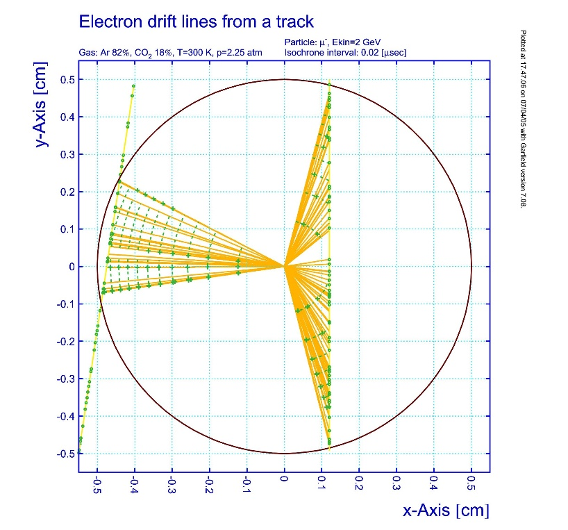
Tracking procedures
Signal leading edge times, convert TDC bins to ns
T0, from extern or internal extraction
Drift times by T0 subtraction and time window t_{max}
Calibration isochrone radius – drift time relation r(t)
polynomial relation, non-linear drift velocity
drift time spectrum: N / R = Σ n_{i} / r(t_{i}) → r(t) = $\sum{P_{i}×t^{i}}$
then: iterative with reco tracks and extracted
wire distances (measured t_{i} → reco r_{i})
Wire positions iterative by reco tracks, residual distribution shifts
x,y position and/or
r(t), r0 (=P0) parameter, abobe/below wire
r(t) relation
$r(t)=\sum_{i=0}^{4}{P_{i}×t^{i}}$
P0=0.03398
P1=0.05358
P2=-3.274E-4
P3=1.279E-6
P4=-1.987E-9

Slide 7
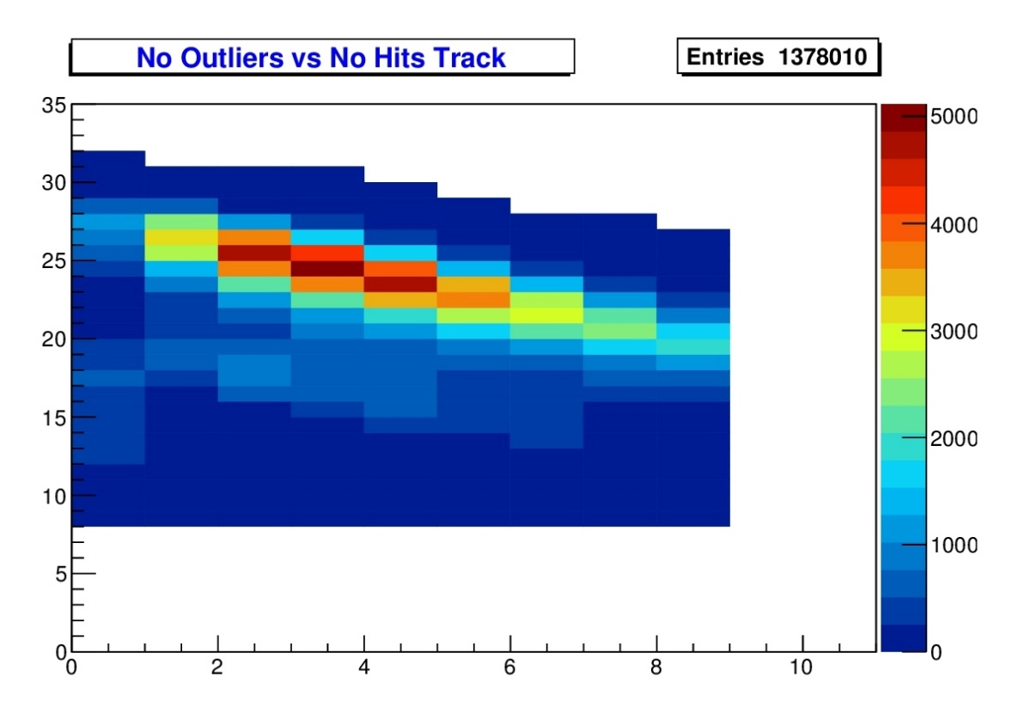
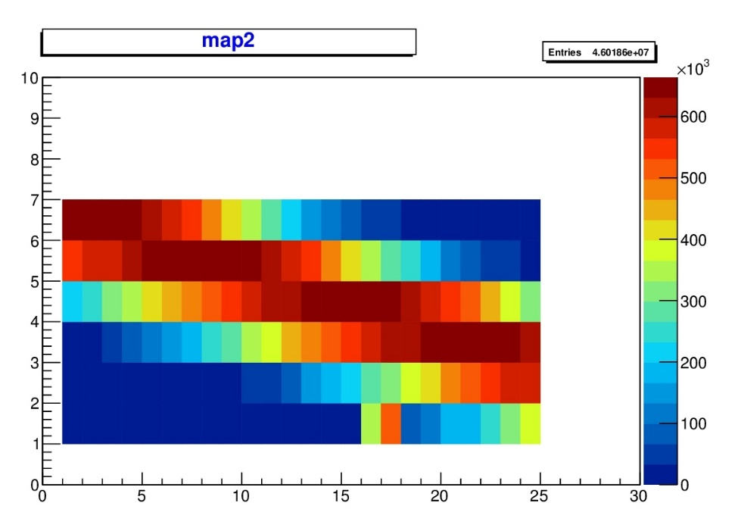
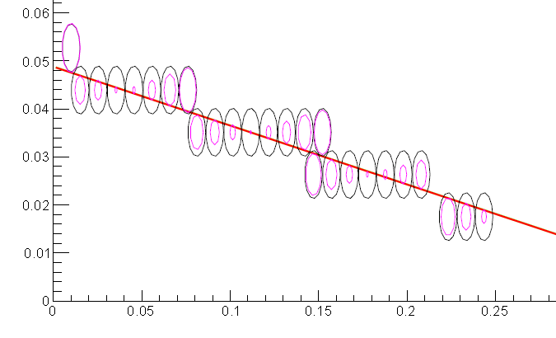
Tracking procedures
Tracking
Start fit parameters from wire positions, | ∆i_{straw}, ∆i_{layer} | ≤ 1
χ2- MINUIT track fit to isochrones
Hit filter, reject single outliers
e.g. δ-electrons, ~ 15% in argon
other spurious (not seen in beam data)
check reco efficiency, remaining #hits for fit
Hits per track
Track reconstruction (testbeam data)
#Rejected outlier hits (sigma cut)
beam

Slide 8
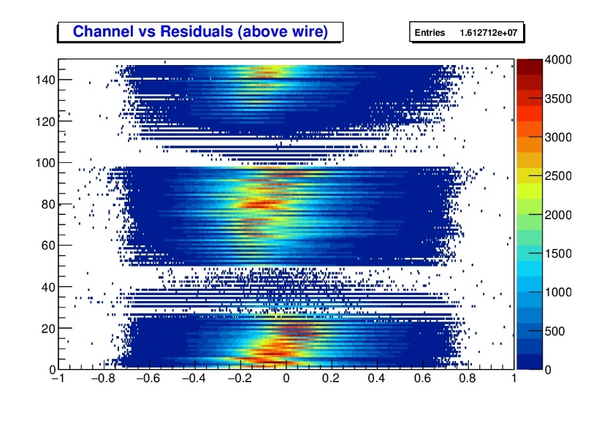
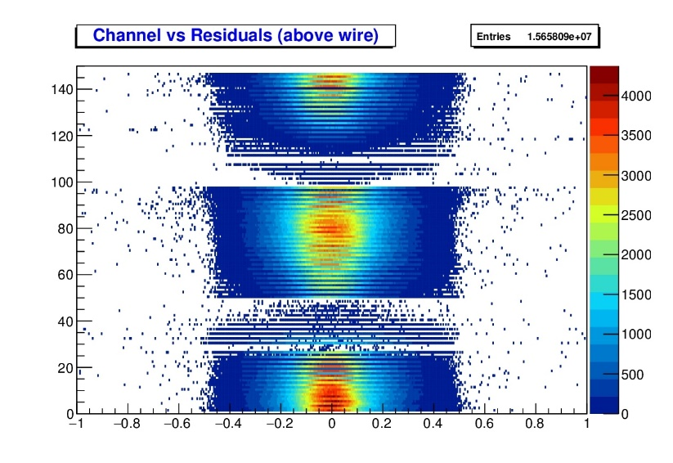
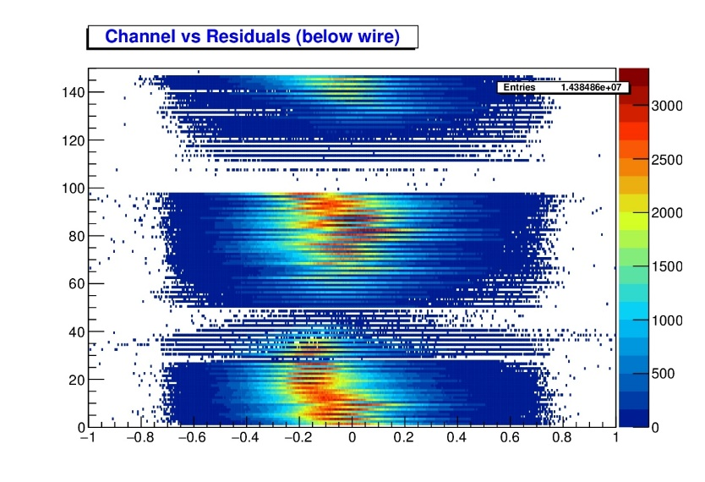
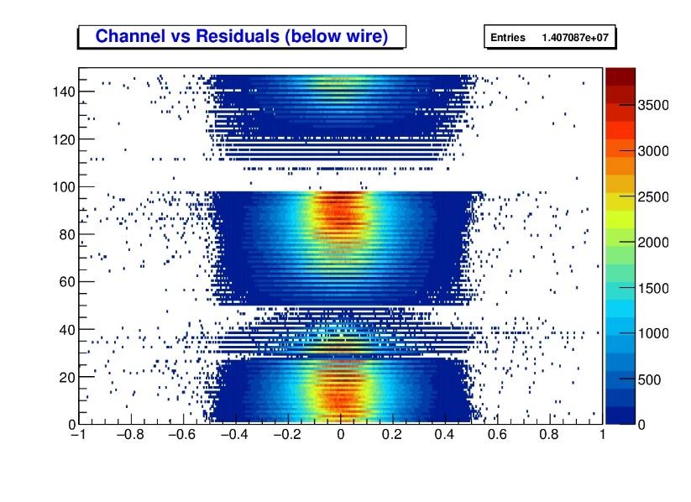
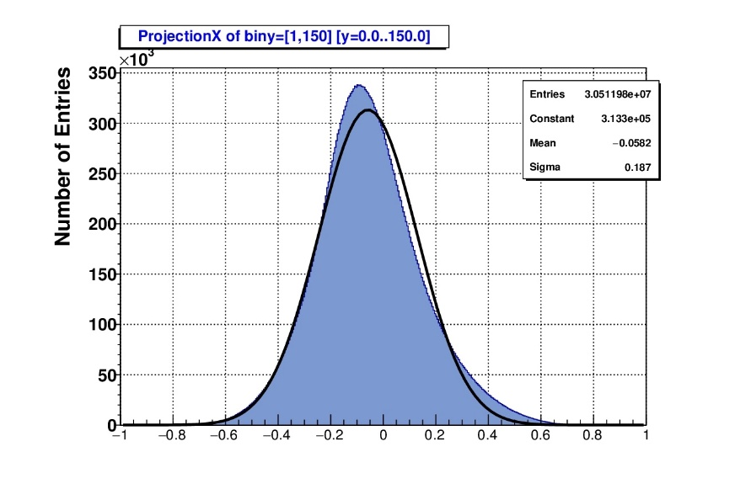
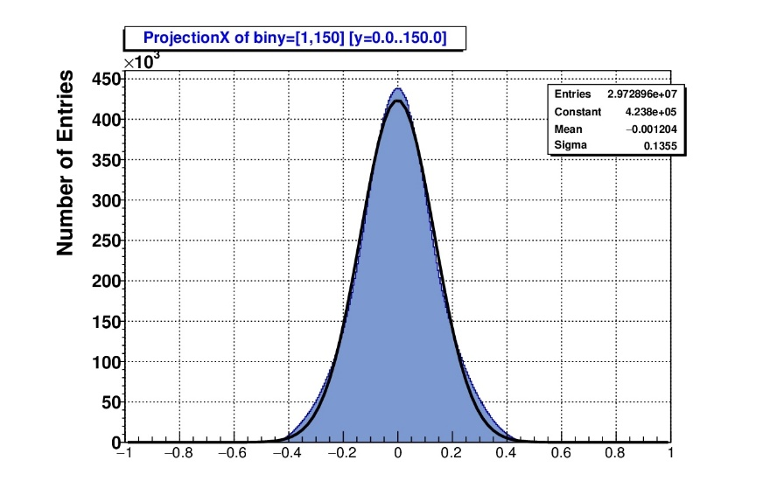
R(t) Calibration & Data Correction
uncorrected
corrected
Reconstruct tracks with uncorrected r(t)
~200µm track resolution, is sufficient
Determine residual shifts (above/below wire)
Correct r(t) by avg. residual shifts
Add R₀ to r(t), above/below wire r(t)s
Re-fit, iteration of shifts (auto procedure)
Uncorr.: σ = 187µm, mean= -58µm
Corr: σ = 135 µm, mean = -1µm
Global r(t) used, R₀ shifts for individ. chan
Individual wire positioning (here!) not nec.
residual
distance
isochrone
Channel no.
trackfit (≈ true track)
Residuals (mm)

Slide 9
Method: T0 Determination by STT
Task: extract absolute time information from STT raw hits
Ref. time from other detectors (MVD, SciTil) not existend for all tracks in STT
Procedure for T0 determination
Step 1: hit to track association using raw hits
Channel cluster (neighbour hits)
Time cumulation
Step 2: Simple T0 calculation from sum of track hits (no fit!)
Σ r(t) / N_{hits} ∼ 2.5 mm (= avg. isochrone radius)
Simplified r(t) ∼ P₀ + P₁ × (t_{dr} – t₀)
Extract t₀

Slide 10
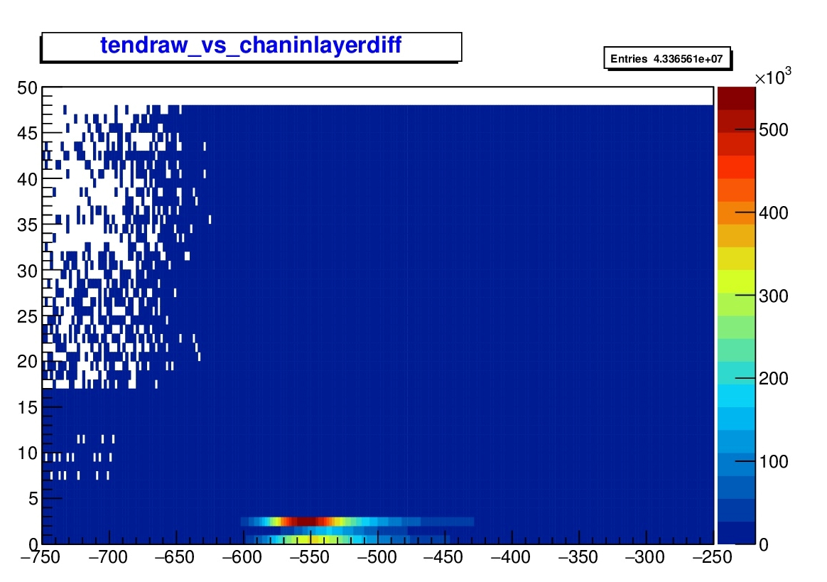
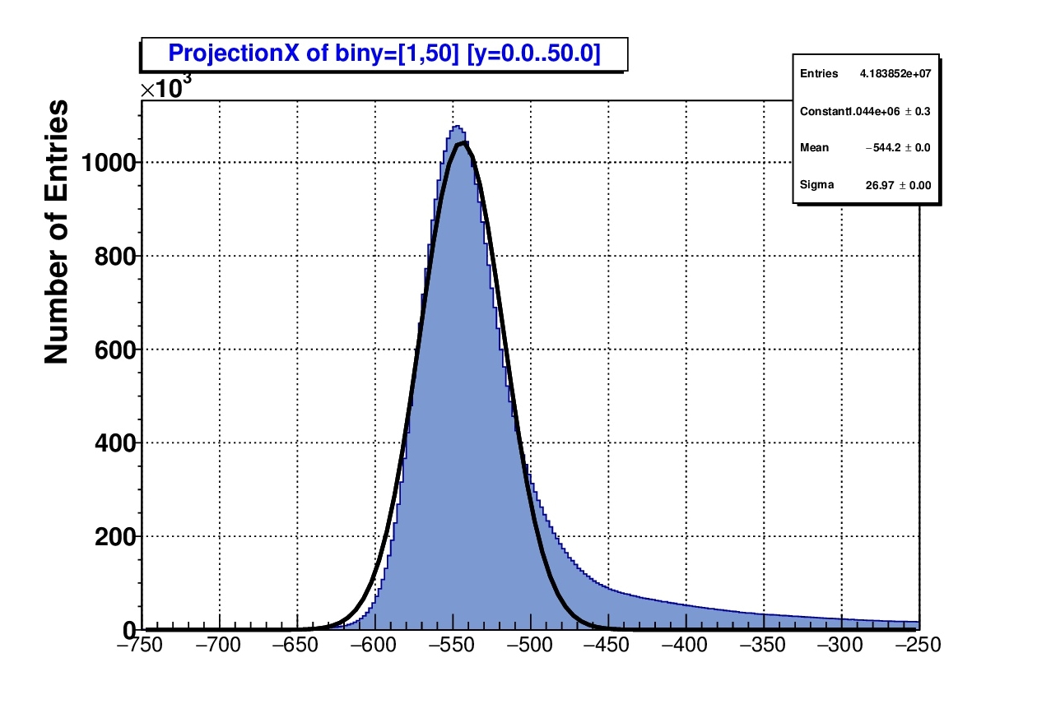
T0 Determination by STT (Step 1)
Hit cluster finder
STT characteristic: continuous tracking
check neighbour straw & neighbout layer
multi-space: Δstraw & ∆layer/ ΔTE-time/ ΔLE-time
TE-time: σ ~ 27 ns, but landau shape
~ 20-30% of hits in Landau tail
Deuteron beam
1.5 GeV/c
Neighbour channel distance
TE-time (ns)
beam
TE-time (ns)

Slide 11
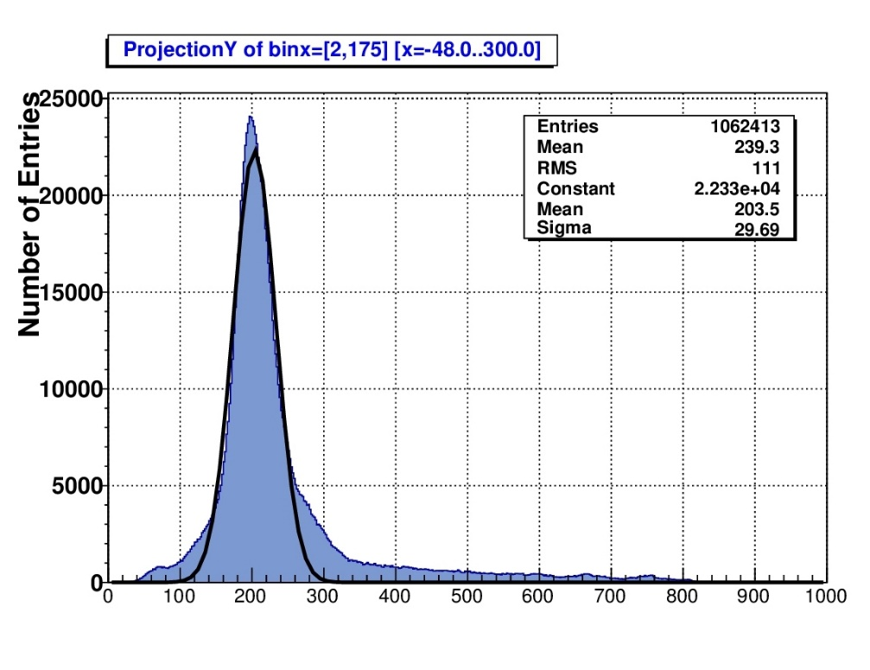
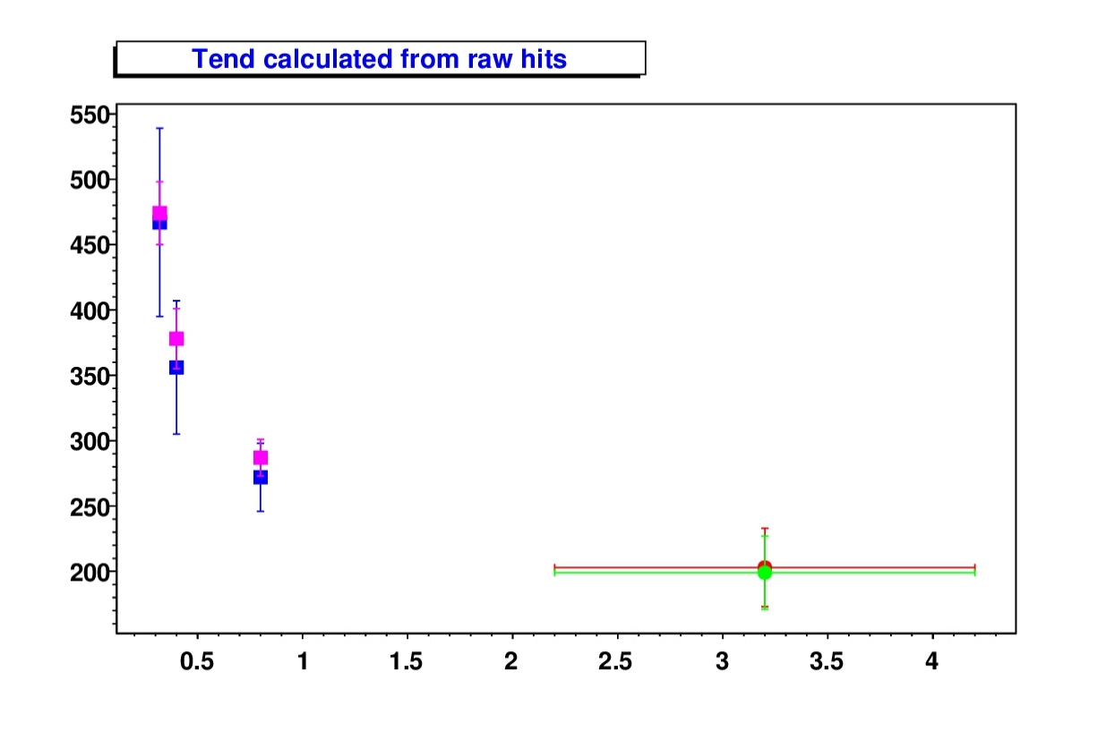
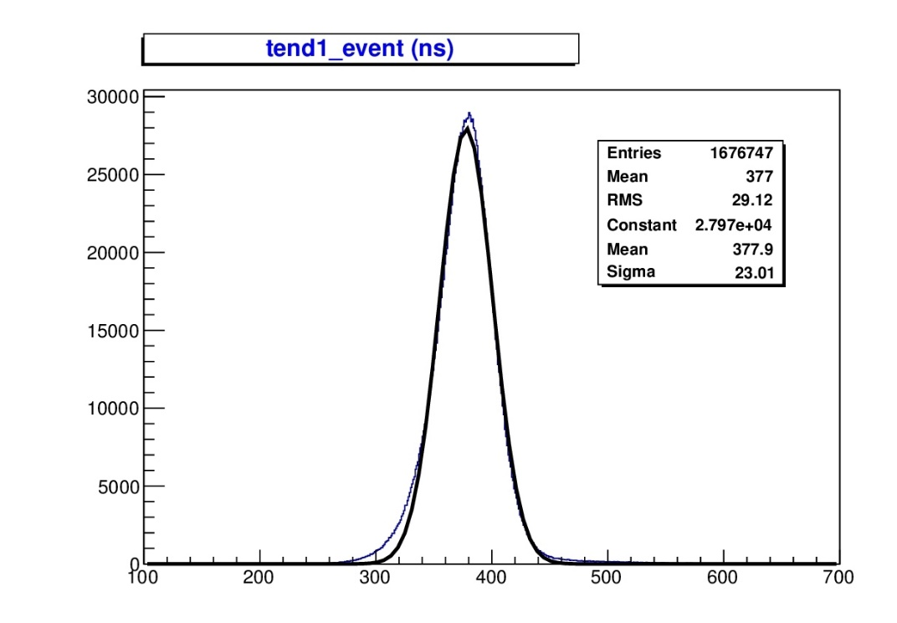
T0 Determination by STT (Step 1)
Investigate TE-time resolution (for deuteron testbeam & cosmic)
Covered dE/dx range ~ 5-50 keV/cm (= full signal dynamical range)
Cosmic tracks w/ large θ-angle range, but only 2D-tracking
Resolution: σ ~ 25 ns (after cleanup)
Resolution slightly worse (σ~30ns) for cosmics as expected
TE-time is track specific (dE/dx), not event specific
Cosmic data,
raw hits, σ = 30 ns
TDC TE-Time (ns)
Raw hits
After hit cleanup
Deuteron
750 MeV/c,
hit cleanup,
σ = 23 ns
TDC TE-Time (ns)
Cosmic
TDC TE-Time (ns)
P/Mc

Slide 12
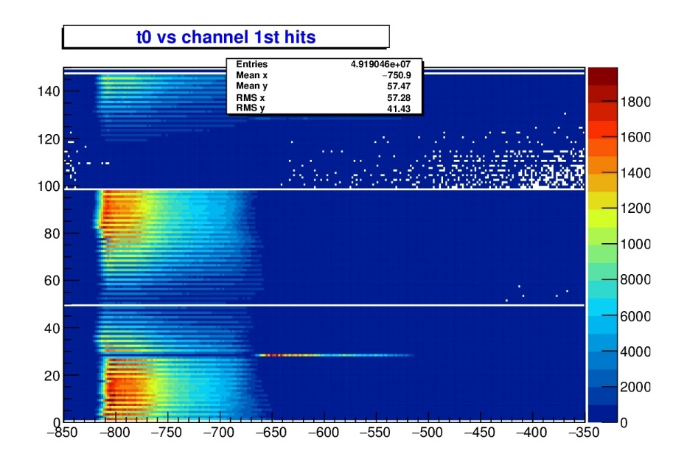
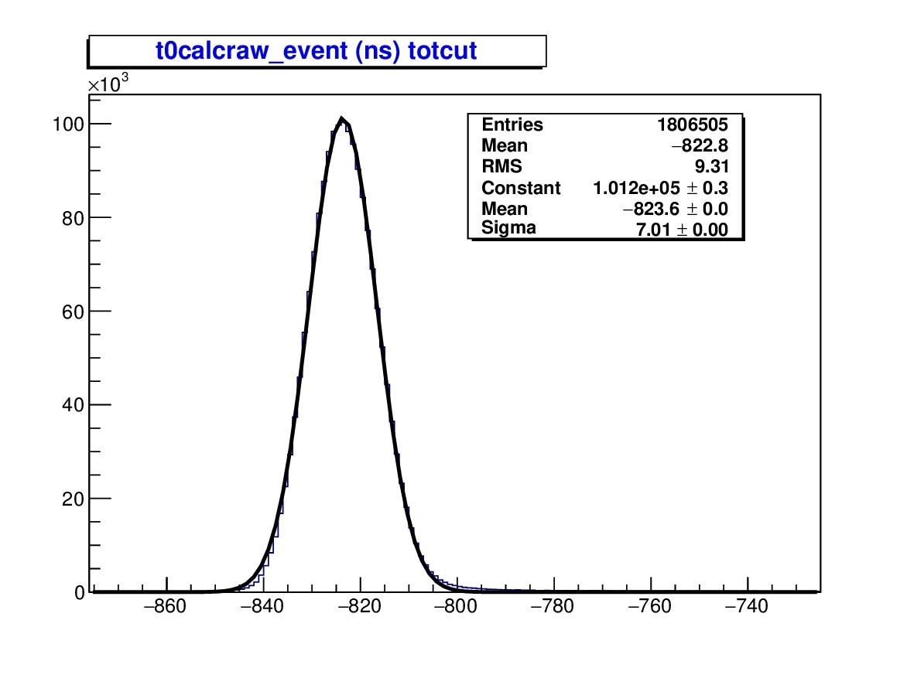
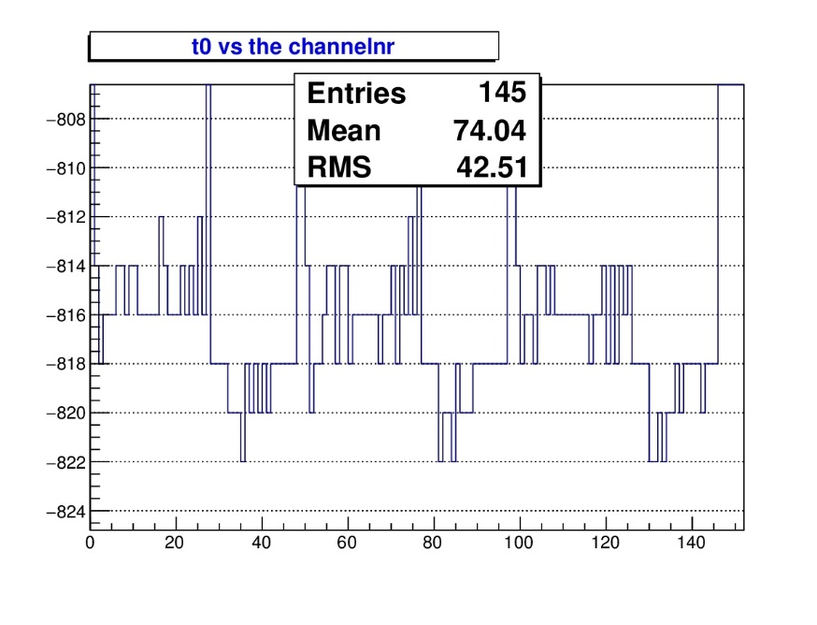
T0 Determination by STT (Step 2)
Calculate T0 from raw TDC candidate hits (sum up hits, T0=shift)
Calculated T0 in good agreement with T0 from TDC spectra
Note: single channel time offset shifts (TDC)
T0-resolution: σ = 7 ns (~ 6 ns after hit cleanup)
Channel No.
Deuteron beam
750 MeV/c
TDC LE-Time (ns)
Entries
Deuteron beam,
750 MeV/c, raw
hits, σ = 7 ns
T0 from TDC spectra (ns)
Calculated T0 (ns)
Channel No.

Slide 13
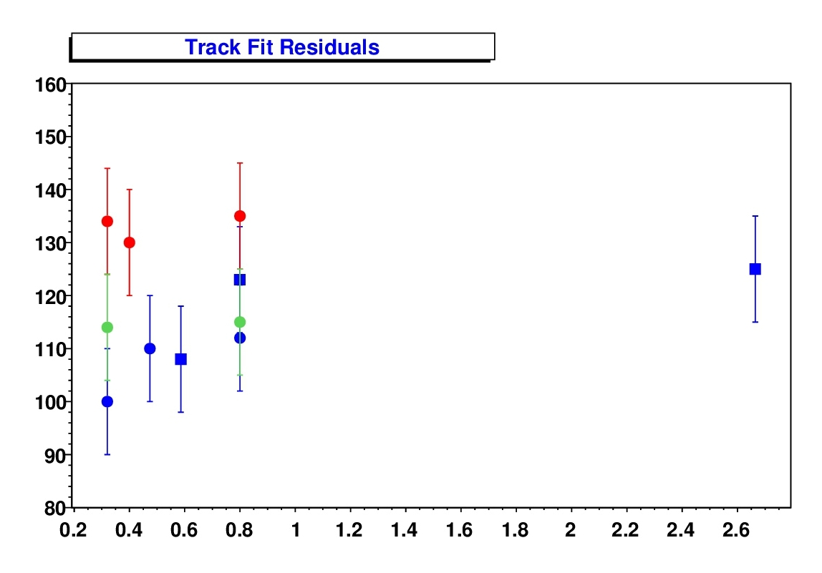
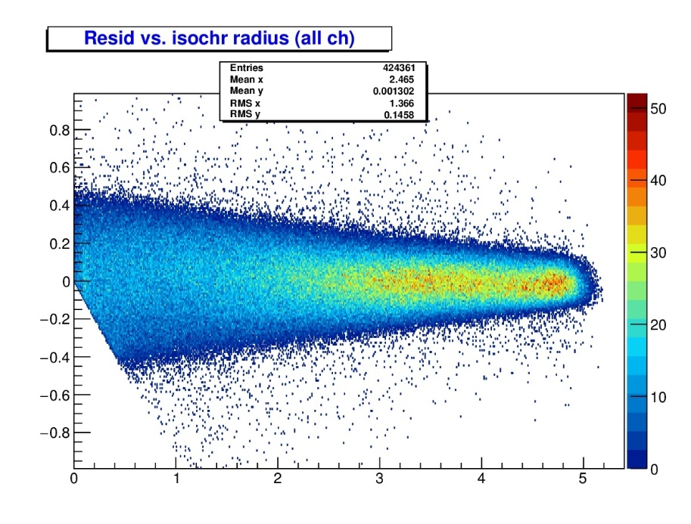
Tracking Results (In-beam) Spatial resolution
Design goal
not yet final
iteration
Isochrone residual (µm)
Residual (mm)
P. Wintz, IKP FZJ
Cosmic data (1 week)
Hit filter (~ 15% δ-electr...)
Isochrone Radius (mm)
p / Mc
Isochrone residual (σ) as spatial resolution
Results well below design goal (150 µm), confidence for STT
Measurements here at worst location (tube length middle)
Straw tube alignment method by data-check
Iterative calibration procedure (wire position and r(t))
residual
distance
isochrone
trackfit (≈ true track)

Slide 14
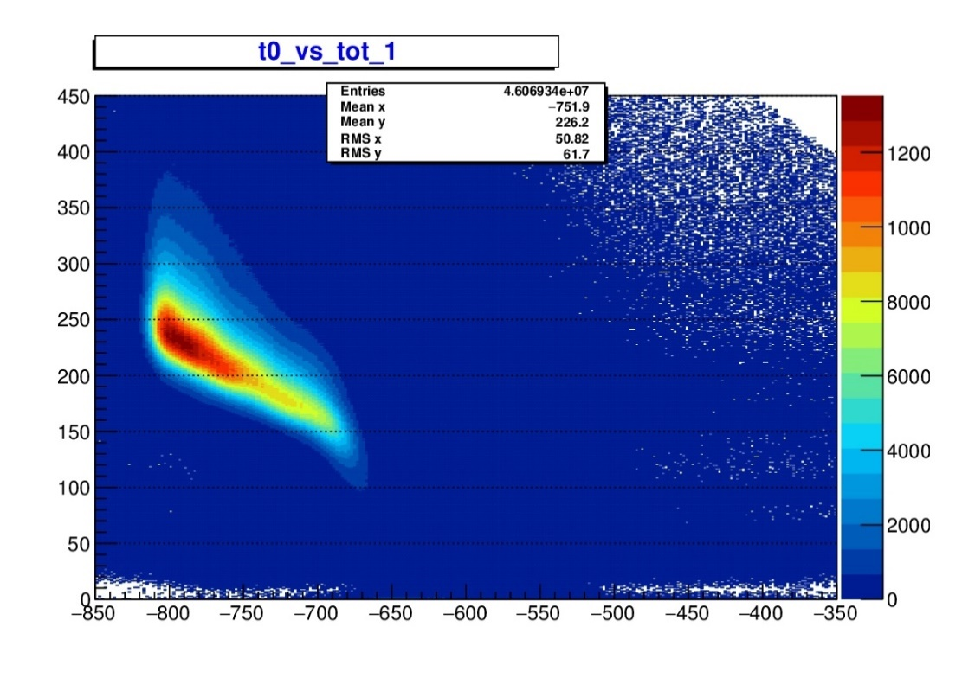
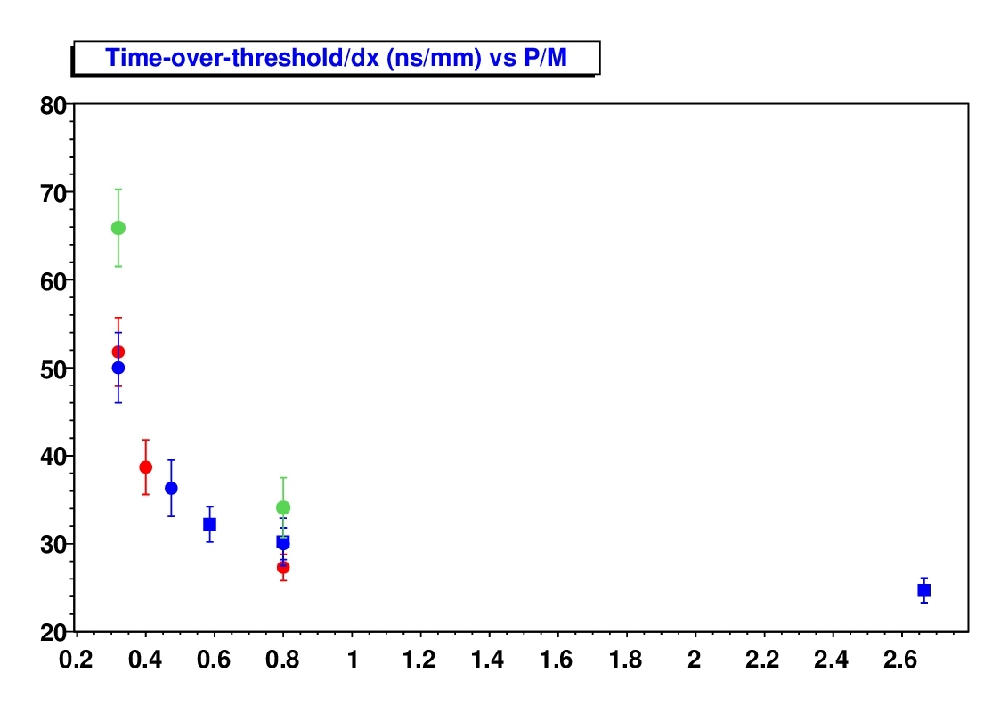
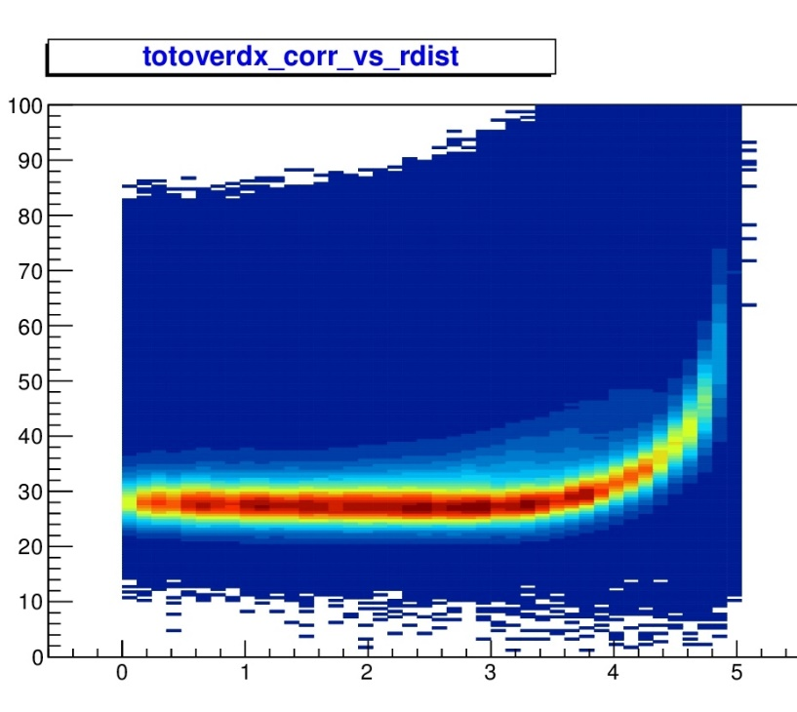
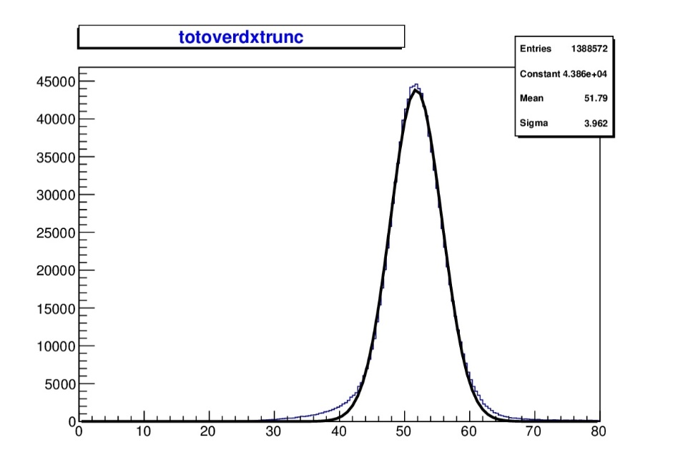
PID Results (in-beam) Time-over-threshold (Preliminary)
Deuteron beam
1.5 GeV/c
P. Wintz, IKP FZJ
Deuteron 2016, Ar/CO2(10%)
Time-over-threshold (ns)
Deuteron 2018, Ar/CO2(20%)
Σ ToT / Σ dx (ns/mm)
ToT/dx (ns/mm)
Proton 2018, Ar/CO2(20%)
Proton 2018, Ar/CO2(20%),
diff. ASIC setting (gain 2)
LE-time (ns)
Radial track distance (mm)
p / Mc
ToT results (deuteron, proton beam & cosmics)
PID separation observable here: Σ ToT / Σ dx
But: low truncation yet, analysis ongoing
Optional: ToT – charge calibration (non-linear)
Optional: other PID separation observable
600 MeV/c
deuteron
Entries
Σ ToT / Σ dx (ns/mm), truncated

Slide 15
PID separation PWR Results (very Preliminary!)
Investigate different methods for S
Proton separation rel. to 2.5 GeV/c
PID observable ToT_{time-corrected} or ToT/dx
ToT/dx (red points)
rough tracking for dx sufficient (online)
ToT| _{t-corr} polynomial fit (blue pts)
needs t0, (offline method?)
track specific polynomial fit (dE/dx)
TDR results (black)
purely simulation, pulse area (dE/dx)
better separation around 0.5 GeV/c
Deuteron beam
1.5 GeV/c
Time-over-threshold (ns)
ToT/dx (ns/mm)
LE-time (ns)
Radial track distance (mm)
ToT/dx
ToT time corrected,
ToT(time) fitted
TDR simulation (p/π)
Separation Power S
$$S=\frac{\left\langle {TOT/dx}_{1}\right\rangle −\left\langle {TOT/dx}_{2}\right\rangle }{{(σ}_{1}+σ_{2})/2}$$
$$S=\frac{\left\langle {TOT}_{1}\right\rangle −\left\langle {TOT}_{2}\right\rangle }{{(σ}_{1}+σ_{2})/2}$$
P. Wintz, IKP FZJ
p / Mc

Slide 16
Thank you
for your
attention

