Slide 1
Machine Learning For Track Finding
18.September.2018 I Waleed Esmail
Institut für Kernphysik (IKP), Forschungszentrum Jülich

Slide 2
Outlines:
Exploring ML for tracking.
PANAD Forward Tracking System.
Two-step tracking strategy.
Kmeans algorithm.
Recurrent Neural Networks.
Conclusion.

Slide 3
Exploring ML for tracking :
Machine Learning and Deep learning has not yet been explored in depth for the problems of particle tracking, and there are many open questions about the best way to incorporate such techniques:
What part of the problem to address?.
How to represent the data?
How to address the many other challenges?
Recurrent Neural Networks (RNN) can be used as state estimators in a way that is similar to a Kalman Filter.
Convolutional Neural Networks (CNN) are expected to be useful for pattern-recognition in track finding.
More advanced methods may also be applicable to tracking problems (Image Caption?!).

Slide 4
PANDA Forward Tracking System (FTS):

Slide 5
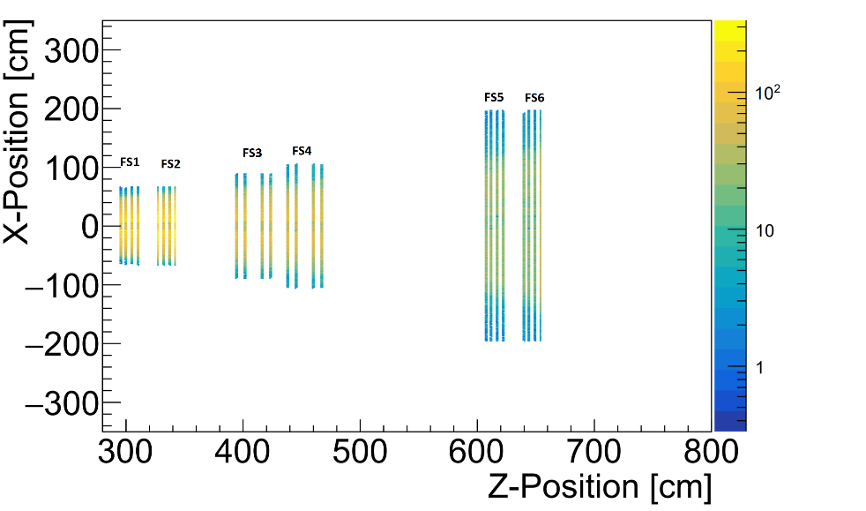
Two-step tracking strategy :
Make use of unsupervised and supervised learning.
Create Track Segments by using Kmeans clustering algorithm.
Track segments in
(FS1+FS2)
(FS3+FS4)
(FS5+FS6)
II. Interpolate Track Segments by using recurrent neural network.
 | TrackSeg 1 | TrackSeg 2 | TrackSeg 3
TrackSeg 1
TrackSeg 2
TrackSeg 3

Slide 6
Creating Track Segments (KMeans):
k-means algorithm searches for a number of clusters within an unlabeled multidimensional dataset.
k-means to group the samples based on their feature similarities.
The Algorithm:
Randomly pick k clusters (centroids) from the sample points as initial cluster centres.
Assign each sample to the nearest centroid. $μ_{j}$: $j∈\{1,…,k\}$.
Move the centroids to the centre of the samples that were assigned to it.
Iterations, Repeat steps 2 and 3 until the cluster assignments do not change or maximum number of iterations is reached.
how do we measure similarity between samples?!.
$d{\left(x,y\right)}^{2}=\sum_{j=1}^{m}{{( x_{j}−y_{j} )}^{2}}$.
Minimization of cluster inertia:
Inertia =$\sum_{i=1}^{n}{\sum_{j=1}^{k}{w^{i,j}}{\left\|x^{i}−μ^{j}\right\|}^{2}}$

Slide 7
Credit: http://shabal.in/visuals/kmeans/2.html/

Slide 8
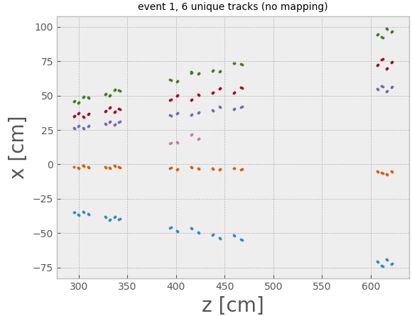
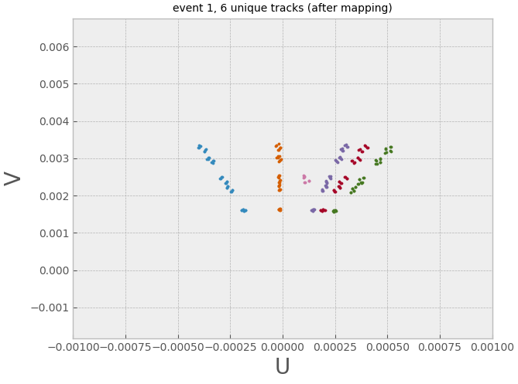
Applying To FTS DATA:
Data are generated by BoxGenerator (no magnetic field):
Momentum range (0.1 - 10) GeV/c.
Multplicity 5 particles per event.
Polar angle ($1^{o}$-${10}^{o}$).
5k Muon events & 5k anti-Muon events.
FTS Data have to be preprocessed before feeding into k-means algorithm.
$U= \frac{x^{2}}{x^{2}+z^{2}}$
V $= \frac{y^{2}}{x^{2}+z^{2}}$

Slide 9
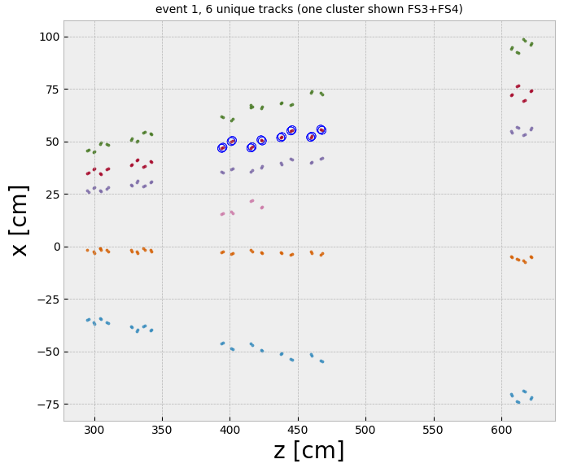
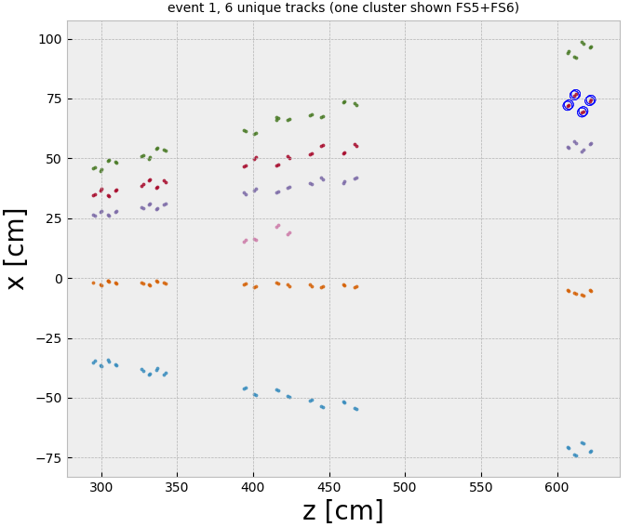
Results of KMeans:

Slide 10
How to specify the k centroids:
1. Elbow method is performance metric for clustering algorithms
The idea behind the elbow method is to identify the value of k where the distortion begins to decrease most rapidly.
2. Silhouette analysis is a measure of how tightly grouped the samples in the clusters are. This can be done by defining silhouette coefficient:
a is cluster cohesion.
and b is cluster separation.

Slide 11
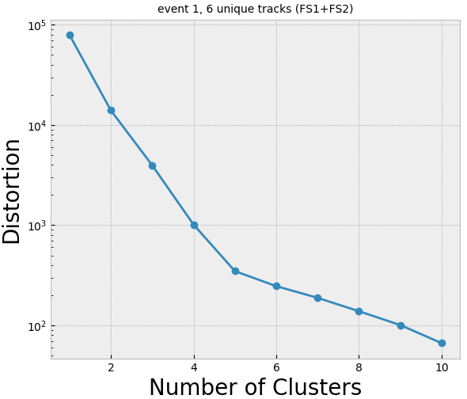
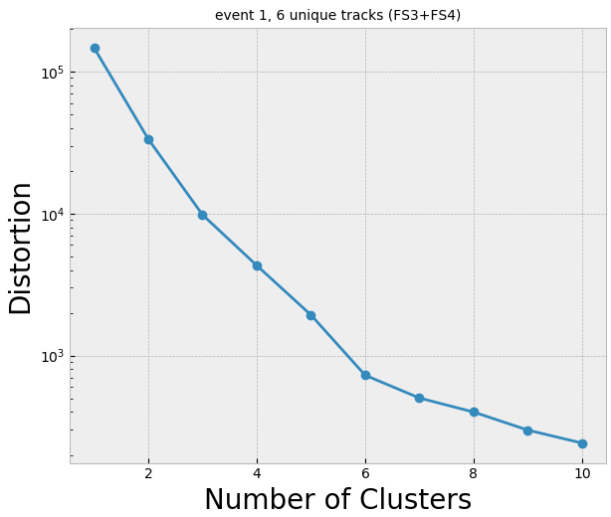
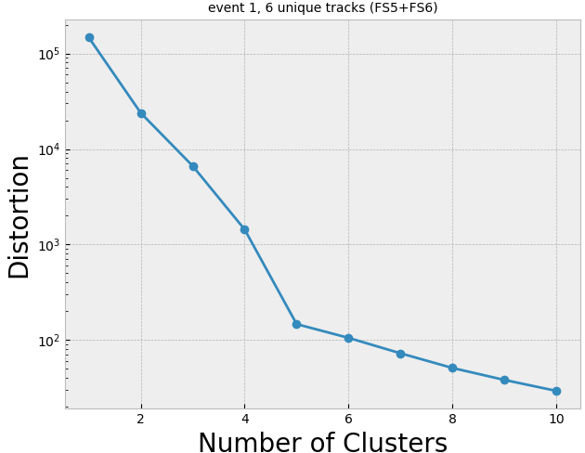
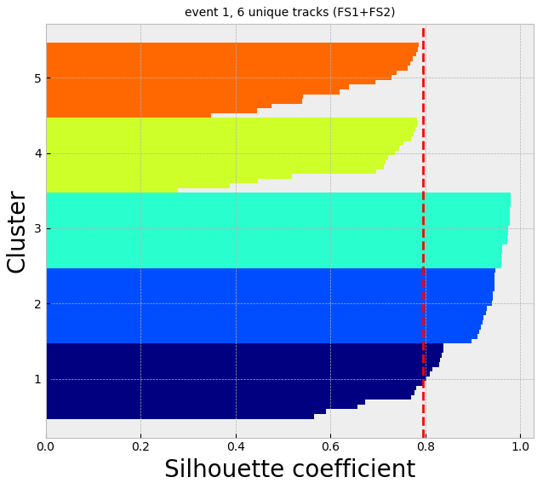
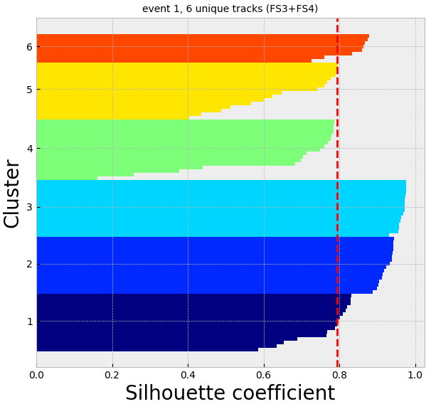
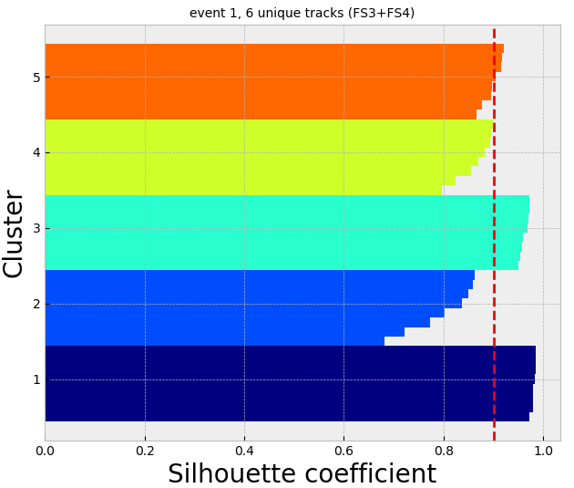

Slide 12
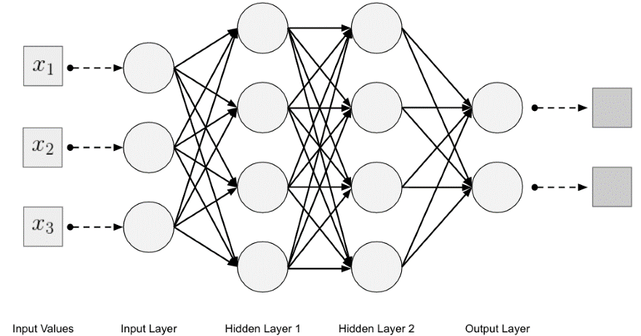
Deep Learning (combining track segments):
Artificial Neural Networks (ANN):
Neural Networks is about meaningfully transform the data.
Transform
Training loop of DNN:
Input data, parameterize by weights (transform the data), predict and compute the loss score, and update (epochs).

Slide 13
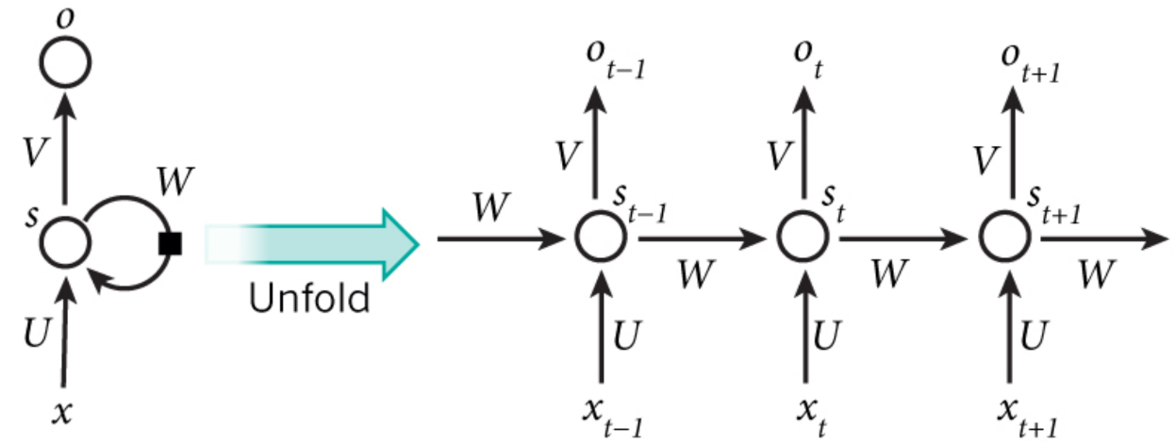
Recurrent Neural Networks (RNNs):
In normal feed forward ANN, each input shown to them is processed independently.
Recurrent Neural Networks (RNNs) are popular models that have shown great promise in many Natural Language Processing (NLP).
RNN processes sequences by iterating through the sequence elements and maintaining a state containing information relative to what it has seen so far.
Credit: http://www.wildml.com/2015/09/recurrent-neural-networks-tutorial-part-1-introduction-to-rnns/

Slide 14
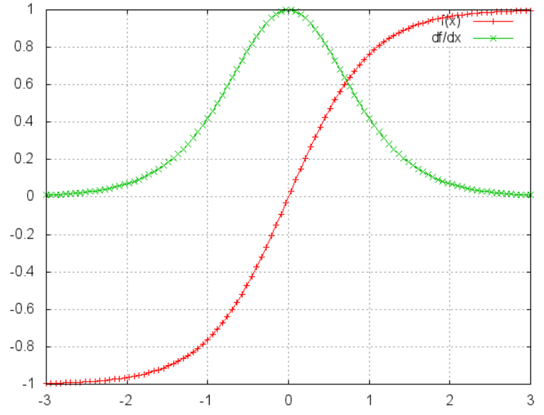
Vanishing Gradient Problem:
Simple RNN can’t be used in real practical problems.
Training the network needs to calculate the gradients of the error with respect to model parameters (U,V,W).
We sum up the gradients at each time step for one training sample, which can be done by the chain rule of differentiation.
In a traditional NN we don’t share parameters across layers, so we don’t need to sum anything.
For t=3:

Slide 15
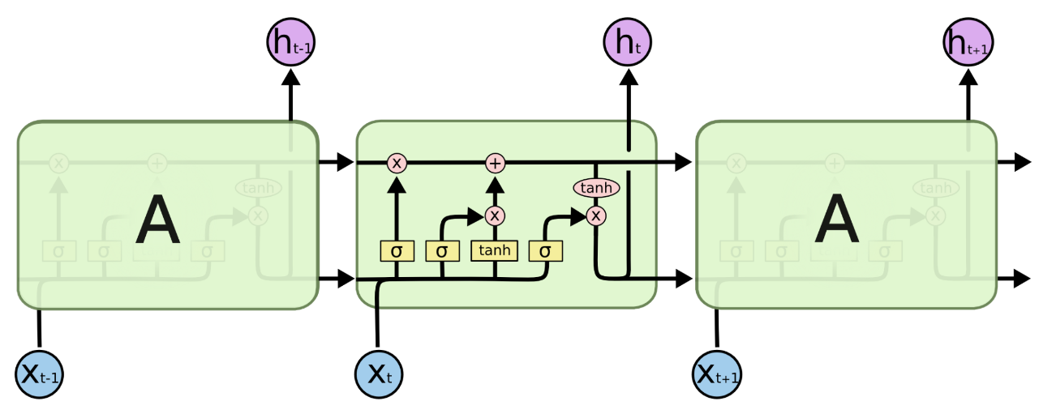
Long Short-Term Memory (LSTM):
LSTMs are a special kind of RNN, capable of learning long-term dependencies.
LSTMs also have the same chain like structure as simple RNN, but the repeating module has a different structure. Instead of a simple neuron, it is a cell.
Credit: http://colah.github.io/posts/2015-08-Understanding-LSTMs/

Slide 16
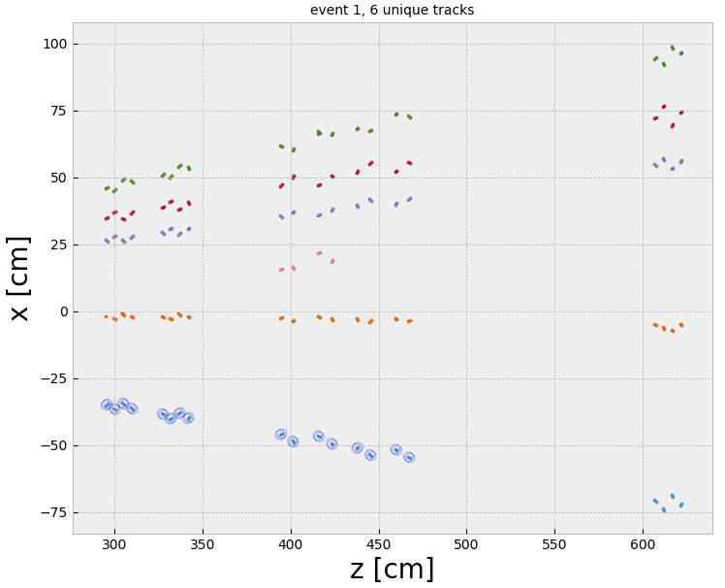
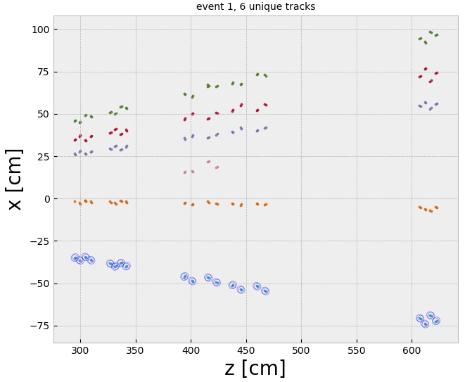
LSTM Architecture & Results:
LSTM trained on ~40k true tracks, and ~60k ghost tracks.
LSTM used as a classifier to identify correct tracks (Binary Classification Problem).
Last layer is sigmoid activation.
95%
90%

Slide 17
Conclusion and outlook:
Results on test data by BoxGenerator (3 particles per event) shows 82% of correctly identify full tracks.
LSTM takes long time to train, although it can provide accurate results if trained well.
K-means shows poor performance for data of (1 particle per event).
Needs to search for better clustering algorithm or to optimize k-means.
Exploring different ways of applying RNN.

Slide 18
Thank You

