Slide 1
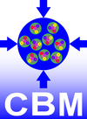
CBM + HADES detector tests at COSY in Q1/2018, and outlook to Q1/2019
Johann M. Heuser
GSI Helmholtz Center for Heavy Ion Research GmbH, Darmstadt, Germany
8th COSY Beamtime Advisory Committee Meeting, IKP FZ Jülich, 2 July 2018

Slide 2
Beamtime in calendar week #9 (26.2. – 5.3.) 2018
with set-up of equipment in the preceding MD week
JESSICA cave, protons of E_{kin} = 1 GeV
detectors tested:
CBM-STS:
prototype modules with near-final integration of sensor, microcable, read-out ASIC
relevance for Sensor Production Readiness Review in April 2018
CBM-MUCH:
had to be cancelled due to travel clearance issue of the VECC team
HADES/CBM Start-Veto:
first test of Ultra-Fast Silicon Detectors
Outlook: further component tests considered in Q1/2019

Slide 3
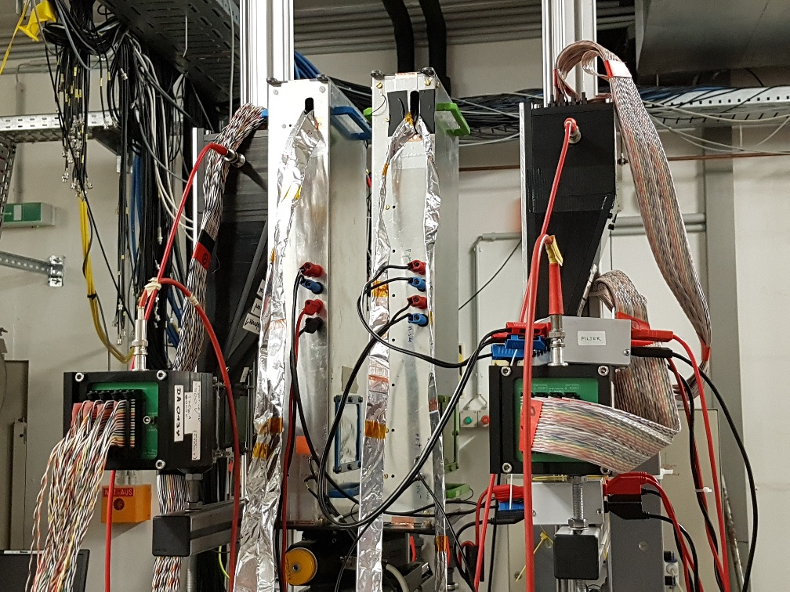
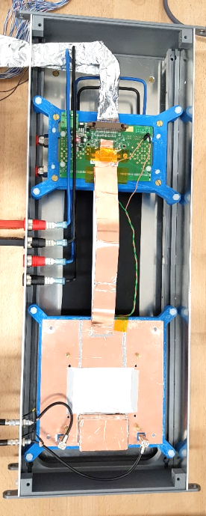
(1) CBM Silicon Tracking System
prototype STS module
fiber Hodo1
STS1
STS2
fiber Hodo2
read out with prototype free-streaming DAQ system
STS-XYTERv2.0 on FEB-B
microcables
silicon microstrip sensor
285 µm thick
strips 4 cm long
2-sided, 7.5 deg stereo angle
128 channels/side read out
→ triangular overlap area
1 GeV protons
preliminary results:
noise: 1090 ±150 e (n) 1350 ±200 e (p)
signal mean: 16720 e (n) 20300 e (p)
read-out threshold: 7000 e
signal-to-noise: 15±3
hit detection efficiency: > 95%

Slide 4
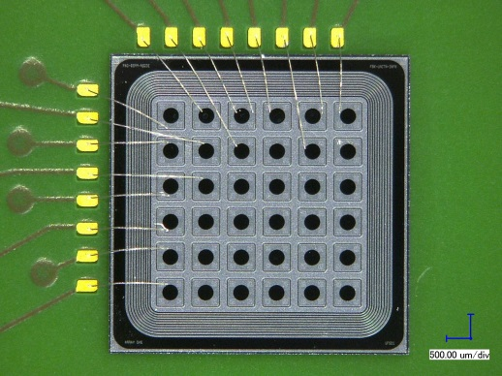
(2) Ultra-Fast Silicon Detectors for the HADES/CBM Start-Veto System
UFSD sensor from Torino
N.Cartiglia, M.Ferrero, V.Sola
First test with 1 GeV proton beam @ COSY
A beam telescope made of 3 sensors:
Two double-sided scCVD diamond sensors
One UFSD with pad readout in between
time precision and efficiency determination
Data analysis in progress
Expected time precision below 100 ps and high rate capability
Possible PID by ToF and dE/dx
Diamond sensors prepared by GSI Detector Laboratory
scCVD
diamond
UFSD
sensor
scCVD
diamond
beam direction
4

Slide 5
Outlook 2019
For further CBM component tests, we consider a further application at CBAC#9:
beam-time in Q1/2019
1 week
component tests towards their production readiness, including e.g.
read-out ASIC STS-XYTERv2.1
TRD front-end electronics
…

Slide 6
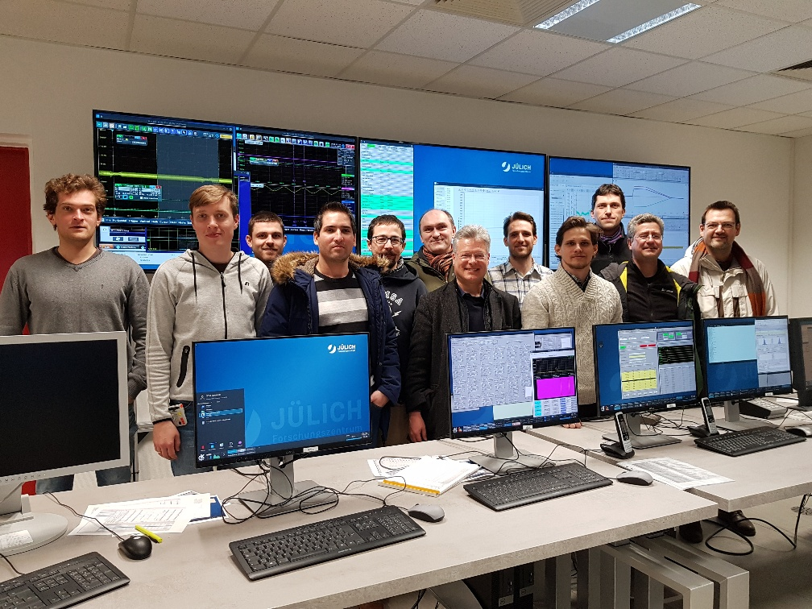
Thanks for the support at IKP!

