Slide 1
Model-based extrapolation of nuclear observables via Bayesian machine learning
Léo Neufcourt
Michigan State University, Dept. of Statistics and Probability / FRIB
ISNET 6, TU Darmstadt, October 12 2018

Slide 2
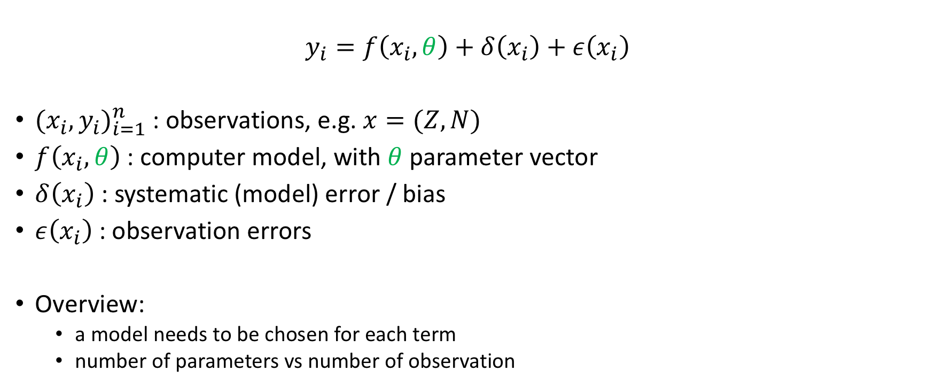
General model
$$y_{i}=f\left(x_{i}, θ\right)+δ\left(x_{i}\right)+ε\left(x_{i}\right)$$
${{(x}_{i},y_{i})}_{i=1}^{n}$ : observations, e.g. $x=(Z,N)$
$f\left(x_{i}, θ\right)$ : computer model, with $θ$ parameter vector
$δ\left(x_{i}\right)$ : systematic (model) error / bias
$ε\left(x_{i}\right)$ : observation errors
Overview:
  a model needs to be chosen for each term
  number of parameters vs number of observation

Slide 3
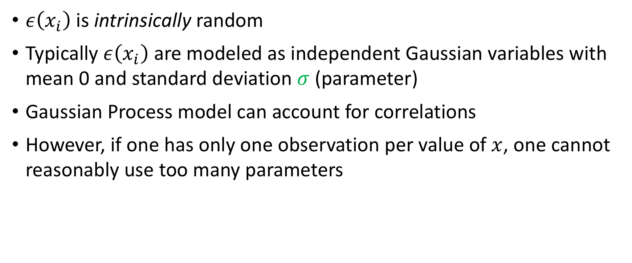
Observation error
$ε\left(x_{i}\right)$ is intrinsically random
Typically $ε\left(x_{i}\right)$ are modeled as independent Gaussian variables with mean 0 and standard deviation $σ$ (parameter)
Gaussian Process model can account for correlations
However, if one has only one observation per value of $x$, one cannot reasonably use too many parameters

Slide 4
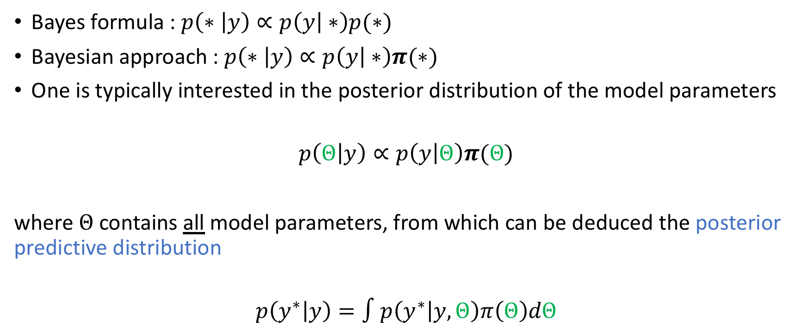
Bayesian approach
Bayes formula : $p\left(∗ | y\right)∝p\left(y | ∗\right)p(∗)$
Bayesian approach : $p\left(∗ | y\right)∝p\left(y | ∗\right)π(∗)$
One is typically interested in the posterior distribution of the model parameters
$$p\left(Θ | y\right)∝p\left(y | Θ\right)π(Θ)$$
where $Θ$ contains all model parameters, from which can be deduced the posterior predictive distribution
$$p\left(y^{∗} | y\right)=∫p\left(y^{∗} | y,Θ\right)π\left(Θ\right)dΘ$$

Slide 5
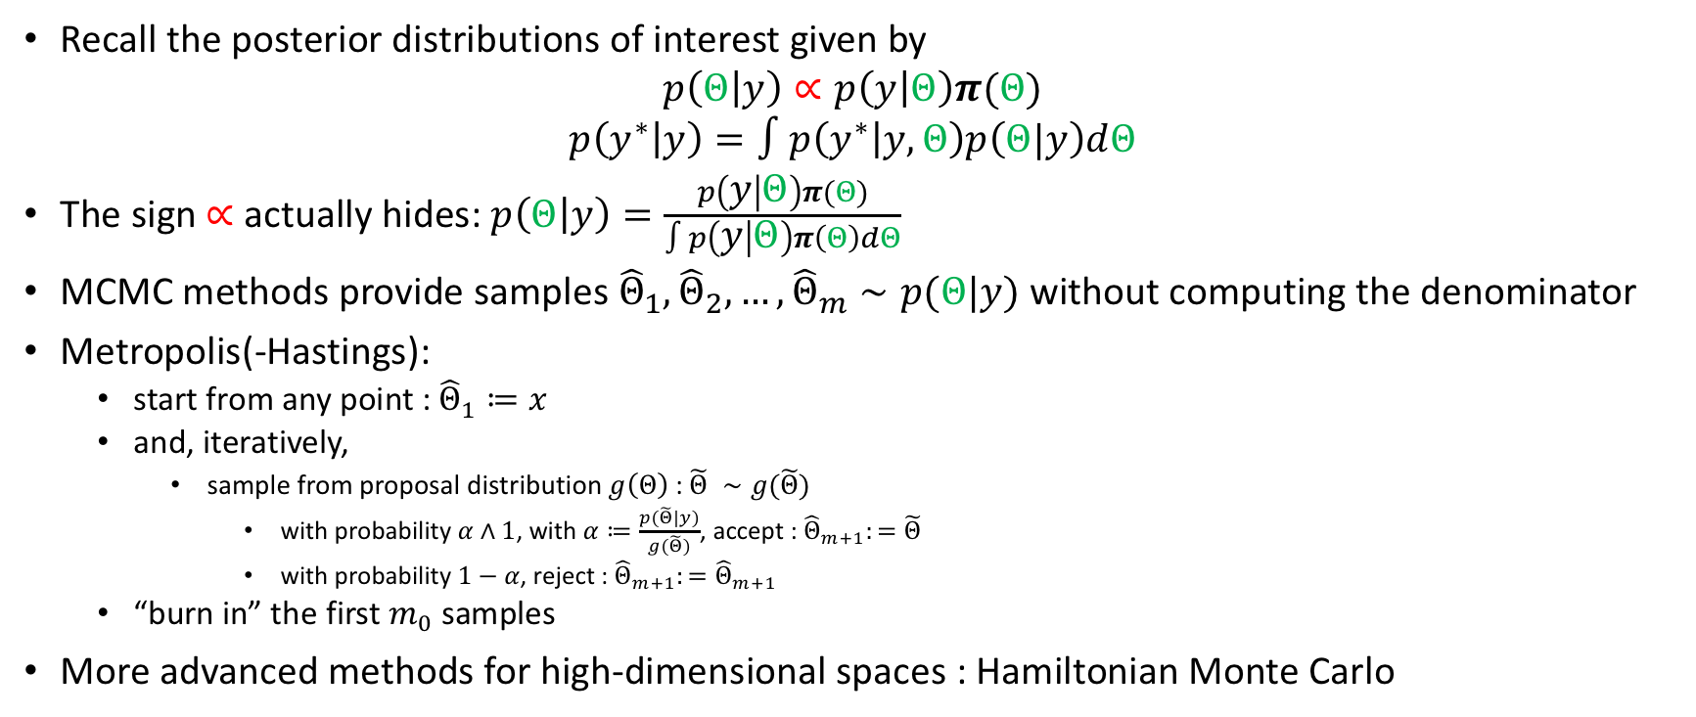
Sampling from the posterior distributions
Recall the posterior distributions of interest given by
$$p\left(Θ | y\right)∝p\left(y | Θ\right)π(Θ)$$
$$p\left(y^{∗} | y\right)=∫p\left(y^{∗} | y,Θ\right)p\left(Θ|y\right)dΘ$$
The sign $∝$ actually hides: $p\left(Θ | y\right)=\frac{p\left(y | Θ\right)π(Θ)}{∫p\left(y | Θ\right)π\left(Θ\right)dΘ}$
MCMC methods provide samples ${\hat{Θ}}_{1},{\hat{Θ}}_{2}, …,{\hat{Θ}}_{m}∼p(Θ|y)$ without computing the denominator
Metropolis(-Hastings):
  start from any point : ${\hat{Θ}}_{1}≔x$
  and, iteratively,
    sample from proposal distribution $g\left(Θ\right)$ : $\tilde{Θ} ∼g(\tilde{Θ})$
      with probability $α∧1$, with $α≔\frac{p(\tilde{Θ}|y)}{g(\tilde{Θ})}$, accept : ${\hat{Θ}}_{m+1}:=\tilde{Θ}$
      with probability $1−α$, reject : ${\hat{Θ}}_{m+1}:={\hat{Θ}}_{m+1}$
  “burn in” the first $m_{0}$ samples
More advanced methods for high-dimensional spaces : Hamiltonian Monte Carlo

Slide 6
Analysis of the residuals
Collaborators:
Witold Nazarewicz, Erik Olsen, Yuchen Cao (FRIB)
Frederi Viens (STT)

Slide 7
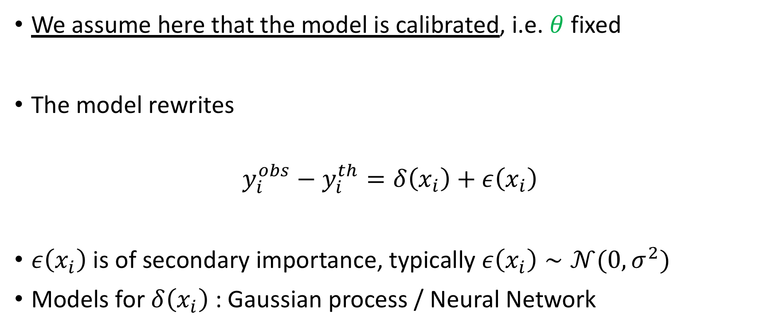
Modeling the residuals
We assume here that the model is calibrated, i.e. $θ$ fixed
The model rewrites
$$y_{i}^{obs}−y_{i}^{th}=δ\left(x_{i}\right)+ε\left(x_{i}\right)$$
$ε\left(x_{i}\right)$ is of secondary importance, typically $ε\left(x_{i}\right)∼𝒩(0,σ^{2})$
Models for $δ\left(x_{i}\right)$ : Gaussian process / Neural Network
residual

Slide 8
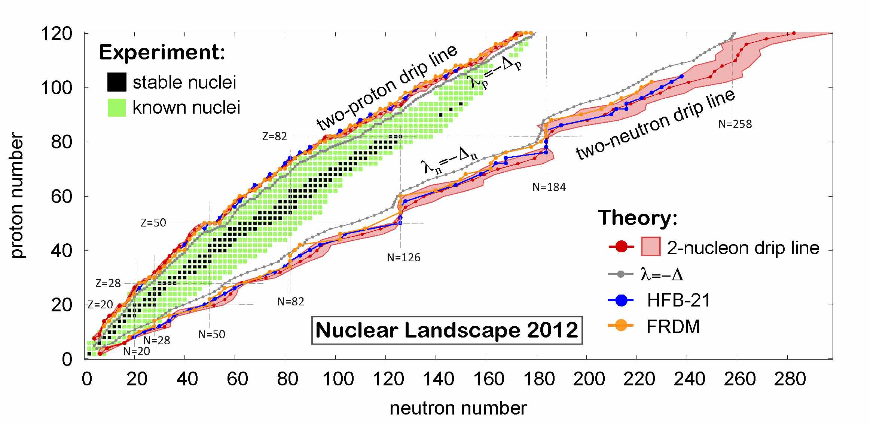
Example:
”The limits of nuclear landscape”
S_{1p} < 0 < S_{2p}
S_{1n} < 0 < S_{2n}
S_{1p/2p} < 0
S_{1p/2p} > 0
S_{1p/2p} < 0
S_{1p/2p} > 0
Erler and al, Nature, 2012

Slide 9
Project papers
Methodology paper :
  Bayesian approach to model-based extrapolation of nuclear observables,
  L.N., Y. M. Cao, W. Nazarewicz & F. G. Viens, Phys. Rev. C 98(3), 034318 (2018)
  Two-neutron separation energies from 4 relativistic DFT + 6 Skyrme DFT + 2 phenomenological models
Application to dripline prediction in the calcium region
  One- and two-neutron separation energies from 7 Skyrme DFT + 2 phenomenological models

Slide 10
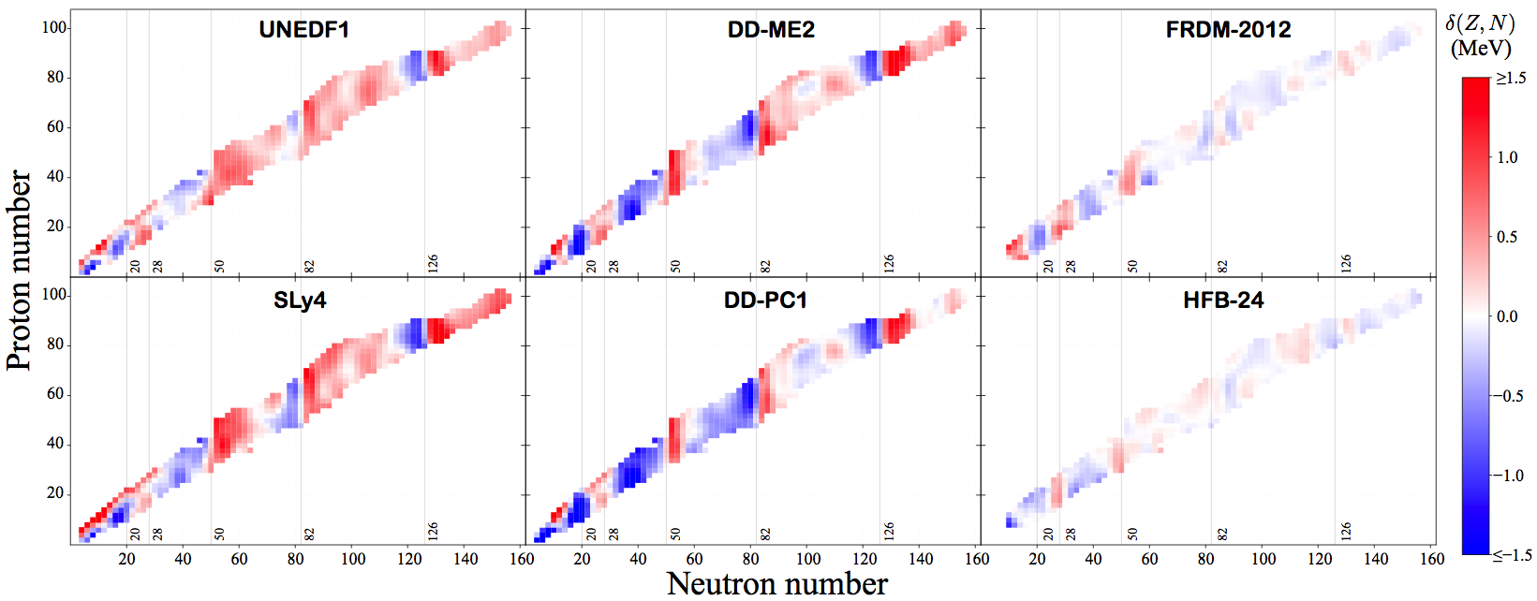

Example : distribution of $S_{2n}$ residuals

Slide 11
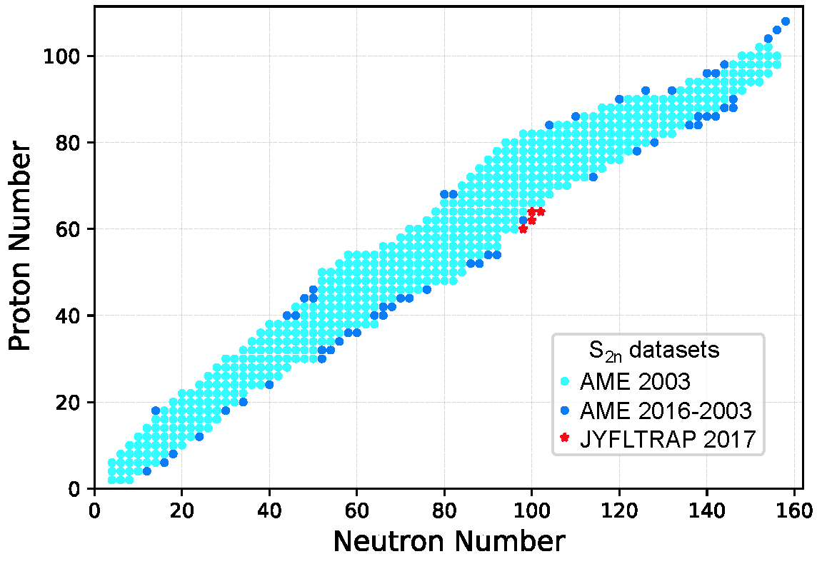
Data
Training set:
537 points
Testing sets:
55+4 points

Slide 12
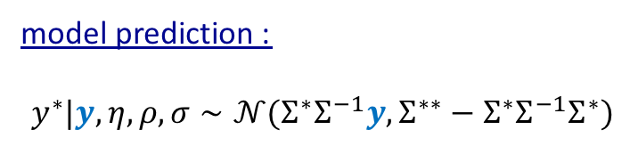
Gaussian Processes I
quadratic exponential covariance kernel
likelihood :
model prediction :
$$y^{∗}|y,η,ρ,σ∼𝒩(Σ^{∗}Σ^{−1}y,Σ^{∗∗}−Σ^{∗}Σ^{−1}Σ^{∗})$$

Slide 13
GP parameters
intensity
correlation effects length scale

Slide 14
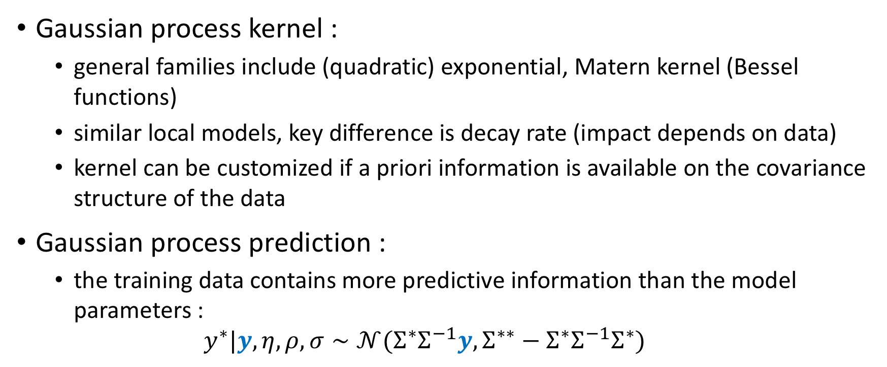
Gaussian Processes II
Gaussian process kernel :
  general families include (quadratic) exponential, Matern kernel (Bessel functions)
  similar local models, key difference is decay rate (impact depends on data)
  kernel can be customized if a priori information is available on the covariance structure of the data
Gaussian process prediction :
  the training data contains more predictive information than the model parameters :
  $$y^{∗}|y,η,ρ,σ∼𝒩(Σ^{∗}Σ^{−1}y,Σ^{∗∗}−Σ^{∗}Σ^{−1}Σ^{∗})$$

Slide 15
Neural Networks I
# of hidden neurons
NN with 1 layer
activation function (tanh)
likelihood
model prediction
Utama & Piekarewicz, PRC, 2017

Slide 16
Neural networks II
“Deep” neural networks are obtained by combining many layers of hidden neurons
Deep NN perform very well on classification problems with high dimension and large amount of data
NN are also often used outside the Bayesian framework

Slide 17
Digression : event identification for GRETINA with neural networks
GRETINA event energy spectrum – ⁶⁰Co
raw
NN filter
with Dirk Weisshaar (FRIB)
Input : energies measured at various locations in the detector for ⁶⁰Co beam
Output : event classes
  toy example : Full Energy / non FE
Model: simple neural network classifier with 3 layers of 20 hidden neurons
Next step : convolutional neural network capturing 3D geometrical features of the detector
Long run: particle identification and tracking for GRETINA
See also CERN’s TrackML challenge

Slide 18

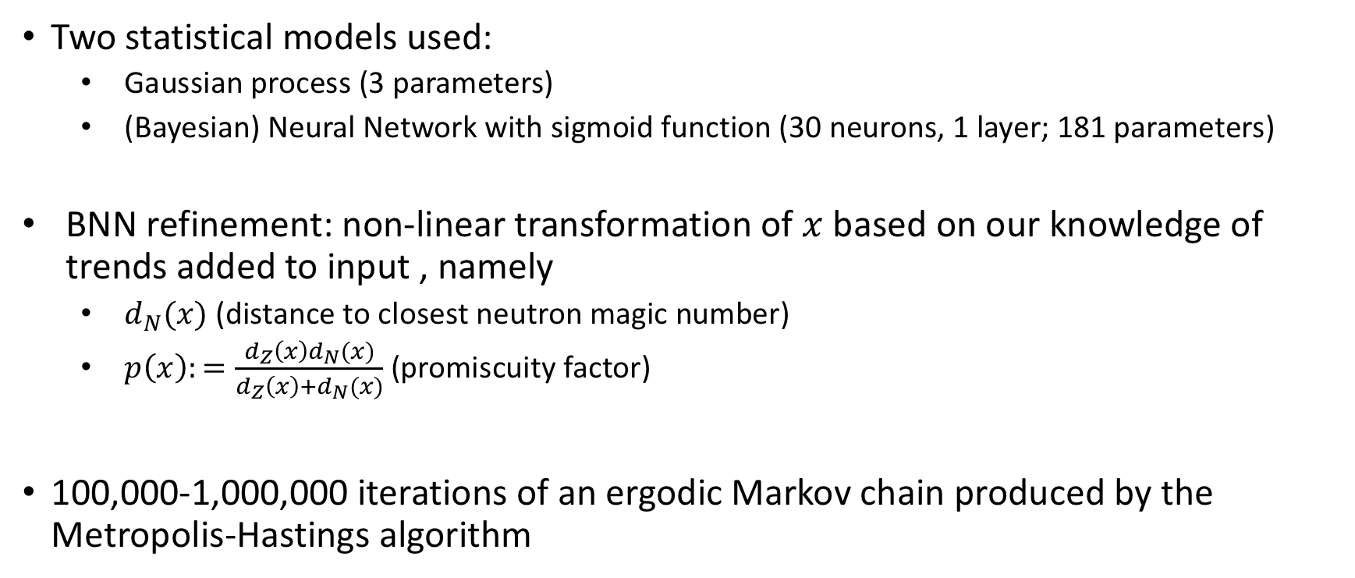
Example : Bayesian analysis of $S_{2n}$ residuals
Two statistical models used:
  Gaussian process (3 parameters)
  (Bayesian) Neural Network with sigmoid function (30 neurons, 1 layer; 181 parameters)
BNN refinement: non-linear transformation of $x$ based on our knowledge of trends added to input , namely
  $d_{N}(x)$ (distance to closest neutron magic number)
  $p\left(x\right):=\frac{d_{Z}\left(x\right)d_{N}(x)}{d_{Z}\left(x\right)+d_{N}(x)}$ (promiscuity factor)
100,000-1,000,000 iterations of an ergodic Markov chain produced by the Metropolis-Hastings algorithm

Slide 19
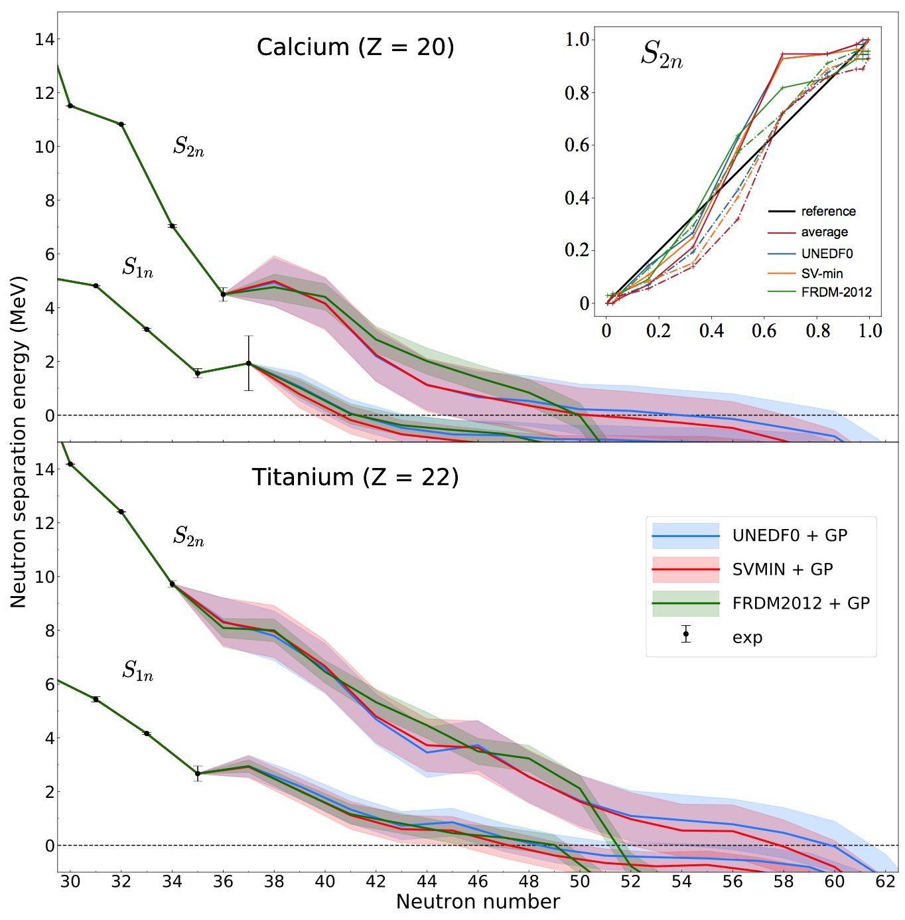
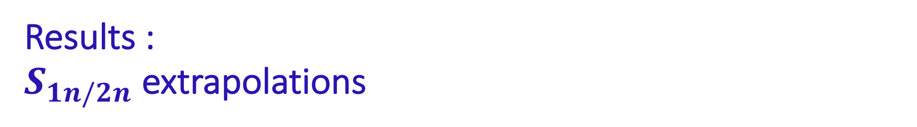
Results :
$S_{1n/2n}$extrapolations
prediction of unknown observable y* given known data y

Slide 20
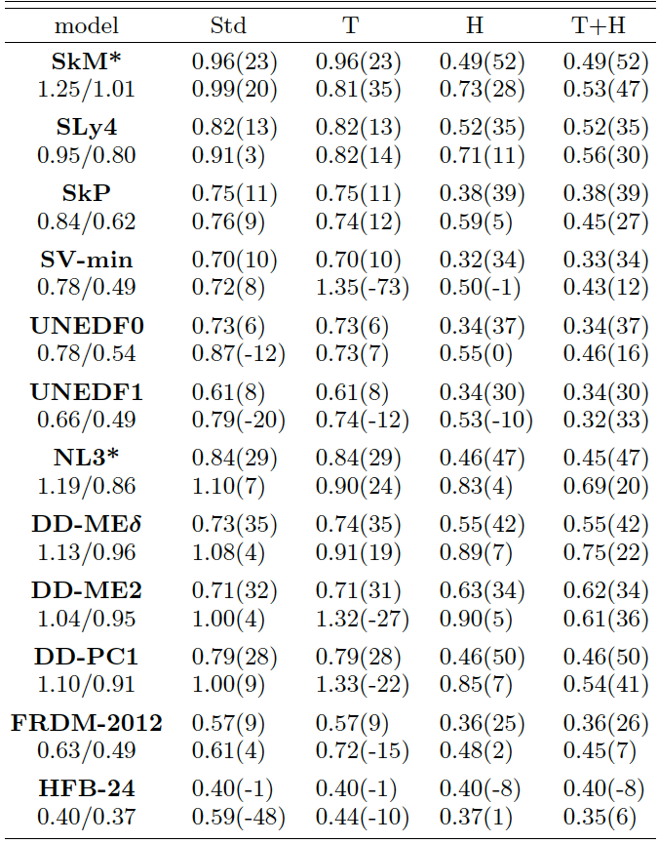

Results : $S_{2n}$rms deviation
GP
BNN
rms deviation is 400-500 keV in the GP(T+H) variant for all theoretical models employed in our study
this suggests that most of the residual structure is captured
but : the predicted mean value is certainly not the whole story!

Slide 21
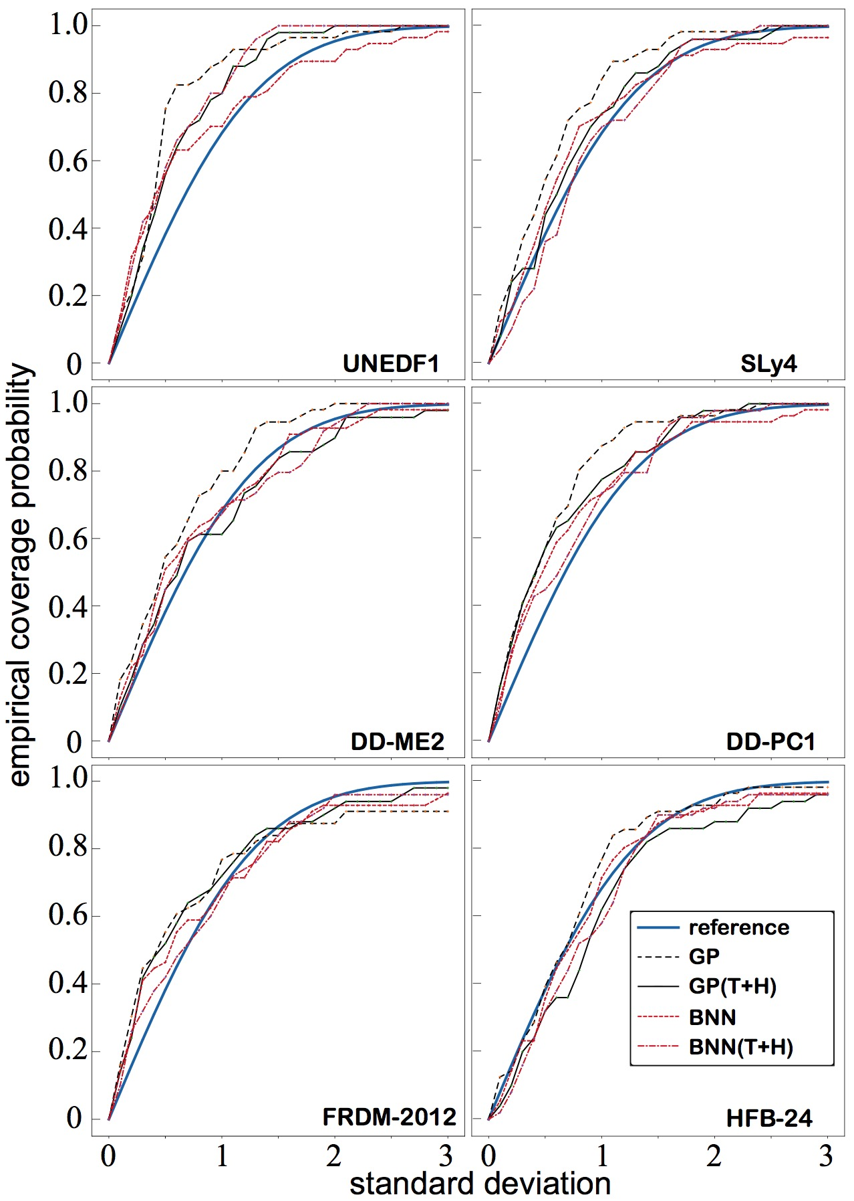

Empirical Coverage Probability I
ECP is a simple and intuitive metric for assessing the quality of a statistical model’s UQ (Gneiting et al., 2007)
The reference curve shows the fraction of predictions which should theoretically fall in a CI centered around the posterior mean prediction according to the model, as a function of the interval width
The other curves give the proportion of data which actually falls in the corresponding CI.
Values for the ECP matching the reference curve are desirable.
A point above the reference curve represents a prediction which is too conservative (or pessimistic).
A point below the reference curve represent a CI which is too narrow (optimistic). This should be considered dishonest, since it is claiming a level of assurance which is higher than it should be.
$$(S_{2n})$$

Slide 22
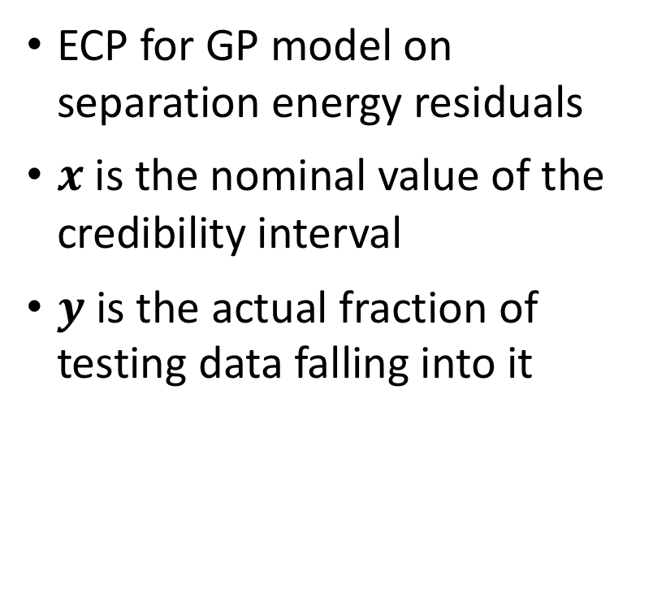
ECP II
ECP for GP model on separation energy residuals
$x$ is the nominal value of the credibility interval
$y$ is the actual fraction of testing data falling into it

Slide 23
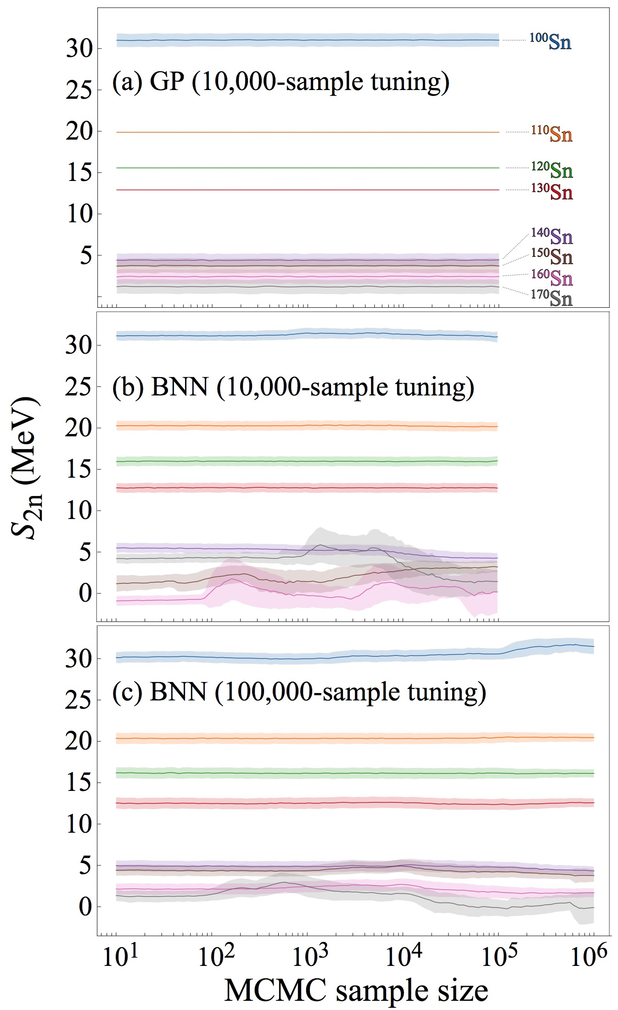
Caveat : convergence of BNN
Massive MCMC runs: BNN shows convergence issues
Due to large number of parameter vs data available
Data profile not best suited for NN (very low number of samples)

Slide 24

Posterior probability of existence
We introduce the posterior probability p_{ex}(Z,N) of the predicted separation energy $S_{1n/2n}(Z,N)$ being positive:

Slide 25
Dripline plot UNEDF0

Slide 26
Dripline plot HFB24

Slide 27
Dripline plot average

Slide 28
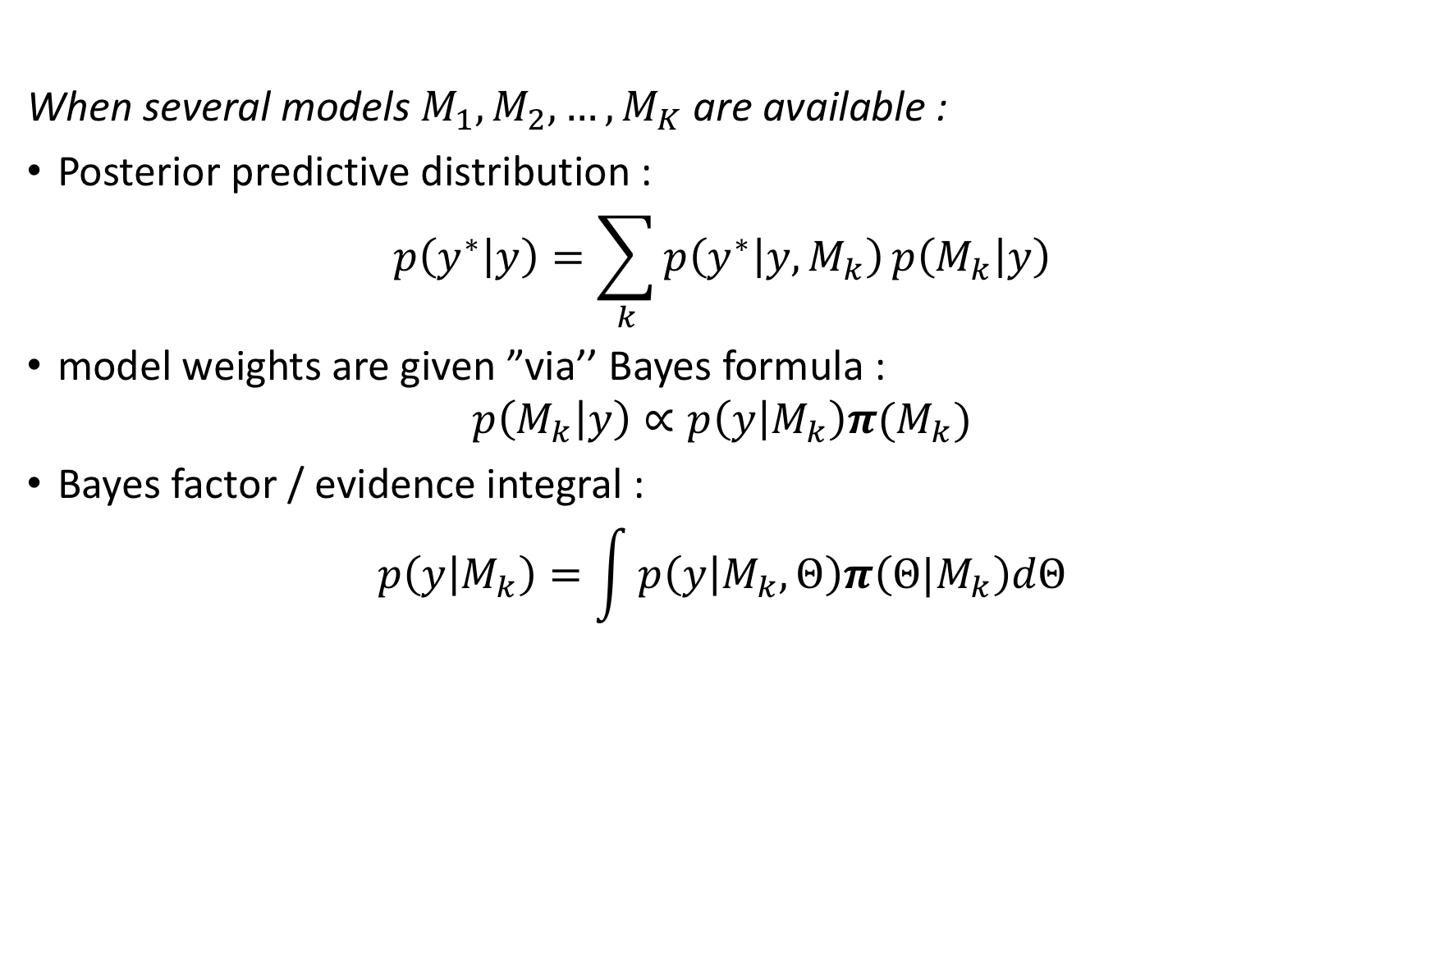
Model averaging I
When several models $M_{1},M_{2},…,M_{K}$ are available :
Posterior predictive distribution :
$$p\left(y^{∗} | y\right)=\sum_{k}{p\left(y^{∗} | y,M_{k}\right)}p\left(M_{k} | y\right)$$
model weights are given ”via’’ Bayes formula :
$$p\left(M_{k} | y\right)∝p\left(y | M_{k}\right)π(M_{k})$$
Bayes factor / evidence integral :
$$p\left(y | M_{k}\right)=\int{p\left(y | M_{k},Θ\right)π\left(Θ|M_{k}\right)dΘ}$$

Slide 29
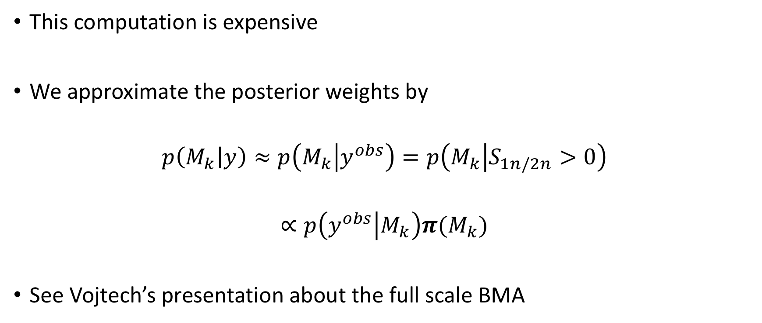
Model averaging II
This computation is expensive
We approximate the posterior weights by
$$p\left(M_{k} | y\right)≈p\left(M_{k} | y^{obs}\right)=p\left(M_{k} | S_{1n/2n}>0\right)$$
$$∝p\left(y^{obs} | M_{k}\right)π(M_{k})$$
See Vojtech’s presentation about the full scale BMA

Slide 30
Dripline posterior average

Slide 31
Preliminary quantified neutron/proton driplines for the full mass table

Slide 32
Expert elicitation
Choice of global models
Prior on models: non-informative
Prior on model parameters: non-informative (in spirit)
  take prior variances as large as possible
  decrease prior variance as long as the posterior is stable

Slide 33
Model calibration
Collaborators:
Vojtech Kejzlar, Frederi Viens, Taps Maiti (STT)
Witold Nazarewicz (FRIB)
Jared O’Neal, Stefan Wild (ANL)
Yannen Jaganathan (GANIL), Nicolas Michel (FRIB)

Slide 34
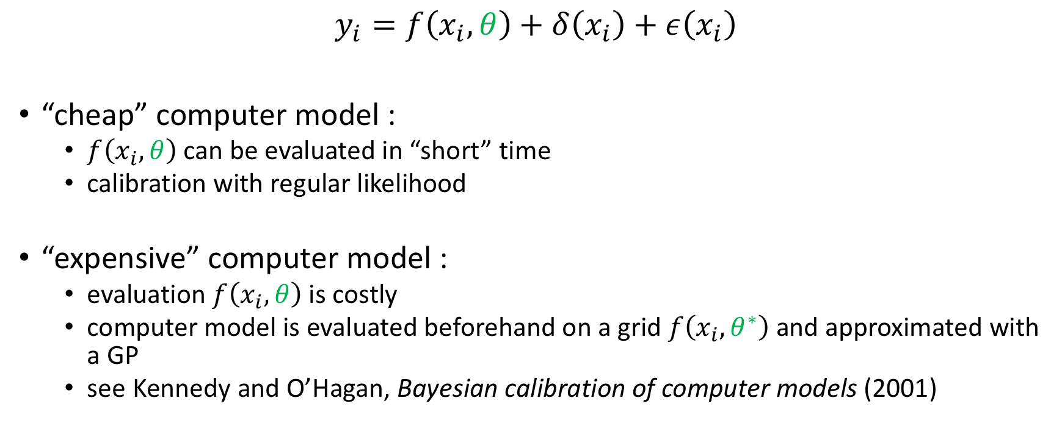
Model calibration
$$y_{i}=f\left(x_{i}, θ\right)+δ\left(x_{i}\right)+ε\left(x_{i}\right)$$
“cheap” computer model :
  $f\left(x_{i}, θ\right)$ can be evaluated in “short” time
  calibration with regular likelihood
“expensive” computer model :
  evaluation $f\left(x_{i}, θ\right)$ is costly
  computer model is evaluated beforehand on a grid $f\left(x_{i}, θ^{∗}\right)$ and approximated with a GP
  see Kennedy and O’Hagan, Bayesian calibration of computer models (2001)

Slide 35



Digression: FRIB beam tuning
Model calibration
Optimal control
with Yue Hao (FRIB), Olivier Coudray, Clément Mantoux (Ecole Polytechnique)
$$σ_{xy}$$
$$σ_{y}$$
$$σ_{x}$$

Slide 36
Thank you!
neufcour@frib.msu.edu

