Slide 1

Bayesian parameter estimation for NN scattering
Sarah Wesolowski
Uncertainty Quantification at the Extremes, EMMI, 2018
Dick Furnstahl (OSU)
Jordan Melendez (OSU)
Matt Pratola (OSU statistics)
Daniel Phillips (OU)
Supported in part by NSF, DOE, and the SciDAC NUCLEI project

Slide 2
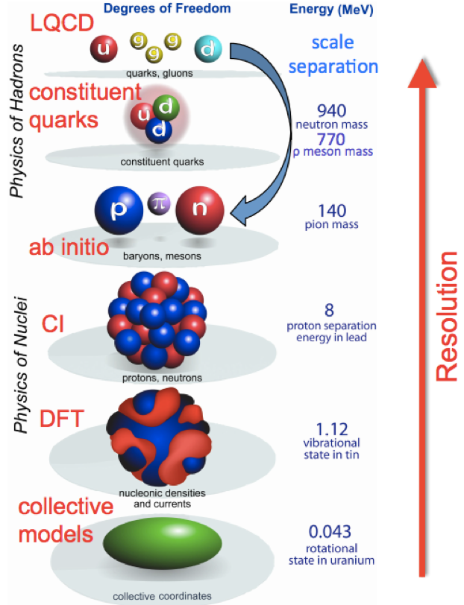
Effective field theory in nuclear physics
Wide range of low-energy nuclear scales
Exploit separation of scales to build an effective theory
Theory is organized by a power counting
Truncation is necessary to make calculations tractable
Unconstrained, natural-sized ~ O(1) coefficients multiply operators
Coefficients are called low-energy constants (LECs)
Results in systematic improvement
Ideal for the application of Bayesian methods!

Slide 3
Major issues for EFT uncertainty quantification
Full uncertainty quantification (UQ) includes all sources of error in the calculation
  Implementation and numerics
  Constraining parameters (LECs) using available data
  Theory error from truncation of the EFT
How to best incorporate prior information
Using data to their fullest extent
Validation and model-checking
  Validate physics expectations and detect physics issues
  Check that statistical models are “working"
Furnstahl, Phillips, and sw, J. Phys. G 42 034028 (2015)
Furnstahl, Klco, Phillips, and sw, Phys. Rev. C 92 024005 (2015)
sw et al., J. Phys. G 43 074001 (2016)
Melendez, Furnstahl, and sw, Phys. Rev. C 96 024003 (2017) [Editor’s suggestion]
sw et al., arxiv:1808.08211

Slide 4
EFTs are special: theory errors
Special EFT properties to be included in UQ:
Experimental discrepancy: usually normally distributed, can be correlated
Theoretical discrepancy: usually difficult to quantify
EFTs: specific expectations for theory error
Theory prediction at a certain order:
Theory prediction at order k
Omitted terms from truncation
Q: expansion parameter, <1
Notes:
\newcommand{\bm}[1]{\boldsymbol{#1}}
\newcommand{\genobs}{\bm{y}}
\genobs_{\text{exp}} = \genobs_{\text{th}} + \delta \genobs_{\text{th}} + \delta \genobs_{\text{exp}}
\genobs_k = \genobs_{\text{ref}} \sum_{n=0}^k c_n Q^n

Slide 5
Application: parameter estimation in the NN sector
Estimate parameters (LECs) in chiral EFT in the nucleon-nucleon (NN) sector
Focus on work in recently posted arxiv:1808:08211
Advantages as a testing ground
  Many modern implementations to test against
  Large database of scattering observables
  Observable evaluations very manageable
Fine details for practitioners:
  Semi-local (SCS) potential of Epelbaum Krebs, and Meißner
  Nijmegen PWA database, np data only
Major goal: estimate LECs and provide statistically meaningful propagated uncertainties
Eur. Phys. J. A 51, 53, (2015)
cf. talk by Andreas Ekstrom

Slide 6
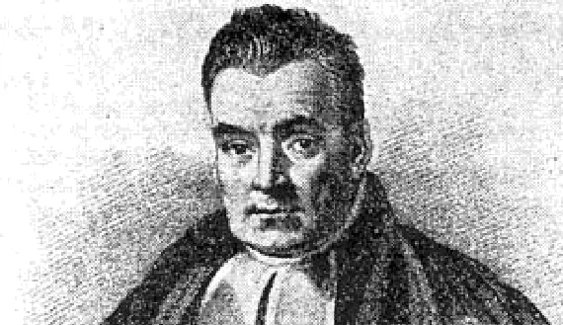
The Bayes way for effective field theory
Why use Bayesian statistics for EFTs?
Parameter estimation: conventional optimization recovered as special case
Update expectations using Bayes’ theorem when have more information
Assumptions are made explicit (e.g. naturalness of LECs)
Clear prescriptions for combining errors
Statistics as diagnostics for physics
Model checking: we can test if our UQ model works and study sensitivities
Model selection: Is the Δ needed? Pionless vs. pionful formulations, …
Particularly well suited for (any) EFT, but generally suited for theory errors
Notes:
Many recent developments of NN chiral EFT interactions, which requires parameter estimation
Different regulators, different fitting protocols (list an issue with each)
Overfitting? Underfitting? What are the consequences? Is a minimal chi-squared the only goal? Not with an EFT if you expect it to work! So one has to decide on goals and how to best do it for each goal.
What awaits with 3NF? How large is 4NF in heavier nuclei?
Worth highlighting EKM→RKE found a significant improvement because of an overfitting issue uncovered by an analysis described here previously but not fully appreciated by us at the time.
Recall this and emphasize other key aspects relevant to parameter estimation
Builds on Jordan’s discussion of truncation errors, which are a key component
Only one part of a Bayesian approach
Work to make it less expensive
Posteriors vs. (simple) optimization
{\color[rgb]{1.000000,0.000000,0.000000}\pr(A|B,I)} =
\frac{{\color[rgb]{0.000000,0.000000,1.000000}\pr(B|A,I)}
{\color[rgb]{0.000000,.5,0.000000}\pr(A|I)}}{\pr(B|I)}
\Longrightarrow
{\color[rgb]{1.000000,0.000000,0.000000}\underbrace{\pr(x|\textrm{data},I)}_{\textrm{posterior}}} \propto
{\color[rgb]{0.000000,0.000000,1.000000}\underbrace{\pr(\textrm{data}|x,I)}_{\textrm{likelihood}} }\times
{\color[rgb]{0.000000,0.500000,0.000000}\underbrace{\pr(x|I)}_{\textrm{prior}}}

Slide 7

Exploring projected posteriors
Starting slow:
Work in a regime where theory error is very small
High enough order where truncation error is small
Regular least-squares likelihood with Gaussian prior
Notes:
\newcommand{\bm}[1]{\boldsymbol{#1}}
\newcommand{\genobs}{\bm{y}}
\newcommand{\pr}{\text{pr}}
\newcommand{\avec}{\vec{a}}
\pr(\avec_k|\genobs_{\text{exp}},\Sigma_{\text{exp}}) \propto \pr(\genobs_{\text{exp}}|\avec_k, \Sigma_{\text{exp}})\ \pr(\avec_k)
\propto e^{-\resvec^T\Sigma_{\text{exp}}^{-1} \resvec} \times e^{-(\avec_k)^2/2\abar^2}

Slide 8
Exploring projected posteriors
Projected posteriors give:
  info. on correlations
  ”best” parameter values
  indication of normality
Uncorrelated and Gaussian
Here: Comparison to EKM’s values from optimization
Should not necessarily match!
3P0 channel at N3LO
np sector
arxiv:1808:08211

Slide 9
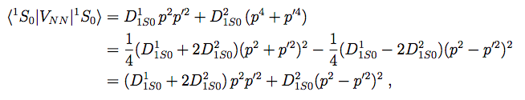
Exploring projected posteriors
1S0 channel at N3LO
np sector
Irregular structure of posterior
Nothing necessarily wrong
But here: a physics issues actually explains the structure
Parameter redundancy at N3LO, one can be eliminated
True in 3S1 channel as well
cf. Christian’s talk
on model selection
arxiv:1808:08211
arxiv:1808:08211

Slide 10
Exploring projected posteriors
1S0 channel at N3LO
np sector
Set to 0 and use only 3 parameters
Description of data still good
Recent explorations have confirmed this also
arxiv:1808:08211

Slide 11
Effect of the prior
Repeat same problem, vary givens
We enough data that
a value of 5 is ok, but
this should always be
tested and verified.
Increase prior width
Less data, prior has much more influence
Increase amount of data, prior has less influence
arxiv:1808:08211
Increase E_{max} (more data at higher energy)

Slide 12
Including truncation errors
Theoretical uncertainty takes this form, and we can put a prior on the unknown higher-order coefficients c_{n}
Just a sum of Gaussian random variables using this prior
(Which we have validated in previous work)
Notes:
\delta \genobsth = \genobs_{\text{ref}} \sum_{n=k+1}^\infty c_n Q^n
{\bf c}_n | \bar{c} \sim \mathcal{N}(0,\bar{c}^2)

Slide 13
Two extreme assumptions
1. Theory error at each kinematic point (Q) is completely uncorrelated
2. Theory error at each kinematic point (Q) is fully correlated, each has same observable coefficients
Notes:
[\delta y_{{\rm th}}]_i = [y_{{\rm ref}}]_i \sum_{n=k+1}^\infty [c_{n}]_i Q_i^n

Slide 14
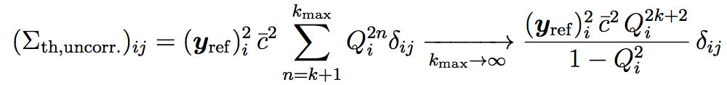
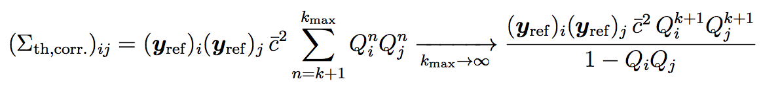
Including truncation errors
Full posterior pdf including theory error:
Covariance matrix for uncorrelated assumption:
Covariance matrix for fully correlated assumption:
arxiv:1808:08211
Notes:
\pr(\avec_k|\genobsexp, \Sigma_{\rm exp}, \Sigma_{\rm th}) \propto e^{-\frac{1}{2}\resvec^T(\Sigma_{\text{exp}} + \Sigma_{\rm th})^{-1} \resvec} \times e^{-(\avec_k)^2/2\abar^2}

Slide 15
Effect of including truncation errors
Use partial-wave cross sections extracted from PWA phase shifts
Uncorrelated assumption
Correlated assumption
arxiv:1808:08211

Slide 16
Effect of including truncation errors
If we have absorbed effects of higher-order operators by
including theory errors, LEC extractions should be independent
of E_{max}, the highest-energy datum used:
Uncorrelated assumption
Correlated assumption
arxiv:1808:08211

Slide 17
Conclusions
Tested by “fitting” (sampling posteriors) of NN LECs in partial waves; lessons are general
Case study 1: The usefulness of projected posterior plots
  Important for understanding the full information content of the data
  Most channels look Gaussian, but do statistical test before approximations!
  Use of projected posterior plots as a physics diagnostic illustrated by the fourth-order s-wave LECs ➔parameter degeneracy
Case study 2: LEC stability with maximum energy for fit
  What is optimal trade-off between more data to determine LECs more precisely and fit contamination at higher energies of omitted higher-order EFT terms?
  Sensitivity to E_{max} removed with Bayesian UQ ➔LECs should be independent
  Accounting for truncation errors; verify with E_{max} plots

Slide 18
Backup slides and extras

Slide 19

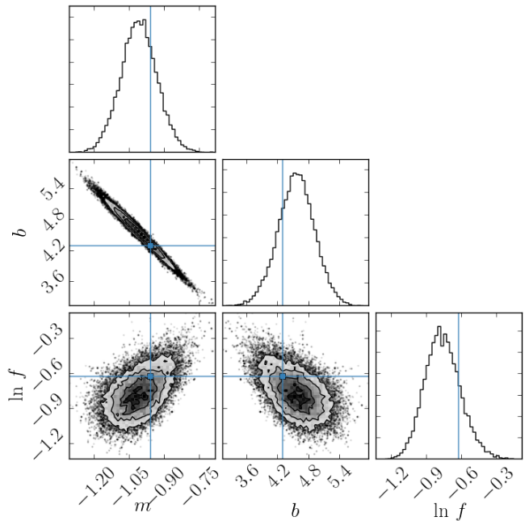
MCMC using the emcee package
Implementation of Goodman and Weare’s affine-invariant ensemble sampler
http://dfm.io/emcee/current/
Implemented in python
Contains other implementations, such as parallel-tempered ensemble sampler
Plots of samples using corner
Use for posteriors
Or for propagated observables
https://github.com/dfm/corner.py

Slide 20
Future Bayesian Plans (Collaborators wanted!)
Use scattering observables directly for parameter estimation
Identify appropriate priors for other theoretical expectations such as Wigner symmetry
Propagate all sources of error, including from LECs, to few- and many-body observables
Estimate the EFT expansion parameter from the expected convergence pattern of additional observable predictions (uniform matter in progress)
Account for correlations between LECs from the πN, NN, and few-body sectors
Assess the impact of available experimental data on the number of orders of the EFT that can be constrained via Bayesian model selection
Employ Bayesian model checking techniques to verify for observable calculations that the EFT expansion is working ``as advertised”
Model selection problems (which degrees of freedom to use)?
Notes:
Mention plans for collaboration
Jordan’s backup slide for the git repository

Slide 21
Effect of including truncation errors
Uncorrelated assumption
Correlated assumption

Slide 22
Effect of including truncation errors
Uncorrelated assumption
Correlated assumption
arxiv:1808:08211

Slide 23
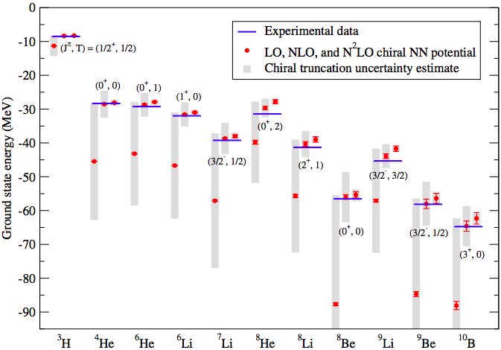
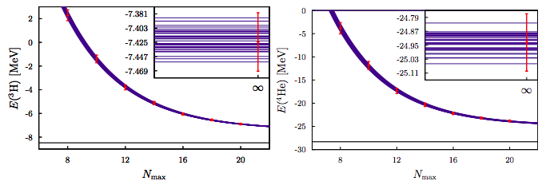
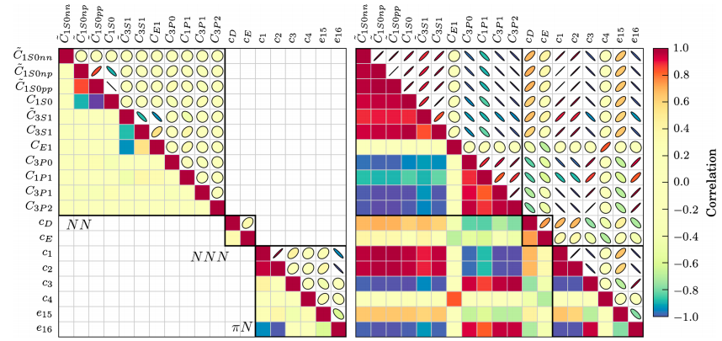
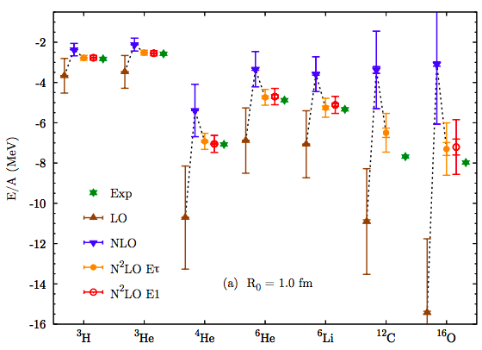
Uncertainty quantification landscape for EFTs
Covariance methods: uncertainty from fitting to data
Bootstrapping: uncertainty from fitting or numerics
Truncation error estimates for EFTs: codifying standard EFT protocols
Bayesian: can fit the above methods into this framework
sep and sim potentials
Navarro Pérez et al., Phys. Rev. C 92, 064003 (2015)
AFDMC: local NN+3N
Truncation error
Q = M_{𝜋}/𝛬_{b}
LEC error (red line)
Barely visible
Q = M_{𝜋}/𝛬_{b}
LENPIC calculations: NN only, NCCI
Carlsson et al., PRX 6, 011019 (2016)
LENPIC: Binder et al., 2018 [arXiv:1802.08584]
NCSM gs energies at particular ℏ𝜔
Phenomenological, NN only
[see also Evgeny’s talk]
Lonardoni et al., Phys. Rev. C 97, 044318 (2018)
Notes:
LENPIC results: NN only calculations using No-core configuration interaction model “diagonalize the resulting many-body Hamiltonian in a sequence of truncated harmonic-oscillator (HO) basis spaces”, estimated here as Q = Mπ/Λb, no 3B included so not complete of course!
Lonardoni et al.: AFDMC results with truncation estimates, local chiral 2N and 3N forces included
Both use the same assumed value of Q

Slide 24
Recent explosion of chiral EFT interactions
Interactions from 2003-4: EM(500, 600 MeV) or family of EGM potentials; used similar non-local regulators and similar fits to NN, 3N
New generation NN+3N interactions [references at end]
Non-local: updated EMN and new soft; Ekstrom et al. sim, sat, and with Δs
Local (for QMC): Gezerlis et al. nucleons only; Piarulli et al. with Δs
Semi-local: Bochum-Julich group, SCS (x-space) and SMS (p-space)
Issues: power counting, regulator artifacts, EFT convergence, fitting protocols, fine-tuning, over/under-fitting, parameter redundancies, how to do UQ?
Parameter estimation issues repeat with LECs for currents and for other EFTs

Slide 25
Bayesian framework for parameter estimation in EFTs
[See sw et al., J. Phys. G 43, 074001 (2016)]
Here: Use parameter estimation for NN phase shifts as test case (SCS potential of EKM)
Good news: well studied, clear example for comparison, fairly easy computation
Bad news: numerous and precise data ➔ differences from conventional approach are subtle. Plan: focus on illuminating cases.
The usefulness of projected posterior plots
LEC stability with maximum energy for fit
Combining theory uncertainties (in progress)
Based on: Exploring Bayesian parameter estimation for chiral effective field theory using nucleon-nucleon phase shifts, sw, R.J. Furnstahl, D. Phillips (posted soon)

Slide 26
References
Some BUQEYE publications on UQ for EFT
“A recipe for EFT uncertainty quantification in nuclear physics”, J. Phys. G 42, 034028 (2015)
“Quantifying truncation errors in effective field theory”, Phys. Rev. C 92, 024005 (2015) [with Natalie Klco]
“Bayesian parameter estimation for effective field theories”, J. Phys. G 43, 074001 (2016)
“Bayesian truncation errors in chiral EFT: nucleon-nucleon observables”, Phys. Rev. C 96, 024003 (2017)
“Exploring Bayesian parameter estimation for chiral effective field theory using nucleon-nucleon phase shifts”, arxiv:1808:08211
Recent publications on fitting chiral EFT interactions
D. R. Entem, R. Machleidt, and Y. Nosyk. “High-quality two-nucleon potentials up to fifth order of the chiral expansion,” Phys. Rev. C 96, 024004, 2017.
B. Carlsson, A. Ekström, C. Forssé́n, D. F. Strömberg, O. Lilja, et al. “Uncertainty analysis and order-by-order optimization of chiral nuclear interactions,” Phys. Rev. X, 011019, 2015.
A. Gezerlis, I. Tews, E. Epelbaum, M. Freunek , S. Gandolfi , K. Hebeler, A. Nogga, A. Schwenk. “Local chiral effective field theory interactions and quantum Monte Carlo applications,” Phys.Rev. C 90, 054323 (2014).
M. Piarulli, L. Girlanda, R. Schiavilla, R. Navarro P ́erez, J. E. Amaro, and E. Ruiz Arriola. “Minimally nonlocal nucleon-nucleon potentials with chiral two-pion exchange including resonances,” Phys. Rev. C, 024003, 2015.
E. Epelbaum, H. Krebs, and U. G. Meißner. “Improved chiral nucleon-nucleon potential up to next-to-next-to-next-to-leading order,” Eur. Phys. J. A 51, 53, 2015.
P. Reinert, H. Krebs, and E. Epelbaum. “Semilocal momentum-space regularized chiral two-nucleon potentials up to fifth order,” arXiv:1711.08821 2017.

Slide 27
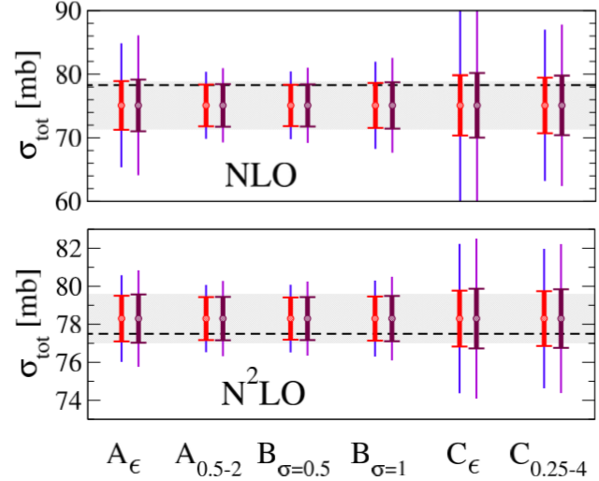
Different prior assumptions for truncation errors
EKM SCS
R=0.9fm
E_{lab} = 96MeV
  Furnstahl, Phillips, Klco, sw, PRC 92, 024005 (2015)

Slide 28
