Slide 1
High Reliability
&
Machine Protection Systems
A. Nordt
&
ESS Machine Protection Team
European Spallation Source ERIC, Sweden
APEC Workshop, Frankfurt am Main, Germany
2018-12-12

Slide 2
This Presentation is Trying to Explain
What Machine Protection (MP) is
How MP can help in increasing operational availability
How reliable MP systems can be
How to build highly reliable MP systems

Slide 3
What is Machine Protection?
MP is Happiness
  Happiness for the scientists
  Happiness for the funding agencies
  Happiness for the staff
Time and money

Slide 4
The Goal for Machine Protection
Machine Protection contributes to operational availability by:
Protecting equipment from damage
Protecting equipment from unnecessary activation due to beam losses

Slide 5
How Does Machine Protection Contribute
Add Availability = ”Subtract Downtime”
Apply the P³ principle:
Protect the equipment
Protect the beam
Provide the evidence
Short Downtime
ESS example:
Downtime (first estimate)
reduced from 2250h/y to 130h/y
Availability (first estimate)
increased from 44% to 96%
Long Downtime
Courtesy of Enric Bargalló (aligned with “ESS Reliability and Availability Requirements” ESS-0064499)
5

Slide 6
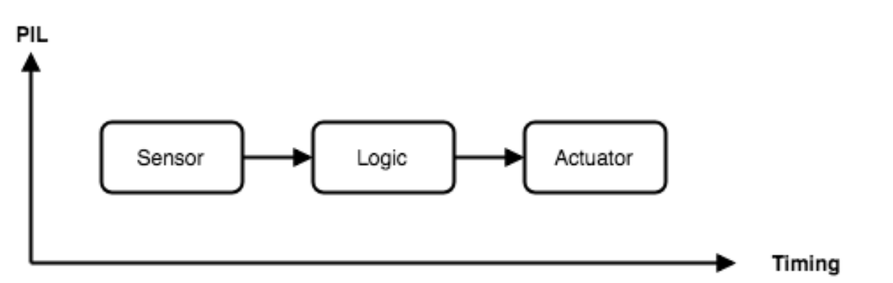
MP-System of Systems (SoS)

Slide 7
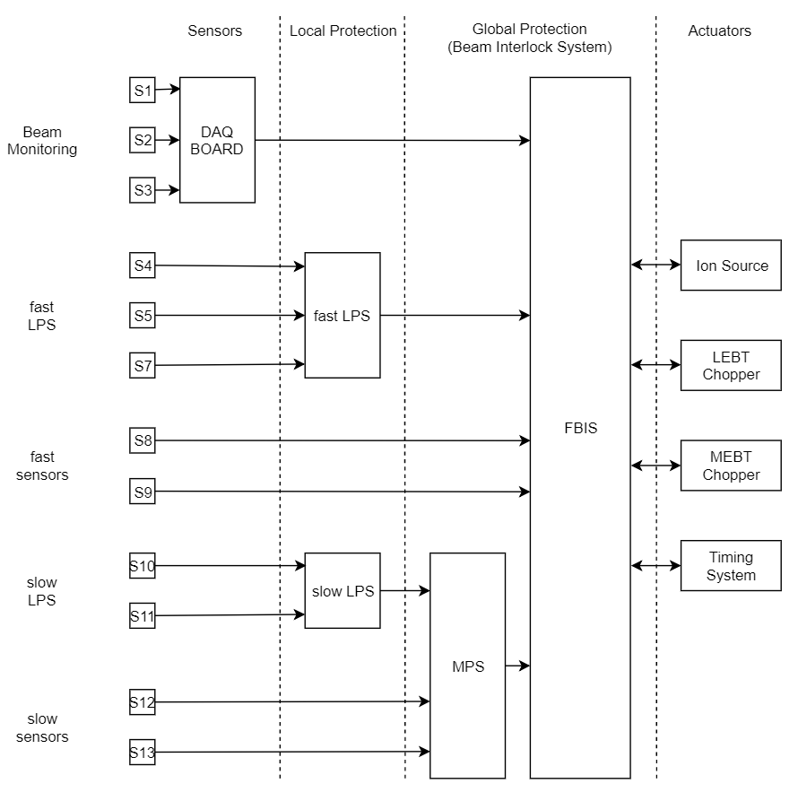
Beam Interlock System – Another View
MP Team is responsible to:
Coordinate MP across ESS
Define (global) protection functions
Develop Beam Interlock System (BIS)
Ensure working interfaces with BIS
Foster awareness that things can break
System Owners are responsible to:
Develop reliable systems
Implement local protection
Provide sensors needed for global protection

Slide 8
Example: Local versus Global
System Owner
ESS MP Team
System Owner
HEELO.
ESS MP Team
System Owner

Slide 9
How To Deal With Complexity?
One of the common advises you get when starting with MP:
Define the damage potential of your machine and the beam you use
(not all machines require machine protection systems, but some do)
2. Create a failure catalogue
Great→ we tried that in 2012 for ESS, and…
Its not rocket science, but…
We ended up with many thousands of failures and required protection functions…
Got lost in the jungle of failures
No good way to prioritise and to know what to focus on

Slide 10
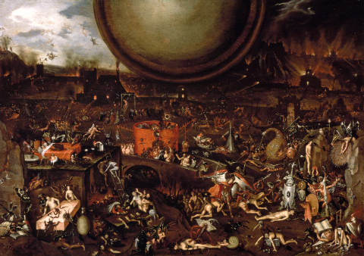
Jungle Or Hell?

Slide 11
Inspired by International Standards

Slide 12
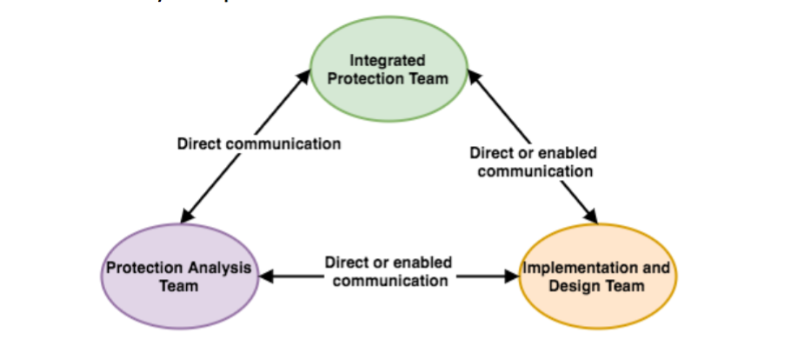
MP SoS - Lifecycle

Slide 13
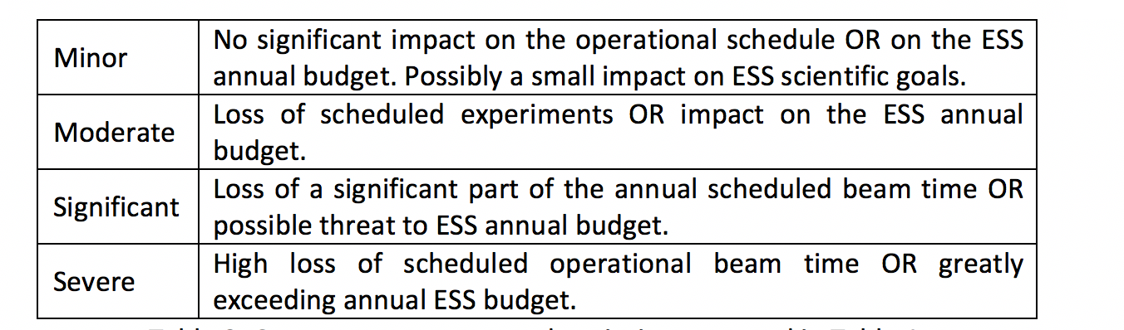
Prioritization

Slide 14
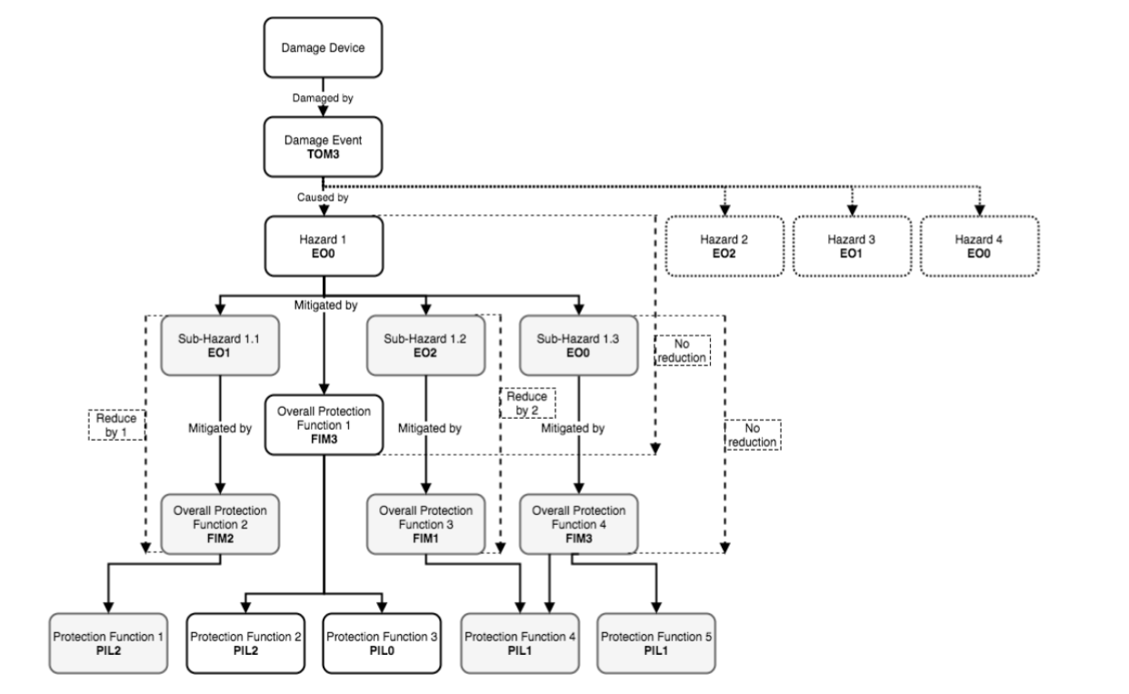
Overview: Analysis Method

Slide 15
Example: Machine Protection for Target
Proton Beam Window
Target Wheel
Moderators
  Water
  Cryogenic
Reflectors
Tuning Beam Dump

Slide 16
Analysis Example – 1041/2/3
Damage Events
Hazards
Overall Protection Functions
Protection Functions
  Sensors
  Logic Elements
  Actuators
  Protection Integrity Level
  Timing Requirements

Slide 17
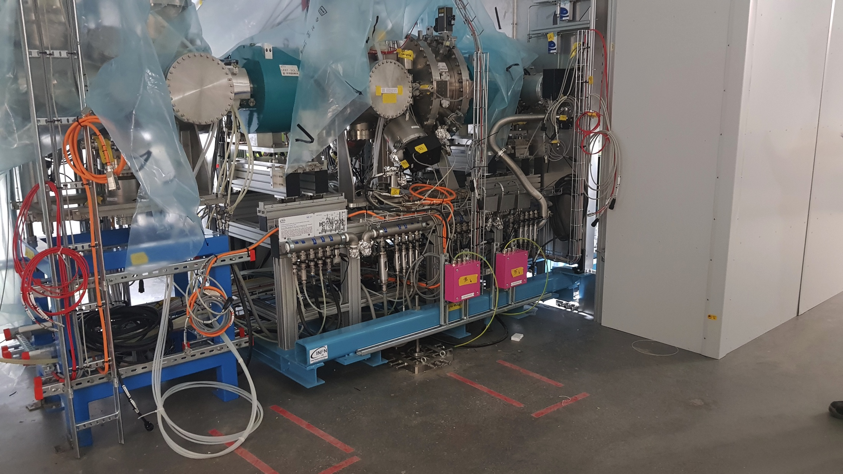
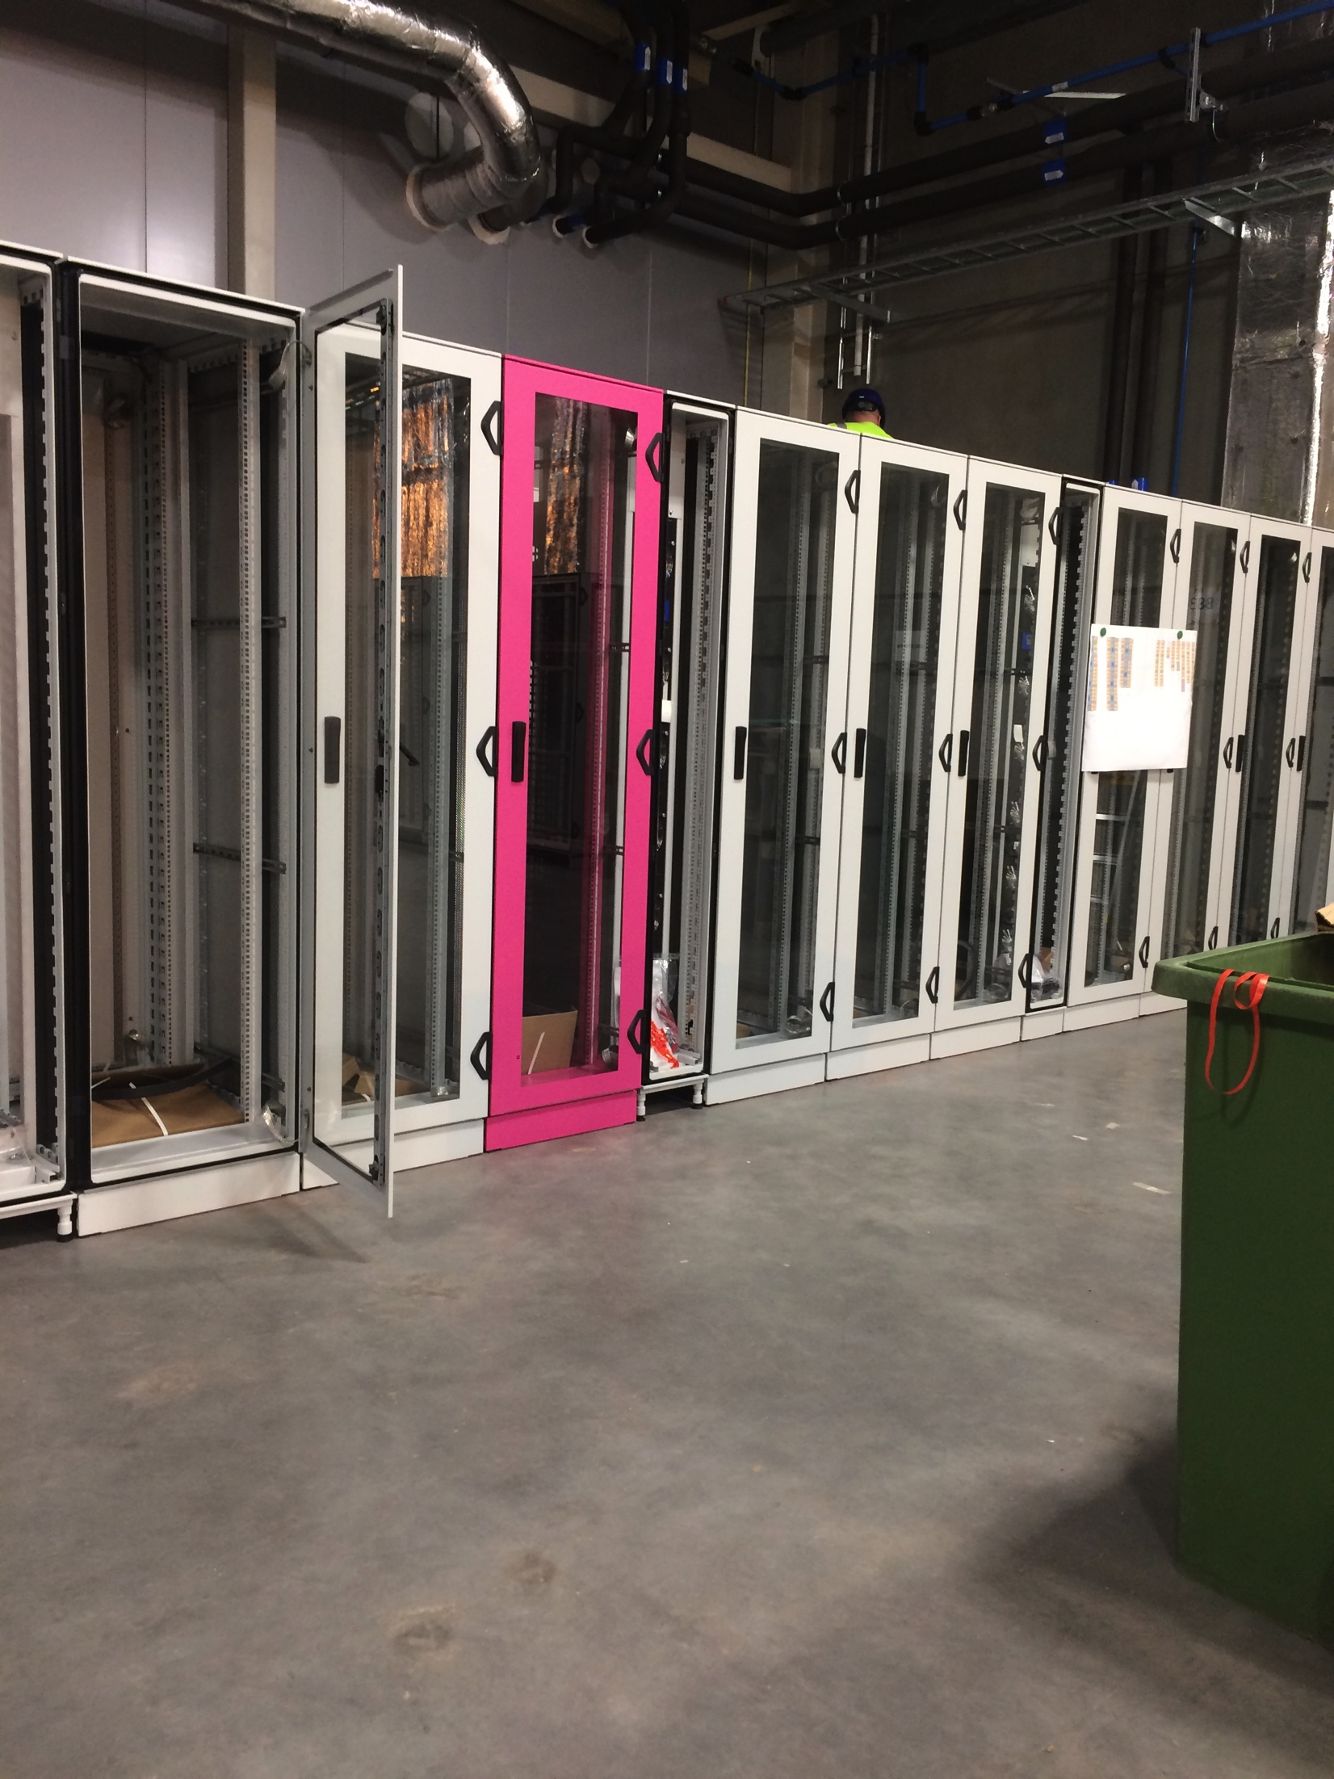
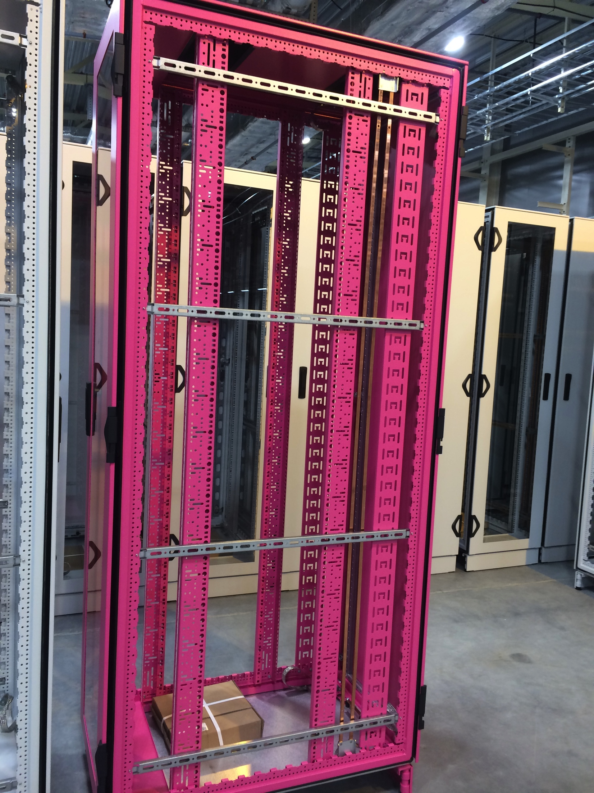
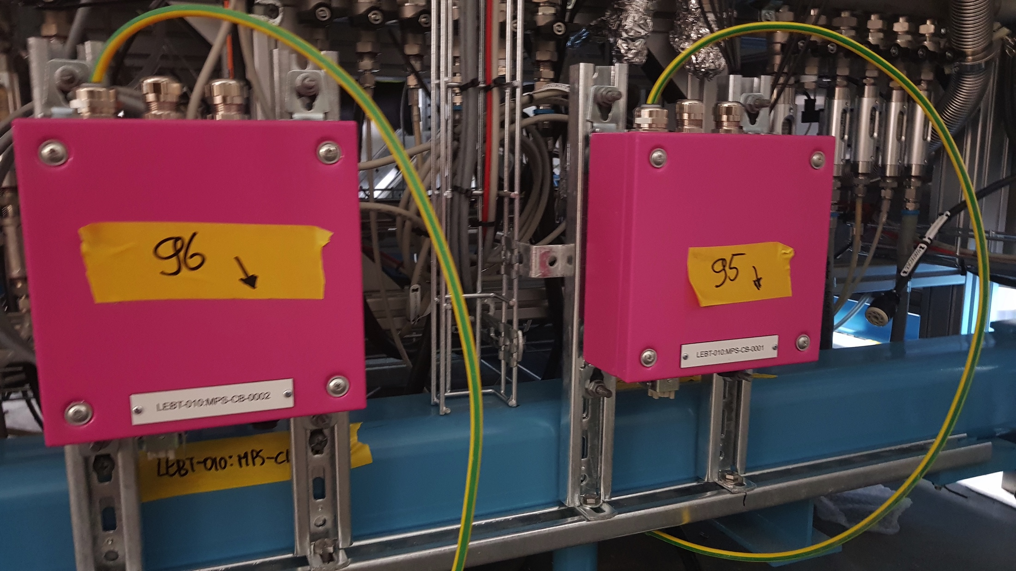
The Machine Protection Look at ESS ☺
ESS MP is
Erikaviolet RAL 4003

Slide 18
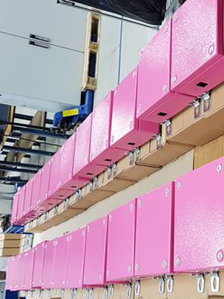
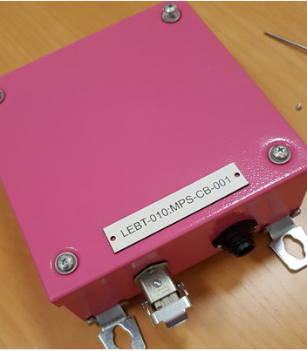
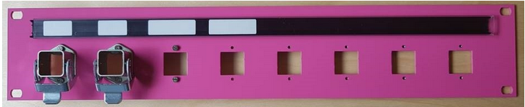
MP connection boxes
MP Patch Panels

Slide 19
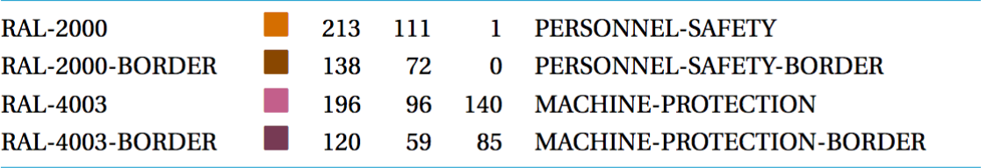


Any Issues with the MP Look ?
Operator Interface Development Styleguide:
Unfortunate…
Very unfortunate..
Now talking to OPI developers to change that
Lesson Learnt: Be careful with how far you go!
What can you really keep under control?

Slide 20
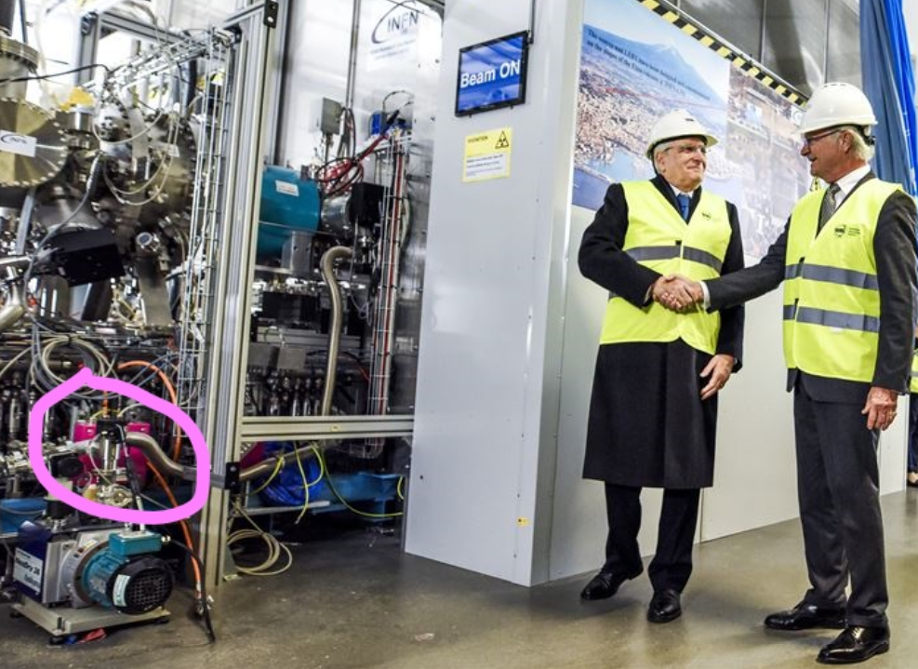
The MP color is now officially approved by the ♚King of Sweden
15th of November 2018

Slide 21
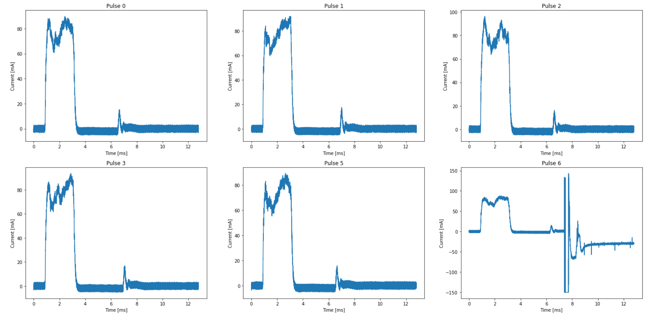

ESS has BEAM! And YES!
NOW, we can talk about it!
ESS 1st Beam on 19th of September 2018
Re-member?..... 19th of September 2008

Slide 22

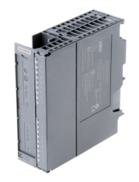
ESS Beam Interlock System Consists of
MPS Vac : Vacuum protection
MPS ID : Insertable devices protection
MPS Mag : Magnets protection
MPS BMg : Bending Magnets protection
MPS Trg : Target protection
MPS NSS : Neutron instruments protection
PLC based interlock systems
- Ring topology with 1 fail safe CPU and multiple, distributed I/O
- Each I/O connects to a sensor (VVS, FC, EMU, WS, QV, QH,…)
Slow ! Reaction time > 10ms
Target PIL: PIL 2
MPS Vac
MPS ID
MPS Mag
MPS Trg
FBIS

Slide 23

The Fast Beam Interlock System is…
Actuators
SCU (Signal Converter Unit) concentrating signals from Sensor Systems and MPS PLC based systems
DLN (Decision Logic Node) concentrating signals from several SCUs, deriving global beam permit and acting on Actuators to stop Beam
SCU
DLN
SCU
DLN
DLN
DLN
MPS Vac
MPS ID
DLN
FPGA based systems
- SCU HW design based on standard mechanical components (cPCI)
- DLN HW based on uTCA standard
SCU
MPS Mag
DLN
DLN
DLN
SCU
SCU
SCU
Fast ! Reaction time ~ 1us
Target PIL: PIL 2
MPS Vac
MPS ID
MPS Mag
MPS Trg
FBIS

Slide 24

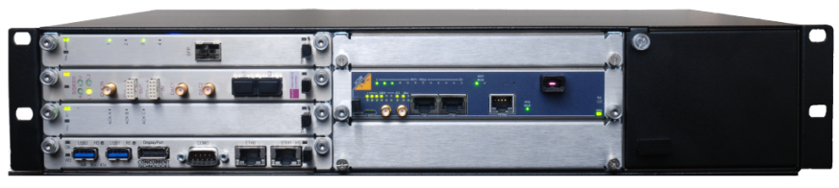
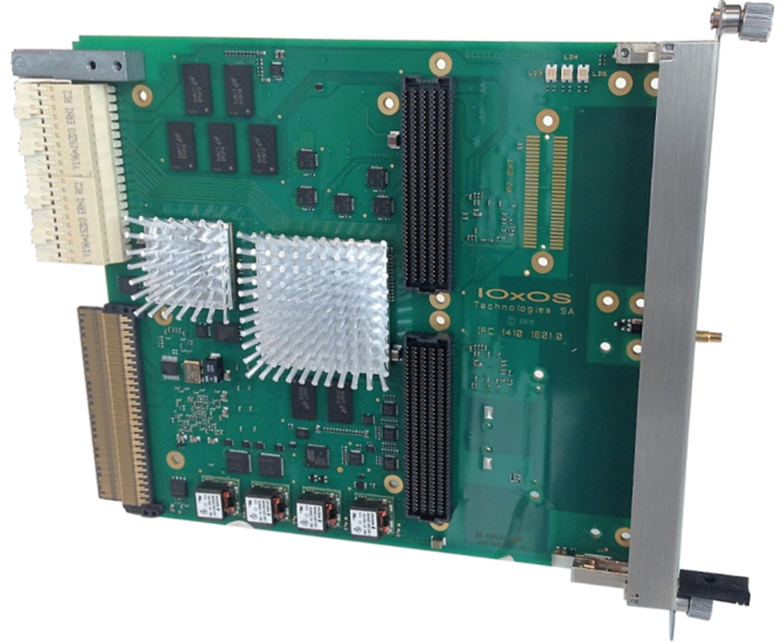

The Fast Beam Interlock System is…
SCU
Optic fibers
DLN
FPGA
Sensor Systems
FPGA:
Critical logic to fulfill protection functions (VHDL hardware description language)
  Decides to remove the global beam permit and stop the beam activating the Actuators
  Decides to inhibit the beam if sensor systems are not ready
  check all MP related systems are properly configured (Beam destination, beam mode)
CPU:
Less critical protection features (c language code)
Interface to EPICS
IFC 1410

Slide 25
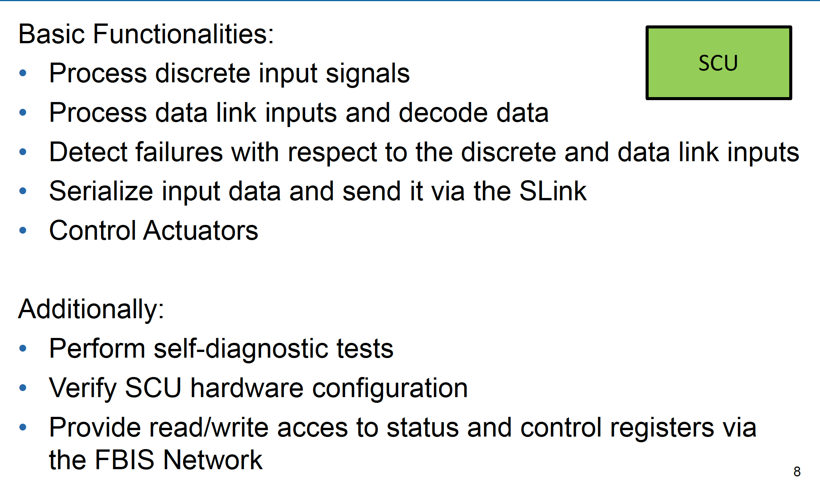
Signal Conditioning Unit (SCU)
hello
25

Slide 26
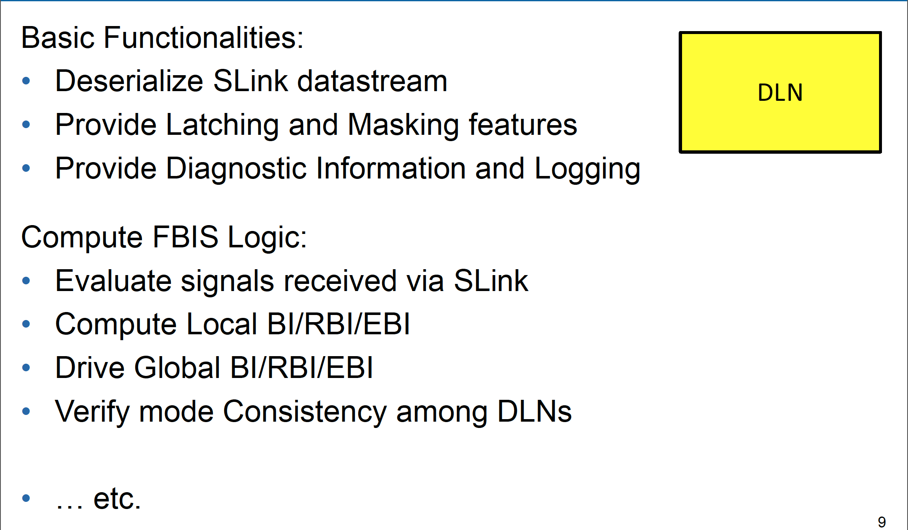
Decision Logic Node (DLN)
hello
26

Slide 27
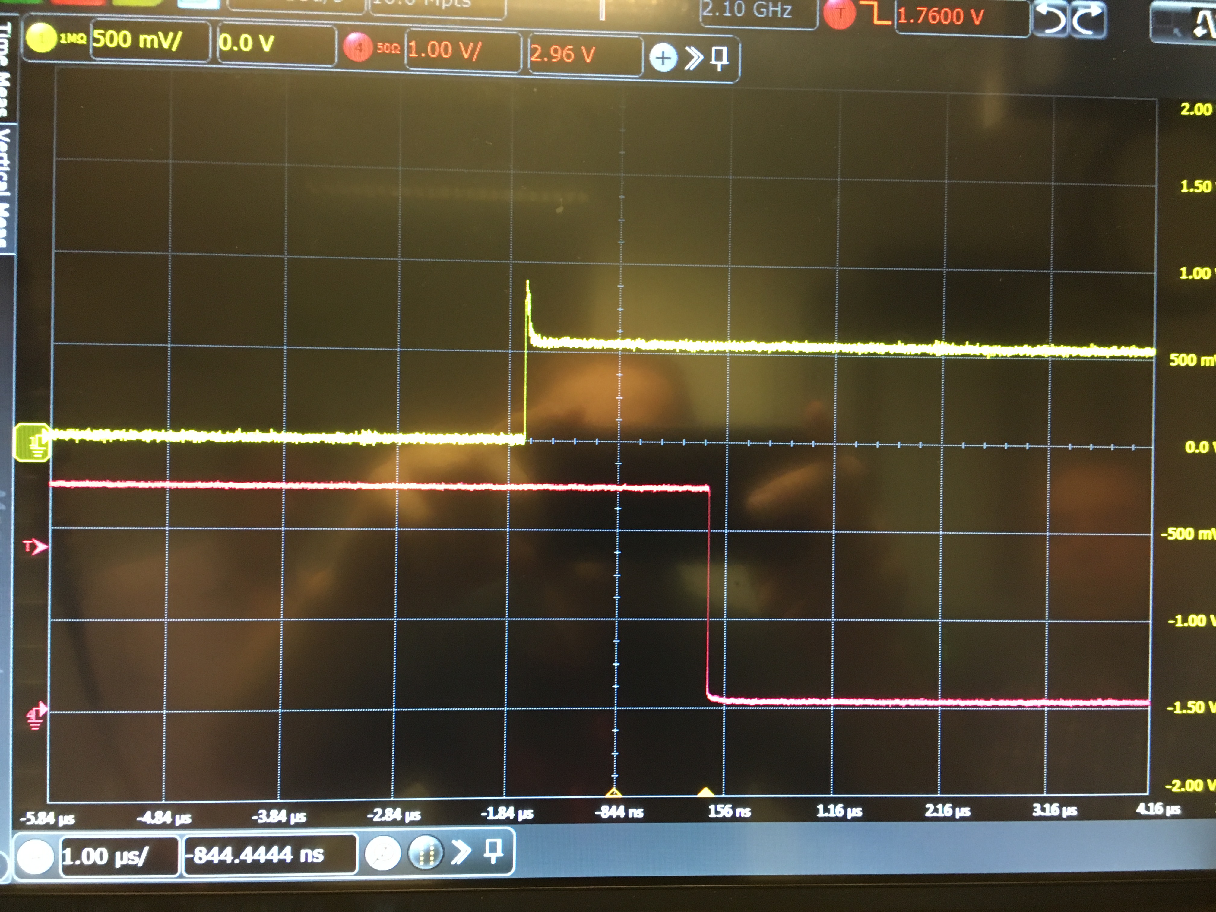
How Fast Can We Be?
BCM test stand: BCM, timing system and FBIS connected!
First results: upon detection of wrong beam current and wrong pulse length, it takes ~ 1.7µsec for the whole data processing chain!
Remember
SNS: degradation of cavities

Slide 28
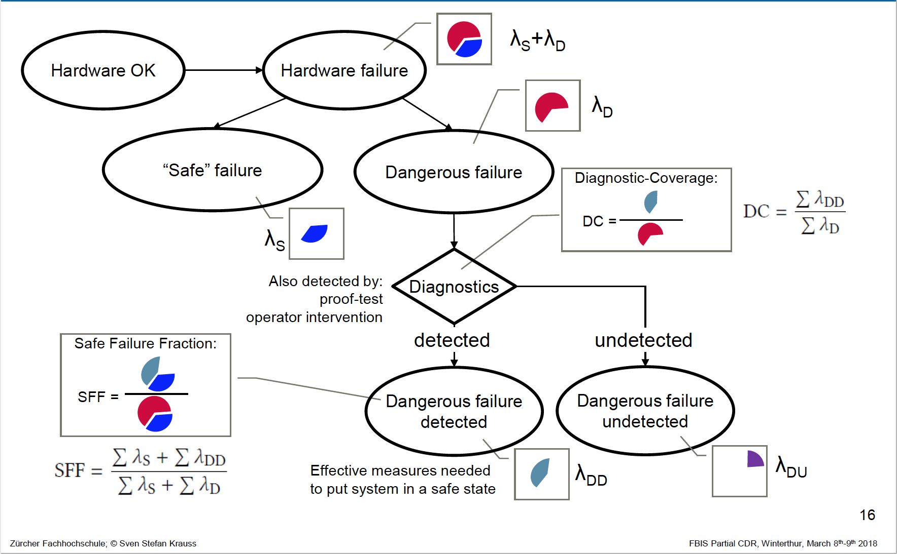
Failure Rates in IEC 61508
28

Slide 29
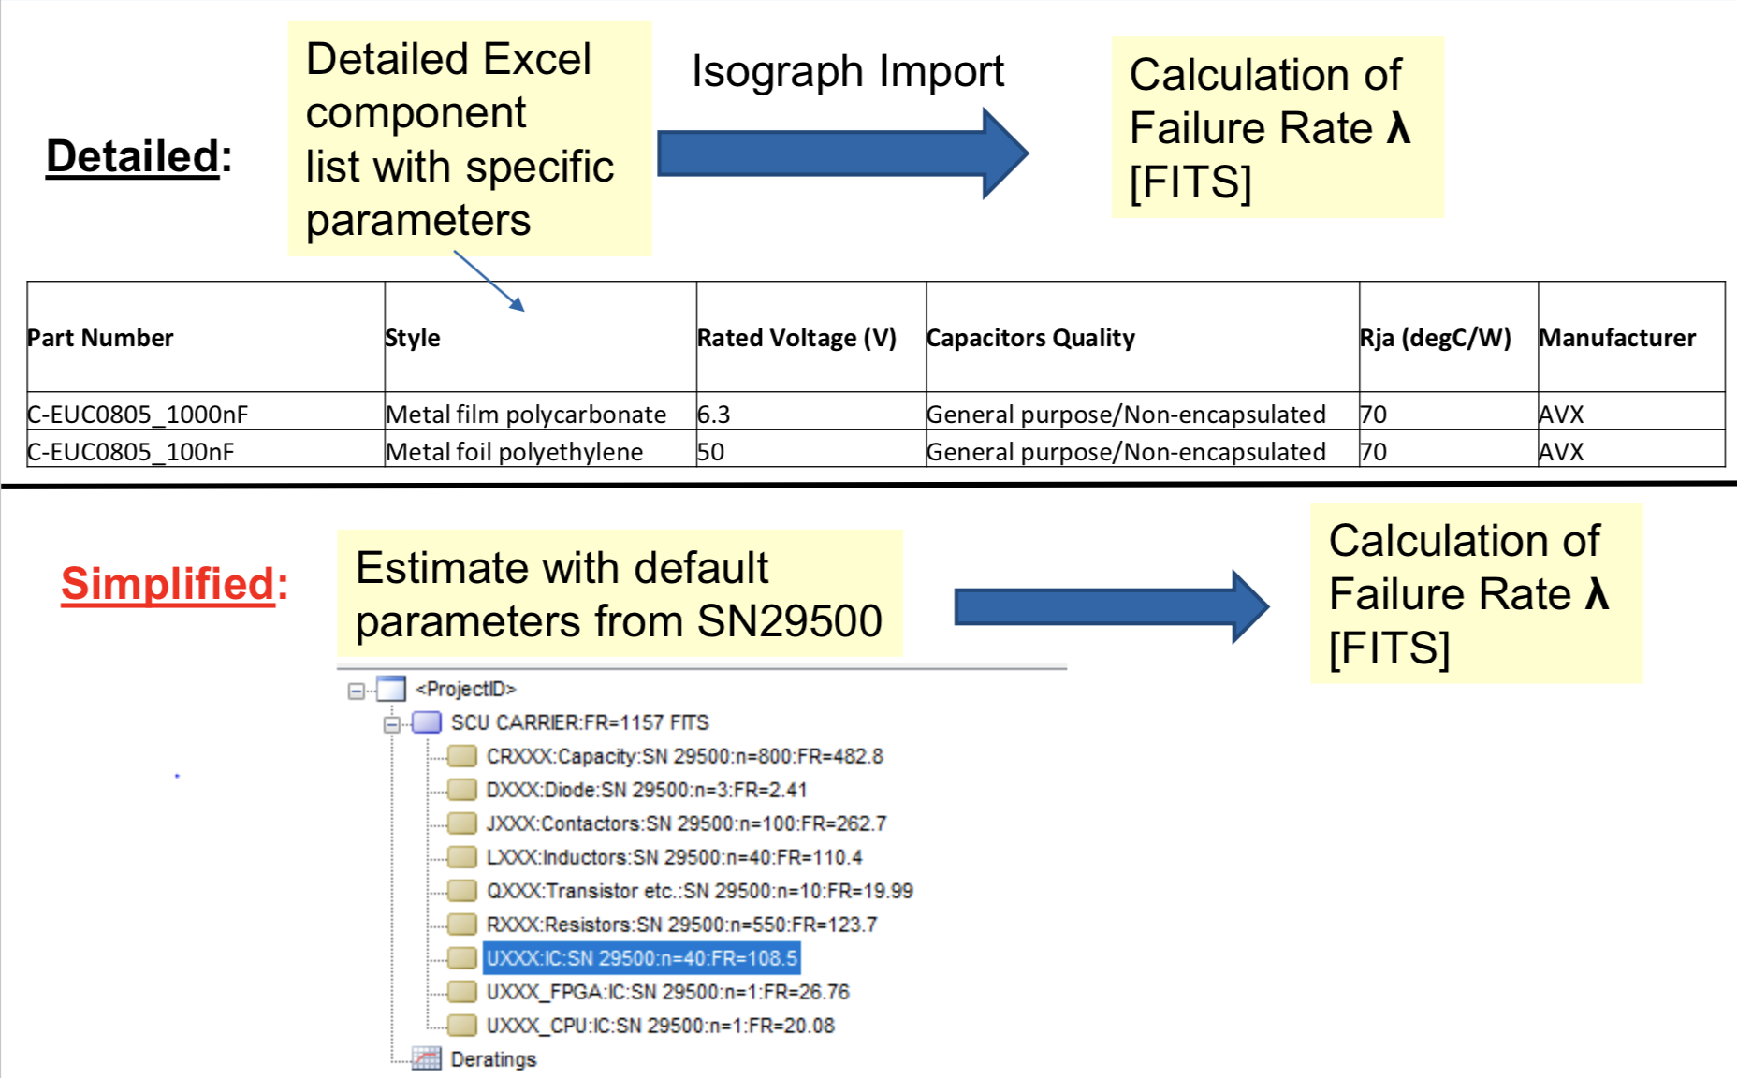
Tool Chain: Isograph Reliability Prediction

Slide 30
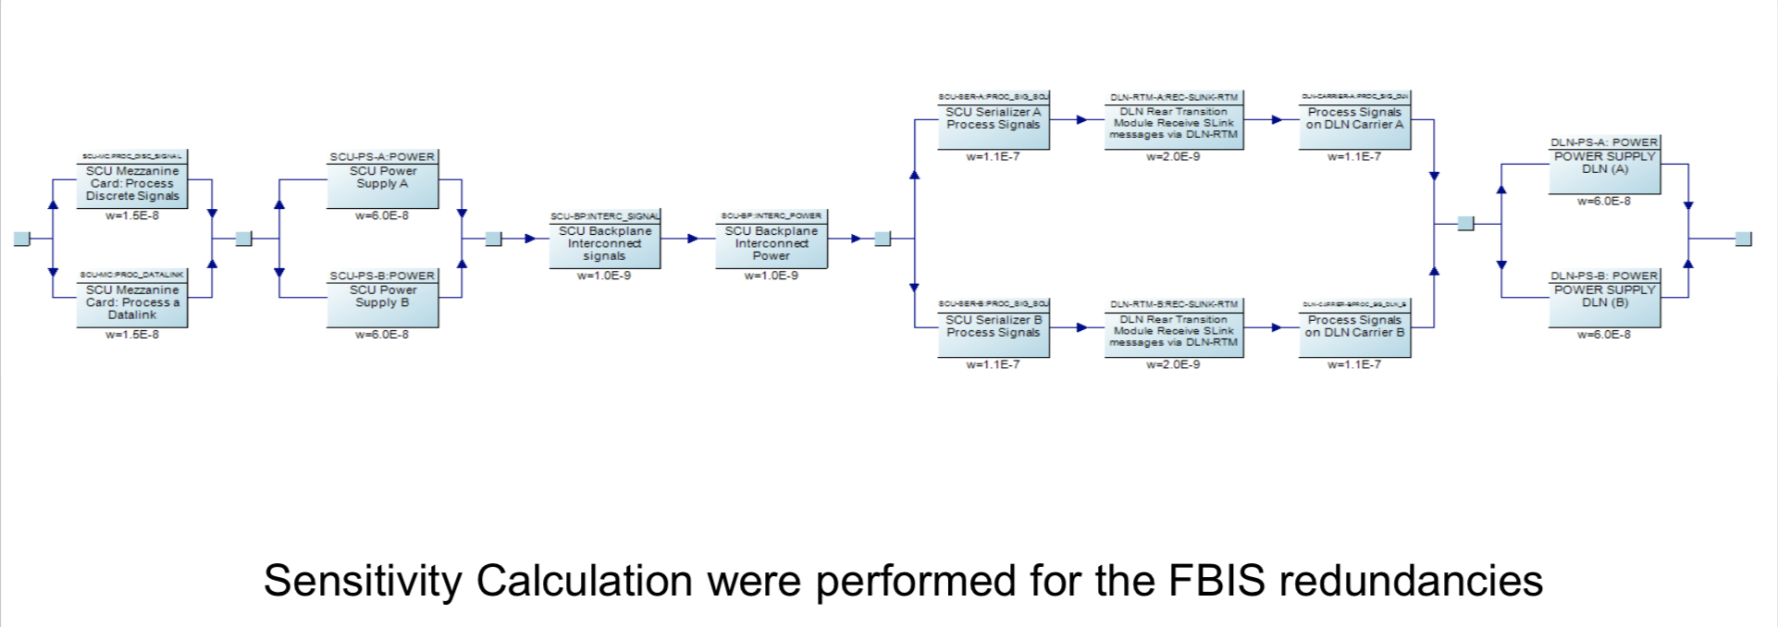
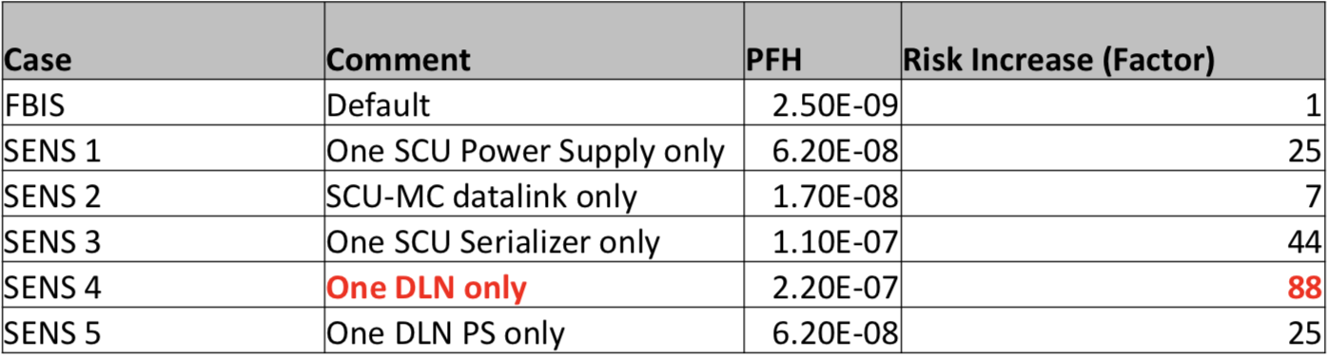
FBIS Sensitivity and Some First Results
The first analysis results are promising
Preliminary PIL for FBIS (SCU and DLN): PFH = 2.5E-09/h

Slide 31
Some Thoughts
It is beneficial to start addressing MP during the early design phase, however its difficult to convince relevant game players during all phases (it is not safety!)
Early phase: why bother? It wont happen, there is no time, nor budget, I am not in charge
Early operations phase: Why was this not addressed?
Discussing failures is never easy and its strongly influence-able by “how” you ask
MP is almost more a psychological exercise than a heavy technical challenge
For sure it is ONE thing → TEAMWORK that requires patience
In the beginning: MP is happiness → but it’s a difficult happiness/ many ups and downs ☺
My advise: Embrace the complexity and the challenge. Never give up. It wont be perfect.

Slide 32
BackUp

Slide 33
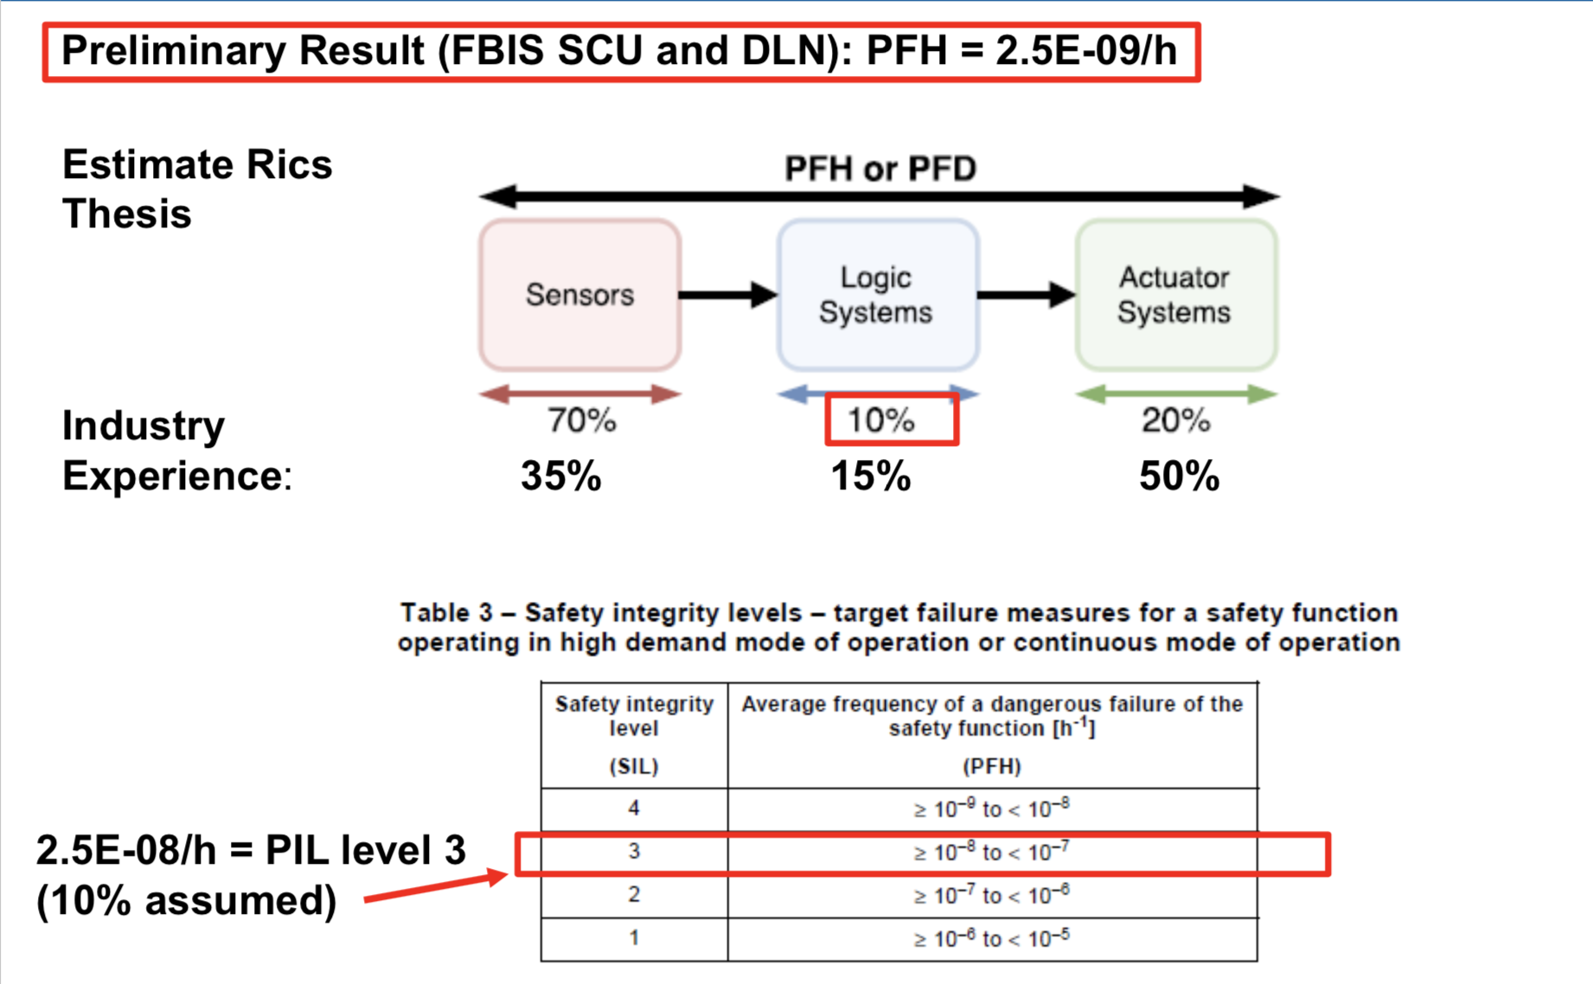
Preliminary Results: FBIS PIL Level

Slide 34
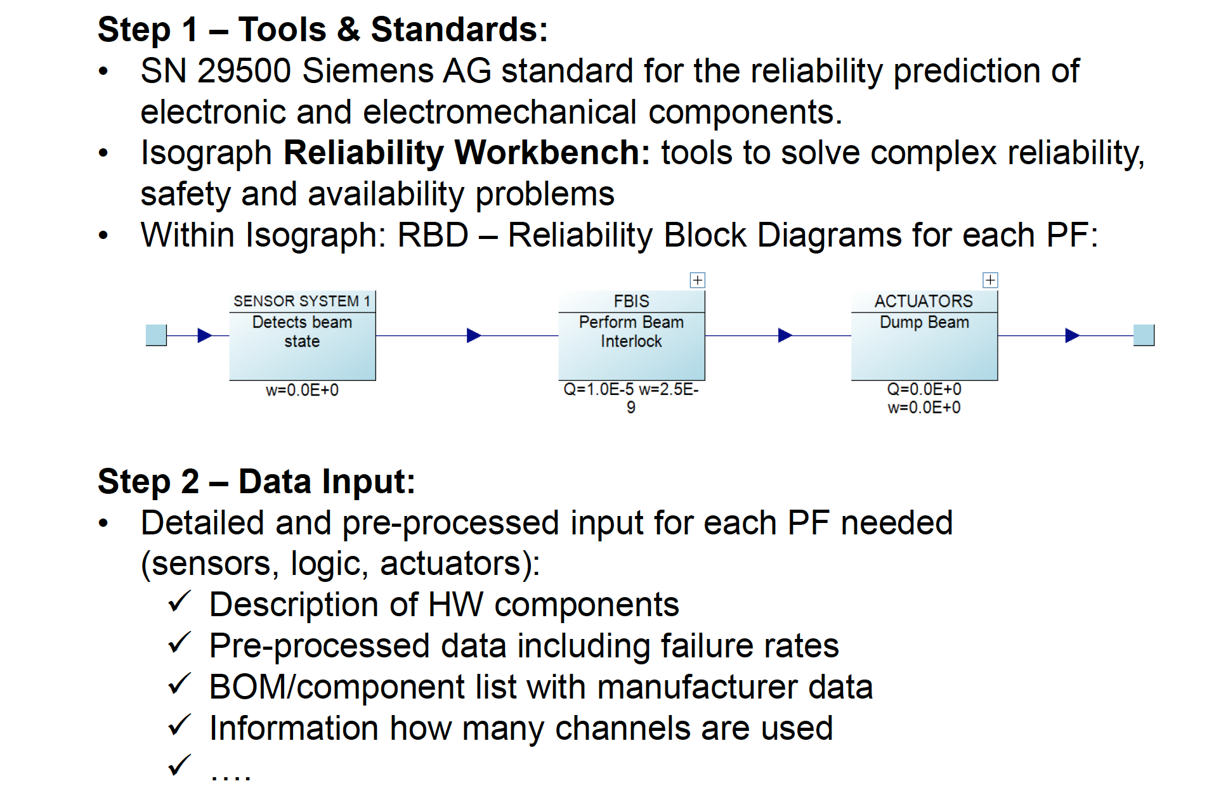
PF Integrity Level Assessment

Slide 35
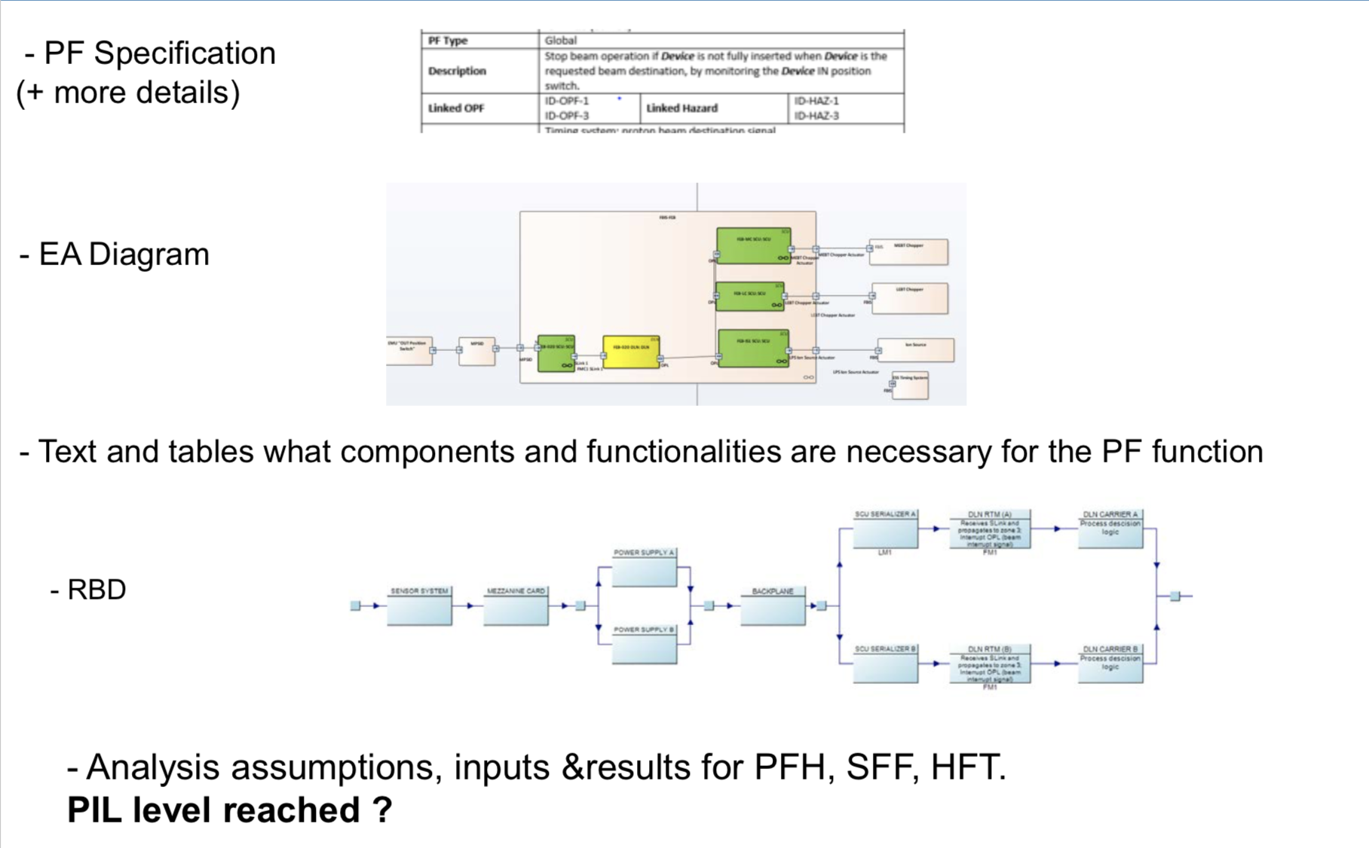
PF Documentation – Suggestion ID-PF-x

