Slide 1

MYRRHA : status of reliability studies and plans
Dirk Vandeplassche
APEC, Frankfurt a.M., 12 December, 2018

Slide 2
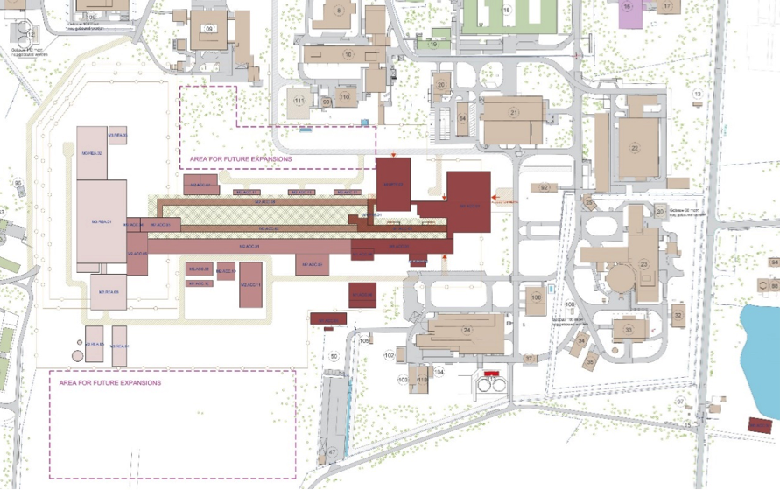
Introduction : MYRRHA masterplan

Slide 3
Introduction
On reliability goals
MYRRHA project : ADS demonstrator
MYRRHA accelerator : reliability requirement
basic specifications
particle | p
beam energy | 600 MeV
beam current | 4 mA
mode | CW
cycle length | 3 months
beam MTBF | > 250 h

Slide 4
Introduction
rationale for reliability requirement:
  thermal stresses
  operational aspects of the reactor (scrams)
  demonstrator for subsequent industrial applications
allowable beam trips : < 3s
satisfying the reliability requirement is vital for MYRRHA
phased approach
100 MeV
MINERVA (commitment for funding)

Slide 5
100 MeV linac overview
Source: [TBD]

Slide 6
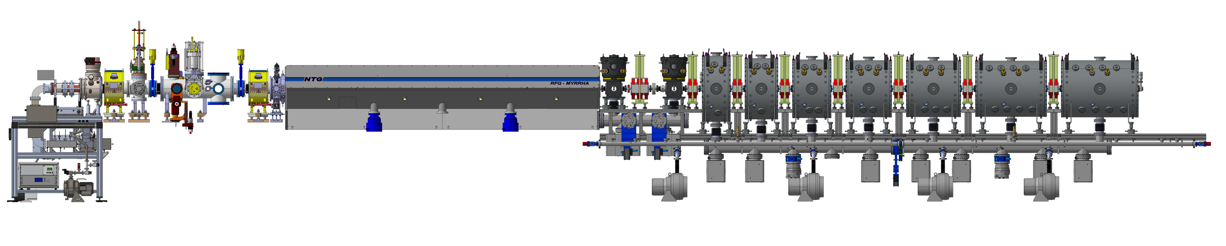
R&D
Injector 5.9 MeV in LLN
Collaboration:
ECR: Pantechnik
LEBT: LPSC
RFQ: IAP / NTG / IBA
CH-string: IAP / Bevatech / IBA

Slide 7
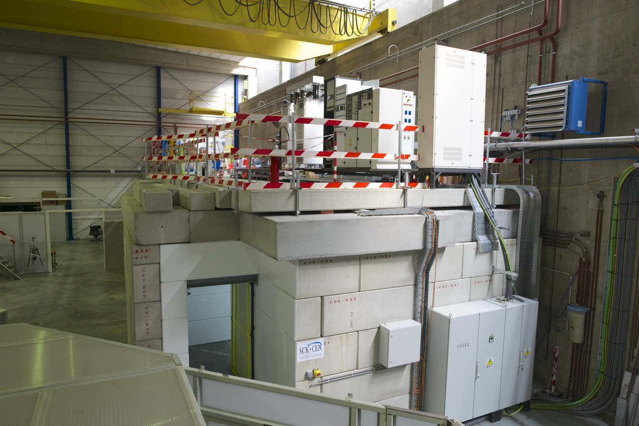
Injector : present status

Slide 8
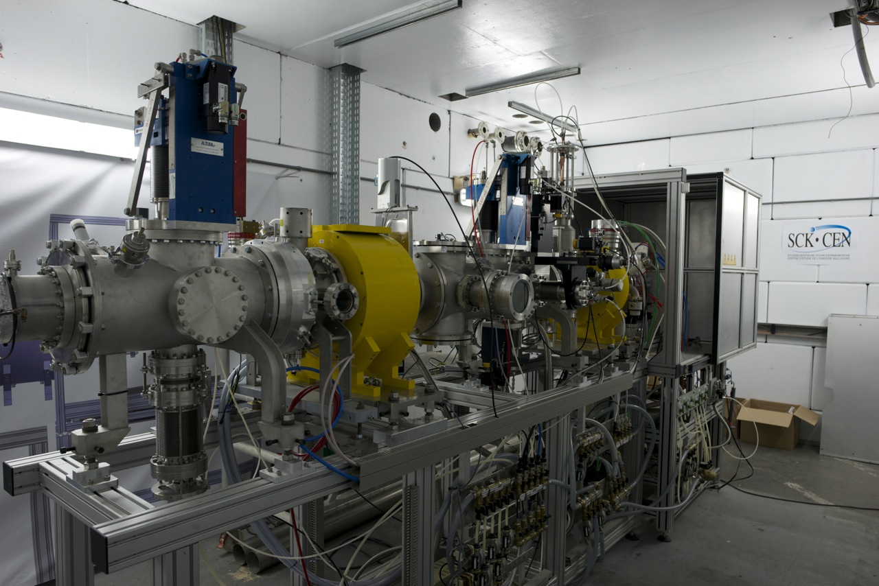
Injector : present status (source + LEBT)

Slide 9
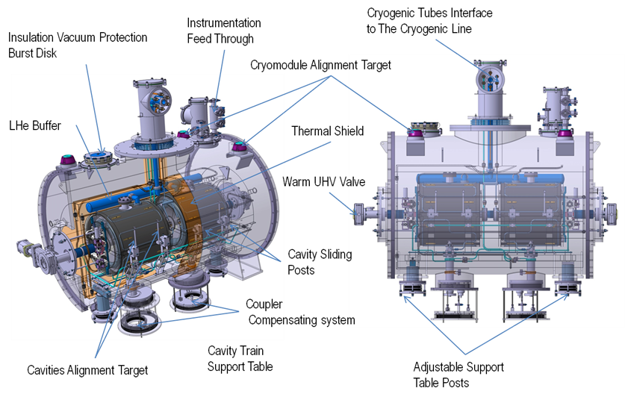
R&D
Collaboration: IN2P3, ACS

Slide 10
Reliability approach
PDS-XADS
  FMEA : introduction of the fault tolerance concept as key to reliability, closely linked to modularity → SC linac with compatible beam dynamics
MAX
  reliability model and study (fault tree analysis)
  important conclusions
    the goal seems achievable, if there is fault tolerance
    the reliability of individual components must be pushed
    the influence of the control system reliability is very high
  need for a consolidated reliability model of the MYRRHA linac
MYRTE
  Linac4 reliability run as new input for the model
  looking forward to the final report
  new developments (e.g. SSA, µTCA) : reliability in industry

Slide 11
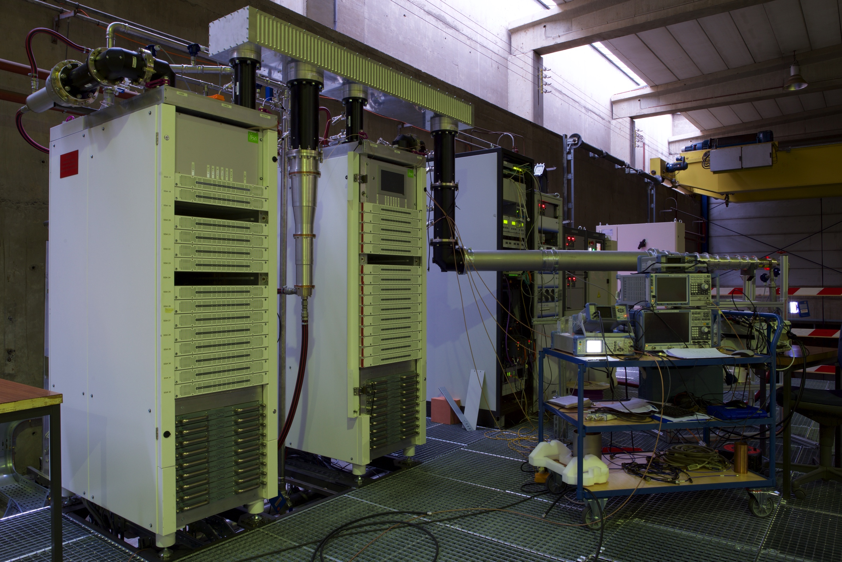
Solid State Amplifier
Source: [TBD]

Slide 12
Reliability approach
near future activities (by our small team)
  initiate the integrated approach : reliability – machine protection
  follow-up of the new reliability model
the present approach
  is based on unchanged principles, is experimental, relies on R&D
  quest for component reliability through
    technological & industrial choices
    R&D, prototyping : injector, cryomodule(s)
  evaluation of the needs for parallel redundancy via
    experience (e.g. long operation runs)
    modeling, incl. compatibility with the maintenance scheme
    anticipating : favouring flexible solutions
  fault recovery procedure = essential issue of fault tolerance

Slide 13
Fault recovery procedure (conceptual)
definition in 3 phases
  fault detection and identification
  reconfiguration
  beam restart
relies on
  modeling of various processes
  time deterministic communications (Real Time)
  high performance of control system, incl. LLRF
tools
  virtual accelerator
  database of alternate configurations, dynamically maintained
  phase 1 : MPS, advanced fault localisation
  phase 3 : autotuning

Slide 14
Fault recovery procedure (conceptual)
meta-tools for virtual accelerator, advanced fault localisation, autotuning, ...
  beam dynamics simulations
  focus on execution speed
  classical simulators (TraceWin) are rather slow ...
  alternate solutions may come up : AI, machine learning methods
  massive learning
    through classical methods
    through experiments
  also needed for decision taking algorithms
  cfr. Mathieu Debongnie's talk
  experiments are foreseen on the injector test platform
  the choice will be strategic !

Slide 15
Conclusion
reliability is vital and faults are unavoidable
  fault tolerance is a must have
  degraded mode operation should be generalized
still in early development phase (in spite of long history)
prototyping platforms : strong asset
effective collaborations
  100 MeV linac : reliability lab / decisional hold point
  modeling : need for predictive power

Slide 16
Copyright © 2018 - SCK•CEN
PLEASE NOTE!
This presentation contains data, information and formats for dedicated use ONLY and may not be copied, distributed or cited without the explicit permission of the SCK•CEN. If this has been obtained, please reference it as a “personal communication. By courtesy of SCK•CEN”.
SCK•CEN
Studiecentrum voor Kernenergie
Centre d'Etude de l'Energie Nucléaire
Belgian Nuclear Research Centre
Stichting van Openbaar Nut
Fondation d'Utilité Publique
Foundation of Public Utility
Registered Office: Avenue Herrmann-Debrouxlaan 40 – BE-1160 BRUSSELS
Operational Office: Boeretang 200 – BE-2400 MOL

