Slide 1
Stability and Availability Study Base on the 10-25 MeV Superconducting Proton Linac (CAFe)
APEC2018, Dec. 10-12, 2018, Frankfurt
Yuan He, Guirong Huang, Zheng Gao, Tiancai Jiang, Weiming Yue, Shenghu Zhang, Xingmeng Liu, Zhongzu Zhou, Weilong Chen, Jiangqiang Wu, Zhijun Wang, Liepeng Sun, Longbo Shi, Chenxing Li, etc.
On behalf of Linear Accelerator Center
Institute of Modern Physics, Chinese Academy of Sciences
Supported by “Strategic Priority Research Program” of the Chinese Academy of Sciences.

Slide 2
Outlines
Introduction of Chinese ADS Project and CAFe
Operation Status of CAFe
Stability Issues
Conclusion

Slide 3

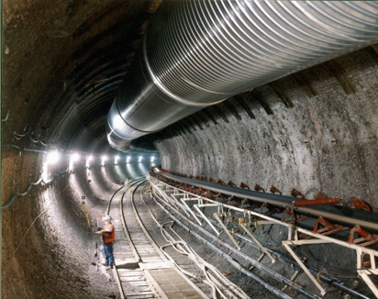
Issues of Sustainable NP and Solution
  China status: ~3% now, ~7% by 2020, ~10% by 2030, the total NP capacity will be the first position
Management and safe disposal of nuclear waste
  1GWe PWR ~25 ton/year;
  ~2200 ton/year in 2030 in China; ~10000 ton/year now in the world
  Total capacity of Yucca Mountain ~ 70000 ton;
“The ADS has the advantage that it can burn pure minor actinides while avoiding a deterioration of the core safety characteristics.”
⎯ ADS and FR in Advanced Nuclear Fuel Cycles – A Comparative Study, NEA/OECD, 2002

Slide 4
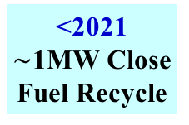




ADS/ADANES Roadmap in China
￥1.78 B
Phase I
2011--2016
Phase II
2017--2024
Phase IV
Phase III
Inject I
Inject II
10 MeV
10 MW_{t}
>500 MW_{t}
≥1 GW_{t}
2014
~2.5 MeV
&10mA
2016
~25 MeV
&~10mA
2024
~500 MeV
&~10mA
<2030
~1.0 GeV
&<15mA
~203x
~1.0 GeV
&>15mA
Key Tech. R&D : Acc., Target, Blanket… Prototypes
Initial Facility
Demo. Facility
Indust. Facility
“strategic Priority Research Program” of the Chinese Academy of Sciences
CiADS

Slide 5



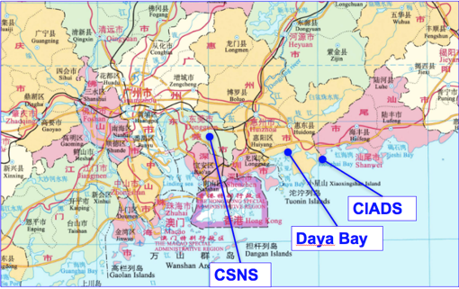
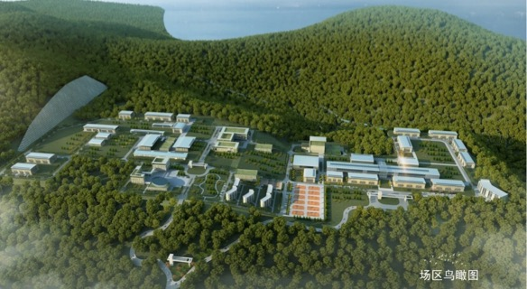
CIADS Project (2018-2024)
Approved in Dec. 2015
Leading institute: IMP
Budget: >1.8B CNY (Gov. and Corp.)
Location: Huizhou, Guangdong Prov.
Contribution Partners:
CIAE, CGN, IHEP, CASHIPS, etc.
HIAF & CiADS

Slide 6
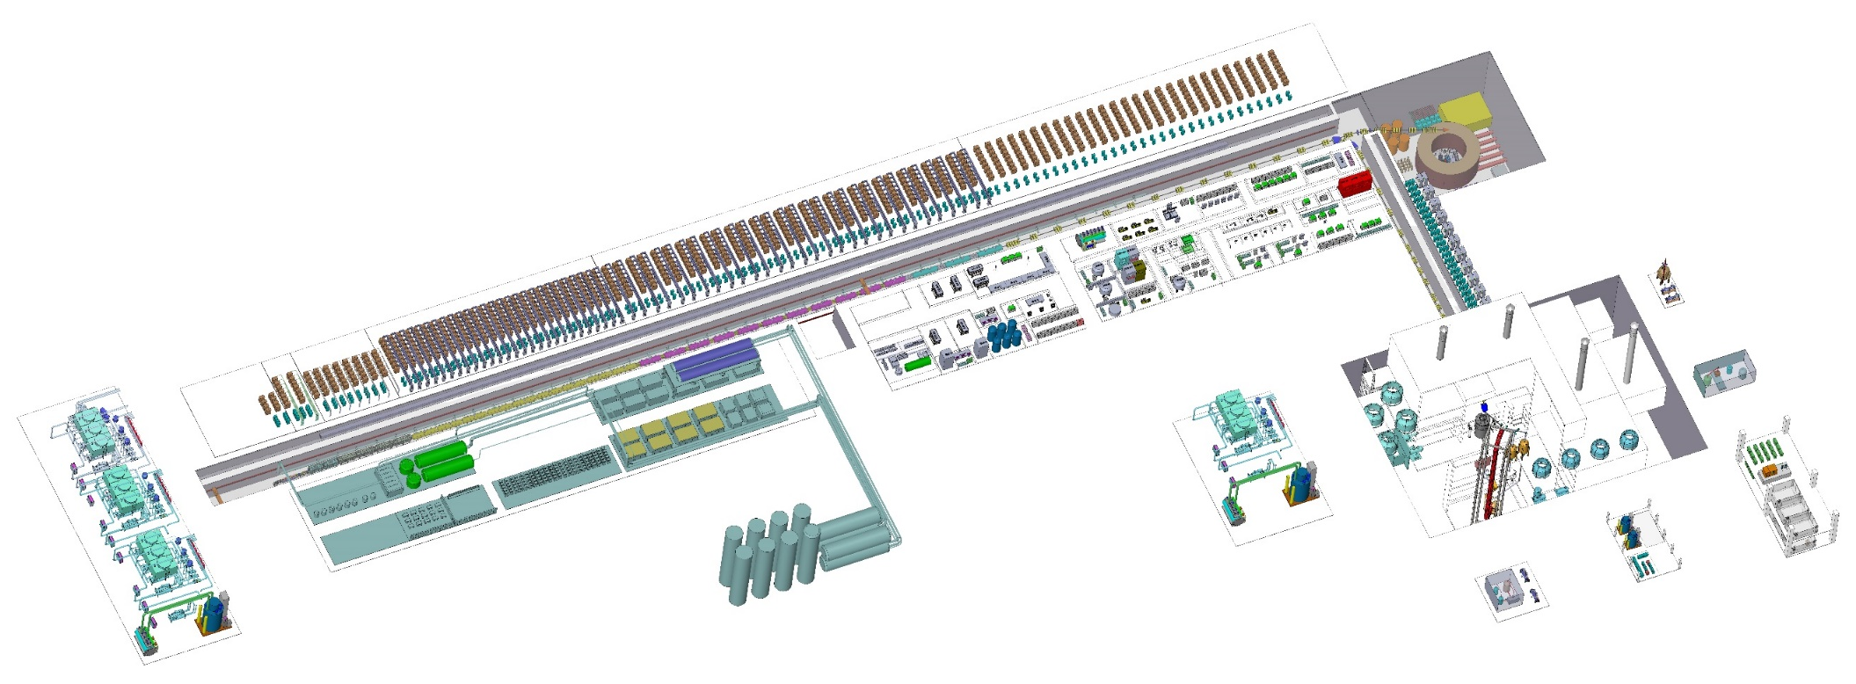
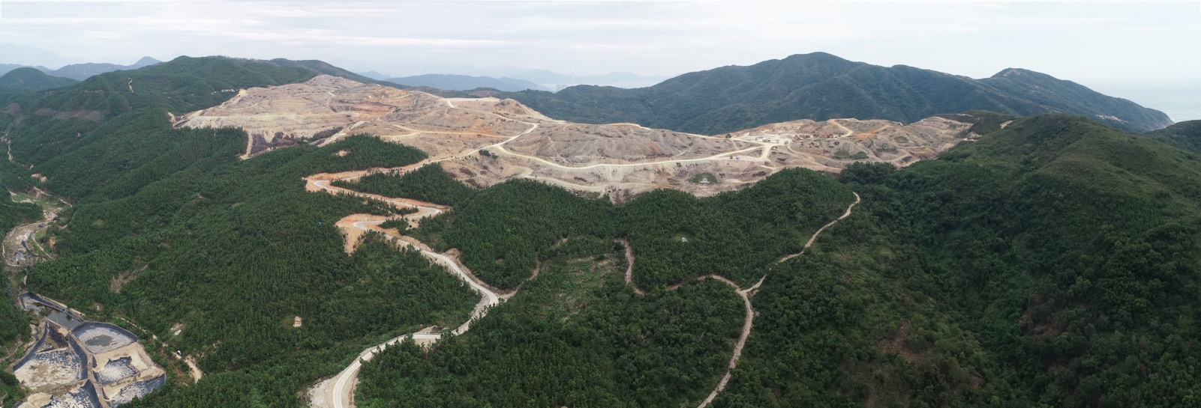
CiADS Project (2018-2024)
CiADS - the Demonstration of ADS at MWs level
Design Particle | proton
Energy | 500 (250) | MeV
Beam current | 5 (10) | mA
Beam power | 2.5 | MW
Operation mode | CW&Pulse
Beam loss | ＜1 | W/m
Reactor power | 7.5 | MWt
Beam trips goal:
<10s, -
10s～5min, 2500/y
>5min, 300/y
SARAF, D, 4MeV, 6kW
SPIRAL2, D, RFQ commissioning
IFMIF, D, RFQ commissioning
PXIE, P, 25MeV, RFQ commissioning
Broke ground

Slide 7
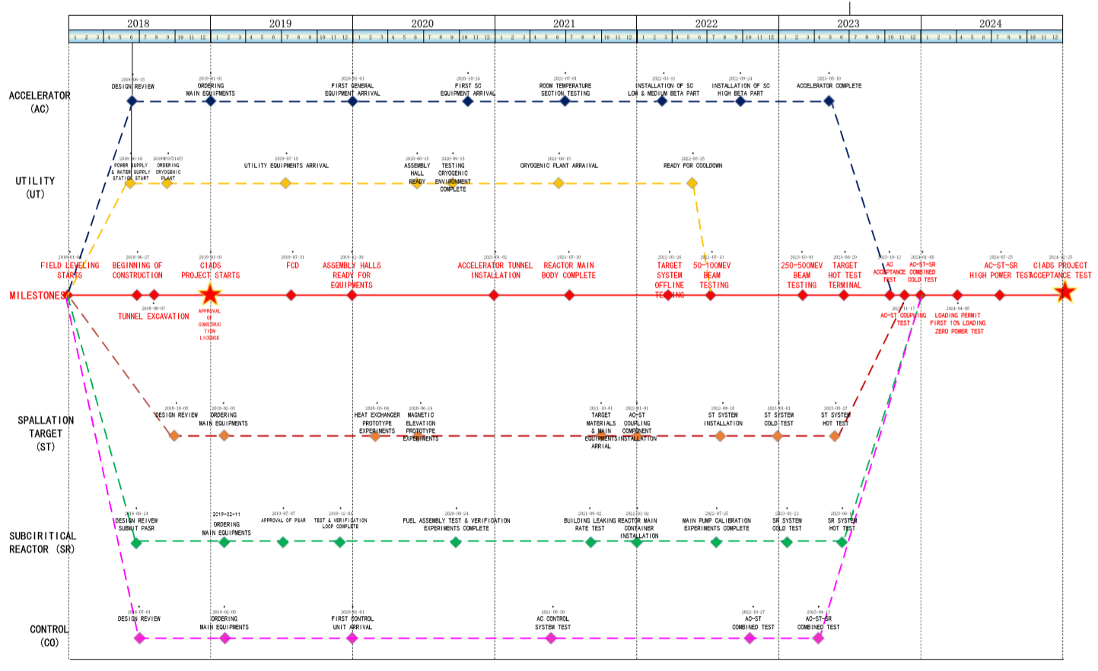
Schedule of CiADS

Slide 8
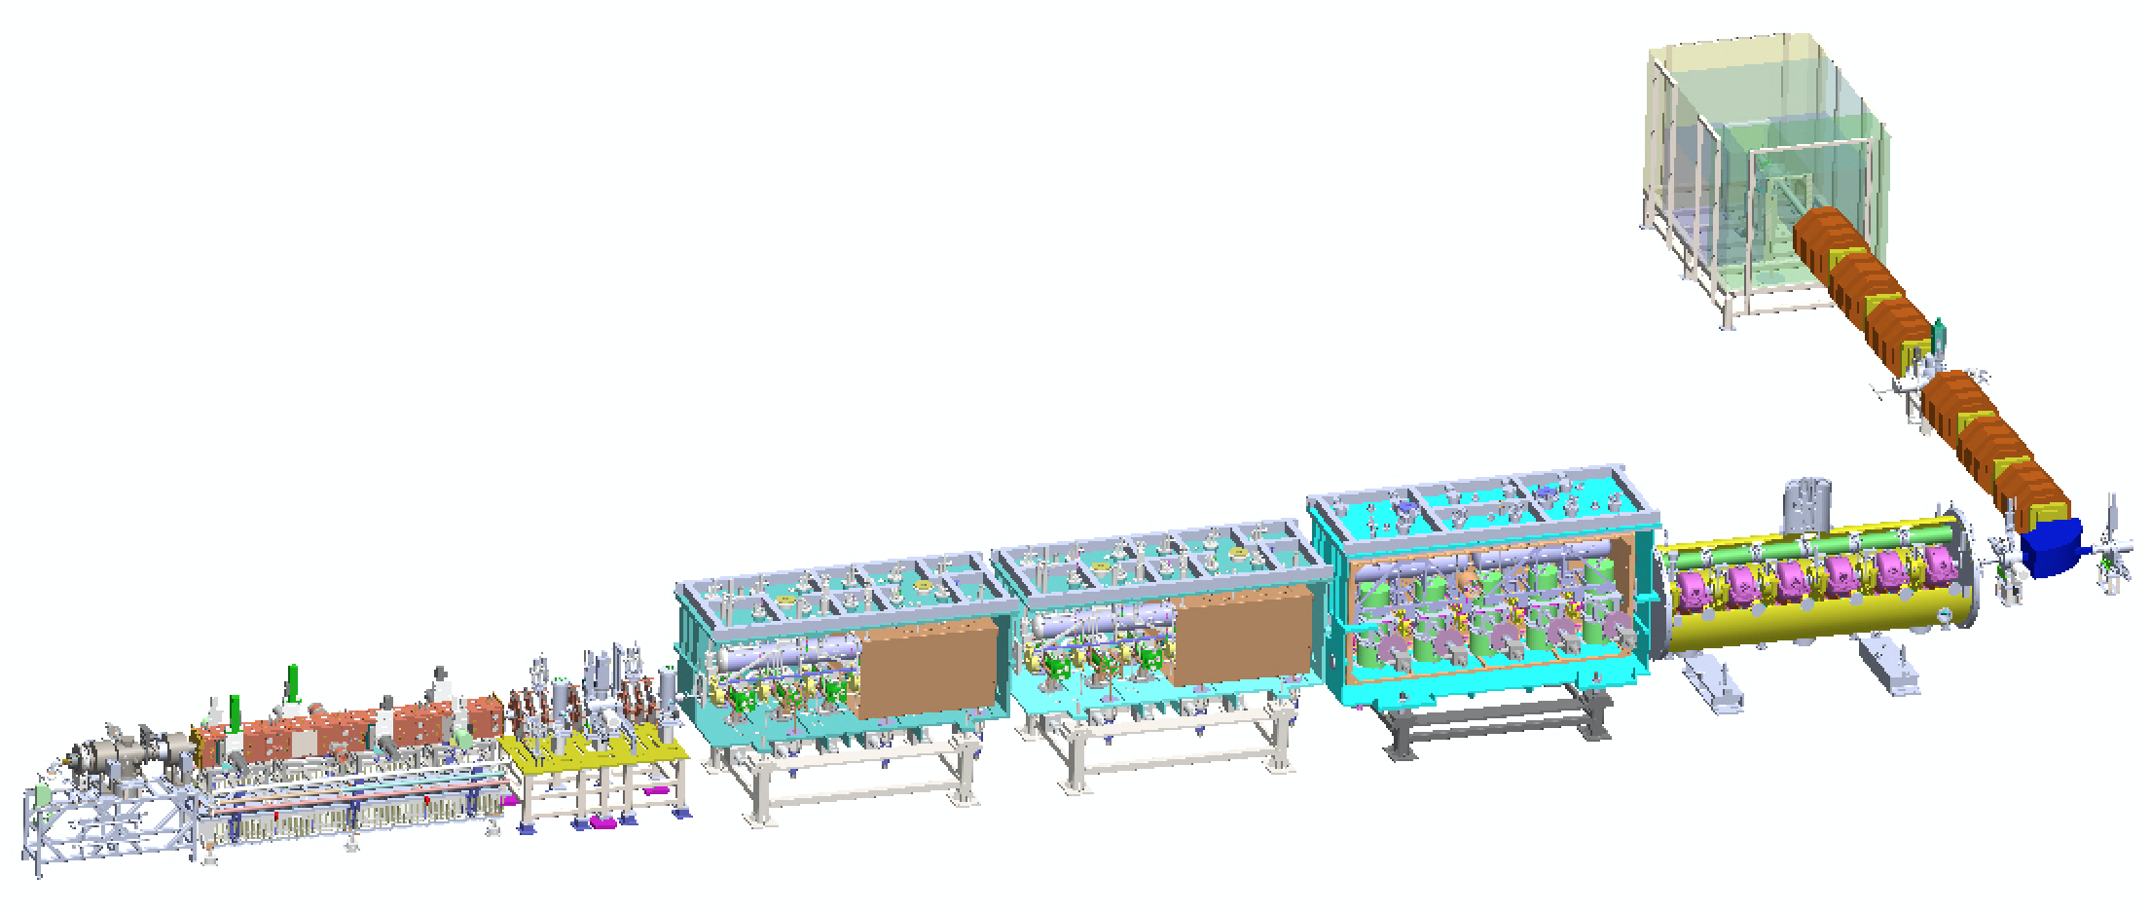
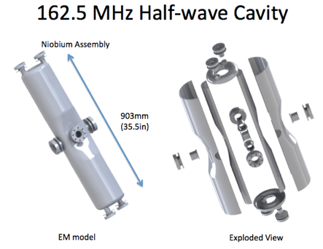
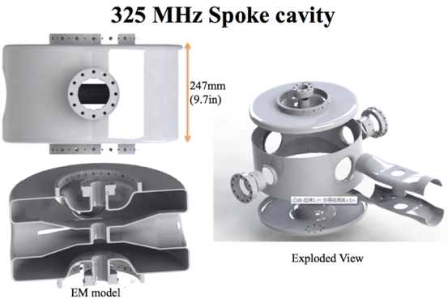
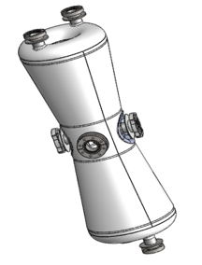
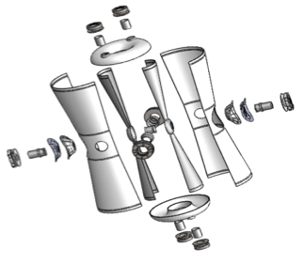
Chinese ADS Front-end Demo Linac (CAFe)
Goal: to demonstrate the technology of 10 mA CW beam of superconducting front-end Linac for CiADS.
Design: 25 MeV, 10 mA, CW, 4.5K
IMP collaboration with IHEP 2011 ~ 2017
DUMP
HEBT
Beta=0.1
Injector II
IMP
162.5 MHz Taper HWR
Beta=0.21
Beta=0.15
IHEP
IMP
Supported by “Strategic Priority Research Program” of the Chinese Academy of Sciences.

Slide 9
Outlines
Introduction of Chinese ADS Project and CAFe
Operation Status of CAFe
Stability Issues
Conclusion

Slide 10
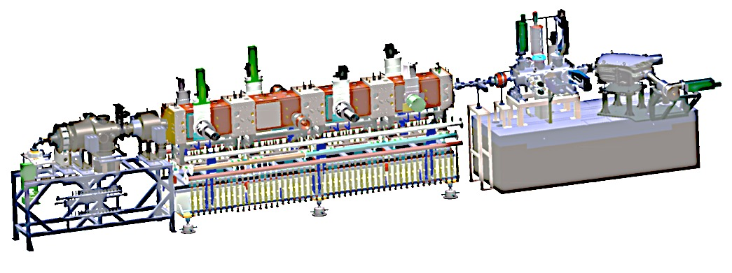
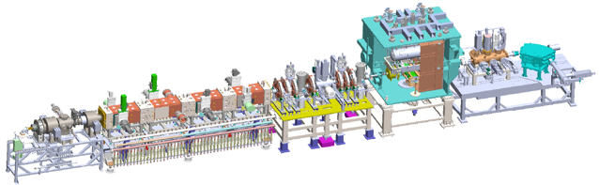
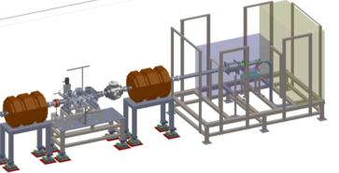
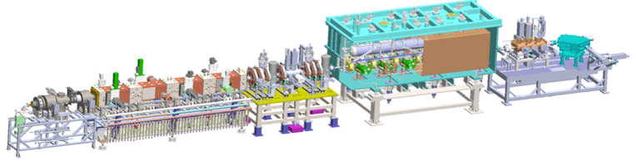
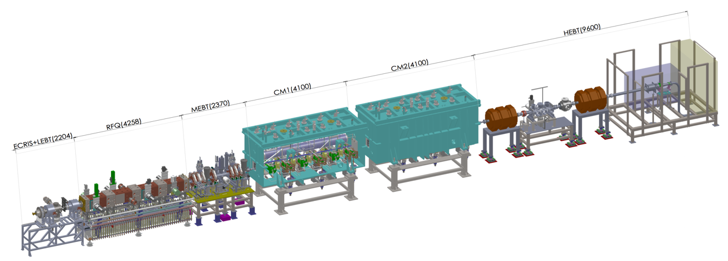
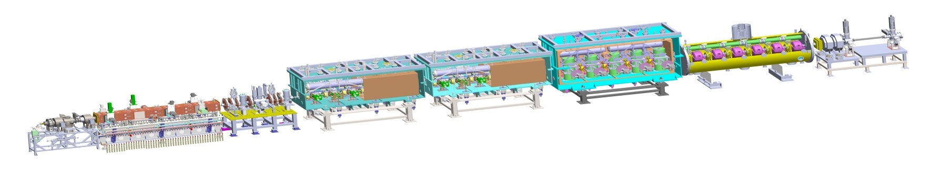
Commissioning of Superconducting Linac
1
Commission stage | First CW beam | Max Energy (MeV) | Beam time (hours) | CW beam time Total (hours) | CW Current Max(A) | CW Power Max(kW)
RFQ | Jun. 21, 2014 | 2.15 | 2036 | 90 | 11 | 23
TCM1 | Nov. 24, 2014 | 2.55 | 208 | 22.5 | 11 | 28
TCM6 | Jun. 24, 2015 | 5.3 | 400 | 20 | 4 | 21
Inject II | Sep. 24, 2016 | 10.2 | 327 | 11 | 2.7 | 26
CAfE | Jun. 7, 2017 | 26.1 | 334 | 27 | 0.3 | 5
162.5 MHz RFQ
2
162.5 MHz HWR010
3
162.5 MHz HWR010
2014.06.06——2014.07.24, RFQ
2014.09.14——2015.02.13, TCM1
2015.03.26——2015.06.29, TCM6, beam accident, RFQ AMP and coupler broken
2015.10.28——2016.01.21, TCM6 commissioning
2016.05.01——2016.06.20, injector II, coupler broken
2016.09.01——2016.12.17, injector II high power
2017.04.28——2017.06.18, CAFe, current leads broken
2017.10.03——2018.01.23, CAFe, operation stability
2018.10.24—— 1 mA CW beam tuning and stability
4
162.5 MHz HWR010
5

Slide 11
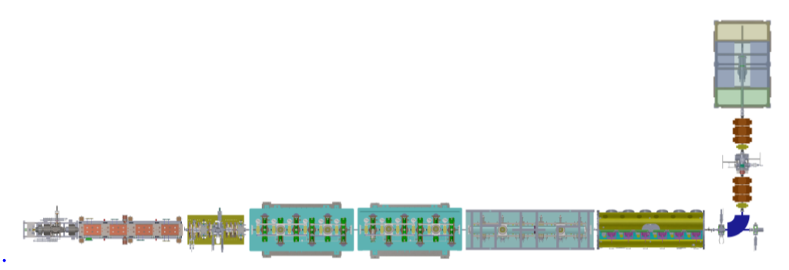
Chinese ADS Front-end Demo Linac
 | Ion source | RFQ/IMP | CM1/IMP | CM2/IMP | CM3/IMP | CM4/IHEP
frequency | DC | 162.5 MHz | 162.5 MHz | 162.5 MHz | 162.5 MHz | 325 MHz
output energy | 35 keV | 2.1 MeV | 5 MeV | 10 MeV | 18.5 MeV | 25 MeV
type | ECR | 4-vane | HWR010 | HWR010 | HWR015 | Spoke021
numbers | 1 | 1 | 6 | 6 | 5 | 6
RFQ
Couplers for RFQ and SRF
RF Amplifiers
Microphonics of SRF
EMC of PS
Beam loss due to halo or tails

Slide 12
Stability of RFQ
3264 hours
2638 hours
Vacuum
Cooling
Arc
MTBF:11.3 hours
MTBF:24.4 hours

Slide 13
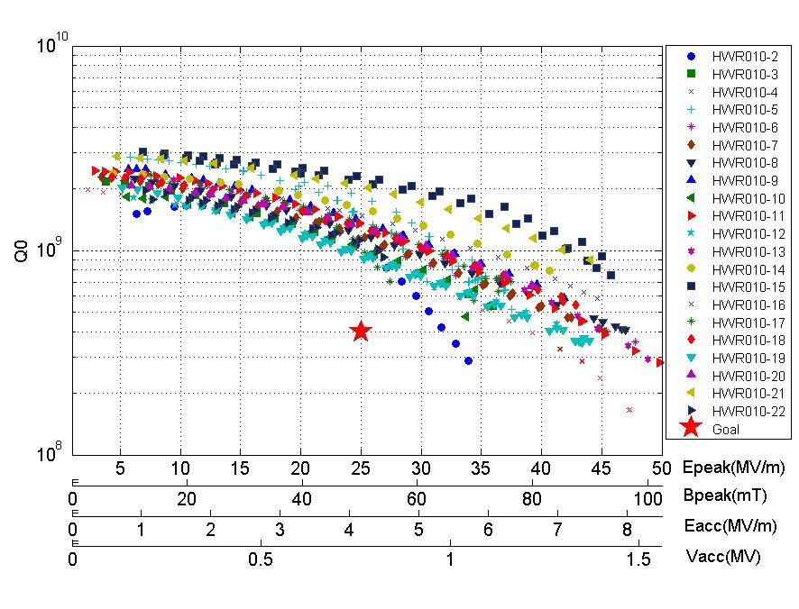
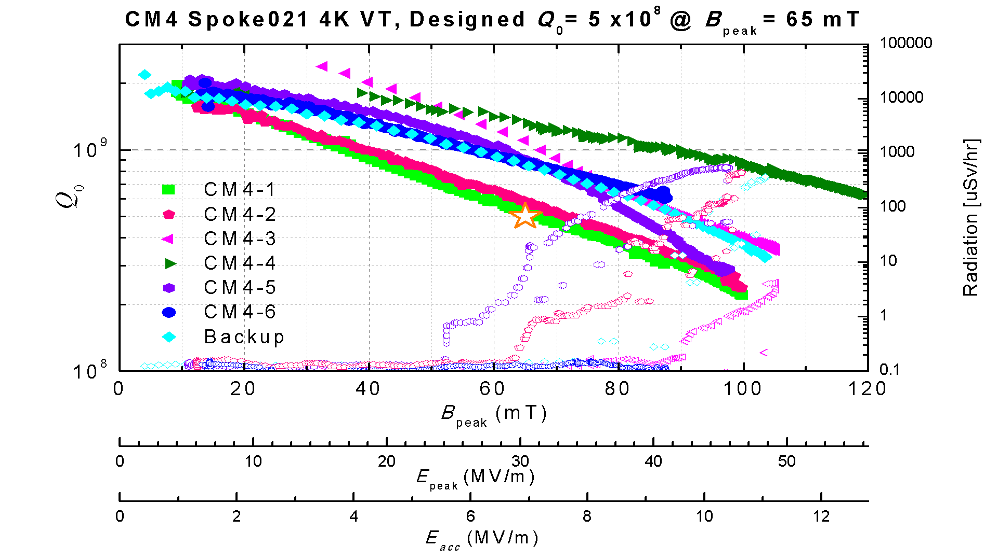
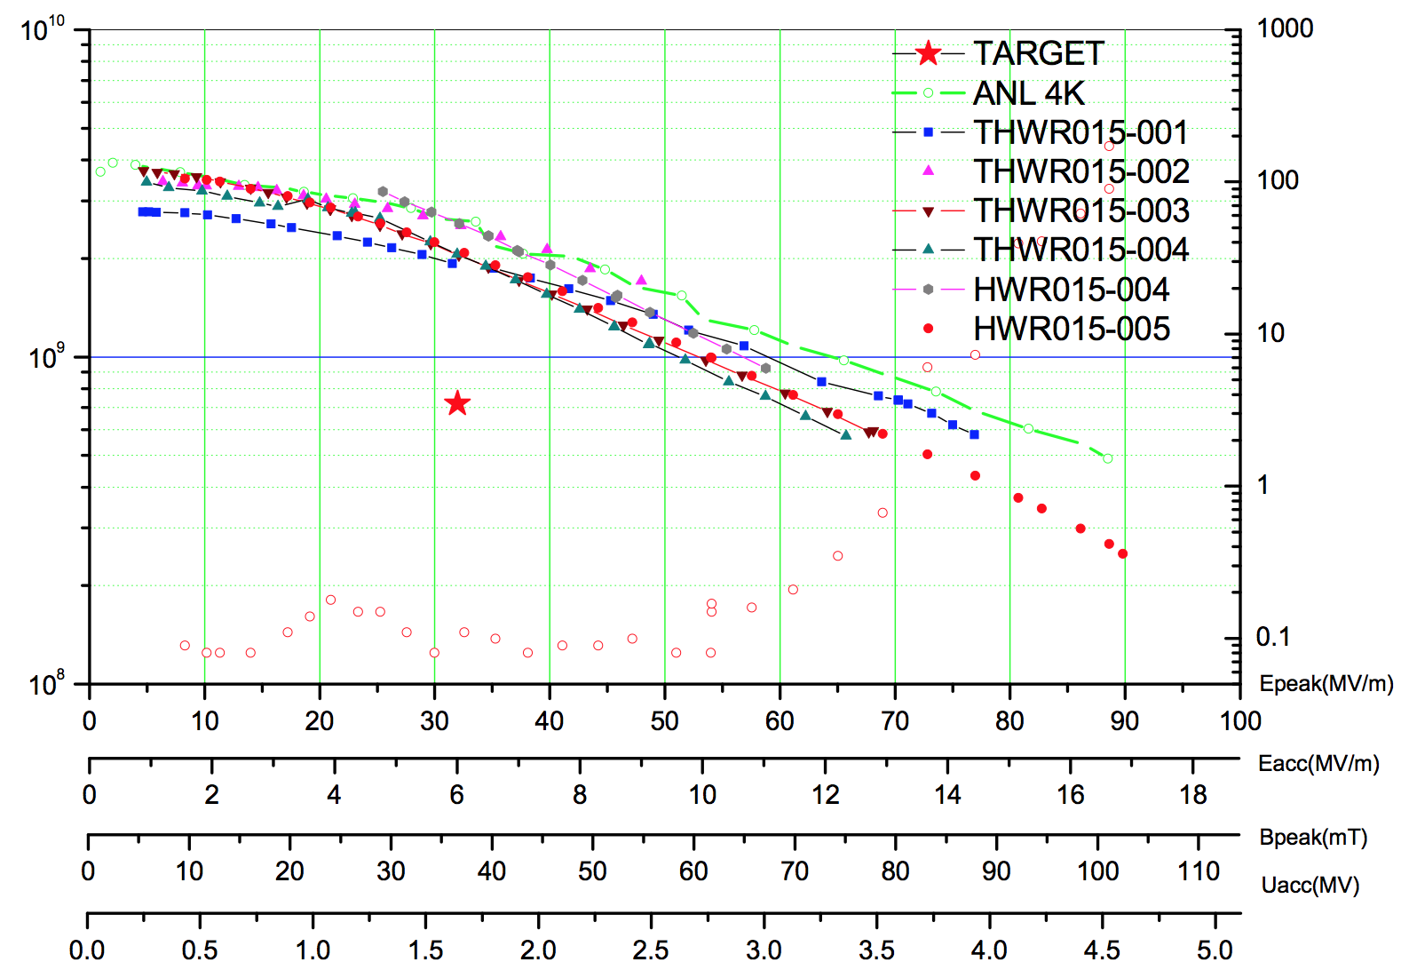
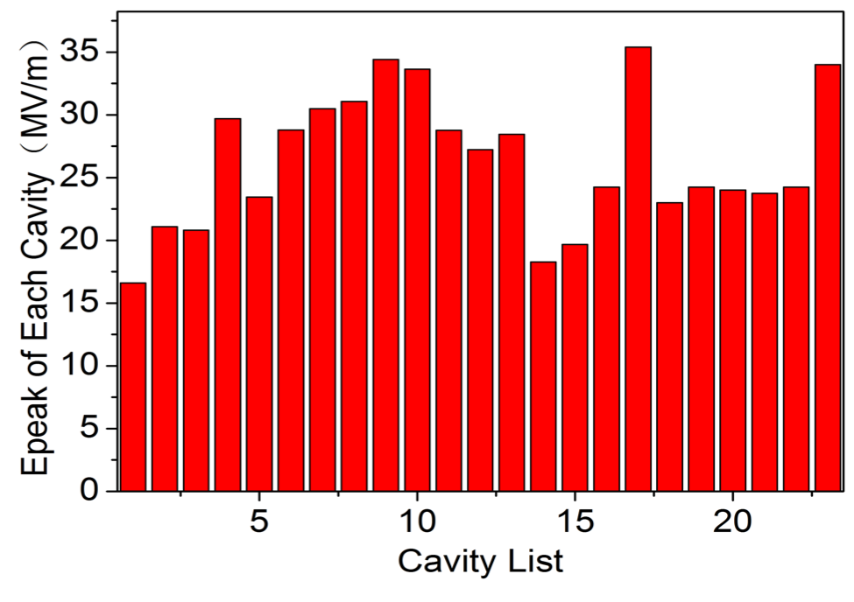
Stability of SRF
HWR010
HWR015
Spoke021
Trips during conditioning
Trips during beam commission

Slide 14
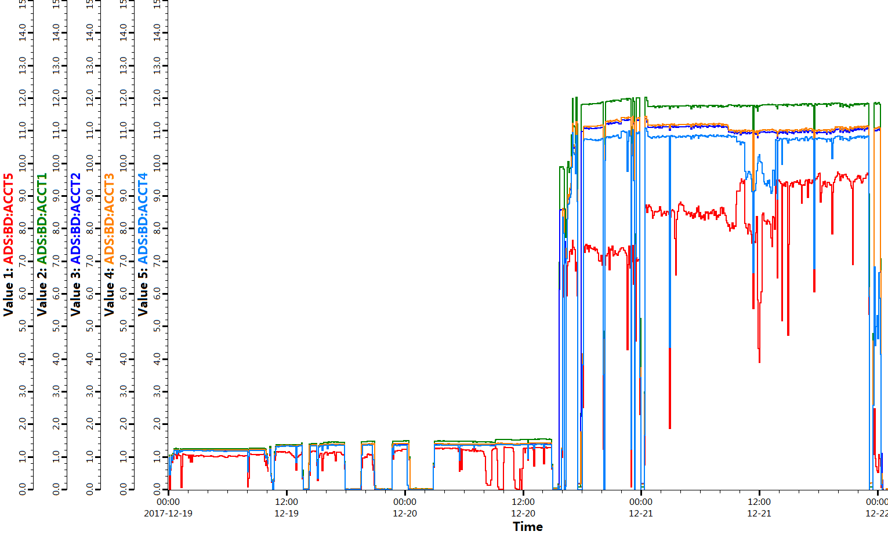
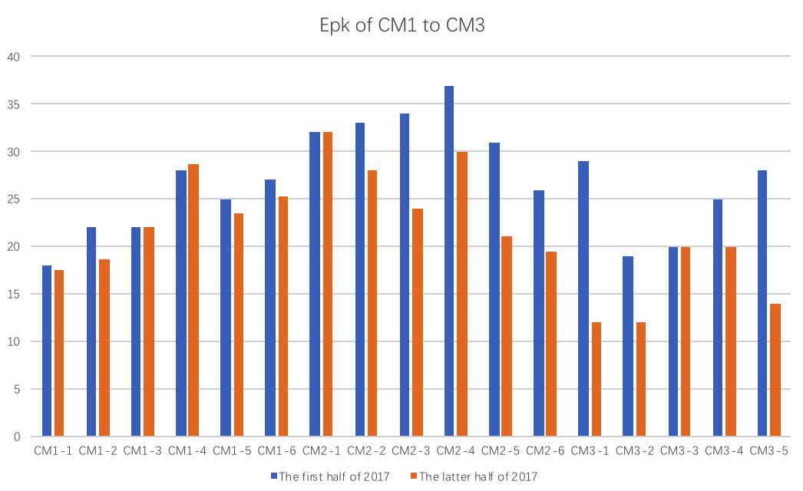
Operation Reliability Test with low power beam
2017-12-19-00：00 ~ 2017-12-22-00：00；72 hours operation test
CW RF and Pulse beam (w/o MPS)
18MeV@1mA@1Hz@10uS & 18MeV@10mA@1Hz@10uS
ECR
HV
RFQ AMP
Diagnostics
test
PS
Cryo-plant
Mag-quench
13

Slide 15
Preliminary RAMI analysis w/o active protection
Beam trip required by ADS demo facility
Beam trips（10s-5min） | 2500/year
Beam trips（>5min） | 300/year
Availability | 80%
Some long time repair failures (> 5 min), such as HV, AMP, Cryo-plant, PS, have very clear reason, can be avoided in the nest stage.
10s-5min-trip number is less than the requirement. Root cause of trips of SRF are still under investigation.
Operation time | Beam time | Down time | Availability
4050 min | 3566 min | 484 min | 0.88
Mean time between failure MTBF (min) | Mean time to repair MTTR (min) | Beam trips (10s-5min) | Beam trips (>5min)
111.4 | 16.1 | 20 | 10
 | ECR HV | RFQ AMP | SRF (incl. LLRF) | Cryo-plant | Power supply
Beam trips | 6 | 2 | 21 | 1 | 1
Down time | 53 min | 77 min | 78 min | 183 min | 100 min

Slide 16
Preliminary RAMI analysis with active protection
Planned running time | Real running time | Total down time | Availability
1723 min | 1010 min | 713 min | 0.57
Mean time between failure | Mean time to repair | Beam trips (10s-5min) | Beam trips (>5min)
8.0 min | 5.7 min | 95 | 16
 | ECR | RFQ | SRF | Control system
Beam trips | 2 | 2 | 99 | 23
Down time | 7 min | 131 min | 419 min | 156 min

Slide 17
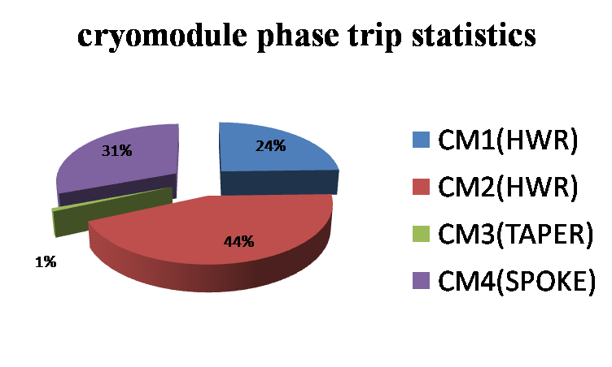
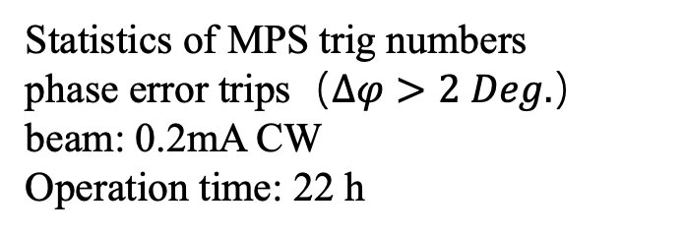
MPS Trigs of phase-error during CW Beam
Statistics of MPS trig numbers
phase error trips（$∆φ>2 Deg.$）
beam: 0.2mA CW
Operation time: 22 h
Weakness FPC coupling of CM2-3, at least 1/3 of the others, means narrow bandwidth, might be the reason.

Slide 18
Outlines
Introduction of Chinese ADS Project and CAFe
Operation Status of CAFe
Stability Issues
Conclusion

Slide 19
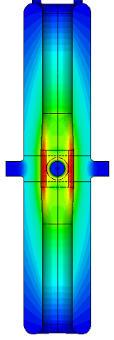
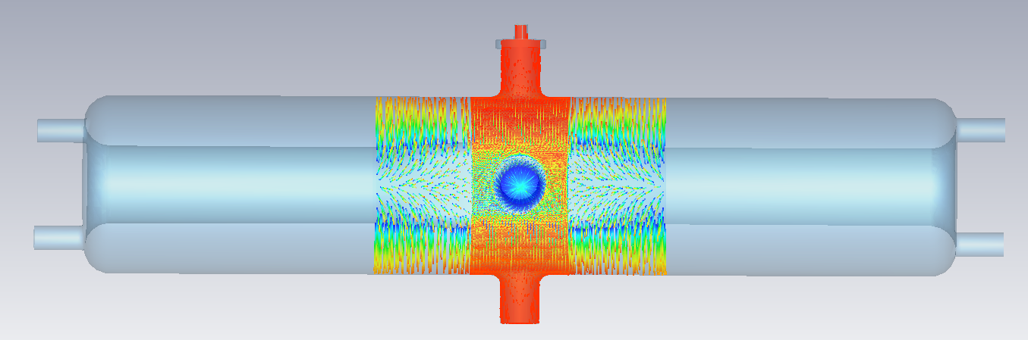
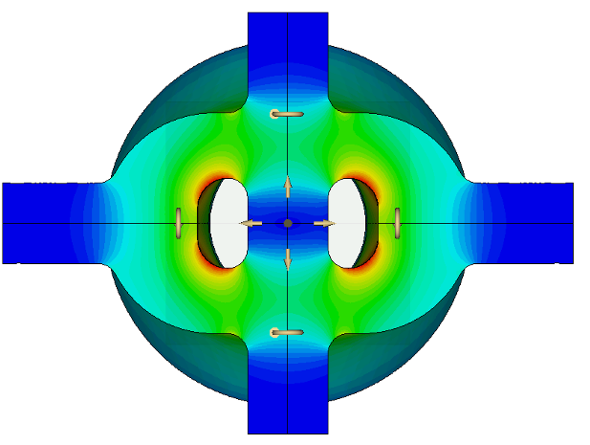
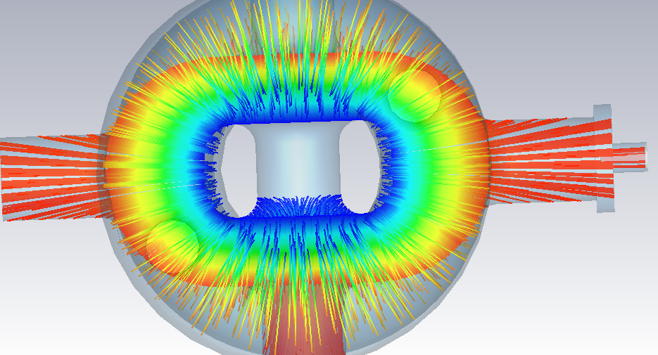
Field emission issues
beam port
H
E
L
0
Trajectory of FE electrons
Pt port
beam port
The coupler and Pt ports are located at the strong electric area of coaxial structure.
Highest surface field areas were designed not to face the pickup ports.
FE electrons can see the windows of FPC and Pt.
Electrons on ceramic discharge when accumulating to a certain value
FPC port

Slide 20
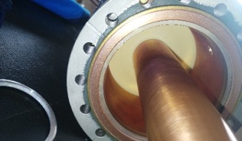
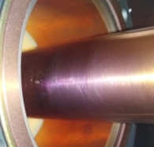
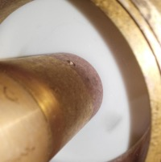
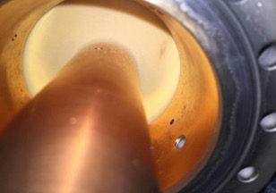
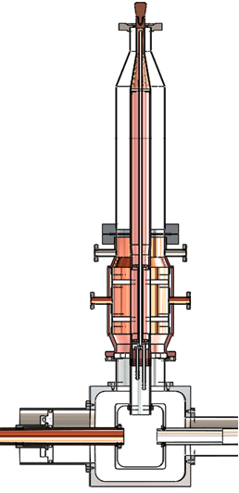
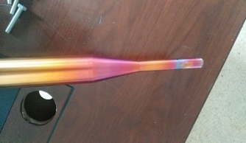
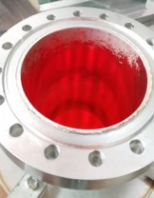
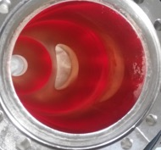
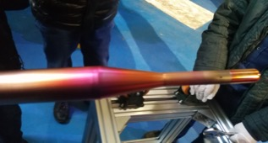
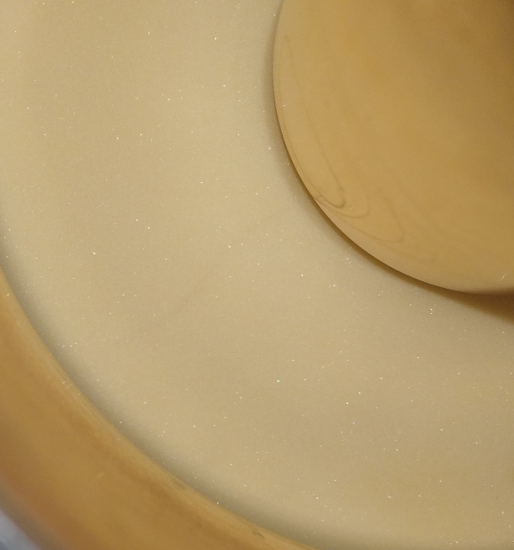
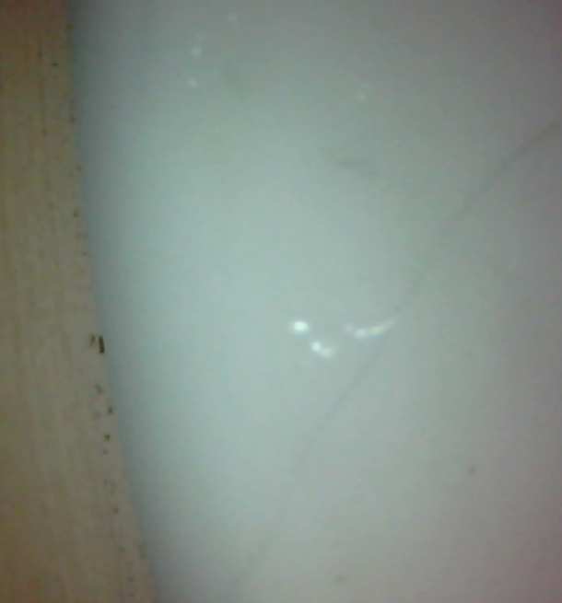
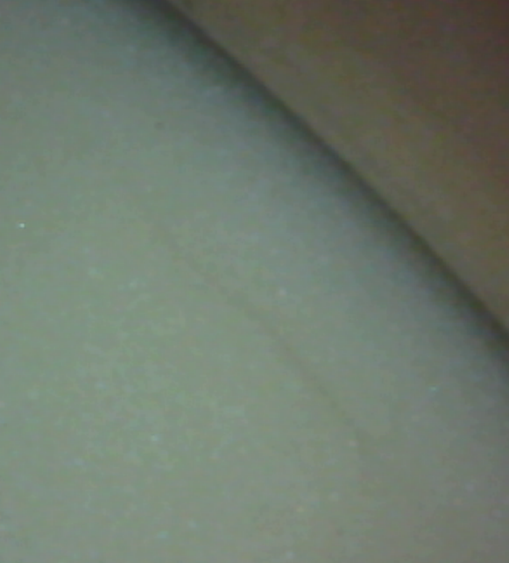
Windows broken due to FE
Broken windows in 2015, Operated for 6 months after broken
windows
Broken windows in 2016

Slide 21
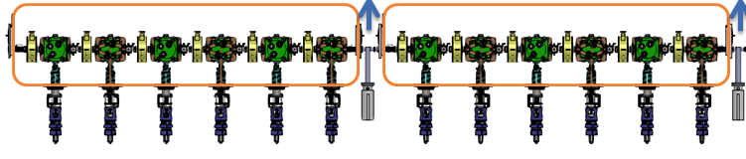
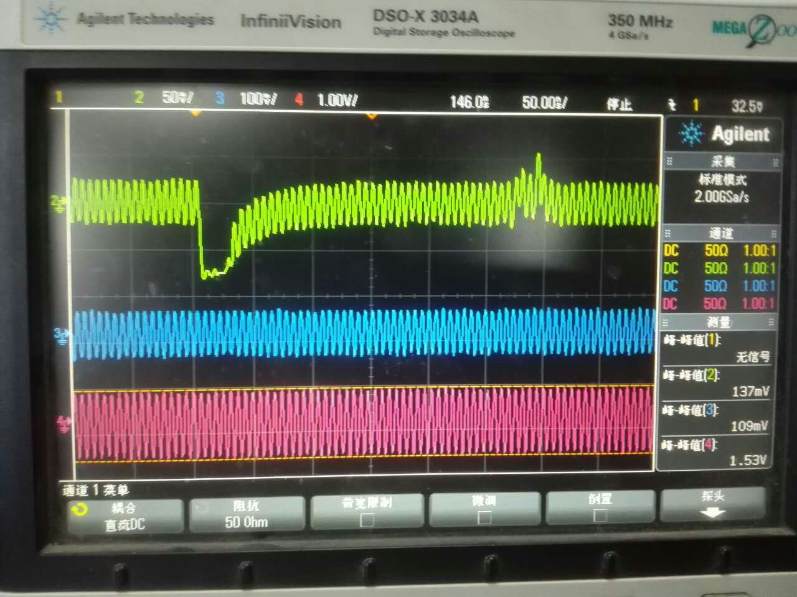
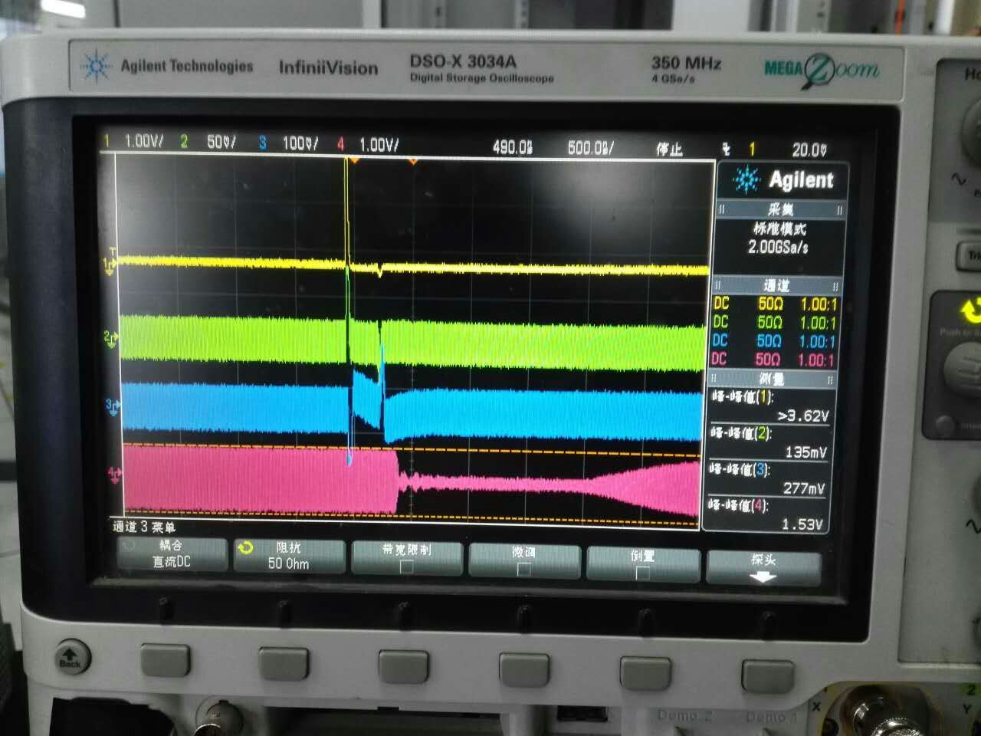
Pickup discharge due to FE
CM1-2
CM1-1
CM1-3
CM1-4
CM1-5
CM1-6
CM1-1：Epk= 18.94 MV/m Gam：355 uSv/h
CM1-2：Epk= 20.53 MV/m Gam：751 uSv/h
CM1-3 : Epk= 21.82 MV/m Gam : 236 uSv/h
CM1-4 : Epk= 27.36 MV/m Gam : 364 uSv/h
CM1-5 : Epk= 23.27 MV/m Gam : 394 uSv/h
CM1-6 : Epk= 24.52 MV/m Gam : 132 uSv/h
GDR
SEL

Slide 22
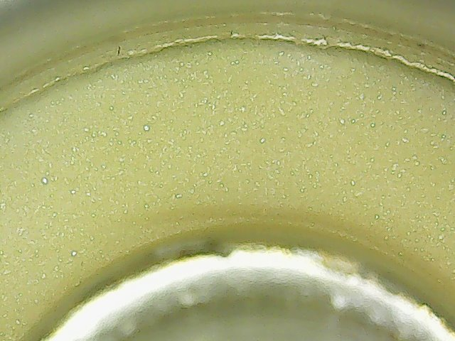
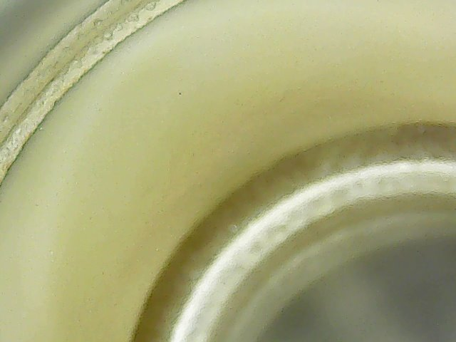
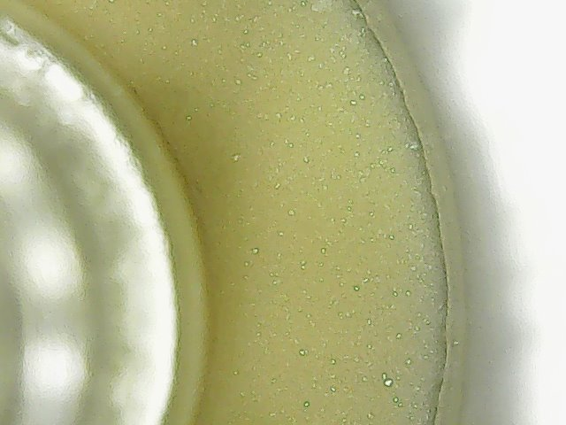
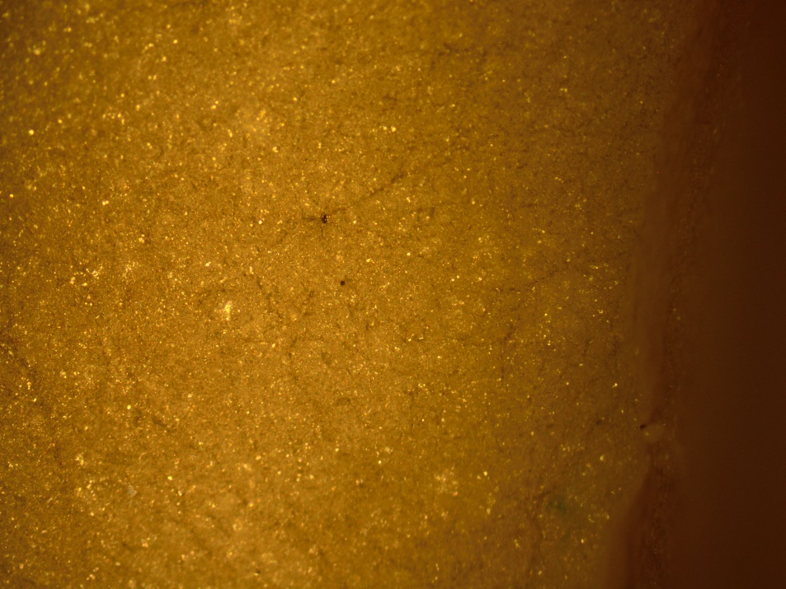

Analysis of pickup
Fluorine
CM1-2
5~10 times

Slide 23
Microphonics of SRF resonators in CM2
The CM2-3 waveguide support
The CM1-1 waveguide support

Slide 24
Vibration Sources to CM2-3
Wat off + Vac off
Wat off + Vac on
Wat on + Vac on
Wat on + Vac isolation
Vacuum Pump for CM
Water pump for RFQ
Side bands cause phase error

Slide 25
CM2-3 spectrum
Open loop
Close loop
155Hz side band is less than -90 dBm

Slide 26






EMC of PS causes mis-trig of MPS
Before upgrading
After upgrading
Main coil 120 A
Ripples p-p 4.1 V
Steering coils 50 A
Ripples p-p 3.4 V
Main coil 120 A
Ripples p-p 0.16 V
Steering coils 50 A
Ripples p-p 0.06 V

Slide 27


Beam loss issues
Operation in December 2017, ~18 MeV
Operate CW beam with 18 MeV / 0.2 mA
Current leads cooling trouble limit the transversal focus in CM3

Slide 28



Beam loss study
The 6-dimensional ellipsoid gaussian is truncated at 3 RMS
1% of the total number of particles was defined as beam halo particles at the position of 10 times of RMS beam size in the horizontal and vertical RMS
With beam halo
 | Alpha X/Y/Z | Beta X/Y/Z m/rad | Emit-X/Y/Z (RMS) π.mm.mrad [ Norm. ] | Emit-X/Y /Z(99.99%) π.mm.mrad [ Norm. ]
Without beam halo | 0.25/-0.05/-0.076 | 0.226/0.096/0.611 | 0.112/0.097/0.094 | 2.06/2.07/2.14
With beam halo | 0.25/-0.05/-0.080 | 0.226/0.096/0.608 | 0.122/0.106/0.010 | 9.16/8.54/8.90

Slide 29
Outlines
Introduction of Chinese ADS Project and CAFe
Operation Status of CAFe
Stability Issues
Conclusion

Slide 30
Conclusion
CAFe is to demonstrate the superconducting front-end. The CW beam of 0.3 mA has been commissioned.
The issues of coupler, AMP, FE, EMC of PS have been realized and resolved partly.
The phase-error protection caused by microphonics is main trip source, we did not find the solution yet.
The beam loss in SCL is not understood yet. More simulation and experiments will be done to figure out it.
The goal will be to operate CW beam at 100 kW stably in 2019.

Slide 31
Thanks for your attention

