Slide 1
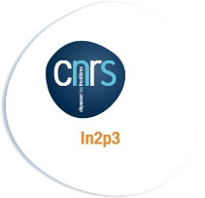
Modelisation of an injector with Machine Learning
Applications on the MYRRHA and IPHI injectors
Presented by Mathieu Debongnie, PhD student, ACS/LPSC Grenoble
Director, J.-M. De Conto, LPSC
Co-director, F. Bouly, LPSC
CIFRE supervisor, T. Junquera, ACS
Workshop APEC - The 11th of December, Frankfurt

Slide 2
Contents
MYRRHA and the Fault Tolerant strategy
Neural Network and Machine Learning
Datasets
Modelling an injector: LEBT + RFQ
Conclusions & perspectives

Slide 3
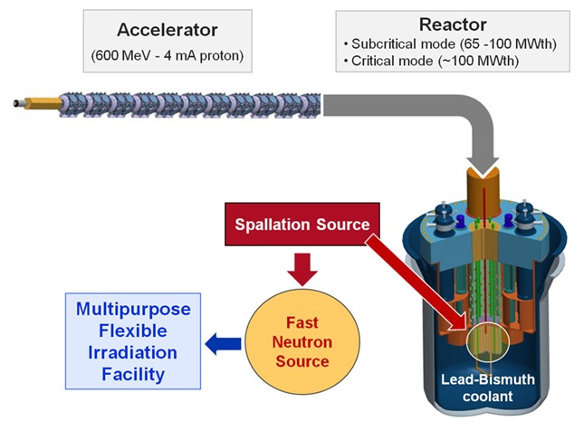
Context
MYRRHA project
ADS demonstrator
In dev. in Belgium
1st phase (100 MeV) funded
Accelerator
Proton – 4mA
CW
600 MeV
NC injector
SC linac
H. Aït Abderrahim, https://academlib.com/26797/environment/development_technologies_current_status_accelerator-driven_system_development

Slide 4
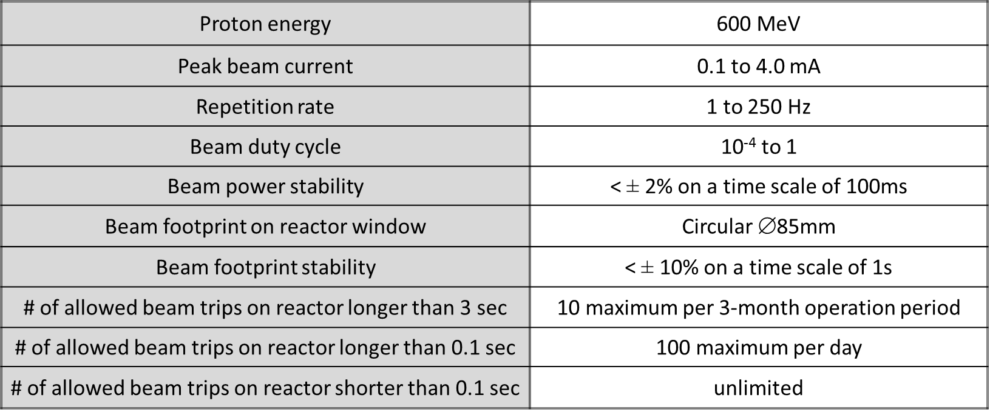
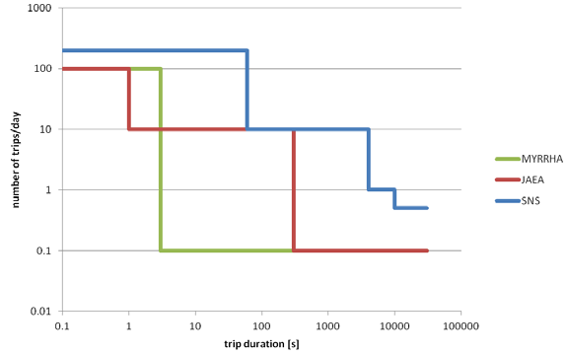
Context
MYRRHA and the reliability challenge
A. Bargallo, “ESS reliability and availability approach”, ARW 2015, Knoxville, Tennessee
High power proton beam (up to 2.4 MW)
SNS initial
SNS 2010-13
MYRRHA
JAEA
Extreme reliability
Limit the beam losses → improve injector control
Fault compensation → improve SC linac control
D. Vandeplassche et al., ”Accelerator Driven Systems”, Proc. IPAC 2012, New Orleans Louisiana, USA, 2012

Slide 5
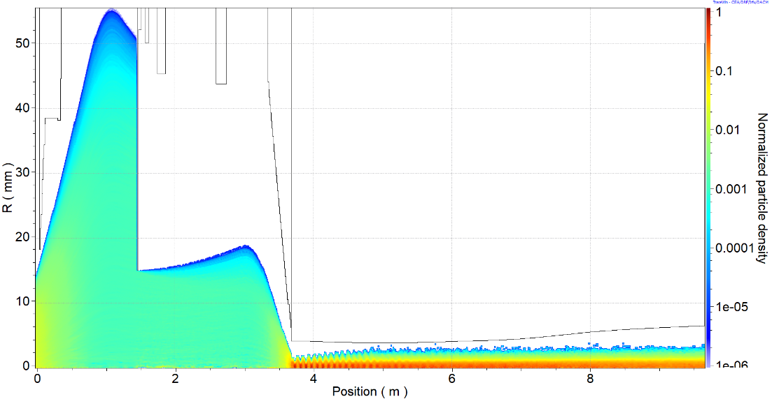
Context
Beam dynamics simulation
TraceWin (CEA) (transport & acceleration)
Slow (Tracking)
Simplified space charge compensation effects for low energy beam
Toutatis (CEA) (RFQ Model)
Even slower (Tracking)
➔Machine Learning as a fast simulator

Slide 6
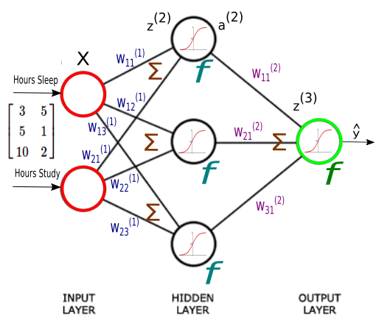
Neural Network
An artificial neuron
Input X
Parameters
W
b
f
# layers
# neurons/layer
Weights W
Bias b
Activation function f
Activation a
Output $a=f(WX−b)$
Can fit any continuous function

Slide 7
Machine Learning
Supervised learning of a neural network
Neural Network
Requires
Training dataset (X, D)
Evaluation dataset (X, D)
Input
$$X$$
Actual output
$$Y$$
Training:
NN parameters
$$W, b$$
Optimizer
Error estimator
Parameters
Neural Network
Error estimator
Optimizer
Desired output
$$D$$
Estimated error
$$D−Y$$
Evaluating:
Neural Network
Actual output
$$Y$$
Input
$$X$$
Simple on principle but difficult in practice
➔”Trial and error” approach
“Score”
Desired output
$$D$$

Slide 8
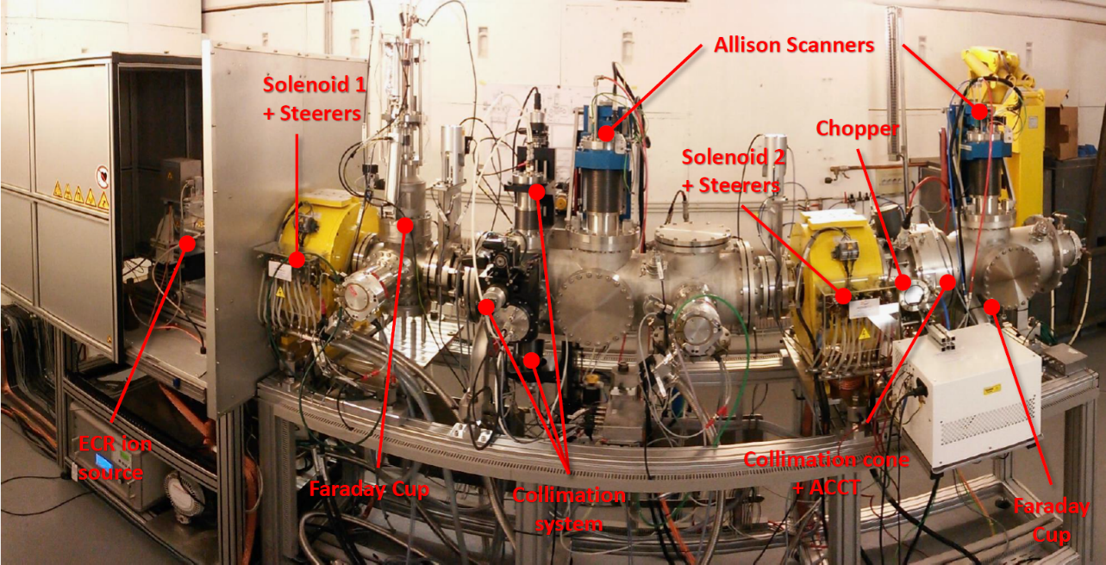
Injectors
MYRRHA LEBT (LPSC- SCK*CEN)
Commisioned @ LPSC (2017)
Currently in recommissioning @ SCK
Up to 20 mA DC p⁺ @ 30 keV
Tests using TraceWin simulator
IPHI (CEA, France)
Up to 90 mA DC p⁺ @ 95 keV
Experimental campaign (2 weeks)
Training using simulator and experimental data
RFQ
Sol + Steer
Sol + Steer
Col

Slide 9
Datasets
MYRRHA (SCK*CEN, Belgium)
Simulated: 13 000 runs
IPHI (CEA, France)
Experimental: ~ 8000 measurements
Simulated: 27 000 runs
60%
Training data
Evaluation data
Validation data
Dataset
20%
20%
Input |  |  |  |  |  |  | Desired output
Current in steerers [A] |  |  |  | Current in solenoids [A] |  | Collimator opening [m] | Transmission [/]
$$I_{SteerH1}$$ | $$I_{SteerV1}$$ | $$I_{SteerH2}$$ | $$I_{SteerV2}$$ | $$I_{sol1}$$ | $$I_{sol2}$$ | $$r_{coll}$$ | $$T_{LEBT}$$ | $$T_{RFQ}$$

Slide 10
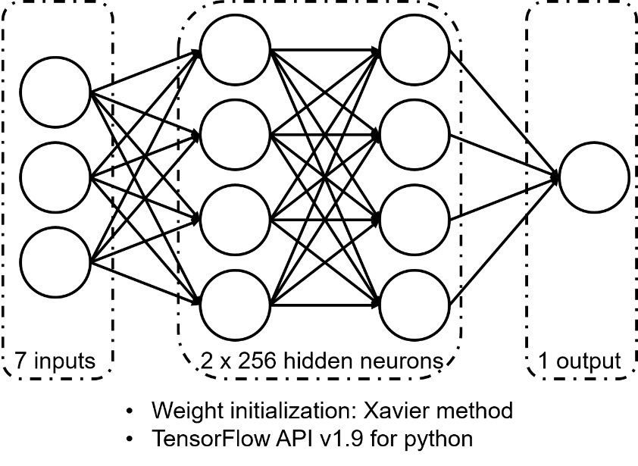
Model
MYRRHA
Prediction of the losses in the LEBT
LEBT transmission, $T_{LEBT}$
IPHI
Prediction of the losses in the RFQ
RFQ transmission, $T_{RFQ}$
Error estimator: $ε=(D−Y)²$
Optimizer: Stochastic Gradient Descent

Slide 11
Results MYRRHA injector
Study on the learning rate
Datasets
Simulated (TraceWin)
Uniform distribution of configurations
Trained network
Final RMS error $≈0.015$
Execution time $\sim {10}^{−5}s$
Average error
# training cycles

Slide 12
Results: IPHI injector
Datasets
Simulated (TraceWin)
LEBT + RFQ
Uniform distribution of configurations
Trained network
Final RMS error $≈0.19$
Execution time $\sim {10}^{−5}s$
NN is “lazy”
➔Need for a uniform output space

Slide 13
Conclusions & Perspectives
NN = non-linear model
Performances are extremely sensitive to the training data
Test on experimental data
New datasets to generate
Test transferability

Slide 14
Extras

Slide 15
Extras

