Slide 1
Machine Learning Platform for Accelerator Controls
Yusi Qiao, PhD Student
Supervisor: Chungming Paul Chu
Accelerator Performance and Concepts Workshop
Institute of High Energy Physics
Chinese Academy of Sciences

Slide 2
Outline
Study Background
Platform Architecture
Data export & uniform
Data pre-processing
General algorithms & Training result visibility
Possible applications
Summary

Slide 3
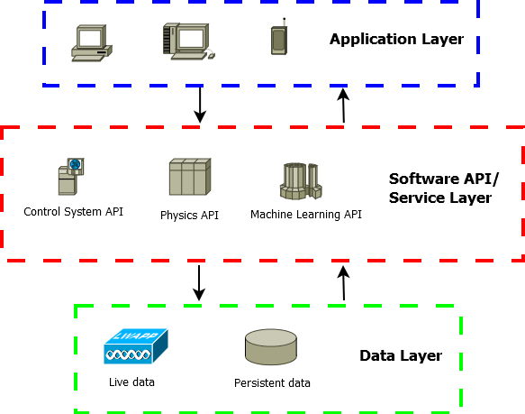
Study Background
Accelerator Application Architecture
Artificial intelligence (AI) & machine learning (ML)
High doorstep for some physicists
Standard format & popular algorithms
Simple APIs to cut development time
C.P. Chu et al. IPAC2018

Slide 4
Platform Architecture

Slide 5
Data Export & Uniform
Data Sources
EPICS live data
TXT/Excel Files
EPICS Channel Archiver
EPISC Archiver Appliance
Other data sources
Output Data Format
Pandas DataFrame
TXT/Excel Files
Other format: HDFS
Code Snippet
pvnames=['BIBPM:R1OBPM02:XPOS','BIBPM:R1OBPM03:XPOS','BIBPM:R1OBPM04:XPOS]
#also can load pvnames from files
engine=LoadData.getKey(server_addr,pvnames)
data=LoadData.getFormatChanArch(server_addr,engine,pvnames,start_time='11/30/2018 14:15:00’,end_time='11/30/2018 14:16:00’,merge_type='outer’,interpolation_type='linear’, fillna_type=None,how=0)

Slide 6
Data Export & Uniform
Raw data characteristics
Large amount of PVs as model features
Different PV has different acquisition period
Handling null or abnormal data
Pandas
DataFrame
Timestamp Alignment
Data Uniform
Data Merging

Slide 7
Data Export & Uniform
For temporal data from archiver
PV Timestamp alignment
3 merge types:
Outer -> smallest time period -> data addition
Inner -> biggest time period -> data deletion
Defined time period -> data addition & deletion

Slide 8
Data Export & Uniform
Data uniform
Standardization
Normalization
Discretization (quantization or binning)
Encoding categorical features

Slide 9
Data Pre-processing
Data quality examine
Handling empty, abnormal, inconsistent data
Padding
Not changing over time
Bad machine status
Interpolation
Linear, nearest, polynomial, cubic, spline……
Neural network
Predict the unknown data through NN algorithm based on known data

Slide 10
Data Pre-processing
Data feature analysis
distribution analysis
comparative analysis
periodic analysis
contribution analysis
correlation analysis
Diagnostic function
common statistical indicators
histograms
scatter matrix diagrams
correlation tables & associated heat maps
box plots

Slide 11
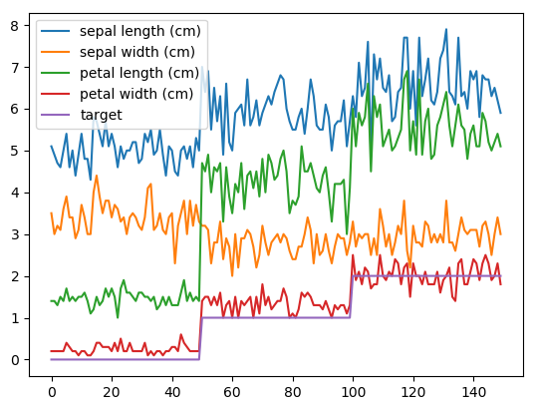
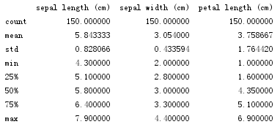
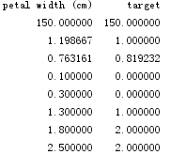
Data Pre-processing
Code Snippet
diabetes = datasets.load_iris()
data=LoadData.dataset2df(diabetes)
DisplayData.showStatistic(data)
DisplayData.showBins(data)
DisplayData.showPlot(data)
DisplayData.showCorrMap(data)
DisplayData.showSPLOM(data)
DisplayData.showSPLOM_G(data)
iris dataset
Classes | 3
Samples per class | 50
Samples total | 150
Dimensionality | 4
Features | real, positive

Slide 12
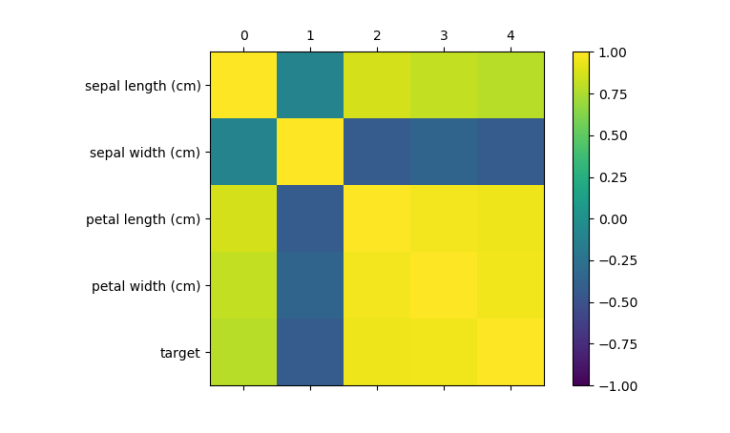
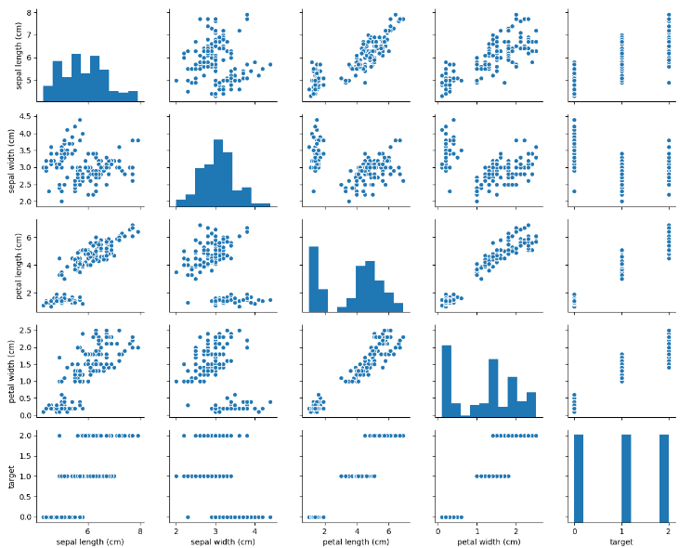
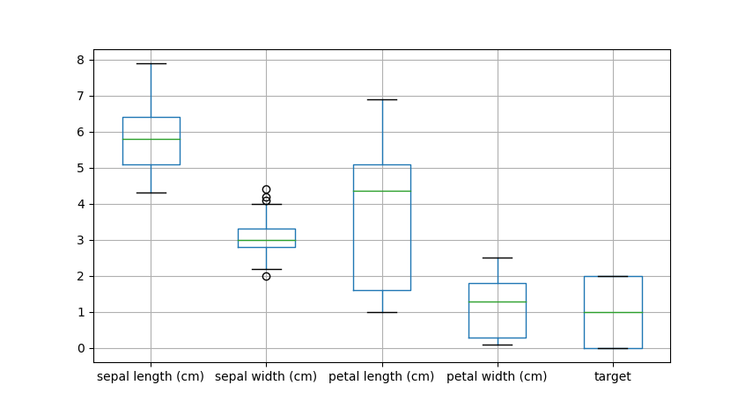
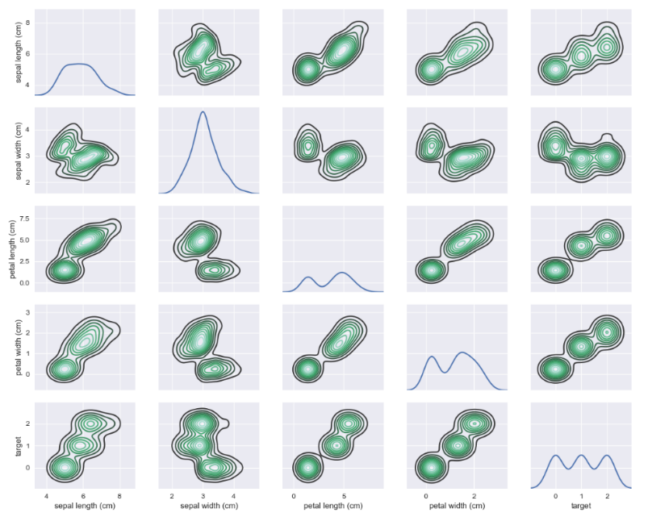
Data Pre-processing
Scatterplot matrix
Correlation heat map
Bin plot
Density plot matrix

Slide 13
General Algorithms
scikit-learn
Machine Learning in Python
Simple and efficient tool for data mining & data analysis
Built on NumPy, SciPy, and matplotlib
Open source, commercially usable - BSD license

Slide 14
Possible Applications
Accelerator facilities monitor
Use accelerator running database and classification algorithms to monitor the status of equipment.
Facilities optimization
Use regression algorithms to improve the performance of key system of accelerator, such as high frequency cavity, superconducting system, water cooling system, etc.
Physical optimization
Apply the machine learning platform to accelerator physical optimization progress, to realize the automatic optimization of DA, emittance, current intensity, etc.
Dengjie Xiao (PhD, IHEP)

Slide 15
General Algorithms
Regression
Predicting a continuous-valued attribute associated with an object.
Linear Regression
Bayesian Linear Regression
Polynomial Regression
maintains the generally fast performance of linear methods, while allowing them to fit a much wider range of data

Slide 16
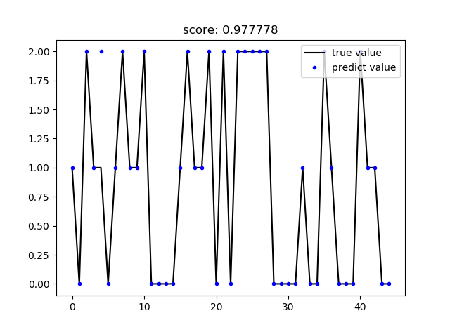
General Algorithms
Decision Tree
non-parametric supervised learning method used for classification and regression.
Advantages
Simple to understand and to interpret
Requires little data preparation
Able to handle both numerical and categorical data
Code Snippet
iris = datasets.load_iris()
data=LoadData.dataset2df(iris)
X_train, X_test, y_train, y_test =TrainData.split_data(data,'target')
pred,score=TrainData.MLDecisionTrees_testmodel( X_train, X_test, y_train, y_test,max_depth=2)
DisplayData.plot_predict(y_test, pred,title='score: %f' % score)

Slide 17
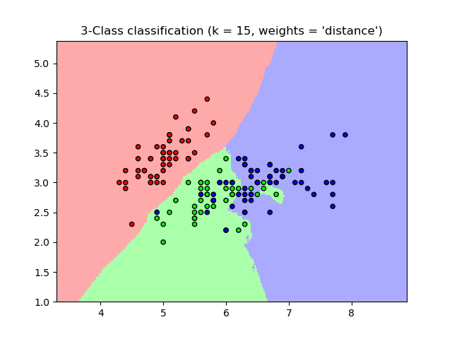
General Algorithms
K-Nearest Neighbors
Supervised neighbors-based learning comes in two flavors: classification for data with discrete labels, and regression for data with continuous labels.
Nearest Neighbors Classification
instance-based learning
computed from a simple majority vote of the nearest neighbors of each point
Code Snippet
iris = datasets.load_iris()
data=LoadData.dataset2df(iris)
TrainData.MLKNN_classification(data,’target’, k=15,weights=‘distance’)

Slide 18
General Algorithms
Multi-layer Perceptron
Advantages:
Neural network models (supervised)
Capability to learn non-linear models
Capability to learn models in real-time (on-line learning)
Disadvantages:
Different random weight initializations can lead to different validation accuracy
requires tuning a number of hyperparameters such as the number of hidden neurons, layers, and iterations
sensitive to feature scaling

Slide 19
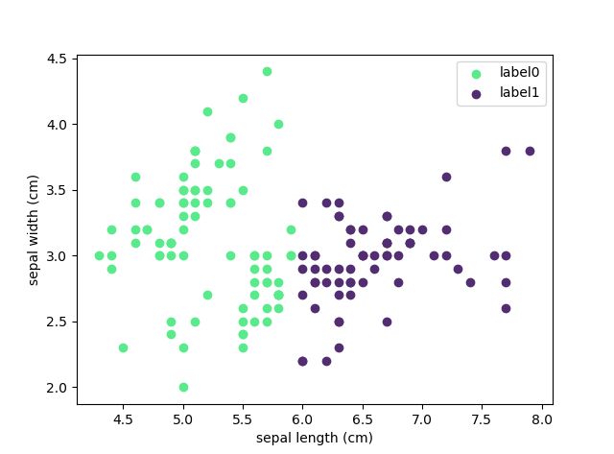
General Algorithms
Clustering
Automatic grouping of unlabeled data into sets.
K-Means
scales well to large number of samples
requires the number of clusters to be specified
Code Snippet
iris = datasets.load_iris()
data=LoadData.dataset2df(iris)
feature_pv1='sepal length (cm)'
feature_pv2="sepal width (cm)"
TrainData.MLKMeans(data,feature_pv1,feature_pv2, cluster=2)

Slide 20
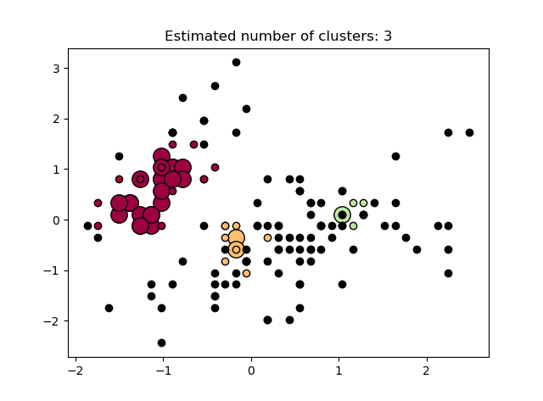
General Algorithms
Clustering
Automatic grouping of unlabeled data into sets.
DBSCAN
views clusters as areas of high density separated by areas of low density
core samples: eps + min_samples
Code Snippet
iris = datasets.load_iris()
data=LoadData.dataset2df(iris)
target_pv="target"
TrainData.MLDBSCAN(data,target_pv, eps=0.5,min_samples=10)

Slide 21
General Algorithms
Model selection and evaluation
Cross-validation
evaluating estimator performance
K-fold
divides all the samples in groups of samples. The prediction function is learned using folds, and the fold left out is used for test.
avoid overfitting & not waste too much data

Slide 22
General Algorithms
Model selection and evaluation
Model evaluation
quantifying the quality of predictions
scoring parameter
for the most common use cases
higher return values are better than lower return values

Slide 23
General Algorithms
 | Scoring | Function
 | Classification
 | ‘accuracy’ | metrics.accuracy_score
 | ‘balanced_accuracy’ | metrics.balanced_accuracy_score
 | ‘average_precision’ | metrics.average_precision_score
 | ‘brier_score_loss’ | metrics.brier_score_loss
 | ‘f1’ | metrics.f1_score
 | ‘f1_micro’ | metrics.f1_score
 | ‘f1_macro’ | metrics.f1_score
 | ‘f1_weighted’ | metrics.f1_score
 | ‘f1_samples’ | metrics.f1_score
 | ‘neg_log_loss’ | metrics.log_loss
 | ‘precision’ etc. | metrics.precision_score
 | ‘recall’ etc. | metrics.recall_score
 | ‘roc_auc’ | metrics.roc_auc_score
 | Clustering
 | ‘adjusted_mutual_info_score’ | metrics.adjusted_mutual_info_score
 | ‘adjusted_rand_score’ | metrics.adjusted_rand_score
 | ‘completeness_score’ | metrics.completeness_score
 | ‘fowlkes_mallows_score’ | metrics.fowlkes_mallows_score
 | ‘homogeneity_score’ | metrics.homogeneity_score
 | ‘mutual_info_score’ | metrics.mutual_info_score
 | ‘normalized_mutual_info_score’ | metrics.normalized_mutual_info_score
 | ‘v_measure_score’ | metrics.v_measure_score
 | Regression
 | ‘explained_variance’ | metrics.explained_variance_score
 | ‘neg_mean_absolute_error’ | metrics.mean_absolute_error
 | ‘neg_mean_squared_error’ | metrics.mean_squared_error
 | ‘neg_mean_squared_log_error’ | metrics.mean_squared_log_error
 | ‘neg_median_absolute_error’ | metrics.median_absolute_error
 | ‘r2’ | metrics.r2_score

Slide 24
Summary
Better data export, normalization & preparation steps
Simplify development of ML applications
Simple visualization plots and common algorithms for primary tryout
Efficient tool for data exploration and knowledge extraction
Physics experts need to define the subjects or problems
More functions to be added!
Better APIs after users’ feedback!
More and more applications to be explored!

Slide 25
Team
Team leader: C. P. Chu
Team members: Dengjie Xiao, Yu Bai, Jinyu Wan, Sinong Cheng, Fang Liu
Contact E-mail: qiaoys@ihep.ac.cn

Slide 26
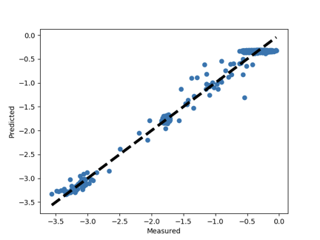
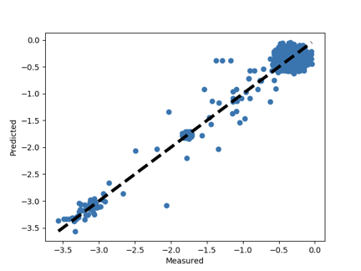
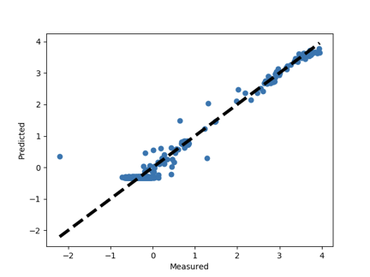
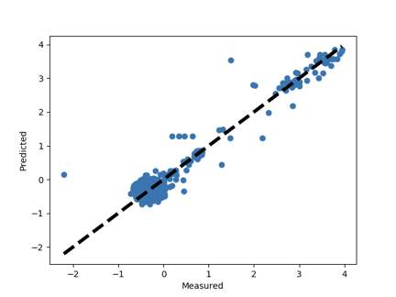
Backup Slides
BPM Status Prediction
For test purpose, we applied BEPC-II(Beijing Electron Positron Collider II) BPM history data(collider state, 3 months) to SVM(Support Vector Machine) regression algorithm to predict the status.

