Slide 1
Towards an Experimental Demonstration of Self-Consistent Beams for Beam Halo Control
N. J. Evans on behalf of SCBD Project
Accelerator Physicist
Oak Ridge National Laboratory

Slide 2
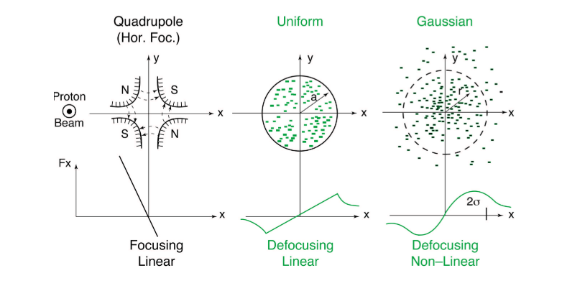
Why uniform beams?
External focusing (quadrupoles) vs. internal de-focusing due to coulomb repulsion – force depends on the particle distribution – in general non-linear, time varying
﻿x’’ + K(s) x = -KSC(s, x-<x>)
In the linear focusing case
space-charge acts like
another defocusing quad
﻿x’’ + (K(s)+KSC(s)) x = 0
Figure from : K. Schindl “Space Charge”
CERN Accelerator School

Slide 3
Uniform Self-Consistent Beams
Figure from : K. Schindl “Space Charge”
CERN Accelerator School
A (uniform) self-consistent distribution*:
Has uniform charge density
(linear space charge force)
Elliptical
Maintains uniform charge density under linear transport
  This includes external focusing and internal focusing from space-charge if that force is linear
Self-consistent - solution of Vlasov equation i.e. df(r,p,t)/dt = 0 (True if f is a function of invariants of the motion)
*For simplicity we colloquially call this a ‘self-consistent beam’

Slide 4
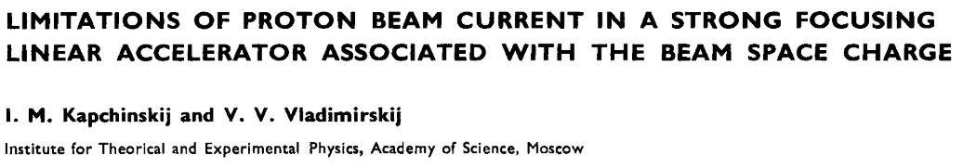
K-V – The original uniform self-consistent distribution
In 1959 Kapchinskij and Vladimirskij devised a uniform, self-consistent distribution – useful for some theoretical work
Problem is distribution is only based on one invariant of motion, the Hamiltonian – we don’t know how to build this experimentally, and has stability issues

Slide 5
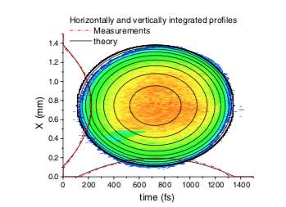
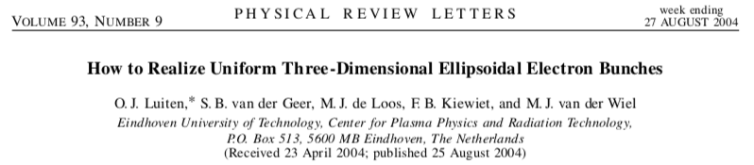
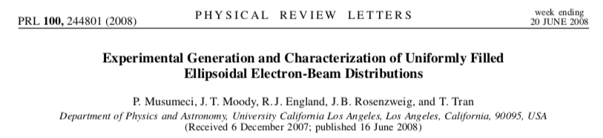
Uniform Self-Consistent Distributions – from the source
Self-consistent uniform electron (not rotating) beams have been created but there are two major issues:
  method can’t be extended to other particle types
  intensity of the bunch is fixed at creation
Experimental production of
uniform density self-consistent
electron beam

Slide 6
Uniform Self-Consistent Beam Distributions at SNS
The SNS project aims to use our flexible transverse painting to build a uniform self-consistent beam out of linac pulses, such that the intermediate stages are also uniform and self-consistent and we can continually add to the distribution
First uniform self-consistent
hadron beam

Slide 7
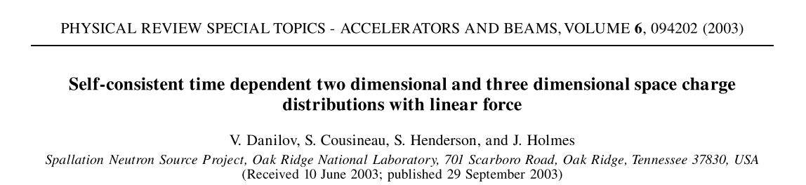
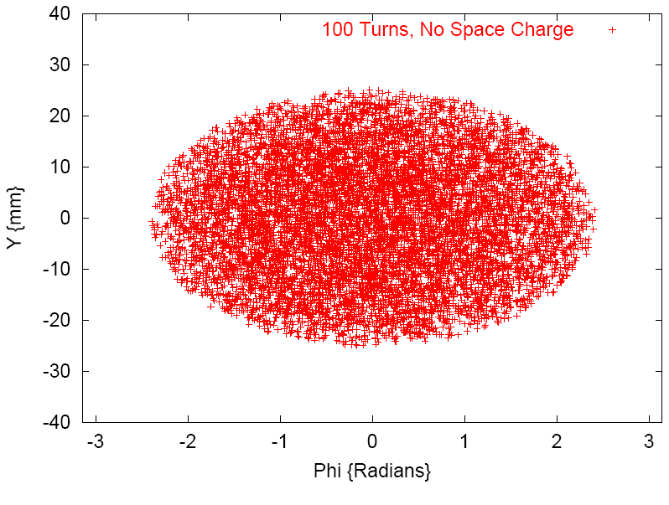
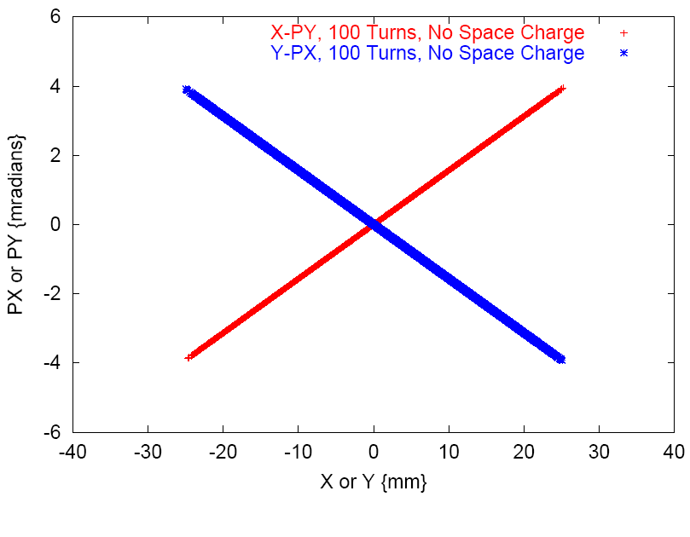
Danilov Distributions
Danilov et al.
  gave procedure to construct 2 and 3D time dependent uniform density, self-consistent distributions based on 2 invariants, one of which is angular momentum - rotating distributions
  Showed that it is possible to build a {2,2} with a flexible transverse painting system

Slide 8
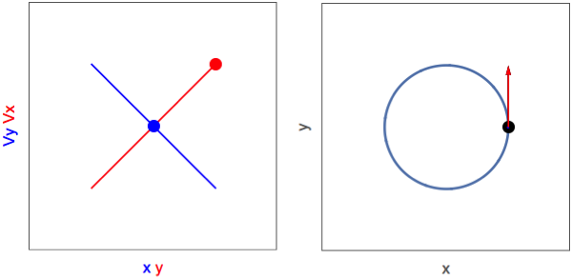
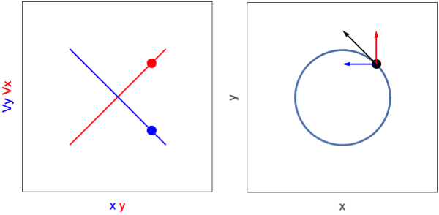
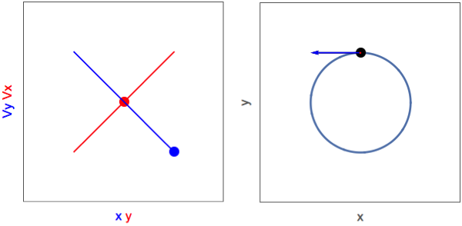
Rotating Distribution
Correlations are a consequence of the rotation – also a phase requirement for each particle with respect to correlations

Slide 9
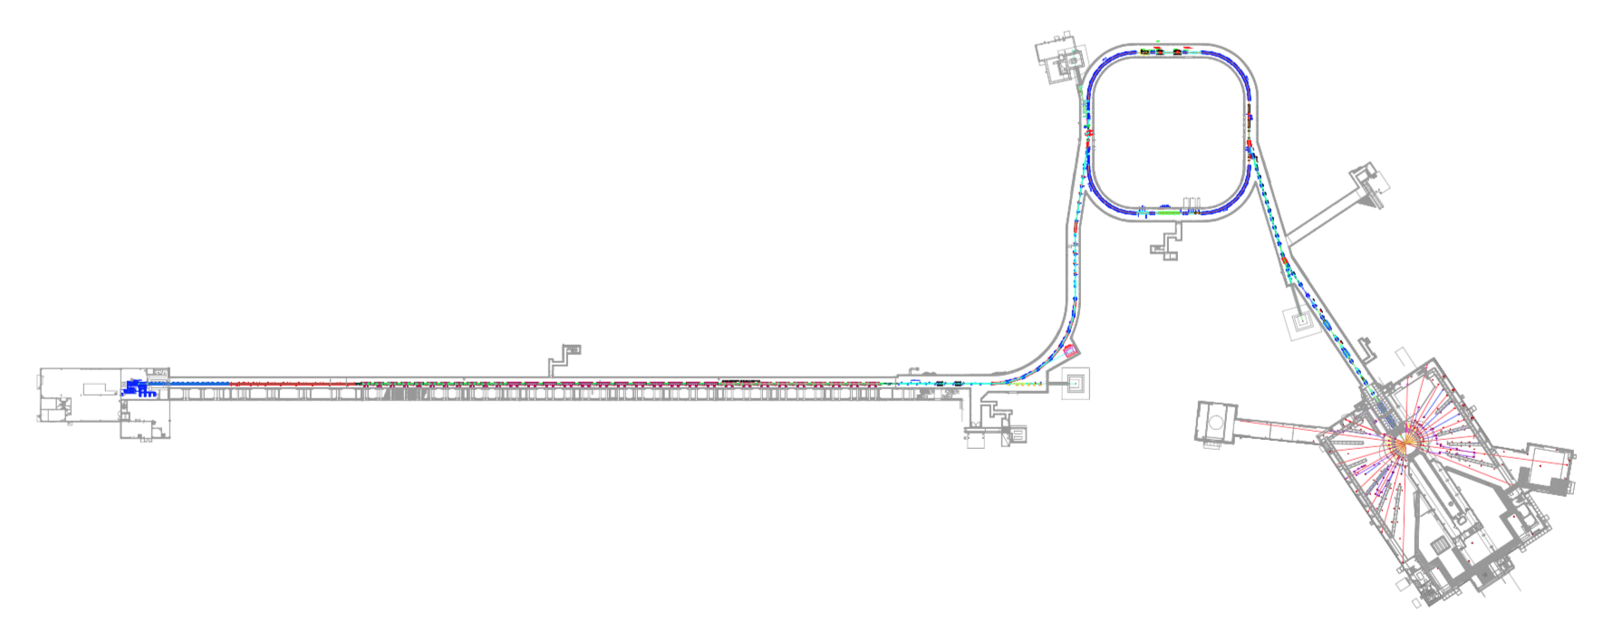
Spallation Neutron Source – Neutron Production
Negative hydrogen is stripped and resulting protons
are accumulated in the ring
increasing the intensity by a factor of ~1000
RFQ 2.5 MeV
CCL 186 MeV
SCL 387 MeV
SCL1000 MeV
Upgrade
1300 MeV
DTL 87 MeV
Over 1 ms 1000 pulses of negative hydrogen ions,
each 700 ns long are accelerated to 1 GeV or 0.87c
Accumulated 700 ns long pulse of 1.5 E14
protons is extracted to target 60 times a
second – roughly 24 kJ per pulse

Slide 10
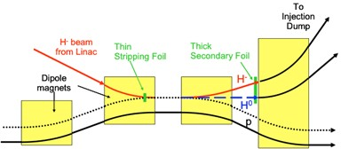
Painting in SNS
SNS has complete control over transverse position and angle of the recirculating beam relative to the injected beam
In theory, flexible enough to paint
rotating distribution
closed orbit

Slide 11
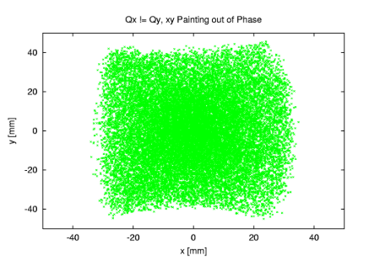
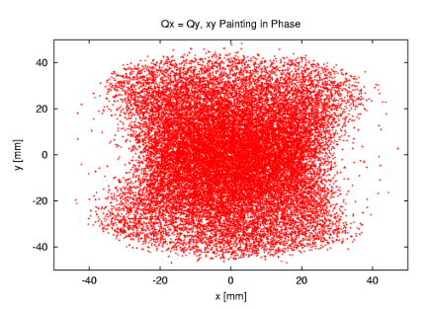
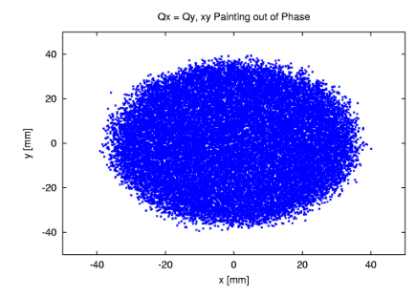
Painting a Self-Consistent Beam
Requirements for painting the self-consistent beam:
To ensure beam is uniform we have to start at the center x=0, y=0
Uniformity requires radius increases ~ Sqrt(t) (i.e. linear increase emittance)
Rotation requires vertical and horizontal painting 90º out of phase – otherwise freedom of phase – can paint along any radius
Require same tunes in x and y planes

Slide 12
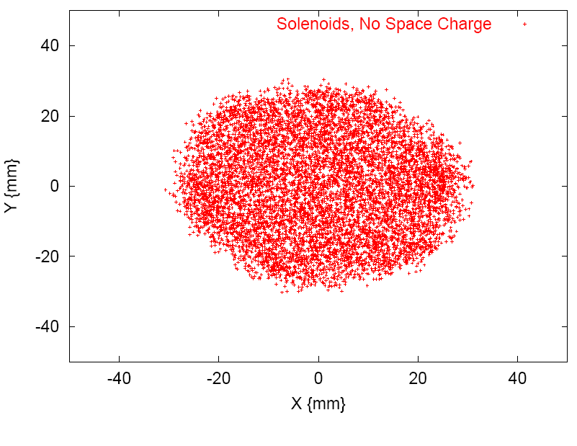
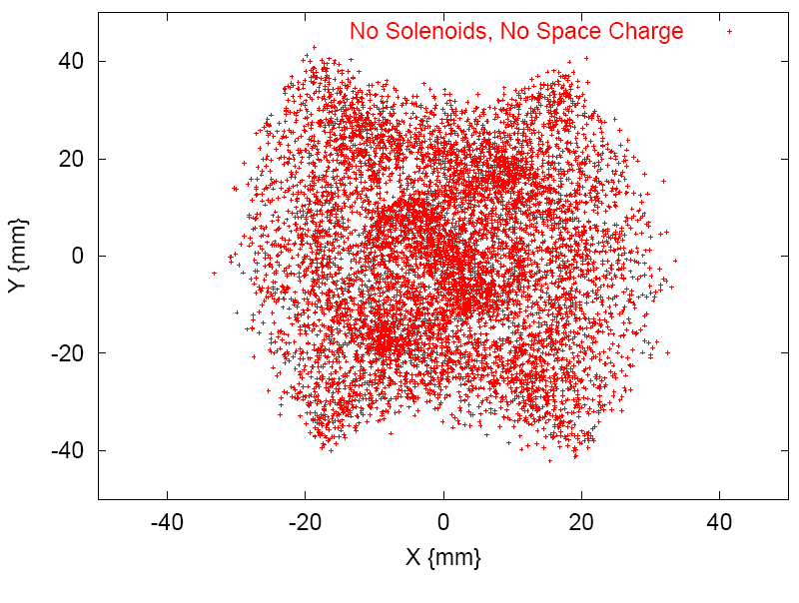
Feasibility Study
Study includes all physics capabilities of ORBIT
  2.5D space charge model
  Extended hard-edge, non-linear fringe field model
  Impedances
  Foil scattering
  Realistic painting – real closed orbit bump,
  off-axis transport through quad doublet,
  power supply/magnet limitations
  Apertures to evaluate losses
  Bunched beam (is it ok for a coasting distribution?)
* Holmes, et al. “Injection of a Self-Consistent Beam with Linear Space Charge Force into a Ring”
Accepted for Publication in Physical Review Accelerators and Beams

Slide 13
Challenges Identified During Feasibility Study
Must start painting with design orbit at foil
  to get a large enough kicker requires lower energy (~600 MeV) and using correctors for a ‘pre-bump’ to maximize number of turns
Non-linear fields cause mixing of counter rotating states – a superposition of these solutions is not self-consistent
  0.6 T·m of solenoid field splits degeneracy
Need to control losses due to scraping in ring
  we can exploit the arbitrary phase to reduce losses
  painting along the x-axis is best solution
Closed orbit evolution

Slide 14
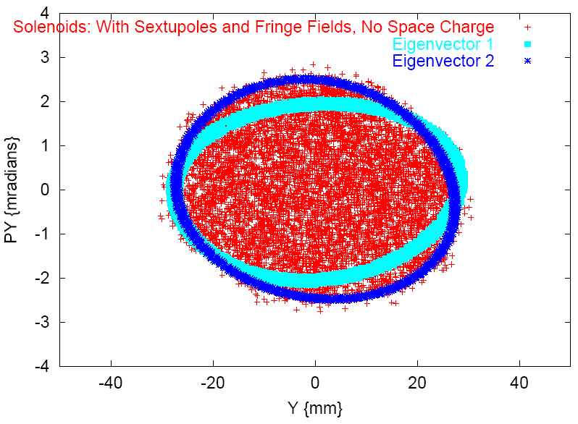
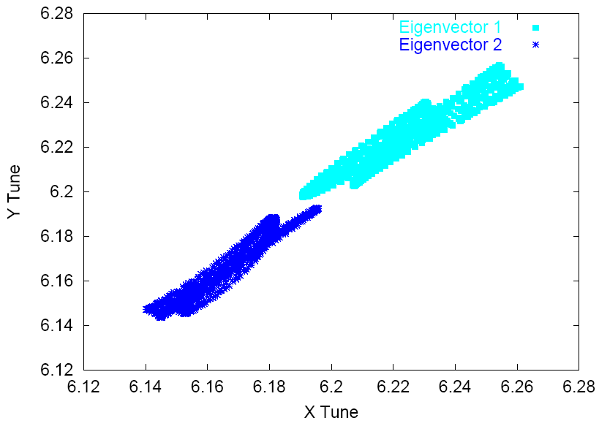
Additional Solenoid
No Solenoid
Solenoid acts on counter rotating states differently, effectively creating a different lattice for each eigenvector
This is a special magnet we need to design for this experiment
An integrated field of 0.6 T· m is enough to maintain self-consistency – insensitive to placement in ring
Solenoid
Tune Split

Slide 15
Experiments at SNS
Two phases:
without solenoids to demonstrate painting and work out technical problems, should be good enough to verify painting of rotating beam – storage is an issue though
After installation of solenoid more studies on stability etc.

Slide 16
Steps to Painting Uniform Self-Consistent Beam
Lower linac energy (600 MeV)
  To get this low we have to ignore the timing system and set some ring systems by hand – we can get to 810 MeV with timing system only allows 40 turns to be injected
Set tunes equal
Add closed orbit – ‘pre-bump’
  Relatively easy – a corrector bump app automates most of this
Define injection kicker end points, then load waveforms
  No automation yet – nearly impossible to do by hand on the time scales we have

Slide 17
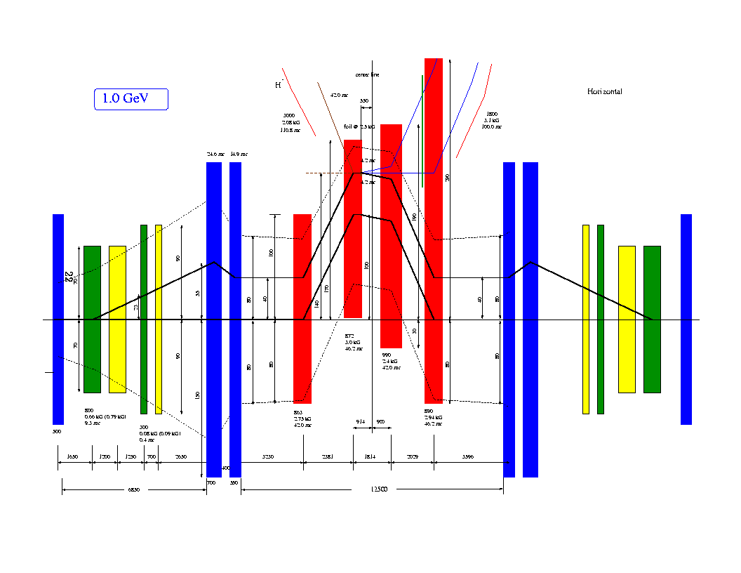
Challenges - More realistic picture of injection
Quads in particular make tuning bump by hand difficult

Slide 18
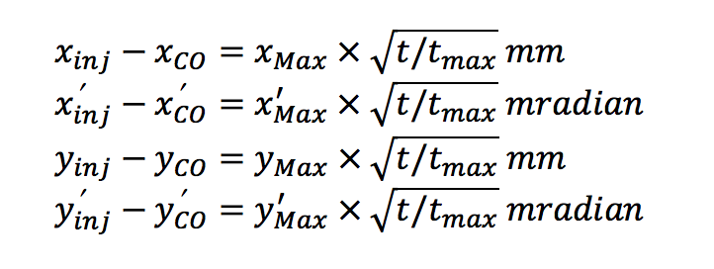
Painting a Uniform Self-Consistent Beam
Matching is also an issue
for painting in x-y’ matching
means determining what y’max we need for a given xmax
In simulation we use bare lattice betafunctions, then statistical betafunctions to refine the guess and then run a couple of cases to see if there is a better match
This is going to be more difficult during experiments – but it’s the best idea we have so far

Slide 19
Stability
We worried about stability, robustness in the face of small imperfections – will the beam maintain it’s shape?
So far the answer is: yes. Detailed simulations indicate that self-consistency can be maintained for a reasonable period of time
– at least the ms timescale of an SNS
cycle – and that the beam is robust
to small perturbations
Even seems to tend toward
self-consistency when,
e.g. tunes are not equal in
both planes

Slide 20
Measuring the Beam
Electron scanner that offers turn-by-turn profile monitoring
Five wire scanners (H,V,D) in the extraction line (RTBT) we are investigating optics for measuring 4D emittance

Slide 21
Long-term benefits of Rotating SCBD?
Interesting from a theoretical point of view – investigations of halo formation
May reduce halo formation in high intensity beams
More charge in the beam for the same tune shift – often an intensity limitation
Uniform distribution is preferable for some target – reduces peak current density
Linear correlation in x-y’ and y-x’ can be rotated into real space creating a ‘flat’ beam that may have uses in colliders, or fixed target experiments

Slide 22
Summary and Plans
With our flexible transverse painting, SNS is the ideal place to test this, but not ideal for implementation – may be niche applications but machines will need to be (re)designed with this sort of painting in mind
Will be difficult to explore limits of halo formation at SNS because of non-linear fields – but we can benchmark simulations done using pyOrbit
We will also do some analytical analysis of stability

Slide 23
Acknowledgements
The SCBD contributors – Jeff Holmes, Mike Plum, Tim Gorlov, Sarah Cousineau
SNS Operations – Charles Peters, SNS operators

